Slide 1
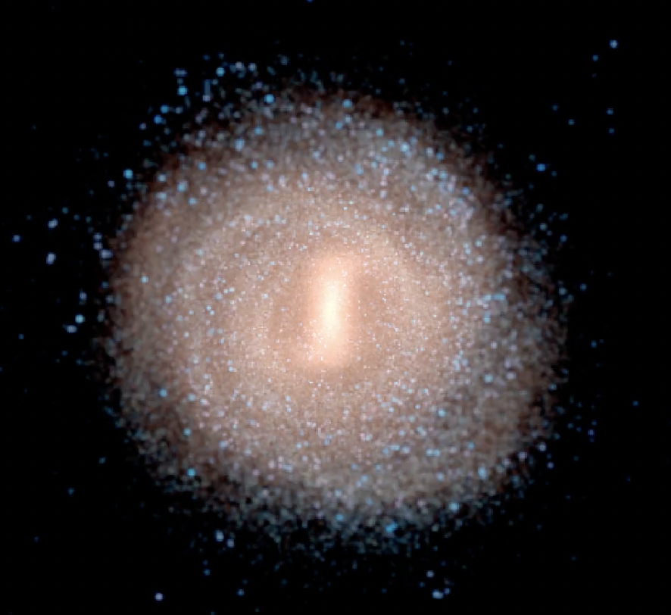
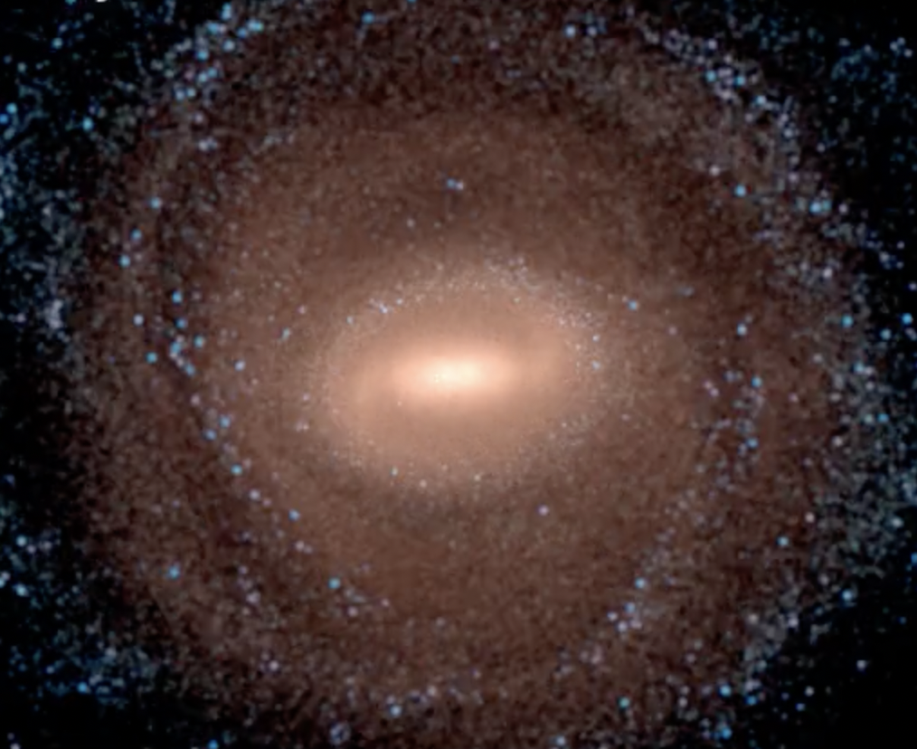
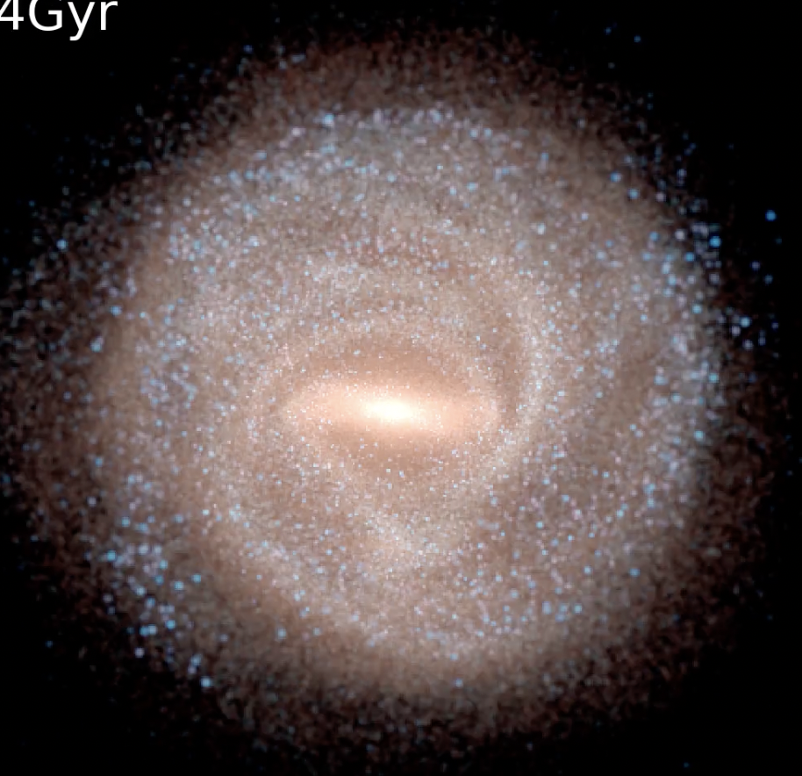
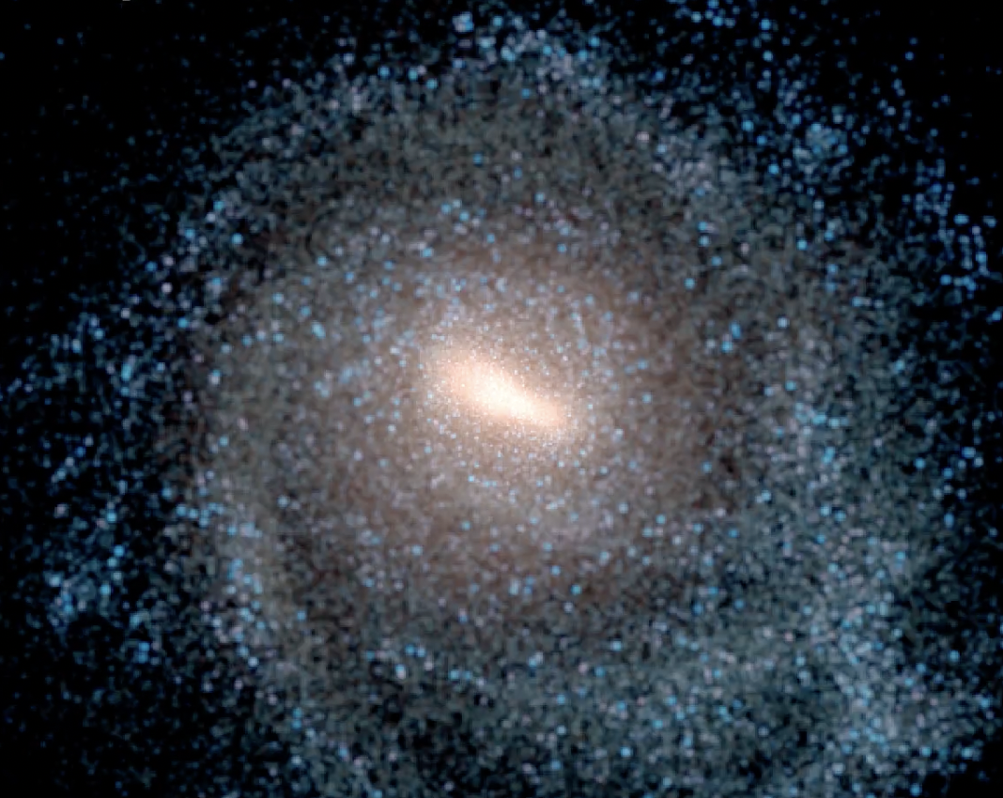
What makes the bar go round?
Drivers of bar pattern speed in cosmological simulations
Alex Merrow
Co-authors – Francesca Fragkoudi, Rob Grand

Slide 2
The Importance of Bar Rotation
Bars drive galaxies’ secular evolution through angular momentum exchange
  Funneling gas inwards
  Stellar migration
  Angular momentum to outer disc and halo
It is then important to understand the angular velocity of the bar itself
Previous talks
e.g. Minchev+2010
e.g. Sellwood 1980, Weinberg+2002

Slide 3
Key Factors in Bar Rotation
Dynamical friction from outer disc and halo slows bars down
  This is the dominant mechanism in many simulations, but produces bars slower than those observed
Gas can stop this slow down, or even speed it up, by losing angular momentum to the bar
Galaxy interactions exert a tidal field which may induce a torque on the bar
Findings that bars formed through galaxy interactions are slower
e.g. Weinberg 1985, Athanassoula 2003
Fragkoudi+2021
e.g. Berentzen+2007, Beane+2023
e.g. Athanassoula 1996, Łokas+2014
e.g. Miwa+1998,
Martinez-Valpuesta+2017
See e.g. Pettit+2018 for counterpoint

Slide 4
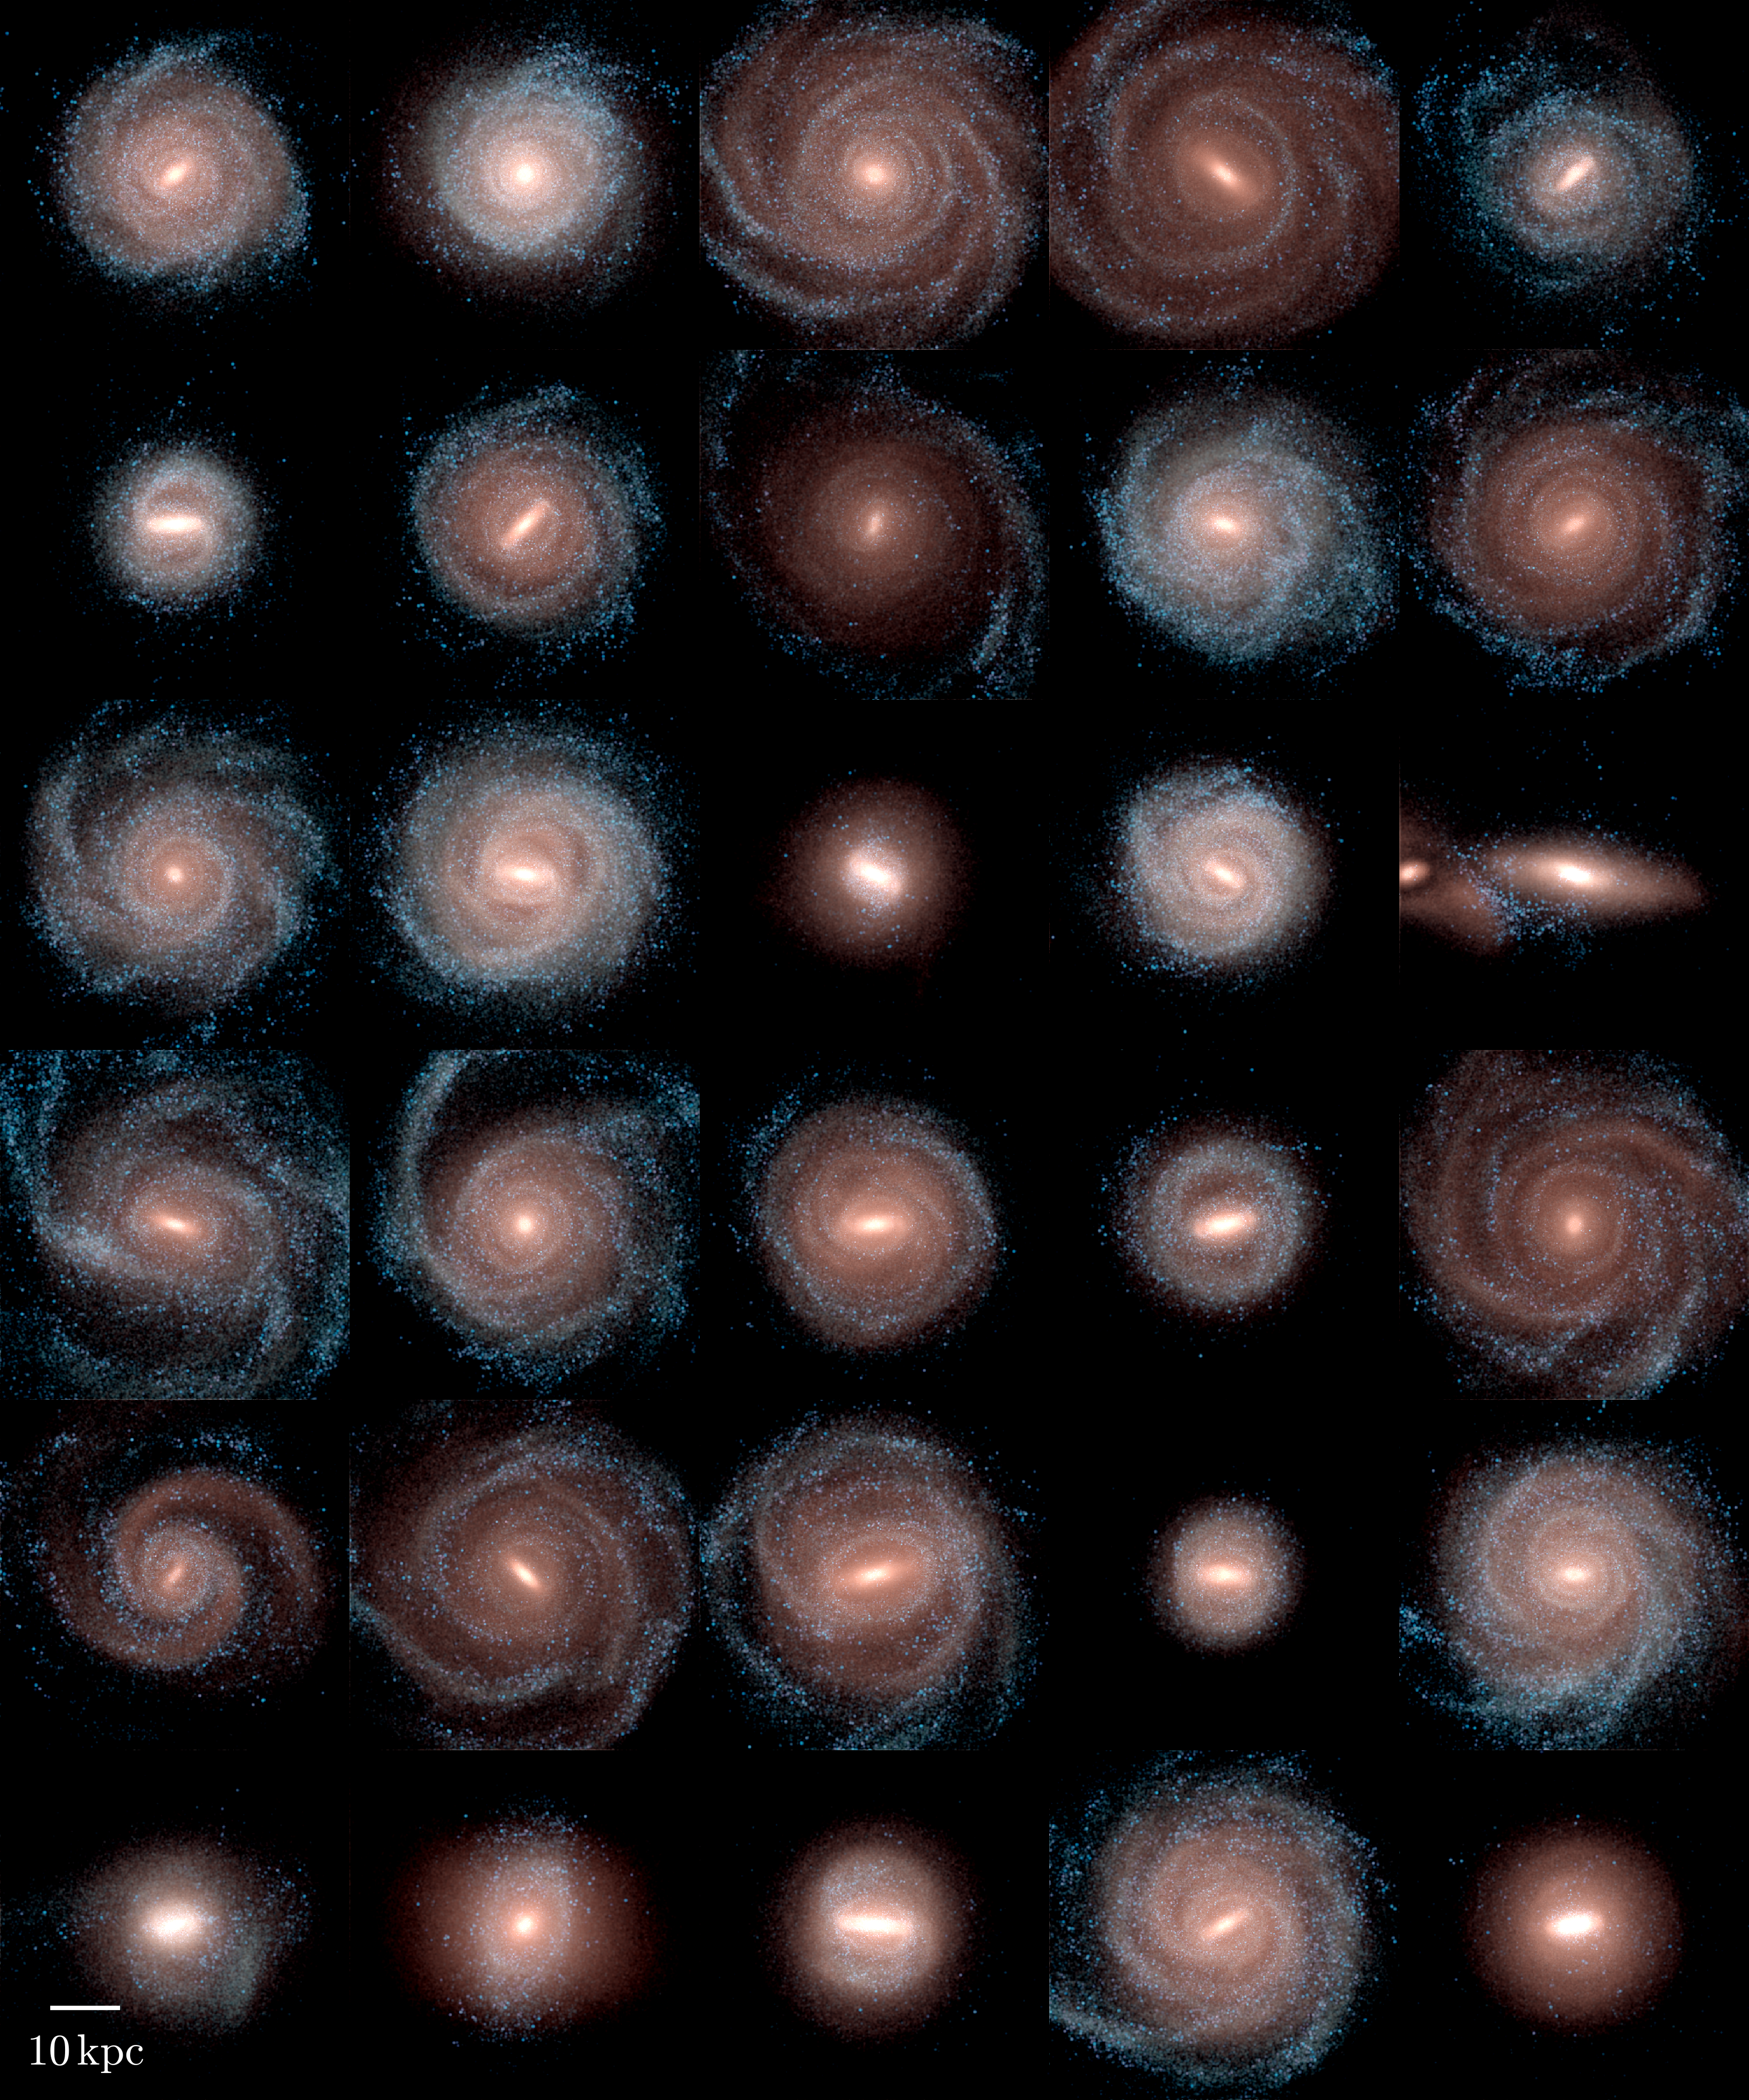
Auriga Simulations
39 hydrodynamical cosmological zoom-in simulations of Milky Way-like halos
More fast bars than many other cosmological simulations, matching observations
Reran to get 5 Myr output intervals for 27 halos including all 22 bars
  Allows pattern speed from change in bar angle between snapshots
Grand+2017,2019
Fragkoudi+2021
Auriga project

Slide 5
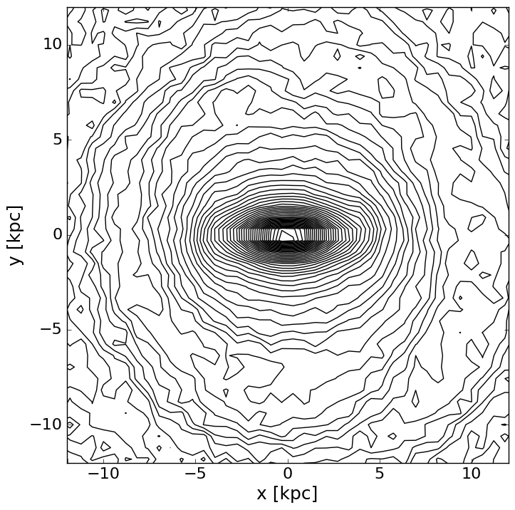
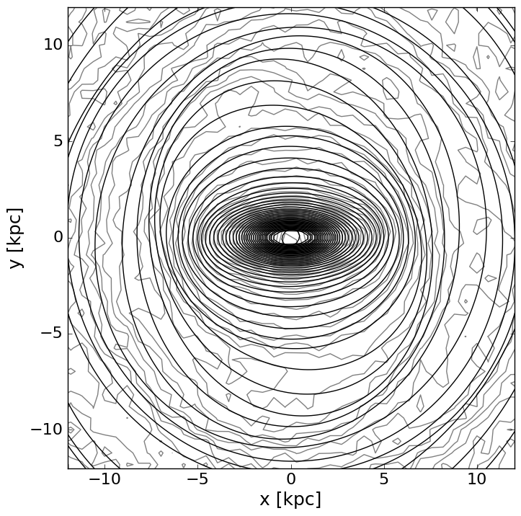
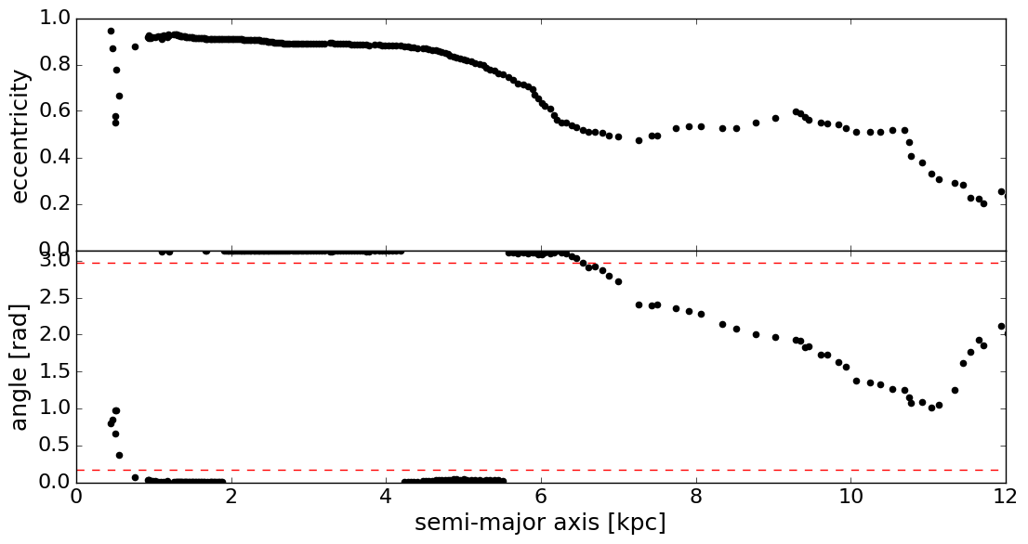
Bar Length
Get contours of stellar surface density
Fit ellipses to the main segment of each contour
Bar length is then minimum of:
  First minimum in eccentricity
  First turning point of ellipse angle outside of the bar
  First time the ellipse angle deviates by more than 15°
Manually done for each initial and final time

Slide 6
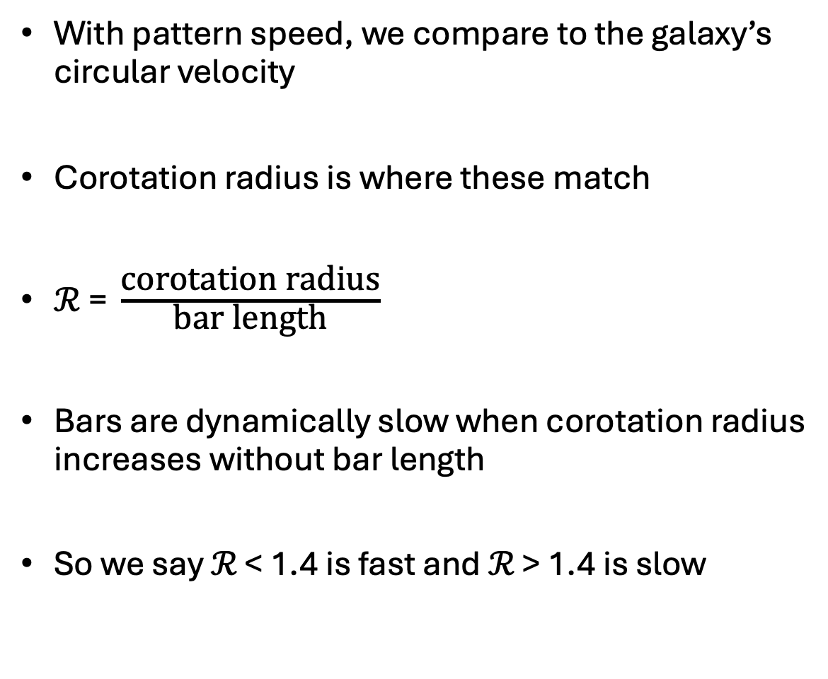
ℛ ratio
With pattern speed, we compare to the galaxy’s circular velocity
Corotation radius is where these match
$\text{ℛ}\text{ = }\frac{\text{corotation} \text{radius}}{\text{bar} \text{length}}$
Bars are dynamically slow when corotation radius increases without bar length
So we say ℛ < 1.4 is fast and ℛ > 1.4 is slow
Debattista+2000

Slide 7
Evolution of ℛ
Most bars have sped up!
Older bars are faster
Stronger bars are faster
  Not only in terms of ℛ

Slide 8
Mass composition
Auriga galaxies tend to lie above the abundance matching relation
Bars in galaxies which lie further above are faster
Galaxies with higher stellar masses are further offset
So, broadly, more massive galaxies host faster bars
This can be tested observationally
Galaxies with higher stellar masses are further offset
See Fragkoudi+2025 for full description of this

Slide 9
Inner mass composition
Bars form from the inner regions
Higher baryon dominance reliably correlates with faster bars at all times
Bars speed up more when their galaxies increase baryon dominance more
Possible mechanism to avoid slow-down from dynamical friction

Slide 10
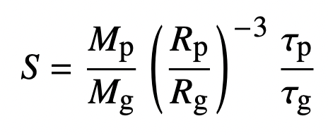
Quantifying interactions
Elmegreen parameter (Elmegreen+1991) describes the tidal impulse imparted by a perturbing galaxy during a pericentre
Includes denominator to describe the comparable forces inside the galaxy to be overcome
Reference point: S > 0.04 tends to form a bar

Slide 11
Effect of interactions
Interactions around bar formation lead to faster bars
This is not immediate, but takes time to speed up
Interactions after this have a less reliable effect on final speed
Stronger interactions do speed the bar up to some degree, however

Slide 12
Conclusions
Bars in Auriga do not slow down from dynamical friction, instead mostly speeding up as they evolve
Their speeds increase to match the increase in baryon dominance of their host galaxies
Interactions have a secondary effect, speeding up the bar, particularly when the interaction coincides with bar formation

Slide 13
