Slide 1
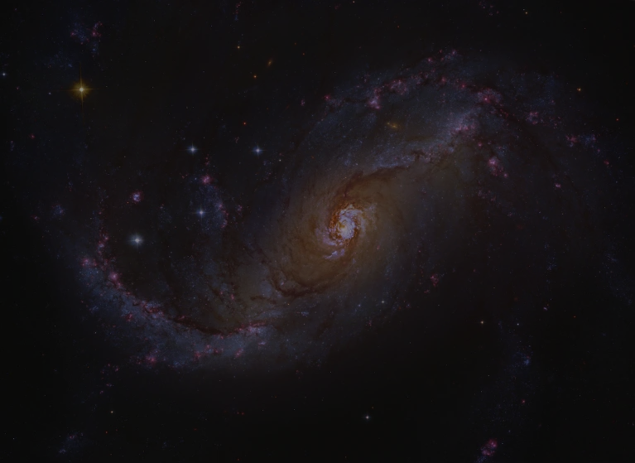
Decoding imprints of bars and AGN in the AMR of the Auriga galaxies
Sara Zahoor, Dr Marie Martig, Dr Robert J. J. Grand & Dr Andreea Font
Ph.D Candidate
Astrophysics Research Institute
09 July 2025
Photo credit: Stocktrek Images/ Getty Images.
Notes:
Sara Zahoor.. PhD candidate in Astrophysics at LJMU I will talk about a case study of a bar galaxy where we found that a small clue can give lot of information about the evolutionary history of galaxies.

Slide 2
BARs and AGNs (Active Galactic Nuclei)
Bars fuel AGN
Marels, V., et al. "The role of bars in triggering active galactic nucleus galaxies." (2025).
AGN can weaken bars
Łokas, Ewa L. "Formation of a barred galaxy in a major merger: The role of AGN feedback." (2022)
It’s a two-way interaction
Irodotou, Dimitrios, et al. "The effects of AGN feedback on the structural and dynamical properties of Milky Way-mass galaxies in cosmological simulations." (2022)
Photo credit: Hubble Space Telescope ( NGC 4731). ESA/Hubble & NASA, D. Thilker
Notes:
Bars can trigger quenching- not just by driving gas inward, but by setting into motion a self-regulating cycle that ultimately disrupts their very own existence.
Bars are both the architects and casualties of AGN fueling. They funnel gas to galactic centers, feeding black holes and activating AGNs. But the resulting feedback heats and expels gas, suppresses star formation, and weakens the bars that enabled it.
While this feedback loop is suggested in theory, its full dynamics remain unclear.
In our barred galaxy simulations, we capture this cycle directly through our indirect clue , revealing how bars, gas inflow, AGN feedback, and star formation are deeply intertwined.

Slide 3
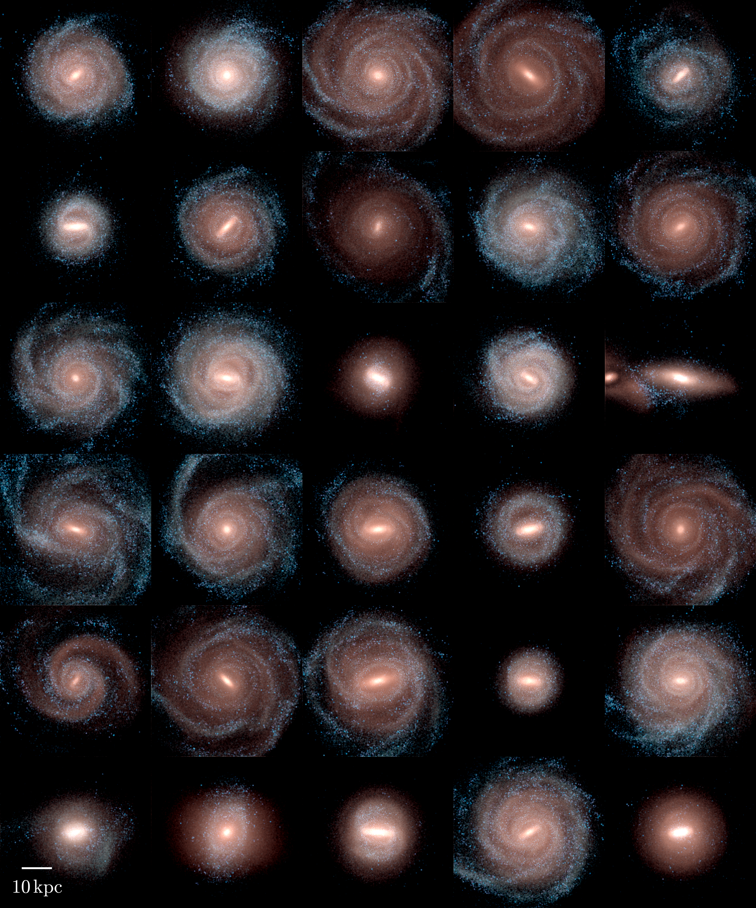
AURIGA Galaxy Simulations Gravo-magnetohydrodynamic cosmological zoom-in simulations (Grand et al., 2024)
Suite: Level 4
Foundational physics model:
ΛCDM universe framework
Initial Mass Resolution : Baryonic (gas + stars) particle mass: ≈ 5 × 10⁴ M☉
Dark matter particle mass: ≈ 3 × 10⁵ M☉
Photo credit: Grand et al., 2024
3
Notes:
Auriga is a series of cosmological zoom-in simulations focused on galaxy formation
They use Lamda CDM cosmological model and the feedback model of auriga incorporates stellar winds, supernovae, and AGN feedback to regulate galaxy formation and evolution.
The suite includes multiple series of simulations: we are working with 40 galaxies of level 4” suite that have the resolution of Milky way like mass galaxies

Slide 4
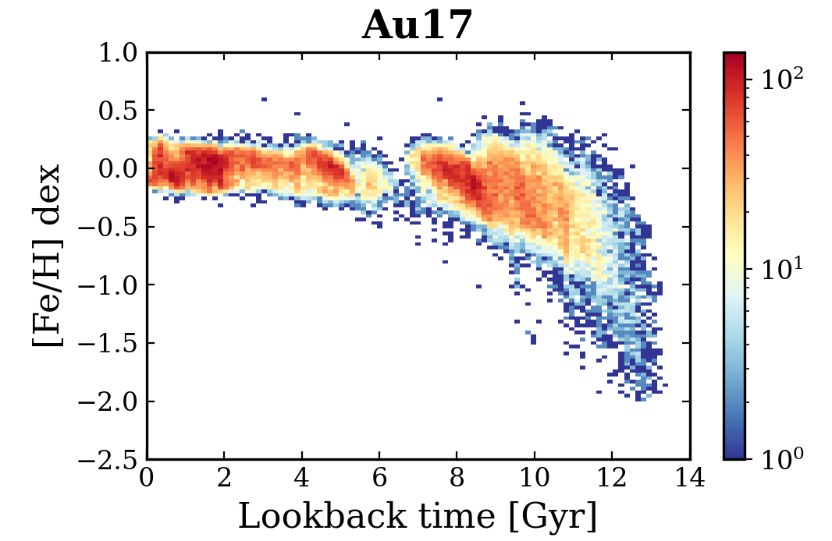
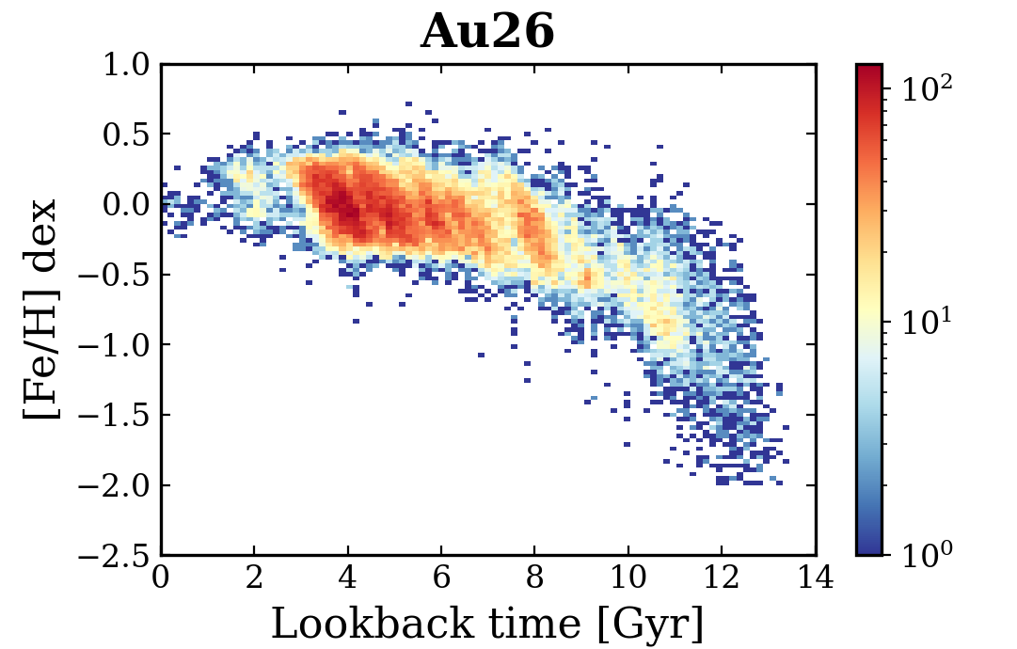
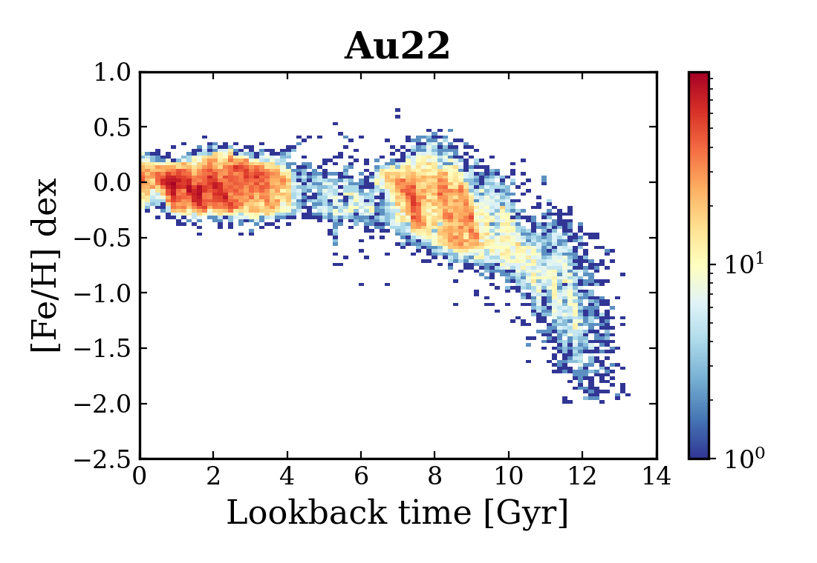
AMRs of Auriga simulations
Notes:
In the Age-metallcity relations of these Auriga galaxies, where Fe/H is plotted on y axis and lookback time on the axis
we notice that some of the Auriga galaxies have very distinctive discontinuous stellar histories.
We characterized our samples based on similar features
This sample of 3 galaxies is such an example with period of decreased SFH. In 17 we see it around 6 gyr, in 26 we see after 2 gyr and in 22 there lies this region between 6.5 and 4 gyr

Slide 5
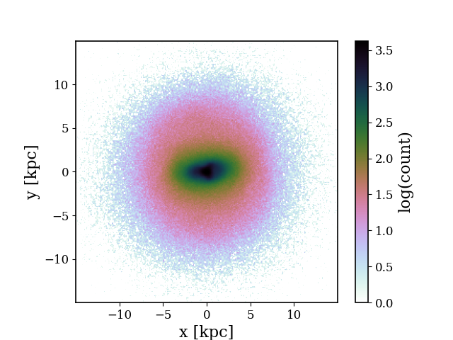
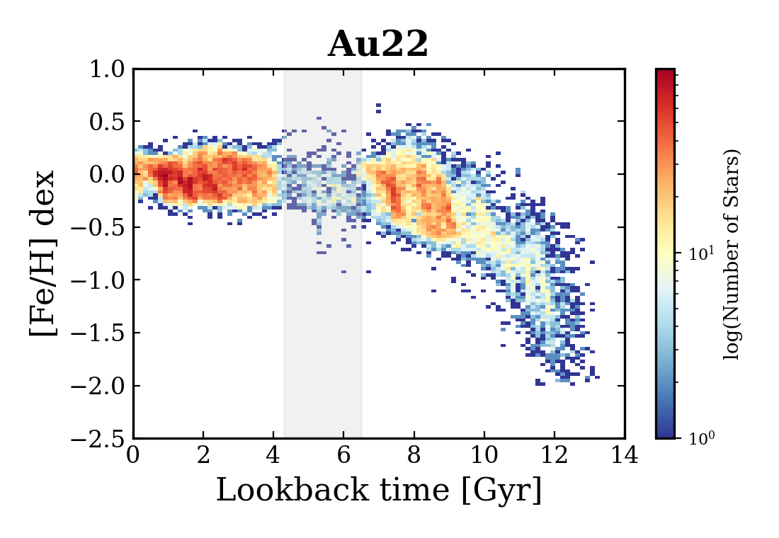
Analysis of Au22
Properties of Au22:
|z| < 1 kpc ∧ 8 < R < 13.5 kpc
Barred galaxy
Total stellar mass: 6.02 × 10¹⁰ M☉
Optical radius: 13.5 kpc.
SF Quenching: 4.3 < gap < 6.5.
Notes:
Au22 is a barred galaxy, with total mass of about 6 into 10 raise to power 10 solar masses and with a optical radius of about 13.5 kpc...
And we selected it from our sample because we have clearly seen a period where the start formation has been significantly declined as seen in this AMR of outer disc region

Slide 6
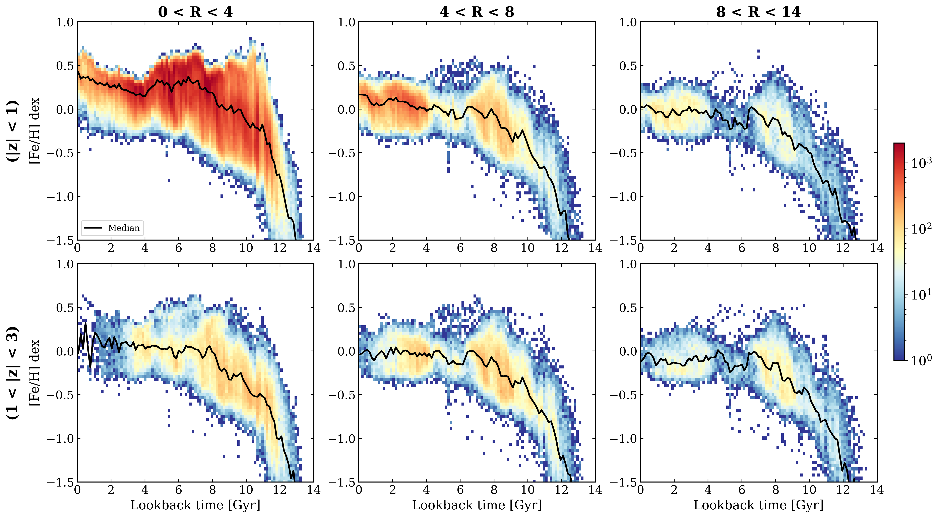
AMRs in radial cuts
Notes:
To explore further the presence of this declined SF, we explored the disc at different radial distances
X axis represents lookback time, and y axis represents metallcitiy. What is most interesting in that central regions we do not see any decline or gap in SF , but as we move towards outer regions, it becomes more prominent.

Slide 7
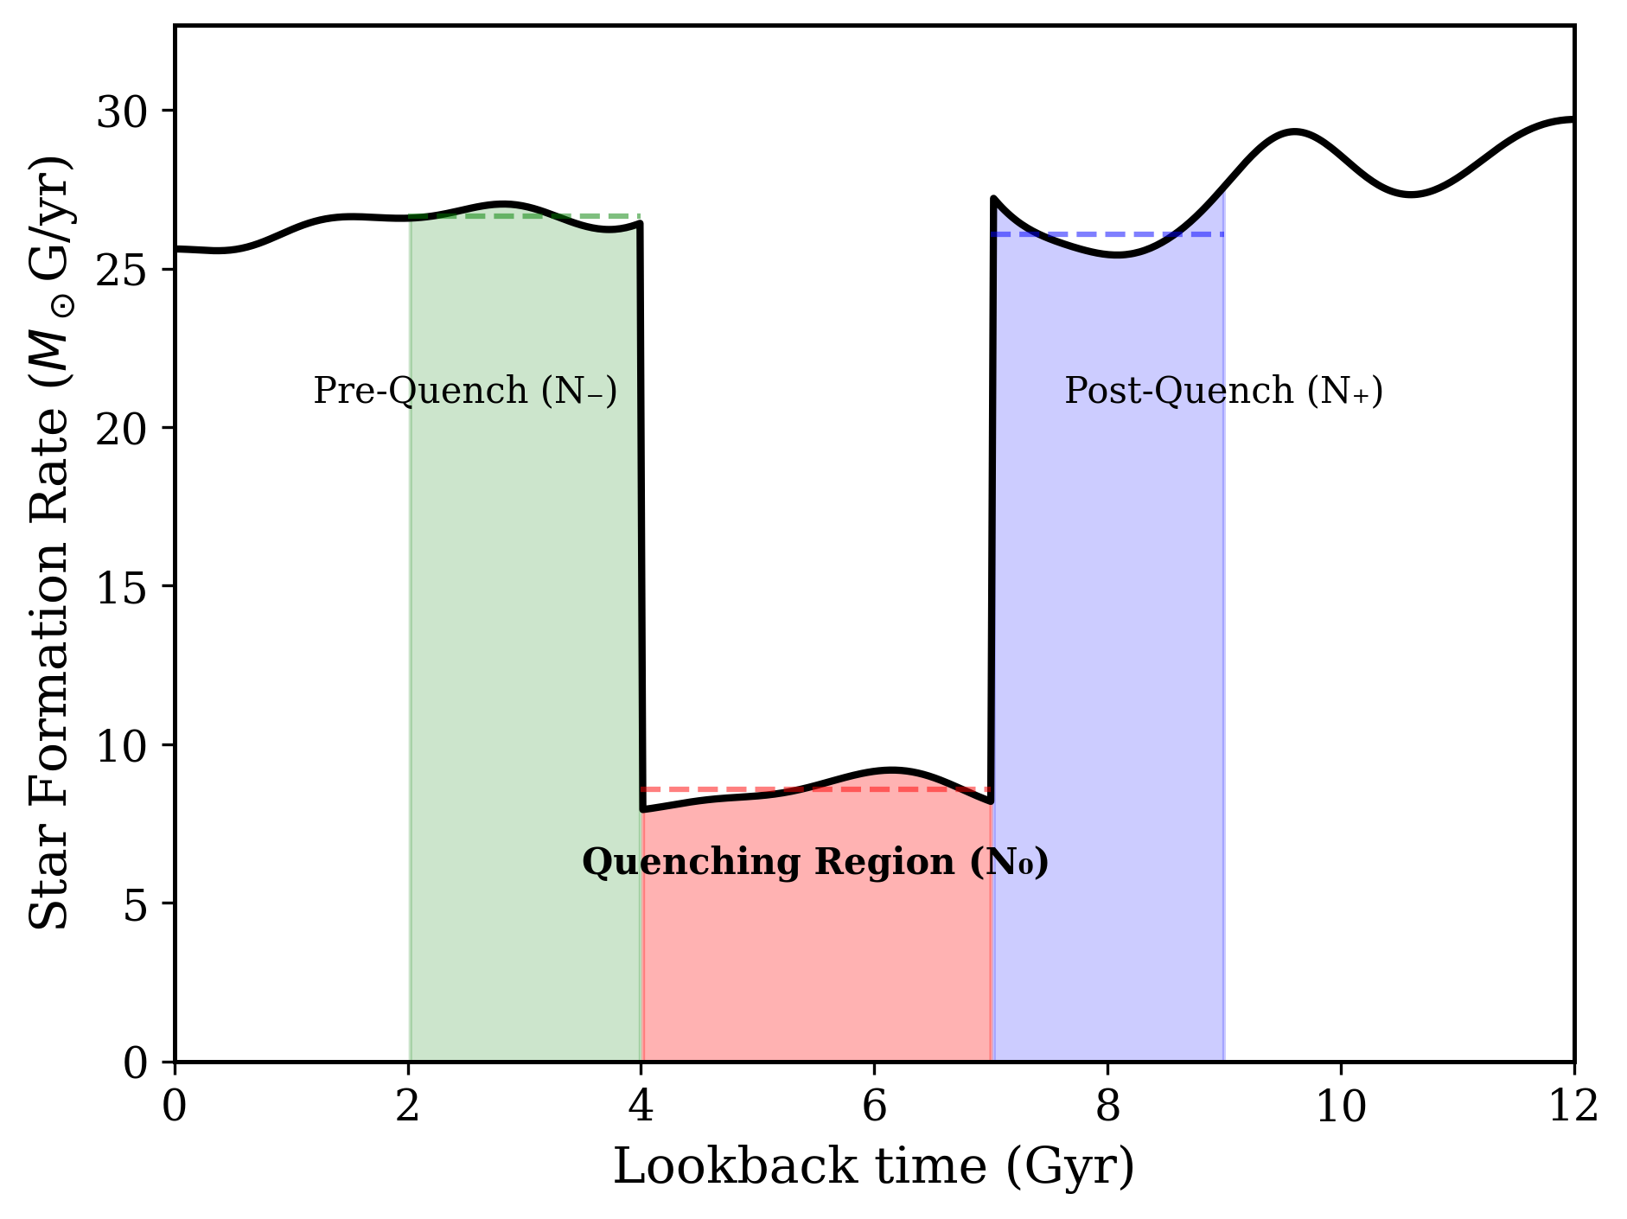
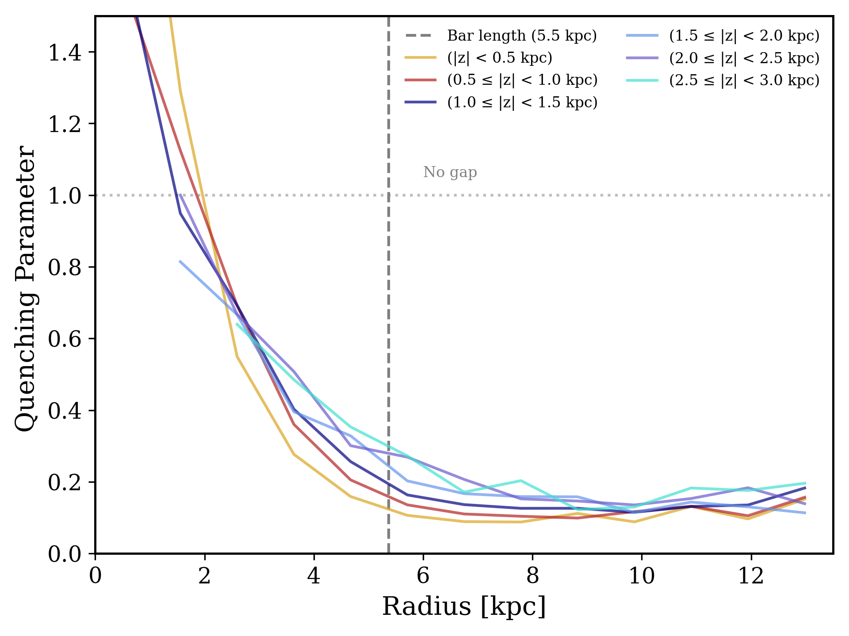
Strength of Gap in vertical cuts
Depletion Size (G) = Average of surrounding populations
N₋ + N₊ G = ──── 2
Quenching Parameter = Depletion during gap period
N₀ Quenching parameter = ──── G
Notes:
To investiagte the strenght the of this gaps in SF at different vertical heights, we deviced a formula to compute gap strenght in SF or as we call it Quenching parameter, i.e. it takes..
Avaerge of surrounding pop and then
Then plotted each region to see its strength of this decreased SF in the vertical cuts
y axis represents quenching parameter and y axis represents the galaxy's disc radius in kpc
We found that strenght of these gaps is higher in the outer disc as compare to inner regions and,
The intensity of quenching dpends on the radius rather than bar

Slide 8
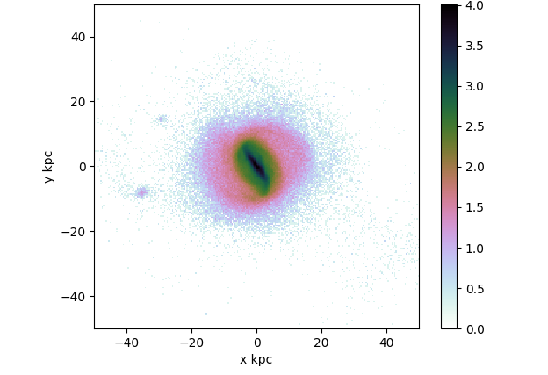
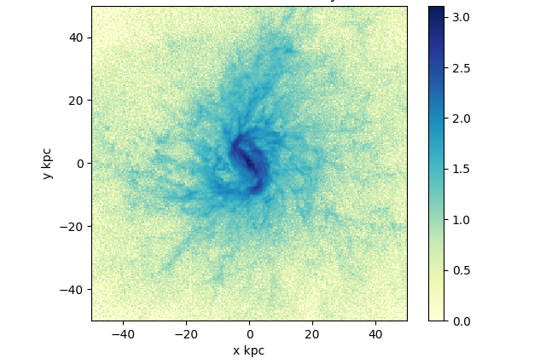
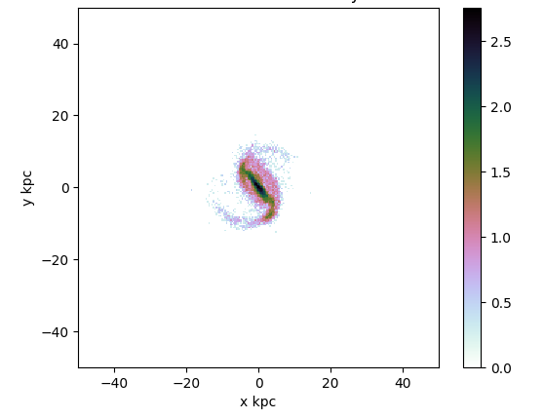
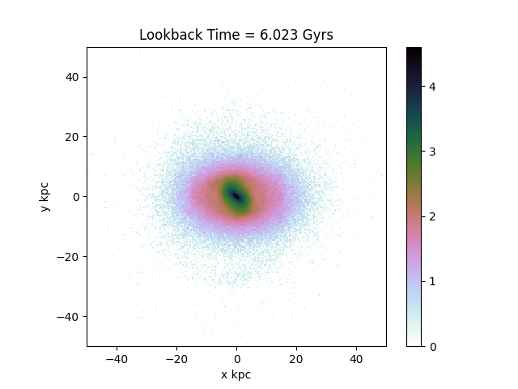
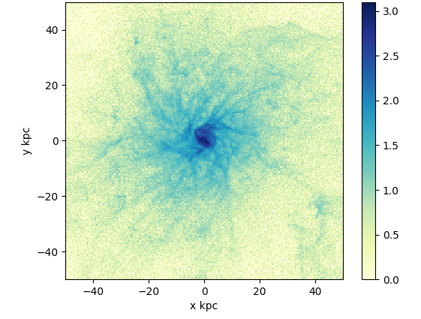
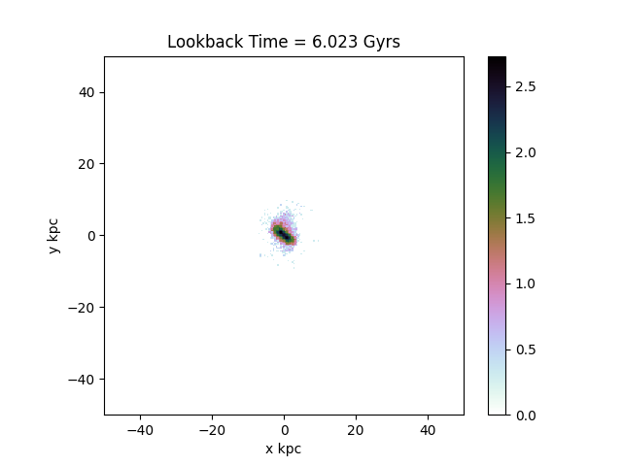
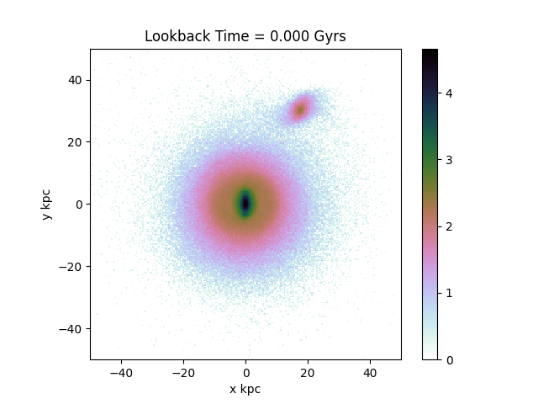
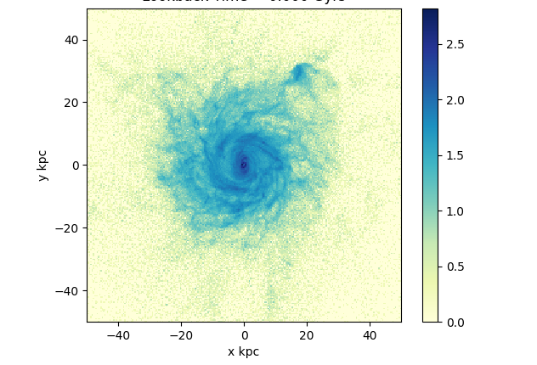
Assembly Histories
Stars
Gas
Young stars (< 200 Myr)
Before the gap (~ 8 Gyr )
During the depletion period (~ 6 Gyr)
z ∼ 0
Notes:
then comes the part where we want to find the cause of this gap.
We started by looking at the galaxy images, here first panel is for stars, second one is for gas and third one is for young stars. As seen we could not spot any external factors, like mergers or interaction with a satellite etc impacting this galaxy at that time period... however we clearly see the presence of a bar.

Slide 9
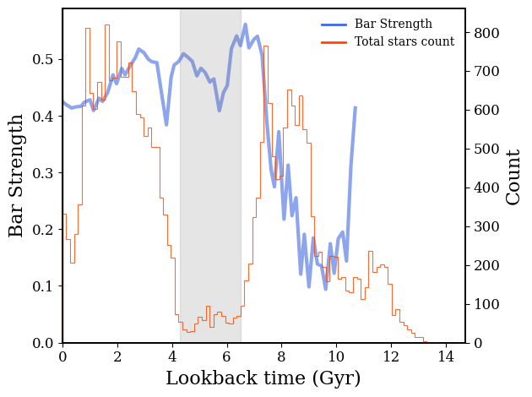
Bar strength & Star counts vs Lookback time
Spatial Definition
Radial Range | 8-13.5 kpc
Vertical Cut | |z| < 1 kpc
Component | Outer Disk
*Bar Formation time: ~ 8.09Gyr (F. Fragkoudi et al., 2024)
Notes:
Francesca Fr.. computed the bar formation times, bar lenght and bar strenght of the Auriga galaxies in paper published last year and we computed we made this plot to see any correlation between the strenght of bar and star formation.
On y axis its bar strenght, x it is lookback time and on right side its star count
We know bar was formed at 8 Gyrs for this galaxy then it kept on increasing and and we can see that it peaked when the gap started and Sf decrease. Bar can funnel gas and stars but it does not give direct evidence of quenching

Slide 10
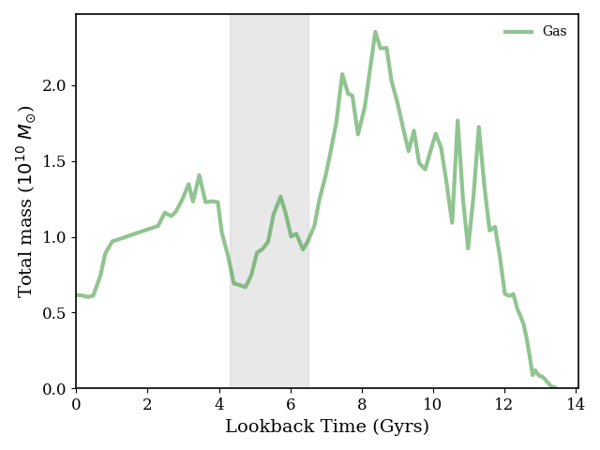
Total gas mass in the outer disc
Outer disc: |z| < 1 kpc ∧ 8 < R < 13.5 kpc
Notes:
Then we looked at the formation history to see what was happening to the gas,
On y axis we have total mass and on x it is lookback time
This green curve for total gas mass clearly shows that not just the SF declined but the gas itself is also seems to disappeared in the galaxy at that time period

Slide 11
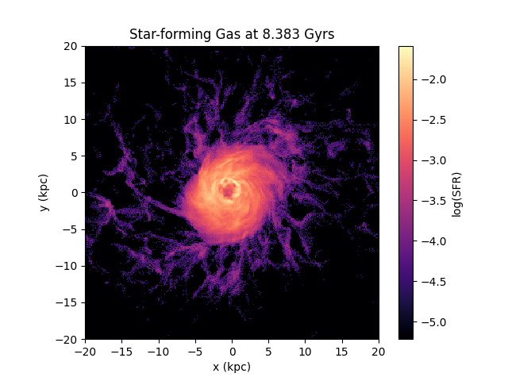
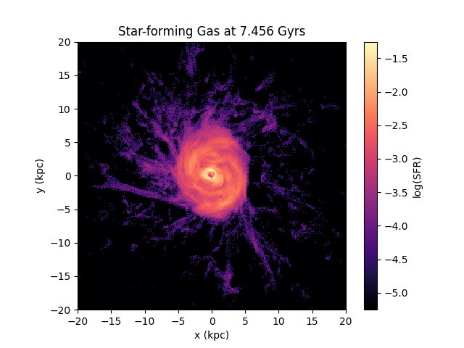
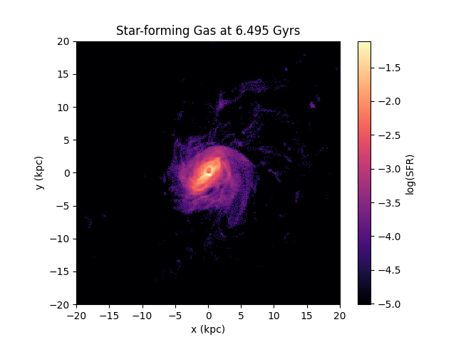
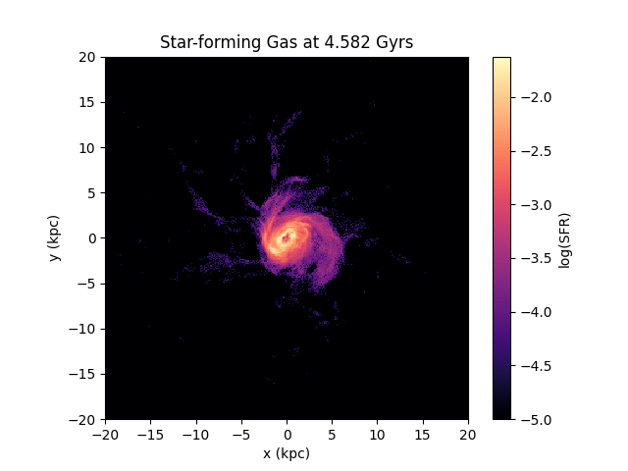
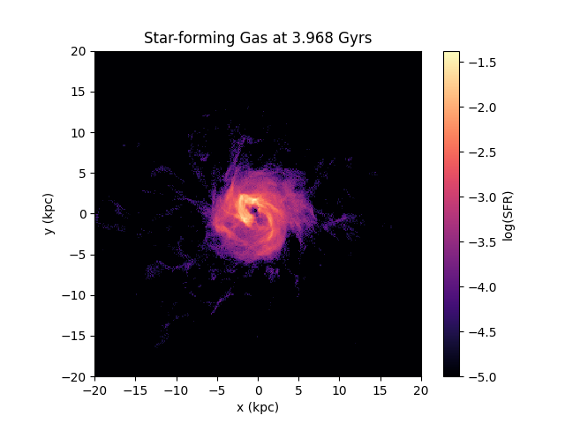
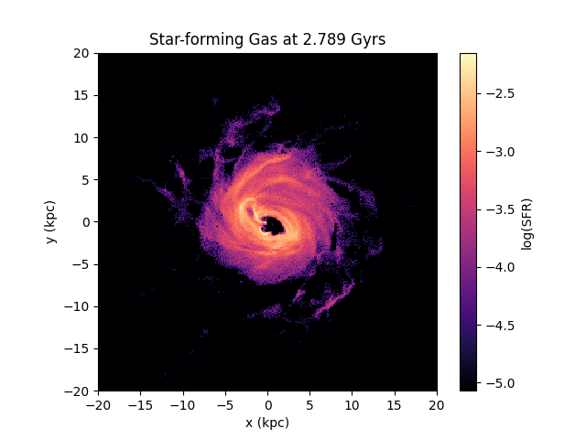
Maps of SF gas
Before the gap ( ~ 8.3 and 7.4 Gyr)
During the gap (~ 6 and 4 Gyr)
After the gap ( ~ 3 and 2 Gyr)
Notes:
To further investigate, we created the maps of SF gas
In Auriga, gas with density above a threshold (log(ρ) > -1 or ρ > 0.1) can form stars using this criteria we made maps of star forming gas, and
Before the gap time period, galaxy was forming stars everywhere in the disc, but during the time of gap, it was centrally concentrated and then again start to spreadout after the gap Previous studies have indicated presence of such centrally concentrated regions in the bar galaxy when there is an active AGN activity

Slide 12
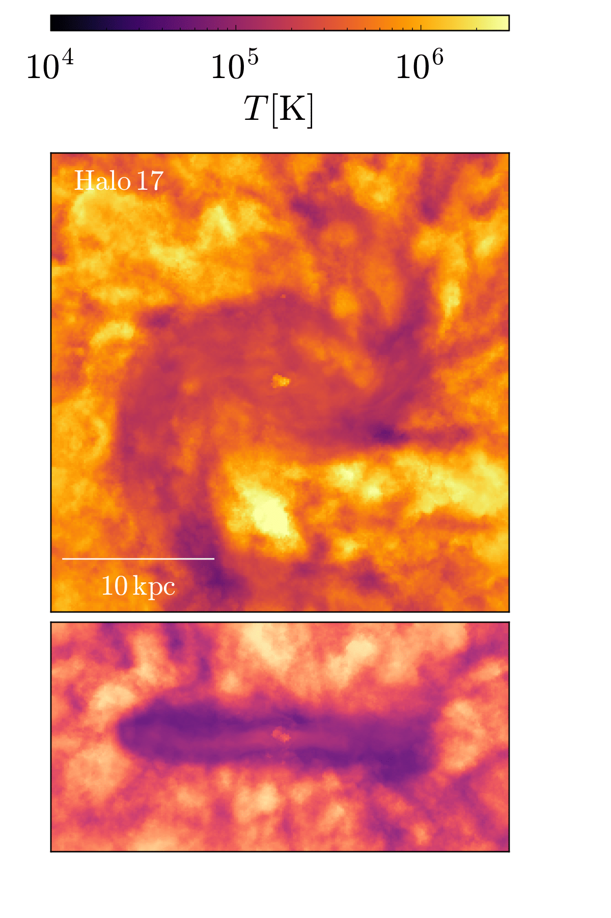
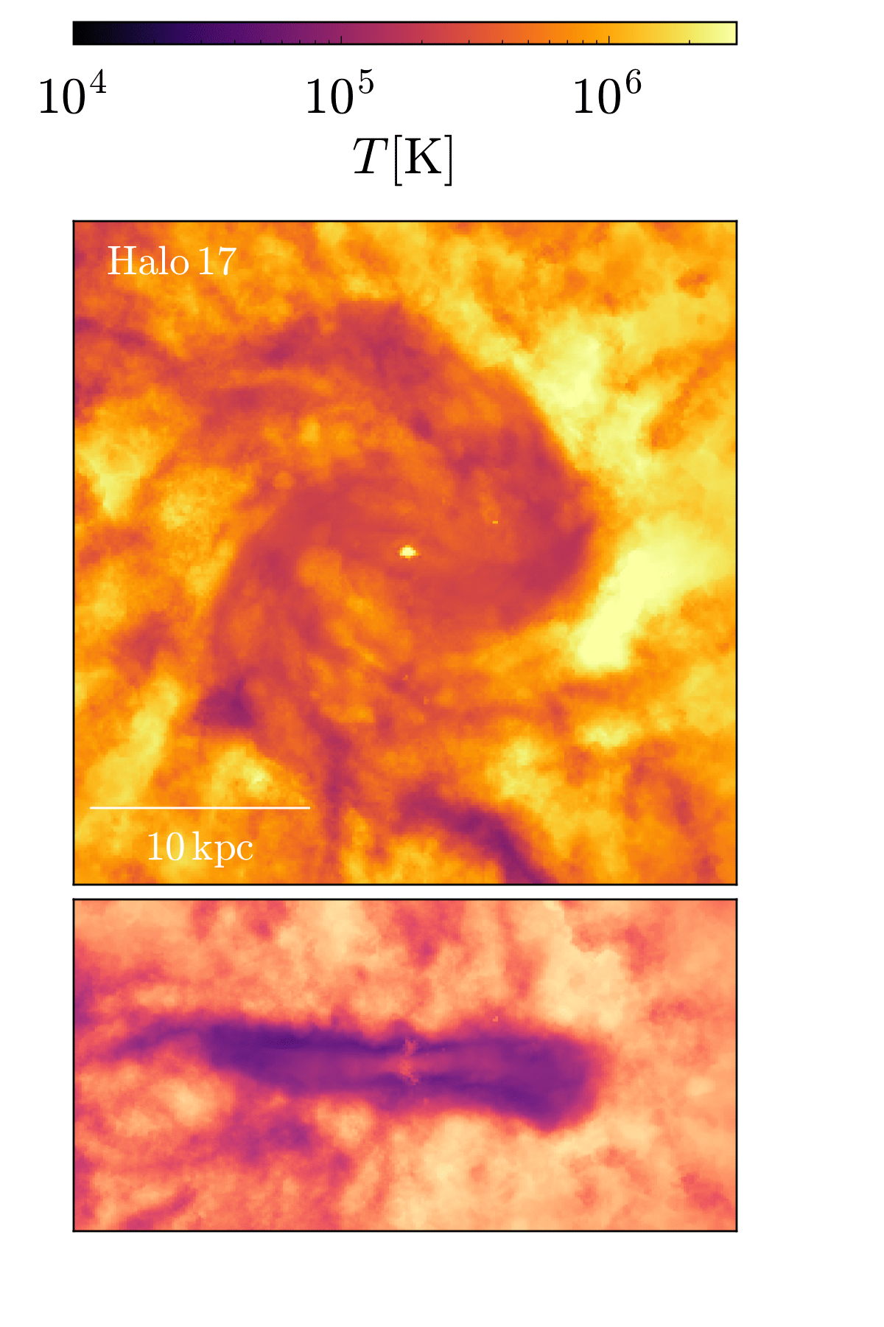
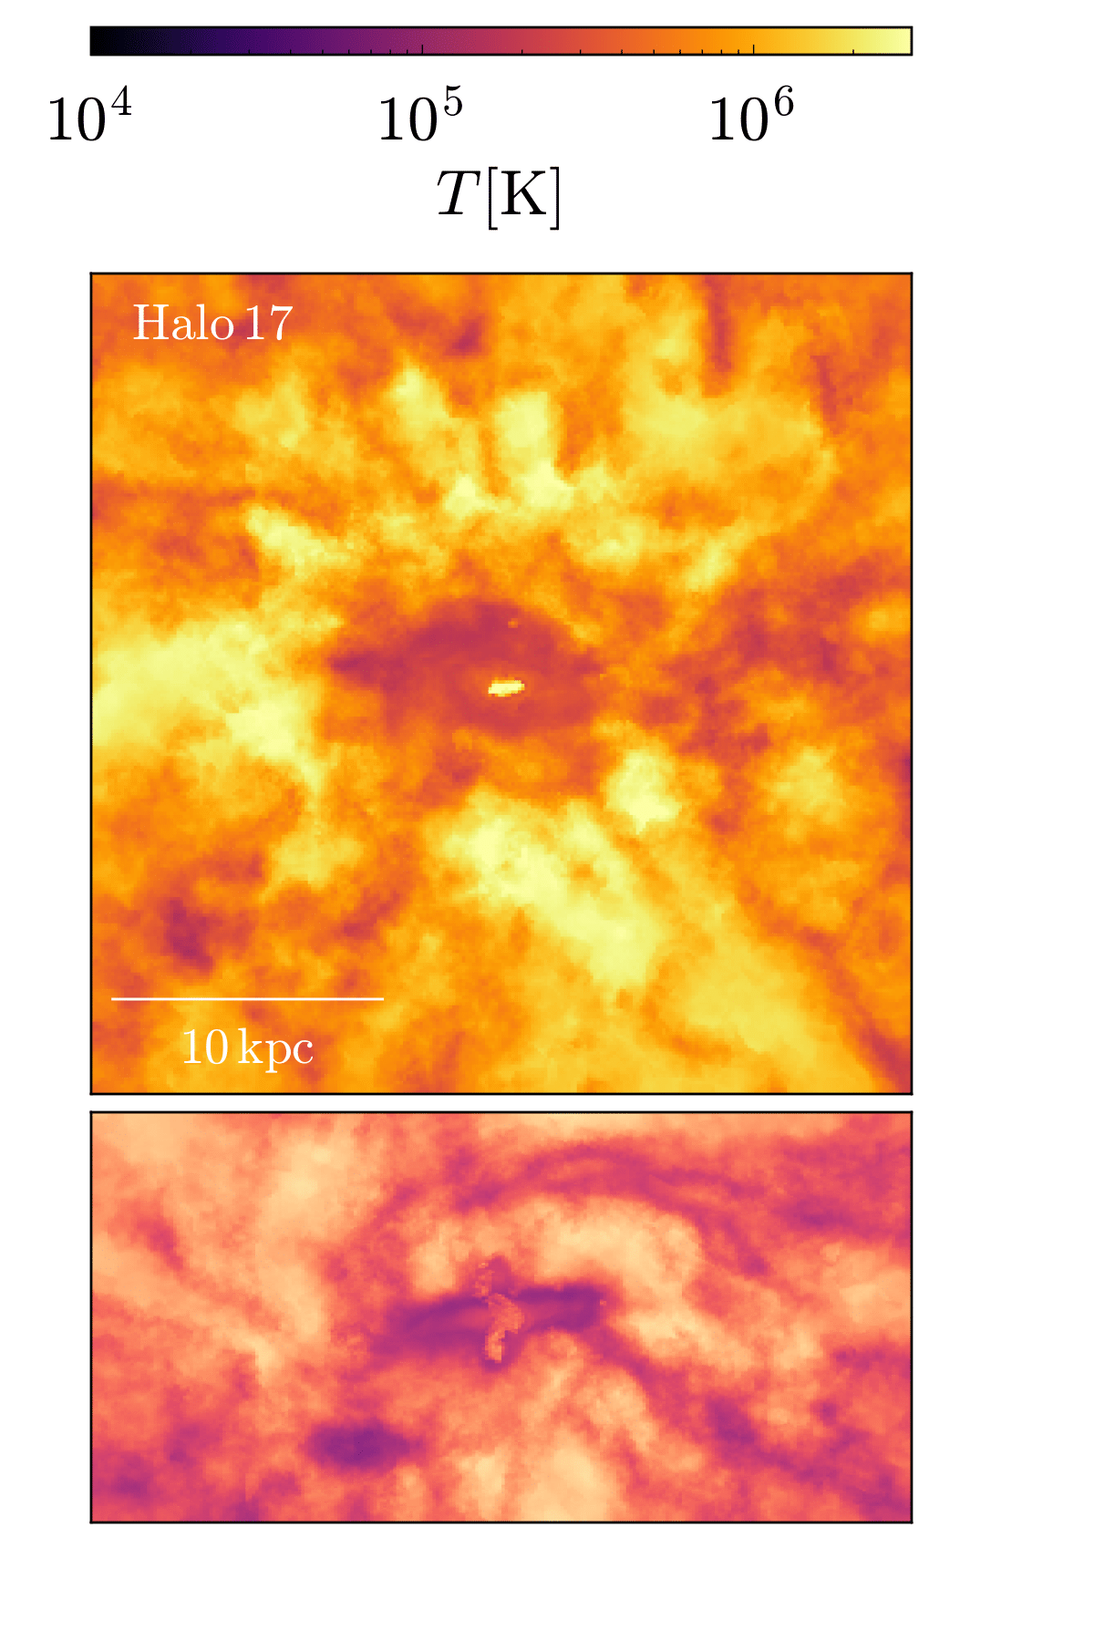
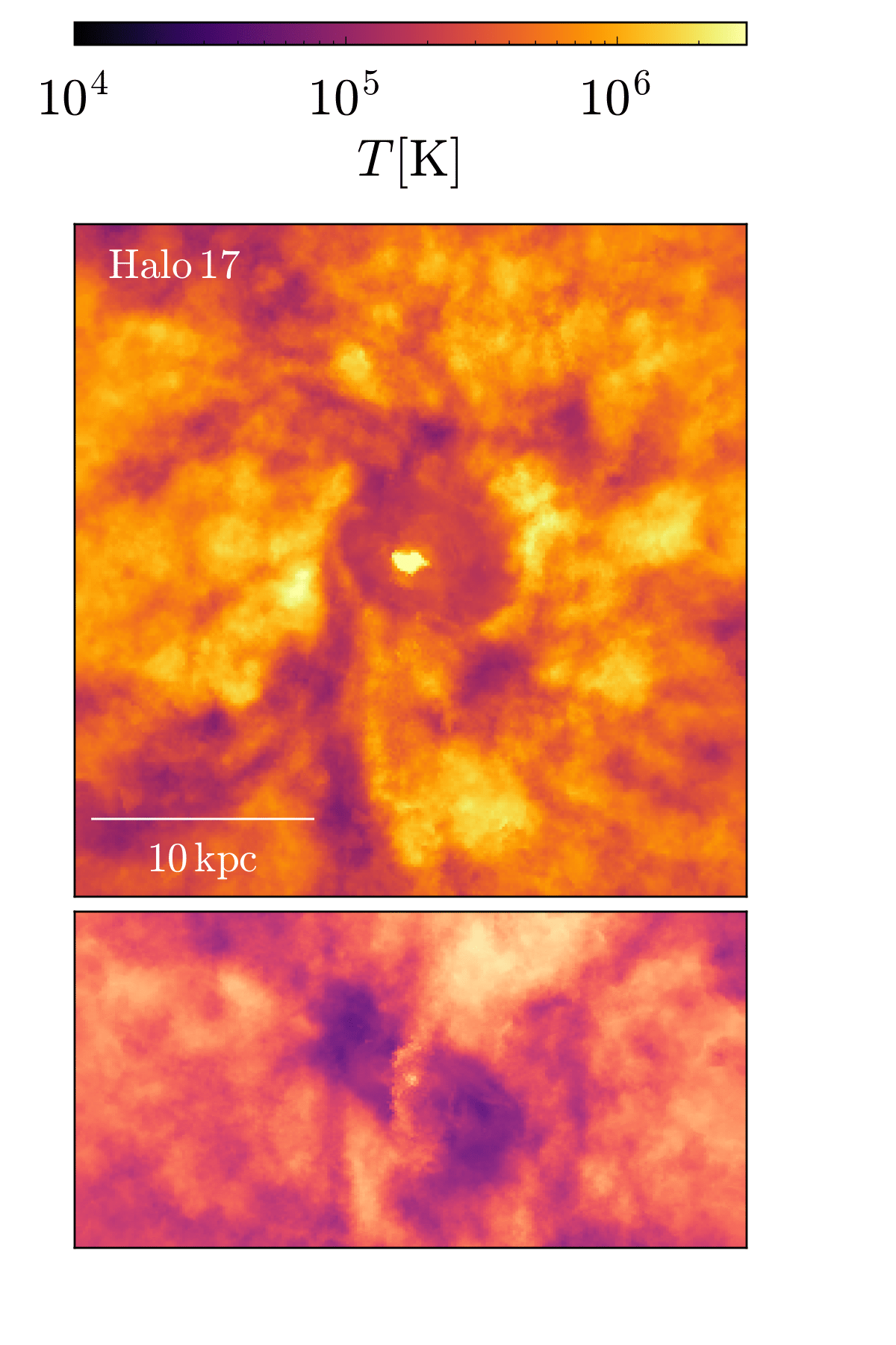
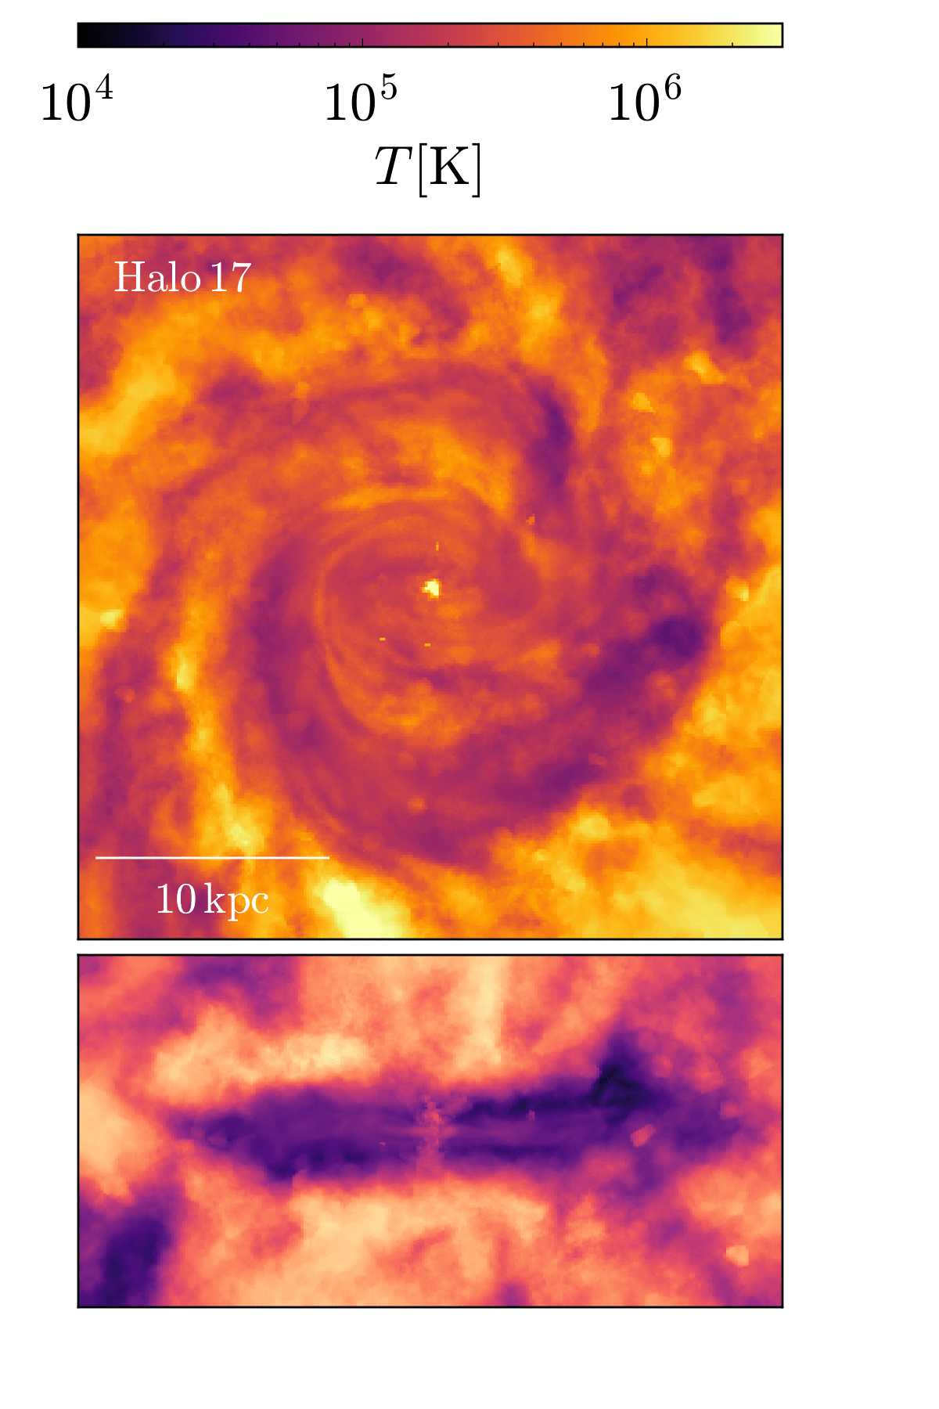
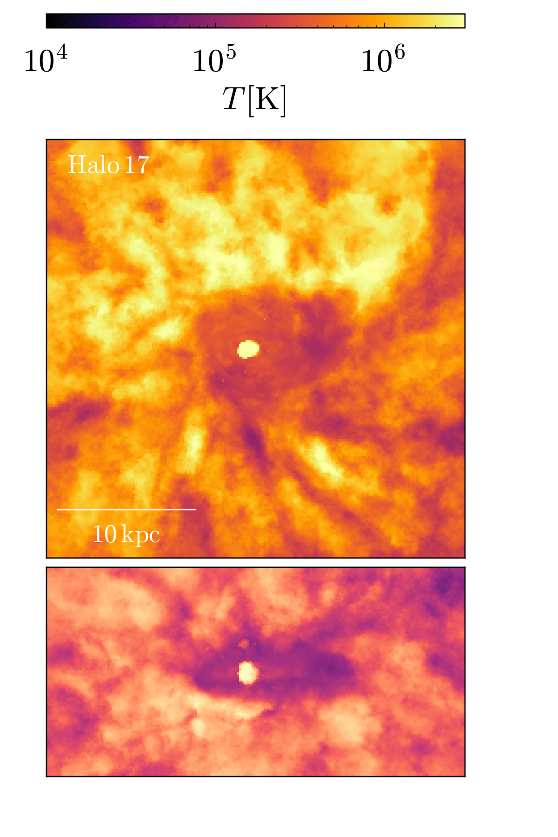
Temperature Maps
Before the gap ( ~ 8.3 and 7.4 Gyr)
During the gap (~ 6 and 4 Gyr)
After the gap ( ~ 3 and 2 Gyr)
Notes:
And when we looked at the temperature maps, we found that at the time of the gap, there was hot gas in the center of the galaxy indicating an AGN activity. Whereas the disc was calm and cool before and after the gap

Slide 13
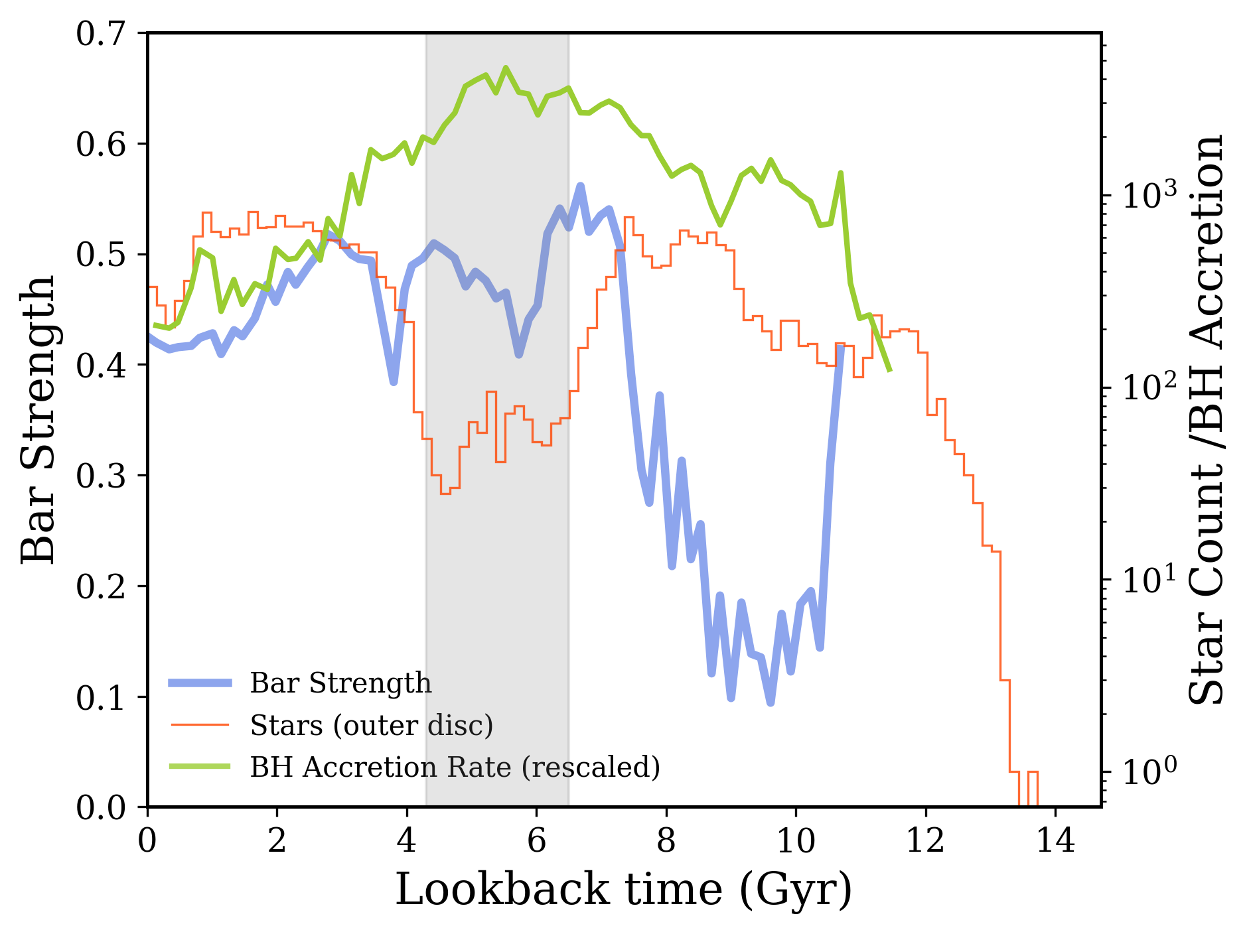
Role of bar, AGN, and the SF
Notes:
In a effort to explain to picture the entire scenerio of quenching of outer disc … we created this plot,
On right axis, its bar strenght, on left axis its SF along with rescaled BH accretion rate
And on x axis or bottom axis we have lookback time
Our analysis indicates the bar formed around 8 Gyr, subsequently driving gas inflows that activated the AGN.
This AGN activity then produced the observed star formation gaps visible in the age-metallicity relations.
however at this stage we are not sure whether it is the bar or AGN that causes the quenching therefore...

Slide 14
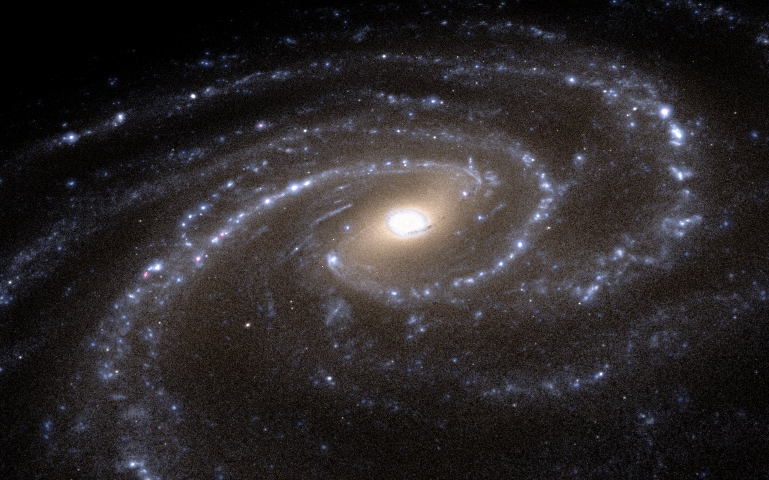
Comparison with Model of Au22 without AGN
Photo credit: Junichi Baba, Hirotaka Nakayama, 4D2U Project, NAOJ
Notes:
To test our hypothesis, we will compare our analysis of Au22 with a variant of Au22. It is the same auriga galaxy but the AGN feedback of Auriga simulations are turned off. Now we will look at the same plots of Au22 but for the variant this time, one simulated without the AGN

Slide 15
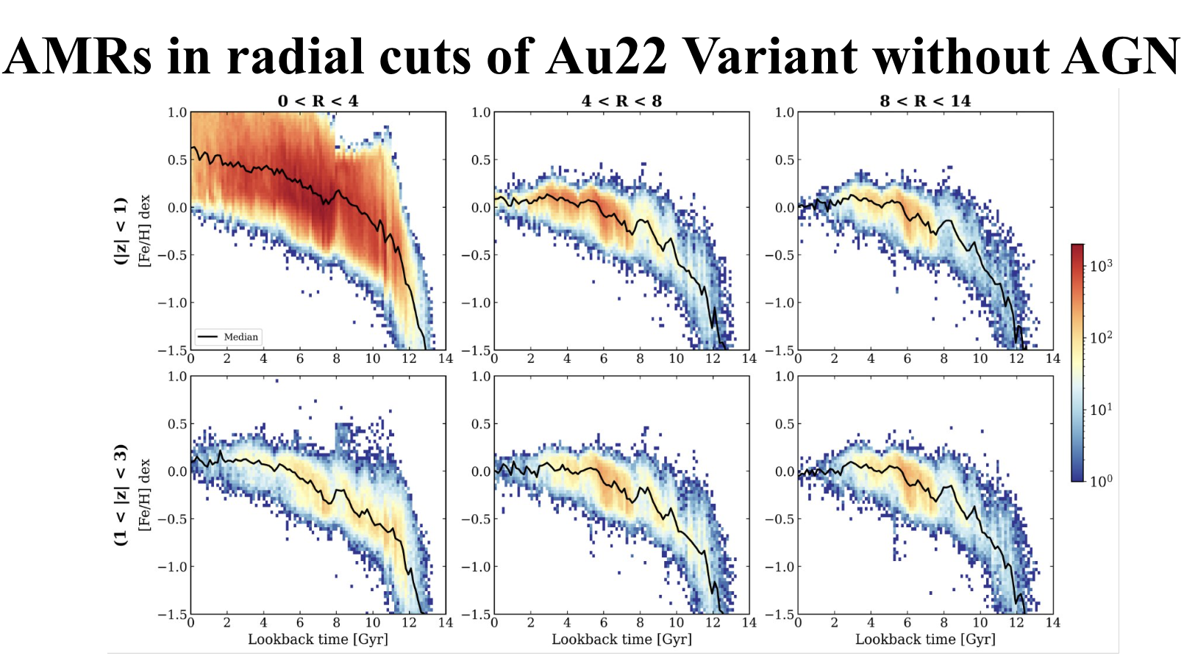
AMRs in radial cuts
Notes:
These were the AMRs for Au22 disc and when they were plotted for the variant it look completely different, and we could not see any such SF gap

Slide 16
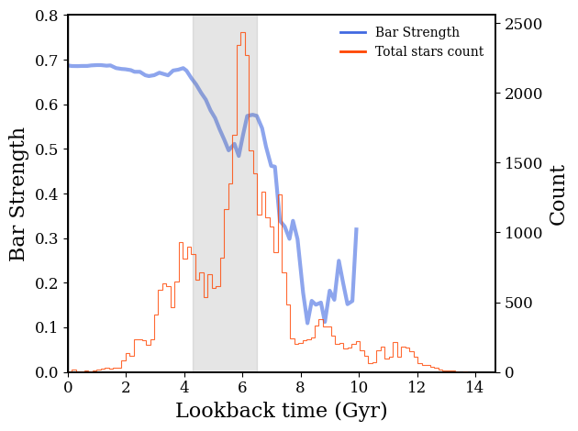
Bar strength & Star counts vs Lookback time
Au22
Au22 (Variant)
*Bar Formation time: ~ 8.09Gyr (F. Fragkoudi et al., 2024)
Notes:
Similarly SF changed, we got more enhanced SF in variant but
One interesting thing is that the strenght of bar is also high here, which could have quenched the galaxy but we found that the bar itself is not enough to cause quenching, so it takes both the AGN and the bar

Slide 17
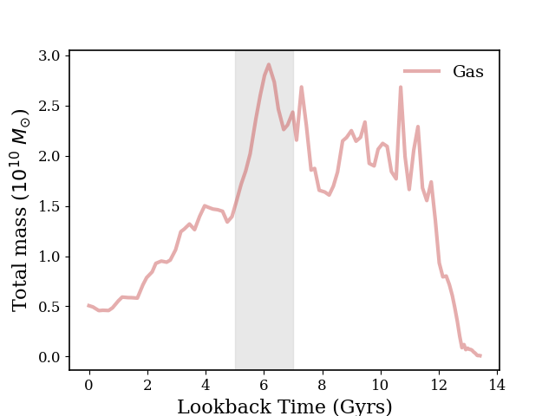
Total gas mass in the outer disc
Outer disc: |z| < 1 kpc ∧ 8 < R < 13.5 kpc
Au22
Au22 (Variant)
Notes:
Also, with the absence of any AGN feedback, there was no sudden decline at the AMR's SF gap time observed in the variant
And later in the variant it is declining because it is consumed by continuous SF.

Slide 18
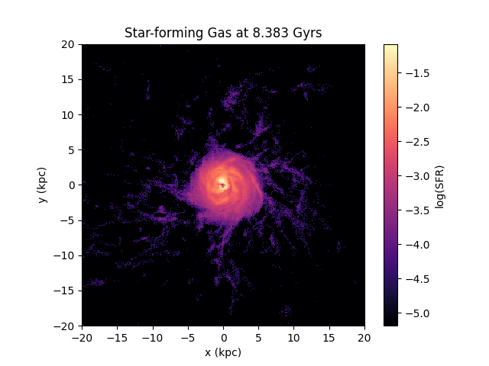
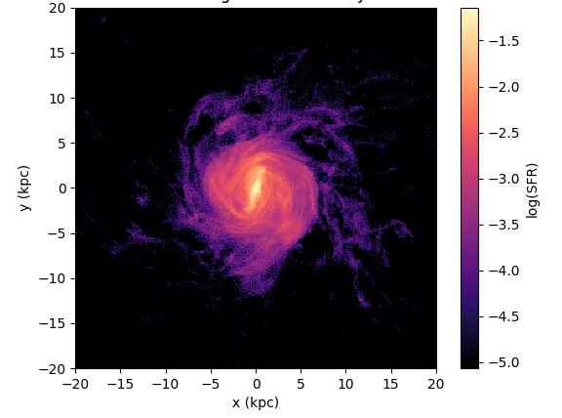
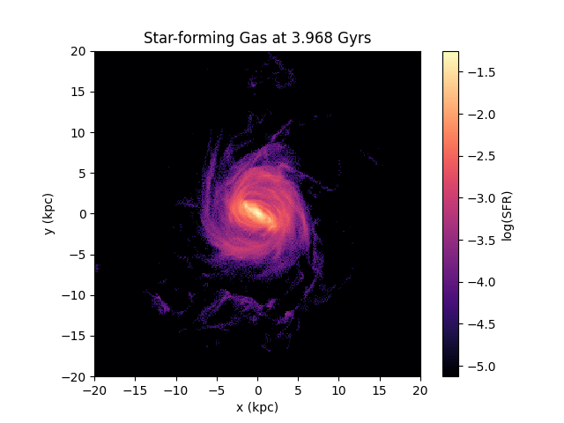
Maps of SF gas
Before the gap ~ 8.3
During the gap ~ 6
After the gap ~ 3
Au22
Au22 (Variant)
Notes:
Finally we looked at the star forming gas of the galaxy
The left panel is for Au22 and the right one is for the variant
Clearly the centrally concentrated structure is not more present in the variant and the gas seems to be spread out in the entire disc So we confirmed that the location of the SF gas has been changed now

Slide 19
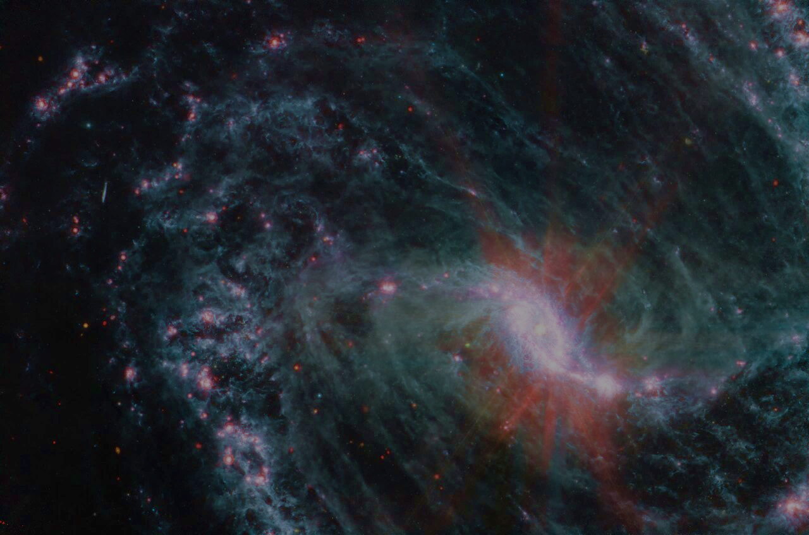
Summary
AMR gaps consistently align with AGN episodes across all three galaxies
Bar-driven inflows initiated AGN activity, leading to:
Gas heating
Outer-disc star formation quenching
Post-AGN gas cooling enabled SF recovery
Control case: The variant without AGN showed:
AGN feedback is necessary for quenching
Stronger, persistent bars, yet bars alone cannot sustain quenching
Zahoor et al. (In Prep)
Photo credit: NASA, ESA, CSA, and J. Lee (NOIRLab), A. Pagan (STScI)
Notes:
The whole summarized scenrio can be explained that Quenching happened in the out disc and it is very dependent the way feedback is implemented in the Auriga galaxies
We analysised and found that same mechanism is responsible in the all 3 galaxies of the sample wit the gap in SF
On the basis of our analysis we understand that Bar is formed that funneled the gas towards centre
It fueled the central blackhole triggering AGN activity
This AGN ejected gas from the galaxy that stopped SF, forming gap
After AGN, stars were formed again
And from our model we learned that Bars are not enough for quenching.

Slide 20
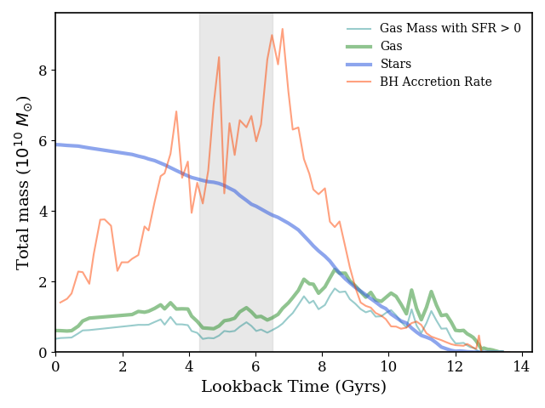
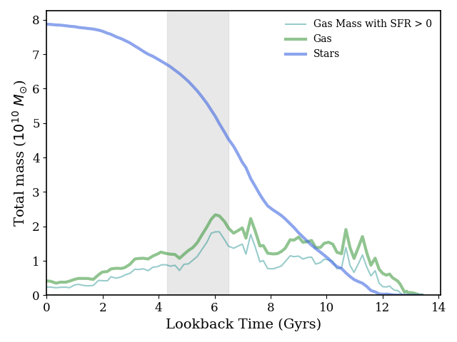
Star Formation Histories (SFHs)
Au22
Au22 Variant without AGN
*Bar Formation time: ~ 8.09Gyr (F. Fragkoudi et al., 2024)
Notes:
Looking at the star formation histories, we confirmed this.
On y axis we have total mass, lookback time at x axis. Thin teal blue line is for star forming gas, green is for the total gas and broad blue line is for the stars, where this orangered line is for the BH accretion rate which is clearly seen high at the time of the gap....
From our anaylsis we concluded that the bar was formed at 8 Gyr then it fueled the ANG, which caused the these gaps in the SF seen in the AMRs.
So we picture this scenerio...

