Slide 1
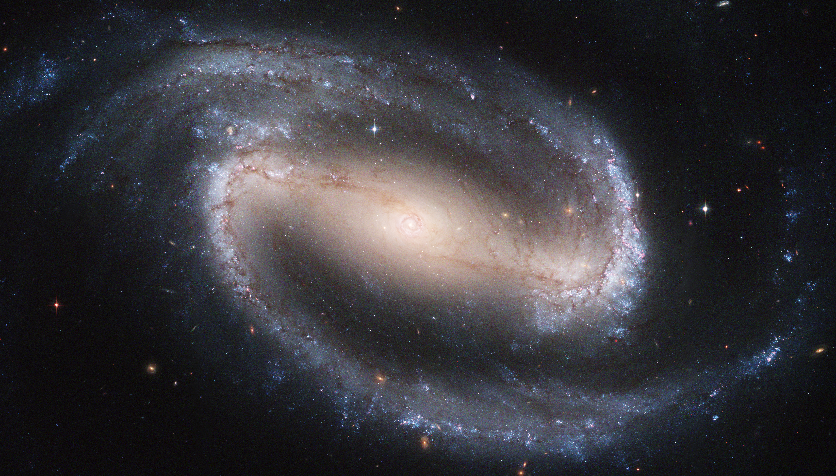
Disc [α/Fe]-bimodality from the bar-driven radial migration
HanYuan Zhang (hz420@cam.ac.uk)
Collaborators: Vasily Belokurov, N. Wyn Evans, Jason L. Sanders, Yuxi(Lucy) Lu, Changye Cao, GyuChul Meyong, Adam Dillamore, Sarah G. Kane , Zhao-Yu Li
Recall Sara’s, Alex’s and Marcin’s great talk yesterday
Zhang H. et al., 2025, ApJL, 983, L10
Notes:
Slide number

Slide 2
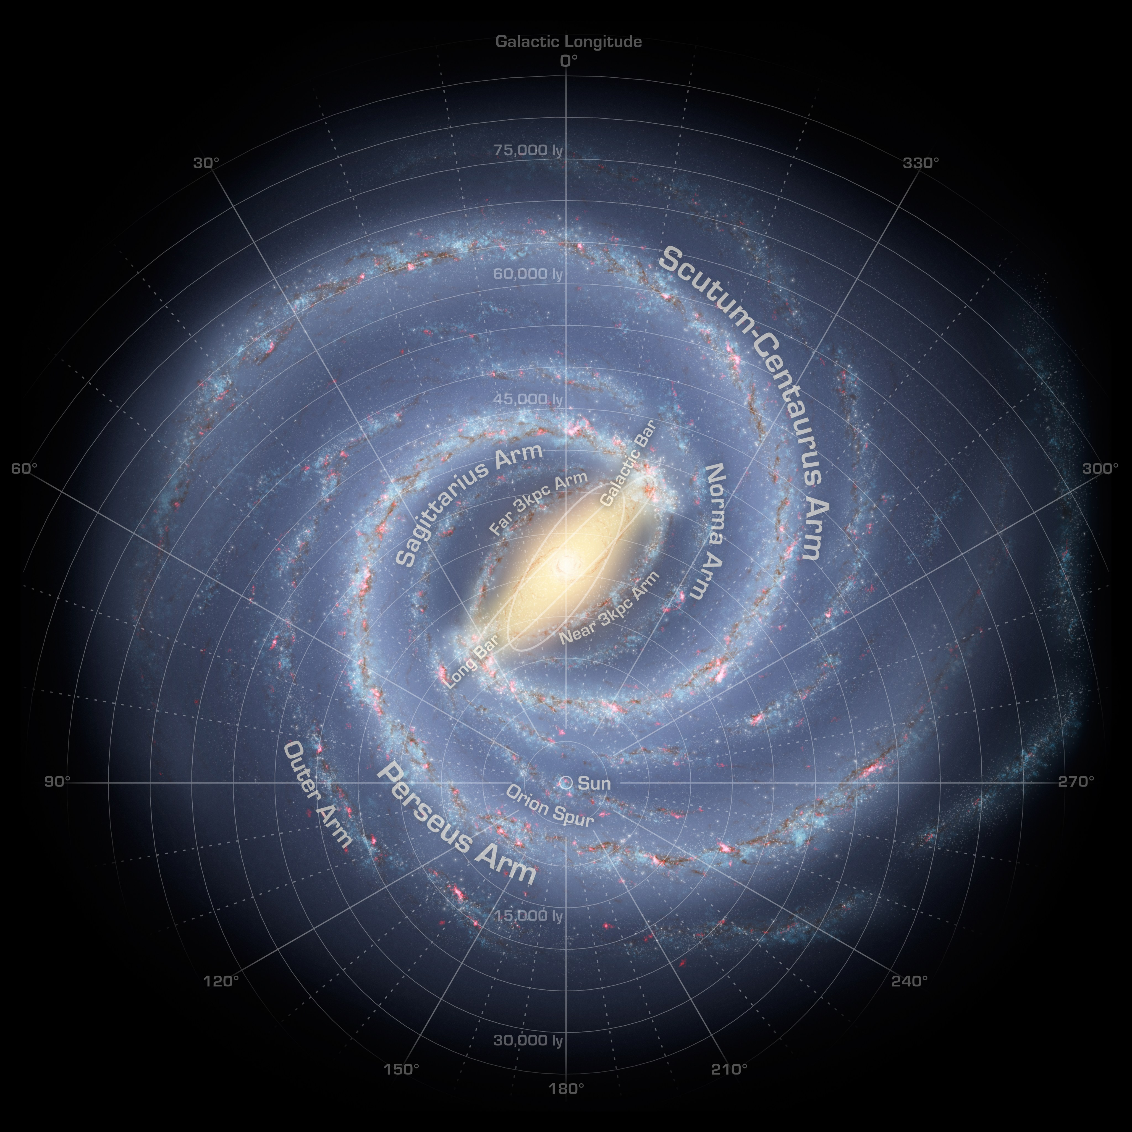
Since Gaia era, we can observe millions of stars with precise:
Kinematics
Metallicity
Chemical abundances
Ages

Slide 3
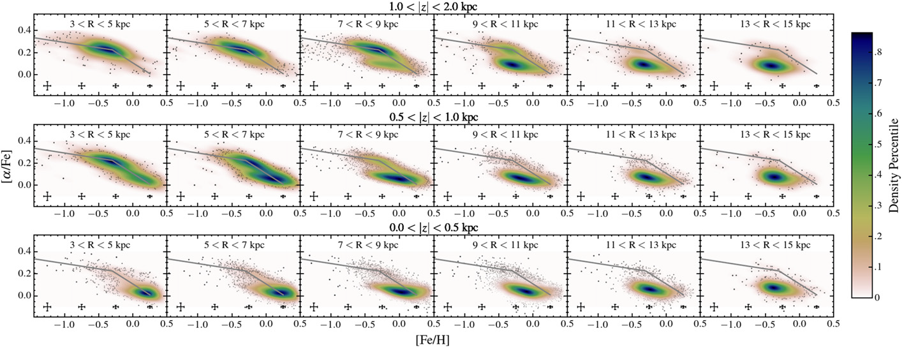
Chemical space of the Milky Way’s disc
Hayden+2015
Radial migration might be one of the many ways to create α-bimodality (See sharma+21)

Slide 4
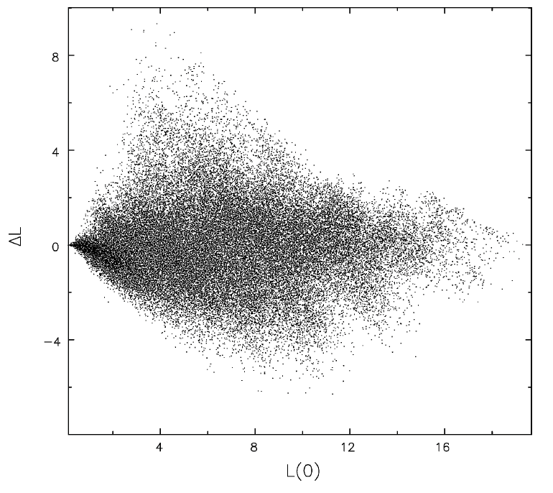
Stellar radial migrations in the Galactic disc
Sellwood & Binney 2002
Stars could move from their birth radius to their present-day radius, called radial migration
This process happens through interaction with non-axisymmetric perturbations, e.g. the transient spiral arms, galactic bar.
Amount of radial migration
Amount of migration $(∆L_{z})∝σ_{[Fe/H]}$
Birth guiding radius of stars
See Sellwood & Binney 02, Minchev & Famaey 10, Halle +15

Slide 5
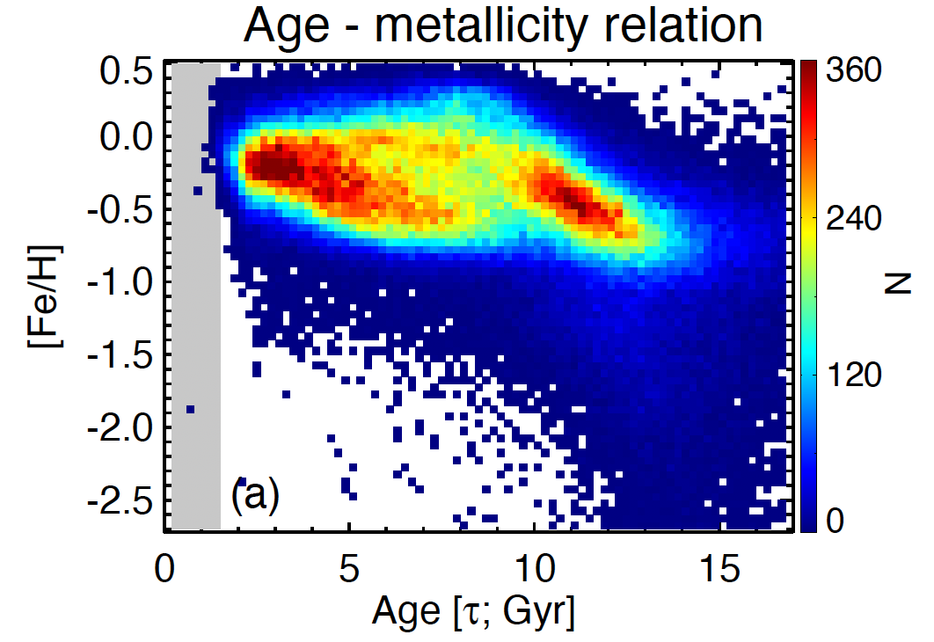
Chemical cartography in the Galactic disc
The age-metallicity plane
Question:
What mechanism caused this bimodal sequences
&
How does it correlate to the chemical bimodality
Xiang & Rix 2022

Slide 6
Resonant dragging of a decelerating bar
A toy demonstration
Stars trapped in the corotation resonance migrate with the expansion of the corotation.
This brings stars from the inner Milky Way to the present-day corotation radius.
HZ+2025
Hawkins 2023
See Chiba+21; Chiba & Schonrich 2021 for analytic descriptions and very beautiful figures
Today’s $\text{corotation} \text{radius} \sim 6.8−7.5 \text{kpc}$ (Chiba+21, Clarke+22, Zhang+24, Dillamore+24,25)

Slide 7
Resonant dragging of a decelerating bar
Test-particle simulation setup
Initialise a quasi-isothermal disc in an axisymmetric disc potential
Grow a galactic bar in the background potential with an initial pattern speed $Ω_{i}=80$ km/s/kpc ($R_{CR, init}\sim 2. 7 kpc$)
Bar reach its maximum strength and start decelerate with
$$η= −\dot{Ω}/Ω^{2}=0.003$$
t = 0 Gyr
t = 3.5 Gyr
t = 4.5 Gyr
11.5 Gyr
Add new disc stellar particles into the simulation constantly with time
Assign metallicity to the test particles afterwards with a model
$$[Fe/H] =f(R_{b}, τ)$$

Slide 8
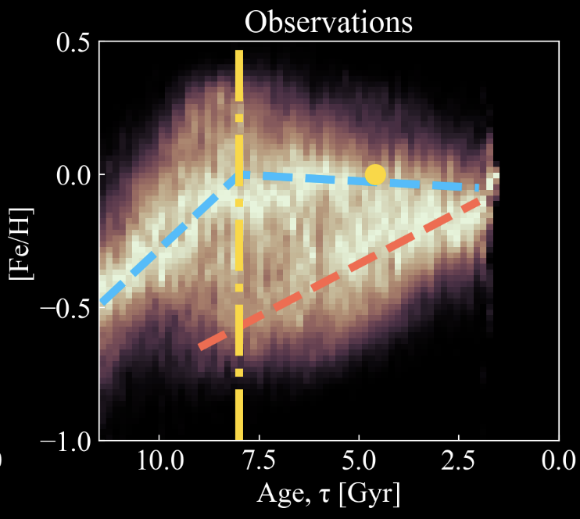
Resulting age-metallicity sequences
Local stars vs. migrated stars
HZ+2025

Slide 9
Resulting age-metallicity sequences
The guiding radii dependence
The bimodal sequences co-exist around the corotation radius
The upper sequence disappeared outside the corotation zone
Observation
Simulation
Hawkins 2023
HZ+2025

Slide 10
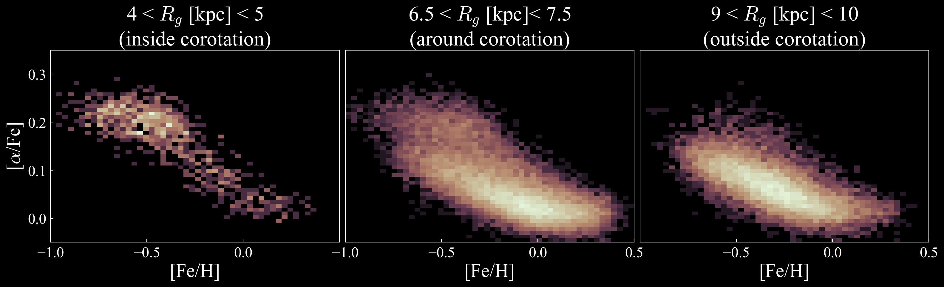
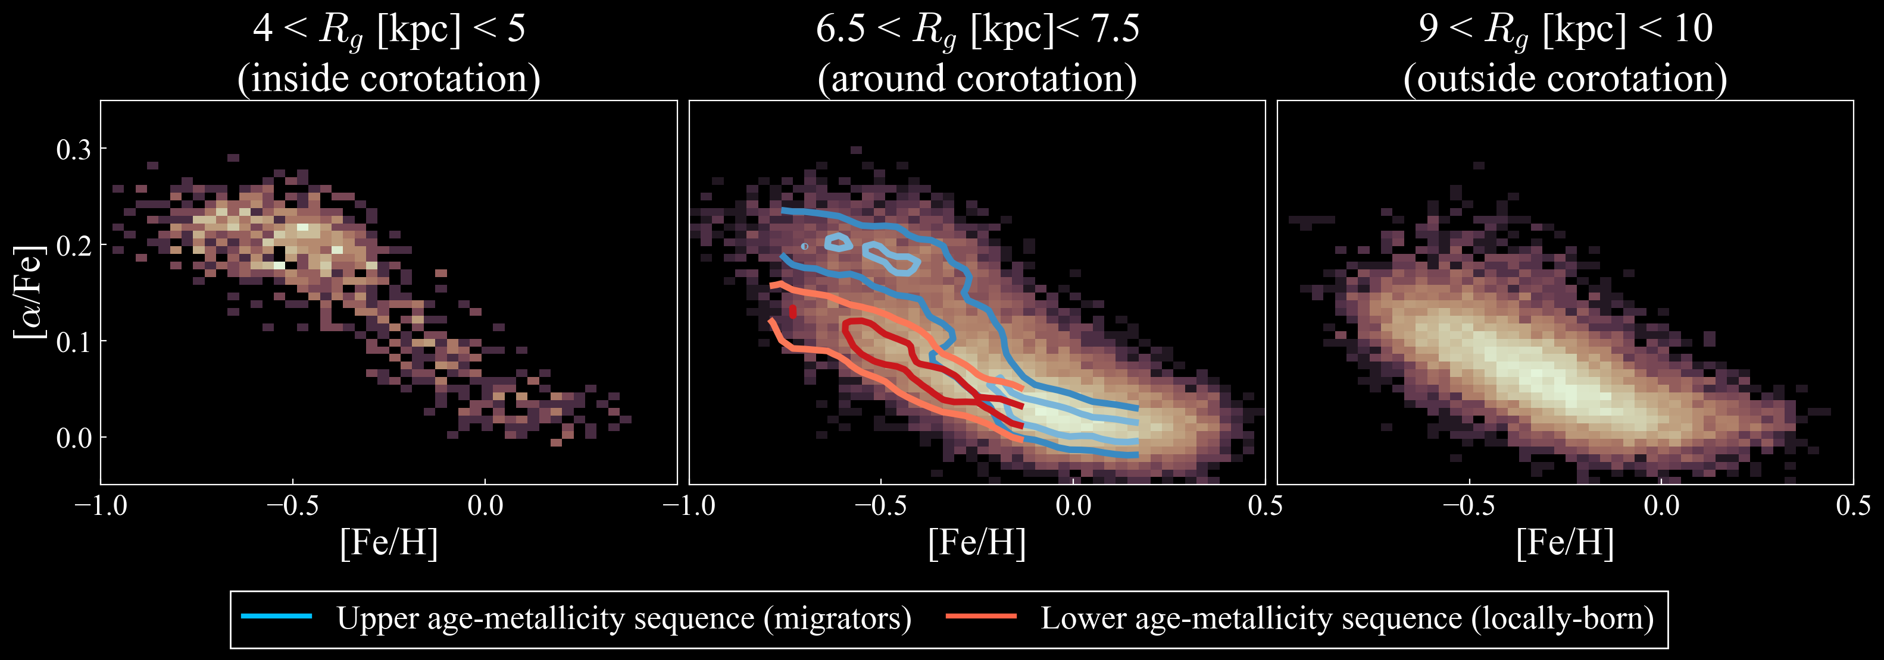
Implications: 1) $[α/Fe]−[Fe/H]$ bimodality
HZ+2025
Hawkins 2023
See more detailed chemical cartography map in Hayden+15
See also Sharma+21

Slide 11
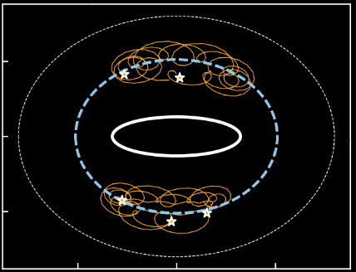
Implications: 2) Azimuthal patterns
Hawkins 2023
HZ+2025

Slide 12
Implications: 2) Azimuthal patterns
Khoperskov et al. 2024
Bar’s minor-axisx
HZ+2025
See also Poggio+23, Hawkins 2023, Hackshaw+24

Slide 13
Conclusion
Zhang H. et al., 2025, ApJL accepted
The Galactic bar redistribute the stars in the disc, and in particular, corotation stars migrated outward when the bar decelerates.
We interpret the bimodal age-metallicity sequences as they consist migrated stars and locally-born stars, respectively
The bimodal age-metallicity correspond to the high-α and low-α sequence of the Milky Way, respectively, which therefore, explains the Milky Way’s [α/Fe]-bimodality and its guiding radius dependence
As the resonance dragging mechanism favours certain regions in a galaxy, so that this mechanism can create radial and azimuthal patterns that also matches with the Milky Way observation.

Slide 15
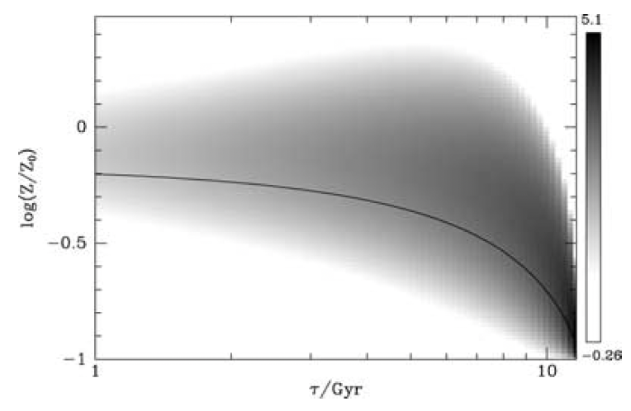
Observational evidence of radial migration
As the Galactic ISM are axisymmetric within $≲$0.1 dex (Wenger+19, etc.), the observed stellar metallicity in the solar neighbourhood should have little spread at each ages.
The large metallicity spread in the stellar metallicity at each age reflects the amount of radial migration in the Galactic disc.
Sellwood & Binney 2002
$$δL_{z}\sim \frac{V_{c} σ_{[Fe/H]}}{|d[Fe/H]/dR|}$$
$δR\sim 3.5 kpc \sqrt{τ/{8 Gyr}}$ from Frankel+18
See Sellwood & Binney 02, Frankel+20

Slide 16
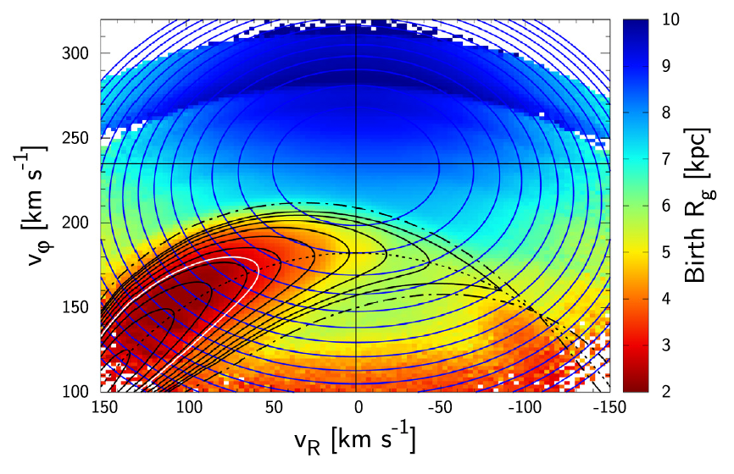
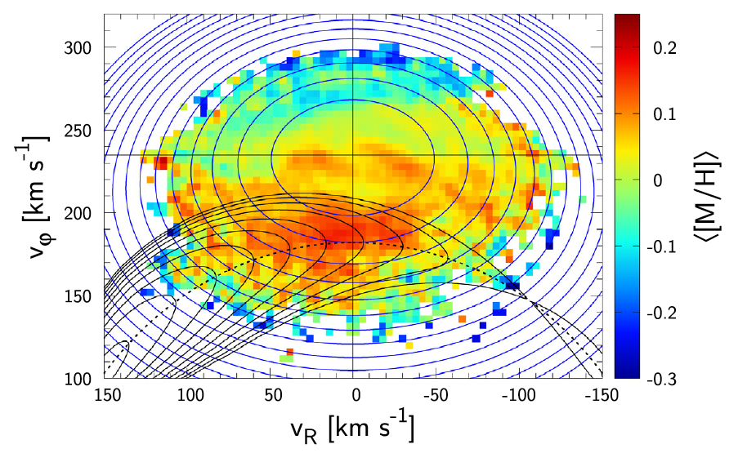
Resonant dragging of a decelerating bar
A quick introduction
Born outer →more metal-poor
Chiba & Schonrich 2021
Hawkins 2023
Today’s bar pattern speed: $Ω_{b}\sim 33−37$ km/s/kpc (Chiba+21; Clarke+22; Zhang+24 ; Dillamore+24, 25) → Corotation radius $R_{CR}\sim 6.2 −7.0$ kpc

Slide 17
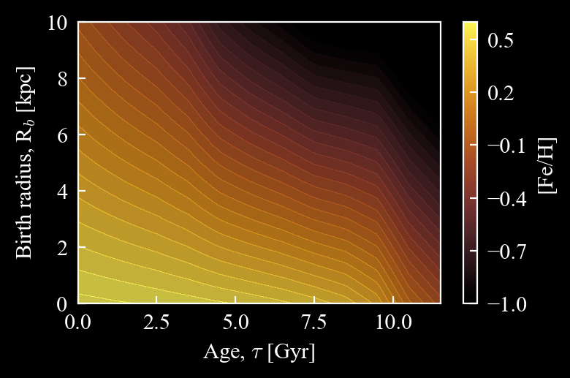
Resonant dragging of a decelerating bar
Test-particle simulation setup
Linear metallicity gradient
This is adopted from Lu+24, which calibrated with observed Milky Way’s metallicity pattern
Metallicity enrichment with time

Slide 18
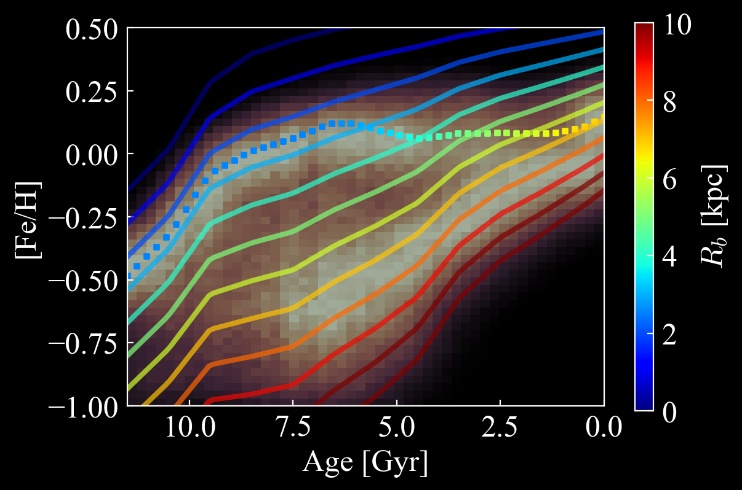
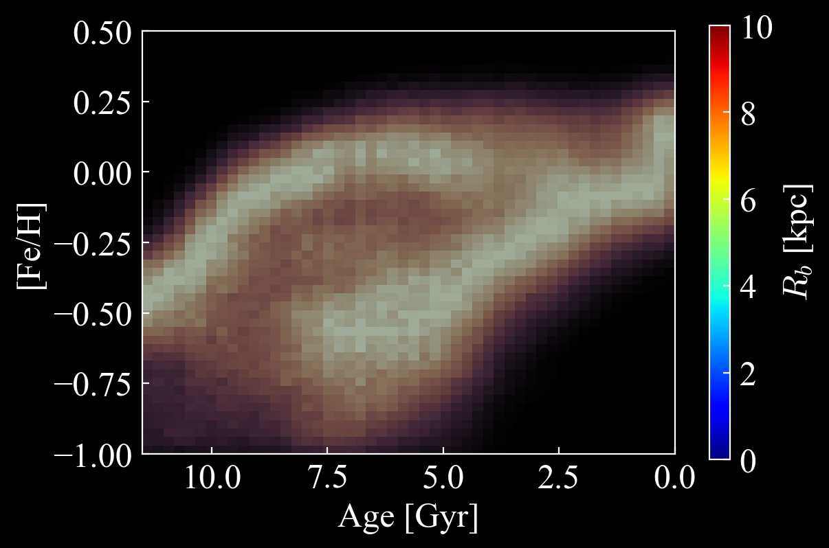
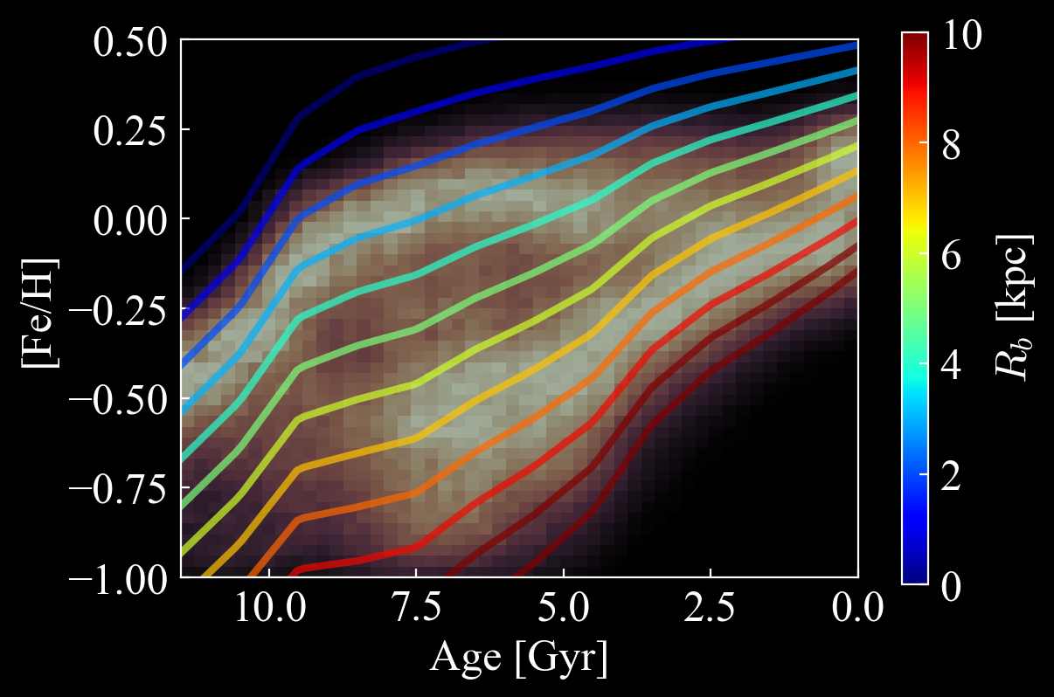
Resulting age-metallicity sequences
Local stars vs. migrated stars
Born before bar formation
Born after
bar formation
Stars born before bar formation:
those that has $R_{b}\sim R_{CR, init}$ experience strong resonance dragging
Age-metallicity sequence tracks$[Fe/H](τ, R_{b}\sim R_{CR, init})$
Stars born after bar formation:
those that has $R_{b}\sim R_{CR}(t=τ)$ experience strong resonance dragging
HZ+2025
Age-metallicity sequence flattens, and tracks $[Fe/H](τ, R_{b}\sim R_{CR, τ})$

Slide 19
Resulting age-metallicity sequences
The guiding radii dependence
HZ+2025
Hawkins 2023

Slide 20
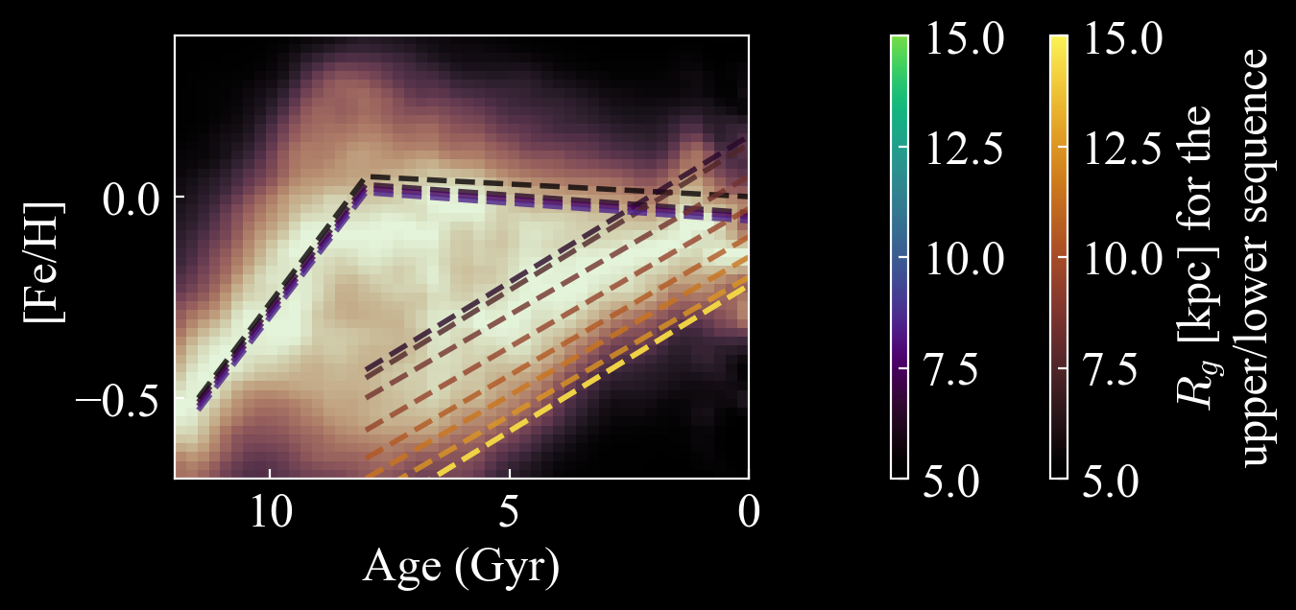
Resulting age-metallicity sequences
The guiding radii dependence
Hawkins 2023
See also Khoperskov+24

Slide 21
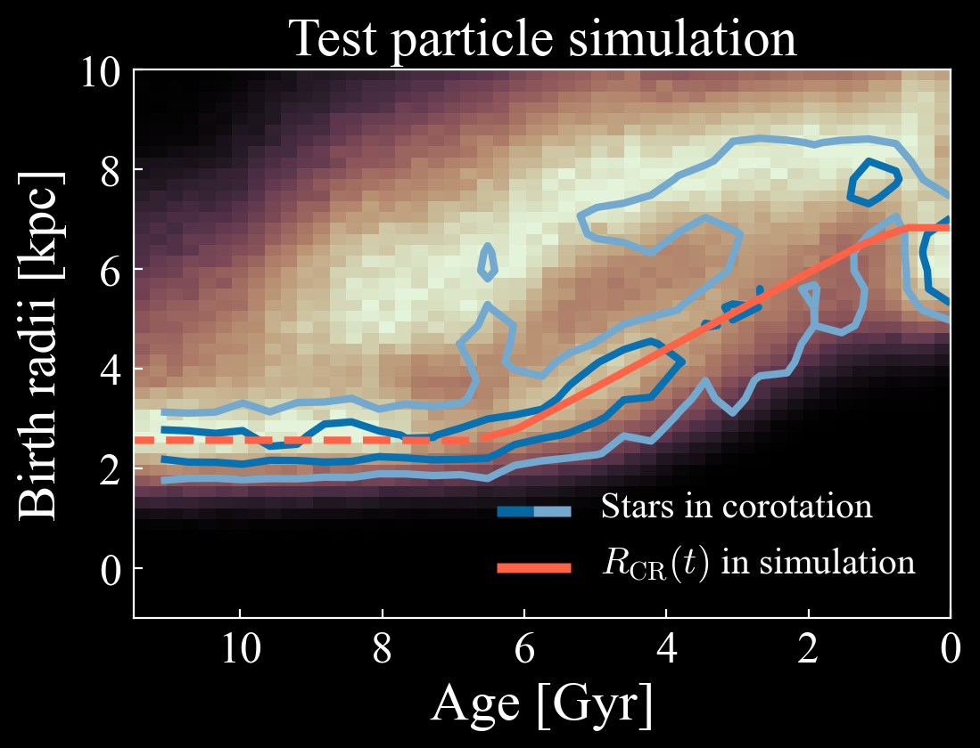
Inferring the pattern speed history of the bar
HZ+2025
Hawkins 2023
In this birth radius calculation method (Lu+24), we can infer:
$t_{bf}\sim 6−8$ $Gyr$; $Ω_{i}\sim 60−100$ $km/s/kpc$; $η=−\dot{Ω}/Ω^{2}\sim 0.0025−0.004$
agree with other independent measurements of $t_{bf}$ and $η$ (Chiba+21, Sanders+24), and non-independently Haywood+24
Notes:
Maybe we can cut this out

Slide 22
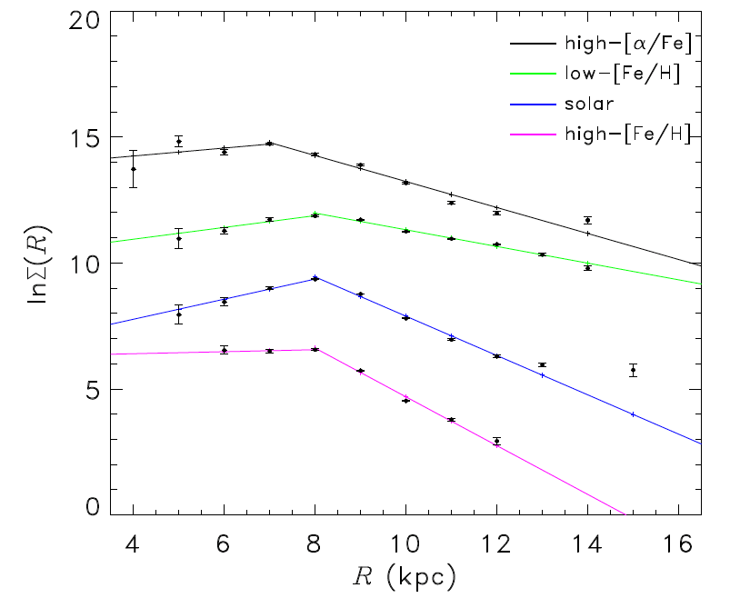
Implications: 3) Broken power-law in stellar density
Yu et al. 2021
Hawkins 2023
HZ+2025
See also Bovy+15, Lian+22

Slide 23
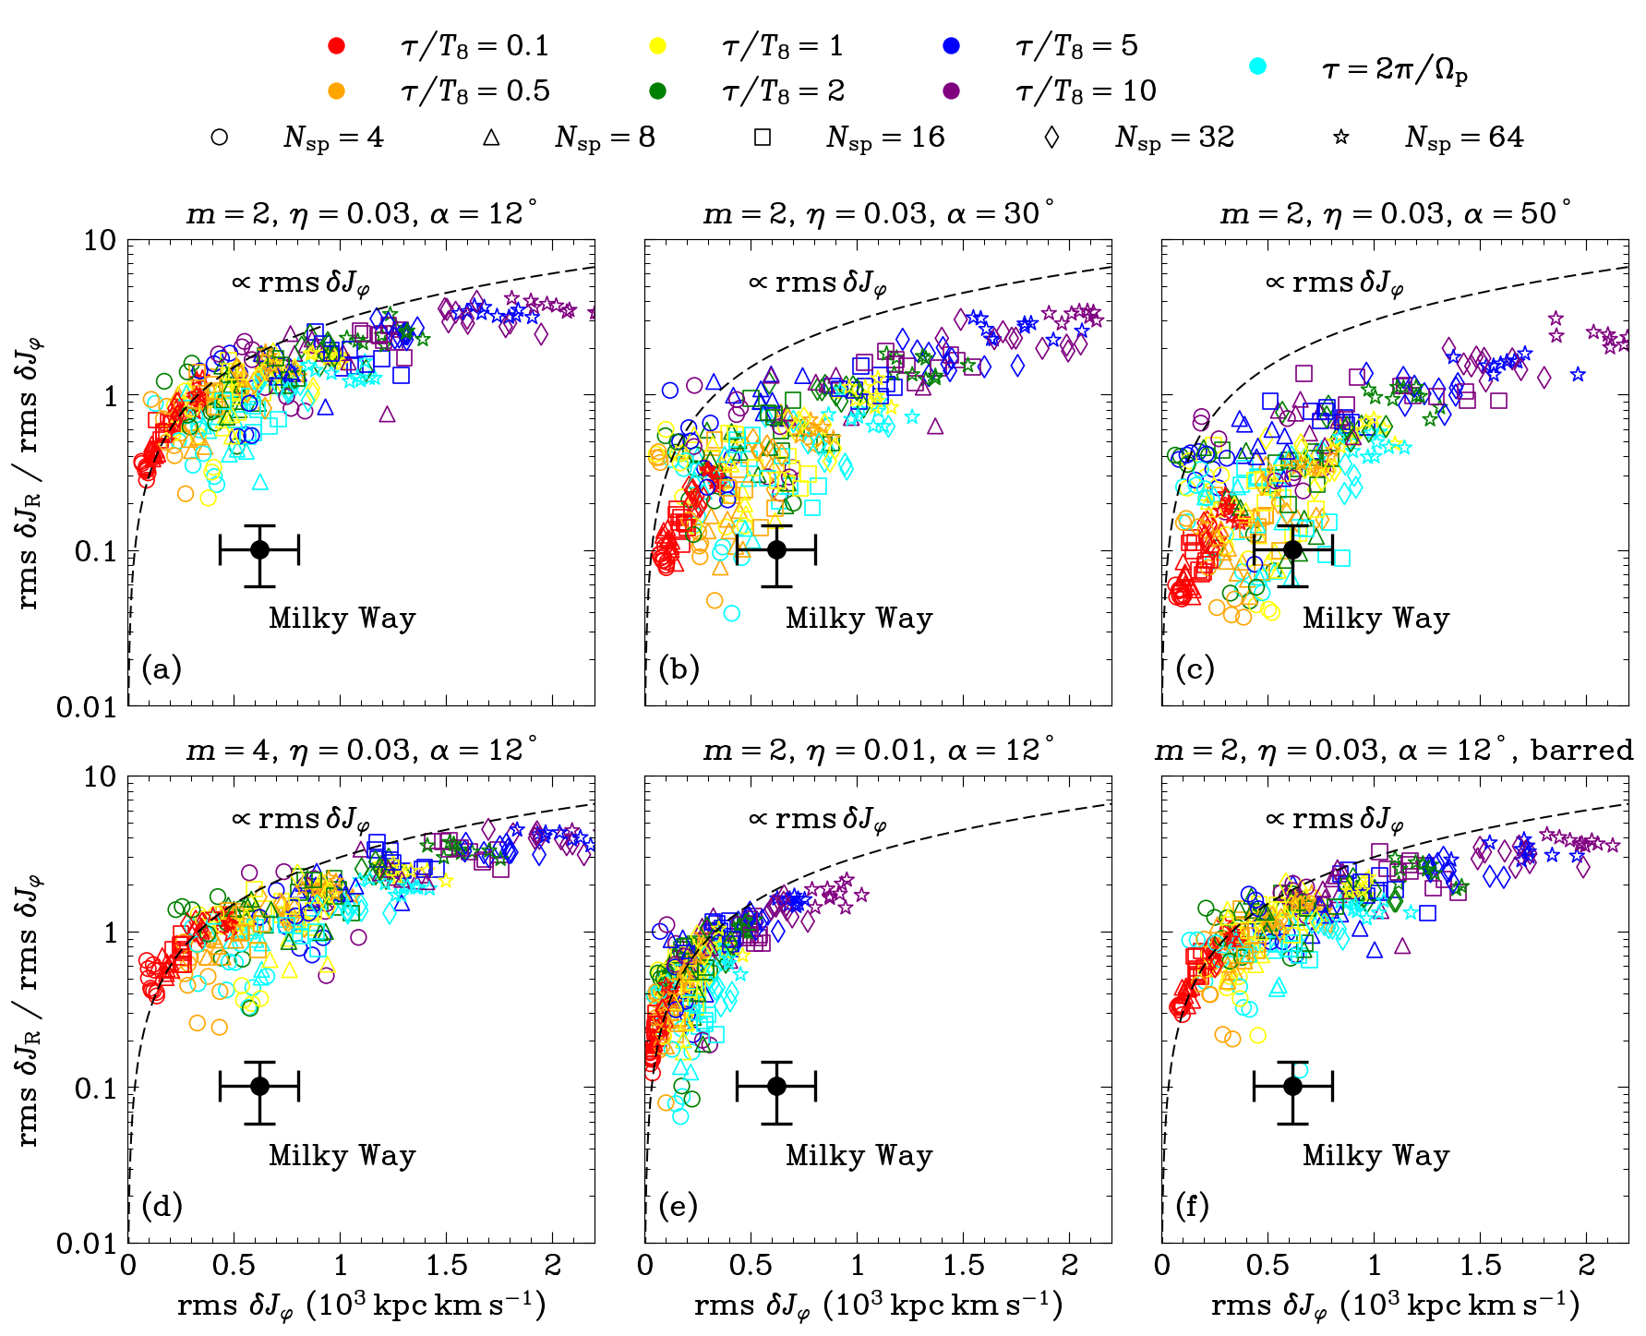
Implications: 4) Coldness of the disc
Hamilton et al. 2024
The Milky Way observation is from Frankel+20
Hawkins 2023
But see also the demonstration in Sellwood & Binney 2025

Slide 24
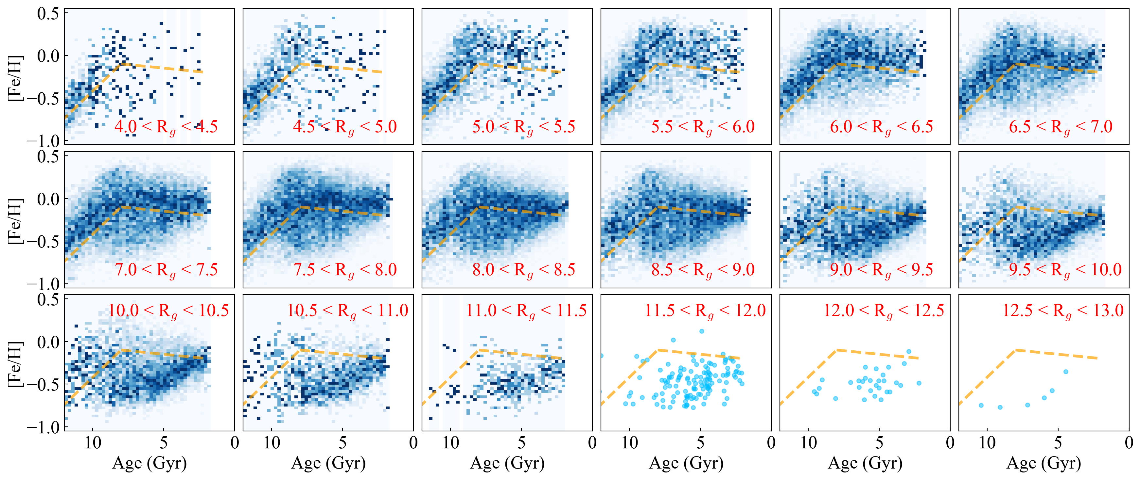

Slide 25
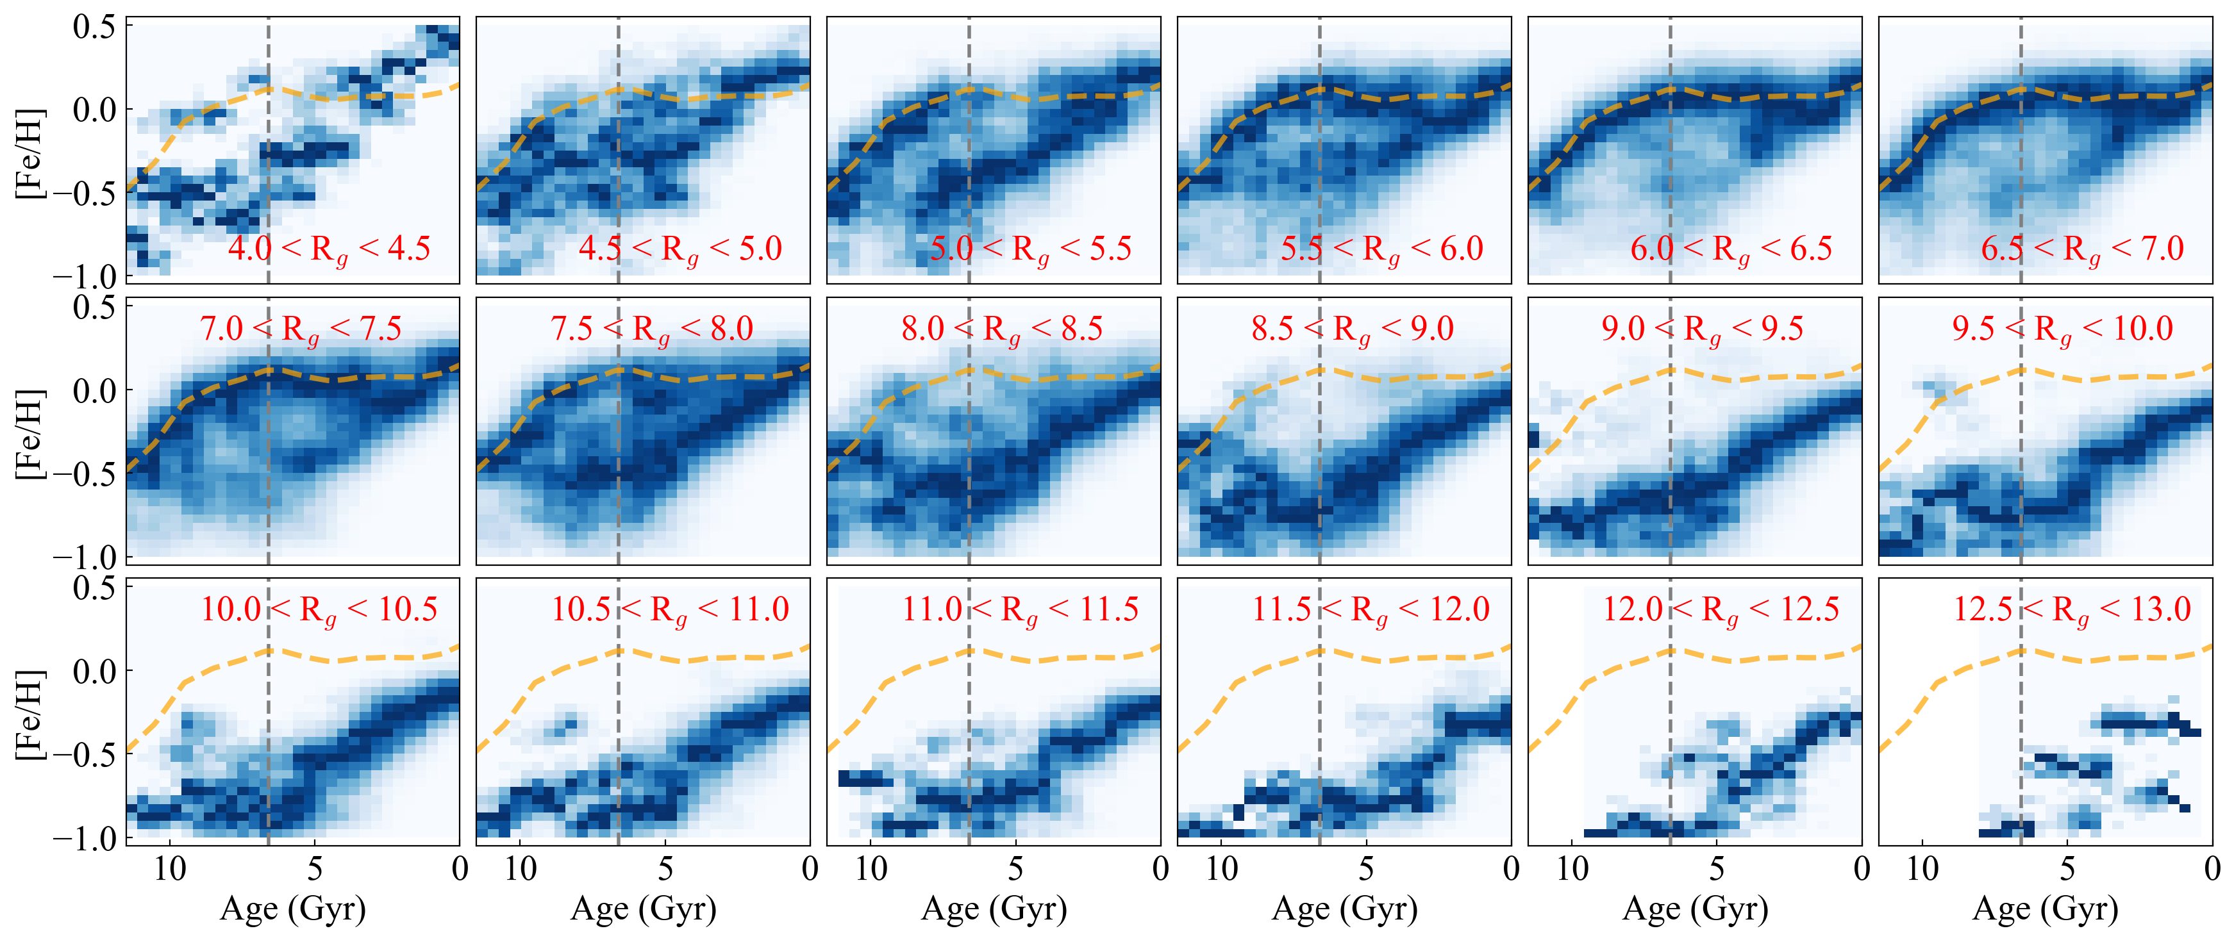

Slide 27
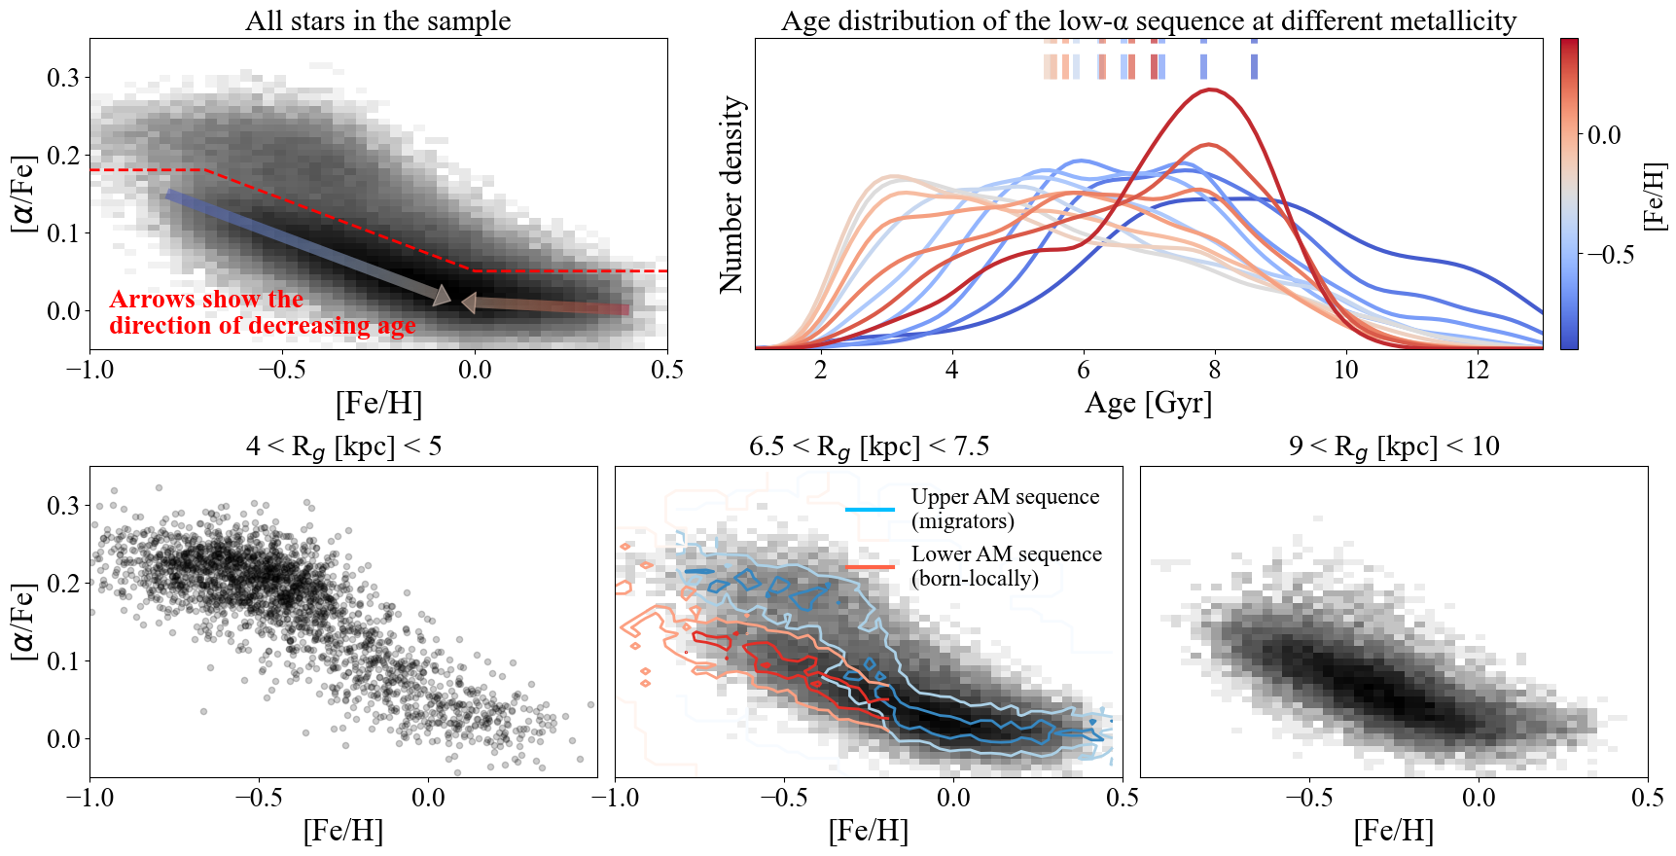

Slide 28
Work in progress

Slide 29
Work in progress

