Slide 1
Automated Bar and Spiral Arm Segmentation using Deep Learning
Dr Ashley Spindler a.spindler@herts.ac.uk
National Astronomy Meeting 2025
Barred Galaxies: Unraveling Their Evolution, Dynamics, and Cosmic Role

Slide 2




Galaxy Segmentation Team @ Galaxy Zoo
(In no particular order…)
Dr Ashley Spindler, University of Hertfordshire
Dr Tobias Géron, University of Toronto
Dr Mike Walmsley, University of Toronto
Prof Karen Masters, Haverford College

Slide 3
Why Segmentation?
Galaxies are complex structures, and their internal components can reveal crucial details about their evolutionary history.
Identifying which pixels belong to different substructures could allow for more targeted studies—particularly with IFU datacubes.

Slide 4
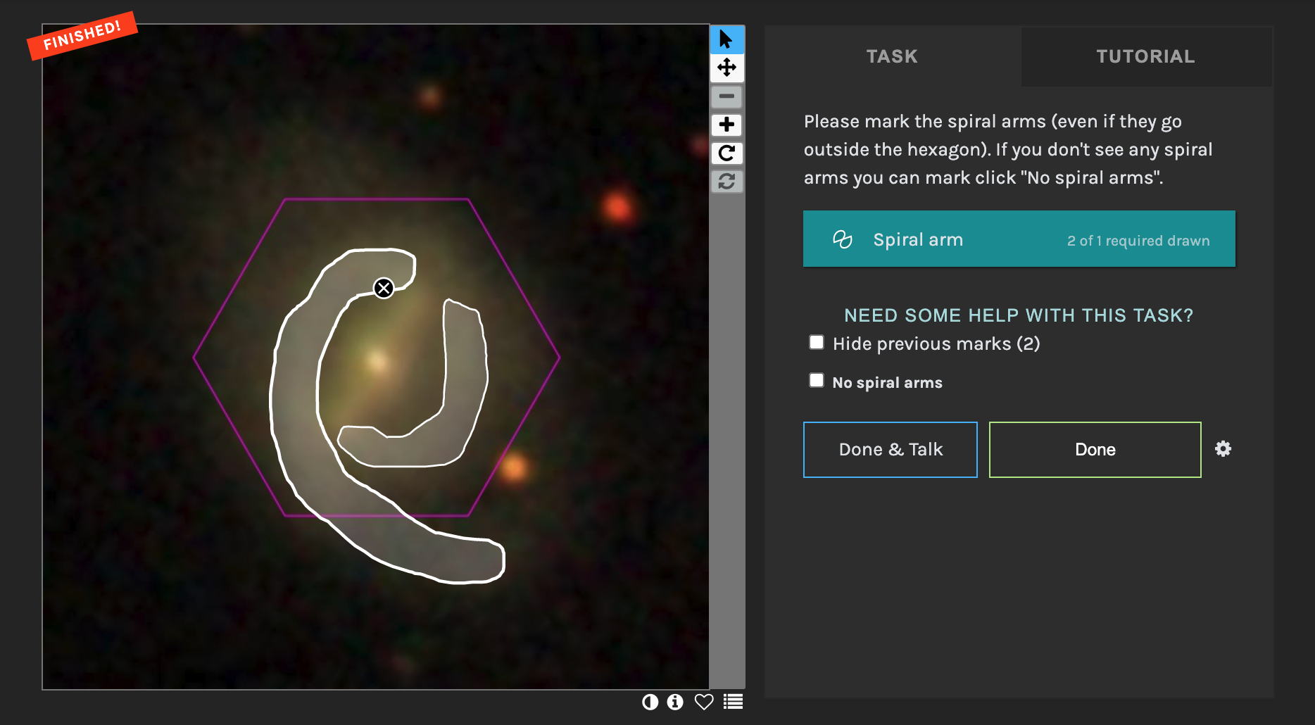
Galaxy Zoo: 3D (Masters et al. 2021)
Citizen Scientists recruited to identify the internal structures of galaxies in the MaNGA Survey sample.
Bars, spiral arms, galaxy centres and foreground stars identified.
Bar and Spiral Arm phase ran from Dec 2017 to Oct 2019, with spiral arm masks taking the longest to complete.
Figure 1 from Masters+21: Galaxy Zoo: 3D Interface

Slide 5
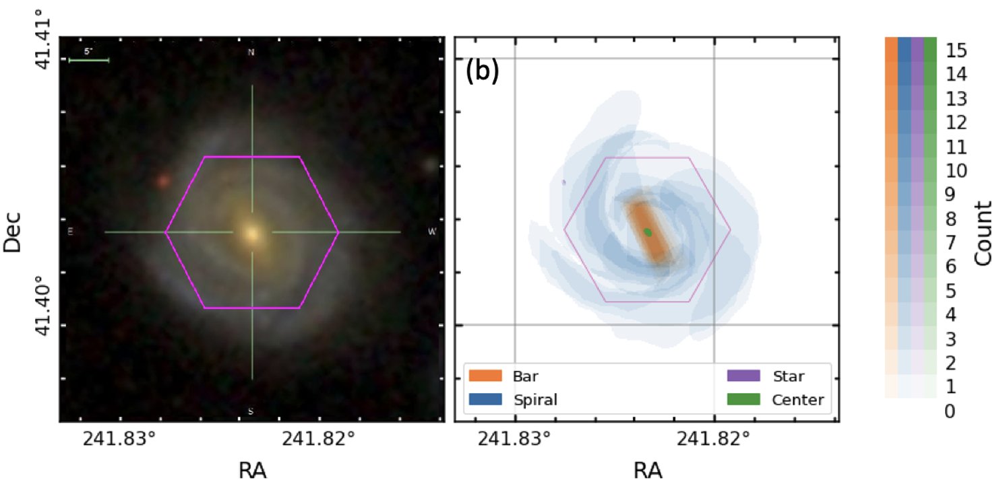
Galaxy Zoo: 3D (Masters et al. 2021)
Each galaxy seen by 15 volunteers.
~7500 galaxies with spiral arm masks in the MaNGA sample, 5500 with bar masks.

Slide 6
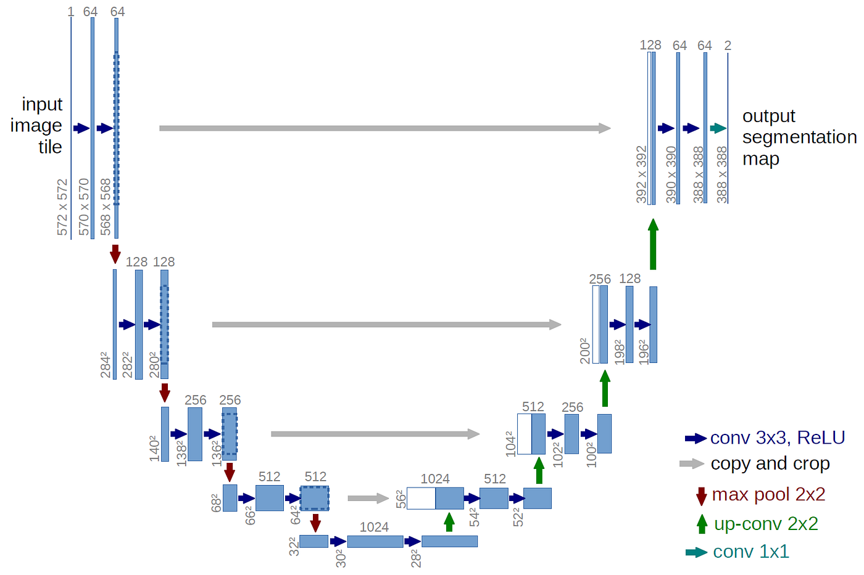
Segmentation with U-Net
Input
Target
Training Data:
DESI RGB images of
Galaxy Zoo 3D targets
Predictions:
Face on disk galaxies
from DESI
(~510,000 spirals,
~230,000 bars)
Training Data:
“Vote Count” pixel maps from Galaxy Zoo 3D for Spirals and Bars
Predictions:
Spiral and Bar segmentation maps
(Exact configuration not show here – for illustrative purposes only)

Slide 7
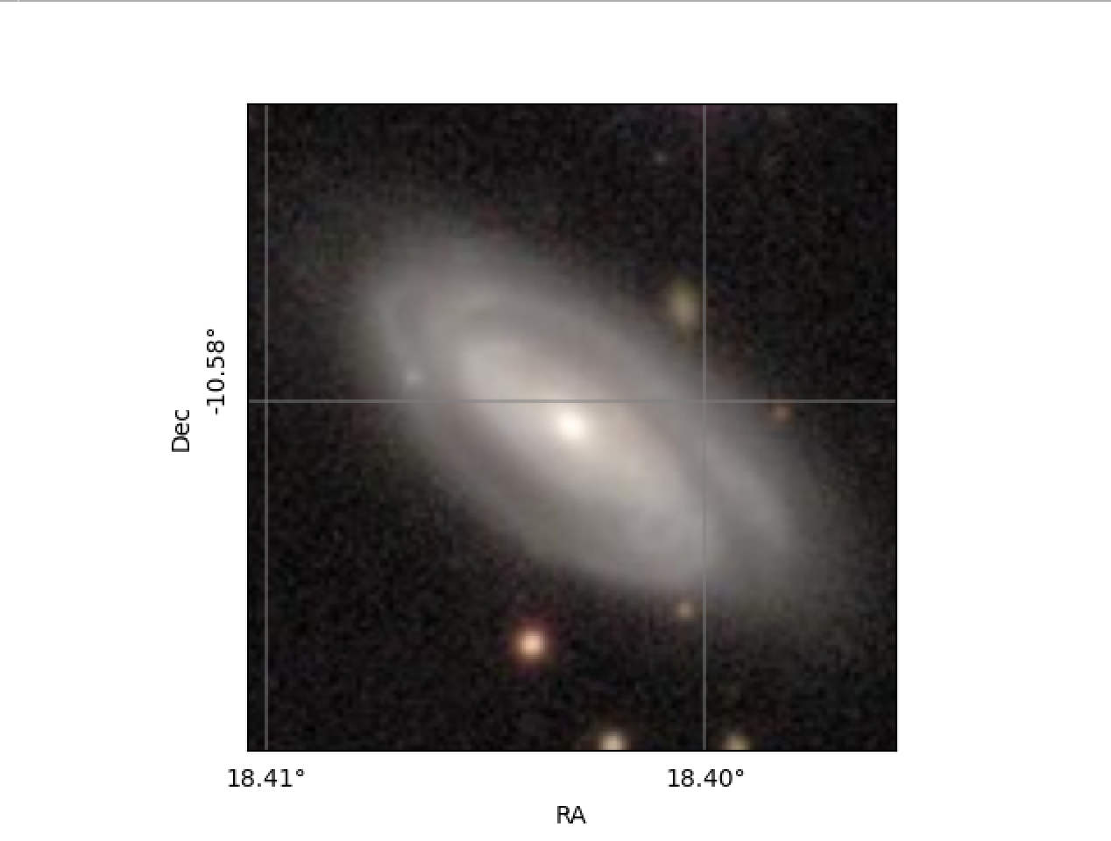
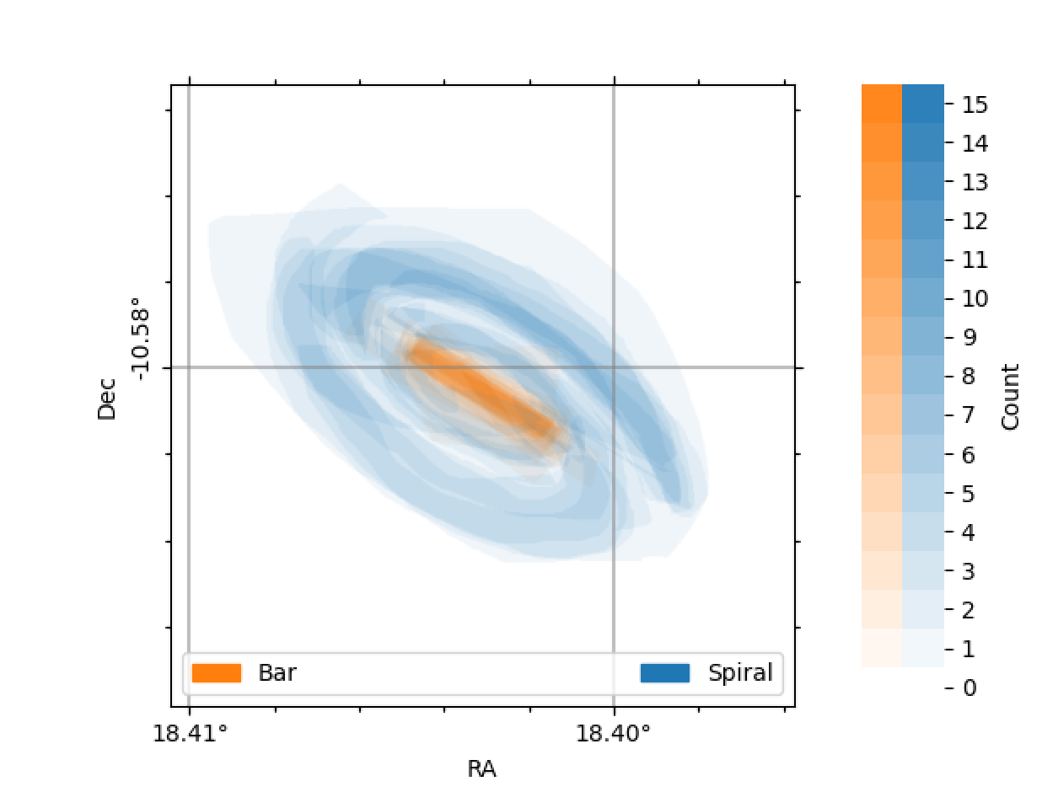
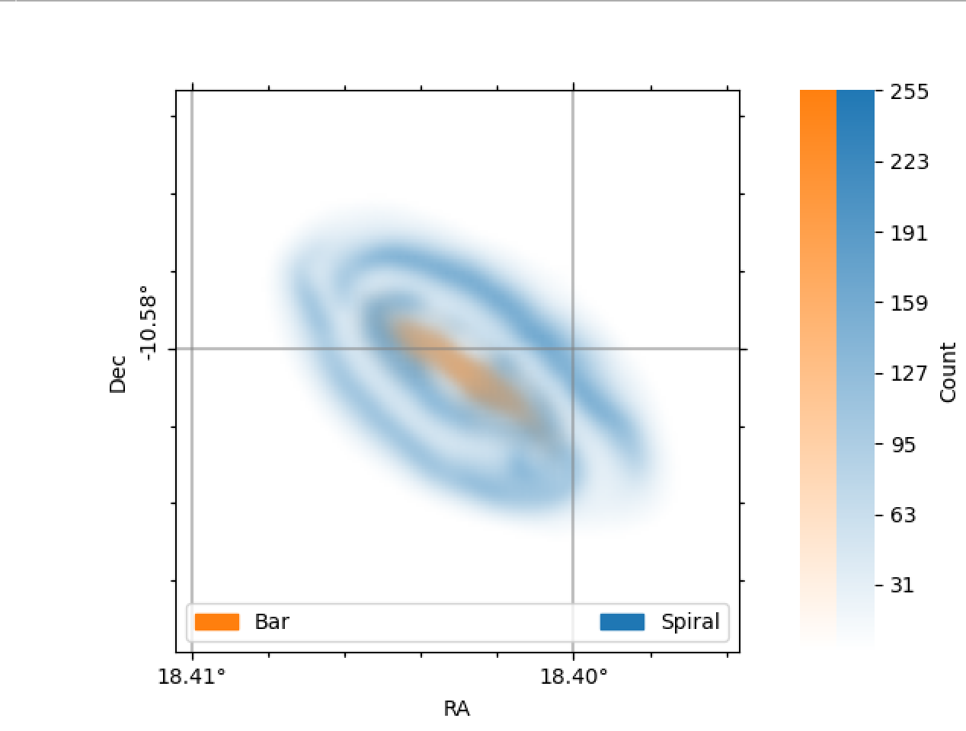
Results – A Close Up

Slide 8
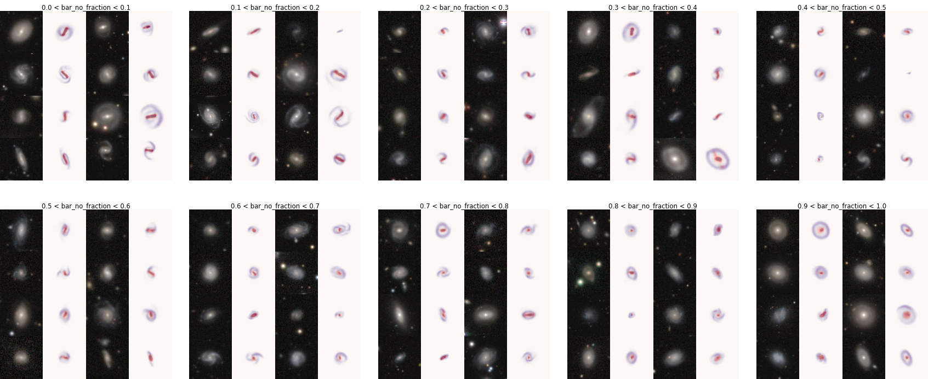
Results – A wider look

Slide 9
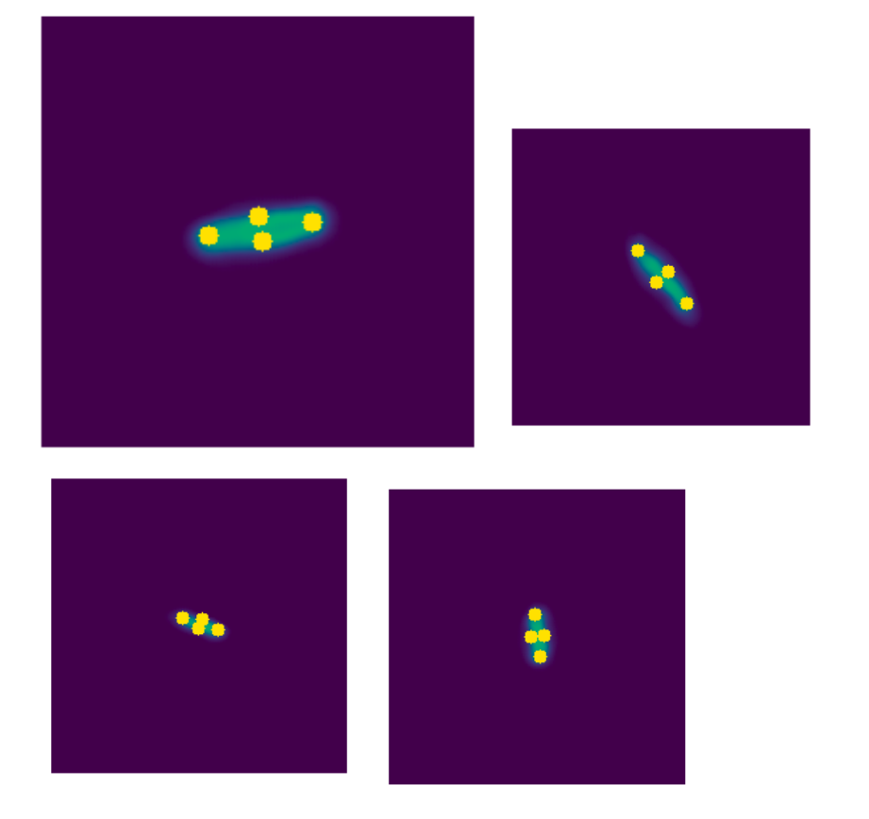
It does “Physics”! (Walmsley & Spindler 2023)
Measure Lots of bars…
Compare with Volunteers

Slide 10
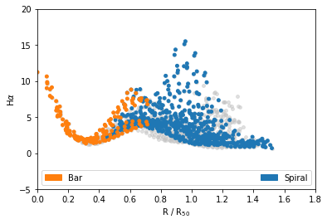
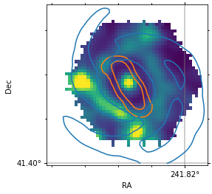
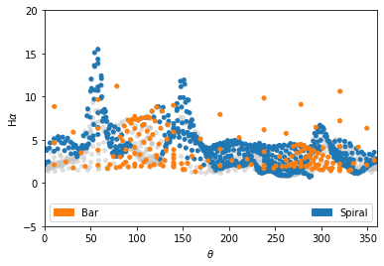
IFU data – easy???

Slide 11
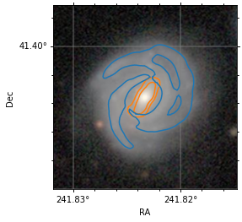
Photometry – Hard???

Slide 12
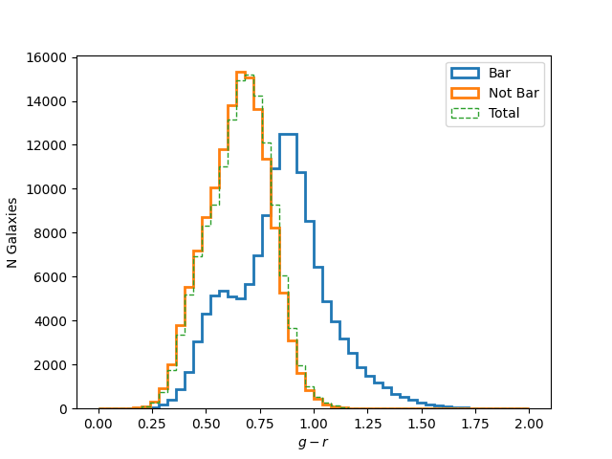
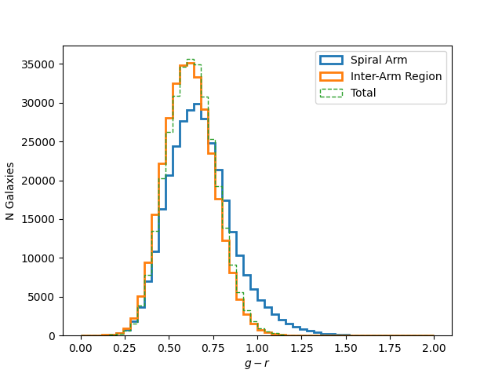
Photometry – Hard???
Colour Comparison of Bar and Non-bar pixels
Colour Comparison of Spiral and Non-spiral pixels

Slide 13


Photometry – Hard???
Colour Comparison of Bar and Non-bar pixels
Colour Comparison of Spiral and Non-spiral pixels

Slide 14
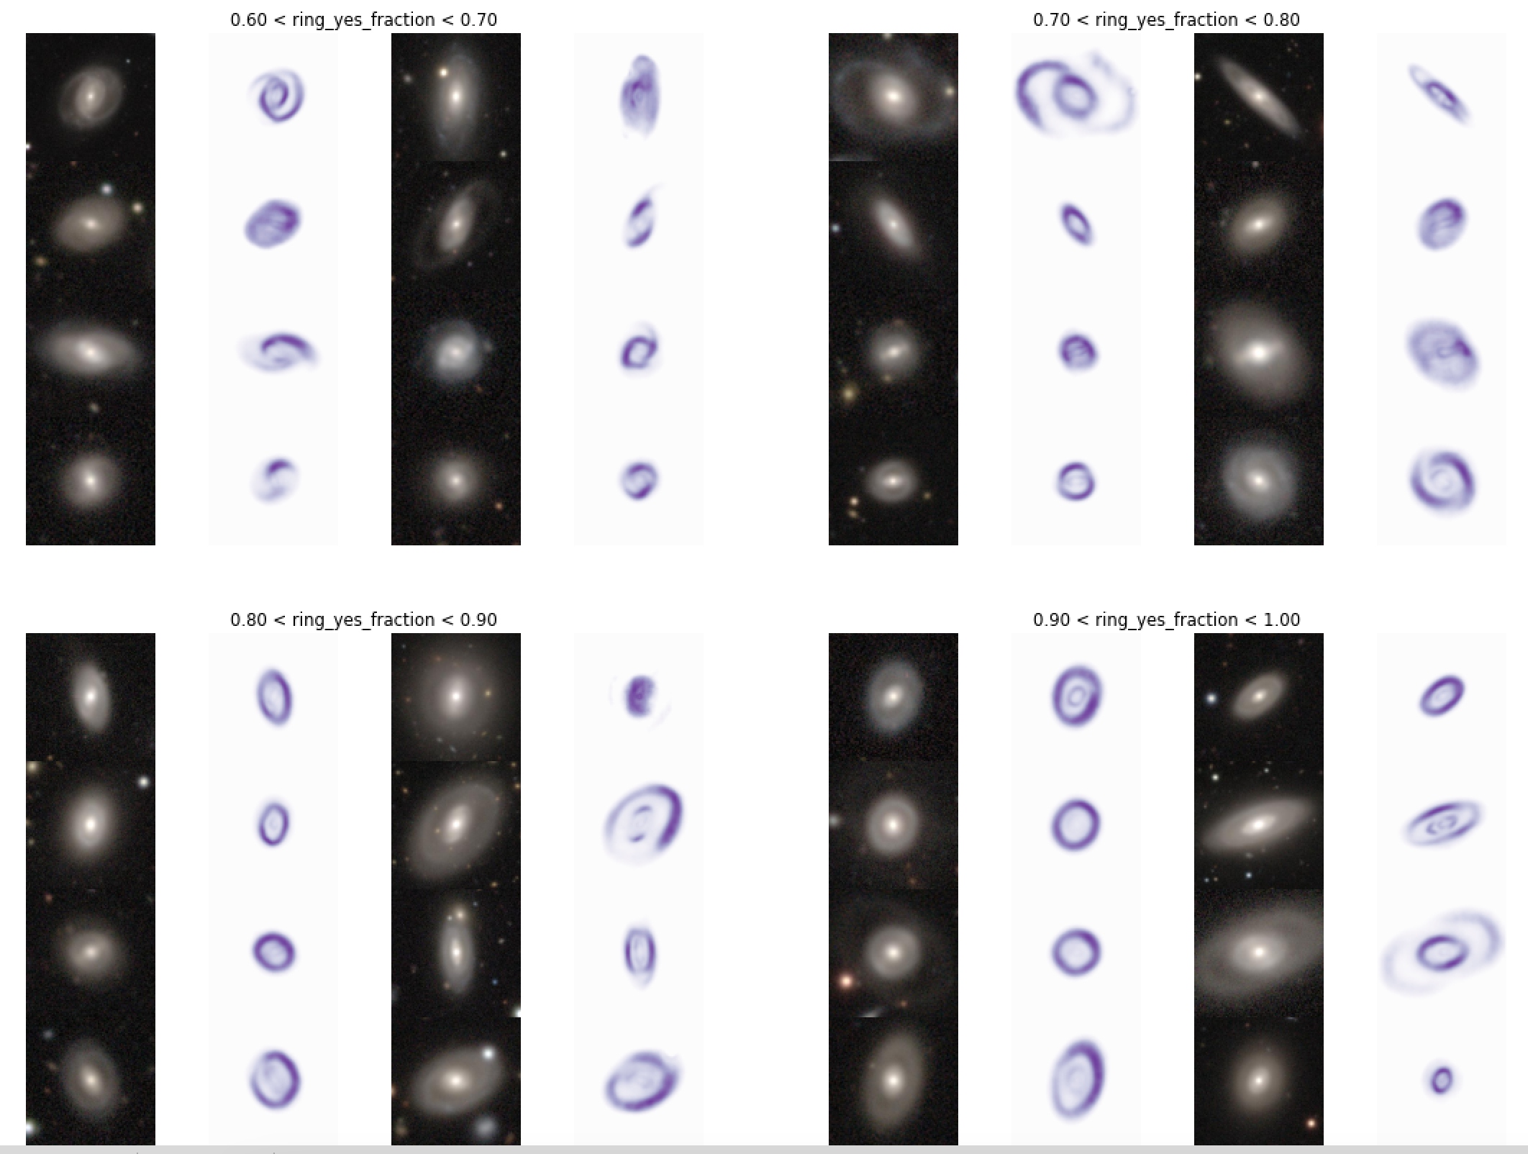
Emergent Behaviour – Rings!

Slide 15
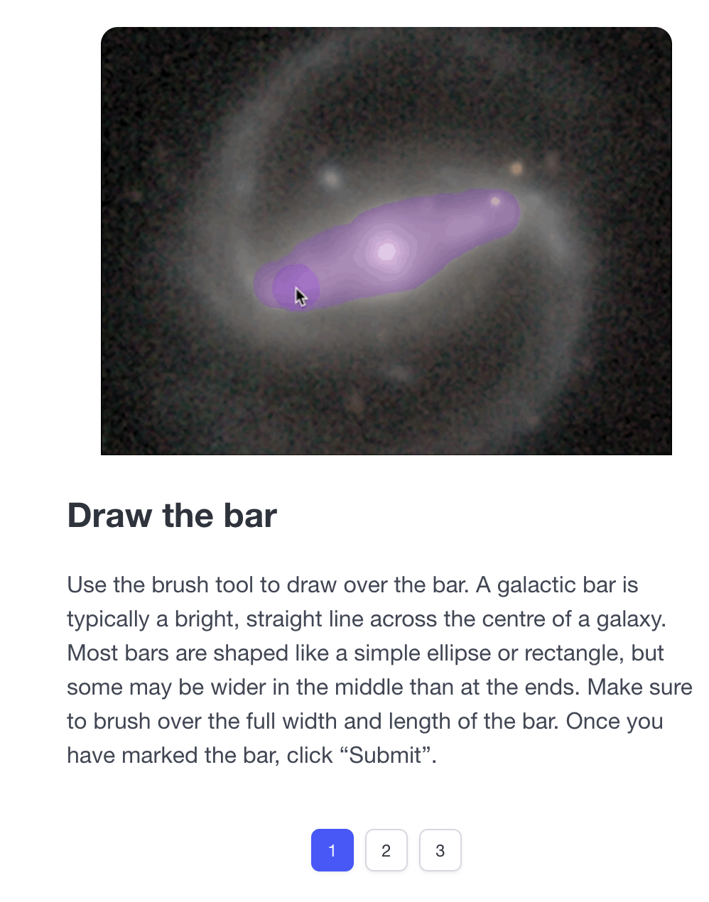
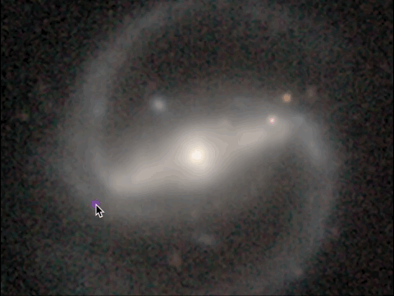
Coming to a Zooniverse Near You…

Slide 16
Questions?
Dataset and Paper coming soon™

