Slide 1

The need to measure the mm sized dust flux in Low Earth Orbit
Mark J. Burchell, Penelope J. Wozniakiewicz
Centre for Astrophysics and Planetary Science,
School of Engineering, Mathematics and Physics,
Univ. of Kent.
m.j.burchell@kent.ac.uk; p.j.wozniakiewicz@kent.ac.uk
NAM July 2025

Slide 2
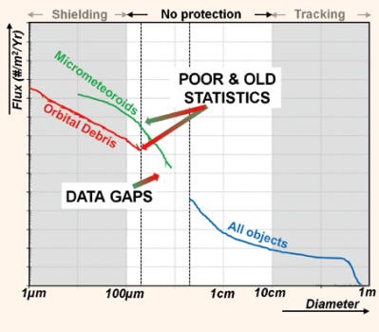
Flux curves depend on orbital altitude and inclination.
But in LEO the curve (left) is typical.
And the gap in knowledge is where we have little in the way of effective shielding or tracking, so protection is weak
Rely on extrapolations, indirect measurements etc.
Wozniakiewicz & Burchell, (2019) Space Dust and Debris Near the Earth. Astronomy and Geophysics, 60 (3). 38 -42. https://doi.org/10.1093/astrogeo/atz150

Slide 3
What speed are impacts?
Again, it depends on orbits, but an estimate is provided below averaged over all altitudes in LEO using the parametrisation of Kessler, D.J., et al. (1989) Orbital Debris Environment for Spacecraft Designed to Operate in Low Earth Orbit. NASA TM 100-471.
See: Varga et al., A NEW LARGE AREA DETECTOR FOR IN-SITU OBSERVATION OF SMALL ANTHROPOGENIC DEBRIS IN LOW EARTH ORBIT – SAILOR. Proc. 9th European Conference on Space Debris, 2025, https://conference.sdo.esoc.esa.int/proceedings/sdc9/paper/338/SDC9-paper338.pdf

Slide 4
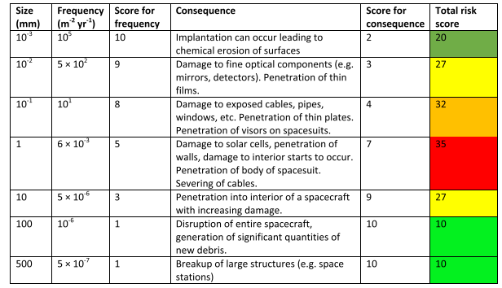
The result is a hypervelocity impact, with potentially severe damage.
How much damage?
Flux below 600 km. See:
Cornwell et al., Adv. Spa. Res. 75, 6944, 2025. https://doi.org/10.1016/j.asr.2024.06.058

Slide 5
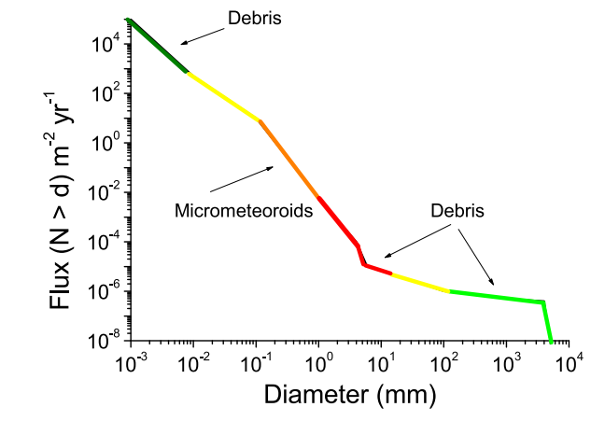
This is the flux below 600 km, colour coded for risk
Cornwell et al., Adv. Spa. Res. 75, 6944, 2025. https://doi.org/10.1016/j.asr.2024.06.058

Slide 6
This is the flux below 600 km, colour coded for risk
And this is the region of poorly determined flux!
Cornwell et al., Adv. Spa. Res. 75, 6944, 2025. https://doi.org/10.1016/j.asr.2024.06.058

Slide 7
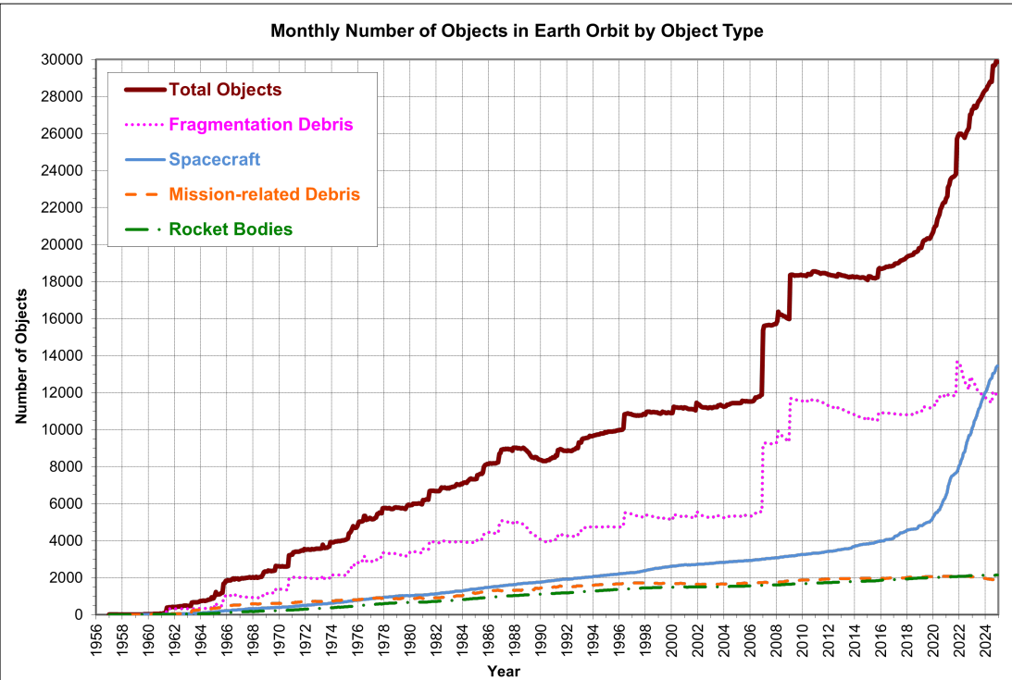
Worse: The number of satellites in orbit is soaring
Source:
NASA Orbital Debris Quarterly, Feb. 2025. https://orbitaldebris.jsc.nasa.gov/quarterly-news/pdfs/ODQNv29i1.pdf

Slide 8
Even with improved design to prevent release of debris from surfaces, improved EOL mitigation strategies, active clearance of old objects from LEO, we should expect more debris.
And, traditionally, people say 5 – 7 cm is the size impactor required to disrupt an entire spacecraft.
But, if a typical new satellite in orbit is say Starlink, the average mass is 260 kg.
And a broad indicator of the catastrophic disruption threshold for a distributed body such as a satellite is 40 J kg⁻¹, then if v = 10 km s⁻¹, the diameter needed to meet this requirement is…..
5 mm

Slide 9
This is the flux below 600 km, colour coded for risk
And this is the region of poorly determined flux!
Cornwell et al., Adv. Spa. Res. 75, 6944, 2025. https://doi.org/10.1016/j.asr.2024.06.058

Slide 10
Urgently require on-orbit capacity to measure the flux of 0.1 to 10 mm sized debris in LEO.
Paradox is that the flux on an individual satellite is low.
So, either need a large fleet of small area detectors (50 cm by 50 cm say) – see discussion in Cornwell et al., Adv. Spa. Res. 75, 6944, 2025. https://doi.org/10.1016/j.asr.2024.06.058
Or
A large area detector (25 – 100 m²), see discussion in Varga et al., A NEW LARGE AREA DETECTOR FOR IN-SITU OBSERVATION OF SMALL ANTHROPOGENIC DEBRIS IN LOW EARTH ORBIT – SAILOR. Proc. 9th European Conference on Space Debris, 2025, https://conference.sdo.esoc.esa.int/proceedings/sdc9/paper/338/SDC9-paper338.pdf

Slide 11
Measurement requirements:
Sufficient exposed area over mission lifetime to produce several impacts
Minimal false triggers
Impactor size (reliable at 10% level or better)
Impactor speed (reliable to 10% level or better)
Impactor trajectory (to better than 10°)
This way you can separate true from fake triggers,
and separate natural impactors (cosmic dust) from debris

Slide 12
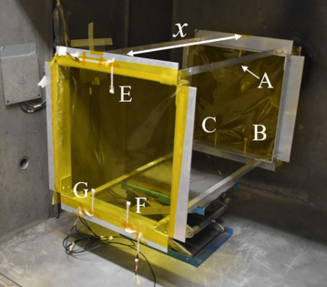
Solutions:
Twin layer thin film devices, which can be small (up to say 50 cm by 50 cm), various proposals, see Cornwell et al., A study on the capabilities and accuracy of Kapton based TOF space dust and debris detector. Advances in Space Research 72, 2959 – 2970, 2023. https://doi.org/10.1016/j.asr.2022.07.022, or LaRiD (Ledford et al., 9th European Conf. Orbital Debris, 2025, In-situ Detection of Small Space Debris with the LArID concept: Breadboard verification and the path to a flight mission | ESA Proceedings Database),

Slide 13
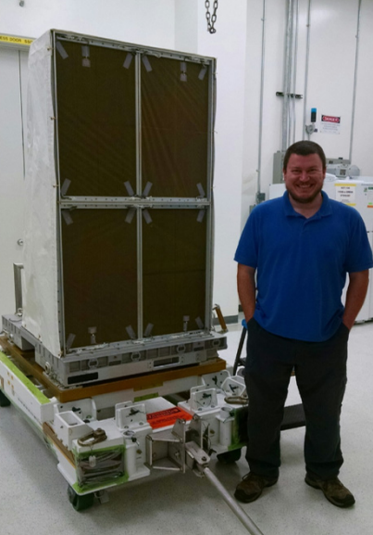
Solutions:
Twin layer thin film devices, which can be small (up to say 50 cm by 50 cm), various proposals, see Cornwell et al., A study on the capabilities and accuracy of Kapton based TOF space dust and debris detector. Advances in Space Research 72, 2959 – 2970, 2023. https://doi.org/10.1016/j.asr.2022.07.022, or LaRiD (Ledford et al., 9th European Conf. Orbital Debris, 2025, In-situ Detection of Small Space Debris with the LArID concept: Breadboard verification and the path to a flight mission | ESA Proceedings Database),
or even 1 m², see NASA SDS deployed on the ISS in Dec/Jan 2017/2018 (see Hamilton et al., 2017, Development of The Space Debris Sensor. 7th European Conference on Space Debris https://conference.sdo.esoc.esa.int/proceedings/sdc7/paper/965/SDC7-paper965.pdf ; Anz-Meador et al., 2019,The Space Debris Sensor Experiment. In First Int’l Orbital Debris Conf., pp. 1–10. The Space Debris Sensor Experiment - NASA Technical Reports Server (NTRS).

Slide 14
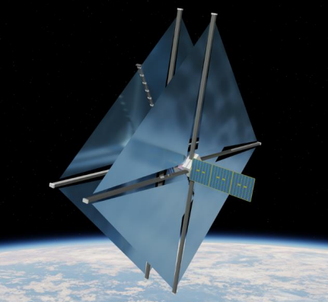
Solutions:
Twin layer thin film devices, which can be small (up to say 50 cm by 50 cm), various proposals, see Cornwell et al., A study on the capabilities and accuracy of Kapton based TOF space dust and debris detector. Advances in Space Research 72, 2959 – 2970, 2023. https://doi.org/10.1016/j.asr.2022.07.022, or LaRiD (Ledford et al., 9th European Conf. Orbital Debris, 2025, In-situ Detection of Small Space Debris with the LArID concept: Breadboard verification and the path to a flight mission | ESA Proceedings Database),
or even 1 m², see NASA SDS deployed on the ISS in Dec/Jan 2017/2018 (see Hamilton et al., 2017, Development of The Space Debris Sensor. 7th European Conference on Space Debris https://conference.sdo.esoc.esa.int/proceedings/sdc7/paper/965/SDC7-paper965.pdf ; Anz-Meador et al., 2019,The Space Debris Sensor Experiment. In First Int’l Orbital Debris Conf., pp. 1–10. The Space Debris Sensor Experiment - NASA Technical Reports Server (NTRS).
or large area, see SAILOR proposal at ESA, Varga et al., A NEW LARGE AREA DETECTOR FOR IN-SITU OBSERVATION OF SMALL ANTHROPOGENIC DEBRIS IN LOW EARTH ORBIT – SAILOR. Proc. 9th European Conference on Space Debris, 2025, https://conference.sdo.esoc.esa.int/proceedings/sdc9/paper/338/SDC9-paper338.pdf
Or non-contact, e.g., if can get LIDAR to work at these size scales in orbit

Slide 15
Conclusion:
There is a vital need for in-situ measurement of mm sized dust in LEO.
We risk stumbling blind into a critical situation for sustained safe access to space.
Funding: Kent work on sustainable space has been supported by STFC/GNOSIS and ESA contracts

