Slide 1
NAM
Faint of the Universe :
Dwarf Galaxies
Stellar Mass-Metallicity Relation
Astha
Prof. Justin Read, Dr. Noelia Noël and the EDGE collaboration

Slide 2
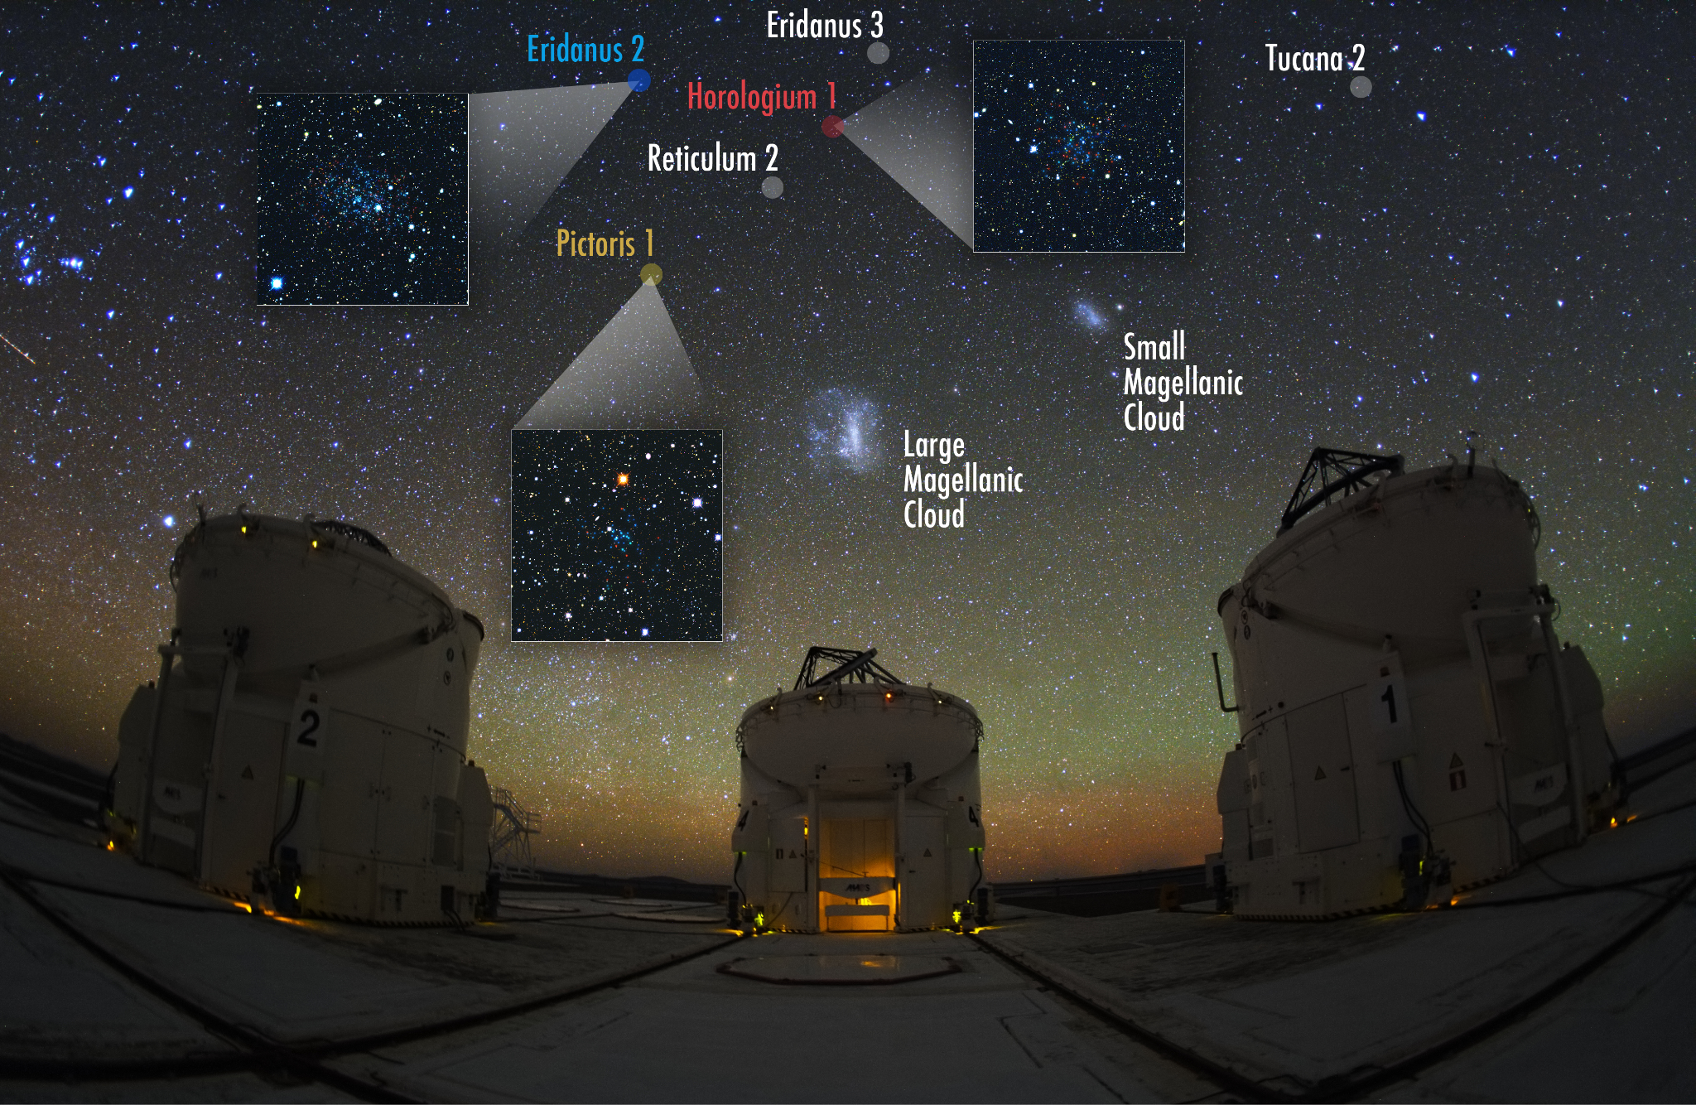
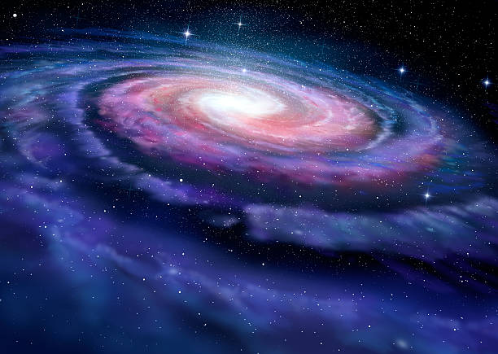
Ultra Faint Dwarf Galaxies
1000-10,000 stars
Extremely less luminous,
(L <10⁵ L★)
Ten million times less luminous than Milky Way
Rich in Dark Matter
300 times more than luminous matter
V. Belokurov, S. Koposov (Institute of Astrophysics, Cambridge). Photo: Y. Beletsky (Carnegie Observatories)

Slide 3
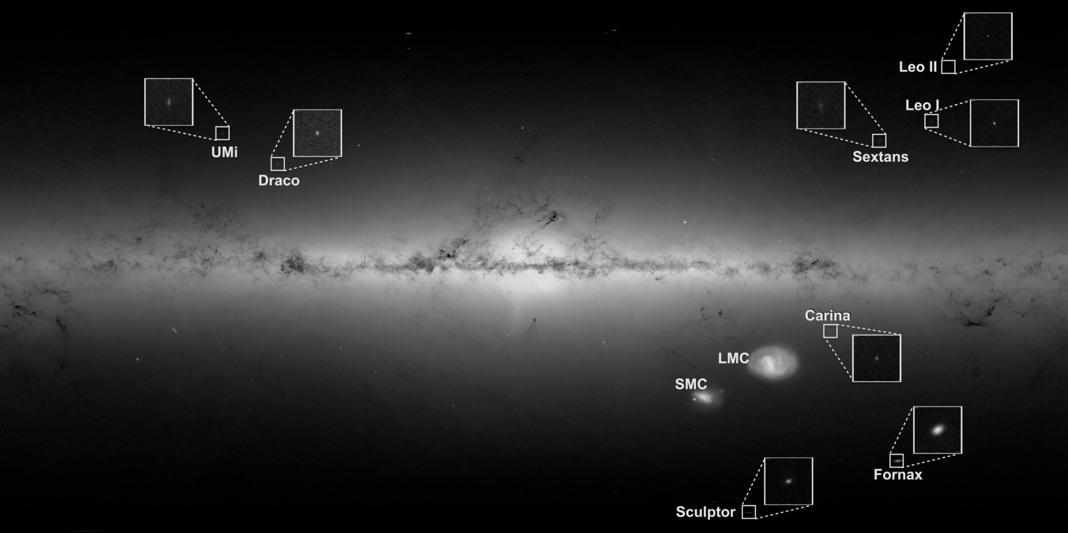
Why are the smallest galaxies so important?
Milky Way
Credits: esa.init

Slide 4
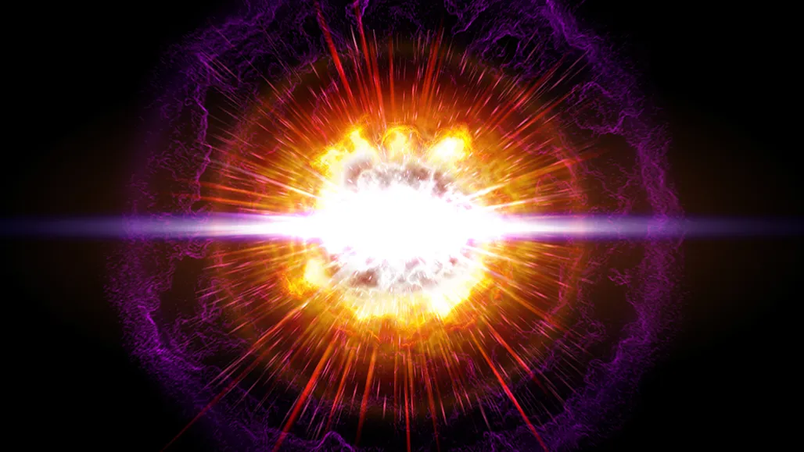
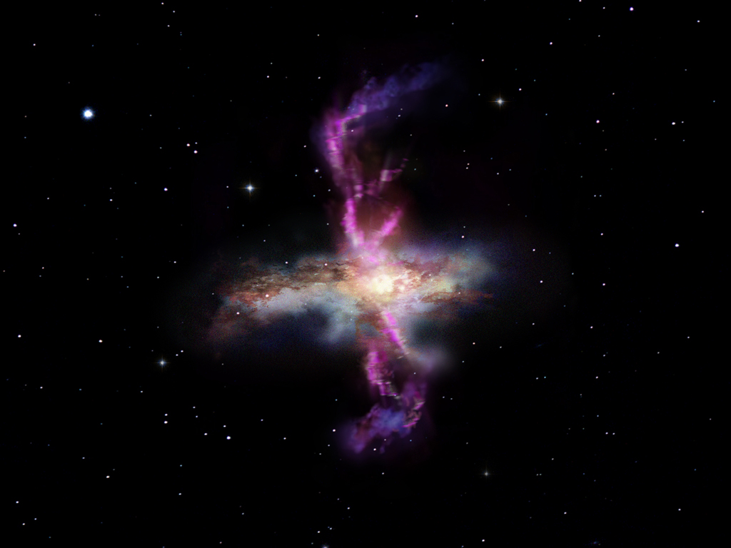
Sensitive to Galaxy formation physics
MZR : Stellar Mass-Metallicity Relationship
The MZR is uniquely sensitive to feedback processes because it directly reflects the metal retention and ejection mechanisms within a galaxy[1][2]
Supernova
Galactic Outflows
[1] Agertz et al. 2019, [2]Rey et al. 2025
Notes:
When it comes to testing sensitivity to galaxy formation physics, we want to look at the observables most sensitive to the observation.several other scaling relations like Size (Half-Light Radius) vs. Stellar Mass, Mass-to-Light Ratio vs. Stellar Mass. However, literature finds that these scaling relations do not provide strong differentiation. Mzr is the only observable, global scaling rela-
tion for nearby dwarfs that is sensitive to feedback physics.

Slide 5
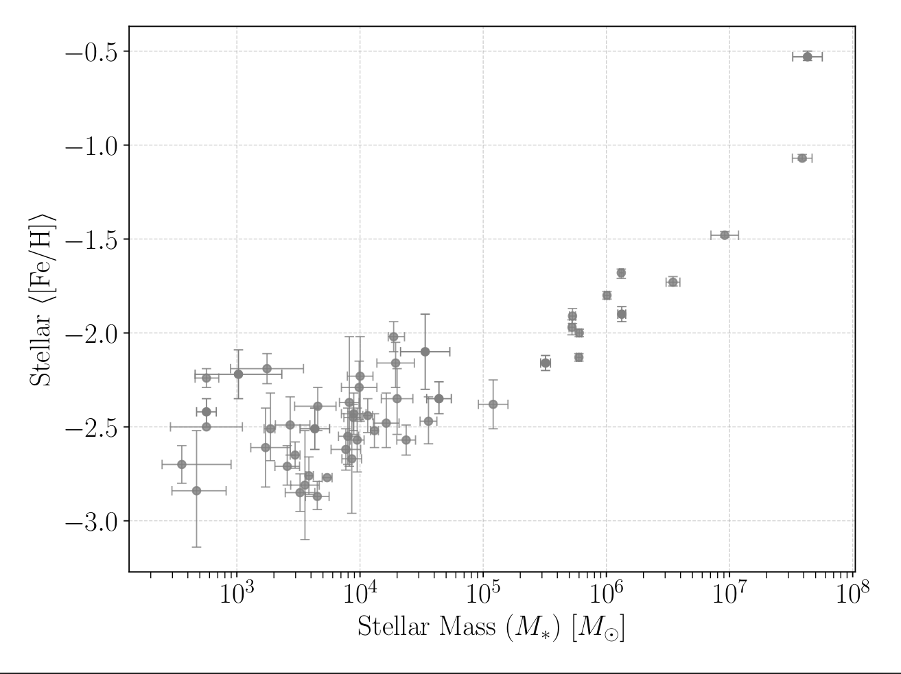
What is the origin of Plateau MZR Relation?
Plateau
Observations of ultra-faint dwarf galaxies show a plateau in the metallicity around [Fe/H] ≈ -2.5.
Answer using EDGE simulations!
MW Dwarfs
Plateau/Scatter?
Notes:
Observations from the Milky Way dwarf galaxies, isolated Local Group dwarfs and Cen A167 are shown. The dashed line and grey shaded regions show the best-fit relation and 1σ scatter. The evolution of metallicity indicates that the higher mass galaxies have higher metallicity, however this relationship does not extrapolate to the low masses where the Observations of ultra-faint dwarf galaxies show a plateau in the metallicity around [Fe/H] ≈ -2.5. What is the reason for the same? Is it a plateau or scatter? To investigate this, we direct ourselves to the time evolution of the mass - metallicity relation. Using simulations of different s UFDs with different physics involved and seeing how it compares with the observations , we can determine the reason for the plateau.

Slide 6
Engineering Dwarfs at Galaxy formations’ EDGE
high-resolution zoom-in cosmological radiation-hydrodynamics simulations of dwarf galaxies

Slide 7
EDGE 1
Δx=3pc, m_{dm}=940 M☉
Some RT
SNe Ia/II
Stellar Winds
Re-ionisation
[Fe/H] and [O/Fe]
CDM
M₂₀₀=10⁷-10^{9.5}M☉
EDGE 2
Non-eq chemistry
RT as standard
8-element chemistry
Improved Yields
Improved Re-ionisation
CDM + WDM
M₂₀₀=10¹⁰M☉
Rey et al. 2025

Slide 8
What is the origin of plateau MZR Relation?
Tides
Quenching
Plateau
MW Dwarfs
Plateau/Scatter?

Slide 9
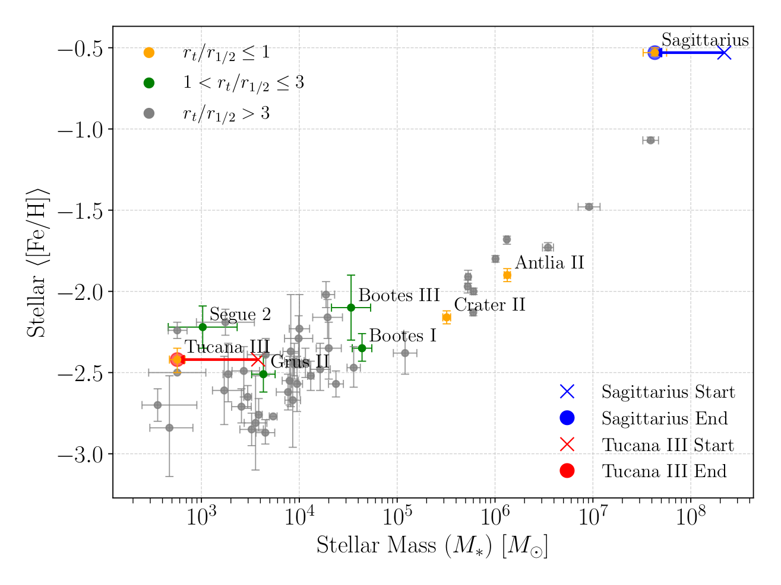
TIDES : Not Sufficient Evidence

Slide 10
What is the origin of plateau MZR Relation?
Tides
Quenching: Time evolution of MZR

Slide 11
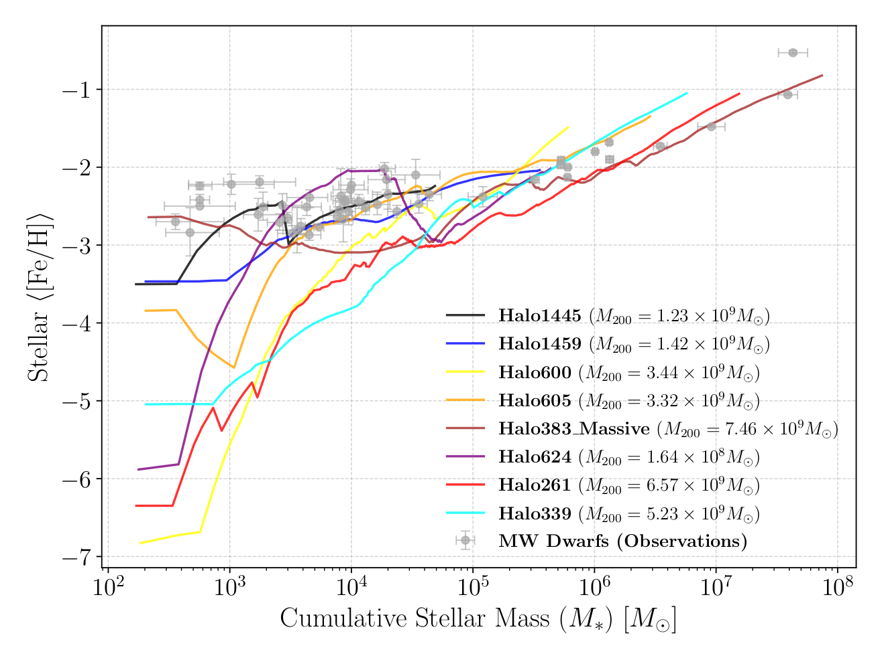
QUENCHING : With EDGE2 Simulations
Local Volume Database, Andrew Pace 2024
Scatter
Galaxies evolve along MZR
Notes:
Answering this will help us in understanding what king of DM halo they are in and will help us in the cosmological calculations

Slide 12
QUENCHING : With EDGE2 Simulations
Local Volume Database, Andrew Pace 2024
Scatter
Galaxies evolve along MZR
Notes:
Answering this will help us in understanding what king of DM halo they are in and will help us in the cosmological calculations

Slide 13
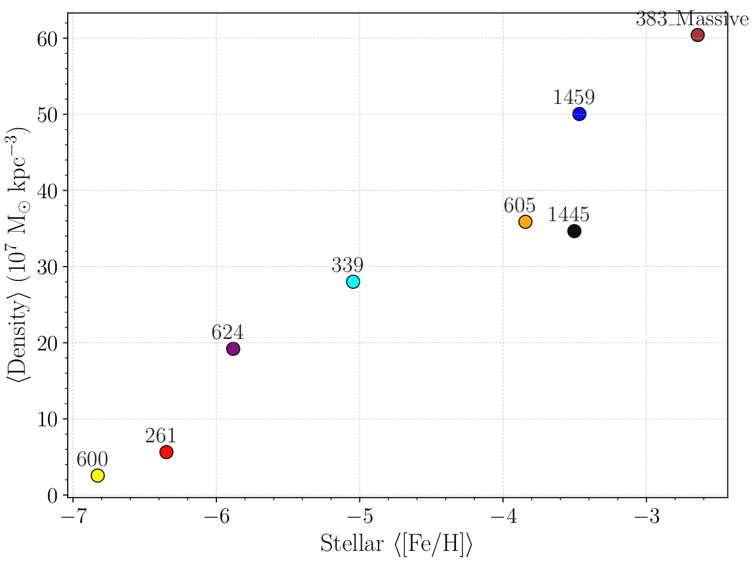
Origins of scatter in the MZR : DENSITY
Mean Stellar-Metallicity vs Stellar mass
At Start of star formation M☉

Slide 14
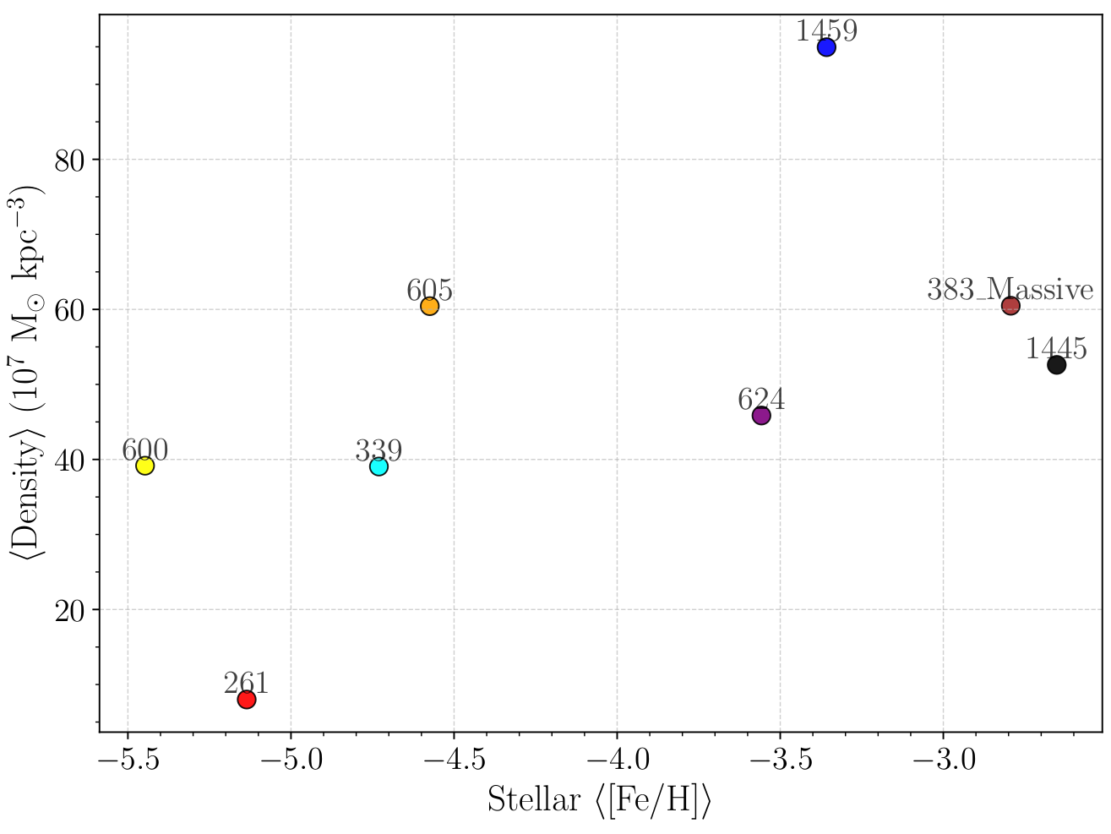
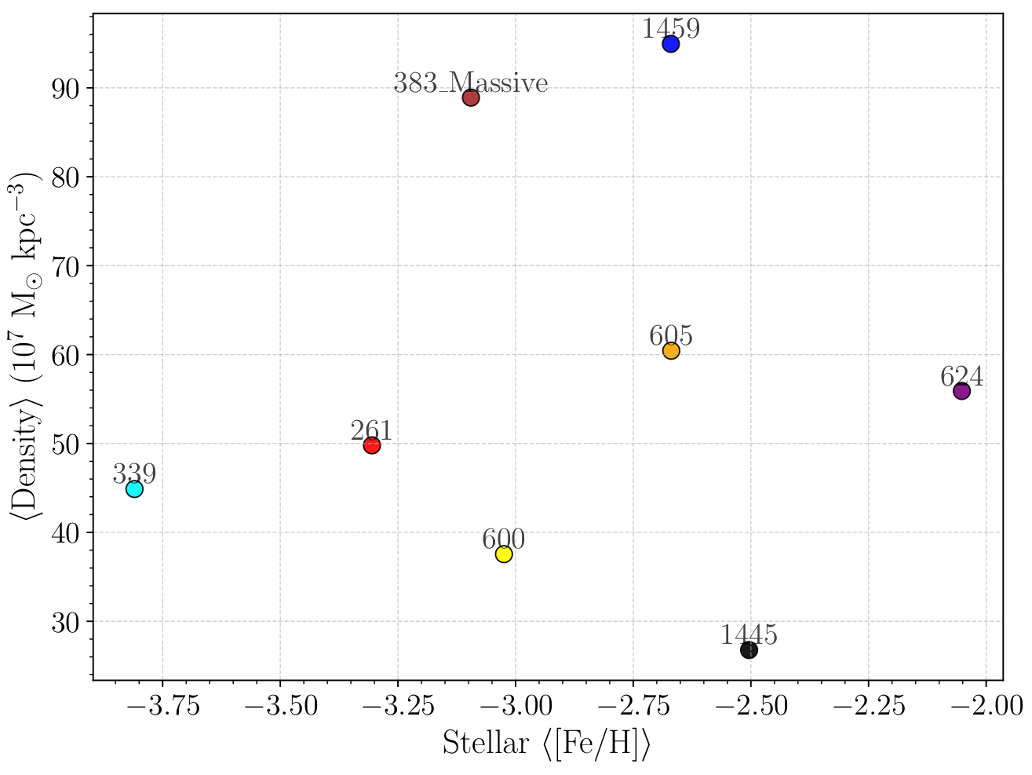
￼
Origins of scatter in the MZR : DENSITY
At 10³ M☉
At 10⁴ M☉
Notes:
s

Slide 15
Origins of scatter in the MZR
Other effects such as :
Dilution
Mergers
Confinement : In next slides
Overall, in regards to quenching, Density can explain the trend at very low metallicities, but not explain the highest metallicities in MZR
Notes:
Answering this will help us in understanding what king of DM halo they are in and will help us in the cosmological calculations

Slide 16
Do Dwarfs Freeze in MZR ?
Notes:
Answering this will help us in understanding what king of DM halo they are in and will help us in the cosmological calculations

Slide 17
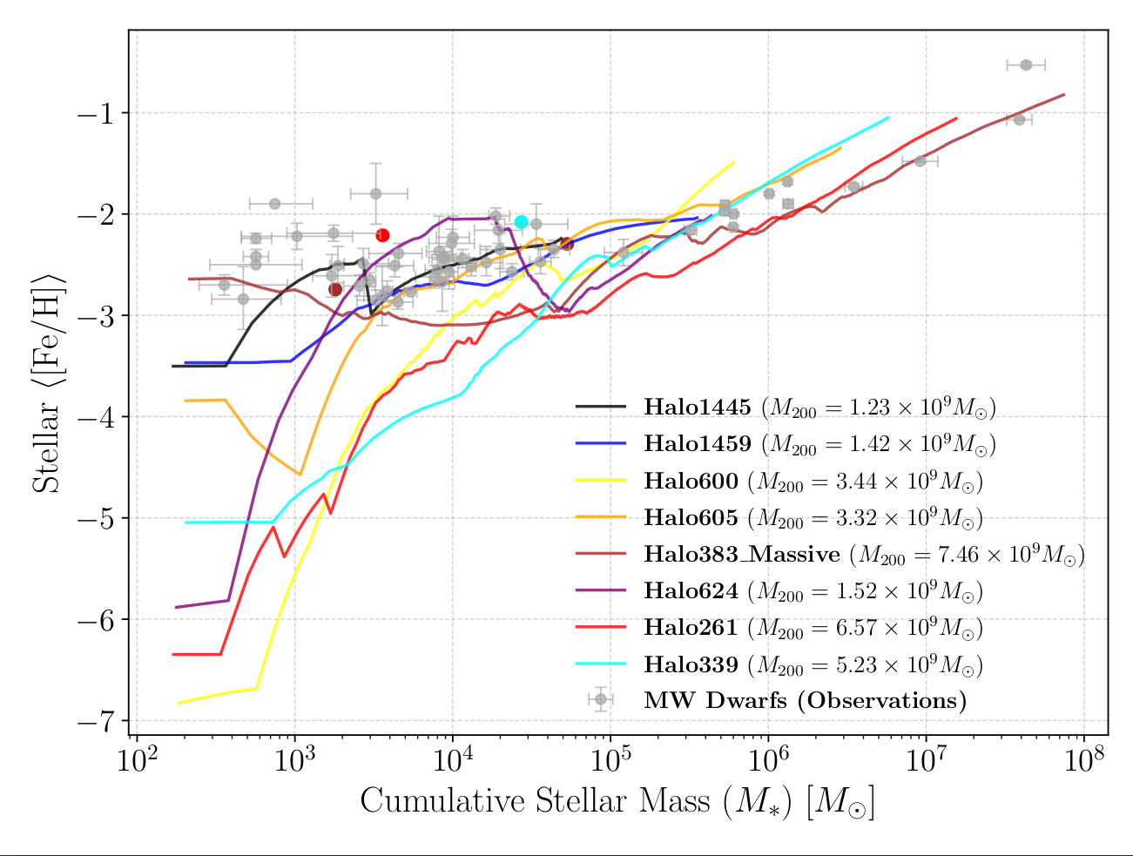
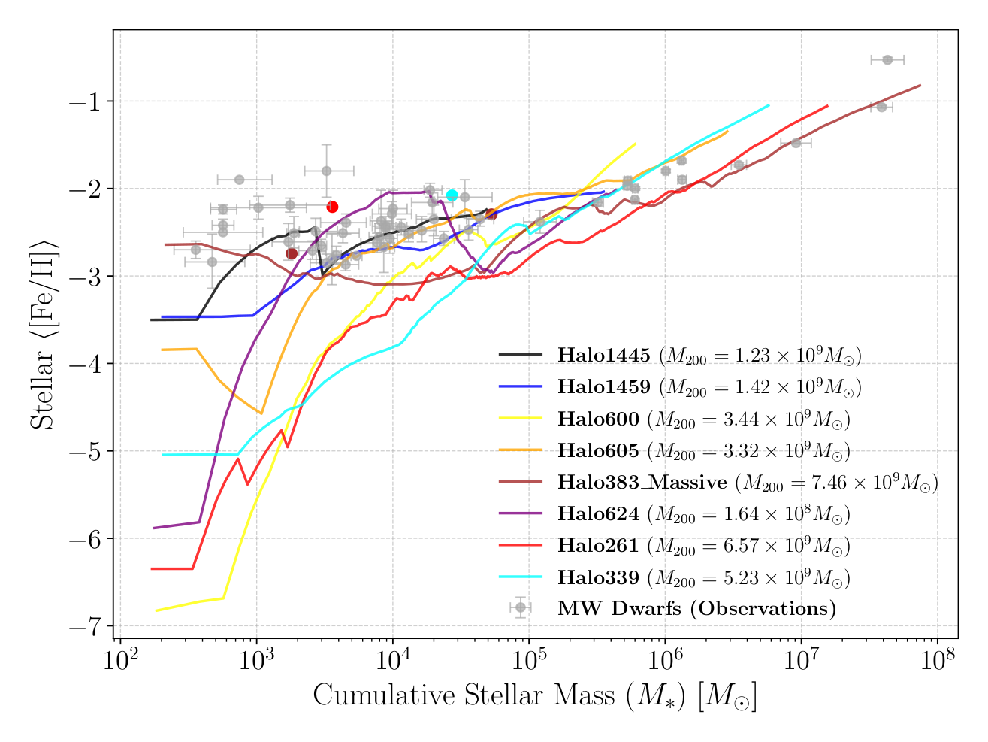
Do Dwarfs Freeze in MZR : Dwarfs-of-Dwarfs
Notes:
Plotting_isolated_e_time_all.py in my laptop and below portion of the code in plotting_isolated_e_time_all in dirac

Slide 18
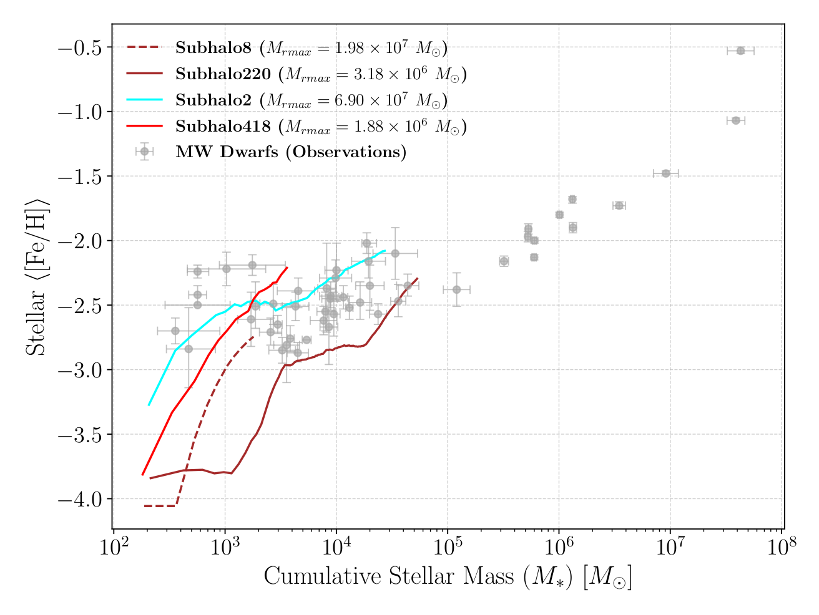
Do Dwarfs Freeze in MZR : Dwarfs-of-Dwarfs
Notes:
Plotting_isolated_e_time_all.py in my laptop and below portion of the code in plotting_isolated_e_time_all in dirac

Slide 19
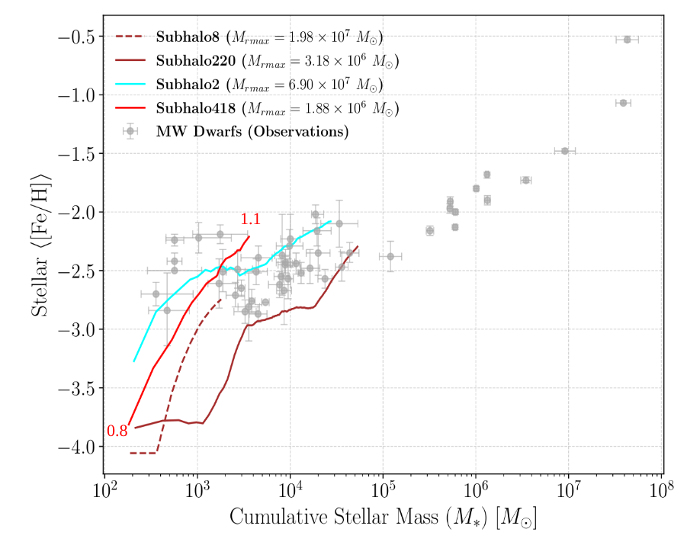
How Subhalos move along MZR? Confinement

Slide 20
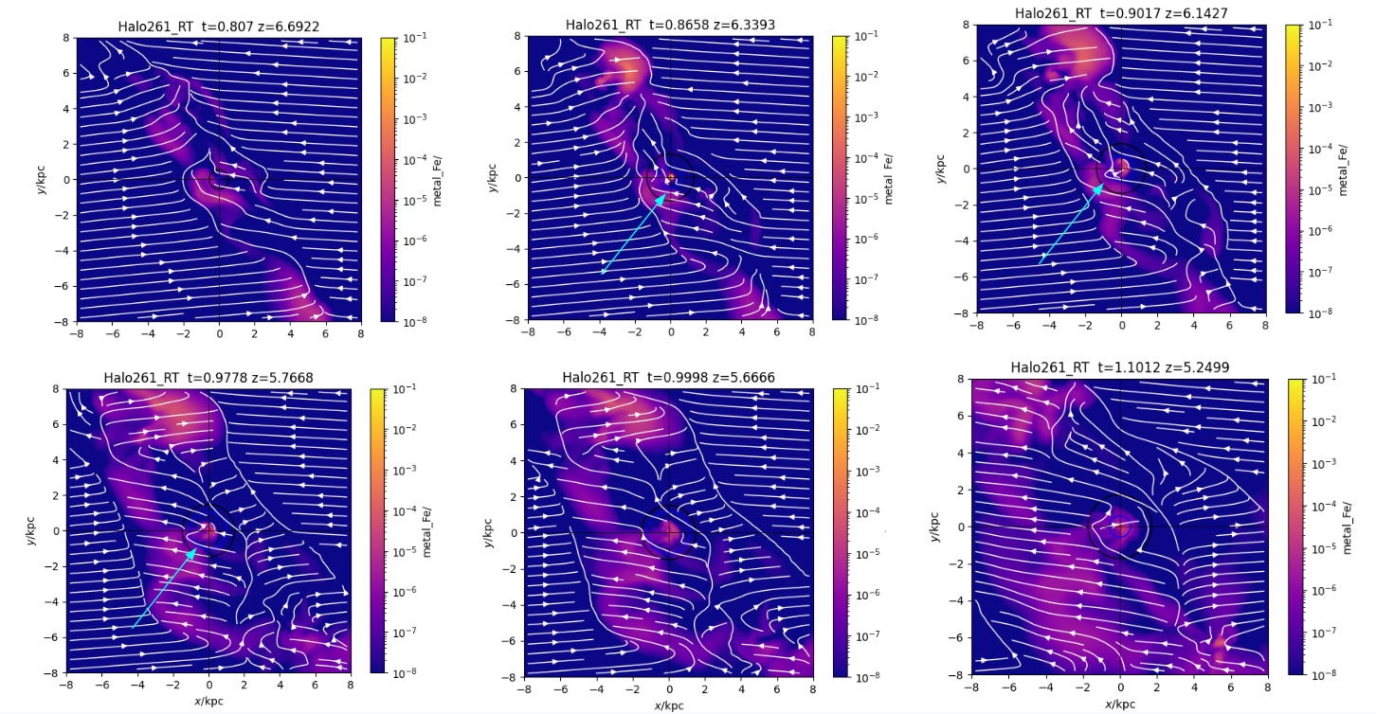

Slide 21
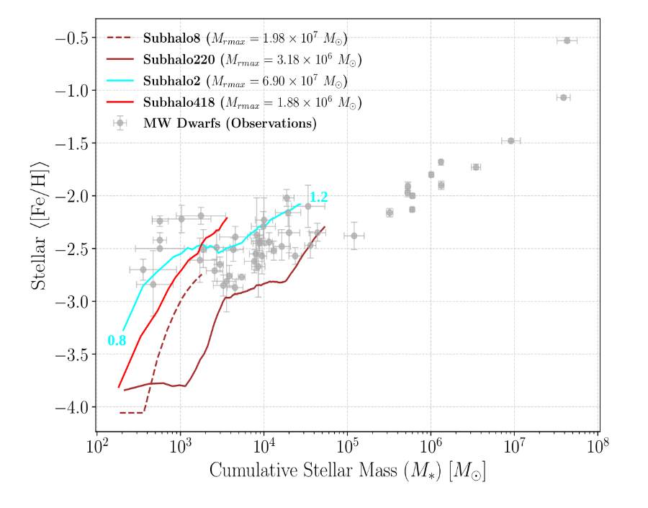
How Subhalos move along MZR? Confinement

Slide 22
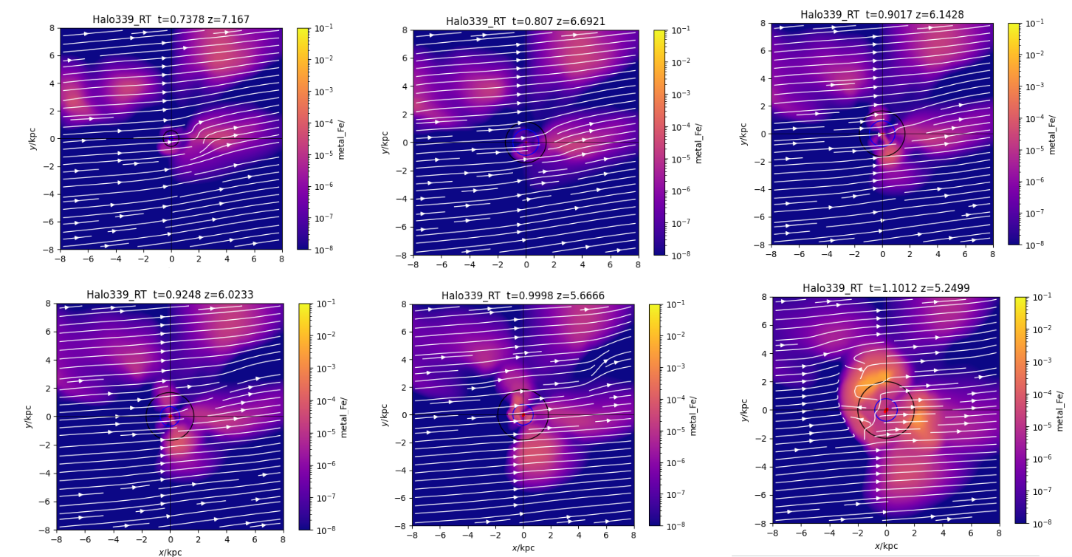

Slide 23
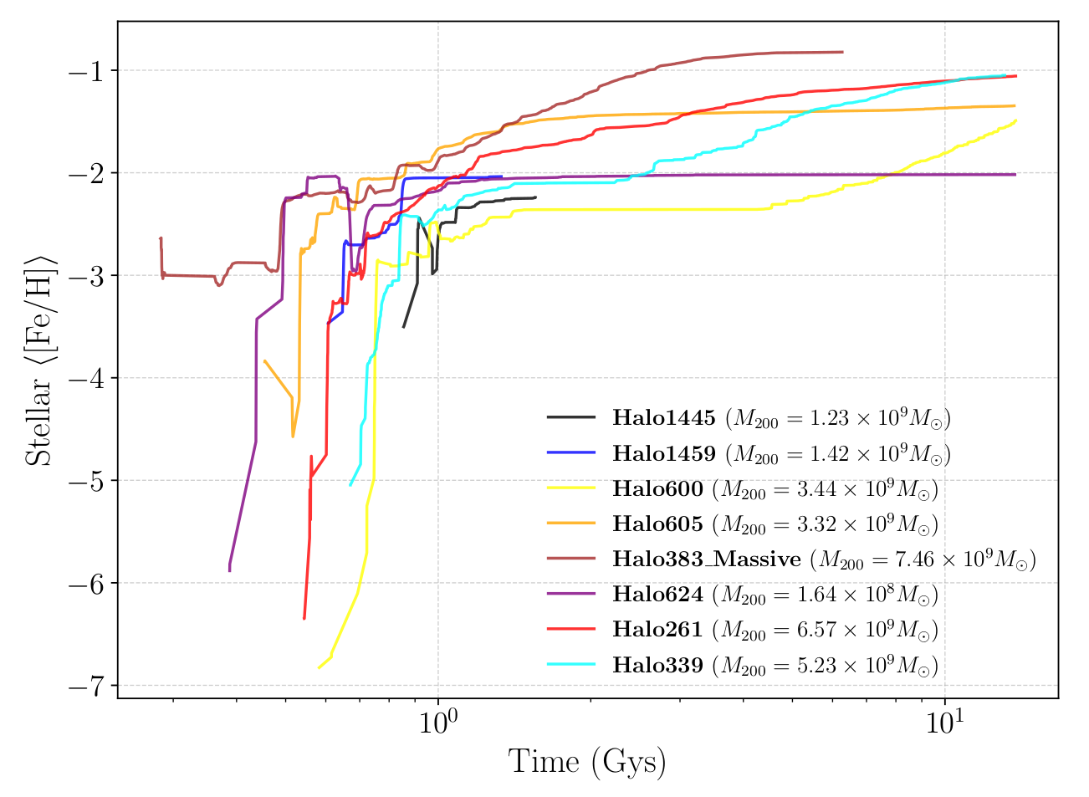
Why plateau does not exist below -3 ?

Slide 24
Conclusion : Reason for Plateau
Tides : Not sufficient evidence for most galaxies
Quenching: Density can explain the trend at very low metallicities, but not explain the highest metallicities in MZR
Confinement: Proved that Dwarfs-of-Dwarfs in EDGE climb to high metallicities due to confinement. Thus, confinement aids in the rapid evolution of the Subhalo, populating the plateau region.
Dwarfs enrich rapidly to reach to <[Fe/H]> = -3.
Notes:
Answering this will help us in understanding what king of DM halo they are in and will help us in the cosmological calculations

Slide 25
THANK YOU!
aa07223@surrey.ac.uk
Chaturvedi et al. in prep
Notes:
Never stop looking at the night sky as even the faintest blobs have the greatest stories to be told

Slide 26
EXTRA SLIDES

Slide 27
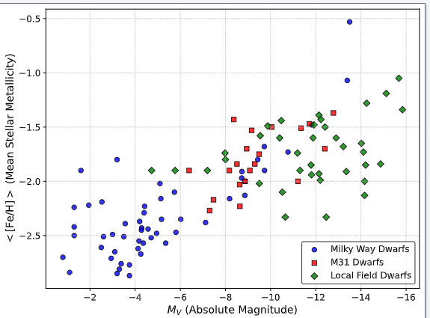
Local Volume Database, Andrew Pace 2024

Slide 28
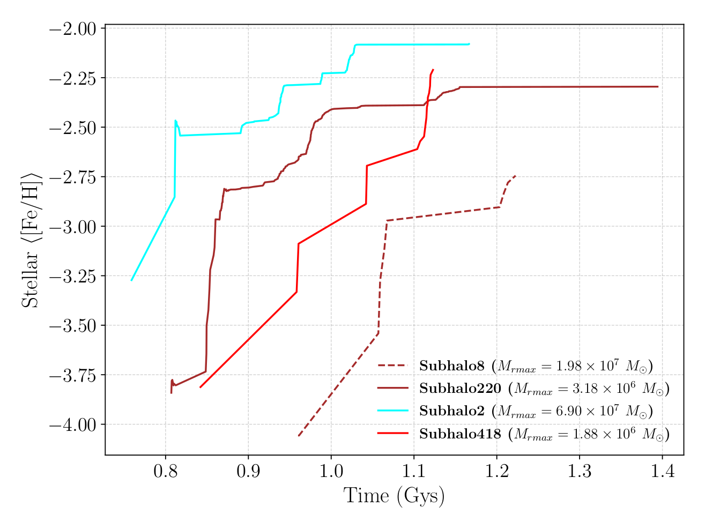
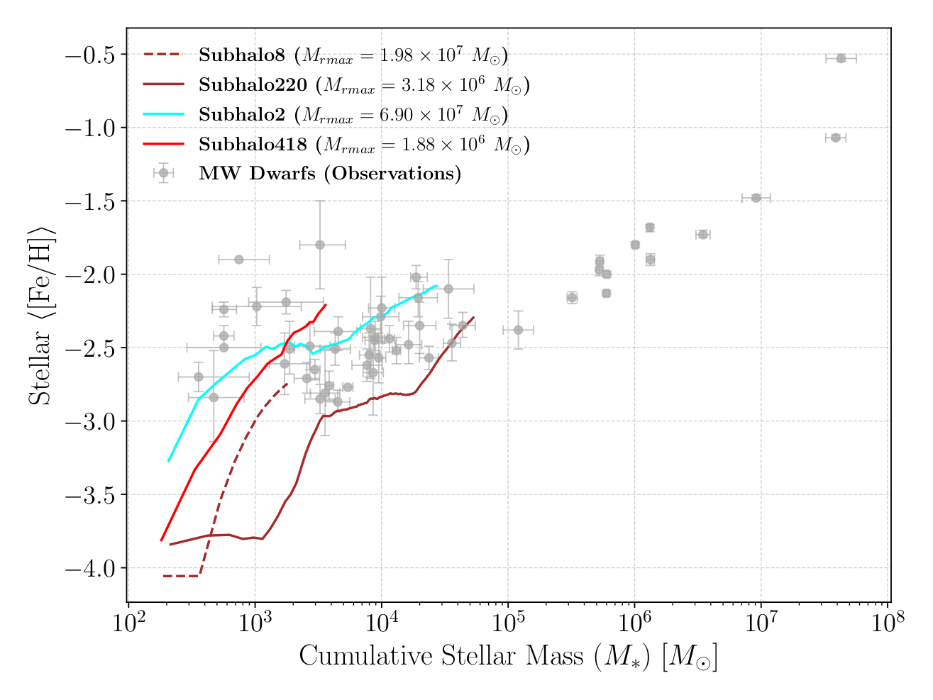

Slide 31
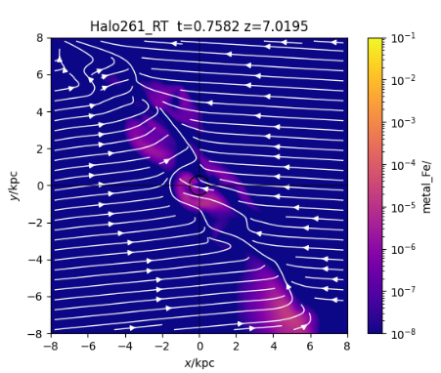
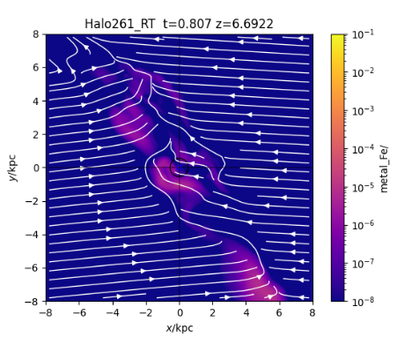
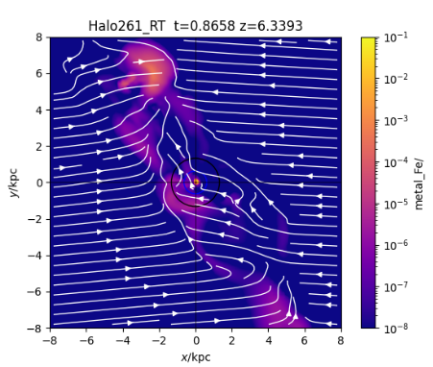
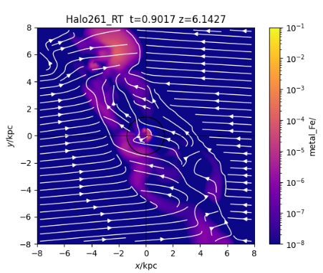
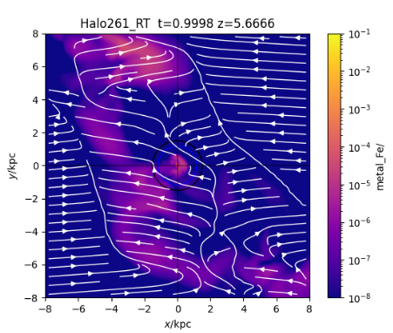
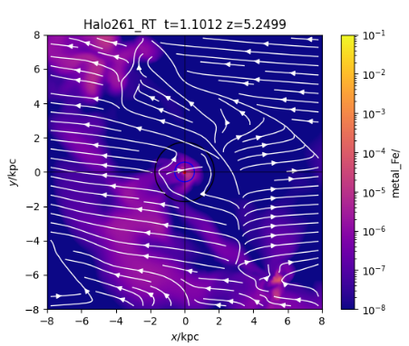
Subhalo 418 of Halo261_RT
Notes:
Shree ganeshaya namah 261_418 :confinement : /home/astha/Videos/movie/zout2May/sgn:rmax3f/Halo261_RTrmax3f_zout_gasm/418

Slide 32
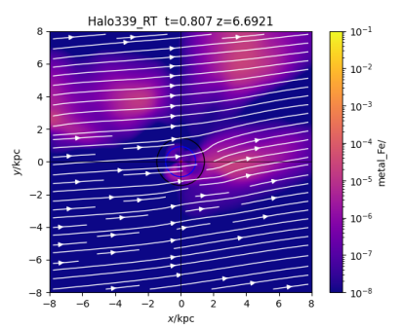
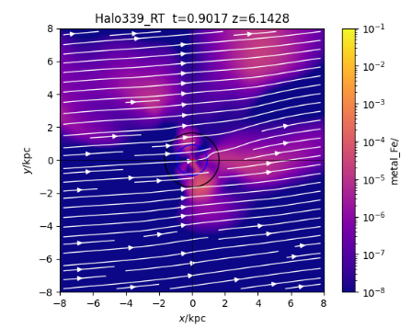
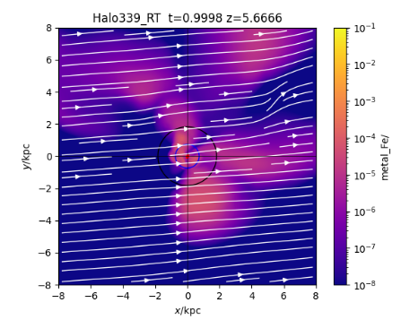
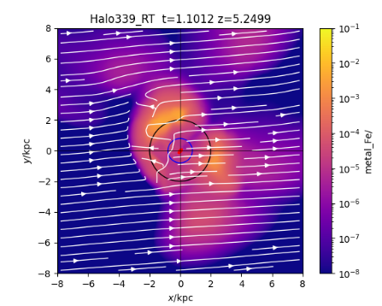
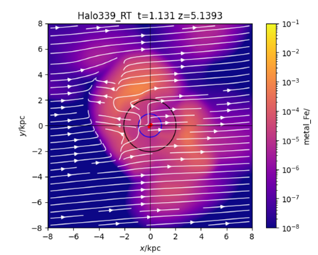
Subhalo 2 of Halo339_RT
Notes:
Shree ganeshaya namah : 339_2 non - confinement : /home/astha/Videos/movie/zout2May/sgn:rmax3f/Halo339_RTrmax3f_zout_gasm/2

Slide 33
Negligible further evolution
Smallest Masses
Oldest Ages
Simplest Assembly history

Slide 34
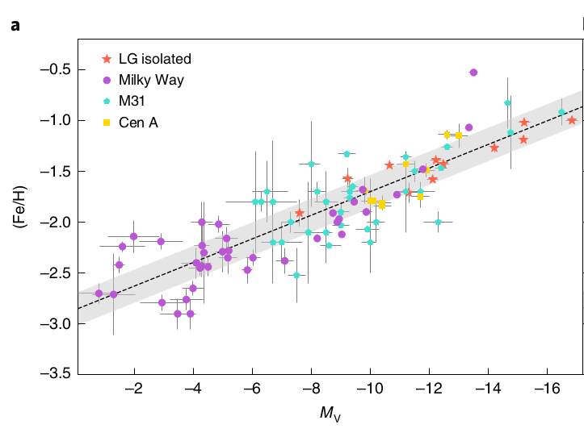
Previous Attempts
Pop III stars , tensions with observations ; Pair Instability Supernovae: 140-300 M☉, rare in dwarf galaxies.
IMF variation: Top-heavy IMF increases number of supernova, but different IMF in star forming regions, is yet to be confirmed
Environment Effects : Pre-enrichment by the MW environment, tidal stripping
Weaker FB
IMF Variation
Increasing Feedback
Top Heavy IMF
Plateau In MZR
FB x 10
plateau/scatter?
Collins and Read 2022

Slide 35
EDGE 2 SIMULATION SUITE [1]
Original volume =100Mpc Δx=3pc
m_{dm}=940 M☉
Radiative transfer from stars, using setup described in Agertz et al 2020
EDGE2 employs non-equilibrium primordial and molecular chemistry Rosdahl et al. 2013 and Nickerson et al. 2018
EDGE2 an eight-species chemical model (C, N, O, Mg, Al, Si, Fe, and Eu), updated metal yields from NuGrid (Pignatari et al. 2016; Ritter et al. 2018).
Floor in Oxygen metallicity , Z_{o}=10⁻³ Z☉
[1] Rey et al. 2025

