Slide 1


LYRA: Intrinsic stellar distributions in the faintest galaxies
Joaquín Sureda
Collaborators: Azi Fattahi, Sownak Bose, Shaun Brown,
Thales Gutcke, Rüdiger Pakmor
NAM25 - Illuminating the Faintest Galaxies
10th of July 2025

Slide 2
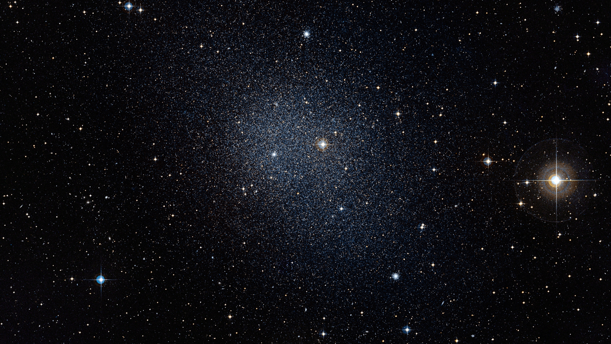
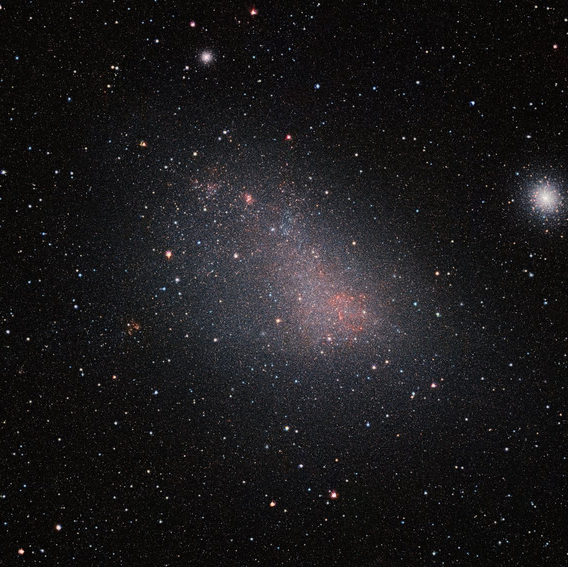
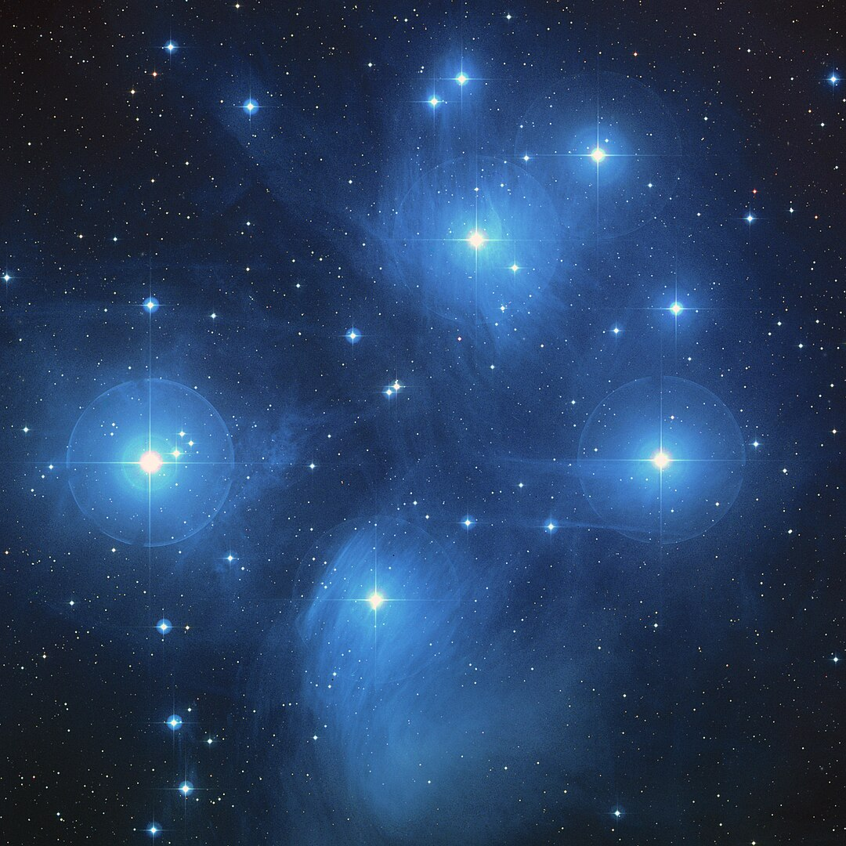
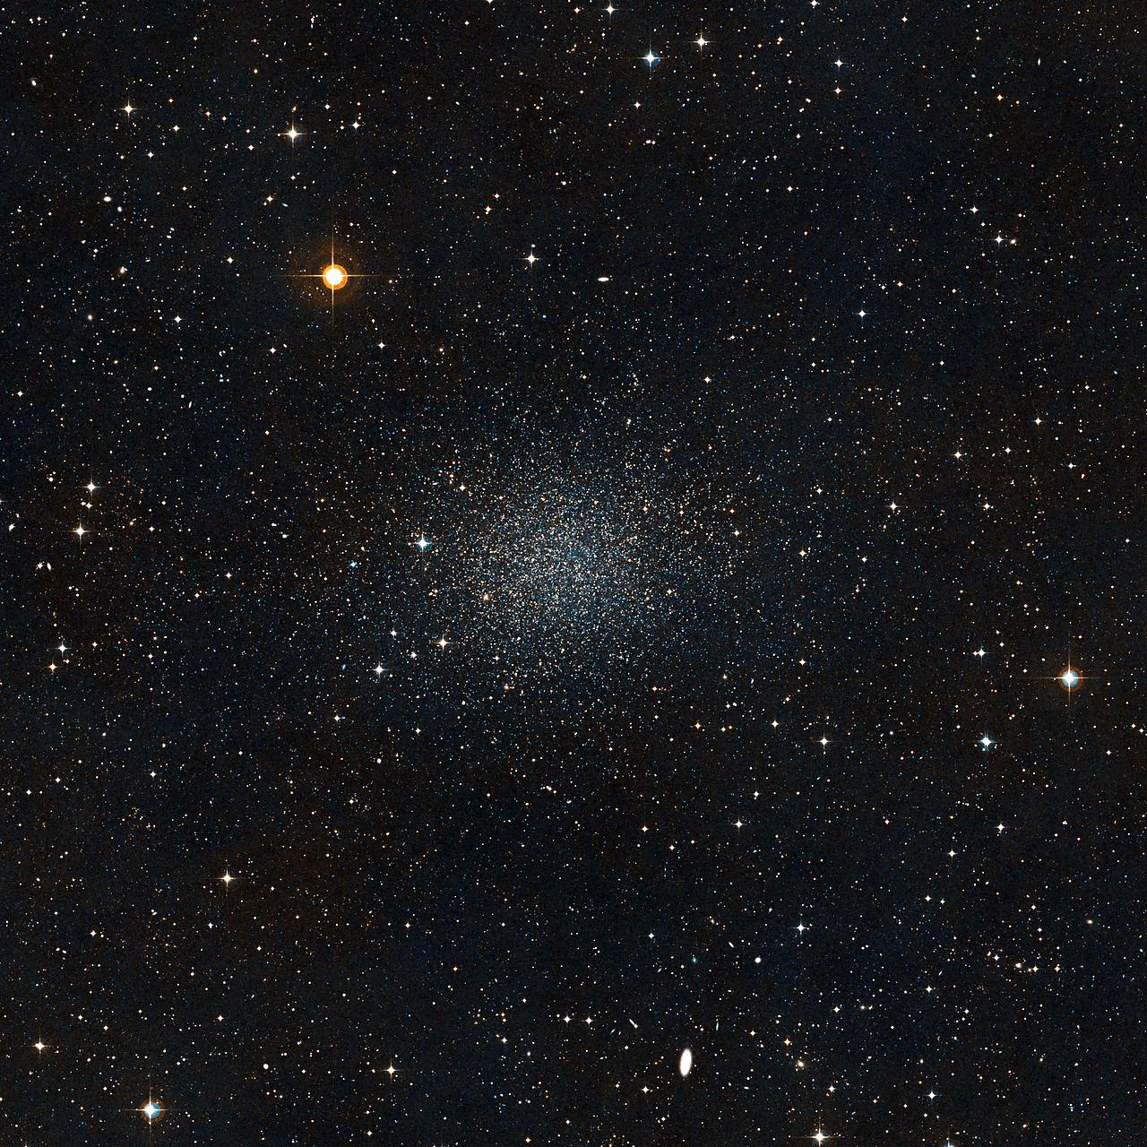
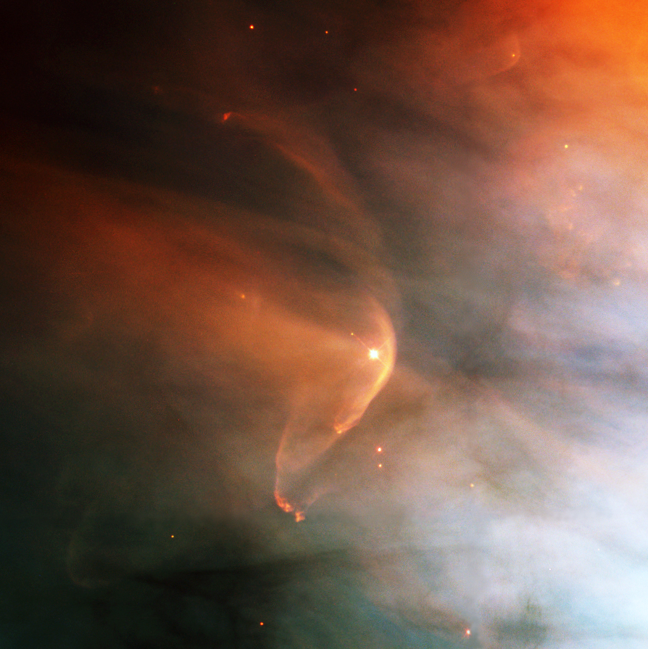
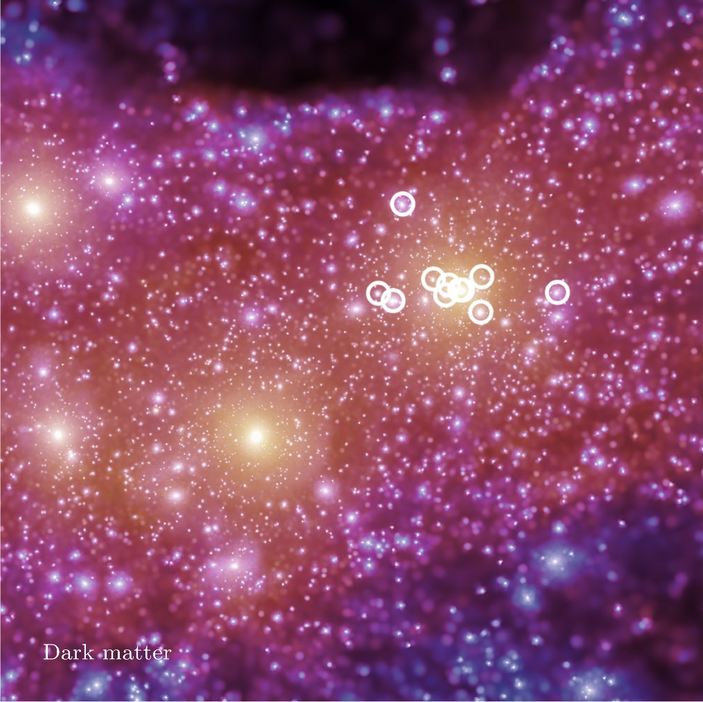
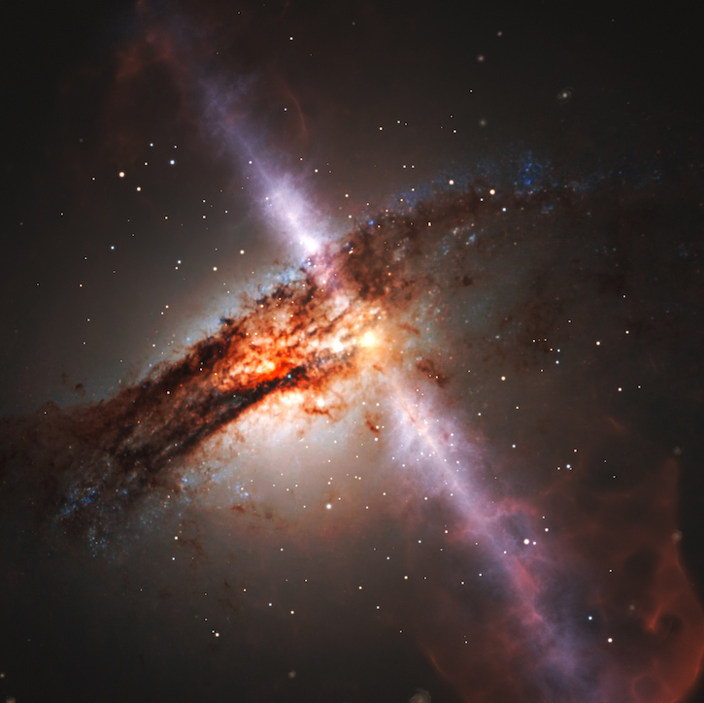

Why Dwarf Galaxies?
Typically $M_{∗}≲{10}^{9}M_{⊙}$ (ultra faints down to $\sim {10}^{3}M_{⊙}$)
Relics of the early universe
Highly sensitive to baryonic feedback processes
(e.g. SN-Feedback, stellar winds and even AGN feedback)
Mass scale sensitive to the nature of Dark Matter
Credits: ESO/Digitized Sky Survey 2

Slide 3
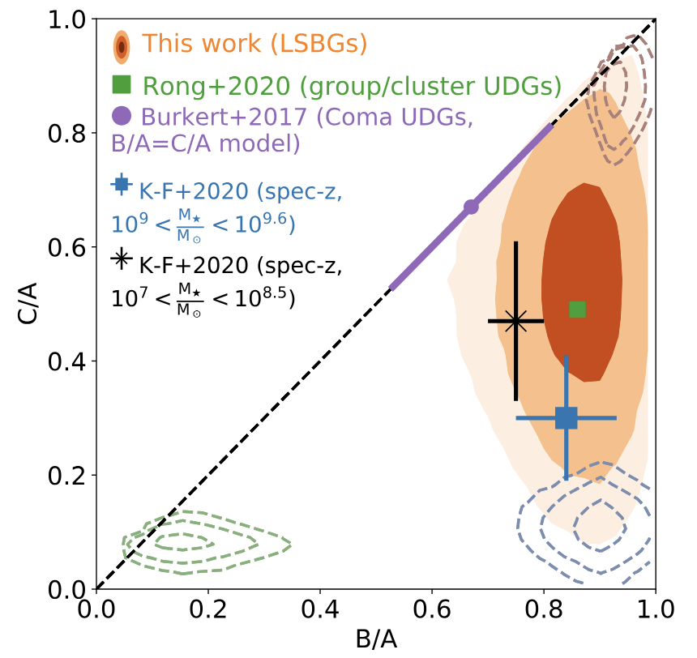
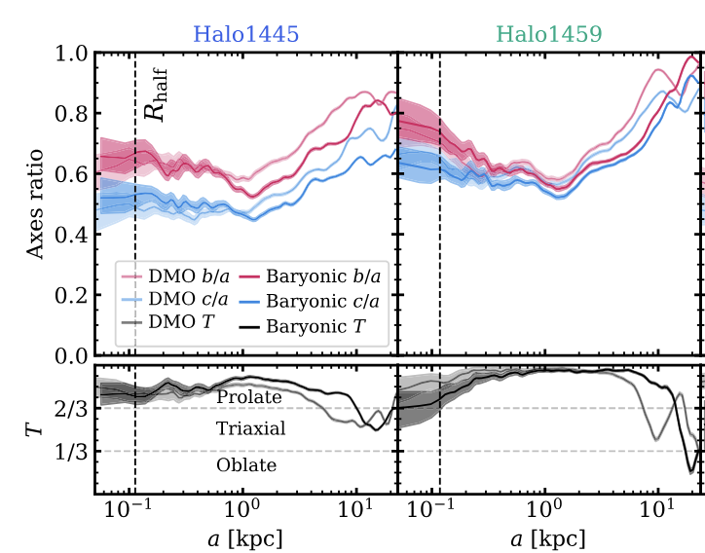
Why Dwarf Galaxies?
We are now expanding our understanding of the intrinsic morphologies to low mass galaxies
Predictions for the impact of baryons into the morphology of halos in the dwarf galaxy regime
Kado-Fong et al. (2021, 2022)
Orkney et al. (2023)
Credits: ESO/Digitized Sky Survey 2

Slide 4
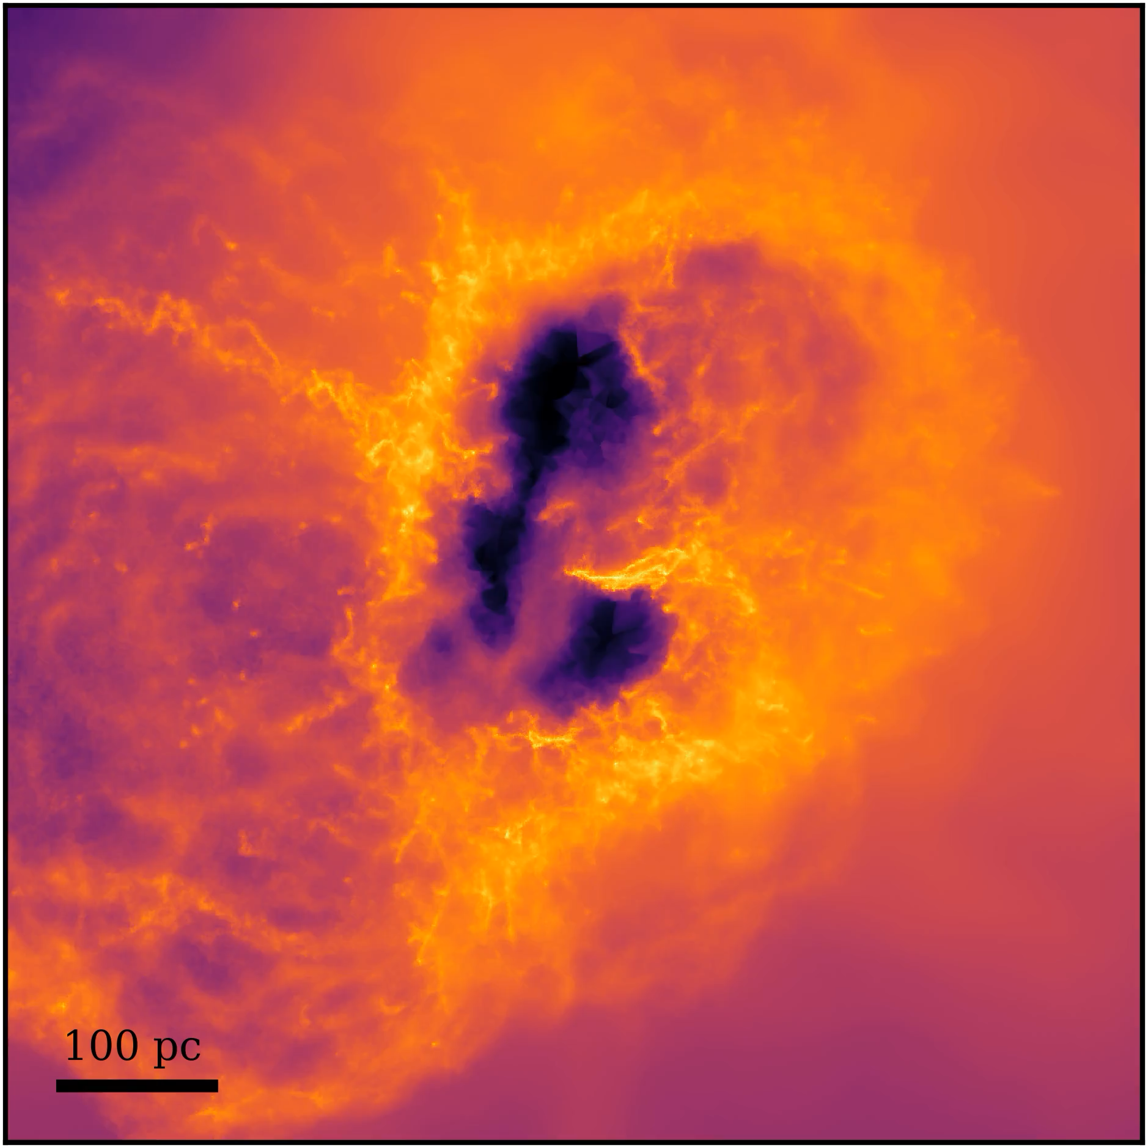
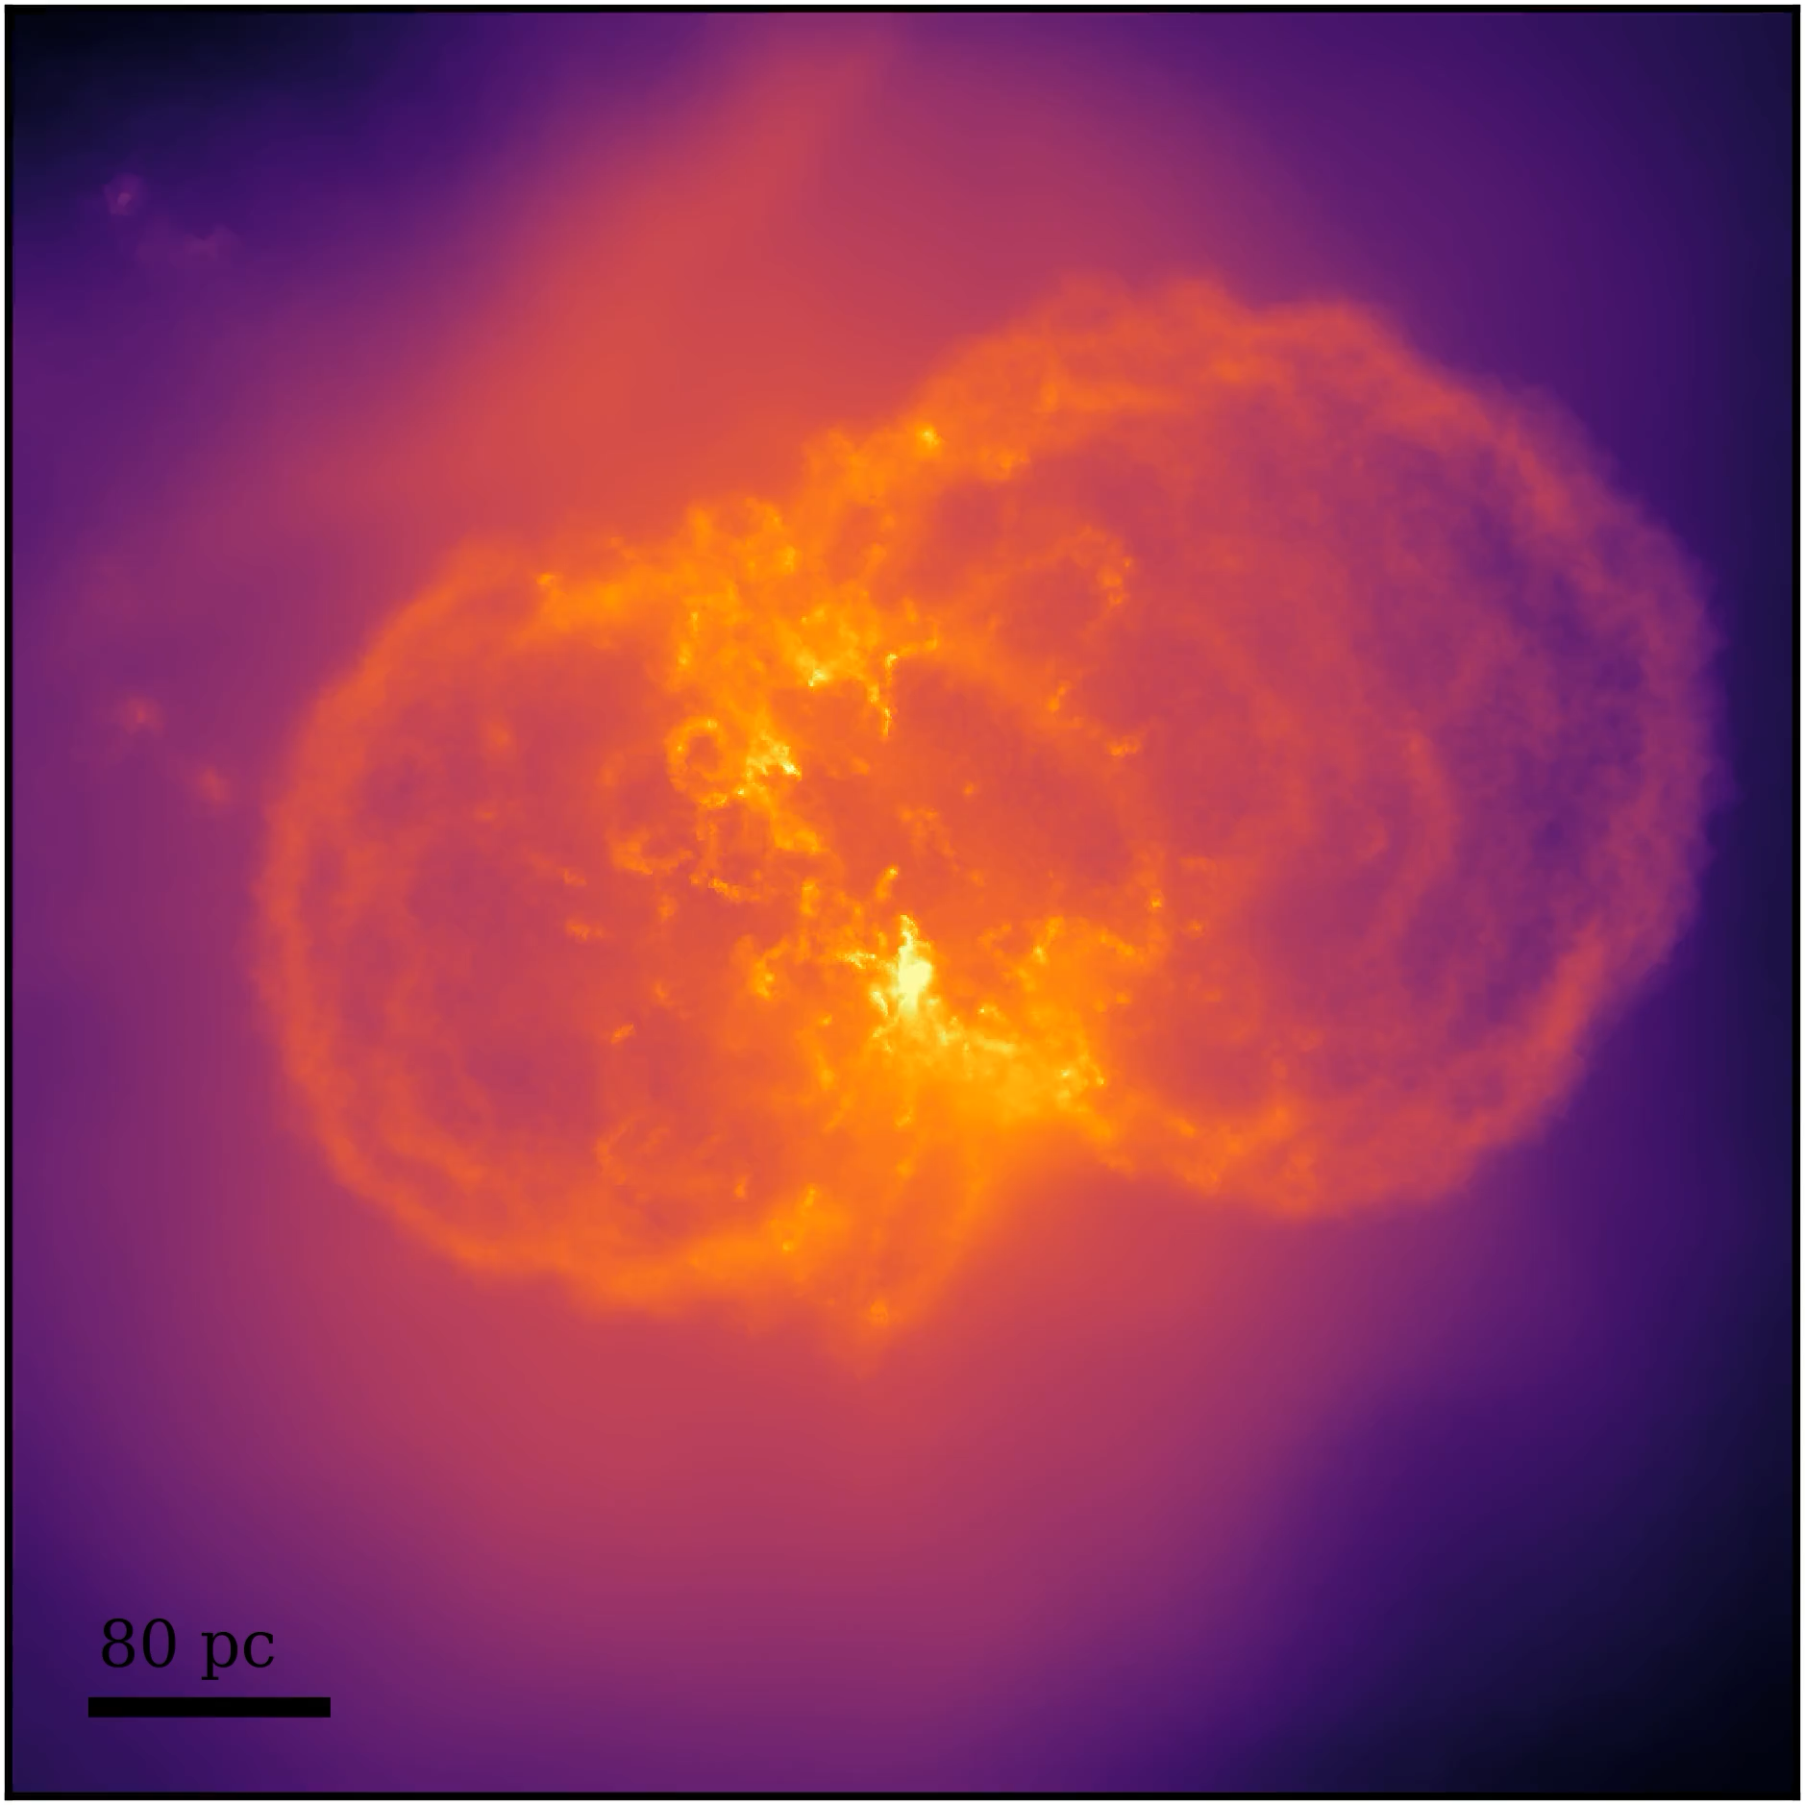

High resolution galaxy formation model
Gutcke et al. (2022)
Gutcke et al. (2022)

Slide 5
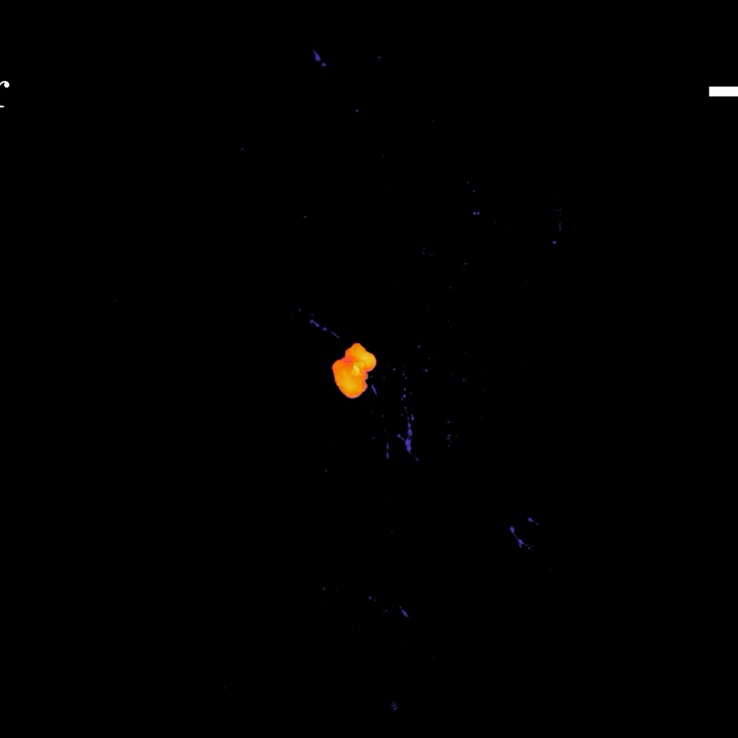
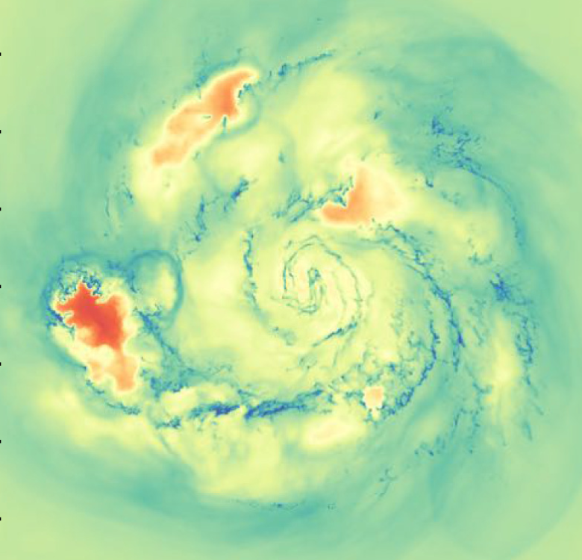
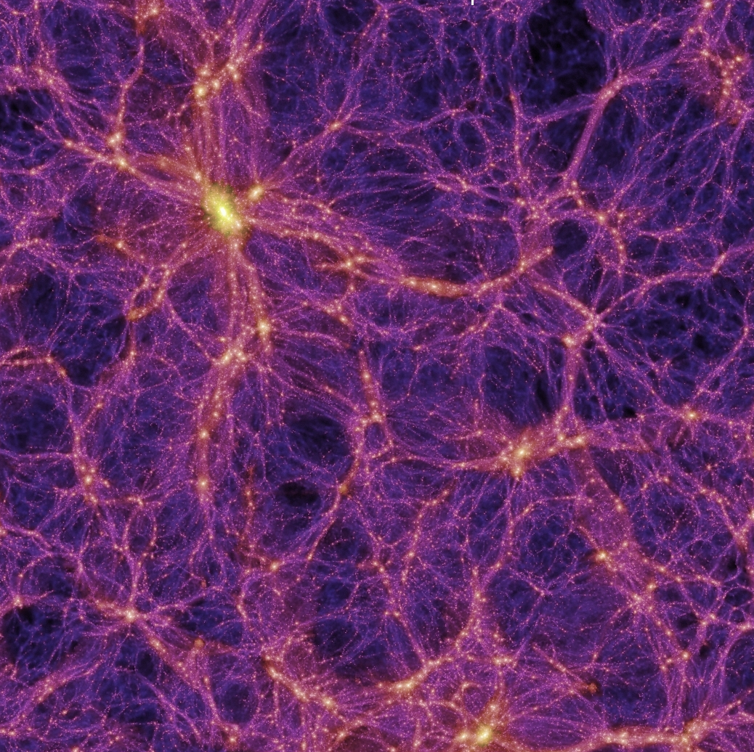
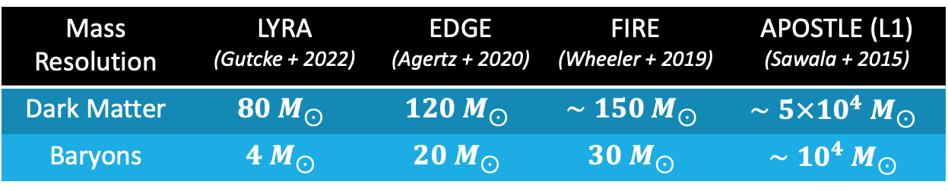
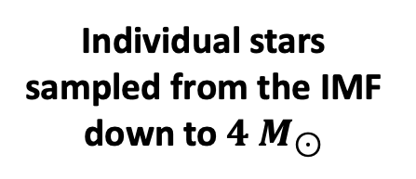
Individual supernova blast waves followed
Resolved multi-phase ISM down to 10K
Individual stars sampled from the IMF down to $4 M_{⊙}$
Cosmological Zoom ICs
Mass Resolution | LYRA (Gutcke + 2022) | EDGE (Agertz + 2020) | FIRE (Wheeler + 2019) | APOSTLE (L1) (Sawala + 2015)
Dark Matter | $$80 M_{⊙}$$ | $$120 M_{⊙}$$ | $$∼150 M_{⊙}$$ | $$∼5×{10}^{4} M_{⊙}$$
Baryons | $$4 M_{⊙}$$ | $$20 M_{⊙}$$ | $$30 M_{⊙}$$ | $$∼{10}^{4} M_{⊙}$$
PopIII star metal enrichment
Notes:
Add a circle for reionisation
Add the comparison with Auriga
Understand and read about the self-shielding implementation in LYRA
Add Authors for the other sets of simulations EDGE -> Agertz, Martin Rey ; FIRE -> Wheeler

Slide 6
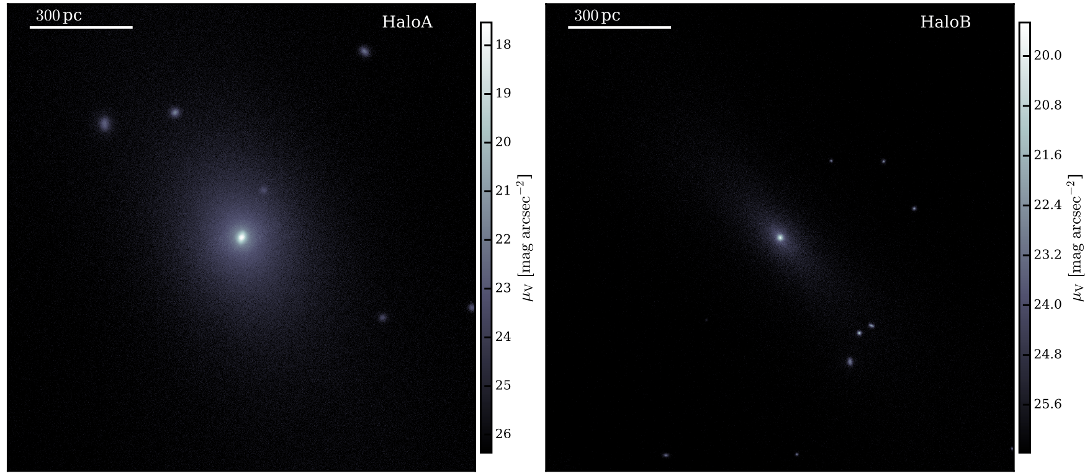
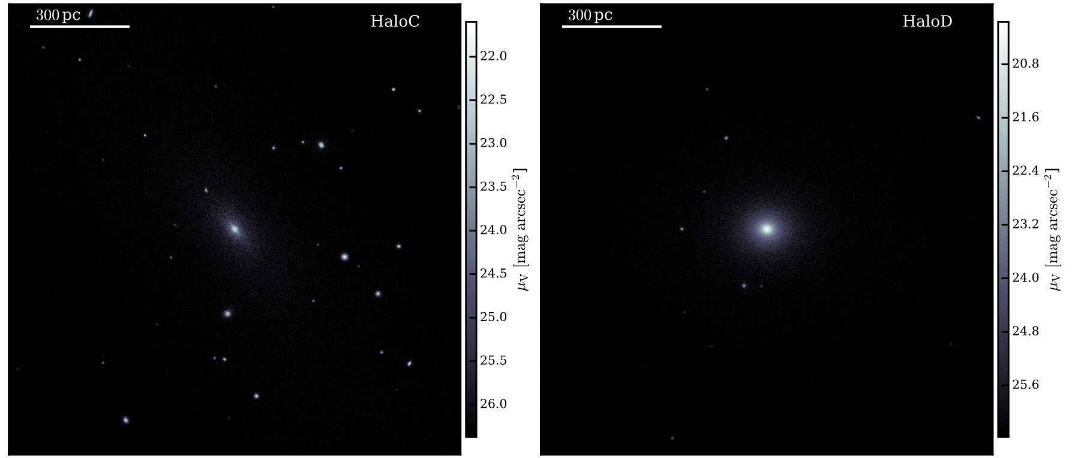
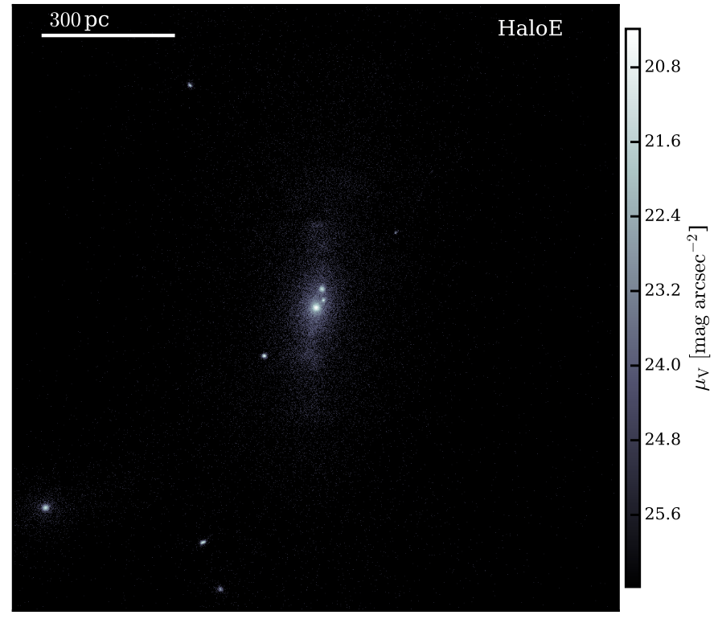
LYRA Dwarf Galaxies
Gutcke et al. (2022)

Slide 7
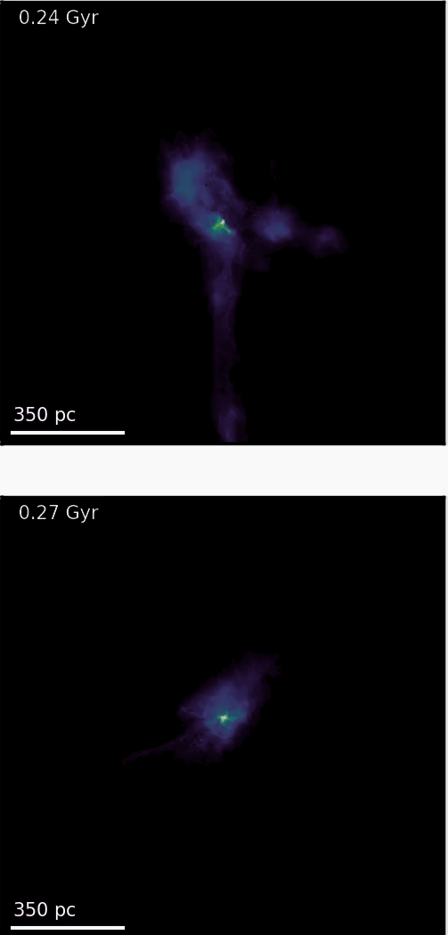
Galaxies with different star formation histories
Reionization
Strongly affected by Reionization
Rejuvenated Galaxy
Impact on galaxy and dark matter halo properties
Reionization Relic

Slide 8
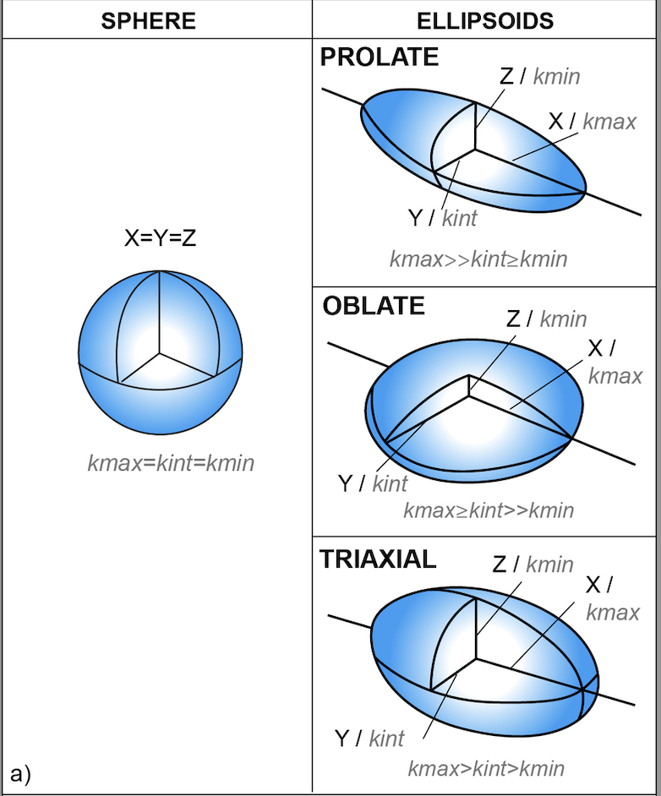


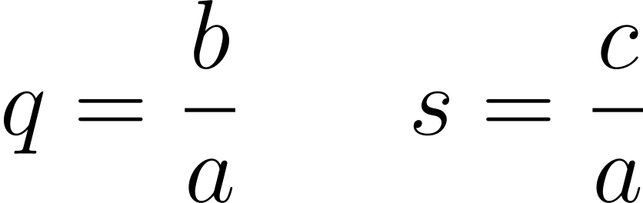

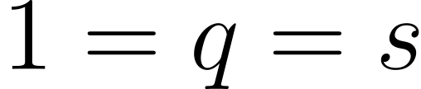
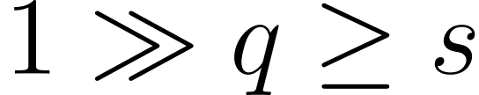
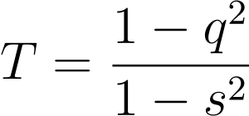
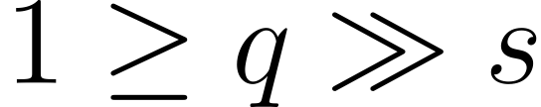
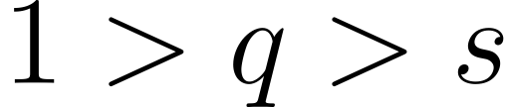
3D Morphology / Ellipsoidal Shapes
Measured using the Inertia Tensor
Sphere
Prolate
Axis ratios
Oblate
Triaxial
Triaxiality Parameter

Slide 9
Rejuvenated Galaxy
Evolution from prolate to spheroidal morphologies
Correlated with stellar mass formed after reionisation
Stellar Ellipsoidal Shape
Reionization Relic
Preserve their primordial prolate morphologies
No significant morphology evolution after reionisation
Sureda et al. (In prep)

Slide 10
Halo Ellipsoidal Shape
DM-Only Run
Ongoing merger
Sureda et al. (In prep)

Slide 11
Halo Ellipsoidal Shape
Halos become rounder when including baryons
Halos hosting relic galaxies evolve less significantly
Morphology of the central region of DM halos follow the trends from the stellar component
Potentially useful to infer dark matter halo shapes based on the morphology of the stelar content
Hydro Run
Sureda et al. (In prep)

Slide 12
Impact of baryons: Dark matter density profiles (Core vs Cusp?)
No dark matter core for any of the galaxies
We do see the contraction of a DM halo
Ask me if you are interested!
Sureda et al. (In prep)

Slide 13
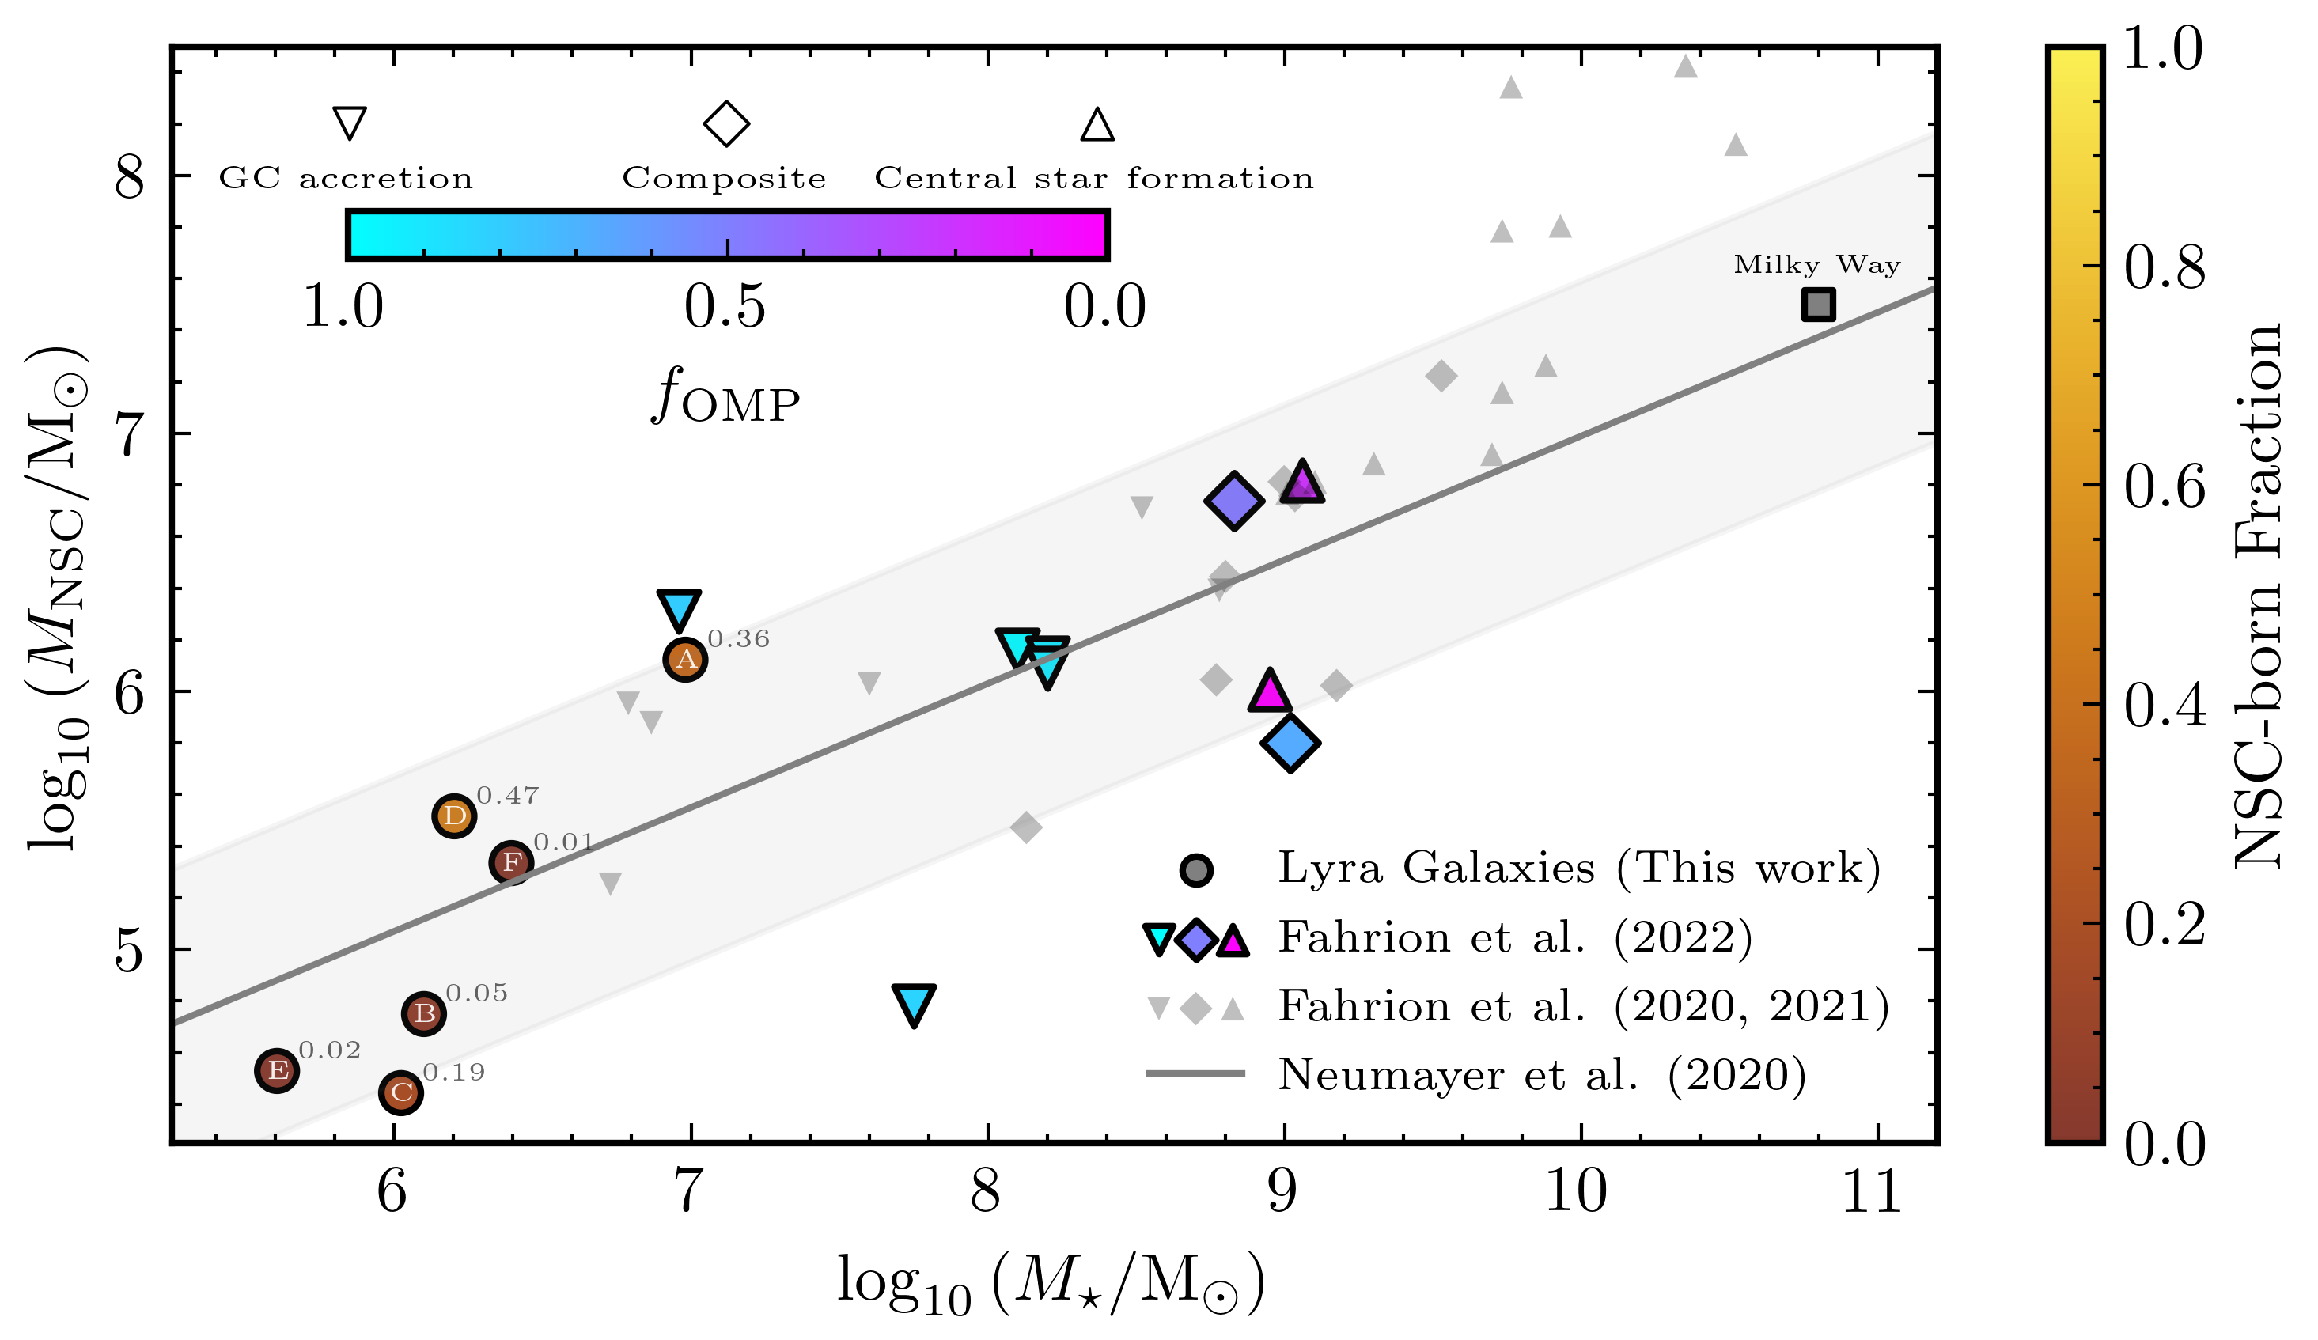
LYRA: Formation of Nuclear Star Clusters
Preliminary!
Happy to discuss about this over coffee!

Slide 14
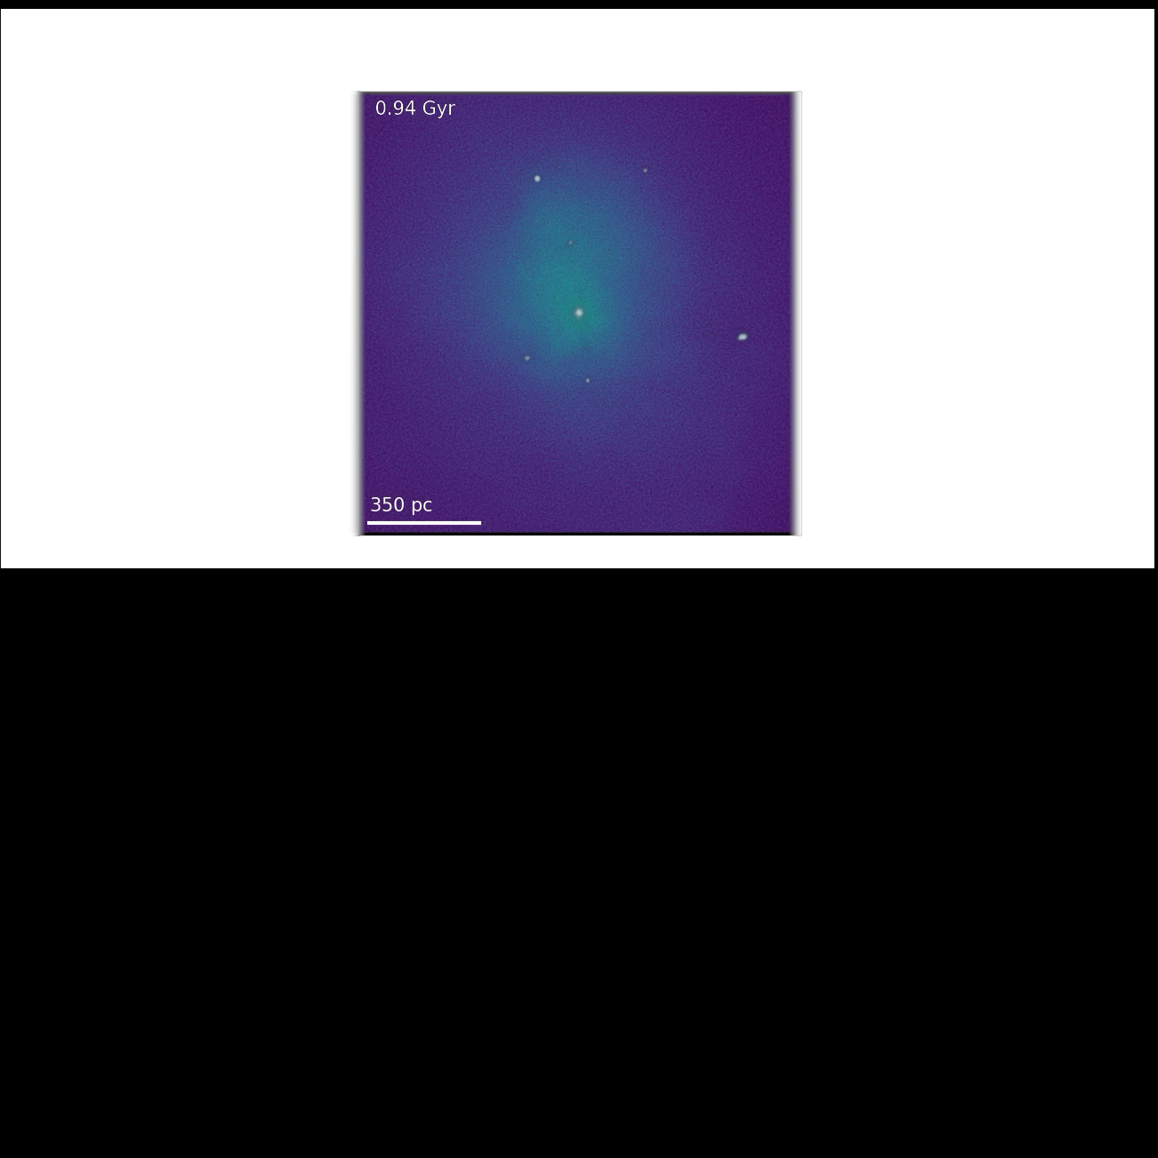
Summary
Baryons show to have an influence in the dark matter component of the LYRA galaxies
  Halos become rounder and follow the stellar trends
Morphology of the stellar and dark matter components is affected by star formation activity
  Rejuvenated halos become more spherical
  Relics do not change significantly
These results could help interpreting observed results of the morphology of local dwarfs
Credits: ESO/Digitized Sky Survey 2

Slide 15
Backup Slides

Slide 16
Dark matter density profiles (Core vs Cusp?)
Core
Cusp
Sureda et al. (In prep)
No signs of a core for any of the galaxies

Slide 17
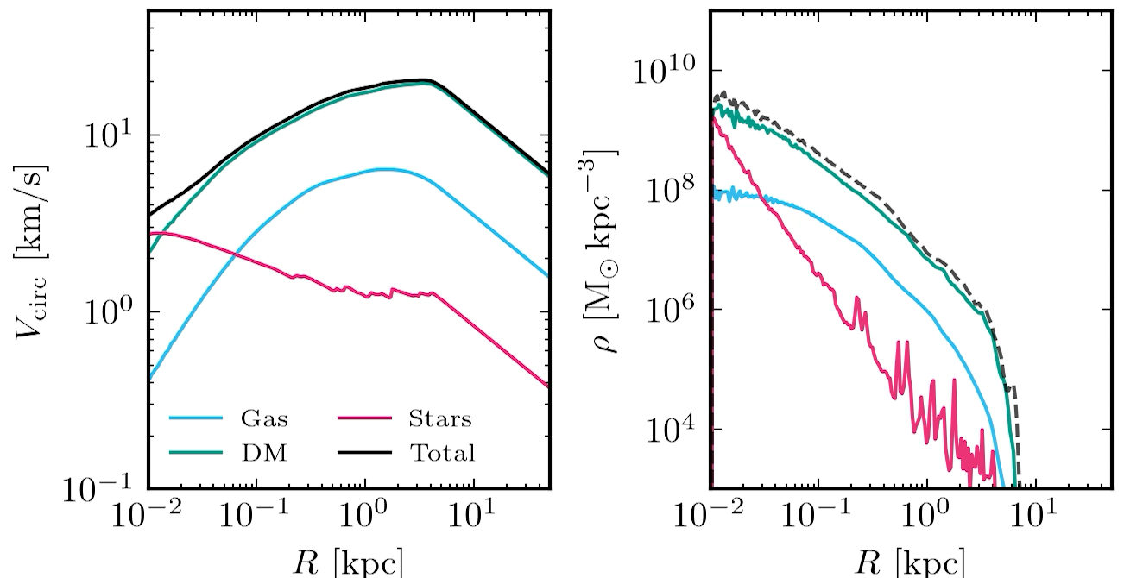
Contraction of the Dark Matter Halo

Slide 18
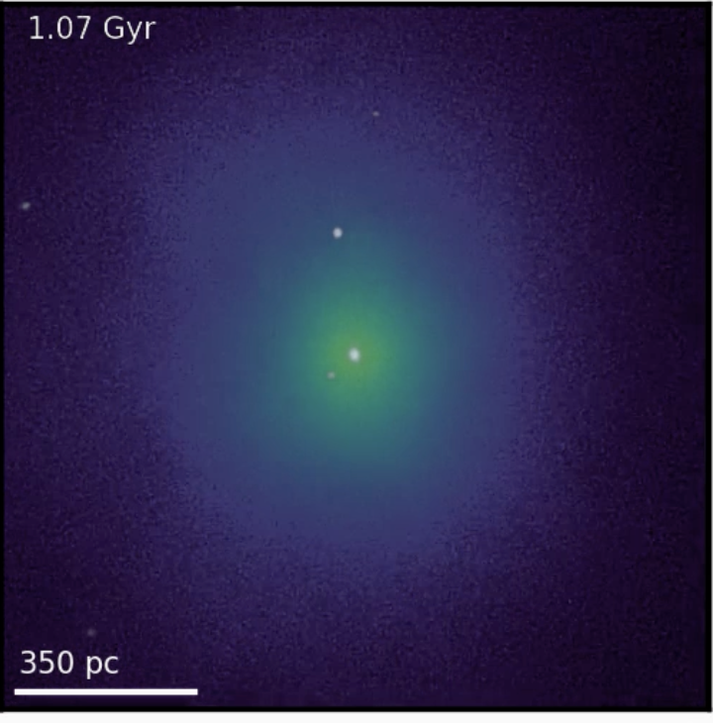

$$z=0$$
Notes:
105

Slide 19
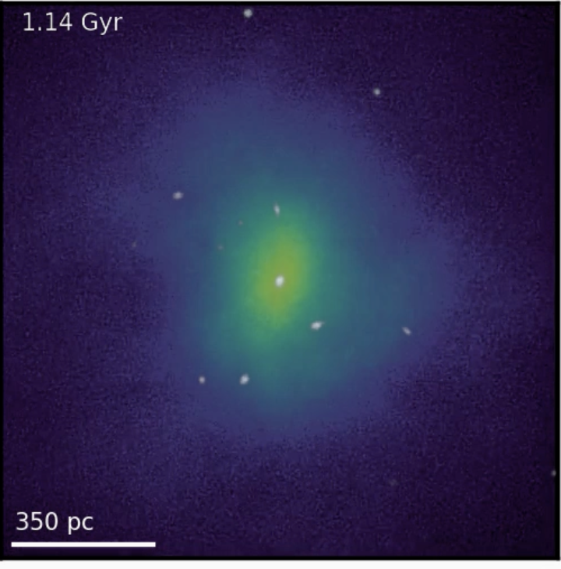
$$z=0$$
Notes:
112

Slide 20
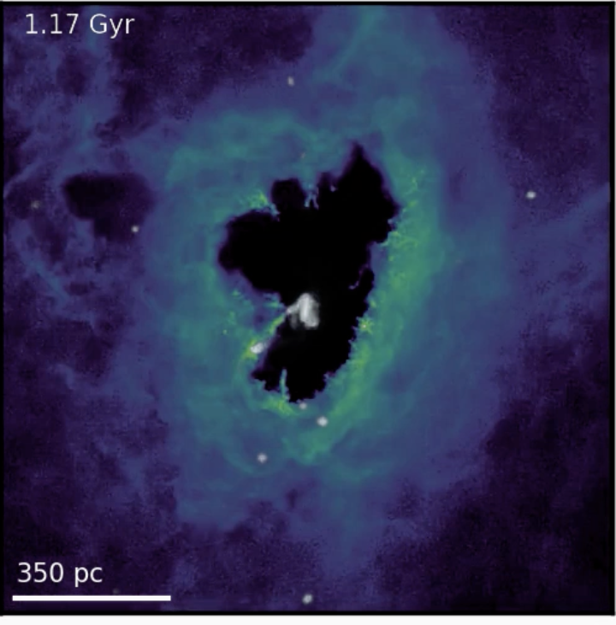
$$z=0$$
Notes:
115

Slide 21
Halo Ellipsoidal Shape
Hydro Run
Sureda et al. (In prep)

Slide 22
Stellar Ellipsoidal Shape
Sureda et al. (In prep)

Slide 23
Gas Ellipsoidal Shape
Identify short-lived gas discs!

Slide 24
Evolution of the inner slope of the density profile
Halo A shows noticeable differences when baryons are included
  It becomes even cuspier
Halo E preserves its density profile shape with no significant changes

Slide 25
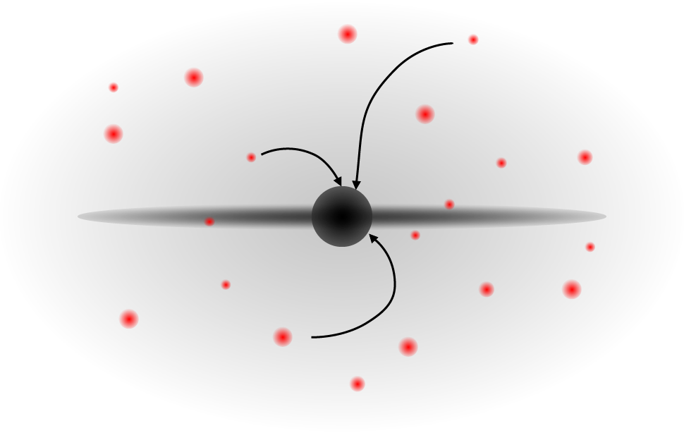
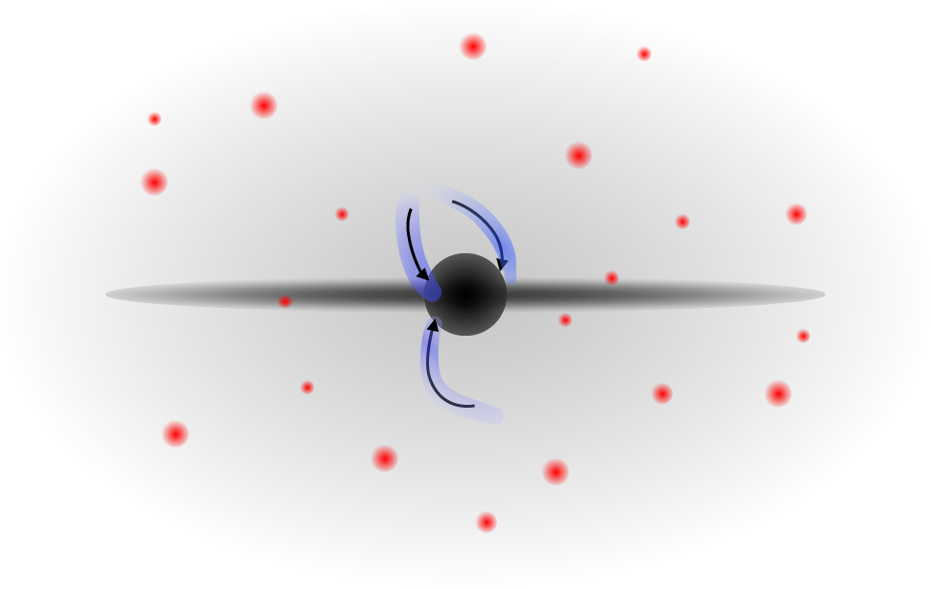
Formation of nuclear star clusters
GC accretion
In-situ star formation
Gas accretion
GC

Slide 26
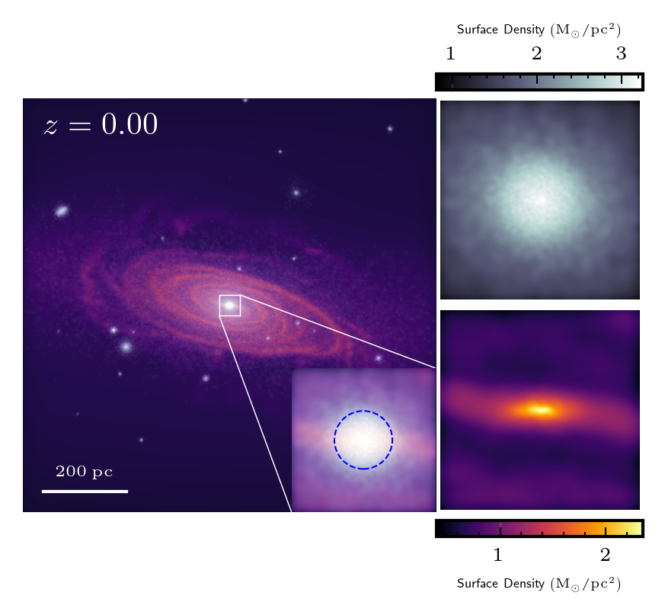
Lyra nuclear star clusters

Slide 27
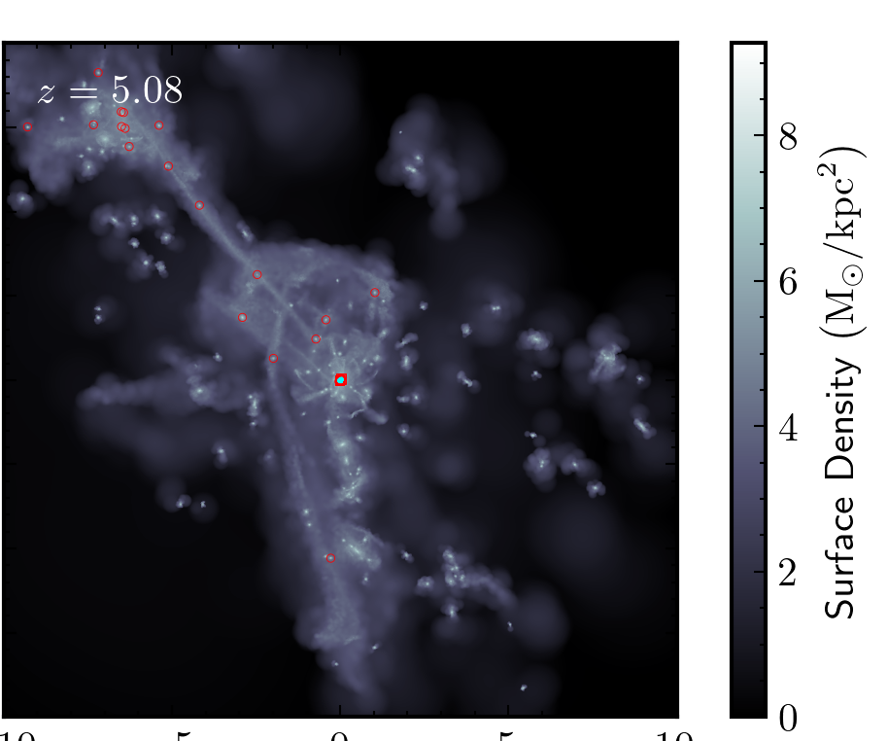
Lyra nuclear star clusters
Current NSC contributions
Globular cluster search

