Slide 1
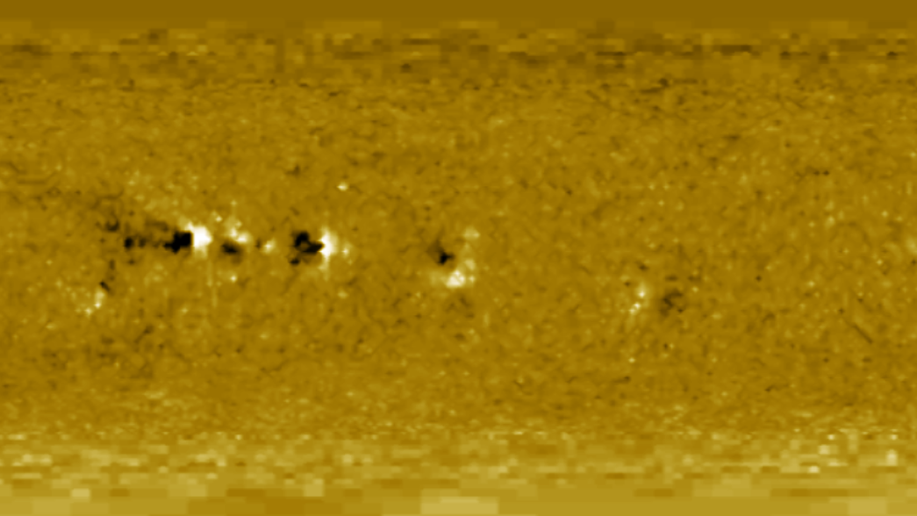


Quantifying what is lost in coronal field modelling with synoptic magnetograms
Jonah Klowss
Duncan Mackay

Slide 2
Contents
The Open Flux Problem
Helicity condensation
Mathematical models
Results
Reference Sun simulation
Comparison with synthetic synoptic magnetograms
Conclusions

Slide 3
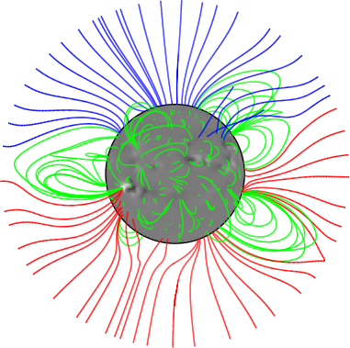

The Open Flux
The part of the solar magnetic field extending out beyond $2.5R_{⊙}$.
Source of:
- high speed solar wind
- interplanetary magnetic field
Capable of influencing geomagnetic interactions at Earth.
Guides propagation of charged particles and shields
Earth from high energy cosmic rays.

Slide 4
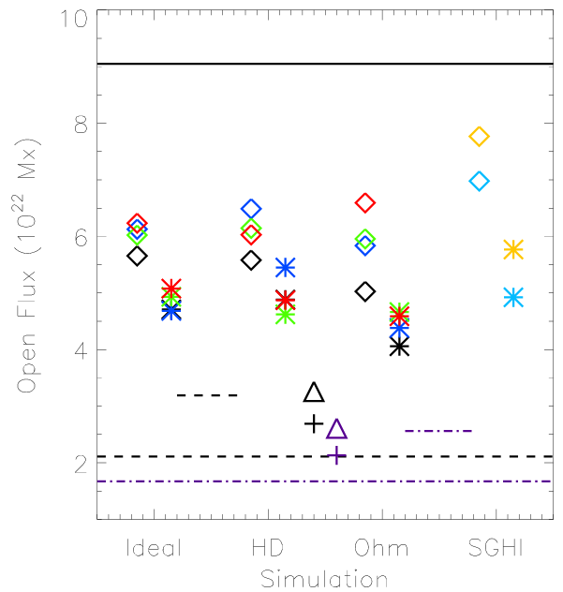
The Open Flux (Problem)
Measured in situ open flux consistently higher
than that in realistic global coronal field simulations.
Non-potential simulations can reduce this discrepancy.
Injection of currents into the low corona through
non-potential mechanisms such as differential rotation
can cause increases in open flux.
Other non-potential mechanisms also exist.
Mackay & Upton (2022)
Mackay, D. H. & Upton, L. A. (2022). A Comparison of Global Magnetofrictional Simulations of the 2015 March 20 Solar Eclipse. The Astrophysical Journal, 939, 22.

Slide 5
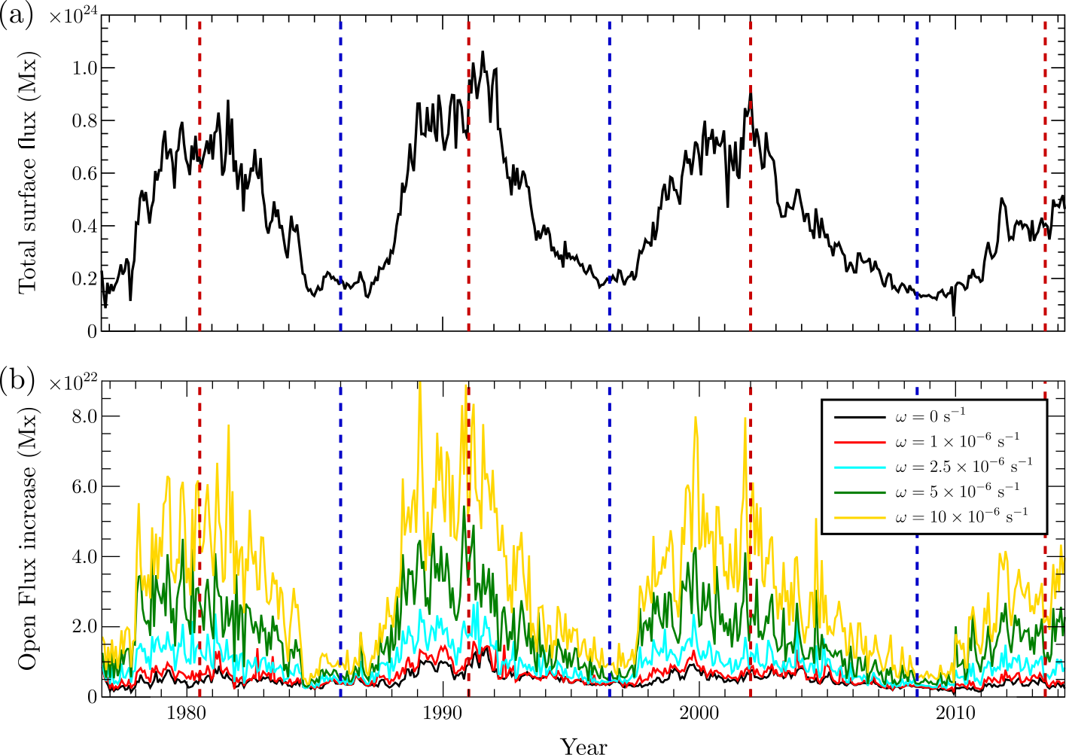
Non-potential Open Flux Enhancement
One of these non-potential
mechanisms could be
helicity condensation.
The contribution from helicity
condensation has been studied
with a static photospheric
configuration over solar cycle
timescales
These studies used synoptic
magnetograms to constrain the
photosphere, which are an
averaged representation of
the surface field.
Klowss, J. J. & Mackay, D. H. (2025). Investigating the Possible Contribution of Helicity Condensation to the Ambient Increase in Solar Open Flux. The Astrophysical Journal, 987, 1.

Slide 6
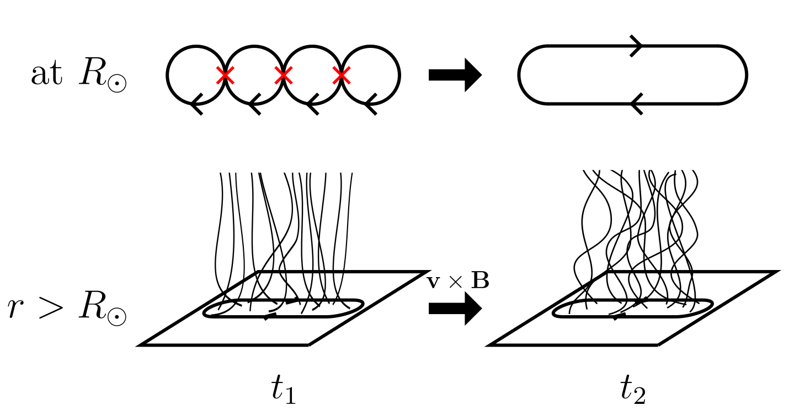
Helicity Condensation
Vortical motions of convective cells rotating on the photospheric surface.
Antiparallel field in adjacent cells leads to reconnection, redistributing the helicity onto larger scales (Antiochos, 2013).
Introduces a horizontal twist component that is then propagated upward into the corona by the Lorentz force.
Antiochos, S. K. (2013). Helicity condensation as the origin of coronal and solar wind structure. The Astrophysical Journal, 772, 72.

Slide 7
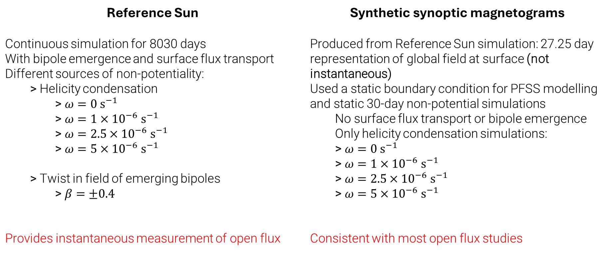
Modelling Approaches
Reference Sun Continuous simulation for 8030 days With bipole emergence and surface flux transport Different sources of non-potentiality: Helicity condensation $ω=0 s^{−1}$ $ω=1×{10}^{−6}{ s}^{−1}$ $ω=2.5×{10}^{−6}{ s}^{−1}$ $ω=5×{10}^{−6}{ s}^{−1}$ Twist in field of emerging bipoles $β=±0.4$ Provides instantaneous measurement of open flux | Synthetic synoptic magnetograms Produced from Reference Sun simulation: 27.25 day representation of global field at surface (not instantaneous) Used a static boundary condition for PFSS modelling and static 30-day non-potential simulations No surface flux transport or bipole emergence Only helicity condensation simulations: $ω=0 s^{−1}$ $ω=1×{10}^{−6}{ s}^{−1}$ $ω=2.5×{10}^{−6}{ s}^{−1}$ $ω=5×{10}^{−6}{ s}^{−1}$ Consistent with most open flux studies
Notes:
As helicity condensation does not affect the flux distribution at the photosphere, we can choose any of the reference sun simulations to be used as the baseline.

Slide 8

Modelling Approaches
Reference Sun Continuous simulation for 8030 days With bipole emergence and surface flux transport Different sources of non-potentiality: Helicity condensation $ω=0 s^{−1}$ $ω=1×{10}^{−6}{ s}^{−1}$ $ω=2.5×{10}^{−6}{ s}^{−1}$ $ω=5×{10}^{−6}{ s}^{−1}$ Twist in field of emerging bipoles $β=±0.4$ Provides instantaneous measurement of open flux | Synthetic synoptic magnetograms Produced from Reference Sun simulation: 27.25 day representation of global field at surface (not instantaneous) Used a static boundary condition for PFSS modelling and static 30-day non-potential simulations No surface flux transport or bipole emergence Only helicity condensation simulations: $ω=0 s^{−1}$ $ω=1×{10}^{−6}{ s}^{−1}$ $ω=2.5×{10}^{−6}{ s}^{−1}$ $ω=5×{10}^{−6}{ s}^{−1}$ Consistent with most open flux studies
Surface flux transport:
$$\frac{∂A_{s}}{∂t}=v_{s}×B_{r}−D∇_{s}×B_{r}+S_{b}$$
Differential rotation:
$$u_{φ}=Ω\left(θ\right)r\sin\left(θ\right)$$
$$Ω\left(θ\right)=0.18−2.30\cos^{2}\left(θ\right)−1.62\cos^{4}\left(θ\right) deg {day}^{−1}$$
Meridional flow:
$$u_{θ}=C\cos\left[\frac{π(θ_{max}+θ_{min}−2θ)}{2\left(θ_{max}+θ_{min}\right)}\right]\cos\left(θ\right)$$
Surface diffusion: $D=600 {km}^{2} s^{−1}$
Notes:
As helicity condensation does not affect the flux distribution at the photosphere, we can choose any of the reference sun simulations to be used as the baseline.

Slide 9
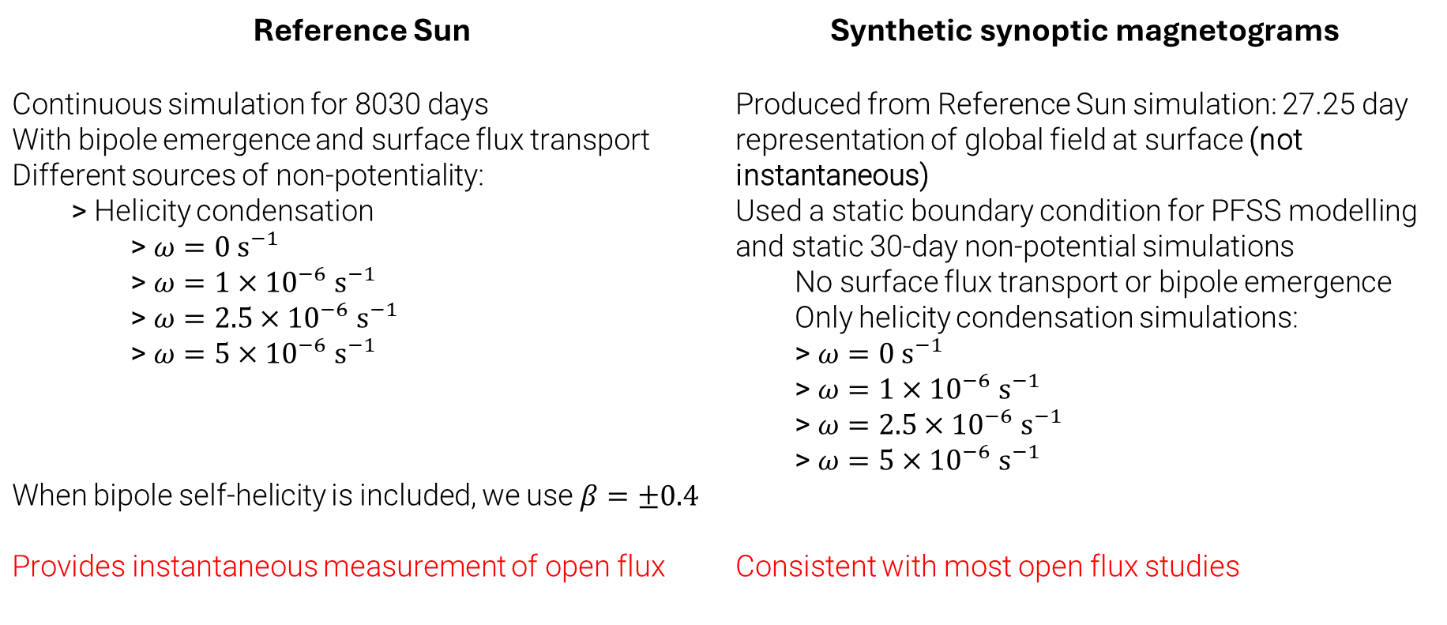

Modelling Approaches
Reference Sun Continuous simulation for 8030 days With bipole emergence and surface flux transport Different sources of non-potentiality: Helicity condensation $ω=0 s^{−1}$ $ω=1×{10}^{−6}{ s}^{−1}$ $ω=2.5×{10}^{−6}{ s}^{−1}$ $ω=5×{10}^{−6}{ s}^{−1}$ When bipole self-helicity is included, we use $β=±0.4$ Provides instantaneous measurement of open flux | Synthetic synoptic magnetograms Produced from Reference Sun simulation: 27.25 day representation of global field at surface (not instantaneous) Used a static boundary condition for PFSS modelling and static 30-day non-potential simulations No surface flux transport or bipole emergence Only helicity condensation simulations: $ω=0 s^{−1}$ $ω=1×{10}^{−6}{ s}^{−1}$ $ω=2.5×{10}^{−6}{ s}^{−1}$ $ω=5×{10}^{−6}{ s}^{−1}$ Consistent with most open flux studies
Bipole emergence at $(x_{b},y_{b},z_{b})$:
$$B_{x}=B_{0}e^{0.5}\left(\frac{z_{b}}{ρ_{0}}e^{ξ}+4β\frac{x_{b}y_{b}}{ρ_{0}^{2}}e^{−2ξ}\right),$$
$$B_{y}=2βB_{0}e^{0.5}\left(1−\frac{x_{b}^{2}+z_{b}^{2}}{ρ_{0}^{2}}\right)e^{−2ξ},$$
$$B_{z}=B_{0}e^{0.5}\left(−\frac{x_{b}}{ρ_{0}}e^{−ξ}+4β\frac{y_{b}z_{b}}{ρ_{0}^{2}}e^{−2ξ}\right),$$
$$ξ≡\left[\frac{\left(x_{b}^{2}+z_{b}^{2}\right)}{2}+y_{b}^{2}\right]/ρ_{0}^{2}$$
Notes:
As helicity condensation does not affect the flux distribution at the photosphere, we can choose any of the reference sun simulations to be used as the baseline.

Slide 10


Modelling Approaches
Reference Sun Continuous simulation for 8030 days With bipole emergence and surface flux transport Different sources of non-potentiality: Helicity condensation $ω=0 s^{−1}$ $ω=1×{10}^{−6}{ s}^{−1}$ $ω=2.5×{10}^{−6}{ s}^{−1}$ $ω=5×{10}^{−6}{ s}^{−1}$ Twist in field of emerging bipoles $β=±0.4$ Provides instantaneous measurement of open flux | Synthetic synoptic magnetograms Produced from Reference Sun simulation: 27.25 day representation of global field at surface (not instantaneous) Used a static boundary condition for PFSS modelling and static 30-day non-potential simulations No surface flux transport or bipole emergence Only helicity condensation simulations: $ω=0 s^{−1}$ $ω=1×{10}^{−6}{ s}^{−1}$ $ω=2.5×{10}^{−6}{ s}^{−1}$ $ω=5×{10}^{−6}{ s}^{−1}$ Consistent with most open flux studies
Coronal model:
$$\frac{∂A}{∂t}=v×B+H_{sg}$$
Coronal velocities:
$$v=\frac{1}{ν}\frac{j×B}{B^{2}}+v_{0}\exp\left(−\frac{2.5R_{⊙}−r}{r_{w}}\right)\hat{r}$$
Helicity condensation:
$$H_{sg}=\left\{\begin{aligned}∇_{r}\left(ζB_{r}\right), r=R_{⊙} \\ 0, otherwise\end{aligned}\right., ζ≡\frac{\overline{l^{2}ω}}{2}$$
Notes:
As helicity condensation does not affect the flux distribution at the photosphere, we can choose any of the reference sun simulations to be used as the baseline.

Slide 11
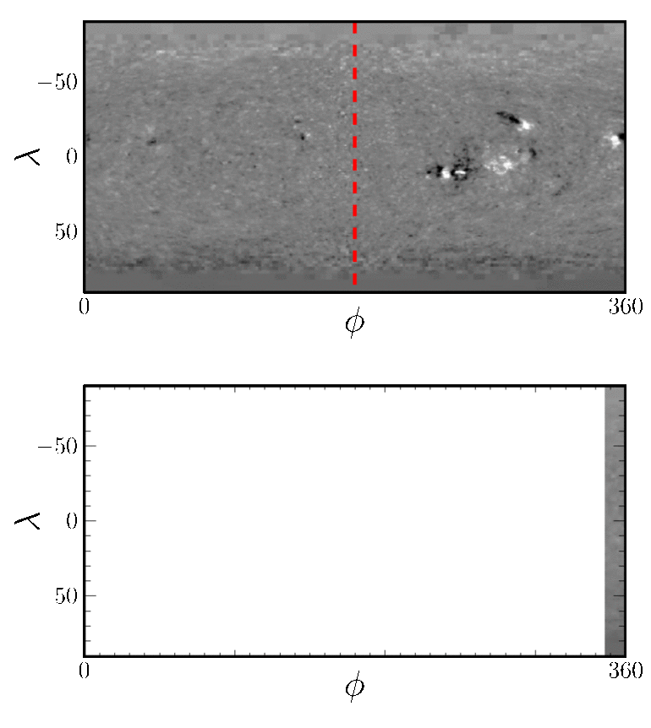
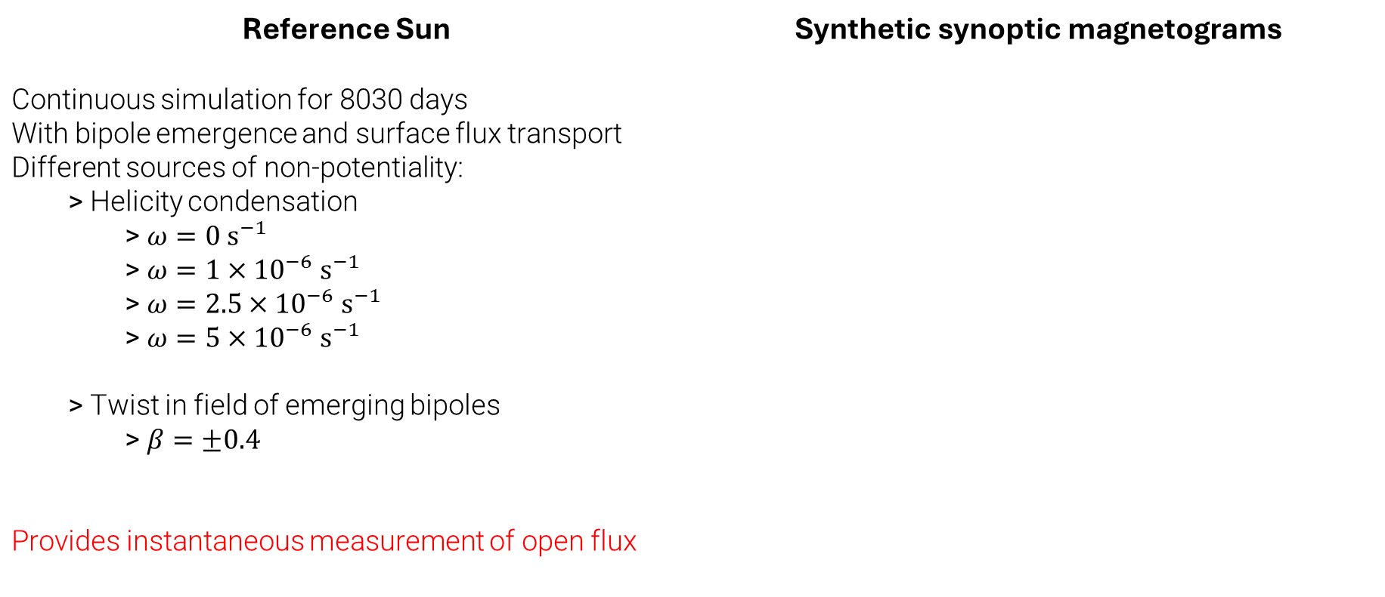
Modelling Approaches
Reference Sun Continuous simulation for 8030 days With bipole emergence and surface flux transport Different sources of non-potentiality: Helicity condensation $ω=0 s^{−1}$ $ω=1×{10}^{−6}{ s}^{−1}$ $ω=2.5×{10}^{−6}{ s}^{−1}$ $ω=5×{10}^{−6}{ s}^{−1}$ Twist in field of emerging bipoles $β=±0.4$ Provides instantaneous measurement of open flux | Synthetic synoptic magnetograms
Coronal model:
$$\frac{∂A}{∂t}=v×B+H_{sg}$$
Coronal velocities:
$$v=\frac{1}{ν}\frac{j×B}{B^{2}}+v_{0}\exp\left(−\frac{2.5R_{⊙}−r}{r_{w}}\right)\hat{r}$$
Helicity condensation:
$$H_{sg}=\left\{\begin{aligned}∇_{r}\left(ζB_{r}\right), r=R_{⊙} \\ 0, otherwise\end{aligned}\right., ζ≡\frac{\overline{l^{2}ω}}{2}$$
Notes:
As helicity condensation does not affect the flux distribution at the photosphere, we can choose any of the reference sun simulations to be used as the baseline.

Slide 12
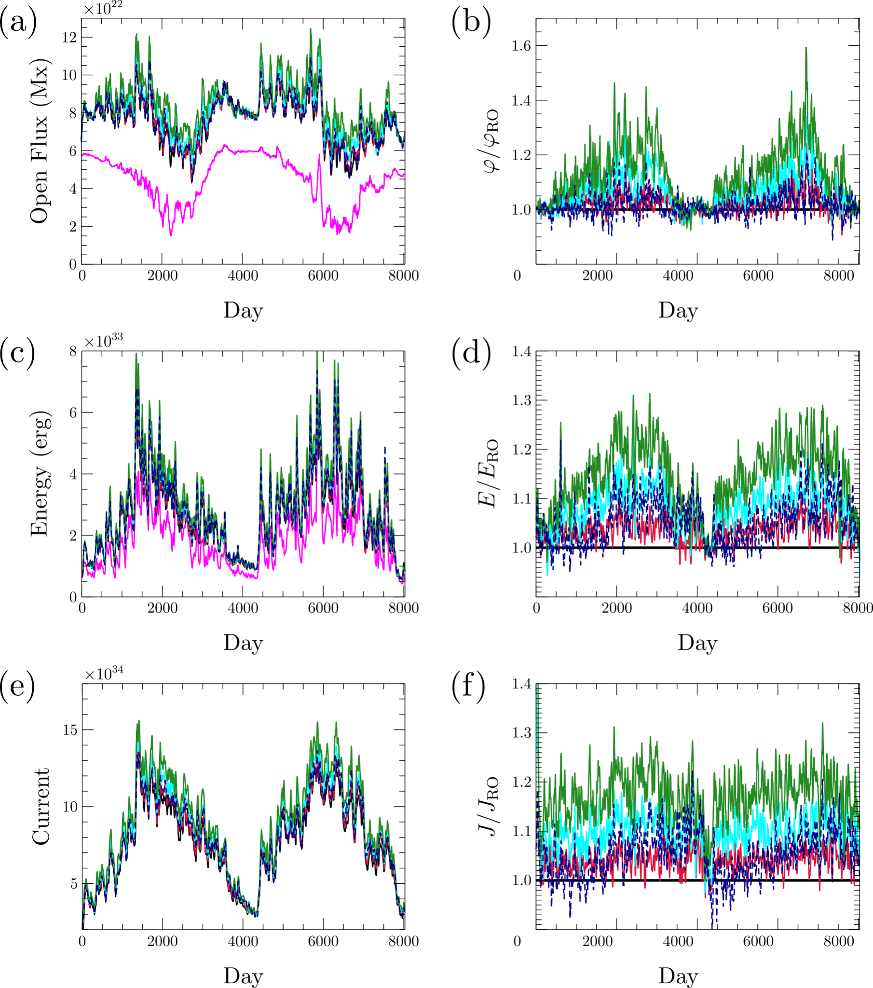


Reference Sun
The $φ_{RO}, E_{RO}, J_{RO}$ simulations
correspond to the $ω=0 s^{−1}$ simulation
(radial outflow only).
Left: absolute amounts
Right: ratio increase relative to
radial outflow simulation (e.g. $φ/φ_{RO}$).
$$PFSS$$
$$Radial outflow only$$
$$ω=1×{10}^{−6} s^{−1}$$
$$ω=2.5×{10}^{−6} s^{−1}$$
$$ω=5×{10}^{−6} s^{−1}$$
$$β=±0.4$$

Slide 13
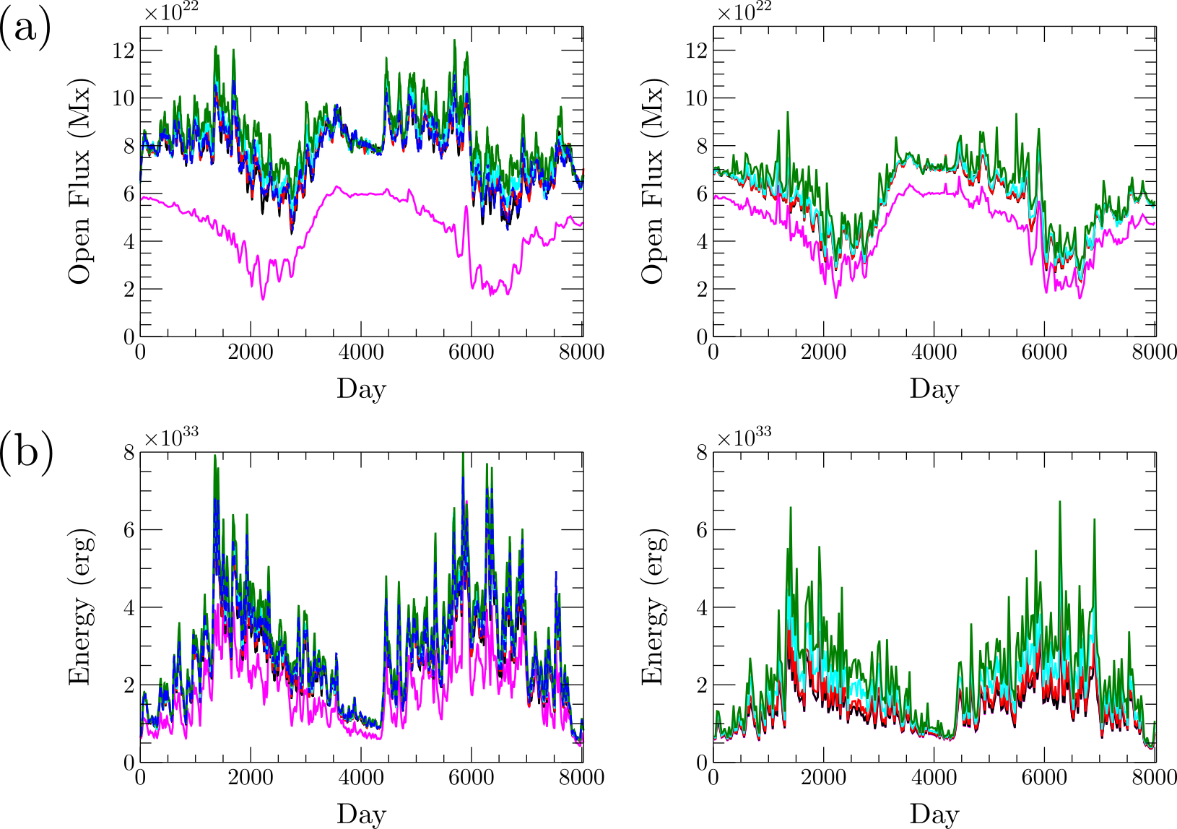
Reference Sun vs Synthetic magnetograms
Open Flux
Energy
Left: Reference Sun
simulations (RS)
Right: synthetic synoptic
magnetograms (SSM)
Increase from PFSS model
to SSM simulations is
roughly half of the increase
from PFSS model to the
RS simulations.

Slide 14
Conclusions
Comparison between Reference Sun simulations and magnetogram simulations to quantify the data loss due to limitations in observations.
  No difference between PFSS models from either synthetic synoptic magnetograms or instantaneous Reference Sun
  Reference Sun simulations cause twice as much enhancement on PFSS models as simulations with fixed surface flux distribution and limited data.

Slide 15
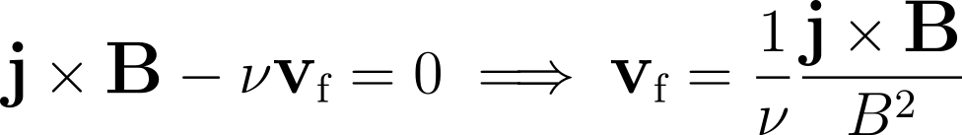
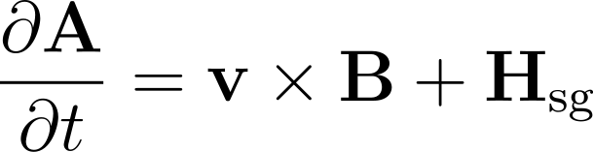
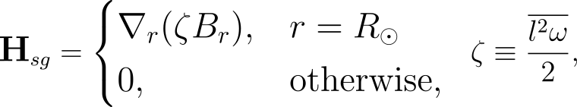
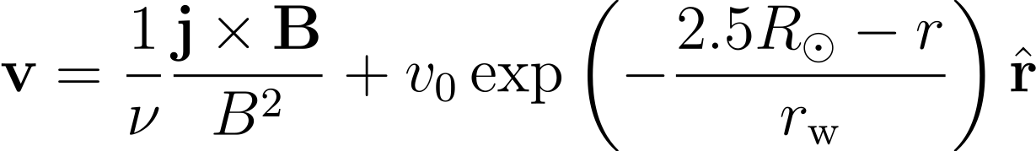
Magnetofrictional model
Method for introducing non-linear force free fields (NLFFFs) in the corona
Introduce an artificial, dissipation-like frictional term into the MHD equation of motion, which reduces so that:
The corona responds dynamically to changes in the field:
where
Coronal flow velocities
Statistically-averaged helicity condensation

Slide 16
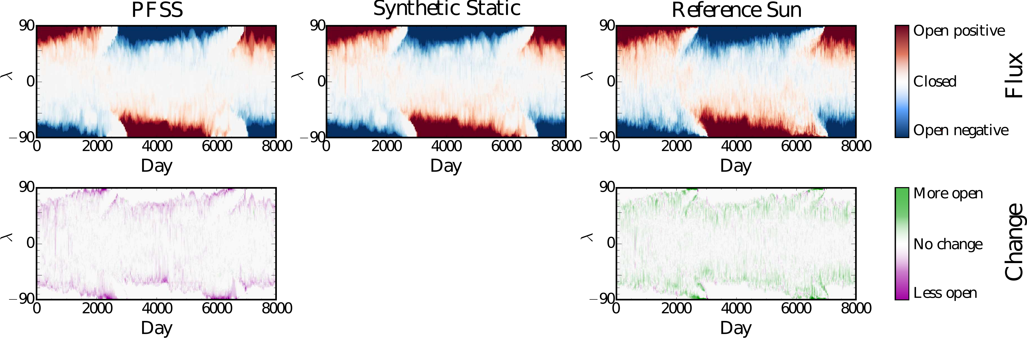

Open footpoint area
$ω=5×{10}^{−6} s^{−1}$ simulations
Top panels show longitudinally-averaged footpoint areas, with blue being negative and red being positive Open Flux footpoints. Bottom panels show difference relative to the top middle (SSM) panel, in absolute Open Flux (discounting positive or negative).

Slide 17
Magnetofrictional model
Method for introducing non-linear force free fields (NLFFFs) in the corona
Introduce an artificial, dissipation-like frictional term into the MHD equation of motion, which reduces so that:
The corona responds dynamically to changes in the field:
where
Coronal flow velocities
Statistically-averaged helicity condensation

Slide 18
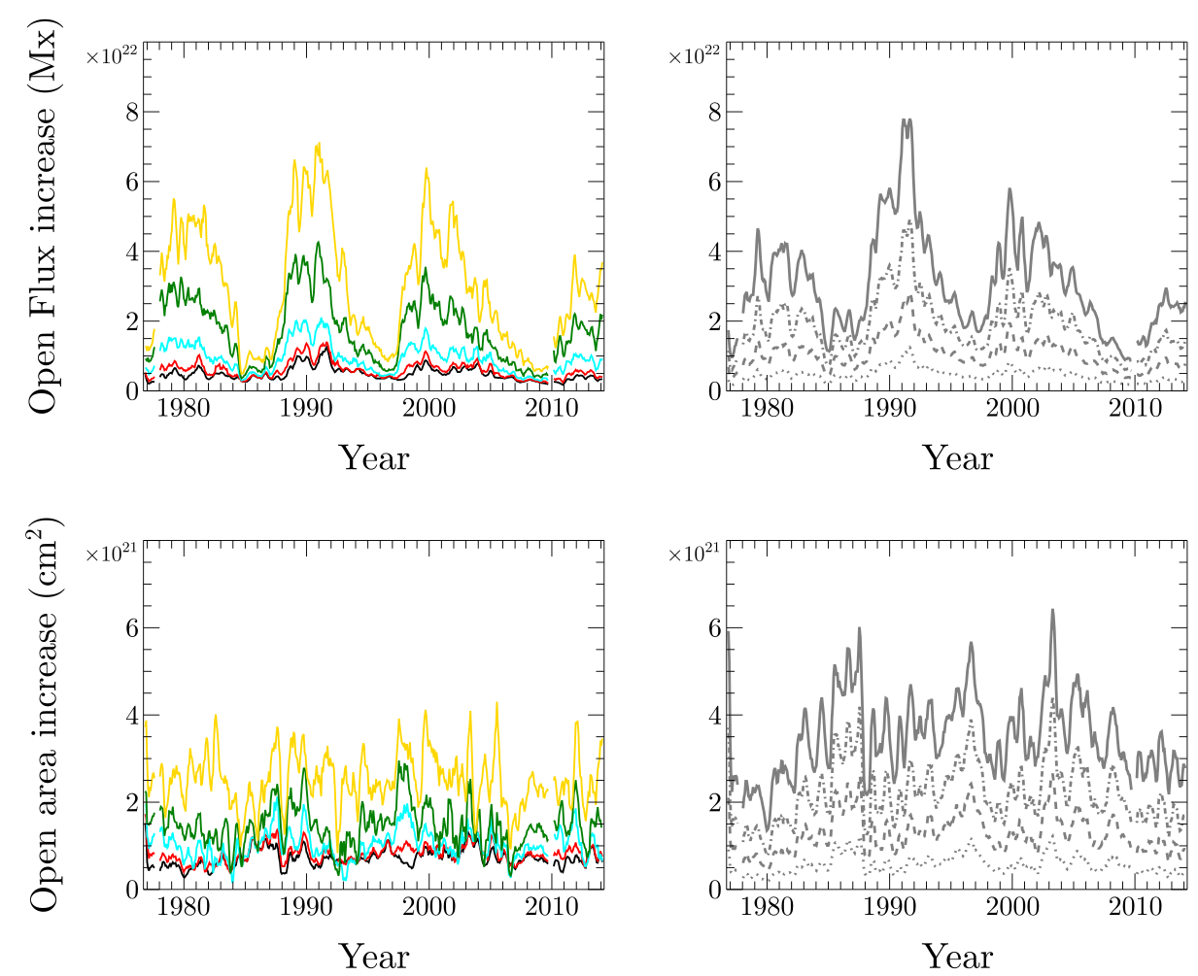
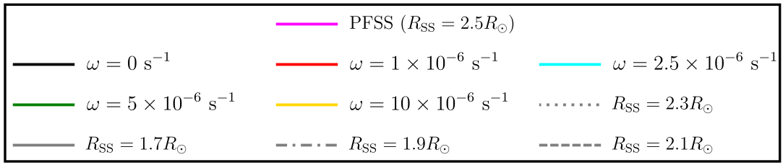

Area enhancements
Key issue: increasing the magnitude
of open flux without increasing the open
footpoint area by too much.
Left: helicity condensation simulations
Right: PFSS models with reduced $R_{SS}$
Enhancements to open flux match
but open footpoint area increases by
less.

Slide 19
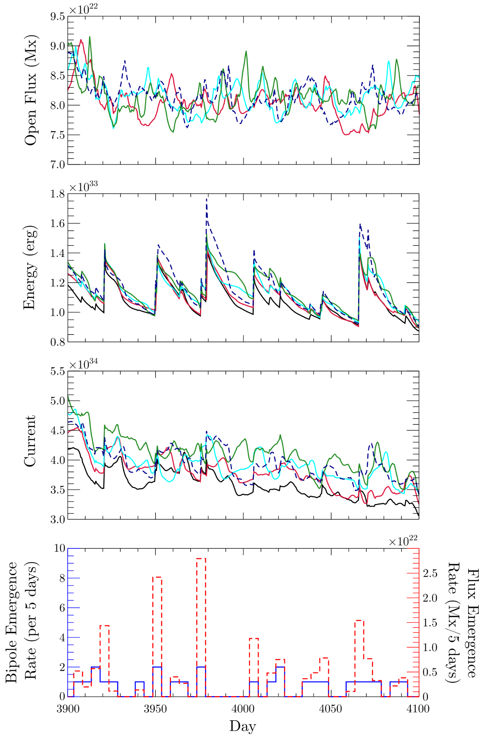


Reference Sun
Solar minimum
No strong relationship between
helicity condensation and open
flux at solar minimum.
Stronger relationship between energy/current
and helicity condensation rate.
Bipole self-helicity sits around the $ω=1×{10}^{−6} s^{−1}$
and $ω=2.5×{10}^{−6} s^{−1}$ profiles.
$$Radial outflow only$$
$$ω=1×{10}^{−6} s^{−1}$$
$$ω=2.5×{10}^{−6} s^{−1}$$
$$ω=5×{10}^{−6} s^{−1}$$
$$β=±0.4$$

Slide 20
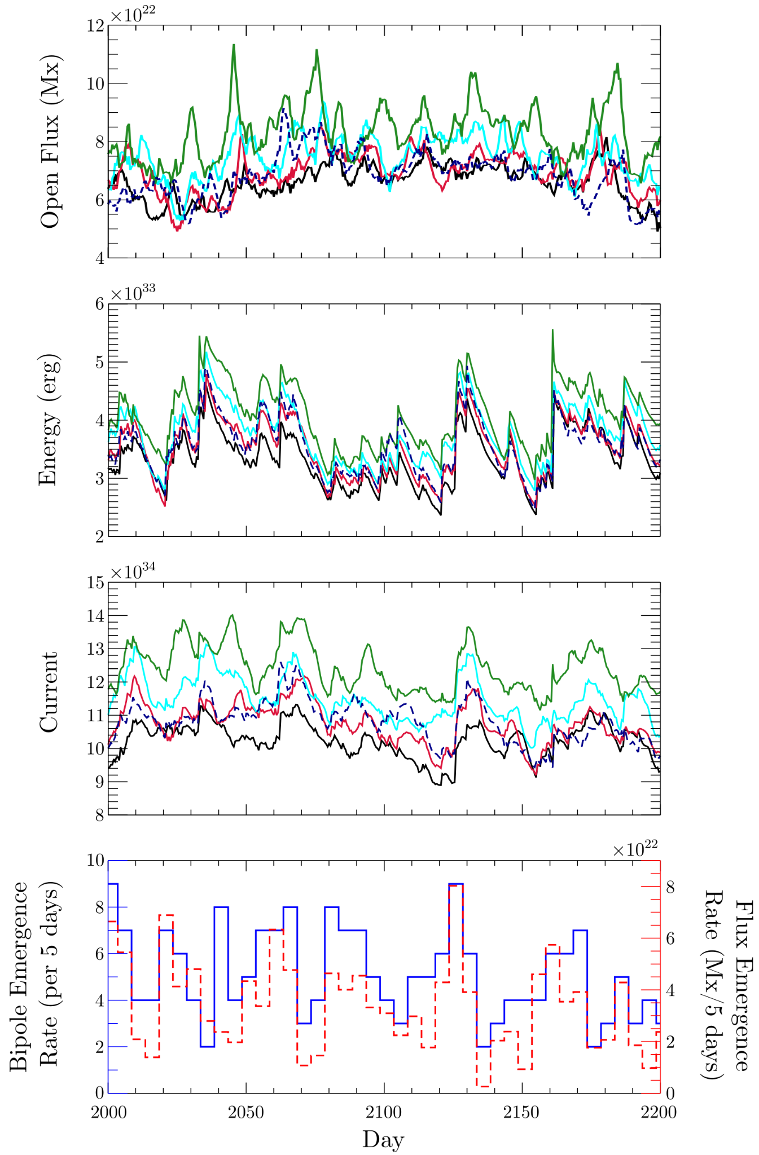
Reference Sun
Solar maximum
Open flux, energy, and current
consistently trend higher as
helicity condensation rate is
increased.
Considerably more bipole emergence activity.
Energy and current profiles fluctuate more due to
this increase in emergence activity.
$$Radial outflow only$$
$$ω=1×{10}^{−6} s^{−1}$$
$$ω=2.5×{10}^{−6} s^{−1}$$
$$ω=5×{10}^{−6} s^{−1}$$
$$β=±0.4$$

Slide 21
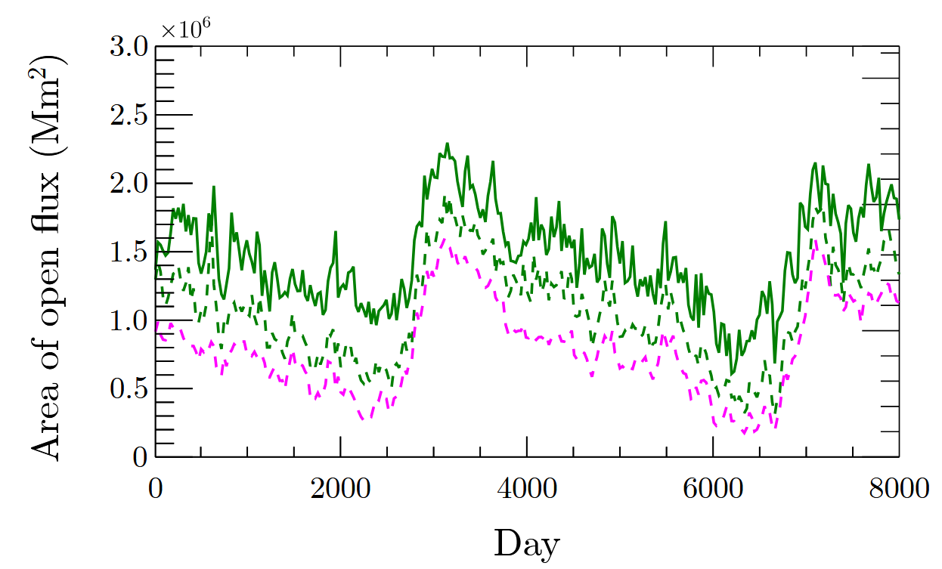
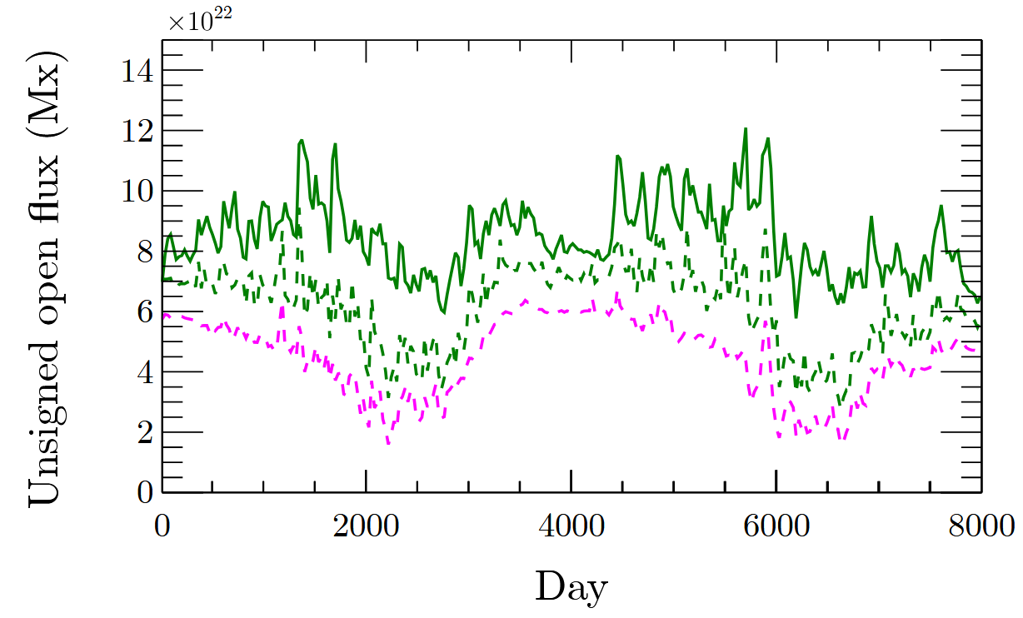
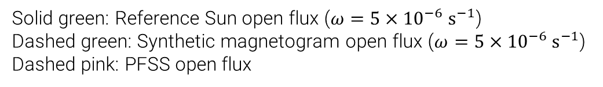
Enhancement: Area and magnitude
Solid green: Reference Sun open flux ($ω=5×{10}^{−6} s^{−1}$)
Dashed green: Synthetic magnetogram open flux ($ω=5×{10}^{−6} s^{−1}$)
Dashed pink: PFSS open flux

Slide 22
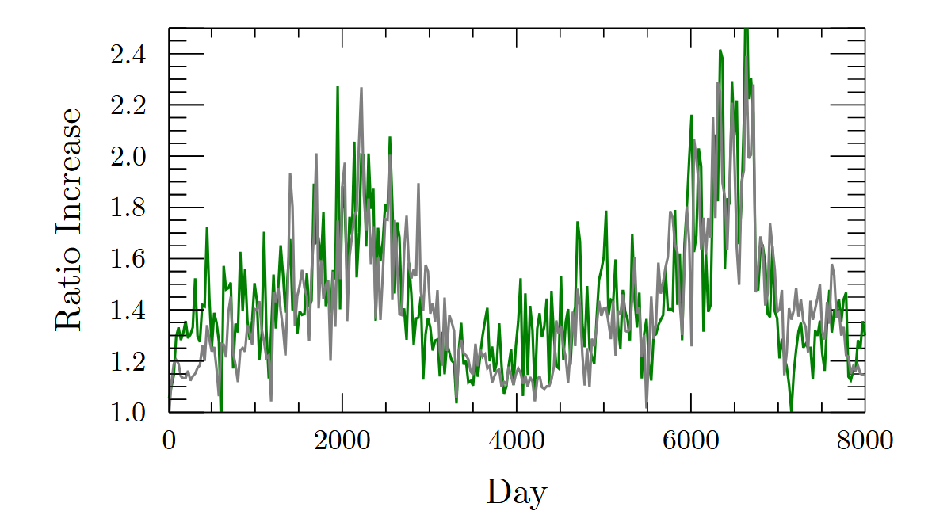
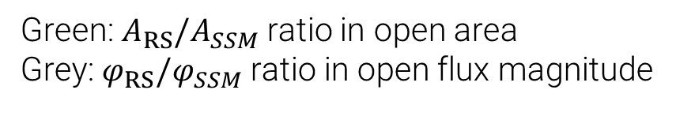
Enhancement: Area and magnitude
Green: $A_{RS}/A_{SSM}$ ratio in open area
Grey: $φ_{RS}/φ_{SSM}$ ratio in open flux magnitude

