Slide 1

Determining distribution functions for collisionless current sheet equilibria: Analytical approach
Thomas Neukirch and Sophie Boswell
School of Mathematics and Statistics
University of St Andrews
(see Poster 811 for “Numerical Approach”)

Slide 2
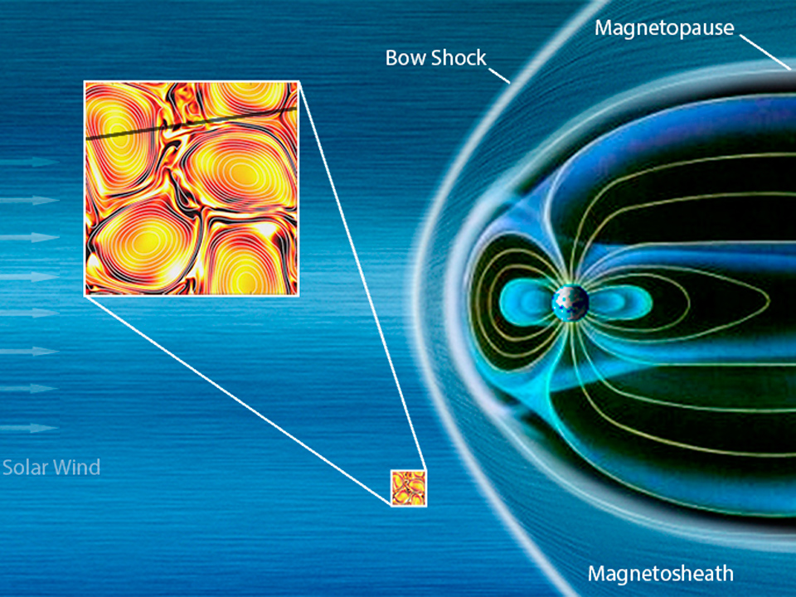
Current sheets are
ubiquitous in solar
system plasmas
This talk:
collisionless plasmas
1D (z dependence)

Slide 3
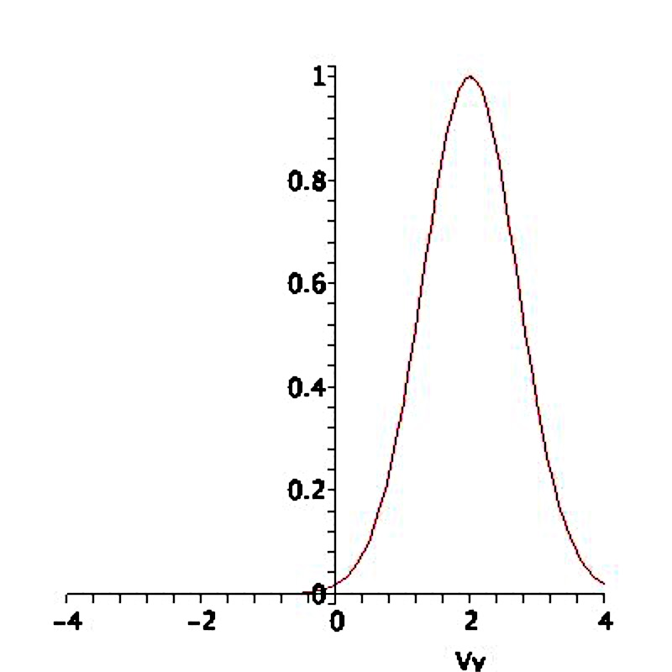
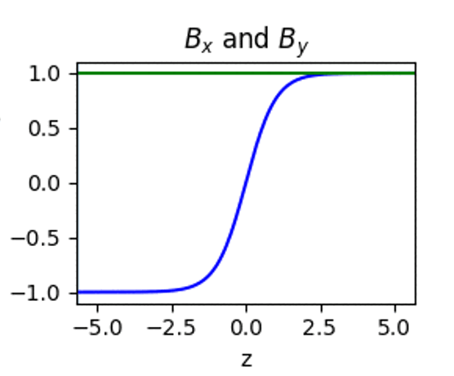
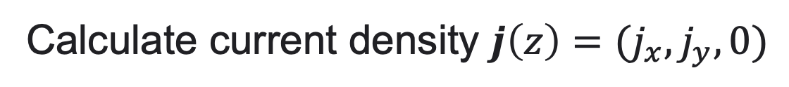
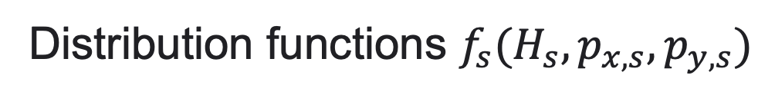
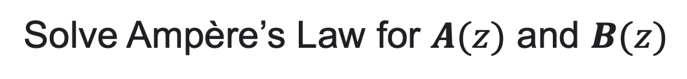
Distribution functions $f_{s}(H_{s},p_{x,s},p_{y,s})$
Calculate current density $j\left(z\right)=(j_{x},j_{y},0)$
Solve Ampère’s Law for $A(z)$ and $B(z)$

Slide 4
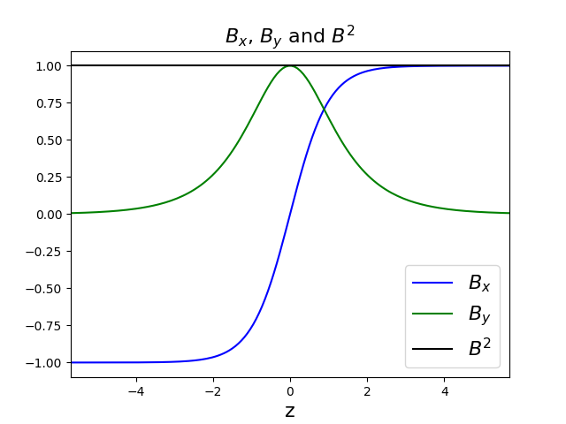
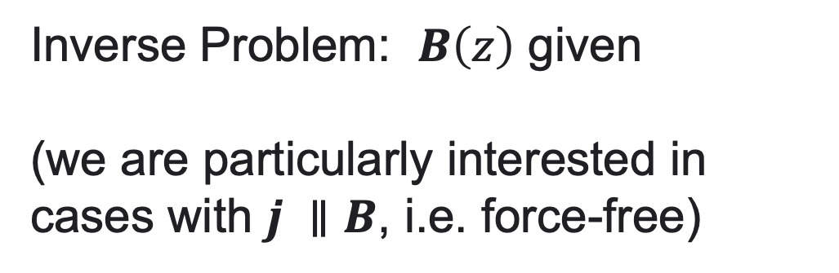
Inverse Problem: $B\left(z\right)$ given
(we are particularly interested in cases with $j ∥B$, i.e. force-free)
?
Want to determine a self-consistent $f_{s}(H_{s},p_{x,s},p_{y,s})$

Slide 5
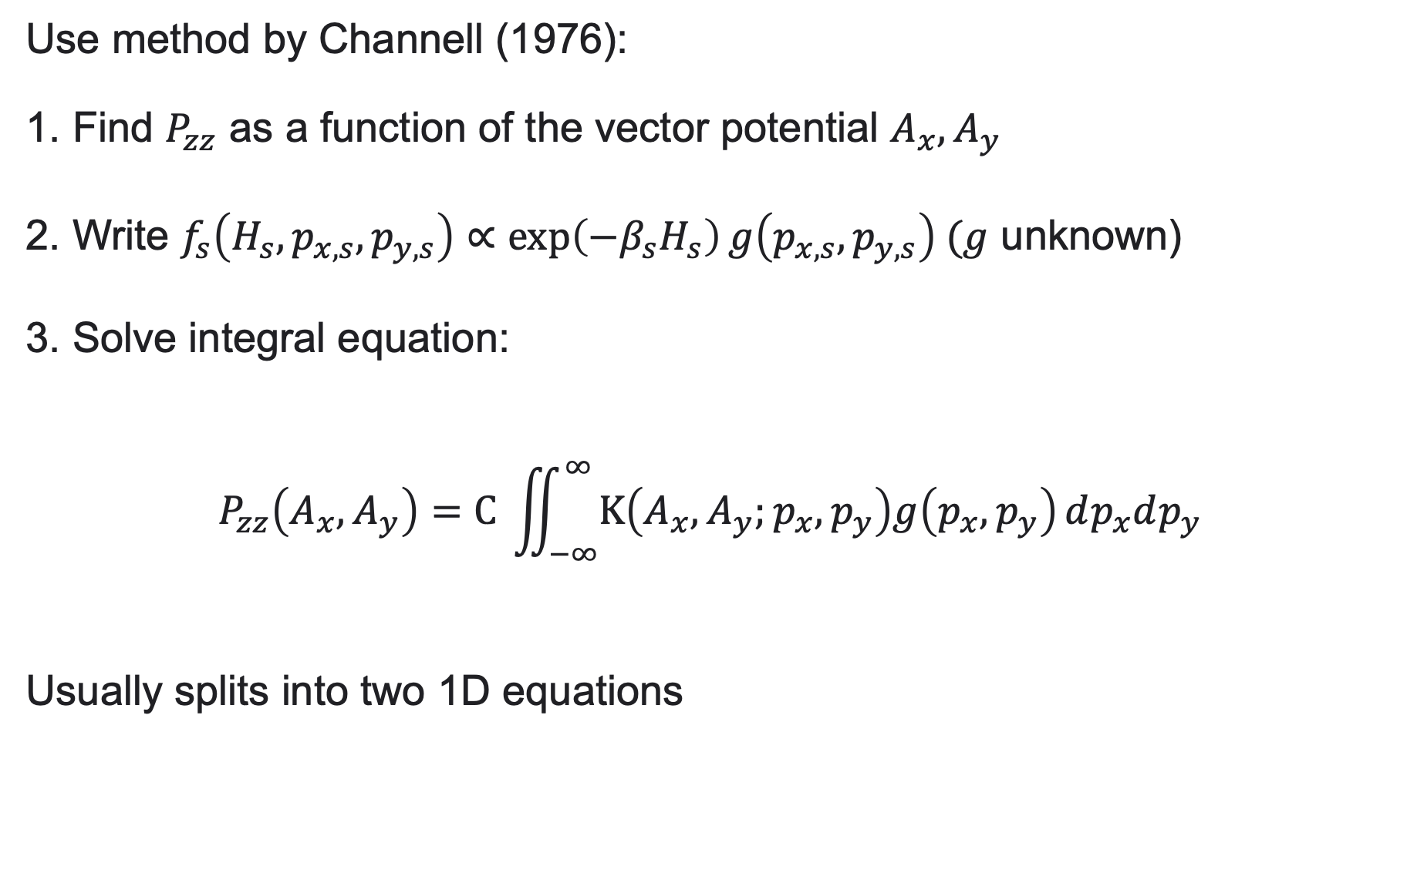
Use method by Channell (1976):
1. Find $P_{zz}$ as a function of the vector potential $A_{x}, A_{y}$
2. Write $f_{s}\left(H_{s},p_{x,s},p_{y,s}\right)∝\exp\left(−β_{s}H_{s}\right)g\left(p_{x,s},p_{y,s}\right) (g$ unknown)
3. Solve integral equation:
$$P_{zz}\left(A_{x},A_{y}\right)=C \iint_{−∞}^{∞}{K\left(A_{x},A_{y};p_{x},p_{y}\right)g\left(p_{x},p_{y}\right)}dp_{x}dp_{y}$$
Usually splits into two 1D equations

Slide 6
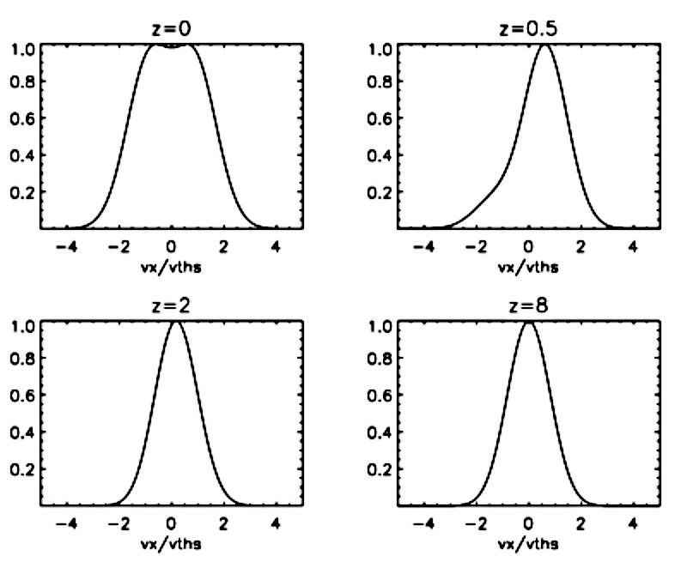

Force-free Harris Sheet, $B_{y}→0 as |z|→∞$
Harrison & TN 2009; TN et al., 2009; Allanson et al., 2015, 2016

Slide 7
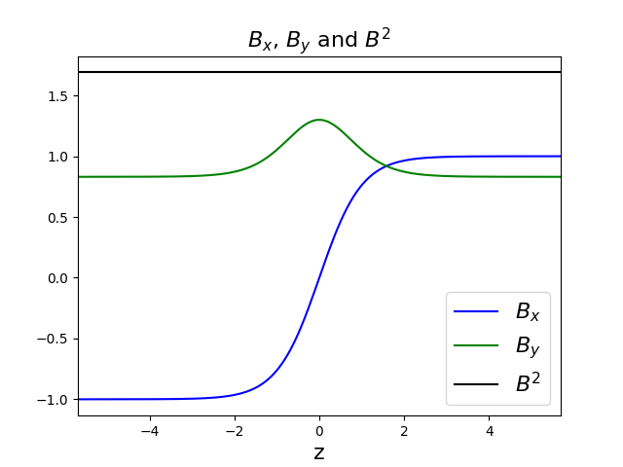
Force-free Harris Sheet, $B_{y}→B_{y∞}≠0 as |z|→∞$
?

Slide 8
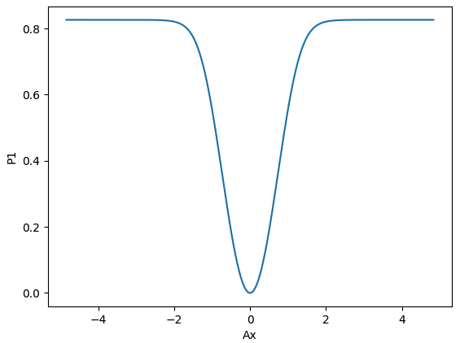

Problem 1: $P_{zz,1}\left(A_{x}\right)$cannot be found explicitly (known implicitly)
Problem 2: How to solve the integral equation?

Slide 9
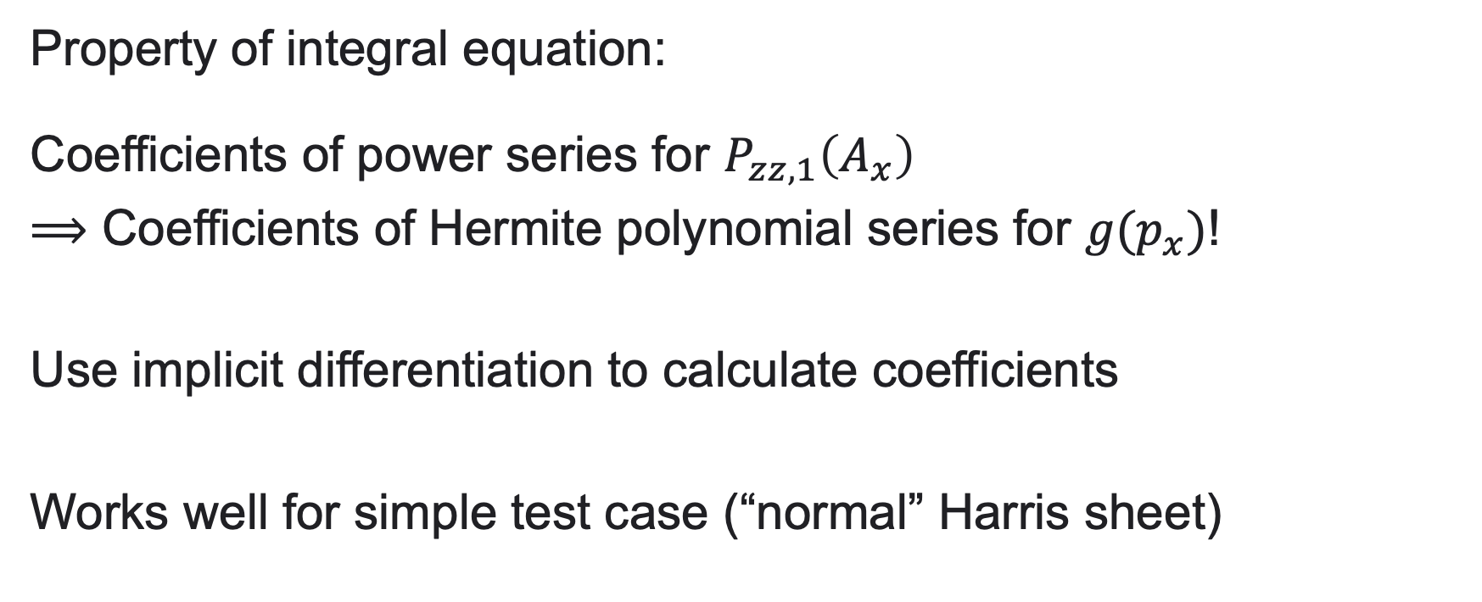
Analytical Method: Use Series Expansion
Property of integral equation:
Coefficients of power series for $P_{zz,1}\left(A_{x}\right)$
$⟹$ Coefficients of Hermite polynomial series for $g(p_{x})$!
Use implicit differentiation to calculate coefficients
Works well for simple test case (“normal” Harris sheet)

Slide 10
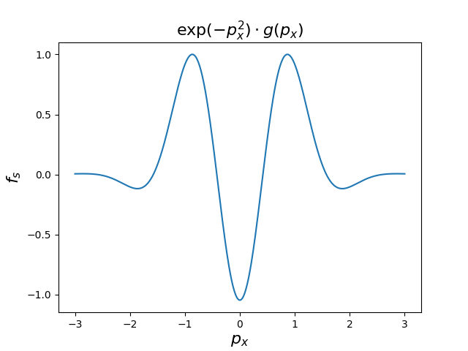
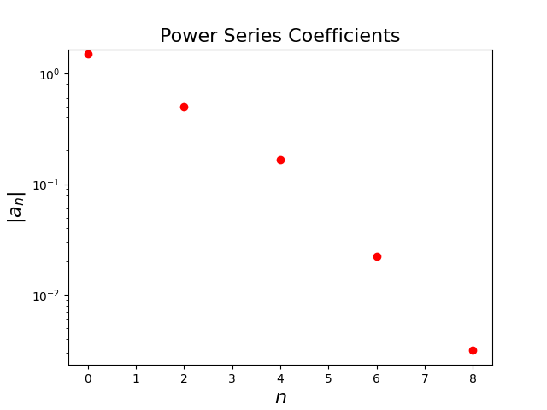
Works in principle for our problem
BUT
coefficients become complicated very quickly!
Only coefficients for even
indices are non-zero

Slide 11
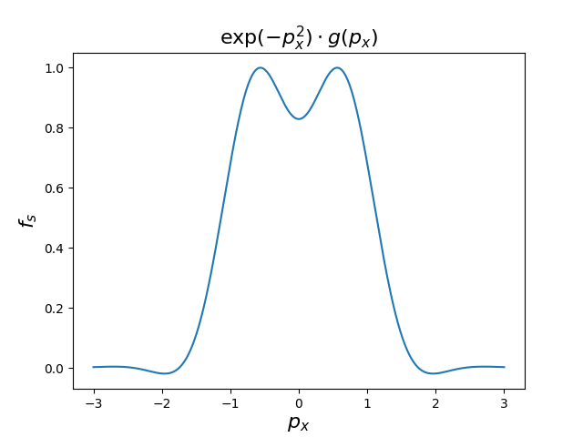
Works in principle for our problem
BUT
coefficients become complicated very quickly!
Only coefficients for even
indices are non-zero

Slide 12
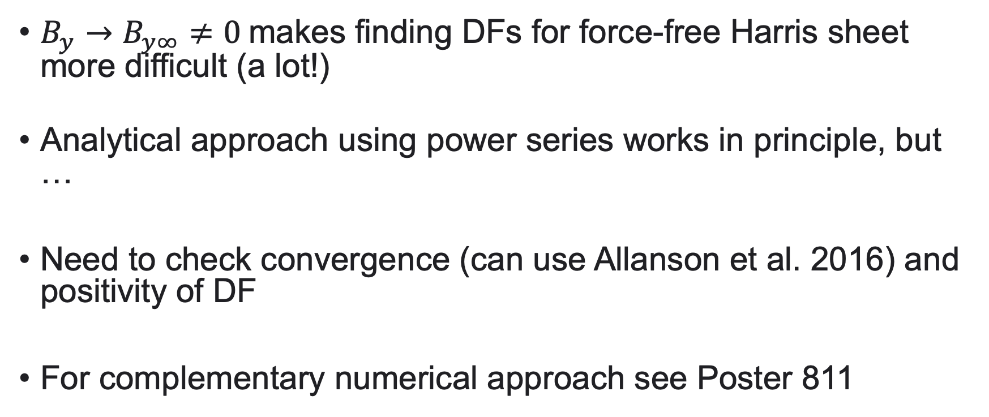
Summary and future work
$B_{y}→B_{y∞}≠0$makes finding DFs for force-free Harris sheet more difficult (a lot!)
Analytical approach using power series works in principle, but …
Need to check convergence (can use Allanson et al. 2016) and positivity of DF
For complementary numerical approach see Poster 811

