Slide 1
Switchback Generation from the Evolution of Torsional Alfvén Waves
Peter Wyper
Durham University
Collaborators:
Lorenzo Matteini, Etienne Pariat, Jade Touresse, Jonathon Squire
NAM
7th July 2025

Slide 2
Switchbacks
Raouafi et al. 24
Typical properties
Alfvénic → in-phase 𝛿v and 𝛿B, e.g. Kasper et al. 19, Bale et al. 19.
Spherically polarized → |B|≈const. implies B is deflected not reduced, e.g. Wooley et al. 20.
Patchy occurrence in data, e.g. Shi et al. 22.
Occurrence increases beyond the Alfvén point (still some below it though!).

Slide 3
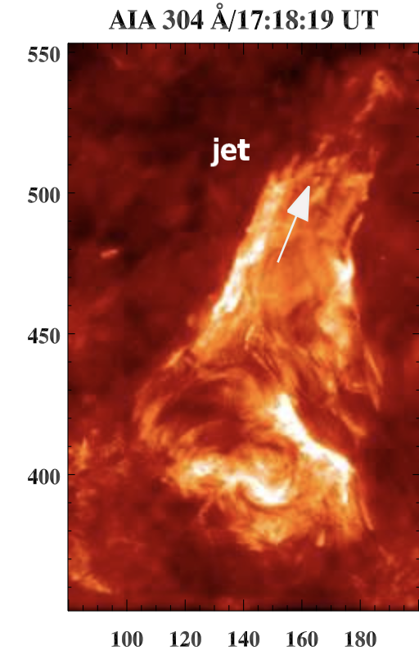
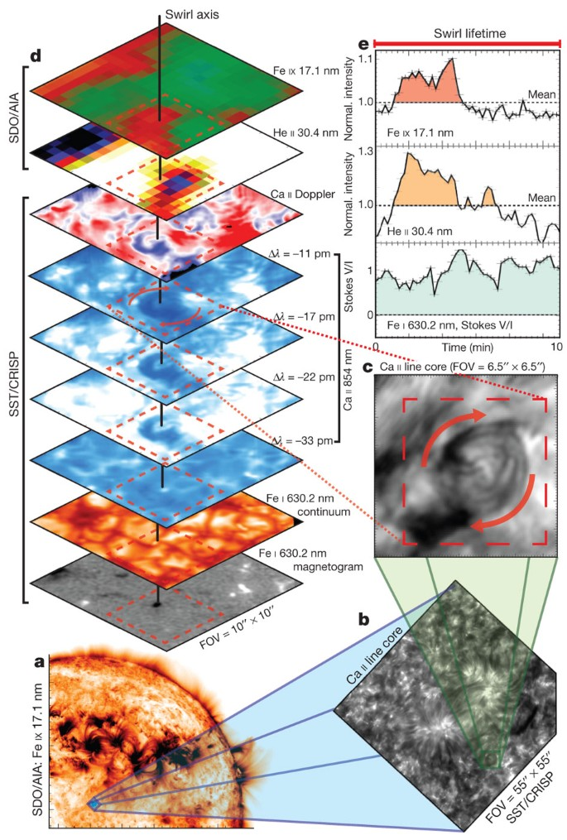
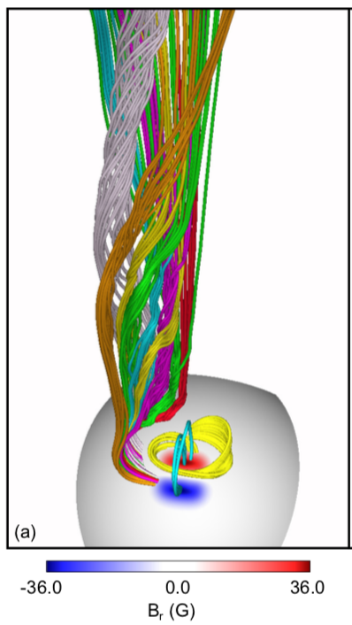
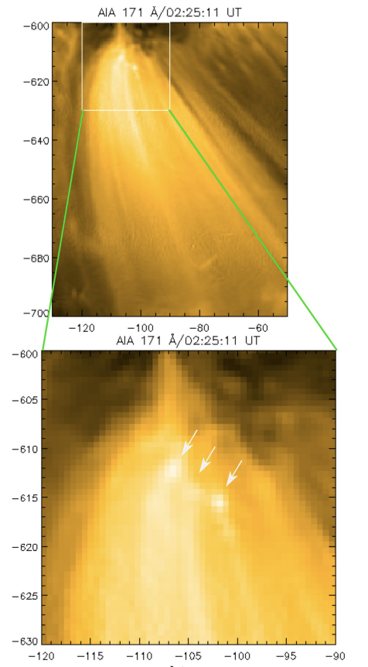
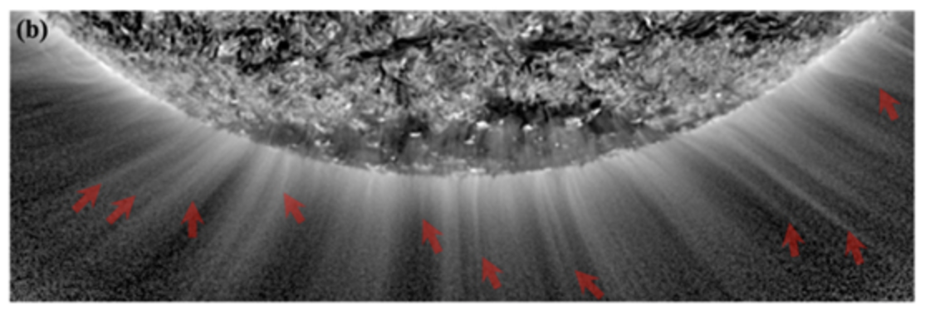
Sources of Torsional Alfvénic Waves
Coronal jets
Swirls/surface motions
Bursty interchange reconnection
Kumar et al. 18
Wyper et al. 18
Jetlets, Spicules etc
Wyper et al. 22
Wedemeyer-Böhm et al. 12,13, Magyar et al. 21
All launch pulses of Torsional Alfvén waves.
Also: Morton et al. 25, DKIST --> Torsional Alfvén waves everywhere!
Raouafi et al. 23, Kumar et al. 23

Slide 4
Wave evolution
-400
-200
0
200
400
Iso-surface: Br = 0
Super-radial expansion; R ≲ 10 Rs.
Low β, sub-Alfvénic → high β, super-Alfvénic.
Rotational surface flow launches a Torsional Alfvén wave pulse.
Duration: 20 mins. Width: 60 Mm. (Large coronal jet values). $V_{drive}≈{0.5V}_{A}$ on surface (300 km/s).
Evolves a ring-shaped volume where $B_{r}<0$.
Similar behaviour with different driving times & speeds.

Slide 5
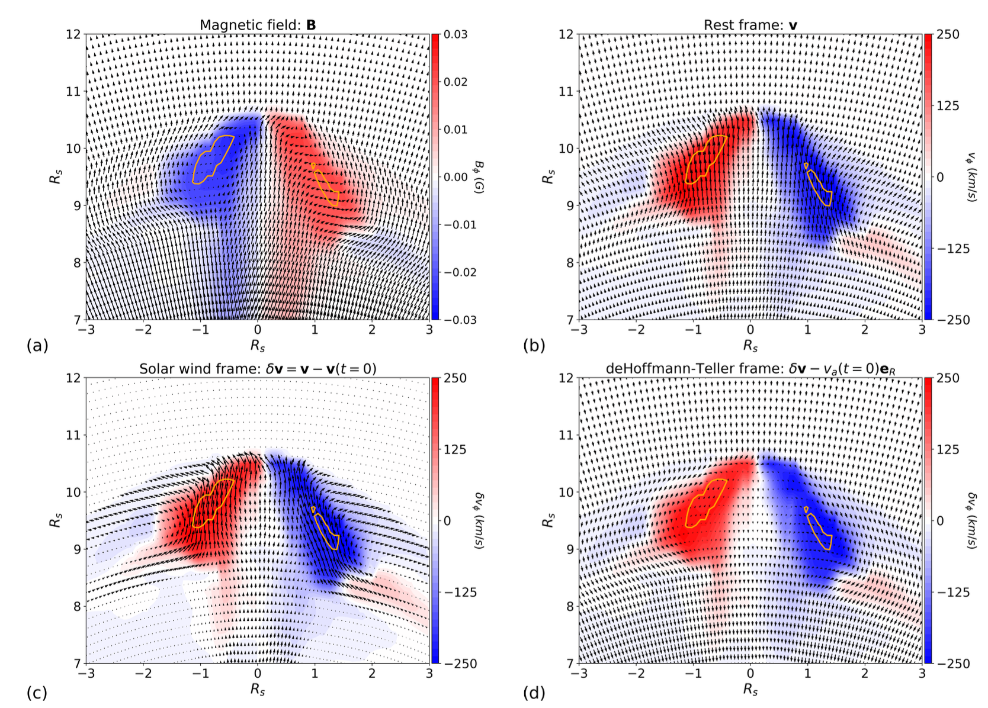
SB structure
Solar wind frame (V_{sw})
deHoffmann-Teller frame (V_{sw} + V_{a})
All consistent with this being a non-linear Alfvénic structure.

Slide 6
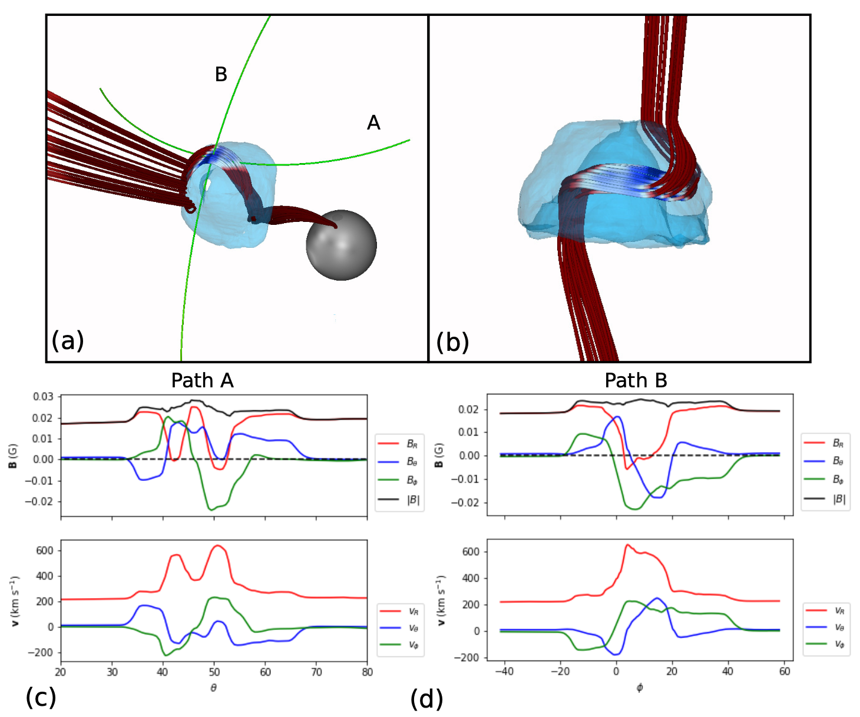
SB structure

Slide 7
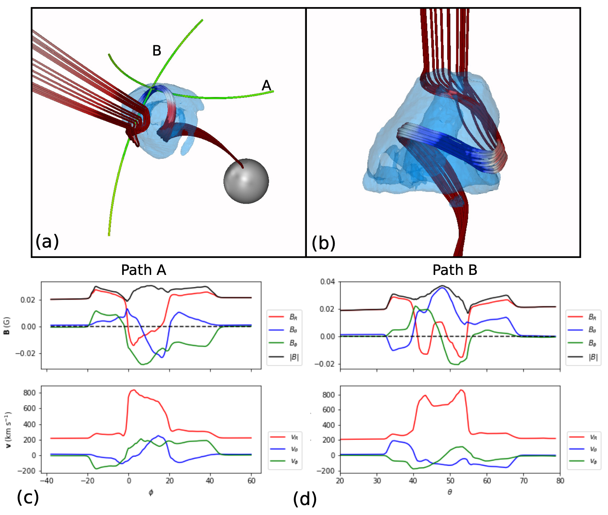
Turn it up to 11…
Same driving time (20 mins).
2 x driving speed → double the turns.
~ 2.4 max turns injected.
Note the enhanced but nearly constant |B| across the wave → local “dynamo” increase in open flux (Bale et al.).

Slide 8
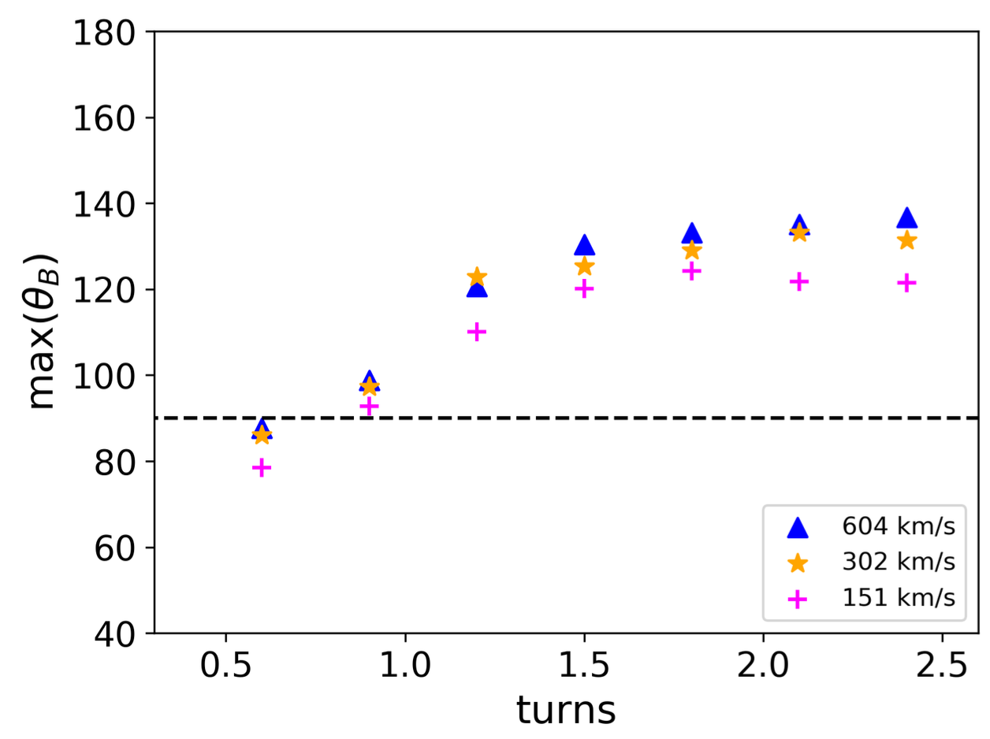
Parameter dependence?
Each curve has the same number & spatial distribution (across the flux tube) of turns injected overall.
Faster driving = higher initial theta_B.
Longer injection → takes longer to steepen, but reaches similar maximum theta_B.
Self limiting plateau → can’t break 140 degrees. Presumably needs some out of plane component to allow the roll over.
All happening below R_{A}.

Slide 9
Summary
Torsional Alfvén waves
Plentiful sources in the solar corona (swirls, jets/jetlets, IR plasmoids).
Naturally develop a vortex ring-like disc structure as they propagate into the solar wind.
Radially extended SB reversals form in the upflows of the ring (local in-situ spikes in Vr).
These simulations are large, but the concept should apply to smaller scales.
Evolution consistent with Alfvén wave growth in expanding wind scenario (e.g. Squire et al. 20, Mallet et al. 21).
Mechanism operates below and above Alfvén point → but SBs form at least a few solar radii out.
Tests so far require around ¾ of a turn within the pulse (well within observed ranges).
Provides a plausible link between interchange reconnection in its various forms (and swirls) and SBs in-situ.

Slide 10
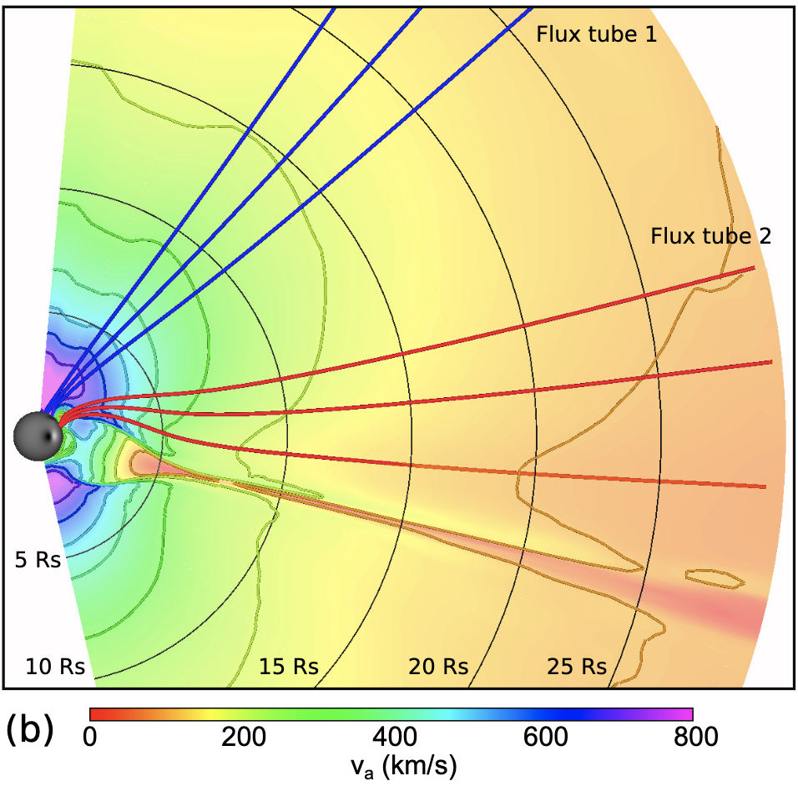
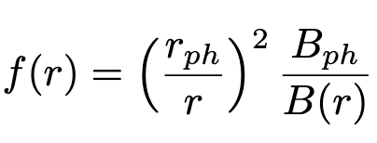
Initial condition
Expansion factor:
Super-radial expansion; R ≲ 10 Rs
Low β, sub-Alfvénic → high β, super-Alfvénic
Flux tube 2 similar.
Full-Sun dynamic equilibrium (Wyper et al. 21) – isothermal wind + PFSS

Slide 11
Asymmetric propagation
Similar evolution → but a tilt develops!
Field line curvature? Alfvén speed gradients? TBD.
Asymmetric SB region.

