Slide 1
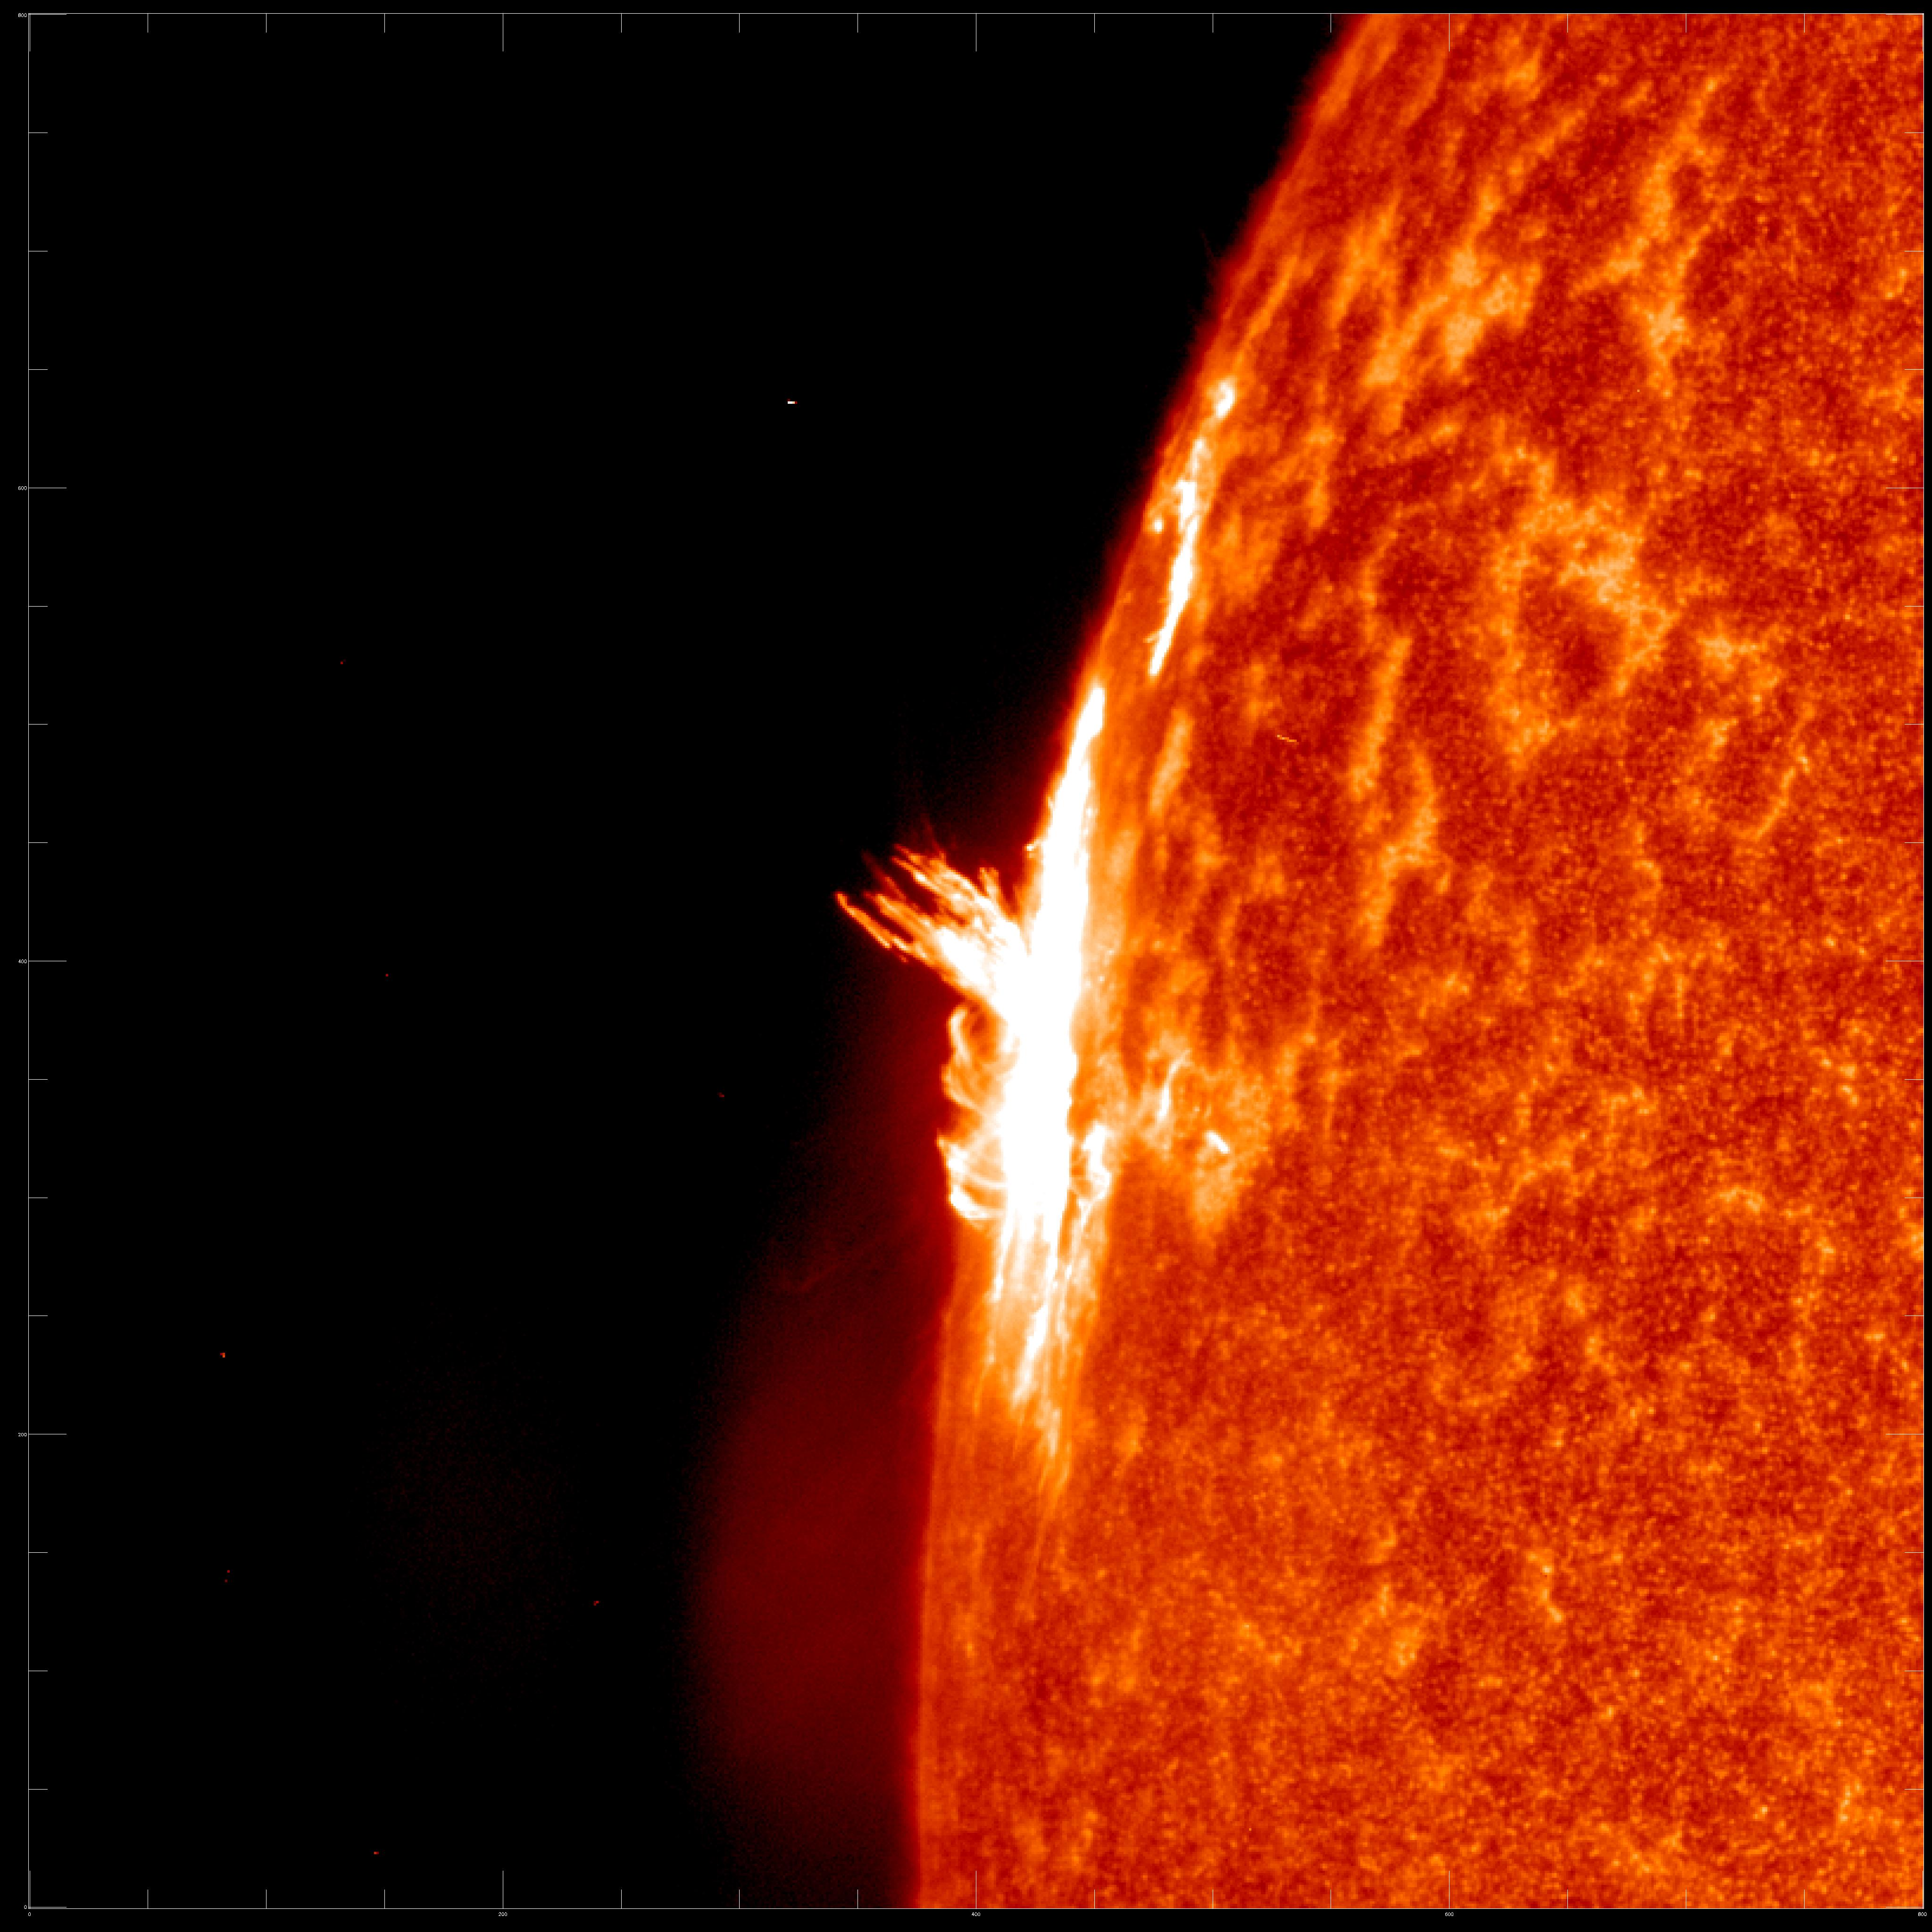

Observations of Flare Induced Doppler Shifts in the Si III 1206 Å line
Luke Majury (he/him)
7th Jul 2025
Primary Supervisor: Dr. Ryan Milligan
Secondary Supervisor: Prof. Mihalis Mathioudakis
lmajury01@qub.ac.uk
Notes:
https://durhamuniversity.zoom.us/j/98610275490?pwd=tH6J8dMerpUAdQUK0R426XSFeNbKCh.1

Slide 2
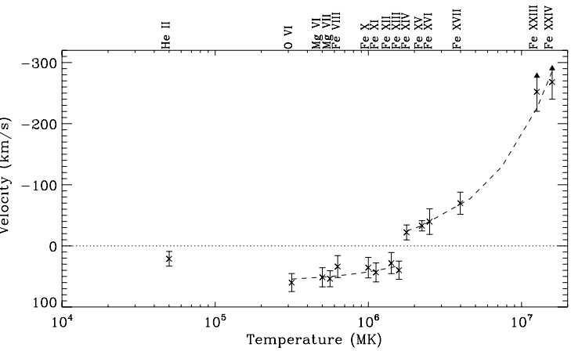
Observations of Doppler Shifts
During Flares
Doppler shifts in spectral lines are commonly used to infer chromospheric condensation and/or evaporation
However, other processes such as filament eruptions and jets may contribute to observed shifts (Batchelor and Hindsley. 1991.)
Spectrally resolved observations of lines at understudied temperatures offer an opportunity to further disentangle these effects
Doppler velocities of lines observed by HINODE/EIS
during a flare (Milligan et al. 2009.)

Slide 3
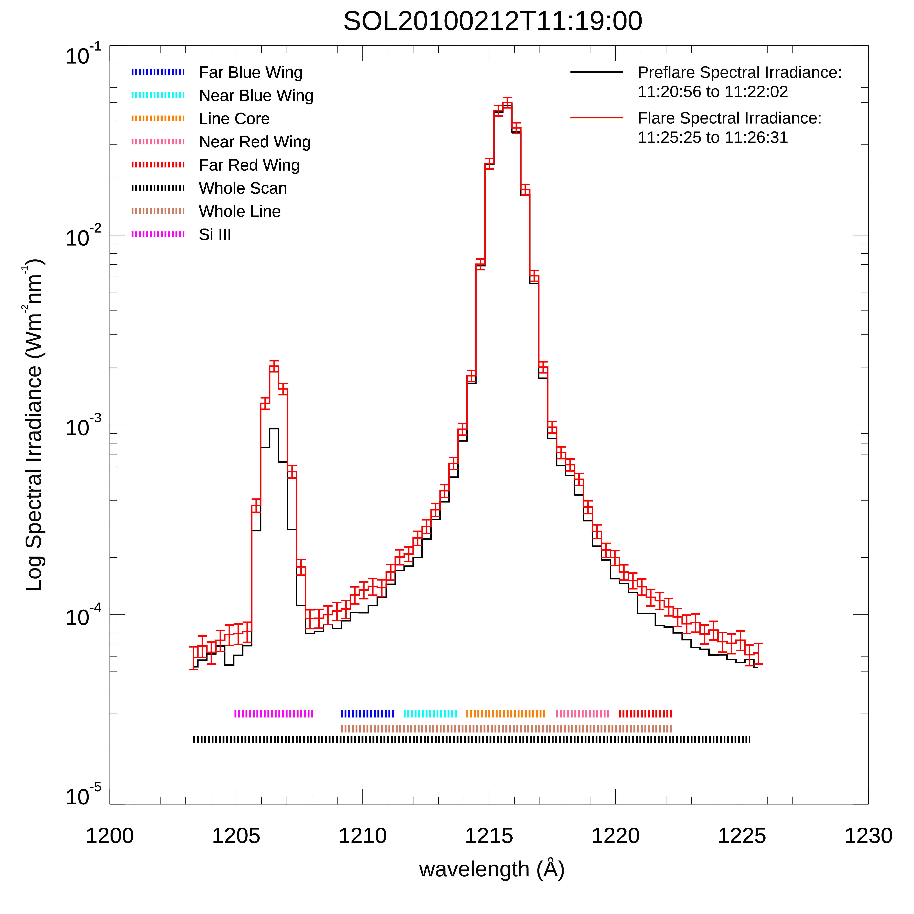


SORCE/SOLSTICE
Ly$α$
Primarily provided low cadence observations of FUV/MUV spectral irradiance
Nominal scans provided profiles (1203-1227 Å) at cadence of ~one minute
Captured 129 flares of GOES C-class or greater
Previous SOLSTICE flare studies focus on $\text{Ly}α$ emission but note significant enhancement of Si III line (e.g. Woods et al. 2004. Milligan et al. 2016. Majury et al. 2025)
Si III
OV

Slide 4
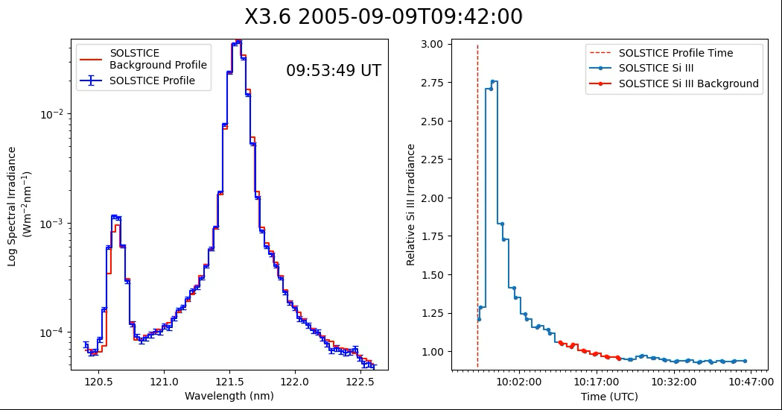
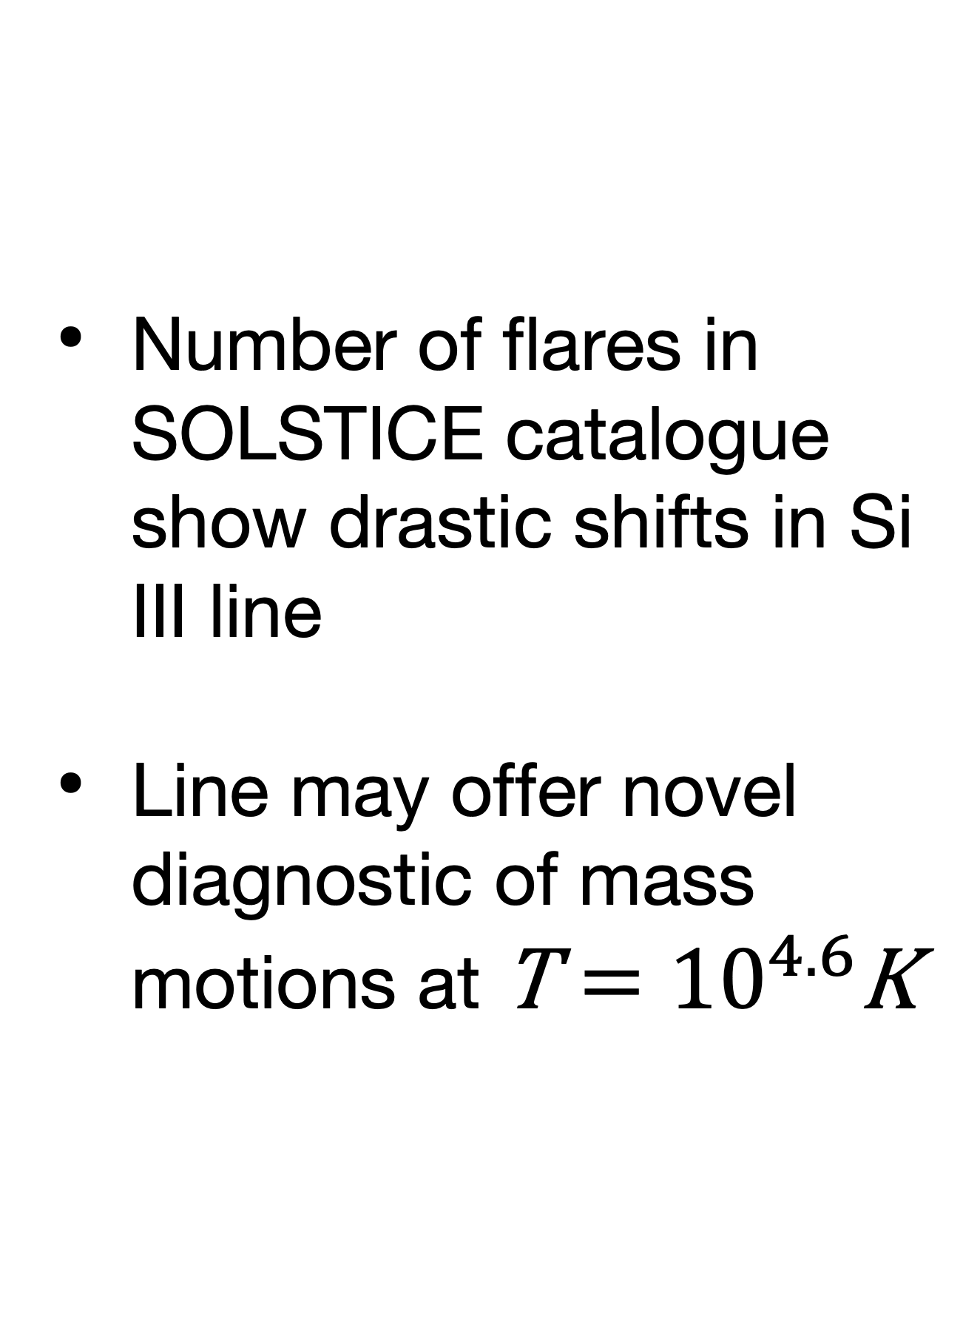
Si III line During Flares
Number of flares in SOLSTICE catalogue show drastic shifts in Si III line
Line may offer novel diagnostic of mass motions at $\text{T}={10}^{4.6}\text{K}$

Slide 5
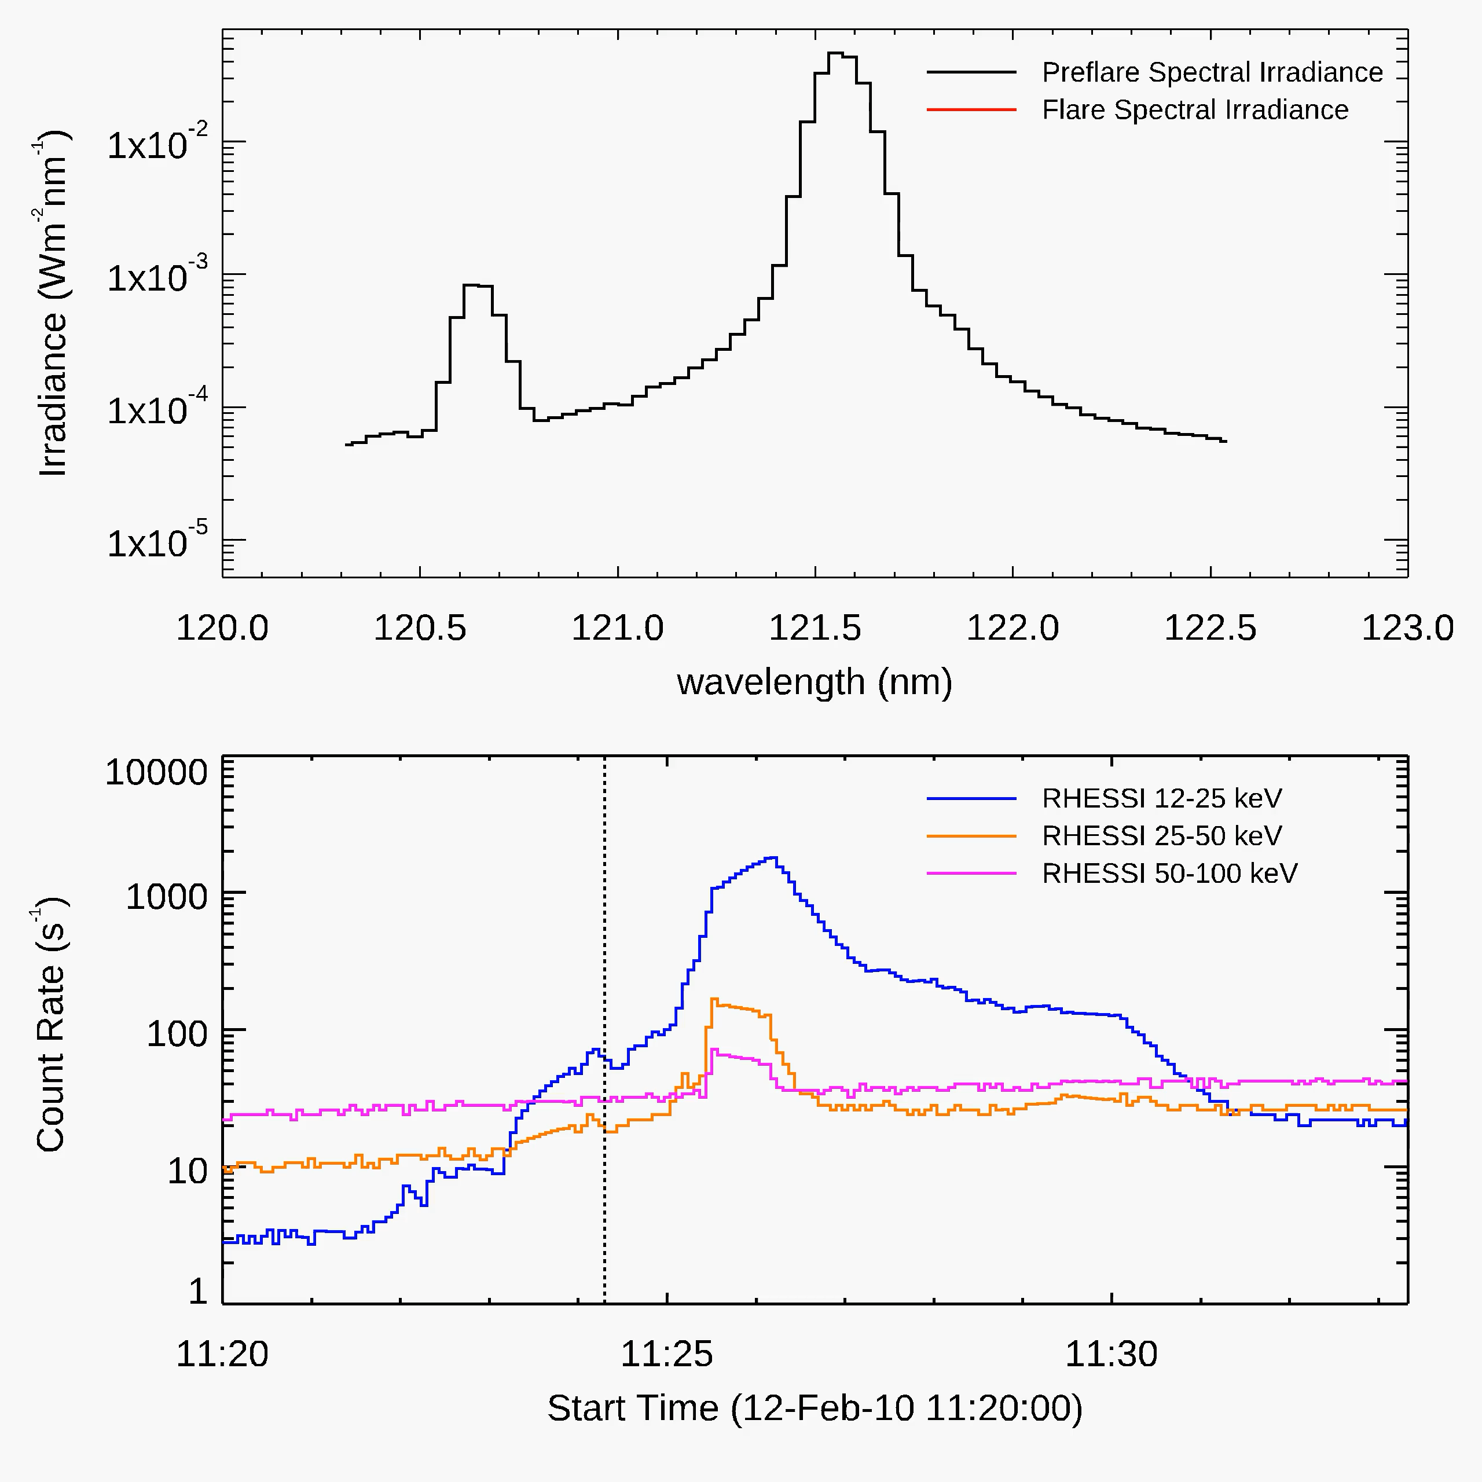
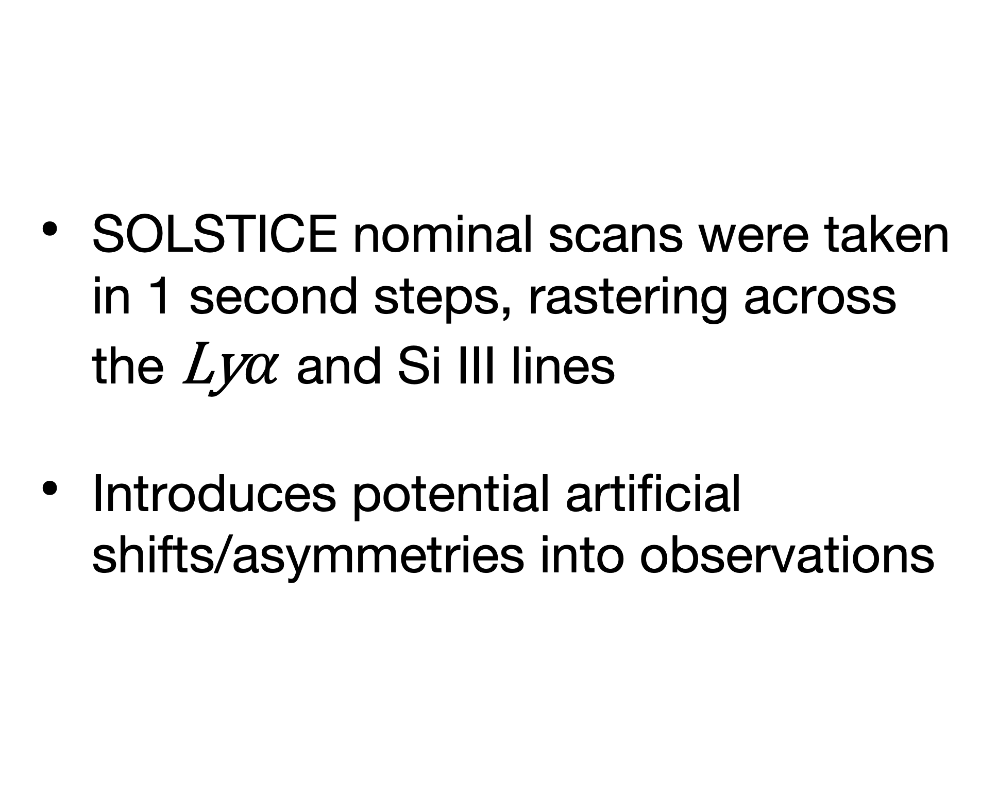
SOSLTICE Rastering
Effects
SOLSTICE nominal scans were taken in 1 second steps, rastering across the $\text{Ly}α$ and Si III lines
Introduces potential artificial shifts/asymmetries into observations

Slide 6
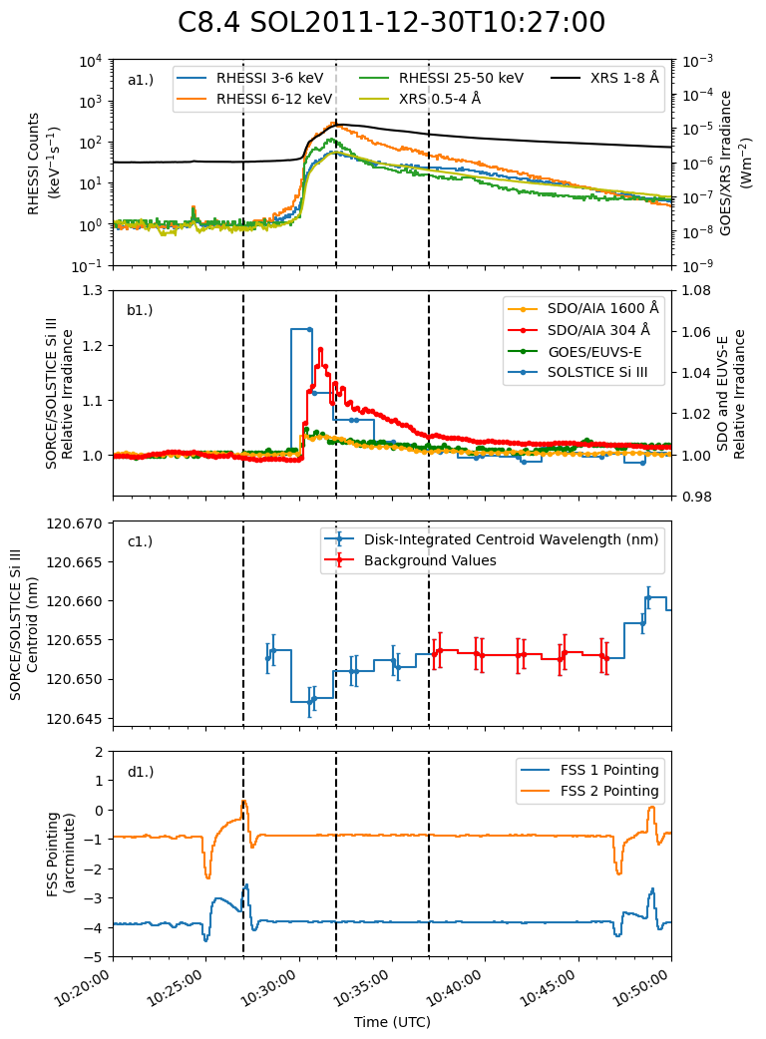
Spacecraft Manoeuvres
SOLSTICE spacecraft manoeuvres cause a shift in absolute position of wavelength grid
Relationship between magnitude of shift and manoeuvres not well characterised
Thus cannot rule out systematic influence on shifts for flares coincident with manoeuvres

Slide 7
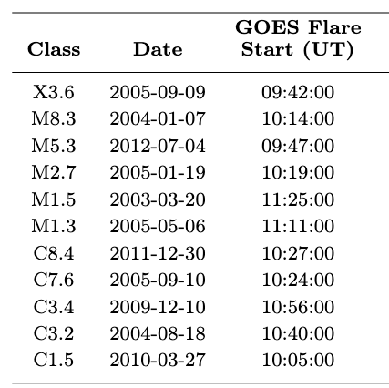
Sample Selection
29 events that had >10% enhancement relative to first scan chosen
Omitted events with spacecraft manoeuvre interference
Set of 11 events chosen for analysis of Doppler shifts

Slide 8
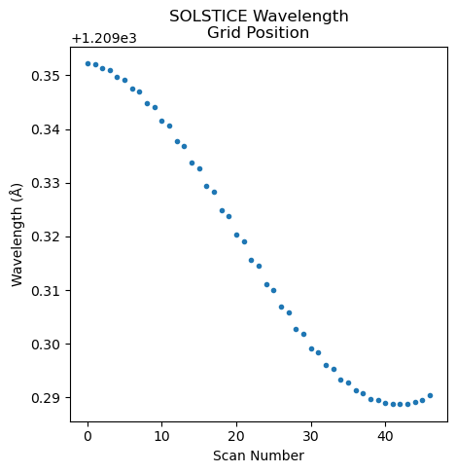
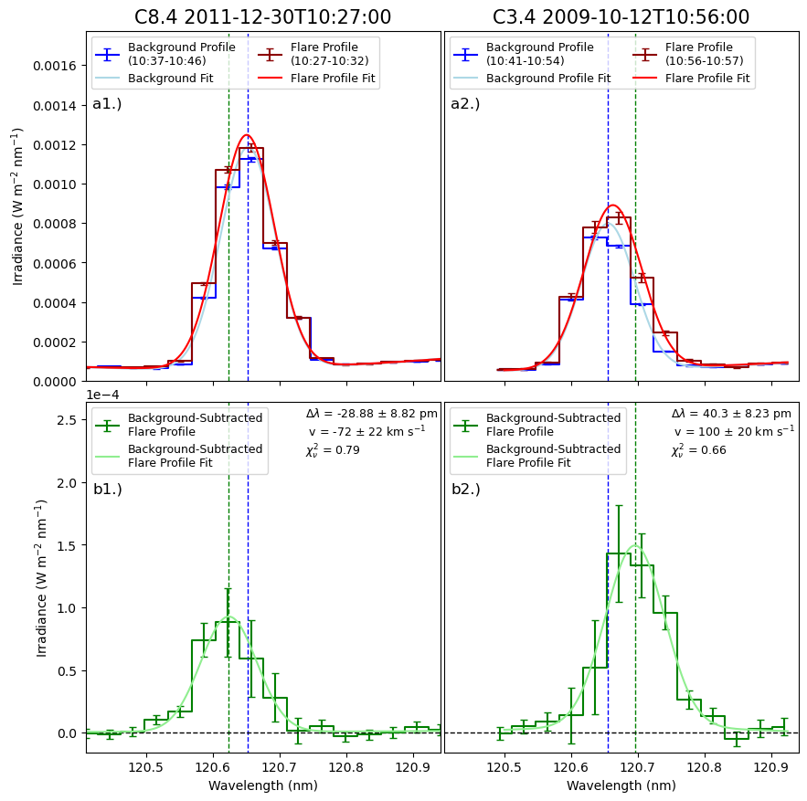
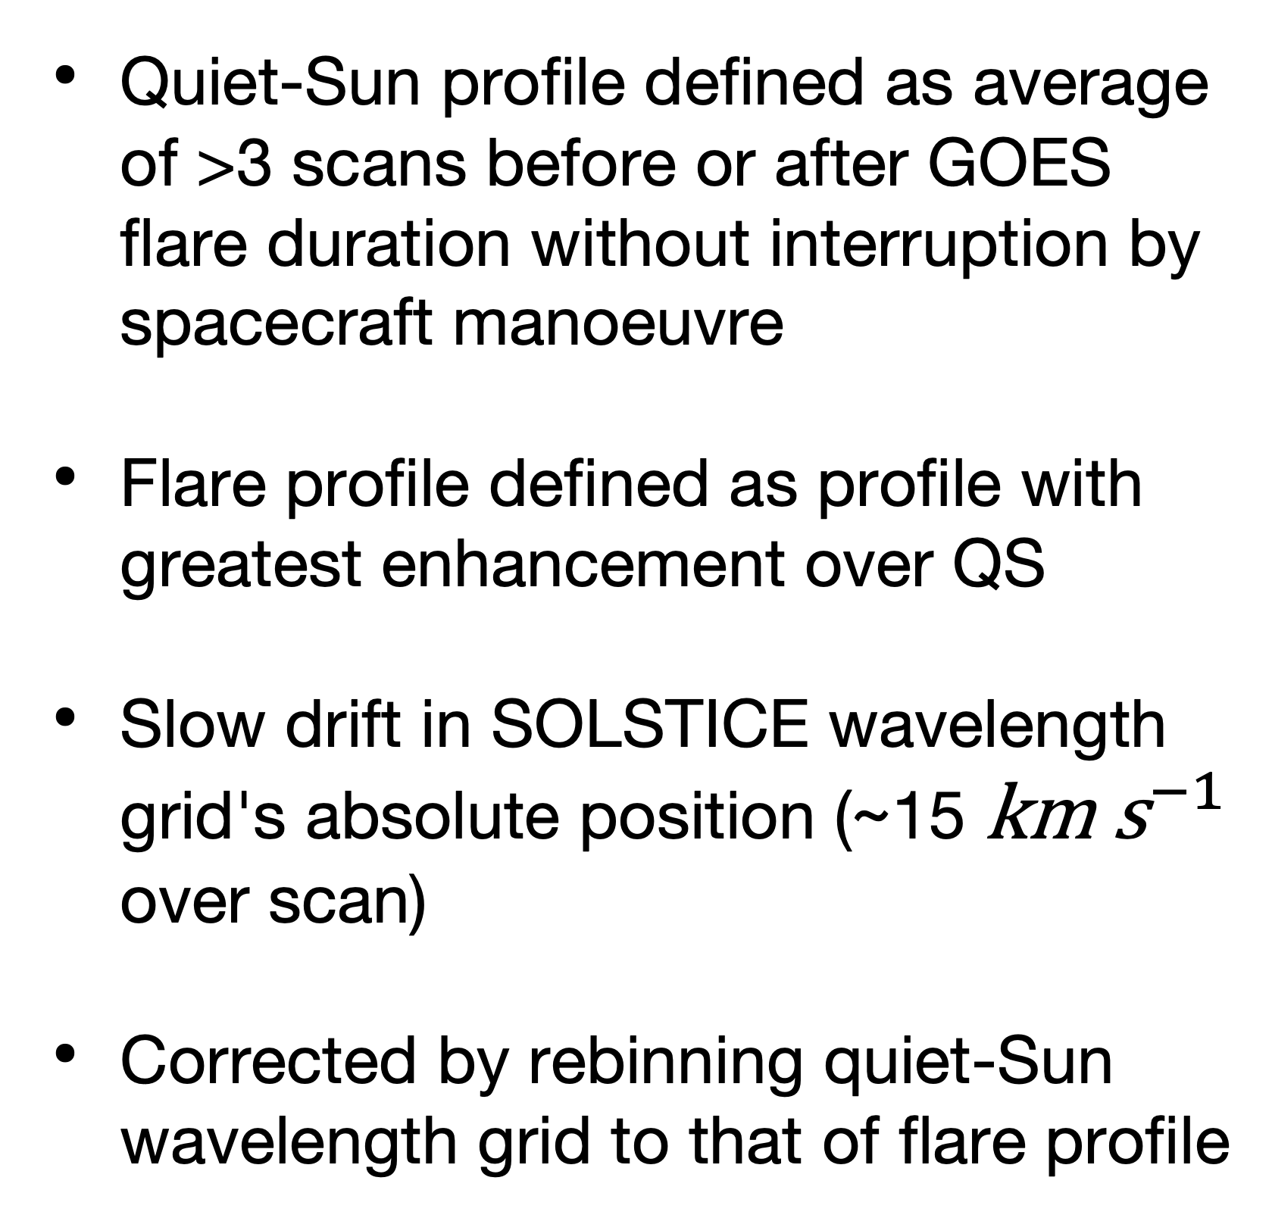
Si III Doppler Analysis
Quiet-Sun profile defined as average of >3 scans before or after GOES flare duration without interruption by spacecraft manoeuvre
Flare profile defined as profile with greatest enhancement over QS
Slow drift in SOLSTICE wavelength grid's absolute position (~15 ${\text{km} \text{s}}^{−1}$ over scan)
Corrected by rebinning quiet-Sun wavelength grid to that of flare profile

Slide 9
Si III Doppler Analysis
Quiet-Sun-subtracted `flare profile' calculated
Change in centroid position relative to quiet-Sun profile determined
Doppler velocity of `flare profile' determined using classical Doppler formula

Slide 10
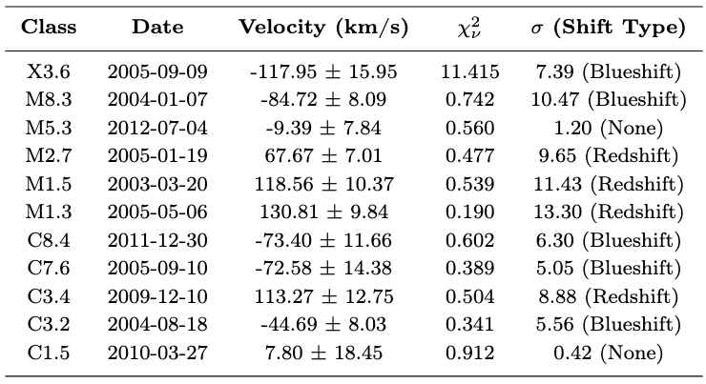
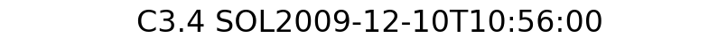
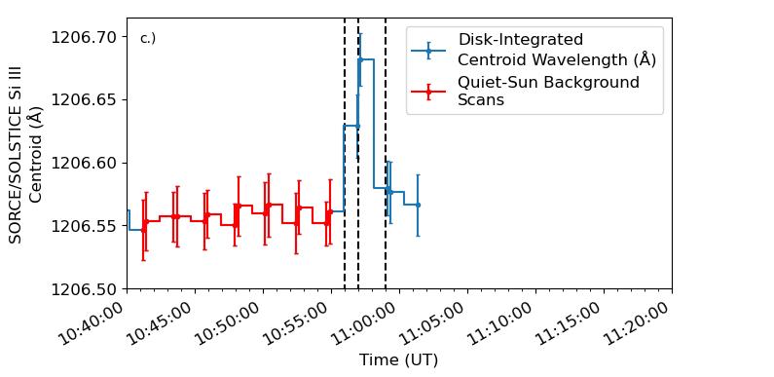
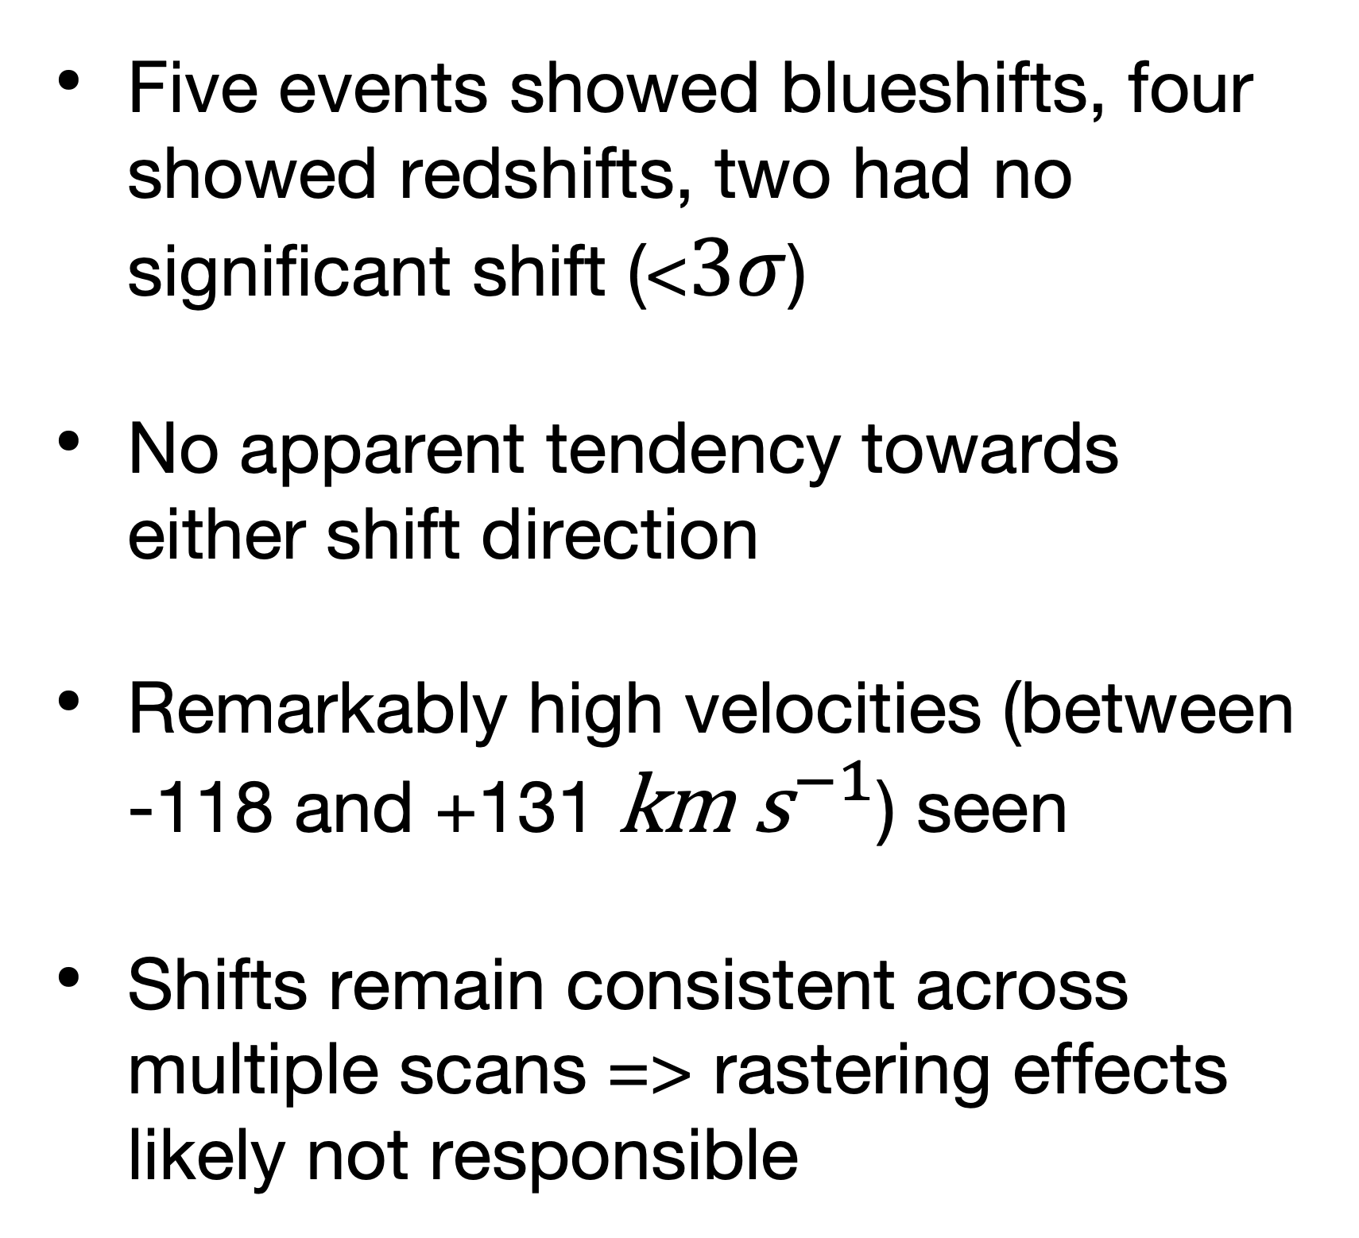
Si III Doppler Analysis
Five events showed blueshifts, four showed redshifts, two had no significant shift (<$3σ$)
No apparent tendency towards either shift direction
Remarkably high velocities (between -118 and +131 ${\text{km} \text{s}}^{−1}$) seen
Shifts remain consistent across multiple scans => rastering effects likely not responsible
Notes:
First peak in filament emission correlates well with enhancement of blue wings in SOLSTICE
Potential blueshifted emission from filament?

Slide 11
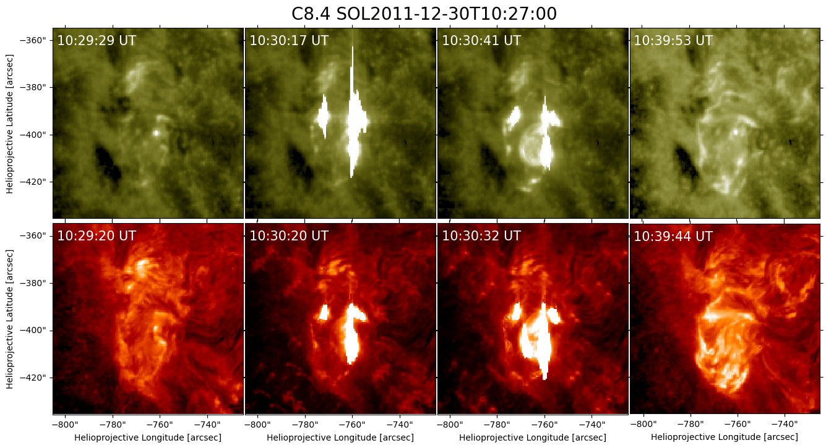
Si III Doppler Analysis
  See filament eruption during C8.4 that coincides with shift in profile
  May indicate that bright emission from filament drove the observed blueshift (Rubio Da Costa et al. 2009. Wauters et al. 2023. Majury et al. 2025.)
  Further imaging observations required to verify whether eruptions are cause of blueshifted velocities

Slide 12
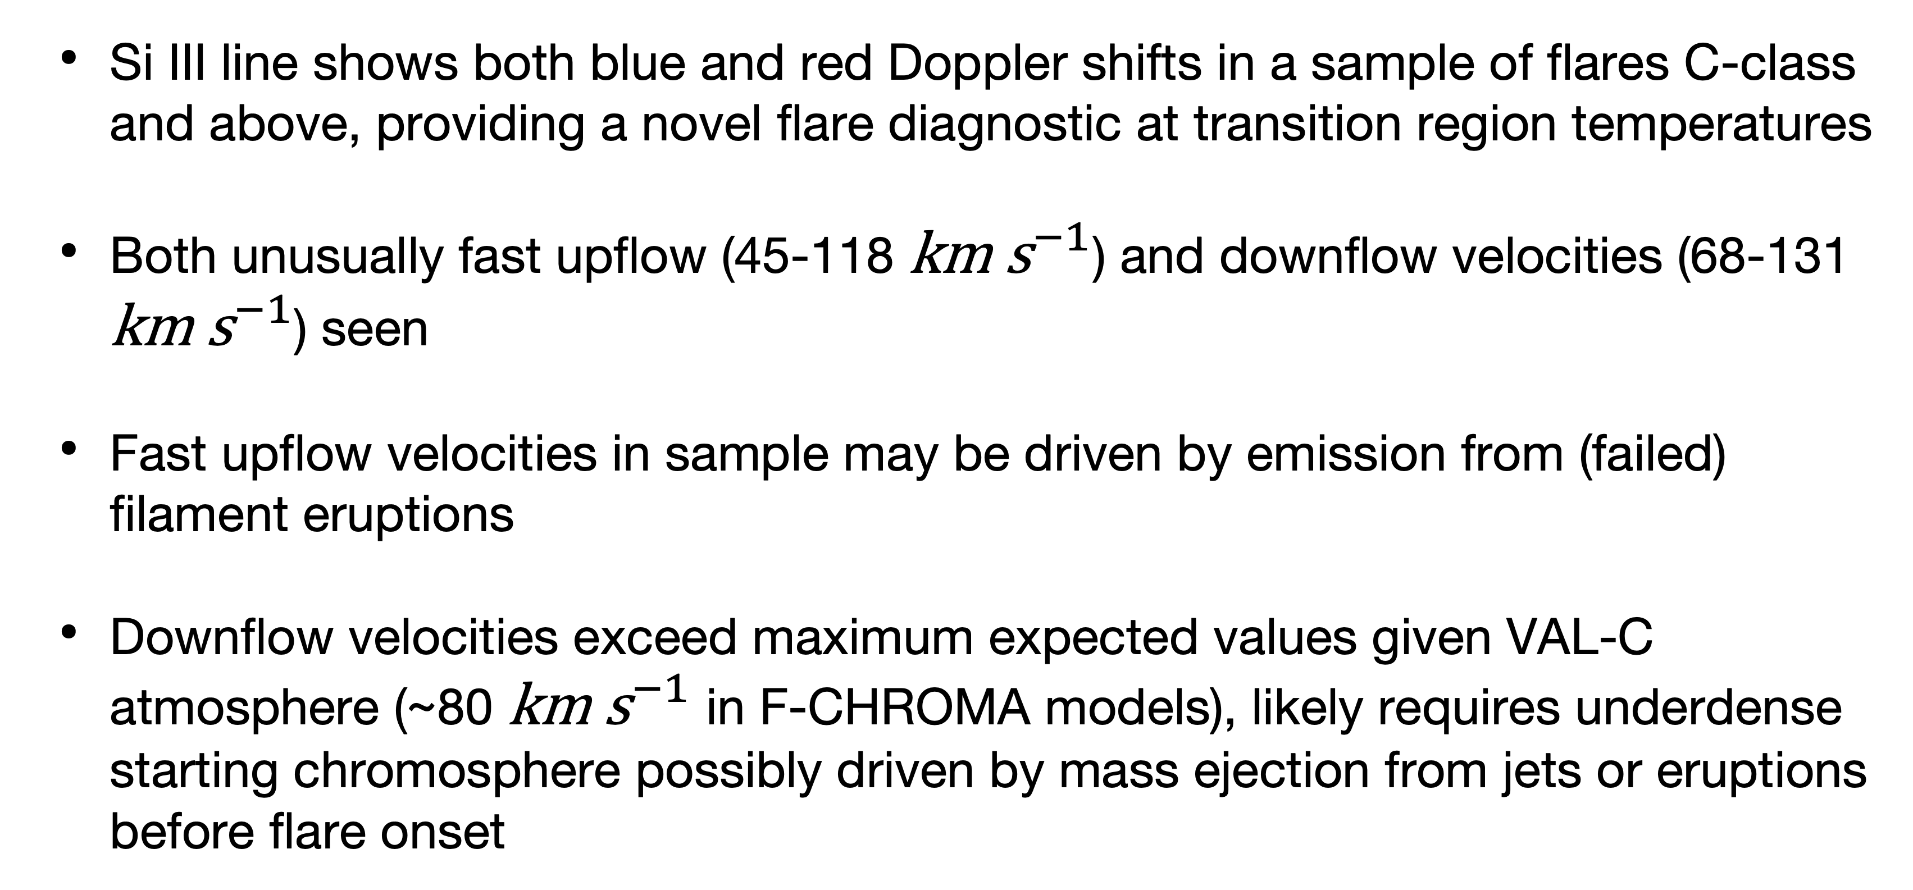
Conclusions
  Si III line shows both blue and red Doppler shifts in a sample of flares C-class and above, providing a novel flare diagnostic at transition region temperatures
  Both unusually fast upflow (45-118 ${\text{km} \text{s}}^{−1}$) and downflow velocities (68-131 ${\text{km} \text{s}}^{−1}$) seen
  Fast upflow velocities in sample may be driven by emission from (failed) filament eruptions
  Downflow velocities exceed maximum expected values given VAL-C atmosphere (~80 ${\text{km} \text{s}}^{−1}$ in F-CHROMA models), likely requires underdense starting chromosphere possibly driven by mass ejection from jets or eruptions before flare onset
Results of study recently submitted to Sol. Phys. !
Majury et. al. 2025b.

Slide 13
Future Work
  Si III line may serve to provide constraint on radiative hydrodynamic flare simulations (e.g. RADYN) which have been investigated for other Si transitions (Kerr et al. 2019.)
  High contrast of the Si III line during flares may make it particularly useful in observations of weak flares from upcoming instruments such as SOLAR-C/EUVST and SNIFS, especially in combination with observations of other lines and by other instruments (e.g. MUSE, EIS, IRIS)

Slide 14
END

Slide 15
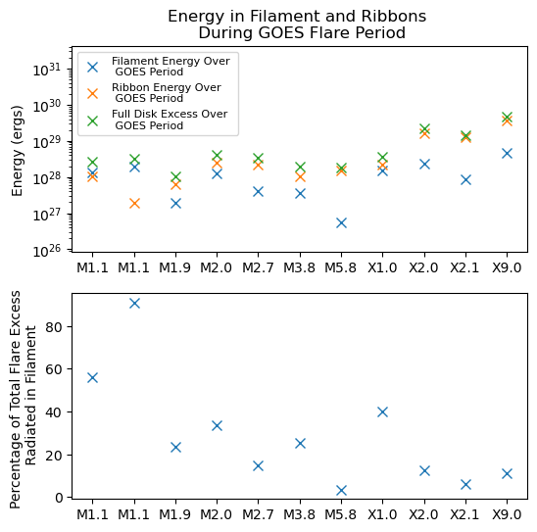
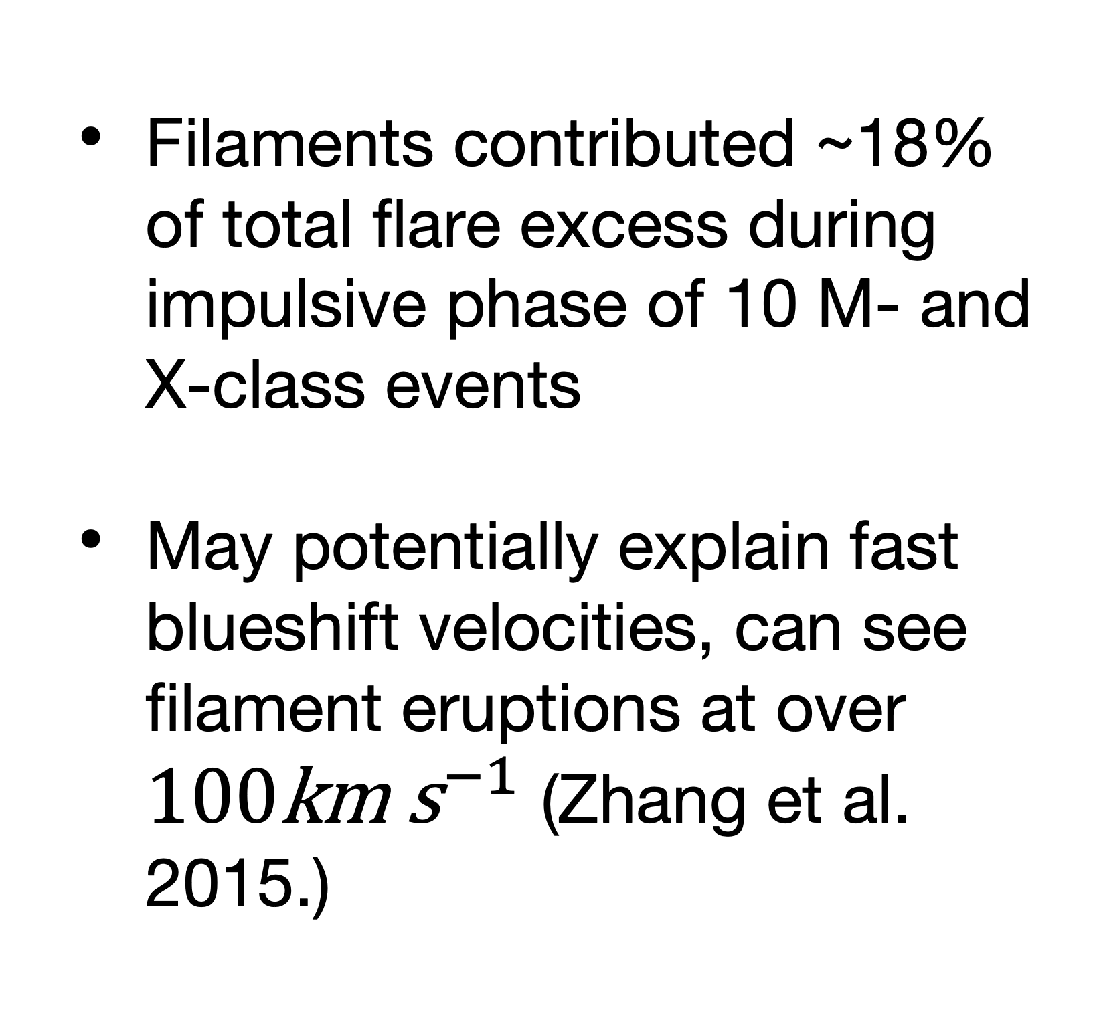
Contribution of Filaments to
Flare Irradiance
  Filaments contributed ~18% of total flare excess during impulsive phase of 10 M- and X-class events
  May potentially explain fast blueshift velocities, can see filament eruptions at over $100{\text{km} \text{s}}^{−1}$ (Zhang et al. 2015.)

Slide 16
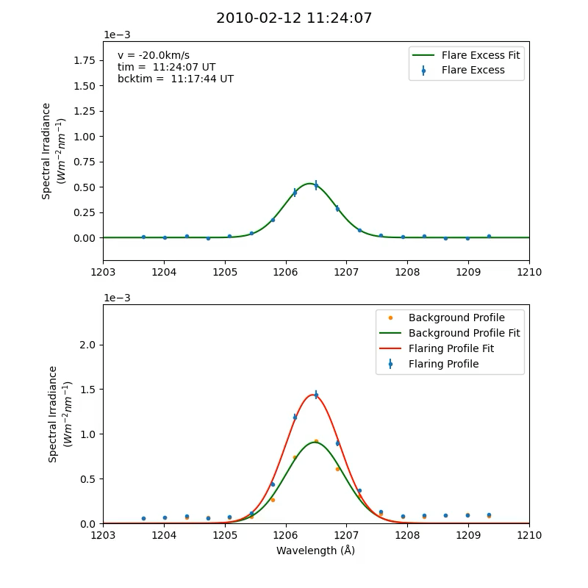
Si III Line
A number of events in the SOLSTICE flare list show large Doppler-velocities in Si III, indicative of chromospheric evaporation and/or condensation

Slide 17
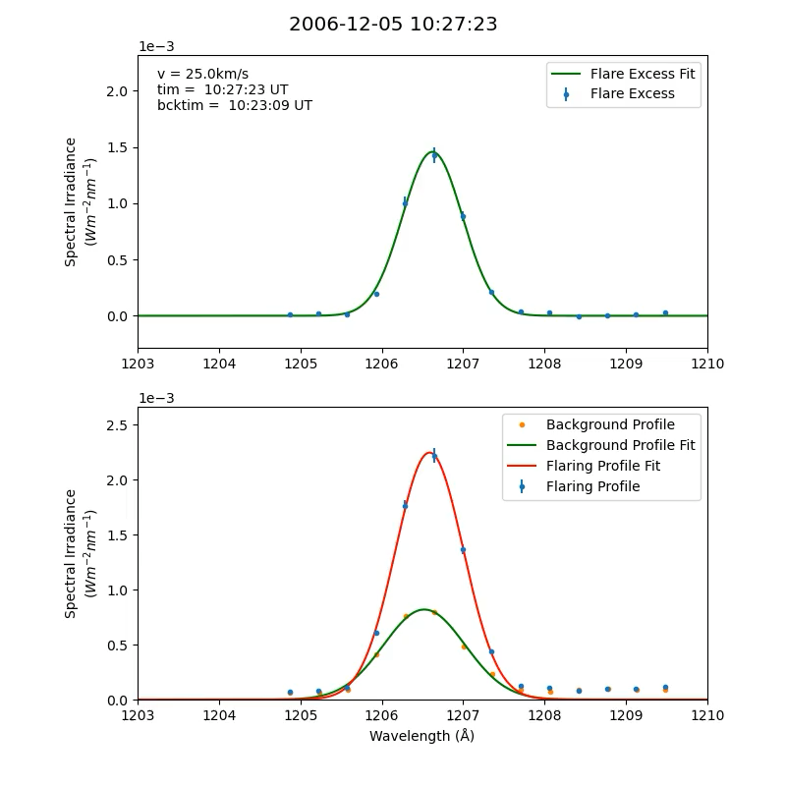
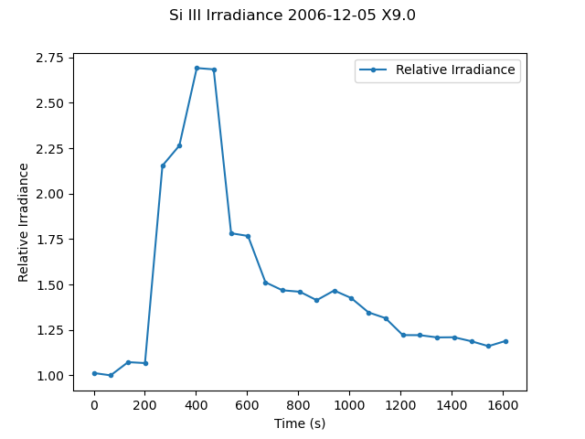
Si III Line

Slide 18

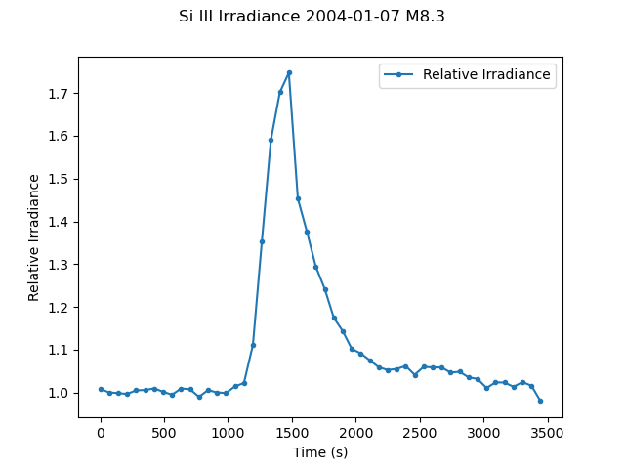
Si III Line

Slide 19
Si III Line
Past research shows similarly chromospheric lines (He II, Si IV) to have much smaller line shifts during flares (Milligan & Dennis 2009, Sellers et al. 2022)
Further research required to reveal underlying cause

