Slide 1
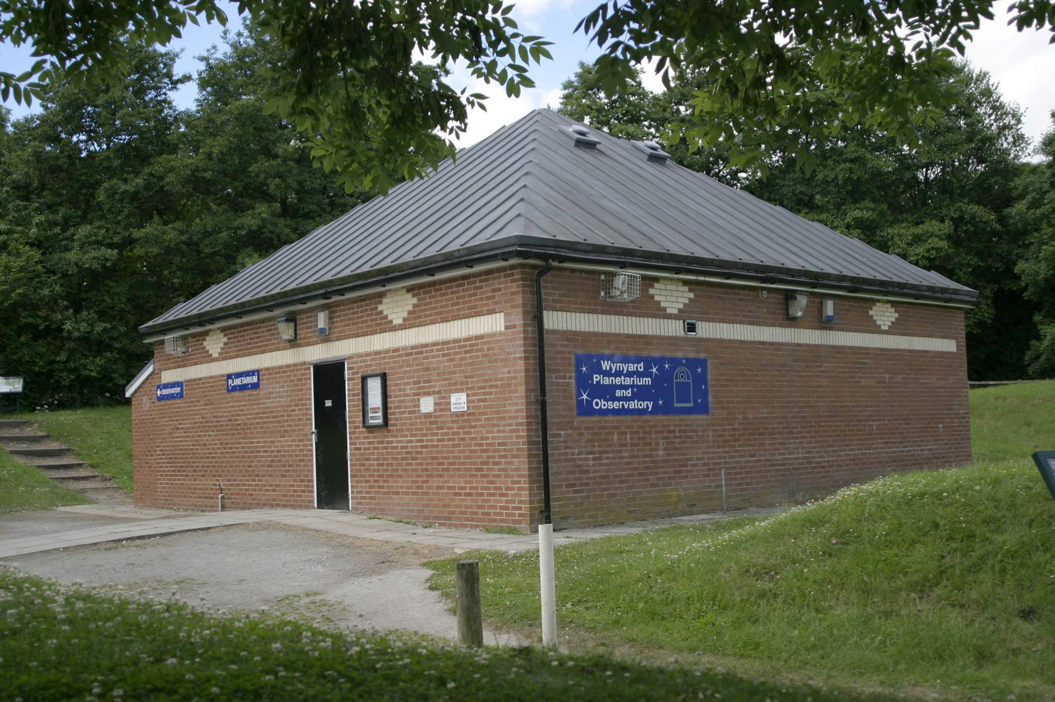
The Wynyard Planetarium
A 100% volunteer-operated outreach facility in the North East
Jürgen Schmoll - TASC secretary & CaDAS chairman

Slide 2

Time line
1979: Cleveland Astronomical society
1980: Darlington Astronomical society
1990: Cleveland and Darlington Astronomical society (CaDAS)

Slide 3
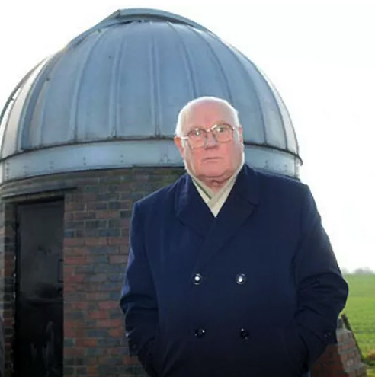
1994: Public observatory
Jack Youdale
From 1996 onwards: The route to having a planetarium!

Slide 4
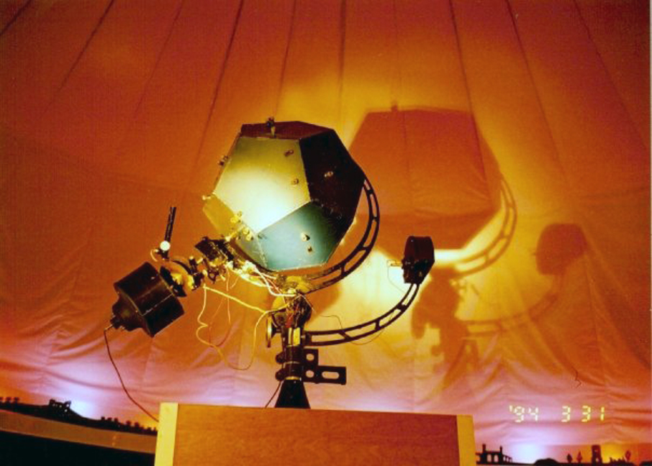
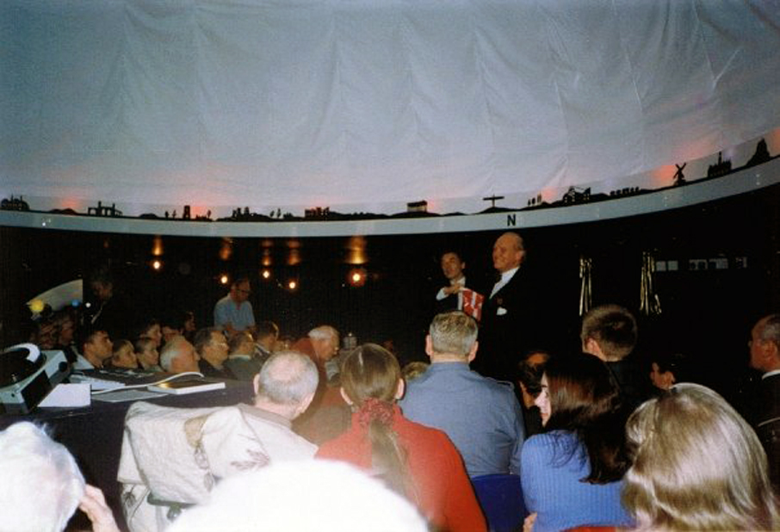
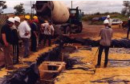
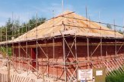
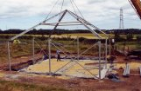
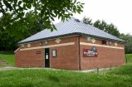
2001: Castle Eden Walkway Planetarium
7m dome suspended by ropes, shaped by air pressure
10x10m², about 45 seats
First projector: Spitz A1

Slide 5
2001-2008
Fully salaried planetarium director
2nd salaried person
Regular school events throughout the week
Public events
Venue for Cleveland and Darlington Astronomical Society
“New” GOTO Eros-2 projector installed
Expansion plans – Spitz A3 in separate dome, more observatory domes

Slide 6
2008 – the “Credit Crunch”
Expansion plans halted
Pay cuts for personnel, finally making both redundant
Finally place threatened by closure
CaDAS getting worried and evaluating chance of rescue

Slide 7
Formation of TASC
“Teesside Astronomical Science Centre”
Organisation as non-profitable charitable organisation (Reg No: 1156793)
Board of trustees to govern it (all volunteers)
Run by members and volunteers
Lease from Stockton Borough Council for 7 years (once extended)
Tenants, paying a “peppercorn rent”
£3000/year needed to run the place

Slide 8
Operation
1 public show / month recommended for age 7+ including adults
1 “family show”/month – shorter and aiming at children
Odd special shows when there is a special occasion
Special interest groups: Scouts/guides, adult societies etc
Every Tuesday free “walk in” event with observing if clear, science demos etc
Income with donations about £6000/year → running costs covered
Surplus used to improve the place – better projectors etc.
13 TASC volunteers/members, about 800 paying guests/year

Slide 9
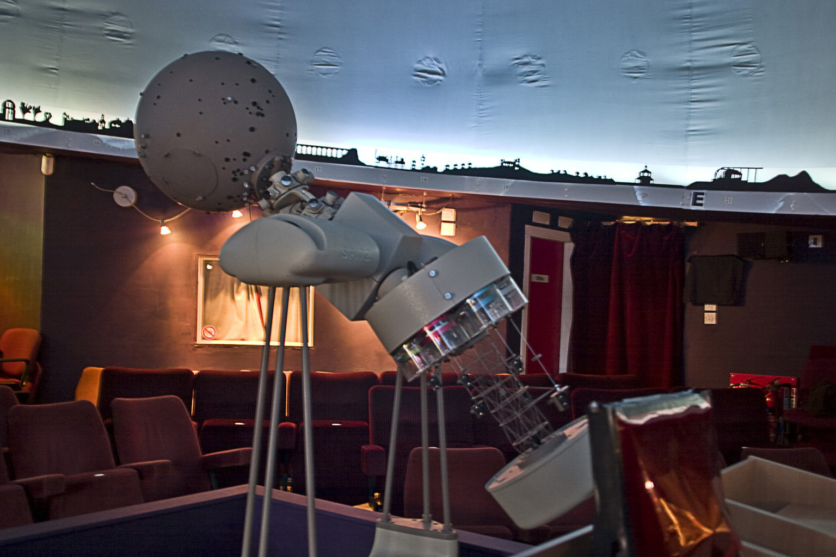
Spitz A5 (former Jodrell Bank) set to enrich digital projection using full-dome projection (Stellarium+Shiraplay)

Slide 10
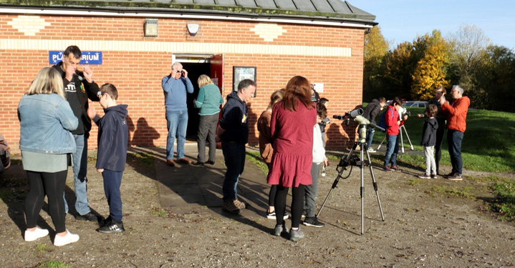
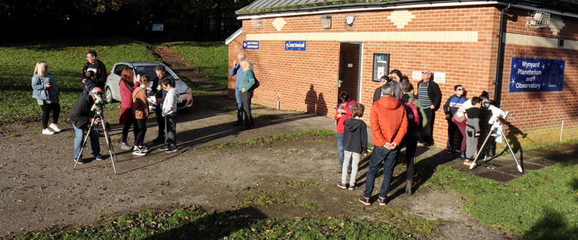
Observations
Telescopes after each show, weather permitting
“Solar days”
Special events: Eclipses, meteor showers
Sky Bortle 6-7 (not great)

Slide 11
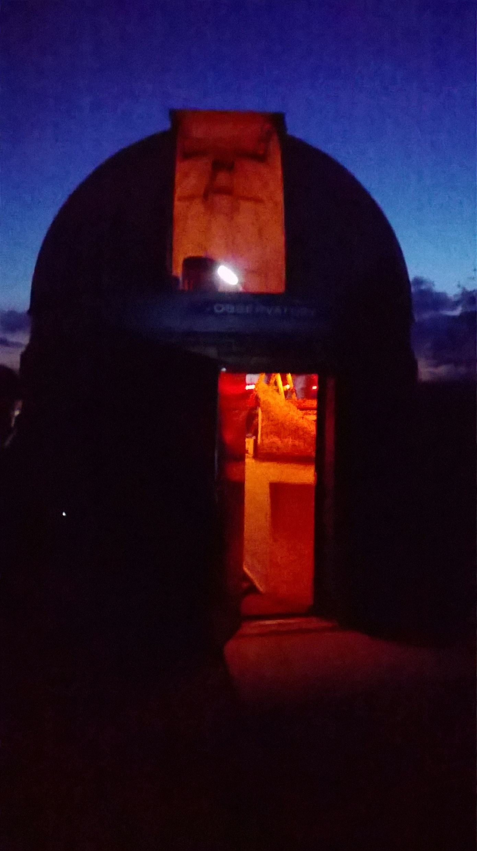
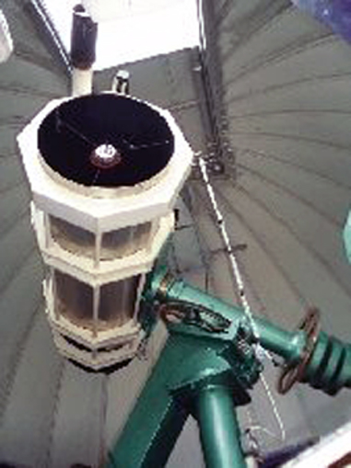
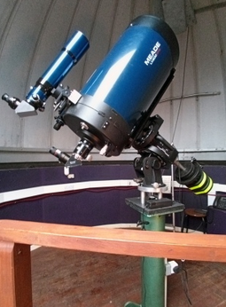
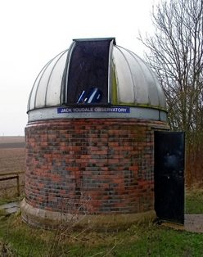
Jack Youdale Observatory
4m Ash dome
8” refractor → 19” Newtonian
Now 14” Meade SCT on EQ8 GEM

Slide 12
Experiences
Team spirit and knowledge of members (lawyer, electrician etc)
Many retired volunteers able to help out on work days
Use of social media (Facebook) brought a visitor boost
Good relationship to Stockton Borough Council helps with problems
Rates are family friendly (£4.40 kids/ £8.80 adults, 10% for booking)
Getting the odd grant helps as well

Slide 13
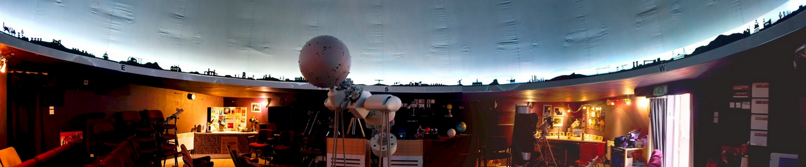
Future
Would like to expand the place (more space, own toilets etc)
Risk: Many retired people – demography!
Risk: Increase of light pollution
Risk: Attracting more young volunteers (not only our problem ...)
Risk: No public transport to park
Still we hope to be around for much longer!

