Slide 1
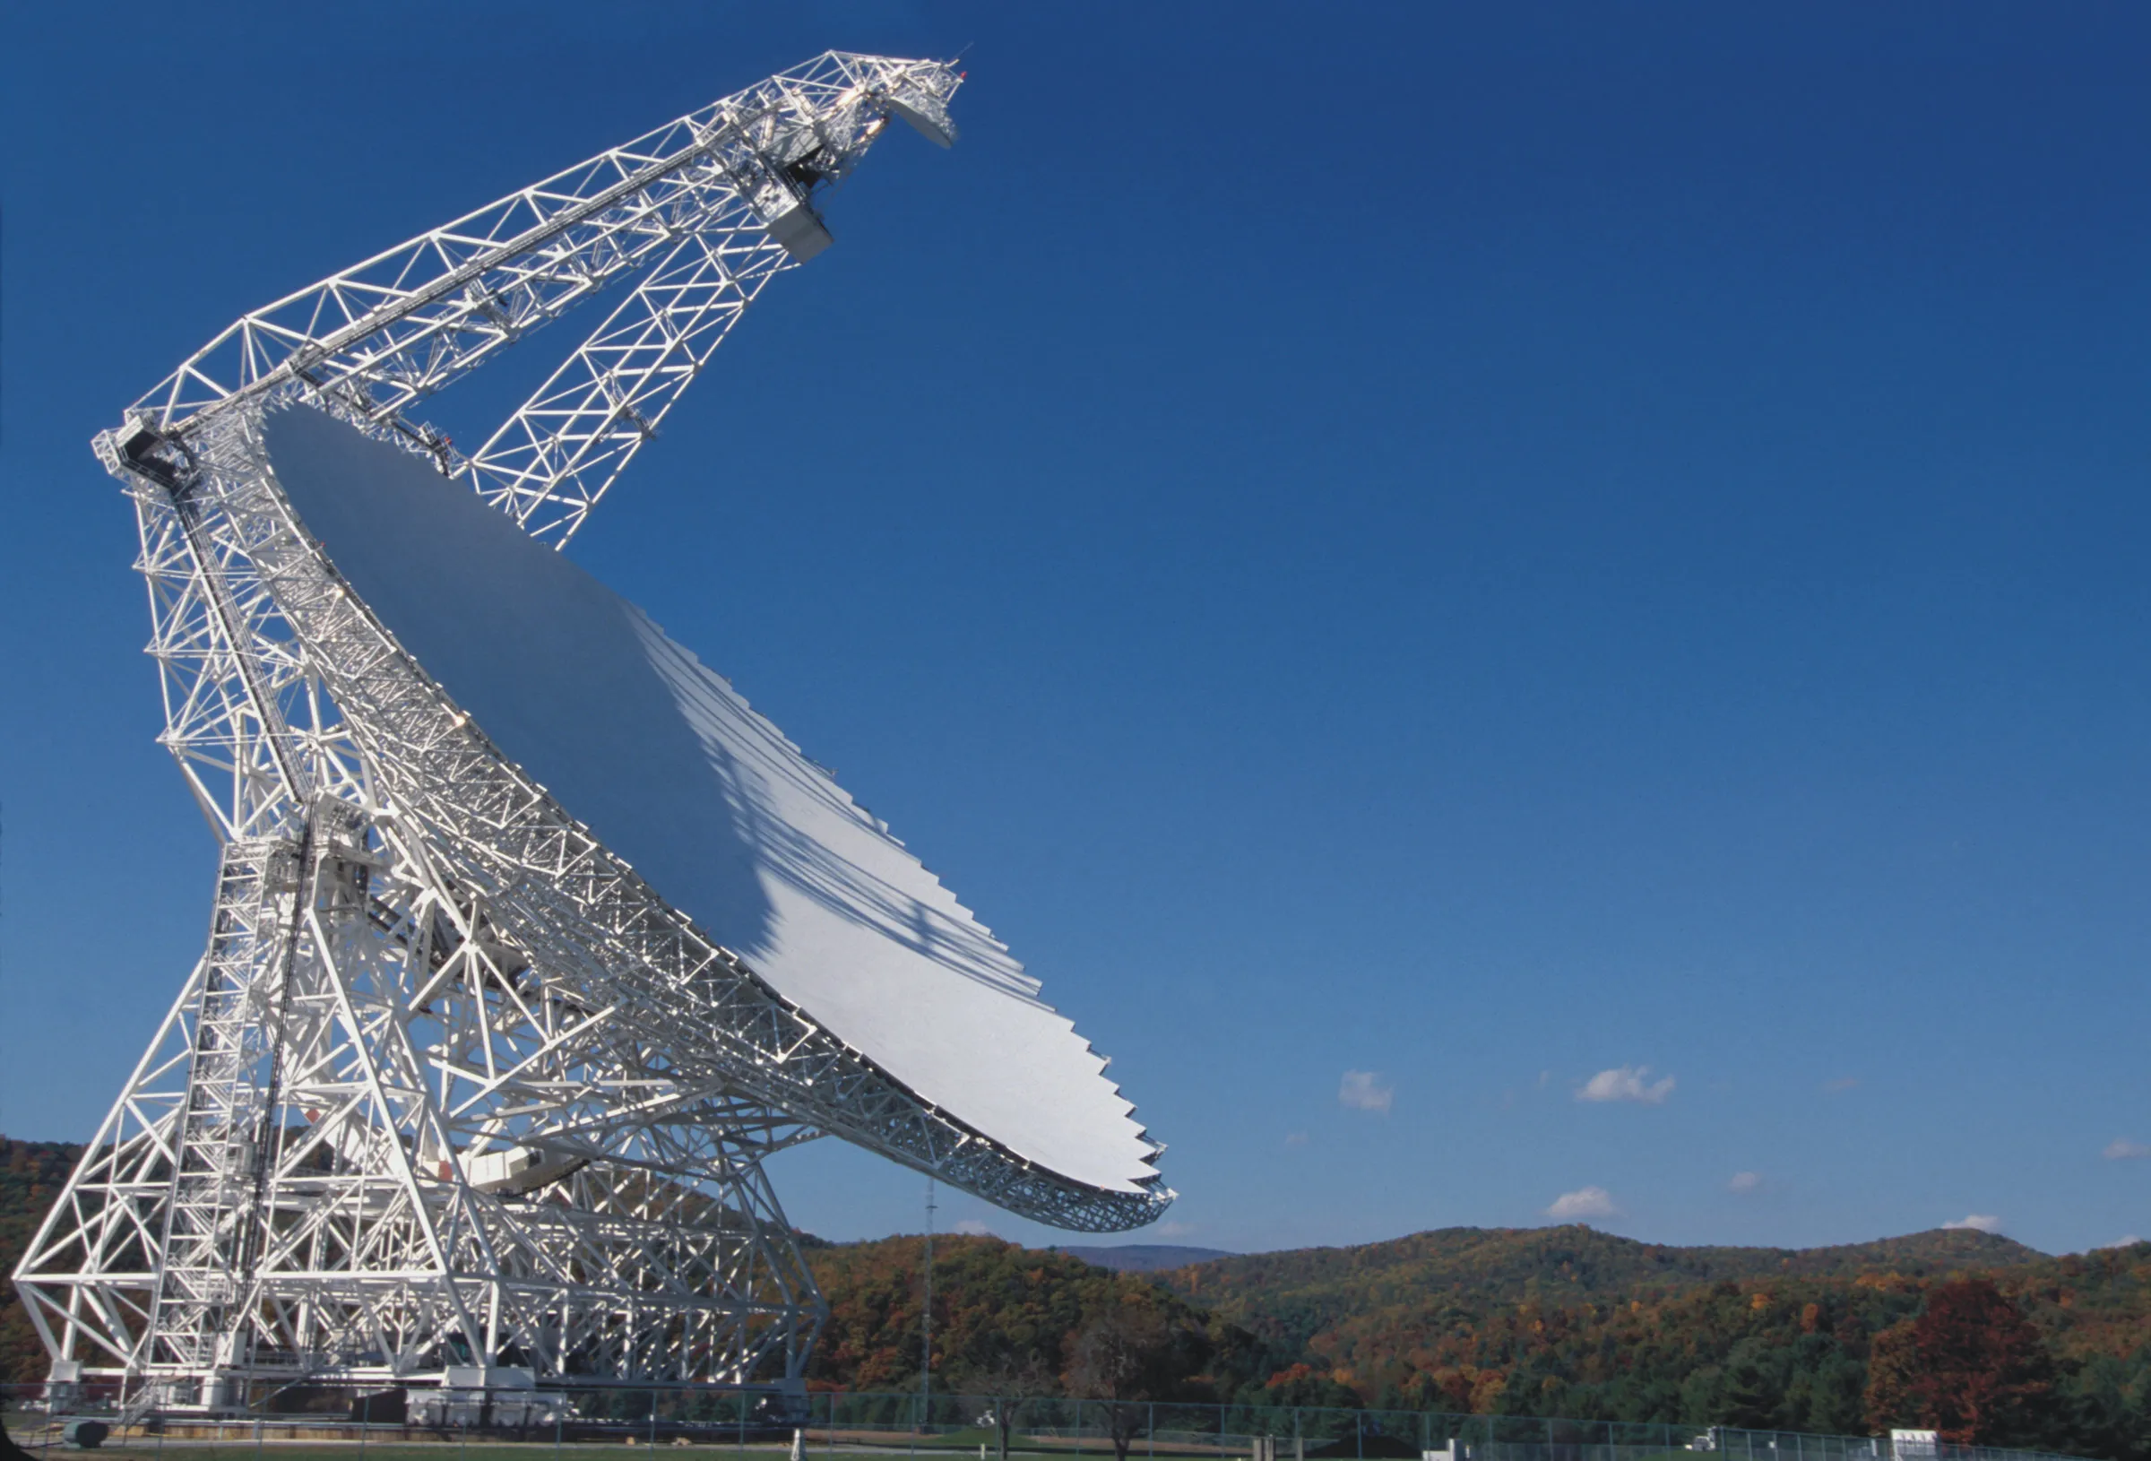
Autoencoder for Anomaly detection in GBT Data
Kai Mulcock (Imperial College London)
Supervisors: Professor Chris Lintott (University Of Oxford), Dr Steve Croft (UC Berkeley)
Image: Green Bank Observatory

Slide 2
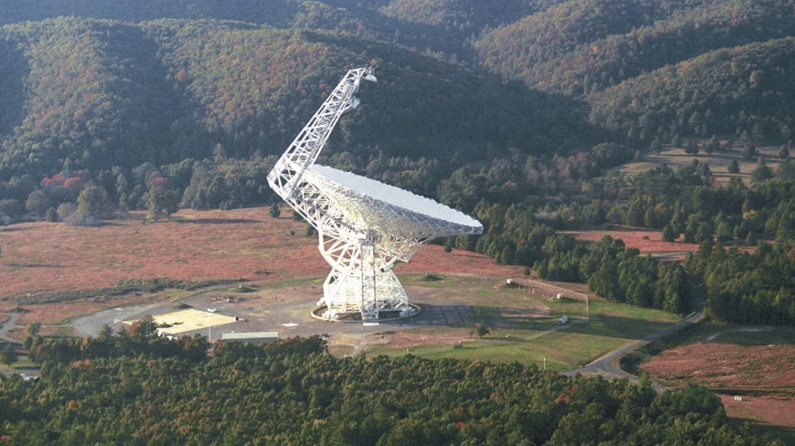
Green Bank Telescope

Slide 3
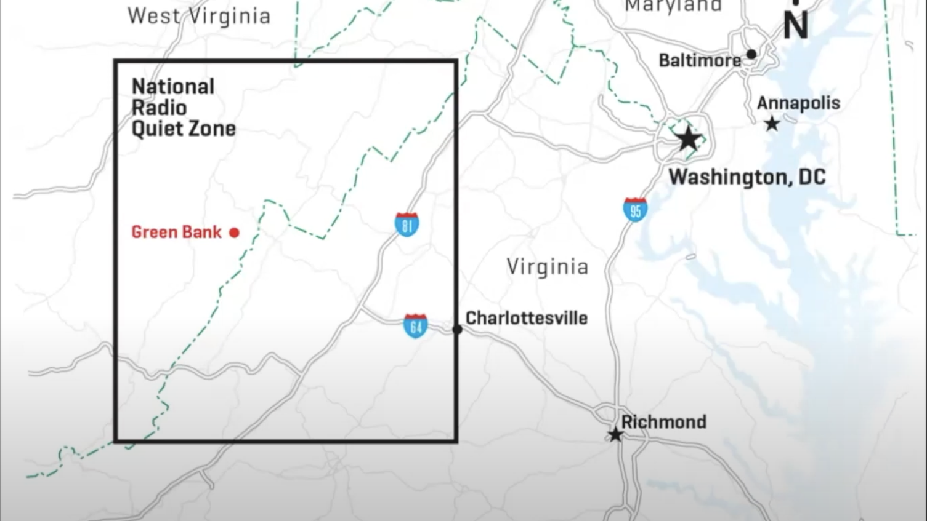
Notes:
impervious to RFI

Slide 4

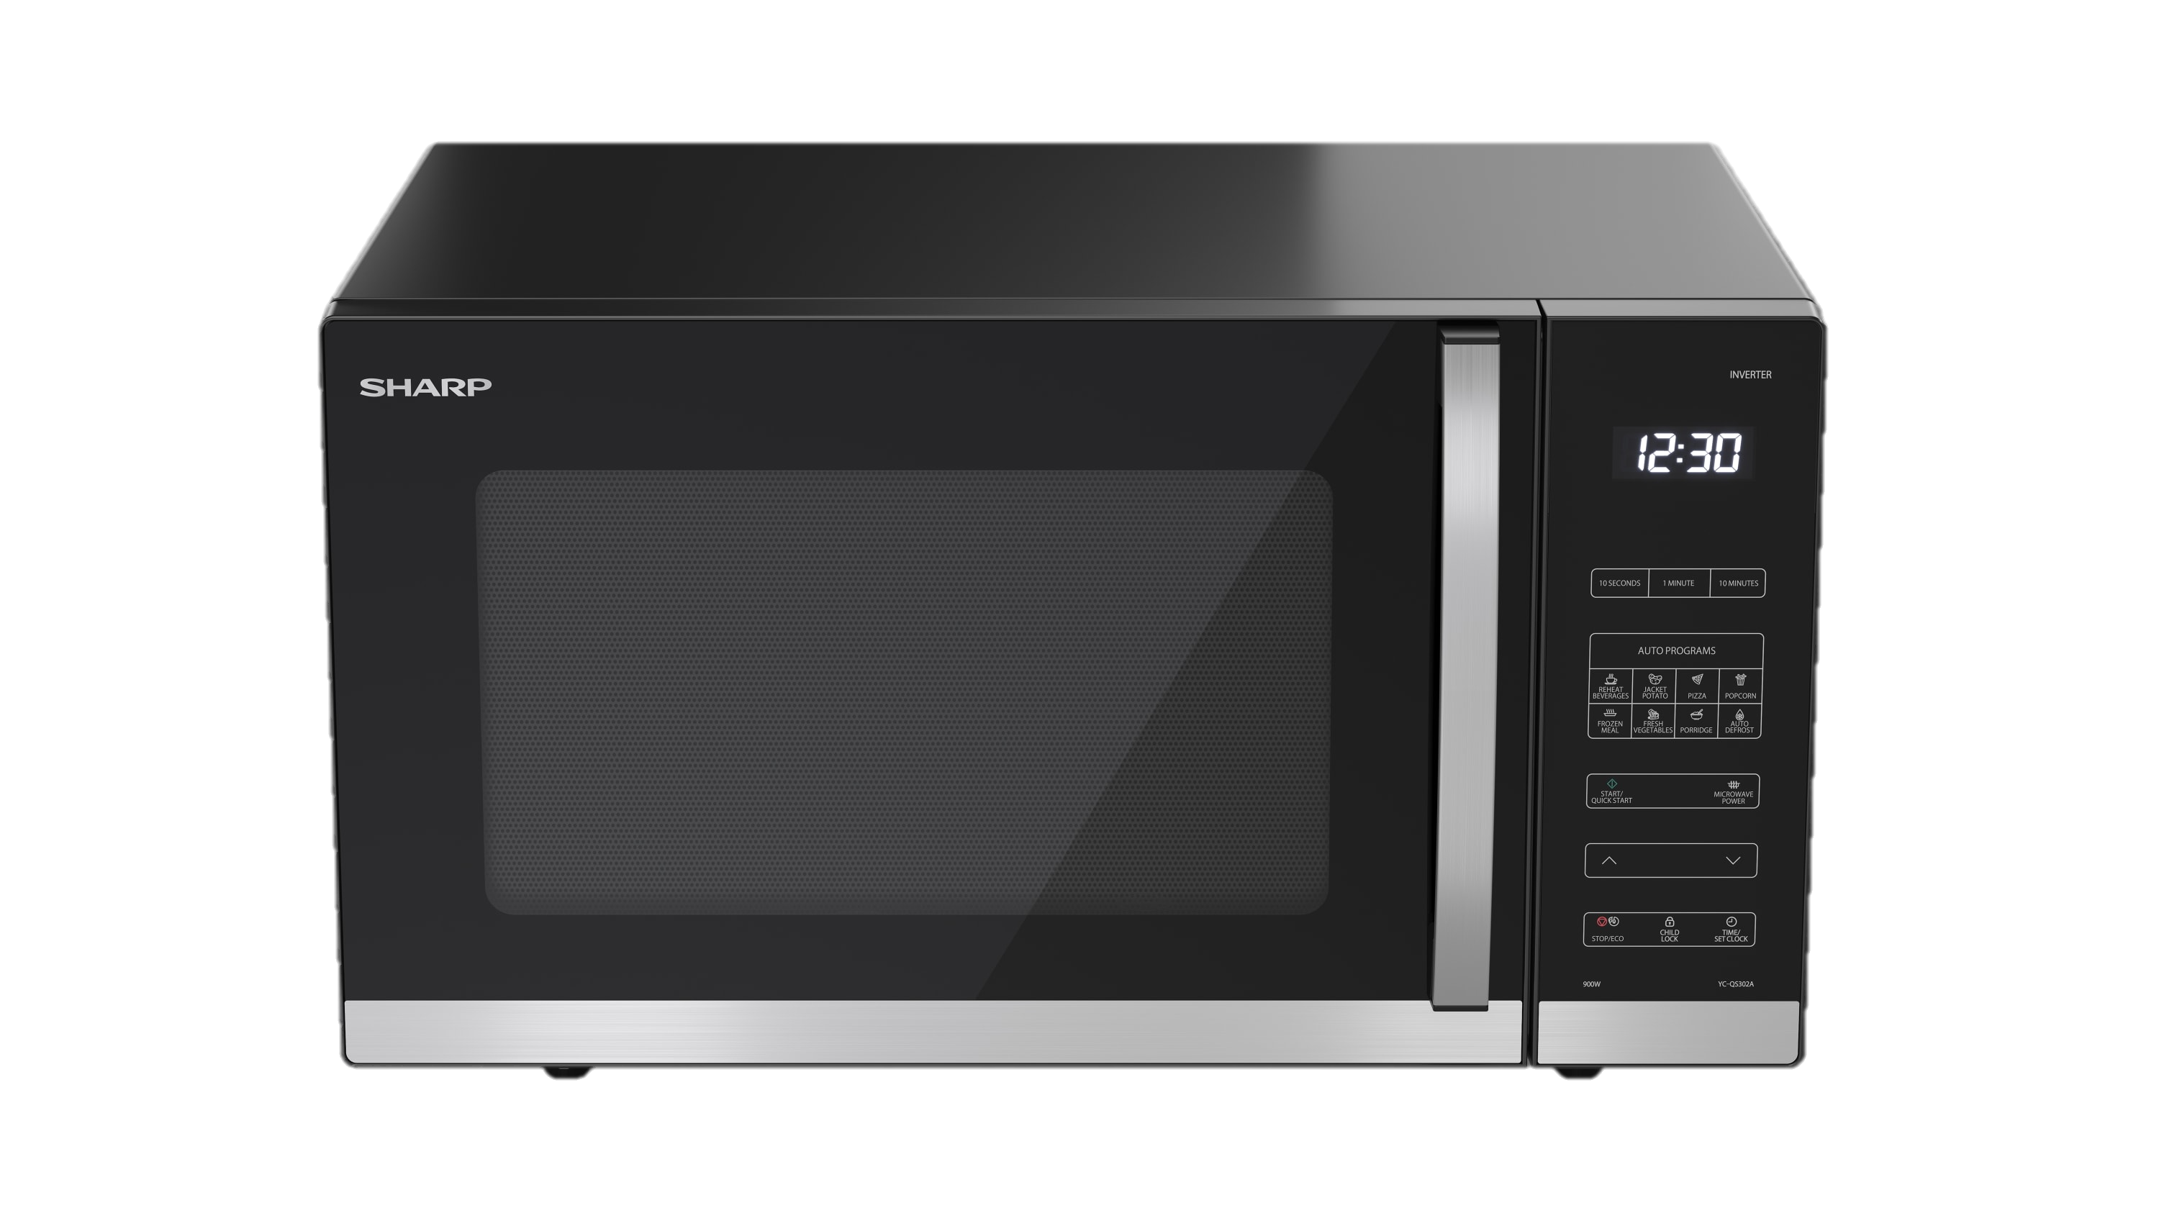
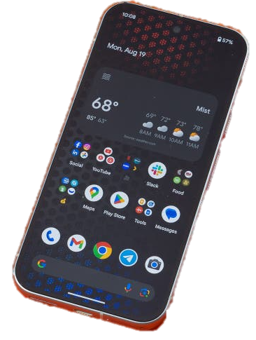
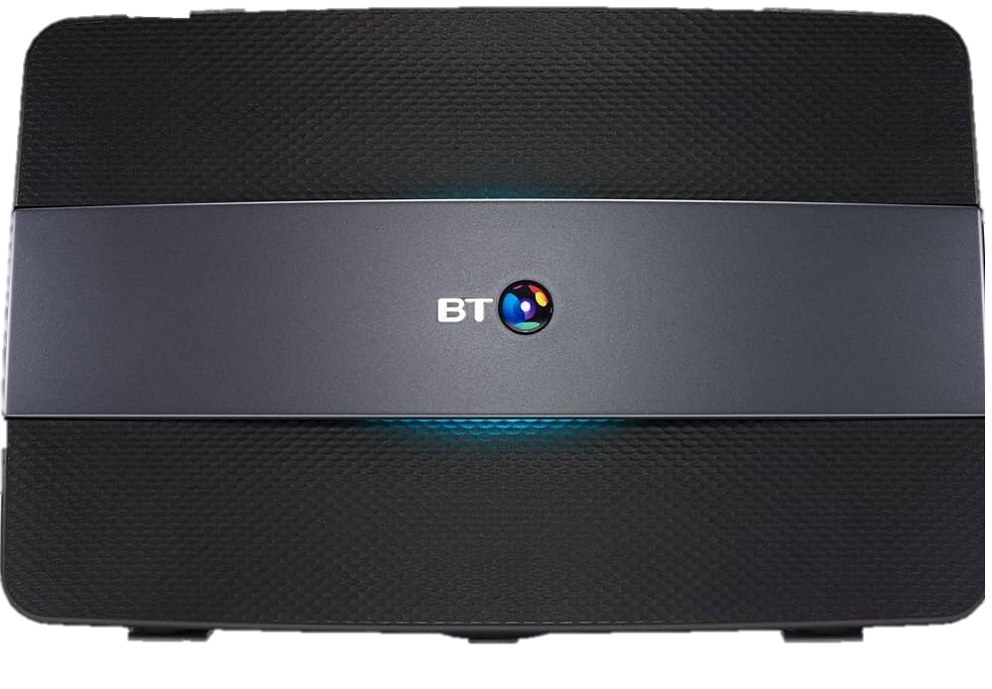
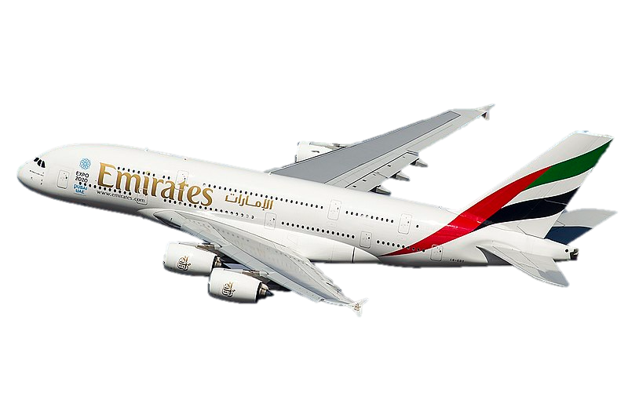
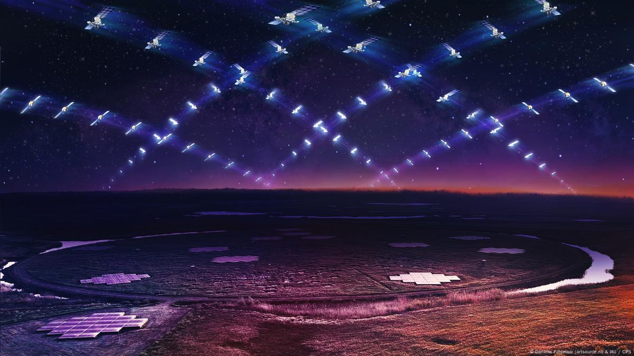

Slide 5


Slide 7

The Problem
Huge amounts of useless data
Image generated using DALL-E by OpenAI.
Notes:
To use a very analogy - you could say its like finding a needle in a haystack

Slide 8

The Problem
Huge amounts of useless data
+
RFI mimics True signals
Image generated using DALL-E by OpenAI.
Notes:
However, the second problem
->Hard to distinguish between RFI and True signals
so youre probably wondering what do our needles look like

Slide 9

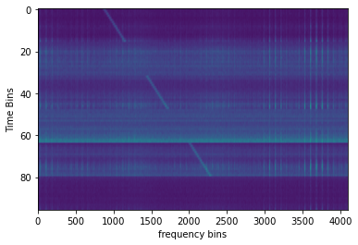
The Goal
Green Bank Telescope Observation pattern : ABACAD
On
Off
On
Off
On
Off
Generated with Setigen - (Brzycki et al., 2022)
E.T. the Extra-Terrestrial Wiki, Fandom

Slide 10
The Data
RFI = Radio Frequency Interference
Green Bank Telescope Observation pattern : ABACAD
A, B, C, and D are different Targets
On : Looking at A
Off : Not Looking at A
Time bins : 18 seconds long
Frequency Bins : 2.73 / 2.83 Hz wide
On
Off
On
Signal could be a technosignature if present only when looking at A
Off
Terminology
Cadence = 6 frames
On
Off
Generated with Setigen - (Brzycki et al., 2022)

Slide 11
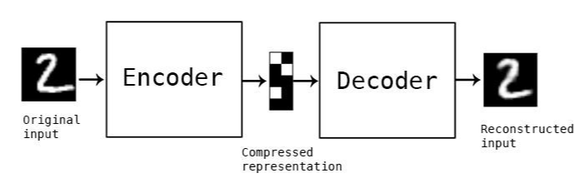
https://towardsdatascience.com/auto-encoder-what-is-it-and-what-is-it-used-for-part-1-3e5c6f017726
The Solution?
An Autoencoder
Reconstruction Loss Function

Slide 12
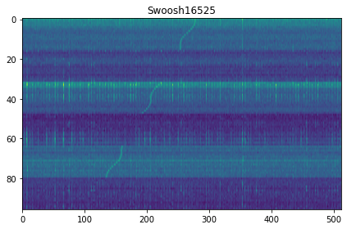
Data Generation
Inject Signals
Normalise
(Using Setigen)
Divide all pixels by max value of the cadence
  Ensures values between 0 and 1

Slide 13
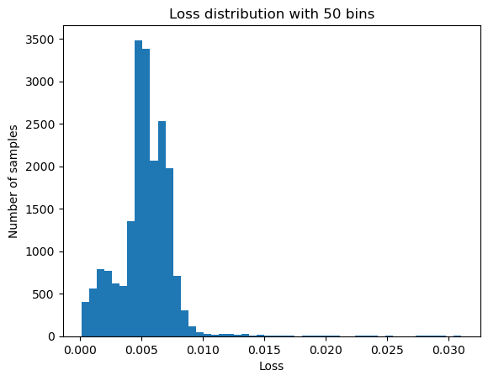
Anomaly Detection – Reconstruction Loss
Normal
Anomalous

Slide 14
https://towardsdatascience.com/auto-encoder-what-is-it-and-what-is-it-used-for-part-1-3e5c6f017726
Reconstruction Loss Function

Slide 15
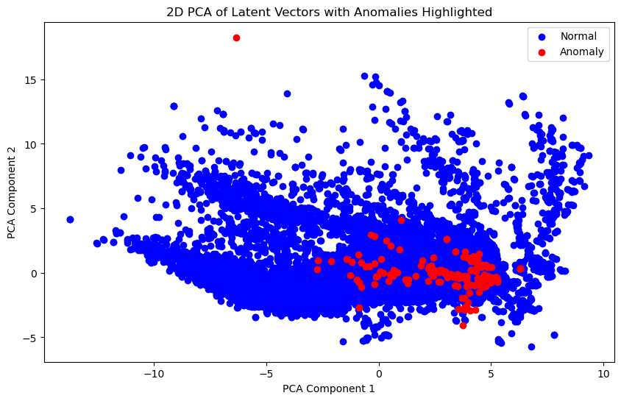

Anomaly Detection - PCA
PCA = Principal Component Analysis

Slide 16

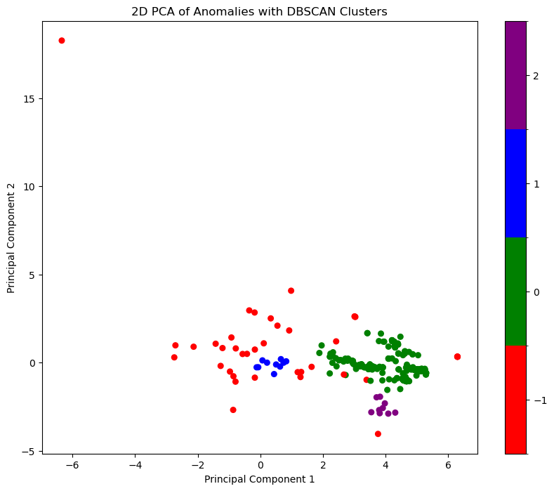


Anomaly Detection – HDBSCAN Clustering
HDBSCAN = Hierarchical Density-Based SCAN
Purple contains 9 samples
Blue contains 10 samples
Green contains 204 samples
Red* contains 39 samples
*Red actually represents ungrouped samples

Slide 17
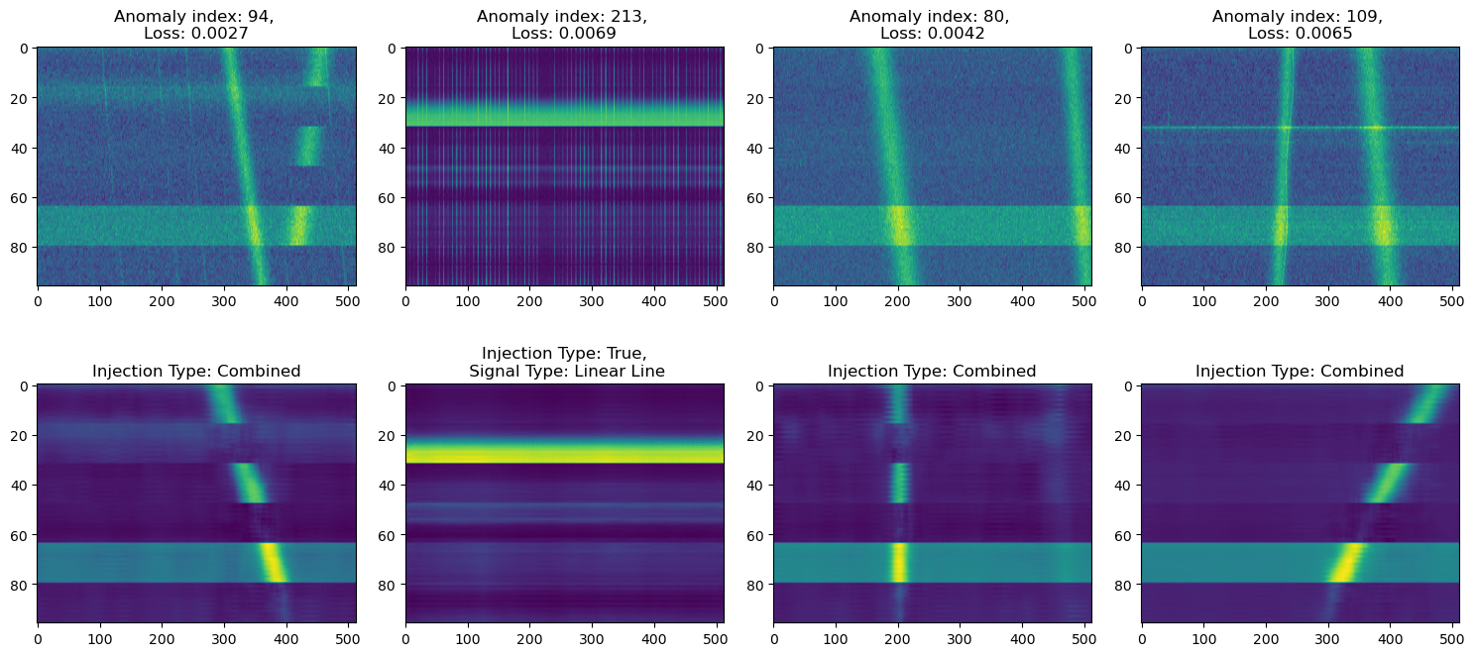
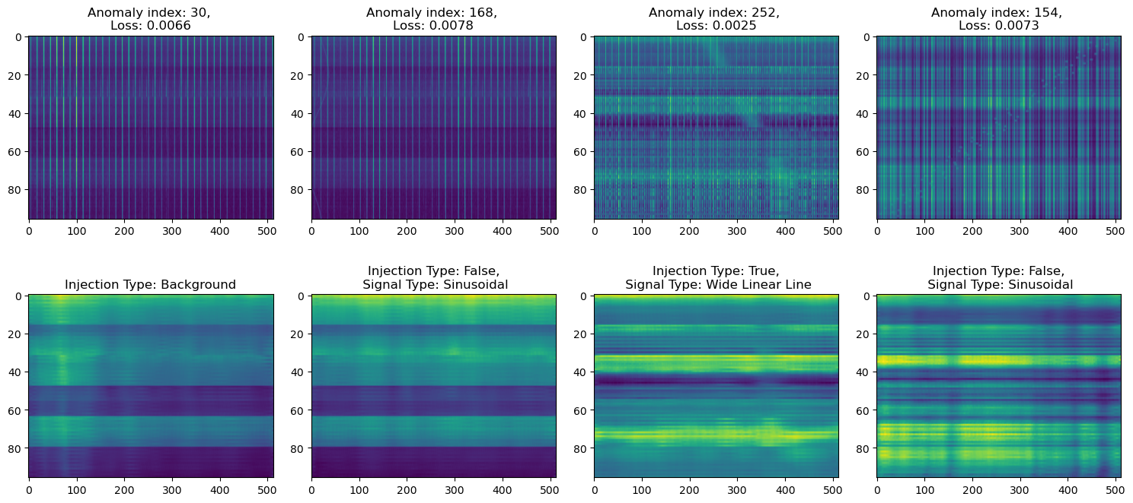
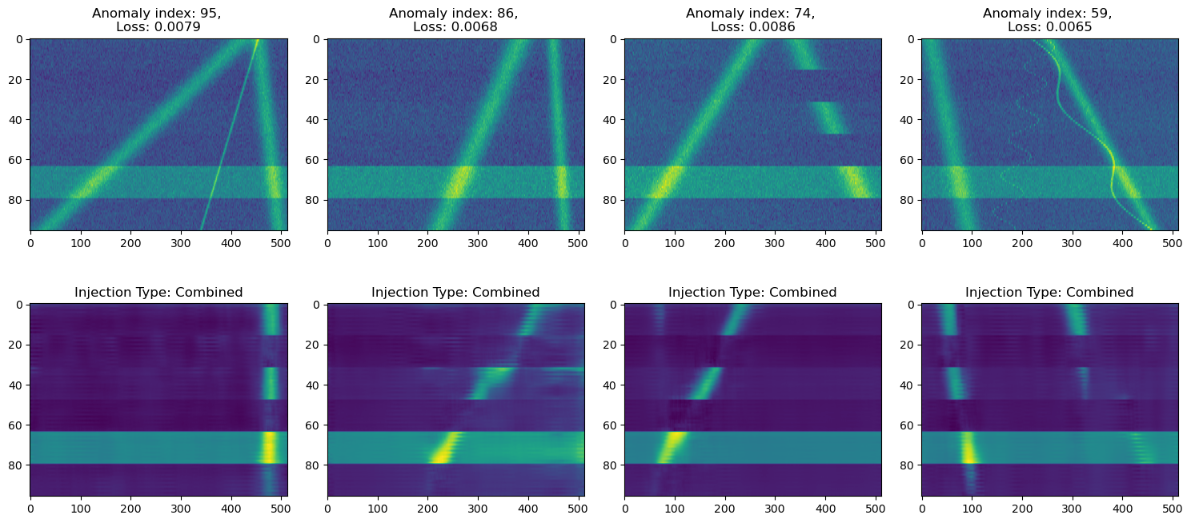
Red, Blue, and Green Clusters
Red Cluster
Blue Cluster
Green Cluster

Slide 18
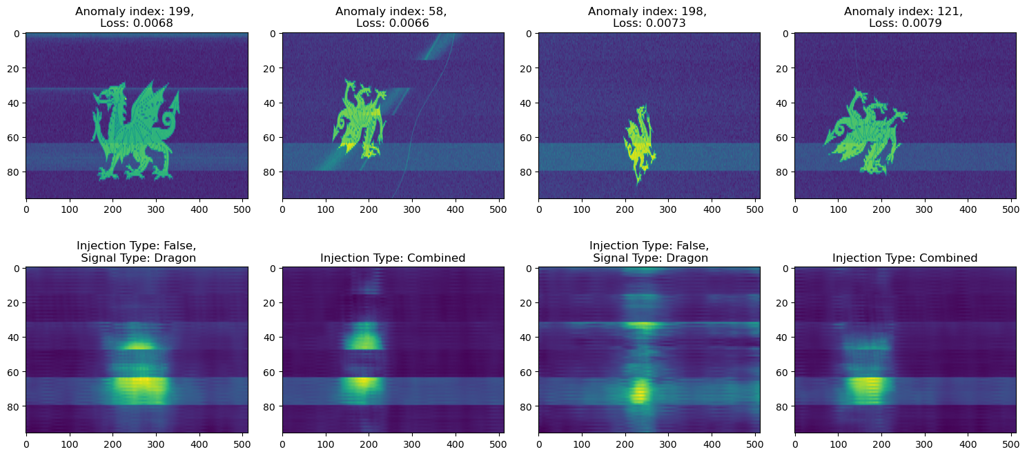
Purple Cluster

Slide 19
Future Prospects
Explore and compare different autoencoder architectures.
Train with more and a greater spread of data.
Attempt to extract interesting signals from data.

Slide 20
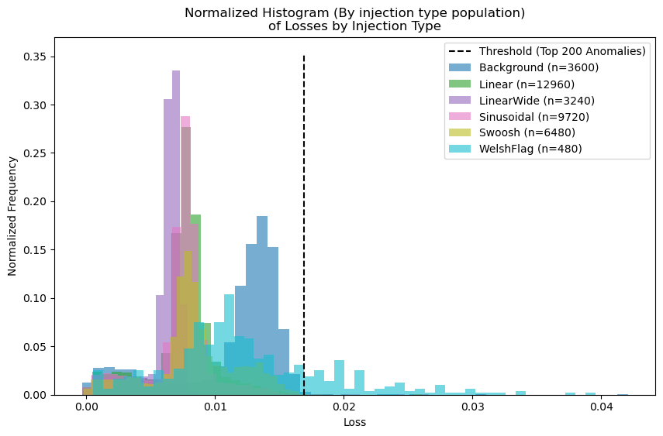
However…
Background

Slide 21
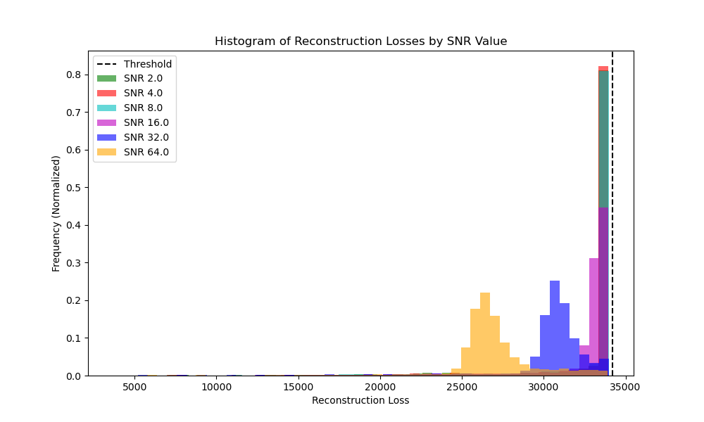
However…

Slide 22
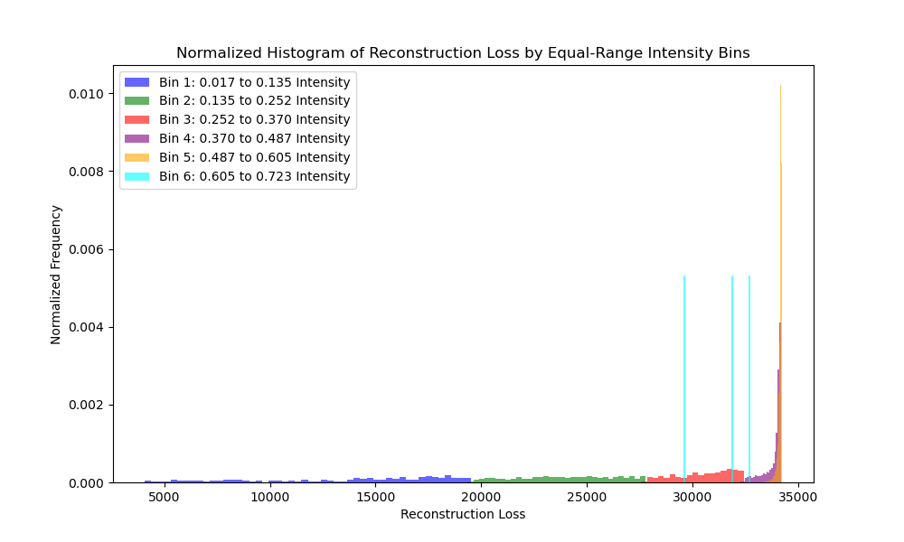
However…

Slide 23
Requirement for Solutions
Choose anomalous frames by some different method
Circumnavigate normalisation issue
So: Threshold our dataset + Alter the method

Slide 24
New Methodology
*Recall cadence -> all 6 frames
Load Data
Inject Signals
Threshold to 0 OR 1
Split Data into manageable frequency bin chunks
(Using Setigen)
Look for cadences with frames existing within different clusters
Cluster the latent space
Train Autoencoder on individual Frames NOT cadences*

Slide 25





Why this Could Work?
Linear Signals
{
PCA 2
Background
PCA 1

Slide 26
Why this Could Work?
Linear Signals
{
PCA 2
Background
PCA 1

Slide 27
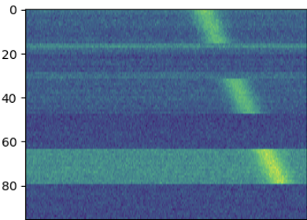
Why this Could Work?
Linear Signals
PCA 2
Background
PCA 1

Slide 28
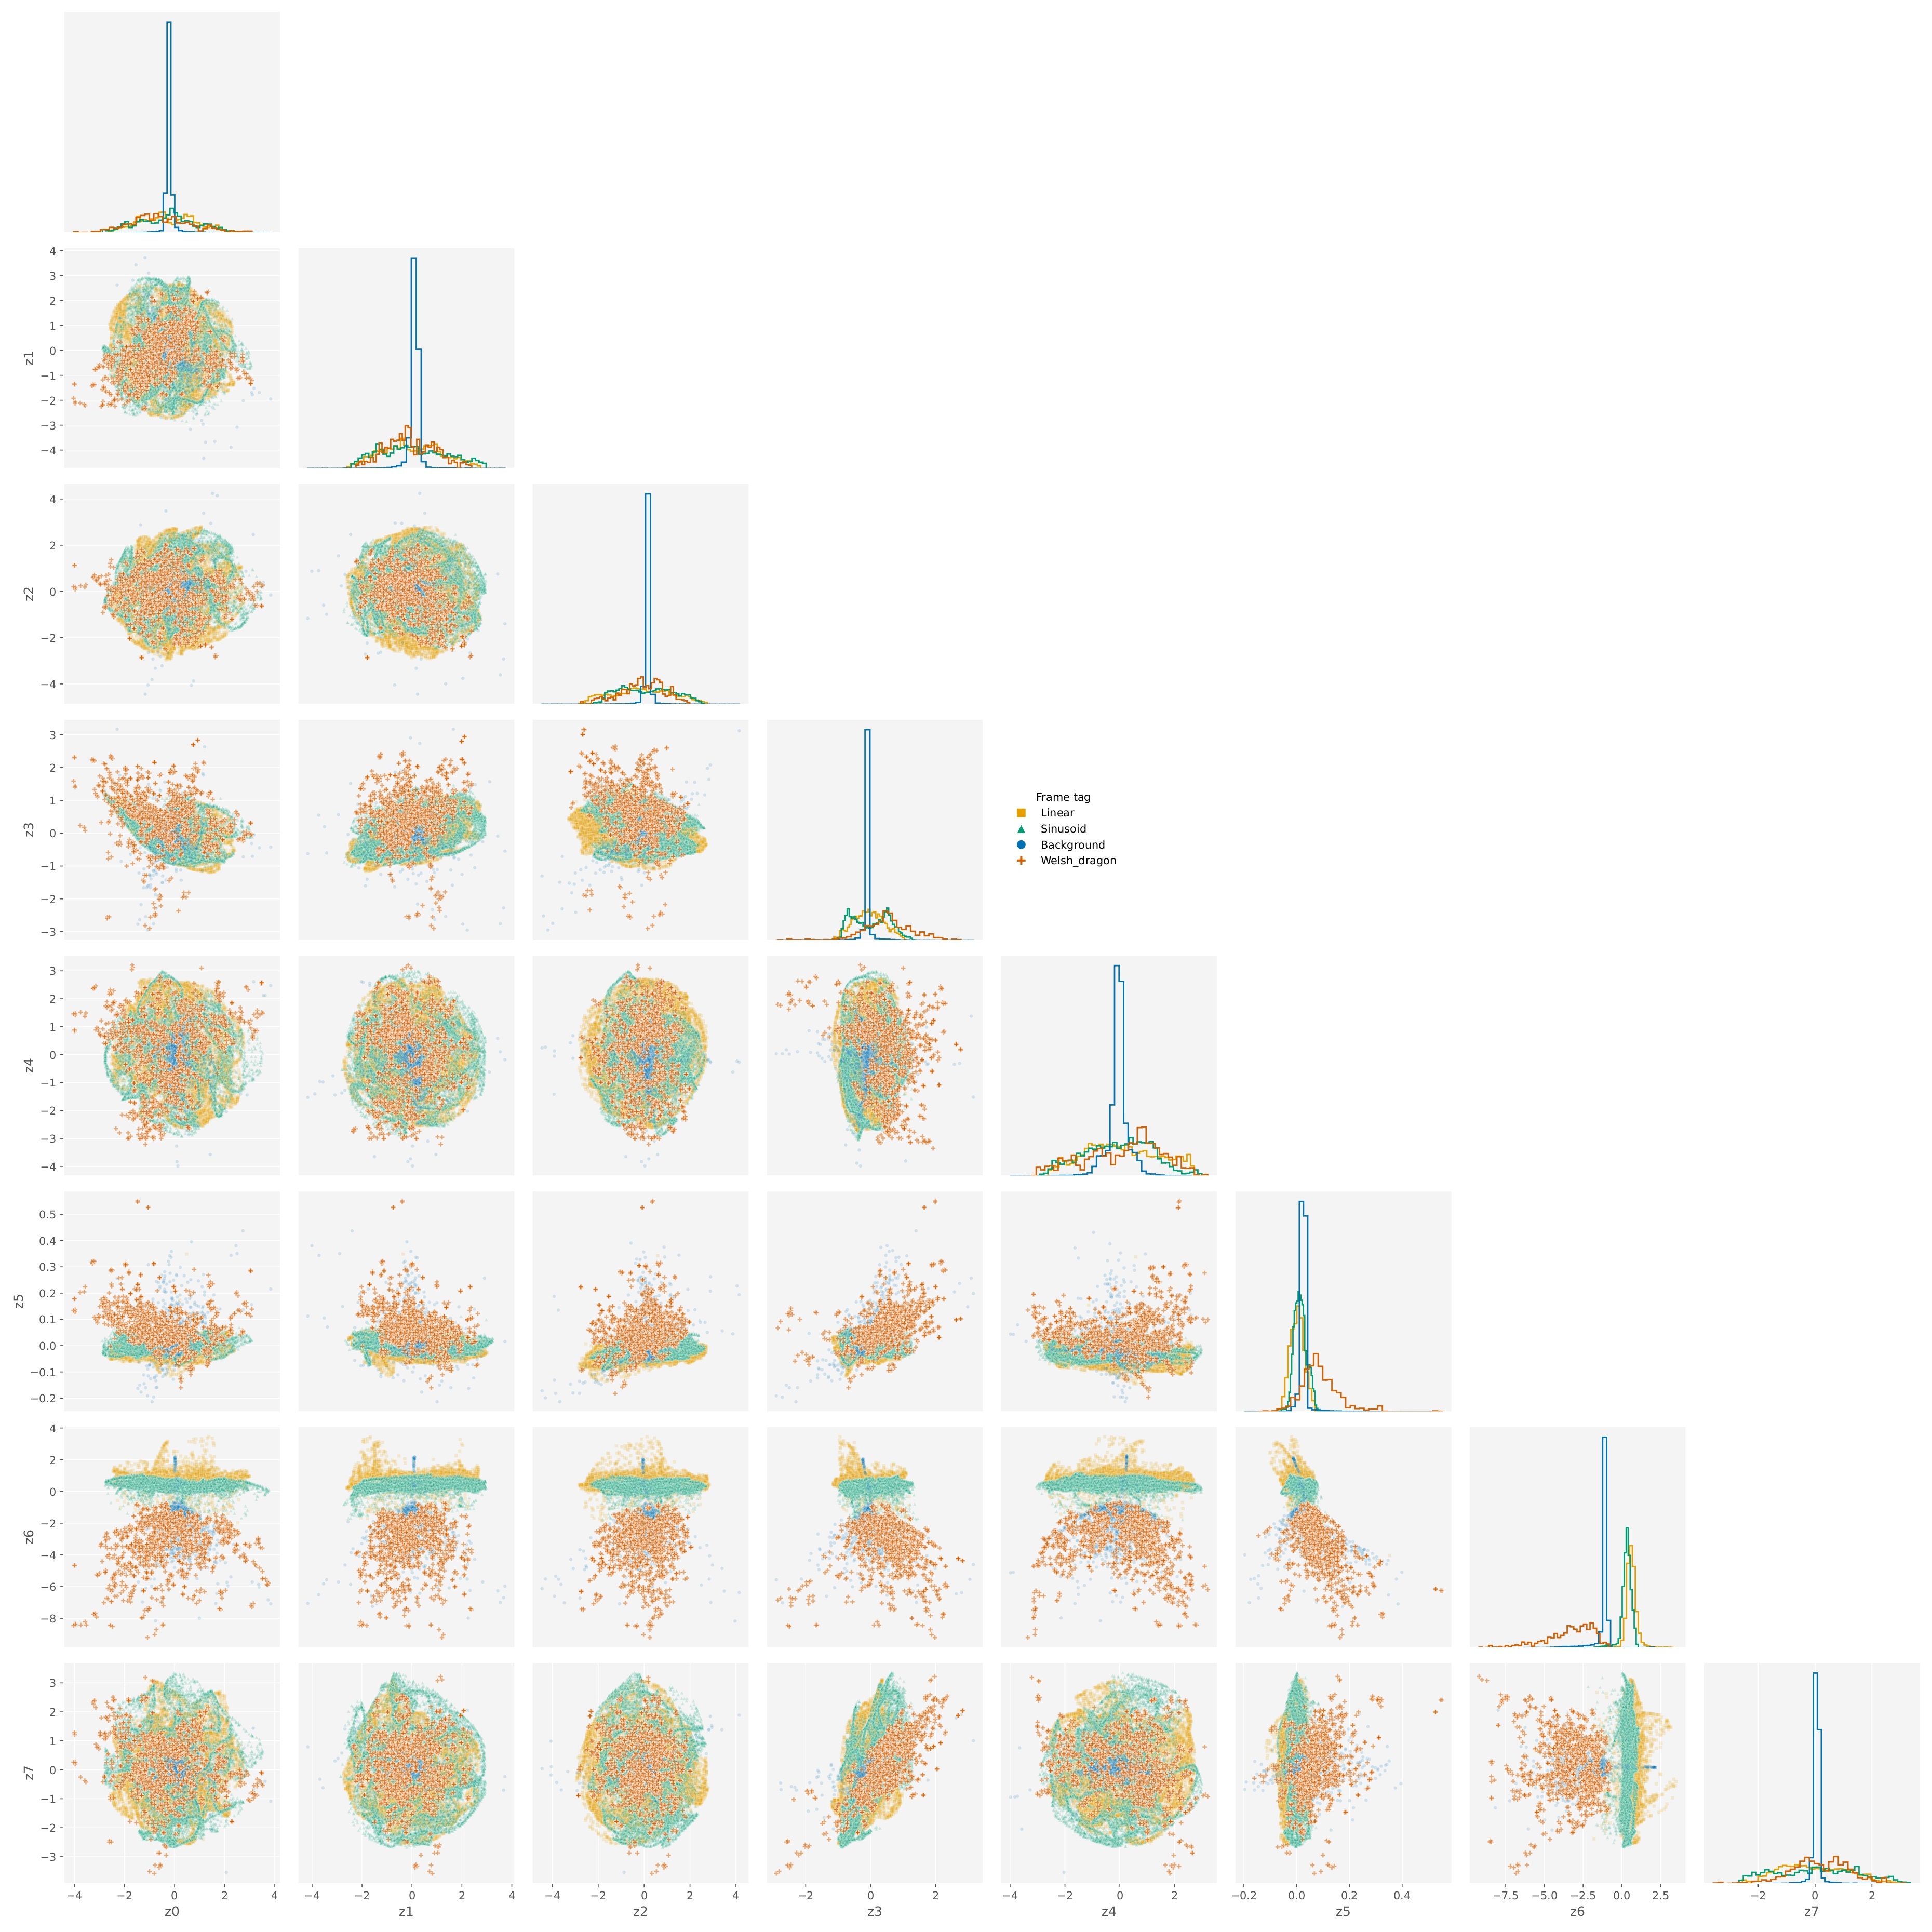
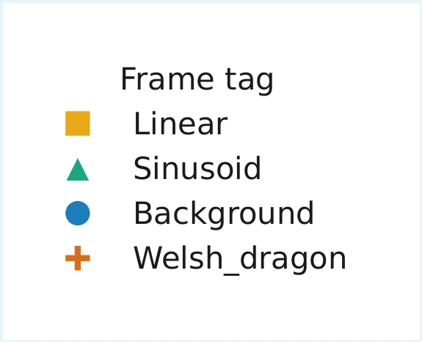
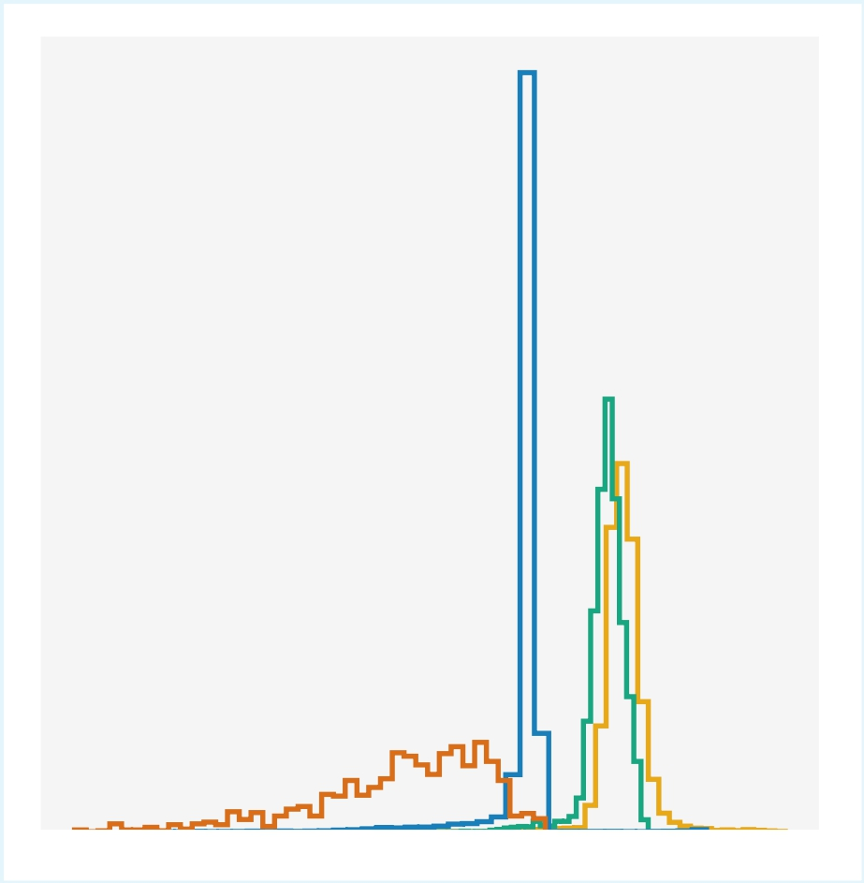
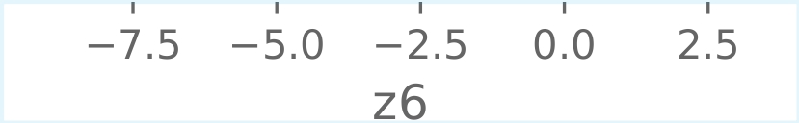
Does this Work?

Slide 29
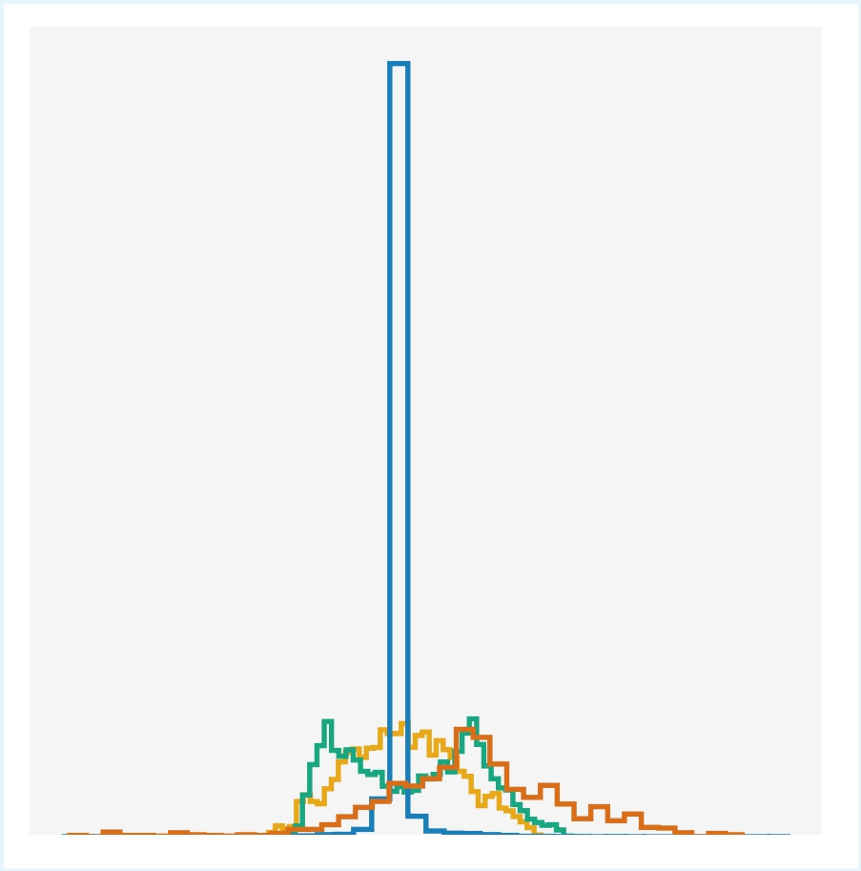

Does this Work?

Slide 30

Kai Mulcock – kjm221@ic.ac.uk
Image: Green Bank Observatory
Work inspired by:
(Ma et al., 2023)
(Rogers et al., 2024)
(Ma et al., 2024)

