Slide 1
A Rubin Community Broker for Alerts
(not Solar System)
Gareth Francis, Andy Lawrence, Terry Sloan, Roy Williams (Edinburgh)
Ken Smith, Dave Young (Belfast)
Stephen Smartt (Oxford)

Slide 2
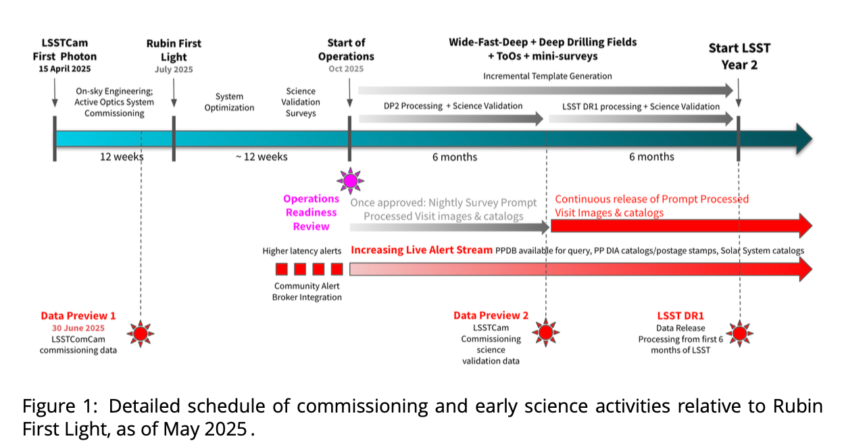
You are here
Sept/Oct

Slide 3
lasair-ztf.lsst.ac.uk
now
lasair.lsst.ac.uk
Lasair doesn’t do Solar System objects
soon
lasair-lsst.lsst.ac.uk

Slide 4
Build your own filter
User builds filter/query
NOT classifications
Great flexibility, extensibility
SQL is the glue
User can share and copy and modify a filter
A good filter lives on
Classifications and added data can be contributed as “annotations”

Slide 5
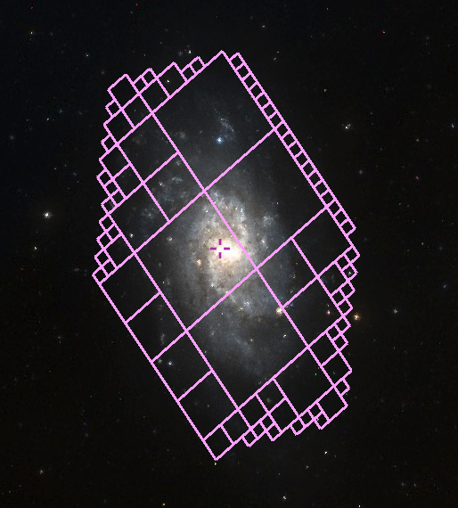
Building blocks
Don’t ask for SNIa, ask for fast blue risers
SQL filter from features
Flux, colour, parametric fit, abs mag
Intelligent crossmatch
Watchlists and watchmaps
Annotations from other users and other brokers
Watchmap for nearby galaxies
Showing M33 at 1 Mpc

Slide 6
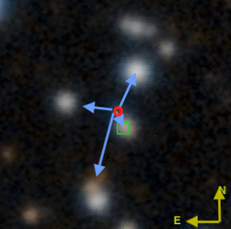
Sherlock is intelligent crossmatch
Several possible matches
Find the best match
VS, CV, BS, AGN, SN, NT, ORPHAN
Host galaxy
Absolute magnitude
Catalogues
Gaia DR3, PanSTARRS, SDSS DR12, DESI legacy surveys, DESI DR1
MILLIQUAS and LASr, Veron AGN, Downes and Ritter CVs, GLADE and NED-D galaxies

Slide 7
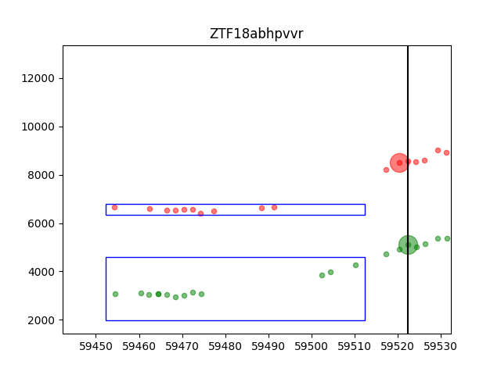
Feature: Jump detection
Test:
10 days
Sample → mean, $σ$
60 days and
> 10 detections
If its 8$σ$, then jump1=8
If its 5$σ$, then jump2=5
(in another band)
6$σ$

Slide 8
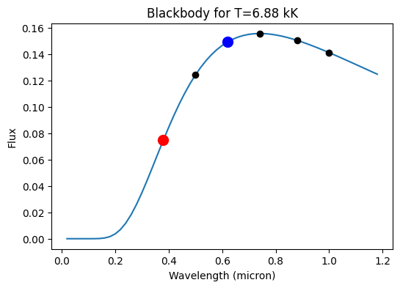
Feature: Pair colour
LSST cadence has 2 detections almost simultaneous
Too many combos of 6 filters
Forget B_V and g-r and r-i and all that
Make a blackbody fit to get temperature
r
i
z
y
g
u
Flux ratio 2 → T=6880K

Slide 9
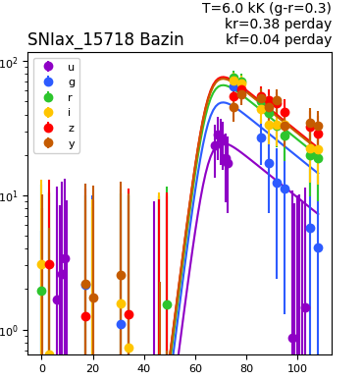
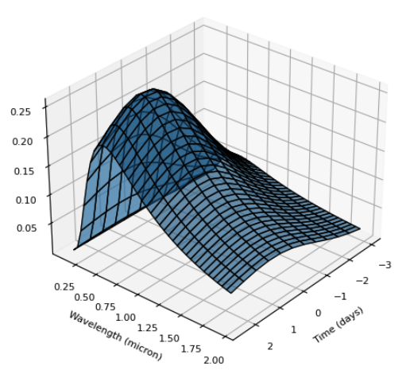
Feature: 2D Bazin Blackbody fit (also does Exponential Blackbody)
Time
Wavelength
… because with 6 filters you can’t do 6 separate lightcurves!

Slide 10
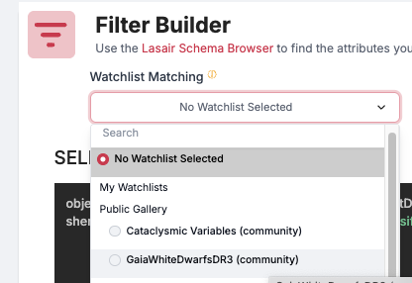
Example filter: Brightness jump in white dwarfs
Combine the watchlist with the SQL SELECT
objects.lastDiaSourceMJD > mjdnow() - 30
AND objects.jump1 > 5 # sigma over the interval [now-70,now-10]
AND objects.jump2 > 3 # sigma in a different band

Slide 11
Example filter: Finding TDEs (1)
Host galaxy

Slide 12
Example filter: Finding TDEs (2)
High temperature

Slide 13
Ready-made Community Resources
Cataclysmic Variables
GaiaWhiteDwarfsDR3
MILLIQUAS: Million quasar catalogue
E+A Galaxies
Golovin nearby stars
Abell clusters
Strong lensing
Gaia nearby stars
Cepheids
RR_Lyrae
Nuclear transients
Flux jump from white dwarfs
SN II from TNS
Galaxies within 5 Mpc
Galaxies within 50 Mpc
Rubin ComCam Fields 2024

Slide 14
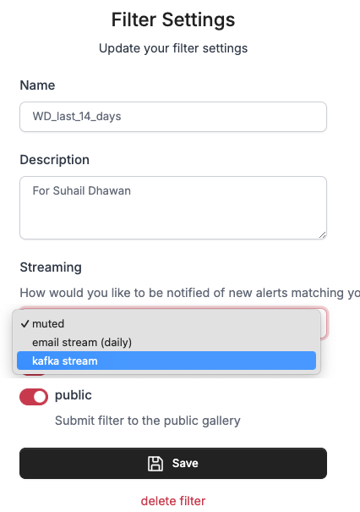
What is ACTIVE?
Can make your filter ACTIVE
Meaning get instant result from filter
Kafka: machine readable
Email: If you must
Public: filter shareable with others
Watchlists and Watchmaps can also be ACTIVE
Crossmatched in near-real time
Active status must be renewed every 6 months

Slide 15
So you have made a filter
Can run filter from web page
Can run automatically near real time
Output by email or Kafka
Eyeball the data with Excelasair or Marshall Notebook
Pull all data, filter further and annotate Lasair
Share it with others
machine-readable!

Slide 16
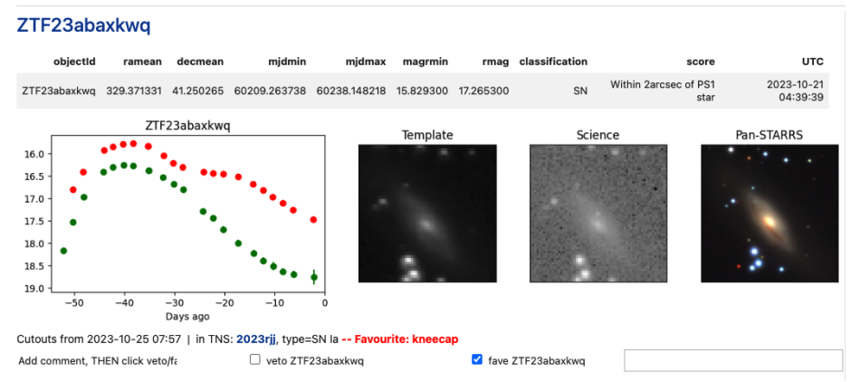
Eyeballing
Tool to build Excel from Kafka stream
Notebook to marshall all the data

Slide 17
lasair.lsst.ac.uk now ZTF, soon LSST
Register so we can keep you informed
Write to me roy@roe.ac.uk

