Slide 1
VLBA observations of the Orion Nebula Cluster and associated radio variability
Eoin O’Kelly
Supervisor: Dr. Jan Forbrich
The Orion Nebula Cluster (ONC) is a close region of active star formation.
The ONC provides a good opportunity to observe many radio sources associated with Young Stellar Objects (YSOs).
Radio observations allow studies of the high energy processes occurring associated with YSOs.
The upgrade to the Very Long Baseline Array (VLBA) enables many sources to be observed simultaneously.
Image credit: Andrew Clegg, NSF
Notes:
The ONC is a relatively close region of active star formation and allows many sources to be observed simultaneously.
The aim is to study radio sources associated with YSO’s and the high energy events occurring.
- The VLA and VLBA have been upgraded with a software correlator allowing hundreds of sources to be studied.

Slide 2
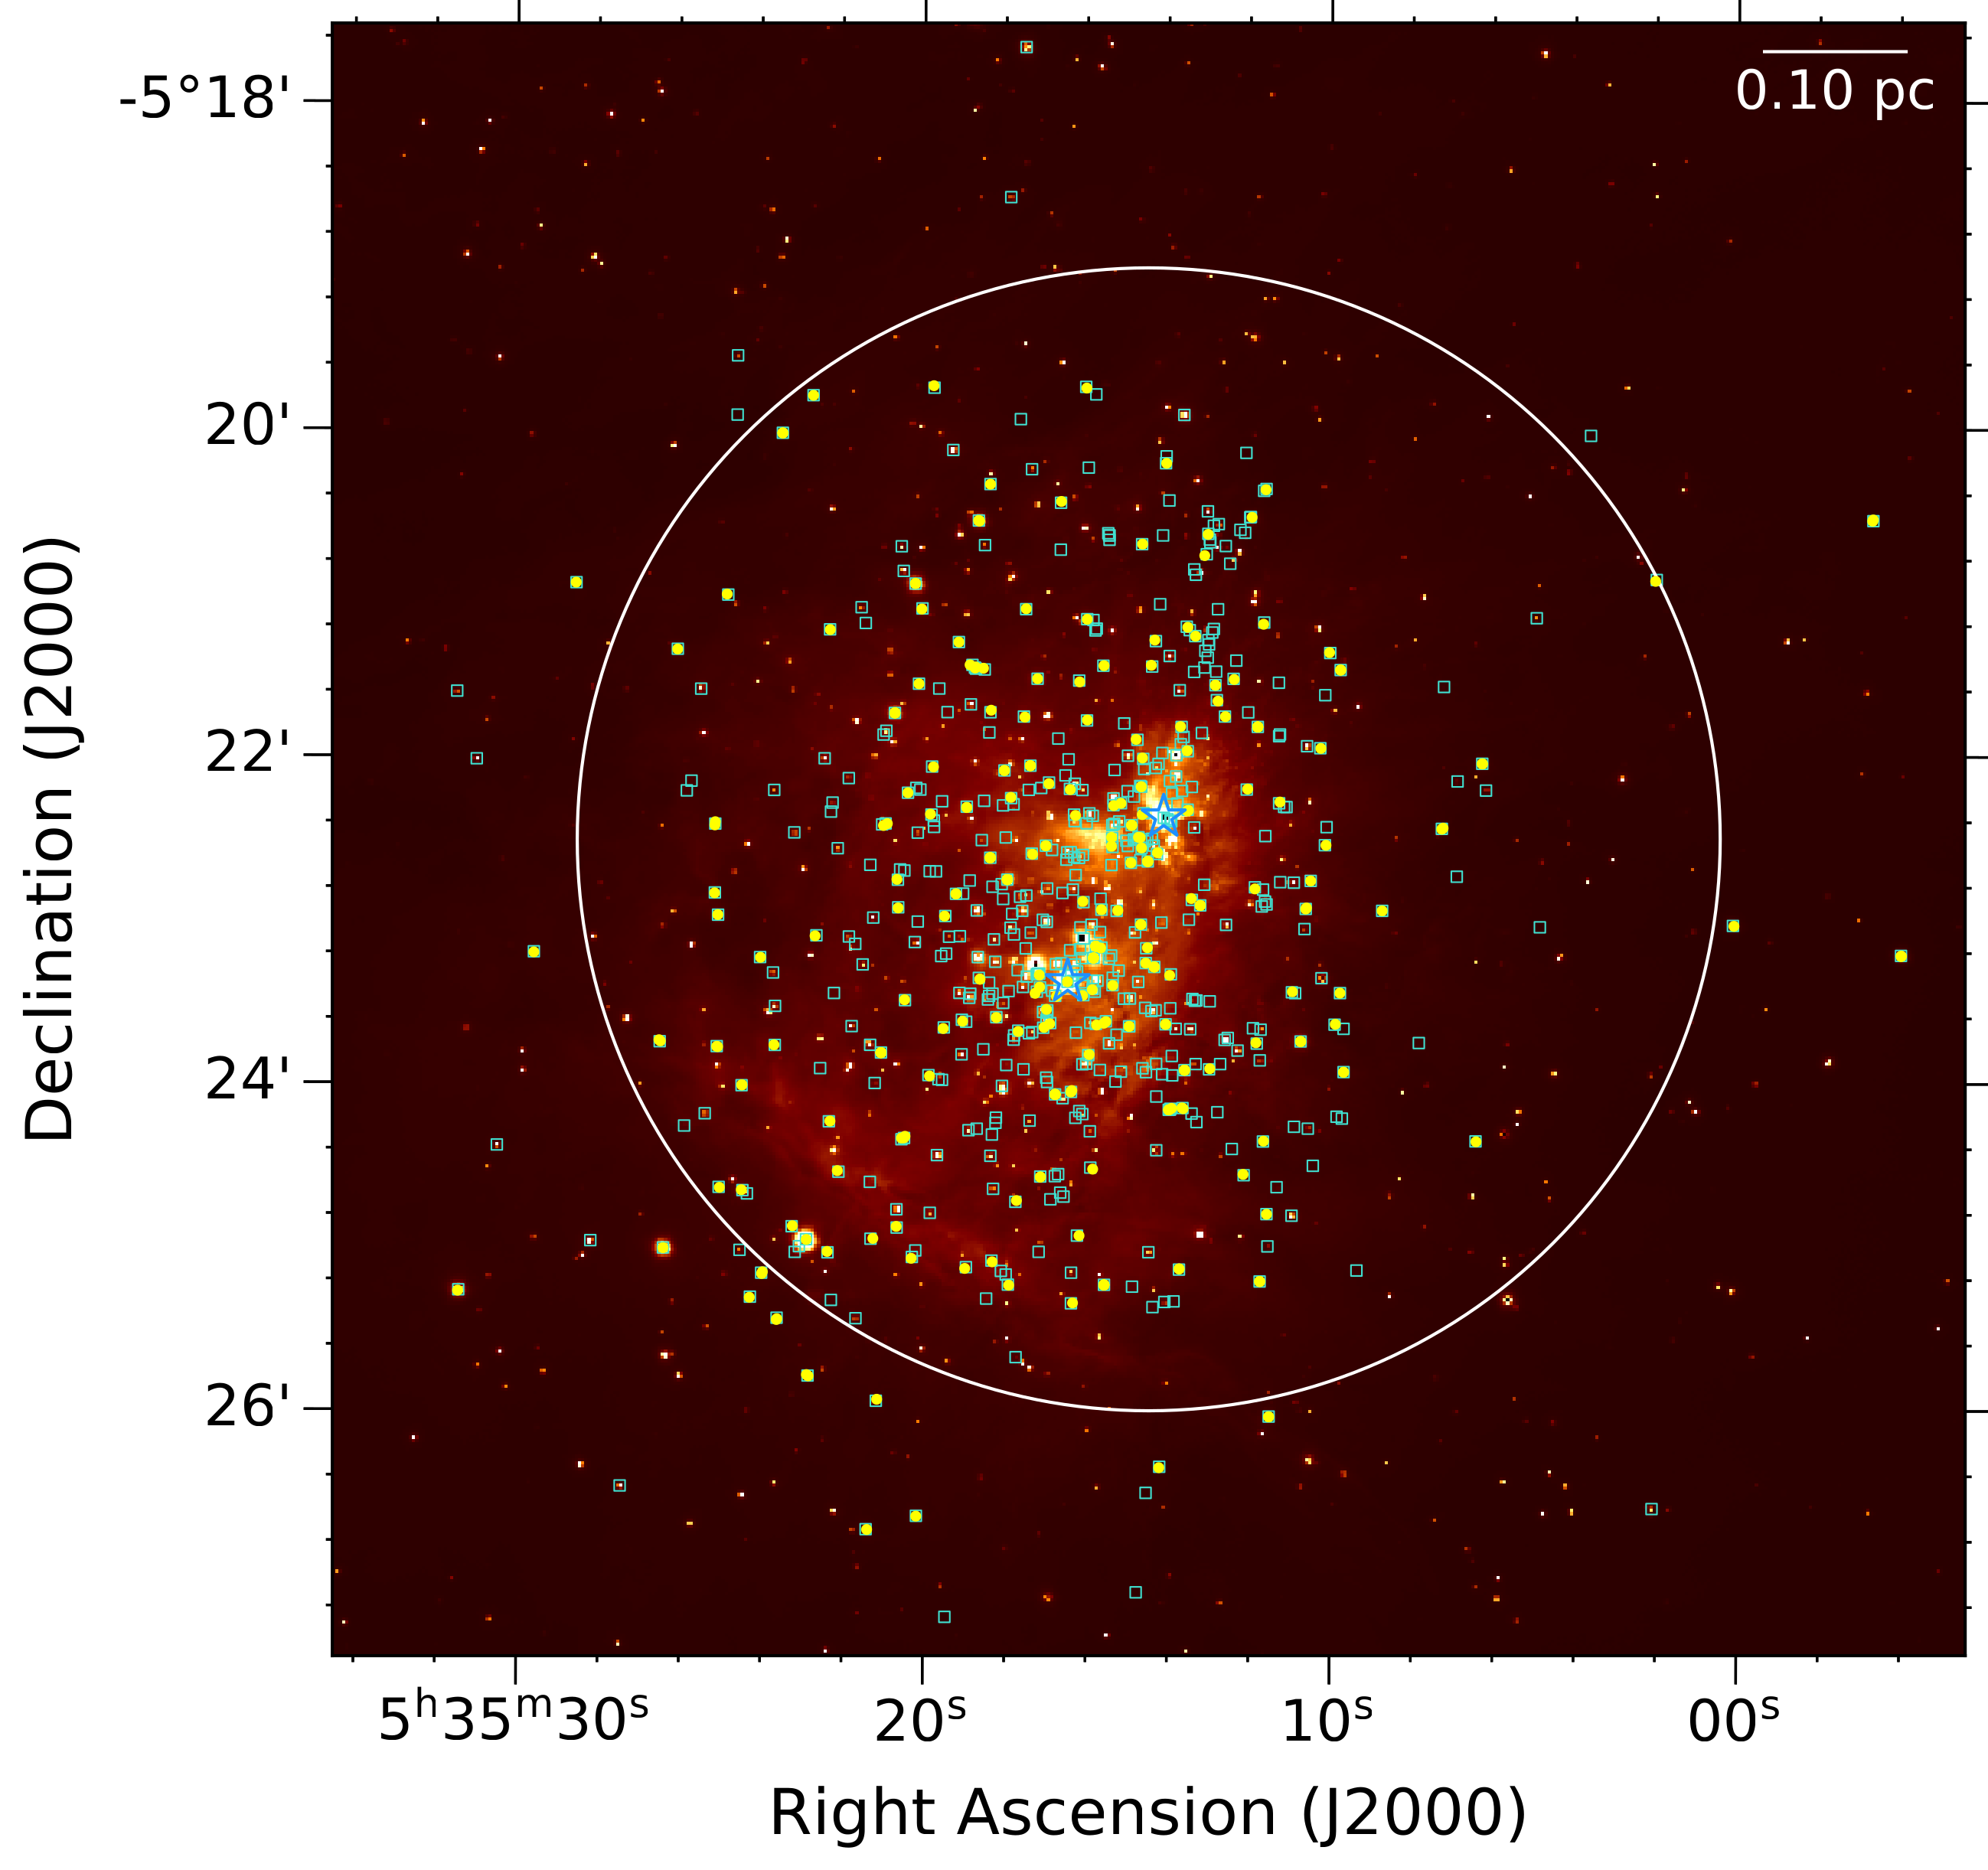
VLBA Data
The VLBA data is in the C-band (4-8 GHz) and is 8 epochs, each ~ 7 hrs in length, covering 6 years and a nominal image sensitivity of 30 µJy/beam.
Very Long Baseline Interferometry is only sensitive to high brightness temperatures. This allows a census of the non-thermal radio population.
This work targets 575 source positions identified in a Very Large Array (VLA) survey by Zapata et al (2004) and Forbrich et al (2016).
We report the detection of 171 sources across all 8 epochs.
References:
Dzib et al (2021), Forbrich et al (2016), Forbrich et al (2021), Vargas-González (2021), Zapata et al (2004).
Figure 1 - The 575 VLBA correlator positions (cyan) overlain on top of a VISION 2.1µm image (O’Kelly et al, in prep). The source detections are marked in yellow, the white circle is the primary beam (3.5 arcmins).
Notes:
VLBA data is in the C-band (7 GHz), 8 epochs, each ~ 7 hrs in length, separated by various timescales mostly years but also on subsequent days.
VLBI allows a census of the nonthermal source population.
This work targets 575 targets identified by the VLA survey conducted by Forbrich et al (2016).
- We report the detection of 171 sources across all 8 epochs.

Slide 3
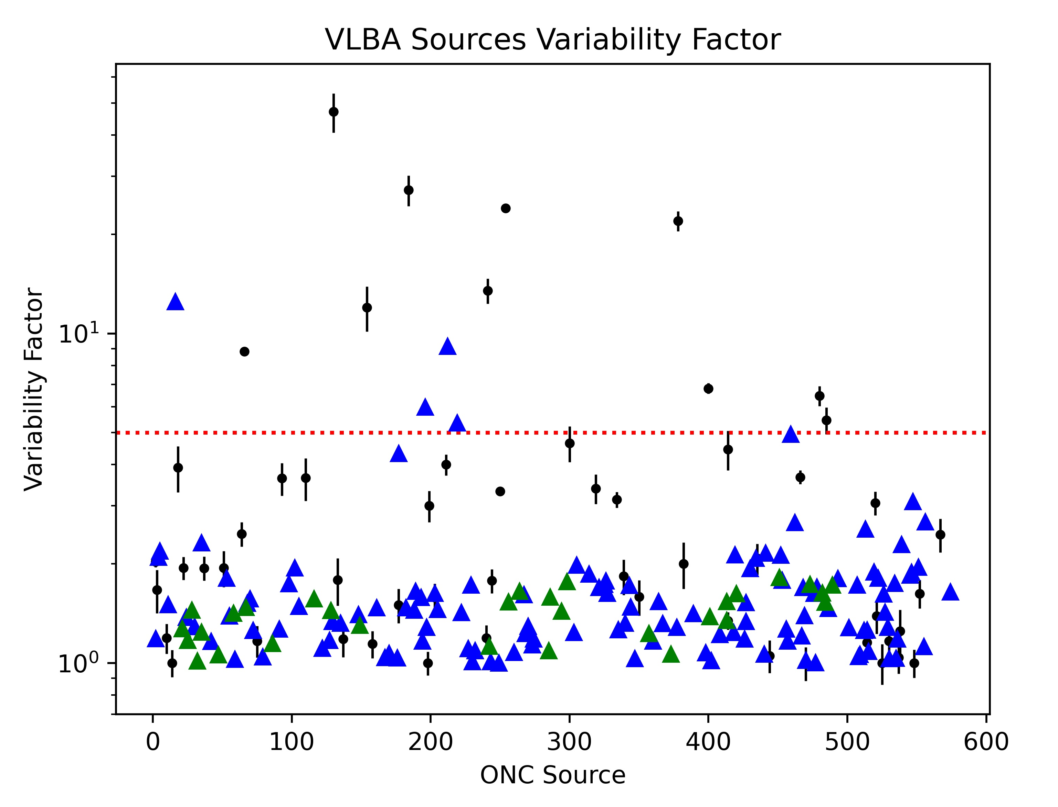
Radio Variability
Radio variability was analysed using the variability factor (VF) which is the ratio between the highest and lowest flux densities.
Sources with higher VFs ≥ 5 occur for 12 sources (~8% of the source population) and 5 sources have lower limits ≥ 5 (~3% of the source population).
The highest variability is mostly associated with longer timespans, but significant variability also occurs at shorter timescales.
References:
Dzib et al (2021), Forbrich et al (2016), Forbrich et al (2021), Vargas-González (2021).
Plot showing the variability factors (black) and lower limits (blue triangles for normal epochs, green for concatenated data) for all source detections. Red dotted line represents the limit for higher variability.
Notes:
Radio variability was analysed using the variability factor, the ratio between the highest and lowest flux densities.
There are 12 sources with higher VFs (>5) which is ~8% of the source population, and 5 sources with lower limits > 5.
- This variability is mostly associated with longer timespans of years rather than days, but there is also significant variability occurring at shorter timescales.

Slide 4
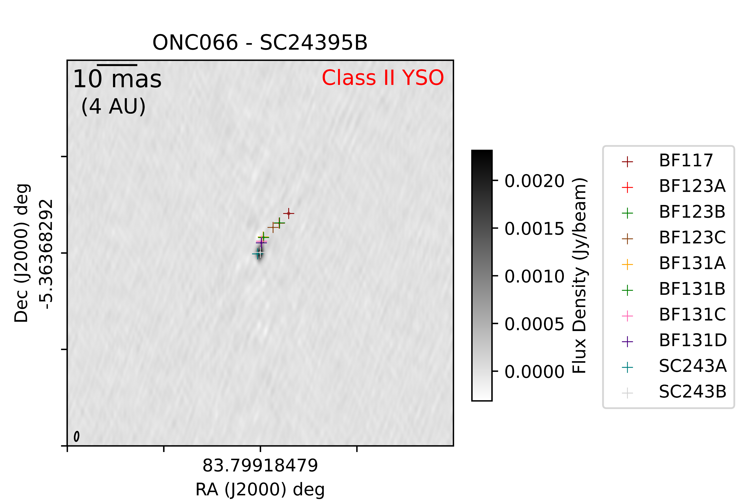
Conclusions and Future Work
Variability is associated with a variety of YSO types and spectral types.
Continued analysis of variability within epochs to explore shorter timespans.
Phase referenced VLBI observations allow high precision astrometry and absolute proper motions.
Further three VLBA epochs expanding the census and timerange.
VLBA image of source [FRM2016] 66 showing the source positions per epoch.
References:
Dzib et al (2021), Forbrich et al (2016), Forbrich et al (2021), Vargas-González (2021).
Notes:
Variability is associated with a variety of YSO types and spectral types.
Continue our analysis of variability within each epoch to explore shorter timescales.
Phase references VLBI data allows high precision astrometry and absolute proper motions. The smallest synthesised beamsize is milliarcseconds in size corresponding to 0.4 AU at the distance of the ONC.
There are three further VLBA epochs to be analysed.

