Slide 1
Theory and observation of plasmoid-modulated magnetic reconnection
Andrew Hillier (University of Exeter)
Shinsuke Takasao (Musashino Art University)

Slide 2
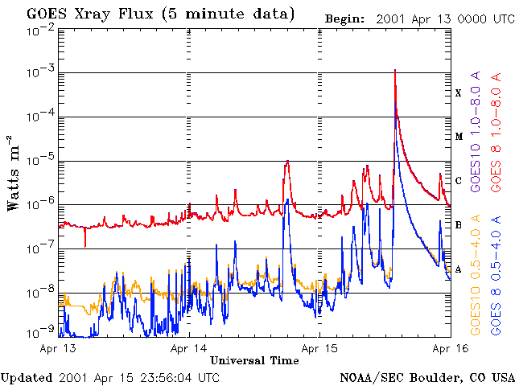
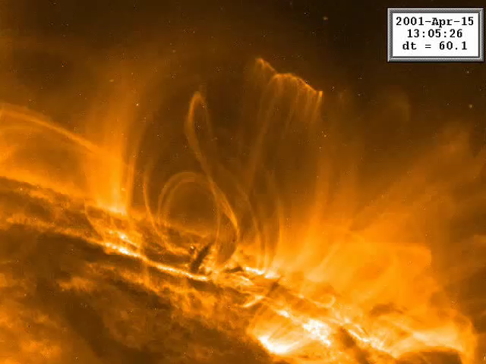
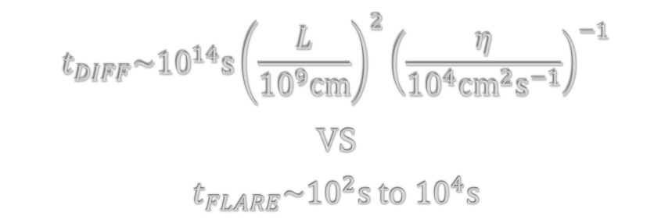
The reconnection timescale paradigm
$$t_{DIFF}\sim {10}^{14}s{\left(\frac{L}{{10}^{9}cm}\right)}^{2}{\left(\frac{η}{{10}^{4}{cm}^{2}s^{−1}}\right)}^{−1}$$
VS
$t_{FLARE}\sim {10}^{2}s$ to ${10}^{4}s$

Slide 3
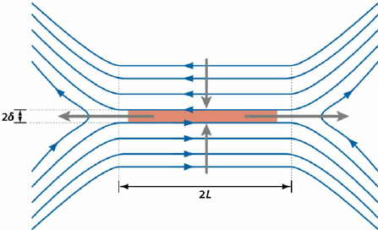
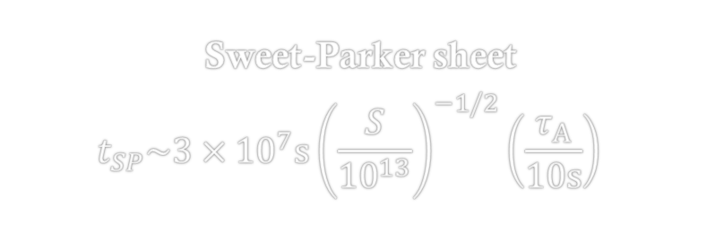


The reconnection timescale paradigm
$$t_{DIFF}\sim {10}^{14}s{\left(\frac{L}{{10}^{9}cm}\right)}^{2}{\left(\frac{η}{{10}^{4}{cm}^{2}s^{−1}}\right)}^{−1}$$
Sweet-Parker sheet
$$t_{SP}\sim {3×10}^{7}s{\left(\frac{S}{{10}^{13}}\right)}^{−1/2}{\left(\frac{τ_{A}}{10s}\right)}^{}$$
Yamada (2011)
$t_{FLARE}\sim {10}^{2}s$ to ${10}^{4}s$
Something further is required

Slide 4
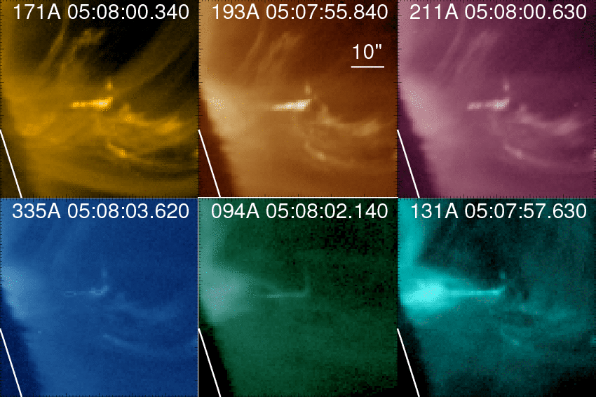
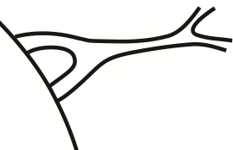
Plasmoid observations in flares
Solar Dynamics
Observatory, AIA
Takasao et al. 12, 16
0.6 MK
1.6 MK
2 MK
2.5 MK
1 & 7 MK
0.4 & 11 MK

Slide 5
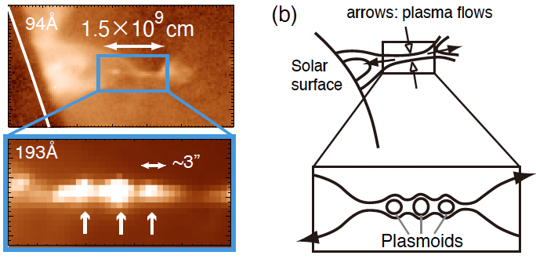
An example observation of plasmoids
Takasao et al. 12, 16
See also, e.g.,
Asai et al. 04,
Wei Liu et al. 13,
Nishizuka et al. 15,
Kumar et al. 19,
Patel et al. 20
See also polarization measurements by French et al. 19
Note: detection of spatially-resolved plasmoids is very rare.

Slide 6
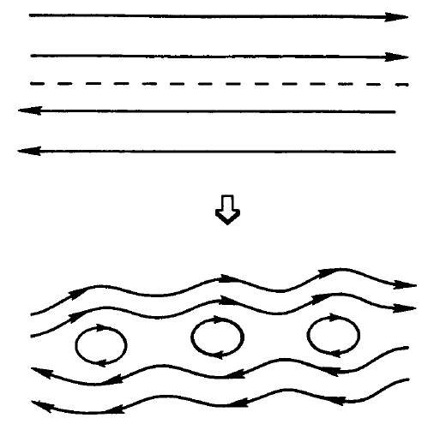




Classical tearing instability
fragmentation of an infinitely long current sheet
$$2a$$
From Tajima & Shibata 02
Based on the work of Furth et al. 1963 (FKR theory) and Steinolfson & van Hoven 1984
Define
$$τ_{A}^{∗}=a/V_{A}$$
$$S^{∗}=aV_{A}/η$$
Note: as we are interested in MHD processes, we use the classical Spitzer resistivity for $η$.
The most unstable mode:
$σ_{max}τ_{A}^{∗}≈S^{∗−1/2}$, $ak_{max}≈S^{∗−1/4}$

Slide 7
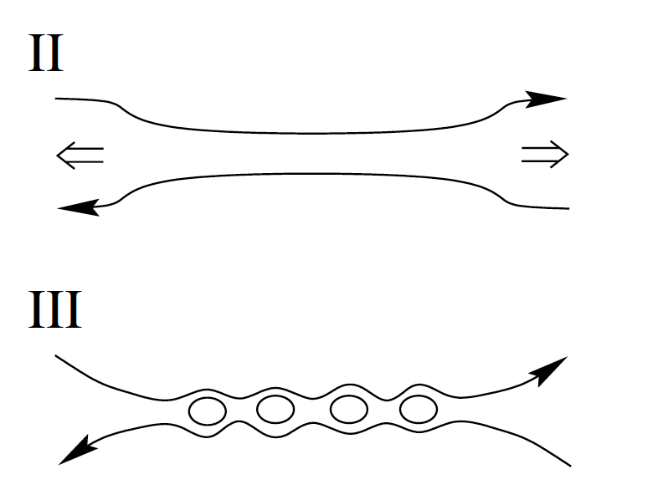




But, what happens in a current sheet with a limited size?
Consider a current sheet whose aspect ratio
scales as $\frac{a}{L}∼S^{−α}$ (physics/model-dependent),
and look for the acceptable $α$.
$$\frac{t_{tear}}{t_{A}}≈S^{−(3α−1)/2}$$
$$2L$$
$$2a$$
${t_{tear}}/{t_{A}}$ does not depend on $S$ when $α=1/3$
(Pucci & Velli 2014, Comisso et al. 2016, McTaggart 2020)
$α≤1/3$ is acceptable.
But, what $α$ value do we find for flares?

Slide 8



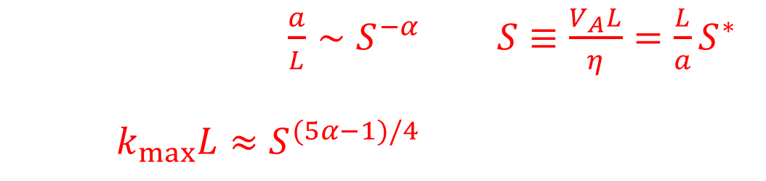


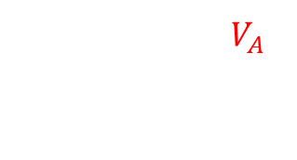
To connect theories to observations…
The most unstable mode of the tearing instability:
$σ_{max}τ_{A}^{∗}≈S^{∗−1/2}$, $ak_{max}≈S^{∗−1/4}$
$$L$$
Using the relations $\frac{a}{L}∼S^{−α}$ and $S≡\frac{V_{A}L}{η}=\frac{L}{a}S^{∗}$,
we get $k_{max}L≈S^{(5α−1)/4}$. By solving this for $α$,
Alfven speed $V_{A}$ from ejection speed
$$k_{max}^{−1}$$
and $S=V_{A}L/η$
$$α=\frac{4}{5}\left(\frac{\log_{10}(k_{max}L)}{\log_{10}(S)}+\frac{1}{4}\right)$$
All of them are observationally measurable!

Slide 9
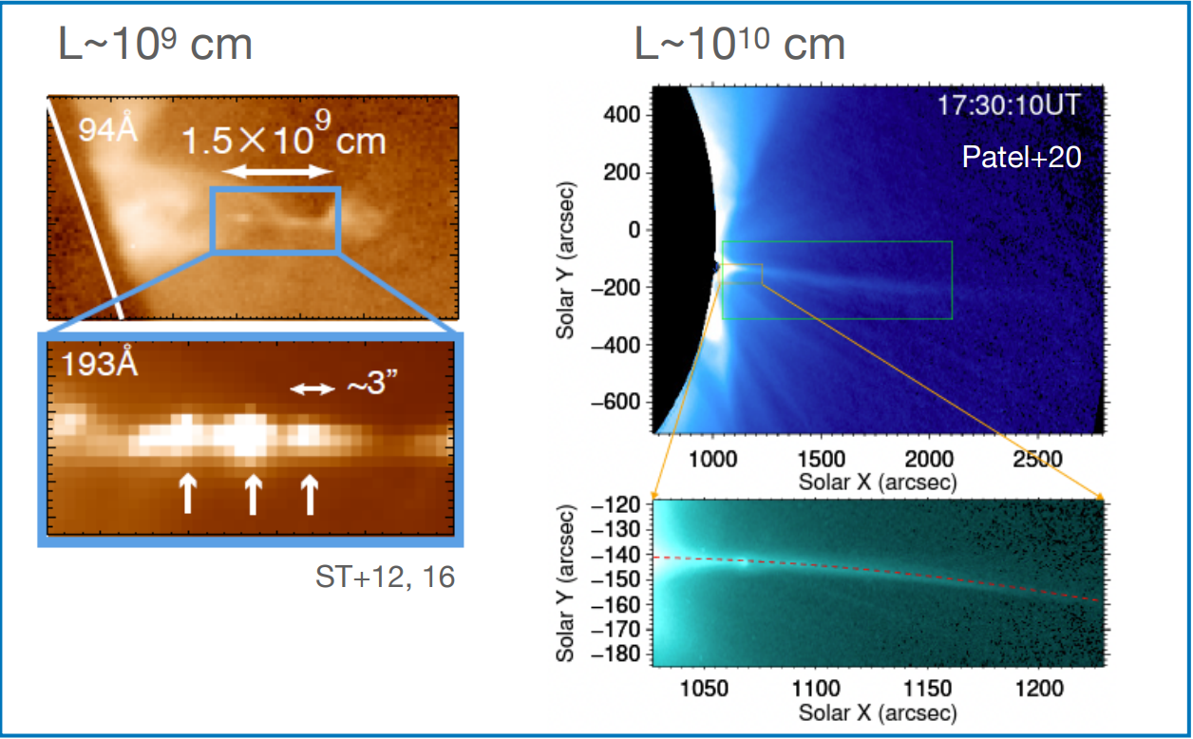

What the observations imply
$$α=0.27−0.31$$
close to the “ideal” limit value of $α=1/3$, but could be different.
Hillier & Takasao 22
Note: Only three flares considered due to lack of published examples

Slide 10



Consequences of the $α$ values
The expected width of the current sheet:
$$a≈2.2×{10}^{5}cm\left(\frac{L}{7×{10}^{8}m}\right){\left(\frac{S}{3.2×{10}^{12}}\right)}^{−0.27}$$
<< observed current-sheet line structure
(e.g. line-of-sight effect)
$$\frac{a}{L}∼S^{−0.27}$$
The expected timescale for the growth of tearing mode:
$$t_{tear}=ω_{max}^{−1}≈150s$$
<< observed flare timescale (hours)
flare timescale is reasonably long for plasmoids to develop.

Slide 11
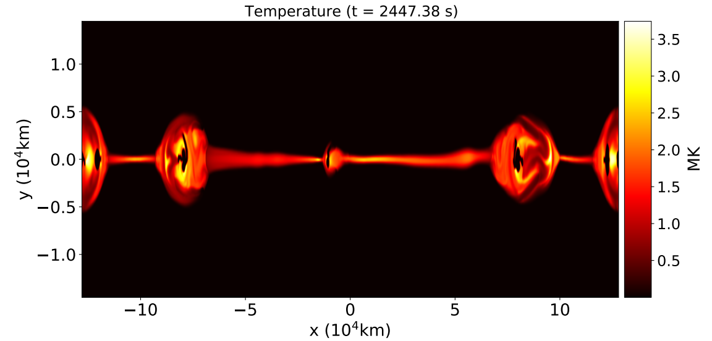

Departure from “ideal” limit
$$α=\frac{4}{5}\left(\frac{\log_{10}(k_{max}L)}{\log_{10}(S)}+\frac{1}{4}\right)$$
Due to the logs there is only a weak dependence of $α$ to quite large variations in parameters
This makes it potentially difficult to reconcile $α=0.27$ and the “ideal” limit of $α=1/3$. Maybe this is a signature of more physics.
Sen & Keppens 2022 show that cooling can enhance tearing modes. Maybe this is related.

Slide 12






Summary
We propose a method to connect theory of plasmoid-modulated reconnection
to observations of solar flares (Hillier & Takasao 2022).
depends on the mechanisms
of the formation/thinning of a current sheet
$$L$$
$$α=\frac{4}{5}\left(\frac{\log_{10}(k_{max}L)}{\log_{10}(S)}+\frac{1}{4}\right)$$
$$k_{max}^{−1}$$
and $S=V_{A}L/η$
We still need
more plasmoid observations (MUSE, Solar-C etc. will help)
theories to predict $α$

