Slide 1



Method of detecting solar flare ribbon fine structures
Dr. Georgios Chouliaras, Dr. Peter Wyper, Dr. Joel Dahlin, Professor Lyndsey Fletcher

Slide 2
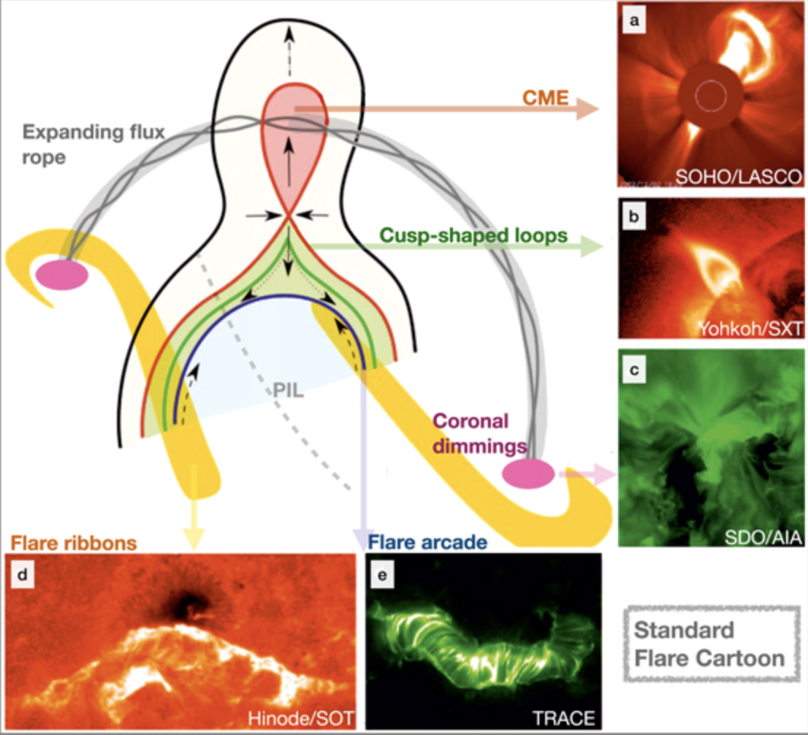
Solar flare ribbons
Solar flares are explosive events in the Sun’s corona that release as much as 10³² ergs in a matter of minutes.
The standard flare model well explains many of the observed features of two-ribbon flares.
Flare ribbons result from particles accelerated in the reconnection region impacting the chromosphere.
Flare ribbon evolution is therefore directly linked to the coronal reconnection process.
Kazachenko et al 2022

Slide 3
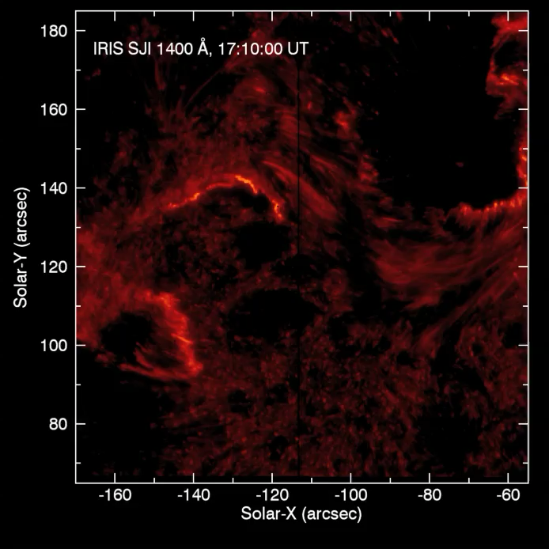
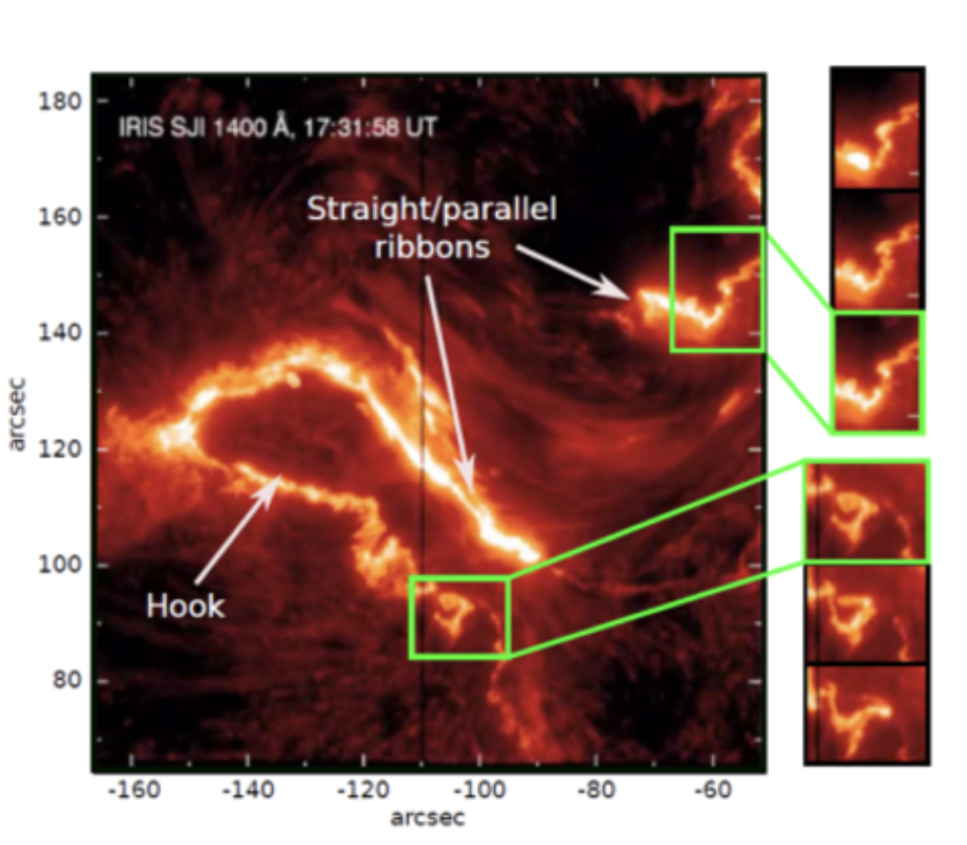
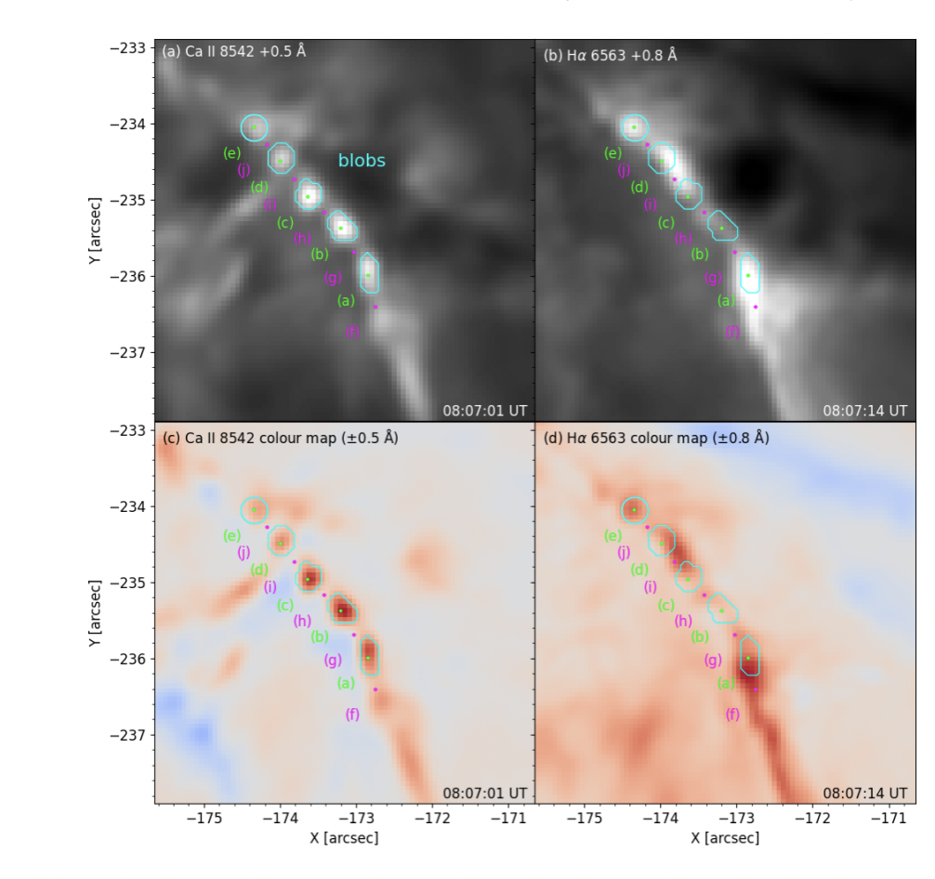
Flare ribbon fine structure
Wyper & Pontin 2021
Faber et al 2024
Spiral, wave-like and blob features often present within the ribbons.
Highly dynamic & evolving features.
Suggests flare reconnection is not smooth but bursty and turbulent, e.g. Shibata et al 2011.

Slide 4
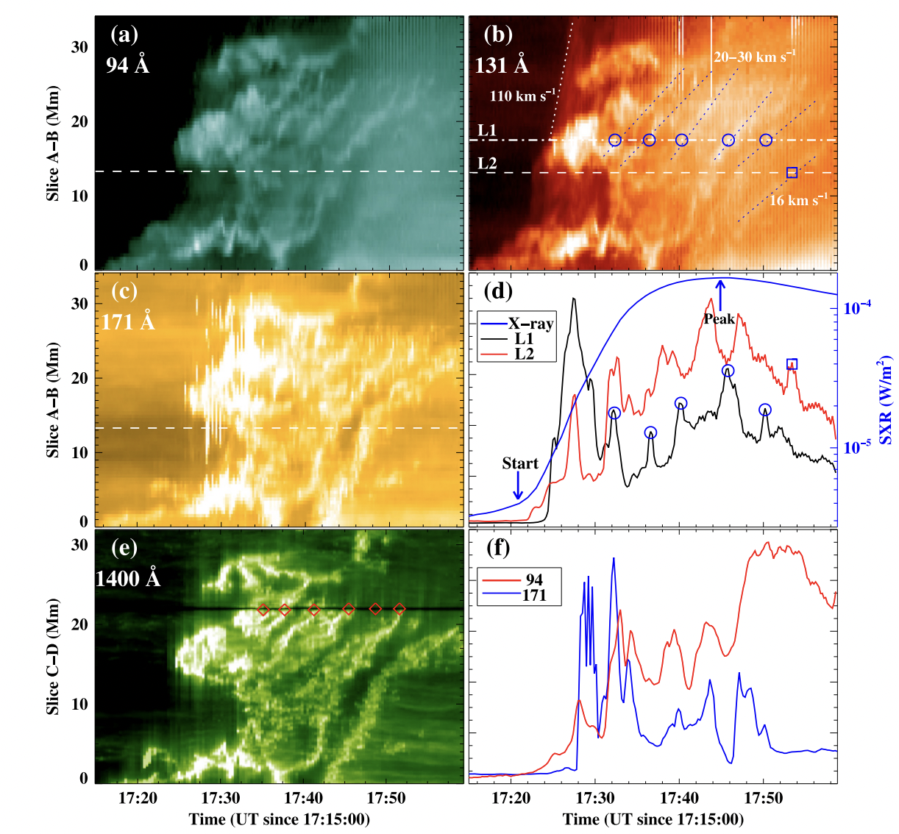
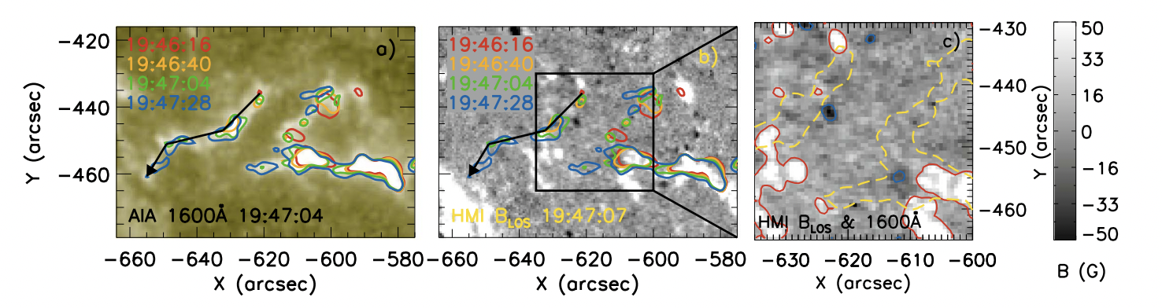
Drift speeds of flare-ribbon fine structure in recent studies
Drifting of bright knots in an X1.6 flare (Li & Zhang 2015)
  94 Å & 131 Å flare loops reveal bright knots that “slip” 20 – 110 km s⁻¹ every ≈ 3–6 min (panels a-d) in their figure.
Kernel/ribbon motions can be extremely fast in weak‑field hooks
  2012 Aug 31 event (Lörinčík et al. 2019) — AIA kernels swept up to ≈ 450 km s⁻¹.
  More recent studies have shown drift speeds > 1000km s⁻¹(Lörinčík et al. 2025)

Slide 5
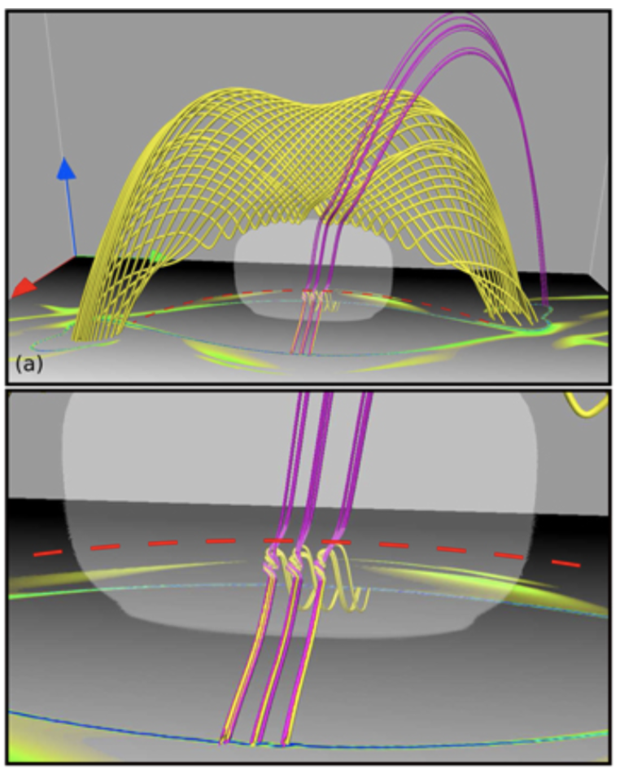
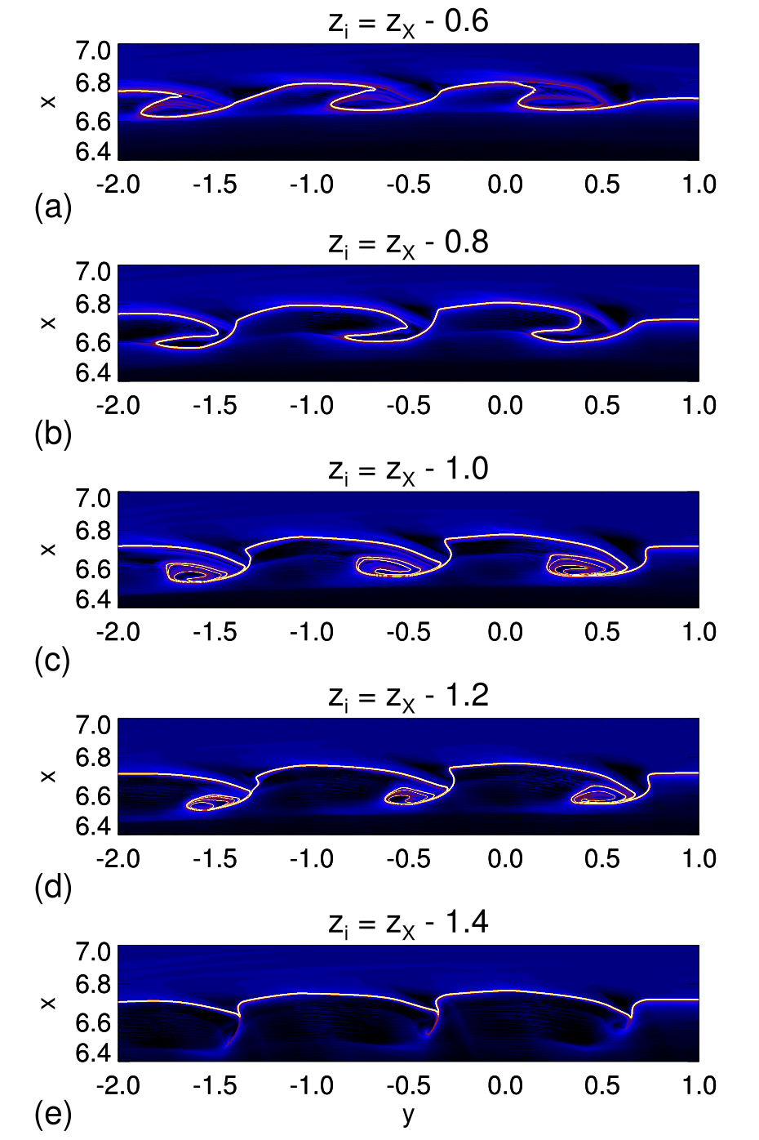
Theoretical modelling
Wyper & Pontin 2021
Analytical toy model representative of a two-ribbon flare.
Local twists representing plasmoids/tearing in the flare current layer produce spirals/waves in the squashing factor (a proxy for flare ribbons).
Suggests that spiral/wave-like ribbon sub-structure is the result of plasmoids.

Slide 6
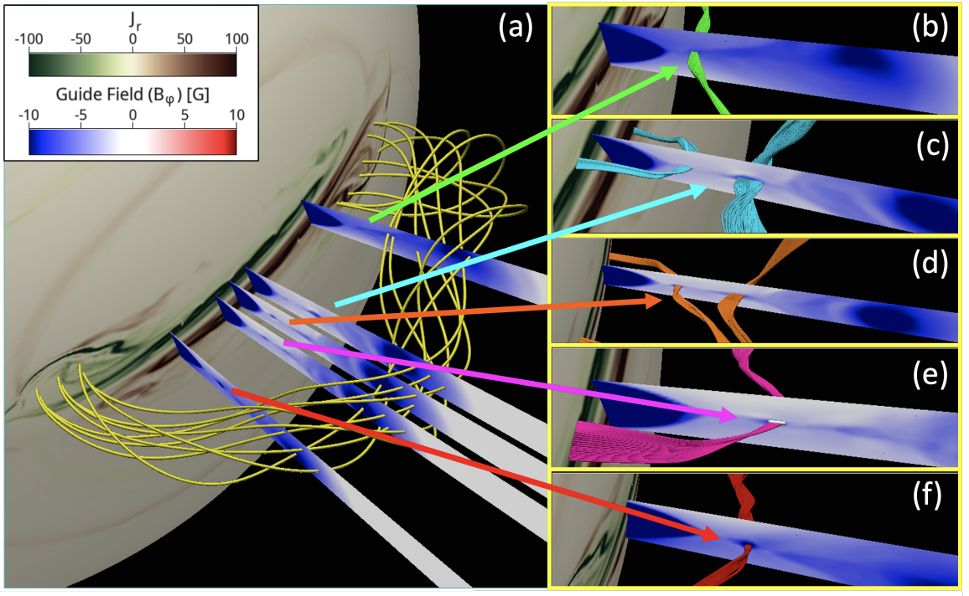
Numerical Simulation
Dahlin et al. 2022, 2025
Highly resolved 3D simulation of a two-ribbon flare in a breakout CME eruption.
Flare current sheet is fragmented with many plasmoids (high effective Lundquist number reached).
Twisted plasmoid field lines connect to spirals in the flare ribbons, confirming the analytical model of Wyper & Pontin 2021.
Can spirals therefore be used to infer current sheet properties?

Slide 7
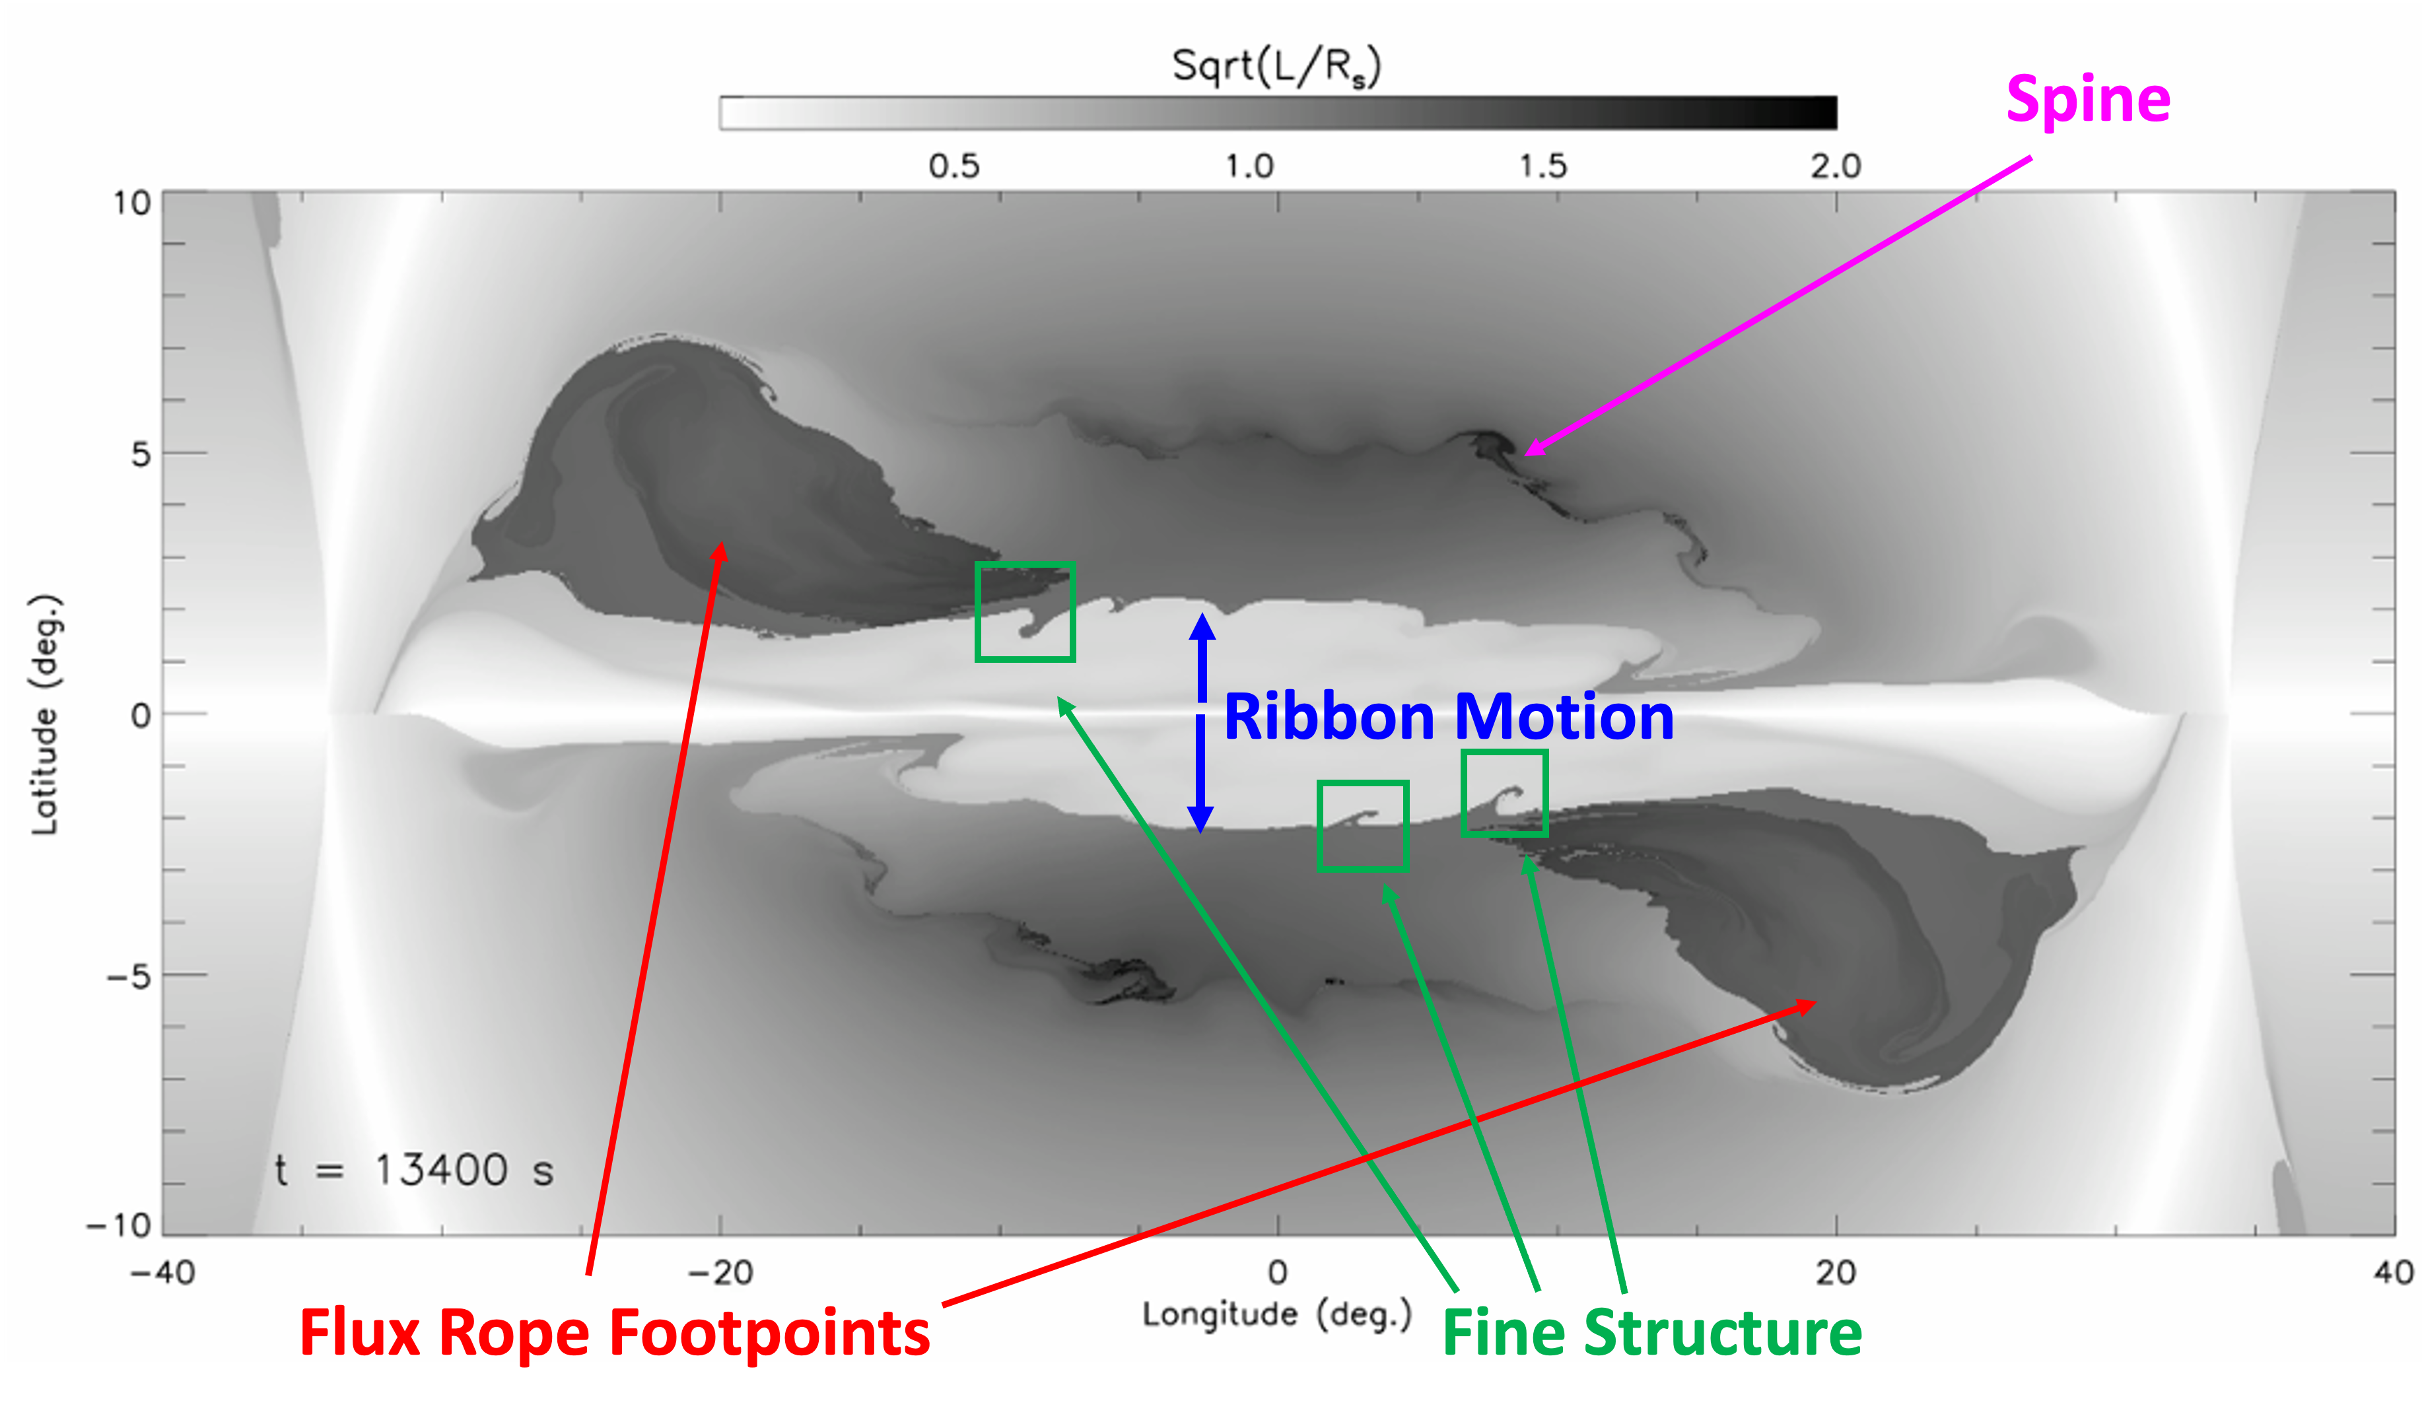
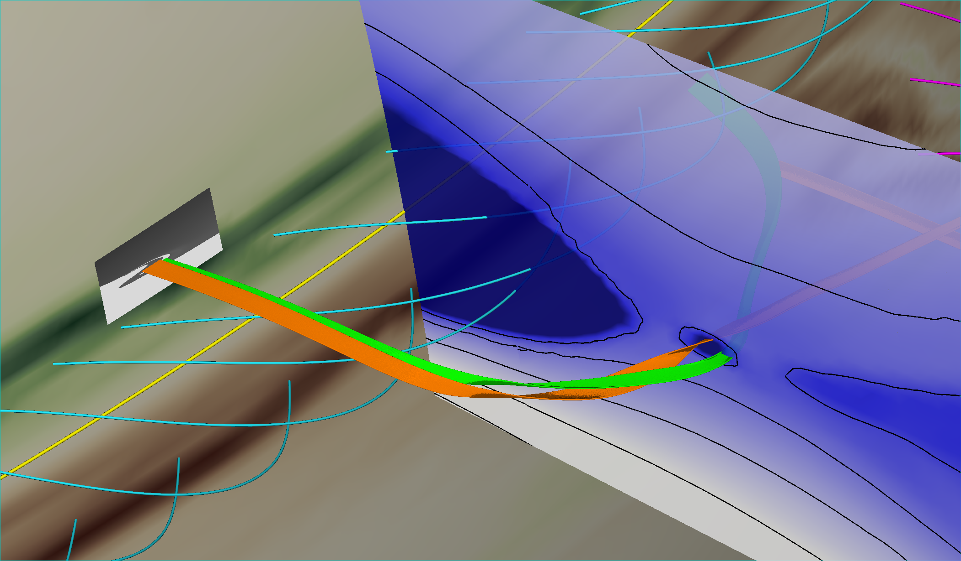
Identifying the ribbon front
Lmaps: simple diagnostic for identifying ribbons and other features.
Illuminates four key features:
  Flare arcade, flux rope footpoints, base of inner/outer spine, fine structure along arcade & flux rope
High-Res FLLM

Slide 8
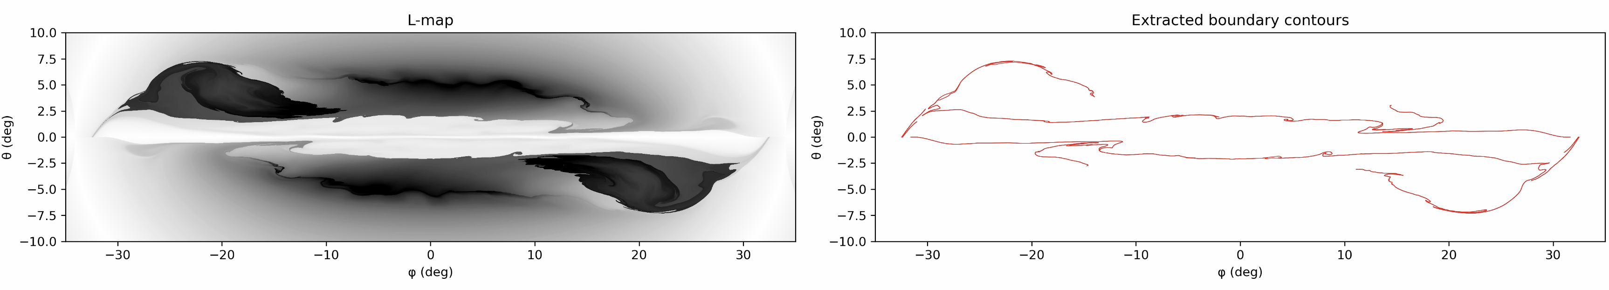
Identifying the ribbon front
A local gradient method is used to pick out jumps in the field line length (red contour lines).
Contours are then uniformly sampled as the first step in automatically identifying the spiral-like features.

Slide 9
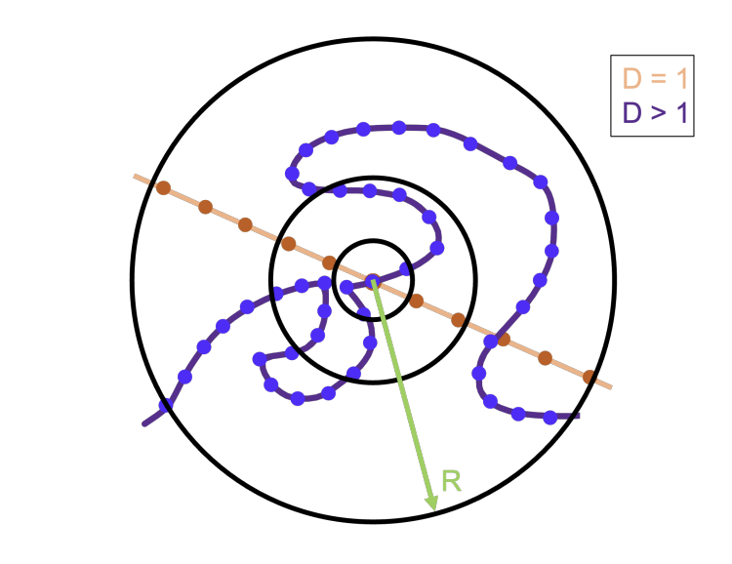
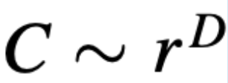
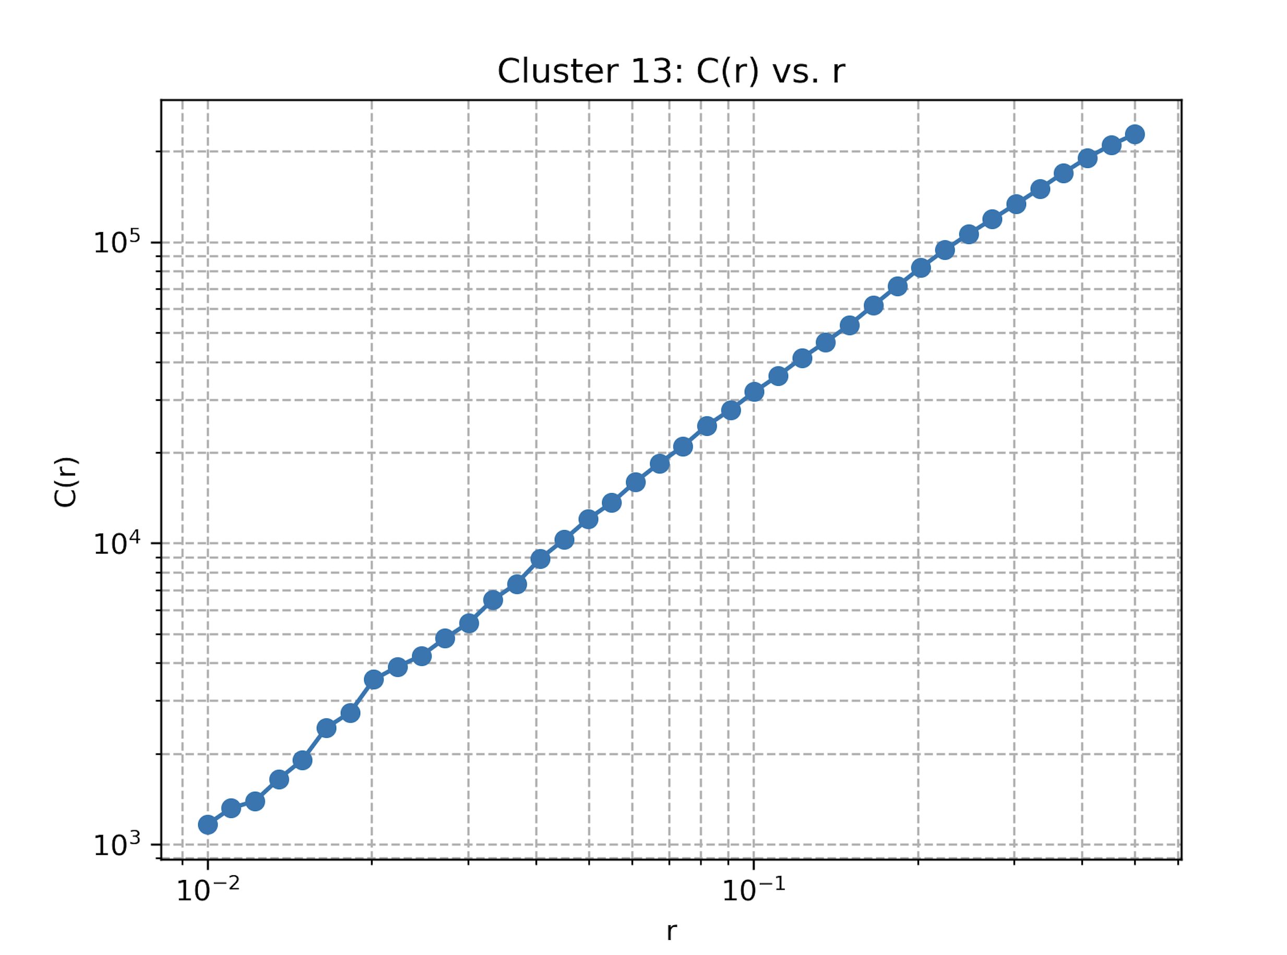
Correlation Dimension Method (CDM)
Mason et al 2022
For each point on the contour, the number of nearby points, C(r), within a given radius (r) is counted.
Typically gives an approximate power law relation that follows:
For a straight line D=1 (e.g. double r, double C(r) – brown line) but for spiral features D is between 1 and 2 (so is fractal between some length scales – blue line).
D is estimated by a linear fit of log C(r) vs log r, and this value assigned to that point on the line.
Mason et al 2022 employed CDM to analyze the complexity and scaling properties of coronal hole boundaries.

Slide 10
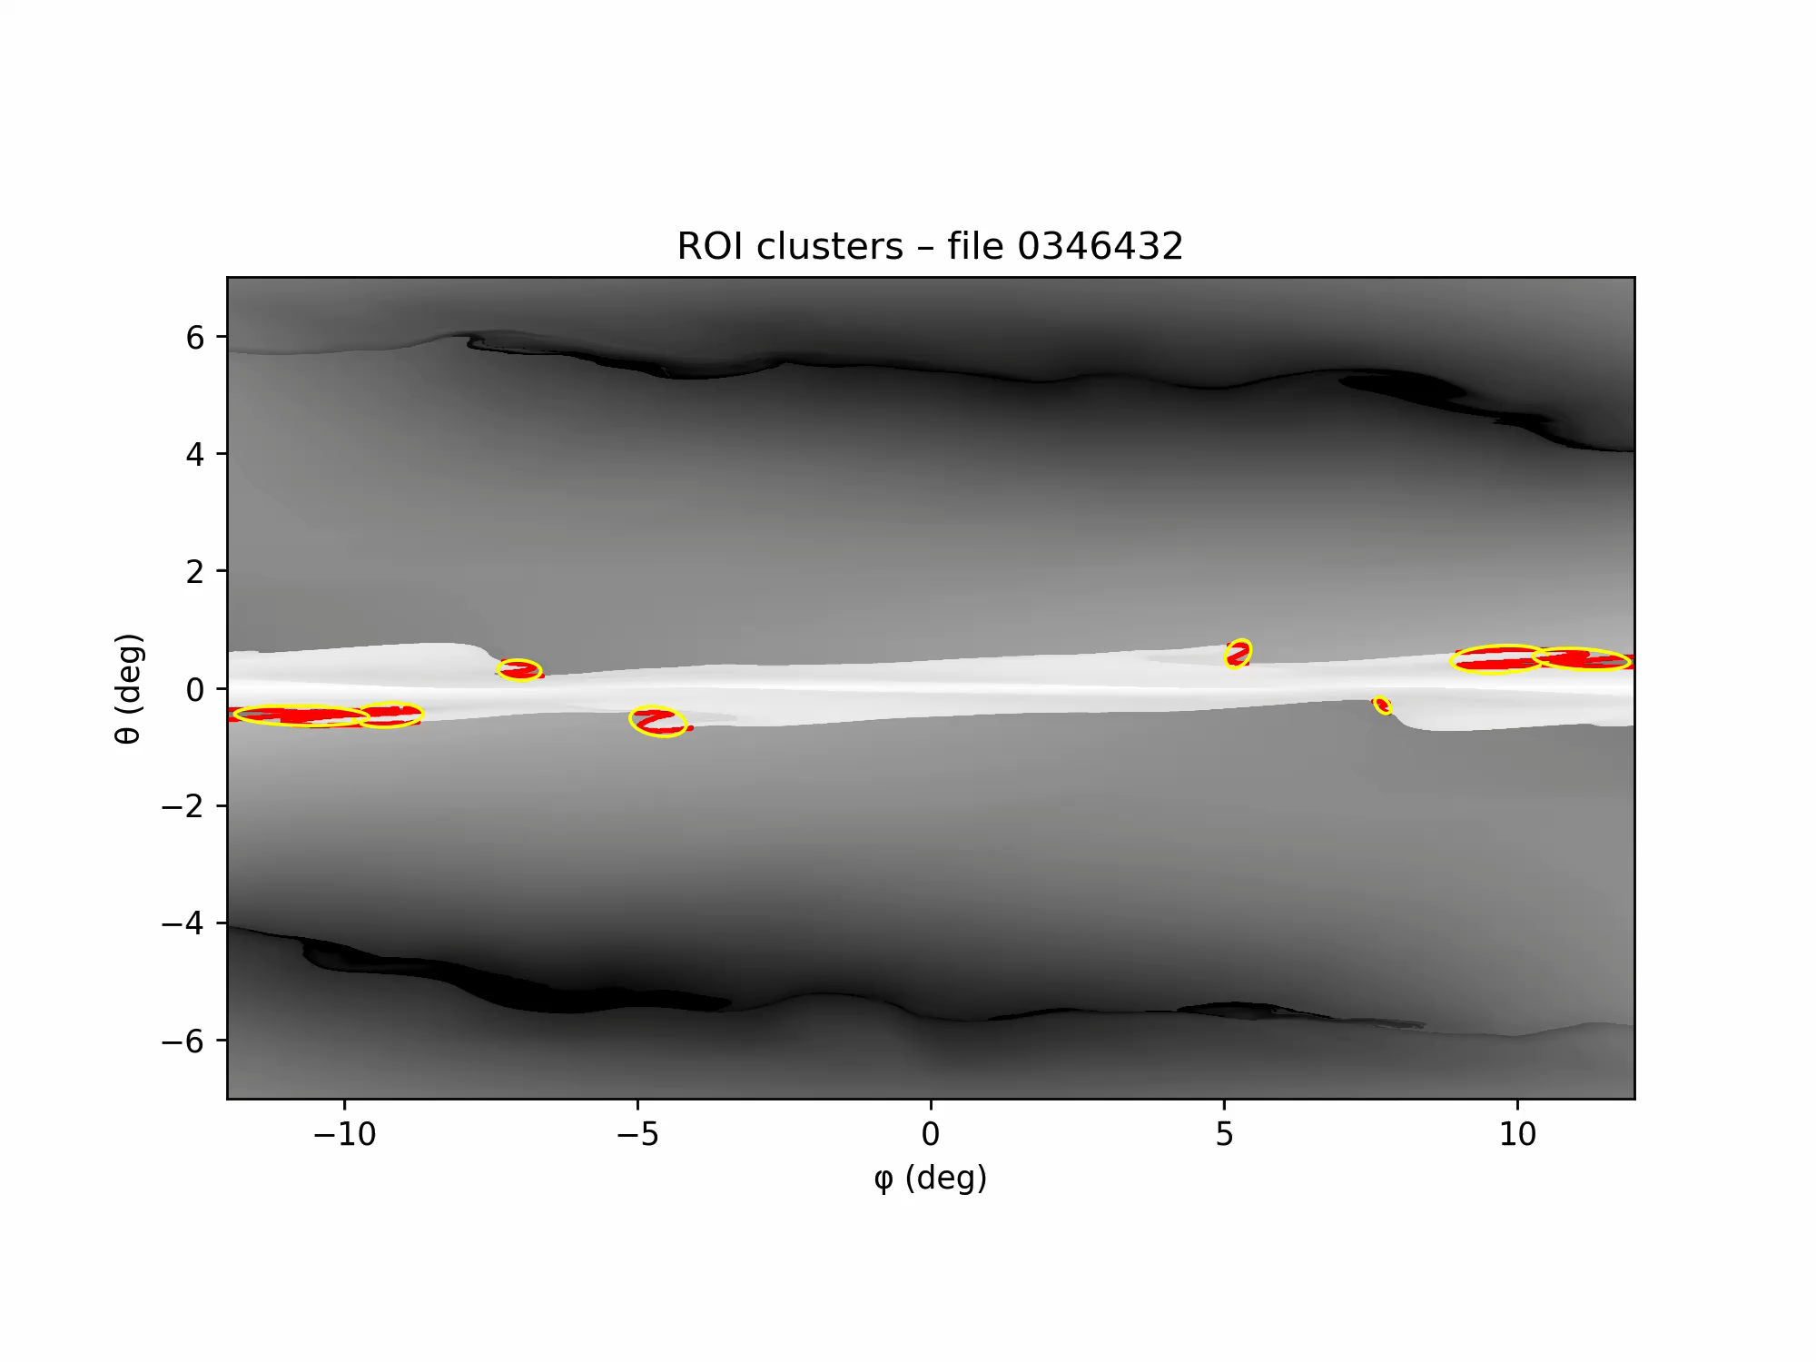
Automatically identifying ribbon sub-structure
Points (red points) whose correlation-dimension D exceeds the threshold are grouped with a density-based machine learning clustering algorithm, isolating the spiral segments.
The scale and complexity of the identified regions is highly dependent on threshold in the CDM and clustering method. Careful testing is needed for a particular dataset.
The yellow contour shows the best-fit ellipse for each cluster, allowing us to track the cluster’s dynamic evolution over time. It is evident from the video that the spirals are drifting.

Slide 11
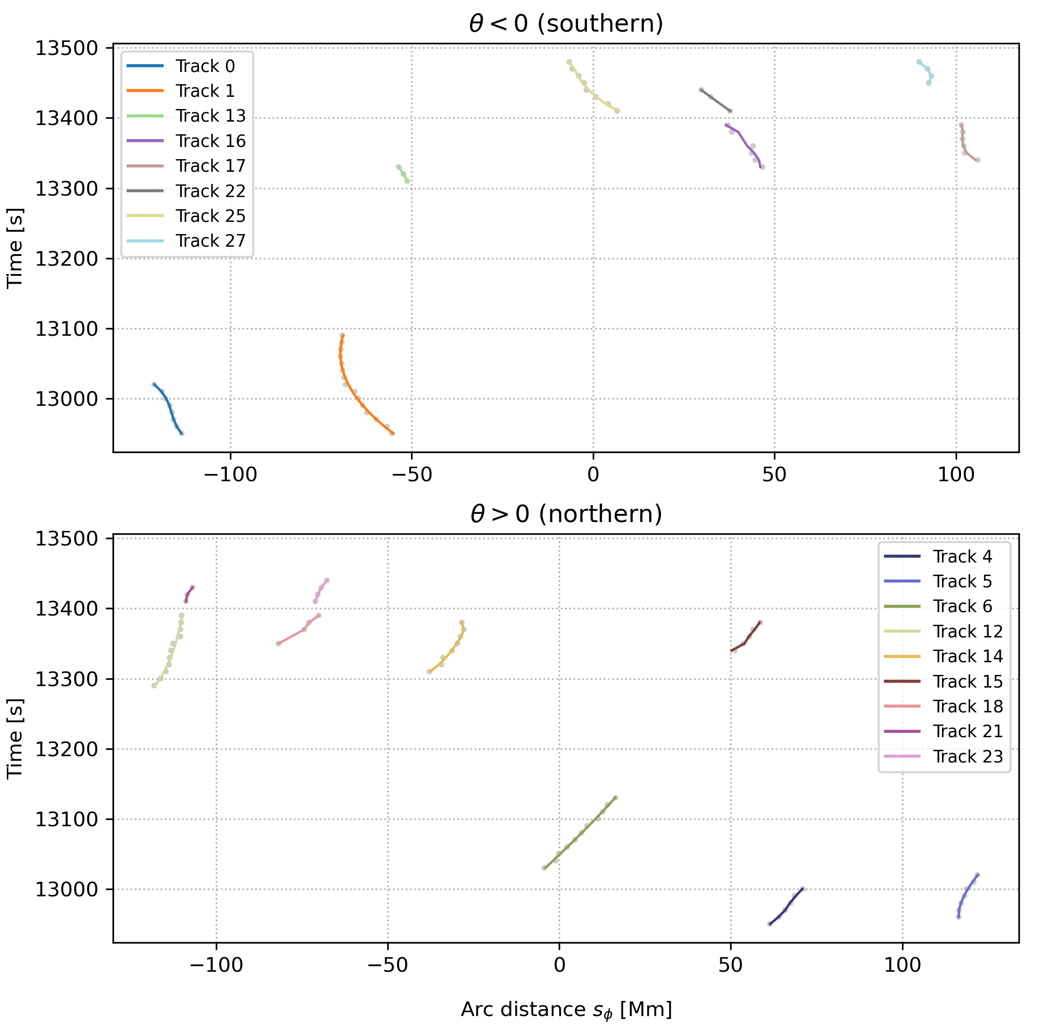
Time-distance plots
The automated method enables us to identify several spirals along the straight segment of the ribbon and to track their lateral motion.
We fit the scatter points using a local polynomial least-squares method.

Slide 12
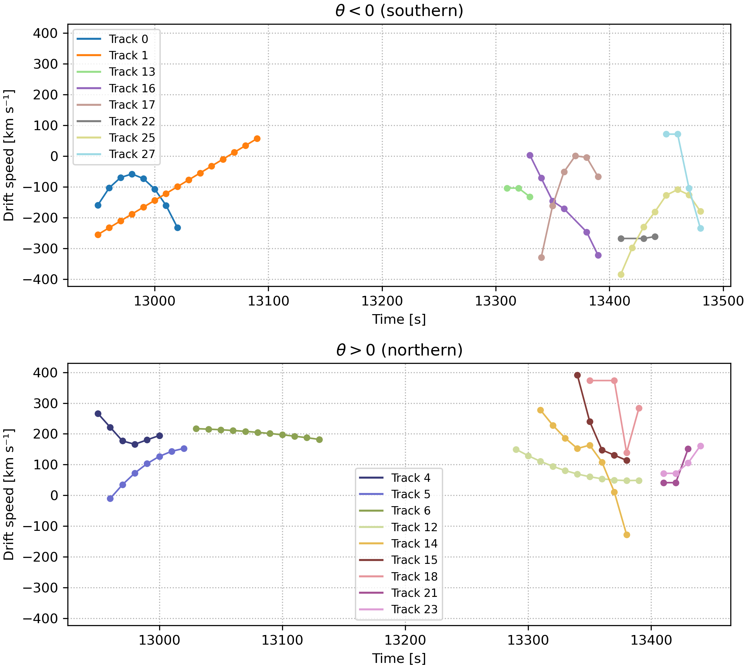
Drift velocities
We evaluate the derivative of the fitted polynomial to compute the drift velocity.
These velocities are of the same order of magnitude as those reported in observational studies e.g Ting Li et al., 2015;Lorincik et al., 2019.
The trends in the drift velocities could be linked with the dynamical evolution of the plasmoid in 3D (work in progress)

Slide 13
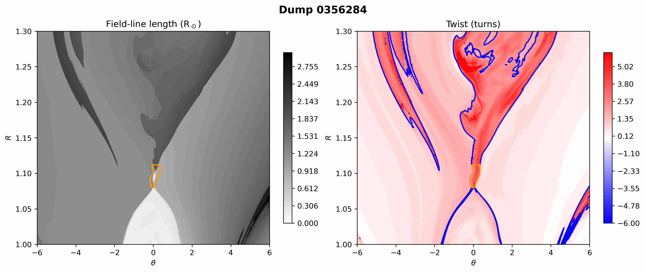
Downward moving plasmoid (vertical cuts)
We take vertical slices at the plasmoid’s ϕ-coordinate.
For each slice we compute the field-line length L and twist as functions of R and θ.
Blue contours: the global iso-line where twist = 2 turns (high-twist boundary for the whole domain).
Orange contours: the portion of that iso-line lying inside the θ and R-window, used to pinpoint the plasmoid.

Slide 14
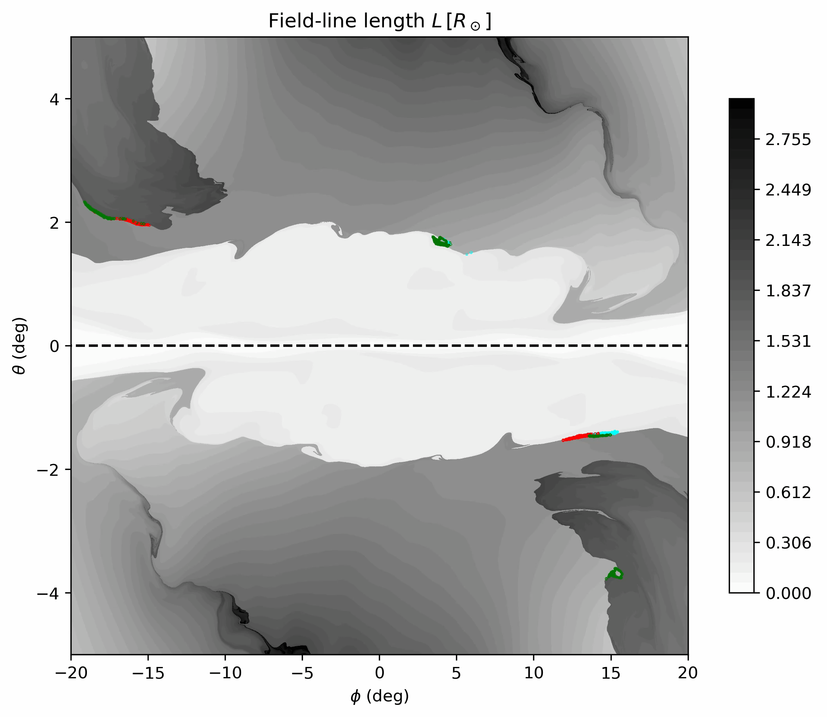
Downward moving plasmoid (photosphere footpoints)
We track the movement of the plasmoid in the volume.
We trace the field-lines from the plasmoid to their photospheric foot-points.
Cyan fieldlines — short flare-loop arcade field-lines.
Green+red fieldlines— medium-length inflow-arcade field-lines.
The observed drift correlates with changes in the magnetic-field connectivity.

Slide 15
Summary & future work
We have developed a new method for automatically identifying flare ribbon spiral-like fine-structure (Chouliaras et al 2025 in prep).
The method is based on finding the most locally ”fractal” regions of curves following the flare ribbon front.
The measured drift is linked with the connectivity changes that occur during the evolution of the plasmoid.
Next steps:
Compare the inferred ribbon evolutions and magnetic fluxes with the plasmoid evolution in the simulation volume.
Evaluate statistics of ribbon sub-structure properties throughout the lifetime of the simulated flare.
Link the different trends in the drift velocities with movement or characteristics of the plasmoid in 3D.
We plan to use this method on real observations.

