Slide 1

Identifying magnetic reconnection to assess its role in collisionless turbulent plasmas using the unsupervised machine learning TICC algorithm
Paulina A. Quijia Pilapaña, Julia E. Stawarz, Andy Smith.
2025 National Astronomy Meeting
paulina.pilapana@northumbria.ac.uk

Slide 2
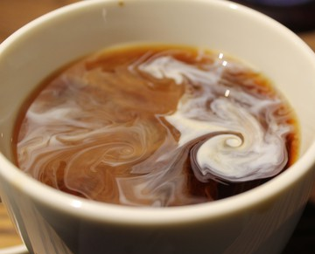
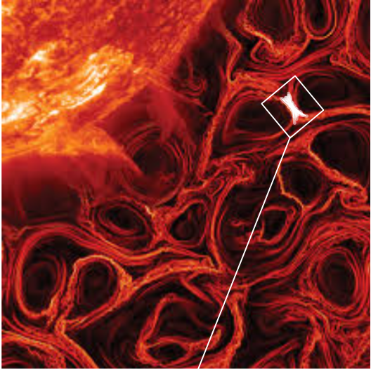
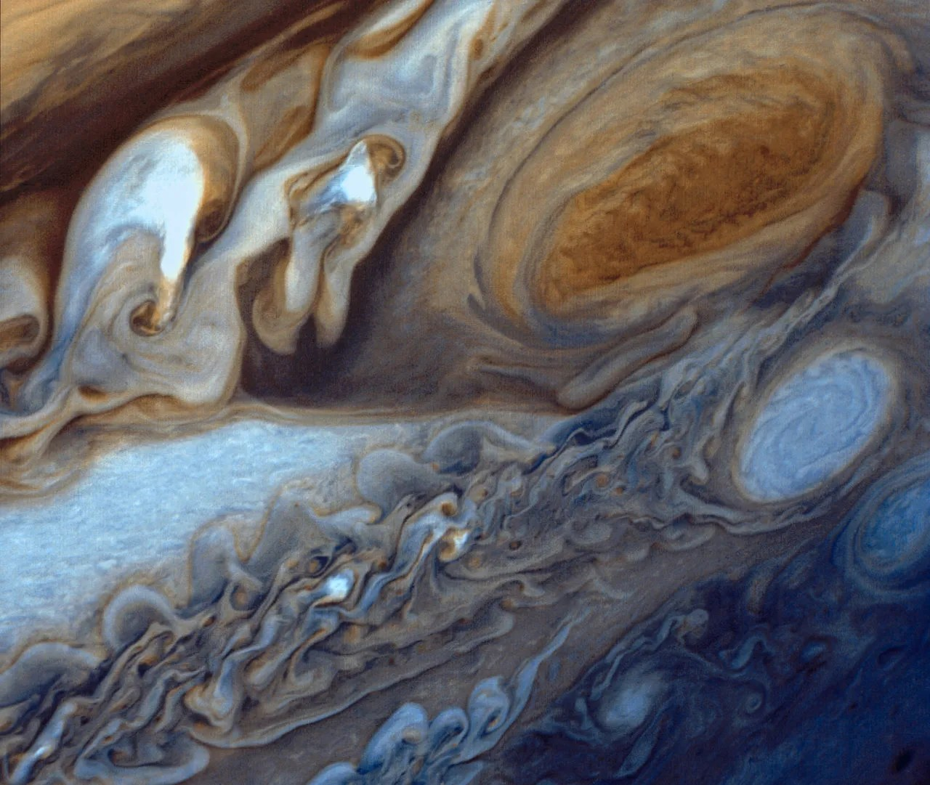
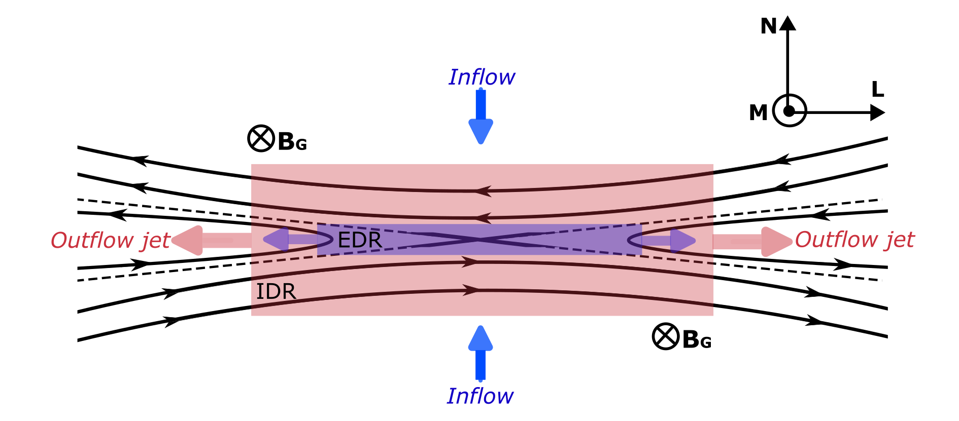
Universal phenomenon
Turbulence and Reconnection in Space Plasma
TURBULENCE
Nonlinear process.
Fluctuations span vast scales.
Naturally creates intense, thin current sheets.
MAGNETIC RECONNECTION
Standard reconnection:
  Ion and electron jets accelerated away from the diffusion region.
Electron-only reconnection (Phan et al., 2018):
  Thinner associated current sheets.
  Just electron outflows observed.
RAS, 2015
Field lines change connectivity releasing magnetic energy.
Nasa/JPL
paulina.pilapana@northumbria.ac.uk 1
Notes:
Turbulence is a universal phenomenon we see everywhere, from fluids like coffee to planetary atmospheres like Jupiter’s. It is a complex, nonlinear process, that generates fluctuations that span over a wide range of scales. In collisionless plasmas, turbulence naturally creates thin, intense current sheets where magnetic reconnection can occur.
Reconnection is a process where plasmas carrying oppositely-directed magnetic fields converge, break, and then reconnect in the diffusion region, releasing stored magnetic energy.
In the standard picture of reconnection, both ions and electrons are accelerated away from the diffusion region. However, it’s also been observed only electron jets, unaccompanied by ion jets. This is associated with thinner current sheets and is known as electron-only reconnection.
Both turbulence and reconnection are key to how energy is dissipated in space, but how this process occurs is not yet fully understood.

Slide 3
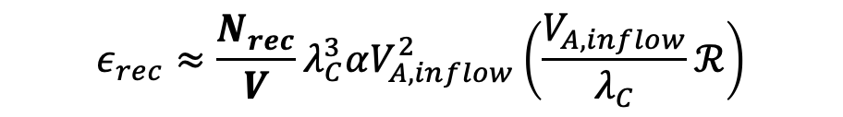
Turbulence-Driven Reconnection
Turbulence and magnetic reconnection is a two way-interaction.
Turbulent properties may be influencing the prevalence of reconnection (Loureiro & Boldyrev, 2017; Stawarz et al., 2019).
Reconnection facilitates the dissipation of energy at small scales (Servidio et al., 2011; Chasapis et al., 2018).
Challenging to identify reconnection events in observations of turbulent environments:
  Time-consuming
  Wide range of scales
  Complex magnetic topology
  Localised reconnection signatures.
Stawarz et al., 2022 identified reconnection from observations using a partially automated process to assess the role of reconnection in turbulent dissipation.
$$ε_{rec}≈\frac{N_{rec}}{V}λ_{C}^{3}αV_{A,inflow}^{2}\left(\frac{V_{A,inflow}}{λ_{C}}ℛ\right)$$
(Shay et al.,
2018)
paulina.pilapana@northumbria.ac.uk 2
Notes:
While turbulence and reconnection is a two-way interaction, my project focuses specifically on the turbulence-driven reconnection.
Our main goal is to understand how the properties of the turbulence affect how often reconnection occurs, as reconnection facilitates the dissipation of energy at small scales.
To do this, we need to be able to count a large number of reconnection events to perform a robust statistical analysis. For example, some models that quantify the energy budged of reconnection events generated by the turbulent dynamics, like the equation shown here, depend directly on the number of reconnection events per unit of volume
However, finding reconnection events in observational data is a huge challenge. It's time-consuming and the signatures are complex and localized. Julia and her colleagues, demonstrated the value of this approach with a partially automated method to identify reconnection events across 60 turbulent intervals to assess their role in dissipation. This work also highlighted the need for a fully automated algorityhm to build a much larger statistical database.

Slide 4
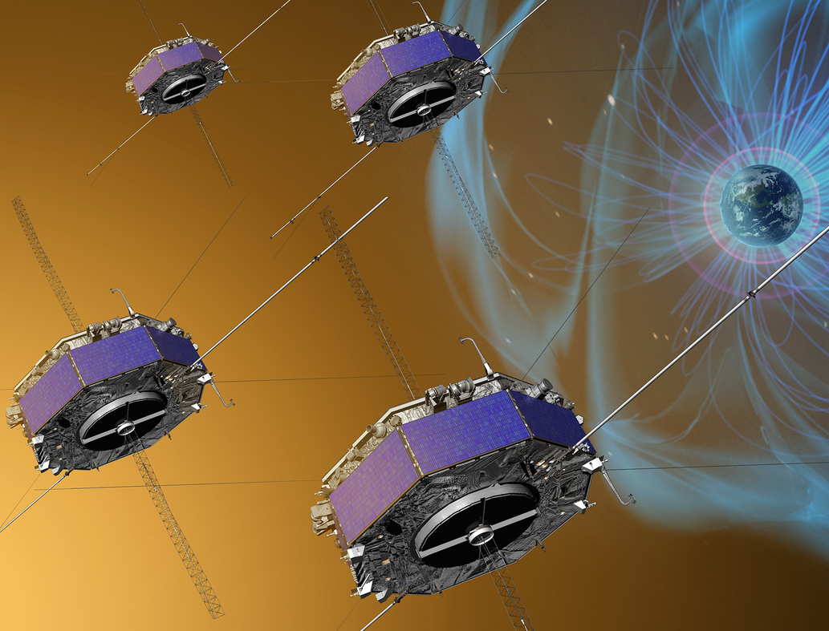
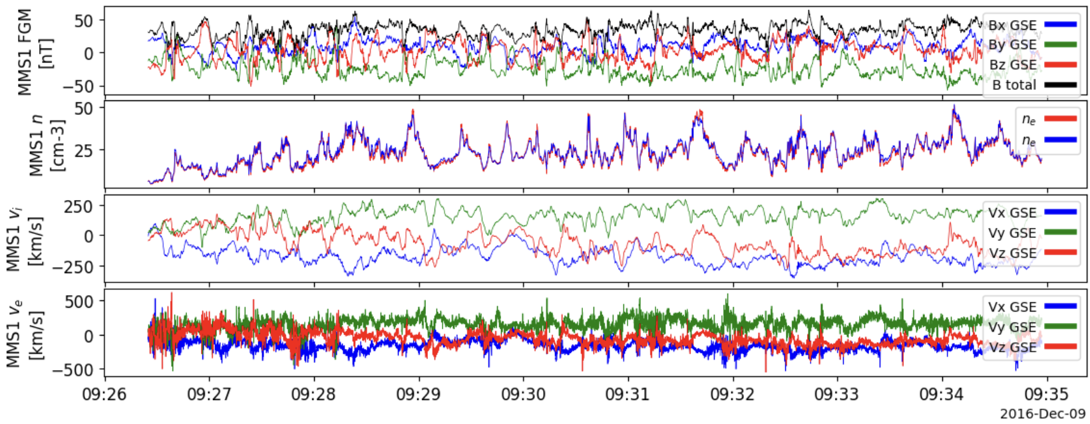
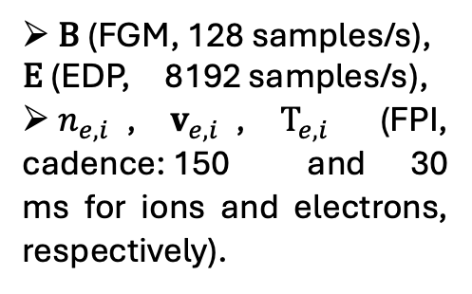
The Magnetosheath and the MMS mission
The magnetosheath: natural turbulence laboratory:
Highly nonlinear behaviour,
Thin intense current sheets where magnetic reconnection can occur.
The Magnetospheric MultiScale (MMS) mission (Burch et al., 2016):
Allows the computation of 3D gradients,
High-resolution measurements.
Adapted from Mary Pat Hrybyk-Keith/NASA
$\text{B}$ (FGM, 128 samples/s), $\text{E}$ (EDP, 8192 samples/s),
$n_{e,i}$, $v_{e,i}$, $T_{e,i}$ (FPI, cadence: 150 and 30 ms for ions and electrons, respectively).
NASA/Goddard
paulina.pilapana@northumbria.ac.uk 3
Notes:
To build an automated method we have the right environment and instruments.
A natural laboratory for turbulent studies is the Earth’s magnetosheath, a collisionless plasma that exhibits highly nonlinear behaviour and is filled with the small-scale current sheets where magnetic reconnection occurs.
The NASA magnetospheric multiscale (MMS) mission gives us access to this turbulent environment. MMS is a revolutionary mission that comprises 4 identical spacecraft in a tetrahedral formation. This allows for the computation of 3D gradients (important in plasma physics) and its instruments provide high-resolution measurements of electromagnetic fields and particle moments like density, velocity and temperature.
Here is an example of MMS observations from the turbulent magnetosheath. These valuable dataset provides the ideal input for our study.

Slide 5
Automatic algorithm to identify reconnection
Unsupervised Machine Learning (ML) algorithm: Toeplitz Inverse-Covariance Clustering (TICC) of Multivariate Time Series Data by D. Hallac et al. (2017).
  Each cluster is modelled with time-invariant correlation network defined by a short window of size (w).
Main steps to identify magnetic reconnection sites using TICC:
1)
Feature selection
2)
Train and apply TICC
3)
Identify reconnection cluster
4)
Isolate discrete reconnection events
paulina.pilapana@northumbria.ac.uk 4
Notes:
So, to perform this automatic analysis, we use an unsupervised machine learning algorithm called TICC, which stands for Toeplitz Inverse-Covariance Clustering.
The idea behind TICC is that different processes in the plasma have their own unique statistical 'fingerprint'. TICC automatically finds these fingerprints by modelling each cluster with a 'correlation network'—which is essentially a map of how all the plasma properties we measure relate to each other over a short time window w. It then groups all the moments in time that share the same fingerprint.
These are the main 4 steps to identify magnetic reconnection using TICC:

Slide 6
Automatic algorithm to identify reconnection
1)
Feature selection
2)
Train and apply TICC
3)
Identify reconnection cluster
4)
Isolate discrete reconnection events
Input set of parameters for the ML algorithm.
Independent-coordinate-system features that highlight reconnection sites using MMS data.
paulina.pilapana@northumbria.ac.uk 5
Notes:
The feature selection is a crucial step for our unsupervised algorithm, as it provides the input for the learning process. Using MMS data, we compute a set of parameters that highlight reconnection sites. These must be algebraic combinations of plasma and field measurements, and independent of any coordinate system.

Slide 7
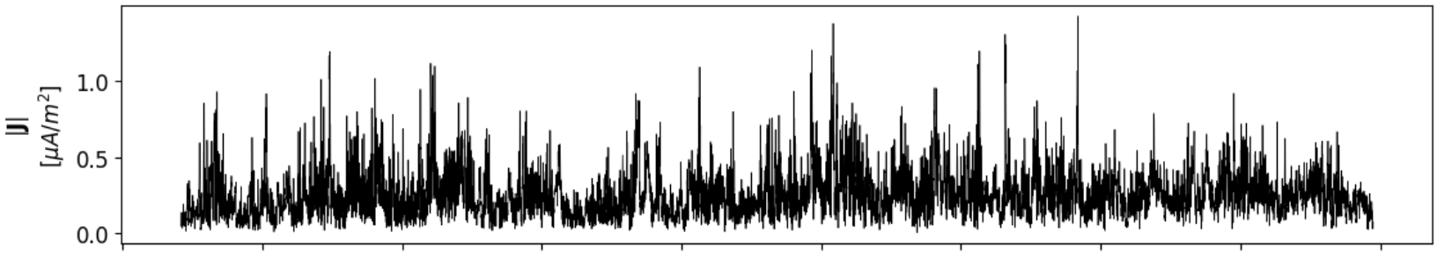
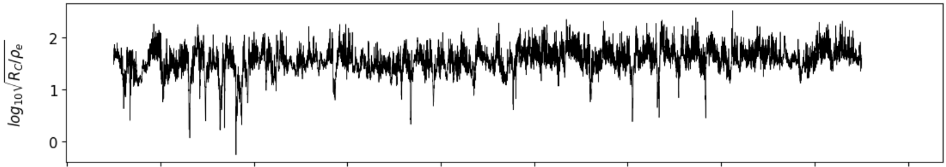
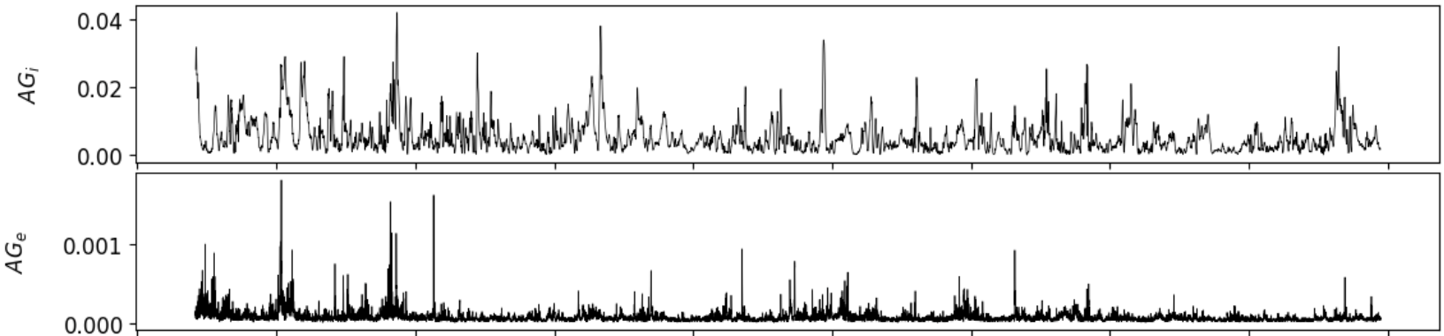
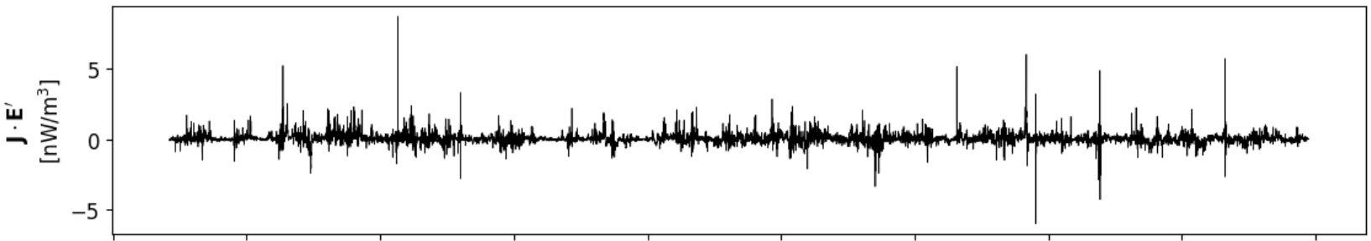
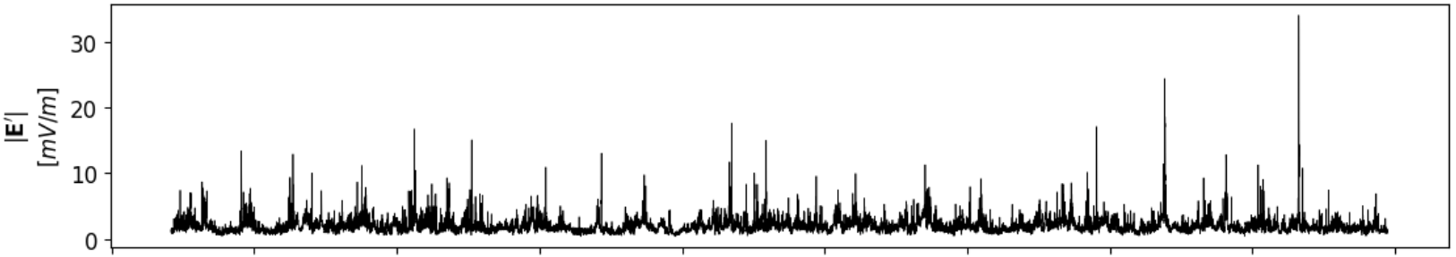
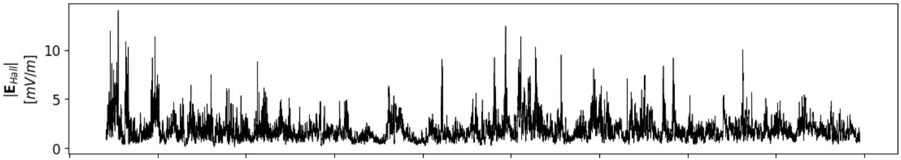
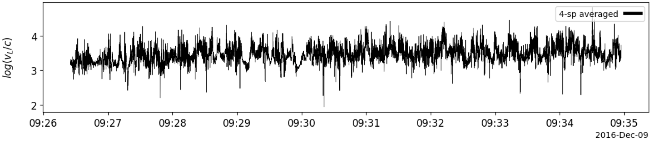
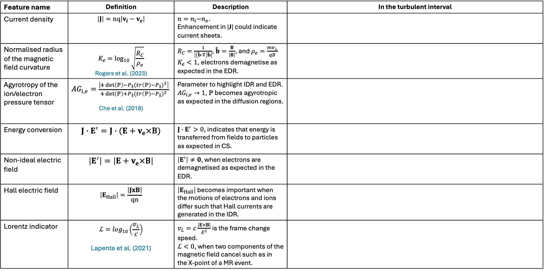
1) Feature selection
Feature name | Definition | Description | In the turbulent interval
Current density | $$\left|J\right|=\text{nq}\left|v_{i}−v_{e}\right|$$ | $n=n_{i}\sim n_{e}$. Enhancement in |J| could indicate current sheets.
Normalised radius of the magnetic field curvature | $$K_{e}=\log_{10}{\sqrt{\frac{R_{C}}{ρ_{e}}}}$$ Rogers et al. (2023) | $R_{C}=\frac{1}{\left|\left(\hat{b}∙∇\right)\hat{b}\right|}$, $\hat{b}=\frac{B}{\left|B\right|}$, and $ρ_{e}=\frac{mv_{⊥}}{qB}$ $K_{e}<1$, electrons demagnetise as expected in the EDR.
Agyrotropy of the ion/electron pressure tensor | ${AG}_{i,e}=\frac{\left|4\det\left(ℙ\right)−P_{∥}{(tr\left(ℙ\right)−P_{∥})}^{2}\right|}{4\det\left(ℙ\right)+P_{∥}{(tr\left(ℙ\right)−P_{∥})}^{2}}$ Che et al. (2018) | Parameter to highlight IDR and EDR. ${AG}_{i,e}→1$, $ℙ$ becomes agyrotropic as expected in the diffusion regions.
Energy conversion | $$J∙E^{′}=J∙(E+v_{e}×\text{B})$$ | $J∙E^{′}>0$, indicates that energy is transferred from fields to particles as expected in CS.
Non-ideal electric field | $$\left|E^{′}\right|=\left|E+v_{e}×\text{B}\right|$$ | $\left|E^{′}\right|≠0$, when electrons are demagnetised as expected in the EDR.
Hall electric field | $$\left|E_{Hall}\right|=\frac{\left|JxB\right|}{qn}$$ | $\left|E_{Hall}\right|$ becomes important when the motions of electrons and ions differ such that Hall currents are generated in the IDR.
Lorentz indicator | $$ℒ=\log_{10}\left(\frac{v_{L}}{c}\right)$$ Lapenta et al. (2021) | $v_{L}=c\frac{\left|E×B\right|}{E^{2}}$ is the frame change speed. $ℒ<0$, when two components of the magnetic field cancel such as in the X-point of a MR event.
paulina.pilapana@northumbria.ac.uk 6
Notes:
This table shows the features we selected to train our algorithm. You can see a description of each, along with how they behave in a sample turbulent interval. For now, I'll just highlight two quick examples.
First, since reconnection happens in intense current sheets, enhancements in the current density—like these sharp spikes—are a primary indicator.
Second is energy conversion. Positive spikes here show where energy is transferred from the fields to the particles, which is the key dissipation process we want to quantify.
The combination of this full set of features creates the data 'fingerprint' that we feed into the TICC algorithm.
-------
We take a pragmatic definition of reconnection to find locations where a reconnection electric field causes an E × B drift that carries two components of the magnetic field toward their elimination. With this in mind as our target, we observe that such locations can be found using a new indicator: the velocity of the Lorentz transformation that eliminates two components of the local magnetic field.
In this table, the features that highlight magnetic reconnection regions, along with a brief description and how they look when computed over the same turbulent interval shown before.
In a reconnection site or close to it, the current density present an enhancement in its quantity.
The normalised radius of the magnetic field curvature helps identifying diffusion regions. When electrons demagnetise from the magnetic field their motion becomes chaotic, and their gyroradius exceeds the magnetic field curvature radius so that this K_e indicator tends to 1.
An indicator that highlights ion and electron demagnetization from the magnetic field is the agyrotropy pressure tensor. As this indicator differs from 0 and tends to 1 it indicates diffusion regions.
An important feature is the energy conversion between fields and particles computed as the product of the current density and the electric field. In magnetic reconnection it is expected a positive energy conversion value as energy is transferred from fields to particles.
There are three terms of the generalised ohm law that become important within diffusion regions: the non-ideal E becomes significant where frozen-in condition breaks. The MHD term decreases because the plasma motion is not aligned with the magnetic field anymore within the electron diffusion region. The Hall term becomes important when ions and electrons decouple in the IDR.
Finally, the Lorentz indicator helps identifying where the magnetic field has singular topology, that is where the magnetic field is cancelled, this indicator drops to values much lower than 0.

Slide 8
1) Feature selection
Feature name | Definition | Description | In the turbulent interval
Current density | $$\left|J\right|=\text{nq}\left|v_{i}−v_{e}\right|$$ | $n=n_{i}\sim n_{e}$. Enhancement in |J| could indicate current sheets.
Normalised radius of the magnetic field curvature | $$K_{e}=\log_{10}{\sqrt{\frac{R_{C}}{ρ_{e}}}}$$ Rogers et al. (2023) | $R_{C}=\frac{1}{\left|\left(\hat{b}∙∇\right)\hat{b}\right|}$, $\hat{b}=\frac{B}{\left|B\right|}$, and $ρ_{e}=\frac{mv_{⊥}}{qB}$ $K_{e}<1$, electrons demagnetise as expected in the EDR.
Agyrotropy of the ion/electron pressure tensor | ${AG}_{i,e}=\frac{\left|4\det\left(ℙ\right)−P_{∥}{(tr\left(ℙ\right)−P_{∥})}^{2}\right|}{4\det\left(ℙ\right)+P_{∥}{(tr\left(ℙ\right)−P_{∥})}^{2}}$ Che et al. (2018) | Parameter to highlight IDR and EDR. ${AG}_{i,e}→1$, $ℙ$ becomes agyrotropic as expected in the diffusion regions.
Energy conversion | $$J∙E^{′}=J∙(E+v_{e}×\text{B})$$ | $J∙E^{′}>0$, indicates that energy is transferred from fields to particles as expected in CS.
Non-ideal electric field | $$\left|E^{′}\right|=\left|E+v_{e}×\text{B}\right|$$ | $\left|E^{′}\right|≠0$, when electrons are demagnetised as expected in the EDR.
Hall electric field | $$\left|E_{Hall}\right|=\frac{\left|JxB\right|}{qn}$$ | $\left|E_{Hall}\right|$ becomes important when the motions of electrons and ions differ such that Hall currents are generated in the IDR.
Lorentz indicator | $$ℒ=\log_{10}\left(\frac{v_{L}}{c}\right)$$ Lapenta et al. (2021) | $v_{L}=c\frac{\left|E×B\right|}{E^{2}}$ is the frame change speed. $ℒ<0$, when two components of the magnetic field cancel such as in the X-point of a MR event.
paulina.pilapana@northumbria.ac.uk 6
Notes:
First, since reconnection happens in intense current sheets, enhancements in the current density—like these sharp spikes—are a primary indicator.
Second is energy conversion. Positive spikes here show where energy is transferred from the fields to the particles, which is the key dissipation process we want to quantify.
The combination of this full set of features creates the data 'fingerprint' that we feed into the TICC algorithm.
-------
We take a pragmatic definition of reconnection to find locations where a reconnection electric field causes an E × B drift that carries two components of the magnetic field toward their elimination. With this in mind as our target, we observe that such locations can be found using a new indicator: the velocity of the Lorentz transformation that eliminates two components of the local magnetic field.
In this table, the features that highlight magnetic reconnection regions, along with a brief description and how they look when computed over the same turbulent interval shown before.
In a reconnection site or close to it, the current density present an enhancement in its quantity.
The normalised radius of the magnetic field curvature helps identifying diffusion regions. When electrons demagnetise from the magnetic field their motion becomes chaotic, and their gyroradius exceeds the magnetic field curvature radius so that this K_e indicator tends to 1.
An indicator that highlights ion and electron demagnetization from the magnetic field is the agyrotropy pressure tensor. As this indicator differs from 0 and tends to 1 it indicates diffusion regions.
An important feature is the energy conversion between fields and particles computed as the product of the current density and the electric field. In magnetic reconnection it is expected a positive energy conversion value as energy is transferred from fields to particles.
There are three terms of the generalised ohm law that become important within diffusion regions: the non-ideal E becomes significant where frozen-in condition breaks. The MHD term decreases because the plasma motion is not aligned with the magnetic field anymore within the electron diffusion region. The Hall term becomes important when ions and electrons decouple in the IDR.
Finally, the Lorentz indicator helps identifying where the magnetic field has singular topology, that is where the magnetic field is cancelled, this indicator drops to values much lower than 0.

Slide 9
Automatic algorithm to identify reconnection
1)
Feature selection
2)
Train and apply TICC
3)
Identify reconnection cluster
4)
Isolate discrete reconnection events
Train TICC over different turbulent datasets to find “the best model”.
paulina.pilapana@northumbria.ac.uk 7
Notes:
The next step is finding the best model after tuning TICC hyperparameters.

Slide 10
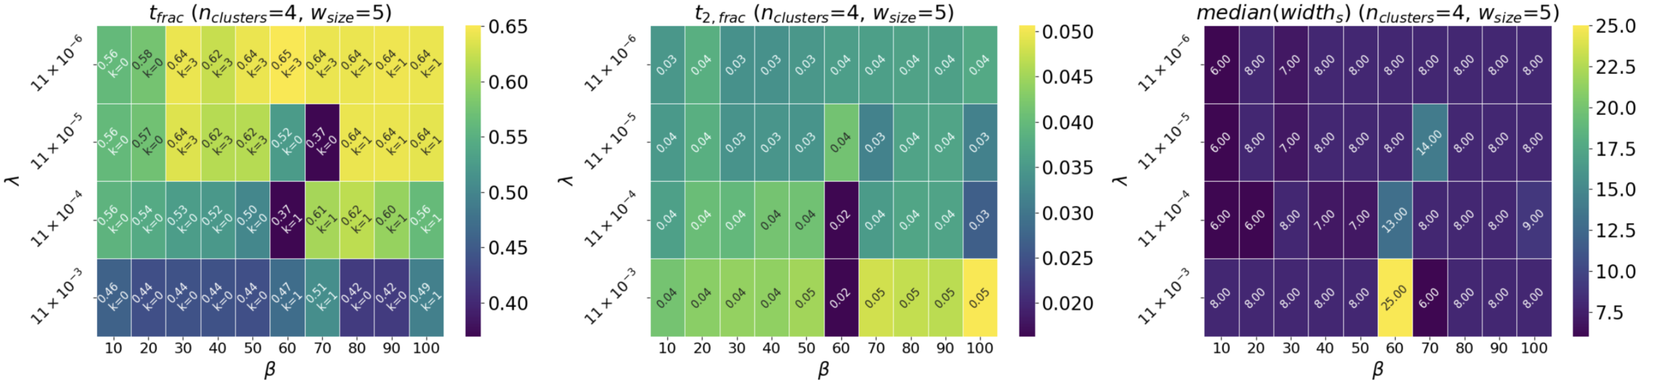
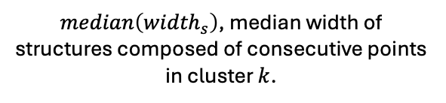
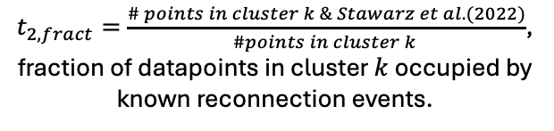
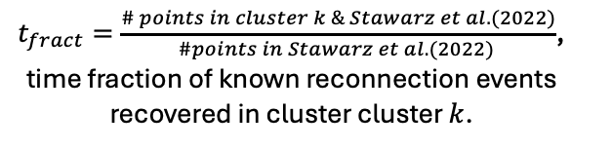
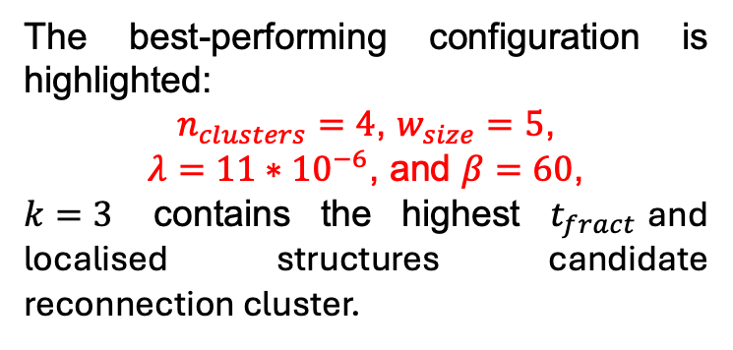
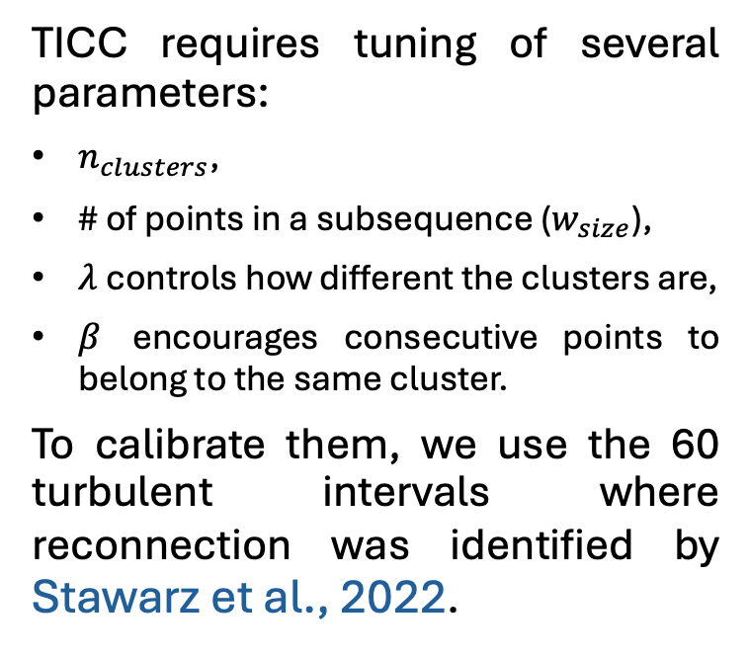
2) Train and apply TICC
TICC requires tuning of several parameters:
$n_{clusters}$,
# of points in a subsequence ($w_{size}$),
$λ$ controls how different the clusters are,
$β$ encourages consecutive points to belong to the same cluster.
To calibrate them, we use the 60 turbulent intervals where reconnection was identified by Stawarz et al., 2022.
$t_{fract}=\frac{\# points in cluster k \& Stawarz et al. (2022)}{\#points in Stawarz et al.(2022) }$, time fraction of known reconnection events recovered in cluster cluster $k$.
$t_{2,fract}=\frac{\# points in cluster k \& Stawarz et al. (2022)}{\#points in cluster k }$, fraction of datapoints in cluster $k$ occupied by known reconnection events.
The best-performing configuration is highlighted:
$n_{clusters}=4$, $w_{size}=5$,
$λ=11∗{10}^{−6}$, and $β=60$,
$k=3$ contains the highest $t_{fract}$and localised structures candidate reconnection cluster.
$median\left({width}_{s}\right)$, median width of structures composed of consecutive points in cluster $k$.
paulina.pilapana@northumbria.ac.uk 8
Notes:
To find the best model, we first tuned its four main hyperparameters. These are: the number of clusters; the window size; lambda, which controls cluster separation; and beta, which encourages temporal smoothness.
Now, to objectively find the best settings, we need a 'ground truth' to compare against. For this, we used the 60 turbulent intervals where Julia, had already identified the reconnection events.
This allows us to test different hyperparameter settings and score the results, which are shown in these heatmaps. We developed three custom metrics to do this. Briefly, they measure:
How well each model recovers the known reconnection events.
Whether the identified cluster contains only reconnection events, or other structures too.
Whether the events are found as localized structures we expect.
The optimal configuration, highlighted in red, consistently shows that cluster 3 is the candidate for reconnection. This has the highest fraction of known events plus more potential reconnection candidates and identified them as localized structures.

Slide 11
Automatic algorithm to identify reconnection
1)
Feature selection
2)
Train and apply TICC
3)
Identify reconnection cluster
4)
Isolate discrete reconnection events
Find the cluster that represents reconnection.
paulina.pilapana@northumbria.ac.uk 9
Notes:
To validate our candidate cluster, we now analyze its statistical properties.

Slide 12
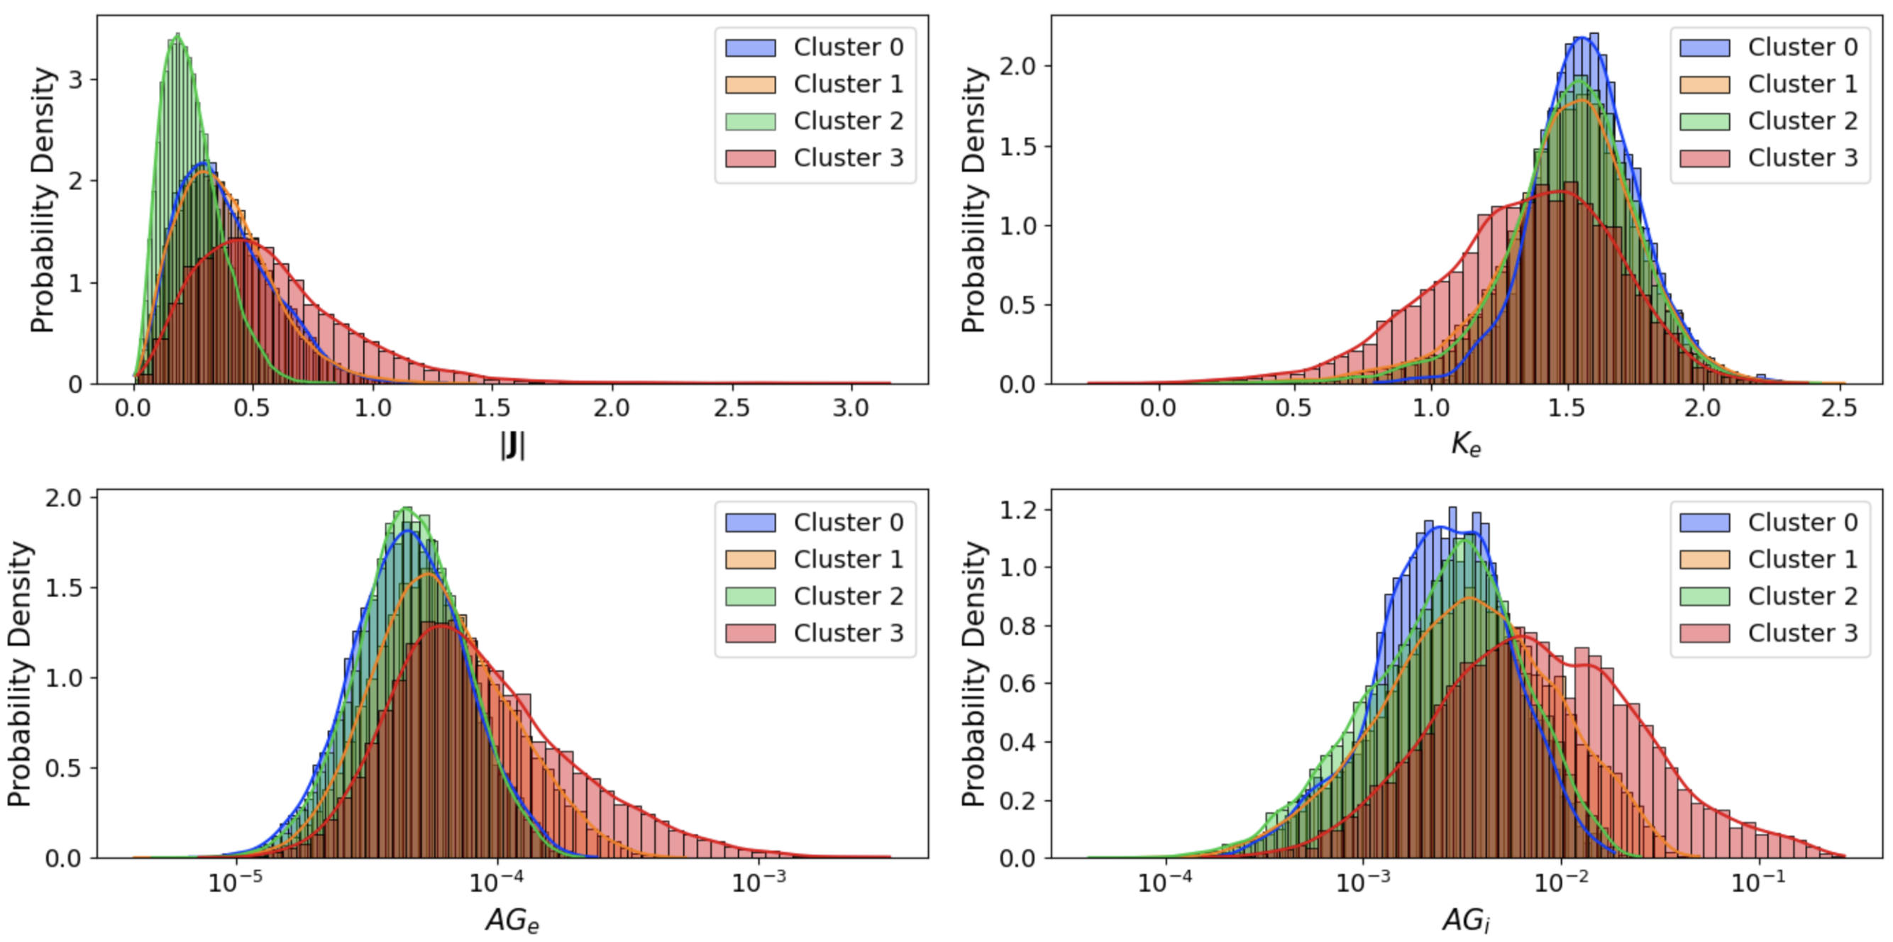
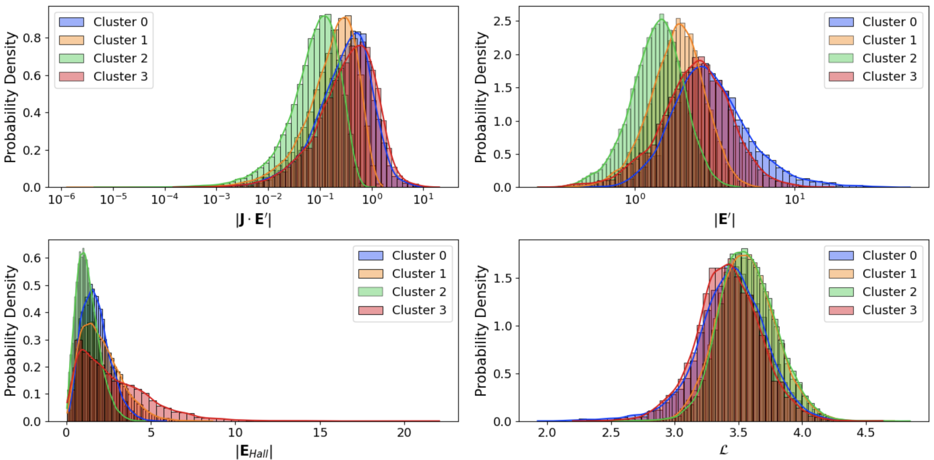
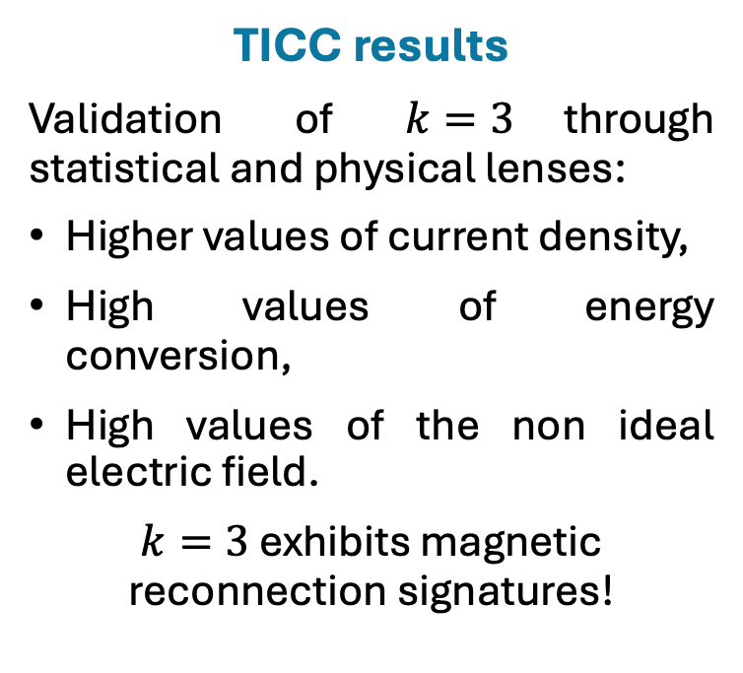
3) Identify reconnection cluster
TICC results
Validation of $k=3$through statistical and physical lenses:
Higher values of current density,
High values of energy conversion,
High values of the non ideal electric field.
$k=3$ exhibits magnetic reconnection signatures!
paulina.pilapana@northumbria.ac.uk 10
Notes:
And these plots show that analysis. We're looking at the probability distributions for three key features across all the clusters found by TICC.
I want to draw your attention to Cluster 3, shown here in red.
For current density, you can see its distribution is clearly skewed towards much higher values.
It also captures the highest values for both energy conversion and the non-ideal electric field.
This confirms that, on a statistical level, Cluster 3 has the correct physical profile for reconnection.

Slide 13
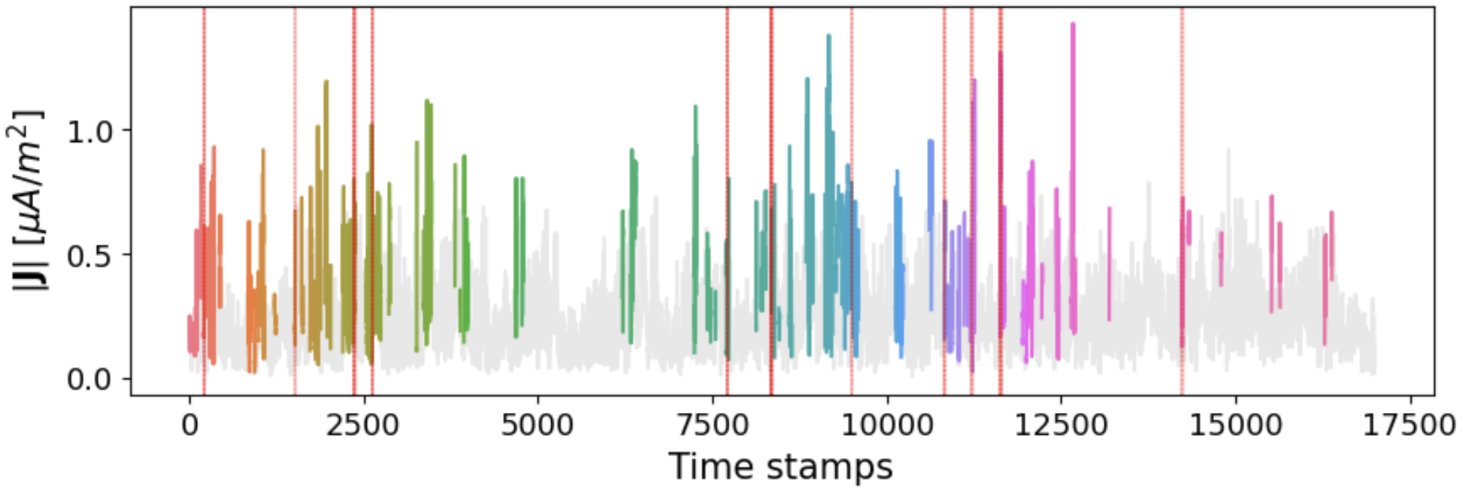
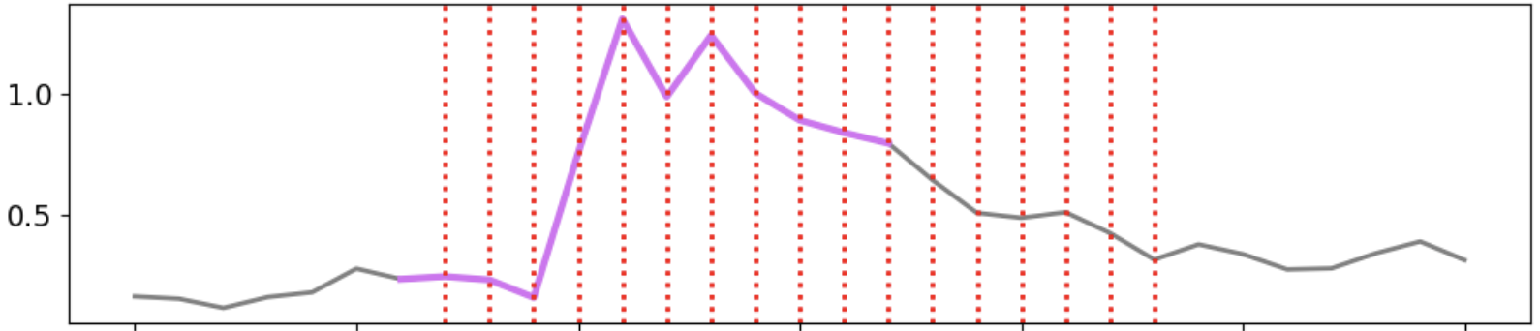
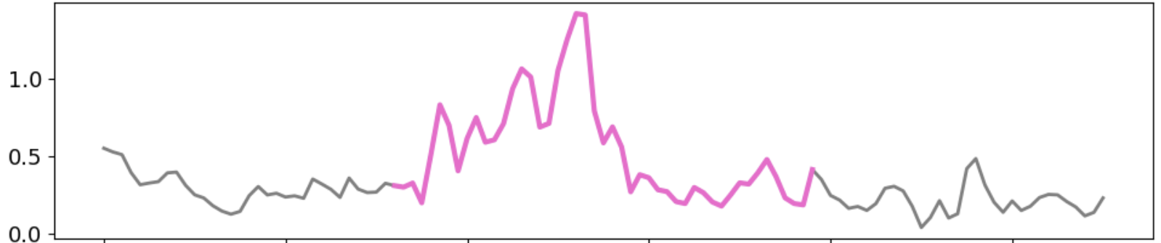
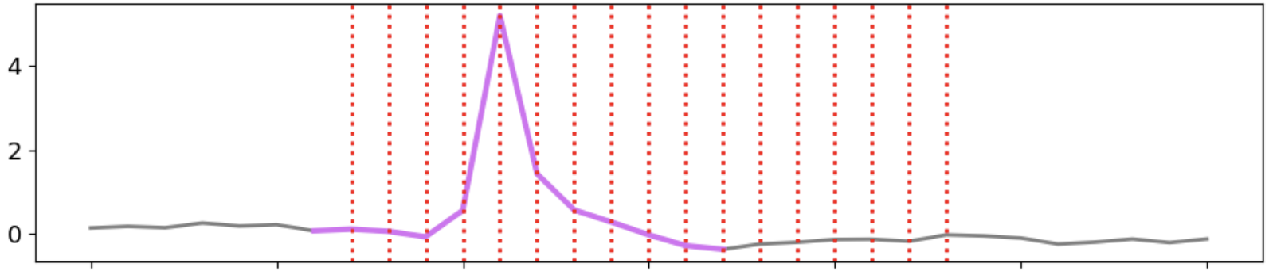
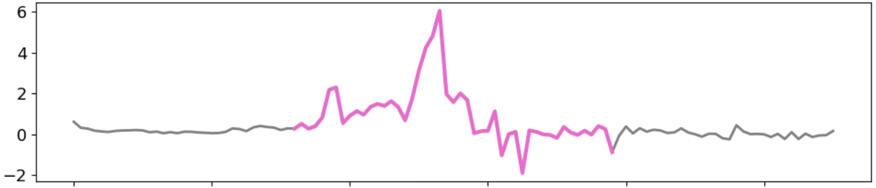
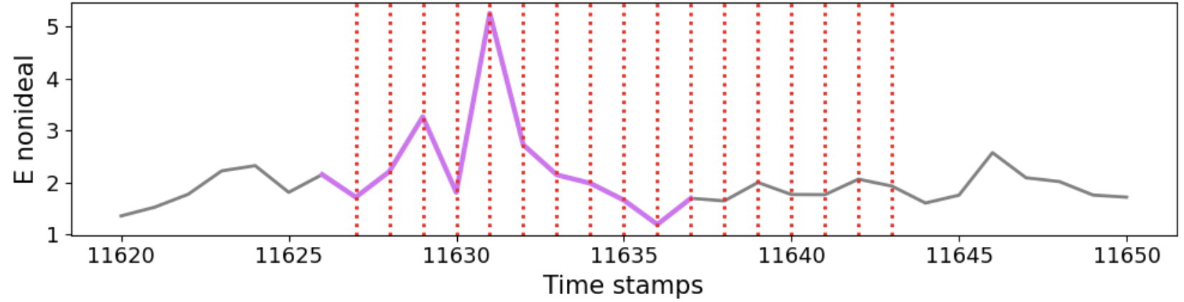
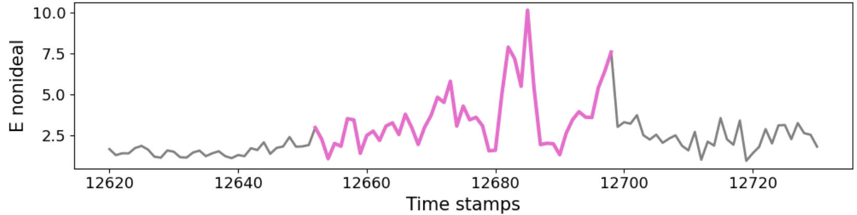






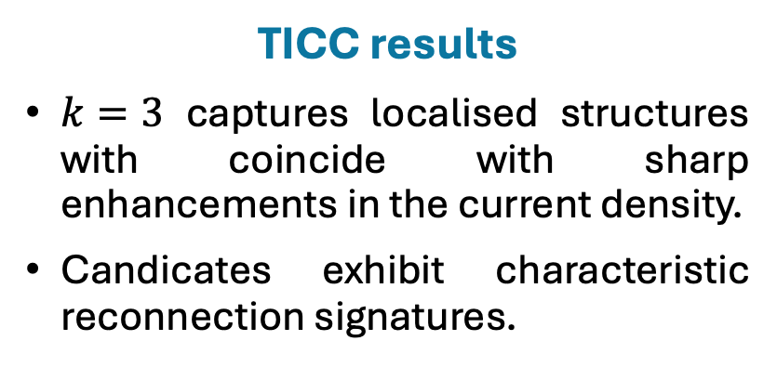







3) Identify reconnection cluster
Different colours represent different possible magnetic reconnection sites. All these structures belong to cluster $k=3$.
TICC results
$k=3$ captures localised structures with coincide with sharp enhancements in the current density.
Candicates exhibit characteristic reconnection signatures.
Reconnection events identified by Stawarz et al., 2022 are marked with red lines, often overlapping with these cluster $k=3$ regions.
$$\left|J\right|$$
$$\left|J\right|$$
[$μA/m^{2}$]
[$μA/m^{2}$]
Known reconnection event
$$J∙E′$$
New possible reconnection event?
$$J∙E′$$
[nW$/m^{3}$]
[nW$/m^{3}$]
$$\left|E′\right|$$
$$\left|E′\right|$$
[mV$/m$]
[mV$/m$]
paulina.pilapana@northumbria.ac.uk 11
Notes:
Now that we've confirmed the statistical properties of Cluster 3, we can examine what the events look like in the time-series data.
This top plot shows a time series of the current density. All the coloured regions are points that our algorithm has labelled as Cluster 3. We see that the algorithm correctly captured most of the known reconnection events, which are marked by the red vertical lines. It identifies these events as sharp, localised structures
Zooming in on a known reconnection event on the left, we see the simultaneous spikes in current density, energy conversion, and the non-ideal electric field. On the right, a new candidate event found by TICC shows very similar physical signatures.

Slide 14
Automatic algorithm to identify reconnection
1)
Feature selection
2)
Train and apply TICC
3)
Identify reconnection cluster
4)
Isolate discrete reconnection events
Systematically verify these candidates are genuine reconnection events or not.
paulina.pilapana@northumbria.ac.uk 12
Notes:
This bring us to the final step which is to take all of these candidates—both the known and the newly found—and confirm they are indeed reconnection events.

Slide 15
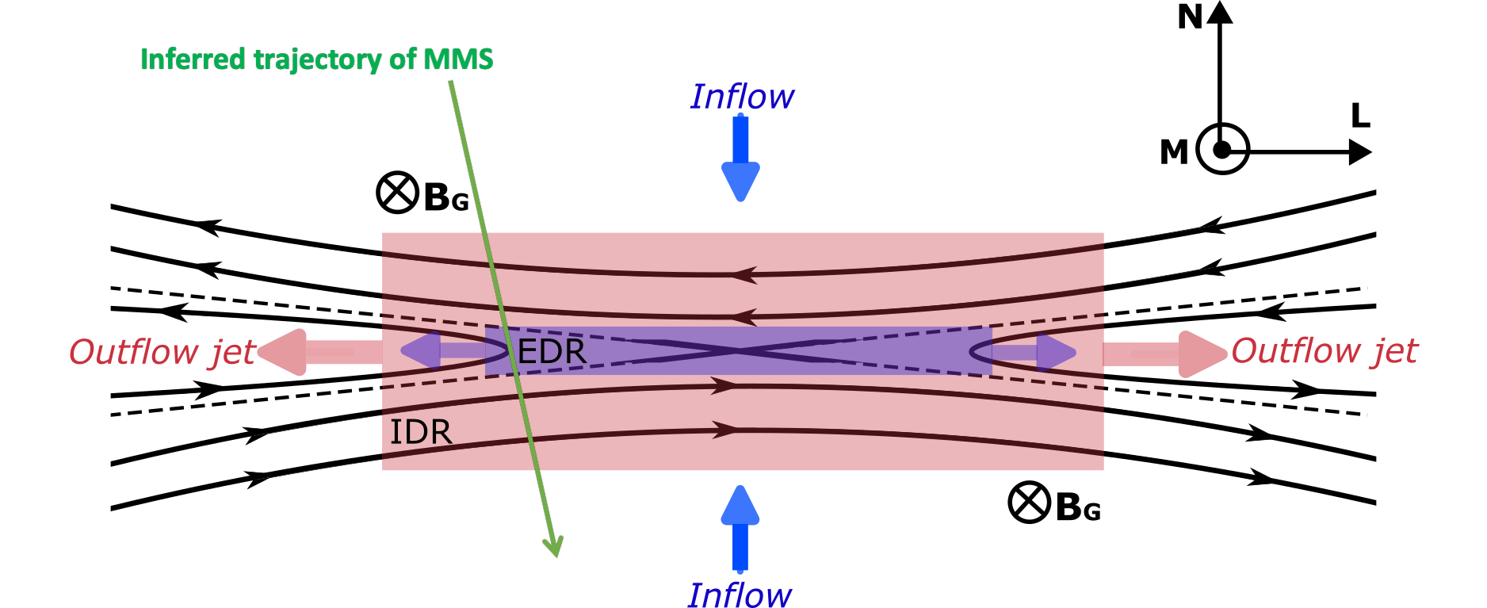
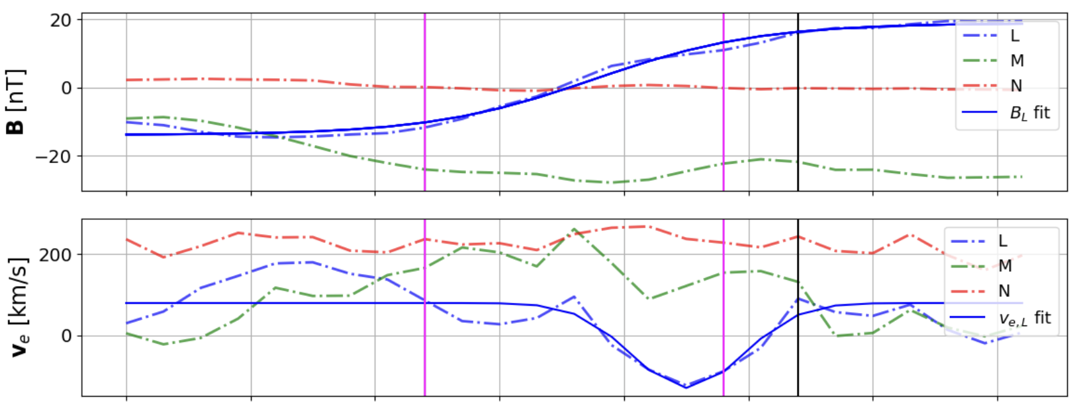
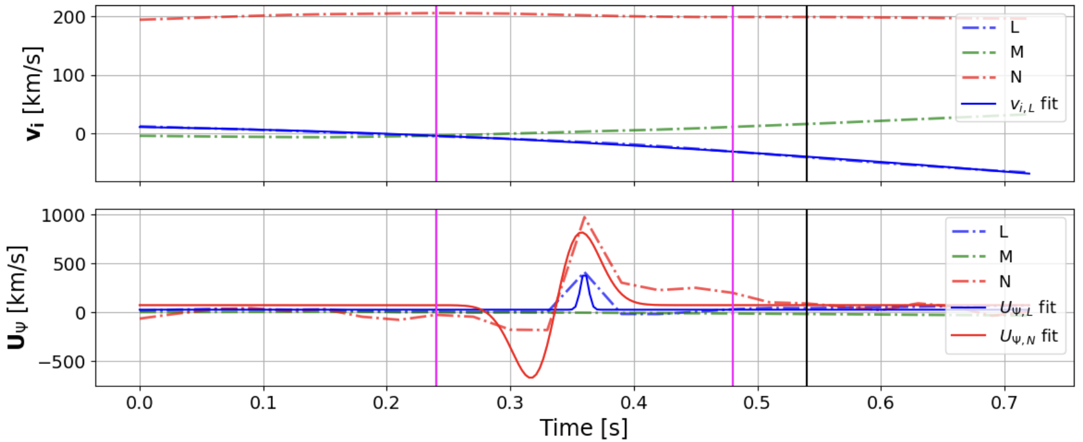
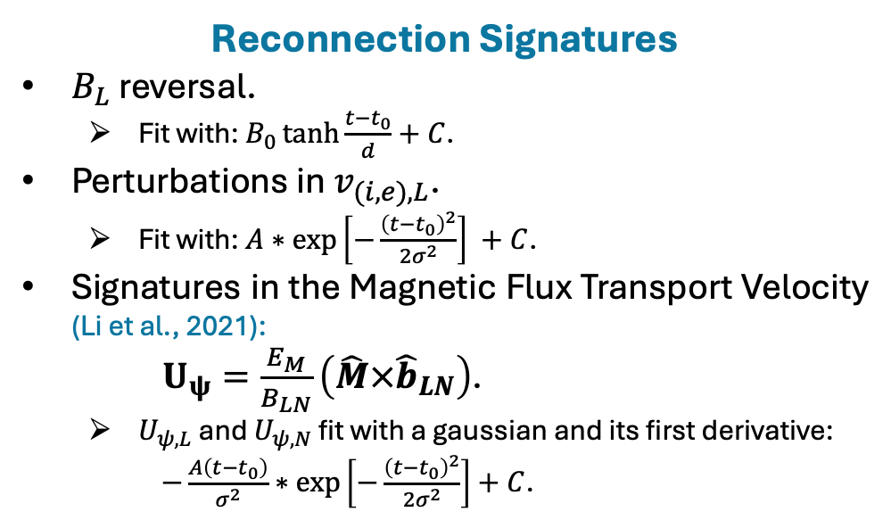
4) Isolate discrete reconnection events
Each candidate belonging to cluster 3 is rotated into a local coordinate system aligned with the current sheet (LMN).
Reconnection Signatures
$B_{L}$ reversal.
  Fit with: $B_{0}\tanh{\frac{t−t_{0}}{d}}+C$.
Perturbations in $v_{(i,e),L}$.
  Fit with: $A∗exp\left[−\frac{{\left(t−t_{0}\right)}^{2}}{2σ^{2}}\right] +C$.
Signatures in the Magnetic Flux Transport Velocity (Li et al., 2021):
$U_{ψ}=\frac{E_{M}}{B_{LN}}\left(\hat{M}×{\hat{b}}_{LN}\right)$.
  $U_{ψ,L}$ and $U_{ψ,N}$ fit with a gaussian and its first derivative:
    $−\frac{A\left(t−t_{0}\right)}{σ^{2}}∗exp\left[−\frac{{\left(t−t_{0}\right)}^{2}}{2σ^{2}}\right]+C$.
The fitting parameters will be the input for the next ML layer that will classify true from false events.
paulina.pilapana@northumbria.ac.uk 13
Notes:
First, because MMS trajectory is not aligned with the orientation of a current sheet, we rotate each candidate into a local coordinate system aligned with the current sheet—known as LMN. This not just makes the physical signatures of reconnection much clearer to identify but also makes it possible to model them with mathematical functions,
For example, we fit the reversal in the magnetic field with a hyperbolic tangent function, the outflow jets with Gaussians and the distinct peaks in the magnetic flux transport as gaussians and first derivative of gaussians. The plot on the right shows a real example of this, where the continuous lines are our mathematical fits to the raw data from one candidate event.
And this is the key to our final classification step. The input for our second unsupervised machine learning layer is the set of parameters from these fits—things like the exact center time, the width, and the amplitude of each signature.
We then use a k-means algorithm to cluster the events based on these fit parameters. This allows us to systematically classify true reconnection events from any false positives. This part of the project is ongoing, but the results are promising and provide us with a final, robustly validated list of events.

Slide 16
Summary
Our physically-motivated features enable the TICC algorithm to reliably identify the complex patterns of magnetic reconnection.
The method successfully finds previously identified events and, crucially, discovers potential new candidates missed by manual methods.
Next steps
Apply the trained model to a comprehensive range of MMS turbulent datasets to build a large-scale event catalogue.
Perform a robust statistical analysis correlating the occurrence rate of reconnection with the bulk properties of the surrounding turbulence.
paulina.pilapana@northumbria.ac.uk 14
Notes:
In summary, we've shown that by using a physically-motivated set of features, TICC can reliably identify the complex patterns of magnetic reconnection within a turbulence environment. Our method not only validates events that were already known, but also, it discovers new potential events that previous manual identification may have missed.
The next step is to finish and polish the last part of the workflow and apply the algorithm to MMS burst data to a more turbulent intervals, to perform a robstatistical study on the reconnection prevalence.

Slide 17
Identifying magnetic reconnection to assess its role in collisionless turbulent plasmas using the unsupervised machine learning TICC algorithm
Paulina A. Quijia Pilapaña, Julia E. Stawarz, Andy Smith.
2025 National Astronomy Meeting
paulina.pilapana@northumbria.ac.uk

Slide 18
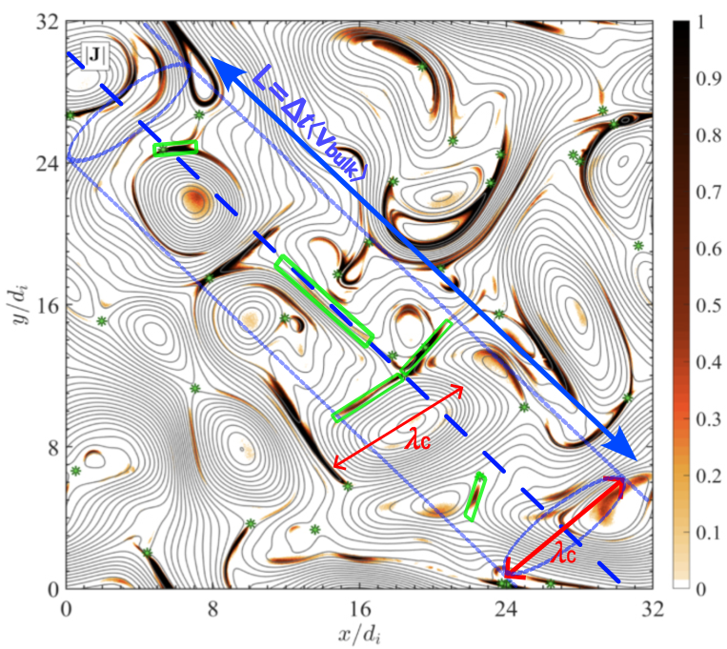
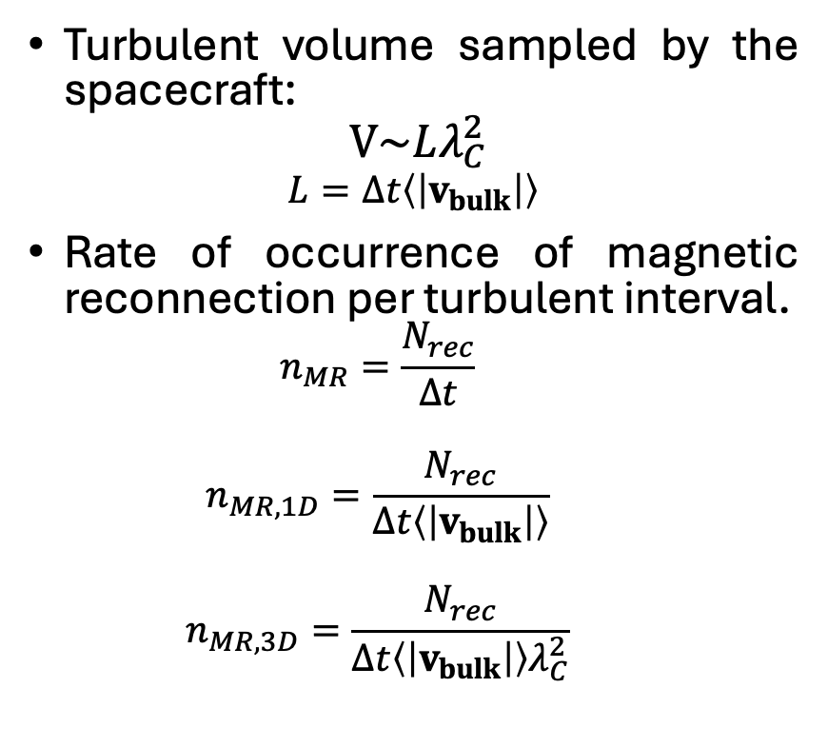
Prevalence of magnetic reconnection
Adapted from Franci et al. (2022)
Turbulent volume sampled by the spacecraft:
$$V\sim Lλ_{C}^{2}$$
$$L=∆t\left\langle \left|v_{bulk}\right|\right\rangle$$
Rate of occurrence of magnetic reconnection per turbulent interval.
  $$n_{MR}=\frac{N_{rec}}{∆t}$$
  $$n_{MR,1D}=\frac{N_{rec}}{∆t\left\langle \left|v_{bulk}\right|\right\rangle }$$
  $$n_{MR,3D}=\frac{N_{rec}}{{∆t\left\langle \left|v_{bulk}\right|\right\rangle λ}_{C}^{2}}$$
paulina.pilapana@northumbria.ac.uk A1
Notes:
To do this, We can assume that the volume spanned by the MMS is that of a cylinder formed around its trajectory with diameter as the correlation length.
length of the trajectory (which is the time of the MMS during that trajectory per the bulk velocity)
The correlation length is the larger magnetic structure associated with this turbulent interval.
In this volume we can count the number of reconnection events to compute this density of reconnection events.

Slide 19
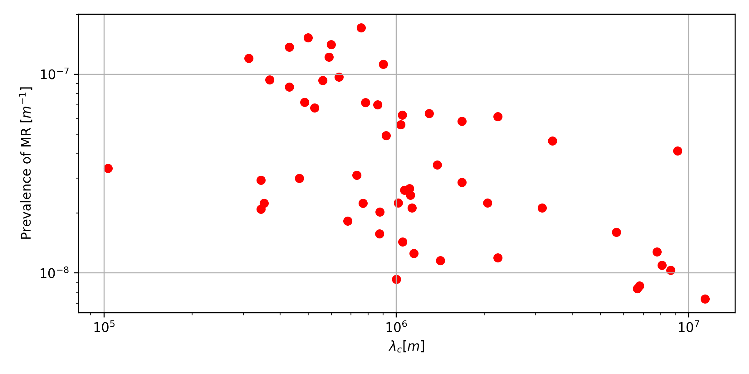
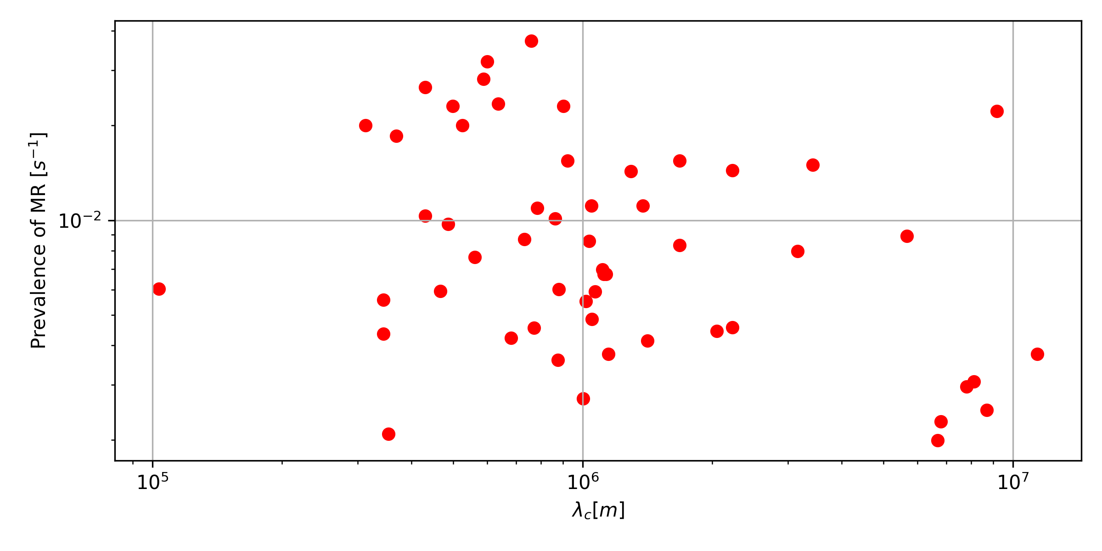
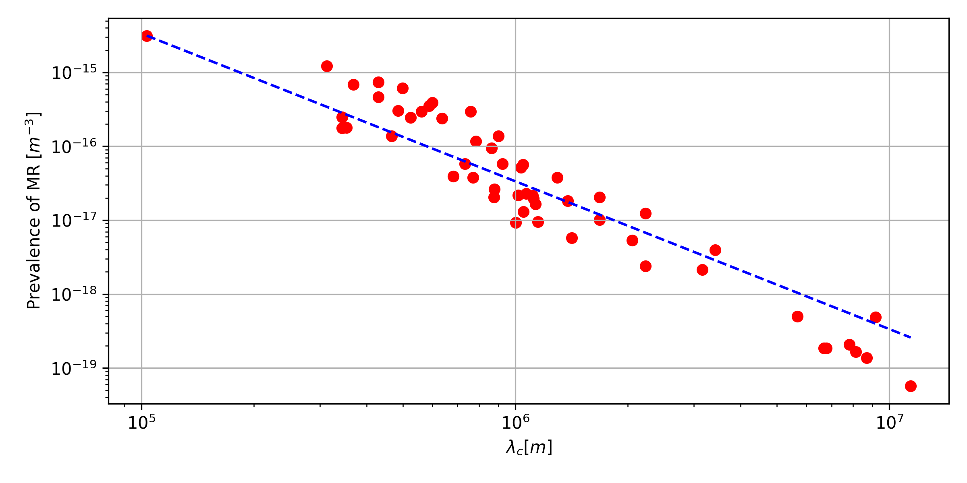
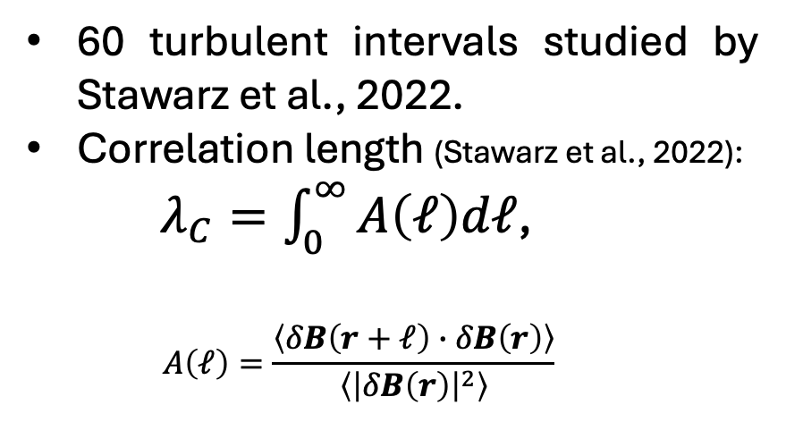




Turbulent properties vs. Prevalence of MR events
60 turbulent intervals studied by Stawarz et al., 2022.
Correlation length (Stawarz et al., 2022):
  $λ_{C}=\int_{0}^{∞}{A\left(ℓ\right)dℓ}$,
  $$A\left(ℓ\right)=\frac{\left\langle δB\left(r+ℓ\right)∙δB\left(r\right)\right\rangle }{\left\langle {\left|δB\left(r\right)\right|}^{2}\right\rangle }$$
$\frac{N_{rec}}{L}$ vs. $λ_{C}$
(b)
$$\sim \frac{1}{λ_{C}^{2}}$$
$\frac{N_{rec}}{∆t}$ vs. $λ_{C}$
(c)
$\frac{N_{rec}}{V}$ vs. $λ_{C}$
(a)
paulina.pilapana@northumbria.ac.uk A2
Notes:
squint

Slide 20
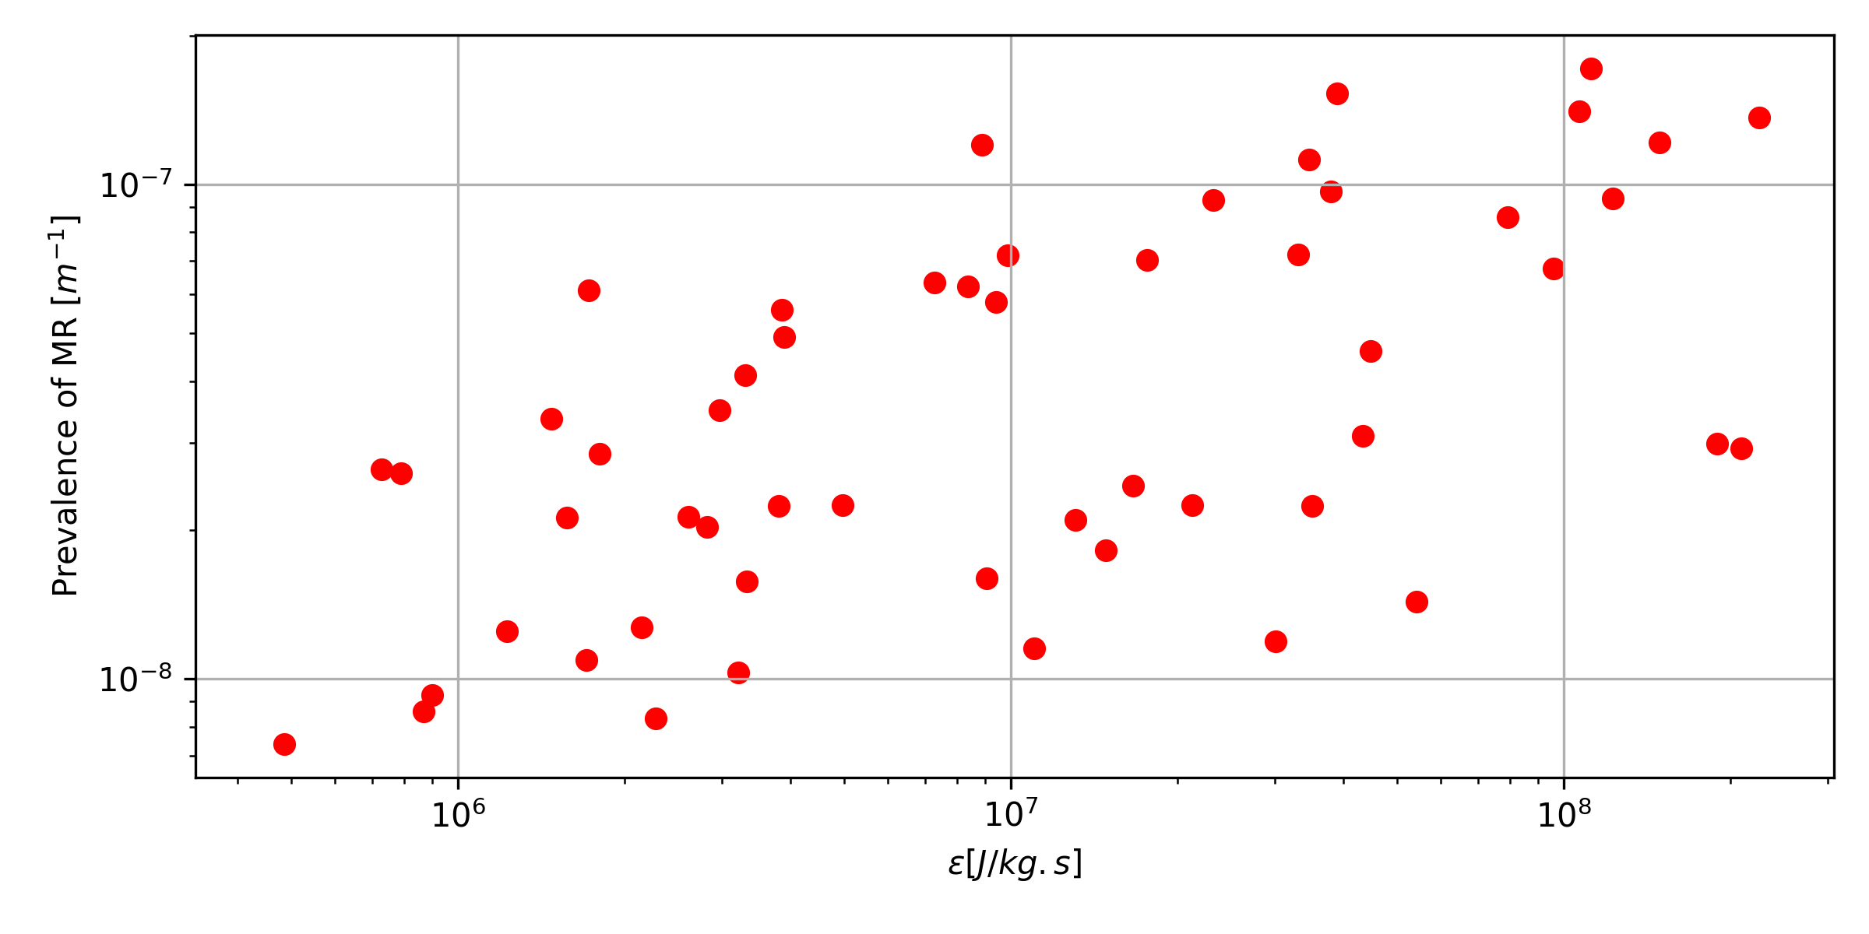
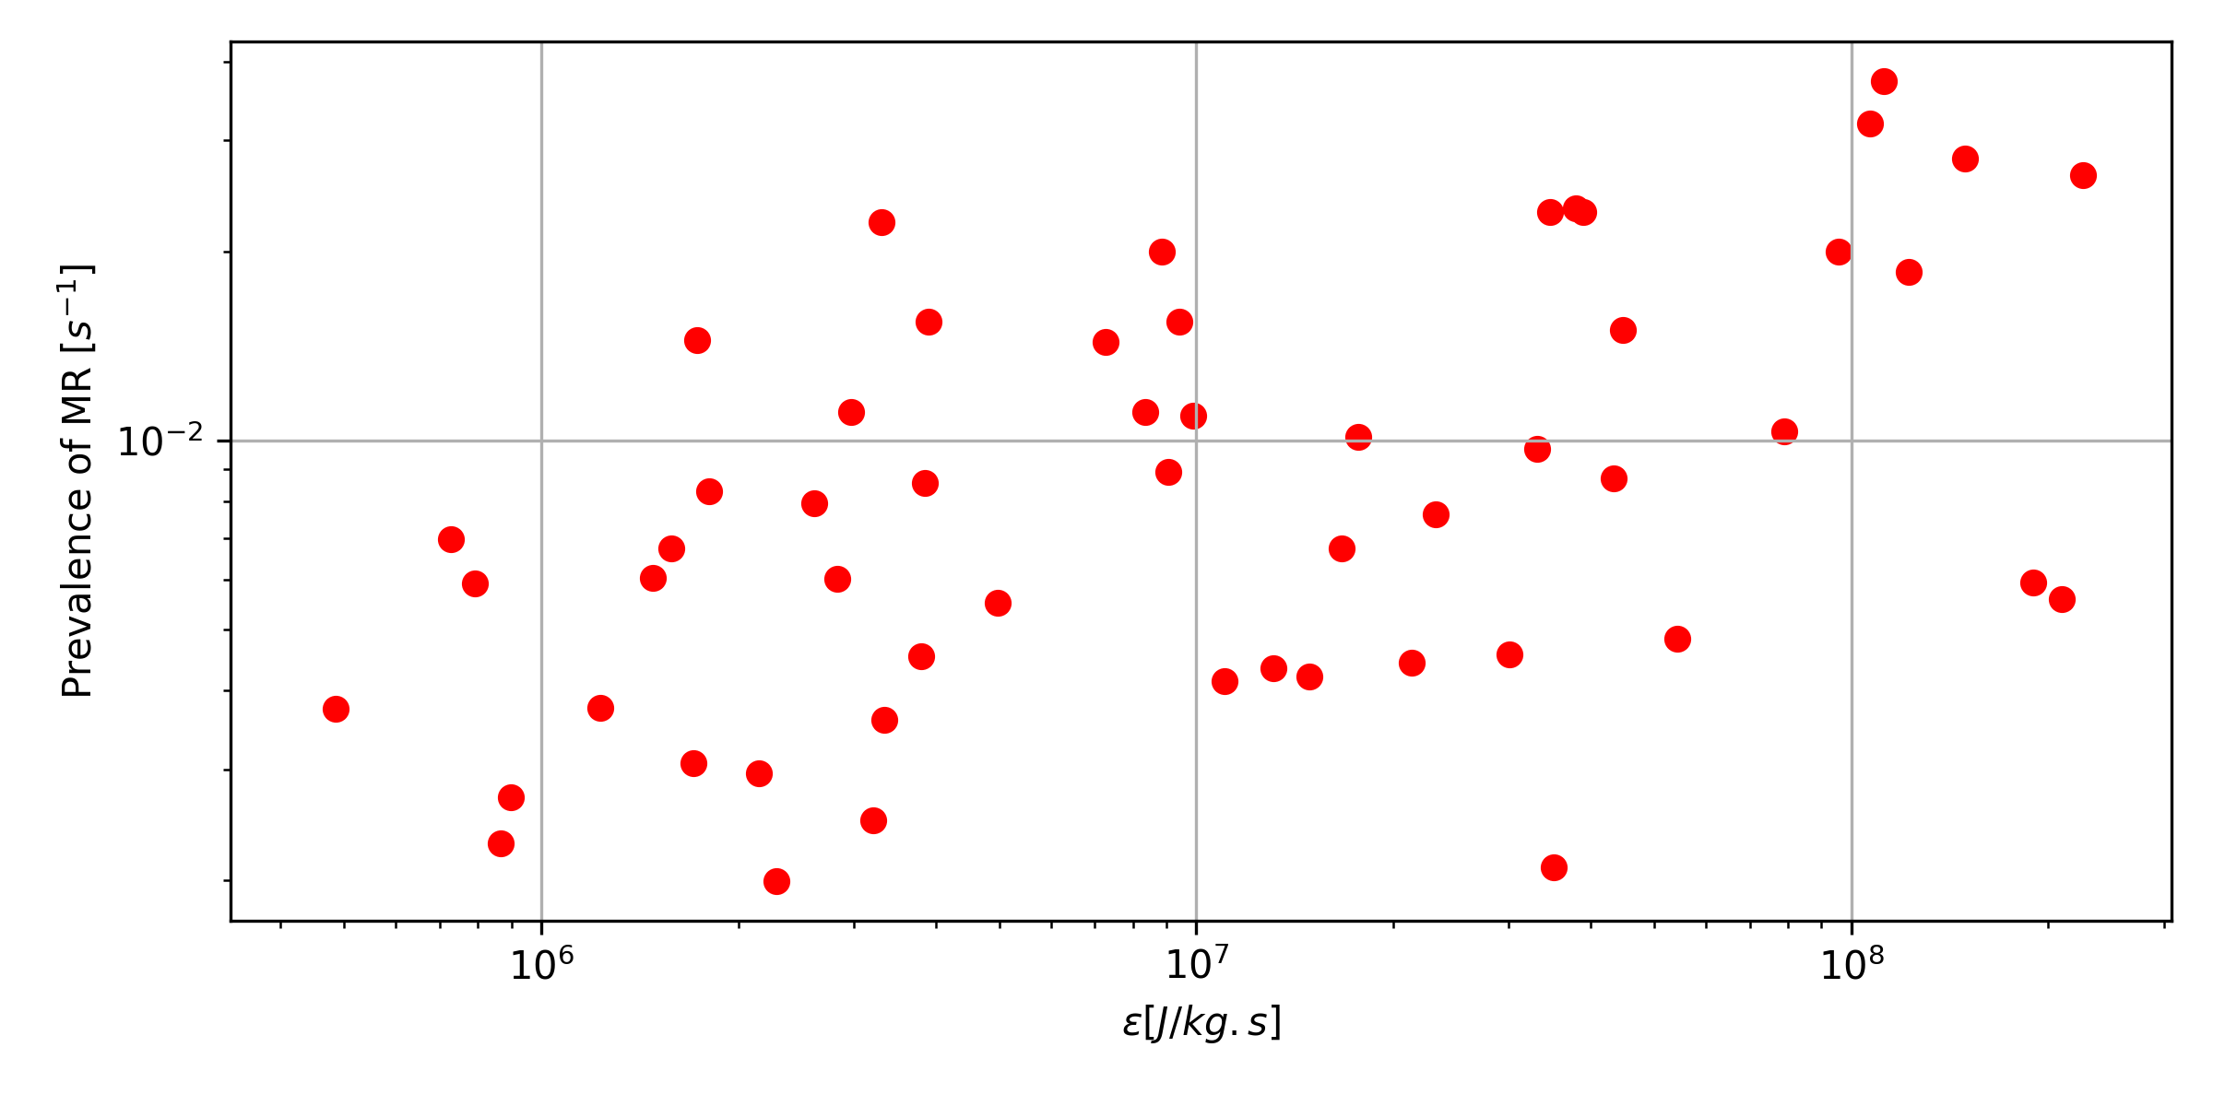
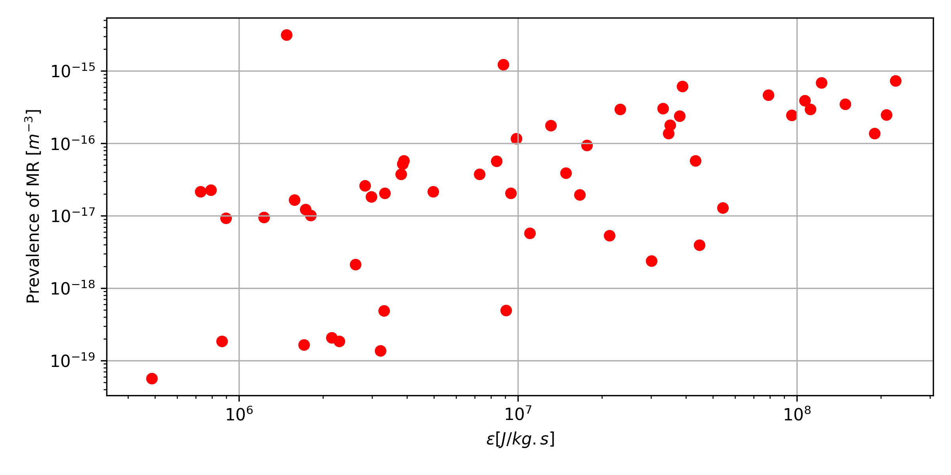
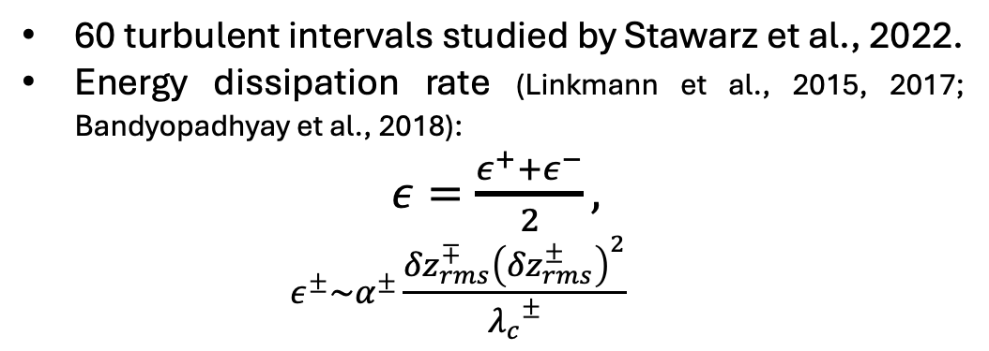



Turbulent properties vs. Prevalence of MR events
$\frac{N_{rec}}{L}$ vs. $ε$
(b)
60 turbulent intervals studied by Stawarz et al., 2022.
Energy dissipation rate (Linkmann et al., 2015, 2017; Bandyopadhyay et al., 2018):
$ε=\frac{ε^{+}+ε^{−}}{2},$
  $$ε^{±}\sim α^{±}\frac{{δz}_{rms}^{∓}{\left({δz}_{rms}^{±}\right)}^{2}}{{λ_{c}}^{±}}$$
$\frac{N_{rec}}{∆t}$ vs. $ε$
(c)
(a)
$\frac{N_{rec}}{V}$ vs. $ε$
paulina.pilapana@northumbria.ac.uk A3
Notes:
Energy transfer rate from large to small scales.
we expect that the decay rate of the energy- containing eddies at
large scales,
for the isotropic and low-cross-helicity case, a = 4C/ (9\sqrt(3) ), where
C. is the dimensionless dissipation rate.

Slide 21
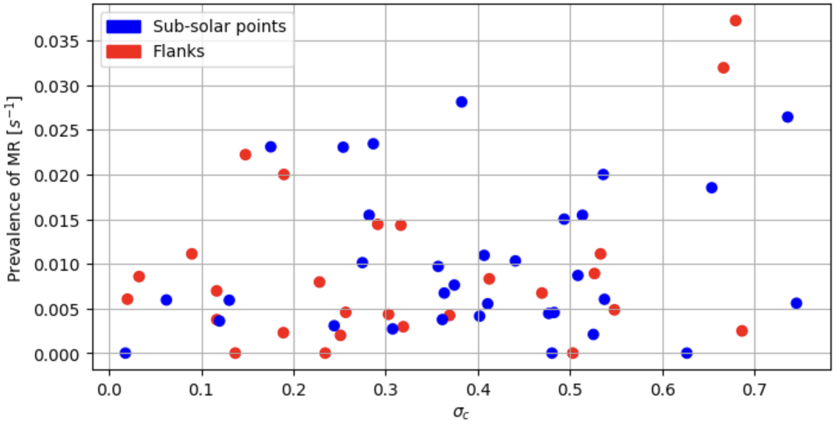
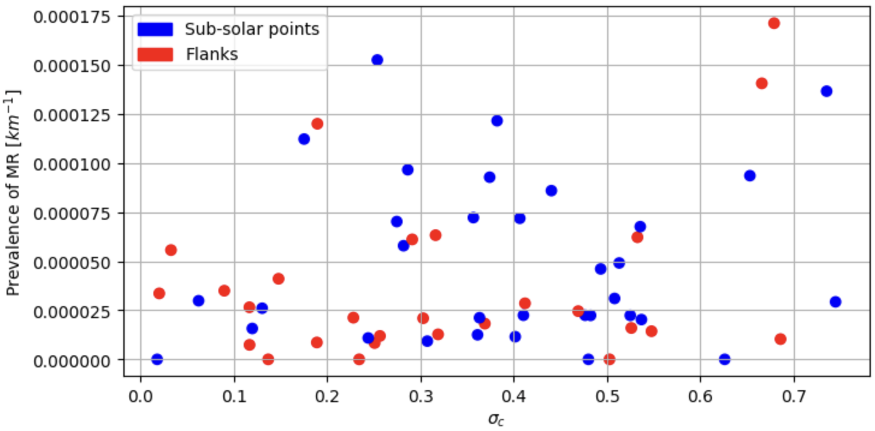

Other turbulent properties…
Cross helicity: $σ_{C}=\frac{2\left\langle v_{i}∙V_{A}\right\rangle }{\left\langle {\left|v_{i}\right|}^{2}+{\left|V_{A}\right|}^{2}\right\rangle }$
paulina.pilapana@northumbria.ac.uk A4

Slide 22



Other turbulent properties
Relative fluctuations of the the magnetic field:
$$\frac{{δB}_{RMS}}{B_{0}}=\frac{\sqrt{\left\langle {\left|B−B_{0}\right|}^{2}\right\rangle }}{B_{0}}$$
paulina.pilapana@northumbria.ac.uk A5

Slide 23


Data Processing
Data normalisation:
-> To understand the structure of data and their values
-> Extreme events in our dataset are not outliers.
-> $z_{i}=\frac{x_{i}−\left\langle x\right\rangle }{σ}$
-> Features scaled between -1 to 1, or 0 to 1.
Tuning number of clusters: -> Bayesian Information Criterion (BIC) score.
> For complex data patterns
-> Potential 5 or 6 clusters
> Diffusion regions, inflow and outflow jets, reconnection sites.
paulina.pilapana@northumbria.ac.uk A6
Notes:
After selecting the features, we need to normalize them such that the structure of the data across all the features and their values respect to their mean are independent of other features’ values.
Also, in machine learning, there are extreme events that could be considered as outliers which are errors in a dataset. In our dataset there are some extreme events such as enhancement in the current density that are not outliers.
Therefore, we normalize each feature such that the mean value is subtracted from each data point and then divided by its standard deviation.
Another challenge of unsupervised ML learning is that we do not know the number of clusters. To find the optimal number of clusters I used the Bayesian Information Criterion BIC score, which is useful when dealing with complex data as turbulent data.
Here we have the BIC score versus the number of clusters. While BIC becomes more negative with number of clusters and converges to a value, it means that we are close to the optimum number of clusters. We applied this score to different datasets and the values found vary from 4 to 7 clusters. These could correspond to diffusion regions, inflow and outflow jets, reconnecting current sheets, and/or other plasma structures.

Slide 24


Toeplitz Inverse-Covariance Clustering (TICC)
Window size, w
Temporal smoothness, $β$
Sparsity, $λ$
Hallac et al. (2017)
paulina.pilapana@northumbria.ac.uk A7
Notes:
This encourages to maintain consecutive points clustered together which guaranties temporal smoothness by the parameter beta. The subsequences are clustered such that their likelihoods are optimized, and the clusters are different enough through the parameter lambda.

Slide 25
















2) Train and apply TICC
Known Reconnection event
New possible reconnection event?
(a)
(b)
$$\left|J\right|$$
(b)
$$\left|J\right|$$
(f)
[$μA/m^{2}$]
[$μA/m^{2}$]
(c)
(d)
(c)
(g)
$$K_{e}$$
$$K_{e}$$
$$J∙E′$$
(d)
$$J∙E′$$
(h)
[nW$/m^{3}$]
[nW$/m^{3}$]
$$\left|E′\right|$$
(e)
$$\left|E′\right|$$
(i)
[mV$/m$]
[mV$/m$]
paulina.pilapana@northumbria.ac.uk A8
Notes:
To find the best model we vary these 4 hyperparameters from TICC: the number of clusters, the number of points in a subsequence (w), lambda that controls how different we want the clusters to be, and beta that encourages to maintain consecutive points clustered together which guaranties temporal smoothness.
We run the algorithm multiple times with different settings on the datasets, shown in these heatmaps for an example of number of clusters 4, window size 5, and different values of lambda and beta. To evaluate the models, we used these three custom metrics based on the reconnection events found in turbulent intervals by Julia and her colleagues. These are: the time fraction of known reconnection events recovered in the cluster k which would be 1 if the exact same points were found by TICC; the fraction of datapoints in cluster k occupied by known reconnection events which which tells if that model finds more events than those found by Julia, and the mean width of the structures composed of consecutive points in cluster k, which indicates whether reconnection events appear as localised structures in the timeseries.
We found the highlighted set of parameters to give the best model as it shows the highest fraction of events found, plus more potential reconnection candidates and also, they are presumably localised structures. Therefore cluster 3 is our candidate reconnection cluster.

