Slide 1


Multispacecraft Observations of Reconnection Topologies and Their Role in the Turbulent Energy Cascade
C. M. Liptrott¹ B. Hnat¹ S. C. Chapman¹ N. W. Watkins^{1,2}
¹Centre for Fusion, Space, and Astrophysics, University of Warwick
²Grantham Institute, London School of Economics
National Astronomy Meeting, July 2025
B. Hnat, S. C. Chapman, C. Liptrott, N. W. Watkins, Solar wind magnetohydrodynamic turbulence energy transfer rate ordered by magnetic field topology, Phys. Rev. Lett. (2025) [Under Review]

Slide 2
Solar Wind Turbulence, Magnetic Topology, and Energy Transfer Rate
MHD turbulence is ubiquitous in the solar wind [1]
Evidence that intermittency corresponds to coherent structures [2] Coherent structure evolution drives energy transfer across spatial scales:
Current sheet breakup can drive energy to smaller scales [3] Flux ropes can merge to drive energy to larger scales [4]
Magnetic Field Topology Turbulent Energy Transfer
Multispacecraft estimates of field topol-
ogy in space domain
Solar Wind
Spacecraft Tetrad
Turbulent energy transfer rate using
MHD Yaglom Law:
4
S_{r} = − ₃ ϵr
Constant positive energy transfer rates identified on MHD scales [5] support a forward cascade
[1] Bruno and Carbone, Living Rev. Solar Phys. (2013) [2] e.g. H. Wu, Honghong et al., Astrophys. J. Lett. (2023)
[3] Pezzi et al., Astronomy and Astrophysics (2024) [4] Boldyrev and Loureiro, Astrophys. J (2017) [5]
Sorriso-Valvo et al., Phys. Rev. Lett. (2007)
Reconnection & Turbulent Cascade

Slide 3
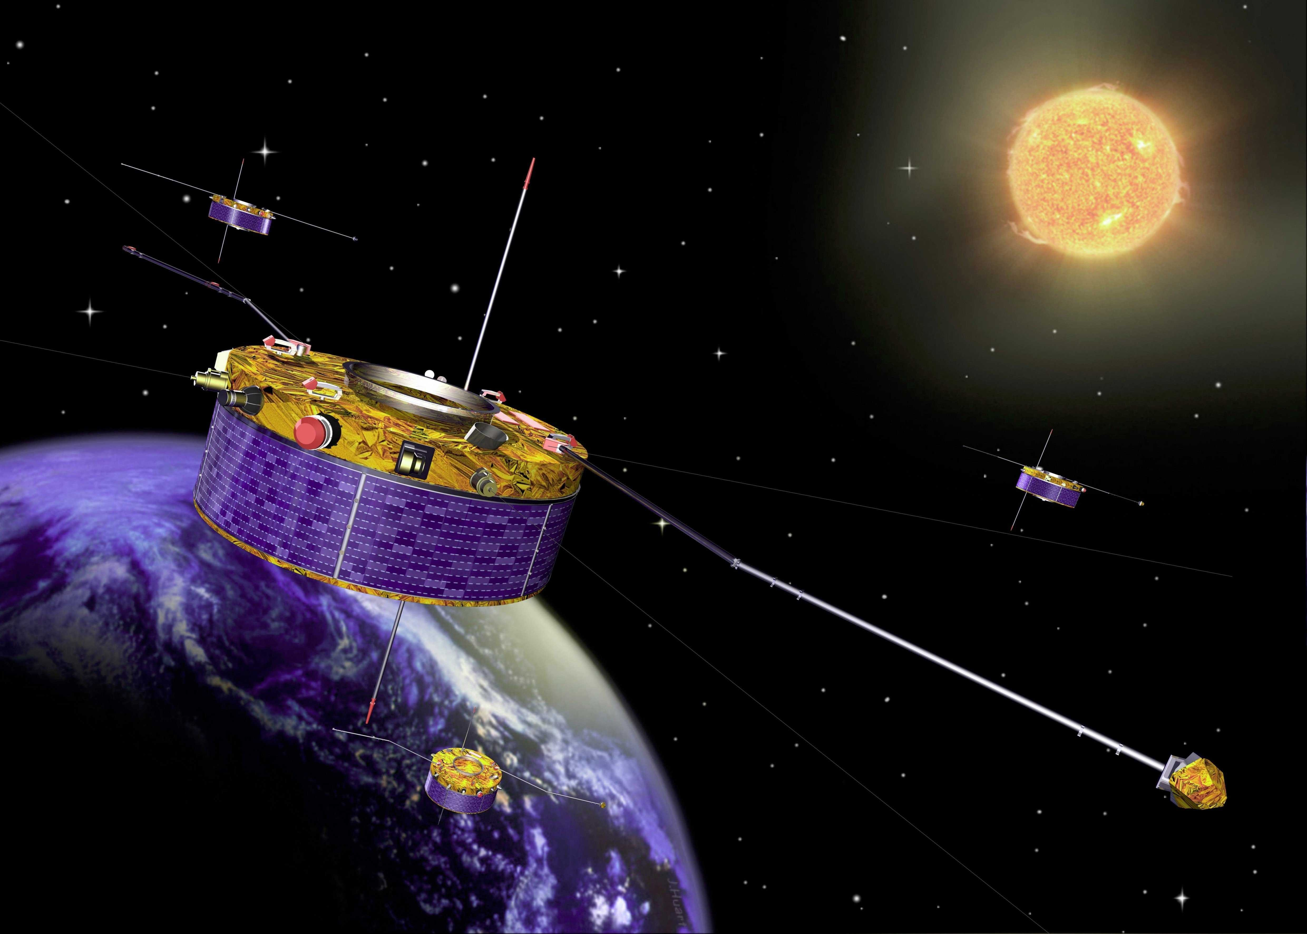
Cluster Mission Solar Wind Data
Solar wind satellite observations are the only in situ observations of astrophysical scale turbulence
Four spacecraft flying in formation in the solar wind/magnetosphere
Magnetic field topology from Cluster-FGM
4 spacecraft magnetic field measurements.
~ 22Hz
Instantaneous energy transfer rate from CIS-HIA
2 spacecraft plasma moment measurements
~ 0.25Hz
We identify 5 data intervals subject to...
INTERVAL CRITERIA:
(i) Solar wind transit time
τtr = L/⟨vsw ⟩ > 4s (CIS-HIA sampling
rate) ⇒ contemporaneous estimates
(ii) Cluster tetrahedron sufficiently regular for accurate B gradient estimation (pseudo-spherical, elongation and planarity < 0.4)
Reconnection & Turbulent Cascade

Slide 4
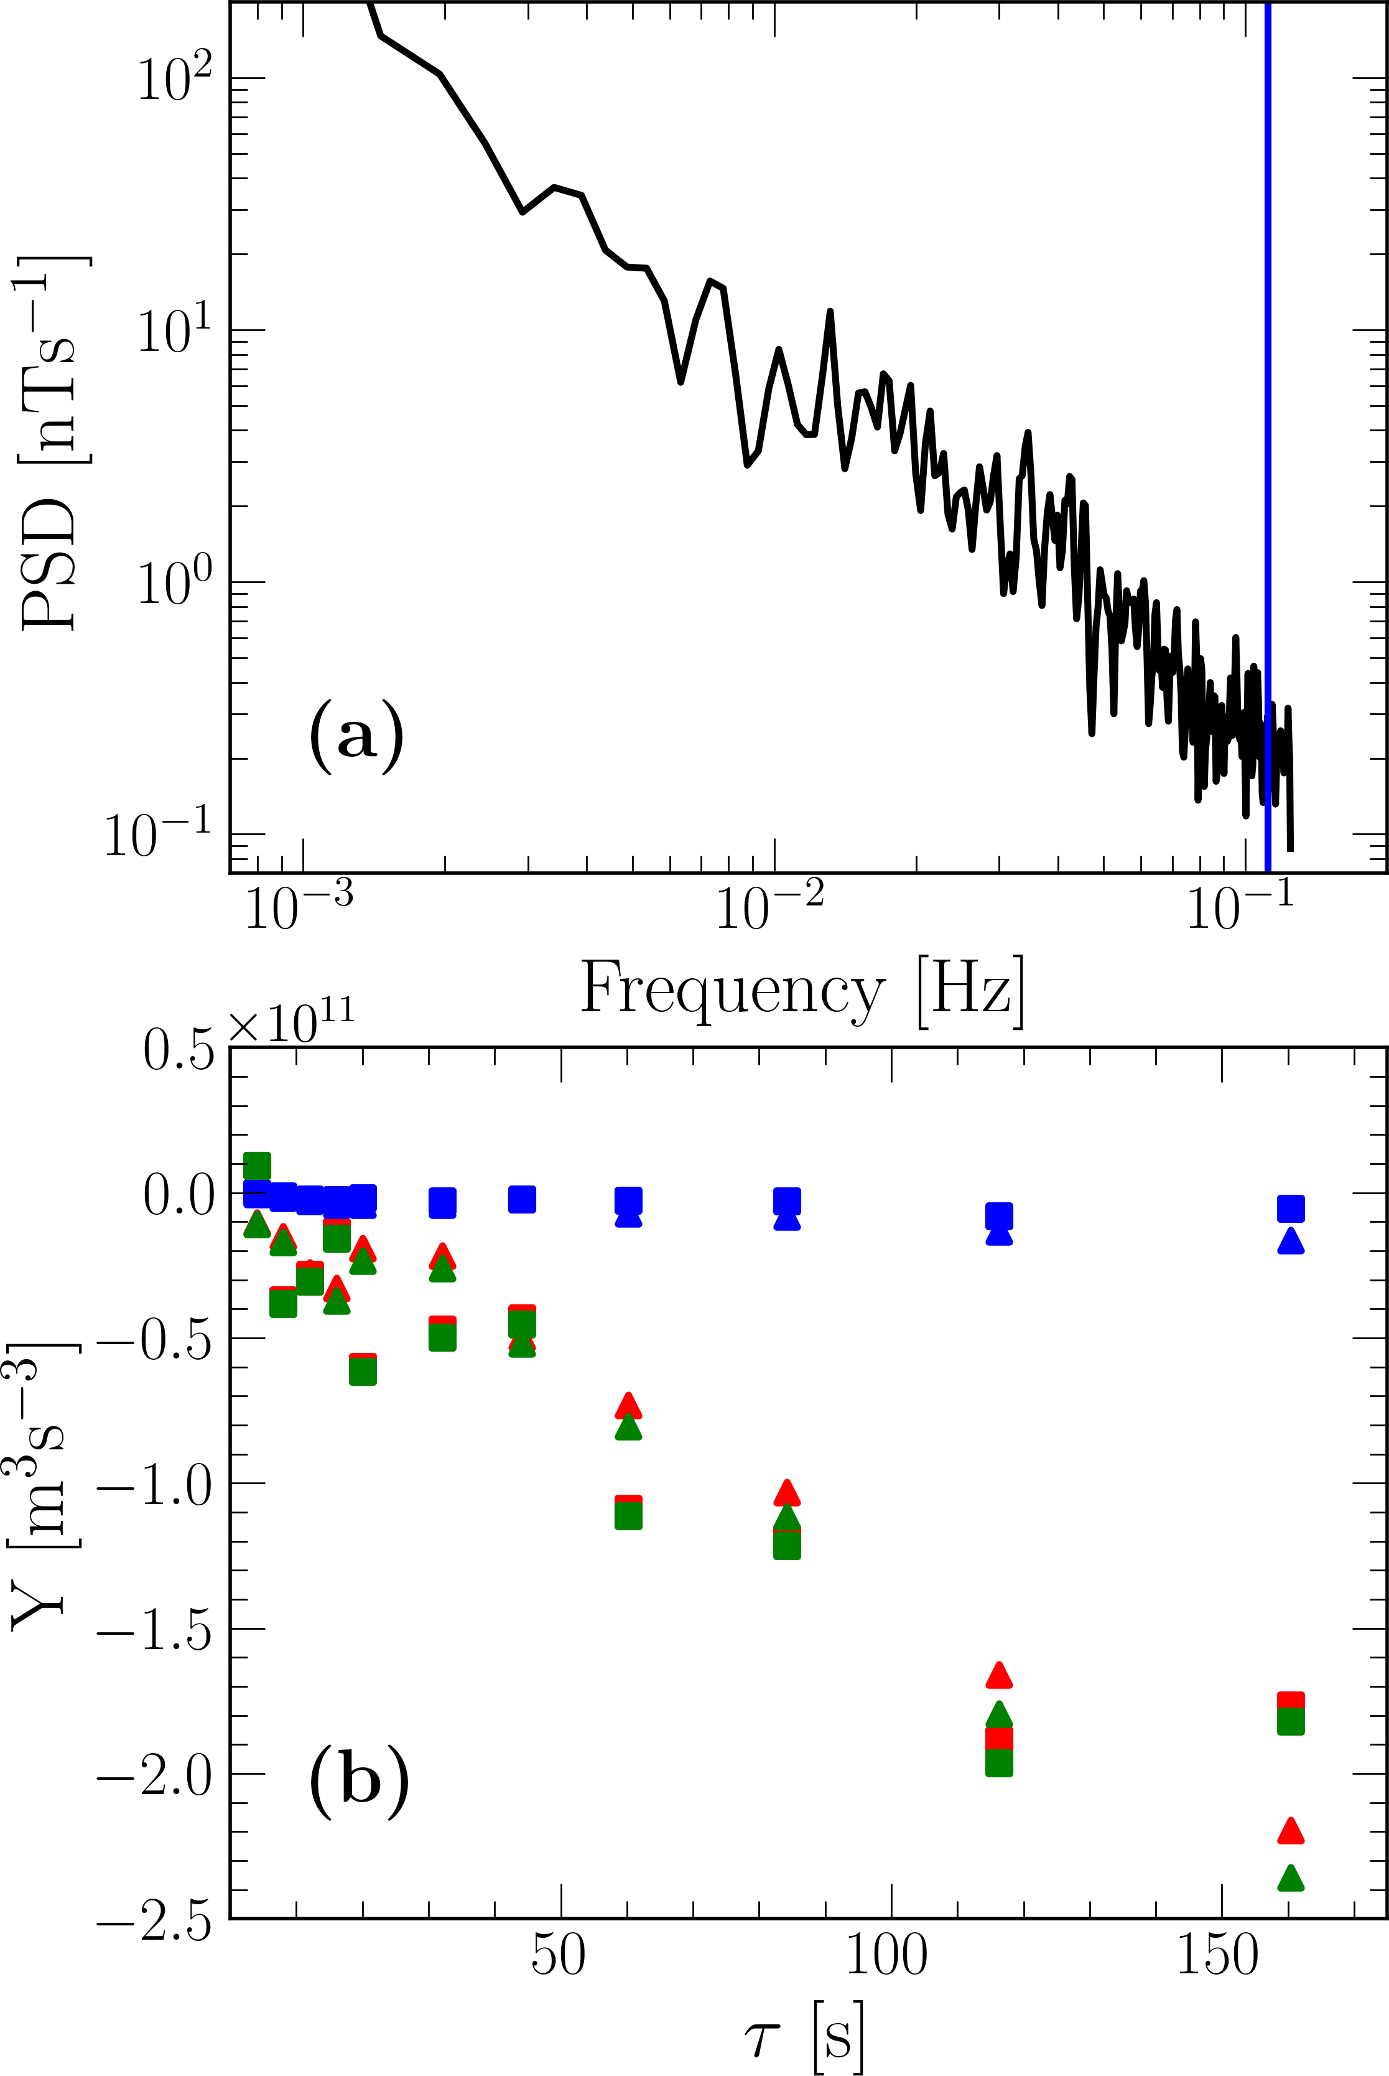
Instantaneous Energy Transfer Rate ε_{L}(t)
Hall-corrected MHD Yaglom Law:
1 4
Sr = Yr + ₂ Hr = − ₃ ϵr,
where Yr and Hr are mixed third-order structure functions given by
Yr = ⟨δvr (|δv|² + |δb|²) − 2δbr (δv · δb)⟩t,
Hr = ⟨2δbr (δb · δj) − δjr |δb|²⟩t.
ϵ is the energy transfer rate. Hall correction Hr is small compared to Yr . Here v, b, j are velocity, magnetic, and current density fields suitably normalised.
(1)
Figure 1: (a) PSD (b) S_{r} (green)
Y_{r} (red) H_{r} (blue)
Reconnection & Turbulent Cascade
4 / 10

Slide 5
Instantaneous Energy Transfer Rate ε_{L}(t)
Hall-corrected MHD Yaglom Law:
1 4
Sr = Yr + ₂ Hr = − ₃ ϵr,
where Yr and Hr are mixed third-order structure functions given by
Yr = ⟨δvr (|δv|² + |δb|²) − 2δbr (δv · δb)⟩t,
Hr = ⟨2δbr (δb · δj) − δjr |δb|²⟩t.
ϵ is the energy transfer rate. Hall correction Hr is small compared to Yr . Here v, b, j are velocity, magnetic, and current density fields suitably normalised.
Field Increments via Time Differences (Taylor’s Hypothesis):
r = −τ ⟨vsw ⟩ ⇒ δa = a(t + τ ) − a(t)
(1)
(2)
Figure 1: (a) PSD (b) S_{r} (green)
Y_{r} (red) H_{r} (blue)
Reconnection & Turbulent Cascade
4 / 10

Slide 6
Instantaneous Energy Transfer Rate ε_{L}(t)
Hall-corrected MHD Yaglom Law:
1 4
(1)
Sr = Yr + Hr = − ϵr,
2 3
where Yr and Hr are mixed third-order structure functions given by
2 2
Yr = ⟨δvr (|δv| + |δb| ) − 2δbr (δv · δb)⟩t,
2
Hr = ⟨2δbr (δb · δj) − δjr |δb| ⟩t.
ϵ is the energy transfer rate. Hall correction Hr is small compared to Yr . Here v, b, j are velocity, magnetic, and current density fields suitably normalised.
Field Increments via Time Differences (Taylor’s Hypothesis):
r = −τ ⟨vsw ⟩ ⇒ δa = a(t + τ ) − a(t)
Instantaneous Energy Transfer Rate ε_{L}(t)
(2)
Identify the instantaneous energy transfer rate ε_{L}(t) such that
⟨ε_{L}(t)⟩t = ϵ at the tetrahedron scale L ⇒ τ ≲ τtr
Contemporaneously estimate ε_{L}(t) on the tetrahedron scale and magnetic field topology.
Figure 1: (a) PSD (b) S_{r} (green)
Y_{r} (red) H_{r} (blue)
Reconnection & Turbulent Cascade

Slide 7
Magnetic Field Topology Classification I
∂B
Magnetic field gradient tensor, [∇B] = , contains all local field information, including
ij
i
∂xi
its topological structure, current, and associated Lorentz force [1].
Estimate ∇B via linear least-squares
Linear first-order least squares optimisation. Estimate gradients using spacecraft differences:
B^{(k)}(r_{α}) − B^{(k)}(r_{β} ) ≈ ∇B^{(k)} · (r_{α} − r_{β} )
Minimise squared residuals:
^{h}∇B^{(k)} · (r_{α} − r_{β} ) − B^{(k)}(r_{α}) − B^{(k)}(r_{β} ) ^{i2} subject to ∇ · B = 0 [2].
[1] Parnell et al. Physics of Plasmas (1996) [2] §12 Paschmann and Daly ISSI Scientific Reports Series 1 (1998). See also Denton et al., J. Geophys. Res. Space Phys.(2023)
Reconnection & Turbulent Cascade

Slide 8
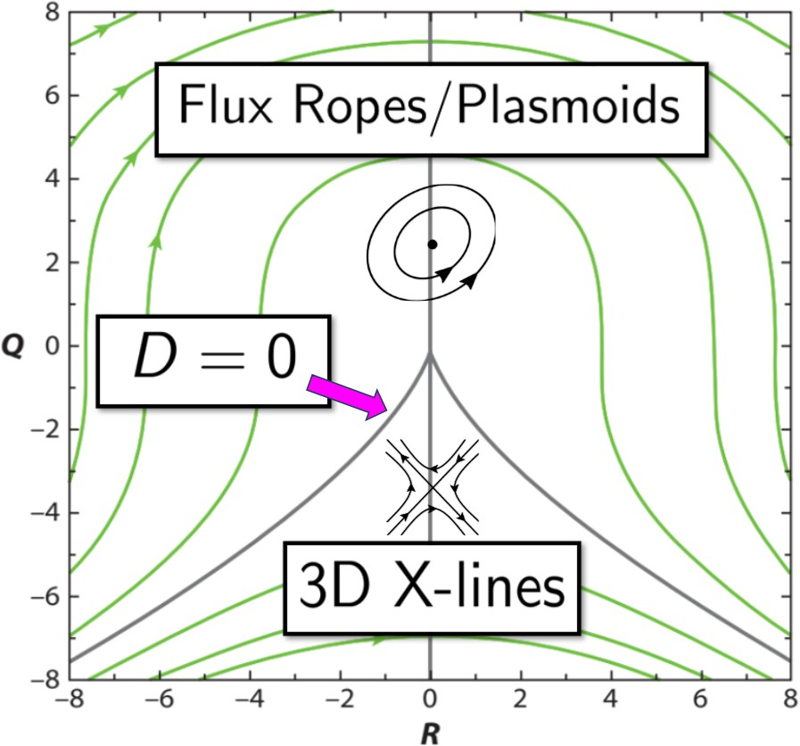
Magnetic Field Topology Classification II
Characterise topology in “R-Q Space” following ref. [1]
Coefficients of ∇B characteristic polynomial:
λ³ + Pλ² + Qλ_{i} + R = 0. (3)
i i
Topology classified by sign of (3) discriminant:
27
D = R² + Q³.
4
D > 0: Flux ropes/Plasmoids
D < 0: 3D X-lines
⇒ Reconnection Topologies
Figure 2: R-Q Space Classification. Adapted from Meneveau, Ann. Rev. Fluid Mech. (2010)
[1] Chong, Perry, Cantwell, Phys. Fluids (1990).
Previous applications: Consolini et al. (2015, 2018), Hnat, Chapman, & Watkins (2021, 2023)
Reconnection & Turbulent Cascade

Slide 9
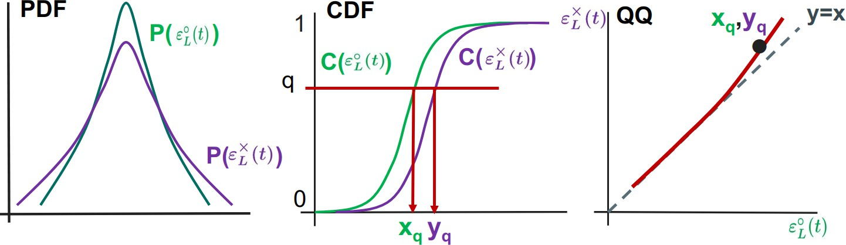
QQ Plots to Compare Distributions of ε◦_{L}(t) and ε_{L}×(t)
Condition εL(t) on topology:
×
Survival Curve
0
ε◦ (t)
10
−5
10
L
ε (t) = ε (t)|D(t) < 0 [Reconnection]
ε_{L}×(t)
L
L
₁₀−1
◦
ε (t) = ε (t)|D(t) > 0 [Plasmoids]
Probability Density
₁₀−6 ₁₀−2
L
L
-5 0 5
Difference is hard to see on PDF plots [Fig. 3]
Instead, directly compare the quantiles of ECDFs using Empirical Quantile-Quantile plots
Gives comparison of tail width/weight + more robust to extreme values
Application: Tindale et al (2016, 2017) Method: Hyndman & Fan (1996)
^{ε}L^{(t)}
₁₀−7
₁₀−8
-5 0 5
^{ε}L^{(t) [102 kJ·kg−1·s−1]}
Figure 3: PDFs of ε◦,×(t) on
semi-log scale
L
Reconnection & Turbulent Cascade

Slide 10
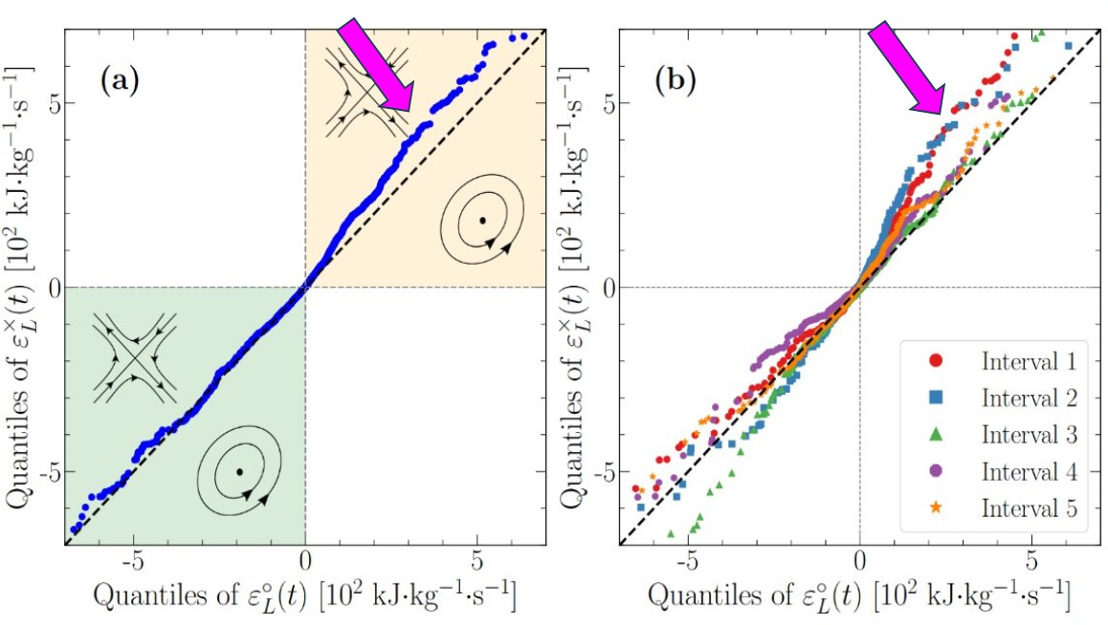
QQ Plots for Solar Wind Intervals: Qualitative Results
Systematically larger ε_{L}(t) > 0 values for D < 0 [Reconnection] vs D > 0 [Plasmoids] at all quantiles.
Reconnection & Turbulent Cascade
8 / 10

Slide 11
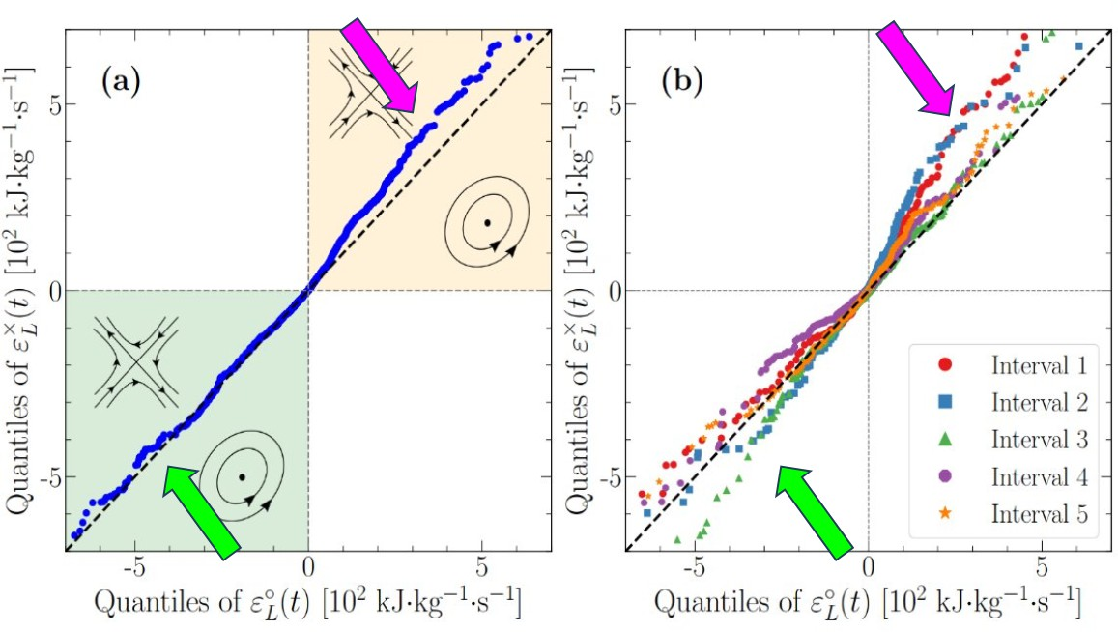
QQ Plots for Solar Wind Intervals: Qualitative Results
Systematically larger ε_{L}(t) > 0 values for D < 0 [Reconnection] vs D > 0 [Plasmoids] at all quantiles.
Interval-dependent ε_{L}(t) < 0 but no preference on average.
Reconnection & Turbulent Cascade
8 / 10

Slide 12
QQ Plots for Solar Wind Intervals: Qualitative Results
Systematically larger ε_{L}(t) > 0 values for D < 0 [Reconnection] vs D > 0 [Plasmoids] at all quantiles.
Larger forward instantaneous energy transfer rates in reconnection topology
Interval-dependent ε_{L}(t) < 0 but no preference on average.
Reconnection & Turbulent Cascade
8 / 10

Slide 13
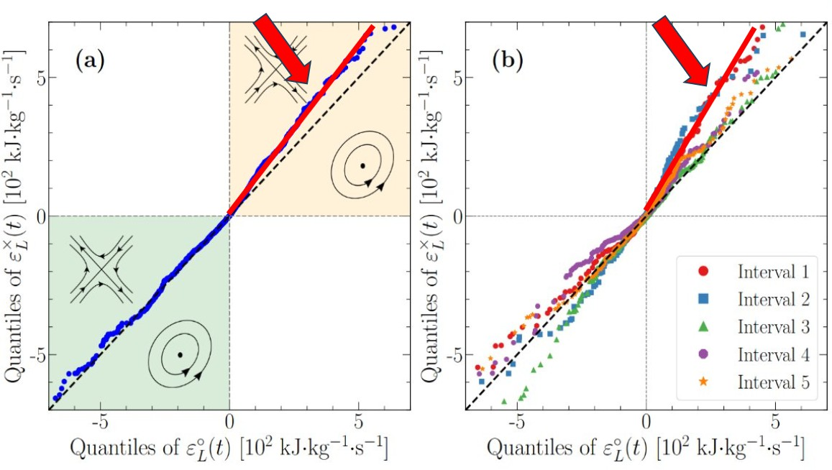
QQ Plots for Solar Wind Intervals: Quantitative Results
Estimate y = Ax + B via linear regression on ε_{L}(t) > 0 for (a) All Intervals (b) Most extreme interval
Reconnection & Turbulent Cascade
9 / 10

Slide 14
QQ Plots for Solar Wind Intervals: Quantitative Results
Estimate y = Ax + B via linear regression on ε_{L}(t) > 0 for (a) All Intervals (b) Most extreme interval
(a) A = 1.25, (b) A = 1.60 ⇒ on average 25% and up to 60% larger forward
instantaneous energy transfer rates in reconnection topology [B small]
Reconnection & Turbulent Cascade
9 / 10

Slide 15
QQ Plots for Solar Wind Intervals: Quantitative Results
Estimate y = Ax + B via linear regression on ε_{L}(t) > 0 for (a) All Intervals (b) Most extreme interval
25% (up to 60%) larger forward instantaneous energy transfer rates in reconnection topology
(a) A = 1.25, (b) A = 1.60 ⇒ on average 25% and up to 60% larger forward
instantaneous energy transfer rates in reconnection topology [B small]
Reconnection & Turbulent Cascade
9 / 10

Slide 16
Summary
WHAT: Instantaneous energy transfer rates differ significantly between topological populations. We find, on average, 25% larger instantaneous energy transfer rates in reconnection topologies compared to flux ropes, suggesting reconnection may drive the forward cascade of energy.
WHY: 3D topology of magnetic field lines is a key feature of reconnection and turbulence. Quantifying contributions of energy transfer by different topologies may help understand the underlying physics of these phenomena.
HOW: Magnetic field line topology classified and associated with with contemporaneous estimate of instantaneous energy transfer rate in 5 Cluster turbulent solar wind intervals. QQ plots compare the two populations.
Reconnection & Turbulent Cascade
10 / 10

Slide 17
Summary
WHAT: Instantaneous energy transfer rates differ significantly between topological populations. We find, on average, 25% larger instantaneous energy transfer rates in reconnection topologies compared to flux ropes, suggesting reconnection may drive the forward cascade of energy.
WHY: 3D topology of magnetic field lines is a key feature of reconnection and turbulence. Quantifying contributions of energy transfer by different topologies may help understand the underlying physics of these phenomena.
HOW: Magnetic field line topology classified and associated with with contemporaneous estimate of instantaneous energy transfer rate in 5 Cluster turbulent solar wind intervals. QQ plots compare the two populations.
Paper Under Review: B. Hnat, S. C. Chapman, C. Liptrott, N. W. Watkins, Solar wind magnetohydrodynamic turbulence energy transfer rate ordered by magnetic field topology, Phys. Rev. Lett. (2025)
Previous Related Works: B. Hnat, S. C. Chapman, N. W. Watkins, Magnetic topology of actively evolving
and passively convecting structures in the turbulent solar wind, Phys. Rev. Lett., 126, 125101 (2021) https://doi.org/10.1103/PhysRevLett.126.125101
Hnat, B., Chapman, S. C, Watkins, N. Topology of turbulence within collisionless plasma reconnection.
Sci. Rep. 13, 18665 (2023). https://doi.org/10.1038/s41598-023-45650-x
Reconnection & Turbulent Cascade
10 / 10

Slide 18
Interval Data Table
Table 1: Data intervals.
Interval Date & Time | β_{p} | ρ_{p} (d_{i}) [km] | ⟨L⟩d_{i}⁻¹ | τtr [s] | ε_{L}(t) counts
10-Feb-03 18:44-19:01 | 0.93 | 80.6 (85.9) | 31.3 | 6.1 | 1506
10-Feb-03 22:30-22:45 | 0.93 | 79.5 (81.6) | 40.4 | 7.6 | 1326
11-Feb-03 00:30-01:15 | 0.76 | 76.7 (85.8) | 44.3 | 8.9 | 4008
19-Feb-03 23:25-23:40 | 0.28 | 139.1 (83.8) | 43.3 | 6.7 | 1416
20-Feb-03 00:34-00:54 | 1.48 | 96.4 (77.6) | 45.5 | 6.6 | 1776
Reconnection & Turbulent Cascade
10 / 10

Slide 19
Yaglom and ϵ Estimates
We find ⟨ε_{L}(t)⟩_{t} = ϵ = 3.4 ± 200 kJ · kg⁻¹ · s⁻¹
Large spread in the distribution average motivated the look at the full distribution.
(a)
(b)
Figure 4: (a) Trace of the magnetic power spectral density tensor P = δ_{ij} B_{i}B_{j} , where i, j = x, y, z from spacecraft C3 for the interval shown in Figure 1. Blue vertical line indicates the proton gyro-frequency. (b) Variation with scale τ of the Yaglom structure function Y (τ ) (red),
Hall-corrected Yaglom structure function S(τ ) (blue), and Hall correction term H(τ ) (green) from spacecraft C1 (triangles) and C3 (squares).
Reconnection & Turbulent Cascade
10 / 10

Slide 20
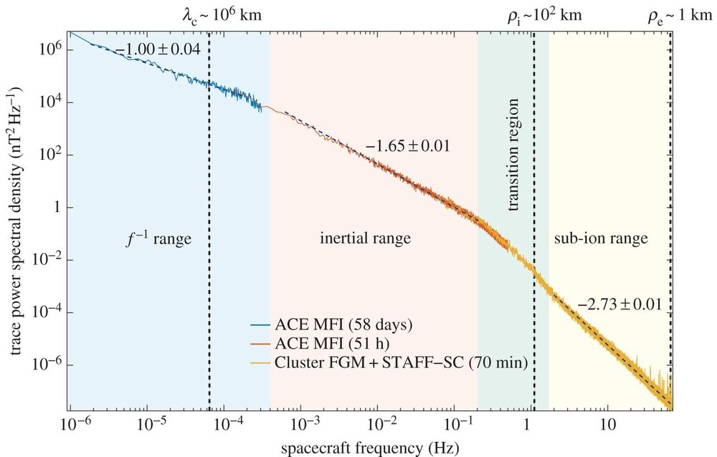
MHD Turbulence Scaling
Figure 5: Kiyani et al 2015 Figure 1
Reconnection & Turbulent Cascade
10 / 10

Slide 21
LS Gradient Estimation
Minimise the objective function S, where
3 N N
Σ Σ Σ
S =
2
[k_{n} · (r_{α} − r_{β} ) − (x_{n}(r_{α}) − x_{n}(r_{β} ))]
(4)
n=1 α=1 β=1
using method of Lagrange multipliers to impose ∇ · B = 0 and obtain the estimator:
_{ΣN}
3
N
Σ
∂B_{i} 1
Σ
(µ) 
=

(µ)

−1
(B (r ) − B (r ))(r − r ) R ,
(5)
∂r_{j} 2N ²
i α i β α
β
µj
µ=1 α=1 β=1
where
N
Σ
(µ) (j)
R = r r
(6)
µj
α α
α=1
is the so-called volumetric tensor.
Reconnection & Turbulent Cascade
10 / 10

Slide 22
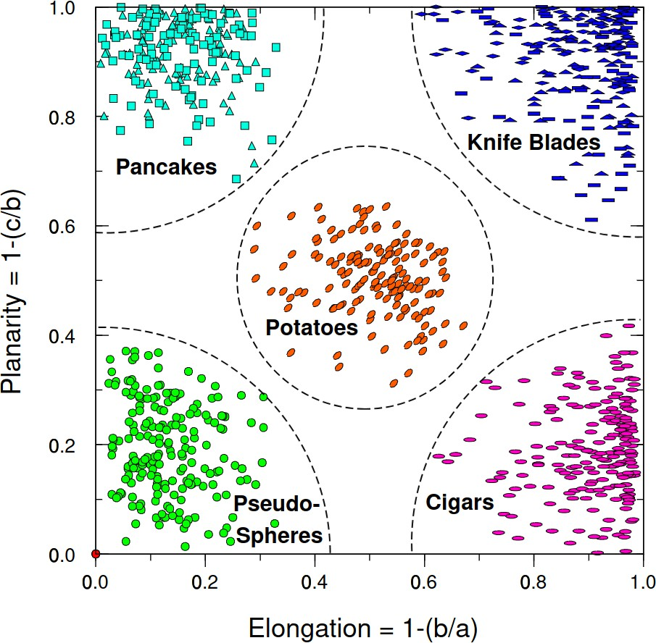
Tetrahedron Quality
Following [Paschmann & Daly (1998)], the volumetric tensor
N
Σ
(µ) (j)
R = r r
µj α α
α=1
contains tetrahedron geometrical information. Characterised by the ordered eigenvalues a > b > c:
,
b
Elongation 1 − : How stretched out spacecraft are.
a
(stretching in two directions)
,
c
Planarity 1 − : How planar they are. (squashed in
b
one direction)
Characteristic scale L = 2√a.
Figure 6: Fig 13.3 from Paschmann & Daly (1998)
Reconnection & Turbulent Cascade
10 / 10

Slide 23
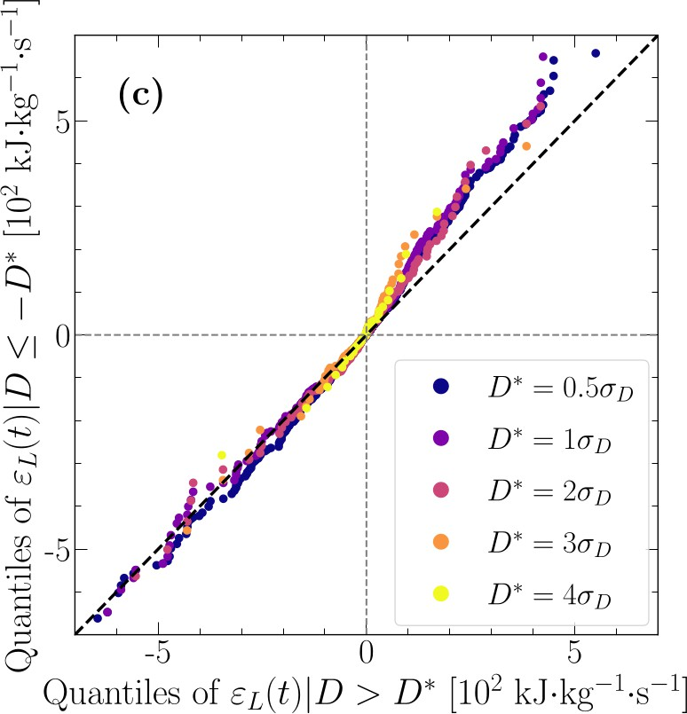
Error Analysis
Reconnection & Turbulent Cascade
10 / 10

