Slide 1
Reconnection between the interplanetary magnetic field and closed magnetotail structures
N. Kaweeyanun¹, R. C. Fear¹, B. S. Lanchester¹, D. K. Whiter¹,
I. L. Gingell¹, A. N. Fazakerley², I. Dandouras³, S. B. Mende⁴
¹ Space Environment Physics group, University of Southampton, UK
² Mullard Space Science Laboratory, University College London, UK
³ Institut de Recherche en Astrophysique et Planétologie, Université de Toulouse/CNRS/ UPS/CNES, France
⁴ Space Sciences Laboratory, University of California Berkeley, USA.

Slide 2
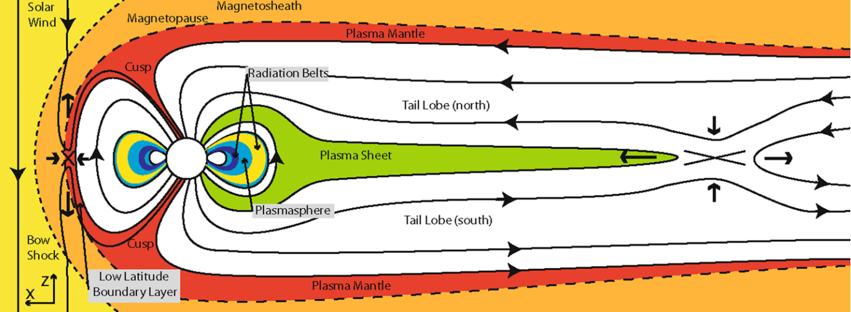
Earth’s magnetosphere: Southward IMF
Figure: Eastwood et al. (2015)
OPEN
CLOSED
CLOSED
OPEN
When Interplanetary Magnetic Field (IMF) is southward (B_{Z}<0), Earth’s magnetosphere strongly driven:
  Reconnection between IMF and magnetosphere opens closed flux
  Reconnection between open magnetotail field lines closes flux

Slide 3
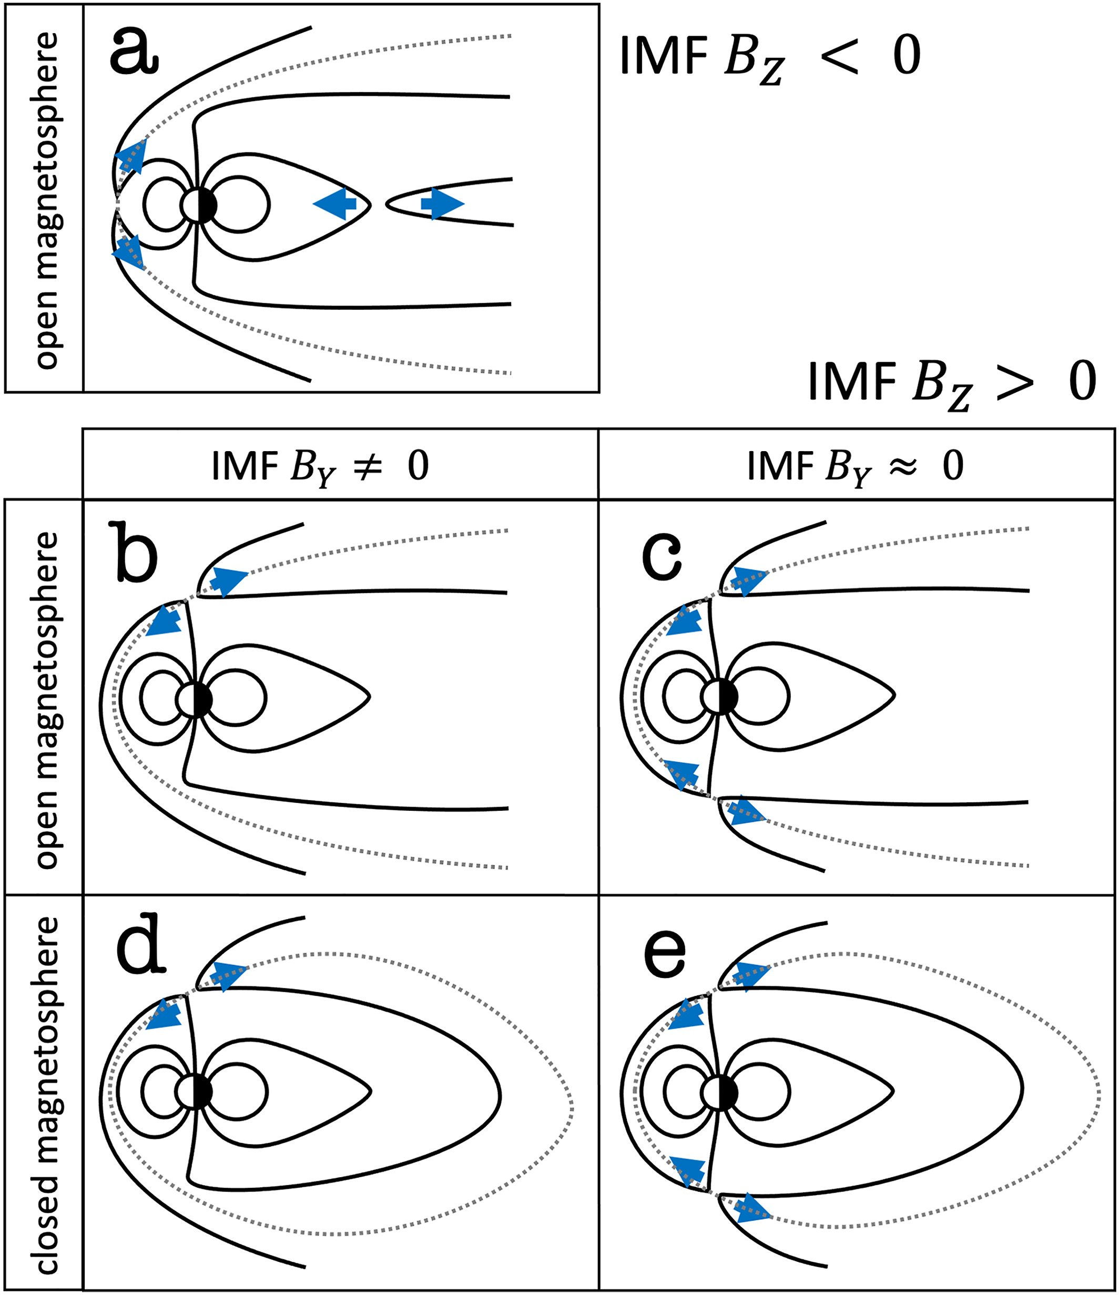
Configurations
Milan et al. (2022), after Cowley (1981)
Southward IMF is just one option…

Slide 4
Configurations
Milan et al. (2022), after Cowley (1981)
Southward IMF is just one option…
When IMF is northward, reconnection site moves to higher latitudes
  Reconnection in one hemisphere: ‘stirs’ open flux in the magnetotail
  Reconnection in both hemispheres: closes open flux in the magnetotail

Slide 5
Configurations
Milan et al. (2022), after Cowley (1981)
Southward IMF is just one option…
When IMF is northward, reconnection site moves to higher latitudes
  Reconnection in one hemisphere: ‘stirs’ open flux in the magnetotail
  Reconnection in both hemispheres: closes open flux in the magnetotail
Cowley (1981) envisaged alternative configurations with a closed magnetotail:
  Reconnection in one hemisphere: opens closed flux in magnetotail
  Reconnection in both hemispheres: transfers closed flux to dayside
Closed magnetotail configurations received recent interest given topologies associated with transpolar arcs, horse-collar auroras
  Fear et al. (2015); Fryer et al. (2023); Milan et al. (2022, 2023); Mooney et al. (2023, 2024, 2025)

Slide 6
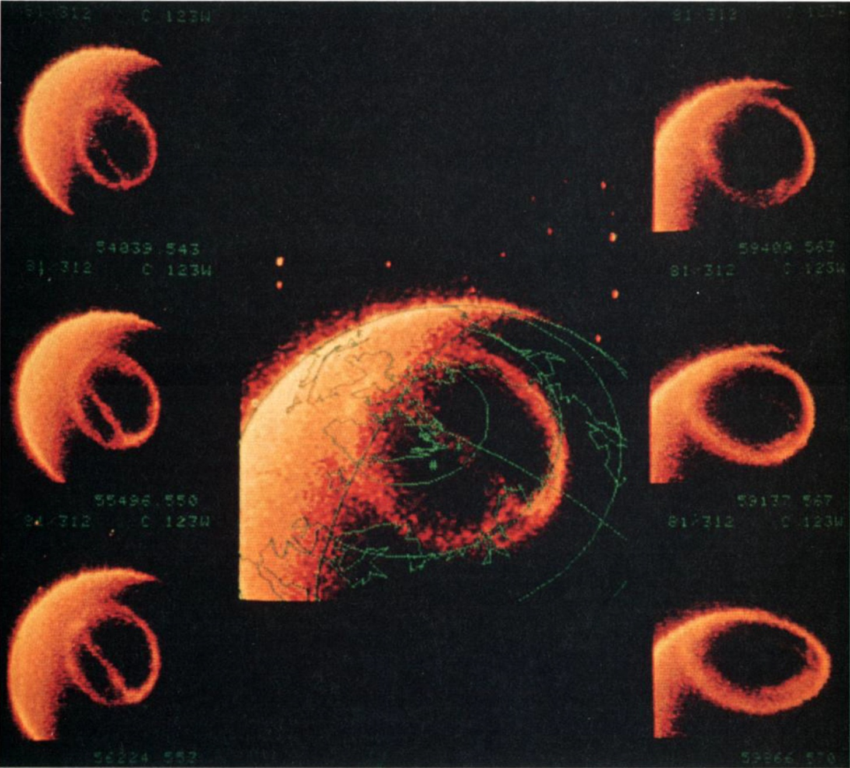
Transpolar arcs (theta auroras)
“Sun-aligned arcs” often form poleward of main auroral oval
  Mawson (1916, 1925); Weill (1958)
Correlated with periods of low geomagnetic activity/northward IMF
  Davis (1963); Berkey et al. (1976)
Can be observed on global scale (“transpolar arcs” or “theta aurora”)
  Frank et al. (1982)
Frank et al. (1982)

Slide 7

Reconnection mechanism for Transpolar Arcs
Open field lines
6 MLT
12 MLT
0 MLT
18 MLT
Combination of ionospheric and in situ observations indicate TPAs form due to build up of closed flux in magnetotail
  Milan et al. (2005); Fear & Milan (2012a,b); Fear et al. (2014)
Flux is closed by magnetotail reconnection but “stagnates” in a certain local time sector due to suppressed dayside driving
Closed field lines

Slide 8
Reconnection mechanism for Transpolar Arcs
Open field lines
6 MLT
12 MLT
0 MLT
18 MLT
Combination of ionospheric and in situ observations indicate TPAs form due to build up of closed flux in magnetotail
  Milan et al. (2005); Fear & Milan (2012a,b); Fear et al. (2014)
Flux is closed by magnetotail reconnection but “stagnates” in a certain local time sector due to suppressed dayside driving
Closed field lines

Slide 9
Reconnection mechanism for Transpolar Arcs
Open field lines
6 MLT
12 MLT
0 MLT
18 MLT
Combination of ionospheric and in situ observations indicate TPAs form due to build up of closed flux in magnetotail
  Milan et al. (2005); Fear & Milan (2012a,b); Fear et al. (2014)
Flux is closed by magnetotail reconnection but “stagnates” in a certain local time sector due to suppressed dayside driving
Closed field lines

Slide 10
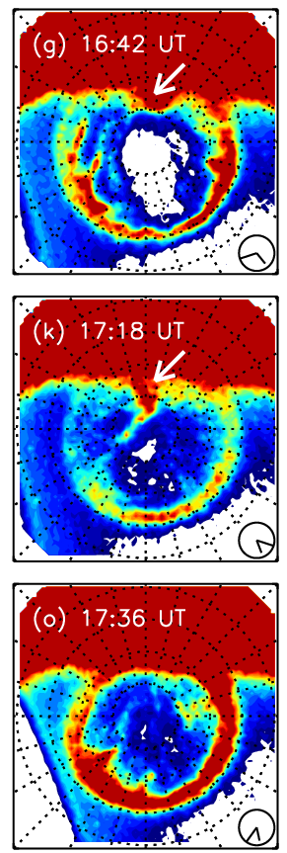
Transpolar arc/cusp spot interaction
Fear et al. (2015) observed interaction between TPA and a cusp spot
  Cusp spot is signature of high latitude (lobe) reconnection
  Transpolar arc and cusp spot intersect
Implication is that lobe reconnection is now opening closed flux associated with transpolar arc
6 MLT
12 MLT
0 MLT
18 MLT
Fear et al. (2015)

Slide 11
Transpolar arc/cusp spot interaction
Fear et al. (2015) observed interaction between TPA and a cusp spot
  Cusp spot is signature of high latitude (lobe) reconnection
  Transpolar arc and cusp spot intersect
Implication is that lobe reconnection is now opening closed flux associated with transpolar arc
6 MLT
12 MLT
0 MLT
18 MLT
Fear et al. (2015)

Slide 12
Transpolar arc/cusp spot interaction
Fear et al. (2015) observed interaction between TPA and a cusp spot
  Cusp spot is signature of high latitude (lobe) reconnection
  Transpolar arc and cusp spot intersect
Implication is that lobe reconnection is now opening closed flux associated with transpolar arc
TPA/Cusp spot interactions should not be rare
  Both are common for northward IMF
  TPA motion is driven by polar cap flows, which “feed in” to cusp spot
  Can we see the TPA/IMF reconnection in situ?
Fear et al. (2015)

Slide 13
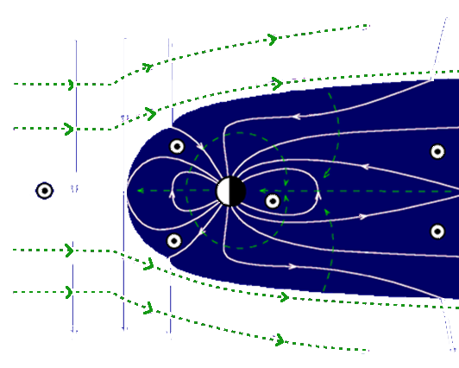

Instrumentation
2000 orbit
IMAGE
  Polar orbit
  Remote imaging of auroral oval
  Wideband FUV imager (WIC)
  Proton precipitation imager (SI-12)
  Operated 2000-2005
Cluster
  Polar orbit
  In situ plasma measurements
  e.g. Magnetic fields, ions, electrons
  Operated 2000-2024
2005 orbit

Slide 14
Can we see TPA/IMF reconnection in situ?
18th March 2002
Kaweeyanun et al. (submitted)
IMAGE
WIC
IMAGE
SI-12
IMAGE SI-12 observed a cusp spot, traversed by footprint of Cluster spacecraft (Phan et al, 2003)
Cluster spacecraft observed signatures of high latitude magnetopause reconnection (Phan et al., 2003)
Re-examination of IMAGE WIC shows simultaneous presence of TPA (Kaweeyanun et al., submitted)
TPA intersects with cusp spot between ~14:30 and ~15:30 UT

Slide 15
OMNI and Cluster observations
IMF is northward (B_{Z} ≈ 10 nT) and solar wind speed moderate (V_{SW} ≈ 450 km/s) [not shown]
Magnetospheric magnetic field has sunward component (B_{X} > 0) confirming Cluster in lobe
Re-examination of Cluster data before the magnetopause crossing (in lobe) reveals:
  Two ion populations (~1-10 keV and ~100 eV)
  Two electron population (~100 eV and ~10 eV)
  Colder populations consistent with upward/downward field-aligned currents associated with polar cap arc structure
  (Teste et al., 2007)
  Higher energy populations consistent with plasma sheet and previous in situ TPA observations
  (Fryer et al., 2021)
Kaweeyanun et al. (in prep)

Slide 16
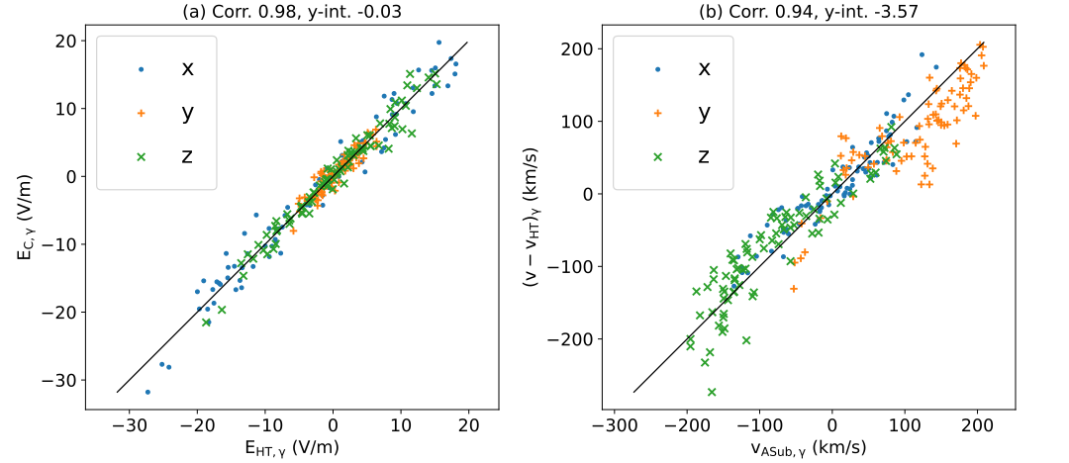
Walen test and interpretation
Kaweeyanun et al. (submitted)
Walén test satisfied
  As known from Phan et al. (2003)
But plasma present in lobe was indicative of closed field line structure associated with transpolar arc
Interpretation: Cluster crossed a magnetopause reconnection site near where the IMF was reconnecting with closed nightside flux
  Result will have been opening of that flux

Slide 17
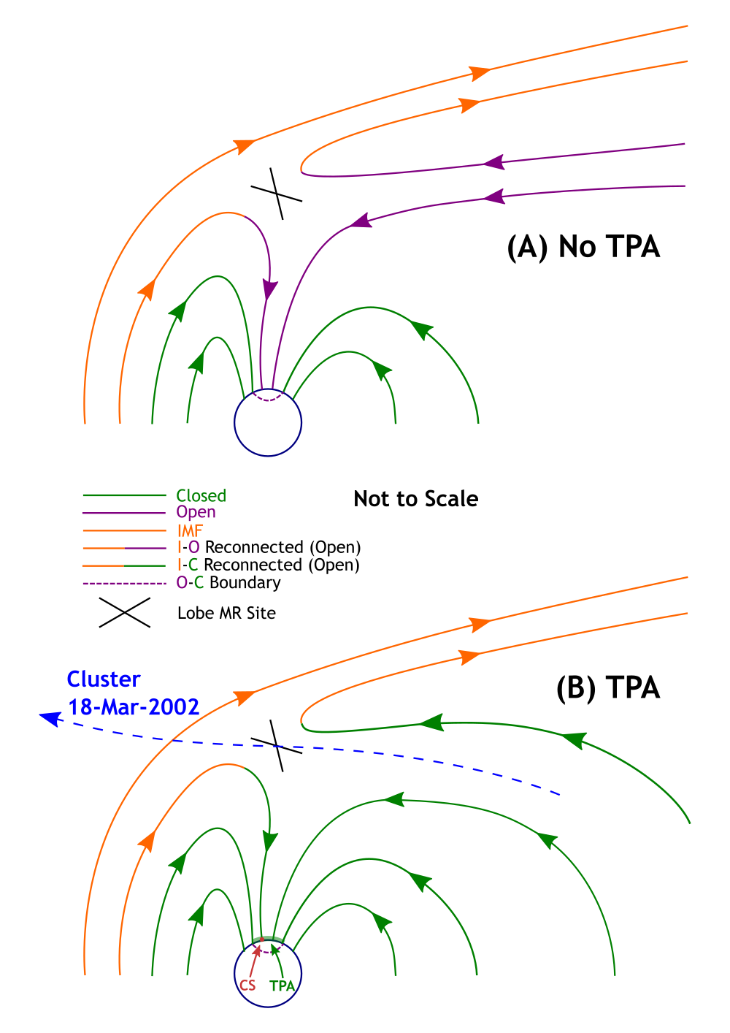
Walen test and interpretation
Kaweeyanun et al. (submitted)
Walén test satisfied
  As known from Phan et al. (2003)
But plasma present in lobe was indicative of closed field line structure associated with transpolar arc
Interpretation: Cluster crossed magnetopause reconnection site near where the IMF was reconnecting with closed nightside flux
  Result will have been opening of that flux

Slide 18
Electron gap – implications
Kaweeyanun et al. (submitted)
Note gap in electrons immediately
before magnetopause crossing
Gap not so clear in ions
Electron gap indicates that in
~10 mins before magnetopause
crossing, Cluster has moved off
the TPA onto open lobe field lines
But presence of ions indicate that Cluster remains within one ion gyroradius (~50 km) of TPA-related closed field lines
Cluster observes reconnection site in situ within ~50 km of closed tail field lines

Slide 19
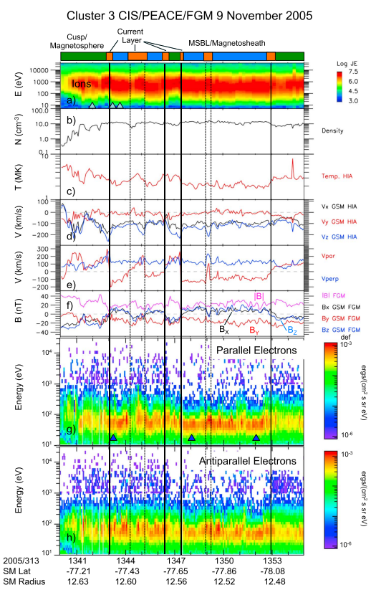
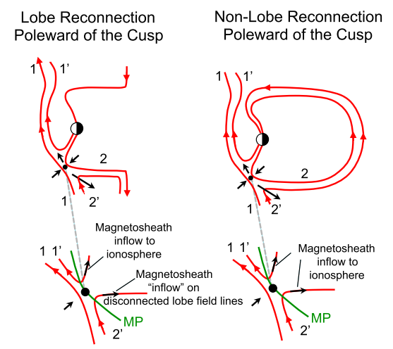
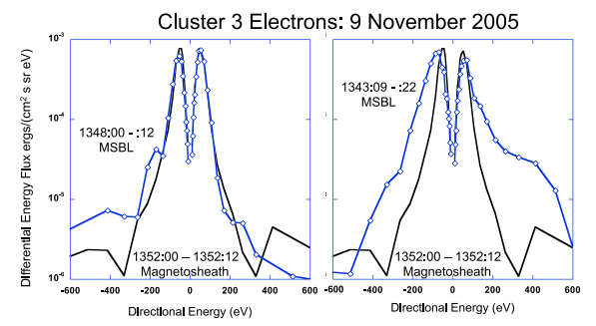
Implications: “Non-lobe” reconnection
Fuselier et al. (2018) surveyed magnetopause boundary layer and identified 13 cases of identified or potential “non-lobe” reconnection
  Reconnection between IMF and closed field lines in magnetotail
Preliminary examination (Kaweeyanun et al., in prep) shows:
  12 have auroral data
  7 have a TPA reaching the cusp
  1 has a horse-collar aurora
8 out of 12 (67%) have polar cap aurora (PCA) present, cf. 20% PCA random sampling
Fuselier et al. (2018)

Slide 20
Summary and conclusions
On 18th March 2002, Cluster passed through a magnetopause reconnection site tailward of the cusp (Phan et al., 2003)
  IMAGE SI-12 observed a cusp spot (auroral signature of magnetopause reconnection)
Re-examination of the Cluster and IMAGE WIC data shows that a transpolar arc was present at this time, the in situ structure of which was observed by Cluster
The transpolar arc and cusp spot coincide, indicating that high latitude magnetopause reconnection was opening closed magnetotail flux associated with arc (Fear et al., 2015)
At the precise time of the reconnection site crossing, Cluster had moved relative to arc but was within one ion gyroradius (~50 km) of it
  Though IMAGE observations do imply that TPA-IMF reconnection continued
These observations may explain previous remote observations of “non-lobe” reconnection (Fuselier et al., 2018)

Slide 21
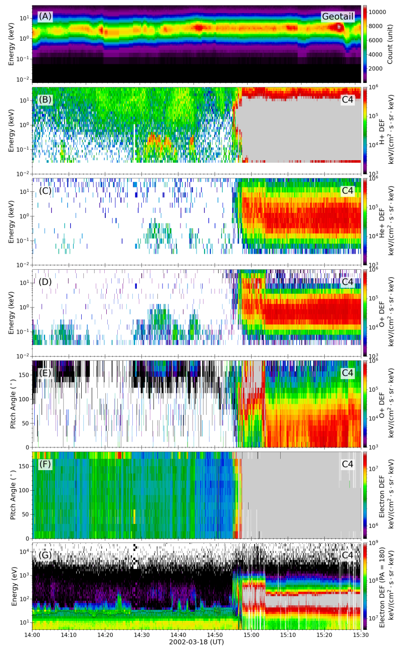
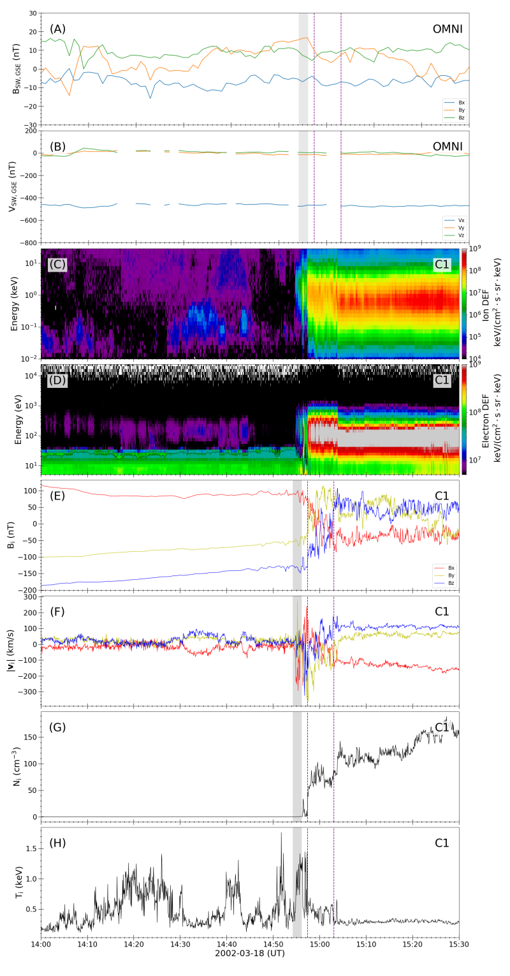
OMNI, Cluster and Geotail
Kaweeyanun et al. (in prep)
Hotter ion population similar to simultaneous observations of plasma sheet by Geotail
  Consistent with TPA in situ signature
C4 CODIF observations show that
  Hotter ion population is predominantly H⁺
  Colder ions have significant O+ contribution, moving antiparallel to the magnetic field
    Consistent with low energy ions upflowing from ionosphere

Slide 22
OMNI, Cluster and Geotail
Kaweeyanun et al. (in prep)
PEACE observations show that there are actually two electron populations at ~100 eV
  An isotropic population that is (largely) present throughout, plus
  An intermittent population at 180° pitch angle
Antiparallel ions and electrons largely alternate
  Interpretation: Upward and downward field-aligned currents associated with polar cap arcs structure (Teste et al, 2007)

