Slide 1
Airglow Characterisation for ELT-Era Observations
Jay Stephan
Rubén Sánchez-Janssen¹, Elena Valenti²,
Jonathan Smoker², Melanie Kaasinen³
1: STFC-UKRI / Isaac Newton Group, 2: European Southern Observatory, 3: Australian National University
Notes:
The abstract pattern can be removed or repositioned if required. Be careful to ‘Send to Back’ so that it does not obscure any important information.

Slide 2
Short Introduction

Slide 3
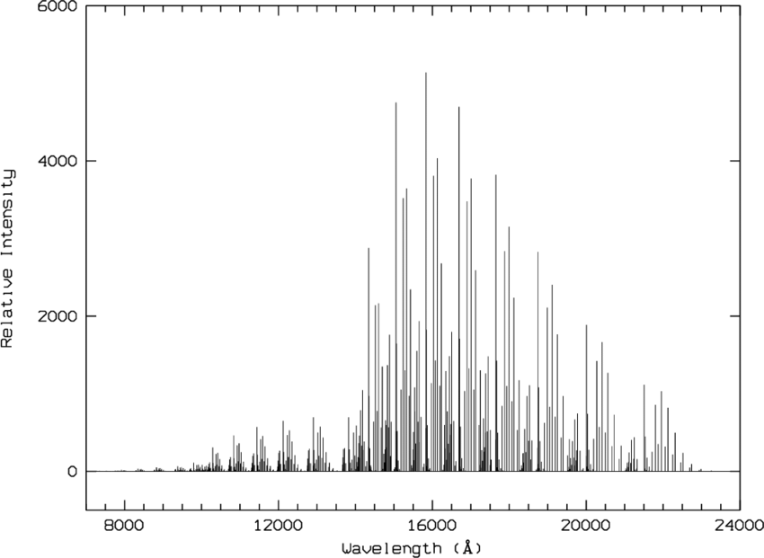
What is airglow?
NIR sky dominated by OH lines
Light from chemical reactions in the upper atmosphere.
Specific reactions and hence emissions occur in certain atmospheric layers.
Airglow consists of a broad pseudo-continuum and dense spectral lines.
Figure: Rousselet et al. 1999

Slide 4
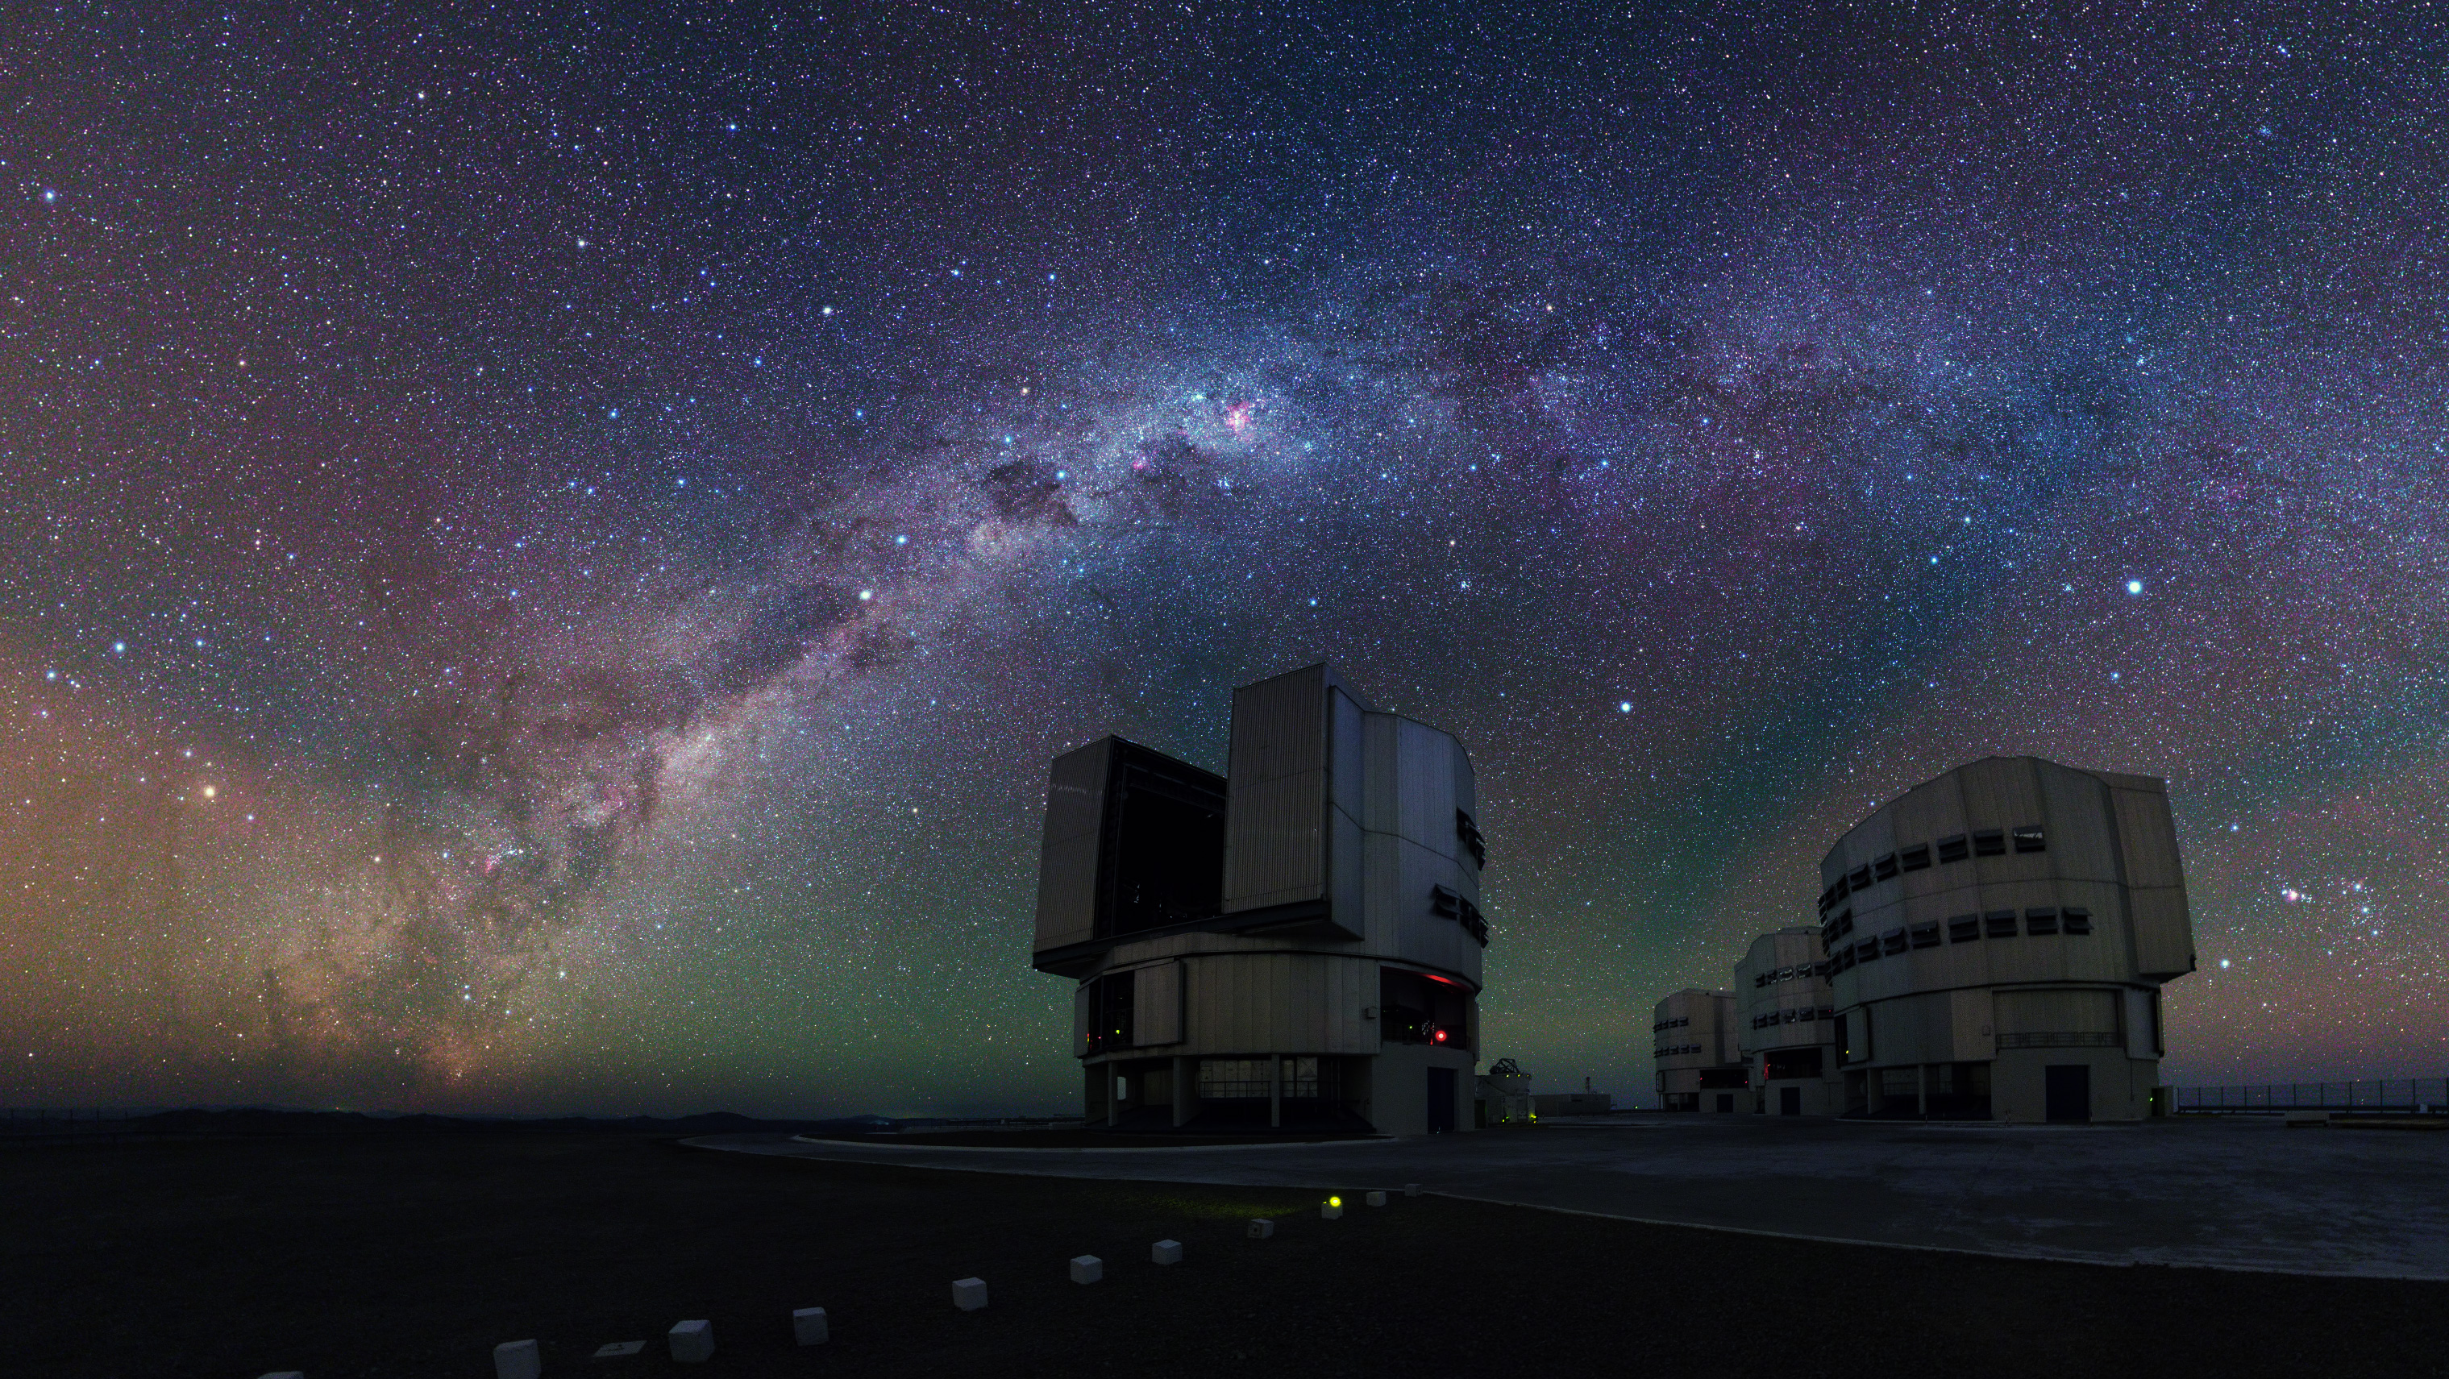
VLT
Gravity Waves
OH ~86km
O
~90-100km

Slide 5
Sky-Subtraction
Airglow can be removed from observations through sky-subtraction. This is done by observing the sky separately from our target object and subtracting the frames.
However, this leaves residuals in the data due to:
Changes in instrument response between frames
Airglow variation between frames (i.e. airmass, and temporal + spatial variations)
- =
Object + Sky Frame Sky Frame Object Frame

Slide 6
ELT Preparation

Slide 7
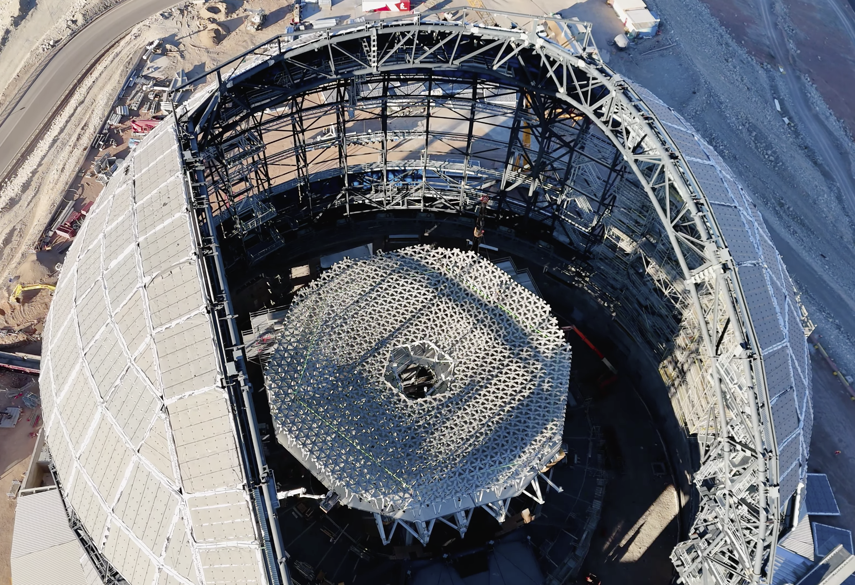
Challenges for the ELT
Airglow is the dominant sky-noise in the NIR (H-band continuum ~19th mag).
It’s hard to remove accurately, and it’s not well characterised.
This becomes a bigger problem as we observe deeper in the NIR (beyond 25th mag with MOSAIC).
Airglow poses a risk to ELT science cases.

Slide 8
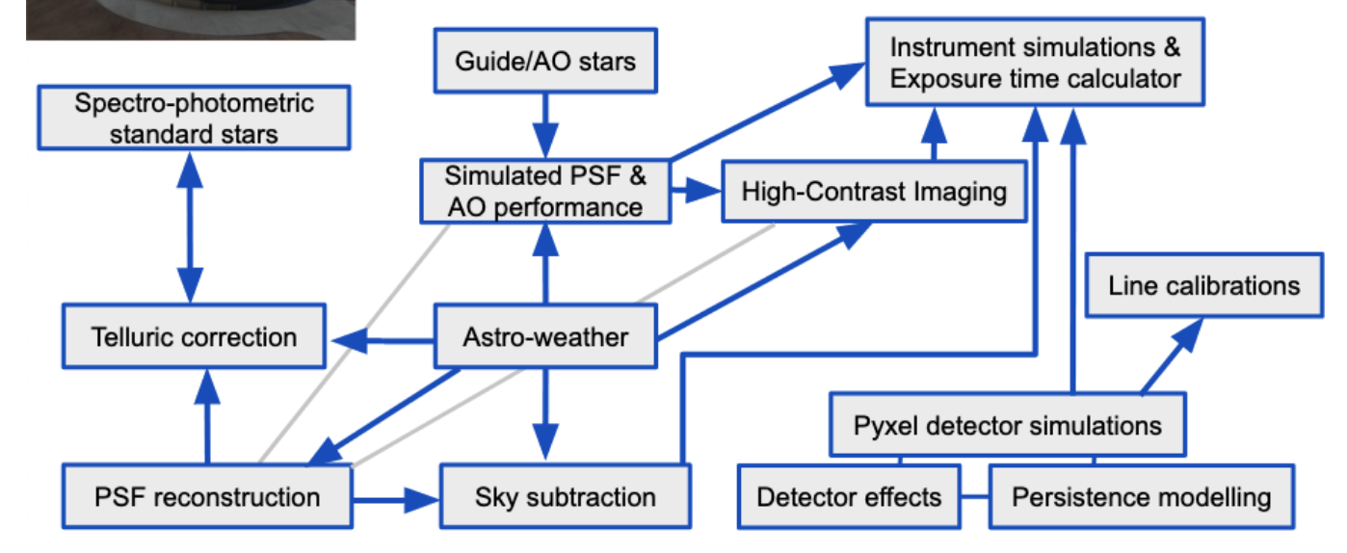
ELT Working Groups
An ELT Working Group has been set-up on the topic.
We were awarded 39h on VLT-CRIRES+ to characterise NIR airglow:
13h in each of H-, J-, and K-bands
R ≃ 100,000
10-minute exposures

Slide 9
1) Line list
When stacked, we have the deepest high-resolution sky-spectra known. Part is plotted below, along with the previous most complete study of lines (Oliva et al 2015 in blue):
We resolve many previous lines into doublets! We spot lots of new faint lines
Previous Line Study: Oliva et al. 2015

Slide 10
1) Line list
To find the transition associated with a line, we can model and predict emissions (Noll et al. 2025 in red). But this still leaves unknowns!
Nevertheless, we will have a NIR line list ready for ELT observations:
H-band: we find ~2-4x more lines as Oliva
J-band: ~2-3x

Slide 11
2) Spatial variation
CRIRES+ has a 10” slit – so we can identify how lines vary spatially on the sky in a frame.

Slide 12
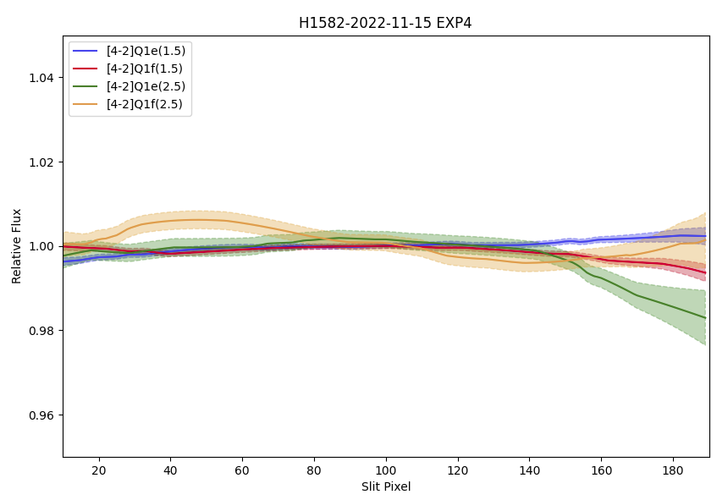
2) Spatial variation
After calibrating for instrument response:
We find no real evidence for airglow spatial variation for 10” scales over 10 minutes.
Variation between these lines should be coherent
'Dodgy’ end of the slit

Slide 13
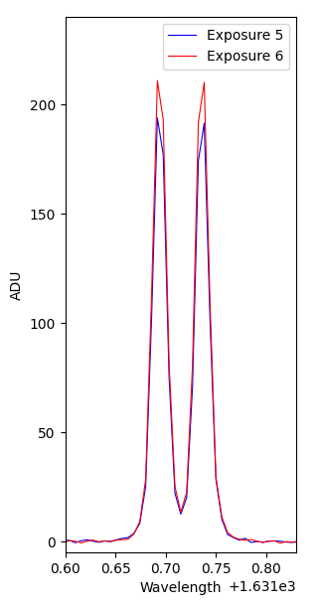
3) Temporal variation
We aim to investigate airglow temporal variations, finding variable line groups, distinct temporal scales, etc.
This typical example suggests ~10% variation is realistic over 10 mins for both bright and faint lines.
8%
9%
10%
6%
18%

Slide 14
Implications for MOSAIC
Our detected spatial and temporal variations can be used to inform sky-subtraction techniques.
Faint lines blend to form pseudo-continuum at MOSAIC’s resolution.

Slide 15
Final Remarks
Airglow is a challenge that needs to be removed from ELT observations to exploit its full potential.
Airglow is currently not well characterised.
By the time the ELT running, we hope to have such a characterisation in the NIR.
Current results suggest:
We will expand on existing catalogues by 2-4x.
Spatial variations in line strength over 10” and 10 minutes are negligible.
Temporal variations on 10-minute scales are significant.

Slide 16
UK Astronomy Technology Centre
@UKATC
@RoyalObs
Notes:
The abstract pattern can be removed or repositioned if required. Be careful to ‘Send to Back’ so that it does not obscure any important information.

Slide 17
VLT

Slide 18
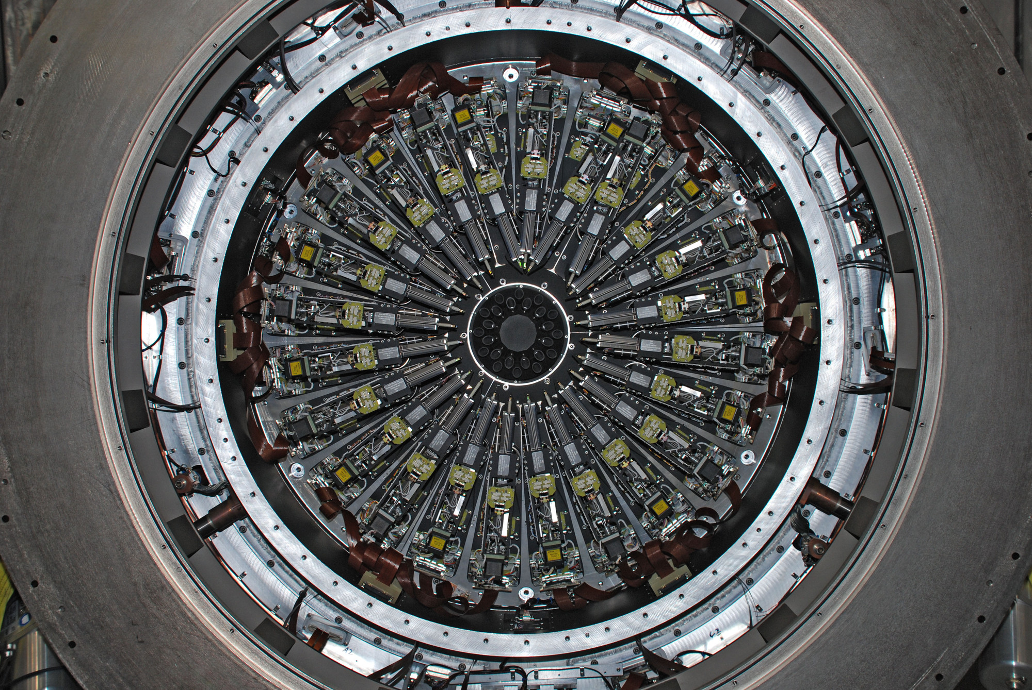
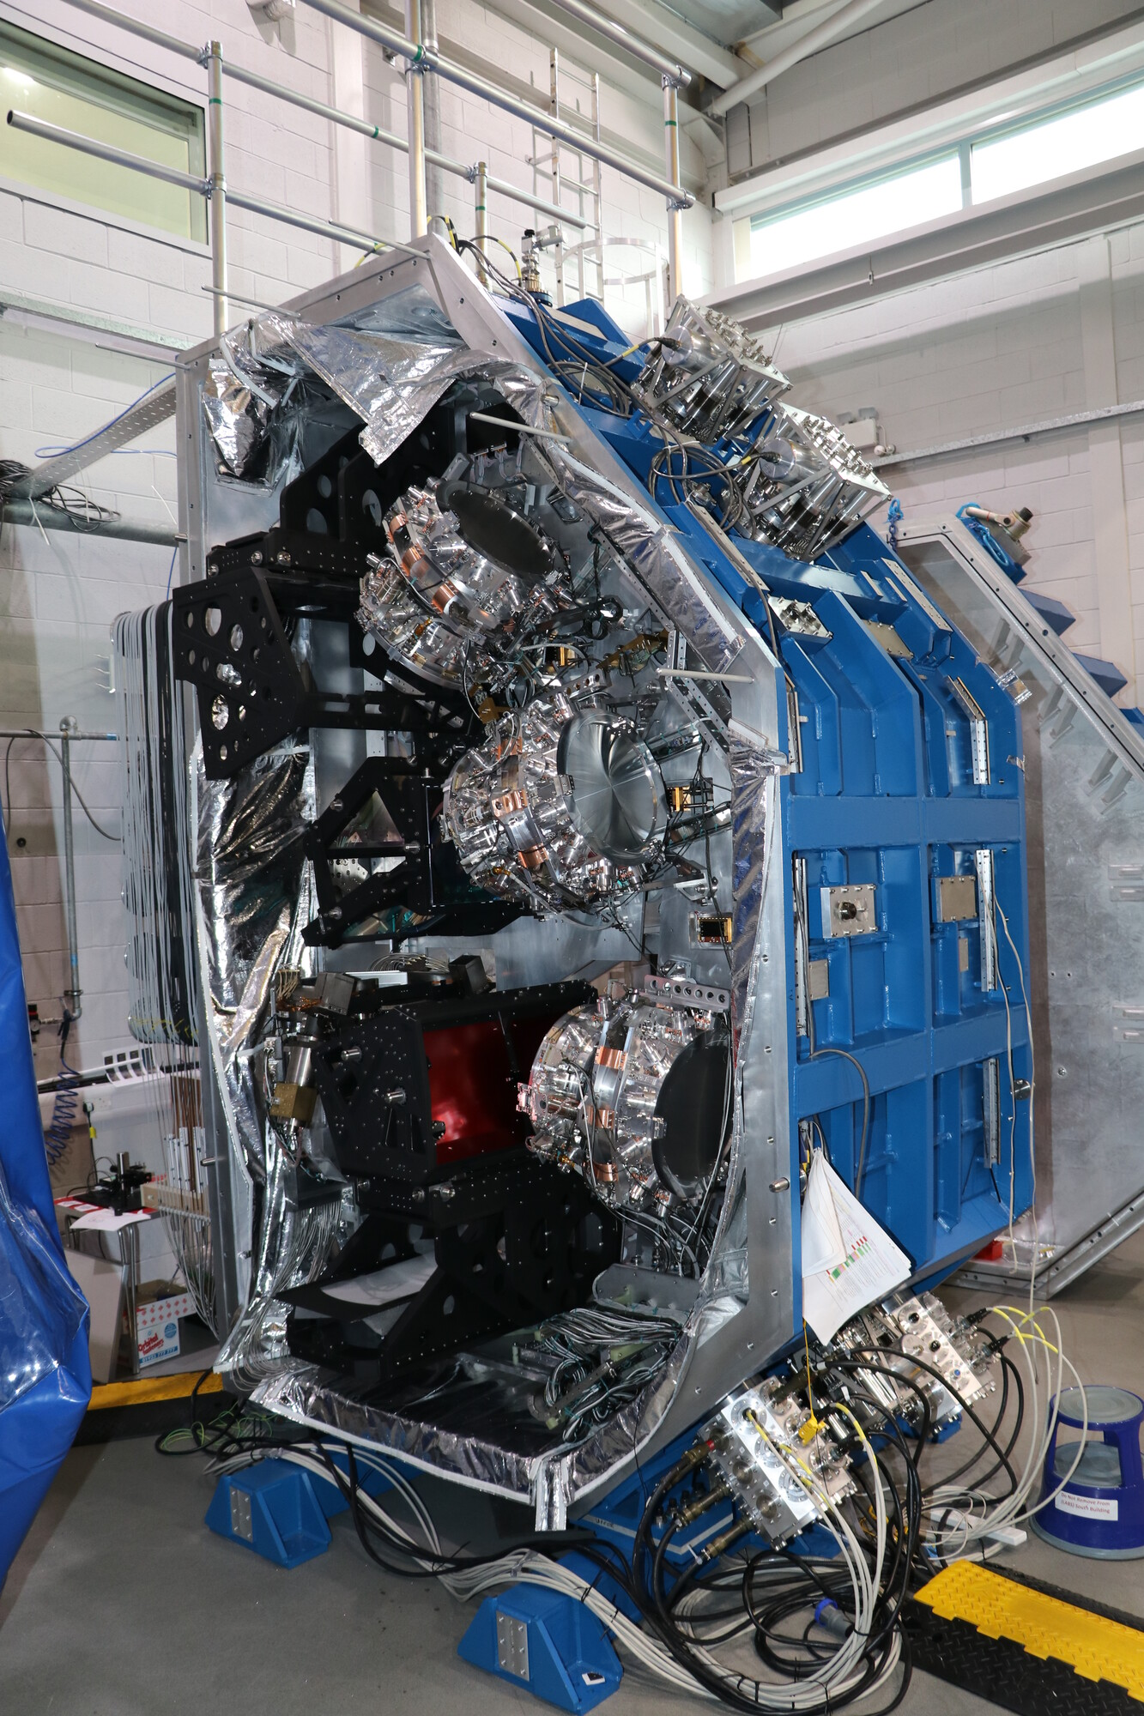
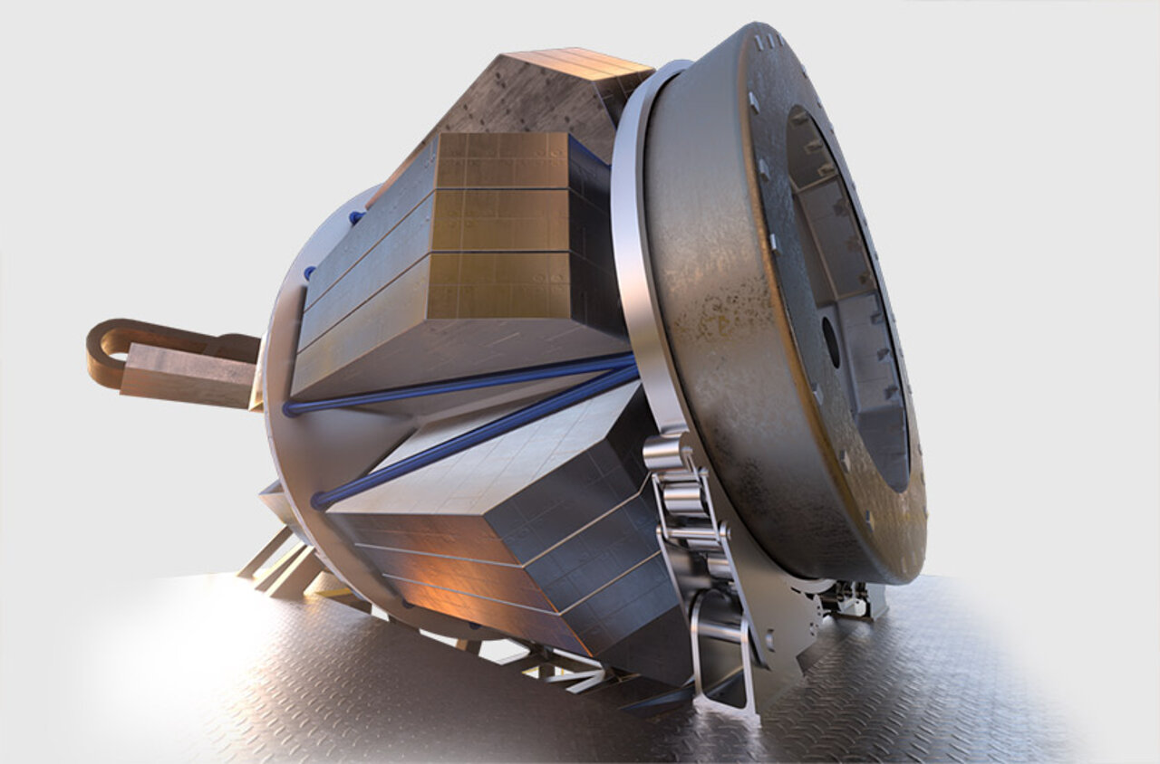
Recovering the Science
Airglow needs to be characterised and removed to recover science spectra.
UK ATC and Durham work on several prominent multi-object spectrographs, so I shall focus on airglow in the context of these.
VLT KMOS (2012) VLT MOONS (2025) ELT MOSAIC (2030s) WST (2040s?)

Slide 19
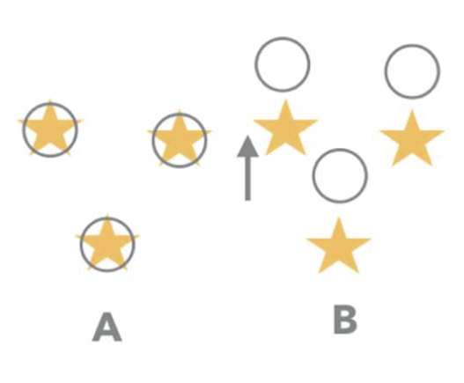
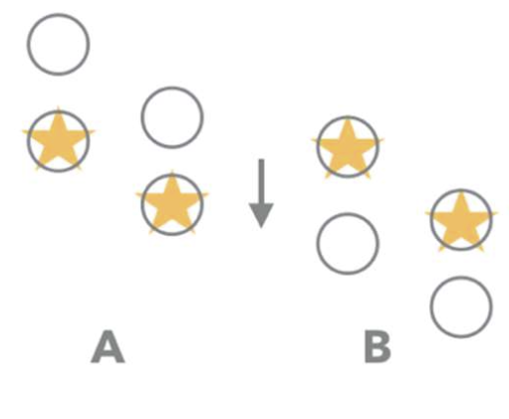
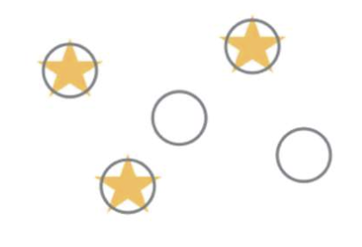
Fibre-MOS Sky-Subtraction Techniques
Staring
High efficiency
Does not correct for instrument response.
Nodding
~Correct for instrument response
Does not correct for airglow temporal variations
50% efficiency
X-switch
~Corrects for instrumental response
Corrects for airglow temporal variations
50% efficiency
Figure: adapted from MOSAIC Consortium

