Slide 1
Observing with MOSAIC
Tim Morris, David G. Bramall, David King, Jennifer King, Nazim Bharmal, Tim Butterley, Polly Gill, Jurgen Schmoll (Durham)
Ian Lewis, Alec York (Oxford)
Gavin Dalton (Oxford/RALSpace)
Jay Stephan, Noah Schwartz, Raziye Artan (UKATC)
Ruben Sanchez-Janssen (UKATC/Isaac Newton Group)
And the MOSAIC consortium

Slide 2
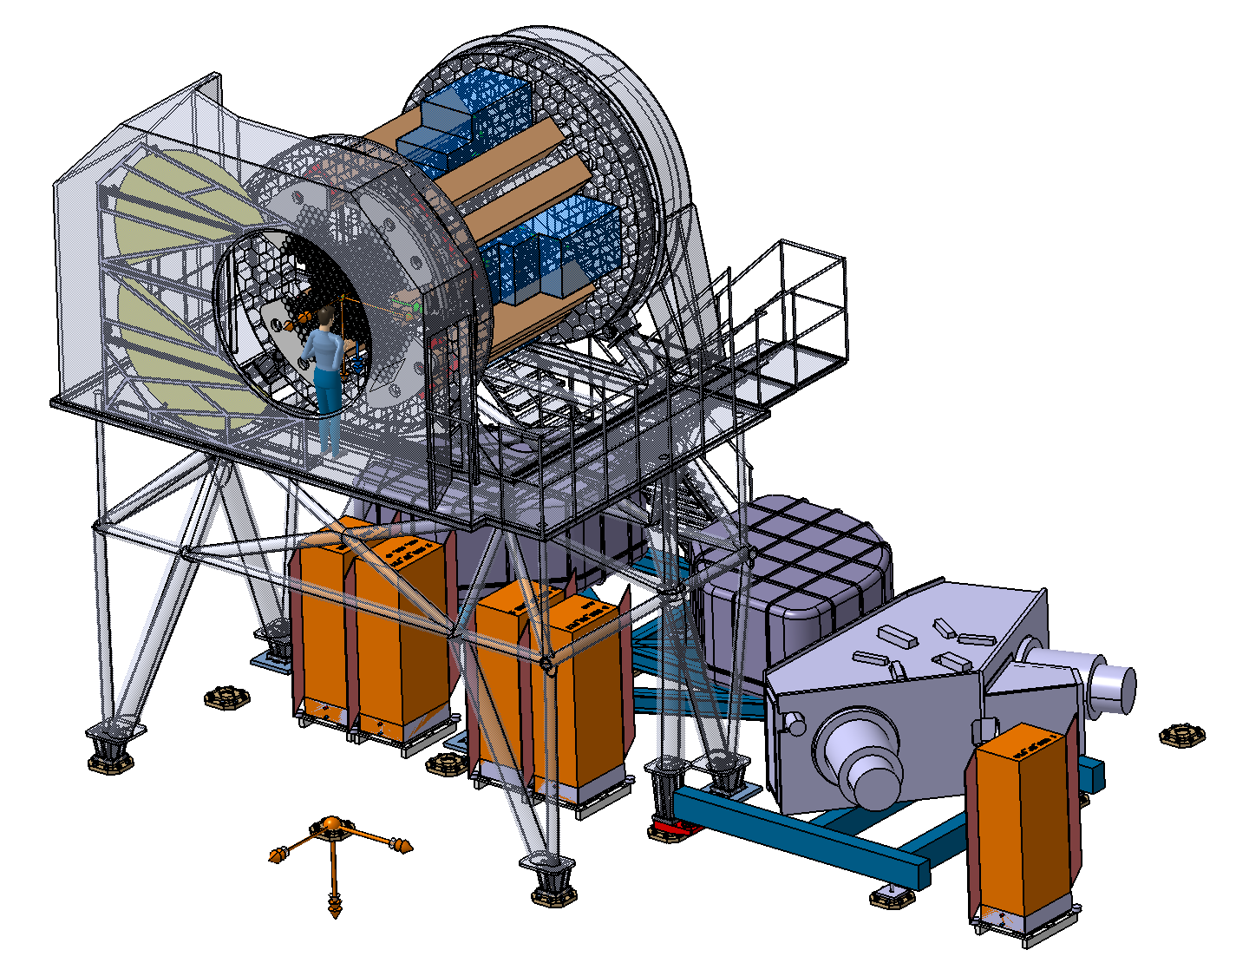
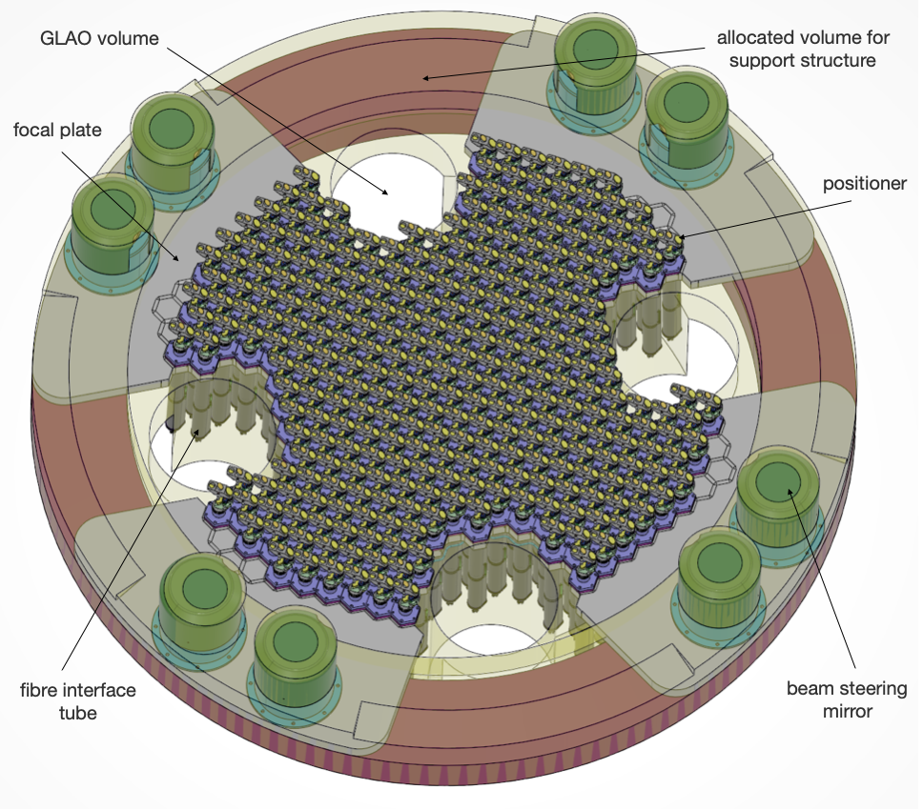
MOSAIC and its Focal Plane
Sky tracking
Calibration Screen
Rotating Structure
Focal Plane
Spectrographs
Electronics

Slide 3
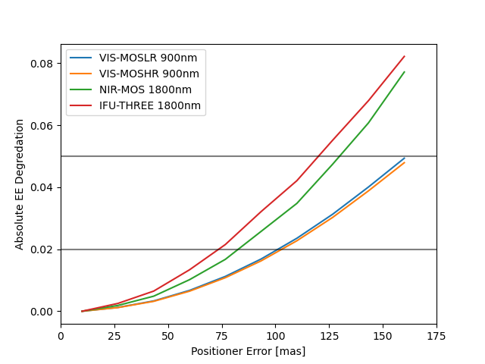
Pickoff and Apertures
1800nm PSF and NIR-MOS aperture
600 mas
Pickoff System Prototype, EPFL & EPIA (Switzerland)
Offset [mas]

Slide 4
The Adaptive Telescope
M2
M1 to M3 are all actively controlled with errors corrected initially using M4 and M5.
Introduces random higher order field distortions up to 150 mas at field edge
Up to ~8% EE loss if not compensated
These change:
For every observation
On few minute timescales
When the telescope changes azimuth by ~15 degrees
If you hand back control to the telescope
M4
(Adaptive
Optics)
M5
M3
M1
Offset [mas]

Slide 5
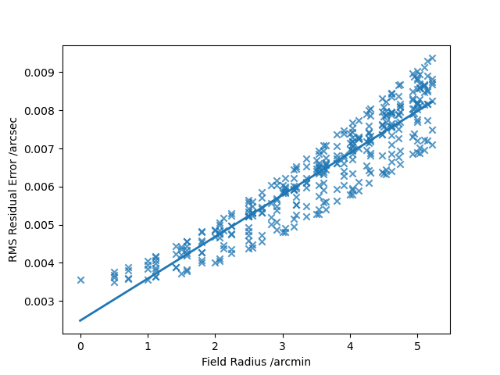
Measured NGS position
Including flexure, measurement, positioning, etc., errors
Distorted NGS position
Guiding and Distortion Model
Field position (arcmin)
Max Pickoff
Distance
Input distortion map
Error on fitted map
150 mas input distortion error reduced to ~10 mas at the field edge
Caveat: Model dependent – don’t have formal ELT models yet…

Slide 6
Distortions and PSF motion
Example
Simulations courtesy MORFEO AO team
<10 mas (TBC) PSF blur for MOSAIC

Slide 7
On to the atmosphere…
High vertical resolution measurement of the optical turbulence strength vs. altitude over a night in La Palma (Osborn et al, Jphys 545, 2015)

Slide 8
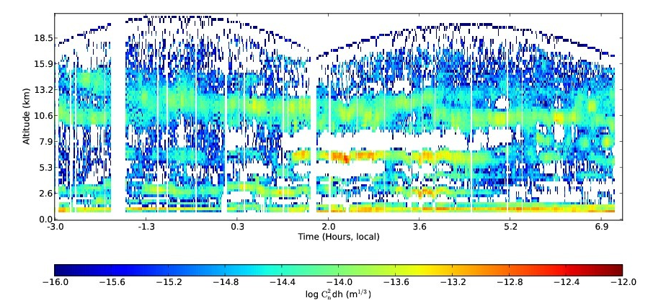
Ground Layer AO
Layered Atmosphere

Slide 9
Ground Layer AO
Layered Atmosphere

Slide 10
Ground Layer AO
Classical AO
(HARMONI/MICADO/METIS)
Layered Atmosphere
Example Solar AO image
Schmidt et al, A&A 597 (2017)

Slide 11
Ground Layer AO
Multi-conjugate AO
(MORFEO)
Layered Atmosphere
Example Solar AO image
Schmidt et al, A&A 597 (2017)

Slide 12
Ground Layer AO
Ground Layer AO
(MOSAIC)
Layered Atmosphere
Example Solar AO image
Schmidt et al, A&A 597 (2017)

Slide 13
Field of view comparison
ELT 1650nm PSF
Log-scaled
1” box size
MOSAIC
8’ field of view
600mas apertures
300 objects
~1.5x EE compared to NoAO
MICADO
1’ field of view
4mas pixels
~50% Strehl ratio

Slide 14
Ground Layer AO
Martins et al, Proc SPIE 12187 (2022)
GMT not ELT!
Layered Atmosphere
Dome and Structure
Vogiatzis et al, Proc SPIE 10705 (2018)
Can’t show ELT models (yet)

Slide 15
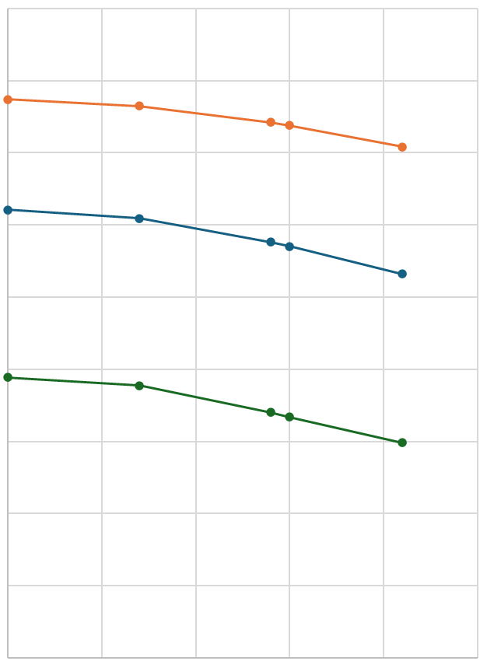
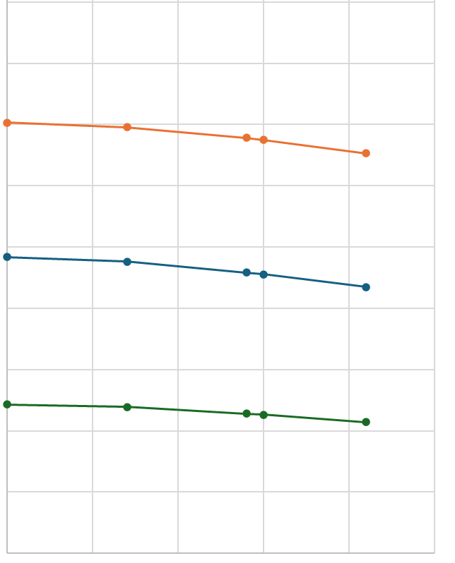
MOSAIC Performance
1800nm PSF and NIR-MOS aperture
NIR–MOS @ 1600nm
VIS–MOSLR @ 500nm
80%
20%-ile conditions
600 mas
60%
Energy within MOS Aperture
Median conditions
40%
20%
80%-ile conditions
2.5% (TBC!) energy loss due to aperture-object offsets
0%
0”
50”
100”
150”
200”
0”
50”
100”
150”
200”
Science target off-axis distance (arcsec)

Slide 16
Acquisition…
Requirement <165s
Requirement <300s
AO system optimisation
Preset
Acquisition
Telescope slews
MOSAIC rotates
Laser launched
NGS acquired
LGS acquired
Distortion mapping
Distortion Correction
Start observing
Small 0.1” offsets
Focal plane (re)configuration
Up to 300 positioners and ADCs to move
Just under 8 minutes (max) from start of slew to open shutter

Slide 17
Observing Efficiently…
Handing back control to the telescope or offsetting for more than ~30” is going to require a full (re)acquisition
Estimate here is about 2-3 minutes to map distortions and reconfigure focal plane
Strategy: Keep control of the telescope and offset the positioners only
Can support complex NIR sky-subtraction observing methods for offsets of up to an arcminute
Compensating for VIS and NIR differential refraction will require moving half the positioners during an observation
Observing strategies may be limited but longer exposures will always be more efficient…

Slide 18
Conclusions
MOSAIC will observe a few hundred objects within a ~8’ diameter field simultaneously
Half at visible wavelengths from 390-930nm
Half in the NIR up to 1800nm
Telescope effects dominate performance but we’re able to couple at least 40-50% of light into fibre bundles across the full field upwards in median conditions
Compensating for telescope effects is possible, but places constraints on how you have to plan observations if you want to observe efficiently

Slide 19
Abstract
MOSAIC is the only instrument proposed for the Extremely Large Telescope (ELT) that makes use of the full 10 arc minute field of view of the telescope.
The Ground Layer Adaptive Optics (GLAO) system for MOSAIC does not reach the diffraction limit but is designed to provide partial AO correction over this entire field, providing up to 1.5x the flux within a MOS aperture over that obtained with the telescope-delivered image quality.
To achieve this, the GLAO system uses wavefront information from multiple laser and natural guide stars to identify only turbulence closest to the ground which is common to all lines of sight.
Determining performance in this mode and understanding the interaction with the telescope control system is challenging, and places constraints both on system performance and the way in which astronomical observations can be made with MOSAIC.
Here we describe some how the design and operation of the MOSAIC instrument addresses these challenges and how the AO system design has been optimised to enable wide-field multi-object spectroscopy.

Slide 20
Credit: ESO
Credit: ESO/L. Calçada/ACe Consortium

Slide 21
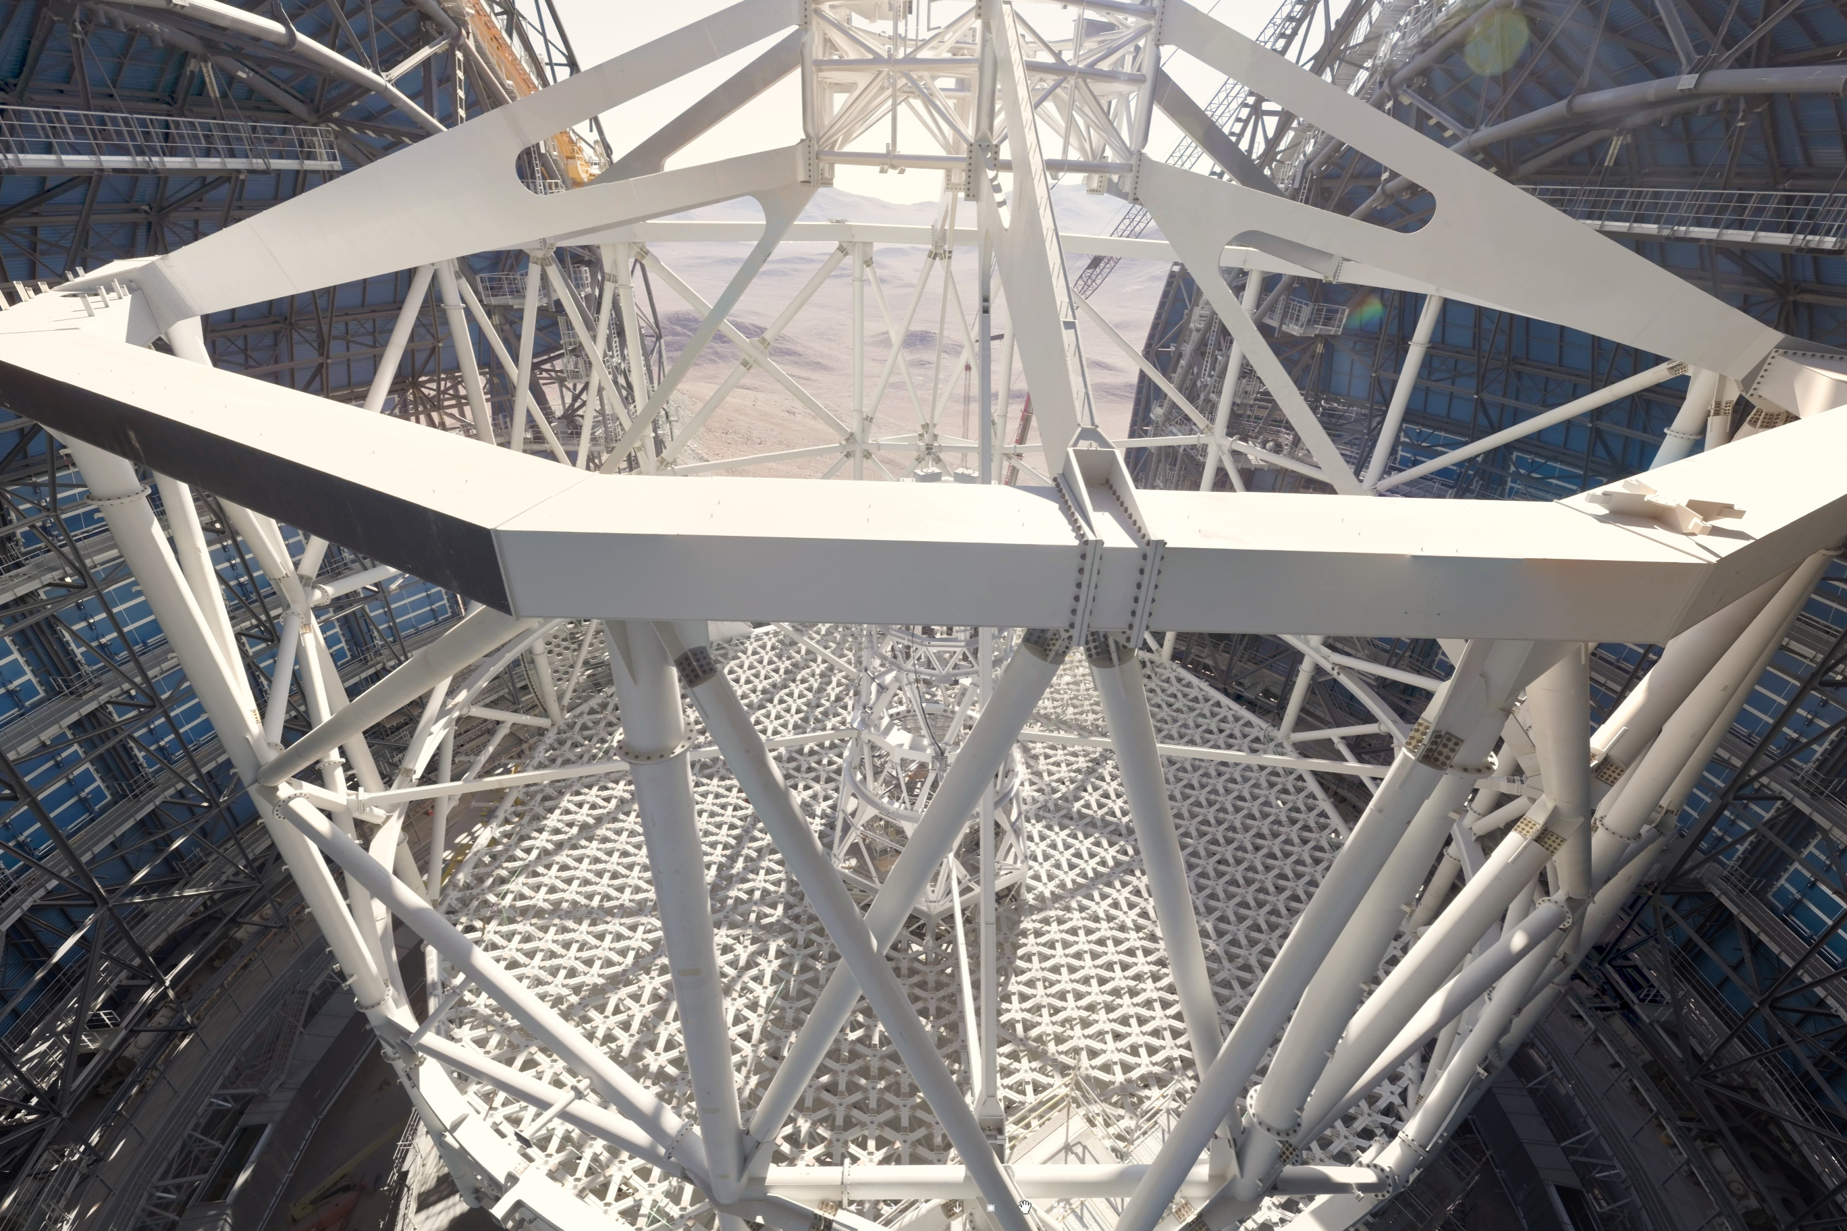
Observing with MOSAIC

