Slide 1
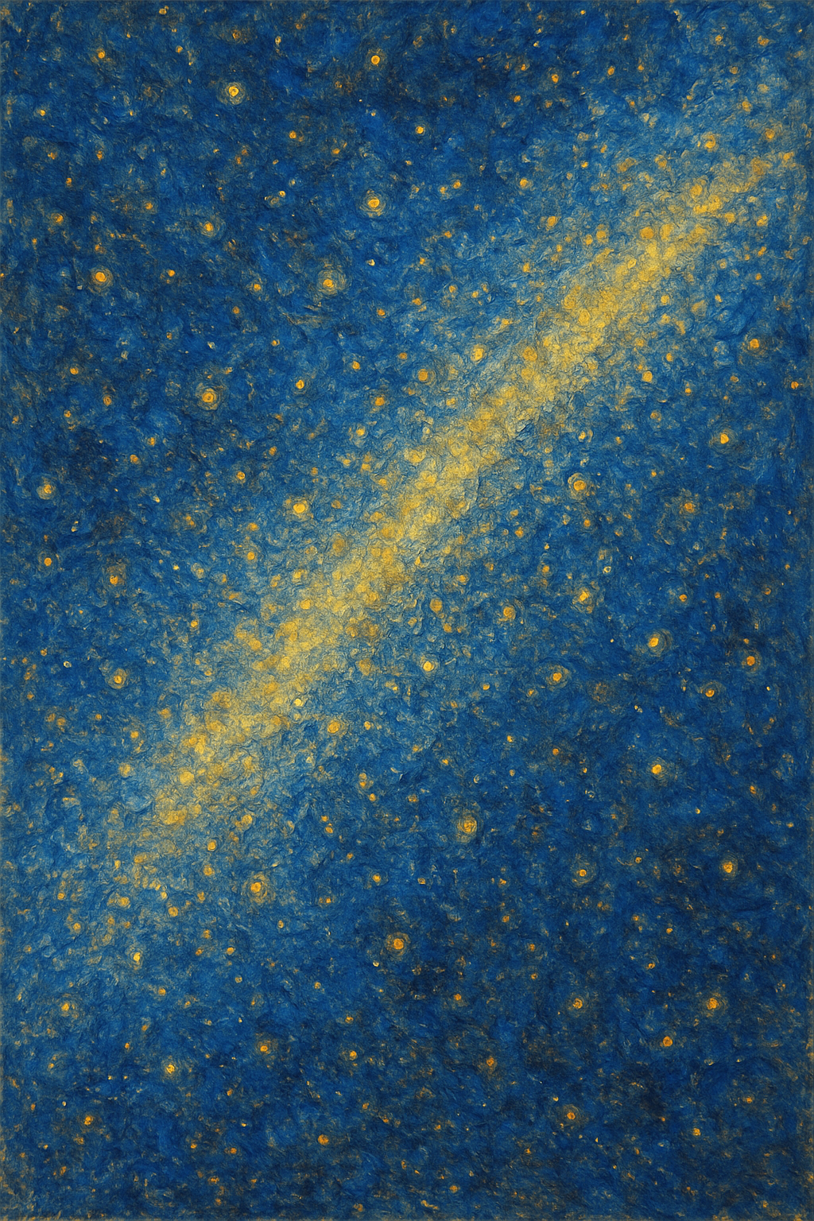




Dynamical streams in the local stellar halo
Adam Dillamore
Jason Sanders, Vasily Belokurov, Hanyuan Zhang

Slide 2
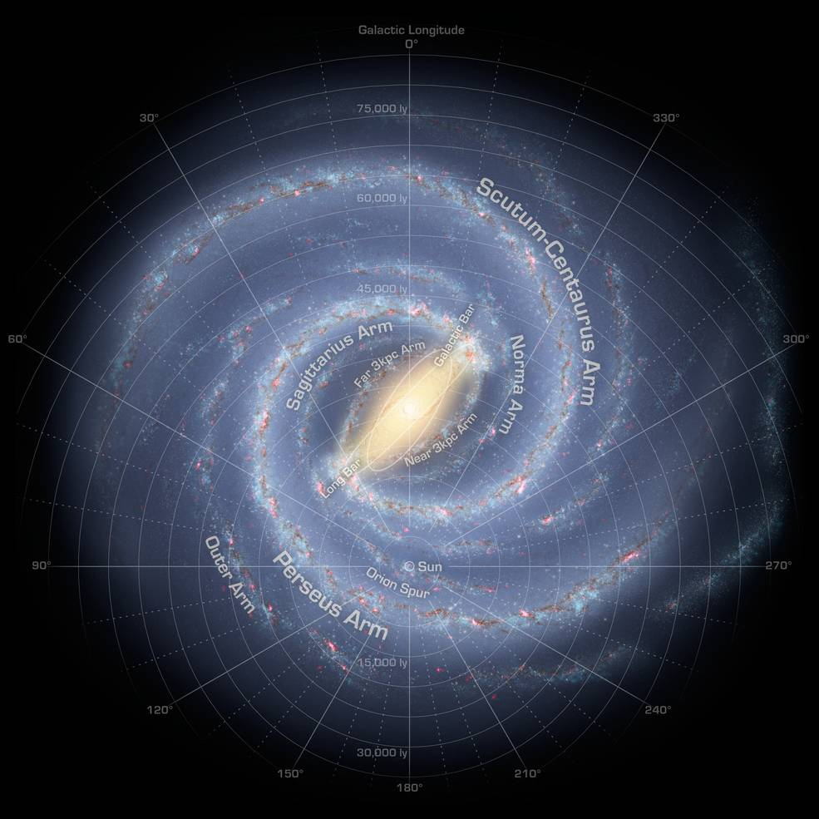


The Milky Way’s bar
$$Ω_{\text{b}}$$
Rotates at a pattern speed (angular frequency) $Ω_{\text{b}}≈30−40$ km/s/kpc
This provides a rotating non-axisymmetric component to the Galactic potential, which has implications for stellar dynamics
[NASA/JPL-Caltech/R. Hurt]

Slide 3
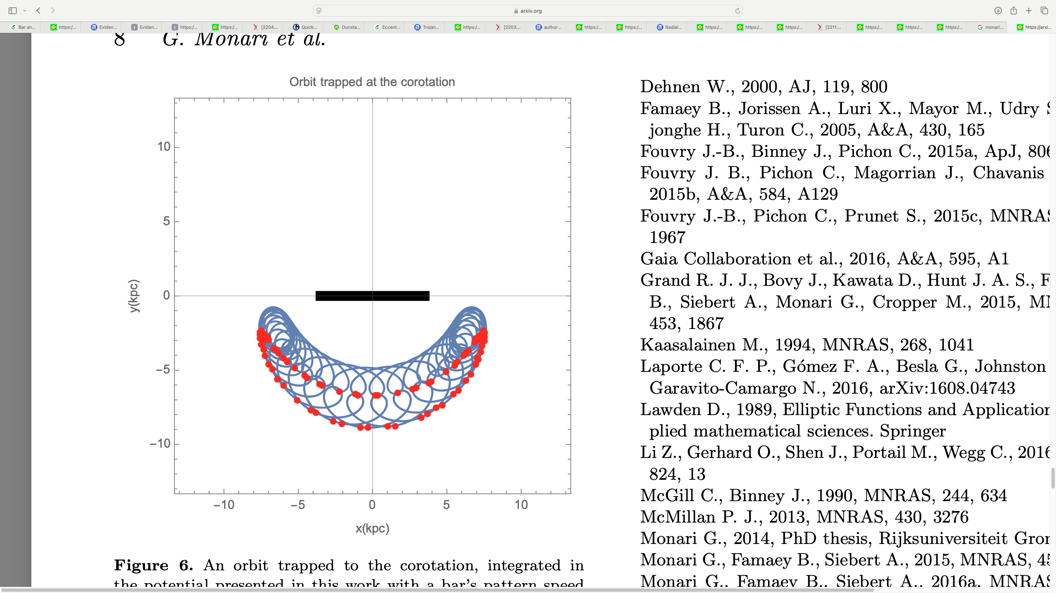
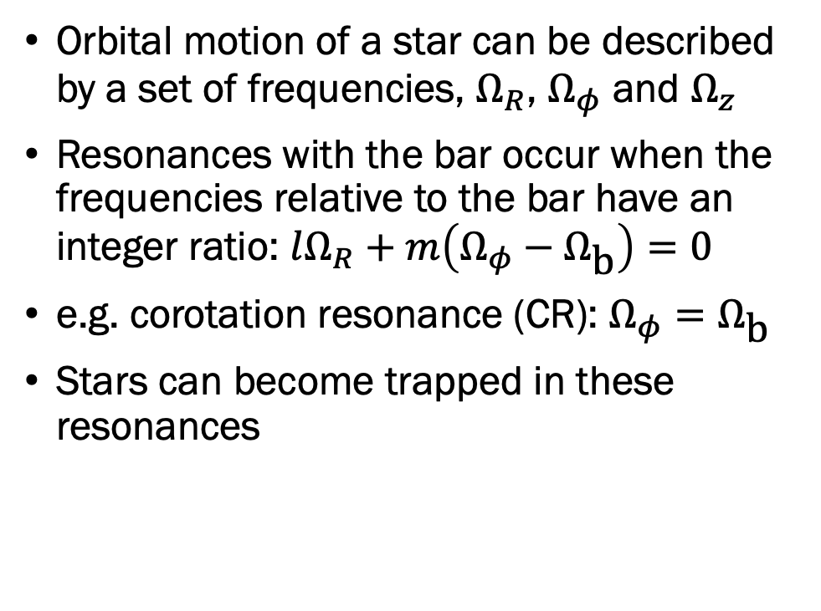
Bar resonances
Orbital motion of a star can be described by a set of frequencies, $Ω_{R}$, $Ω_{φ}$ and $Ω_{z}$
Resonances with the bar occur when the frequencies relative to the bar have an integer ratio: $lΩ_{R}+m\left(Ω_{φ}−Ω_{\text{b}}\right)=0$
e.g. corotation resonance (CR): $Ω_{φ}=Ω_{\text{b}}$
Stars can become trapped in these resonances
[Monari+ 2017]

Slide 4
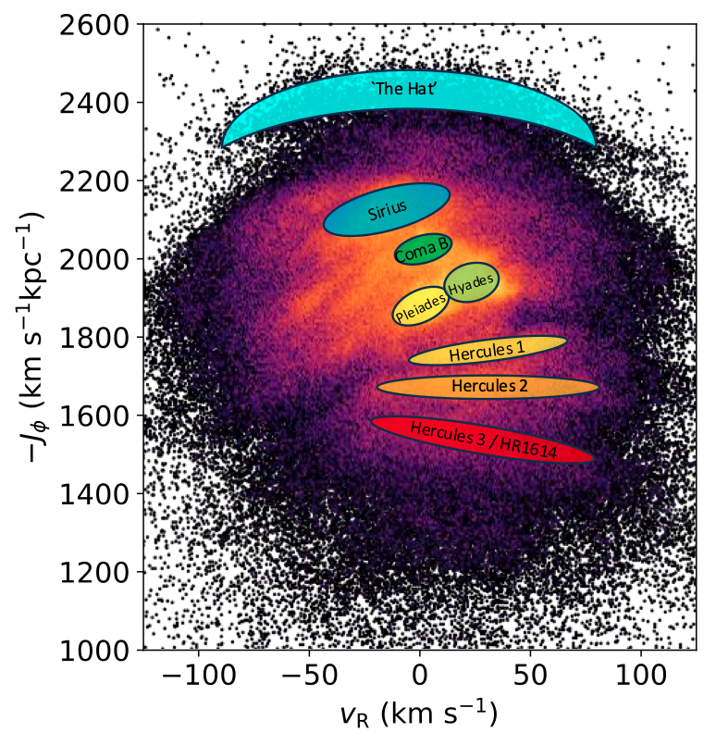
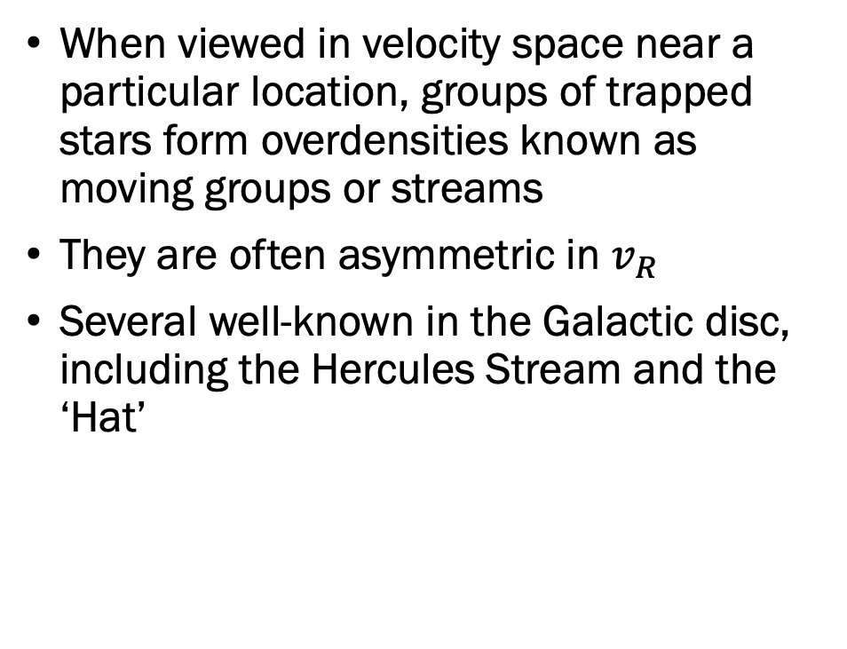
Moving groups…
Velocity space
When viewed in velocity space near a particular location, groups of trapped stars form overdensities known as moving groups or streams
They are often asymmetric in $v_{R}$
Several well-known in the Galactic disc, including the Hercules Stream and the ‘Hat’
Angular
momentum
Radial velocity
[Hunt & Vasiliev 2025]

Slide 5
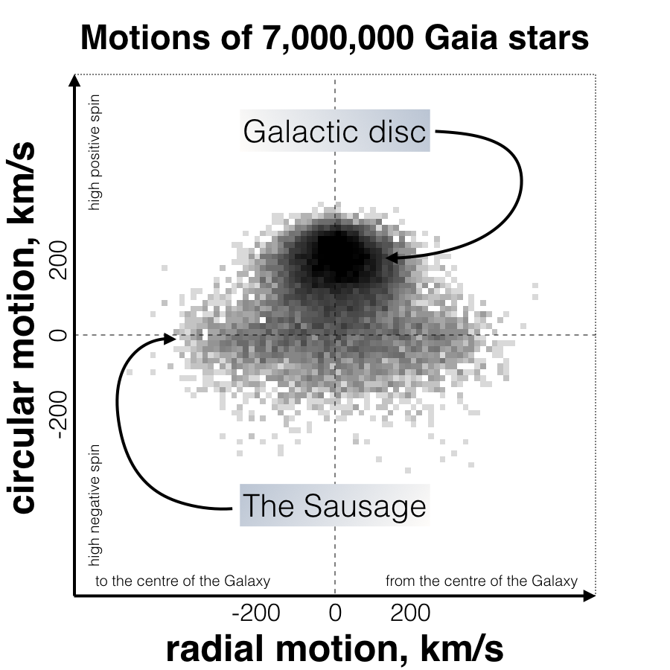
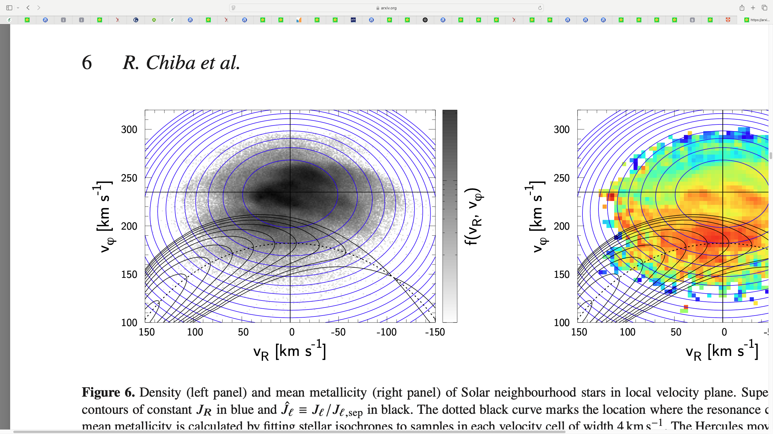
… in the halo?
What’s down here?
But stars on eccentric orbits can also be trapped by the bar
Are there any moving groups in the halo associated with resonances?
CR trapped
orbits
[Chiba & Schönrich 2021]
[V. Belokurov]

Slide 6
Mapping resonances in velocity space
Orbits
Velocity Space
Trapped
orbits
Angular momentum
Radial velocity

Slide 7
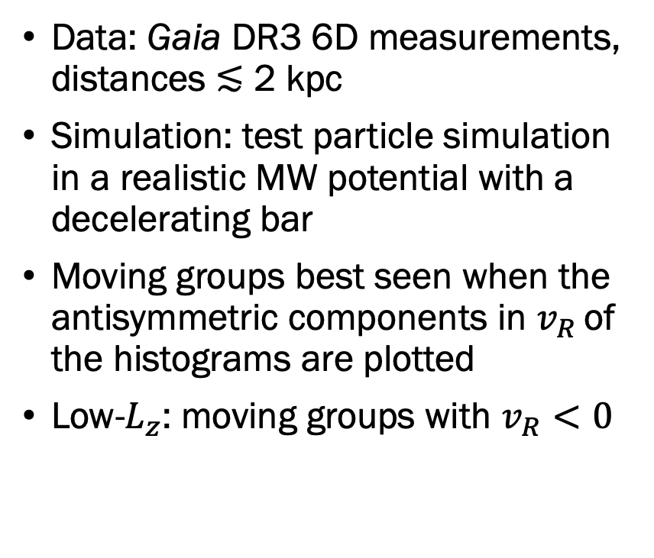
Moving groups in data and simulation
Distributions
Asymmetry
Data: Gaia DR3 6D measurements, distances ≲ 2 kpc
Simulation: test particle simulation in a realistic MW potential with a decelerating bar
Moving groups best seen when the antisymmetric components in $v_{R}$ of the histograms are plotted
Low-$L_{z}$: moving groups with $v_{R}<0$
Data
Hercules
stream
Sim

Slide 8
Moving groups vs resonances
Contours show observed asymmetry, colours show resonant trapping

Slide 9
Metallicities

Slide 10
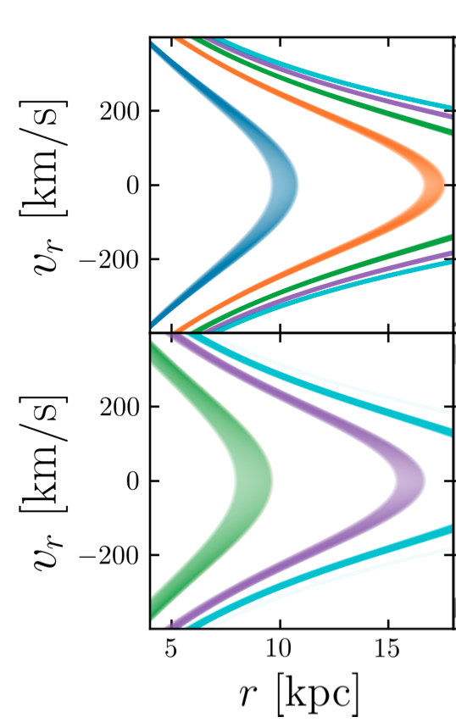
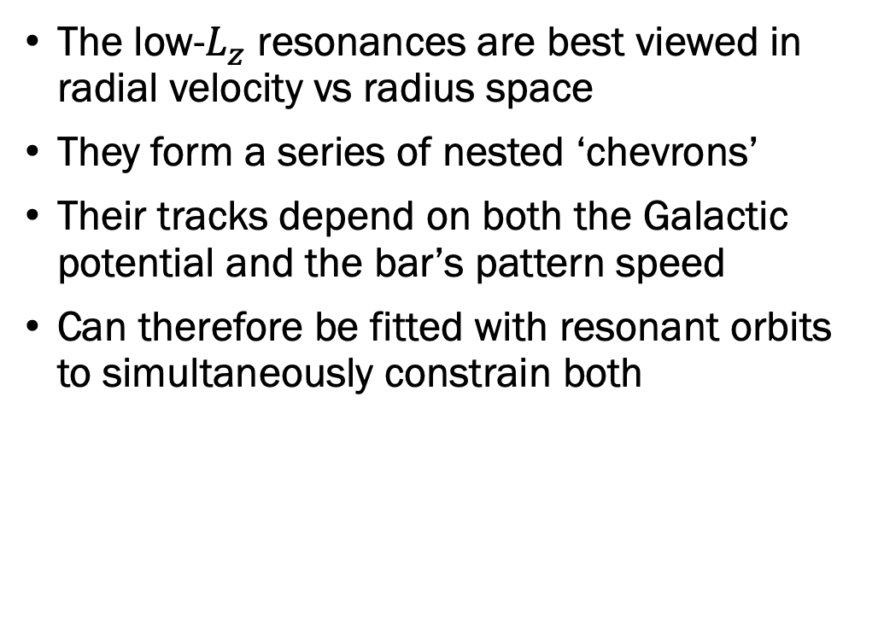
Radial phase space
Prograde
The low-$L_{z}$ resonances are best viewed in radial velocity vs radius space
They form a series of nested ‘chevrons’
Their tracks depend on both the Galactic potential and the bar’s pattern speed
Can therefore be fitted with resonant orbits to simultaneously constrain both
Retrograde

Slide 11

Radial phase space
Distributions
Asymmetry
Data
The observed low-$L_{z}$ moving groups at $v_{R}<0$ can be traced over a range of radii
These are reproduced well by the CR and OLR resonances in the simulation
Sim

Slide 12

Constraint on the Milky Way’s potential
Mass enclosed within 20 kpc is $M\left(<20 \text{kpc}\right)=(2.17±0.21)×{10}^{11}M_{⊙}$
The fitted potential is in close agreement with previous results

Slide 13

Constraint on Ω_{b}
$Ω_{\text{b}}={31.9}_{−1.9}^{+1.8} \text{km}\text{/}\text{s}\text{/}\text{kpc}$
This is lower than most constraints, though consistent with some recent works

Slide 14

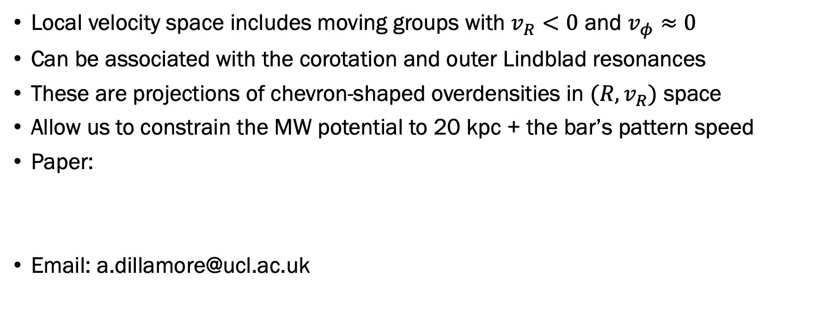
Summary
Local velocity space includes moving groups with $v_{R}<0$ and $v_{φ}≈0$
Can be associated with the corotation and outer Lindblad resonances
These are projections of chevron-shaped overdensities in ${(R,v}_{R})$ space
Allow us to constrain the MW potential to 20 kpc + the bar’s pattern speed
Paper:
Email: a.dillamore@ucl.ac.uk

