Slide 1


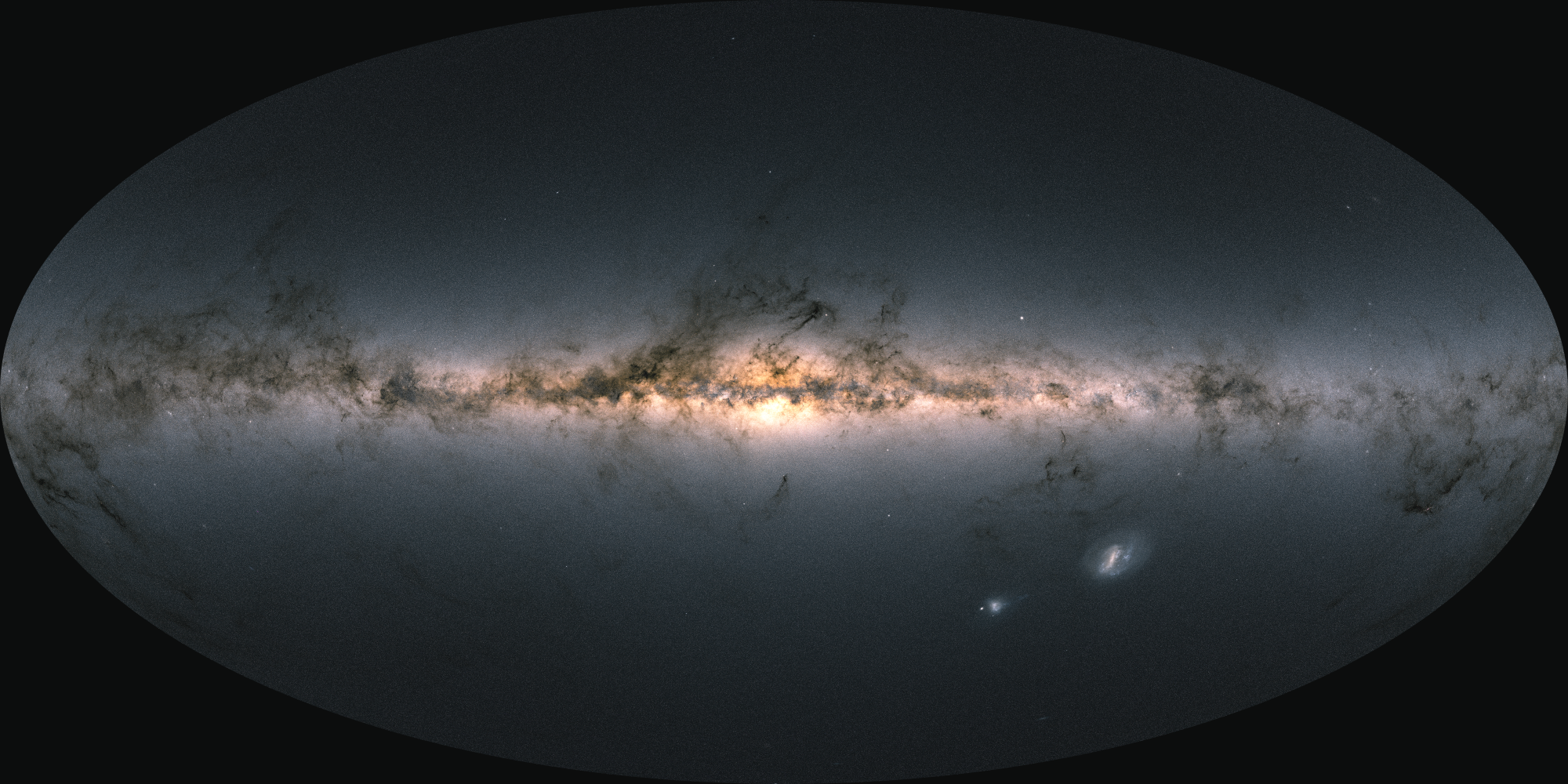

The disturbance(s) of the outer Milky Way disc
Paul McMillan
(University of Leicester)
Collaborators: Simon Alinder, Thomas Bensby, Viktor Hrannar Jönsson, David Hobbs, Daniel Mikkola, Jonathan Petersson (Lund Observatory); Seti Astrophel, Urvi Modha (Leicester); Gaia DPAC
@mcmillan-astro.bsky.social

Slide 2
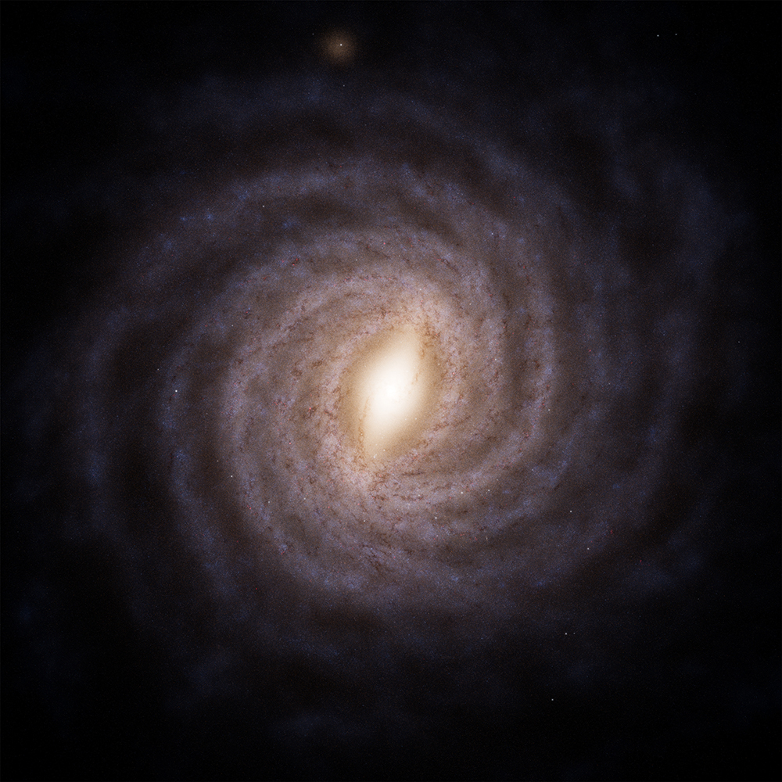
The Milky Way is not a simple smooth object
+8
We know it has spiral arms & a bar
Gaia has measured associated velocity disturbance
(Gaia Collaboration: Drimmel et al 2021)
V_{R} [km/s]
-8
Adapted from ESA/Gaia/DPAC, Stefan Payne-Wardenaar
Not a photo

Slide 3
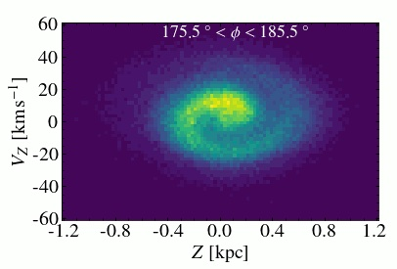
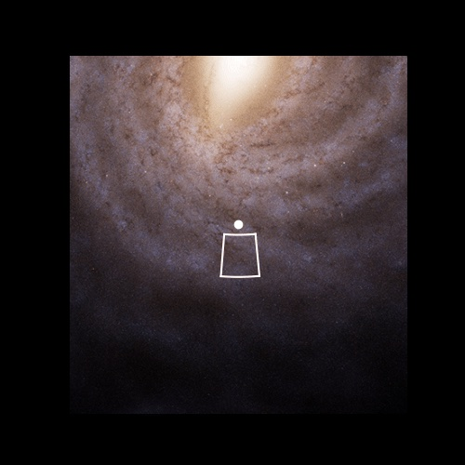
Plot stars in Z and v_{Z} and you’ll see a spiral
This “phase-spiral” is not something you can see from just stellar positions
Sign of incomplete mixing after a disturbance
(Antoja et al. 2018, and many following)

Slide 4
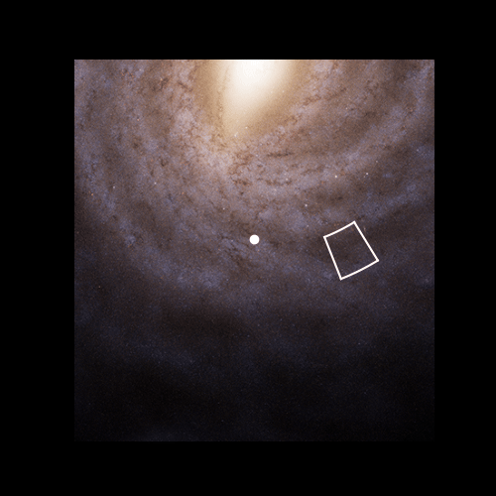
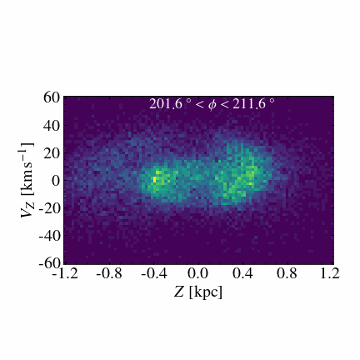
Looking carefully, you can even see the phase spiral rotate when you look around the Galaxy
Alinder, McMillan & Bensby (2023)
(see also Laporte et al 2019, Bland-Hawthorn et al 2019, Xu et al 2020, Li 2021, Hunt et al 2022, Antoja et al 2023, Darragh-Ford et al 2023, Frankel et al 2023)

Slide 5
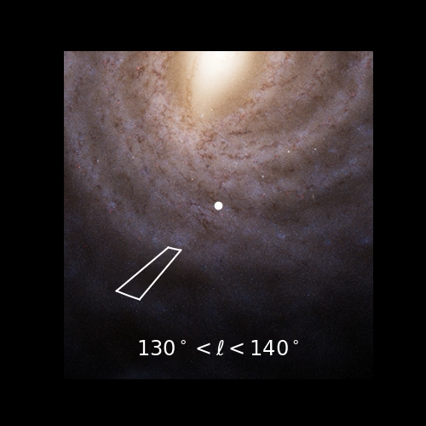
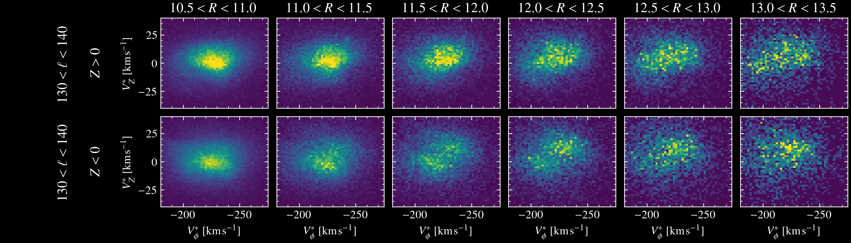
Star velocities across the outer galaxy are:
Bimodal
Different above and below plane
Gaia Collaboration et al 2021
McMillan et al 2022

Slide 6
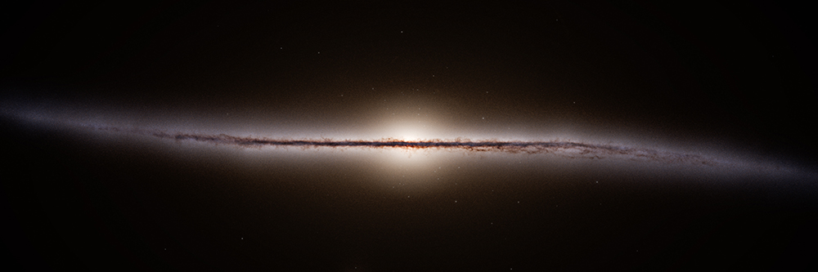
And the Milky Way is warped
Also not a photo
Credit: ESA/Gaia/DPAC, Stefan Payne-Wardenaar
Notes:
Warp
Bending vs breathing mode

Slide 7
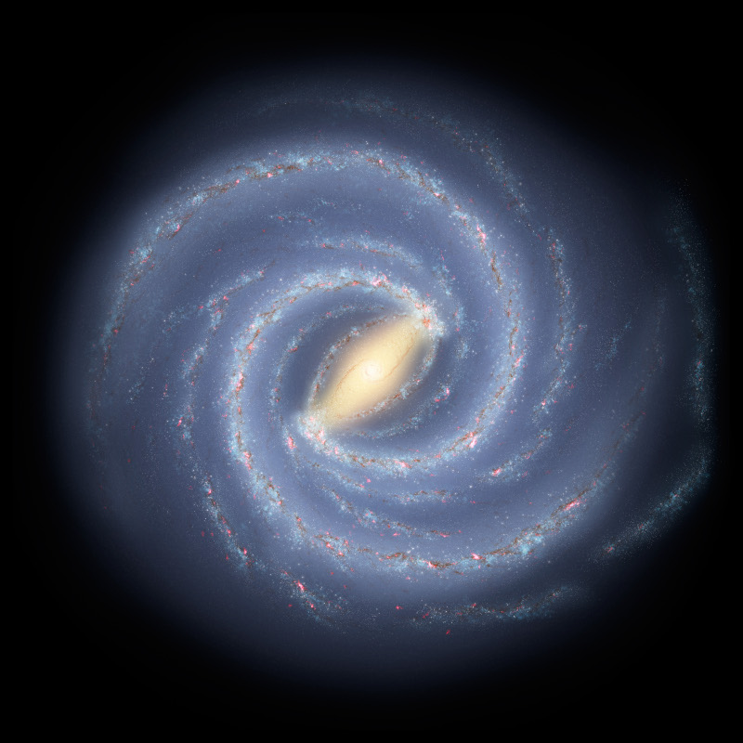
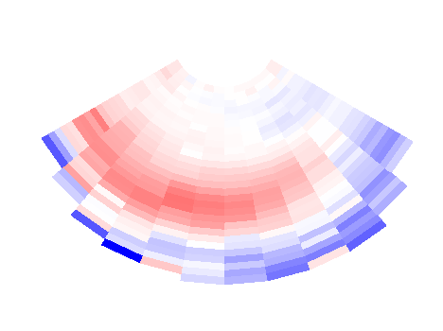
Looking at this with stellar velocities from Gaia DR3
Note that the velocity goes upwards, then downwards as we go out from centre
+10
Warped upwards
Warped downwards
V_{Z}
Rotation
Sun
-10
(see also Chen et al 2019, Cheng et al 2020, Poggio et al 2020, 2021, Dehnen et al 2023, Cabrera-Gadera et al 2024, Uppal et al 2024)
Hrannar Jónsson & McMillan (2024)

Slide 8
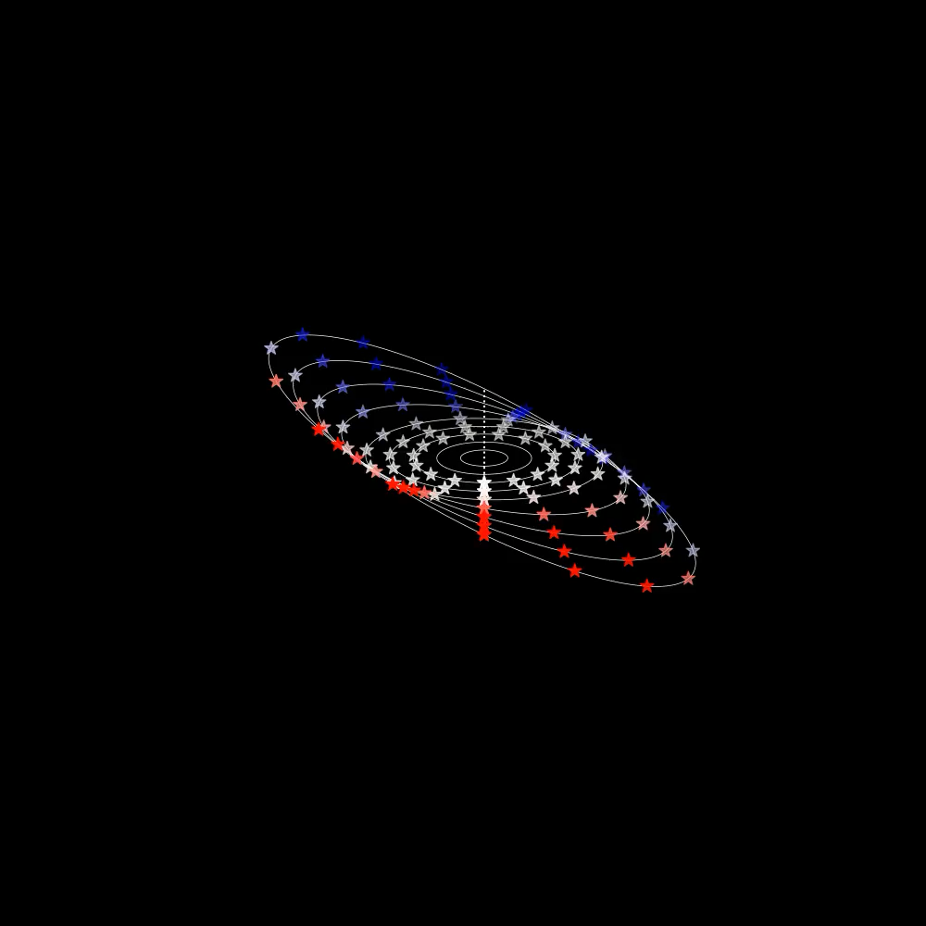
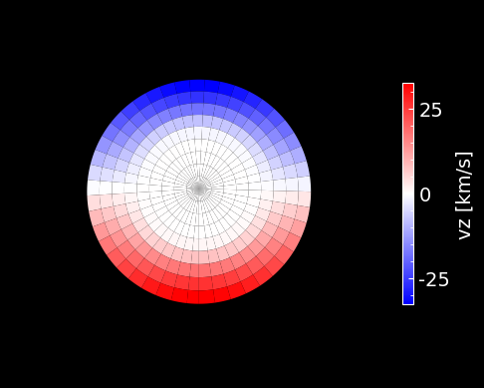
Stationary warp
Toy model
View from above

Slide 9
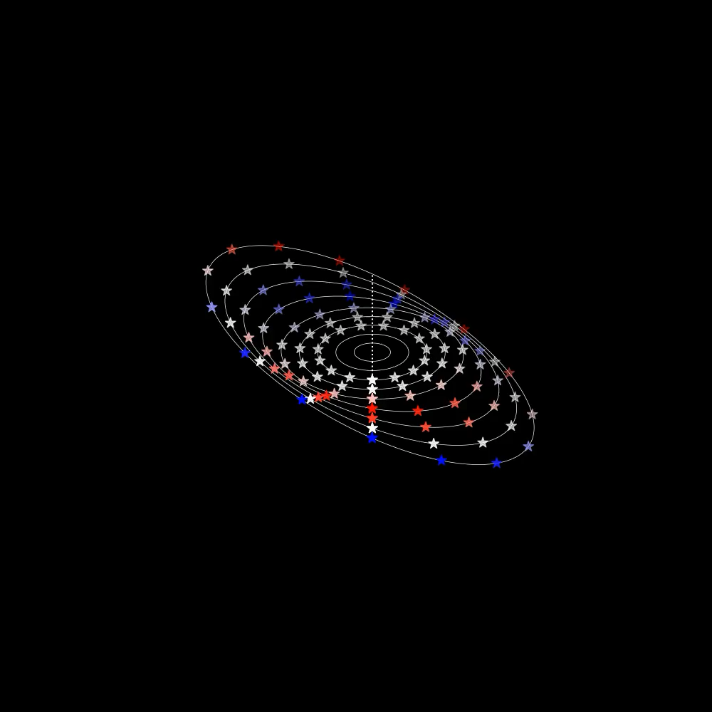
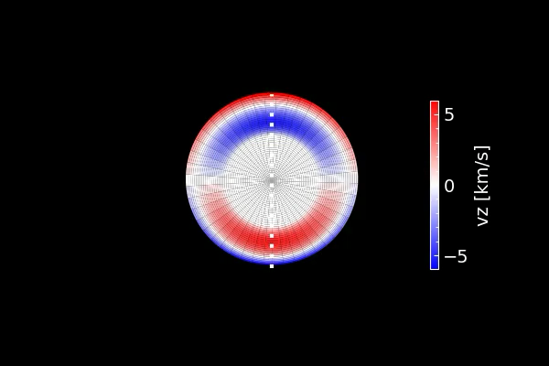
Precessing warp
Toy model
View from above

Slide 10
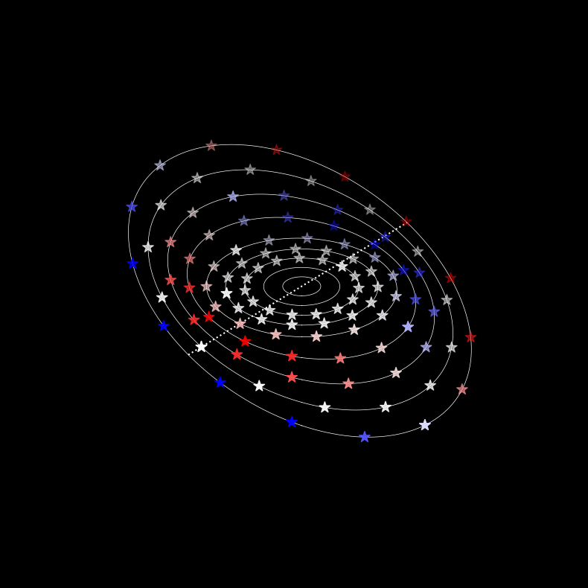
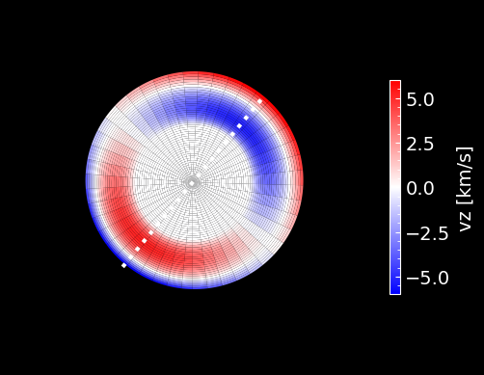
Precessing warp
Toy model
View from above

Slide 11
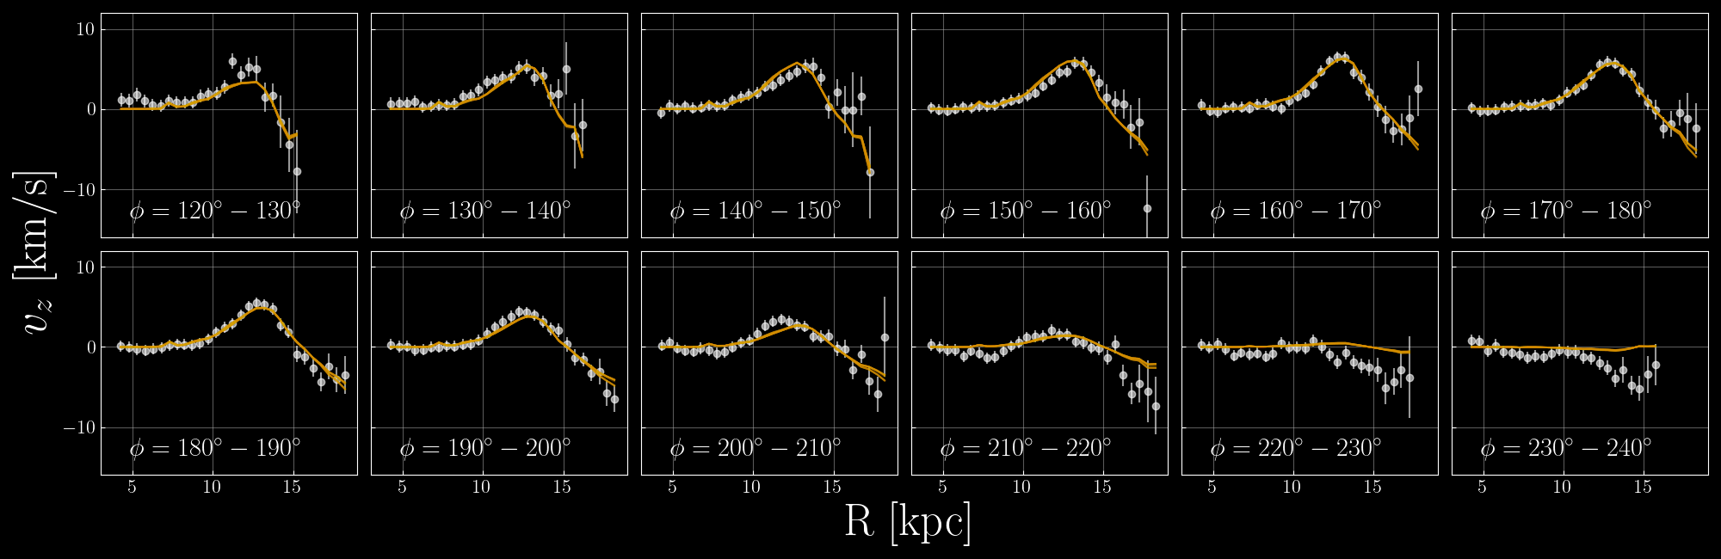
We can fit a simple warp model to this data
Precession ~13 km/s/kpc
Hrannar Jónsson & McMillan (2024)
(again, see also Chen et al 2019, Poggio et al 2020, 2021, Dehnen et al 2023, Cabrera-Gadera et al 2024, Uppal et al 2024)

Slide 12
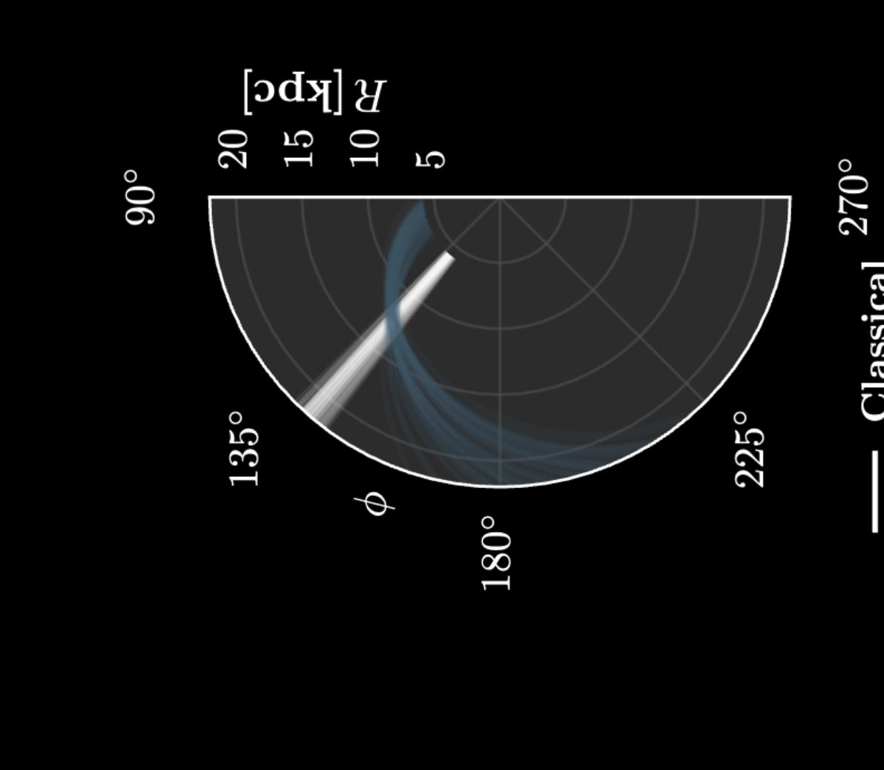
R[kpc]
☉
Warp line-of-nodes (purely kinematics estimate)
From stellar positions, should be ~180°
Hrannar Jónsson & McMillan (2024)

Slide 13
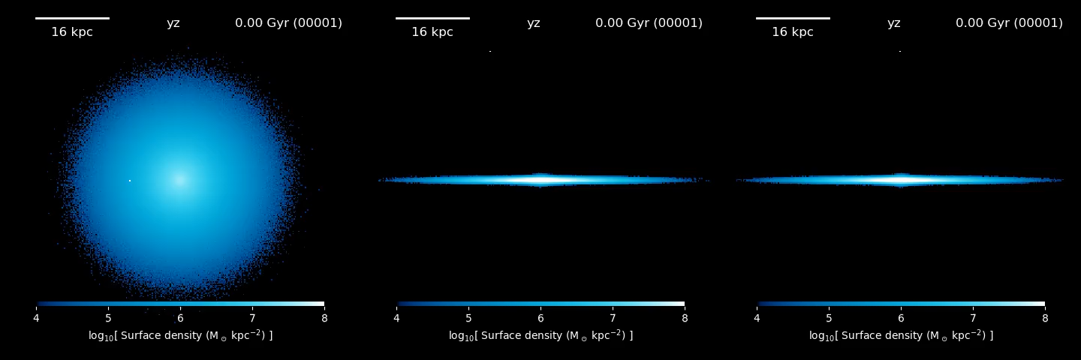
McMillan et al 2022
(following Bland-Hawthorn & Tepper-Garcia, 2021)
Simplified simulation of impact

Slide 14
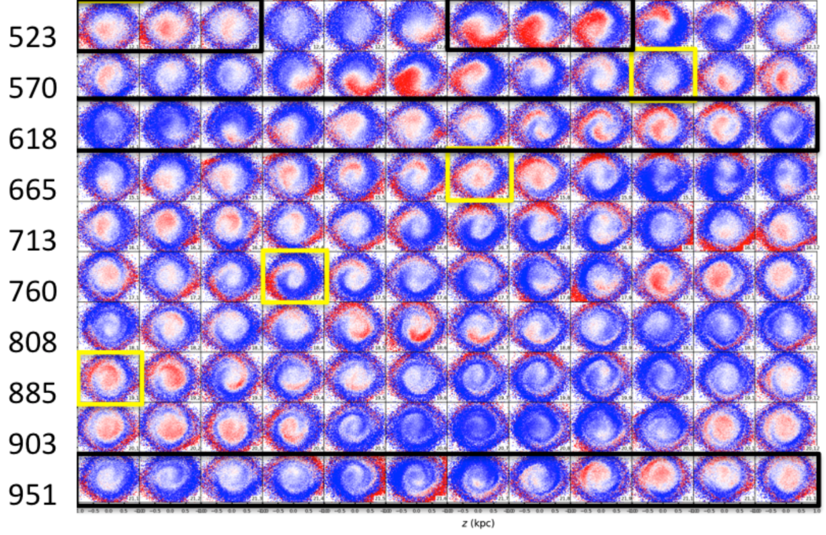
Set up to be a self gravitating
simulation of impulsive perturbation
Phase-spiral forms
(Bland-Hawthorn & Tepper-Garcia 2021)
Time in Myr →
← Different angles around galaxy →
See also Laporte et al 2019, Hunt et al 2021, Gandhi et al 2022
Notes:
N.B. 13 minutes total

Slide 15
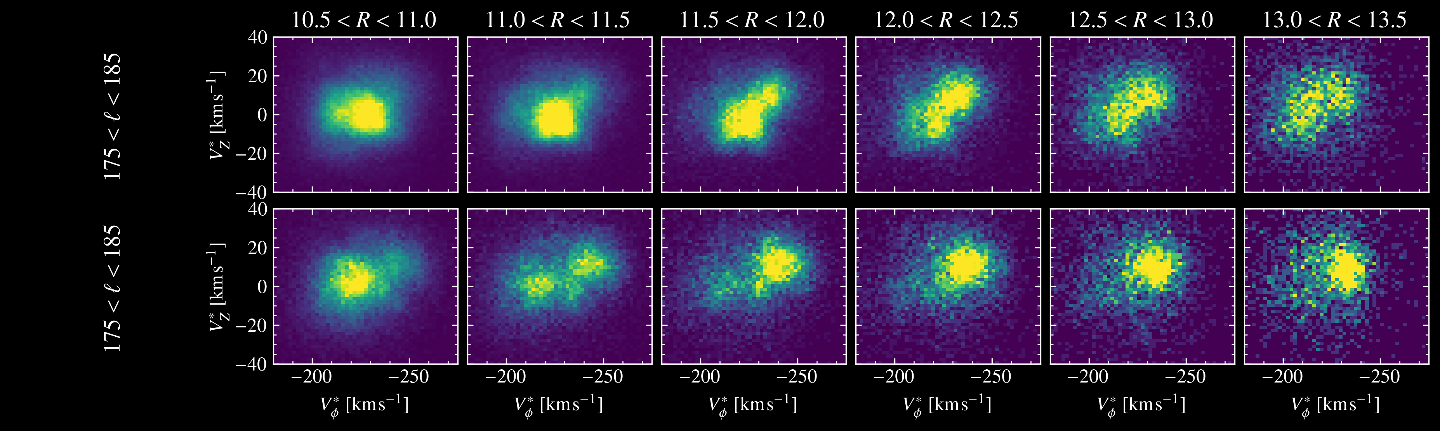
Reminder of what we see in the Milky Way

Slide 16

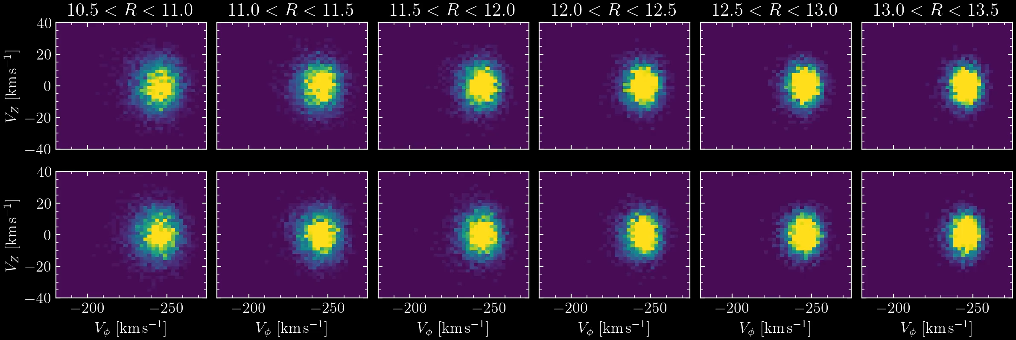
Velocity bifurcation appears in outer disc

Slide 17
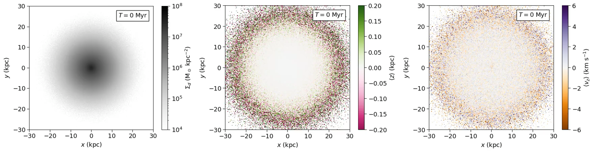
Warp?
Animation from Tepper-Garcia
Unclear. Investigation ongoing…

Slide 18
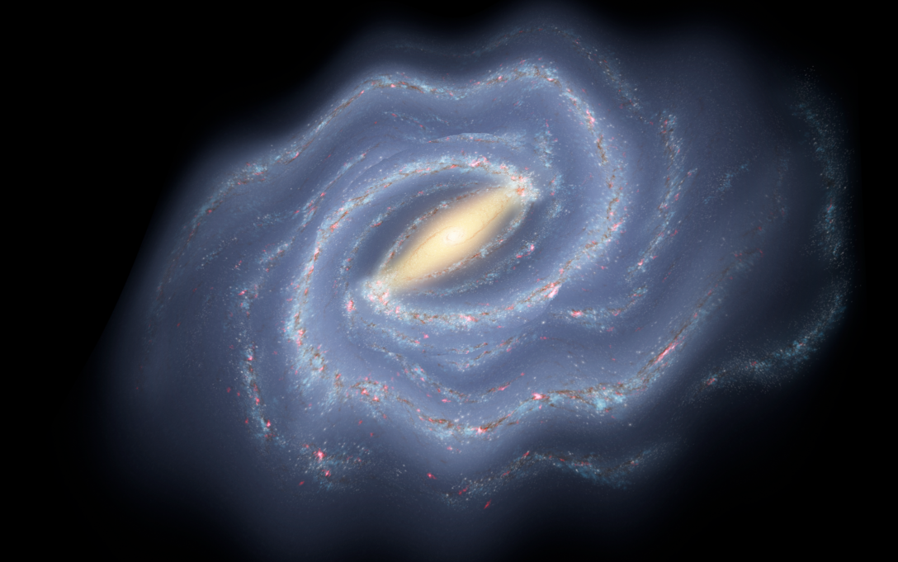

Summary
The outer disc is shaking vertically
This manifests as a phase spiral, velocity break, and warp (depending on how you look at it)
The kinematics of the warp do not match its position for simple models – dynamical evolution?
A challenge for warp formation scenarios: Is it precessing fast? Are its physical and kinematic ‘line-of-nodes’ inconsistent ?

Slide 19
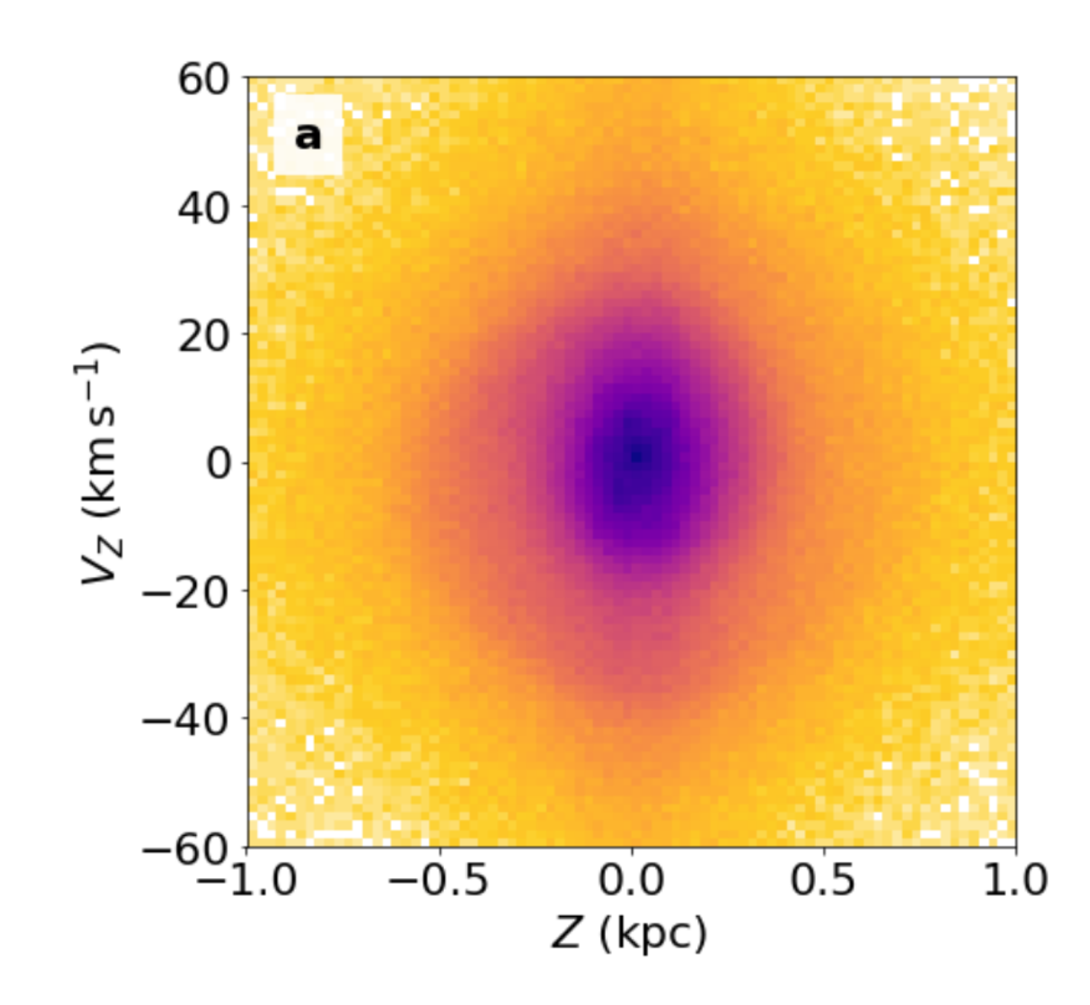
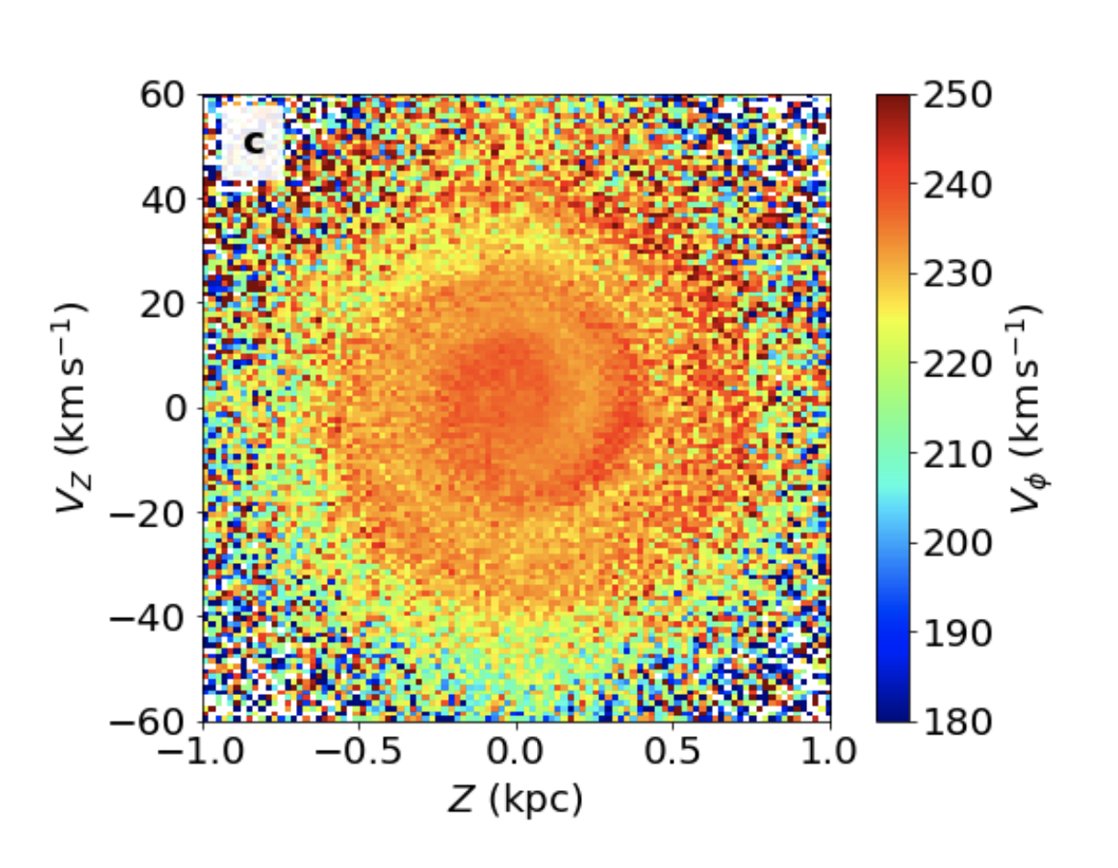
I’m going to focus on vertical disturbances
R~8kpc
Phase-space snail, Phase-spiral, …
(Antoja et al 2018, and many others following)
Notes:
Solar neighbourhood
Disk outskirts (>10kpc from Sun)

Slide 20
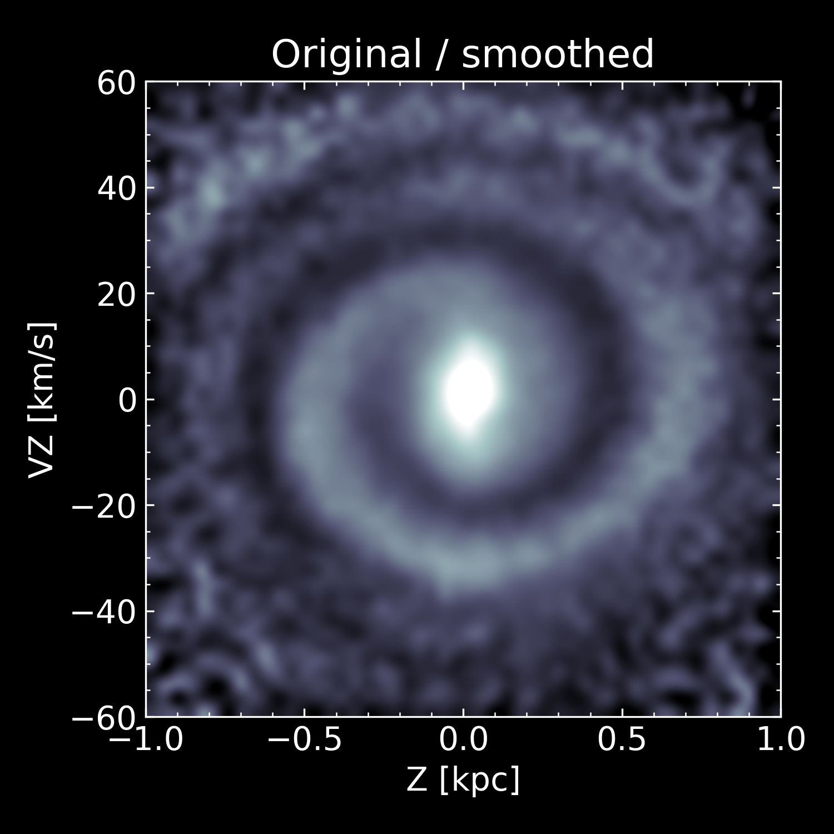
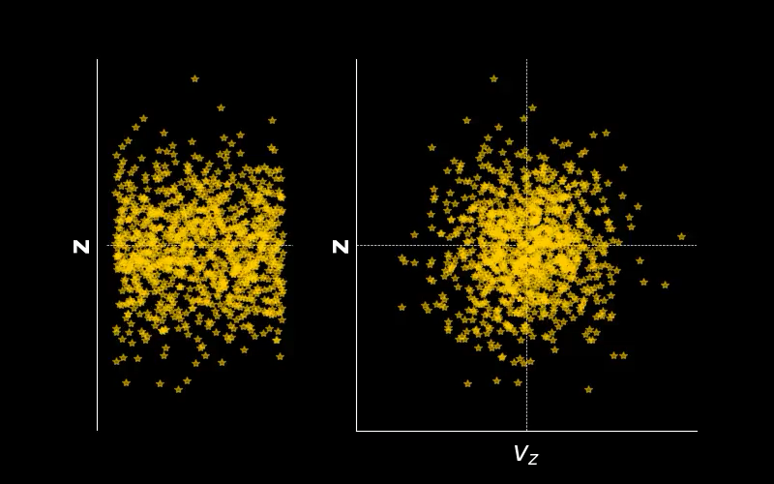
Semi-realistic scenario:
Stars start at random phases in their orbits
Sudden ‘impact’ from something shifts all stars in z.
Disturbance winds up as a phase spiral

Slide 21
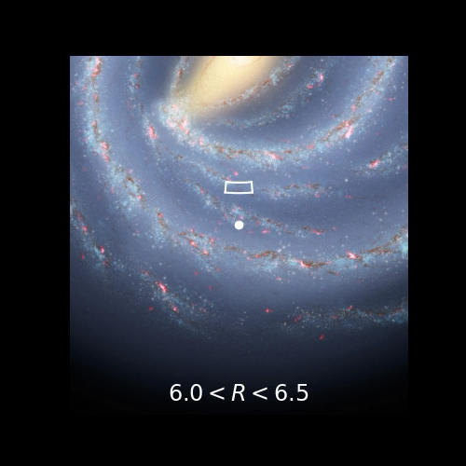
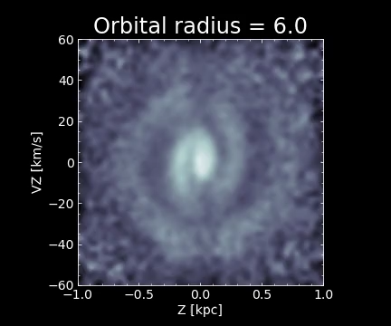
Phase-spiral changes in shape and character
[Orbital radius = L_{z}/236 km/s]

Slide 22
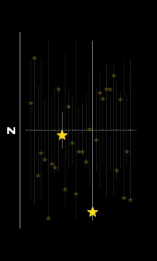
Stars oscillate around z = 0
Frequency decreases as oscillation gets bigger
(isolating two stars so you can see this clearly)

Slide 23
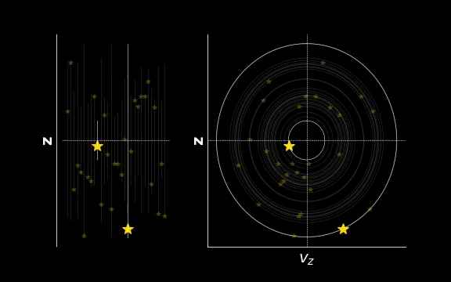
Stars oscillate around z = 0
Frequency decreases as oscillation gets bigger
In the z-v_{z} plane, each star follows an ellipse/circle*
*roughly.

Slide 24
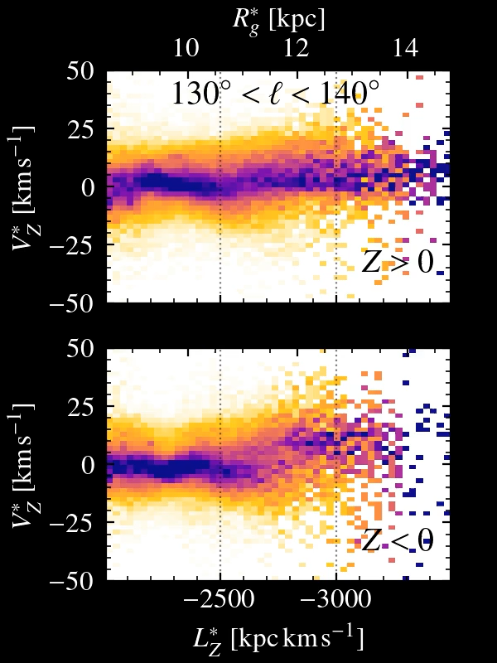
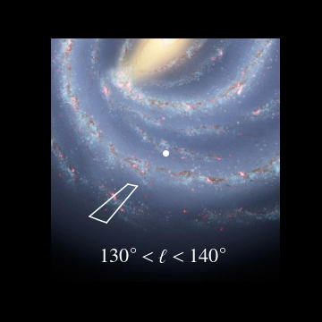
Nicely shown in angular momentum
McMillan et al 2022

Slide 25
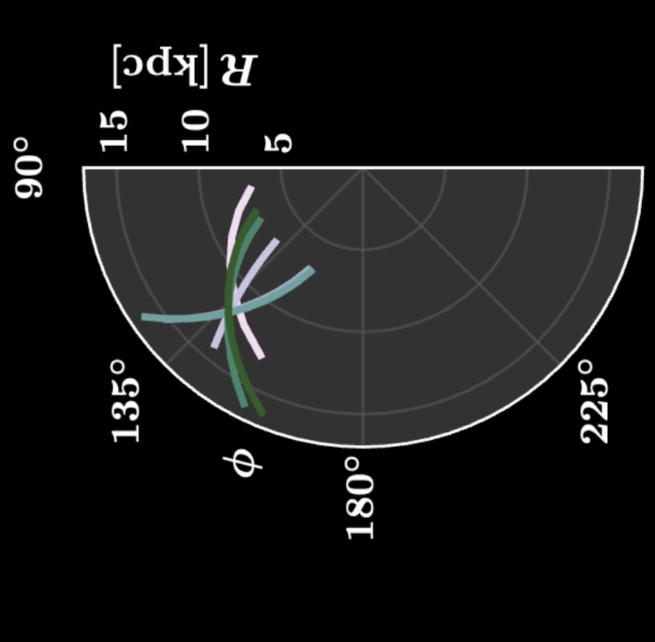
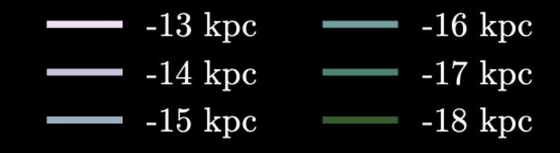
☉
Warp line-of-nodes (purely kinematics estimate)
From stellar positions, should be ~180°
Hrannar Jónsson & McMillan (2024)

Slide 26
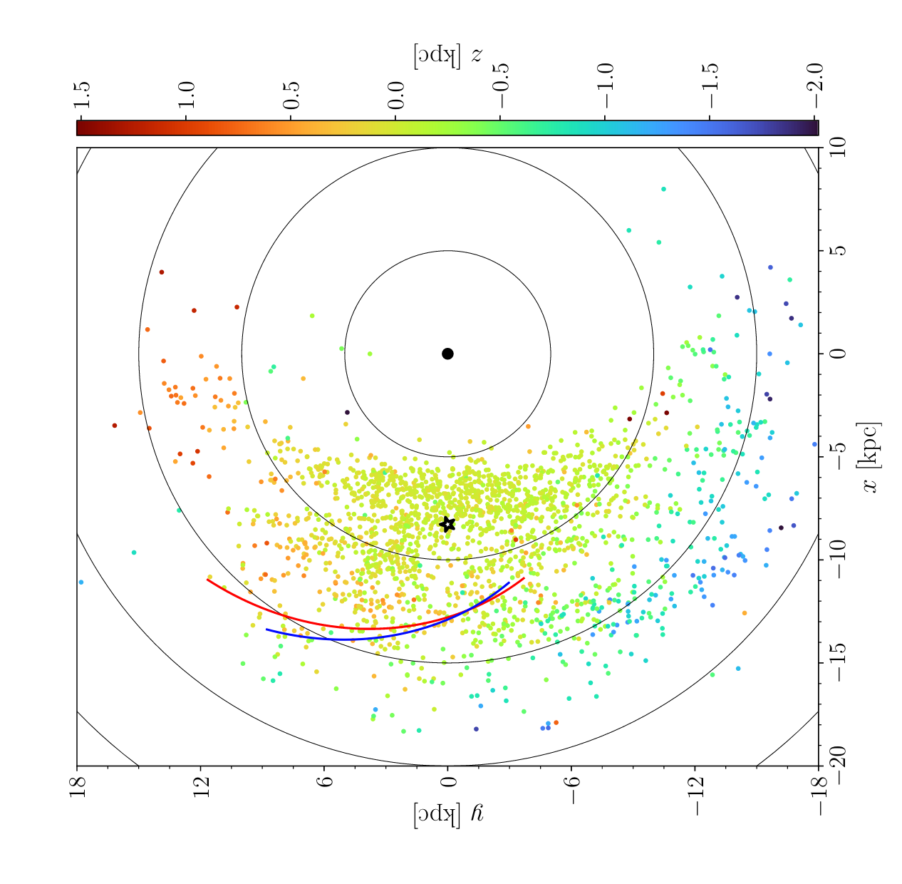
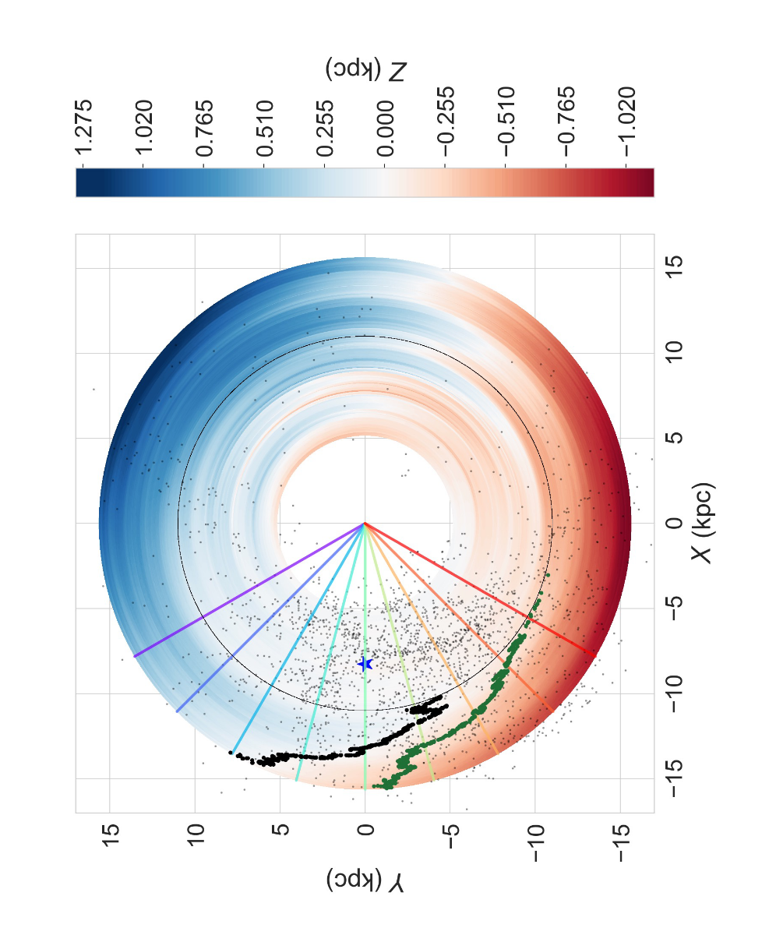
Offsets in Cepheids
Dehnen et al (2023)
Line of nodes from positions (red); orbital planes (blue)
Cabrera-Gadea et al (2024)
Line of nodes (black);
line of maximum Vz (green)

Slide 27
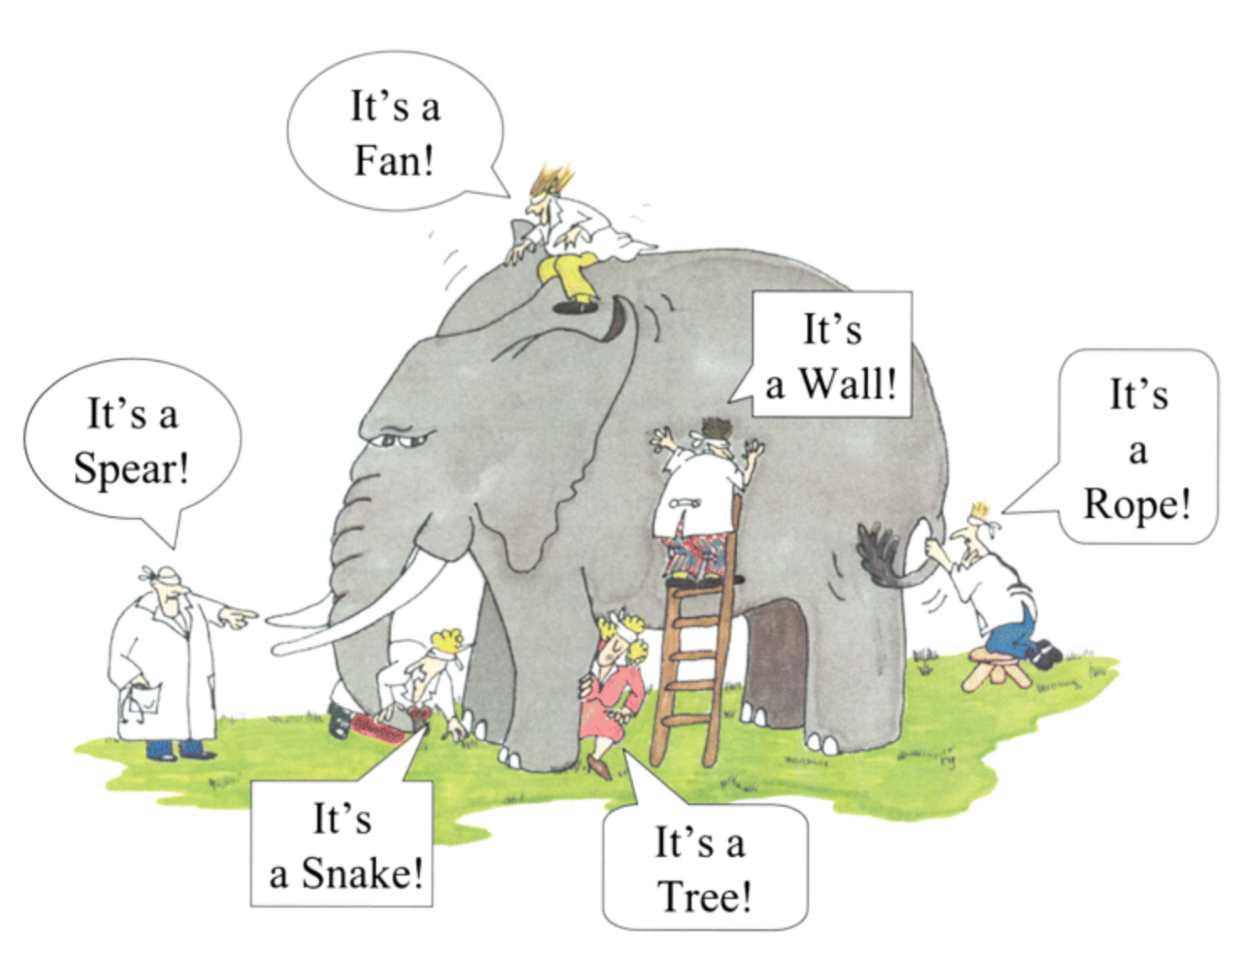
Phase spiral
Galactic dynamics in the Gaia era (an artist’s impression )
Warp
Two
n
Velocity clumps
elephant
Spiral arm
Velocity ridge

