Slide 1
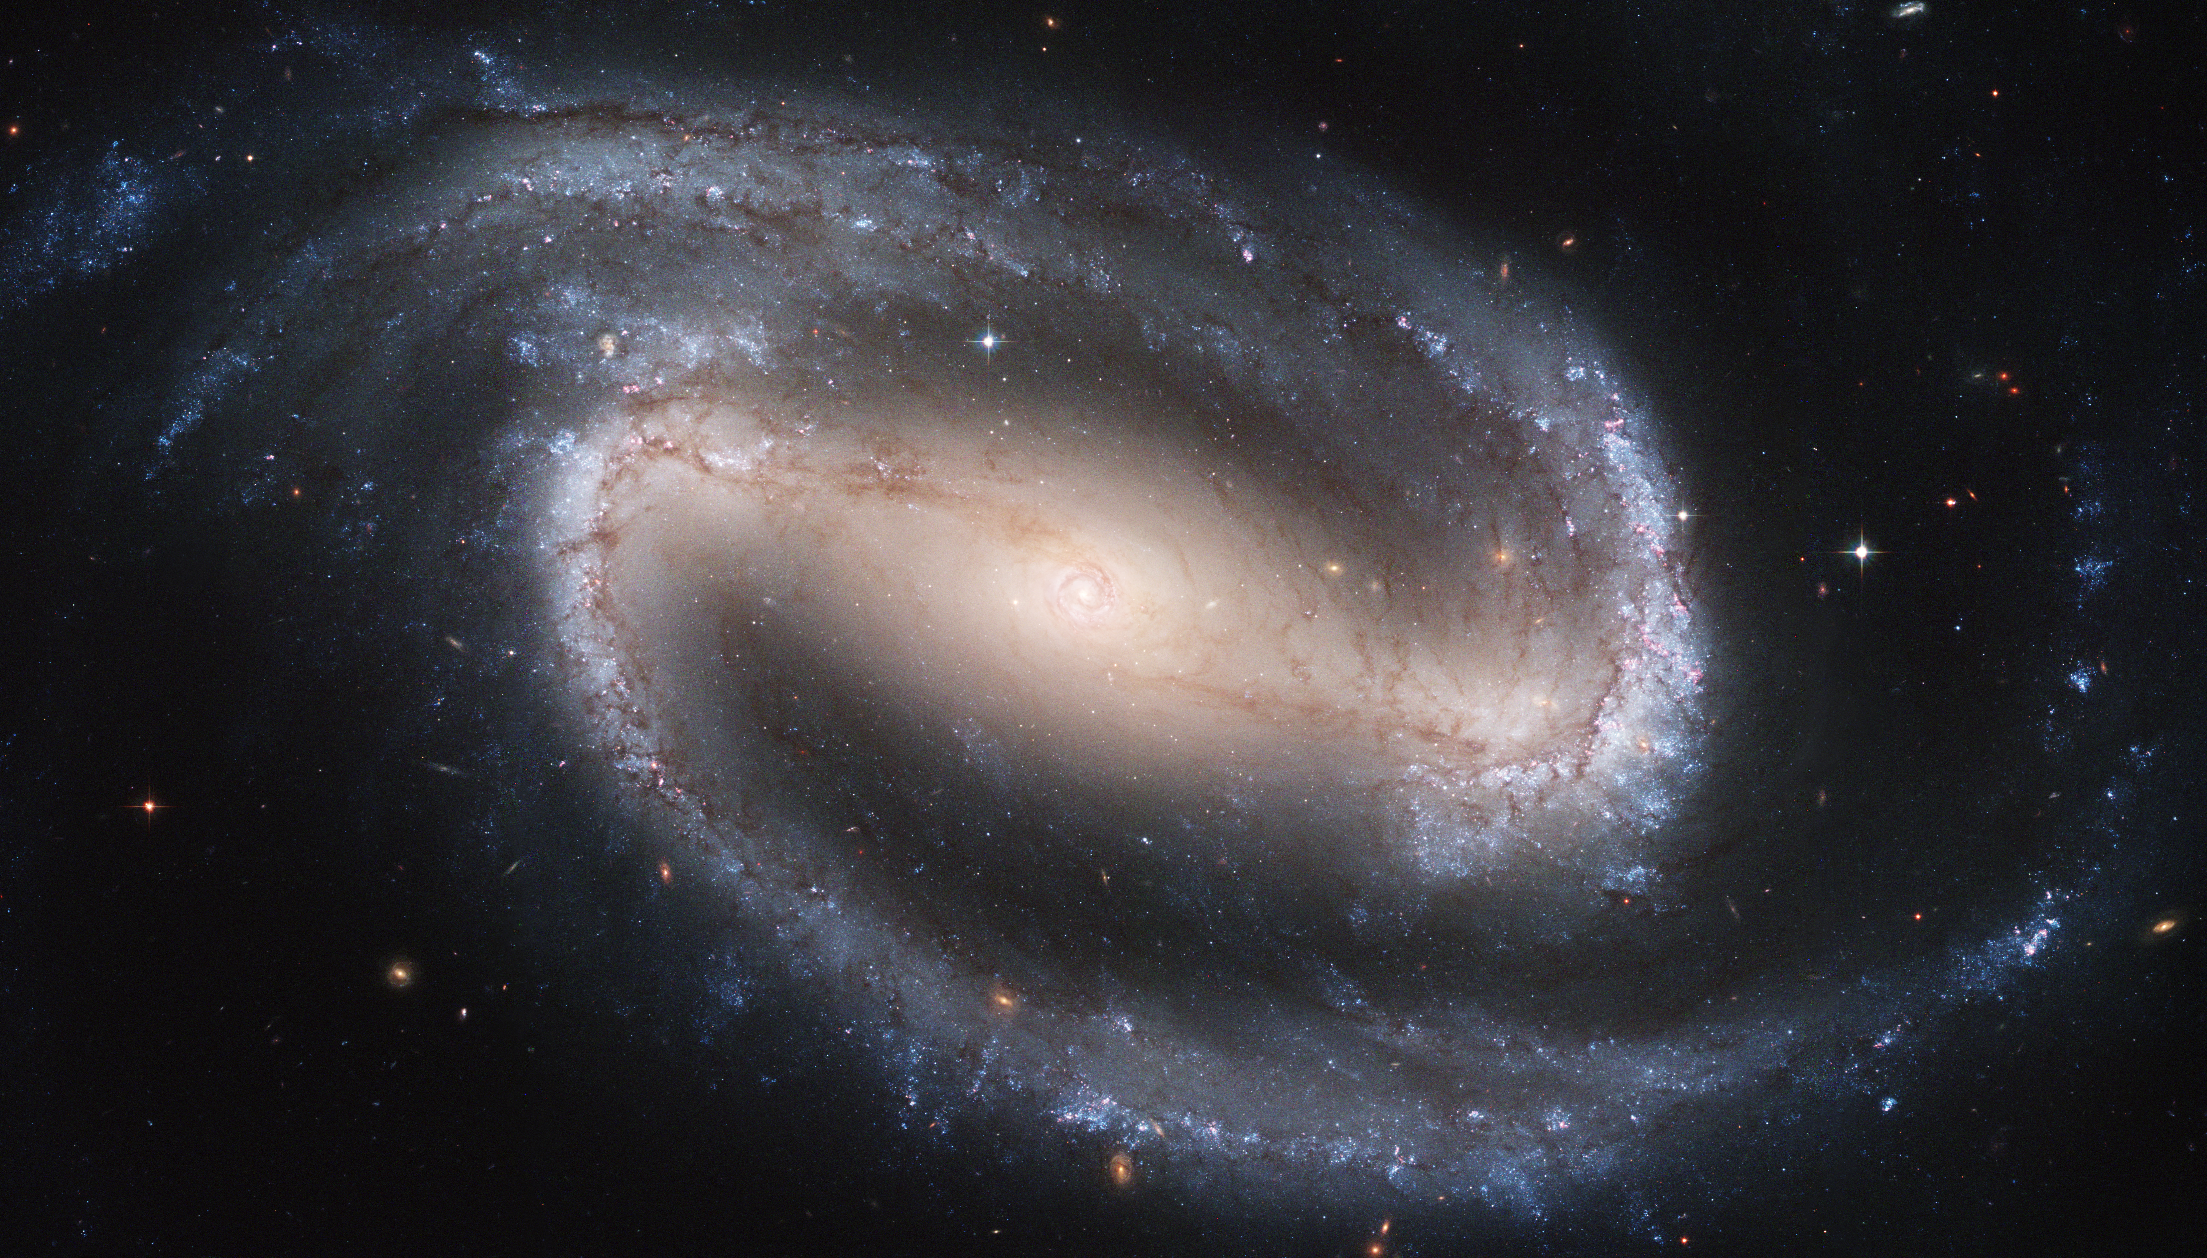
Radial migration in the Galactic disc with a decelerating bar
HanYuan Zhang (hz420@cam.ac.uk)
Collaborators: Vasily Belokurov, N. Wyn Evans, Jason L. Sanders, Yuxi(Lucy) Lu, Changye Cao, GyuChul Meyong, Adam Dillamore, Sarah G. Kane , Zhao-Yu Li
Zhang H. et al., 2025, ApJL, 983, L10
Notes:
Slide number

Slide 2
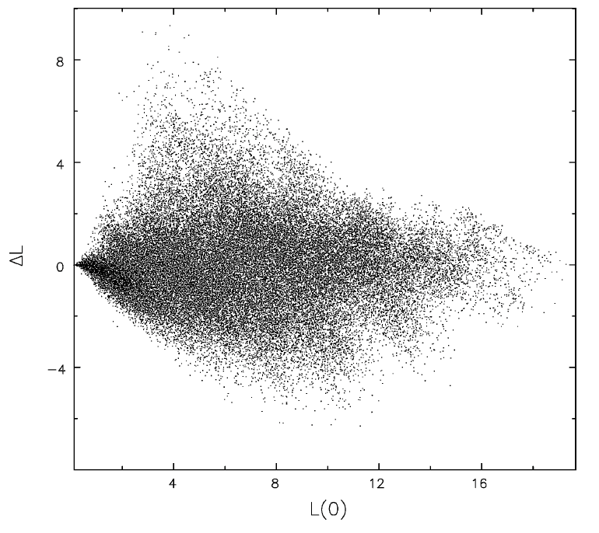
Stellar migrations in the Galactic disc
Stars could move from their birth radius to their present-day radius, called radial migration
This process happens through interaction with non-axisymmetric perturbations, e.g. the transient spiral arms, galactic bar.
As radial migration re-distributed stars around the disc, this effect can be studied by the chemical pattern in the disc
Sellwood & Binney 2002
Amount of radial migration
Amount of migration $(∆L_{z})∝σ_{[Fe/H]}$
Birth guiding radius of stars
See Sellwood & Binney 02, Minchev & Famaey 10, Halle +15

Slide 3
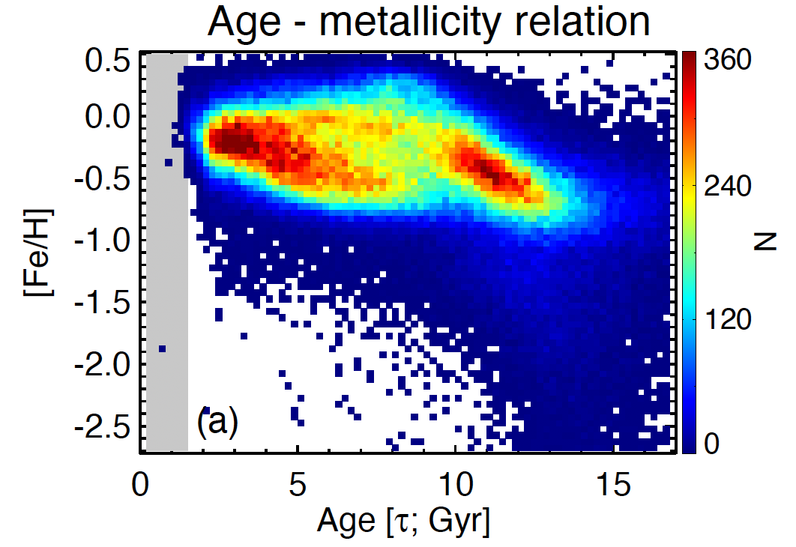
Chemical cartography in the Galactic disc
The age-metallicity plane
Sample used in this work: LAMOST subgiants/MSTO stars
What mechanism caused this bimodal sequences
&
What can we learn about the past of the Milky Way from this
Spoil alert: we can study bar deceleration with it!
Xiang & Rix 2022

Slide 4
Resonant dragging of a decelerating bar
A toy demonstration
Stars trapped in the corotation resonance migrate with the expansion of the corotation.
This brings stars from the inner Milky Way to the present-day corotation radius.
HZ+2025
Hawkins 2023
See Chiba+21; Chiba & Schonrich 2021 for analytic descriptions and very beautiful figures
Today’s pattern speed$\sim 32−35$ km/s/kpc (Chiba+21, Clarke+22, Zhang+24, Dillamore+24,25); corotation radius $\sim 6.8−7.5$ kpc

Slide 5
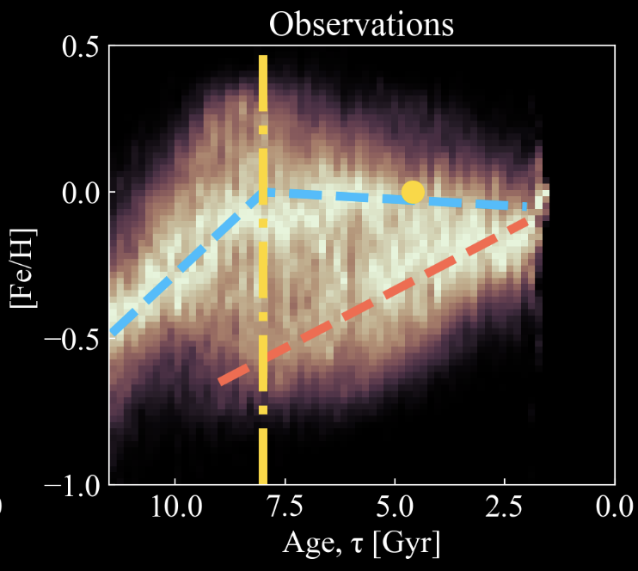
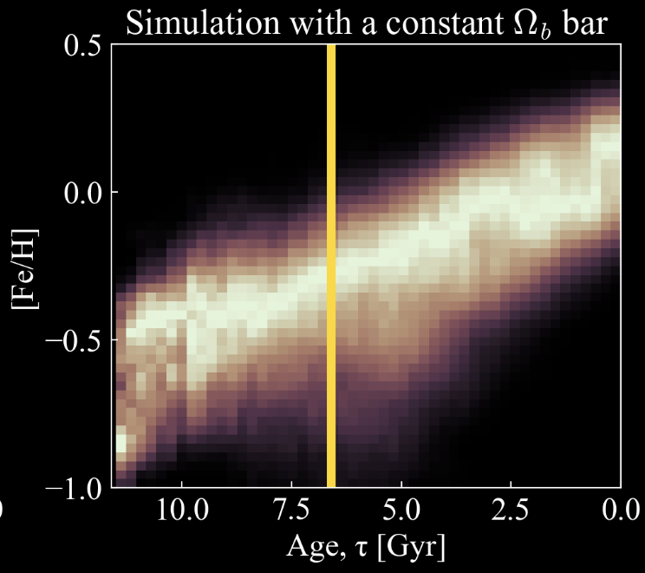
Resulting age-metallicity sequences
Local stars vs. migrated stars
Migrated stars via bar resonance dragging
Migrated stars via bar resonance dragging
Stars born around solar circle
Stars born around solar circle
HZ+2025
HZ+2025

Slide 6
Resulting age-metallicity sequences
The guiding radii dependence
The bimodal sequences co-exist around the corotation radius
HZ+2025
Hawkins 2023
The upper sequence disappeared outside the corotation zone

Slide 7
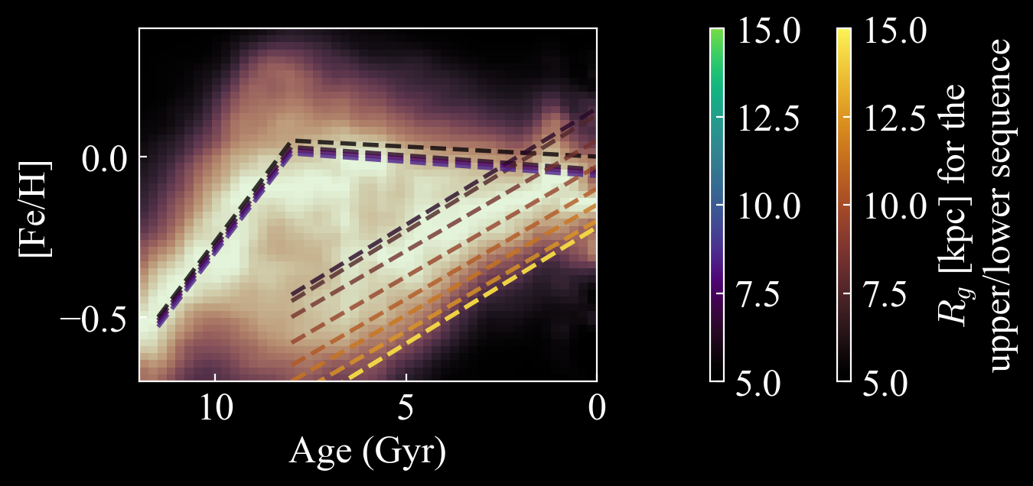
Resulting age-metallicity sequences
The guiding radii dependence
Hawkins 2023
See also Khoperskov+24

Slide 8
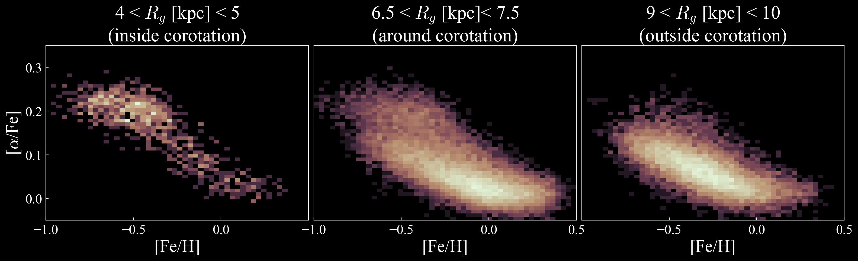
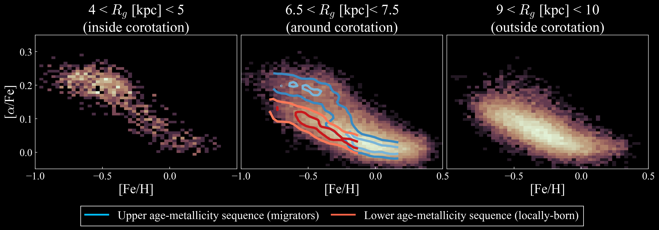
Implications: 1) $[α/Fe]−[Fe/H]$ bimodality
HZ+2025
Hawkins 2023
The bimodality is due to the co-existence of the local and migrated stars
The bimodality indeed only appear around the corotation
See more detailed chemical cartography map in Hayden+15
See also Sharma+21

Slide 9
Inferring the bar deceleration rate
The age-metallicity relation upper sequence should be:
$[Fe/H](τ)$ $=[Fe/H](τ, R_{CR}(τ))$
Very flat !
$\frac{D[Fe/H]}{Dt}=\frac{∂[Fe/H]}{∂t}+\frac{∂[Fe/H]}{∂R}\frac{dR_{CR}}{dt}～0$
$≜V_{c} × η$
(the deceleration rate)
$η= \frac{{∂\left[{Fe}/H\right]}/{∂t} −{D\left[{Fe}/H\right]}/{Dt}}{\left|{∂\left[{Fe}/H\right]}/{∂R}\right|}\frac{1}{V_{c}}\sim 0.004$
Chiba+21 got 0.002$−$0.0045 using kinematic features of bar resonance in the solar vicinity

Slide 10
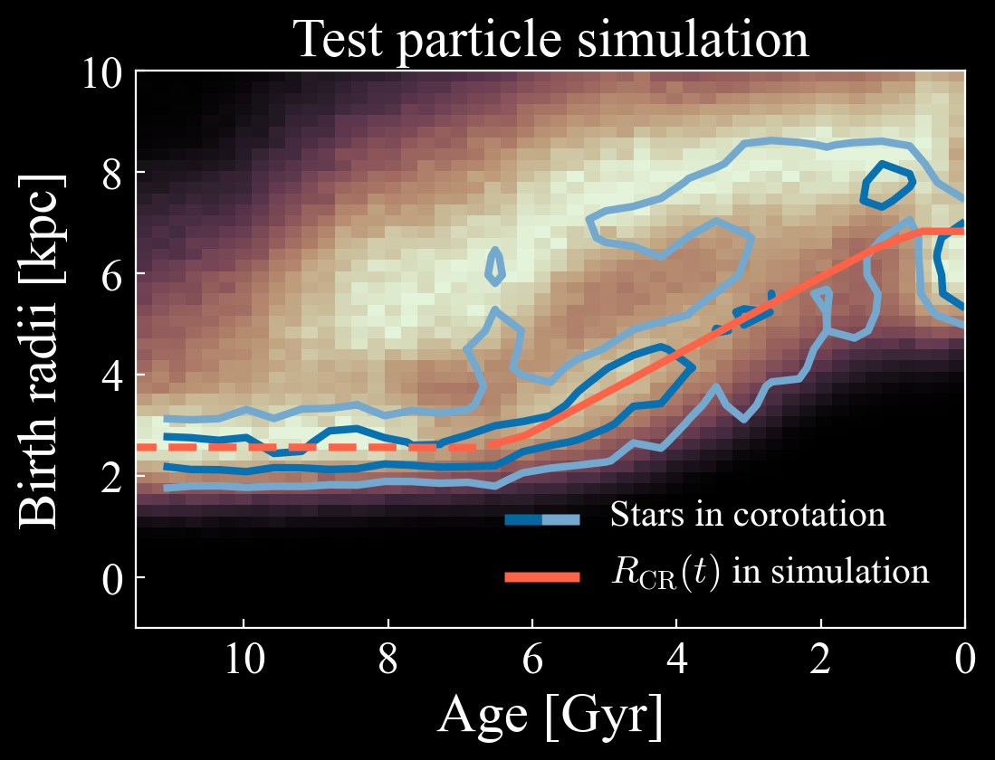
Inferring the pattern speed history of the bar
Stars experienced resonance dragging closely traces the pattern speed evolution in the past
HZ+2025
Hawkins 2023
In this birth radius calculation method (Lu+24), we can infer:
$t_{bf}\sim 6−8$ $Gyr$; $Ω_{i}\sim 60−100$ $km/s/kpc$; $η=−\dot{Ω}/Ω^{2}\sim 0.0025−0.004$
agree with other independent measurements of $t_{bf}$ and $η$ (Chiba+21, Sanders+24), and non-independently Haywood+24
Notes:
Maybe we can cut this out

Slide 11
Conclusion
Zhang H. et al., 2025, ApJL, 983, L10
The Milky Way’s age-metallicity distribution shows two distinct sequences, and exhibit clear transition as a function of $R_{g}$
We interpret the two distinct sequences as they consist migrated stars and locally-born stars, respectively, in which the migrated stars are driven by the corotation resonance dragging of the decelerating bar.
This interpretation could also help to explain the disc’s $α$-bimodality and its guiding radii dependence, the observed azimuthal chemical patterns, the broken stellar density distribution, and the coldness of the disc.
We could infer the pattern speed history of the Galactic bar. We obtained
${ t}_{bf}\sim 6−8$ $Gyr$; $Ω_{i}\sim 60−100$ $km/s/kpc$; $η=−\dot{Ω}/Ω^{2}\sim 0.0025−0.004$

Slide 12
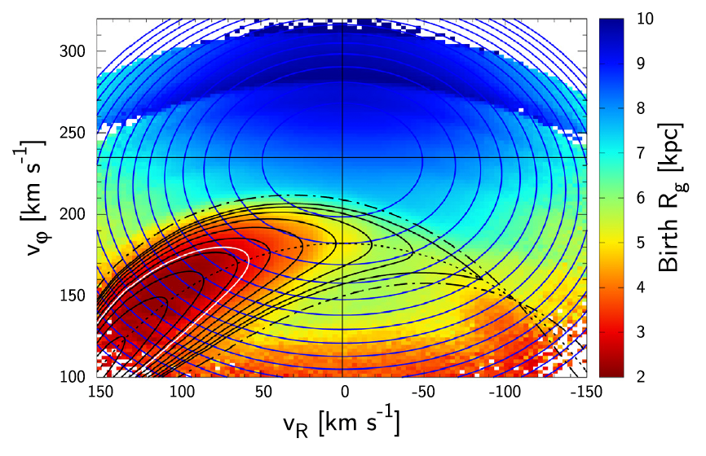
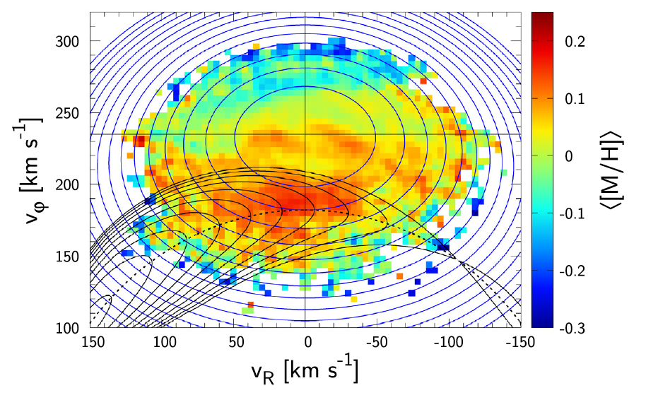
Resonant dragging of a decelerating bar
A quick introduction
Born outer →more metal-poor
Chiba & Schonrich 2021
Hawkins 2023
Today’s bar pattern speed: $Ω_{b}\sim 33−37$ km/s/kpc (Chiba+21; Clarke+22; Zhang+24 ; Dillamore+24, 25) → Corotation radius $R_{CR}\sim 6.2 −7.0$ kpc

Slide 13
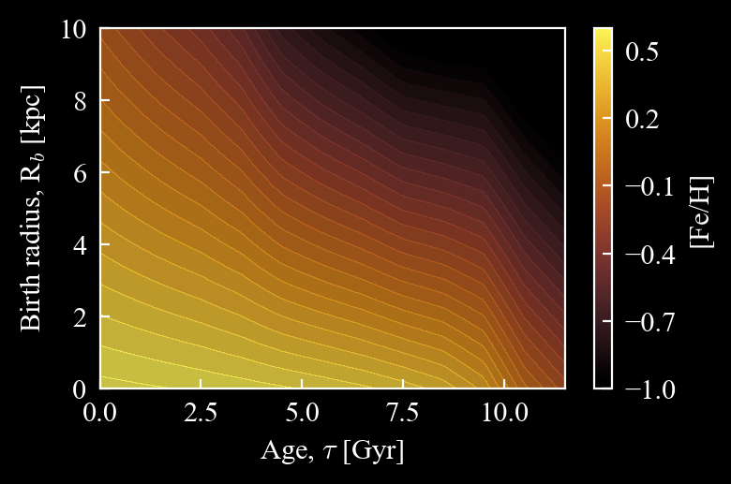
Resonant dragging of a decelerating bar
Test-particle simulation setup
Linear metallicity gradient
This is adopted from Lu+24, which calibrated with observed Milky Way’s metallicity pattern
Metallicity enrichment with time

Slide 14
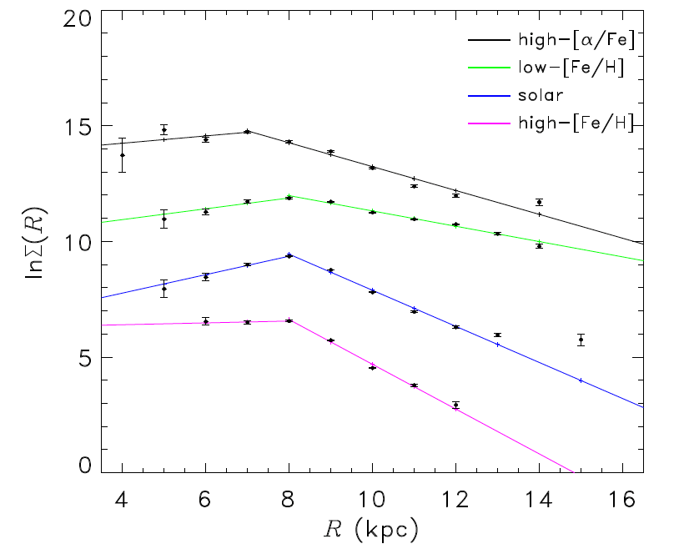
Implications: 3) Broken power-law in stellar density
Yu et al. 2021
Hawkins 2023
HZ+2025
See also Bovy+15, Lian+22

Slide 15
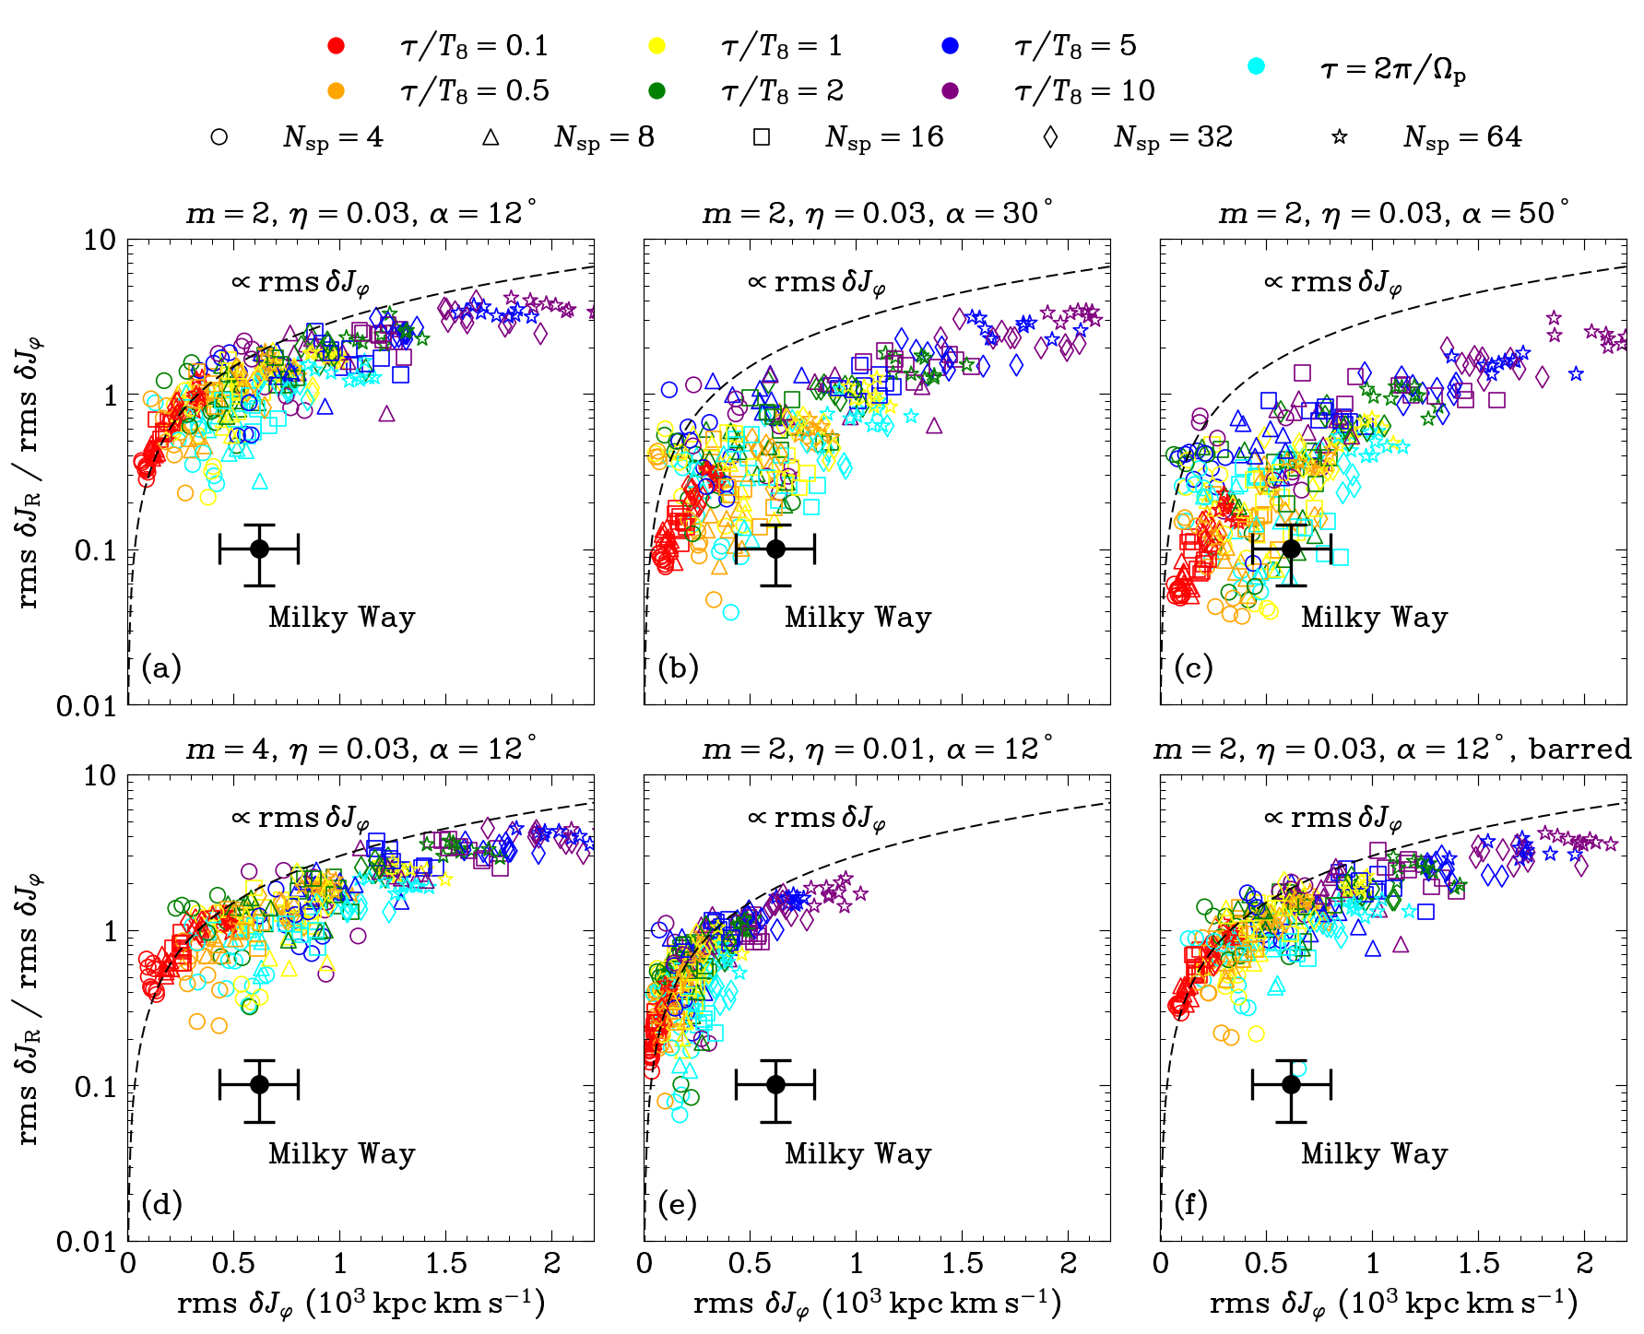
Implications: 4) Coldness of the disc
Hamilton et al. 2024
The Milky Way observation is from Frankel+20
Hawkins 2023
But see also the demonstration in Sellwood & Binney 2025

Slide 16
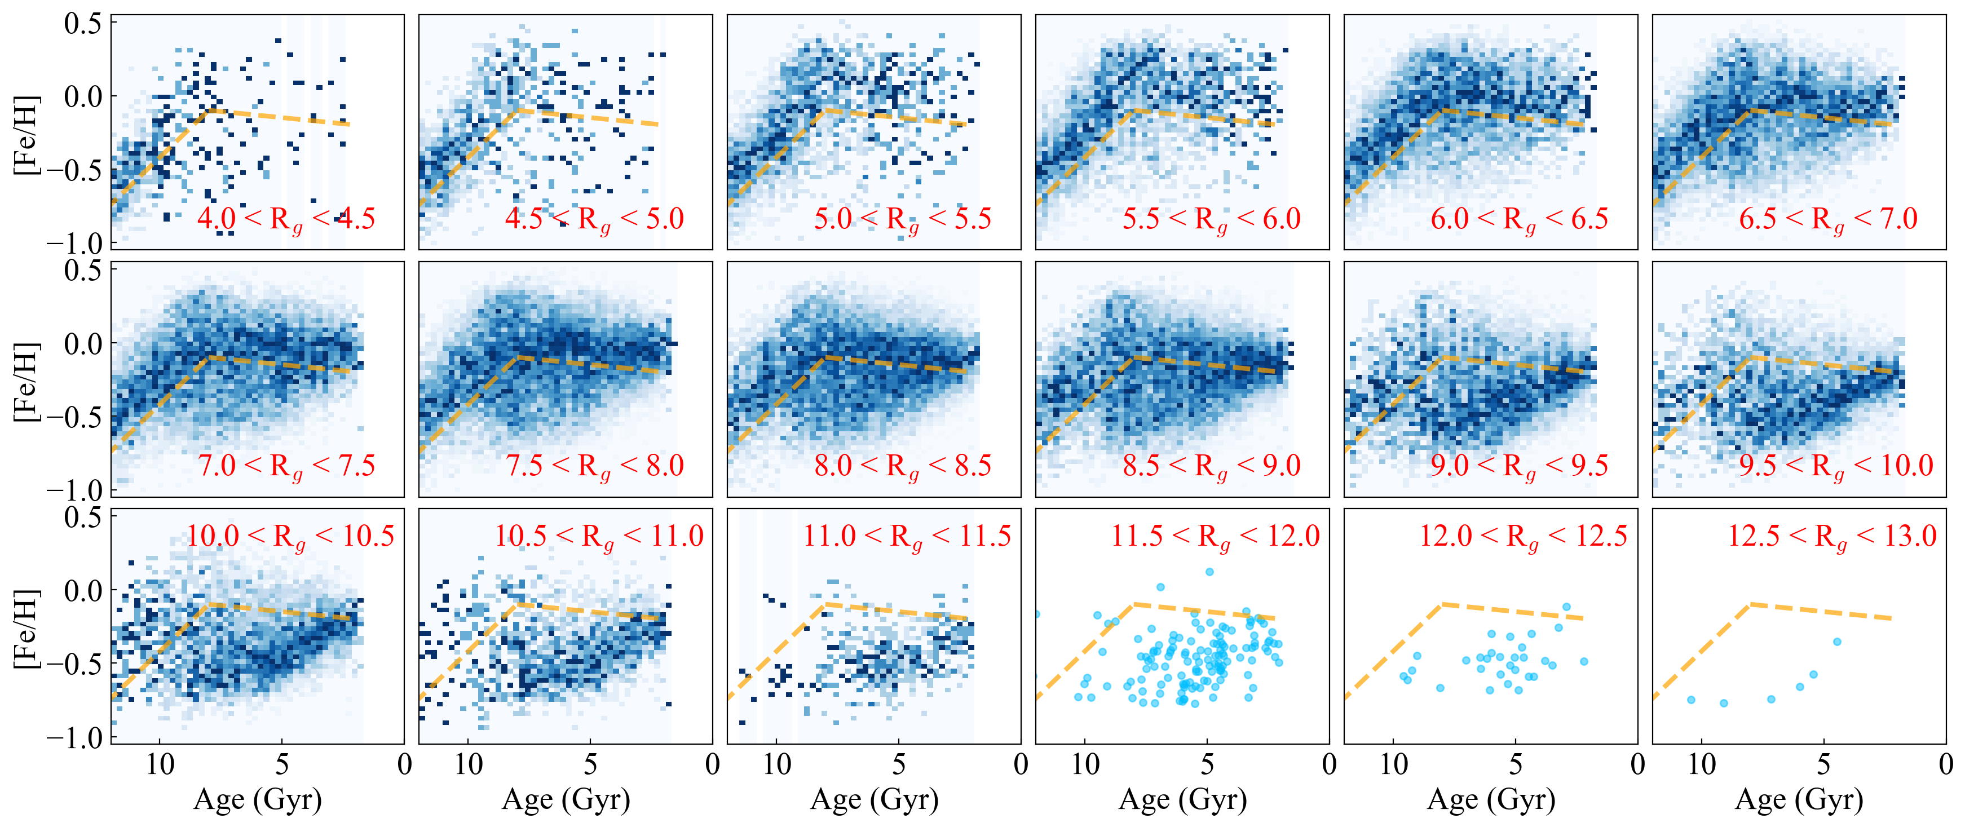

Slide 17
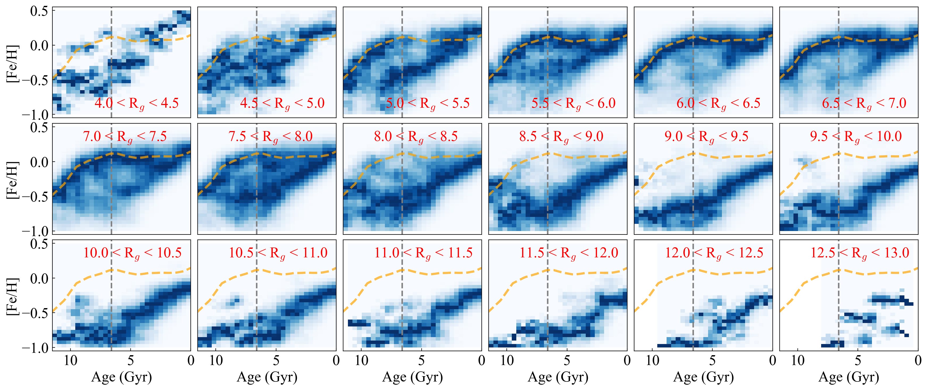

Slide 19
Implications: 2) Azimuthal patterns
Hawkins 2023
HZ+2025

Slide 20
Implications: 2) Azimuthal patterns
Khoperskov et al. 2024
HZ+2025
See also Poggio+23, Hawkins 2023, Hackshaw+24

Slide 21
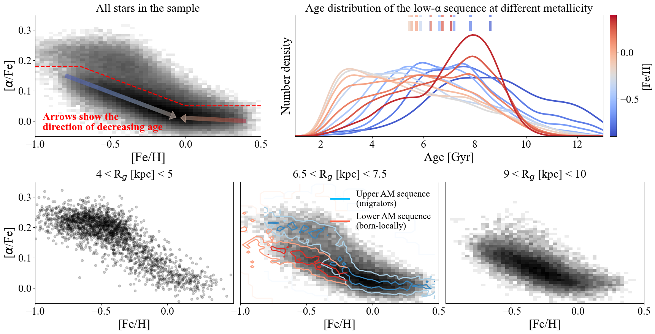

Slide 22
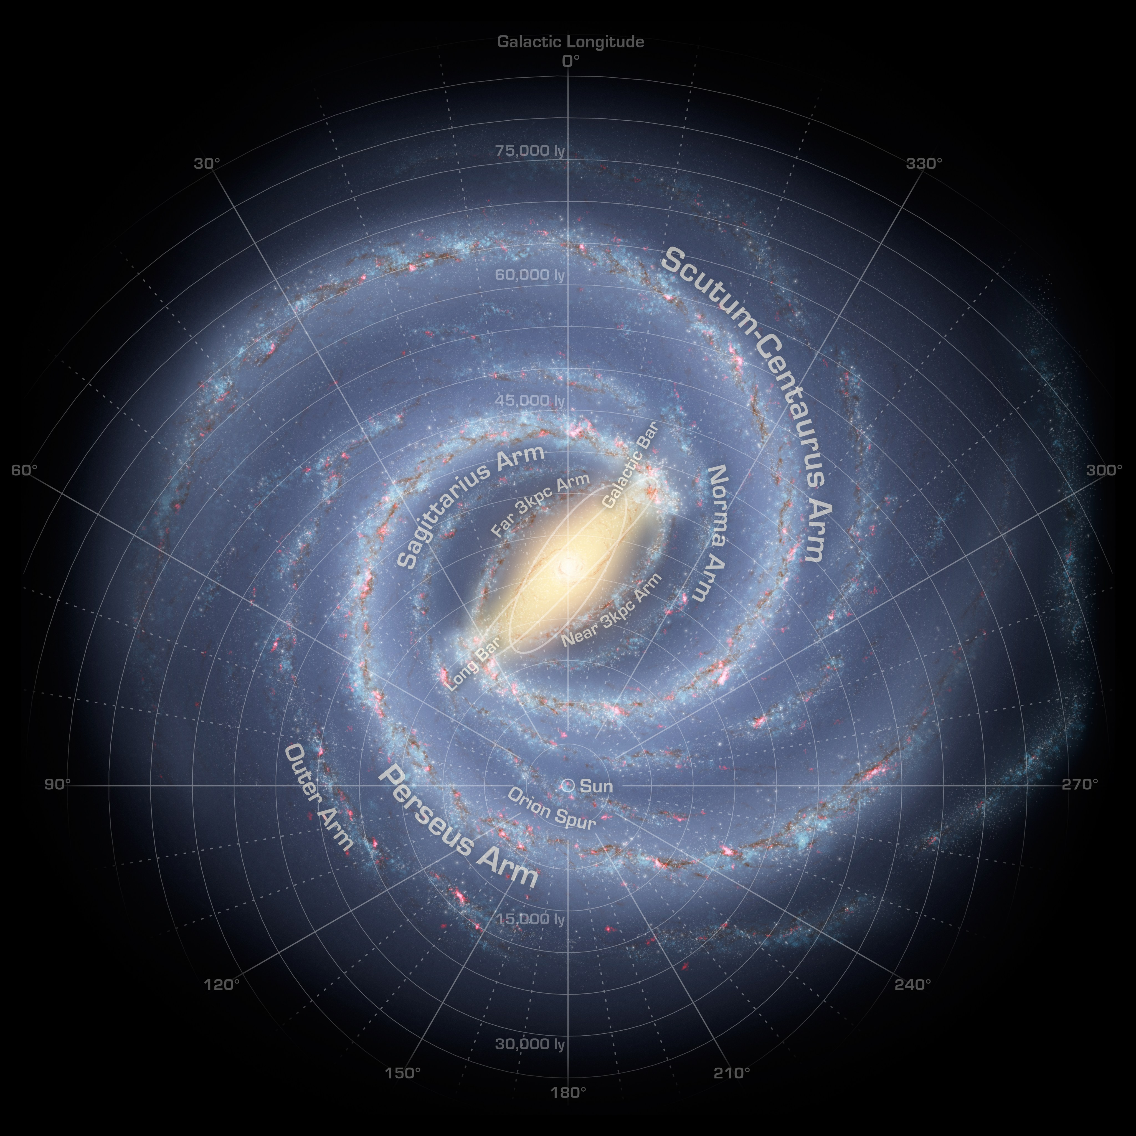
For stars in the solar neighbourhood, we can measure their:
Kinematics
Metallicity
Chemical abundances
Ages
Where were these stars born in the Milky Way?

Slide 23
Resulting age-metallicity sequences
The guiding radii dependence
The bimodal sequences co-exist around the corotation radius
The upper sequence disappeared outside the corotation zone
Observation
Simulation
Hawkins 2023
HZ+2025

