Slide 1
MOS tech development at the UKATC National Astronomy Meeting 2025, Durham

Slide 2
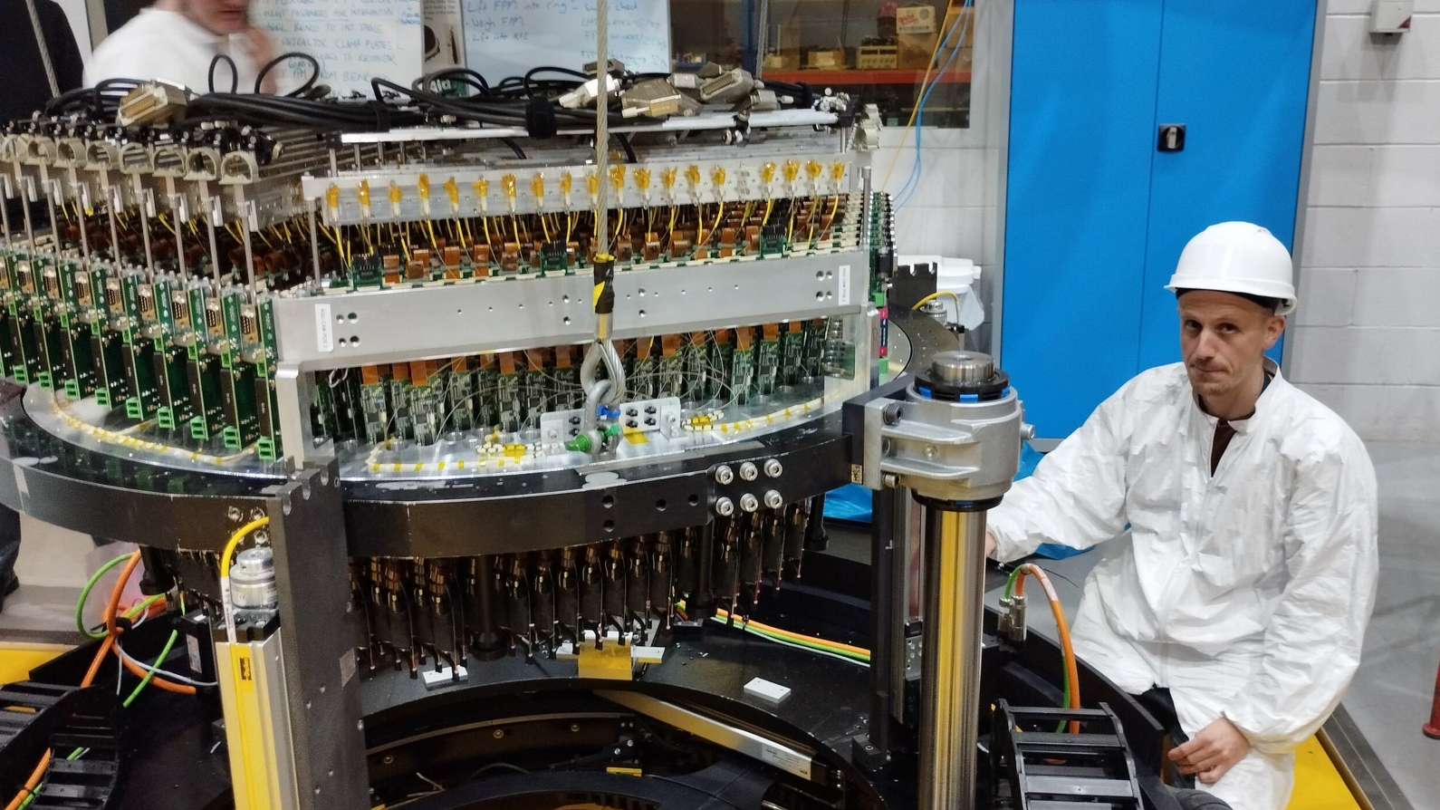

Slide 3
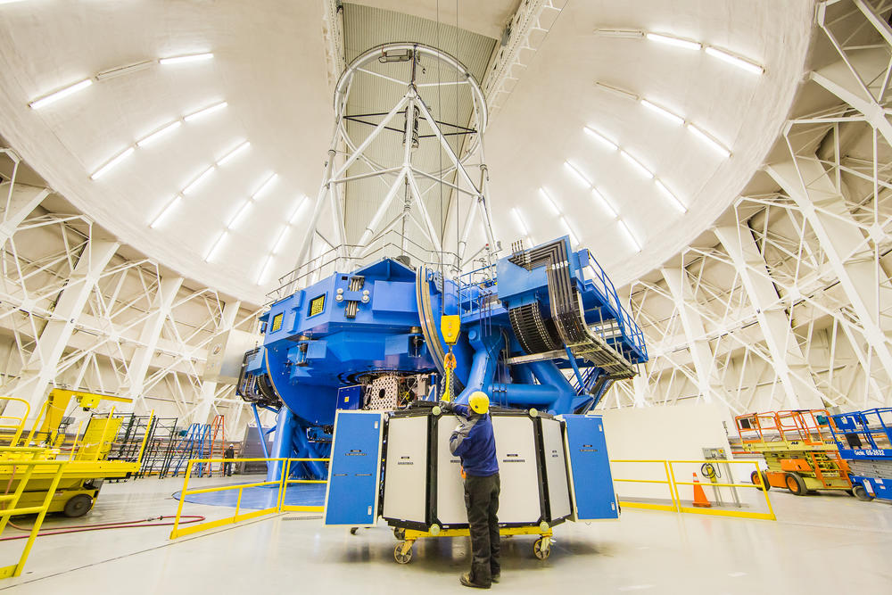
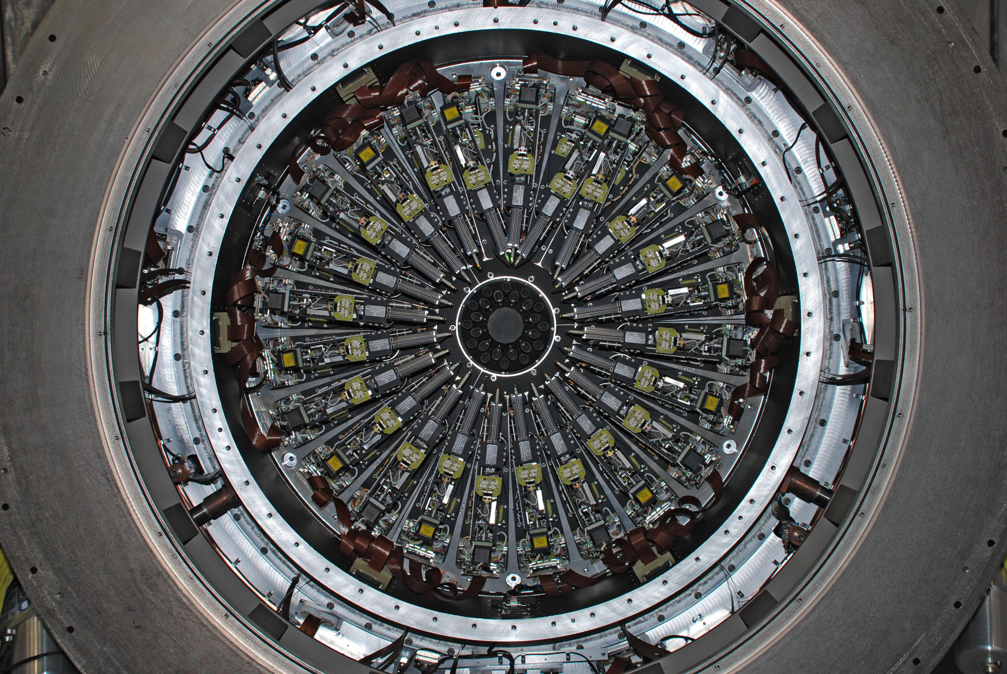
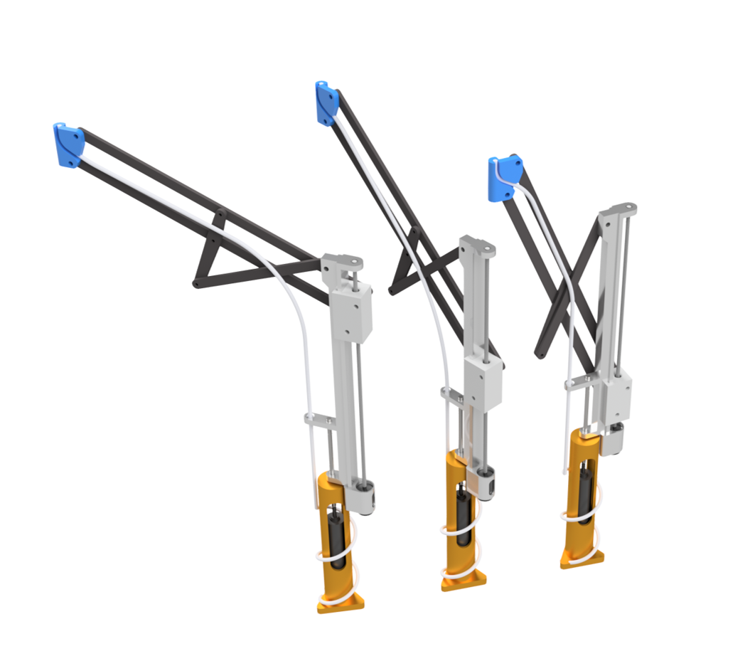
UKATC MOS: past, present and future
GMOS, Gemini (2001)
KMOS, VLT (2012)
MOONS, VLT (2025)
WST
HRMOS, VLT

Slide 4
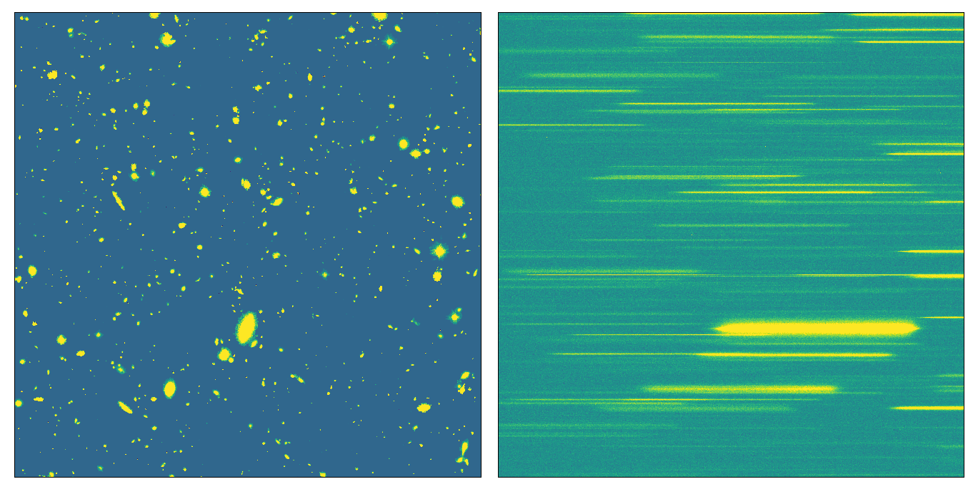
Slitless spectroscopy

Slide 5
Long-slit spectroscopy

Slide 6
Fibre-fed spectroscopy

Slide 7
Multi-object fibre-fed spectroscopy

Slide 8
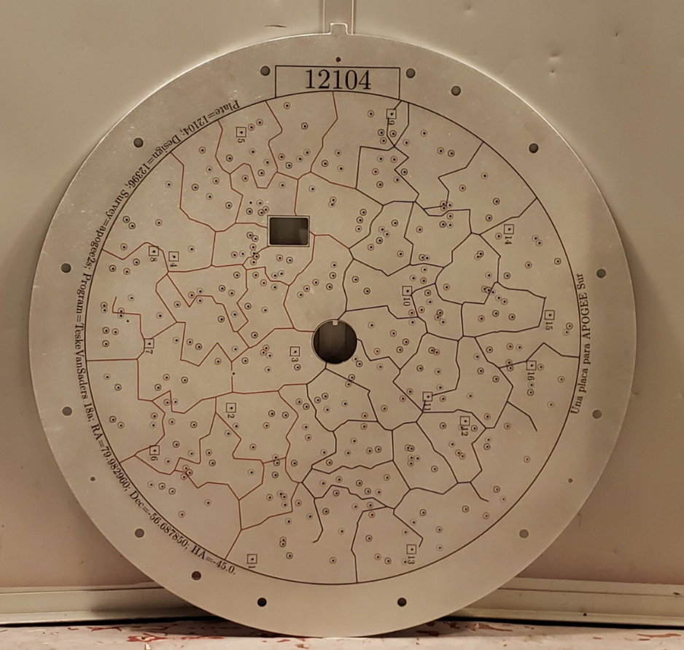
SDSS
Plug plate

Slide 9
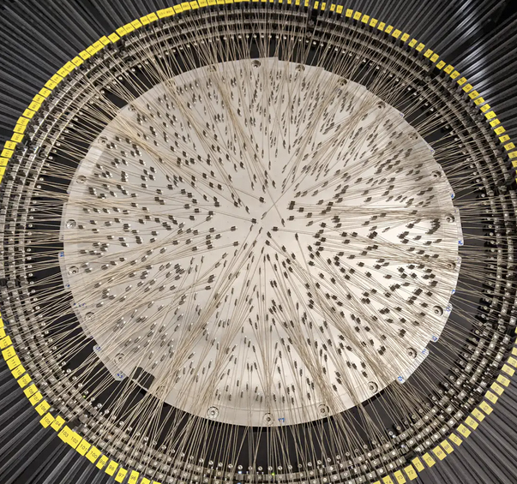
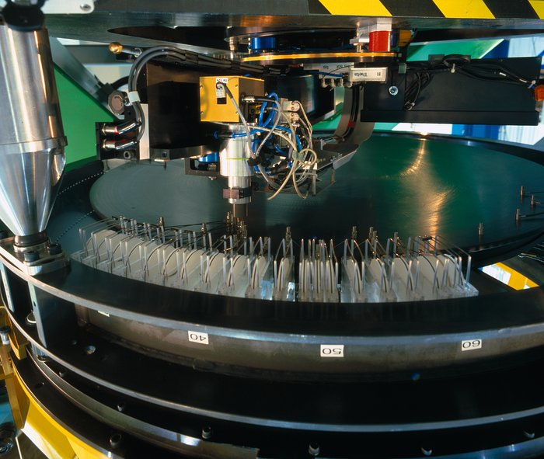
Pick and place
WEAVE
FLAMES

Slide 10
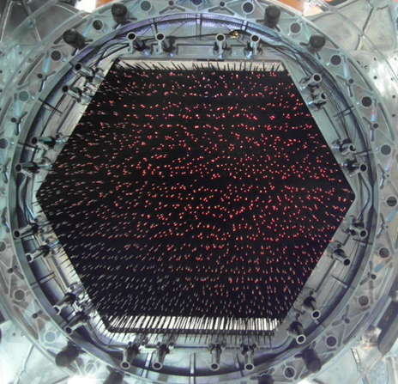
Tilting spines
4MOST

Slide 11
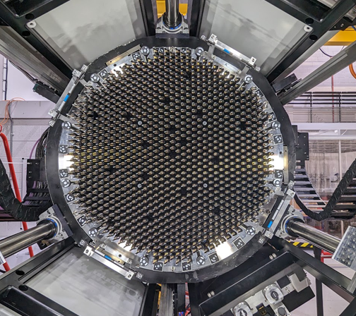
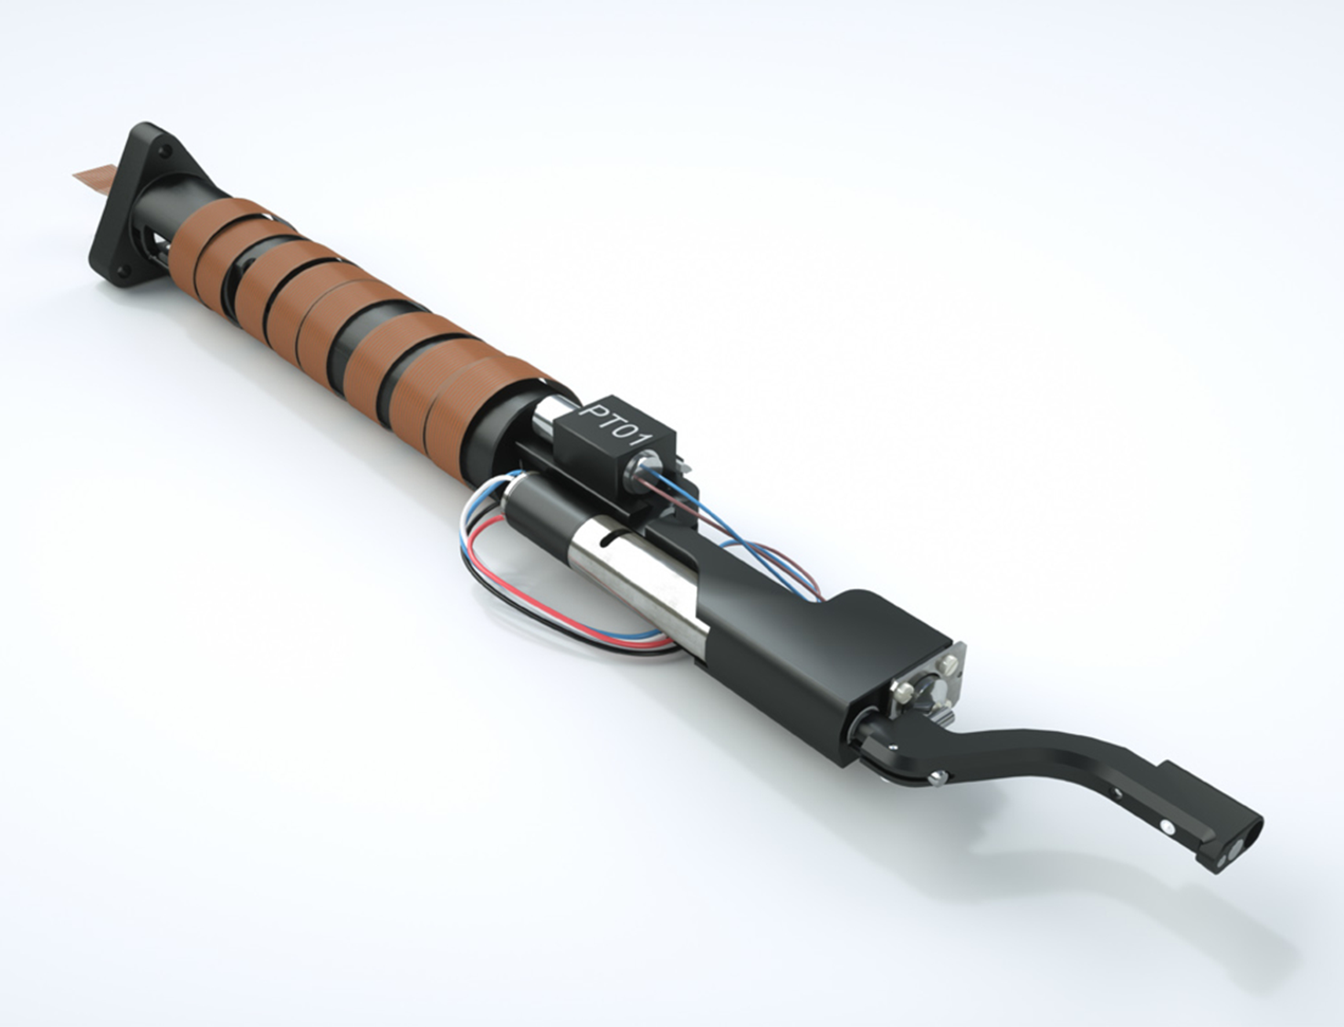
Theta-Phi

Slide 12
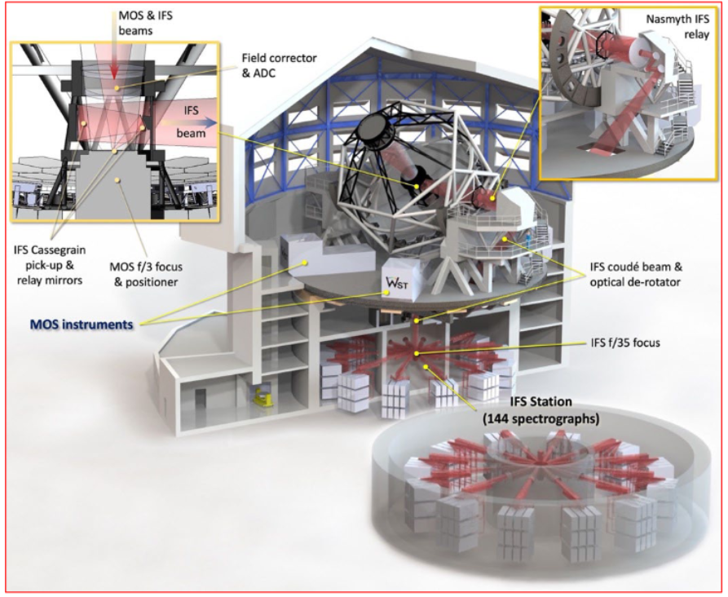
Wide-field Spectroscopic Telescope
WST is a new observatory proposed as a spectral follow-up to current all-sky imaging surveys
Seeing-limited in visible wavelength
12m mirror & 3.5deg² FoV
Focal plane diameter of ~1.4 m
32,000 fibres (30,000 LR, 2000 HR)
Simultaneous LR/HR MOS and IFS operation
Targets of Opportunity

Slide 13
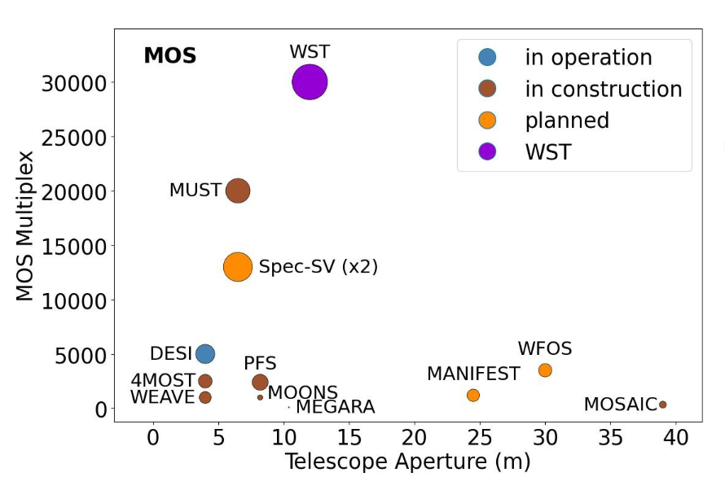
Circle diameter is FoV

Slide 14
theta-phi
?
tilting spines
pick and place
slit mask / StarBug
Circle diameter is FoV

Slide 15
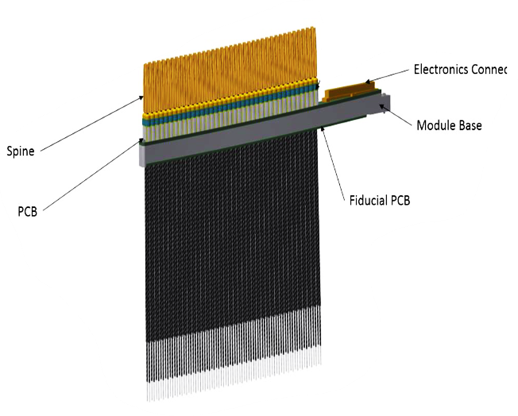
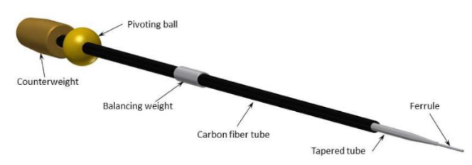
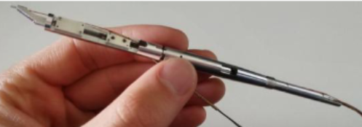
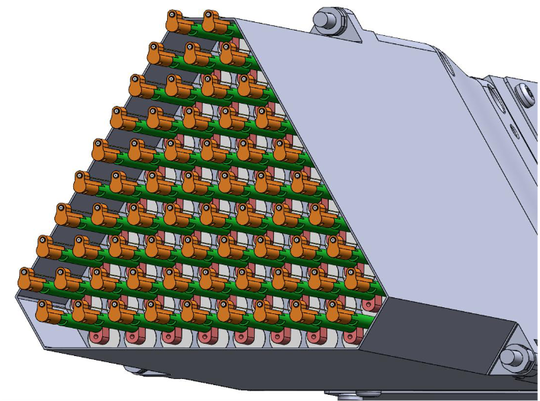
Positioner groups and concepts
Positioner
Module
AAO – tilting spines
AIP – bending spines (FLEX)
EPFL – theta-phi
UKATC – r-theta

Slide 16
UKATC R-theta positioner
R-theta concept advantages
Large patrol radius, high proportion of FoV covered by >1 fibres
Good control of pupil alignment and focus
Onboard position sensing allowing closed-loop positioning
Good operational flexibility

Slide 17
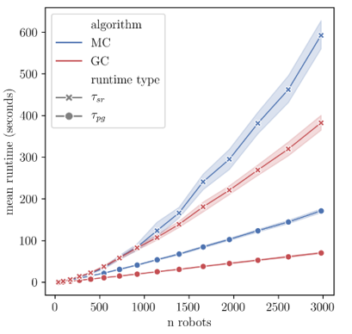
UKATC R-theta positioner
MOONS swept path
Path planning runtime

Slide 18
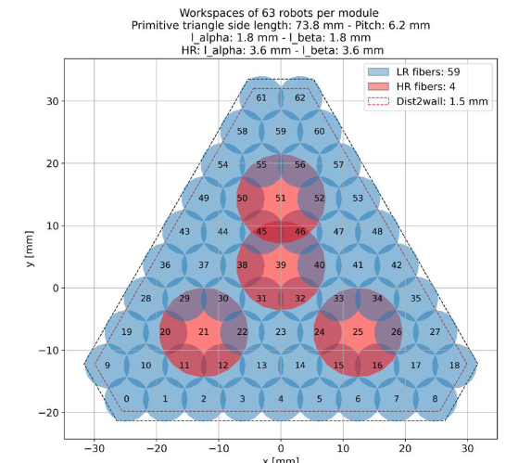
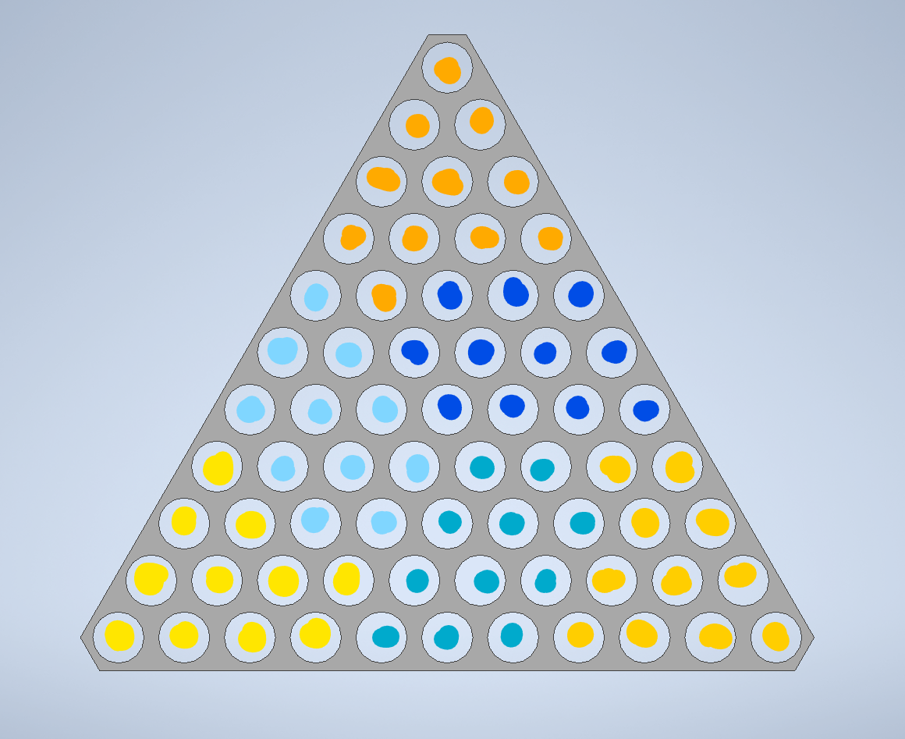
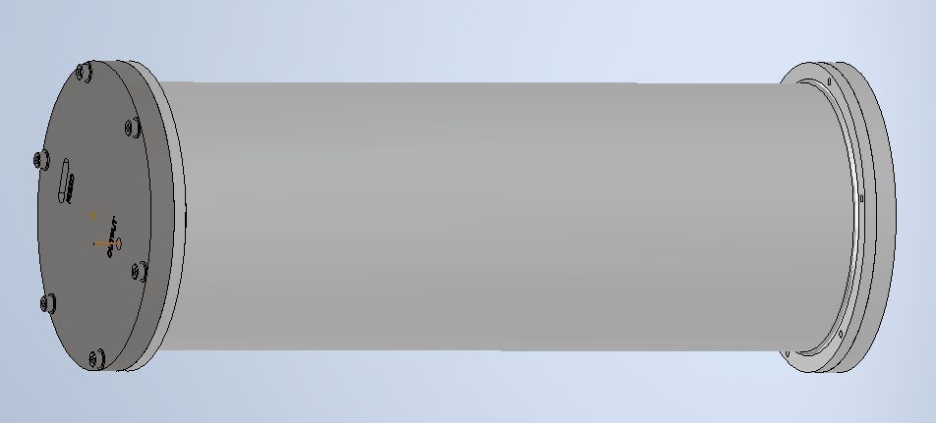
UKATC fibre switch
100% FoV coverage in both HR and LR modes is very difficult!
Big patrol zones
Fibre switches
SWITCH
HR SPEC
LR SPEC

Slide 19
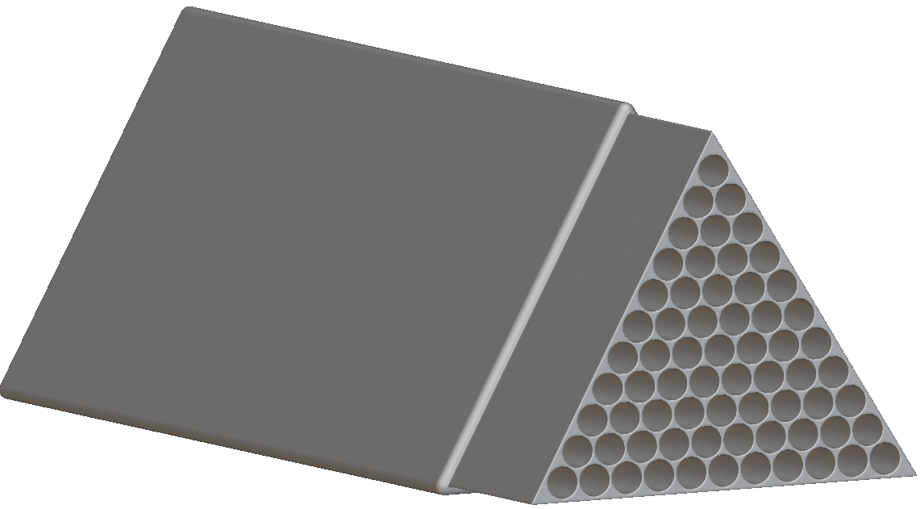
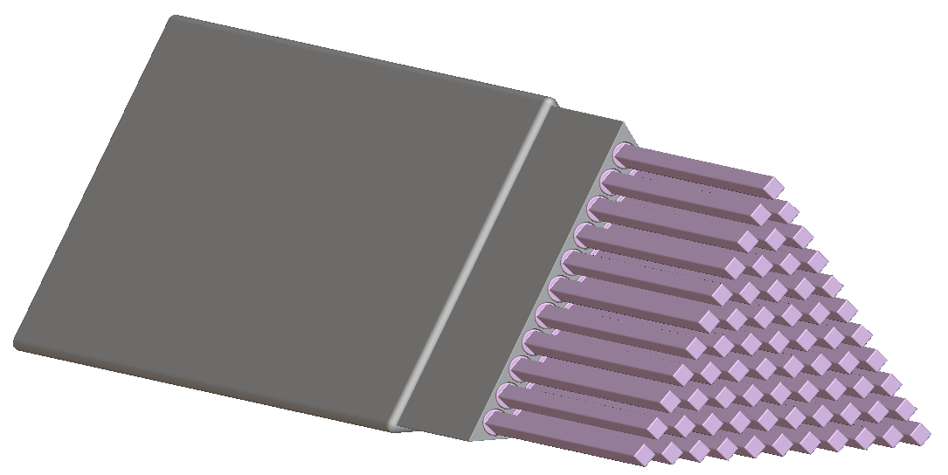
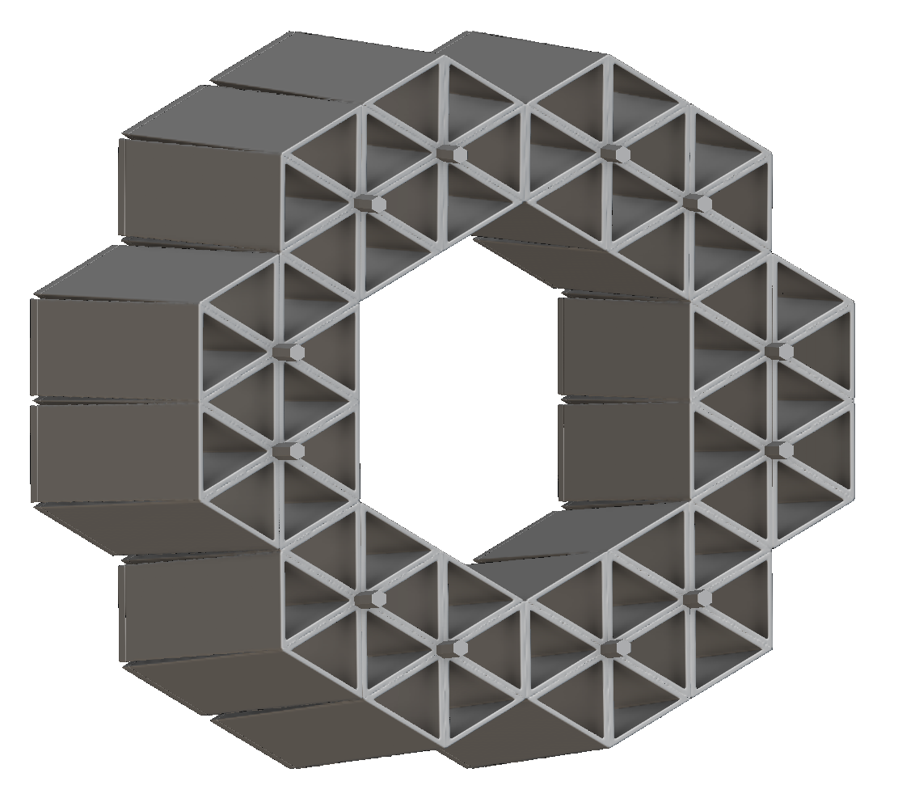
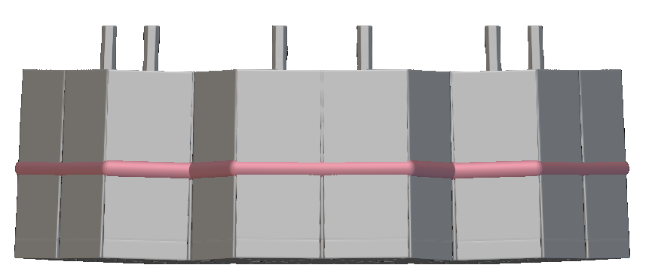
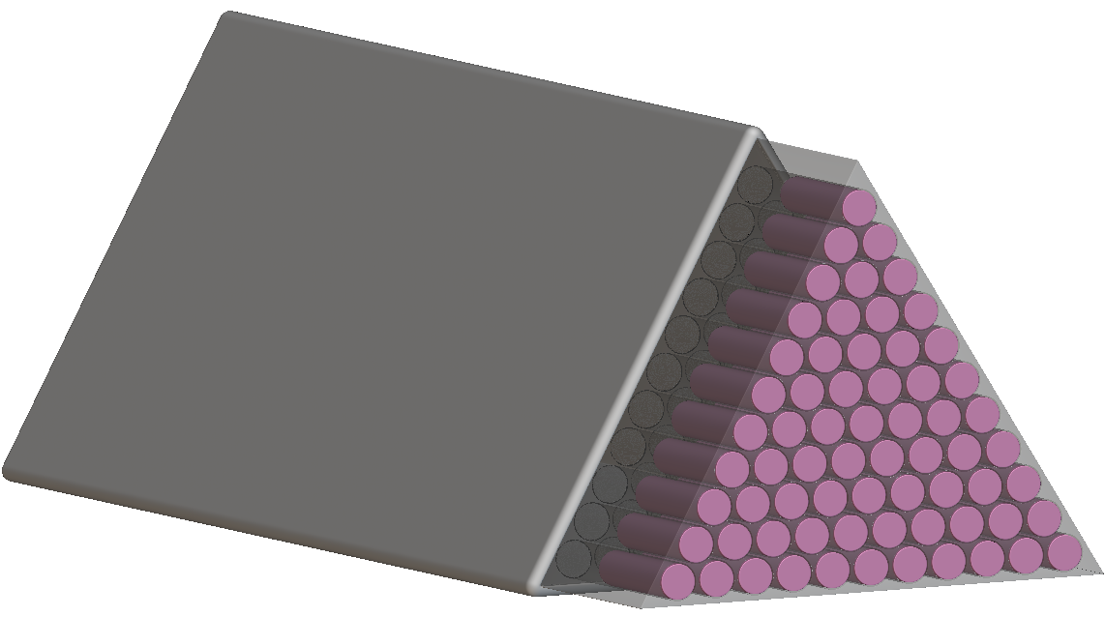
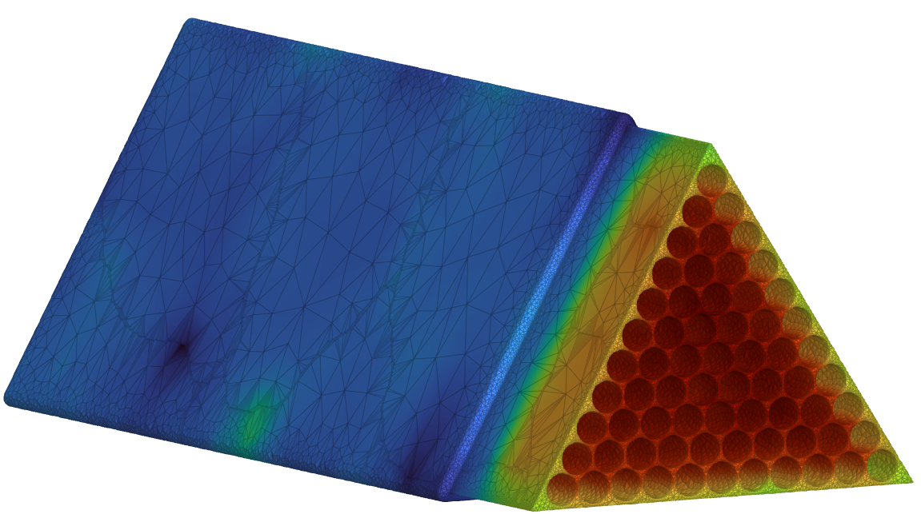
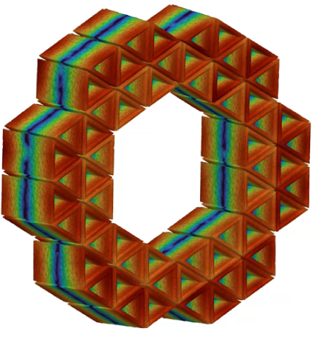
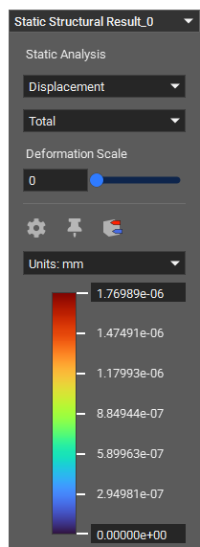
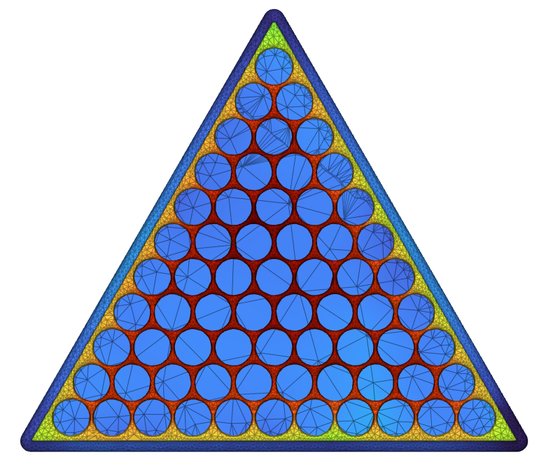
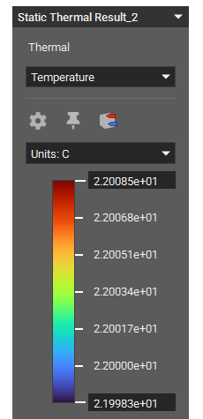
UKATC focal plane parametric design
Thermal steady state FEA
Structural FEA
Displacement restraint
Gravity load
Individual Positioners Envelope
Simulation Inputs:
Gravity load in -Z
Displacement restraint
Outputs:
Displacement distribution
Future steps:
Include mass load of electronics
Include parametric mass from
number of positioners which defines module mass
Individual motors envelope
Simulation Inputs:
Heat from motors
Module and Frame conduction
Outputs:
Steady state temperature
Future steps:
PCB envelope and heat
Air convection

Slide 20
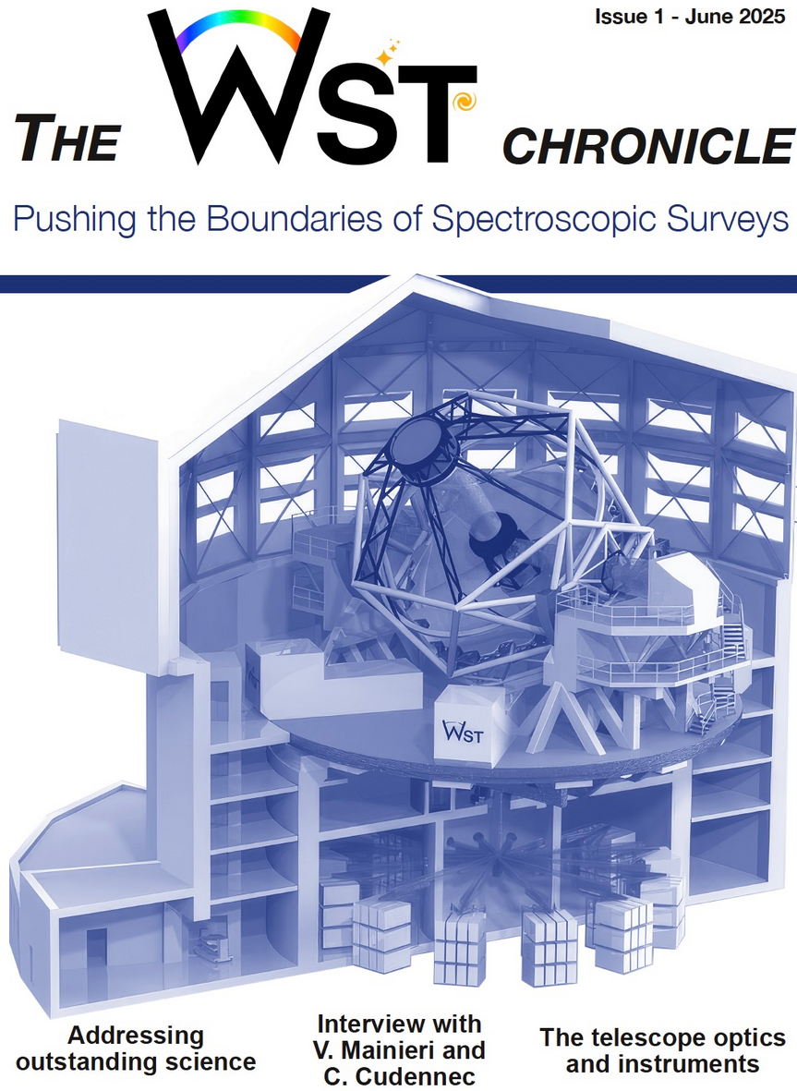
Questions

