Slide 1
South Pole Telescope – Shirokoff Line Intensity Mapper: On-Sky Results and Spectral Calibration
Chris S. Benson¹, Peter S. Barry¹, Kyra Fichman², SPT-SLIM Collaboration.
¹School of Physics and Astronomy, Astronomy Instrumentation Group, Cardiff University, UK
²Department of Physics and Astronomy, University of Chicago

Slide 2
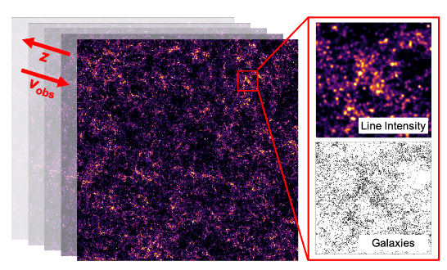
Mm Line Intensity Mapping
3D power spectrum of large-scale structure
Spatial axes (2) + z (1)
Spatially unresolved galaxy distributions.
Target CII and rotational CO
Competitive constraints on expansion history, neutrinos, and reionisation dynamics
Requires spectrometers with high mapping speeds, large FoVs, target R=1000
Karkare+ 2022

Slide 3
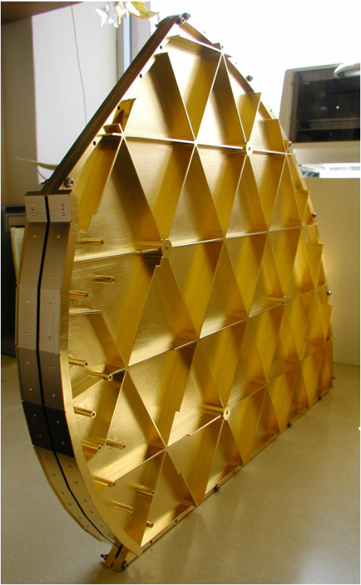
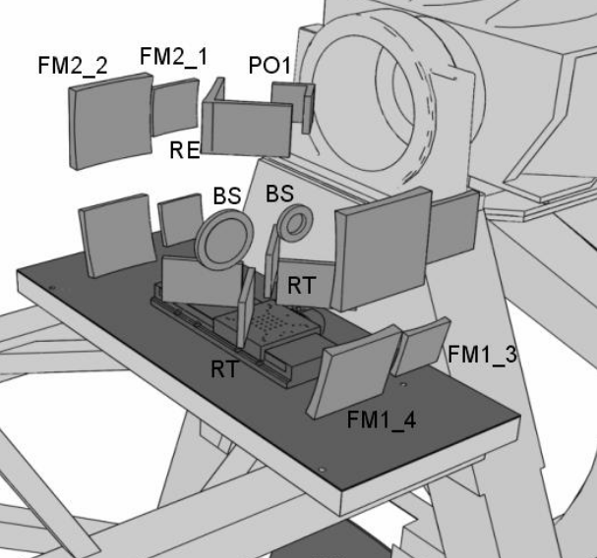
Spectroscopic Architectures
ZSpec: Bradford+ 2004
Gratings
Size scales with R and λ
Reduced throughput from slit apertures
Spatial dimension dedicated to spectral detection
Sacrifice spatial dimension
Fourier Transform Spectroscopy (FTS)
Throughput advantage
Multiplexing advantage
Noise penalty: full spectral band incident on each detector.
Photon noise $∝\sqrt{bandwidth}$
FTS-2: Naylor+ (2006)
Notes:
Significant drawback to each

Slide 4
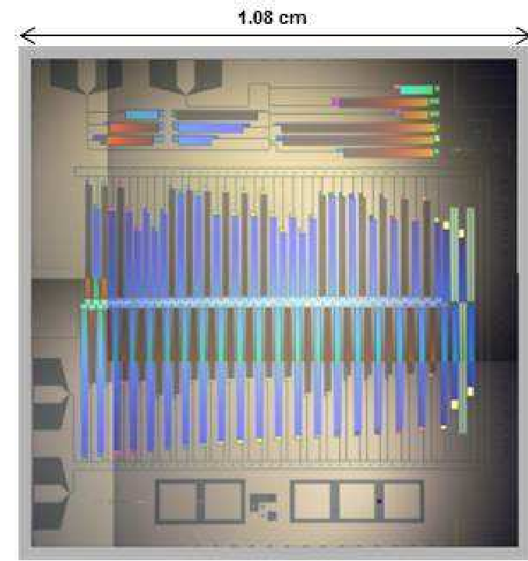
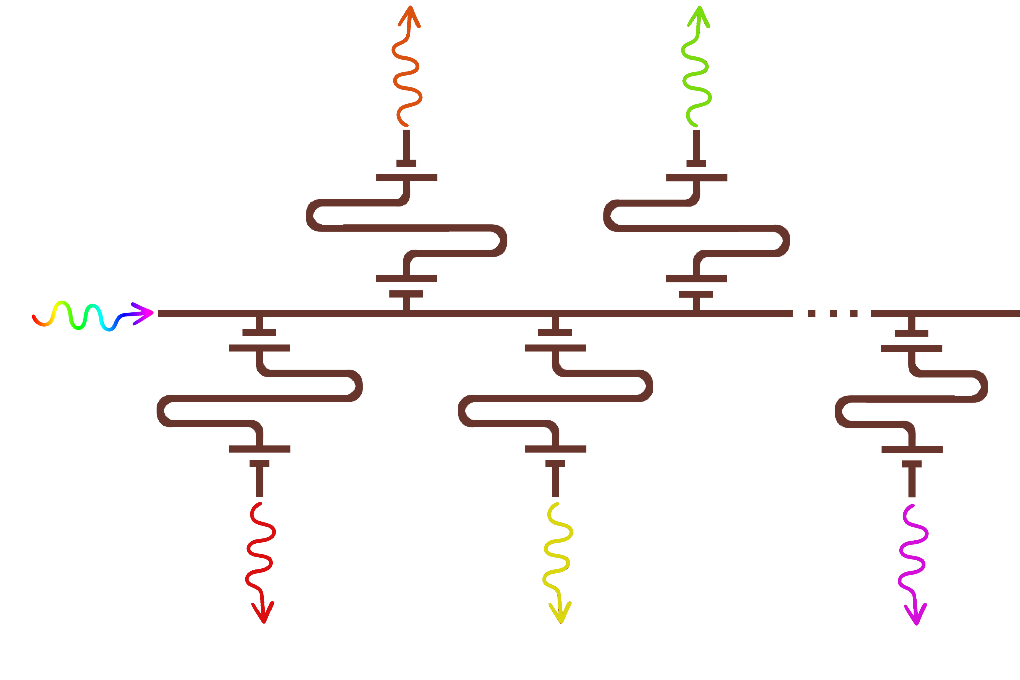
On-Chip Filterbank Spectrometers (FBSs)
Spectral dispersion over a few mm
Couple light from an antenna into superconducting waveguide
SuperSpec: S. Hailey-Dunsheath+ 2014
$$λ_{2}$$
$$λ_{4}$$
Filters allow narrowband transmission centered at different $λ$
Terminate each filtered band in a low-noise direct detector
Kinetic inductance detectors (KIDs)
Microstrip feedline
Signal from antenna
λ/2 filters
$$λ_{1}$$
$$λ_{3}$$
$$λ_{n}$$

Slide 5
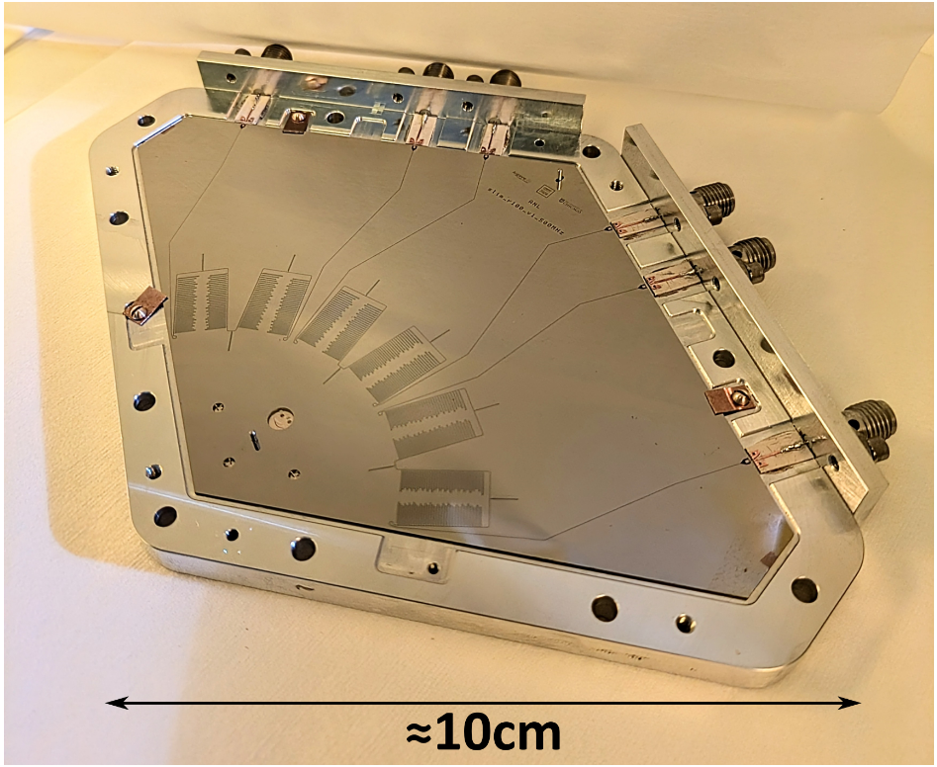
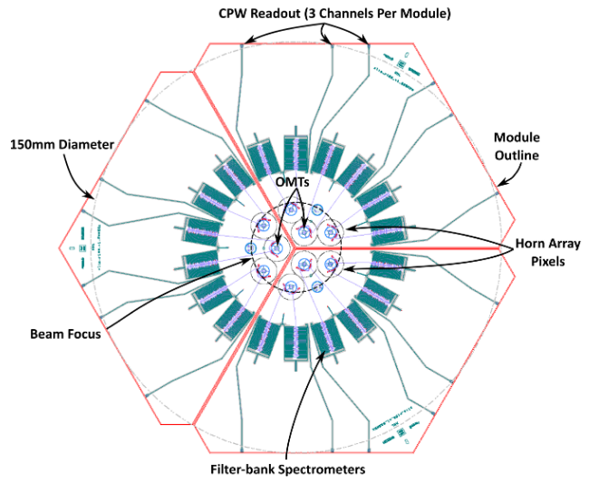
FBS Focal Plane
FBS Focal Planes
Focal plane of compact spectrometers.
SPT-SLIM submodule. G. Robson

Slide 6
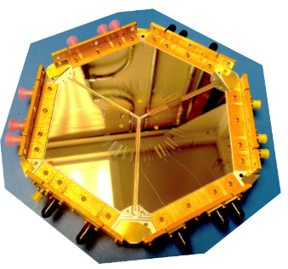
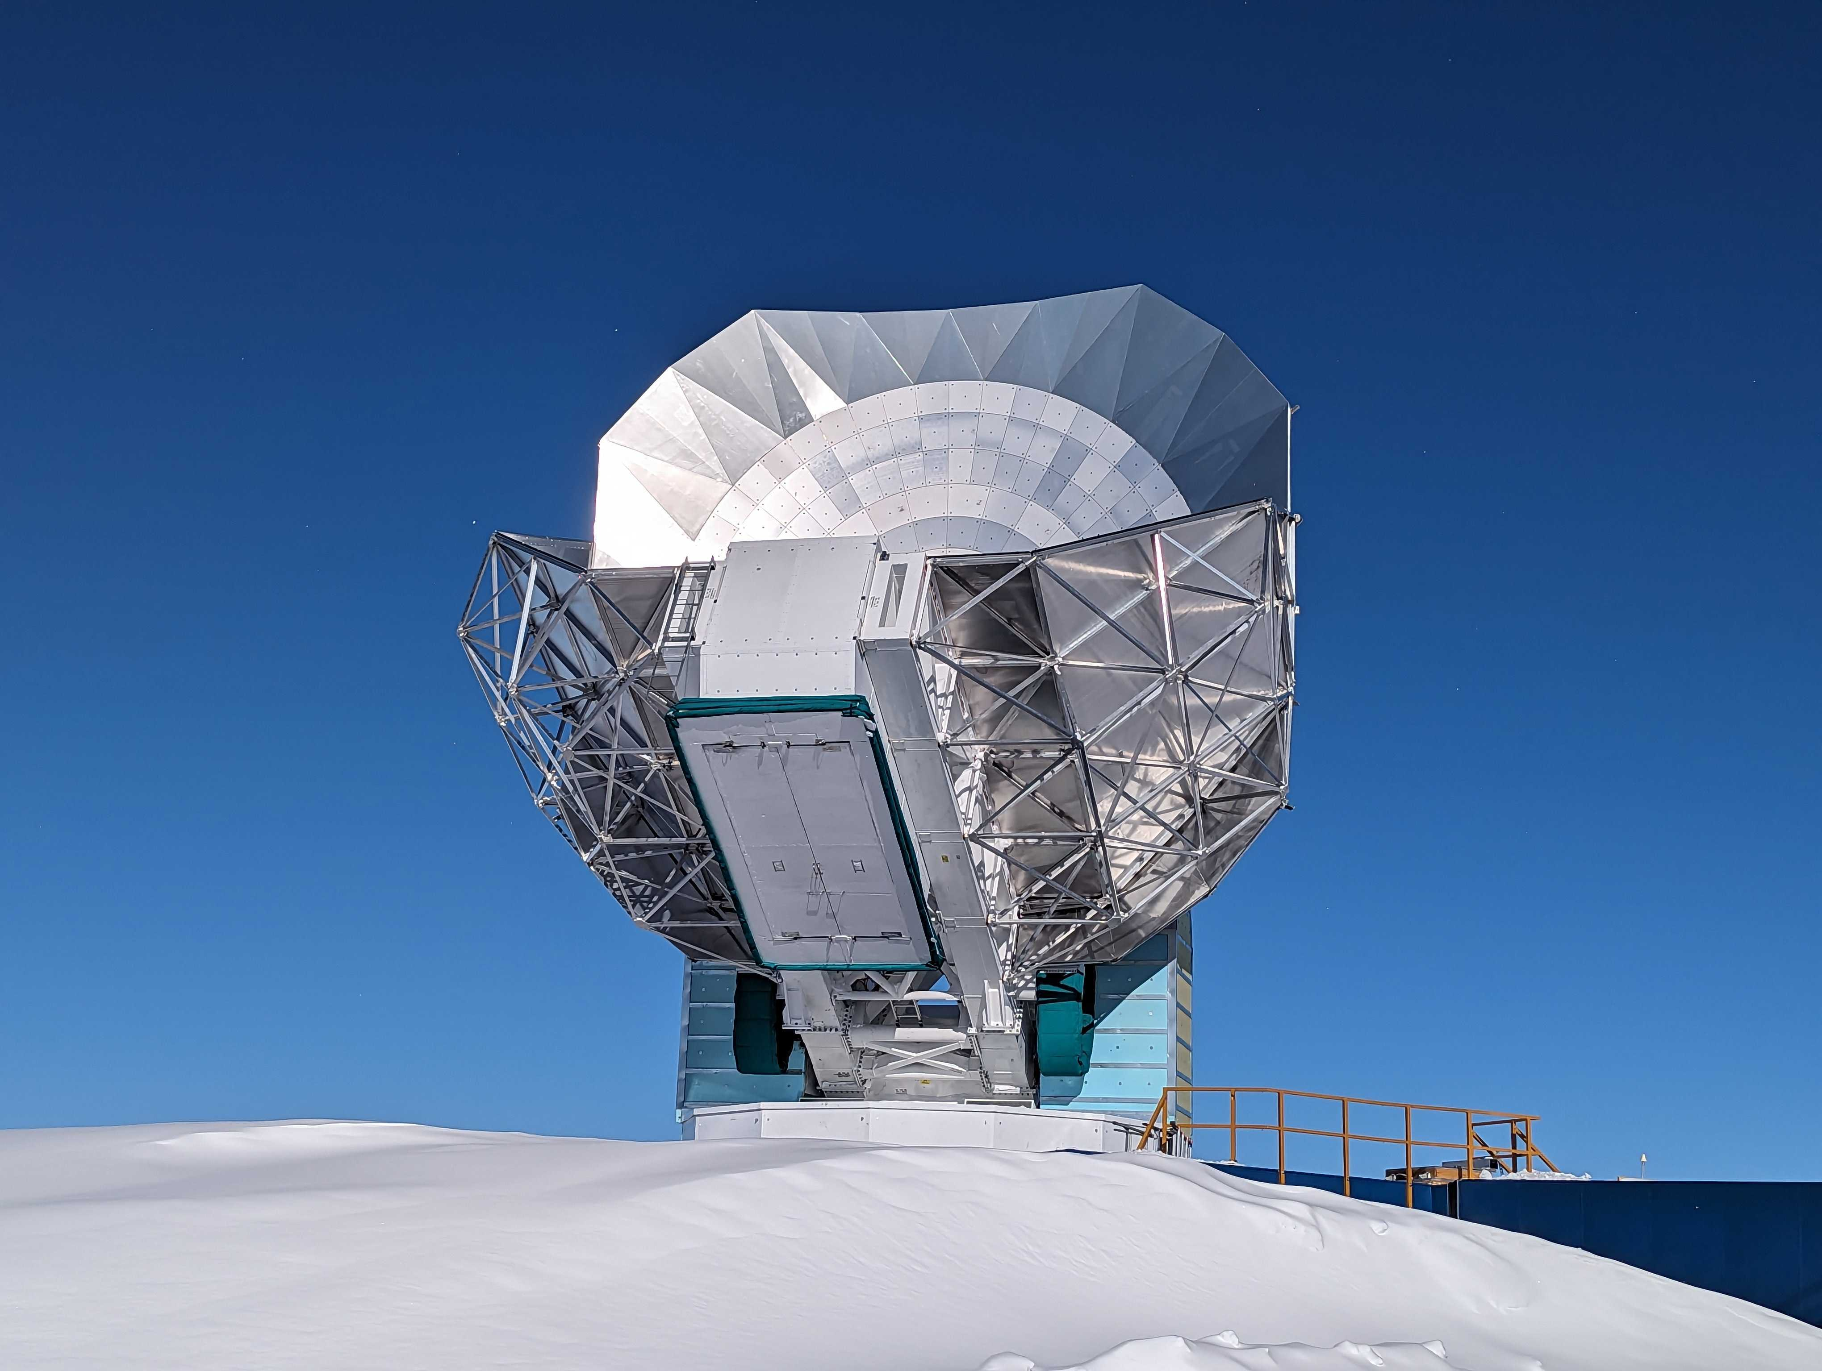
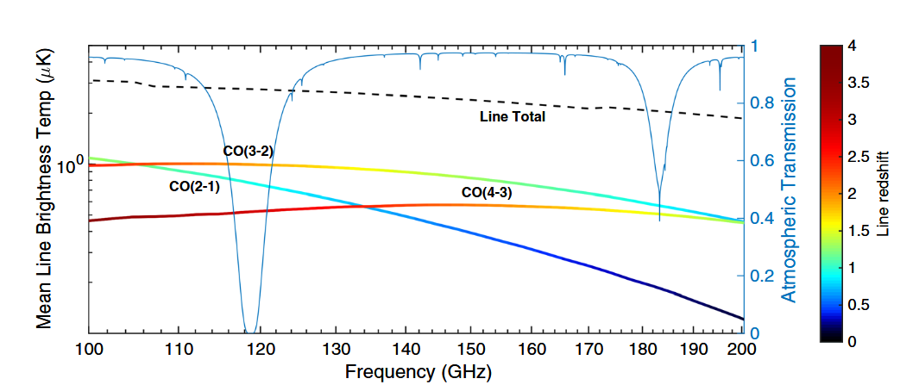
SPT-SLIM
SPT collaboration (image)
South Pole Telescope (SPT)
10m telescope, millimetre λ
Excellent atmospheric transmission
SPT-Shirokoff Line Intensity Mapper
Pathfinder LIM with FBSs
9 Dual polarisation pixels, 18 FBSs with 65 bands, ~1,200 KIDs total
R=100, 120-180 GHz (2.5-1.7mm)

Slide 8
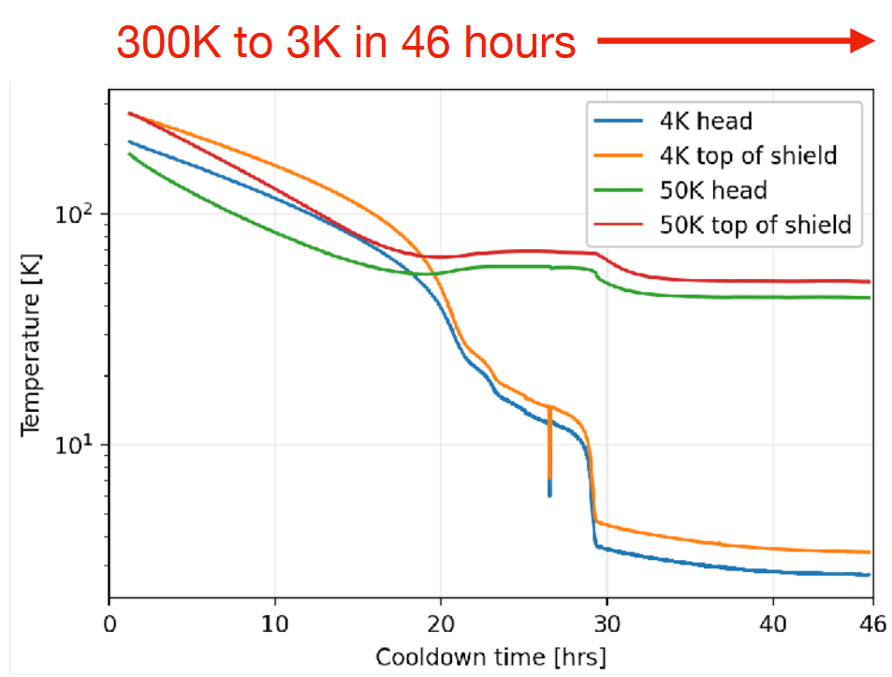
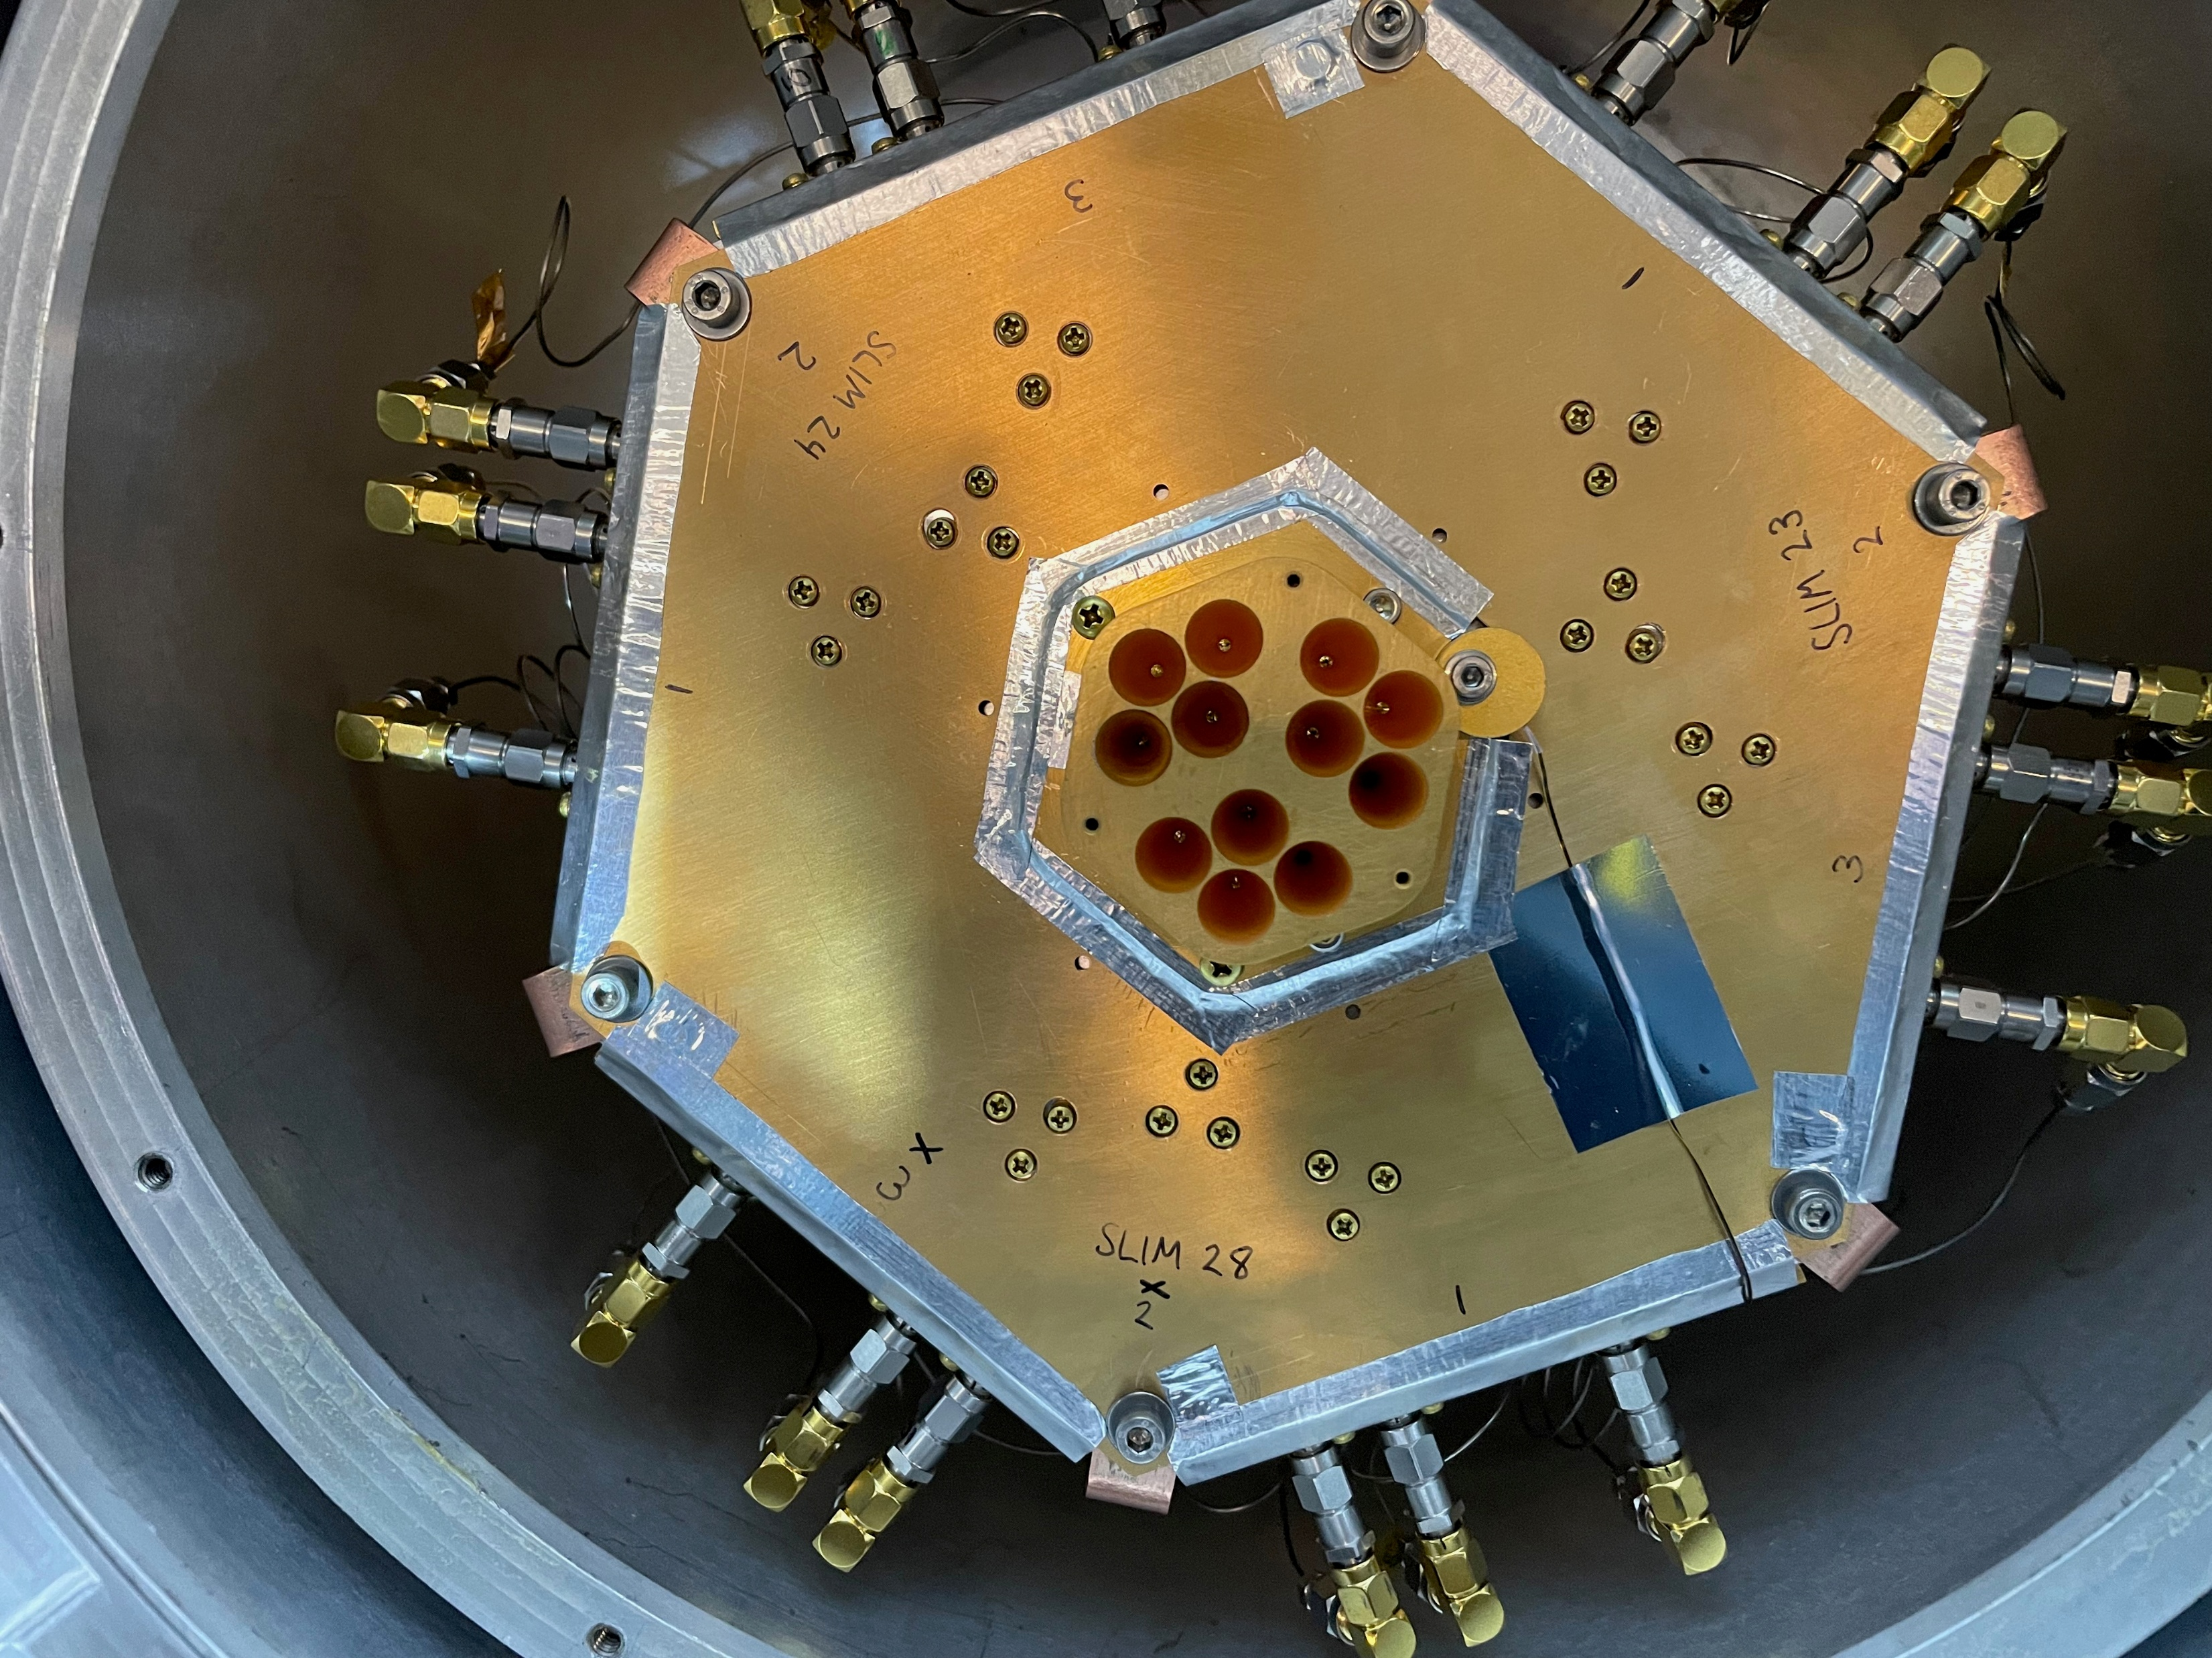
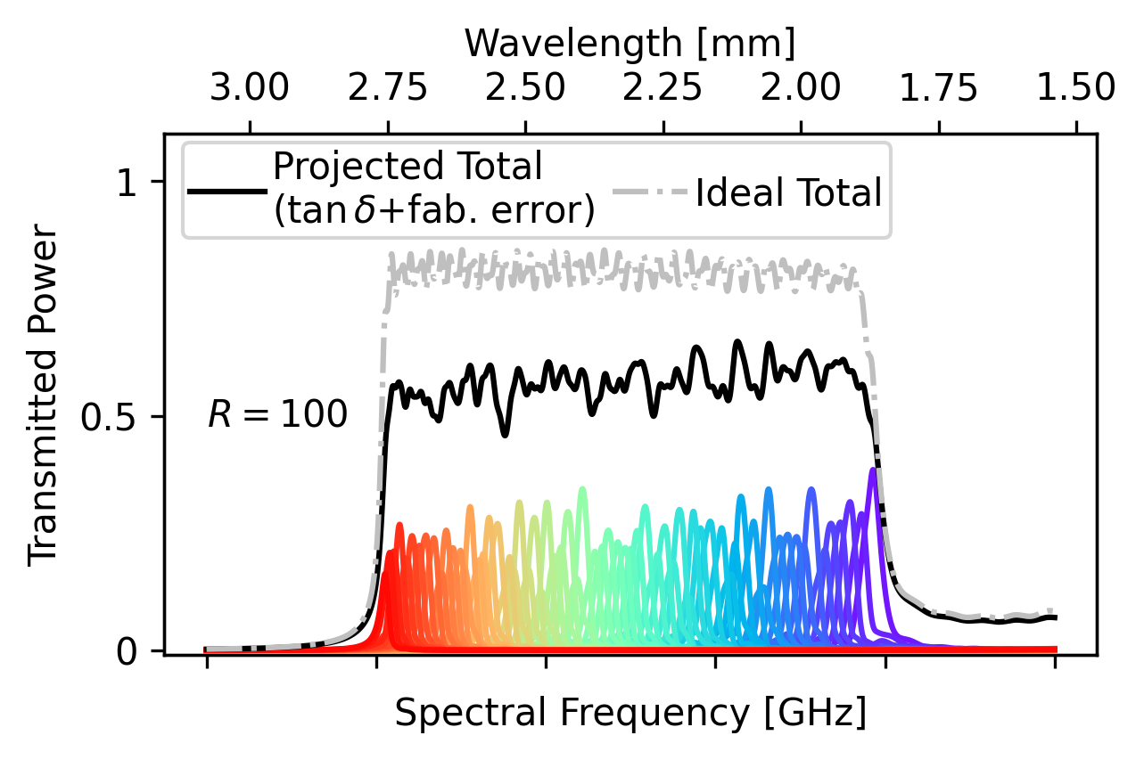
SPT-SLIM: Expected Performance

Slide 9
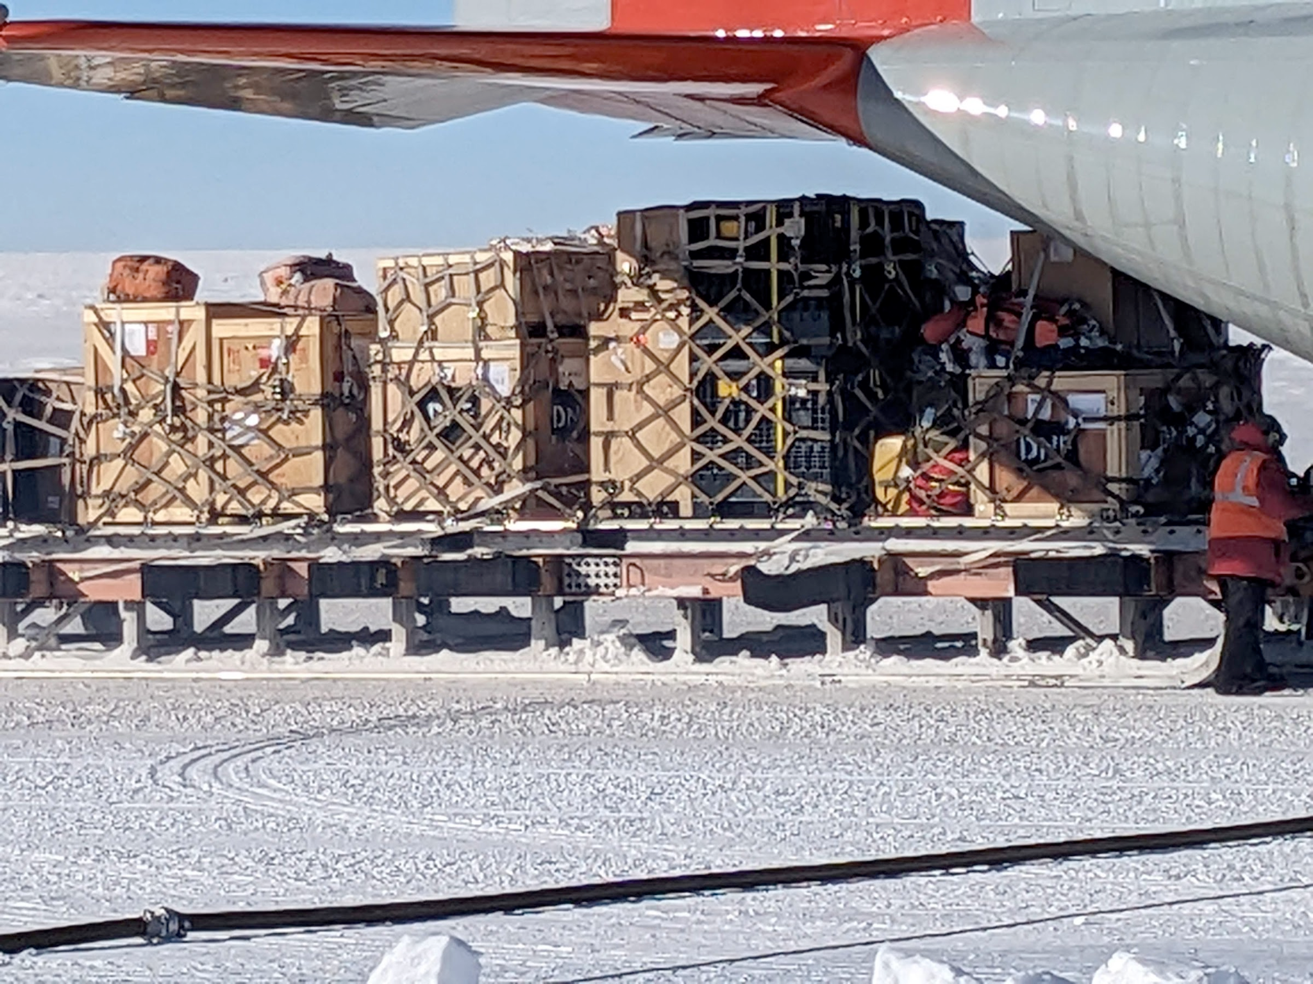
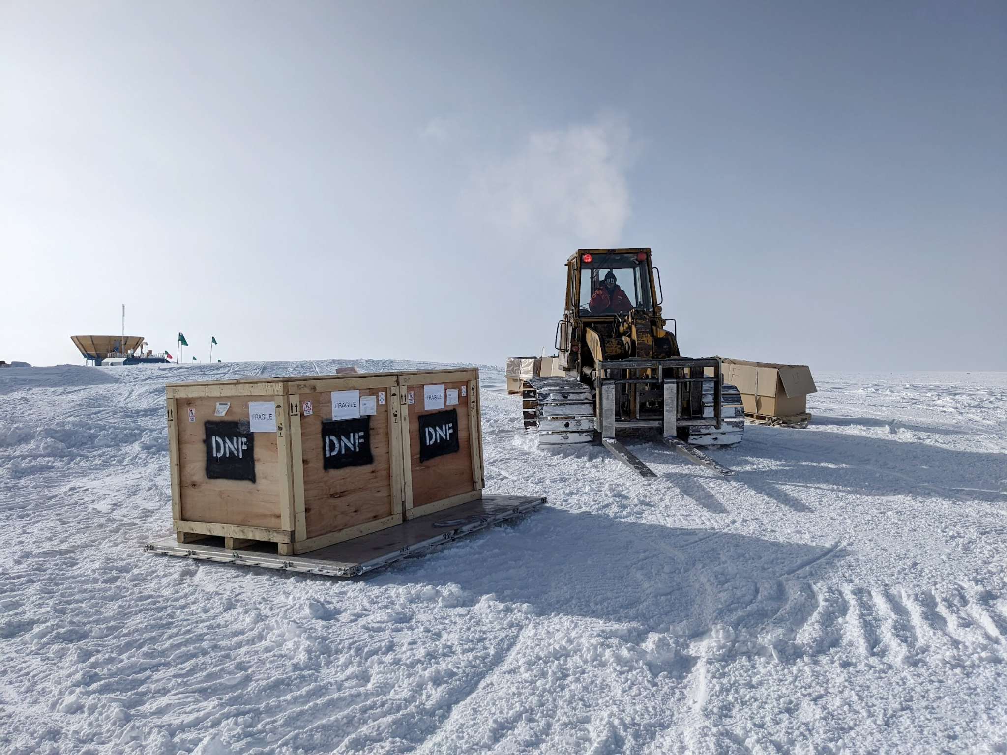
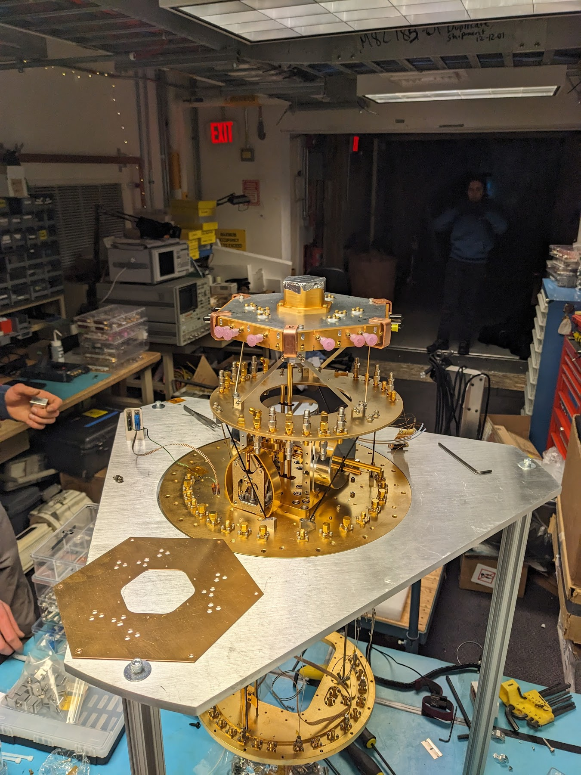
South Pole Logistics:
Notes:
Cargo was delayed by about a month
Only a week and a half on-sky D:

Slide 10
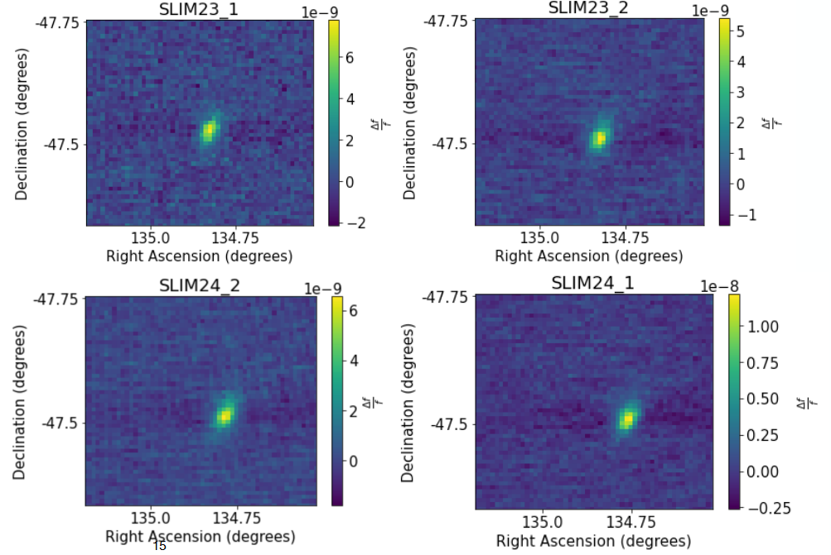
SPT-SLIM first observing run!
Preliminary
HII region: RCW38
Herschel-SPIRE: ESA (500 μm)
SPT:SLIM (2 mm)

Slide 11
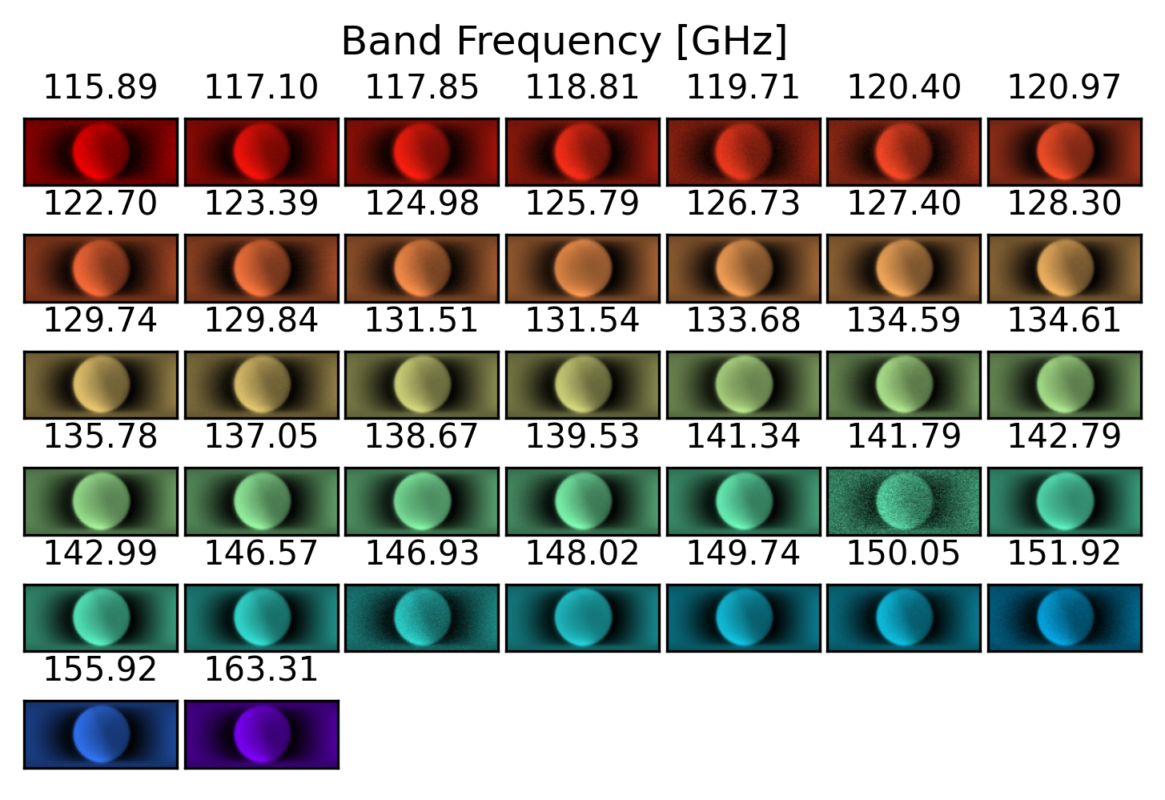
SPT-SLIM first observing run!
Preliminary

Slide 12
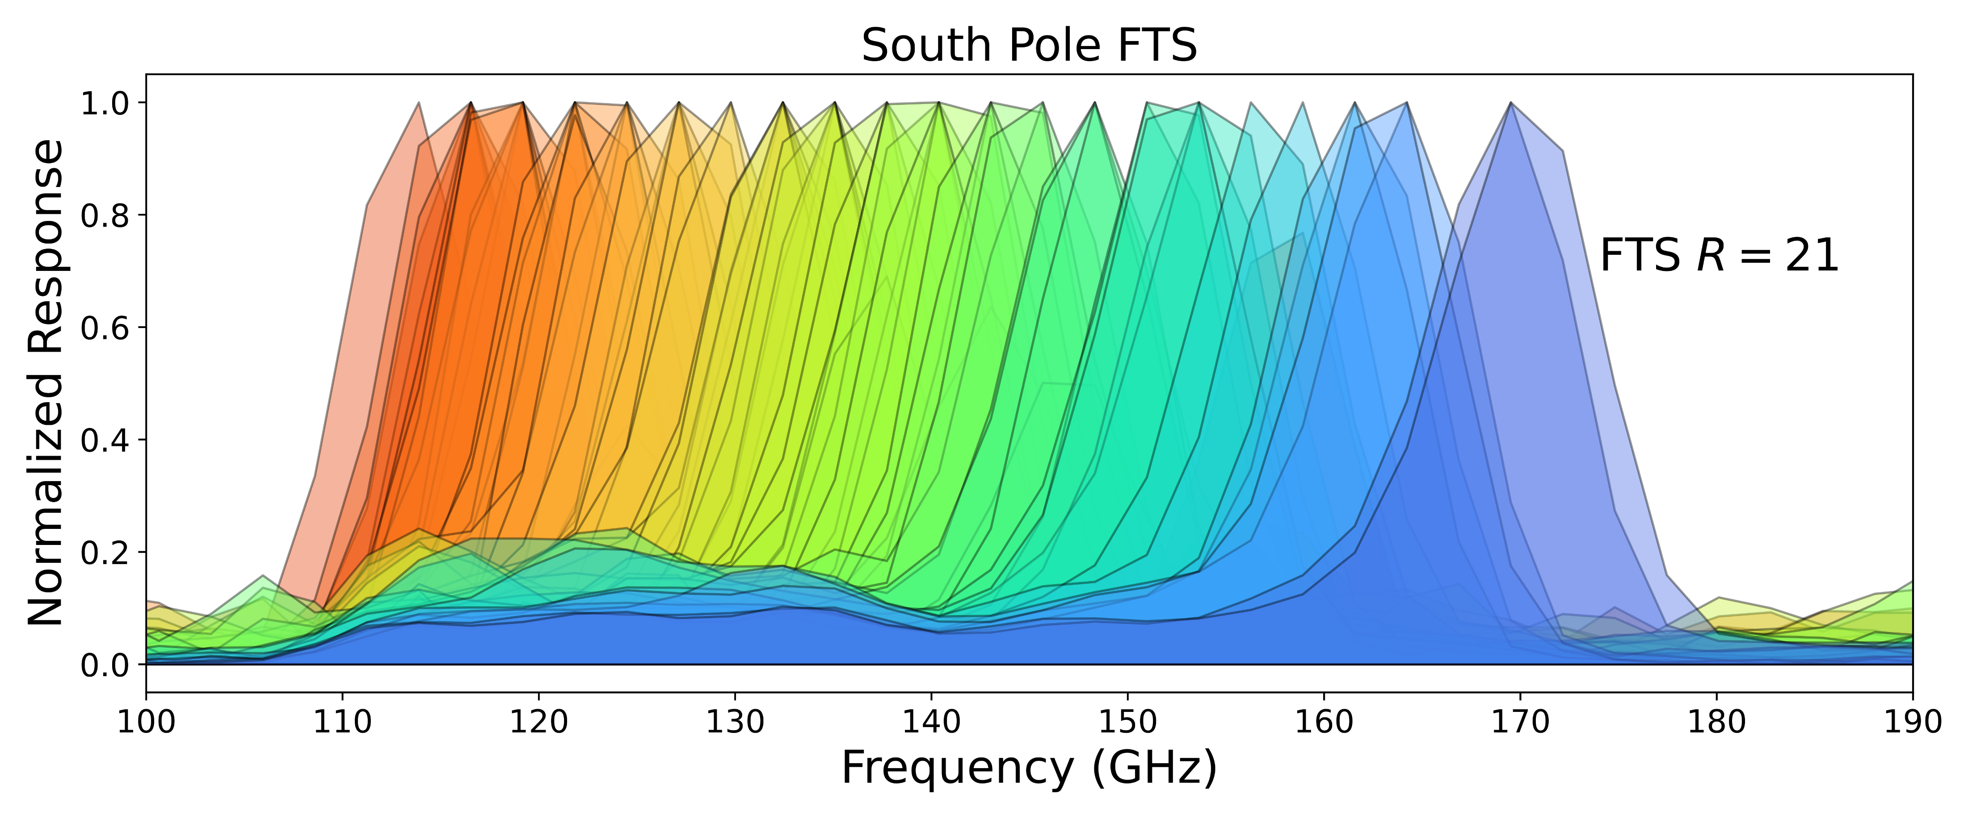
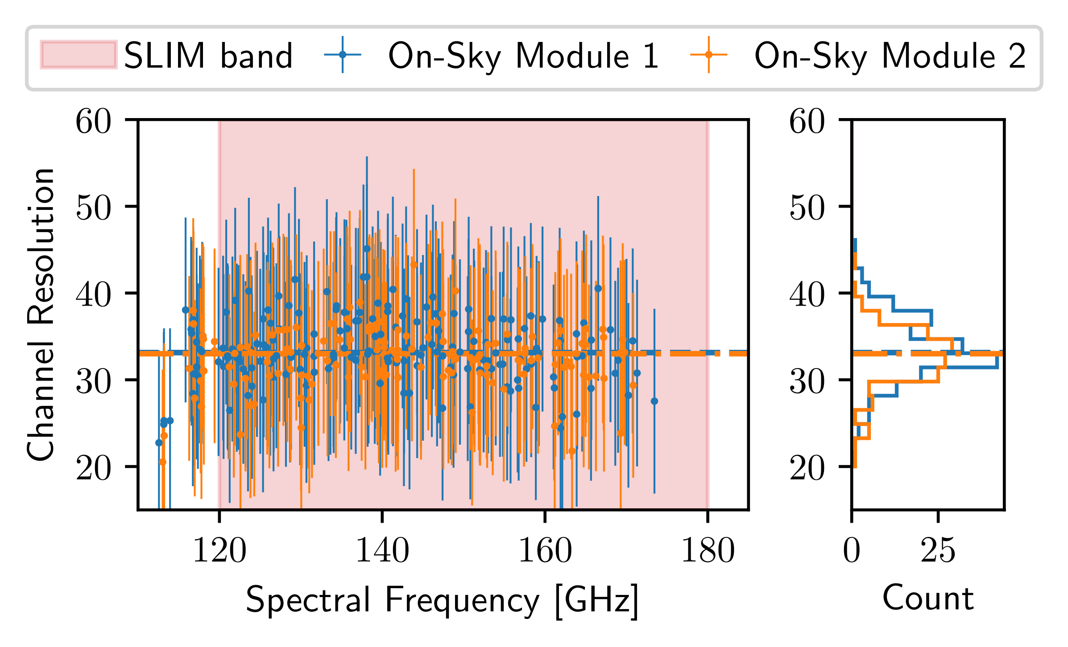
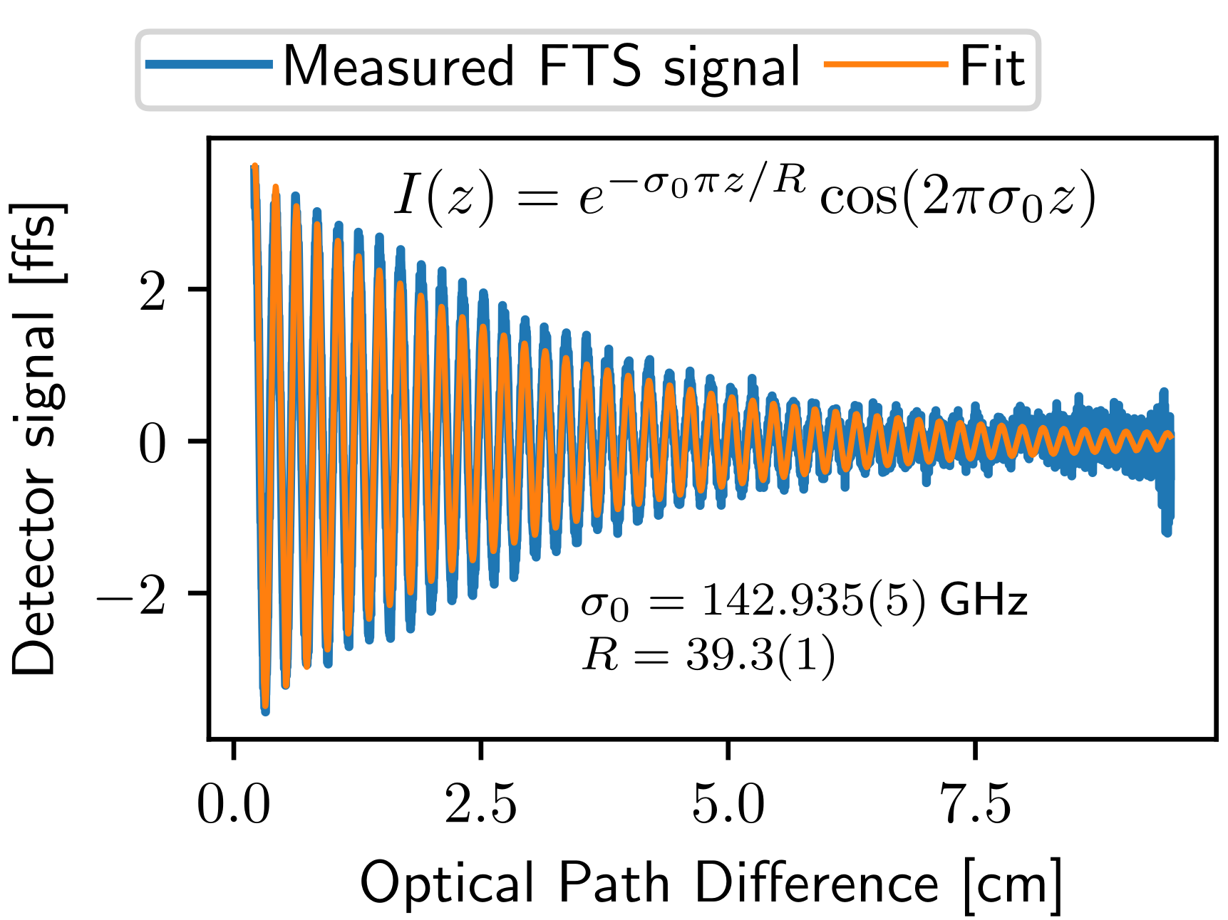
Spectral calibration
Fichman K, Benson C S, 2025 (in press)

Slide 13
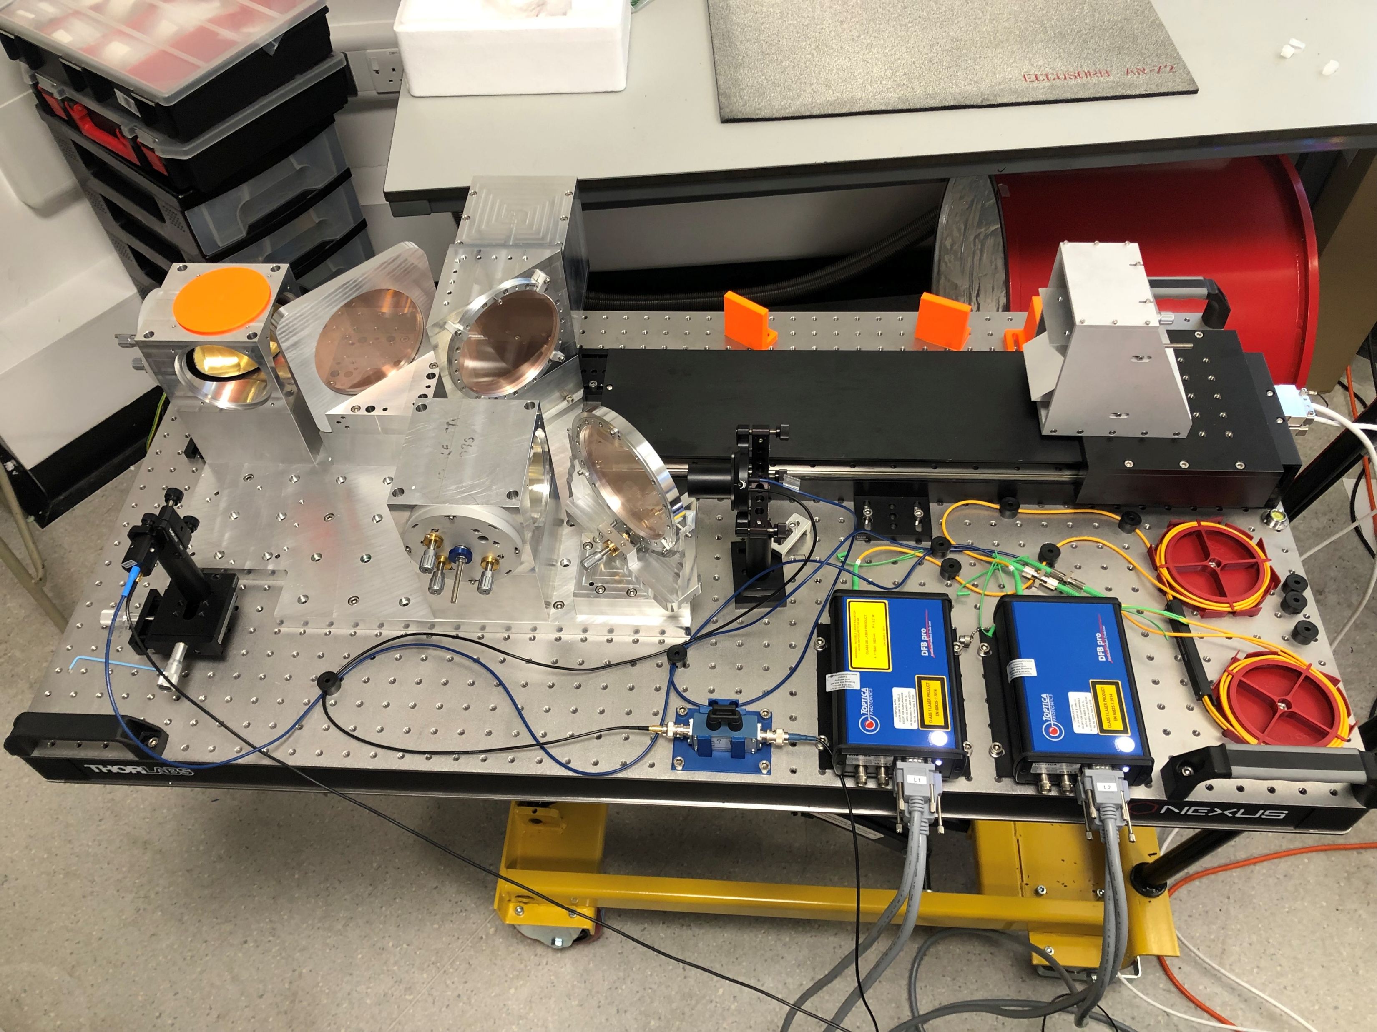
What’s Next for SLIM?
Improvements to SLIM
Poor sensitivity
Vibrational pickup from cryocoolers
Better optimise readout hardware
KID performance not ideal
Iterating on design and fabrication process.
Resolution R~35
Higher loss SiN dielectric than expected
Fabrication improvements.
Fabricate improved devices for 2026-2028 LIM Science deployment
Optical power calibration from atmospheric data
Parallel fabrication and testing program
Faster design, fabricate, test feedback loop
Technology pathfinder successful! Multipixel FBS on sky!
Notes:
Fabrication improvements:
Decrease KID thickness to increase responsivity
More compact design (shorten microstrips and shrink capacitors
Redesigning our input analogue chain to deliver more power to KID tones.

Slide 14
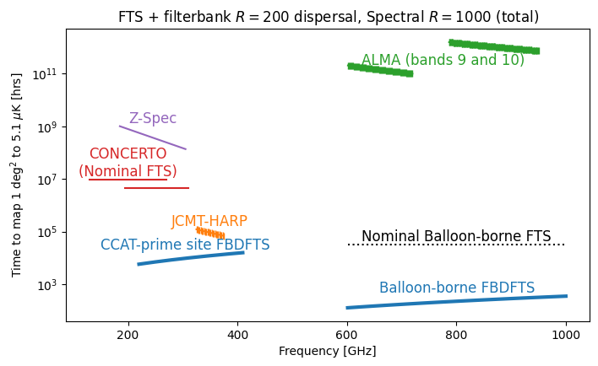
Future Directions
Filterbank + FTS (FBDFTS)
FBSs struggle to scale to R=1000
Detector count
Dielectric loss
Couple a high-R FTS with a filterbank backend disperser
Reduce photon noise on each detector
Maintains FTS advantages

Slide 16
Extra Slides

Slide 17
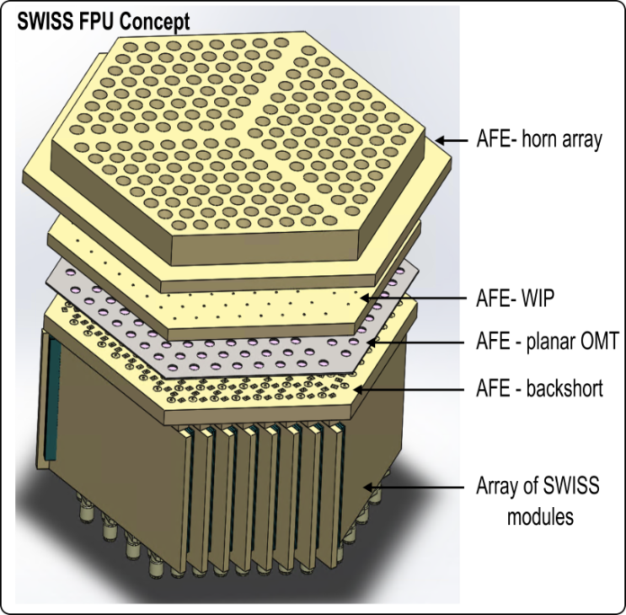
Future directions
Rotating out of the plane
SWISS: Superconducting waveguide FBS.
Better focal plane packing!
No dielectric loss!

Slide 18
Future directions
Rotating out of the plane
SWISS: Superconducting waveguide FBS.
Better focal plane packing!
No dielectric loss!
Filterbank + FTS
FBSs struggle to scale to R=1000
Detector count
Dielectric loss
Couple a high-R FTS with a filterbank backend disperser
Reduce photon noise on each detector
Maintains FTS advantages

Slide 19
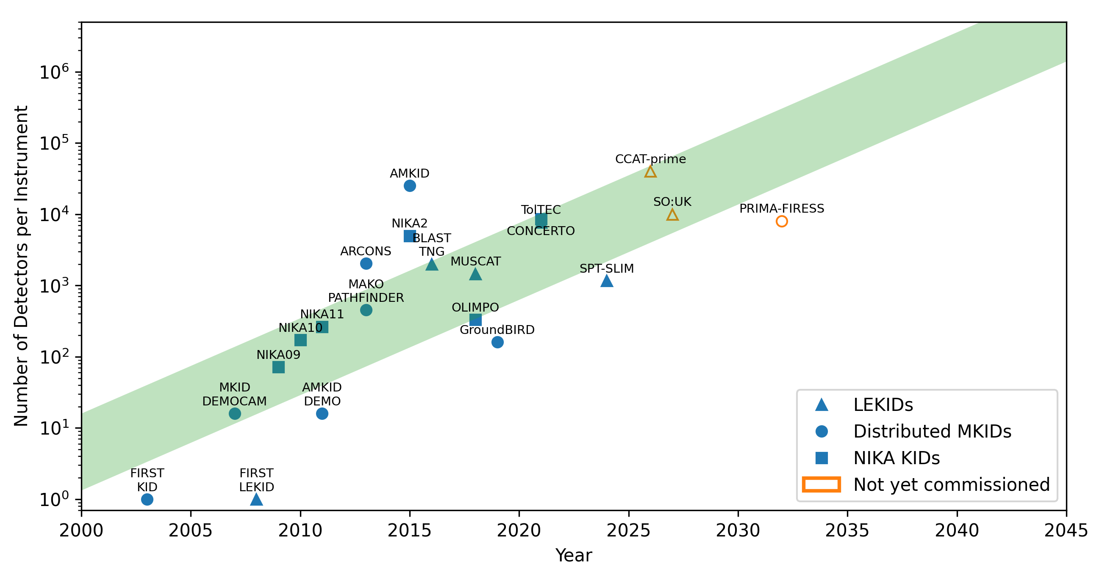
High-R FBS: Detector Count
Each spatial FBS “pixel” requires ~4x resolution, R, spectral detectors.
Even a modest focal plane of R=1000 FBSs quickly exceeds near-term arrays.
Notes:
Shows the number of detectors deployed for various astronomical instruments ranging millimetre to far-infrared.
If we weight things towards past decade and near-term planned instruments, we see the trend in green here.
Provided that trend holds and the rate doesn’t continue to slow. Won’t see the 1 million KID readouts needed for another two decades

Slide 20
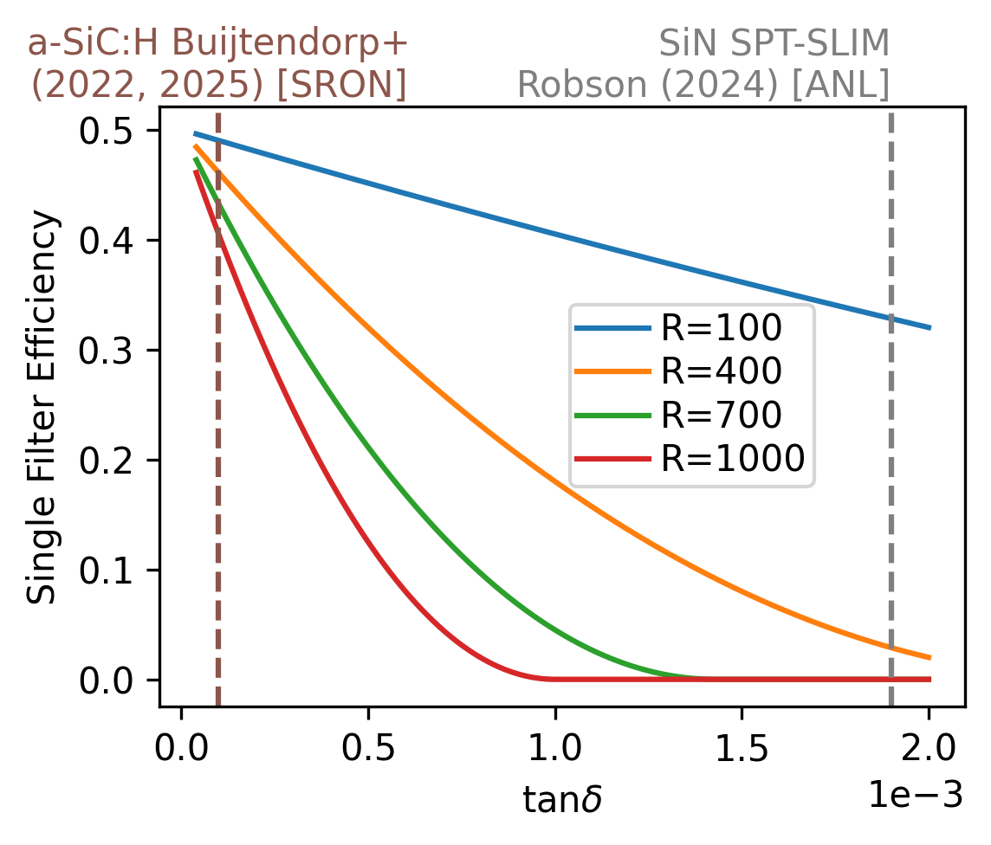
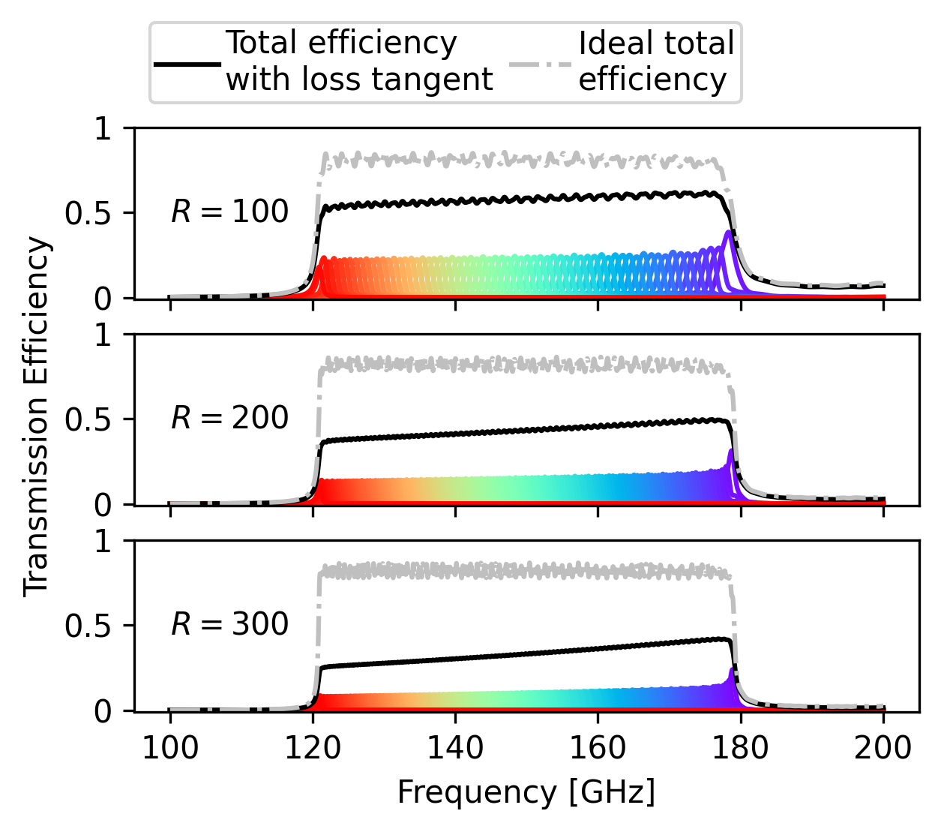
High-R FBS: Dielectric Loss Tangent
Loss mechanism through the dielectric.
Exacerbated for higher quality factor/resolution filters.
Low-loss dielectrics needed to achieve R=1000 FBSs.
a-SiC:H promising
SPT-SLIM efficiency simulation. Robson (2024)
Fabrication Tolerance:
An R~1000 FBS requires feature variation < 50nm.
Currently impractical to scale to large focal planes.
Notes:
Dielectric loss tangent.
Energy dissipation through TLS mechanisms
Becomes worse at higher R filters. On resonance, signal oscillates more times along the length of the microstrip providing more opportunity for loss
Can see that the SiN we used for SLIM really becomes a limiting factor in what we can do for resolution.
Low-loss dielectrics are extremely important to push to higher resolution filterbanks.
Amorphous hydrogenated silicon and SiC has seen some promising results at higher frequency.
Using some simulations put together by a Ph.D. student in our group, can see the effects on a SLIM-type FBS.
Dropping down to only ~20% efficient at R=300.
Fabrication itself also becomes increasingly more challenging at high resolution.
For R=1000 we would need feature variation less than ~50nm.
While this has been done for a single pixel FBS through some very challenging E-beam lithography, scaling this to a large focal plane in any practical way has yet to be seen.

Slide 21
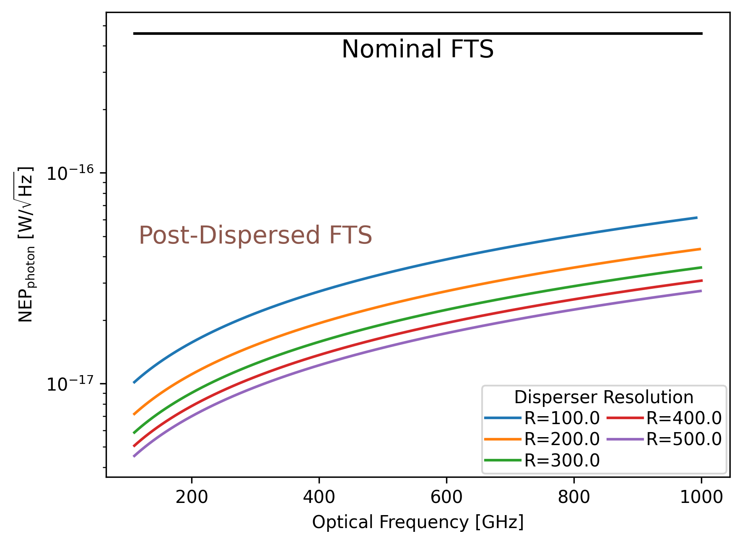
Post Dispersed FTS
A low-resolution spectrometer is placed at the FTS output.
Significant reduction in photon noise.
Provides an elegant low-R mode.
Heritage (gratings):
SPICA-SAFARI: Ground based demonstrations.
PRIMA-FIRESS: Phase A Study.
Filterbank Spectrometers provide an extremely promising post-dispersion device.
Notes:
With FBSs having a quite a few things to figure out in order to reach this R=1000 goal,
Turn to a technique that’s becoming increasingly popular: Low R spect + high R spect
Post dispersed FTS is an increasingly popular solution for a medium R imaging spectrometer
A medium R FTS is paired with a low-R dispersive spectrometer.
FTS provides the spectral resolution
Low R serves as a dispersing element to reduce the spectral band incident on each detector
Also provides an elegant low-resolution mode
Can see here that an R of ~200 is enough to reduce photon noise by more than an order of magnitude.
This technique has some heritage using a diffraction grating.
Considered for Origins, the flagship far-IR NASA space observatory
Was developed and ground tested for the SAFARI spectrometer on the ESA SPICA space telescope
Currently being developed as the FIRESS spectrometer for the PRIMA space telescope
We think that Filterbank spectrometers are well suited for this application and is extremely near-term viable.
We went on sky with SPT:SLIM last austral summer. Demonstrating multipixel filterbank spectrometer with an R~100

Slide 22
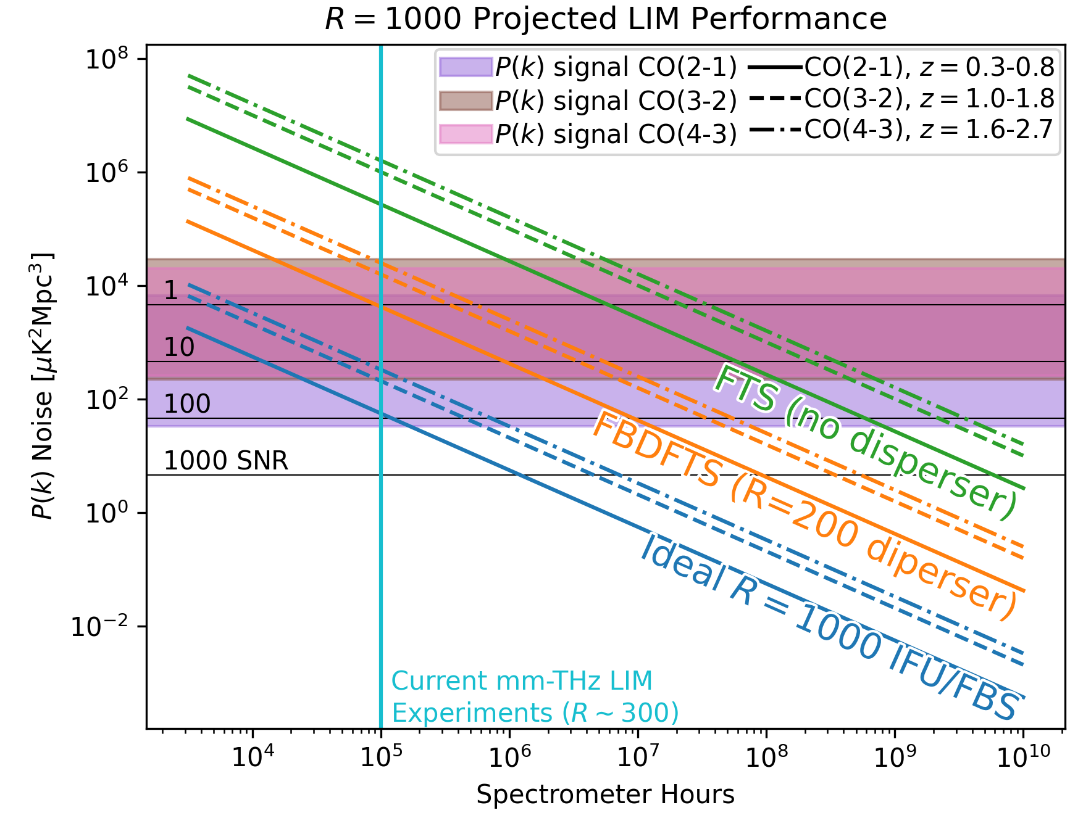
High Resolution LIM Experiment
Measure large scale structure over z
Target R=1000
LIM experiment from SPT at 150GHz band.
Effort level/integration time represented by spectrometer hours.
A significant step towards far-future ideal LIM instrument.
R=1000 LIM experiment with SNR 10-100 within near-term surveys!
Introduces Optical Complexity.
Notes:
The LIM noise levels that could be obtained as a function of spectrometer hours (integration time x number of spectrometers) for a 1deg^2 field from a SPT-like platform at 150 GHz
This is shown for three CO lines at variety of redhsifts
Note line signal, shown by coloured bars, a function of spatial frequency
Vertical line shows the spectrometer hours of current R=300 LIM experiments. Reaching 10^6 hours well within capabilities as pixel counts increase
A filterbank dispersed FTS would be capable
Stress Blue line not currently possible
The NEP requirements on an R=1000 FBS means that with current dets, would be closer to the orange line.
And with modest and very sensible improvements (2x focal planes, higher R disperser), another factor of 2-3 closer to blue is possible

Slide 23
SPT-SLIM Collaboration
Spectrometer design:
Fabrication:
Readout:
Cryostat:
Laboratory Testing and Characterisation:
Science:
Notes:
Note, not hard boundaries

