Slide 1
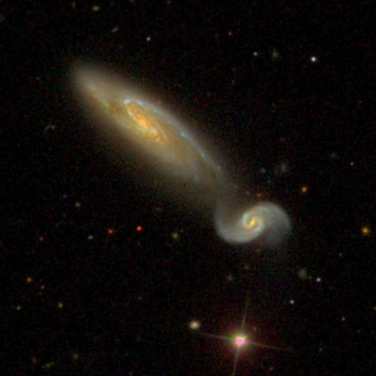
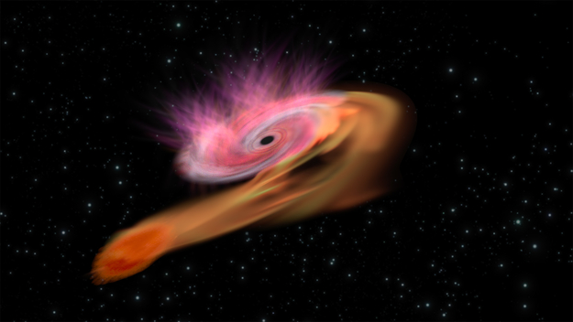
Investigating the host galaxies of Tidal Disruption Events
Paige Ramsden
University of Birmingham
Supervisors: Dr Sean McGee & Dr Matt Nicholl

Slide 2
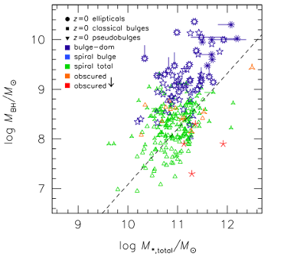
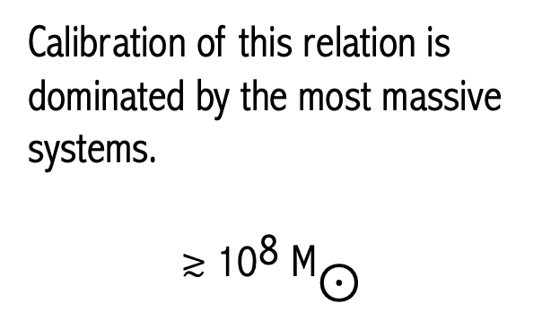
SMBHs in the nuclei of most galaxies
Calibration of this relation is dominated by the most massive systems.
$$\text{≳}{ \text{10}}^{\text{8}} {\text{M}}_{\text{⊙}}$$
Kormendy and Ho, 2013.

Slide 3


Tidal Disruption Events (TDEs)
Unbound Debris
Bound Debris
Tidal Radius > Schwarzschild Radius
$${\left(\frac{\text{6}{\text{M}}_{\text{BH}}}{\text{πρ}}\right)}^{\frac{\text{1}}{\text{3}}} \text{≥} \frac{\text{2}\text{G}{\text{M}}_{\text{BH}}}{{\text{c}}^{\text{2}}}$$
$${\text{R}}_{\text{T}}$$
Hills,1975. Nature
BH
BH

Slide 4
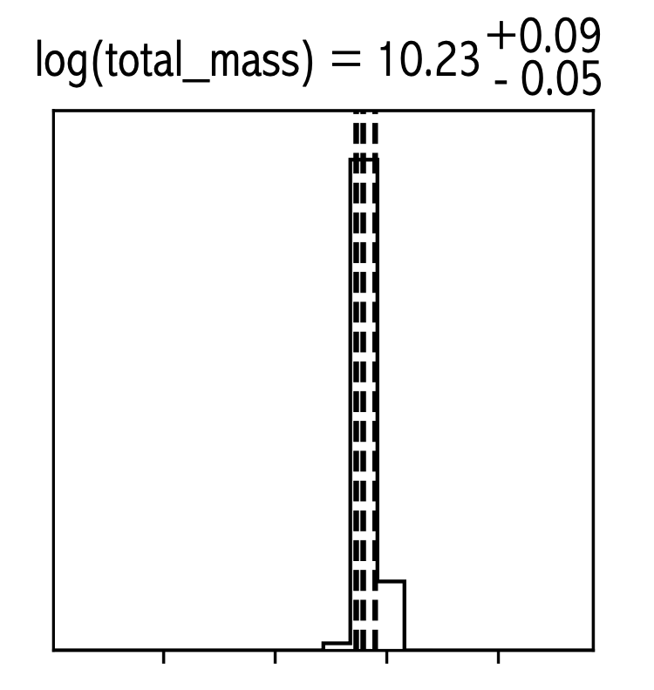


Data Collection and SED Modelling
Sample of $\sim$120 TDE hosts
Automatic collection of broadband photometry:
  SDSS & PanSTARRS – optical
  2MASS - near infrared
  WISE – mid infrared
  GALEX - UV
Sample of $\sim \text{40}$ TDE hosts
Automatic collection of broadband photometry:
  SDSS & PanSTARRS – optical
  2MASS – near infrared
  WISE – mid infrared
  GALEX – UV

Slide 5
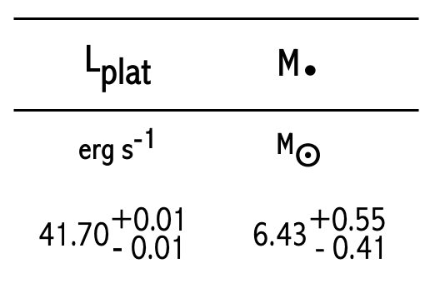
x (B/T)g
Mummery, et al. 2024

Slide 6


Combined with High Mass Regime
TDE-Only,
$$\frac{{\text{M}}_{\text{•}}}{{\text{10}}^{\text{9}}{\text{M}}_{\text{⨀}}}\text{=}\left({\text{0.15}}_{\text{−0.03}}^{\text{+0.03}}\right)\text{∙ }{\left(\frac{{\text{M}}_{\text{Bulge}}}{{\text{10}}^{\text{11}}{\text{M}}_{\text{⨀}}}\right)}^{\text{1.17}\text{±}\text{0.10}}$$
$$\text{; }{\text{ε}}_{\text{0}}\text{=0.24 }\text{dex}$$
TDE+KH13,
$$\frac{{\text{M}}_{\text{•}}}{{\text{10}}^{\text{9}}{\text{M}}_{\text{⨀}}}\text{=}\left({\text{0.31}}_{\text{−0.01}}^{\text{+0.01}}\right)\text{∙ }{\left(\frac{{\text{M}}_{\text{Bulge}}}{{\text{10}}^{\text{11}}{\text{M}}_{\text{⨀}}}\right)}^{\text{1.34}\text{±}\text{0.03}}$$
$$\text{; }{\text{ε}}_{\text{0}}\text{=0.45 }\text{dex}$$

Slide 7
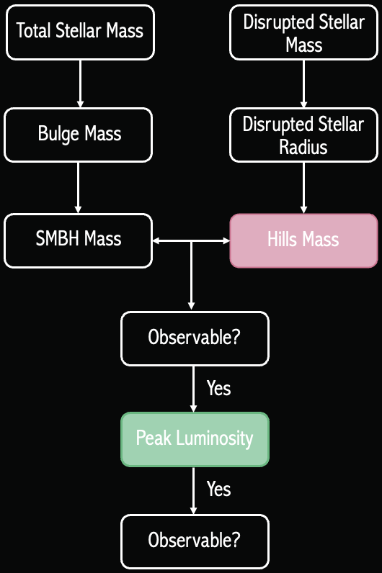


Forward Modelling
Hills Bias
${\text{log}}_{\text{10}}\text{(}{\text{M}}_{\text{•}}\text{/}{\text{M}}_{\text{⨀}}$)
Distance
Yes
Malmquist Bias
Peak Luminosity
Simulated Population
Yes
${\text{log}}_{\text{10}}\text{(}{\text{M}}_{\text{Bulge}}\text{/}{\text{M}}_{\text{⨀}}$)

Slide 9
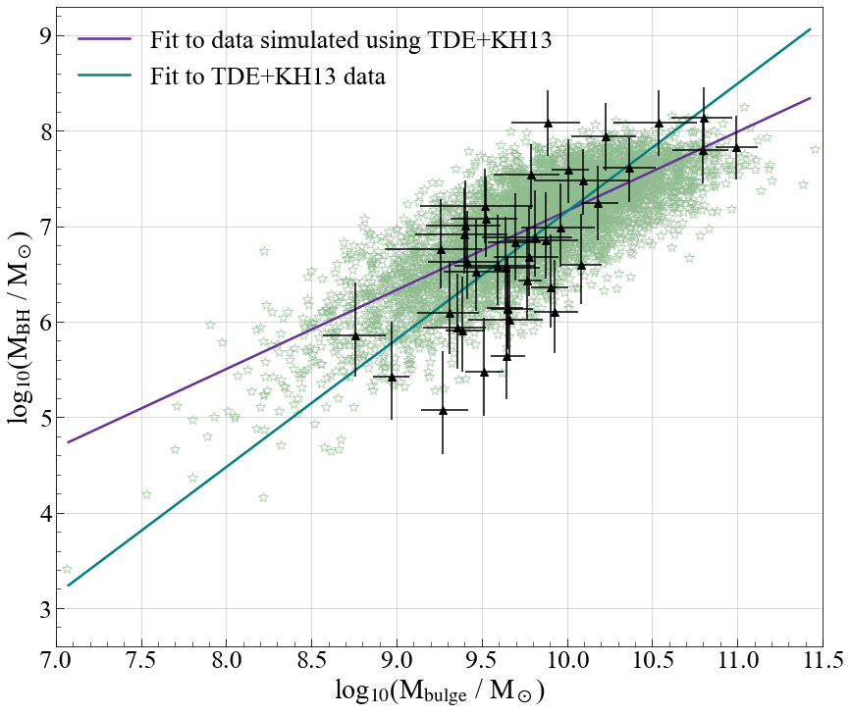
Canonical scaling relations do not recover the observed population
  Selection effects cannot account for overall steepening
But, using the steeper TDE+KH13 relationship - observed population is recovered.
  Selection effects can account for the comparative flatness in the TDE-only relationship.
If a single slope is expected to extend the full SMBH mass range, it must be steeper to encompass the lower mass TDE population.

Slide 10
Canonical scaling relations do not recover the observed population
  Selection effects cannot account for overall steepening
But, using the steeper TDE+KH13 relationship - observed population is recovered.
  Selection effects can account for the comparative flatness in the TDE-only relationship.
If a single slope is expected to extend the full SMBH mass range, it must be steeper to encompass the lower mass TDE population.

Slide 11
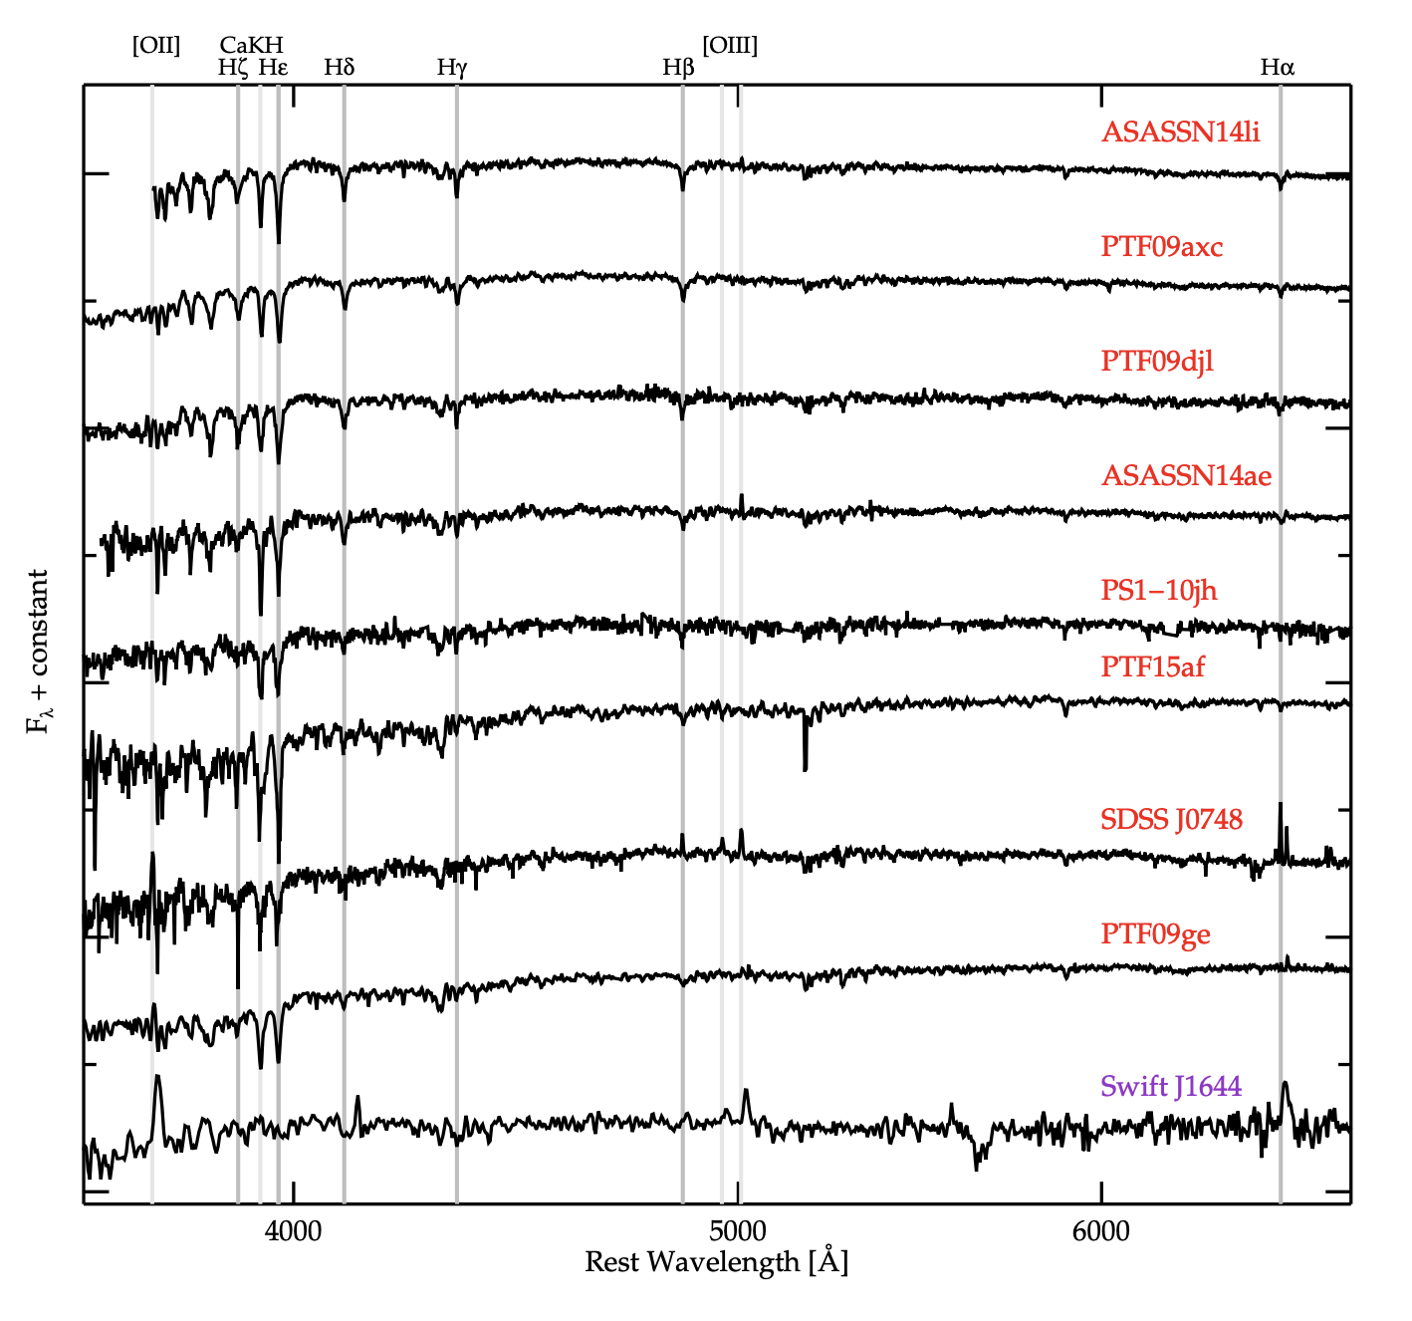
Unusual
Host Galaxies
French, et al. 2016

Slide 12
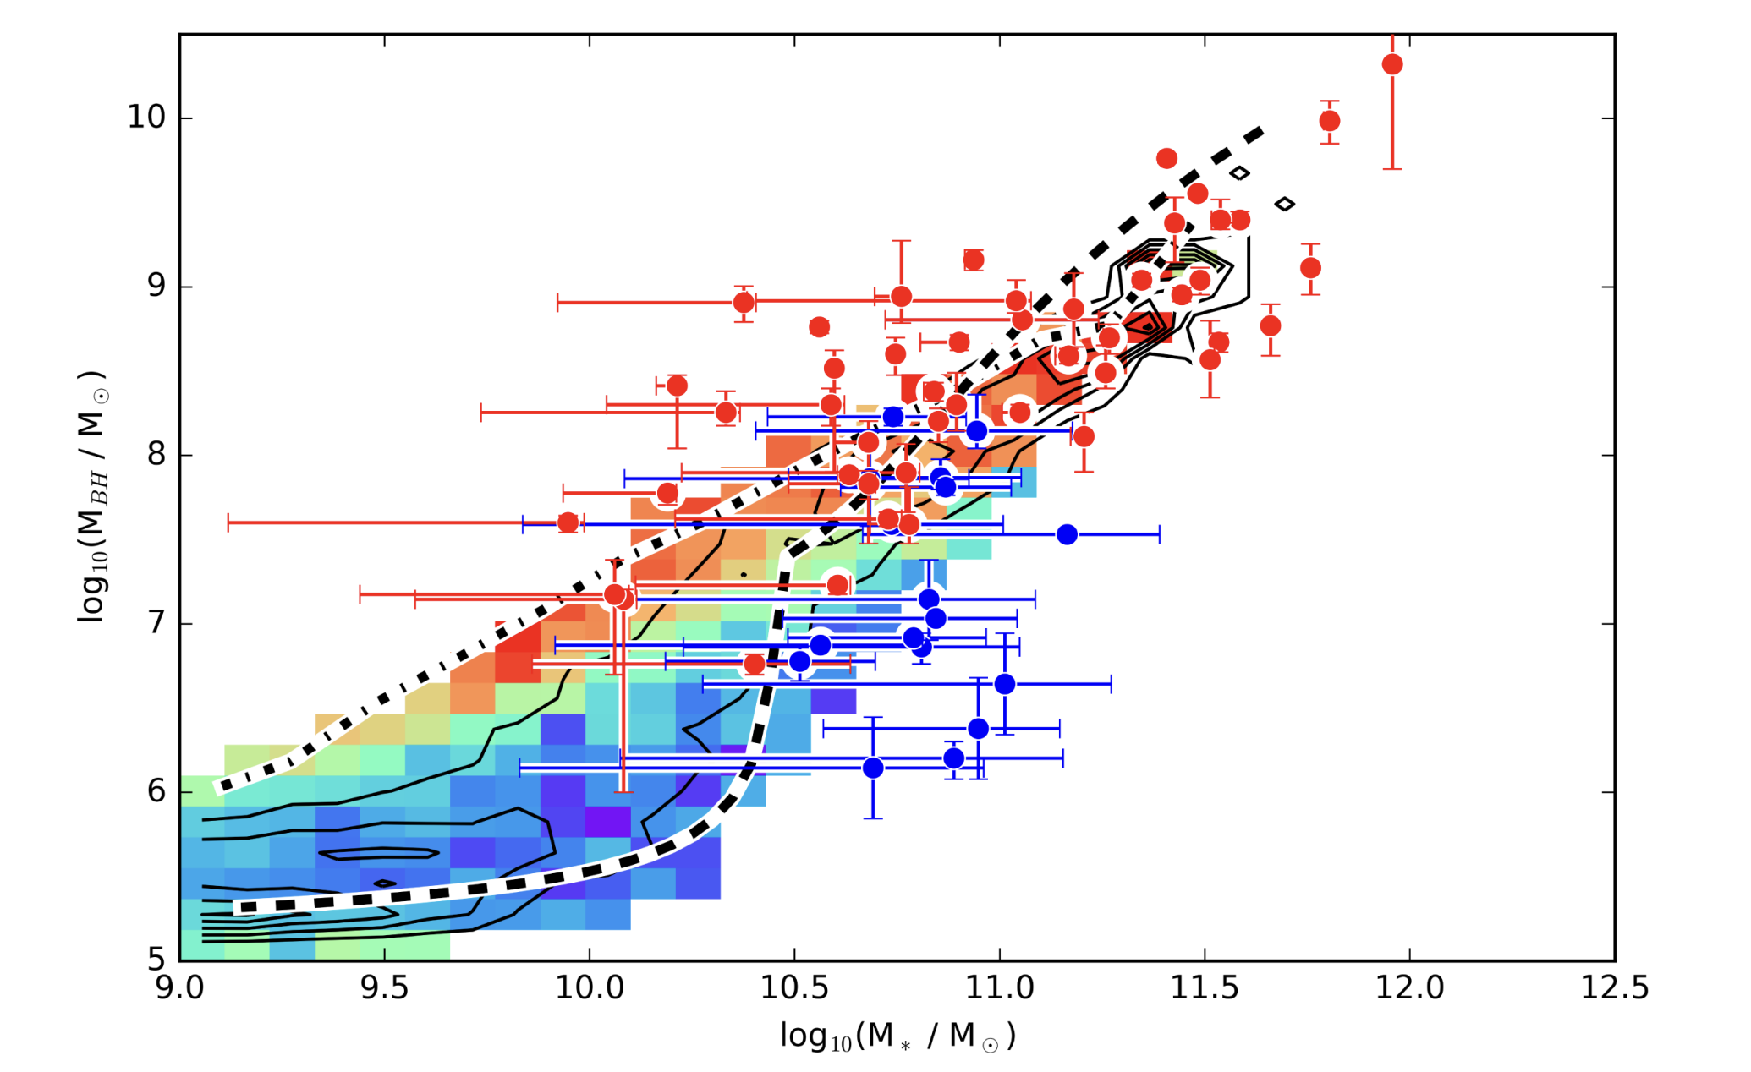
Combined with High Mass Regime
The SMBH - Star Formation Rate Connection
Savorgnan et al. 2016 find a connection between black hole mass and galaxy morphology.
The Bower et al. 2017 cosmological model sees black holes and star formation competing to regulate the gas content of a given galaxy.
They find that the transition from blue to red sequence is driven by black hole growth.
Bower, et al. 2017

Slide 13
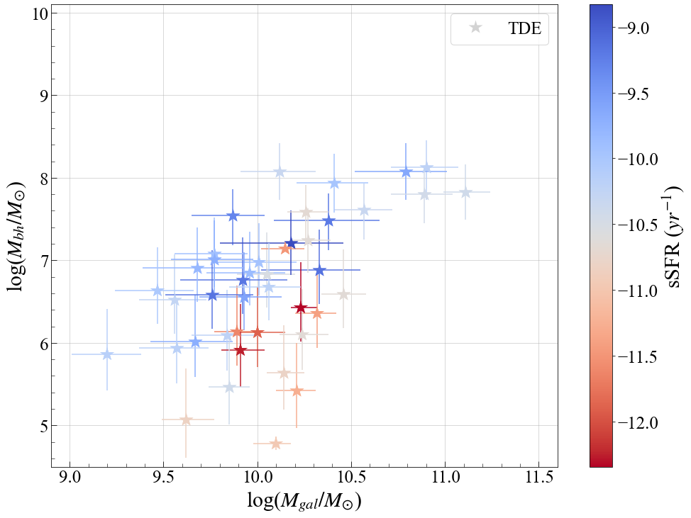
The SMBH - Star Formation Rate Connection
for the TDE sample
PRELIMINARY RESULT

Slide 14
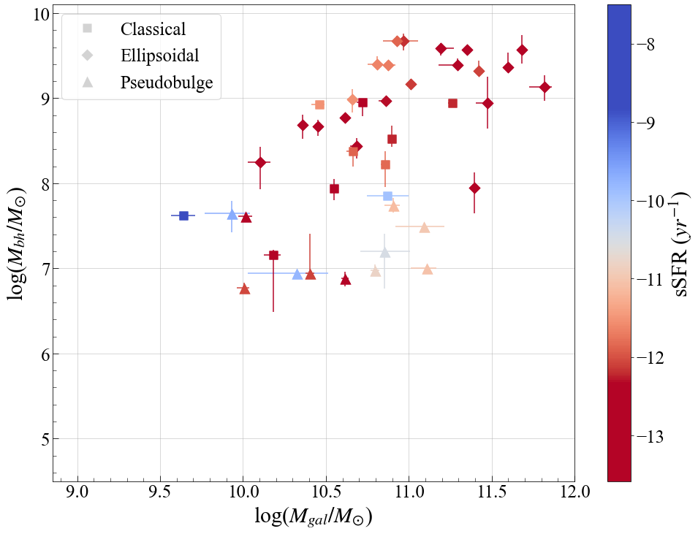
The SMBH - Star Formation Rate Connection
for the KH13 sample
PRELIMINARY RESULT

Slide 15
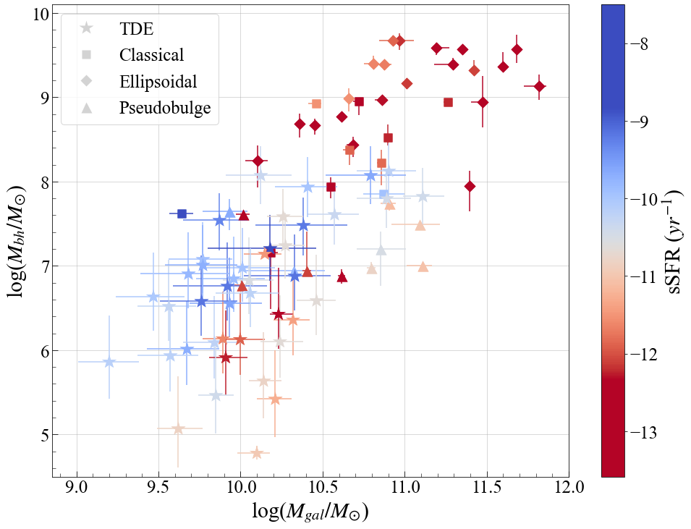
PRELIMINARY RESULT

Slide 16

  We find significant correlation between TDE SMBH mass and host galaxy bulge mass.
  When combining the observed TDE sample with that of the high mass regime, we recover a strong positive correlation, where TDEs anchor the relationship at the low mass-end.
  If a single power-law relation does describe the SMBH-bulge scaling across this mass range, we find marginal evidence for a steeper relation than previous calibrations when including TDEs.
  As in previous work, the TDE-only relation is comparatively flatter than the relation including the full TDE+KH13 data set. Forward modelling is used to consider the impact of selection effects, such as the Hills and Malmquist biases. We find that the shallower slope within the TDE population can be explained by these effects.
  In the TDE sample, contrary to cosmological simulations and SFRs in massive galaxies, we find a reversed trend. Quenched TDE host galaxies, are those with the lowest mass BHs.
  Stay tuned while we work out why this might be, and if you have any ideas please come and chat!
In Summary…
Paper now published!
“Evidence for a steeper SMBH–Bulge mass relationship extended to low masses using TDE host galaxies”

