Slide 1
Lensed Type IIn Supernovae with LSST
How Ultraviolet Suppression Shapes Detection Rates
Andrés Ponte Pérez
University of Birmingham NAM @ Durham, 9th July 2025
aip981@student.bham.ac.uk

Slide 2
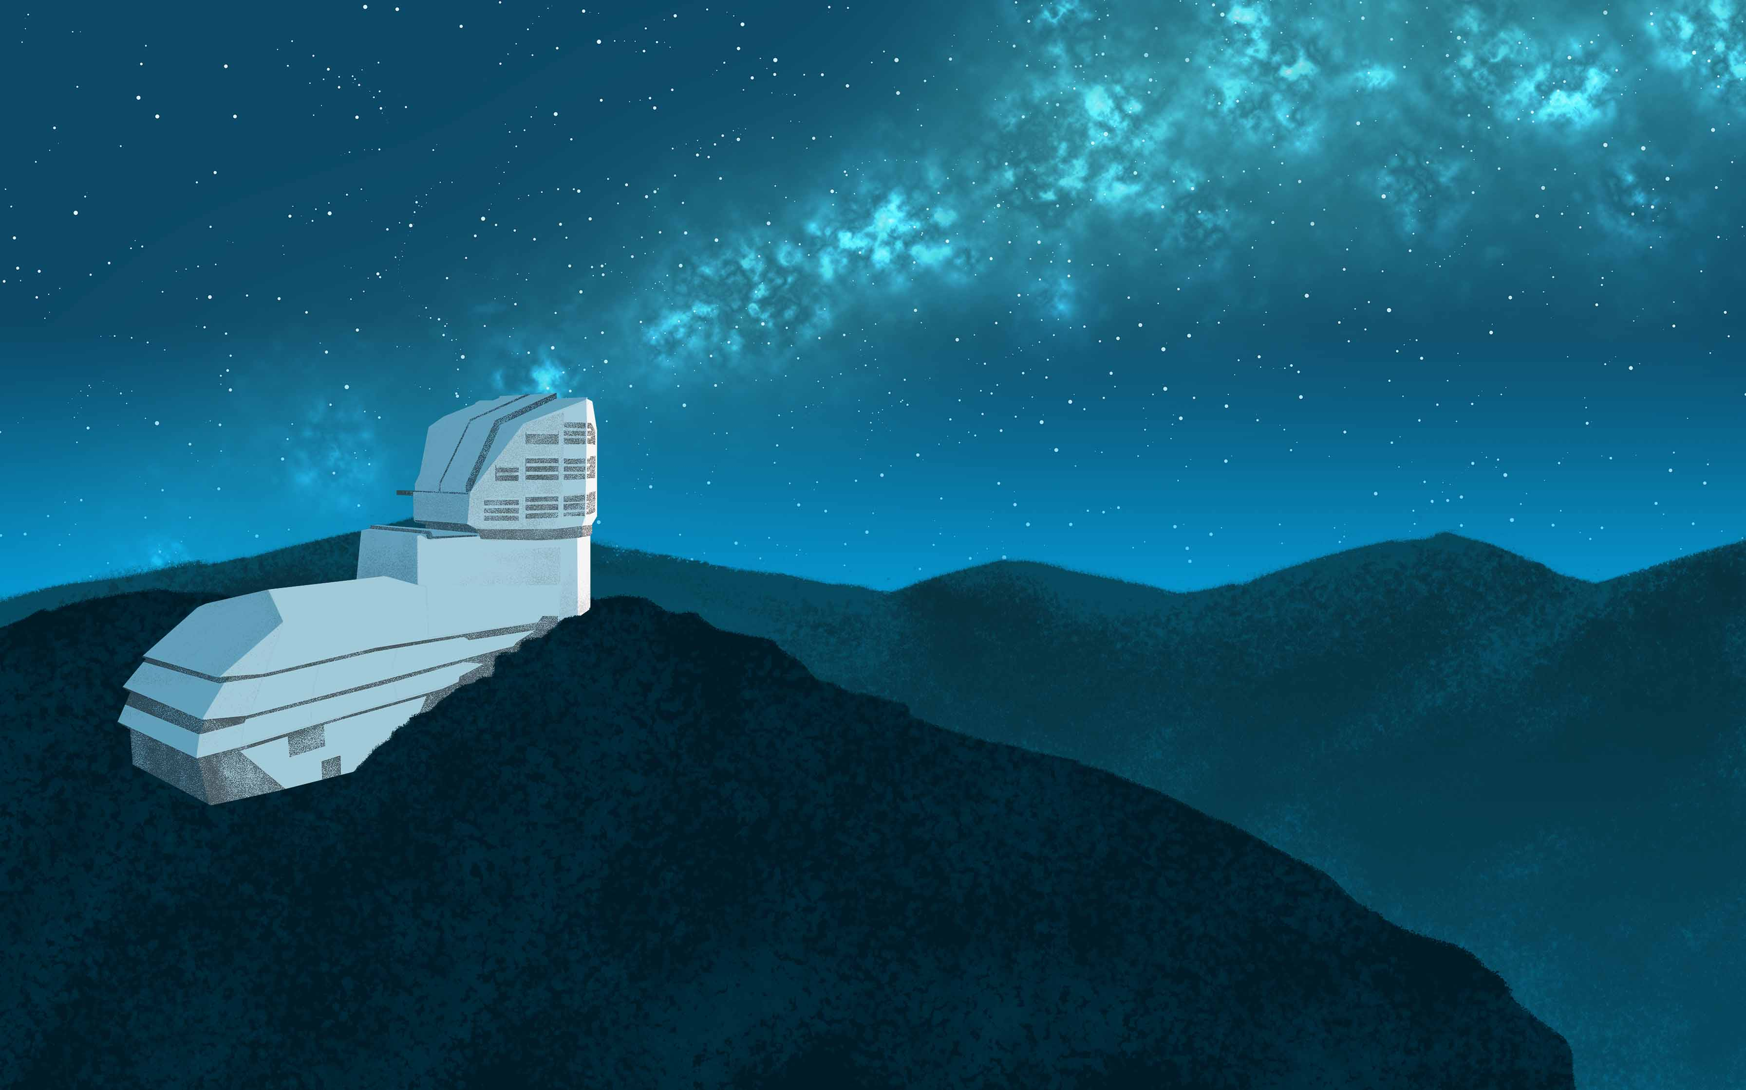
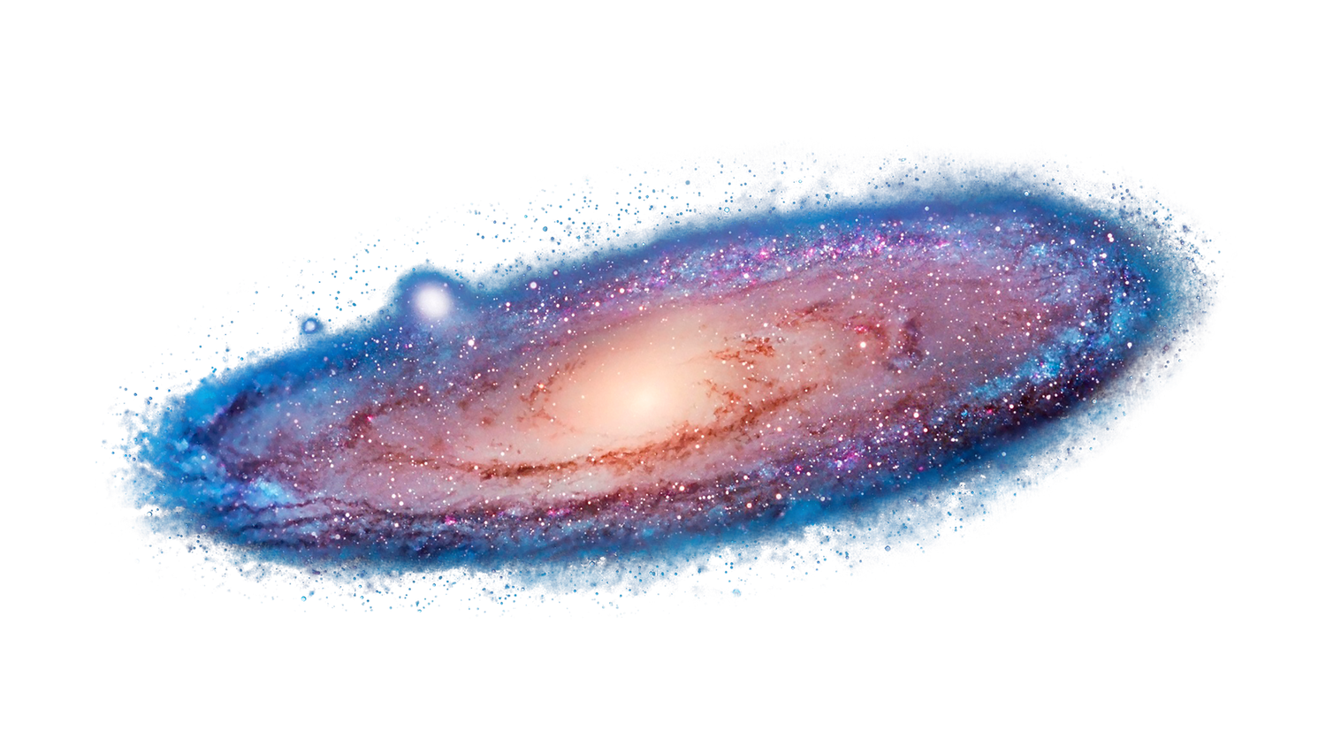
Multiple images
Magnified images
Time delay between images

Slide 3
Multiple images
Magnified images
Time delay between images
1
Andrés Ponte Pérez
aip981@student.bham.ac.uk

Slide 4
1. Multiple images
$$\overset{⃗}{α}=\overset{⃗}{θ}-\overset{⃗}{β}$$
$$⇒\overset{⃗}{β}=\overset{⃗}{θ}-\overset{⃗}{α}$$
$$\overset{⃗}{α}$$
$$\overset{⃗}{α}=\frac{4MGD_{LS}}{c^{2}D_{L}D_{S}}\frac{\overset{⃗}{θ}}{θ^{2}}$$
$$b$$
$$α$$
$$θ$$
$$θ_{E}=\sqrt{\frac{4MGD_{LS}}{c^{2}D_{L}D_{S}}}⇒\overset{⃗}{α}=\frac{θ_{E}^{2}}{θ^{2}}\overset{⃗}{θ}$$
$$β$$
$$D_{L}$$
$$D_{LS}$$
$$D_{S}$$
When
$$θ=θ_{E},β=0$$
and…

Slide 5
Van Dokkum et al. (2024)

Slide 6
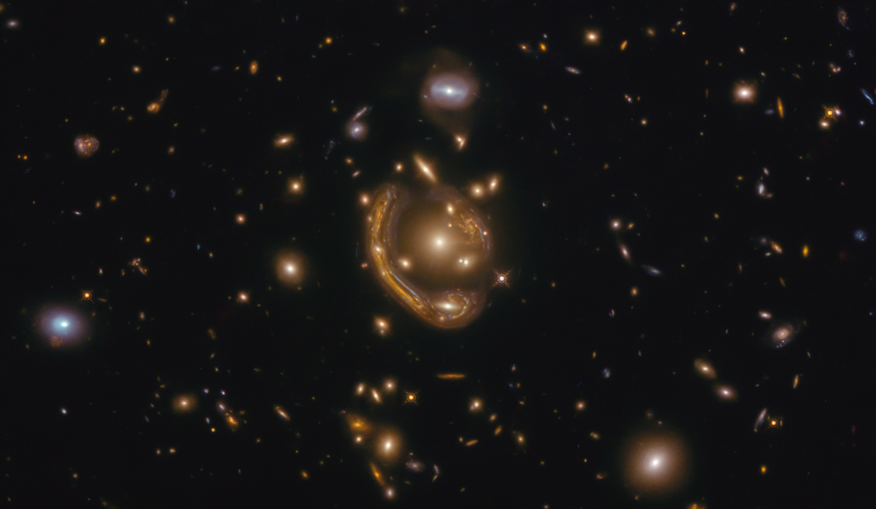
Jha and Shatz (2020)

Slide 7
2. Magnified images
$$μ$$
$$\overset{⃗}{α}$$
$$b$$
$$α$$
$$θ$$
$$β$$
$$D_{L}$$
$$D_{LS}$$
$$D_{S}$$

Slide 8
3. Time Delays
$$Δt=Δt_{geo}+Δt_{Sh}$$

Slide 9
Vera C. Rubin Observatory
Andrés Ponte Pérez
aip981@student.bham.ac.uk

Slide 10
The Legacy Survey of Space and Time (LSST)
10 year survey commencing this year (2025).
Will take multi-band ugrizy images of ~20 000 deg² of the sky.
All sky cadence of 2-3 days.
Limiting magnitude of ∼ 24.
WIDE
FAST
DEEP
2
Andrés Ponte Pérez
aip981@student.bham.ac.uk

Slide 11
Science Case: Strongly Lensed Supernovae
WIDE
Strong lensing is rare, roughly 1/1000 objects are strongly lensed.
Supernovae evolve relatively fast around peak brightness.
Cosmic supernova rate increases with distance.
Probability of lensing increases with distance.
DEEP
FAST
DEEP
DEEP
To date:
By 2035 with LSST:
8
0
1
2
3
5
10
50
100
500
1000+
3
Andrés Ponte Pérez
aip981@student.bham.ac.uk

Slide 12
Science Case: Strongly Lensed Supernovae
Supernova Type | Rate of lensed detections by LSST [yr⁻¹]
 | Goldstein, Nugent and Goobar (2019) | Wojtak, Hjorth and Gall (2019)
Ia | 47.84 | 89
IIP | 88.51 | 16.3
IIL | 12.78 | 11.9
Ib/c | 15.43 | 15.8
IIn | 209.32 | 210
4
Andrés Ponte Pérez
aip981@student.bham.ac.uk

Slide 13
Why is this surprising?
Type IIn supernovae only make up around 5 - 10% of non lensed core-collapse supernova detections.
Andrés Ponte Pérez
aip981@student.bham.ac.uk

Slide 14
Why Type IIn Supernovae?
Andrés Ponte Pérez
aip981@student.bham.ac.uk

Slide 15
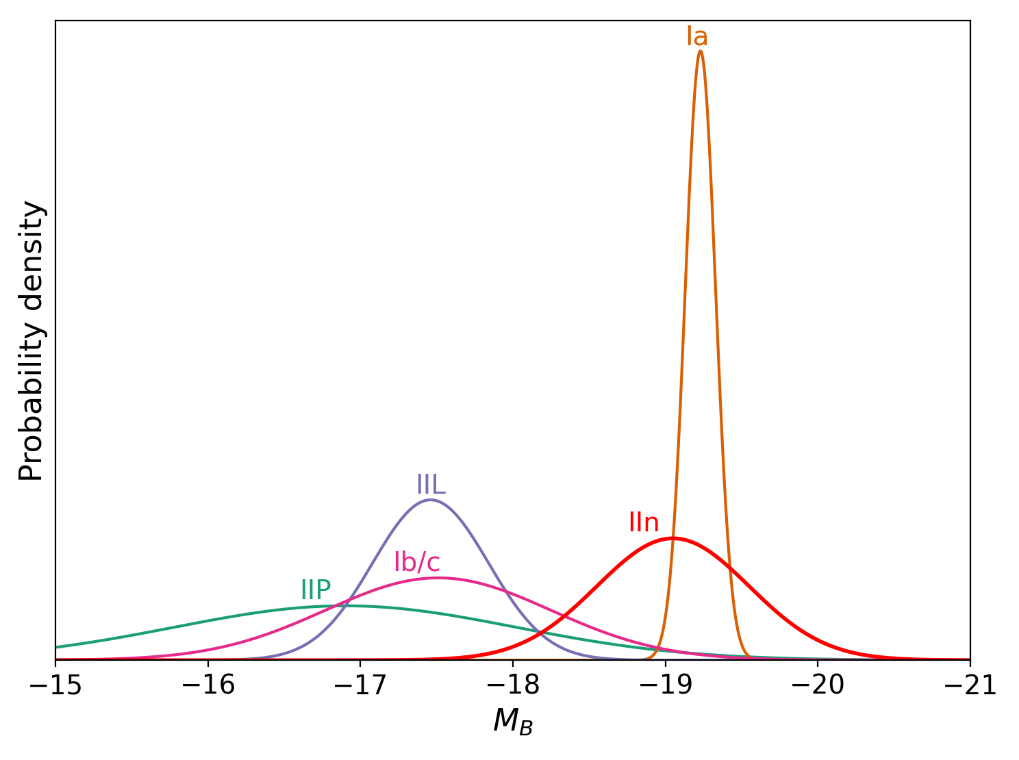
Reason 1: Brightness
Data from Goldstein, Nugent and Goobar (2019)
Andrés Ponte Pérez
aip981@student.bham.ac.uk

Slide 16
Reason 2: Colour (and rate evolution)
Andrés Ponte Pérez
aip981@student.bham.ac.uk

Slide 17
“What actually are Type IIn Supernovae - and why are they interesting?”
Andrés Ponte Pérez
aip981@student.bham.ac.uk

Slide 18
What are type IIn supernovae?
Type II because they have hydrogen lines.
The 'n' distinction is because these hydrogen lines are narrow.
Broad lines
Ionised gas
Narrow lines
Shocked ejecta
Broad lines
Narrow lines
Broad lines
5
Filippenko (1997)
Andrés Ponte Pérez
aip981@student.bham.ac.uk

Slide 19
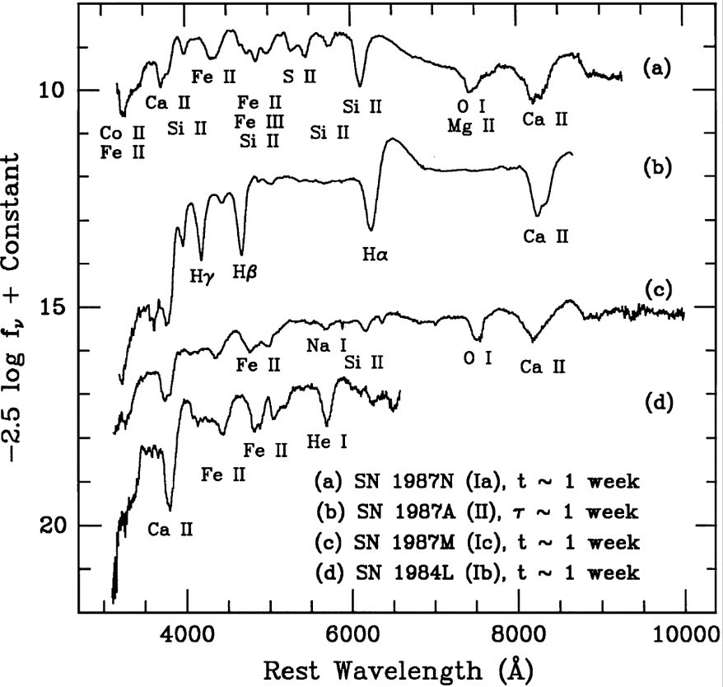
Filippenko (1997)
Andrés Ponte Pérez
aip981@student.bham.ac.uk

Slide 20
Why are they interesting?
Sometimes when a star dies, the progenitor star becomes violently unstable in the years, decades, or centuries before explosion.
Circumstellar material (CSM) interaction is an efficient engine for making bright transients.
The CSM interaction may also be highly non-spherical.
The CSM properties are a proxy for the stellar structure. Lensed type IIn supernovae allow us to investigate how this evolves with redshift.
6
Andrés Ponte Pérez
aip981@student.bham.ac.uk

Slide 21
There’s a catch…
Andrés Ponte Pérez
aip981@student.bham.ac.uk

Slide 22
Two Problems:
Goldstein+ and Wojtak+ did not account for an accurate LSST cadence.
Goldstein+ and Wojtak+ both used a standard IIn template (based on SN1999el). This models the IIn spectrum as a pure blackbody.
7
Andrés Ponte Pérez
aip981@student.bham.ac.uk

Slide 23
The issue of cadence
Arendse+ (2024) use the LSST baseline v3.0 cadence and find that only 50% of the type Ia supernovae detected by Wojtak+ are recovered.
8
Andrés Ponte Pérez
aip981@student.bham.ac.uk

Slide 24
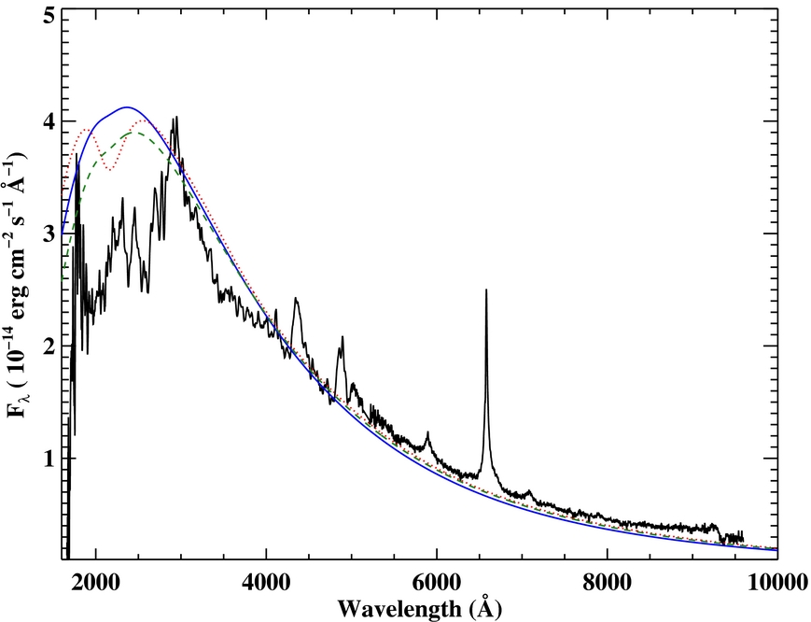
The issue of template
Because type IIn supernovae are blue and have significant high redshift detections (z > 2), the ultraviolet (UV) spectrum is relevant.
Across almost all supernovae, the UV spectrum falls below the blackbody continuum.
This is due to line-blanketing - the absorption of high energy photons by iron-group elements and other metals.
Roming+ (2012)
9
Andrés Ponte Pérez
aip981@student.bham.ac.uk

Slide 25
Simulating a Sample of Lensed IIn Detections
Andrés Ponte Pérez
aip981@student.bham.ac.uk

Slide 26
Cadence
We use the v3.4 LSST observing strategy.
Consists of two main survey modes, wide-fast-deep (~90%) and deep-drilling fields (DDF).
Arendse+ (2024)
10
Andrés Ponte Pérez
aip981@student.bham.ac.uk

Slide 27
Template
For comparison, we use the standard IIn blackbody template used by Goldstein+ and Wojtak+ as a starting point.
We then incorporate a simple power law model:
$$f_{λ}\left(T\right)={\left(\frac{λ}{λ_{0}}\right)}^{β}f_{λ,BB}$$
We create a suite of templates with ranging from 2600-3600 and from 0 (blackbody) to 4.0.
$$λ_{0}$$
$$Å$$
$$β$$

Slide 28
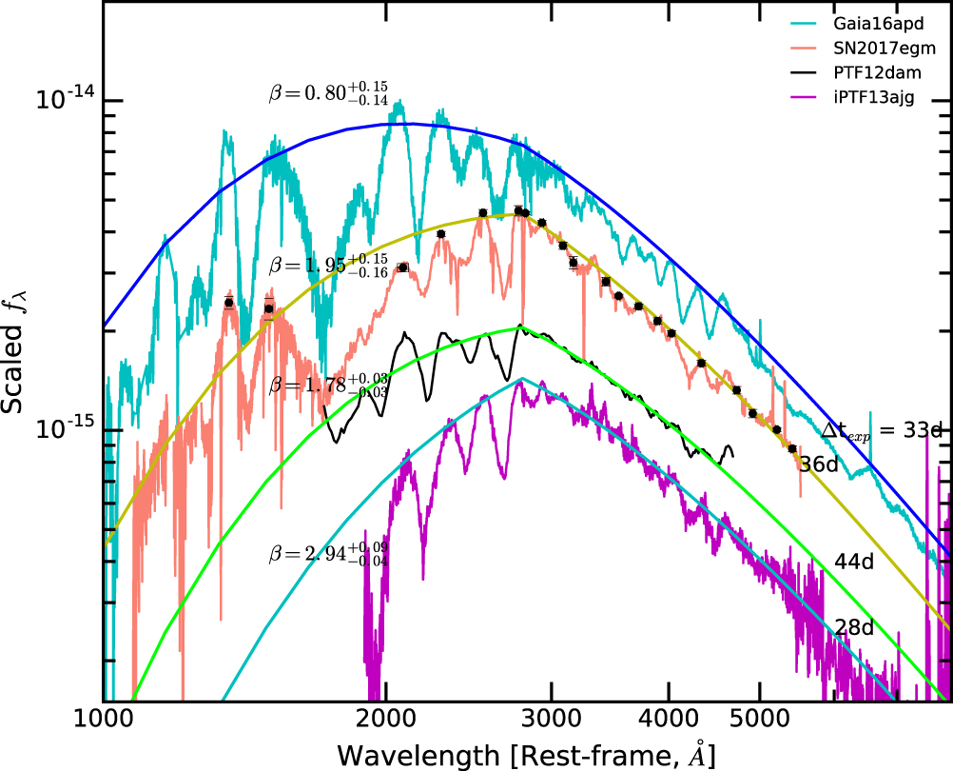
Template
$$f_{λ}\left(T\right)={\left(\frac{λ}{λ_{0}}\right)}^{β}f_{λ,BB}$$
Object
SN2017egm
Gaia16apd
iPTF13ajg
PTF12dam
$$β$$
$$λ_{0}[Å]$$
$${1.95}_{-0.14}^{+0.15}$$
$${2817.5}_{-10}^{+78}$$
$${0.51}_{-0.16}^{+0.40}$$
$${3133}_{-549}^{+453}$$
$${2.86}_{-0.09}^{+0.18}$$
$${2820}_{-10}^{+13}$$
$${1.78}_{-0.06}^{+0.08}$$
$${2819}_{-17}^{+51}$$
11
Yan+ (2018)
Andrés Ponte Pérez
aip981@student.bham.ac.uk

Slide 29
Calculation
$$R_{det}=∫_{0}^{∞}dΛ∫_{μ_{min}}^{∞}dμ∫_{0}^{z_{max}}dzN_{phys}\left(z\right)\frac{dτ}{dμdz}ϕ\left(z,Λ\right)$$
$$\frac{dτ}{dμdz}$$
$$N_{phys}\left(z\right)$$
$$ϕ\left(z,Λ\right)$$
12
Andrés Ponte Pérez
aip981@student.bham.ac.uk

Slide 30
Calculation
$$N_{phys}\left(z\right)$$
= the number of type IIn supernovae that happen per year as a function of redshift.
$$\frac{dτ}{dμdz}$$
= the lensing optical depth. The fraction of the the sky in which objects in a given redshift shell are magnified with magnification
$$≥μ.$$
$$ϕ\left(z,Λ\right)$$
= the probability that a given lensed supernova is detected by LSST.
13
Andrés Ponte Pérez
aip981@student.bham.ac.uk

Slide 31
$$N_{phys}\left(z\right)=R_{0}g(z)\frac{dV}{dz}⋅(1+z)^{-1}$$
local coming rate density of type IIn supernovae
Star formation rate density
Cosmological volume element
Time dilation
$$R_{0}=4.77⋅{10}^{-6}{yr}^{-1}{Mpc}^{-3}$$
Cold and Hjorth (2023)
Madau and Dickinson (2014)

Slide 32
$$\frac{dτ}{dμdz}∝\frac{D_{c}{\left(z\right)}^{3}}{μ^{2}}$$

Slide 33
$$ϕ\left(z,Λ\right)=\frac{N_{det}}{N_{sim}}$$
Whether or not a source is detected depends on:
Position in the sky.
Redshift.
The timing, filters and observing conditions of each LSST visit.
Intrinsic brightness - absolute magnitude.
Whether or not the multiple images formed by lensing are resolved.
The time delay between the images.

Slide 34
$$ϕ\left(z,Λ\right)=\frac{N_{det}}{N_{sim}}$$

Slide 35
Simulation
We simulate 200 000 unique lensed type IIn supernovae drawing parameters from the following distributions:
For a source in our study to be detected, it must have 5 separate observations in any combination of filter.
$$z∼U\left(0,6\right)$$
$$μ∼U\left(0,50\right)$$
$$M_{B}∼N\left(-19.05,0.5\right)$$
14
Andrés Ponte Pérez
aip981@student.bham.ac.uk

Slide 36
Simulation cont.
If it falls outside the survey footprint, or has no visits by LSST, it is not detected.
We then apply analytical expressions for a range of lens models (e.g. galaxy, group, cluster) to calculate the time delay and angular separation between images.
The simulated lightcurves are fed through a mock LSST observing run which produces a series of observations.
For a source in our study to be detected, it must have 5 separate observations in any filter.
Andrés Ponte Pérez
aip981@student.bham.ac.uk

Slide 37
Results
Andrés Ponte Pérez
aip981@student.bham.ac.uk

Slide 38
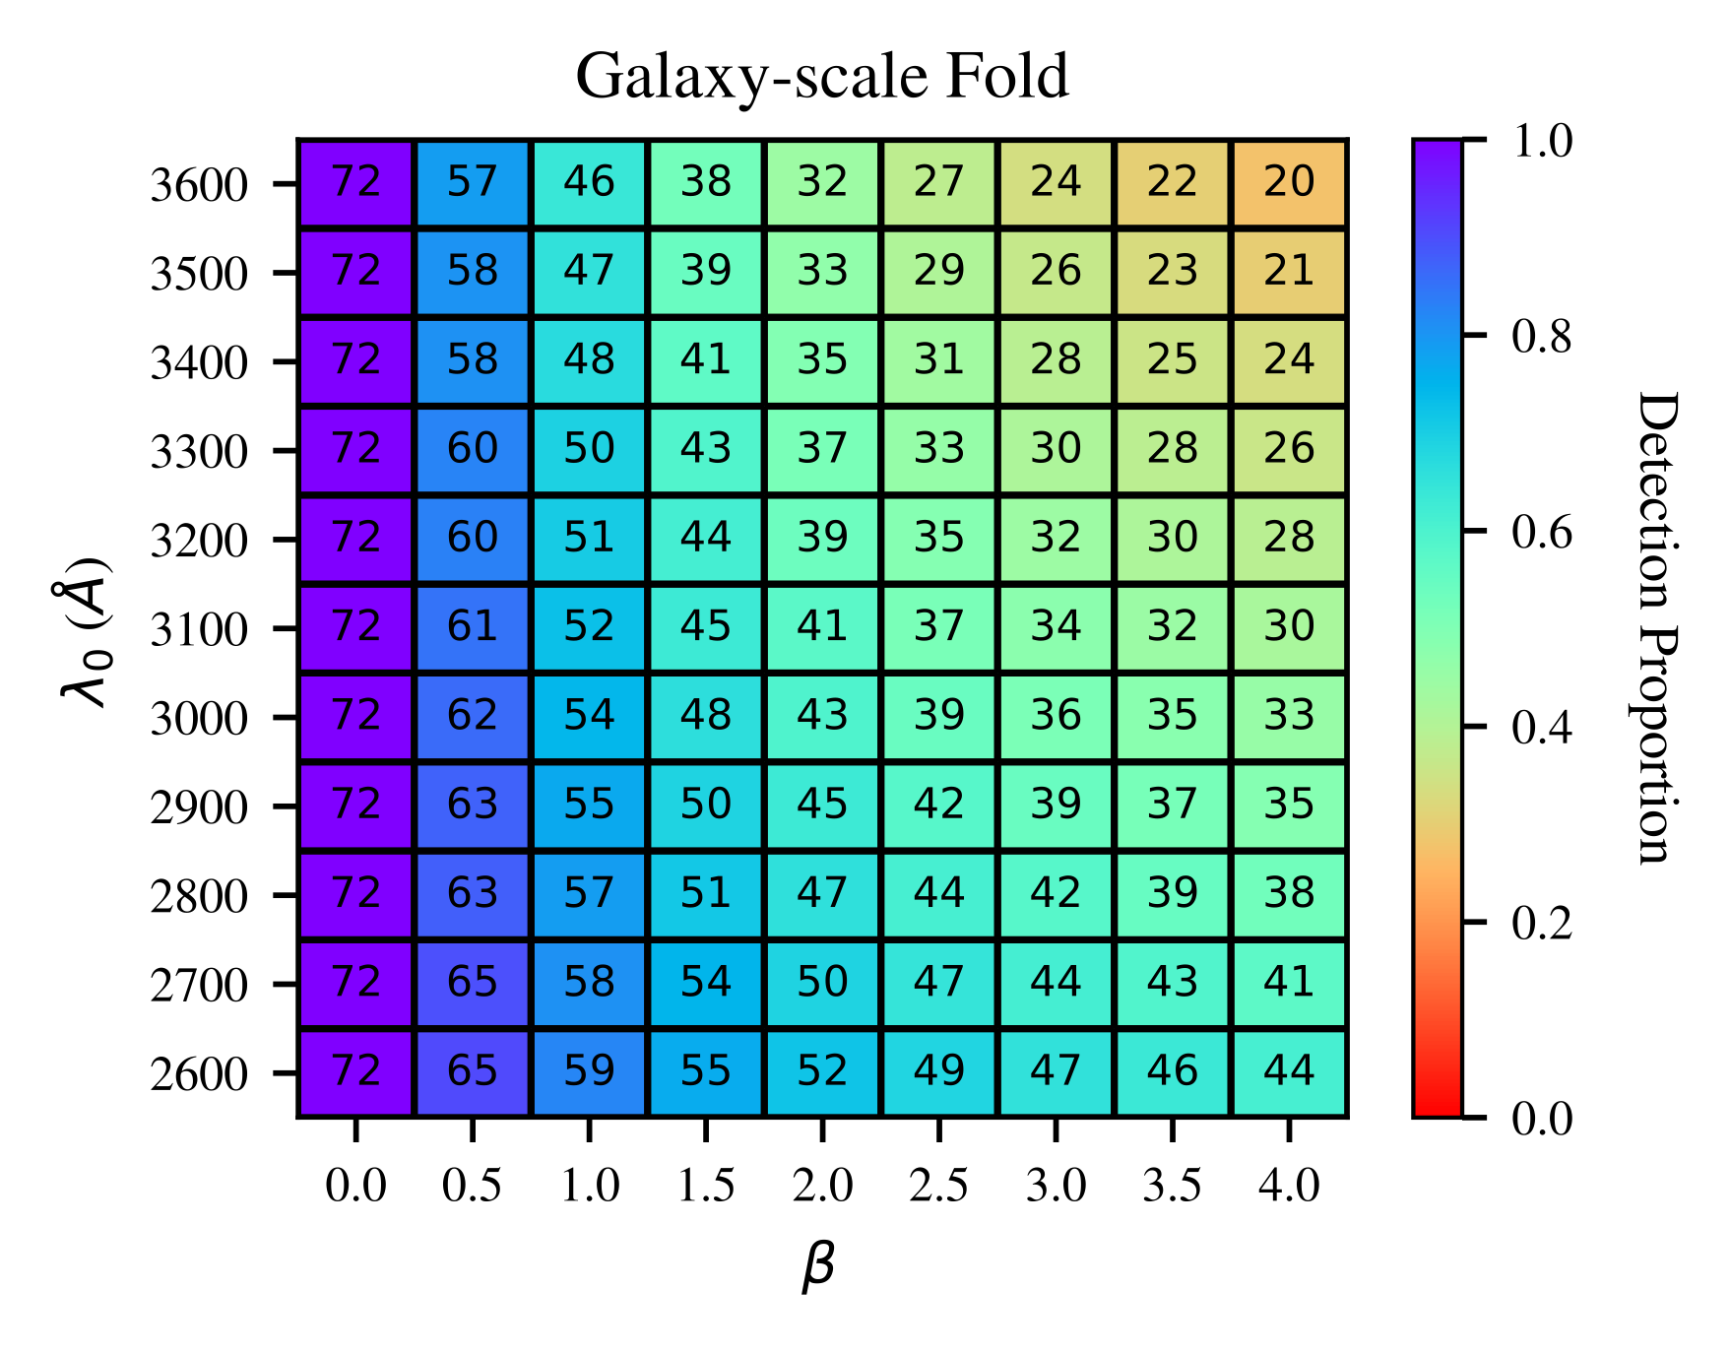
Total yearly detections
Reminder: Goldstein+ and Wojtak+ predicted 210 lensed type IIn SNe per year using a pure blackbody.
15
Ponte Pérez, Smith+ (2025)
aip981@student.bham.ac.uk

Slide 39
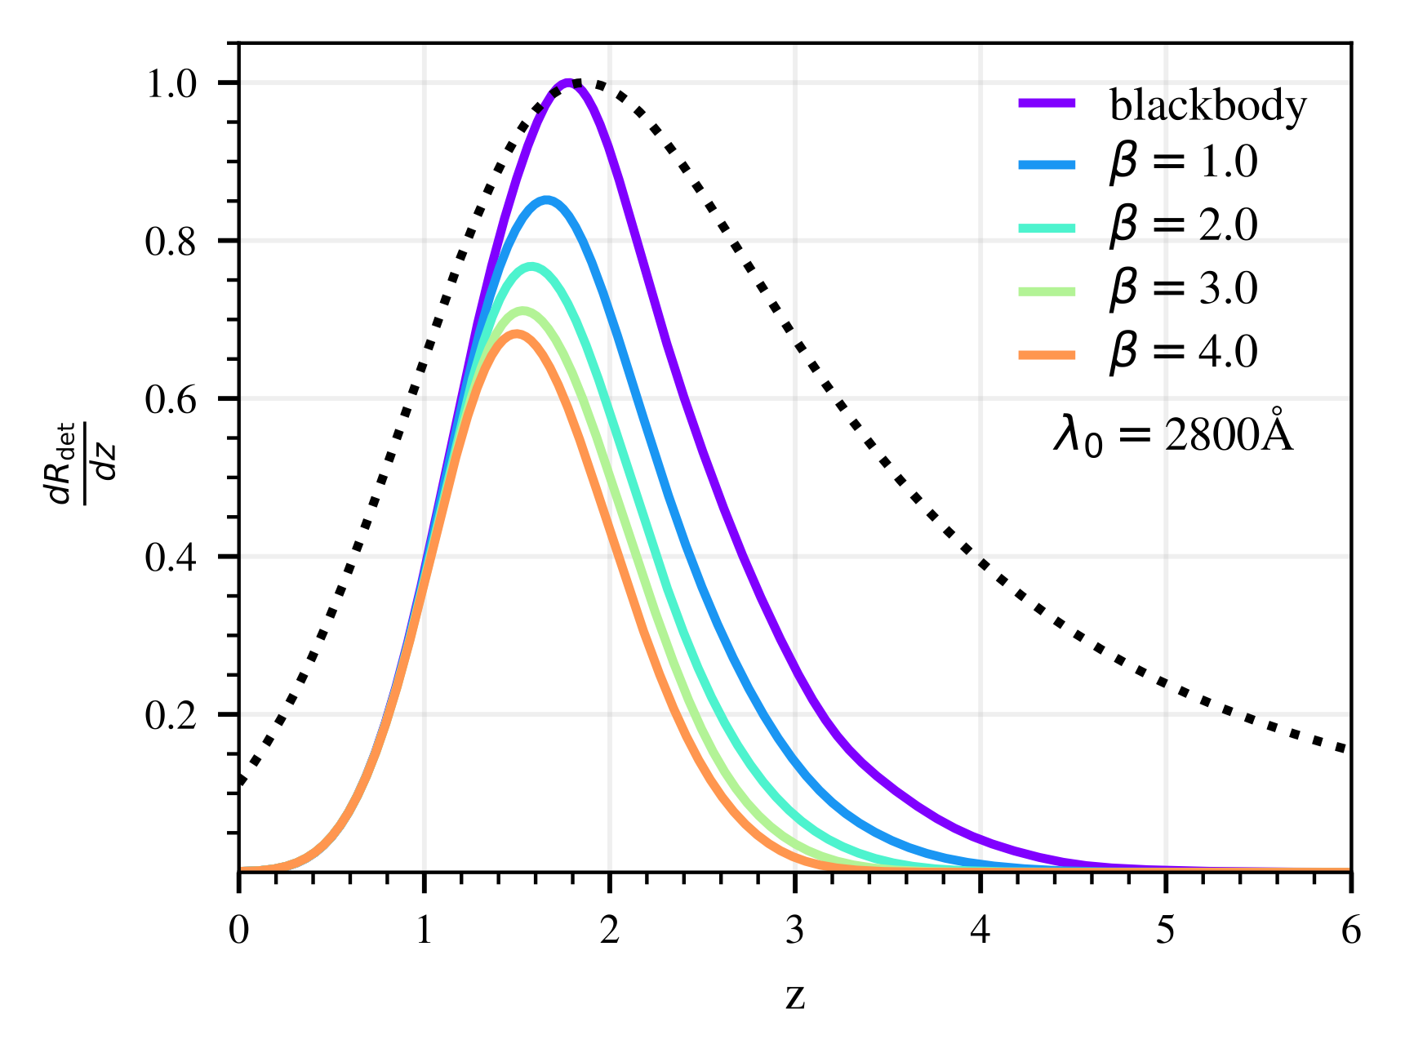
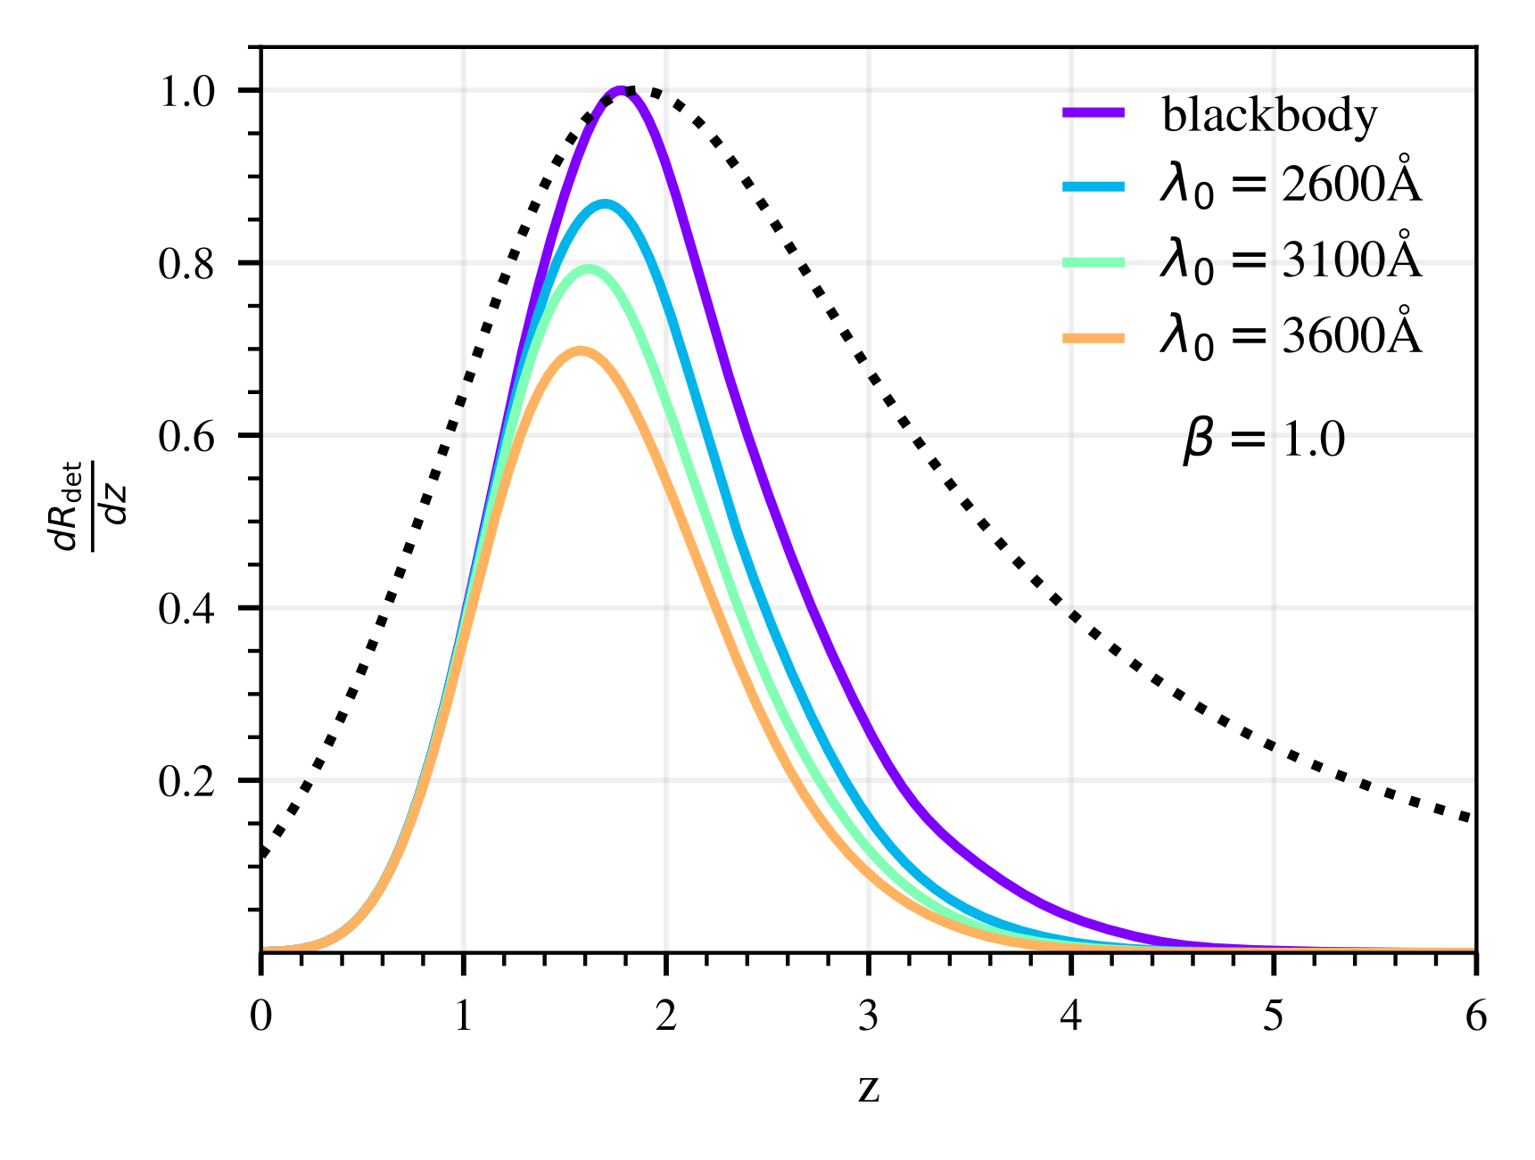
Redshift
Ponte Pérez, Smith+ (2025)
Ponte Pérez, Smith+ (2025)
16
Andrés Ponte Pérez
aip981@student.bham.ac.uk

Slide 40
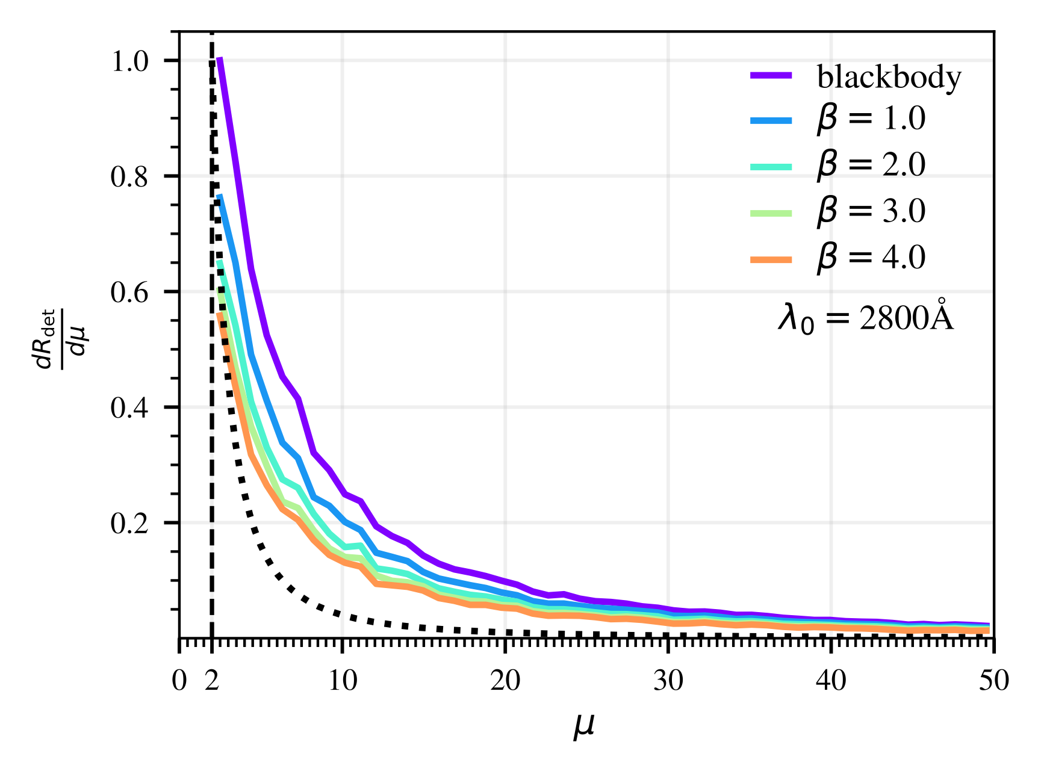
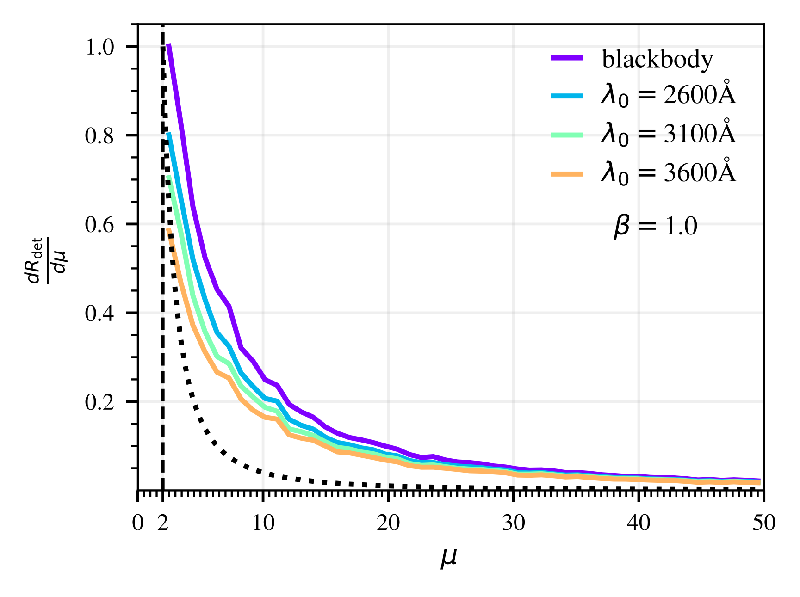
Magnification
Ponte Pérez, Smith+ (2025)
Ponte Pérez, Smith+ (2025)
Andrés Ponte Pérez
aip981@student.bham.ac.uk

Slide 41
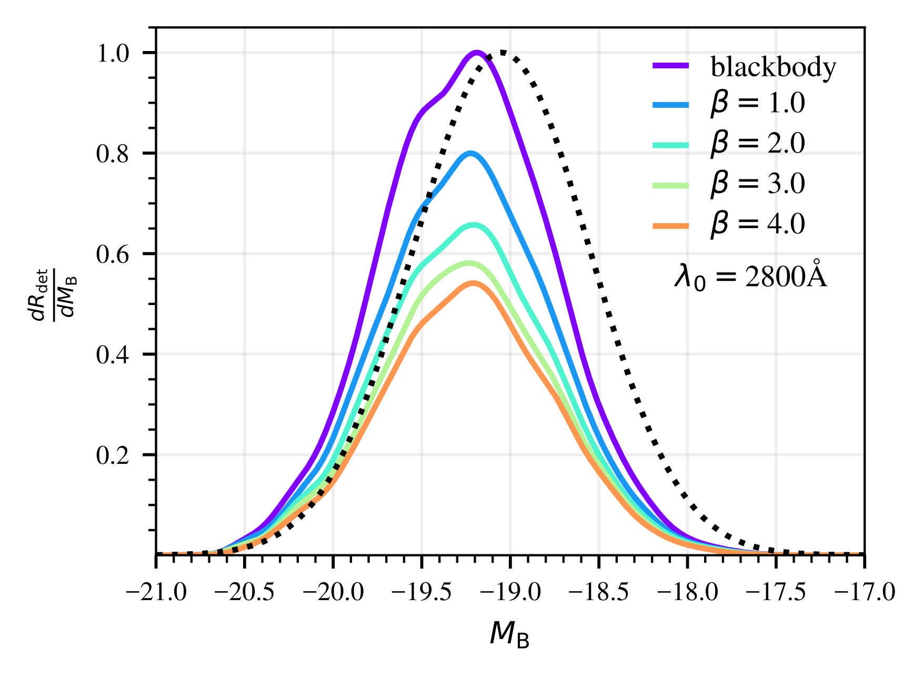
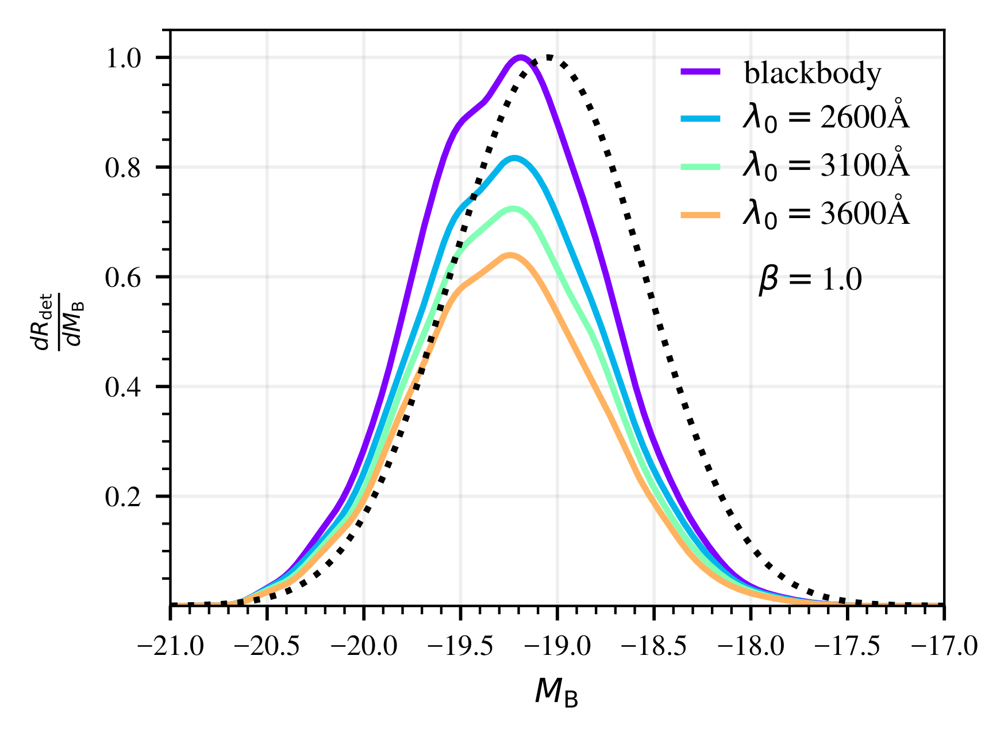
Magnitude
Ponte Pérez, Smith+ (2025)
Ponte Pérez, Smith+ (2025)
17
Andrés Ponte Pérez
aip981@student.bham.ac.uk

Slide 42
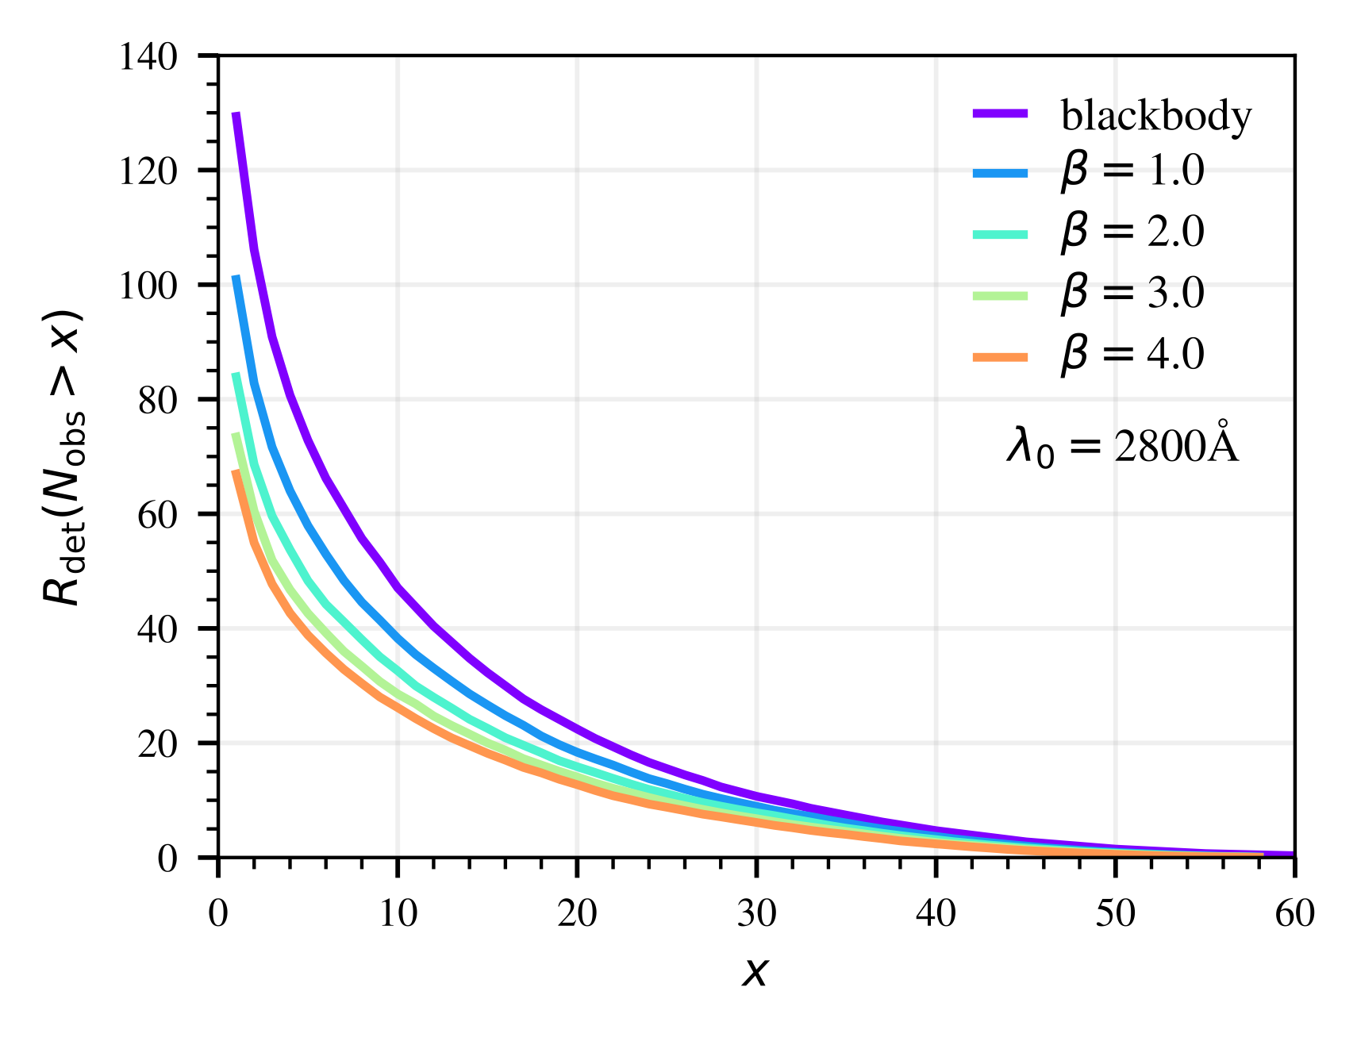
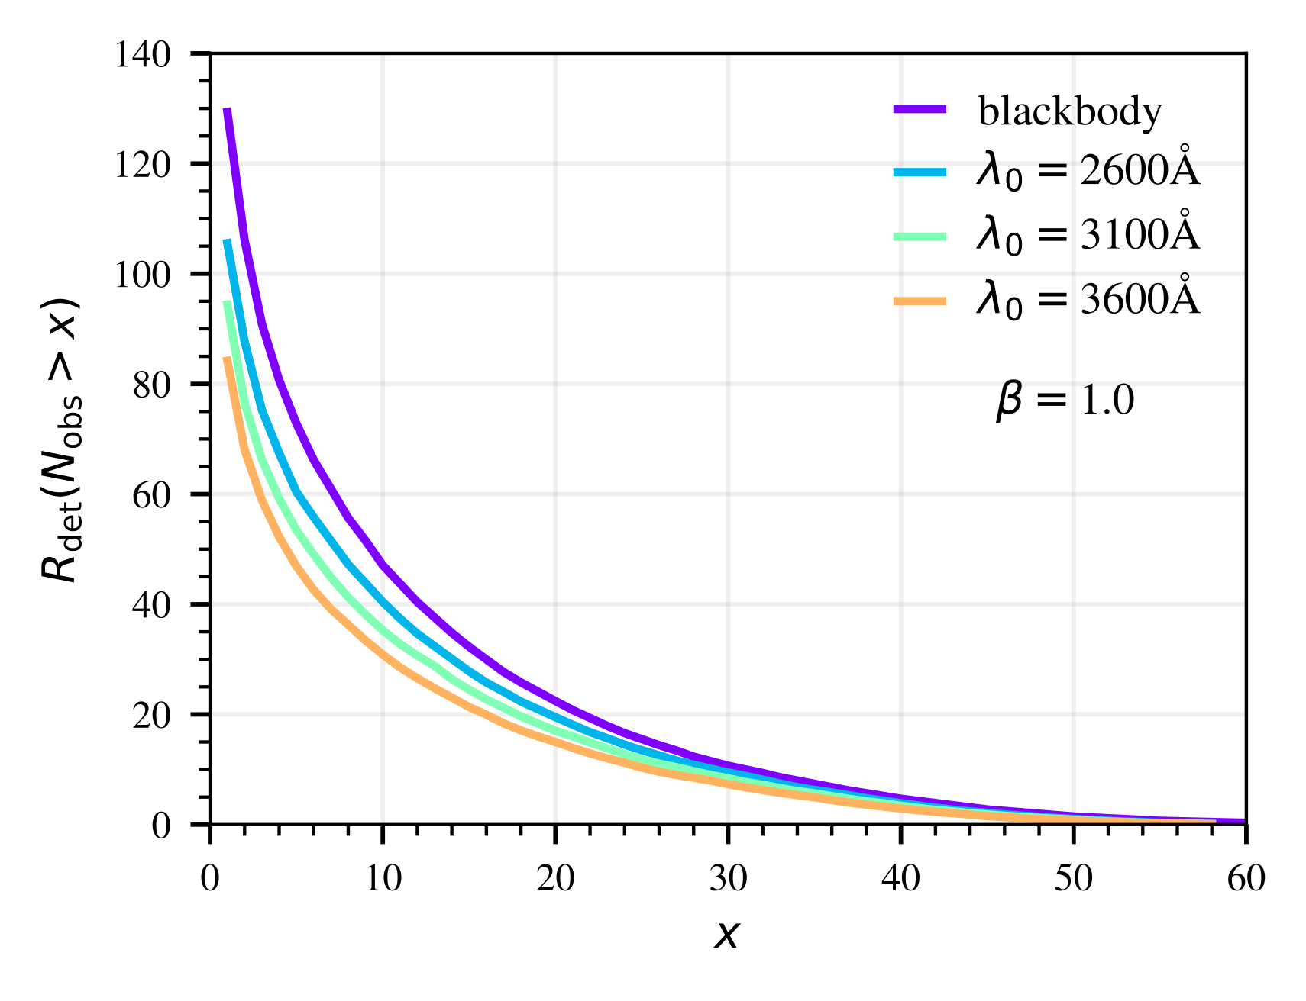
Number of observations
Andrés Ponte Pérez
aip981@student.bham.ac.uk

Slide 43
What I didn’t get the chance to cover
Cosmological prospects of lensed Type IIn SNe (e.g utilising multi-source plane lensing).
How many of these lensed Type IIn SNe will we get to do interesting science with (spectroscopic “gold sample”)
How we calculated image separations and time delays for our range of lens models.
Identification - how will we know it is a Type IIn and how will we know if it is lensed?
Type IIn SN lightcurve heterogeneity.
Time evolving CSM interaction (aspherical CSM, winds etc.).
18
Andrés Ponte Pérez
aip981@student.bham.ac.uk

Slide 44
Key Takeaways and a View on the Future
Ultraviolet suppression does not extinguish prospects for lensed type IIn supernovae, even in the most pessimistic model (hooray!).
Strongly lensed type IIn supernovae provide a unique laboratory to investigate stellar structure, populations and the terminal stages of giant stars at high redshift.
LSST is a one of a kind survey and will offer unprecedented advances in many areas of astrophysics.
Paper now on ArXiv! - Please reach out if you want to know more!
19
+ huge thanks to my many collaborators and the LSST Strong Lensing Science Collaboration!
Andrés Ponte Pérez
aip981@student.bham.ac.uk

Slide 45
References
van Dokkum, P., Brammer, G., Wang, B. et al. A massive compact quiescent galaxy at z = 2 with a complete Einstein ring in JWST imaging. Nat Astron 8, 119–125 (2024).
Jha S., Shatz L., 2020, Rings of Relativity, https://esahubble.org/images/potw2050a/
Goldstein D. A., Nugent P. E., Goobar A., 2019, The Astrophysical JournalSupplement Series, 243, 6
Wojtak R., Hjorth J., Gall C., 2019, Monthly Notices of the Royal Astronomical Society, 487, 3342
Filippenko A., 1997, Annual Review of Astronomy and Astrophysics, 35, 309
Arendse N., et al., 2024, Monthly Notices of the Royal Astronomical Society, 531, 3509
Roming P. W. A., et al., 2012, The Astrophysical Journal, 751, 92
Yan L., Perley D. A., Cia A. D., Quimby R., Lunnan R., Rubin K. H. R., Brown P. J., 2018, The Astrophysical Journal, 858, 91
Cold, C. Hjorth, J. 2023, Astronomy and Astrophysics, 670, A48
Madau P., Dickinson M., 2014, Annual Review of Astronomy and Astrophysics, 52, 415

