Slide 1
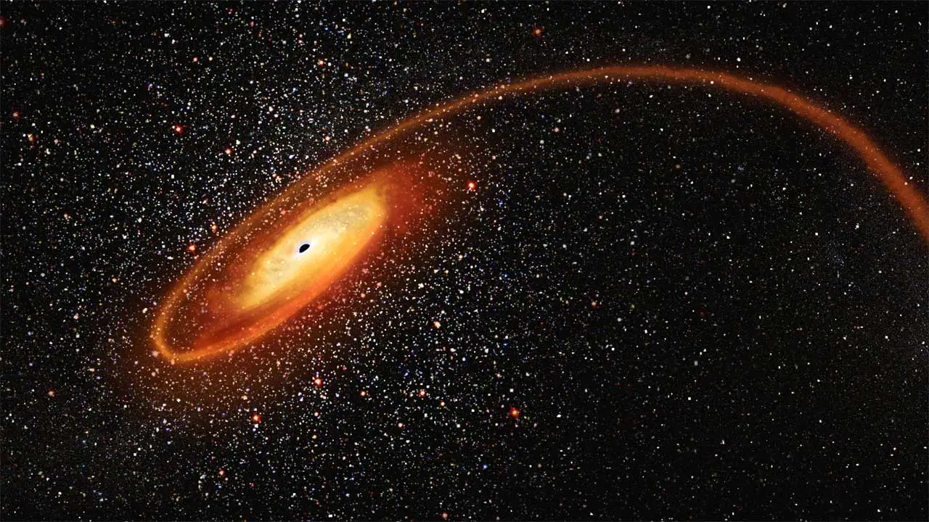

A tidal disruption event that turned off
Rob Eyles-Ferris,
Chris Nixon, Eric Coughlin, Phil Evans, Paul O’Brien & Rhaana Starling

Slide 2
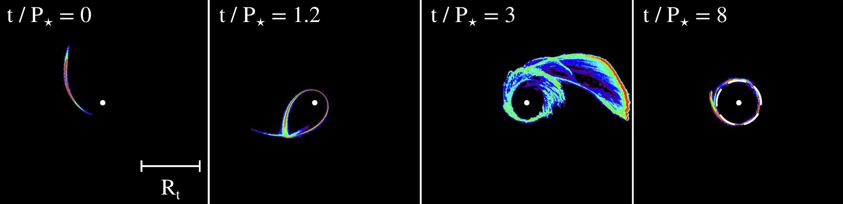

What are tidal disruption events?
Stars get torn apart when they get too close to a supermassive black hole and ~half the material remains bound to be accreted
Fallback rate typically declines as $t^{−5/3}$ for a full disruption or $t^{−9/4}$ for a partial disruption
Accretion rate can be highly super-Eddington at early times
Typical hosts are green valley and centrally concentrated galaxies
Bonnerot et al. 2016

Slide 3
How can we find X-ray TDEs?
First, we need an X-ray catalogue
The Living Swift-XRT Point Source Catalogue
  All the point sources Swift has observed
  342 080 sources as of this morning
  Living – this is a unique resource
Has a built in transient detector*
  Already made a significant TDE contribution with the discovery of rpTDE Swift J0230
Evans et al. 2023
*See poster by Srijan Srivastava

Slide 4
What do TDEs look like (X-rays)?
Most emission is thermal from the accretion flow or stream self-interactions
  Soft or super-soft spectra – typical blackbody temperatures ~50 to ~100 eV
Decline consistent with fallback rate decline
  Remain luminous for years (over a decade in some cases)
UVOIR counterparts in some cases but not all (probably angular dependence)
4 TDEs (out of ~100) have relativistic jets
  3 found by Swift
Repeating partial TDEs/QPEs/PNTs
  Quasi-periodic thermal emission as a star is repeatedly disrupted

Slide 5
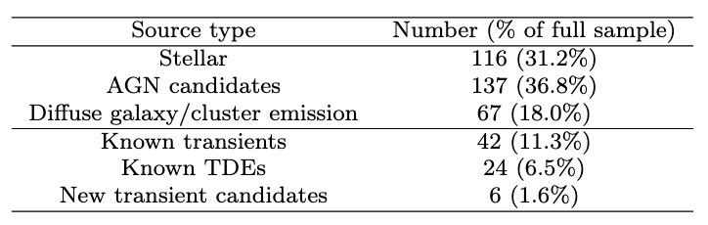
How can we find X-ray TDEs?
Often look for flaring sources
But TDEs are supersoft so can use the spectra instead
  Works with XMM-Newton (Sacchi et al. 2023) and eROSITA (Eyles-Ferris et al. submitted)
Set some criteria and we get ~400 sources to manually classify
Picked up pretty much all the TDEs Swift has observed
6 new candidates including LSXPS J0956

Slide 6

How can we find X-ray TDEs?
Consistent with a $t^{−5/3}$ or $t^{−9/4}$ decay
(Super)soft thermal spectra
Spatially consistent with the nucleus of a galaxy
Host often green valley galaxy

Slide 7
Eyles-Ferris et al. in prep.

Slide 8
Eyles-Ferris et al. in prep.

Slide 9
Eyles-Ferris et al. in prep.

Slide 10
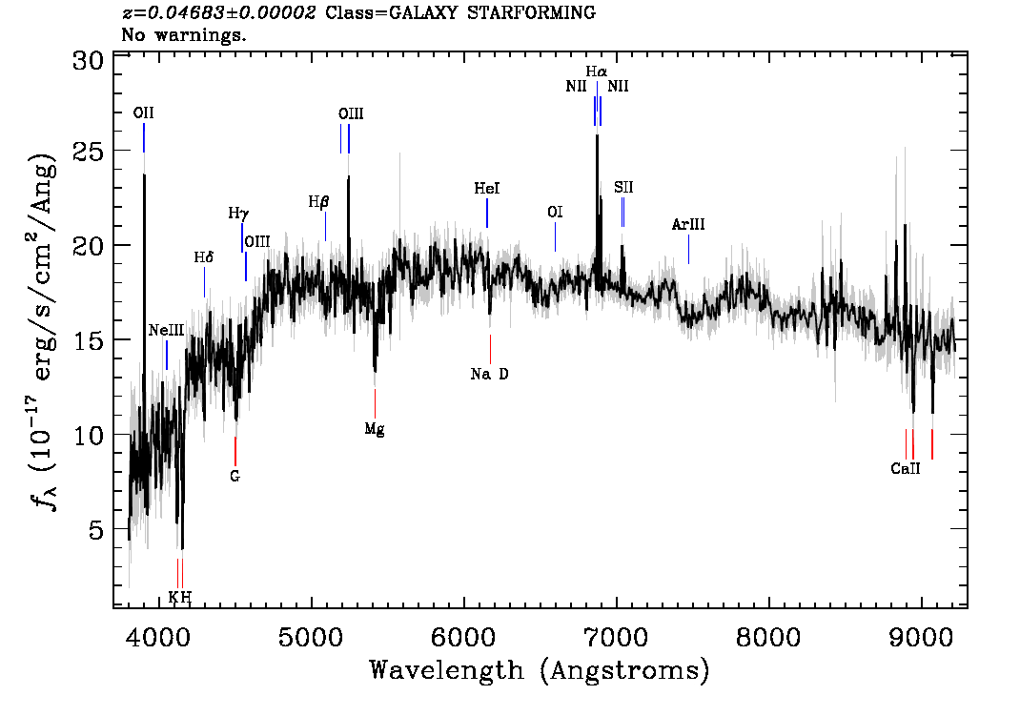
Eyles-Ferris et al. in prep.

Slide 11
So what makes LSXPS J0956 special?
Eyles-Ferris et al. in prep.

Slide 12
So what makes LSXPS J0956 special?
Eyles-Ferris et al. in prep.

Slide 13
Can we explain this behaviour?
Repeating TDEs/periodic nuclear transients do fade quickly
  Monte Carlo modelling based on observed duty cycles
  <1% chance of reproducing the light curve
But there are other options

Slide 14
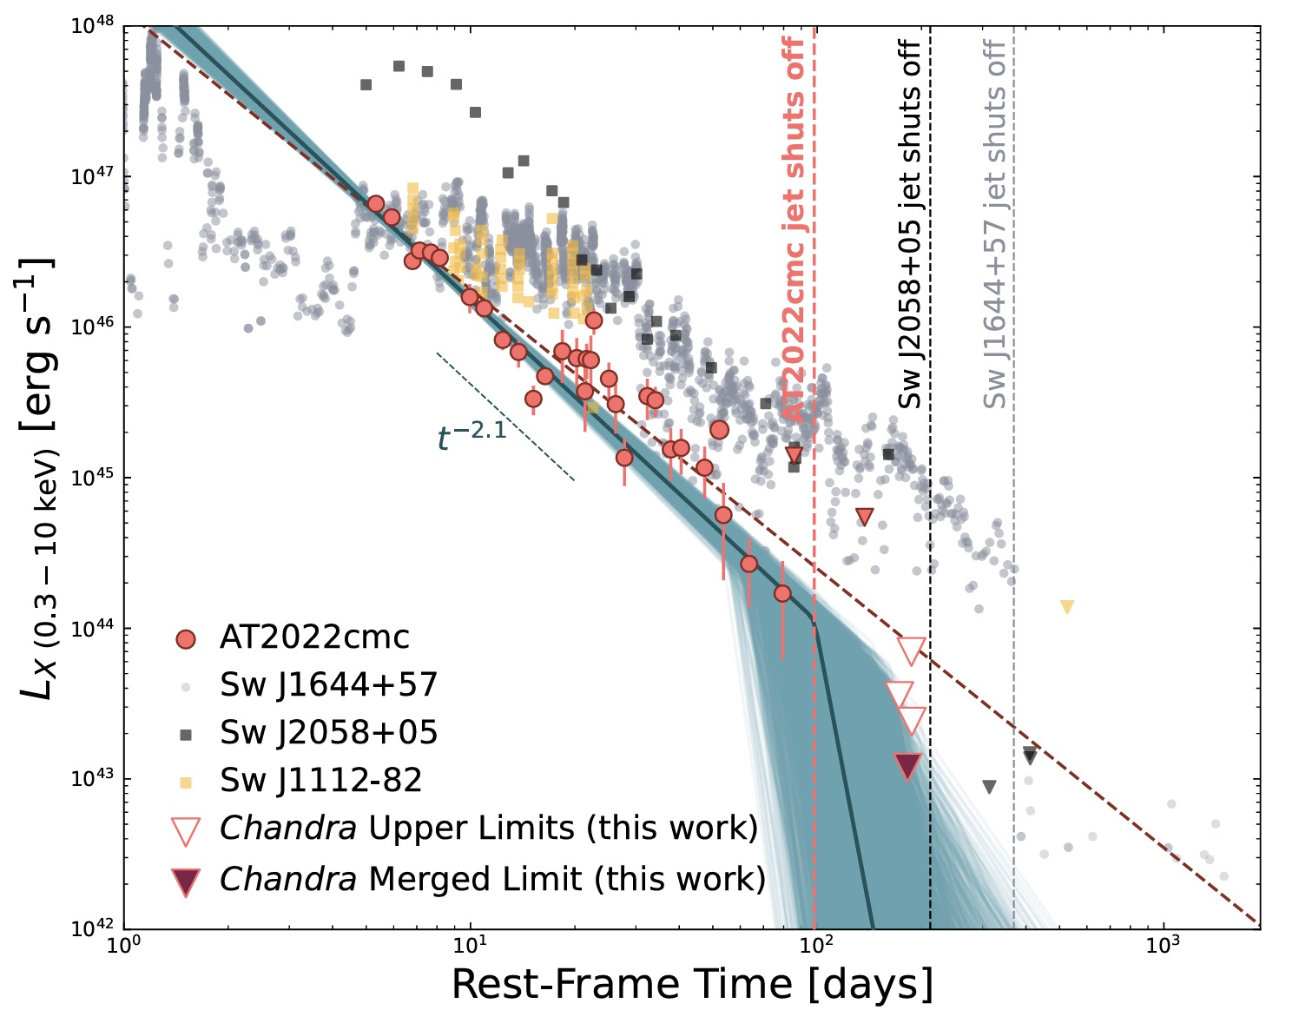
Jetted TDEs
Some TDEs do show this exact behaviour – jetted TDEs
Fade slowly before abruptly declining
  Seems to be tied to black hole mass/accretion rate dropping below Eddington
  Timescale works with estimated black hole mass
But…
  These are jets so should have power law spectra…
Eftekhari et al. 2024

Slide 15
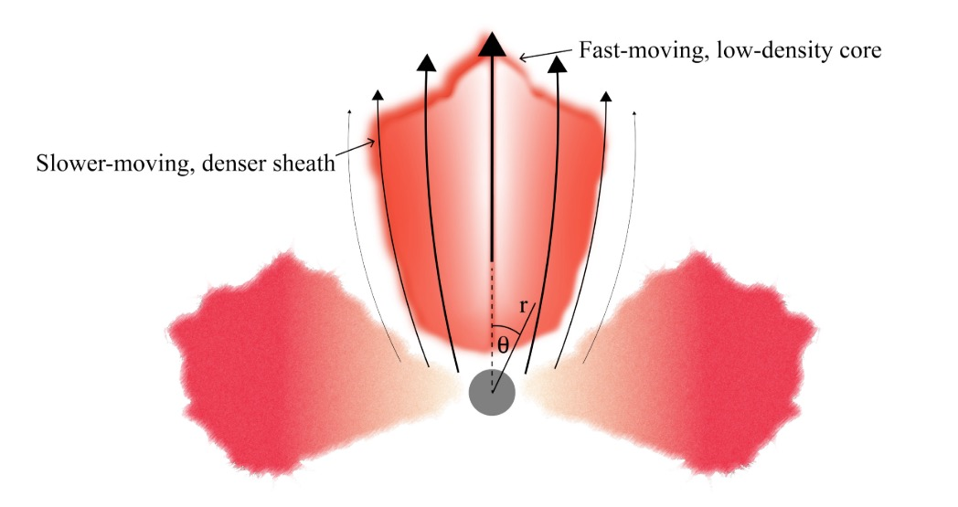
An off-axis jet
How about a structured jet?
Viscous-like interactions between jet and medium produces slower moving and dense sheath
Line of sight is aligned with the sheath
  Optically thick
  Varying optical depth and composite regions produce effective photosphere and quasi-thermal spectrum
First example of an X-ray off-axis jetted TDE?
Coughlin and Begelman, 2020

Slide 16
Testing the jet model
Radio observations can be used to test this model.
eMERLIN observed last year
Full analysis is on going but non-detection
  E_{jet} ≳ 1-2 orders of magnitude smaller than Swift J1644+57
Not necessarily ruled out but…
Eyles-Ferris et al. in prep.

Slide 17
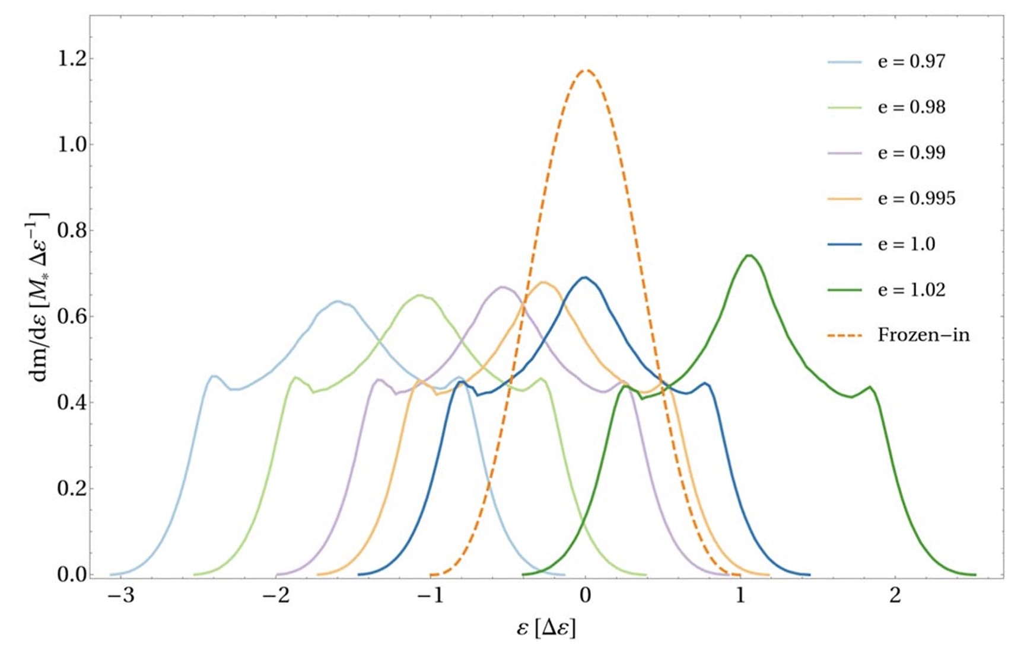

Another option – fully bound TDEs
Stars are normally assumed to have parabolic orbits
  Means ~half the material is bound when its disrupted
But this fraction depends on the eccentricity of the orbit
  More circular orbits mean more debris is bound
  Below $e_{crit}^{−}$, all debris is bound
Can produce the orbit through Hills capture
Cufari, Coughlin and Nixon, 2022

Slide 18
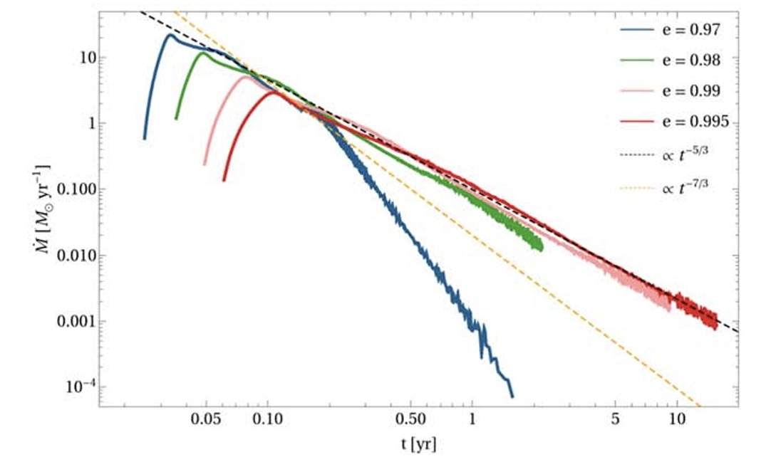

What do fully bound TDEs look like?
Fallback rate rises and initially decays slowly
Sudden drop at late time as the entire star is accreted
  Can derive this time analytically
For a Solar type star and a 10⁷ $M_{⊙}$black hole, e ~ 0.98 gives required timescale
  Numerical simulations will confirm
First example of a fully bound TDE?
Cufari, Coughlin and Nixon, 2022

Slide 19
Conclusions
LSXPS J0956 is unique – a thermal X-ray TDE that turns off
Two possible models
  Off-axis jetted TDE
  Fully bound TDE
Do all jetted TDEs look like jetted TDEs?
Are eccentric orbits common in TDEs and how do they affect them?

Slide 20
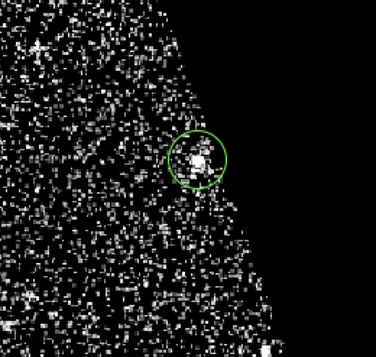
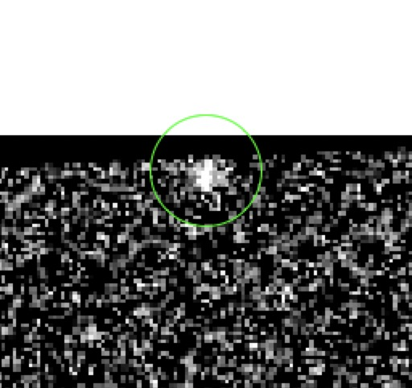
BONUS SLIDE – What about UVOT?

Slide 21
BONUS SLIDE – What about UVOT?

