Slide 1
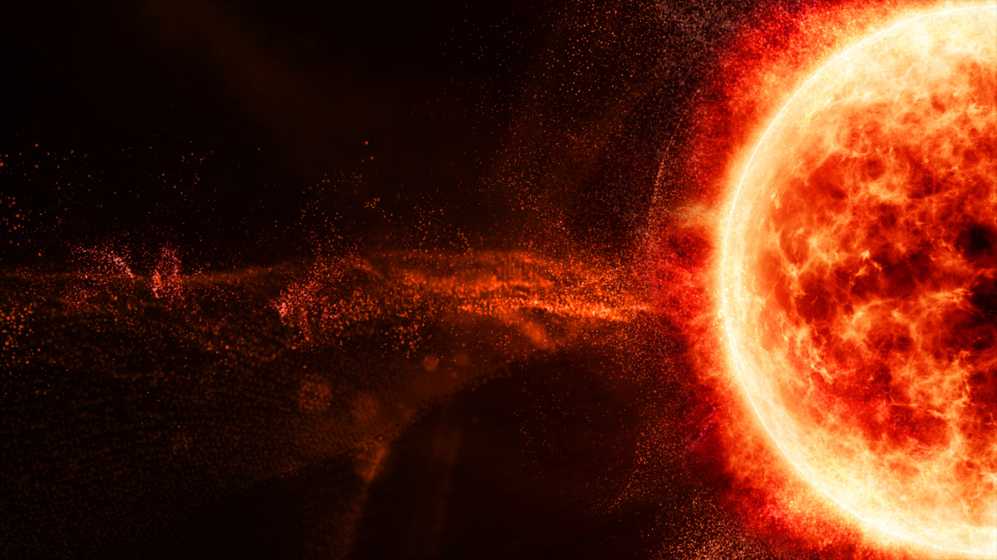
Fermi LAT analysis of
Solar Flares
Amrit Nayak
Prof. Anthony Brown
Prof. Paula Chadwick
09 July 2025
amrit.p.nayak@durham.ac.uk

Slide 2
Outline
Introduction
Fermi LAT observation
Spectral information
Flare classification
Conclusion

Slide 3
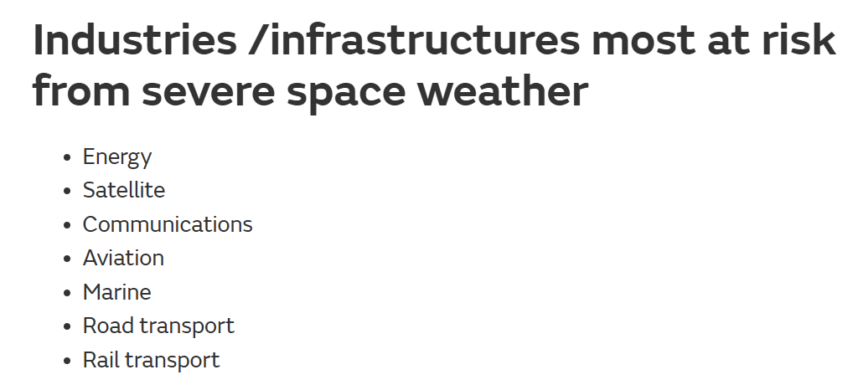
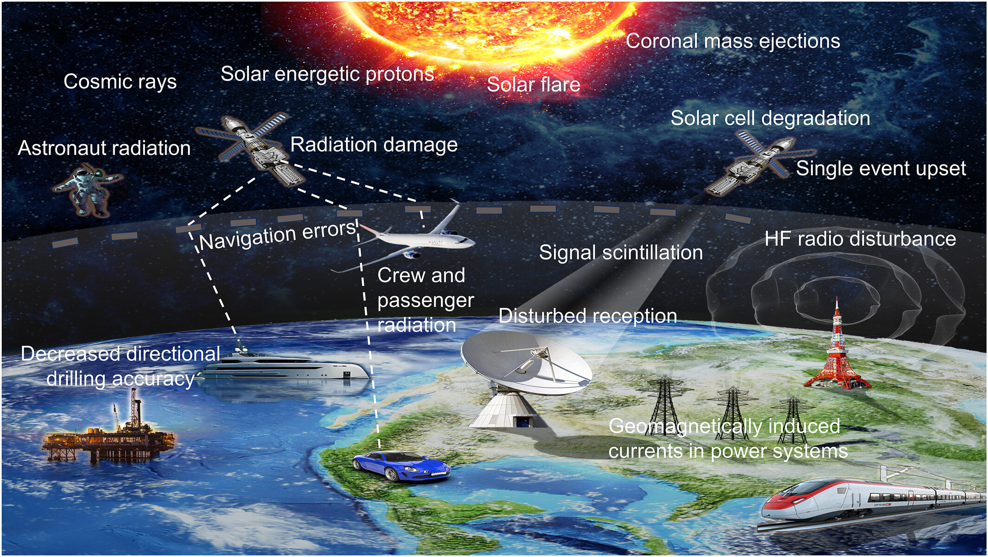
Importance of Space Weather

Slide 4
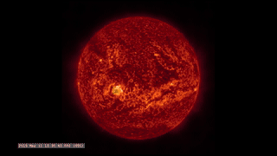
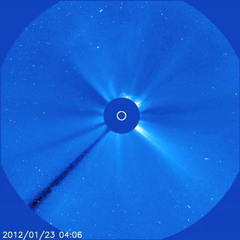
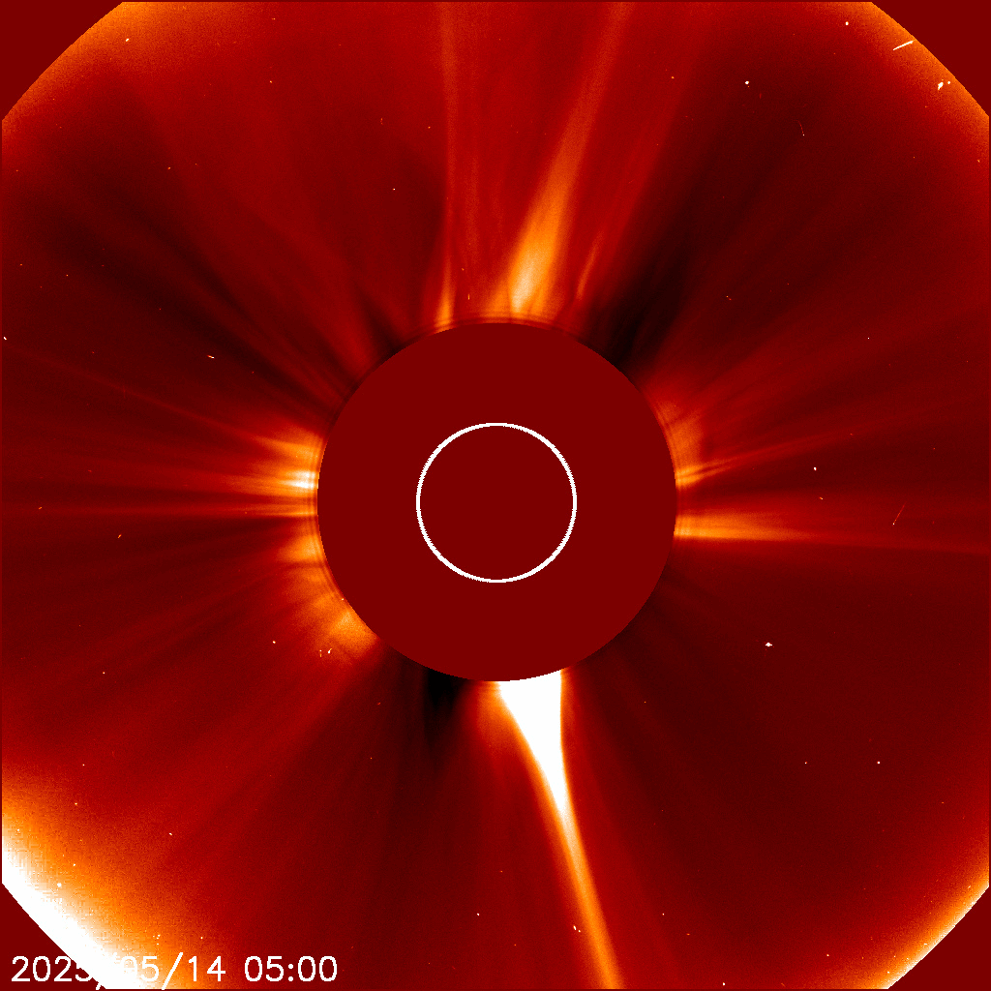
Solar Activity (Thermal Emission)
Event | Solar Flare | Solar Energetic Particle | Coronal Mass Ejection
Images
Cause | Magnetic reconnection | Particle acceleration in reconnection or shock | Magnetic reconnection
Effect | Sudden release of EM radiation | Acceleration of charged particles to high energies | Release of plasma and magnetic field from Sun’s corona
Affected | Radio communication, GNSS | Polar flights, Space equipment, Astronauts | Power grids, Satellite drag
(Credit – NASA science visualisation studio)
https://svs.gsfc.nasa.gov/4282/
(Credit – NASA science explore)
https://science.nasa.gov/sun/solar-storms-and-flares/
Generated from LASCO C2 Data

Slide 5
Solar Activity (Non-Thermal Emission)
Magnetic reconnection
Electrons and protons travel downward towards sun
Thick target interaction
Electrons produce hard X-rays via Bremsstrahlung
Protons produce Gamma rays via Pion decay
KeV to tens of MeV energy radiation
~30 MeV to few GeV energy radiation
Standard Solar Flare Model
(Credit - Lysenko et.al 2019, X-ray and gamma-ray emission of solar flares)

Slide 6
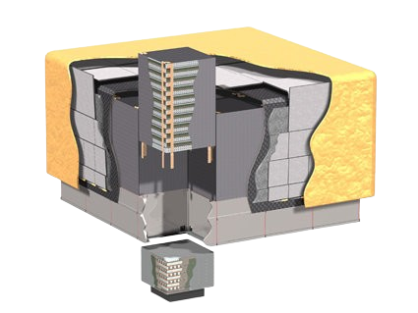
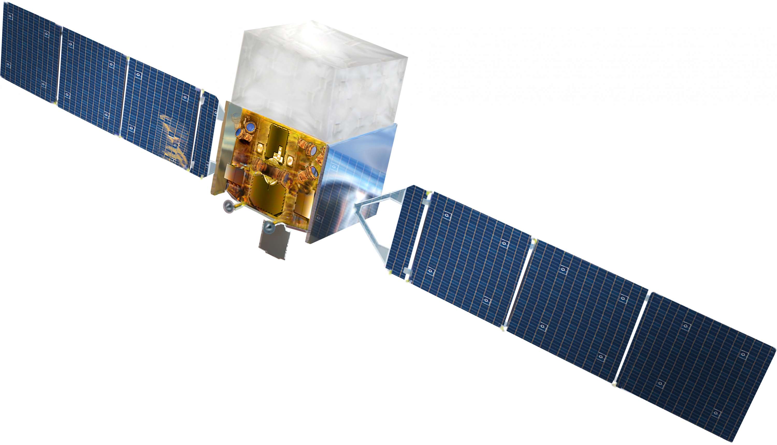
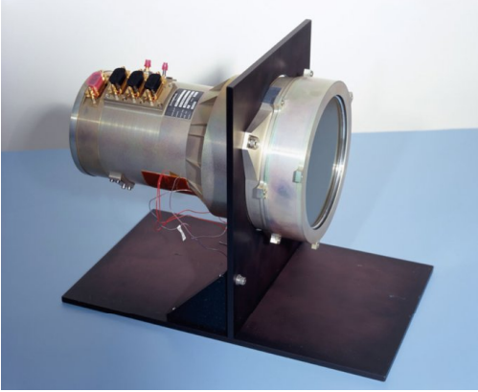
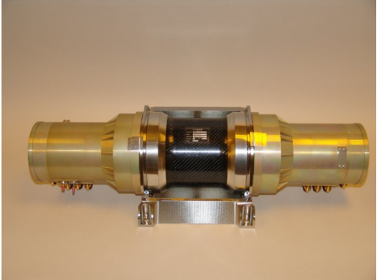
Observation
Large Area Telescope
Energy range | 100 MeV – 300 GeV
Angular resolution | 3.5° (100 MeV) <0.15° ( >10 GeV)
Energy resolution | <10%
Detection method | Pair production
Fermi is the only open-science space-based telescope doing dedicated gamma ray observation.
Fermi Telescope
Mode | Survey Mode
Orbital Period | ~96 mins
FoV | All sky
Operation Period | 2008 - Present
Gamma Ray Burst Monitor
Energy range | 10 KeV – 25 MeV
Angular resolution | 15° ( Alert) 3° (Final)
Energy resolution | <10%
Detection method | Scintillation

Slide 7
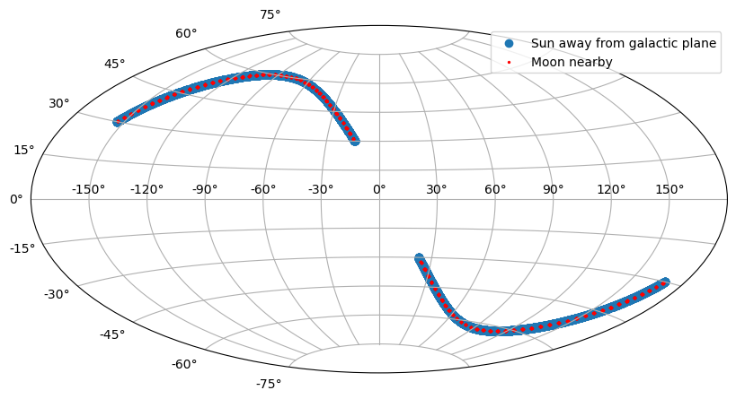
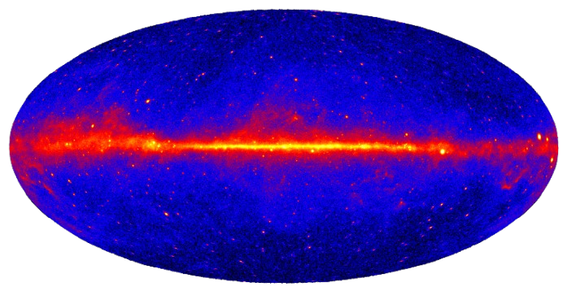
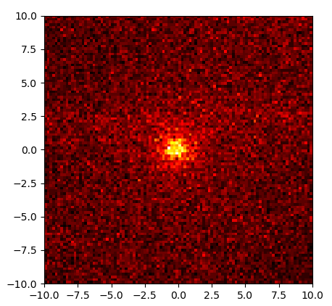
Data Analysis
Data
Weekly photon files
Weekly spacecraft files
Recipe
Photon selection in 10° ROI
Exposure calculation
Model Selection
Forward folding with IRF
Unbinned Likelihood analysis
Flare observation profile
45
Solar flares detected by FermiLAT 2010 – 2018
(Source – FermiLAT solar flare catalogue)
Result
Best fit parameter
Spectral energy density
Quiet Sun gamma ray emission

Slide 8
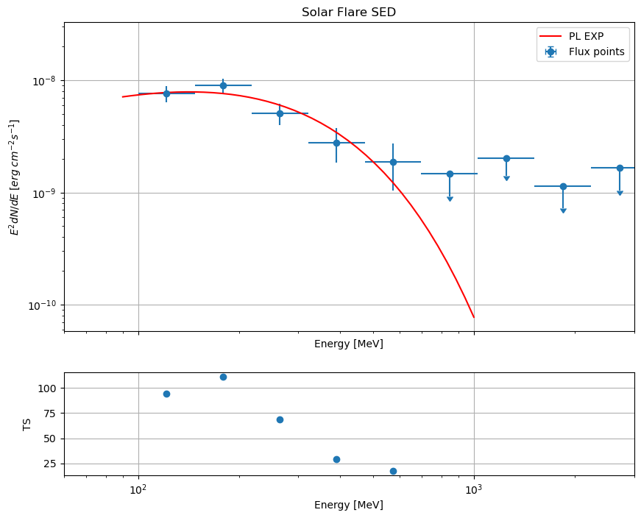
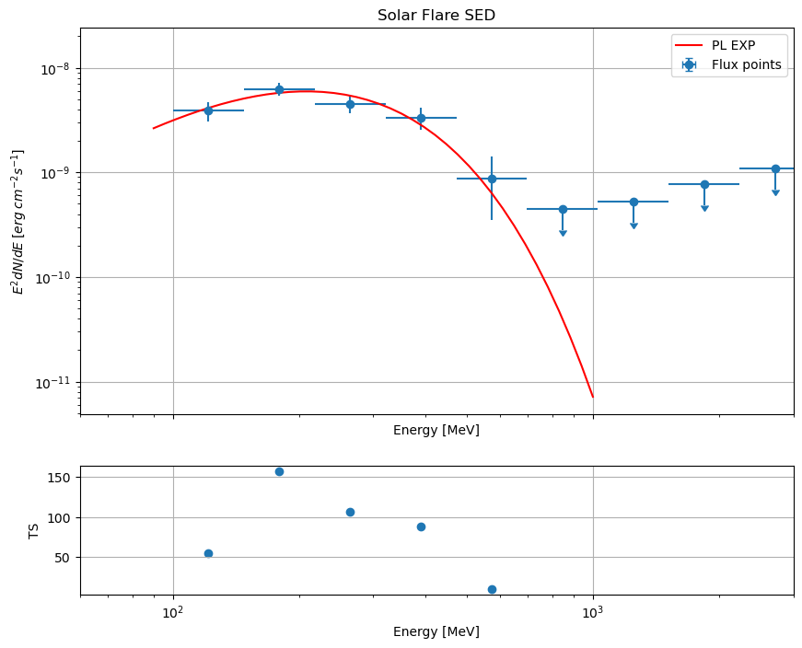
Spectral Information

Slide 9
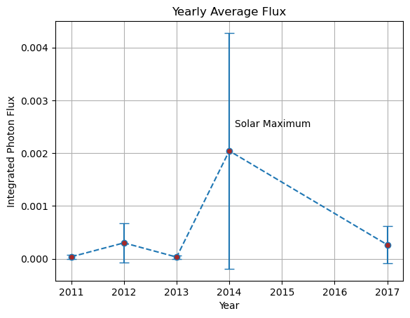
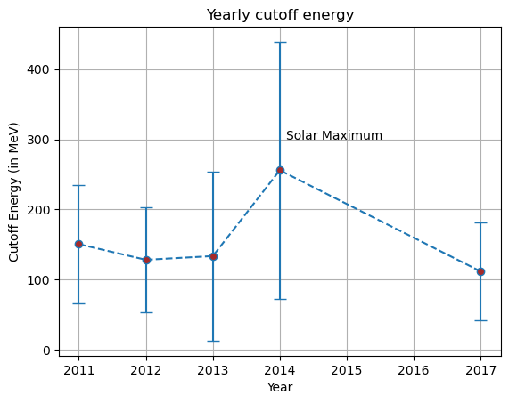
Fermi Solar flare results

Slide 10
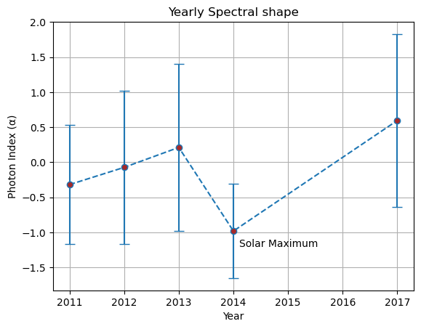
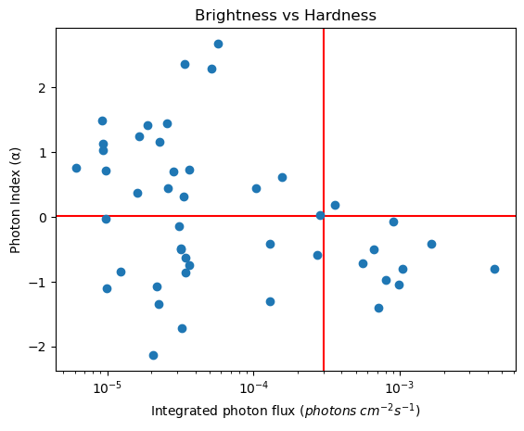
Fermi Solar flare results

Slide 11
Flare Classification
This summary is based on the FermiLAT solar flare catalogue.
(https://iopscience.iop.org/article/10.3847/1538-4365/abd32e/pdf)
Prompt Emission
14324
CMEs from 2010 – 2018
(Source – LASCO CME catalogue)
45
Solar flares detected by FermiLAT 2010 - 2018
Delayed Emission
Behind the limb
The emission mechanism for all these different types of flares is not completely understood.

Slide 12
Conclusion
Open Questions
Limited potential of observing the solar flares directly with ground-based instruments.
Origin of sustained gamma ray observation hours after the prompt phase.
Gamma ray flux are correlated with the solar maxima
Acceleration site of the particle.
Chromosphere vs higher up in corona
All flares have similar cutoff energy

