Slide 1
The competing effects of recent and long-term star-formation histories on galaxy chemical abundances
Nicholas Boardman, Vivienne Wild, Natalia Vale Asari, Francesco D’Eugenio
arXiv: 2505.07018
Notes:
Introduce myself. For anyone who doesn’t know me, I’m a postdoc in St Andrews. And I’m going to start with the key takeaway…

Slide 2
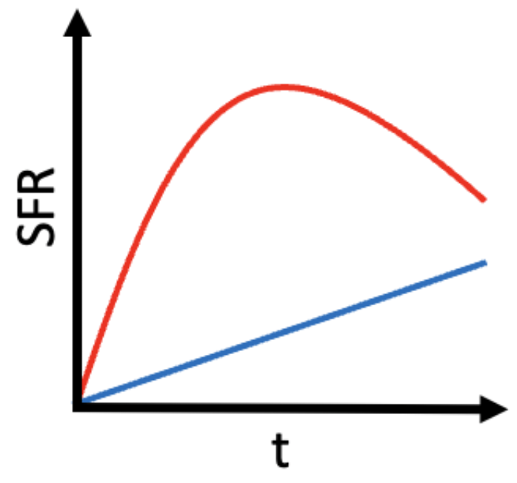
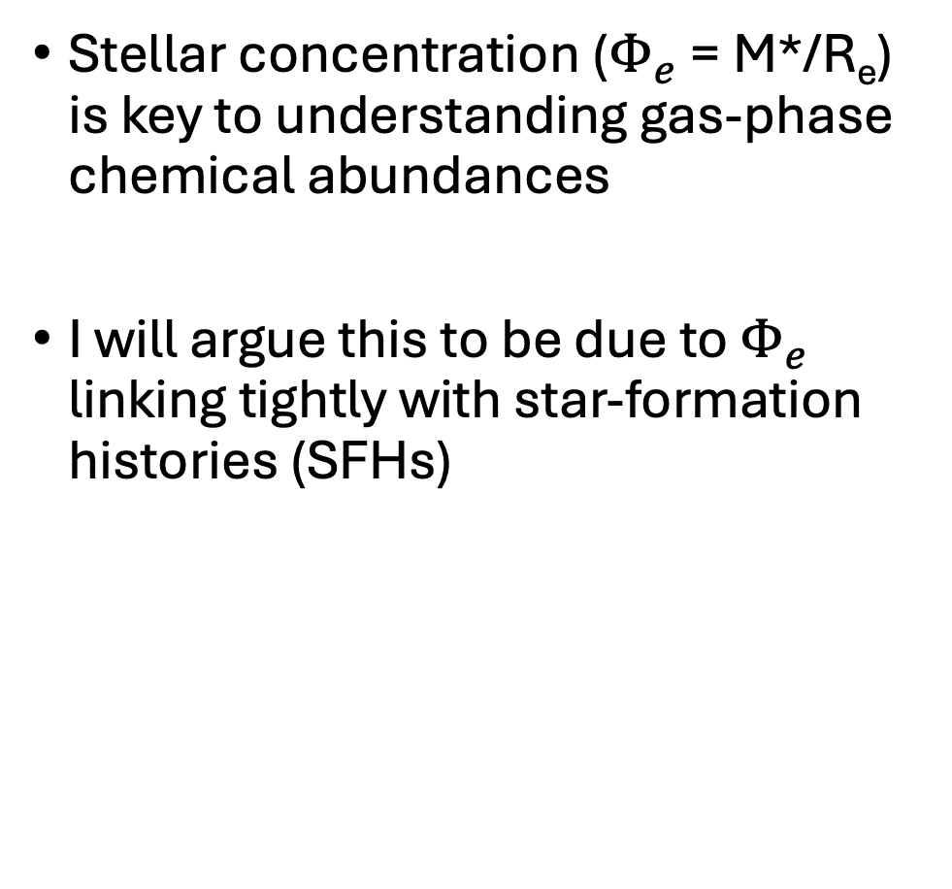
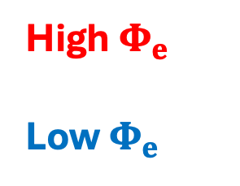
The key takeaway
Stellar concentration ($Φ_{e}$ = M*/R_{e}) is key to understanding gas-phase chemical abundances
I will argue this to be due to $Φ_{e}$ linking tightly with star-formation histories (SFHs)
High $Φ_{e}$
Low $Φ_{e}$
Adapted from Boardman et al. 2025
Notes:
I’ll actually start with what I want you to take away from this talk. Firstly, the parameter Phi_e - stellar mass divided by effective radius - is a key parameter for understanding gas phase chemical abundances. I will argue that this is due to Phi_e being tightly linked to the star-formation history of galaxies: with high Phi_e galaxies possessing earlier star-formation histories and low Phi_e galaxies possessing later star-formation histories. This is all based on low z observations but will have implications for higher-z work.

Slide 3
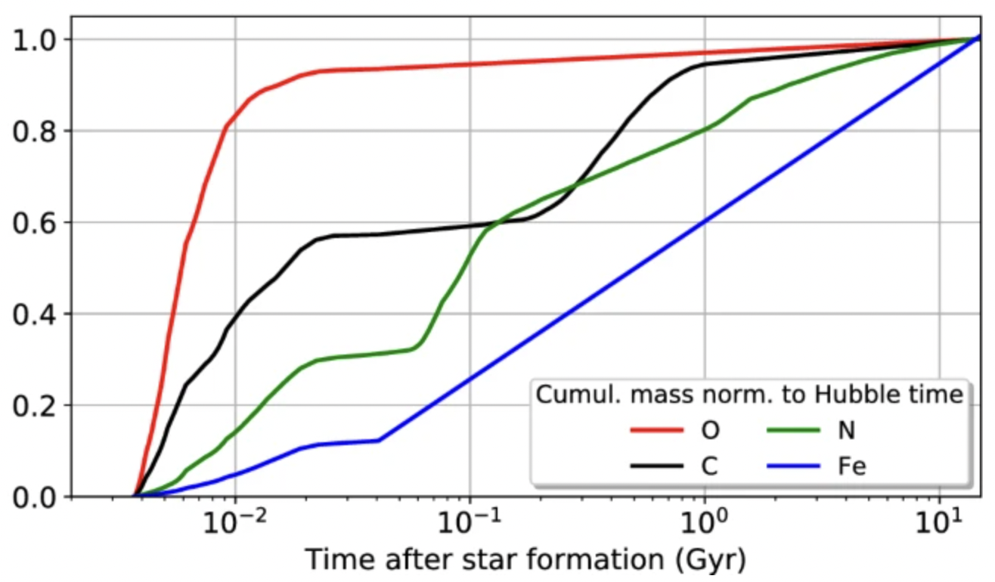
The value of gaseous chemical abundances
Maiolino & Mannucci 2019; attributed to model of Vincenzo et al. in prep.
Gaseous chemical abundances are end-products of galaxy evolution
O and N are both easy to measure in star-forming gas
N enrichment proceeds over longer timescales at a metallicity-dependent rate
  Though, still not well-understood, as certain JWST results can attest!
Notes:
Now, gaseous chemical abundances represent the end-products of galaxy evolution, making them an observable consequence of how galaxies form and evolve. Within star-forming gas, two elements which are comparatively easy to measure are O and N. O is released on very short timescales after any given star-formation event, whereas Nitrogen is released over much longer timescales at a metallicity-dependent rate…though Nitrogen is still not well-understood, as JWST result can attest!

Slide 4
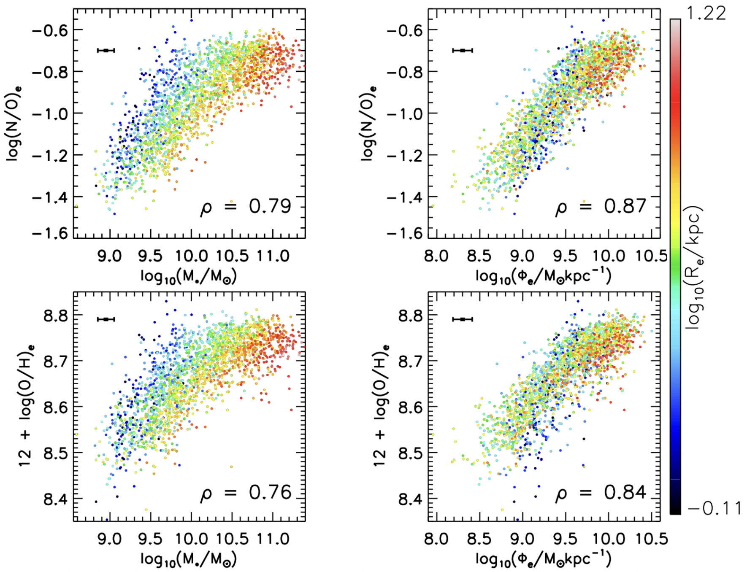



The $Φ_{e}$-N/O relation across galaxies
16
N/O correlates more strongly with $Φ_{e}$ than with M*, as has previously been reported for metallicity¹
Interestingly, $Φ_{e}$ appears to correlate more strongly with N/O then with metallicity
  This suggests that $Φ_{e}$ is indicative of star-formation histories
Spearman correlation coefficient
(Remember: $Φ_{e}$=M*/R_{e})
Boardman et al. 2024
arXiv: 2407.17945
¹D’Eugenio et al. 2018
Notes:
Recently, I led a study looking how the Phi_e parameter correlates with the gaseous N/O abundance ratio in star-forming MaNGA galaxies. I plot at the top N/O vs stellar mass and N/O vs Phi_e, with data points coloured by effective radius and with spearman correlation coefficients also shown. I show equivalent relations for the gas metallicity O/H below. I find Phi_e to provide the tighter correlation with no clear residual dependence on effective radius, similarly to what has been reported previously for metallicity; interestingly however, Phi_e actually seems to correlate slighrtly more tightly with N/O than with the oxygen abundance, based on the derived correlation coefficients.

Slide 5
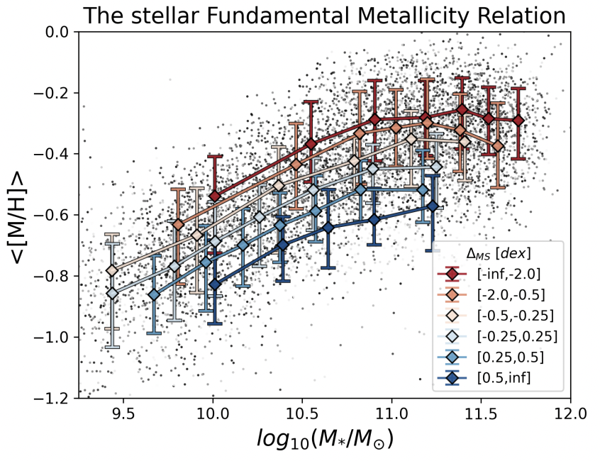
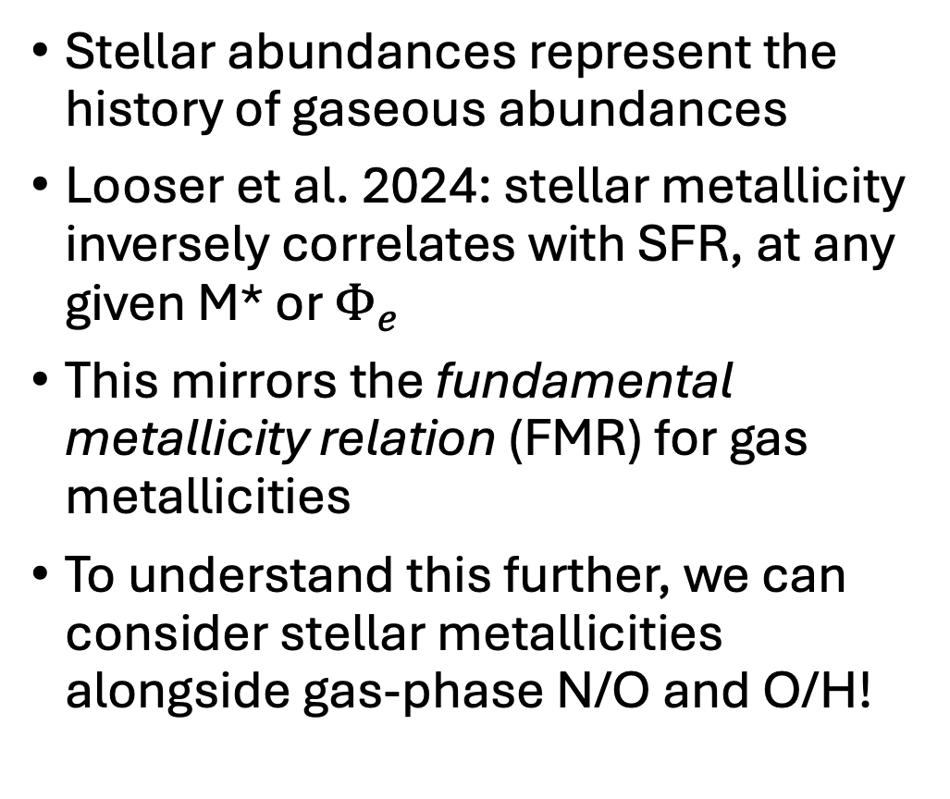
What about stellar metallicity?
Stellar abundances represent the history of gaseous abundances
Looser et al. 2024: stellar metallicity inversely correlates with SFR, at any given M* or $Φ_{e}$
This mirrors the fundamental metallicity relation (FMR) for gas metallicities
To understand this further, we can consider stellar metallicities alongside gas-phase N/O and O/H!
Looser et al. 2024
Notes:
Stellar chemical abundances provide another useful tool, due to these effectively representing the chemistry of gas at the time stars were formed. It was recently reported in Looser et al. that, at any given stellar mass or Phi_e, stellar metallcity inversely correlated with star-formation rate. This mirrors were so-called fundamental metallicity relation between stellar mass, star-formation rate and gas metallicity, and it suggests a significant connection between a galaxy’s star-formation properties and its metallicity history. We can gain more information however by combining this with the gaseous O/H and N/O abundances, to probe the chemistry of galaxies over a wide range of timescales.

Slide 6
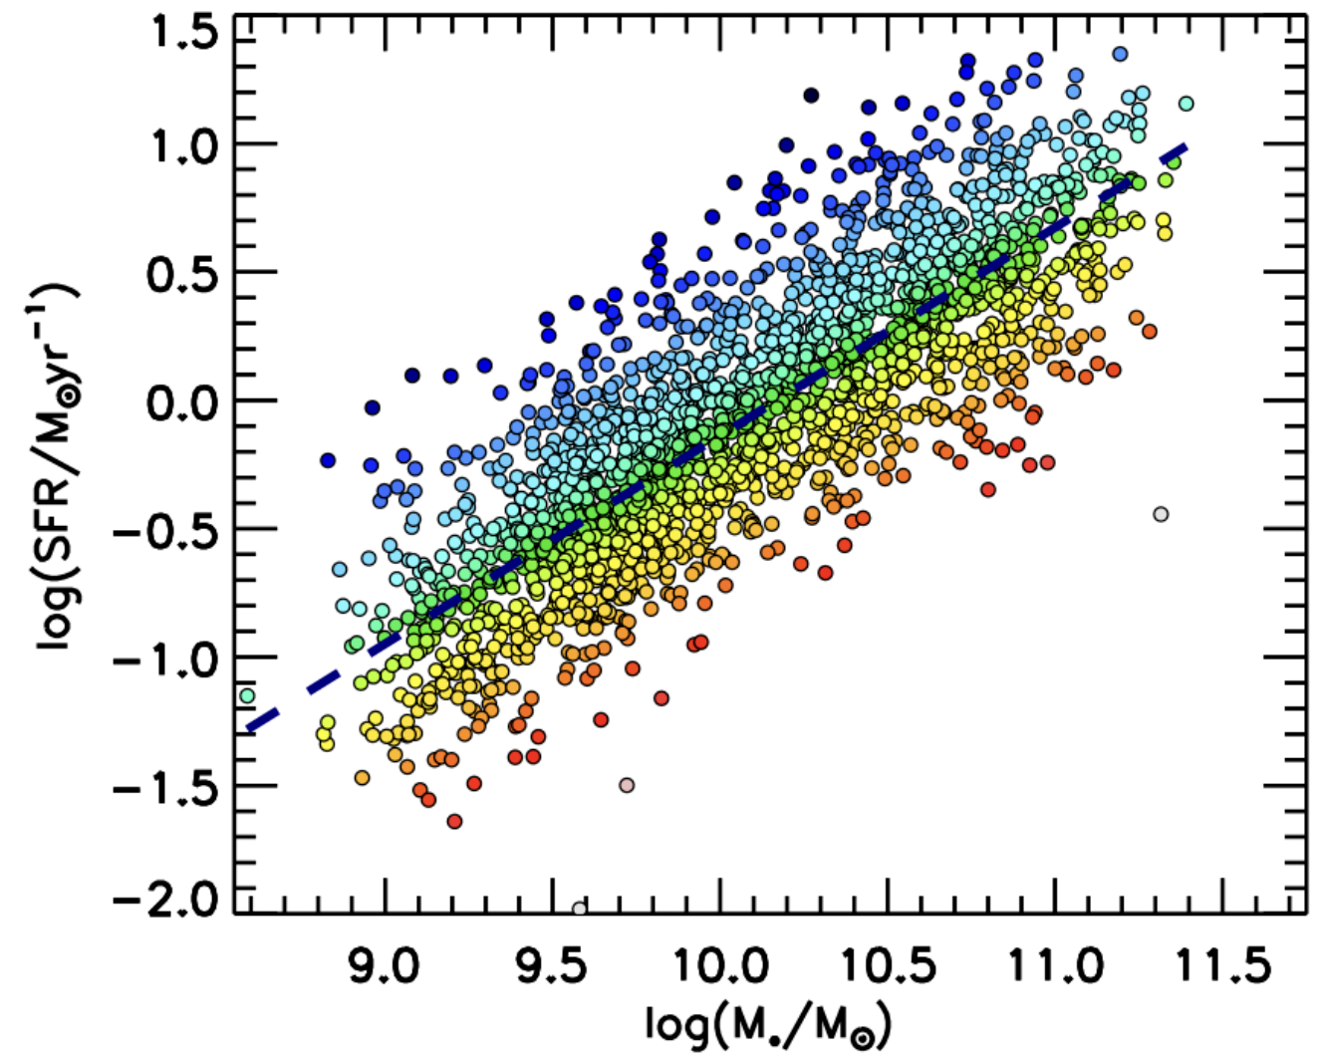


Sample & Data
$Δ$SFR
We obtained emission line maps from MaNGA survey data
From these maps, we determined N/O and O/H values at 1 R_{e}
M* and R_{e} obtained from NASA-Sloan-Atlas catalog (Blanton et al. 2011)
Light-weighted 1 R_{e} stellar metallicities [Z/H] from pyPipe3d DR17 release (Sánchez et al. 2022)
Galaxy sample also used in Boardman et al. 2024
1.2
Final sample: 2070 galaxies
-1.2
(SFRs are H$α$ SFRs from pyPipe3d)
Boardman et al. 2025
Notes:
Sample consists of galaxies with enough star-forming MaNGA spaxels to reliably estimate O/H and N/O, resulting in a sample of star-forming galaxies. For each galaxy, we tracked the offset from the fitted star-forming sequence. M*, Re and light weighted [Z/H] all obtained from published catalogs

Slide 7
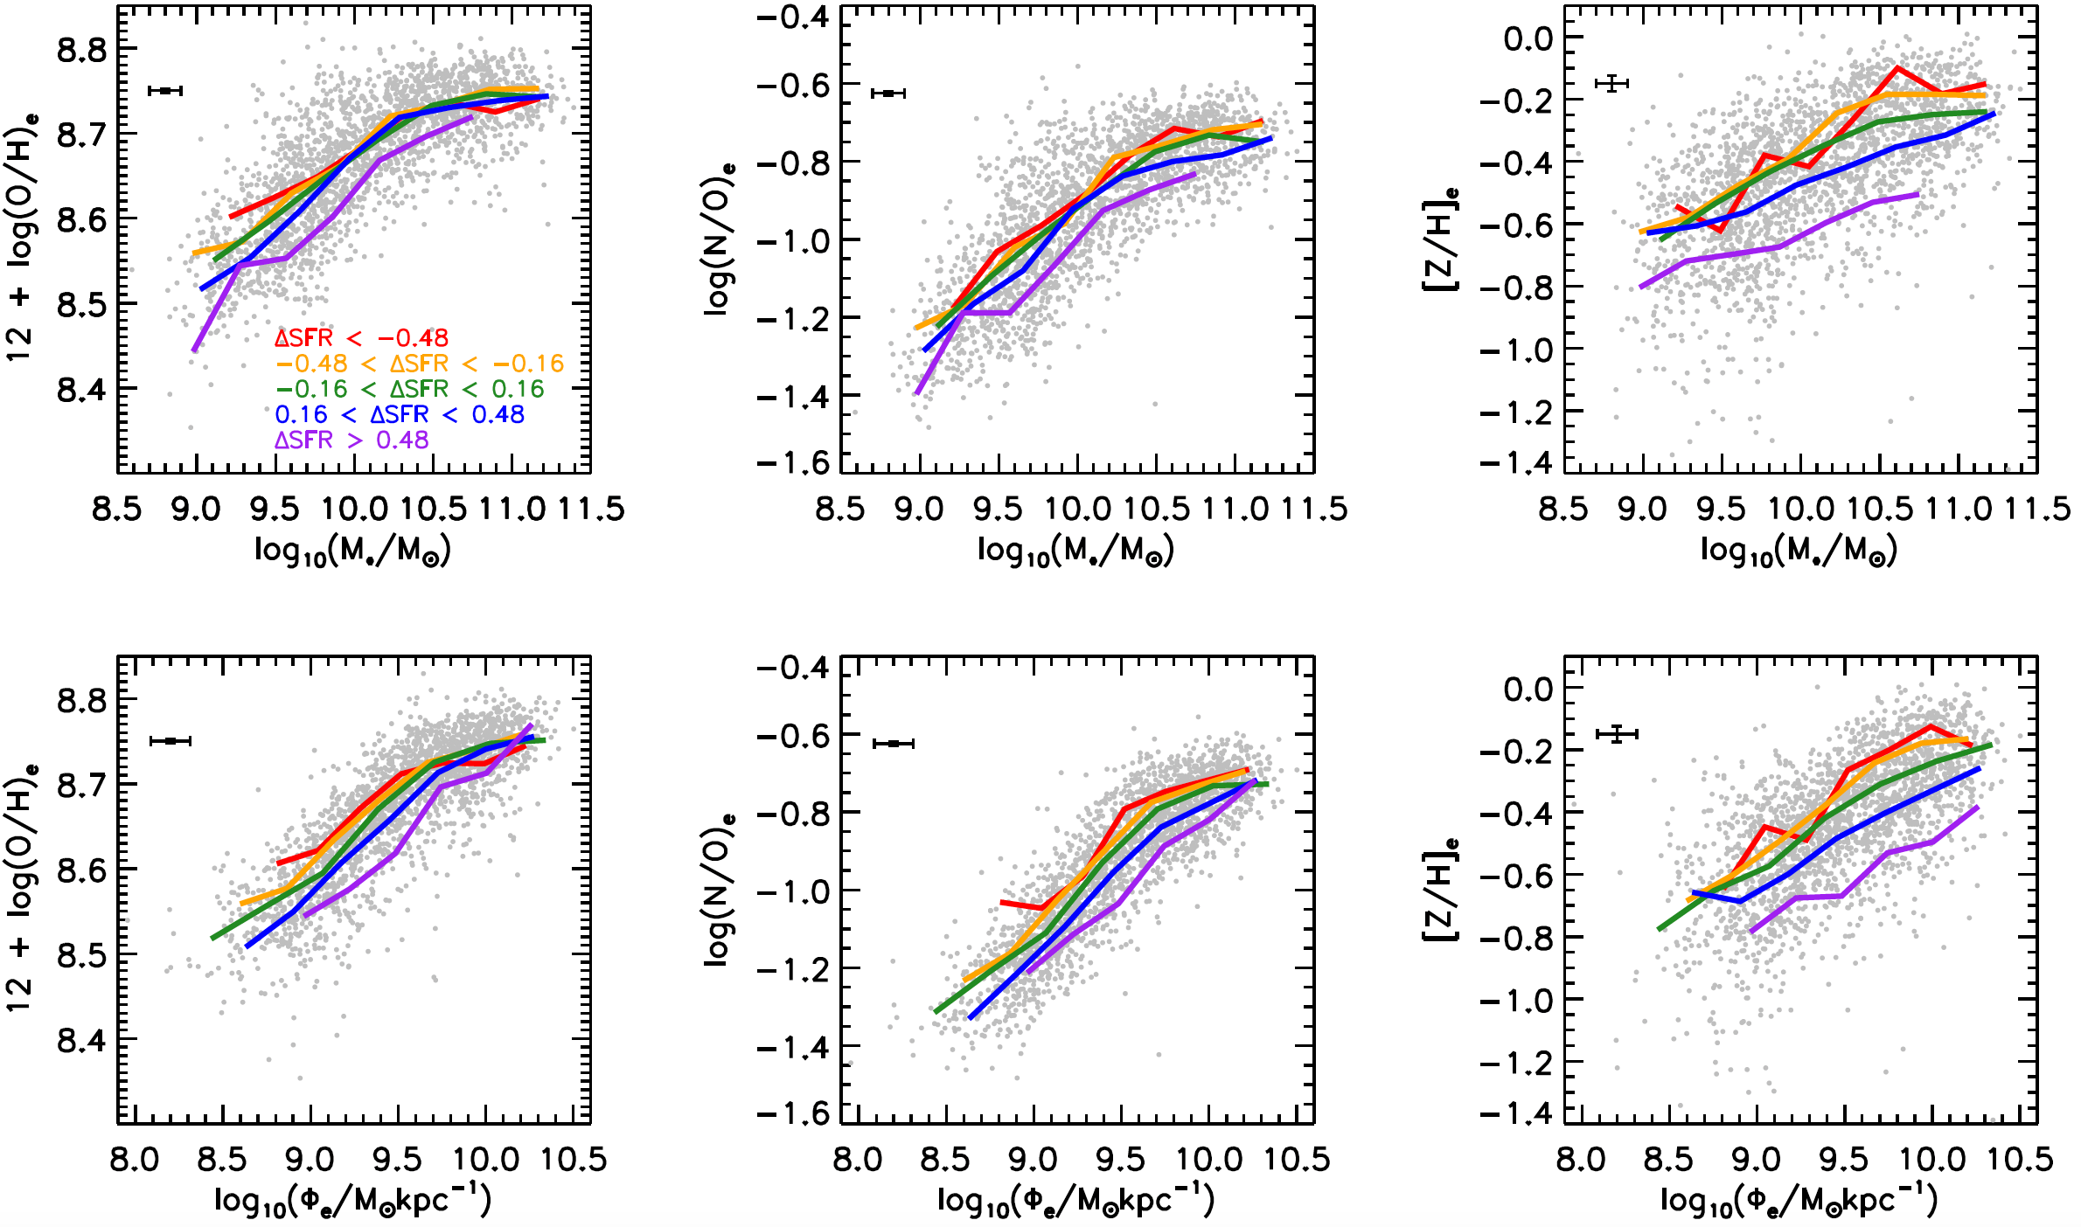
How informative are different ‘fundamental’ relations?
Traditional FMR weakens at high M*; N/O relation persists, while [Z/H] relation strengthens
Replacing M* with $Φ_{e}$ significantly strengthens the gaseous relations
Boardman et al. 2025
Notes:
I now show the fundamental metallicity relation on the left, with equivalent relation for N/O and stellar metallicity plotted in the middle and right. The grey points represent individual galaxies, while the coloured lines represent medians for galaxies grouped by their star formation rate. We can see how the traditional FMR effectively disappears at higher masses, which is a well-known result; however, we can see that the N/O relation persists over the full mass range, while the stellar metallicity relation actually seems to become somewhat stronger at higher masses.

Slide 8
How informative are different ‘fundamental’ relations?
Traditional FMR weakens at high M*; N/O relation persists, while [Z/H] relation strengthens
Replacing M* with $Φ_{e}$ significantly strengthens the gaseous relations
Boardman et al. 2025
Notes:
I next show equivalent plots to the above ones, in which Phi_e has replaced stellar mass. Looking at the plots for gas abundances, we see a greater separation between coloured lines, indicating that Phi_e and SFR capture the scatter quite a bit better than do stellar mass and SFR. Again however, we see that gas metallicity relation falls off at high phi_e, while the N/O relation persists and while the stellar metallicity relation strengthens.

Slide 9


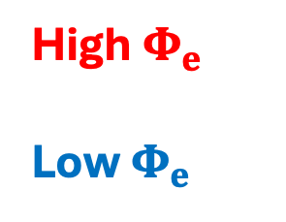


Why is$Φ_{e}$ so predictive of chemical abundances?
($Φ_{e}$=M*/R_{e})
High $Φ_{e}$
Low $Φ_{e}$
Low $Φ_{e}$
Late SFH
Lower O/H
High $Φ_{e}$
Early SFH
Higher O/H
Boardman et al. 2025
Notes:
So why is Phi_e so predictive of chemical abundances? Essentially, we believe this to be due to Phi_e relating tightly to star-formation history with in turn relates tightly to chemical evolution history. In this view, low Phi_e corresponds to late and gradual star-formation histories, with slow metal enrichment along with low final metallicities. High Phi_e corresponds to earlier SFHs, faster metal-enrichment and higher final metallicities…

Slide 10
Why is$Φ_{e}$ so predictive of chemical abundances?
($Φ_{e}$=M*/R_{e})
High $Φ_{e}$
Low $Φ_{e}$
Low $Φ_{e}$
Late SFH
Lower O/H
Lower N/O
High $Φ_{e}$
Early SFH
Higher O/H
Higher N/O
Boardman et al. 2025
Notes:
So why is Phi_e so predictive of different chemical abundance measures? Essentially, we believe this to be due to Phi_e relating tightly to star-formation history with in turn relates tightly to chemical evolution history. In this view, low Phi_e corresponds to late and gradual star-formation histories, with slow metal enrichment along with low final metallicities. High Phi_e corresponds to earlier SFHs, faster metal-enrichment and higher final metallicities…we should not however that N/O will also be affected due to N enrichment depending on metallicity, producing different tracks in N/O-metallicity space.

Slide 11
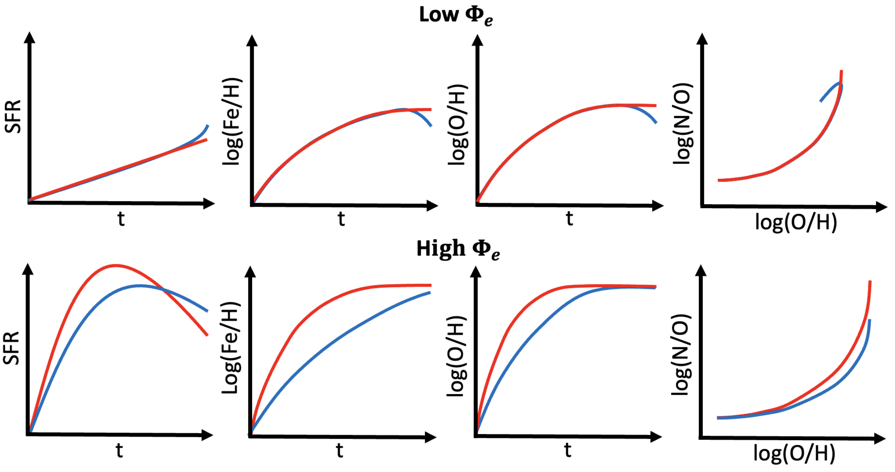

A unified interpretation of ‘fundamental’ relations
Low $Φ_{e}$
SFR variations
Late-time gas inflow variations
Boardman et al. 2025
Notes:
And next we can consider why star-formation state seems to matter so much at a given Phi_e. Or to put it another way, how can we interpret the so-called ‘fundamentall’ relations. In the case of low Phi_e, we believe this to be driven by short-term variations in gas inflow histories, as for instance shown in the above cartoon, where an increased gas infall into one galaxy has caused their star-formation rates to diverge…

Slide 12
A unified interpretation of ‘fundamental’ relations
Low $Φ_{e}$
SFR variations
Late-time gas inflow variations
BUT: little impact on measured [Z/H]
O/H variations
Boardman et al. 2025
Notes:
And next we can consider why star-formation state seems to matter so much at a given Phi_e. Or to put it another way, how can we interpret the so-called ‘fundamentall’ relations. In the case of low Phi_e, we believe this to be driven by short-term variations in gas inflow histories, as for instance shown in the above cartoon, where an increased gas infall into one galaxy has caused their star-formation rates to diverge…

Slide 13
A unified interpretation of ‘fundamental’ relations
Low $Φ_{e}$
SFR variations
Late-time gas inflow variations
BUT: little impact on measured [Z/H]
O/H variations
N/O variations
Boardman et al. accepted
Notes:
And next we can consider why star-formation state seems to matter so much at a given Phi_e. Or to put it another way, how can we interpret the so-called ‘fundamentall’ relations. In the case of low Phi_e, we believe this to be driven by short-term variations in gas inflow histories, as for instance shown in the above cartoon, where an increased gas infall into one galaxy has caused their star-formation rates to diverge…

Slide 14

A unified interpretation of ‘fundamental’ relations
High $Φ_{e}$
SFR variations
Long-term SFH variations
Boardman et al. 2025
Notes:
Reveal these in stages; delete the Fe/H to prevent confusion; make clear these are ISM abudnances. Also, use block charts to make it easier to digest; can reveal low Phi_e and high Phi_e separately.

Slide 15
A unified interpretation of ‘fundamental’ relations
High $Φ_{e}$
SFR variations
Long-term SFH variations
BUT: little impact on final measured O/H
[Z/H] variations
Boardman et al. 2025
Notes:
Reveal these in stages; delete the Fe/H to prevent confusion; make clear these are ISM abudnances. Also, use block charts to make it easier to digest; can reveal low Phi_e and high Phi_e separately.

Slide 16
A unified interpretation of ‘fundamental’ relations
High $Φ_{e}$
SFR variations
Long-term SFH variations
BUT: little impact on final measured O/H
[Z/H] variations
N/O variations
Boardman et al. 2025
Notes:
Reveal these in stages; delete the Fe/H to prevent confusion; make clear these are ISM abudnances. Also, use block charts to make it easier to digest; can reveal low Phi_e and high Phi_e separately.

Slide 17
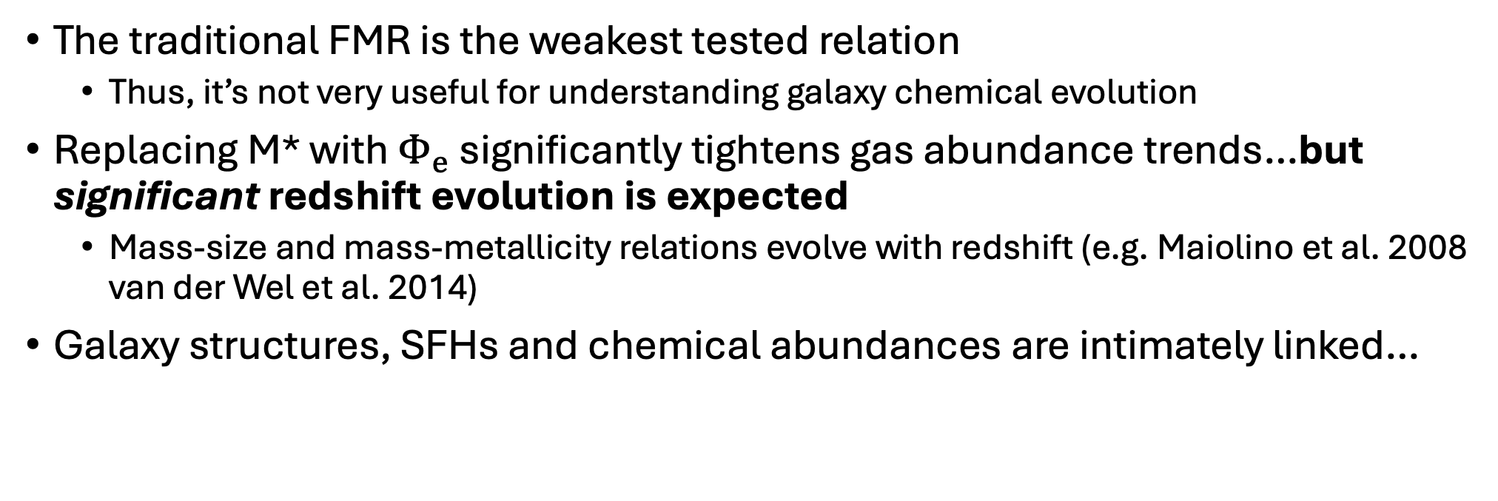
Implications for high-redshift observations
The traditional FMR is the weakest tested relation
  Thus, it’s not very useful for understanding galaxy chemical evolution
Replacing M* with $Φ_{e}$ significantly tightens gas abundance trends…but significant redshift evolution is expected
  Mass-size and mass-metallicity relations evolve with redshift (e.g. Maiolino et al. 2008 van der Wel et al. 2014)
Galaxy structures, SFHs and chemical abundances are intimately linked…
Structure
Chemical abundance
SFH
Notes:
Emphasize top points if I’m running low on time…

Slide 18
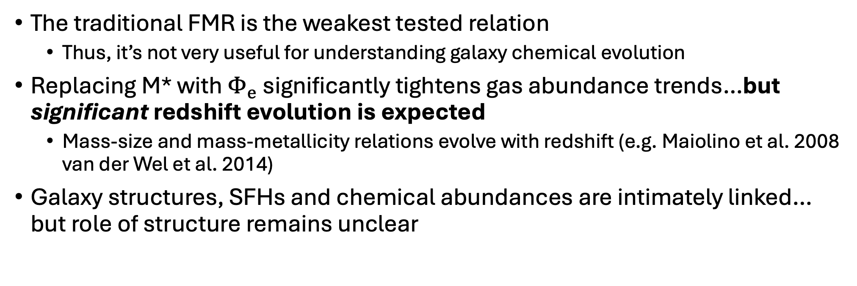
Implications for high-redshift observations
The traditional FMR is the weakest tested relation
  Thus, it’s not very useful for understanding galaxy chemical evolution
Replacing M* with $Φ_{e}$ significantly tightens gas abundance trends…but significant redshift evolution is expected
  Mass-size and mass-metallicity relations evolve with redshift (e.g. Maiolino et al. 2008 van der Wel et al. 2014)
Galaxy structures, SFHs and chemical abundances are intimately linked… but role of structure remains unclear
?
Structure
?
?
?
?
Chemical abundance
?
?
SFH
Notes:
Emphasize top points if I’m running low on time…

Slide 19
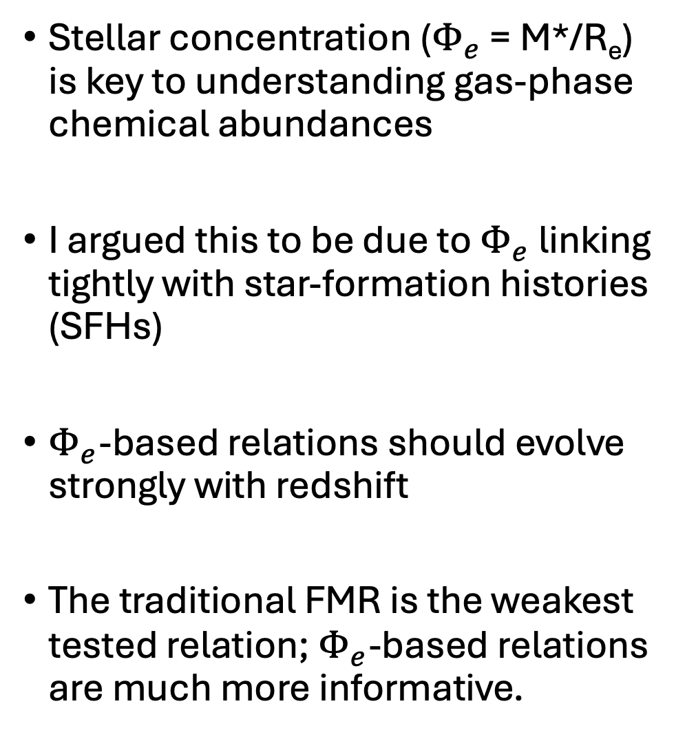
Summary
Stellar concentration ($Φ_{e}$ = M*/R_{e}) is key to understanding gas-phase chemical abundances
I argued this to be due to $Φ_{e}$ linking tightly with star-formation histories (SFHs)
$Φ_{e}$-based relations should evolve strongly with redshift
The traditional FMR is the weakest tested relation; $Φ_{e}$-based relations are much more informative.
High $Φ_{e}$
Low $Φ_{e}$
Adapted from Boardman et al. 2025
arXiv: 2505.07018
Notes:
Just leave up; I’ll be out of time.

Slide 21
Sample & Data
We obtained emission line maps from MaNGA survey data
From these maps, we determined N/O and O/H values at 1 R_{e}
M* and R_{e} obtained from NASA-Sloan-Atlas catalog (Blanton et al. 2011)
Light-weighted 1 R_{e} stellar metallicities [Z/H] from pyPipe3d DR17 release (Sánchez et al. 2022)
Galaxy sample also used in Boardman et al. 2024
$Δ$SFR
1.2
-1.2
(SFRs are H$α$ SFRs from pyPipe3d)
Boardman et al. accepted
Notes:
Sample consists of galaxies with enough star-forming MaNGA spaxels to reliably estimate O/H and N/O, resulting in a sample of star-forming galaxies. For each galaxy, we tracked the offset from the fitted star-forming sequence. M*, Re and light weighted [Z/H] all obtained from published catalogs

Slide 22
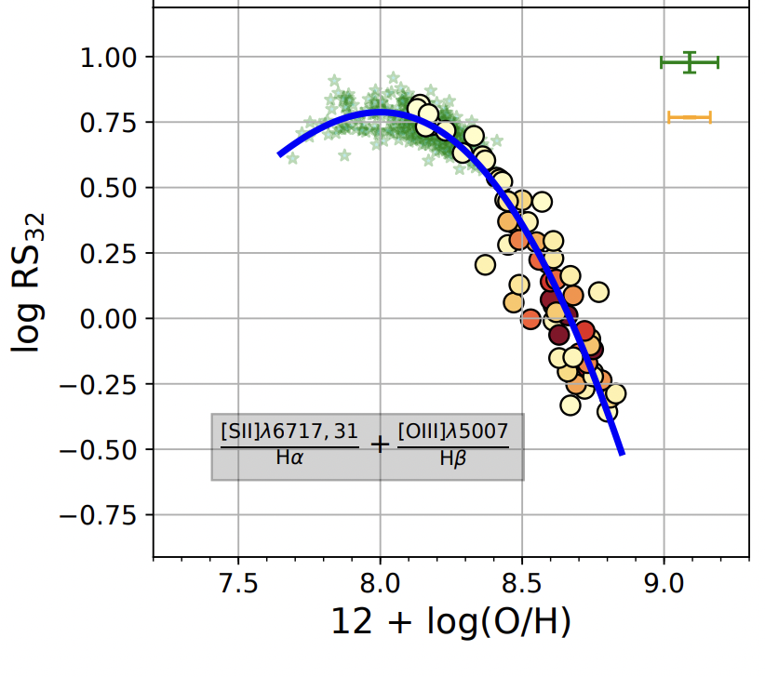
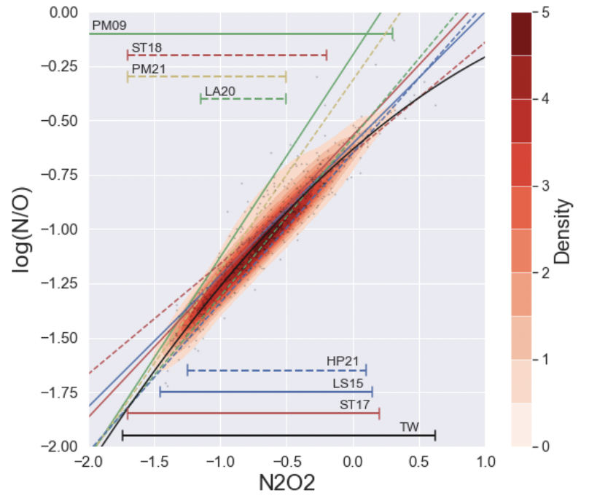
O/H and N/O calibrators
[NII]λ6585
[OII]λ3727, 29
Curti et al. 2020
Florido et al. 2022
O/H and N/O calculated via direct method strong line calibrators
Calibrators chosen for their independence: RS₃₂ for O/H, N2O2 for N/O

Slide 23
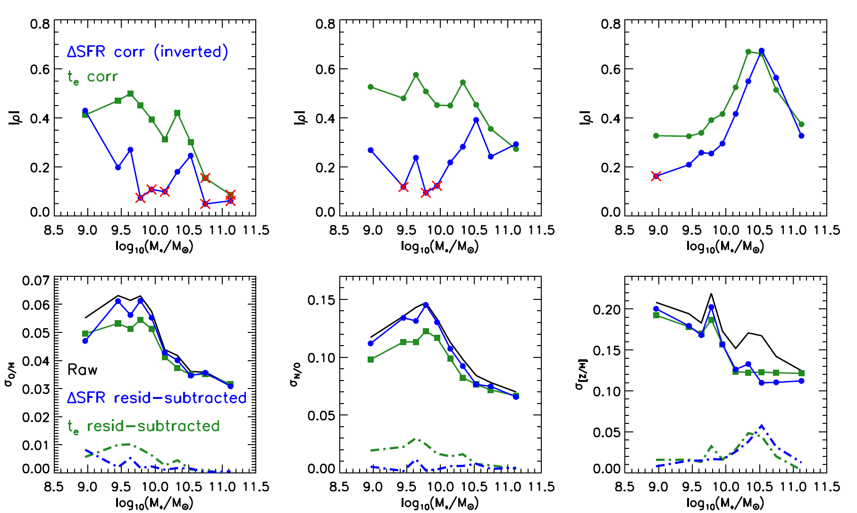
Traditional FMR weakens at high M*; N/O relation persists, while [Z/H] relation strengthens
Replacing M* with $Φ_{e}$ significantly strengthens the gaseous relations
Boardman et al. accepted

Slide 24
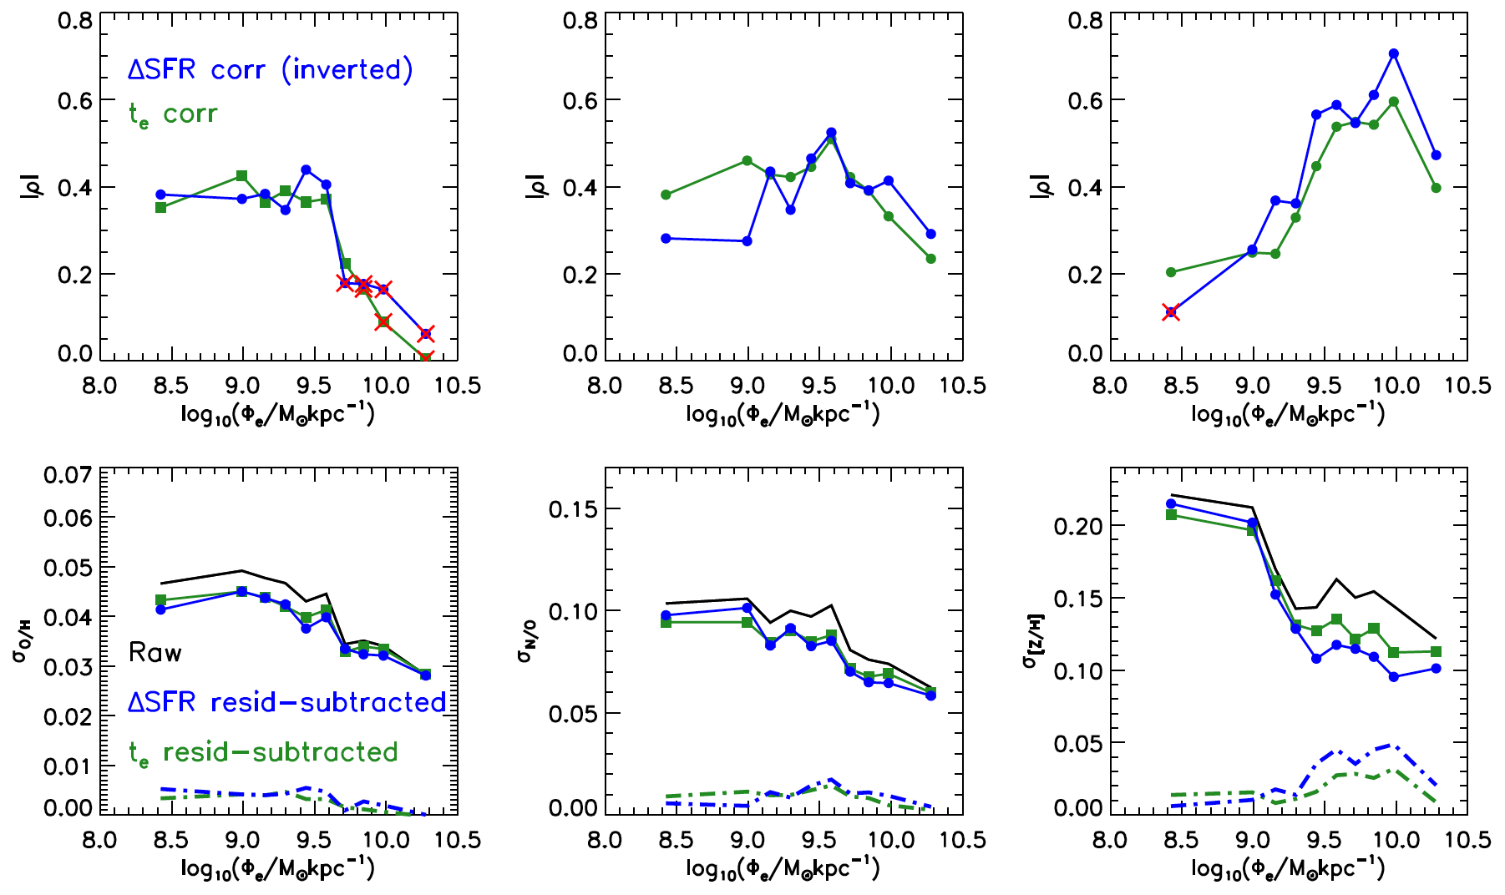
Traditional FMR weakens at high M*; N/O relation persists, while [Z/H] relation strengthens
Replacing M* with $Φ_{e}$ significantly strengthens the gaseous relations
Boardman et al. accepted

Slide 25
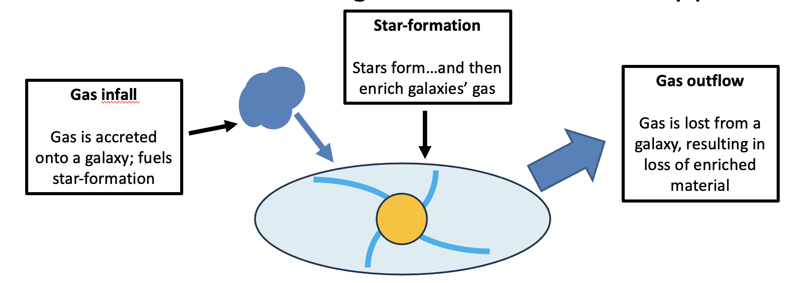
Chemical evolution in galaxies
Chemical abundances are key to understanding galaxy formation and evolution
Chemical evolution in galaxies involves three key processes:
Gaseous abundances represent the end-results of these processes
Stellar abundances represent the properties of gas when stars formed

