Slide 1

Chemodynamical Simulations of Dust in the Distant Universe
Alice Ferreira
NAM
Durham University, 9th July
Notes:
Hi I'm Alice I'm a first year PhD student working with Chiaki here at UoH
I'm going to tell you today about my project on simulating dust on a cosmological scale

Slide 2
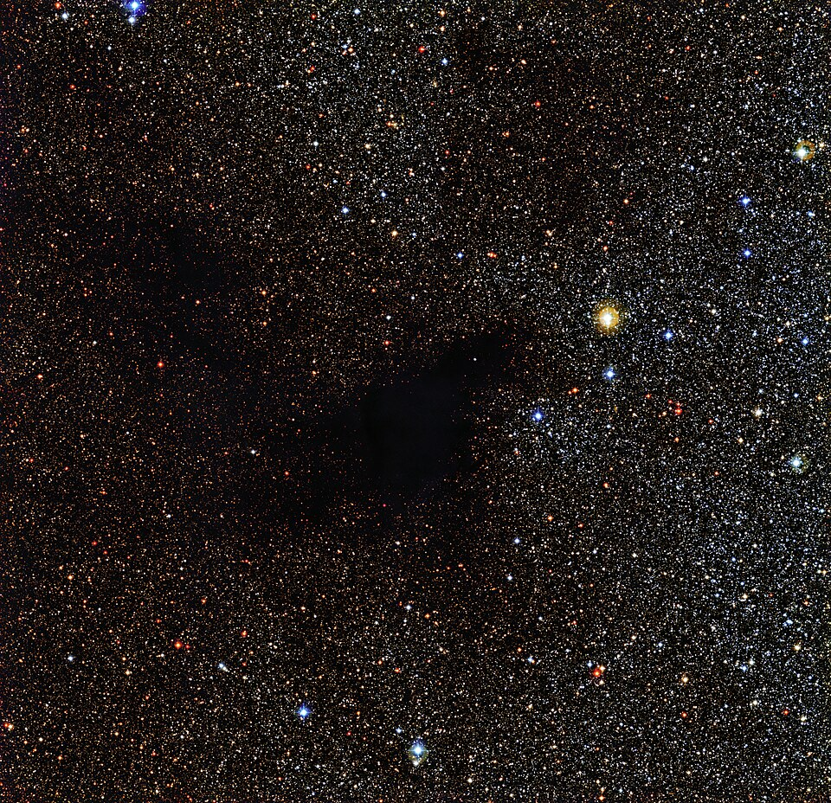
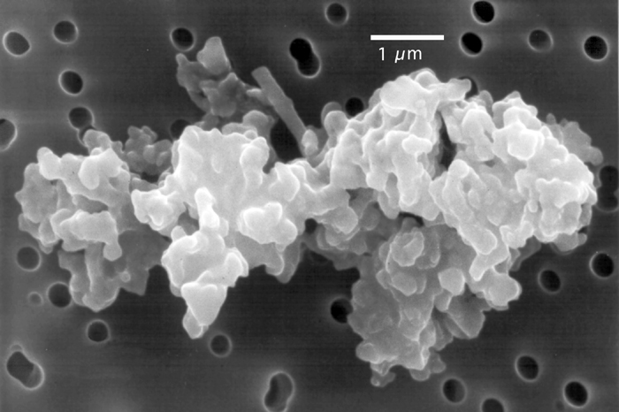
Dust
Notes:
First, what is dust?
I know many of you are observers. You probably know dust as this annoying thing that gets in the way of you seeing stars and galaxies
Dust itself is small solids, from the size of a few molecules to a grain of sand
When light travels through a cloud of dust, shorter wavelengths are scattered more, making the light appear redder, or if very dense blocked completely
This makes understanding how dust works crucial for correcting for it in observations

Slide 3
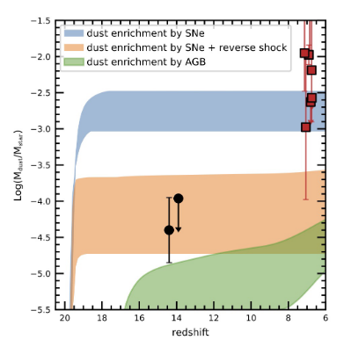
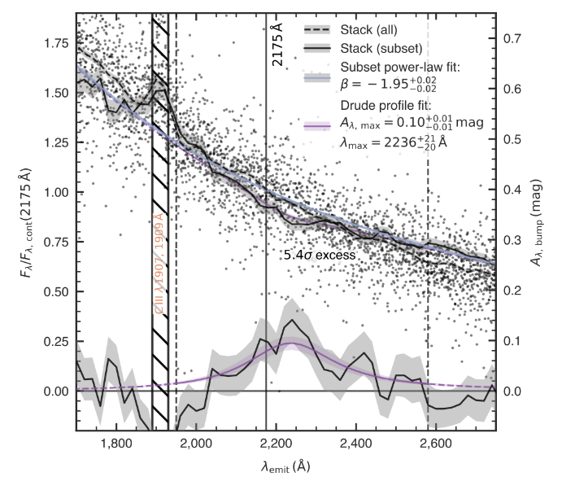
Dust at high redshift
Log(M_{dust} / M_{stellar})
F_{λ}/F_{λ,cont}(2175 Å)
Redshift
λ_{emit}(Å)
Carniani+24
Wistok+23
Notes:
We also see strangely high dust content in some galaxies at high redshift. On right, z14 agrees with dust formation models, but z6 - 8 doesn't
Likewise, carbon bump on right at z > 4 shows significant amounts of carbonaceous dust. Which is weird because we expect that to mostly come from AGB stars, which haven't had enough time to die in significant numbers yet.
So we need detailed models of dust to explain this.

Slide 4
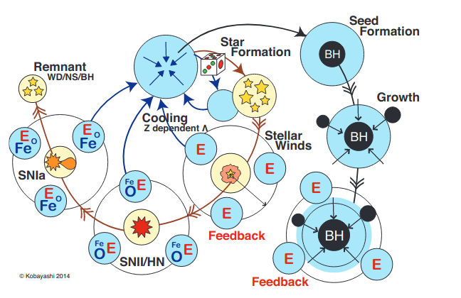
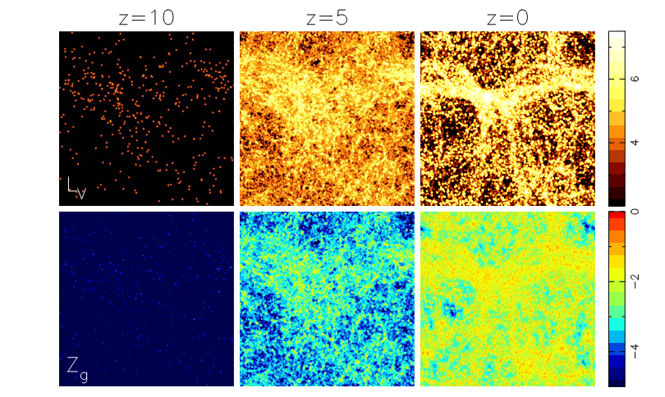
Our simulation
Kobayashi+20
Kobayashi+14
Notes:
The simulation I am using was developed by Kobayashi&Taylor (2014), based on the hydrodynamical code GADGET-3.
It models a cosmological box with particles representing gas, stars, dark matter (and black holes) and uses fluid dynamics to run a mini universe of about 10 to perhaps 100 mpc (depending on chosen scale) from initial conditions at around z150 to z0, calculating cosmological structure formation
You can see a projection of properties on the left
On the right is the baryon physics that has been added, including star formation, feedback, cooling, etc, and particularly tracing chemical evolution using the latest nulceosynthesis yields from Kobayashi & Taylor (2020)
What I am doing is calculating the metals going into the dust phase on top of this

Slide 5
Types of dust we include
Silicates
Forsterite - Mg₂SiO₄
Fayalite - Fe₂SiO₄
Enstatite - Mg₂Si₂O₆
Ferrosilite - Fe₂Si₂O₆
Quartz - SiO₂
Carbonaceous
Carbon - C
Other
Iron - Fe
Magnetite - Fe₃O₄
Corundum - Al₂O₃
Silicon Carbide - SiC
Notes:
Following not just total amount but species by species
We have been able to study presolar dust grains found in meteorites
They come from oxygen and carbon rich environments - generally AGB stars and CCSN
Means the main types of dust are:
Silicates, including types of quartz, olivine and pyroxene
Carbonaceous dust, typically in the form of graphite
Some other types including iron and alumina
This is not an exhaustive list, but this is the list of species we are tracing in our simulation
The main thing to note is carbon and silicate dust tends to be mutually exclusive as C and O atoms preferentially form CO molecules, meaning only the excess of one of the two elements forms dust

Slide 6
Simulating dust on a cosmological scale
Notes:
Here is my overview equation of my basic dust model. It involves dust being produced in stars, accreting metals from the gas phase in the ISM, being destroyed in hot gas by thermal sputtering, being destroyed by supernova shock waves, and being destroyed by star formation

Slide 7
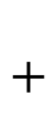
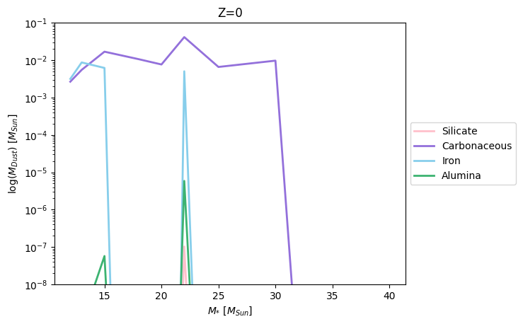
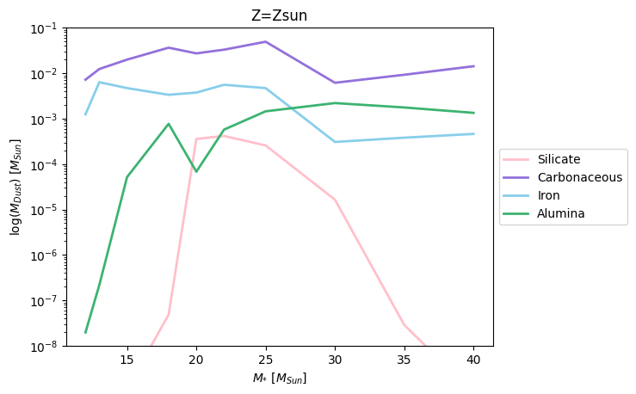
Dust production in core-collapse supernovae
Dust produced at solar metallicity (Z = 0.02)
Dust produced at Z = 0
M_{dust} / M☉
M_{dust} / M☉
M* / M☉
M* / M☉
Yields from Bianchi+07
Notes:
Dust is formed in the wake of a supernova as the dense ejecta cools and condenses to form dust
The dust species produced are a function of progenitor mass and metallicity
Higher mass stars experience more fallback of heavy elements onto black hole/supernova
But also more metal rich composition leads to more metal rich ejecta leads to more silicates, iron, etc
Different dust synthesis models have different outputs -- depends on mixing inside star, mixing of ejecta, how detailed prescription of molecule formation is, if you already assume all C and O in CO, etc
These yields do not include rotational mixing inside star, meaning less C gets trapped in CO
Hence why such high C yields even though I previously said we expect more C from AGBs (alongside IMF effect)
Also the SN dust is subject to the reverse shock, where the ambient medium shocked by the supernova forward shock triggers a reverse shock that travels back through the ejecta and destroys most of the dust
Depending on the density of the ISM, as little as 2% of the dust mass could be left
Hence why these yields will be similar in size to the AGB ones even though supernovae release much more material

Slide 8
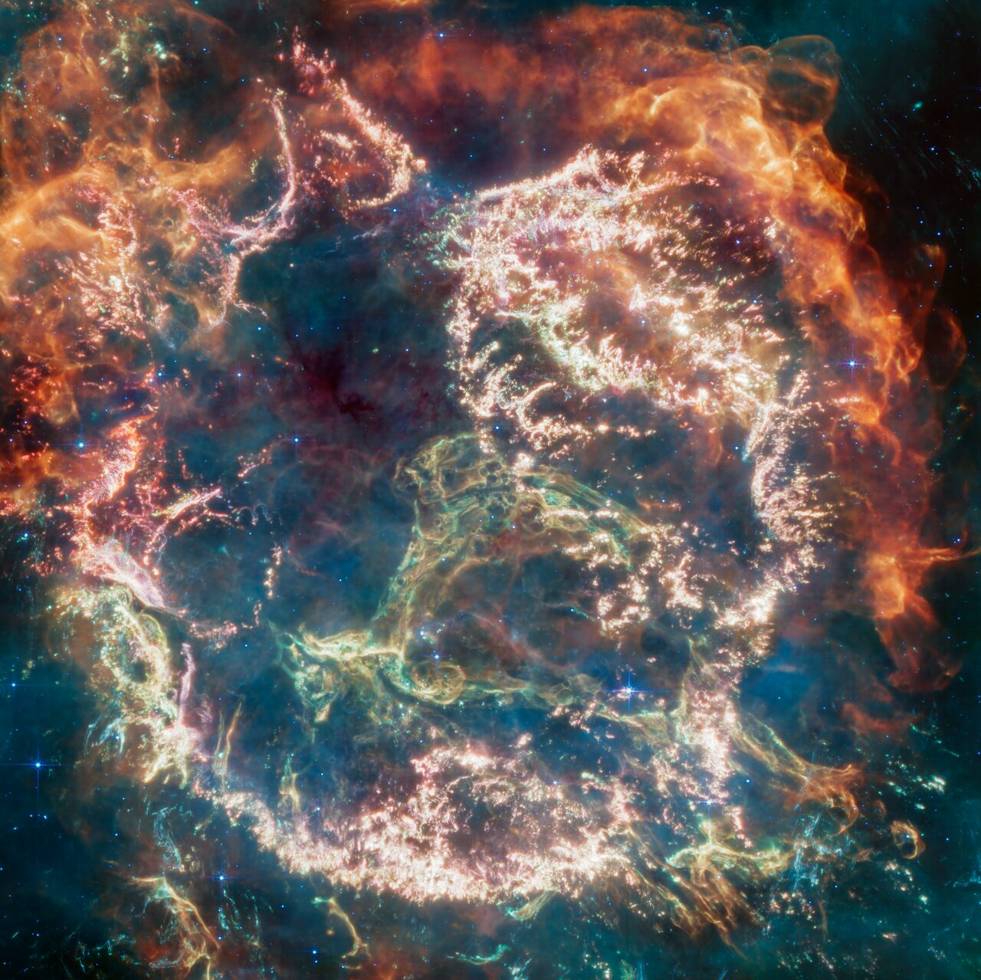
Dust production in core-collapse supernovae
NASA, ESA, CSA, D. Milisavljevic (Purdue University), T. Temim (Princeton University), I. De Looze (UGent), J. DePasquale (STScI)

Slide 9
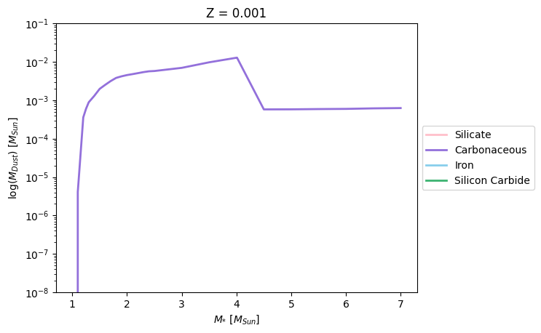
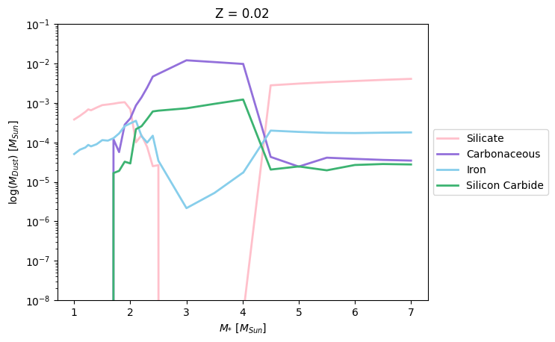
Dust production in AGB stars
Dust produced at low metallicity (Z = 0.001)
Dust produced at solar metallicity (Z = 0.02)
M_{dust} / M☉
log(M_{dust} / M_{sun})
M_{dust} / M☉
M* / M☉
M* / M_{sun}
M* / M_{sun}
M* / M☉
Yields from Zhukovska+08
Notes:
Dust condenses in the strong winds of an AGB star as it sheds its mass
This is also a function of mass and metallicity -- the C/O ratio of the stellar surface, which strongly affects dust formation, is strongly impacted by mass
AGBs all start with more oxygen than carbon in their atmospheres -- carbon gets dredged up as the star undergoes flash helium shell burning periods that cause mixing and dredge up carbon
Smaller stars don't undergo enough of these dredge ups to exceed C/O ~ 1 before they die. Higher mass stars undergo hot bottom burning which converts a lot of carbon into nitrogen, preventing C/O exceeding 1 until near the end of its life. Hence these stars form more silicates than carbon dust
But between around 2 and 4 solar masses is what I call 'silicate valley' where C/O quickly exceeds 1 and most carbon dust is formed
These yields are even more dependent on metallicity as AGBs don't produce silicon, iron, etc intrinsically, so that all comes from the star's initial composition

Slide 10
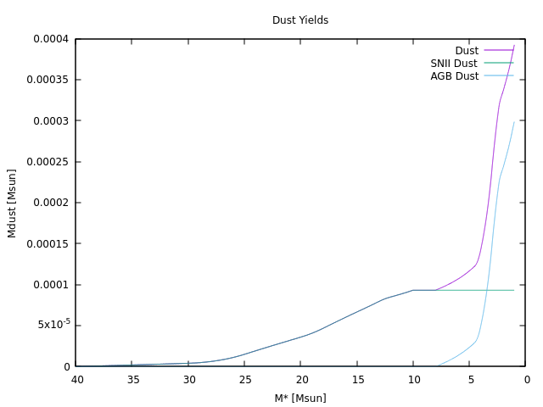
Our stardust model
💀
💀
💀
tm_{n}
tm_{n-1}
tm_{n}
Notes:
So how do we implement this in our simulation? Here I've created the animation of the century to show you
We take these yields and interpolate and integrate them by the IMF to get the cumulative dust released by a simple stellar population over its lifetime as a function of turnoff mass (mass of stars currently dying)
In our code, we have star particles, which represent a whole star cluster of the same age and metallicity
As timesteps go by, we measure the age of the population and see what mass stars should now be dead
Then we release the total cumulative dust yield of all the stars that have now died into the neighbouring gas particles, weighted by distance
Next timestep, we do the same thing but take away the dust already distributed
And so on

Slide 11
Simulating dust on a cosmological scale
Notes:
Here is my overview equation of my basic dust model. It involves dust being produced in stars, accreting metals from the gas phase in the ISM, being destroyed in hot gas by thermal sputtering, being destroyed by supernova shock waves, and being destroyed by star formation

Slide 12
Grain growth in the interstellar medium
Dust
Atomic metal
Notes:
Dust also undergoes processing in the ISM
First, preexisting dust grains in cooler regions of the ISM accrete atomic metals from their surroundings
This causes an increase in dust mass
While some researchers argue this may be the cause of the high dust masses at high redshift, others have argued this process isn’t efficient enough to explain it

Slide 13
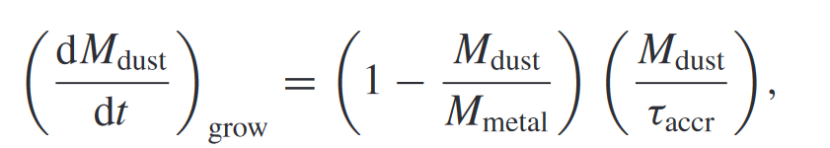
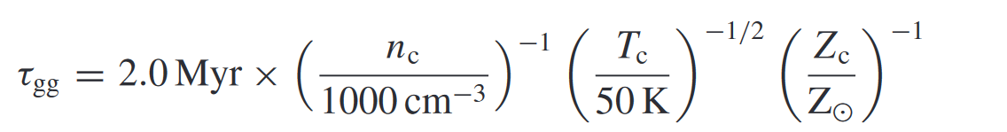
Grain growth in the interstellar medium
Equations from Graziani et al (2020), Davé et al (2019) and Dwek (1998)
We calculate based on:
Density
Temperature
Metallicity
Dust
Atomic metal
Notes:
We calculate the mass increase as a function of the density, temperature and metallicity of the gas particle in question and assume dust mass has to be > 0 for this process to occur

Slide 14
Simulating dust on a cosmological scale
Notes:
Here is my overview equation of my basic dust model. It involves dust being produced in stars, accreting metals from the gas phase in the ISM, being destroyed in hot gas by thermal sputtering, being destroyed by supernova shock waves, and being destroyed by star formation

Slide 15
Thermal sputtering in the interstellar medium
Dust
Hot gas
Atomic metal
Notes:
Dust is also subject to destructive processes, such as by thermal sputtering
This is when dust grains in hot gas are eroded by energetic ions
Occurs at about 2x10^6 K
They are subsequently returned to the gas phase, and overall dust mass decreases

Slide 16
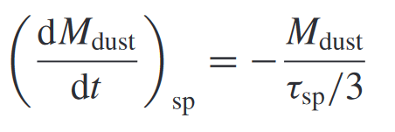
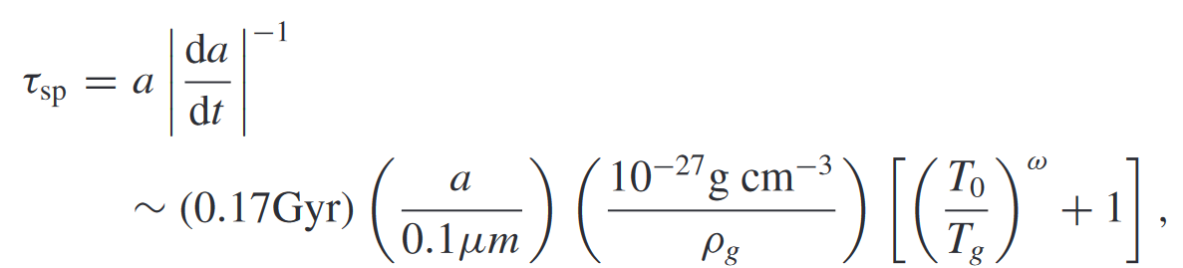
Thermal sputtering in the interstellar medium
Equations from Davé et al (2019) and Tsai and Matthews (1995)
We calculate based on:
Density
Temperature
Dust
Hot gas
Atomic metal
Notes:
We similarly calculate this as a function of temperature and density of the surrounding gas
This process occurs at roughly 2 million K

Slide 17
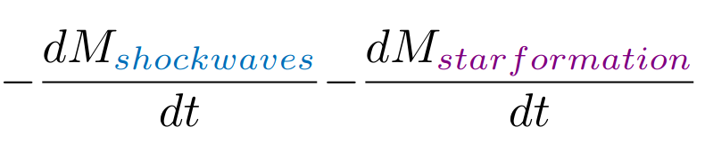
Simulating dust on a cosmological scale
Notes:
Here is my overview equation of my basic dust model. It involves dust being produced in stars, accreting metals from the gas phase in the ISM, being destroyed in hot gas by thermal sputtering, being destroyed by supernova shock waves, and being destroyed by star formation

Slide 18
Dust destruction by supernova shock waves
Supernova
Red supergiant
Dust
Atomic metal
Notes:
Dust can also be destroyed when a supernova explodes in its vicinity
At the moment, we use a crude recipe to calculate this based on estimated local supernova rate and destruction efficiency, but we are planning to implement a more detailed prescription based on the actual local supernova rate and energy released soon
(This was me rushing to get this process implemented for NAM lol)

Slide 19
Simulating dust on a cosmological scale
Notes:
Here is my overview equation of my basic dust model. It involves dust being produced in stars, accreting metals from the gas phase in the ISM, being destroyed in hot gas by thermal sputtering, being destroyed by supernova shock waves, and being destroyed by star formation

Slide 20
Destruction by star formation
Dust
Star
Notes:
Lastly, dust is also destroyed when stars form
The dust in the collapsing cloud is melted inside the newly formed protostar(s)
This implementation is again very crude (for NAM) where we take away an amount of dust proportional to a newly formed 'star particle' (remember this is a cluster) when it forms from a gas particle

Slide 21
Destruction by star formation
— metal mass
— metal mass
— dust mass
(+ dust mass)
Notes:
Lastly, dust is also destroyed when stars form
The dust in the collapsing cloud is melted inside the newly formed protostar(s)
This implementation is again very crude (for NAM) where we take away an amount of dust proportional to a newly formed 'star particle' (remember this is a cluster) when it forms from a gas particle

Slide 22
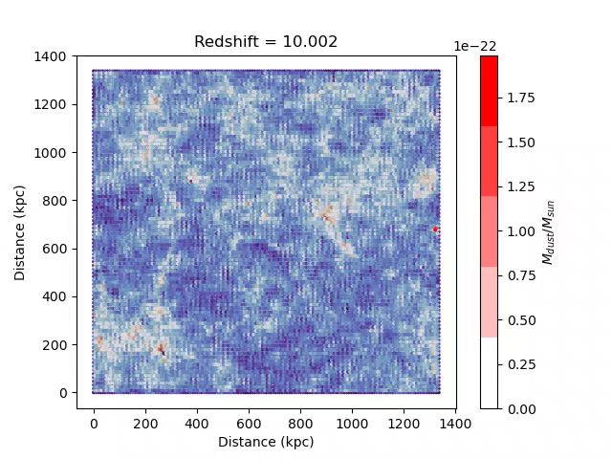
Dust evolution with redshift
Notes:
So far these are the processes we have implemented
Here are our preliminary results, starting with a video of the dust evolution in our simulation
The blue is the gas density of the simulation
The red is the total dust mass in given gas particles
Behind this movie calculating structure with DM
Start from z10
Structure will grow as a function of redshift/time
Can see more dust here etc
Seems easy but I am spending a few months debugging this code (to get laugh)

Slide 23
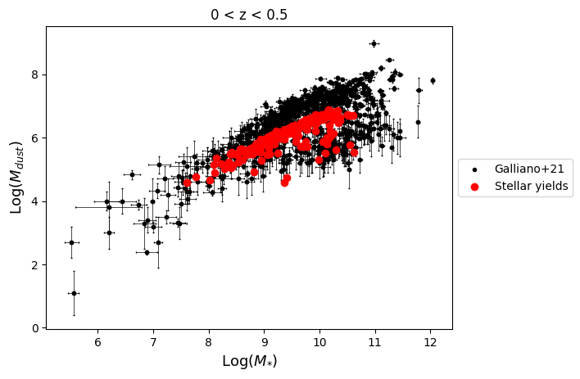
Dust mass vs stellar mass at z < 0.5

Slide 24
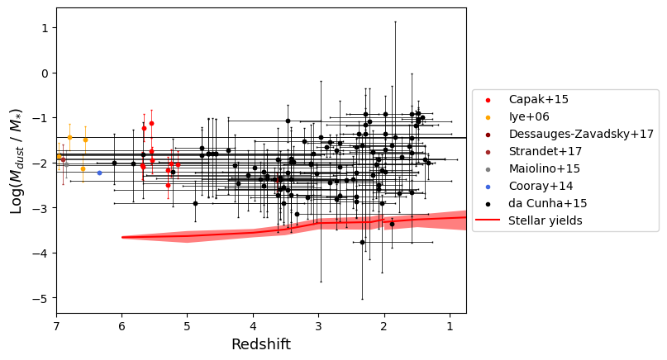
Dust mass to stellar mass ratio in galaxies with decreasing redshift
Notes:
Here is a comparison of the median dust to stellar mass ratios in galaxies in our simulation found with a friend of friends algorithm with a 1 sigma scatter (at the redshifts that wanted to work TT__TT) showing the impact of various processes in comparison to some observations from Cunha et al
You can see the stardust alone isn't enough to account for the observations
The destruction processes decrease it (as expected)
And then grain growth takes the simulation all the way up here. Yeah it's uh. Not supposed to do that
(I am working on it TT__TT)
But this is the rough dust to stellar mass ratio we'd expect to see based on other simulations
Not bad! (Apart from grain growth...)

Slide 25
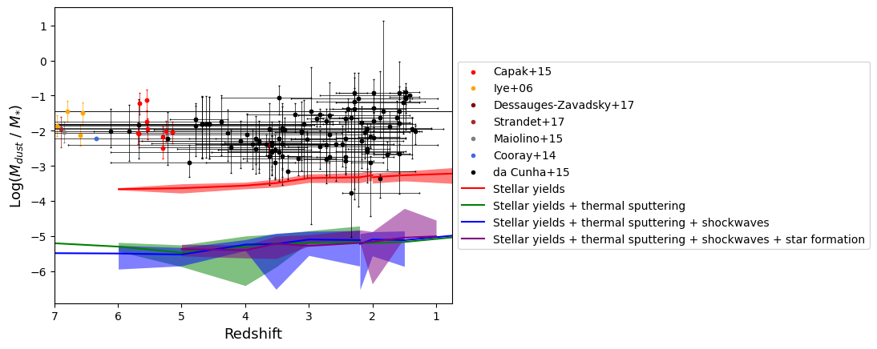
Dust mass to stellar mass ratio in galaxies with decreasing redshift
Notes:
Here is a comparison of the median dust to stellar mass ratios in galaxies in our simulation found with a friend of friends algorithm with a 1 sigma scatter (at the redshifts that wanted to work TT__TT) showing the impact of various processes in comparison to some observations from Cunha et al
You can see the stardust alone isn't enough to account for the observations
The destruction processes decrease it (as expected)
And then grain growth takes the simulation all the way up here. Yeah it's uh. Not supposed to do that
(I am working on it TT__TT)
But this is the rough dust to stellar mass ratio we'd expect to see based on other simulations
Not bad! (Apart from grain growth...)

Slide 26
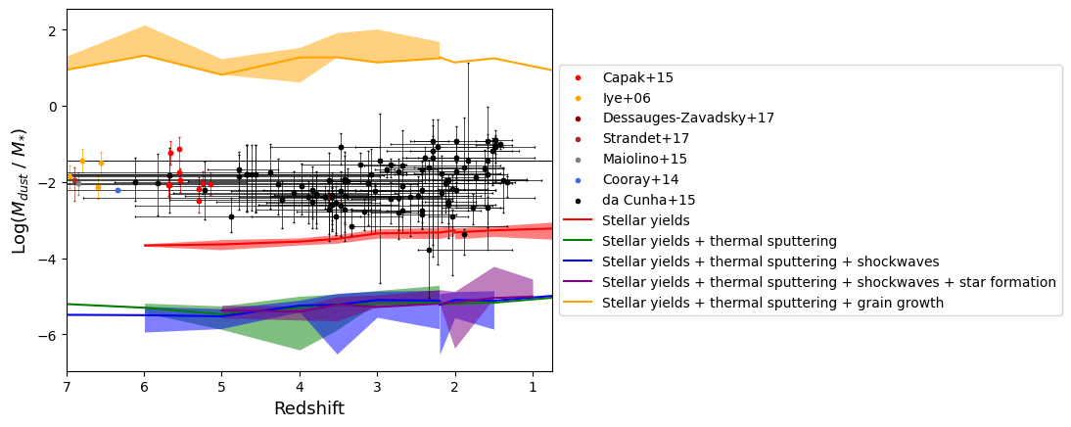
Dust mass to stellar mass ratio in galaxies with decreasing redshift
Notes:
Here is a comparison of the median dust to stellar mass ratios in galaxies in our simulation found with a friend of friends algorithm with a 1 sigma scatter (at the redshifts that wanted to work TT__TT) showing the impact of various processes in comparison to some observations from Cunha et al
You can see the stardust alone isn't enough to account for the observations
The destruction processes decrease it (as expected)
And then grain growth takes the simulation all the way up here. Yeah it's uh. Not supposed to do that
(I am working on it TT__TT)
But this is the rough dust to stellar mass ratio we'd expect to see based on other simulations
Not bad! (Apart from grain growth...)

Slide 27
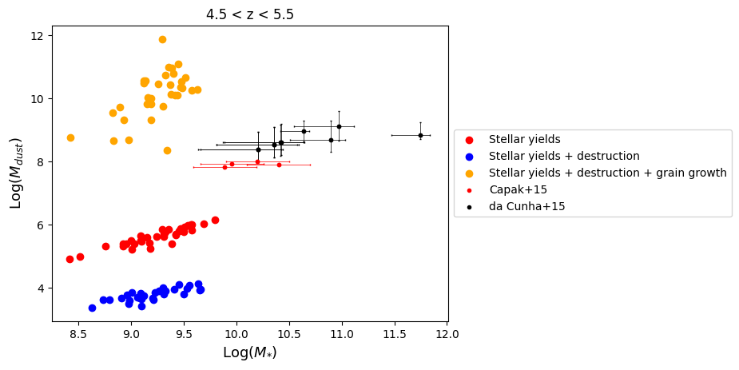
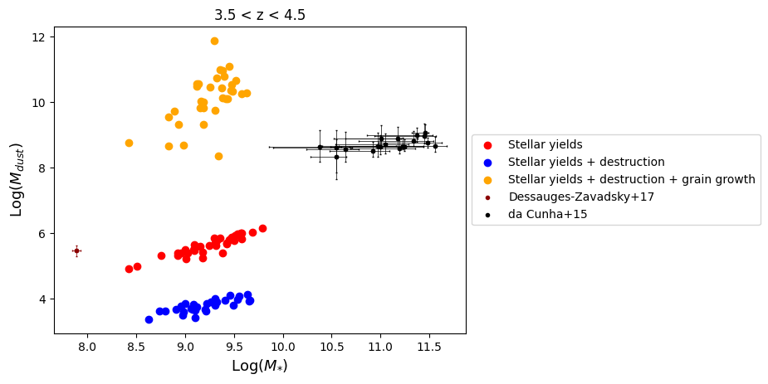
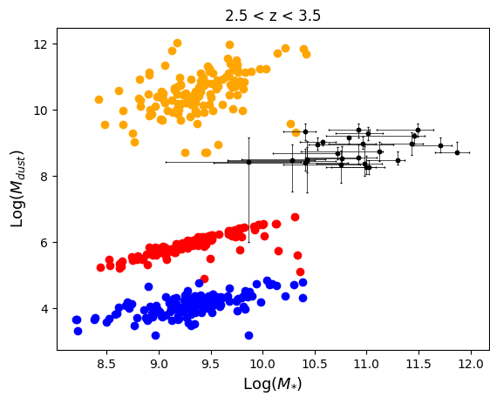
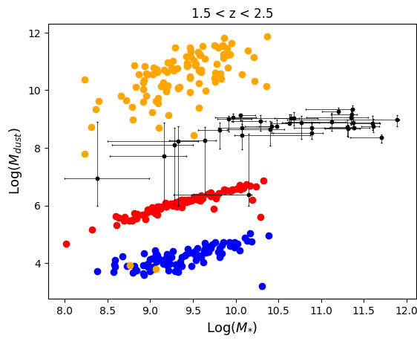
Dust vs stellar mass at various redshift intervals

Slide 28
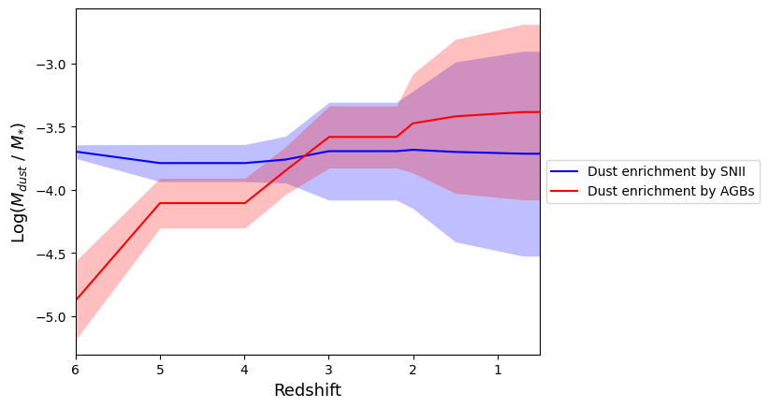
Dust mass to stellar mass ratio in galaxies with decreasing redshift
Notes:
On the left we can see agb stars becoming the dominant dust production mechanism
However at the moment this does not happen until about redshift 3 to 2.5 in our simulation, which is too late to explain observed dust at high redshift
Due to our high carbon yields from SN, we do also have higher amounts of carbon than silicate dust throughout
Spend some time on these
Explain
- dust to stellar mass etc
Ind etail
Sn constant while agb sharp increase
Then do for other figure
Splitting species of dust
In future we will use updated yields to see the effect this has
Spend more than one minute each on figures – 2 mins on each figure slide, they are the highlight
Want people to remember
Can say going to calculate yields myself using new dust synthesis code-cite paper

Slide 29
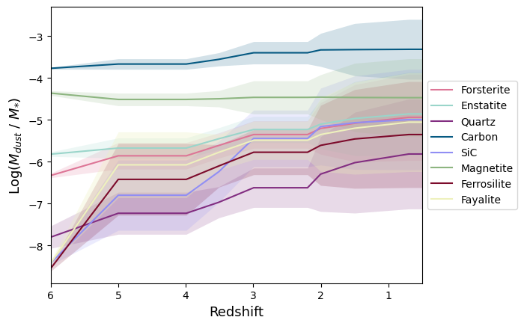
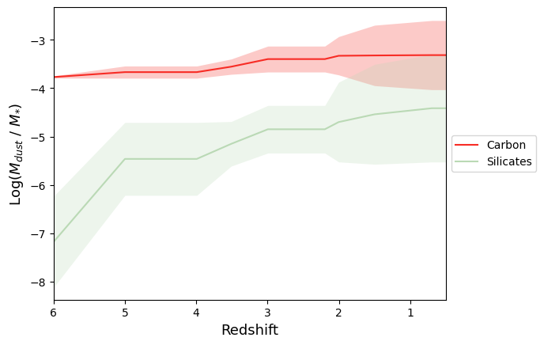
Dust mass to stellar mass ratio in galaxies with decreasing redshift
Notes:
On the left we can see agb stars becoming the dominant dust production mechanism
However at the moment this does not happen until about redshift 3 to 2.5 in our simulation, which is too late to explain observed dust at high redshift
Due to our high carbon yields from SN, we do also have higher amounts of carbon than silicate dust throughout
Spend some time on these
Explain
- dust to stellar mass etc
Ind etail
Sn constant while agb sharp increase
Then do for other figure
Splitting species of dust
In future we will use updated yields to see the effect this has
Spend more than one minute each on figures – 2 mins on each figure slide, they are the highlight
Want people to remember
Can say going to calculate yields myself using new dust synthesis code-cite paper

Slide 30
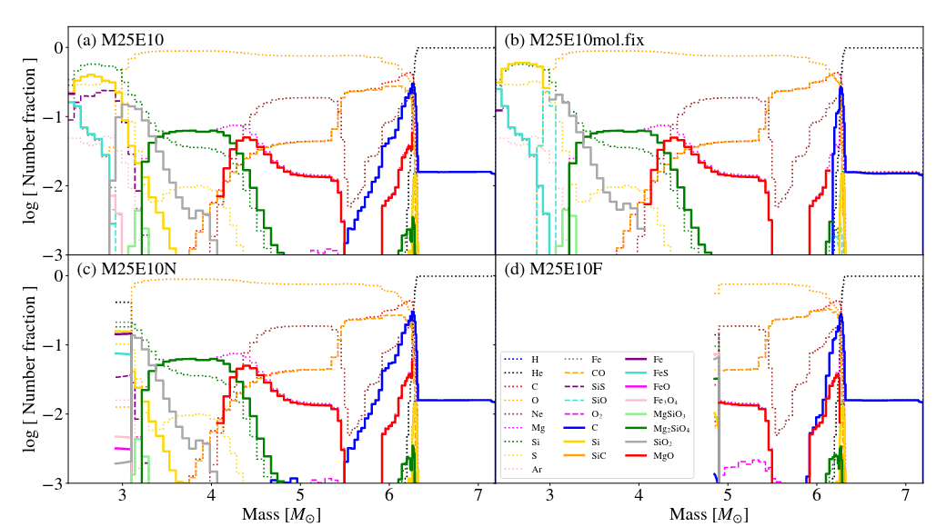
Future work
Chiaki+25
Notes:
So what next? Other than cleaning up our simulation...
Once that is done and the latter processes are implemented in more detail,
We are going to take the new dust synthesis model produced by Gen Chiaki et al which is the most detailed supernova dust synthesis model to date
I am going to use it to fill out the yield table myself and then implement the updated yields into the simulation and compare the results to our original yields. Fun!

Slide 31
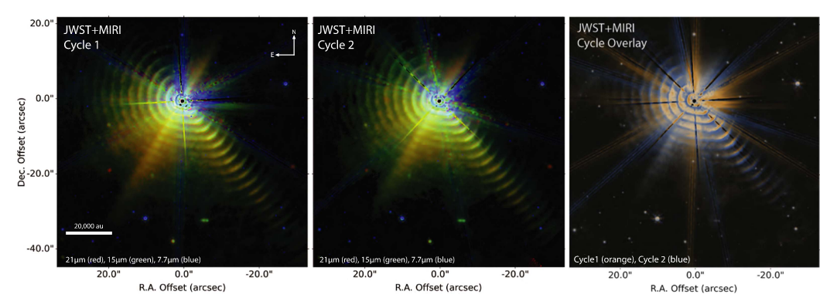
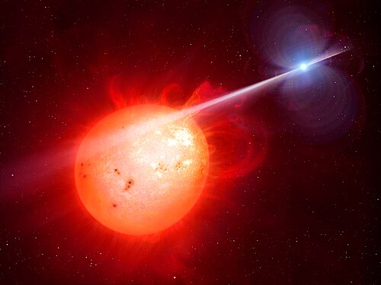
Future work
Notes:
We would also like to implement dust yields from other stars such as Wolf Rayets and look at the impact of binary stars on dust yields more generally (stepping on Rob's toes a bit there)

Slide 32
Summary
Modelling dust is important to explain dust masses at high redshift and more accurately correct for dust in observations
We include the processes of dust production by stars, grain growth, and destruction by thermal sputtering, supernova shock waves and star formation in the ISM in our cosmological simulations
We have preliminarily compared our results with observations
Notes:
Just show if run out of time

Slide 33
Appendix

Slide 34
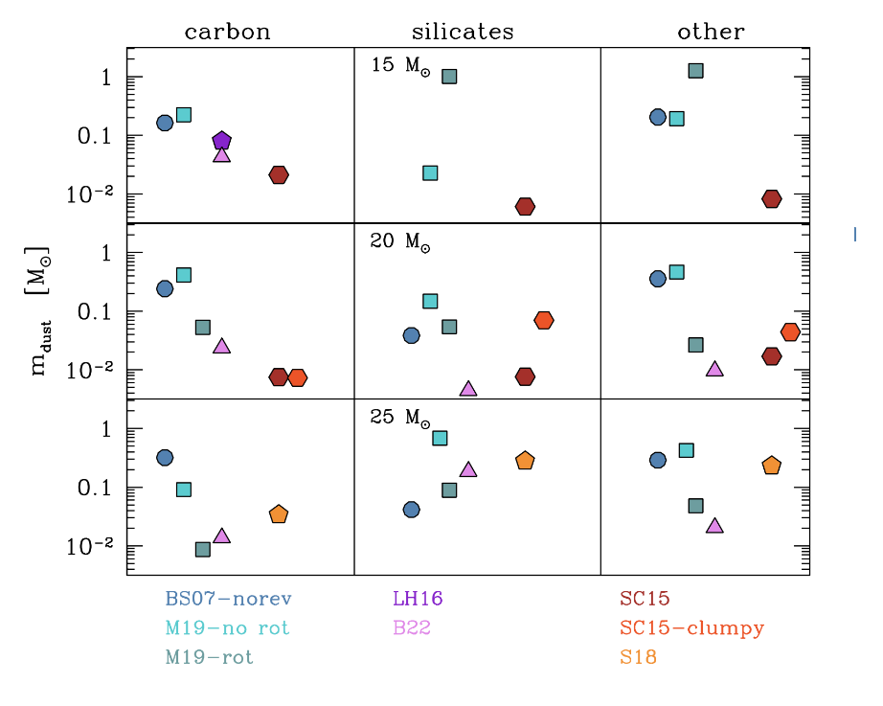
Dust production in core-collapse supernovae
Schneider+24
Notes:
There is a big difference when rotation/mixing included than when not as it affects where the carbon and oxygen is
We are currently using yields from bianchi & schneider for now with reverse shock which have no rotation which decreases silicate dust yield
However, it is worth noting yields by other groups have a lower amount of carbon dust

Slide 35
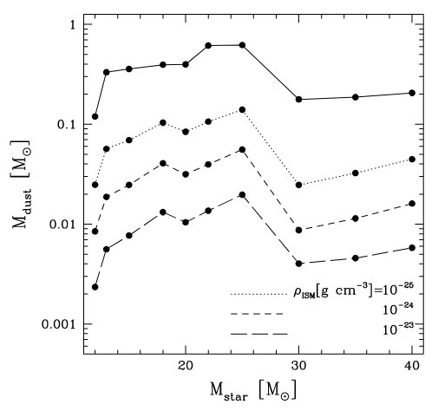
Dust mass survival after the reverse shock
Bianchi+07
Notes:
Important also is the reverse shock
As the supernova bubble expands it triggers an inward ‘reverse’ shock which destroys much of the dust
Depending on the density of the ISM it there could be as little as 2% of the dust left
Therefore supernovae are inefficient dust producers

Slide 36
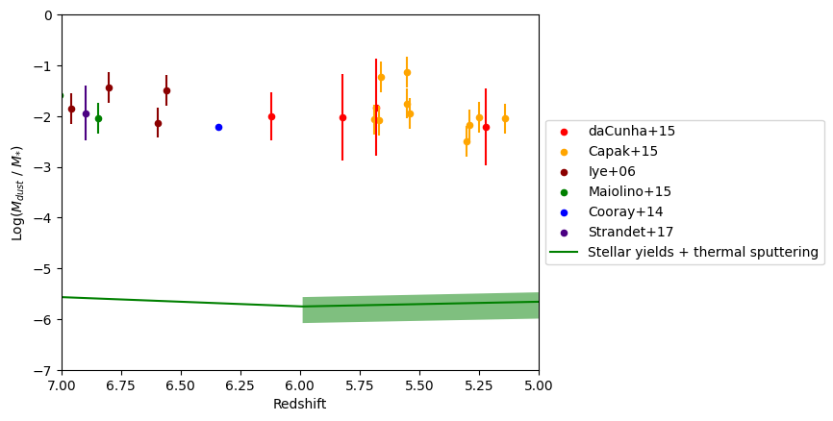

Slide 37
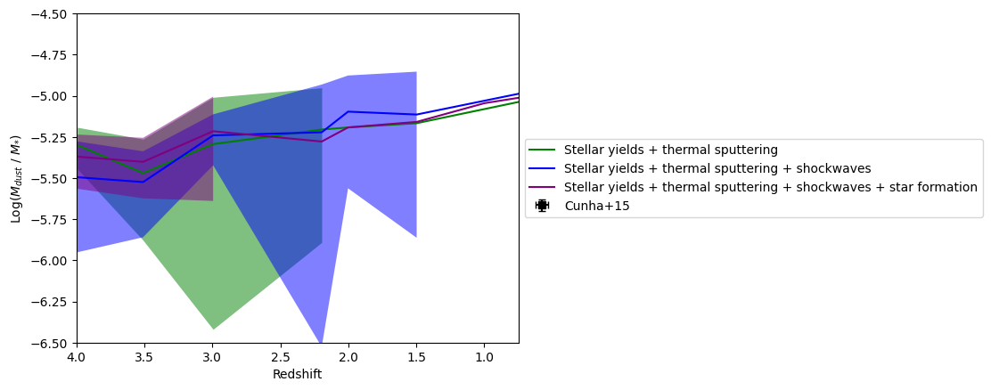

Slide 38
