Slide 1
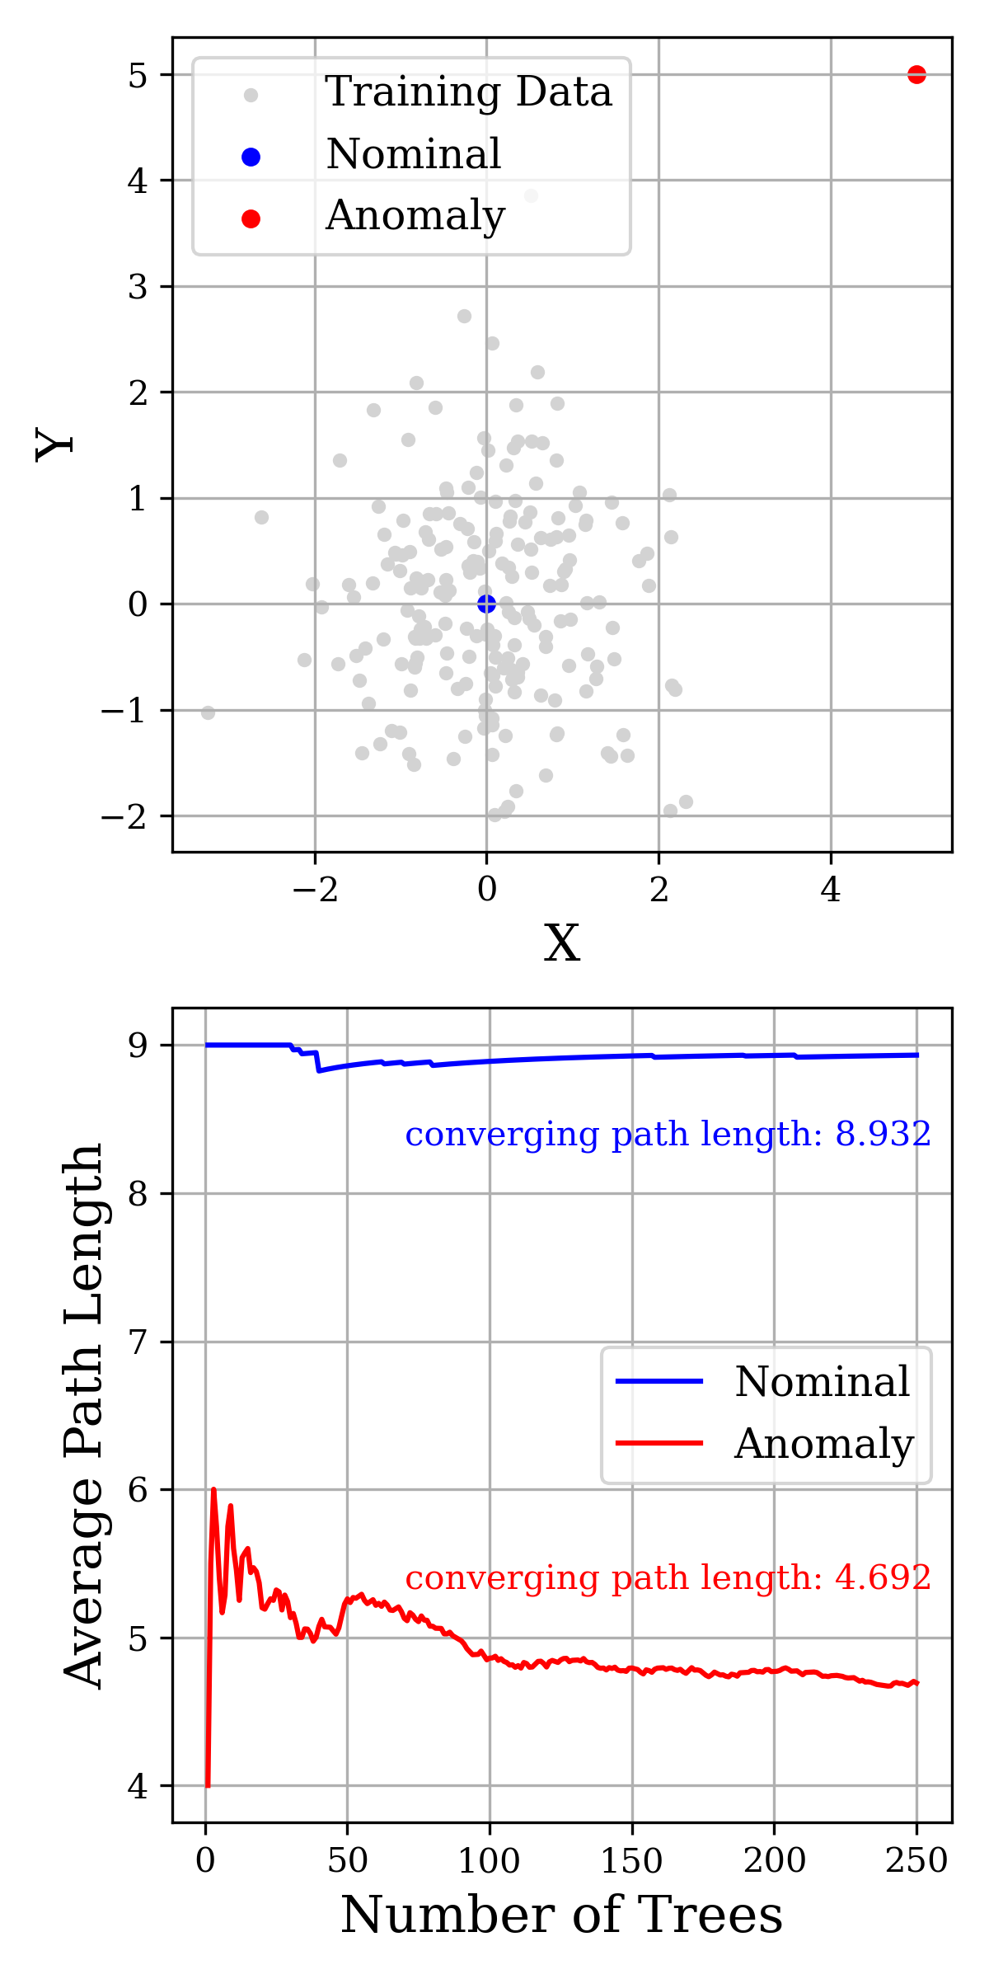
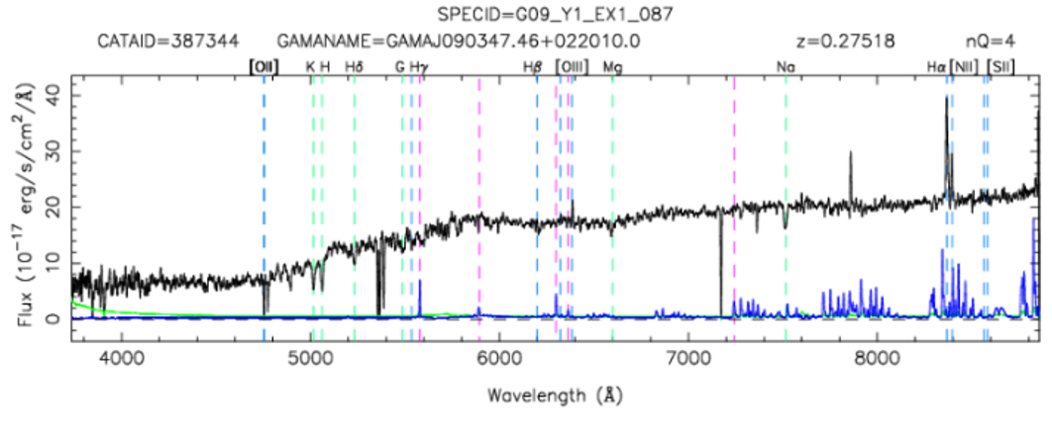
Isolating Anomalous Galaxies Using an Isolation Algorithm Kieran Broadbelt, Kevin Pimbblet & Daniel Farrow k.broadbelt-2018@hull.ac.uk

