Slide 1
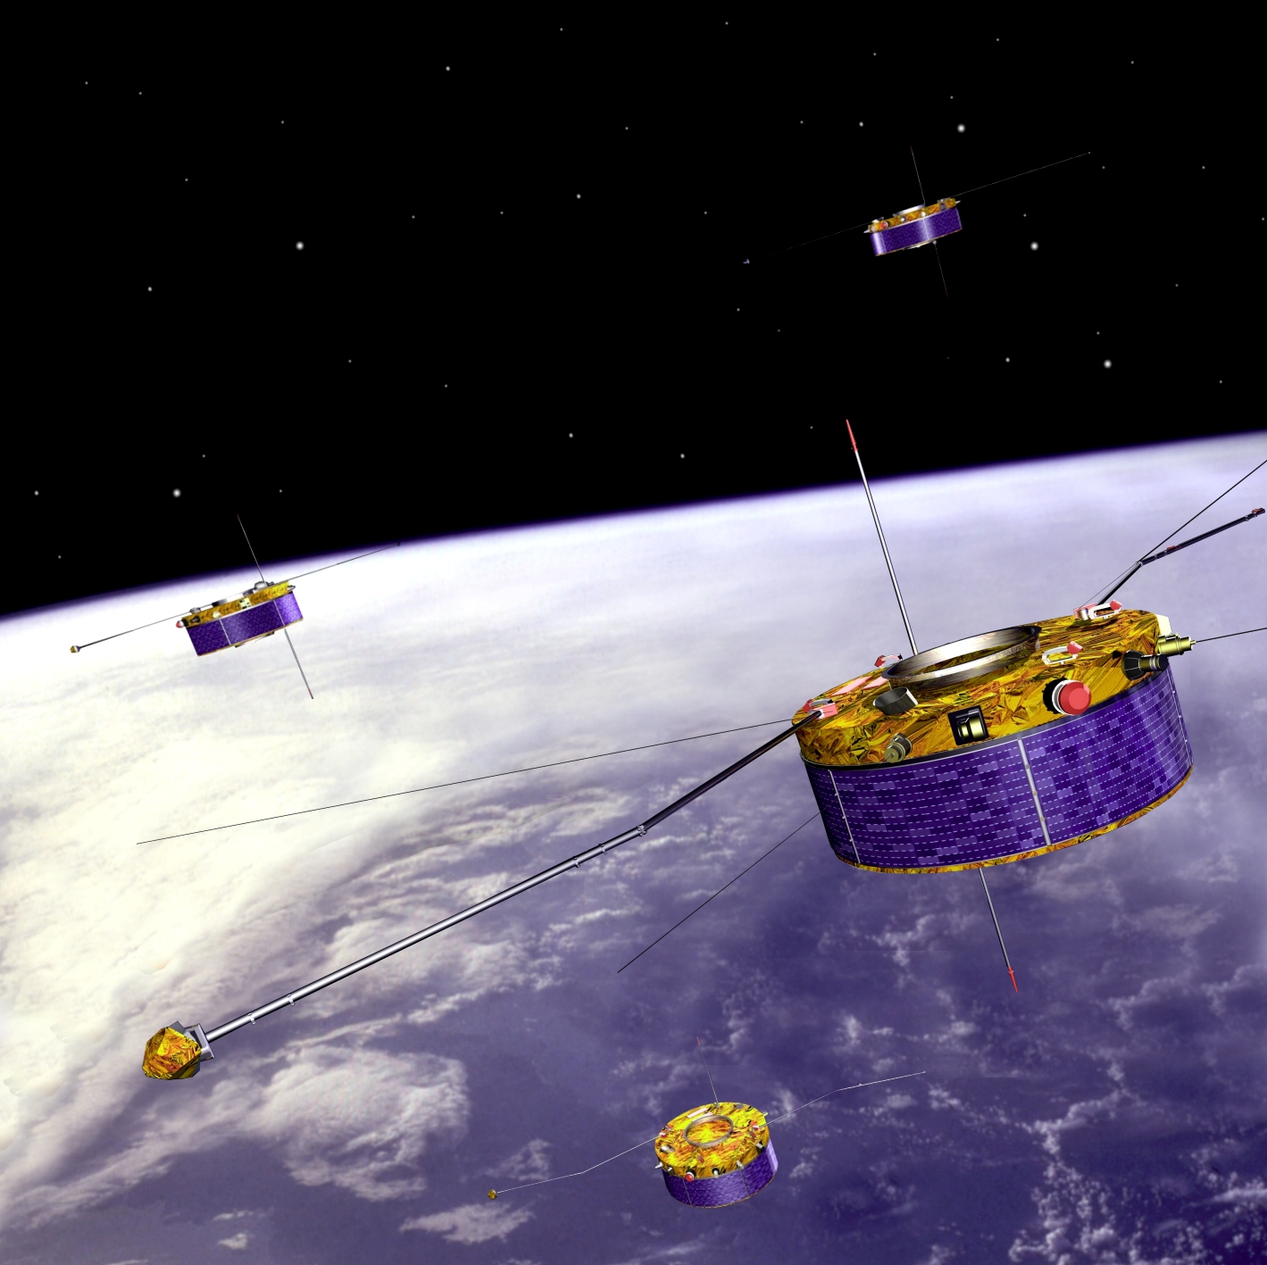
Opportunities and interfaces with the European Space Agency
Jonny Rae
jonathan.rae@northumbria.ac.uk

Slide 2
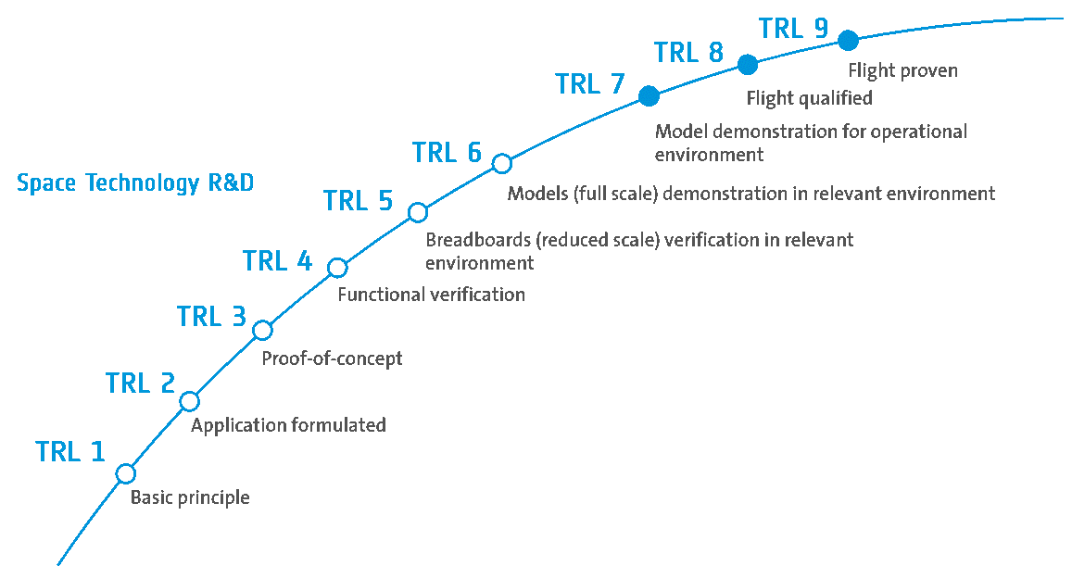
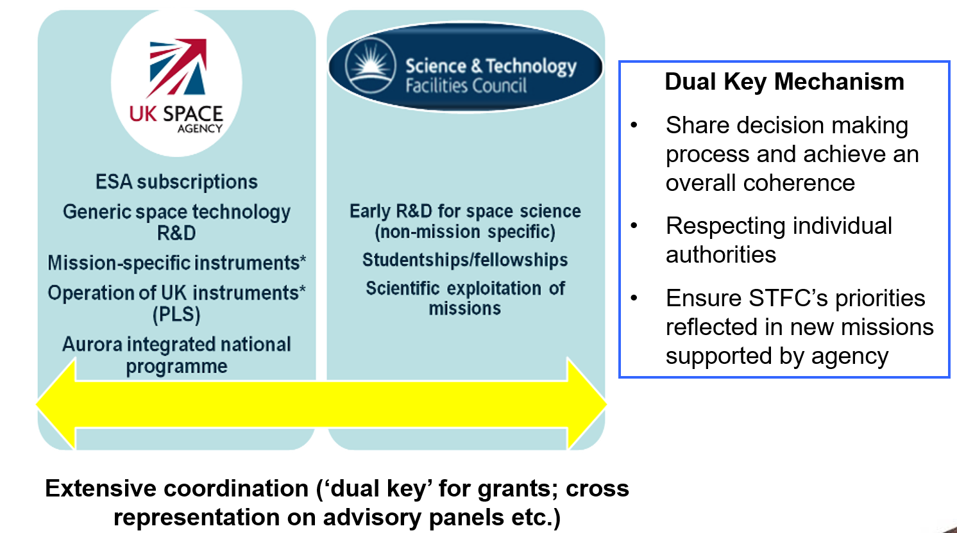
National Cooperation: The risks/rewards of STFC vs UKSA
STFC funds Technology Readiness Levels 1(concept)-4
UKSA funds TRL 5-9 (launch)
To ensure a smooth pipeline through “dual key”
No separate STFC call for technology
Hence, these are graded for its science
A perception that our technology stagnates
But is this true?
A challenge to UKSA and STFC to provide statistics so the community is aware of low TRL successes

Slide 3

So how do you interface with ESA?
I’m not sure, but let’s talk about it…..

Slide 4
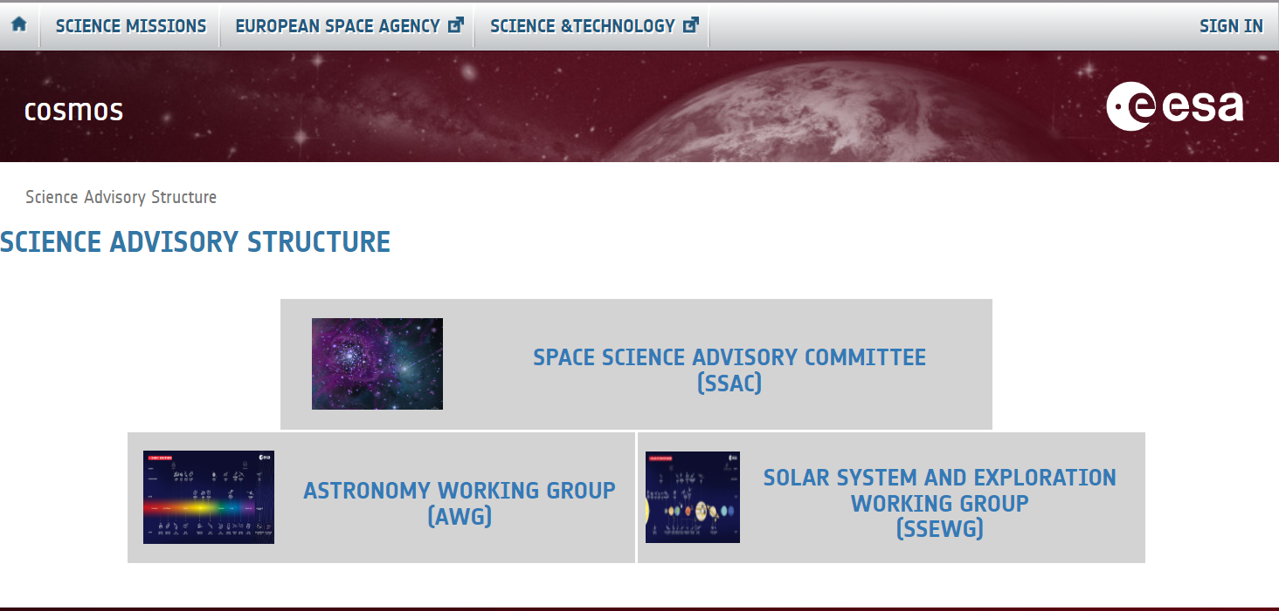
We typically think our work is D/SCIENCE
D/SCI advisory structure
https://cosmos.esa.int/science-advisory-structure
Science Program Committee (SPC) Delegate Page
https://www.cosmos.esa.int/web/SPC

Slide 5
Above the advisory structure lies the decision making Science Program Committee
SPC Chair
Cecilia Hernandez
Direccion de Ciencia Techologia e Innovacion
Vice Chair
Caroline Harper
UKSA
Science Program Committee (SPC)
UK Delegates
Adam Amara
University of Portsmouth
or
Gillian Wright (DACS Chair)
UK Astronomy Technology Centre
Ryan King
UKSA
Stephanie Gooby
UKSA
Space Science Advisory Committee
(SSAC)
Astronomy Working Group
(SSEWG)
Solar System & Exploration Working Group
(SSEWG)

Slide 6
Space Science Advisory Committee (SSAC)
2021-2025
Fabienne Casoli
Observatoire de Paris
Matt Griffin
Cardiff University
Luisa Lara
Instituto de Astrofísica de Andalucía
Pasquale Palumbo
Istituto di Astrofisica e Planetologia Spaziali (IAPS)-INAF
2024-2026
Olivier Grasset (Chair)
Nantes Université
David Berghmans
Royal Observatory of Belgium
Elena Rossi (AWG Chair)
Leiden Observatory
Paolo Natoli
Università degli Studi di Ferrara
2025-2027
Emma Bunce
University of Leicester
Vassilis Charmandaris
University of Crete
Rumi Nakamura
Austrian Academy of Sciences
Ana-Catalina Plesa (SSEWG Chair)
Deutsches Zentrum für Luft- und Raumfahrt e. V. (DLR)
Ex-Officio Invitees
SPC Chair Cecilia Hernández Rodríguez, Agencia Espacial Española
ACEO Carla Braitenberg
Università degli Studi di Trieste
ESSC Chair Chris Rapley
University College London
HESAC Chair Dr Harald Hiesinger Westfälische Wilhelms-Universität
PSWG Chair Albert Roura
German Aerospace Center (DLR)
Observer ESO Director of Science Bruno Leibundgut
European Southern Observatory

Slide 7
Astronomy Working Group (AWG)
2022-2025
Almudena Alonso-Herrero
Centro de Astrobiologia
Ágnes Kóspál
Konkoly Observatory
Gabriel Pratt
CEA Saclay
Alberto Sesana
University of Milano Bicocca
2024-2026
Elena Rossi (Chair)
Leiden Observatory
Nadine Neumayer
Max Planck Institute for Astronomy
Judith Croston
The Open University
Luca Fossati
Austrian Academy of Sciences
David Hobbs
Lund Observatory
Pascale Jablonka
EPFL LASTRO - Observatoire
2025-2027
Lucas Labadie
I. Physikalisches Institut der Universität zu Köln
Yaël Nazé
Université de Liège

Slide 8
Solar System Exploration Working Group (SSEWG)
2021-2025
Caitriona Jackman
Dublin Institute for Advanced Studies
David Orozco Suárez
Instituto de Astrofísica de Andalucía
Francesco Valentini
University of Calabria
2024-2026
Ana-Catalina Plesa (Chair)
German Aerospace Center (DLR)
Petr Brož
Institute of Geophysics, Czech Academy of Sciences,
Thibault Cavalié
Laboratoire d'astrophysique de Bordeaux (LAB)
Valentina Galluzzi
INAF - Istituto di Astrofisica e Planetologia Spaziali (IAPS),
Zita Martins
Departamento de Engenharia Química
Viviane Pierrard
Royal Belgian Institute for Space Aeronomy
Audrey Vorburger
University of Bern
2025-2027
Alice Le Gall
LATMOS- Université de Versailles Saint-Quentin
Manish Patel
The Open University

Slide 9
Formal space science related input into ESA Director General
D/NAV
D/SCI
D/HRE
D/EOP
D/OPS
D/TEC
Global Navigation Satellite System Science Advisory Committee
(GSAC)
Space Science Advisory Committee
(SSAC)
Human Spaceflight and Exploration Science Advisory Committee
(HESAC)
Sci Advisory Committee on Earth Observation
(ACEO)
Data, Operations, Science and Technical Advisory Group (DOSTAG)
Space Situational Awareness Advisory Group
(SSA-AG)
Driven by programmatic needs of other D/ and ad-hoc activities
Ex efficio membership and observers across some advisory committees
Report* mainly to SSAC, but also HESAC and ACEO.
Report* mainly to HESAC, but also SSAC and ACEO
Astronomy Working Group
(AWG)
Solar System & Exploration Working Group
(SSEWG)
Life Sci. Working Group
(LSWG)
Based on ESA/C(2025)95
Physical Sci. Working Group
(PSWG)
* Any Directorate can request appropriate advice from any of the Working Groups.
Notes:
his slide tries to visualise all advisory groups and working groups that have the term ‘science’ in their description in ESA_C_2023_00_EN

Slide 10
Physical Sciences Working Group (PSWG)
Advises on all aspects of material sciences, fundamental physics and experiments in microgravity conditions. It reports mainly to HESAC and SSAC, but also to ACEO (formerly ESAC) and GSAC.
Patrick Guenoun
French Atomic Energy Commission (CEA), Gif-sur-Yvette, France
Fulvio Scarano
Technical University Delft, Delft, The Netherlands
Ruth Bamford
Rutherford Appleton Laboratory, United Kingdom
Guglielmo Tino
University of Firenze, Italy
Elisa Padovano
Politecnico di Torino, Italy
Giovanni Volpe
Göteborgs universitet, Sweden
Eleonora Secchi
ETH Zürich, Switzerland
Thomas Voigtmann
DLR, Koln, Germany
Chiara Falsetti
Technical University of Delft, The Netherlands
Karl Kainer
Helmholtz-Zentrum Hereon, Germany
Peter Lee
University College London, United Kingdom
Albert Roura (Chair)
Institute of Quantum Technologies, German Aerospace Center, Germany

Slide 11
Life Sciences Working Group (LSWG)
Advises on all aspects to related to Life Sciences, including Human Research as well as Biology and Environmental Monitoring activities. It reports mainly to HESAC but also to SSAC and ACEO
Rodrigo Fernandez-Gonzalo (Chair)
Karolinska Institute, Department of Laboratory Medicine, Stockholm, Sweden
Karen Olsson-Francis
The Open University, United Kingdom
Lonnie Grove Petersen
MIT, United States
Silvana Miranda
GSI Helmholtzzentrum für Schwerionenforschung GmbH
Margerete Boos
Universität Götingen, Göttingen, Germany
Judith-Irina Buchheim
Ludwig-Maximilians-Universität, Dpt. Of Anesthesiology, München, Germany
Colleen Deane
University of Southampton, Southampton, United Kingdom
Raúl Herranz Barranco
Centro de Investigaciones Biológicas (CSIC), Madrid, Spain
Adrienne Kish
MCAM, Paris, France
Isabella Mack
University Hospital Tübingen, Tübingen, Germany

Slide 12
Where can you get involved?
Community Scientists
ESA/Delegates
D/SCI
D/EOP
Science Program Committee (SPC)
Program Board – Earth Obs (PB-EO)
Data, Operations, Science and Technical Advisory Group (DOSTAG)
Space Science Advisory Committee
(SSAC)
Sci Advisory Committee on Earth Observation
(ACEO)
Astronomy Working Group
(SSEWG)
Solar System & Exploration Working Group
(SSEWG)
Notes:
his slide tries to visualise all advisory groups and working groups that have the term ‘science’ in their description in ESA_C_2023_00_EN

Slide 13
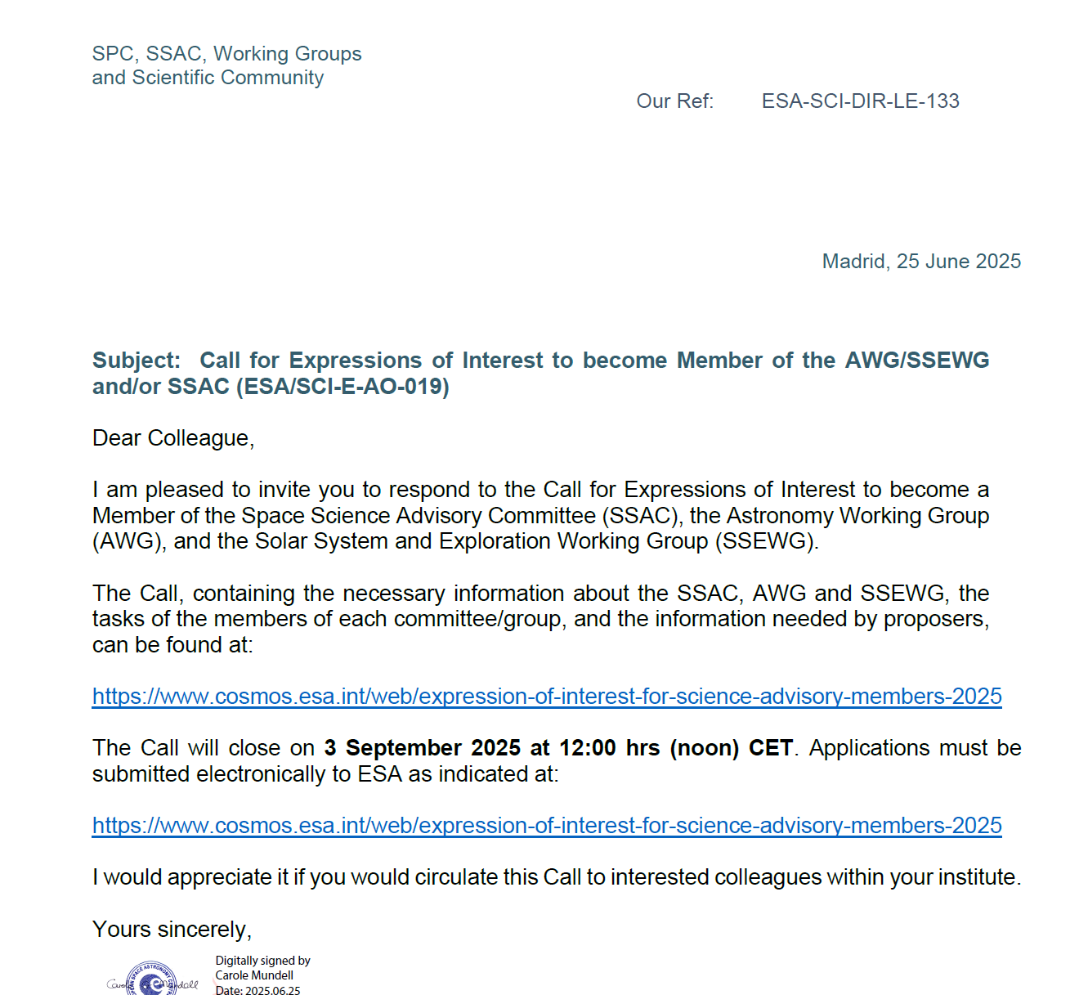
How can you get involved?
UK Discovery Advisory Committee for Science (DACS) advises UK SPC Delegates (contact Caroline Harper for details)
ESA D/SCI now operate an open call to self- or nominate a colleague to be part of these committees (Not all Directorates do)
ESA consider these positions as the gateway into your community, get involved!
Nominate yourself for ESA Science Advisory membership (Deadline: 3rd September 2025 (noon) CET)

Slide 14
Mission Selection Process in D/SCI
ESA convene a panel of independent experts starting with the advisory structure (SSAC, AWG, SSEWG etc)
Any conflicts of interests are discussed and managed
Additional members may be required for specific reviews
Proposals go through rigorous multi-stage peer-review with a panel composition that reflects the number and discipline of submissions
Proposals also receive a concurrent technical and financial review to determine viability

Slide 15
So how do you interface with ESA?
Work with your SSAC/SSEWG members and give them the ammunition to put your ideas forward
Work with your SPC delegates; do you know and work with them?
Engage through all ESA Directorates
So that ESA have:
Fewer, higher quality mission proposals
Communities that self-organise
A diverse programme

