Slide 1
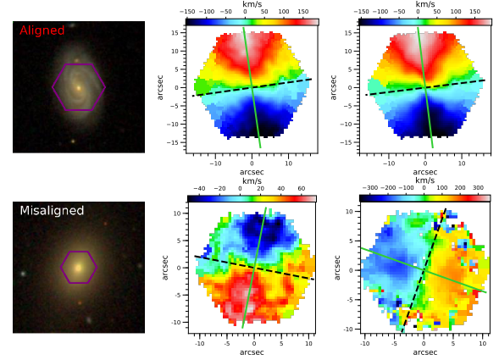
Relaxation timescales of stellar-gas kinematic misalignments in EAGLE galaxies
SDSS Image
Stellar velocity field
Hα velocity field
Maximilian Baker, Timothy A. Davis, Freeke van de Voort, Ilaria Ruffa
NAM 2025
Duckworth et al. (2019)

Slide 2
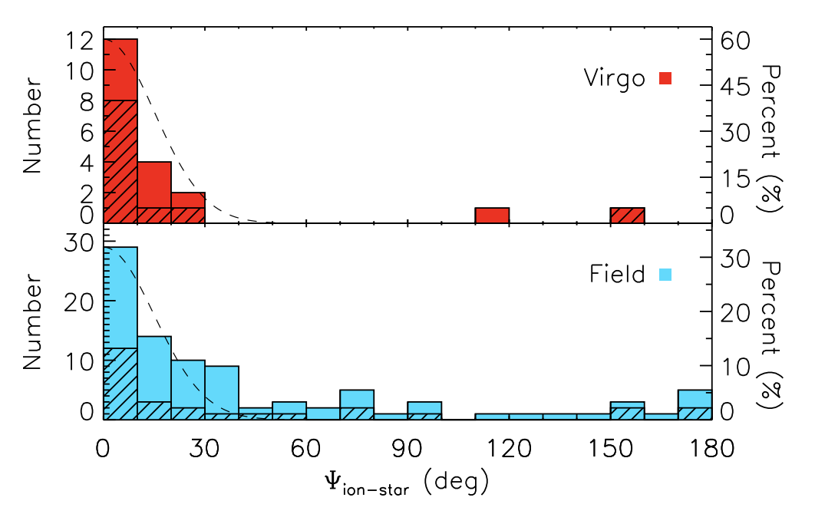
Misalignments and gas replenishment
Significant molecular gas reservoirs found in ~20% of local ETGs (Young et al. 2014, Davis et al. 2019).
Many of these ETGs show signs of recent cold gas replenishment, but dominant physical driver is unresolved.
Misalignments trace recent accretion/replenishment of misaligned gas (Bryant et al. 2019, Khim et al. 2021).
Transient phenomenon with expected lifetimes of ~0.1 Gyr for a typical ETG.
Seen in 30 – 40% of H⍺-detected ETGs, and ~7% of LTGs (Davis et al. 2011, Bryant et al. 2019).
Distribution of misalignment angles in ETGs | Davis et al. (2011)

Slide 3
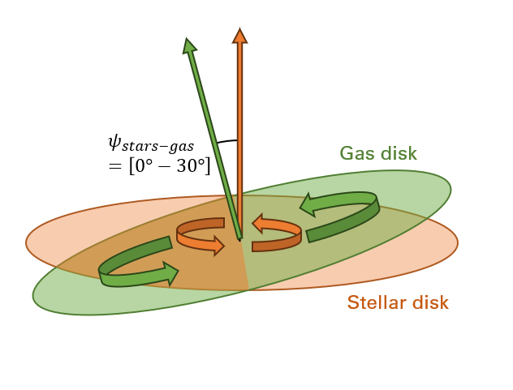
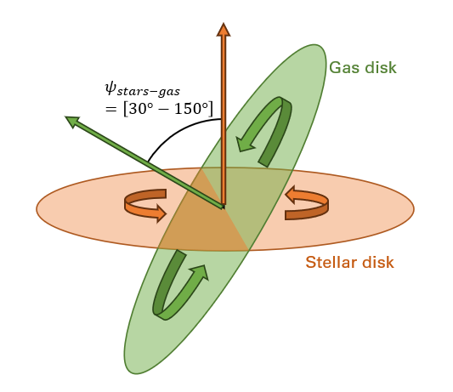
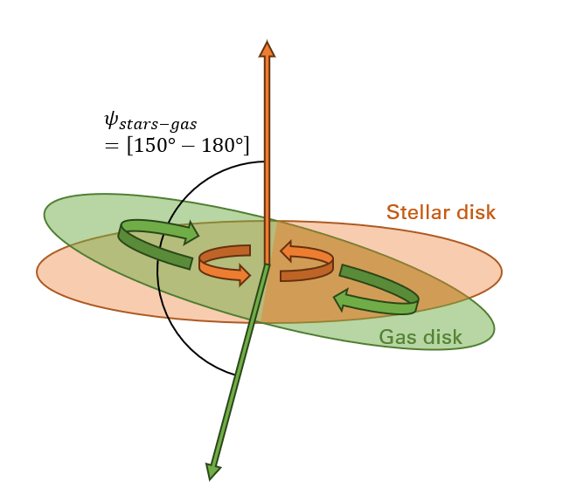
Misalignment relaxation timescales
Stable co-rotation
Unstable misalignments ‘relax’ into the galactic plane, either returning to co-rotation or forming counter-rotation.
Merger-driven replenishment/formation + short duration misalignments cannot explain observed misalignment distributions (Davis & Bureau 2016).
One proposed solution is a dominant population of long-lived misalignments ($t_{relax}/t_{torque}≫1$)
Unstable misalignment
(expected lifetimes ~0.1 Gyr)
Stable counter-rotation
We use EAGLE to investigate typical misalignment timescales for a large representative galaxy population with $M_{∗}>{10}^{9.5}M_{⊙}$ for the first time.
$$t_{relax}/t_{torque}$$
Schematic of a misalignment relaxation
Measured relaxation time / Theoretical relaxation time

Slide 4
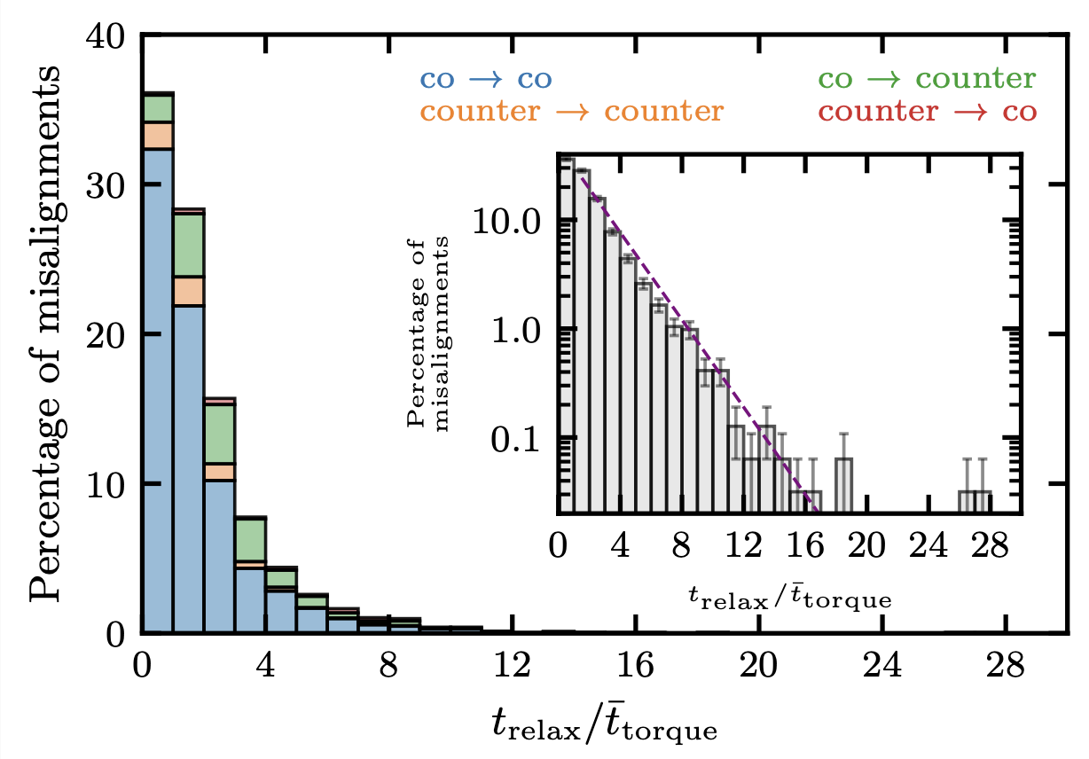
${t_{relax}/t}_{torque}$ distributions
Median ratios of ${t_{relax}/t}_{torque}≈1.4$ suggest most misalignments relax on short timescales roughly in agreement with theoretical predictions.
Relaxation timescales and ratios described by a log-linear distribution.
A population of long relaxations exist, with $≈20\%$of all misalignments with ${t_{relax}\text{/}t}_{torque}>3$
Baker et al. (2025)

Slide 5
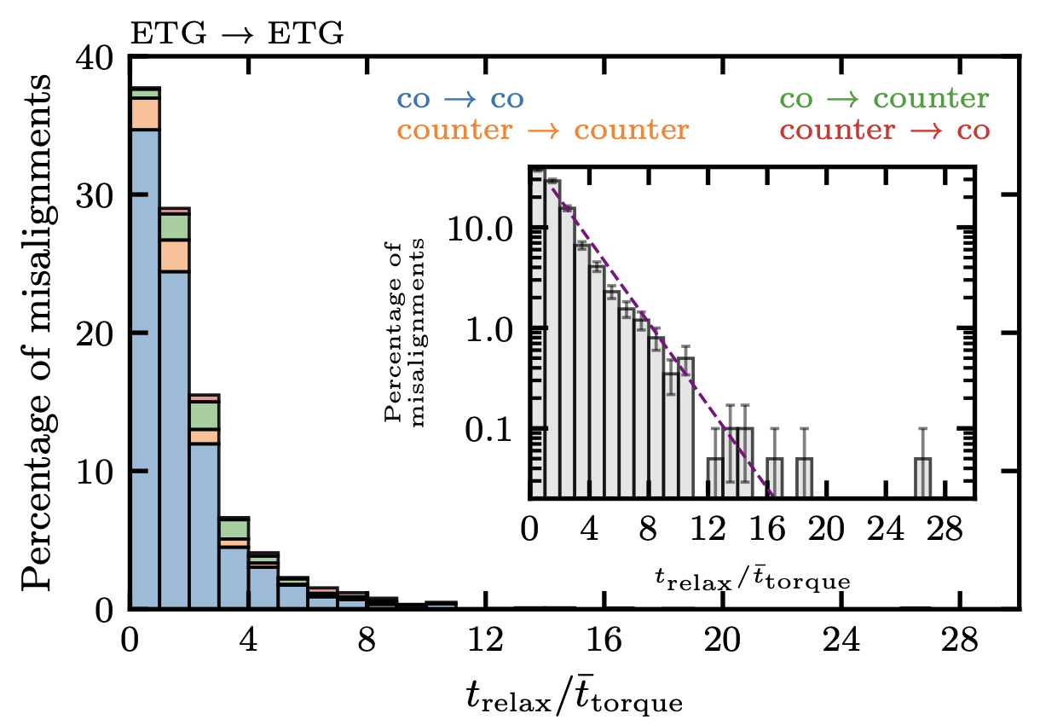
${t_{relax}/t}_{torque}$ distributions: ETGs
Baker et al. (2025)
No dominant population of ${t_{relax}≫t}_{torque}$ in ETGs → long-lived misalignments are rare.
Instead, misalignment events tend to occur frequently and often displaced by small angles (≲ 50º ), resulting in many co → co relaxations. Gas discs of LTGs are more resilient to this and show less frequent misalignments.

Slide 6
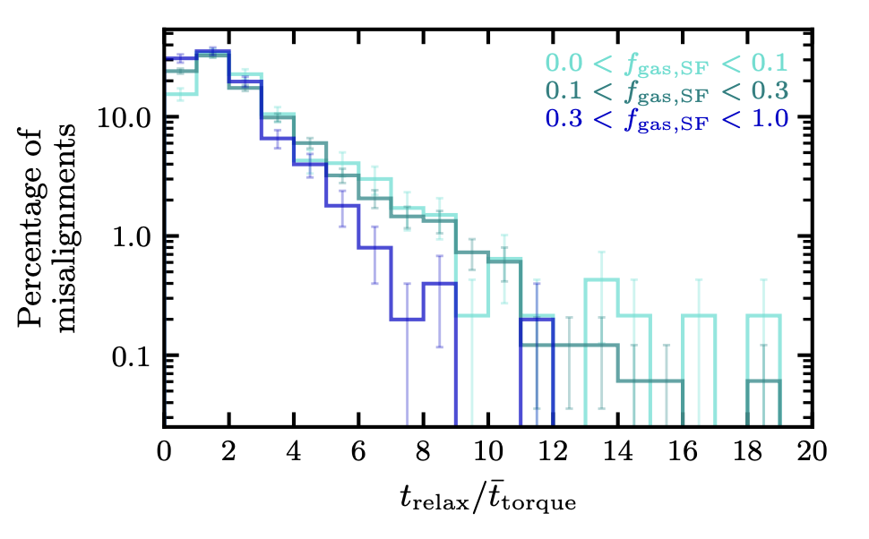
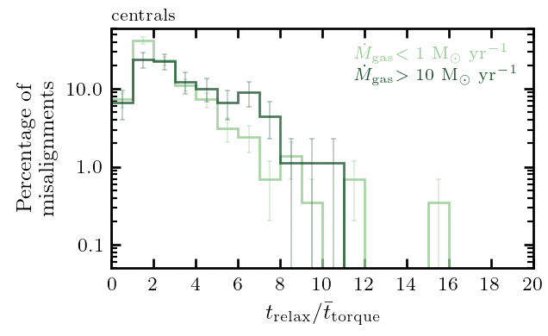
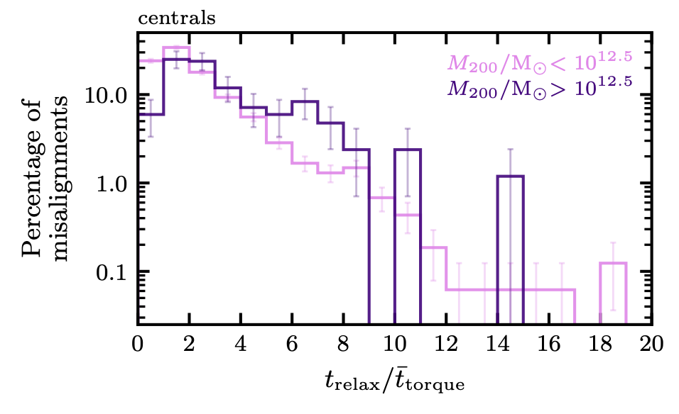
What drives the long-lived misalignments?
Long(er)-lived misalignments more common in galaxies with:
Lower star-forming gas fraction
More gas inflow post-formation (centrals)
Reside in more massive halos (centrals)
What could explain these trends?
Less massive gas discs → more easily perturbed
More inflow → more misaligned smooth accretion?
More massive halos → more halo cooling from a misaligned halo?
Baker et al. (2025)

Slide 7
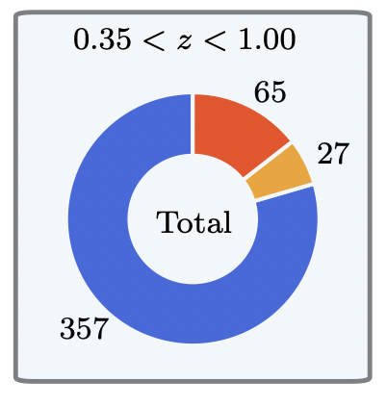
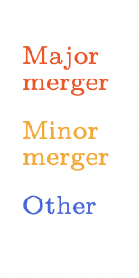
Incidence of mergers with misalignment formation
Within $z<0.35,$ mergers coincide with only $≈10\%$ of unstable misalignment formation.
This holds true for stellar mass $>{10}^{10}{ M}_{\text{☉}}.$
Consistent with other hydro simulations (e.g. Khim et al. 2021, Casanueva et al. 2019).
Among ETGs, this is $≈14\%.$
Major mergers are more effective than minor mergers at forming unstable misalignments.
Baker et al. (2025)

Slide 8
Incidence of mergers and unstable misalignments
Within $z<0.35,$ mergers coincide with only $≈10\%$ of unstable misalignment formation.
This holds true for stellar mass $>{10}^{10}{ M}_{\text{☉}}$
Among ETGs, this is $≈14\%.$
Major mergers are more effective than minor mergers at forming unstable misalignments.
Baker et al. (2025)

Slide 9
Summary from EAGLE:
Email: bakermk@cardiff.ac.uk
Misalignments tend to be short-lived and are described by a log-linear relationship.
Small population of long-lived misalignments does exist, but these are not dominant.
ETG misalignments occur frequently and displaced by small angles, resulting in many co → co relaxations. Gas discs of LTGs are more resilient to this.
i.e. there is no dominant population of long-lived unstable misalignments in ETGs.
Misalignment timescales are enhanced in galaxies that have: lower star-forming gas fractions, higher gas inflow rate post-formation, and reside in more massive halos.
We attribute this to the susceptibility of relatively lower-mass gas discs to perturbations and halo cooling in more massive systems.
Mergers do not dominate formation of misalignments.
i.e. unstable misalignments form through diverse formation pathways suggesting cold-gas replenishment in ETGs does the same.

