Slide 1
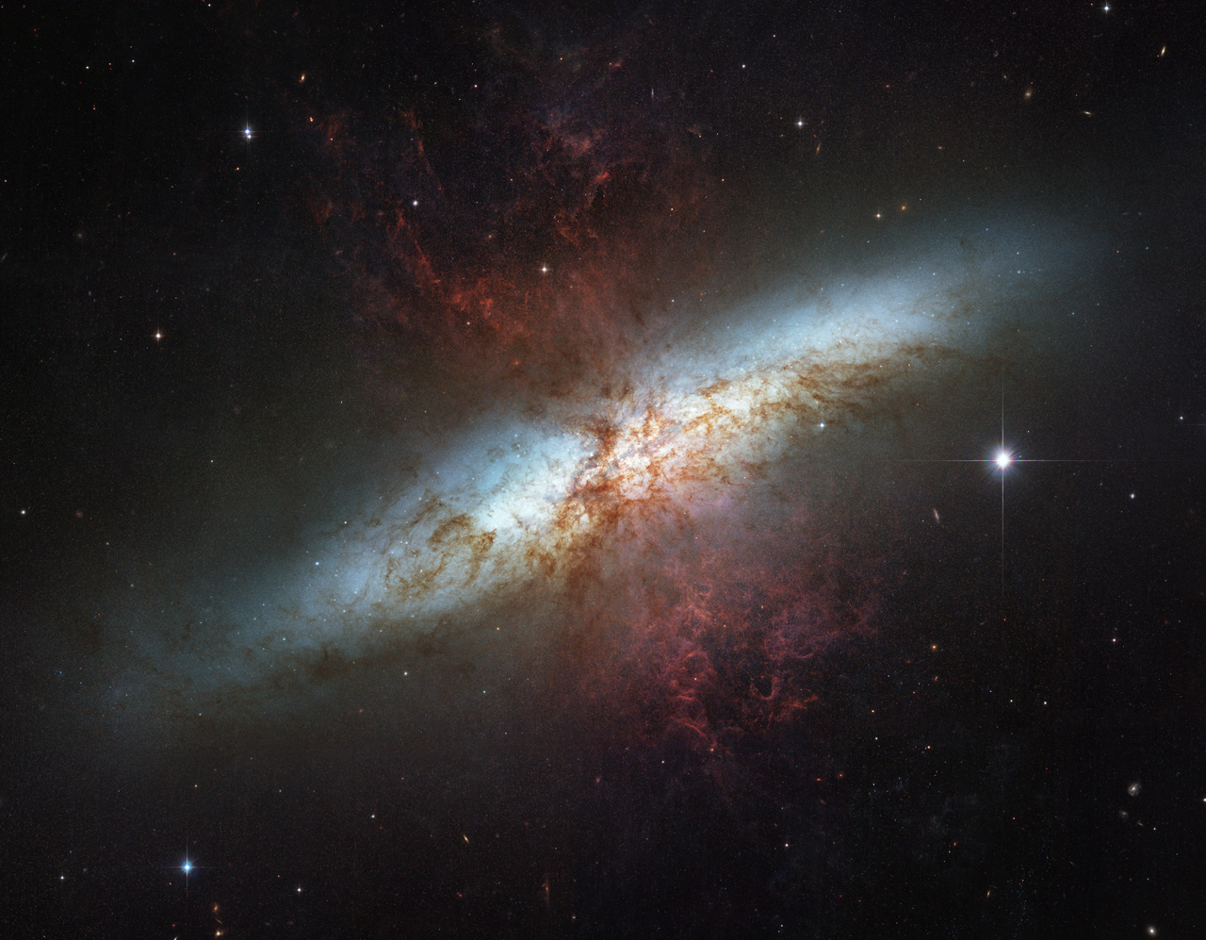


The MUSE Ultra-Deep Field: Tracing the baryon cycle through low-mass galaxies since cosmic noon
Alex Beckett
National Astronomy Meeting, Durham, 7th Jul 2025
Marc Rafelski, Mitchell Revalski, Michele Fumagalli, Matteo Fossati, Alaina Henry, Pratika Dayal, Sebastiano Cantalupo, Valentina D’Odorico, Marta Galbiati, Celine Peroux
Notes:
8 mins talk - 3 mins intro + data, 2 mins MZR, 2 mins CGM, 1 min DISCS

Slide 2
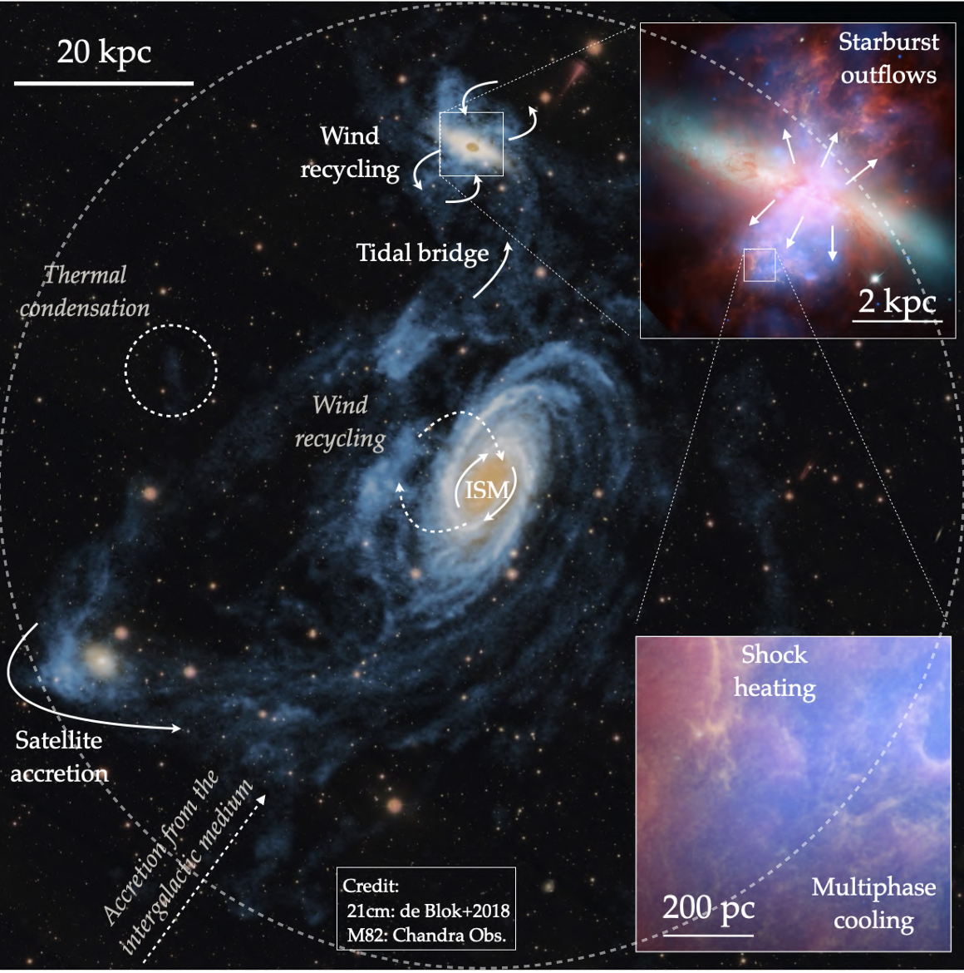
Gas flows in and around galaxies
CGM gas flows are complex, multi-phase, multi-scale
Dependances on galaxy properties, redshifts, environments
Deep observations needed to detect the gas and uncover these processes
Chen & Zahedy (2024)
Notes:
Mention size of the field – 2 arcmin.

Slide 3
MUDF
UVES spectra of two bright quasars
  Both at redshift z~3.23
Deepest MUSE observations ever taken
  total 142 hrs, program 1100.A−0528
Deepest WFC3 grism observations ever taken
  90 orbits G141M, program 15367
Multi-band HST imaging
  F336W, F450W, F702W, F125W, and F140W
Additional data from ALMA, XMM, HAWK-I
  Improved masses, AGN identification and detection of obscured galaxies
Beckett et al. (2024)
Notes:
Mention size of the field – 2 arcmin.

Slide 4
MUDF
419 galaxies with confident spectroscopic redshifts
73 galaxies with measured metallicities
304 measured absorption lines comprising 31 absorption systems
Masses as low as 10⁶ M⦿ and SFRs as low as 10⁻³ M⦿ /yr
Beckett et al. (2024)
Notes:
Mention size of the field – 2 arcmin.

Slide 5
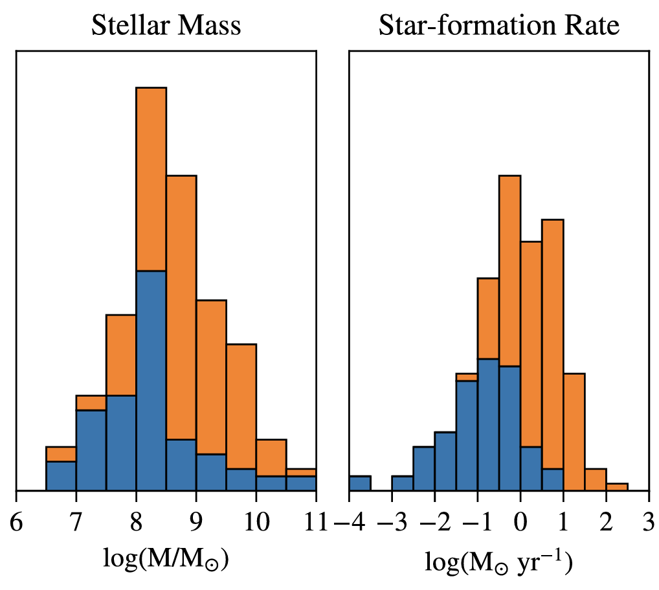
MUDF
Revalski et al. (2024)
Beckett et al. (2024)
Notes:
Mention size of the field – 2 arcmin.

Slide 6

The Mass-Metallicity Relation
The relationship between mass, metallicity and SFR is a result of the gas exchange between the ISM and CGM
Image produced by Mitchell Revalski
Notes:
Figure created by Mitchell using Curti data

Slide 7
The Mass-Metallicity Relation
Higher metallicities than previous studies due to lower SFRs in the MUDF sample
Low-mass slope of MZR matches expectations
Metals ejected from galaxies due to stellar feedback may be detected in the CGM
Revalski et al. (2024)
Notes:
Clarify stacks vs individual
Curti+20 – YES, THIS IS SDSS!

Slide 8
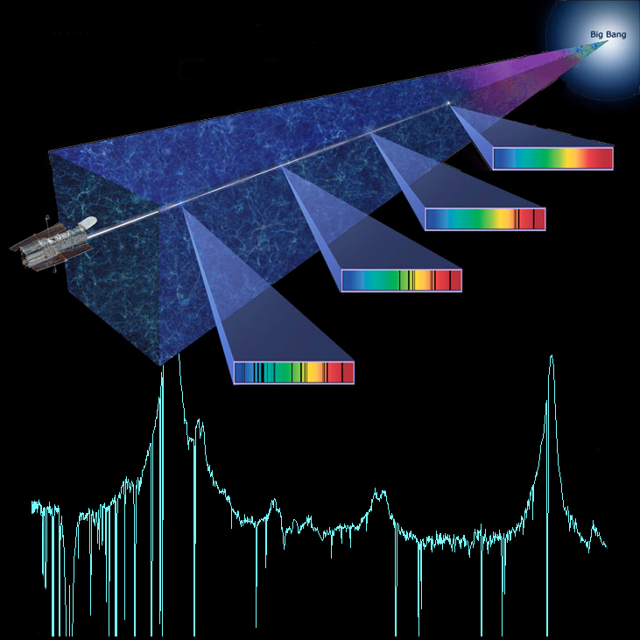
Metals in the CGM
Low-density gas can only be detected in absorption in the quasar spectra
Metal absorption lines indicate the redshift and properties of CGM gas
Image credit: Charles Danforth

Slide 9
Inflows and outflows
Absorption from inflows and outflows causes a bimodal position angle distribution
We measure the significance of this bimodality using a dip test
Earlier work shows a significant dip in HI absorption around z < 1 galaxies
‘dip’
accretion
outflows
Image adapted from Schroetter et al. (2016) and Beckett et al. (2021)
Gas accretion and outflows occur at different azimuthal angles
Notes:
Spend a bit longer on azimuthal angle
Lead onto p-value

Slide 10
Inflows & Outflows in the MUDF
HI coverage only at z > 2.4 in the MUDF, where we don’t have strong emission lines from the galaxies!
We consider MgII and FeII lines probing cool gas at 0.5 < z < 2.4
Beckett et al. (2024)
Notes:
Mention size of the field – 2 arcmin.

Slide 11
Inflows & Outflows in the MUDF
The bimodality is detected at 2-sigma only in low-impact-parameter and high-sSFR samples
Consistent with stellar-feedback-driven outflows
Beckett et al. (2024)

Slide 12
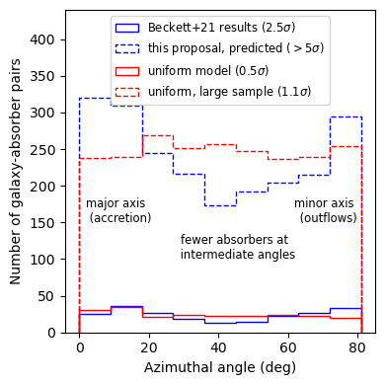
DISCS
Direct Imaging Survey of Circumgalactic Structure,
Aims to collate much larger sample of galaxy-absorber pairs across a wide redshift range to determine prevalence and extents of CGM structures
At z < 1.5:
~40 fields, > 2000 galaxy-absorber pairs
At z ~4:
14 fields, > 150 galaxy-absorber pairs
Notes:
Mention size of the field – 2 arcmin.

Slide 13
Conclusions
High-SFR galaxies have lower metallicities, indicating gas ejected from galaxies
Excess CGM absorption along the major and minor axis of high-sSFR galaxies also indicates outflows and inflows
Future prospects
JWST can access galaxies at z > 2.4, allowing direct comparisons between gas and galaxy metallicities in the MUDF
Larger samples needed to find outflow properties and redshift evolution – DISCS will help with this

Slide 14
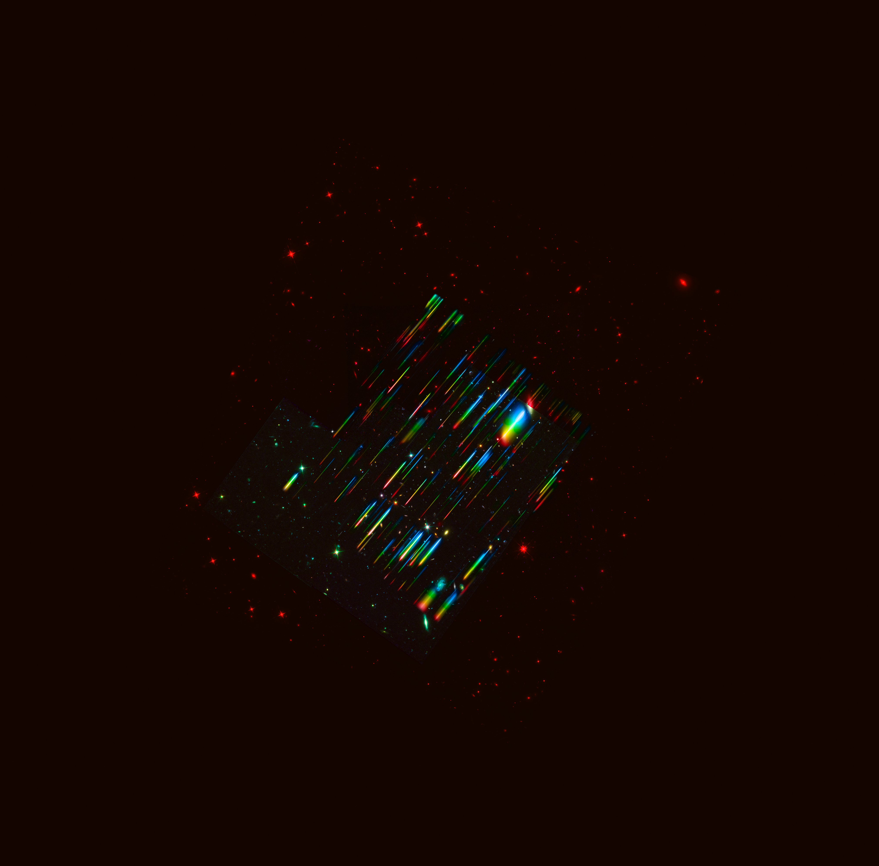


Thanks for listening!
abeckett@stsci.edu
Revalski et al. 2024, ApJ 966, 228
Beckett et al. 2024, ApJ 974, 2
all MUDF papers!
Notes:
TODO: Add contact details

Slide 15
Notes:
Aim for 15 minutes - ~8 min CGM, 4 min LyC, 3 min future work

Slide 16
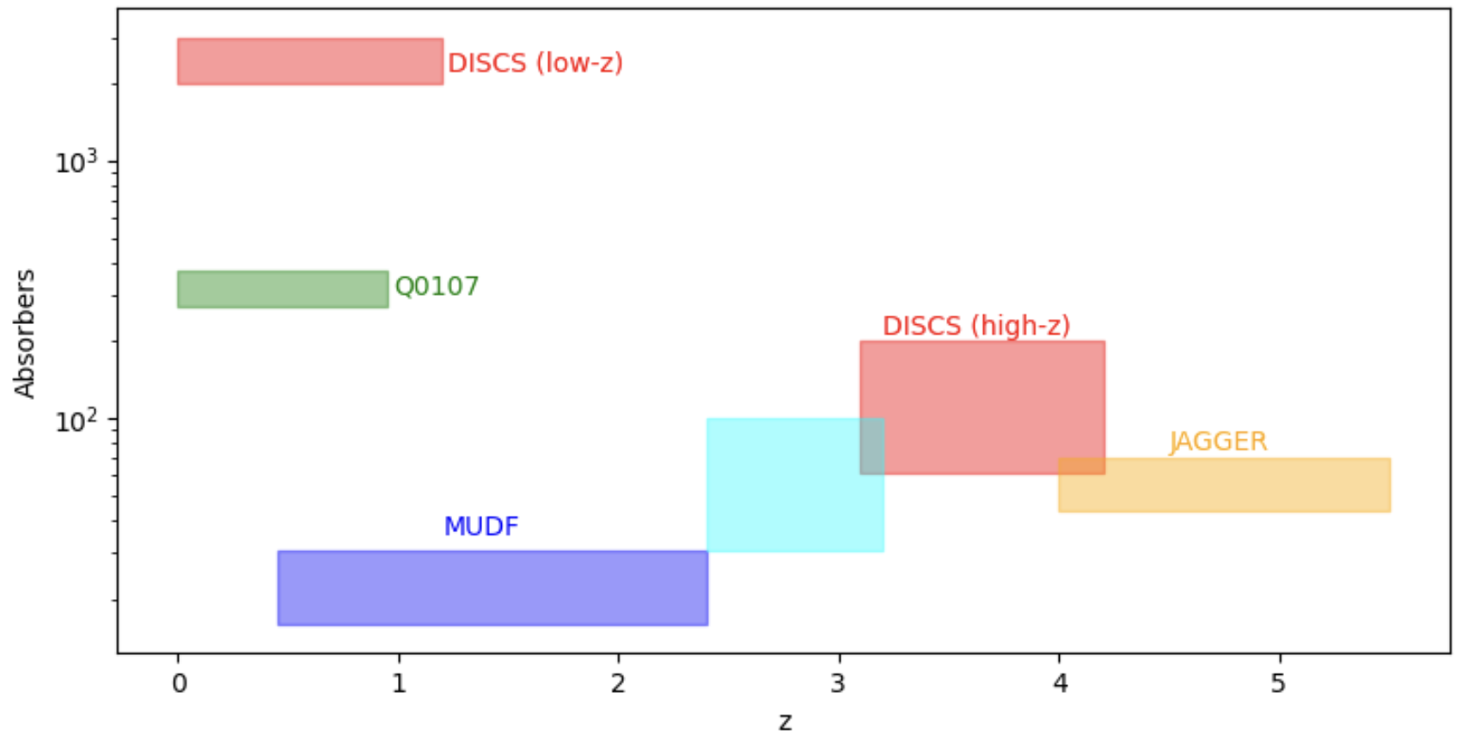
Prospects
Using quasar sightlines we can probe the baryon cycle across cosmic time, from the end of reionization to the present day.
Notes:
Mention size of the field – 2 arcmin.

Slide 17
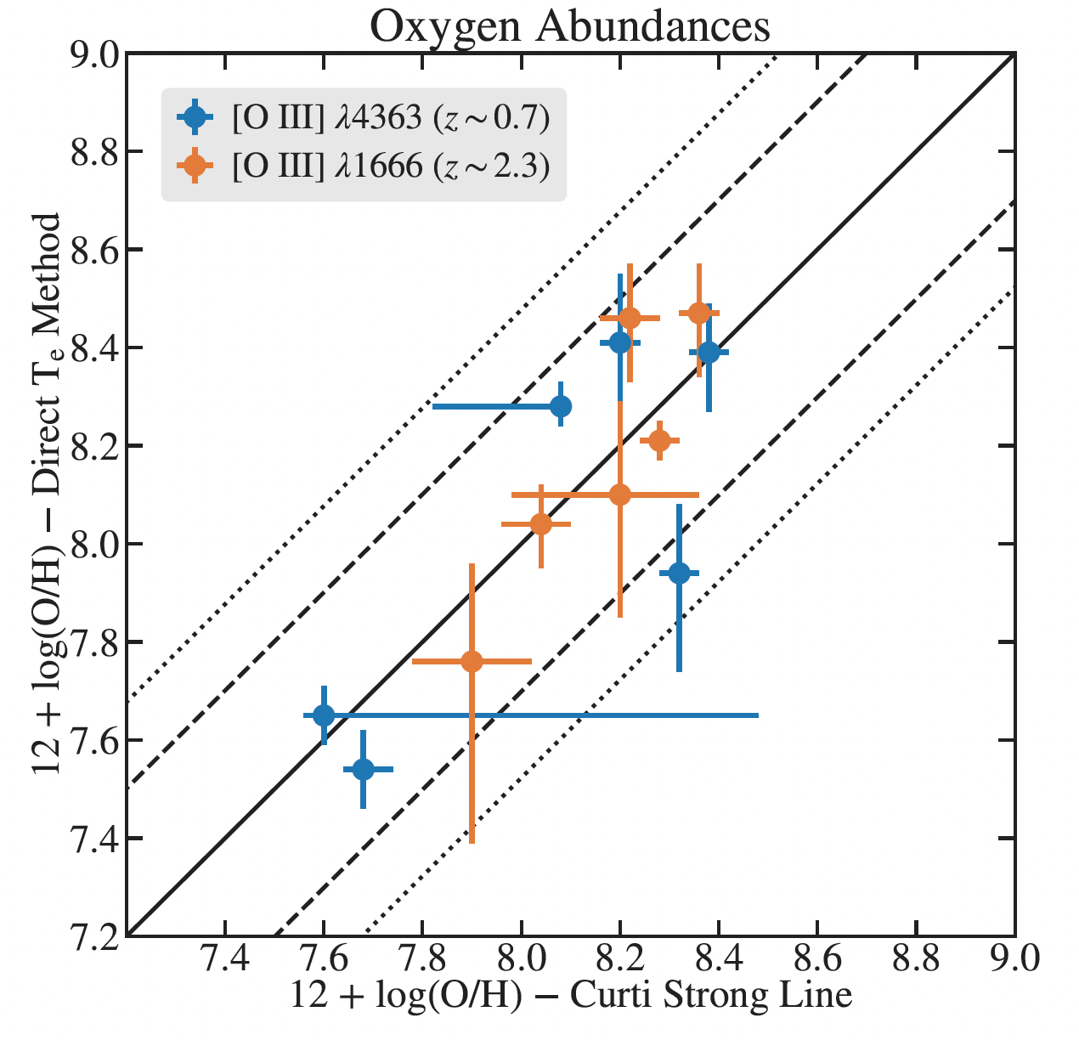
ISM Metallicities
Using calibrations from Curti+17, we find that direct and strong-line metallicities agree up to z~2.5
Revalski et al. (2024)
Notes:
Lower mass than most previous 1666 measurements – avg 10^8.8 – where outflows are more likely
(Not in talk: calibrators at low z are good analogs for z~2 explains some of the alignment)

Slide 18
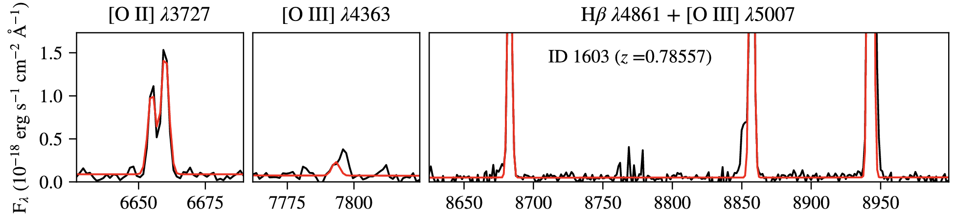
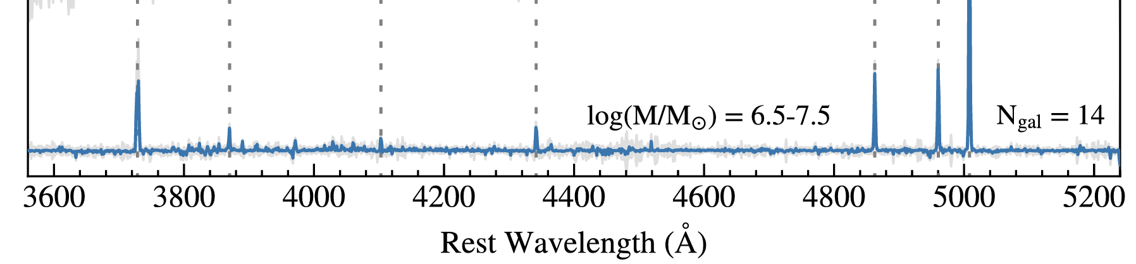
ISM Metallicities
‘Direct’ methods:
  Auroral lines allow a direct Te measurement
  We use [OIII] 1666 and 4363 lines
  These lines are weak and only detected for a few sources
‘Strong-line’ methods:
  Strong lines visible in most galaxies
  Need to be calibrated based on direct metallicities
Revalski et al. (2024)
Notes:
Spend a bit longer on auroral lines – 1666 needed to measure at higher redshifts – could include postage stamps from paper appendix
Be clearer on stacked vs individual metallicities
Switch to high-z?

Slide 19
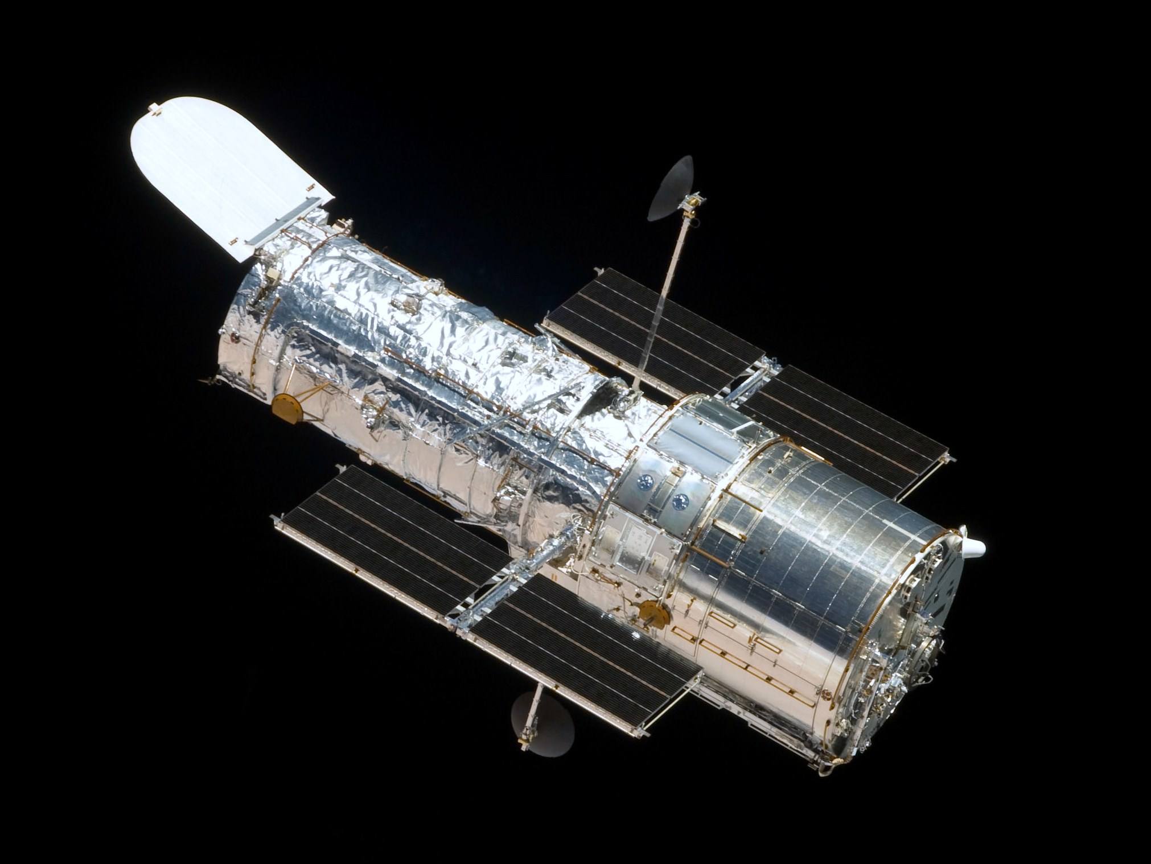
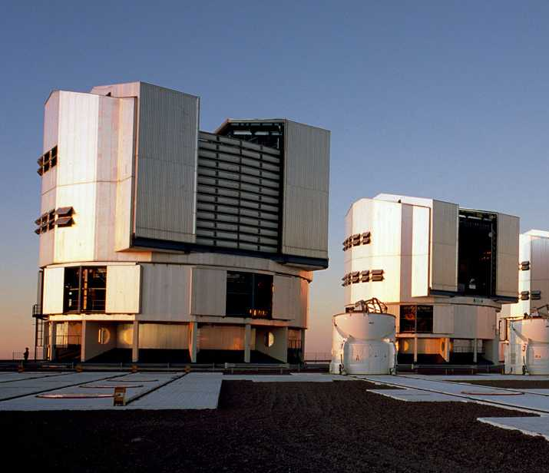
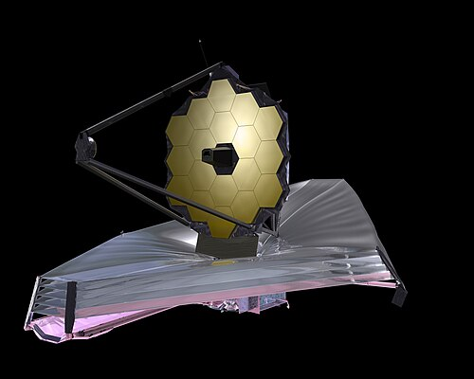
Why is this so hard?!
Gas in the outer CGM can only be seen in absorption, so studying CGM properties as a function of location around galaxies requires:
Quasar spectra
High-S/N spectra required to detect weak absorption lines
Usually HST/COS at low-z, ground-based (e.g. HIRES, UVES) at high-z
Galaxy redshifts
Need deep spectra to confirm galaxy redshifts out to large distances
MUSE generally most efficient
Galaxy orientations/morphologies
High-resolution requires space-based imaging
HST at low-z, JWST at high-z
Notes:
Mention size of the field – 2 arcmin.

Slide 20
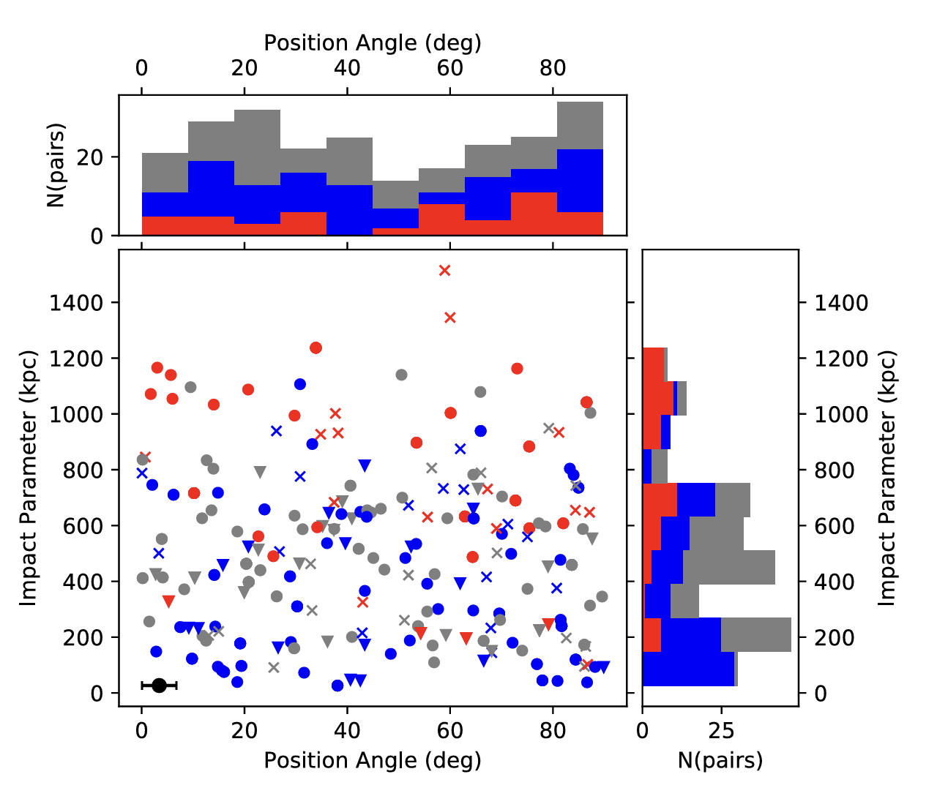
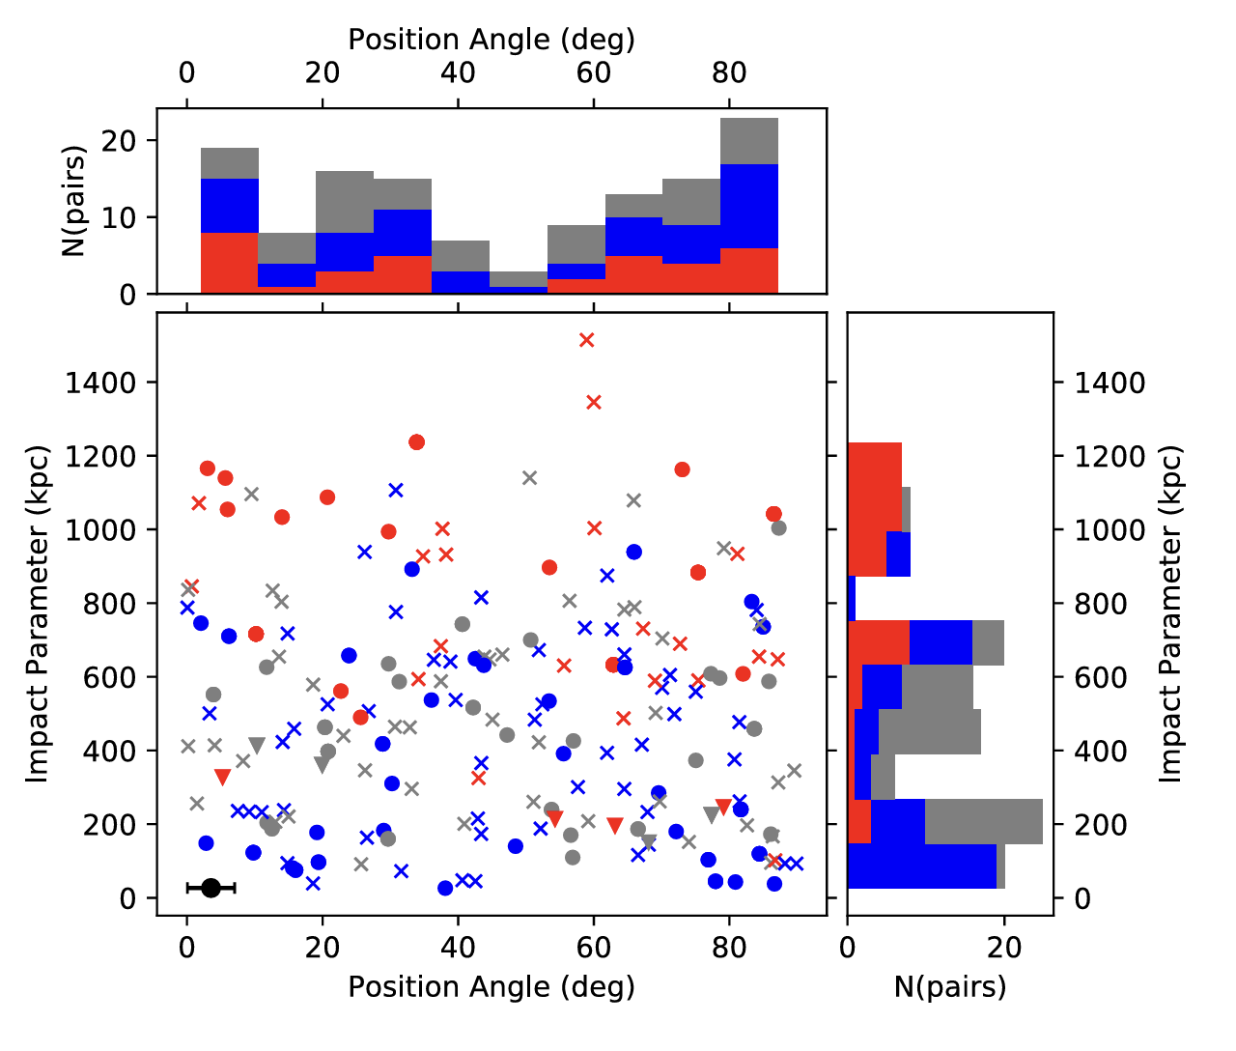
Azimuthal angles – Q0107
Full Sample (~2.5𝜎)
Log(N) > 14 (~3𝜎)
Beckett et al. (2021)
Notes:
Mention size of the field – 2 arcmin.

Slide 21
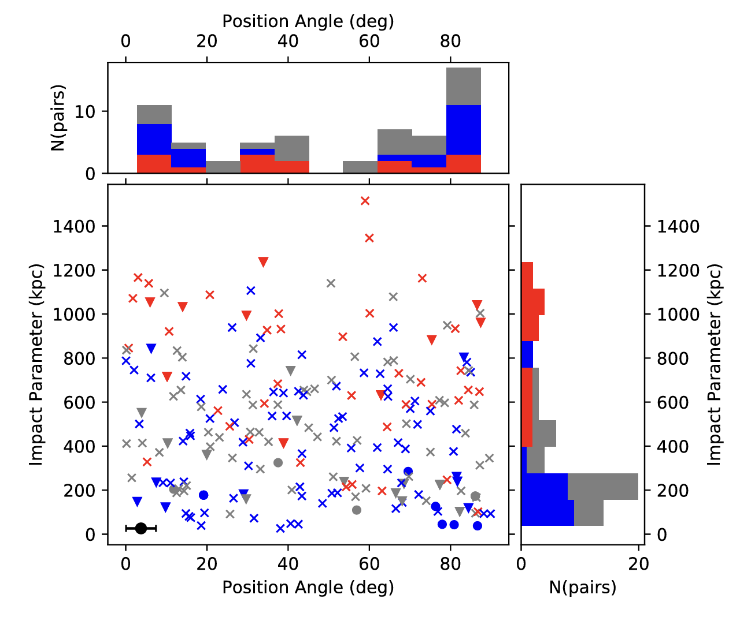
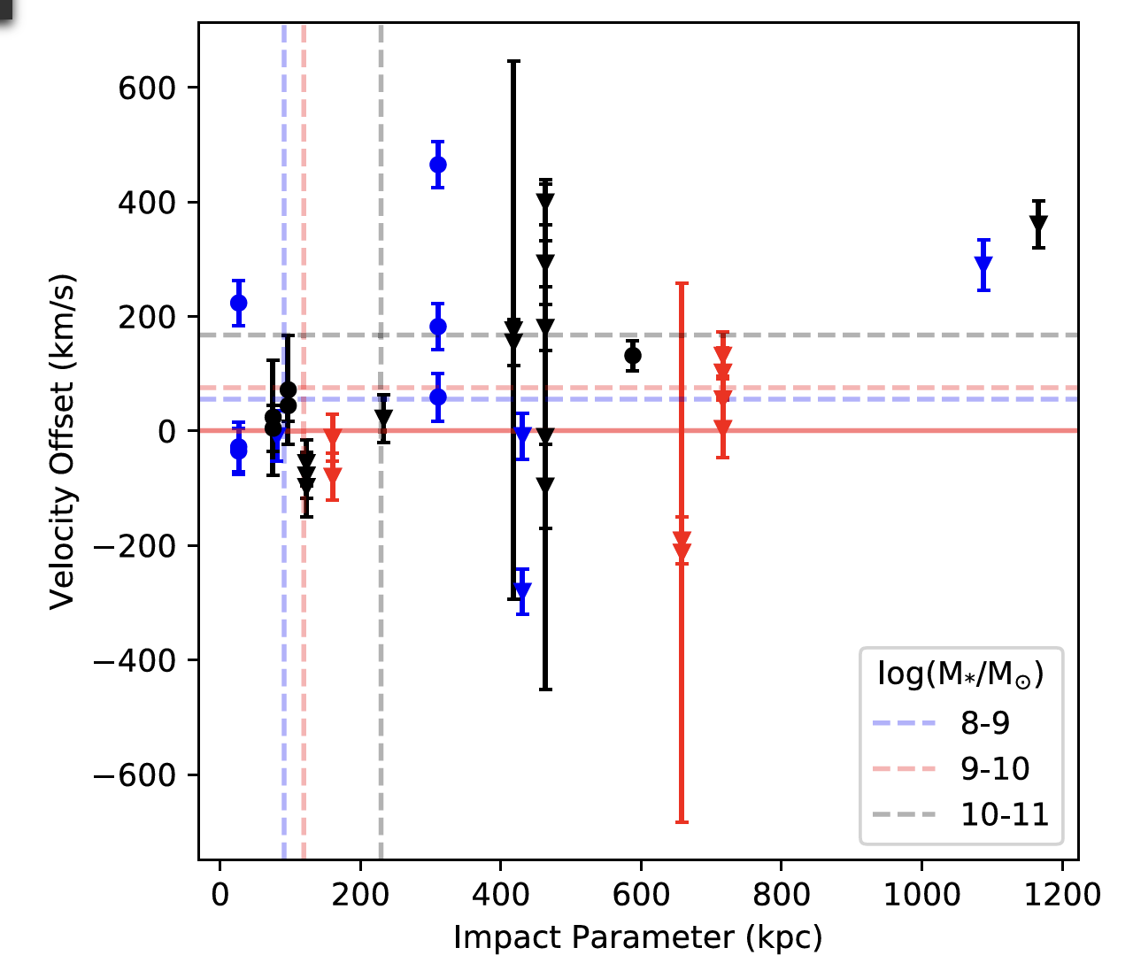
Azimuthal angles – Q0107
O VI (~3.5𝜎)
Beckett et al. (2021)
Notes:
Mention size of the field – 2 arcmin.

Slide 22
MUDF
Bimodal distribution at small impact parameters around highly star-forming galaxies
Consistent with stellar-feedback driven outflows and accretion around low-mass galaxies
Beckett et al. (2024)
Notes:
Mention size of the field – 2 arcmin.

Slide 23
Thanks for listening!
Outflowing/accreting structures seen in most models and many observations, but properties not clear
Large surveys needed to build up statistical samples and measure these properties for different populations of galaxies
Q0107: Beckett et al. 2021, 2022, 2023
MUDF: Beckett et al. 2024
abeckett@stsci.edu
Notes:
Aim for 15 minutes - ~8 min CGM, 4 min LyC, 3 min future work

