Slide 1
MgII Absorbers in the Circumgalactic Medium of Post Starburst Galaxies
Zoe Harvey
Supervisors:
Dr Rita Tojeiro
Prof Vivienne Wild

Slide 2
Leung et al 2024
Post Starburst Galaxies
Galaxies tend to be bi-modal in terms of their colour and star formation rate.
The Post Starburst Galaxies are a rare population of galaxies which have experienced a burst of star formation then a period of rapid quenching.
They have strong Balmer absorption lines and an enhanced A/F-Star Population.
Maltby et al 2019

Slide 3
SDSS Datasets
Sloan Digital Sky Survey DR12 BOSS for CMASS galaxies, removing any galaxy with Z < 0.35.
SDSS DR7 for Quasars removing anything below Z < 0.35.
We removed strong MgII absorbers with EW > 3Å from Rimoldini Strong Absorber Catalogue.
Value Added Catalogue from Granada providing Stellar Masses.

Slide 4
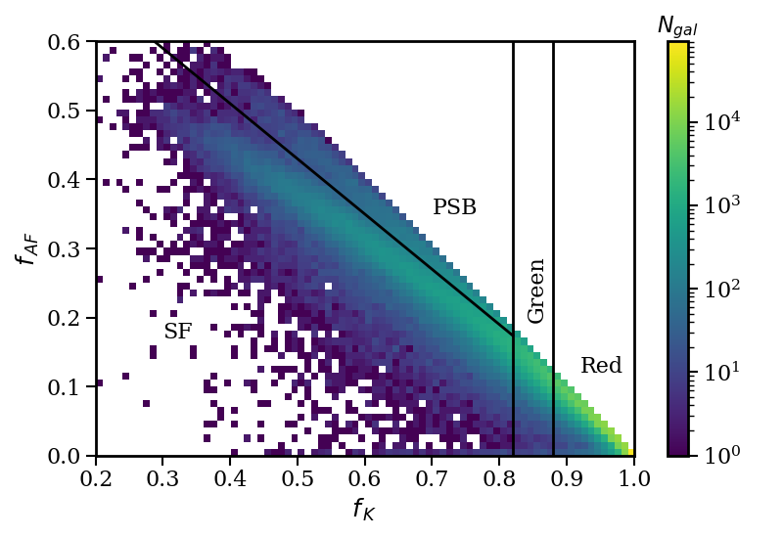
MFICA
Mean Field Independent Component Analysis.
Data-driven spectral analysis similar to PCA.
Galaxy classification using galaxy spectra.
Using MFICA, we classified galaxies as quiescent, star forming or post starburst.
This split confirmed by galaxy spectra stacking.
Old Stars
Krishna et al Submitted

Slide 5
Quasar Line of Sight
Pairs were calculated using the quasar line of sight method.
The distance between the galaxy and the quasar line of sight is the impact parameter.
The quasar spectra is shifted to the rest frame of the galaxy for each pair.
We looked for MgII absorption in stacks of quasar spectra in different galaxy classes.
Galaxies
Quasar
Impact Parameter

Slide 6
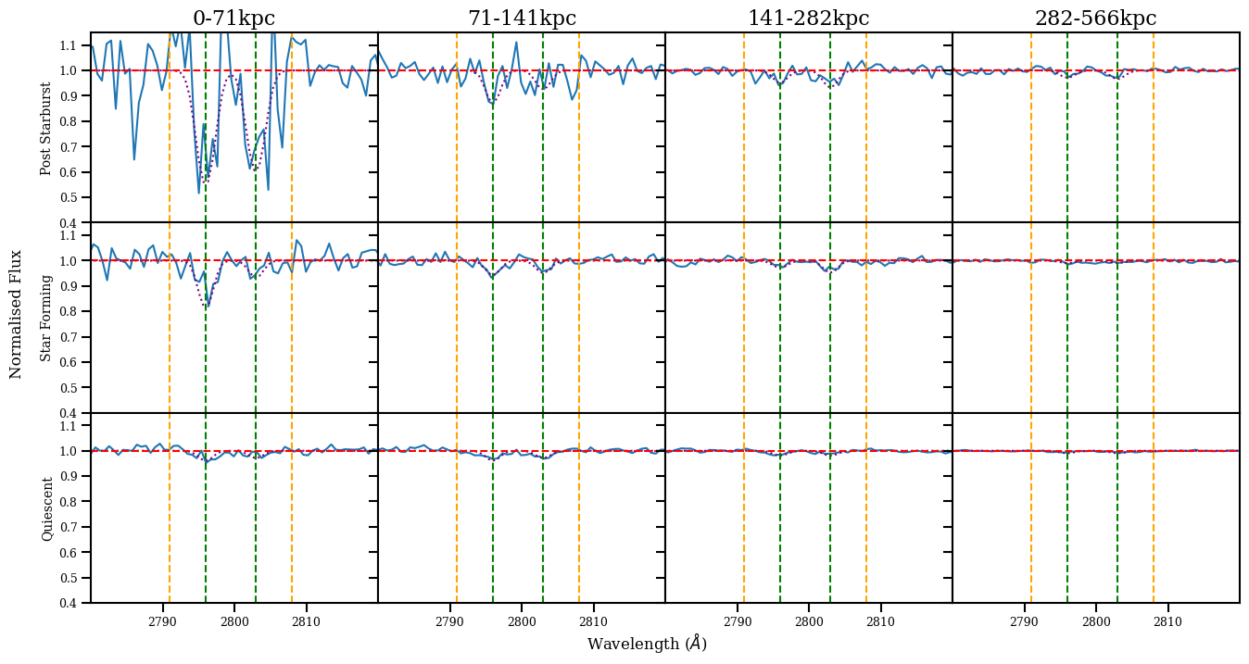
Stacking

Slide 7
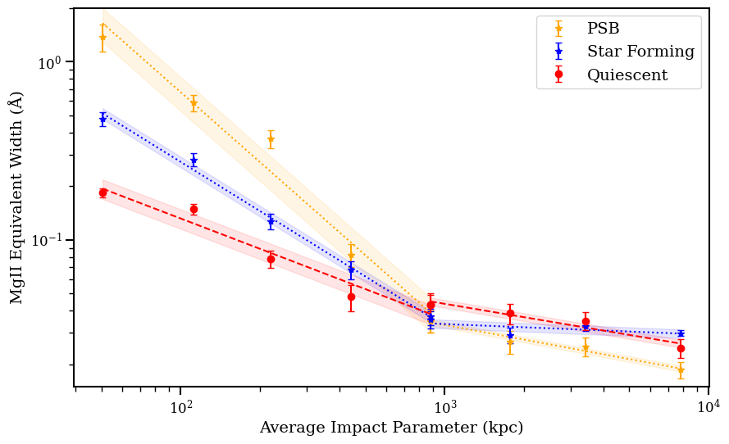
Splitting by Galaxy Class
Link to the paper

Slide 8
Magnesium II Outflows
At intermediate redshifts (z - 0.6) fast galactic outflows (v > 1000kms ) have been detected in high mass Post Starburst Galaxies.
It is unclear if these outflows can quench galaxies.
-1
out
Tremonti et al 2007 Discovery of Outflows in Massive PSB Galaxies

Slide 9
Discussion
MgII outflows in PSB galaxies could be leading to the higher levels of MgII in their CGM.
1000kms outflows will travel ~ 100kpc in 100Myr.
For an average PSB age of 500Myr, our results are consistent with the observed outflows.
-1
Tremonti et al 2007 Discovery of Outflows in Massive PSB Galaxies

Slide 10
Conclusion
Post Starburst Galaxies have stronger MgII absorption than Star Forming Galaxies, while Star Forming have more than Quiescent.
This could be linked to MgII outflows in Post Starbursts, but also due to other mechanisms such as gas-rich mergers.
Harvey et al 2025
Arxiv: 2506.22287
Link to the paper
-1
out

Slide 11
The Future
So if starbursts have a significant impact on CGM, what happens if we look at the time since starburst?
Using other data sets to investigate this same problem, such as DESI.
PSB 0379.579.51789 ALMA (ESO/NAOJ/NRAO)
S. Dagnello (NRAO/AUI/NSF)

Slide 12
Sanity Checks
Weighting by Redshift and Stellar Mass
Does not change the results - in fact it highlights the SFR result.

Slide 13
The Origin of MgII
MgII is used to trace the cool gas - sometimes called the cold gas - in the CGM.
The Origin of the cold gas is somewhat debated, but comes from a number of different processes.
The MgII itself comes from these processes.
Decataldo, Davide et al 2024, The origin of cold gas in the circumgalactic medium

