Slide 1
Investigating Star-Planet Compositional Ties for Systems with Host Stars of Varying Composition
NAM – 9th July 2025
Daisy Turner
dat936@student.bham.ac.uk

Slide 2
1/10
Planet Formation
Daisy Turner
Star-Planet Composition
dat936@student.bham.ac.uk
Notes:
stars and planets formed in the same environment
∴ it is often assumed that there is a relationship between their compositions
many studies have found relationships (1:1, etc.)
a common feature of these studies is a lack of homogeneity and a small sample size

Slide 3
2/10
Sample Comparison
my sample
Daisy Turner
Star-Planet Composition
dat936@student.bham.ac.uk
Notes:
work on expanding this sample with a particular focus on homogeneity of both planetary and stellar parameters
__% increase
my work involves measuring stellar abundances
to aid in the determination of stellar abundances, i limit my sample to FGK stars, specifically bright ones (V<12)
measure stellar abundances and compare specific abundances to the interior composition of their orbiting planets (specifically mantle and core)

Slide 4
2/10
Sample Comparison
homogenous
my sample
Daisy Turner
Star-Planet Composition
dat936@student.bham.ac.uk
Notes:
work on expanding this sample with a particular focus on homogeneity of both planetary and stellar parameters
__% increase
my work involves measuring stellar abundances
to aid in the determination of stellar abundances, i limit my sample to FGK stars, specifically bright ones (V<12)
measure stellar abundances and compare specific abundances to the interior composition of their orbiting planets (specifically mantle and core)

Slide 5
2/10
Sample Comparison
~65% increase in size compared to similar studies
homogenous
my sample
Daisy Turner
Star-Planet Composition
dat936@student.bham.ac.uk
Notes:
work on expanding this sample with a particular focus on homogeneity of both planetary and stellar parameters
__% increase
my work involves measuring stellar abundances
to aid in the determination of stellar abundances, i limit my sample to FGK stars, specifically bright ones (V<12)
measure stellar abundances and compare specific abundances to the interior composition of their orbiting planets (specifically mantle and core)

Slide 6
2/10
Sample Comparison
~65% increase in size compared to similar studies
homogenous
my sample
FGK stars
Daisy Turner
Star-Planet Composition
dat936@student.bham.ac.uk
Notes:
work on expanding this sample with a particular focus on homogeneity of both planetary and stellar parameters
__% increase
my work involves measuring stellar abundances
to aid in the determination of stellar abundances, i limit my sample to FGK stars, specifically bright ones (V<12)
measure stellar abundances and compare specific abundances to the interior composition of their orbiting planets (specifically mantle and core)

Slide 7
2/10
Sample Comparison
~65% increase in size compared to similar studies
homogenous
my sample
FGK stars
V < 12 mag
Daisy Turner
Star-Planet Composition
dat936@student.bham.ac.uk
Notes:
work on expanding this sample with a particular focus on homogeneity of both planetary and stellar parameters
__% increase
my work involves measuring stellar abundances
to aid in the determination of stellar abundances, i limit my sample to FGK stars, specifically bright ones (V<12)
measure stellar abundances and compare specific abundances to the interior composition of their orbiting planets (specifically mantle and core)

Slide 8
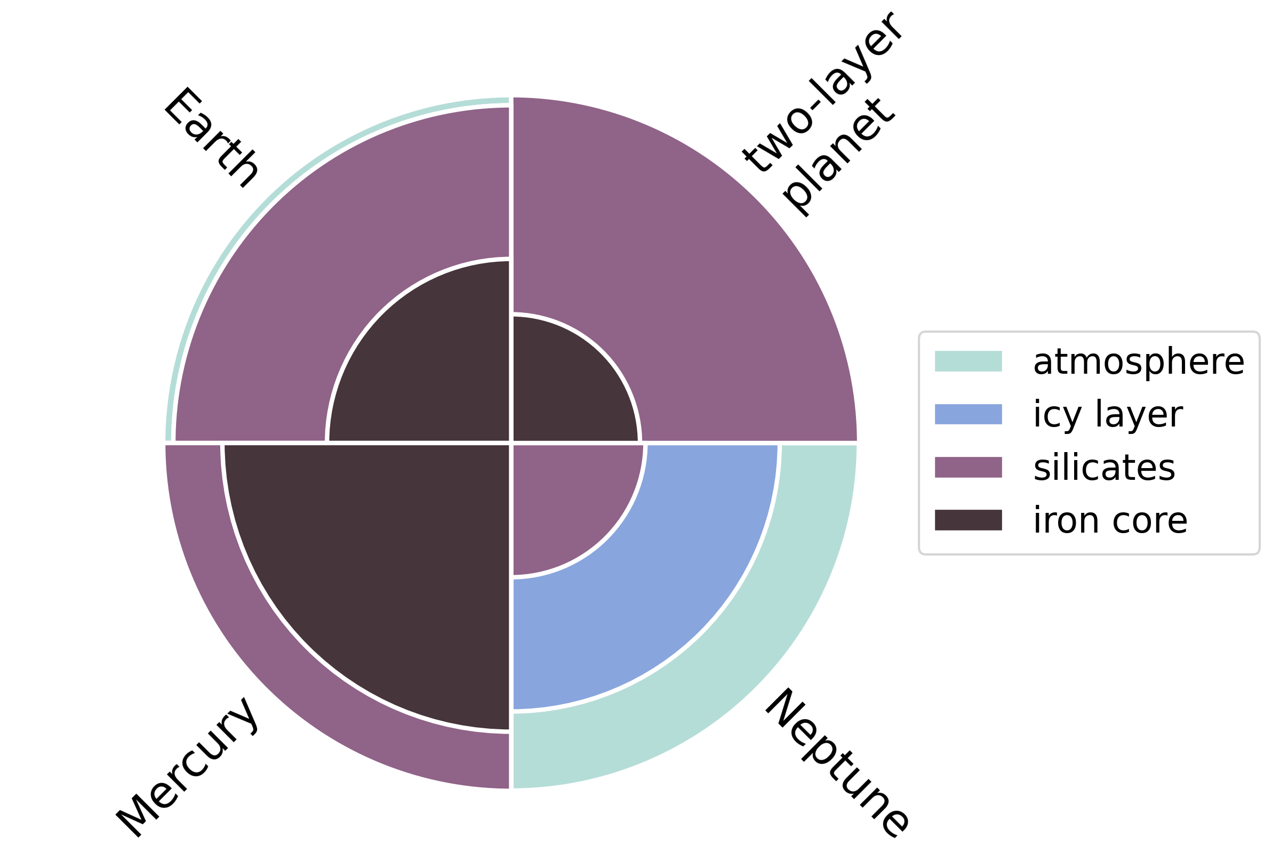
3/10
Interior Structure
Daisy Turner
Star-Planet Composition
dat936@student.bham.ac.uk
Notes:
Here I show the approximate mass compositions of three solar system planets and a planet with two interior layers
typically discuss interiors with reference to four layers:
Iron core, silicates (rock), icy and atmosphere
For rocky planets, a two-layer model is a decent approximation, as any potential icy/atmosphere is limited
I limit my sample to Rp < 4Roplus (Neptune radius), allowing us to study sub-Neptunes, super-Earths and smaller
The abundances I focus on on the stellar side are selected based on these interior layers within exoplanets
These chemical abundances are the alpha elements
alpha elements are those formed via the alpha process
NEXT SLIDE
in this case, Mg, Si, and Ti are the elements of interest as they make up exoplanet mantles
∴ we wish to look at systems across a wide range of \[α/Fe\] values

Slide 9
3/10
Interior Structure
Mg
Si
Ti
Daisy Turner
Star-Planet Composition
dat936@student.bham.ac.uk
Notes:
Here I show the approximate mass compositions of three solar system planets and a planet with two interior layers
typically discuss interiors with reference to four layers:
Iron core, silicates (rock), icy and atmosphere
For rocky planets, a two-layer model is a decent approximation, as any potential icy/atmosphere is limited
I limit my sample to Rp < 4Roplus (Neptune radius), allowing us to study sub-Neptunes, super-Earths and smaller
The abundances I focus on on the stellar side are selected based on these interior layers within exoplanets
These chemical abundances are the alpha elements
alpha elements are those formed via the alpha process
NEXT SLIDE
in this case, Mg, Si, and Ti are the elements of interest as they make up exoplanet mantles
∴ we wish to look at systems across a wide range of \[α/Fe\] values

Slide 10
4/10
Alpha-Enrichment
Daisy Turner
Star-Planet Composition
dat936@student.bham.ac.uk
Notes:
Explain x-axis
Explain y-axis
2d hist using GALAH population – representative of the thin and thick disc stars in the Milky Way

Slide 11
4/10
Alpha-Enrichment
Daisy Turner
Star-Planet Composition
dat936@student.bham.ac.uk
Notes:
Here you can see two populations:
lower population is the chemical thin disc
and the upper population is the chemical thick disc

Slide 12
4/10
Alpha-Enrichment
Daisy Turner
Star-Planet Composition
dat936@student.bham.ac.uk
Notes:
for the host stars in my sample, looking in terms of alpha-enrichment vs iron abundance, we see that there is more variation in alpha-enrichment at sub-solar metallicities
focusing my investigation on iron-poor stars will allow me to study stars that occupy the full range of alpha-enrichment
Iron-poor stars are usually alpha-enhanced
Need to investigate entire parameter space to have a comprehensive study (find any compositional links)

Slide 13
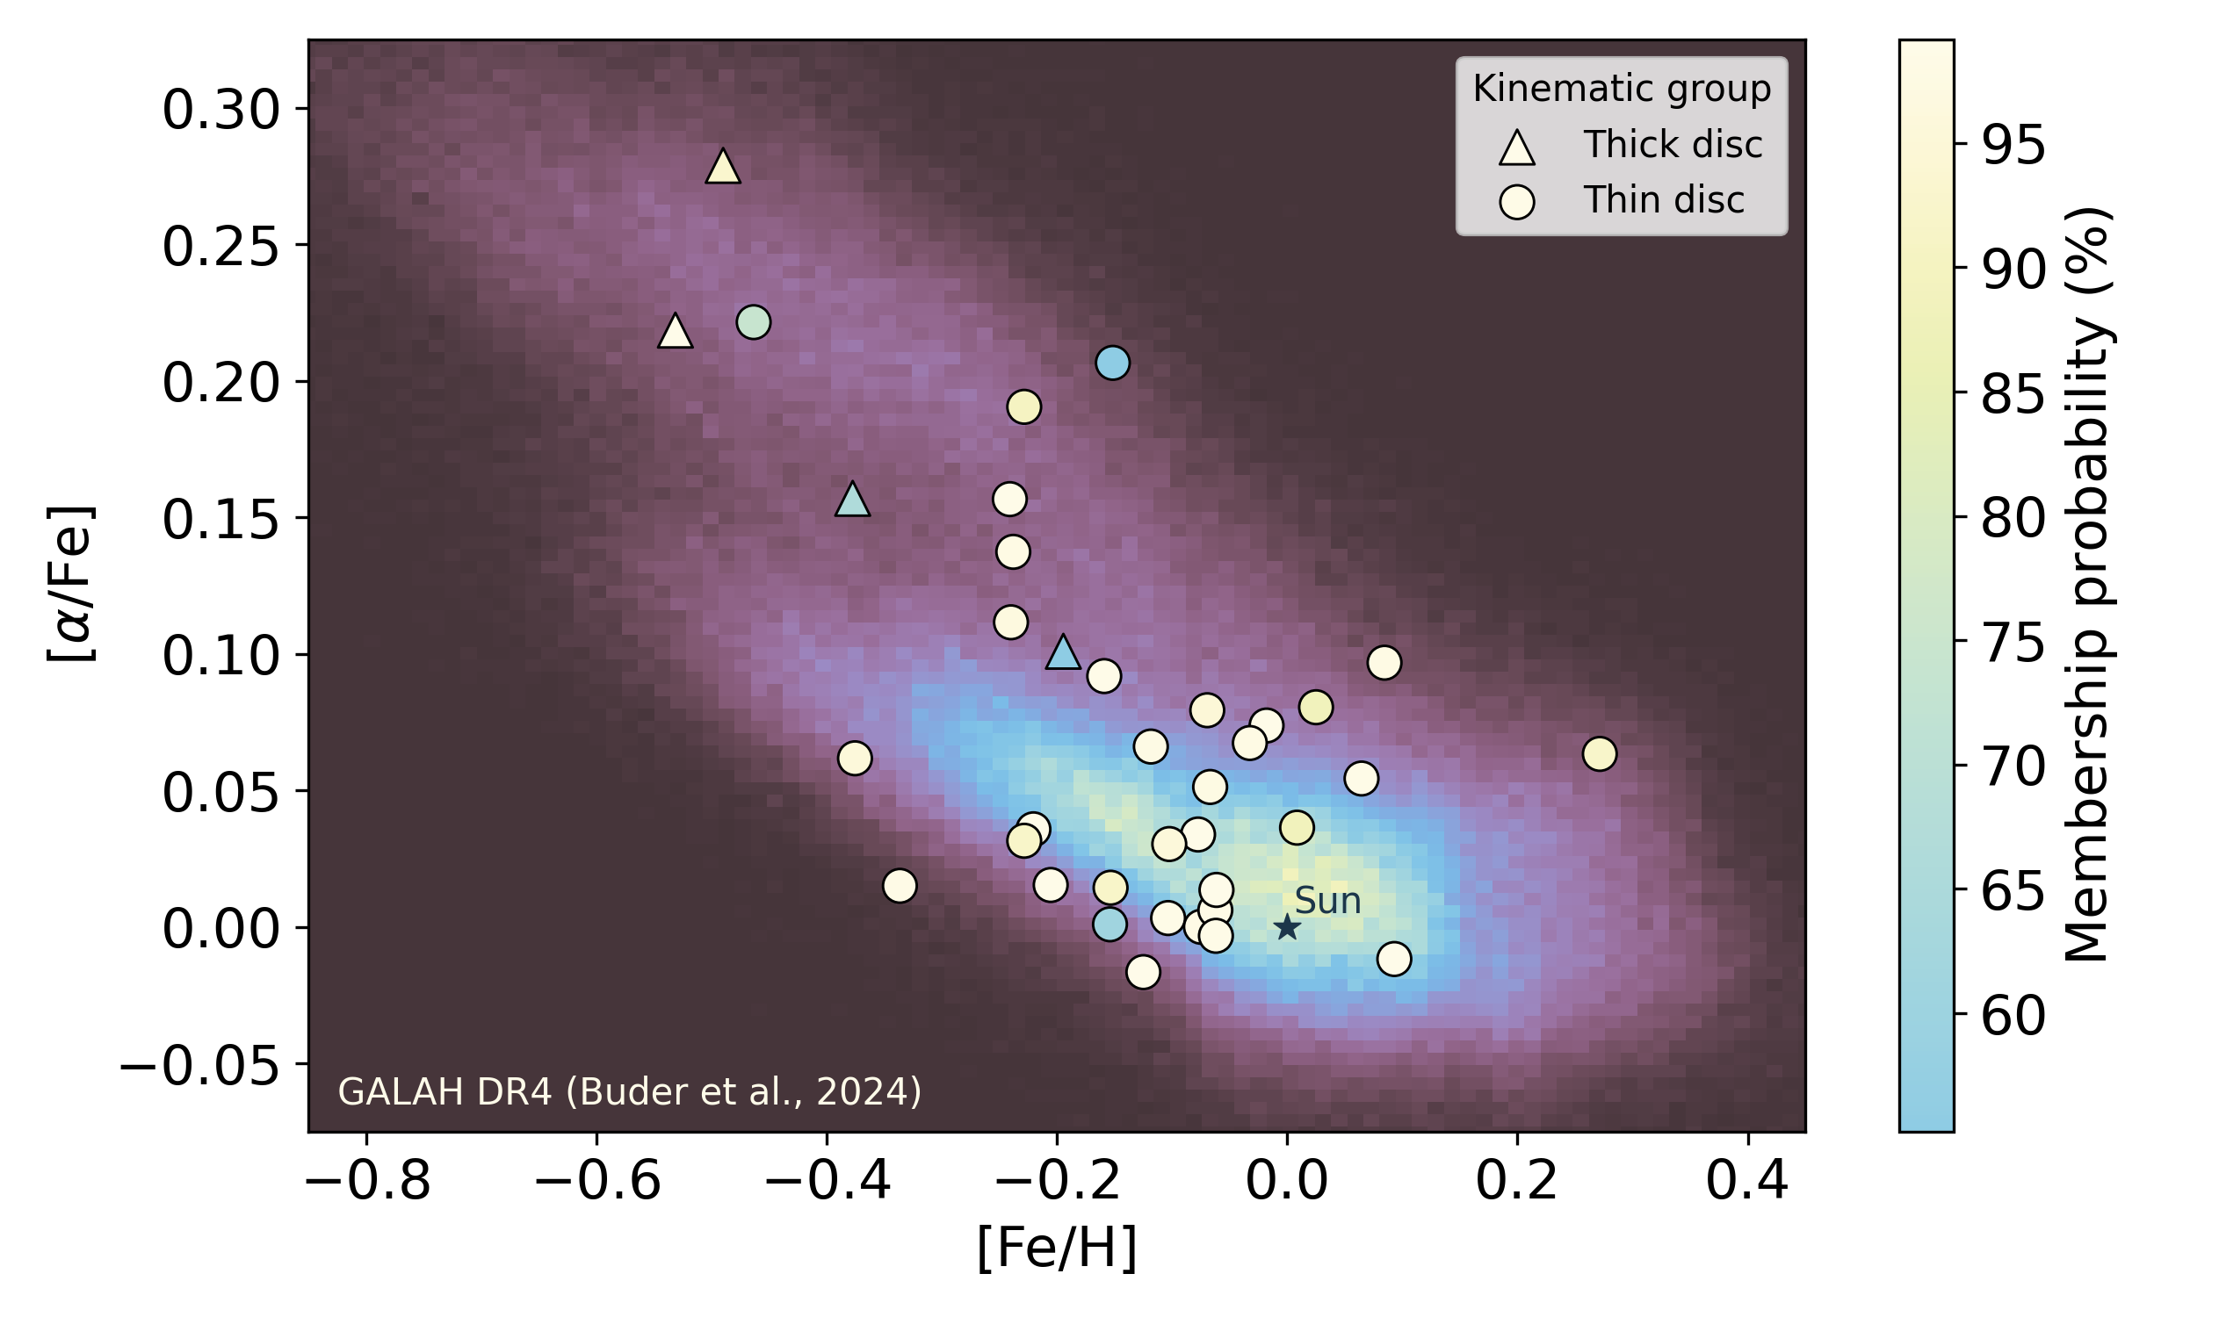
5/10
Alpha-Enrichment
Turner+ (in prep.)
Daisy Turner
Star-Planet Composition
dat936@student.bham.ac.uk
Notes:
Another way to classify is with kinematics
Less clear cut than chemically distinguishing them
Here are the targets I'm investigating, sorted into kinematic groups
4 kinematically thick-disc stars
Two methods don’t agree. But I still have a variety of thick and thin disc stars

Slide 14
6/10
Sample Selection
38 stars hosting 52 planets
PlanetS database Parc+2024:
homogeneity
Zeng+2019, Chen & Rogers 2016
Turner+ (in prep.)
Daisy Turner
Star-Planet Composition
dat936@student.bham.ac.uk
Notes:
38 stars with a total of 52 orbiting planets
Here I plot my sample on an m-r diagram
composition lines from Zeng and Chen & Rogers
Not fixed density lines
lines with 100% iron, Earth-like (32% iron, 68% MgSiO3 (pyroxene)), rocky+1%, 5%, 10% envelope mass fraction
using targets that have relative uncertainties smaller than 8% in radius and 25% in mass (PlanetS catalogue)
Homogeneity:
stellar mass and radius are calculated then these values are used to re-extract a planetary mass and radius
Points are coloured by stellar iron mass fraction
Metric used for stellar composition

Slide 15
6/10
Sample Selection
homogeneity
38 stars hosting 52 planets
PlanetS database Parc+2024:
Zeng+2019, Chen & Rogers 2016
Turner+ (in prep.)
Daisy Turner
Star-Planet Composition
dat936@student.bham.ac.uk
Notes:
38 stars with a total of 52 orbiting planets
Here I plot my sample on an m-r diagram
composition lines from Zeng and Chen & Rogers
Not fixed density lines
lines with 100% iron, Earth-like (32% iron, 68% MgSiO3 (pyroxene)), rocky+1%, 5%, 10% envelope mass fraction
using targets that have relative uncertainties smaller than 8% in radius and 25% in mass (PlanetS catalogue)
Homogeneity:
stellar mass and radius are calculated then these values are used to re-extract a planetary mass and radius
Points are coloured by stellar iron mass fraction
Metric used for stellar composition

Slide 16
7/10
Stellar Iron Mass Fraction
Daisy Turner
Star-Planet Composition
dat936@student.bham.ac.uk
Notes:
Ratio of mass of iron within a star compared to the mass of molecules containing these alpha elements
use `ARES+MOOG` to obtain stellar abundances

Slide 17
8/10
Other Studies
Planetary composition
Stellar composition
Adibekyan+21
Daisy Turner
Star-Planet Composition
dat936@student.bham.ac.uk
Notes:
for comparison's sake, look at another study
first planetary metric was scaled density
to account for planets of different masses having different densities with the same composition
everything is pulled to higher gradient by TOI-561 b
Aim to fill in low firon region to investigate if any suggested relationships still hold

Slide 18
9/10
Planetary vs. Stellar Composition
Turner+ (in prep.)
Daisy Turner
Star-Planet Composition
dat936@student.bham.ac.uk
Notes:
M/R^4 to account for compression
composition lines are closer to following 1/R^4 than 1/R^3
filled in area of iron-poor stars

Slide 19
9/10
Planetary vs. Stellar Composition
Turner+ (in prep.)
Daisy Turner
Star-Planet Composition
dat936@student.bham.ac.uk
Notes:
New empty area in upper corner
denser ∴ should be easy to detect
made a mess of relation
may have upper limit to relation
Uncertainties are larger, but are more representative of true uncertainties
Two layer assumption breaks down near Nep
Future work…

Slide 20
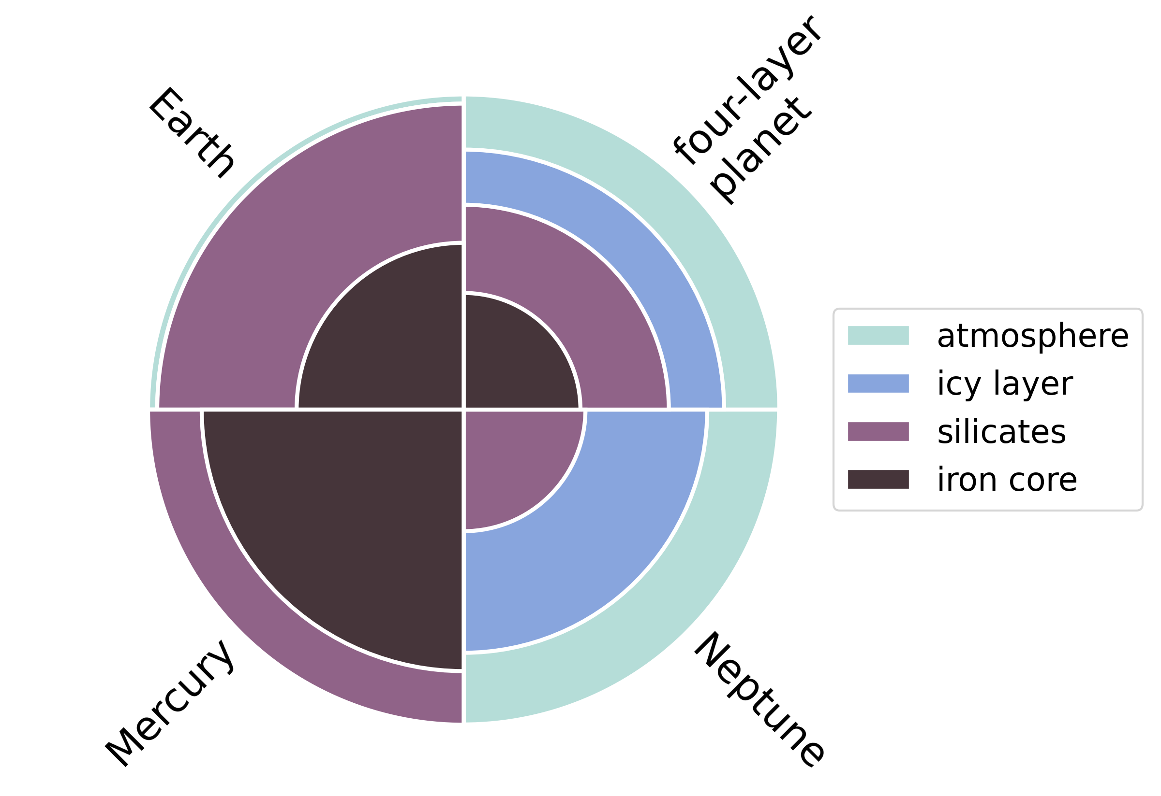
10/10
Future Work
Interior modelling codes such as plaNETic (Egger+24)
Turner+ (in prep.)
Daisy Turner
Star-Planet Composition
dat936@student.bham.ac.uk
Notes:
Use interior modelling codes (such as plaNETic, described in Egger+24) to model interior of planets in my sample
another planetary metric is planetary iron mass fraction

Slide 21
Summary
The link between stellar and planetary composition is too complex to be captured by a linear relationship.
Uncertainties on stellar abundances are often underestimated.
A four-layer treatment of planetary interiors could provide deeper insights into the connection between stellar and planetary composition.
Daisy Turner
Star-Planet Composition
dat936@student.bham.ac.uk
Notes:
i'll leave my summary up here

Slide 22
Summary
The link between stellar and planetary composition is too complex to be captured by a linear relationship.
Uncertainties on stellar abundances are often underestimated.
A four-layer treatment of planetary interiors could provide deeper insights into the connection between stellar and planetary composition.
Shameless plug:
The mass of the exo-Venus Gliese 12 b, as revealed by HARPS-N, ESPRESSO, and CARMENES
Turner, Eschen, Murgas et al. (submitted)
Daisy Turner
Star-Planet Composition
dat936@student.bham.ac.uk
Notes:
i'll leave my summary up here

Slide 23
Gliese 12 b!
Daisy Turner
Star-Planet Composition
dat936@student.bham.ac.uk
Notes:
i'll leave my summary up here

Slide 24
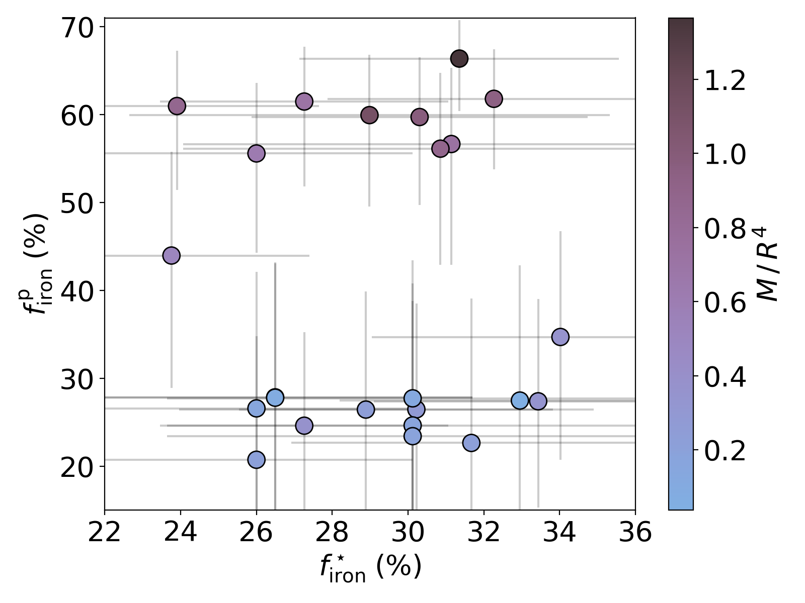
Daisy Turner
Star-Planet Composition
dat936@student.bham.ac.uk
Notes:
i'll leave my summary up here

