Slide 1
Small exoplanets and their host stars: from Kepler and TESS to PLATO
Faculty of Mathematical and Physical Sciences
Department of Space and Climate Physics, Mullard Space Science Laboratory (MSSL)
Vincent Van Eylen v.vaneylen@ucl.ac.uk
NAM Durham
July 2025

Slide 2
We now know over 5000
extrasolar planets
or exoplanets
How do planets form?
Is Earth special?
Are planets common?
Are we alone?
All 5000 known exoplanets to scale, 8 solar system planets in white.

Slide 3
Planets are diverse

Slide 4
Planets are diverse

Slide 5
Planets are diverse

Slide 6
Planets are diverse

Slide 7
Planets are diverse
Most known exoplanets are transiting exoplanets and orbit interior to the orbit of Mercury.

Slide 8
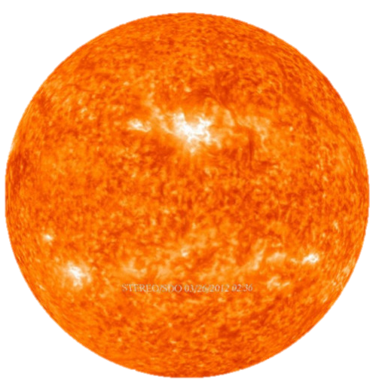
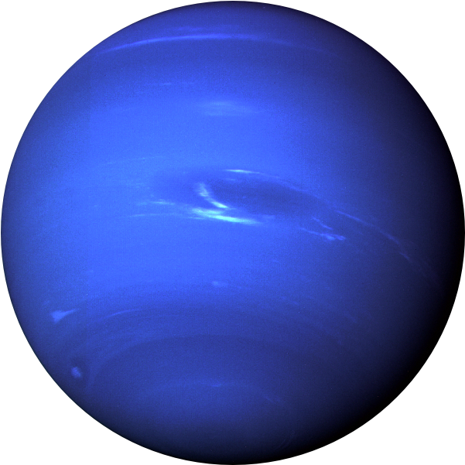
Understanding stars, planets
$$R_{s}$$
$$R_{s}+20\%$$
$$∆F$$
$$∆F$$
Image courtesy Angharad Weeks

Slide 9
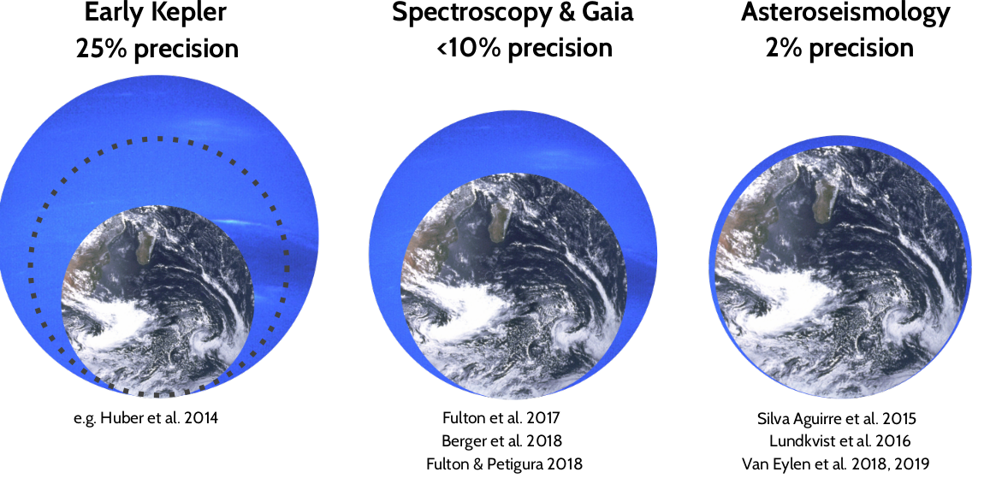
Understanding stars, planets

Slide 10
The discovery of the radius valley
Early Kepler planet candidates, with large uncertainties on stellar (planetary) parameters.
Early Kepler (Q12 table)

Slide 11
The discovery of the radius valley
Early Kepler planet candidates, with large uncertainties on stellar (planetary) parameters.
Improved stellar parameters from spectroscopy.
Adapted from Fulton+ 2017

Slide 12
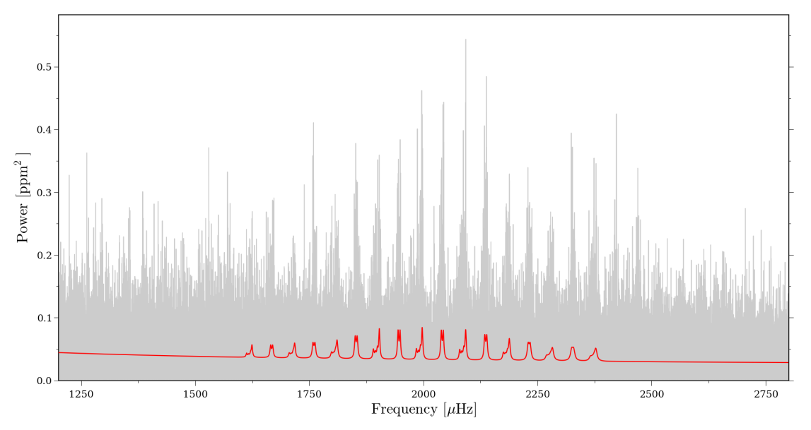
The discovery of the radius valley
Early Kepler planet candidates, with large uncertainties on stellar (planetary) parameters.
Improved stellar parameters from spectroscopy.
Solar-like oscillations can be studied for a subset of stars
Van Eylen+ 2014

Slide 13
The discovery of the radius valley
Early Kepler planet candidates, with large uncertainties on stellar (planetary) parameters.
Improved stellar parameters from spectroscopy.
Solar-like oscillations can be studied for a subset of stars
Van Eylen+ 2018

Slide 14
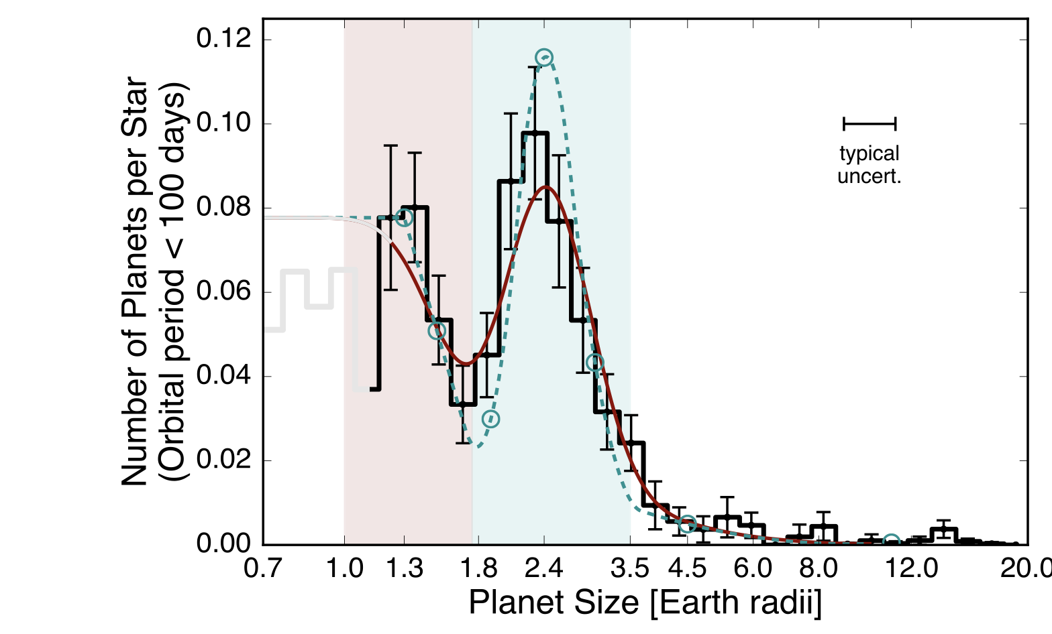
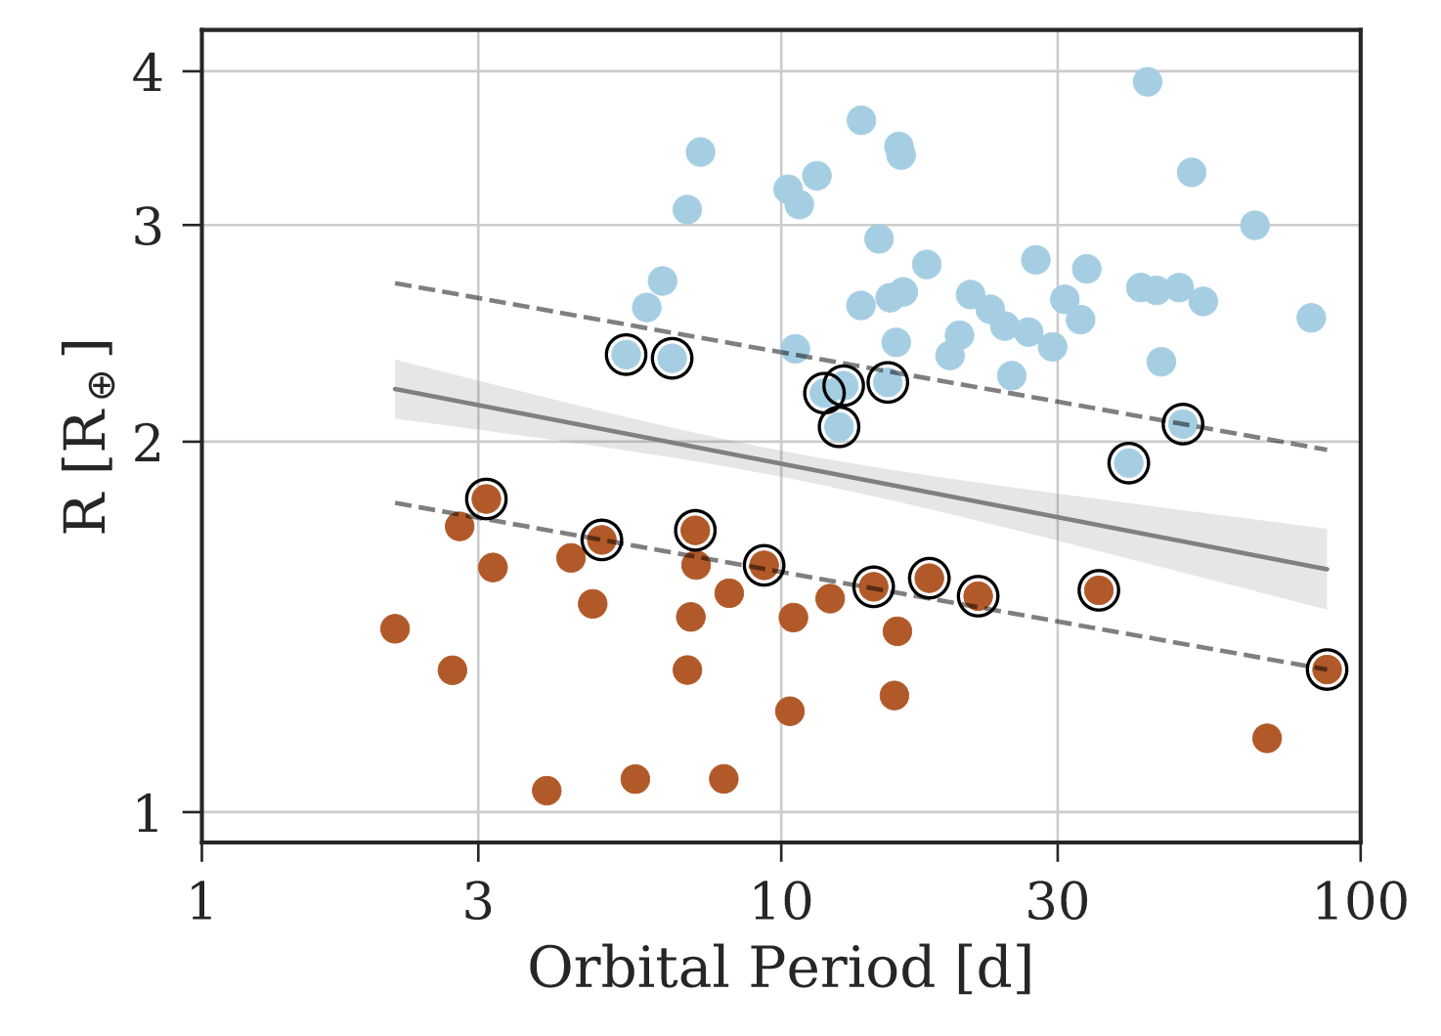
The discovery of the radius valley
‘Sub-Neptunes’
‘Sub-Neptunes’
H-He
Mg/Si
$$Fe$$
Mg/Si
$$Fe$$
‘Super-Earths’
‘Super-Earths’
Fulton+ 2017
Van Eylen+ 2018

Slide 15
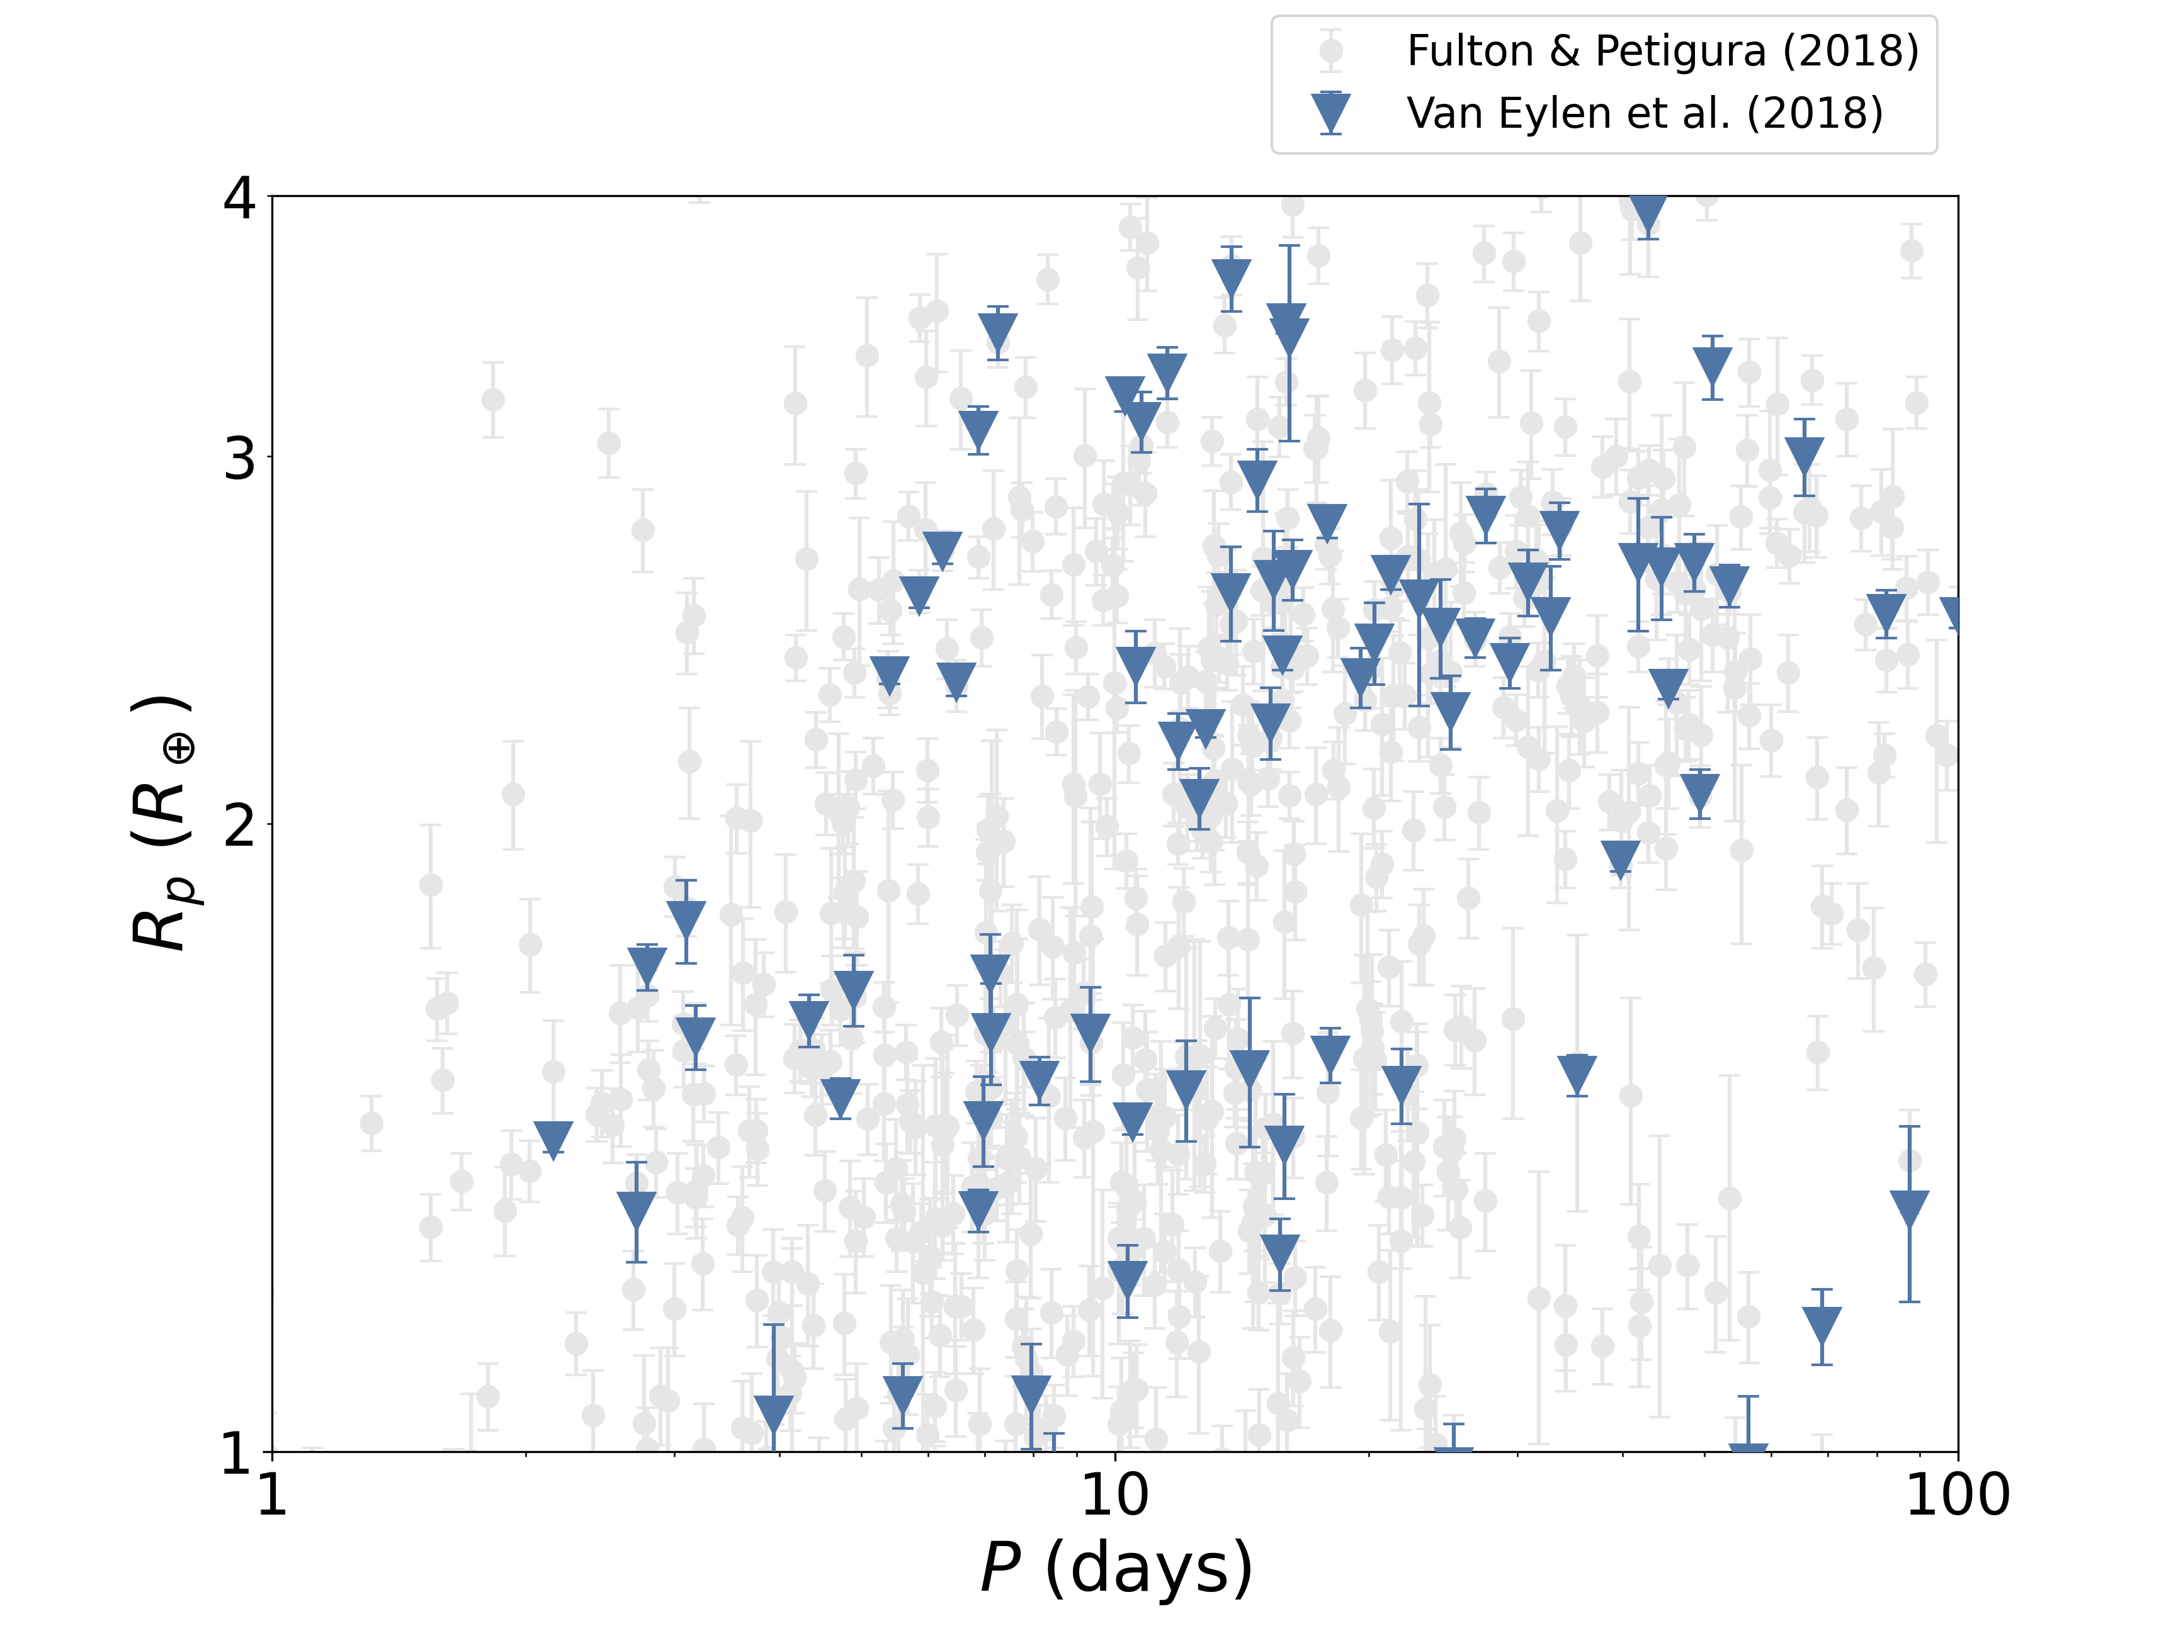
The valley's emptiness

Slide 16
The valley's emptiness
Photoevaporation can broadly explain the valley, but open questions remain.
Is the valley empty or not? Why the lack of agreement?
Stellar parameters:
Asteroseismology is the gold standard
But: stellar radii are generally well-known in the Gaia era
Renewed attention to planet parameters!

Slide 17
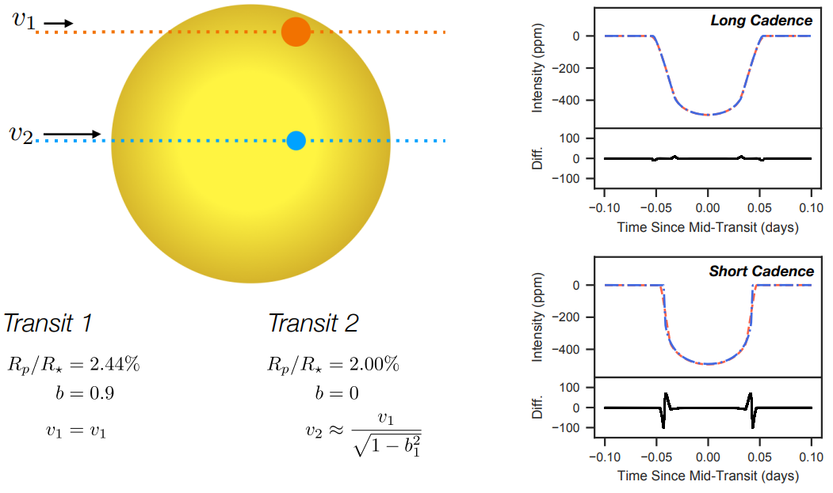
The valley's emptiness
Petigura 2020

Slide 18
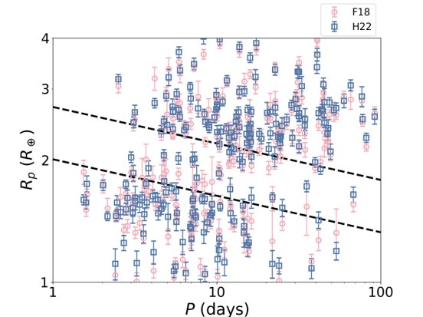
A deeper valley from new short-cadence transit fits
The impact of 30-min long cadence vs. 1-min short cadence Kepler observations.
Work led by Cynthia Ho:
Fitted 431 Kepler planets with 1-minute short-cadence data (only 60 of which previously fitted)
A deeper radius valley (for same stellar parameters)
From Ho & Van Eylen 2023, comparing Fulton+ 2018 (F18) values with new short-cadence fits, using the same stellar parameters

Slide 19
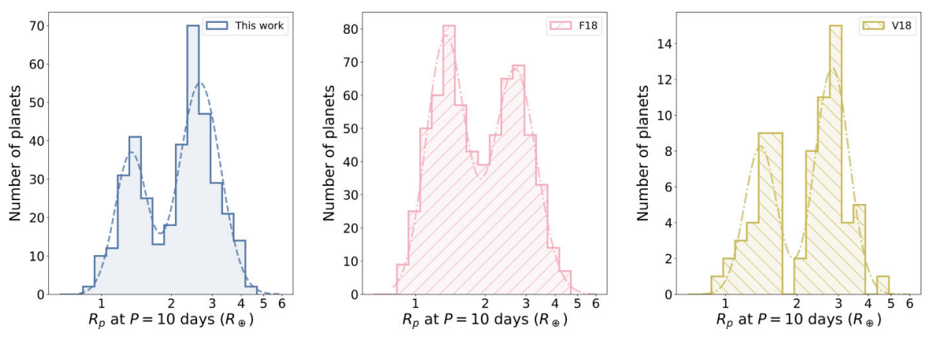
Short-cadence transit fits: a deeper valley
Ho & Van Eylen 2023
Fulton & Petigura 2018
Van Eylen+ 2018
Ho & Van Eylen 2023

Slide 20
Short-cadence transit fits: a deeper valley
$R_{p}∝P^{α}{M_{⋆}}^{β}{\left(age\right)}^{γ}$
$α={−0.096}_{−0.027}^{+0.023}$
$β={0.231}_{−0.064}^{+0.053}$
$γ={0.033}_{−0.025}^{+0.017}$
Strong dependence with $P$, $M_{⋆}$, weak dependence with age
$R_{p}∝P^{α}{M_{⋆}}^{β}{\left(age\right)}^{γ}$
$α={−0.096}_{−0.027}^{+0.023}$
$β={0.231}_{−0.064}^{+0.053}$
$γ={0.033}_{−0.025}^{+0.017}$
Strong dependence with $P$, $M_{⋆}$, weak dependence with age
Ho & Van Eylen 2023

Slide 21
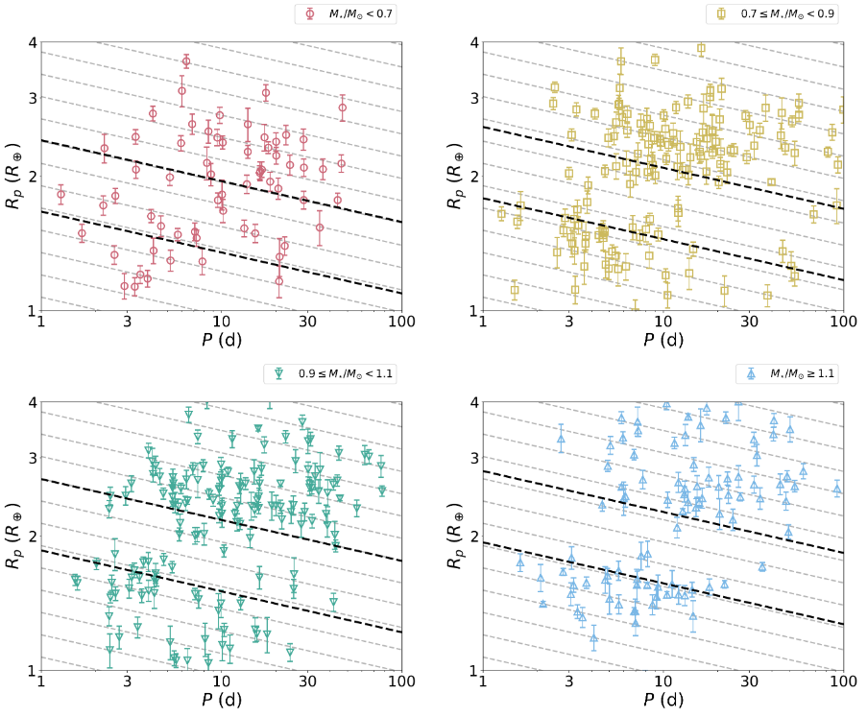
The valley for different stars
The valley's location changes with stellar type
A consequence of photoevaporation
The valley's emptiness changes too
Does not match models
New ingredients needed: ice planets? collisions?
Ho et al. 2024

Slide 22
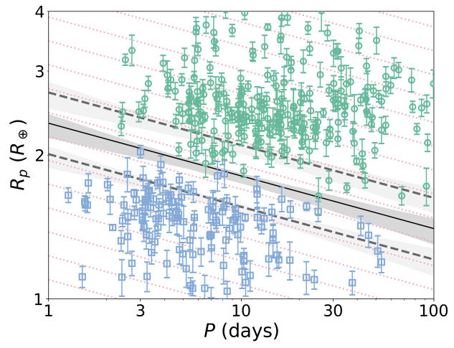
Planet mass: a missing key parameter
Can we go from period-radius to period-radius-mass?
Virtually none of the Kepler planets have masses.
We need to look at other samples.
Ho & Van Eylen 2023

Slide 23
Transit photometry
$$R_{s}$$
$$∆F$$
2
Image courtesy Angharad Weeks
NASA: Eyes on exoplanets

Slide 24
Transit photometry
$$R_{s}+20\%$$
$$∆F$$
Image Credit NASA: Eyes on exoplanets
Image courtesy Angharad Weeks

Slide 25
Transit photometry
Radial Velocity
$$R_{s}+20\%$$
$$M_{s}$$
X
To Earth
$$∆F$$
NASA: Eyes on exoplanets
Image courtesy Angharad Weeks

Slide 26
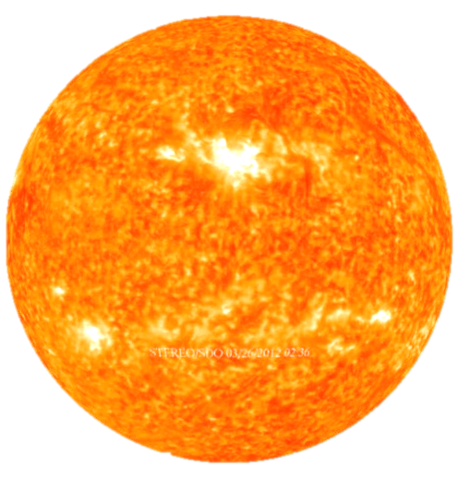
Transit photometry
Radial Velocity
$$R_{s}+20\%$$
$$M_{s}+20\%$$
X
To Earth
$$∆F$$
Image Credit NASA: Eyes on exoplanets
Image courtesy Angharad Weeks

Slide 27
Homogeneous stellar characterisation
‘Sub-Neptunes’
2% H2 envelopes
Water rich core
Rocky Core
Earth Composition
100% Iron
‘Super-Earths’
Weeks et al. 2025

Slide 28
Homogeneous stellar characterisation
‘Sub-Neptunes’
H-He
Mg/Si
$$Fe$$
2% H2 envelopes
Water rich core
Earth-like (33% Fe + Mg / Si)
Rocky Core
100% Iron
Mg/Si
$$Fe$$
‘Super-Earths’
Weeks et al. 2025

Slide 29
Homogeneous stellar characterisation
Gaia DR3 (GSPSpec)
Gaia DR3 (Photometry)
𝝊max
RA
Dec
𝜛
Teff
M/H
BP
RP
G
𝛥𝝊
BASTA
GARSTEC
Mass
Radius
Distance
Age
Bayesian Stellar Algorithm (BASTA), Aguirre Boersen-Koch et al. 2021, image courtesy Angharad Weeks

Slide 30
Mass
Radius
Distance
Age
Star
$$K$$
$$R_{p}/R_{⋆}$$
Planet
Mass
Radius

Slide 31
Mass
Radius
Distance
Age
Star
$$K$$
$$R_{p}/R_{⋆}$$
Planet
Mass
Radius
Density
Composition

Slide 32
Mass
Radius
Distance
Age
Star
$$K$$
$$R_{p}/R_{⋆}$$
Mass
Radius
How dense are these Super-Earths?
What is their composition?
How does that link to stellar properties?
Planet
Density
Composition

Slide 33
Mass
Radius
Distance
Age
Star
$$K$$
$$R_{p}/R_{⋆}$$
Planet
Mass
Radius
Density
Composition

Slide 34
Galactic Chemical Evolution
Nucleosynthesis:
Type II supernovae
Type Ia supernovae
Stellar Feedback
Evolution of alpha (Mg, Si) different than Fe
$$\frac{α}{Fe}$$
e.g., Bedell et al. 2016, 2019, Ciuca et al., 2023 – and many other GCE papers!
Time [Gyr]

Slide 35
Galactic Chemical Evolution
Nucleosynthesis:
Type II supernovae
Type Ia supernovae
Stellar Feedback
Evolution of alpha (Mg, Si) different than Fe
Younger stars :
More iron (wrt alpha) in disk
$$\frac{α}{Fe}$$
Older stars :
Less iron (wrt alpha) in disk
e.g., Bedell et al. 2016, 2019, Ciuca et al., 2023 – and many other GCE papers!
Time [Gyr]

Slide 36
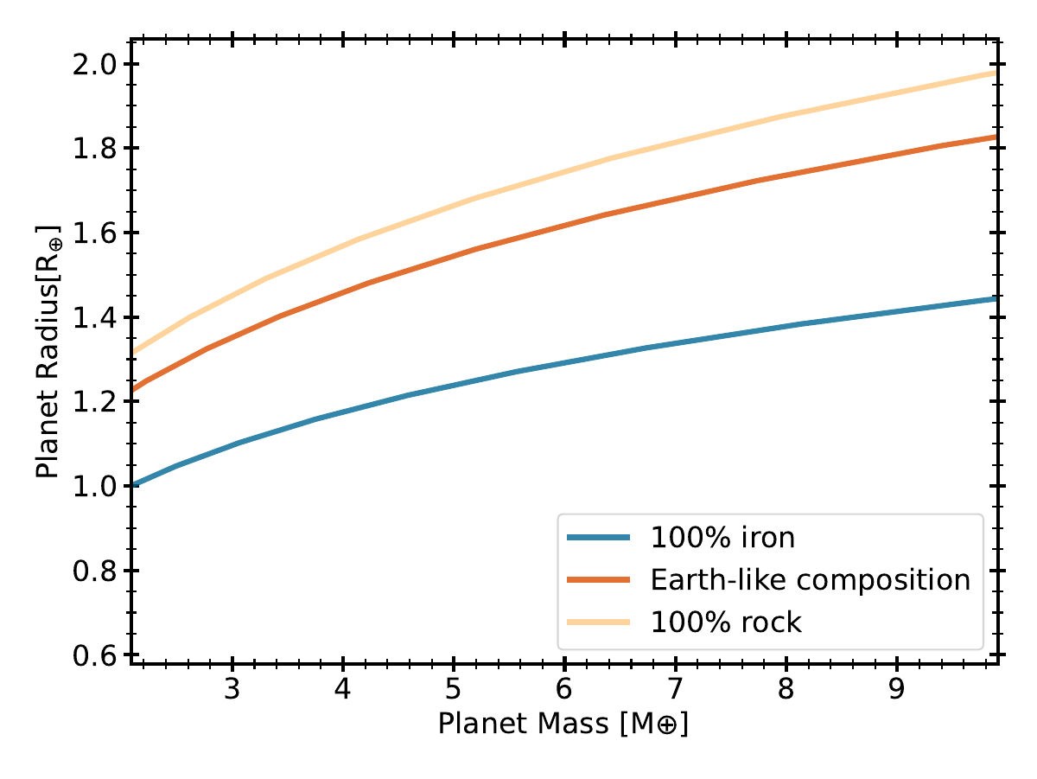
Galactic evolution: planet density?
Weeks et al. 2025

Slide 37
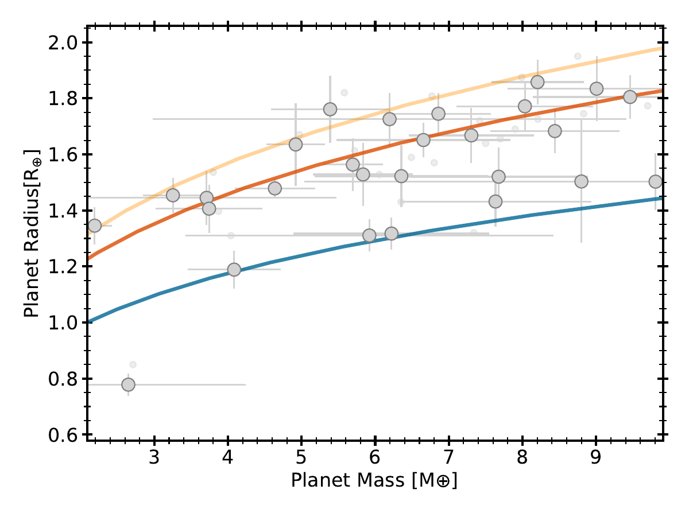
Galactic evolution: planet density?
Weeks et al. 2025

Slide 38
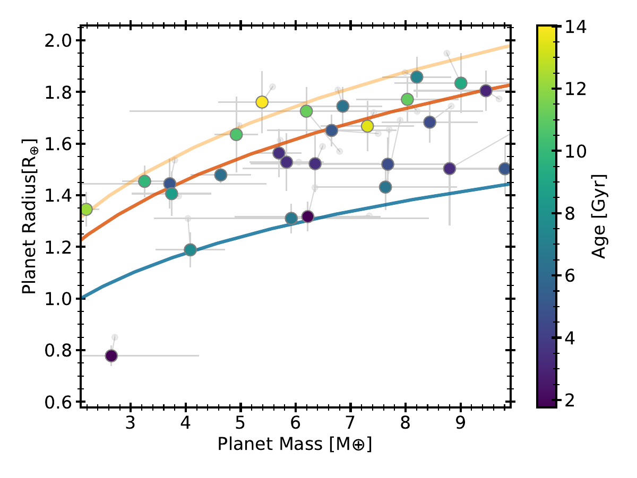
Younger stars host denser planets
Weeks et al. 2025

Slide 39
Galactic Chemical Evolution
Mg/Si
$$Fe$$
$$\frac{α}{Fe}$$
Mg/Si
$$Fe$$
Time [Gyr]

Slide 40
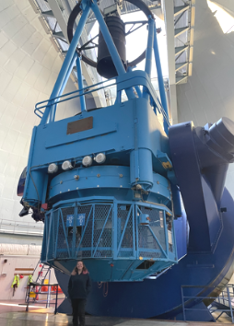
Understanding exoplanet compositions
Homogeneous modelling of the radial velocity observations
Work led by Hannah Osborne:
Measuring new masses
Homogeneous characterisation of radial velocity observations, using archival HARPS observations
HARPS @ ESO 3.6m in La Silla

Slide 41
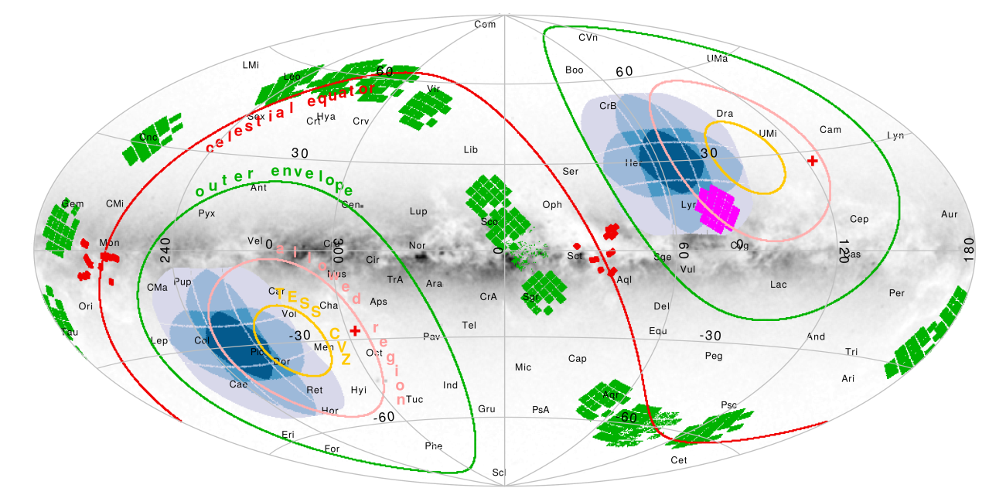
Looking forward to PLATO
PLATO offers:
much larger sample of stars;
that can be homogeneously studied;
in both stellar and planetary parameter space
+ the promise of ages!
Nascimembi et al. 2022

Slide 42
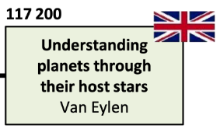
PLATO work packages
Let me know if you are interested in joining!

Slide 43
Small exoplanets and their host stars: from Kepler and TESS to PLATO
The properties of small exoplanets are shaped by photoevaporation, which sculpts a radius valley.
Many small exoplanets have rocky cores, some have H-He atmospheres.
A more detailed understanding of their demographics and composition requires a detailed and homogeneous modelling of both star and planet.
PLATO will provide a major step forward.
Vincent Van Eylen – v.vaneylen@ucl.ac.uk

