Slide 1
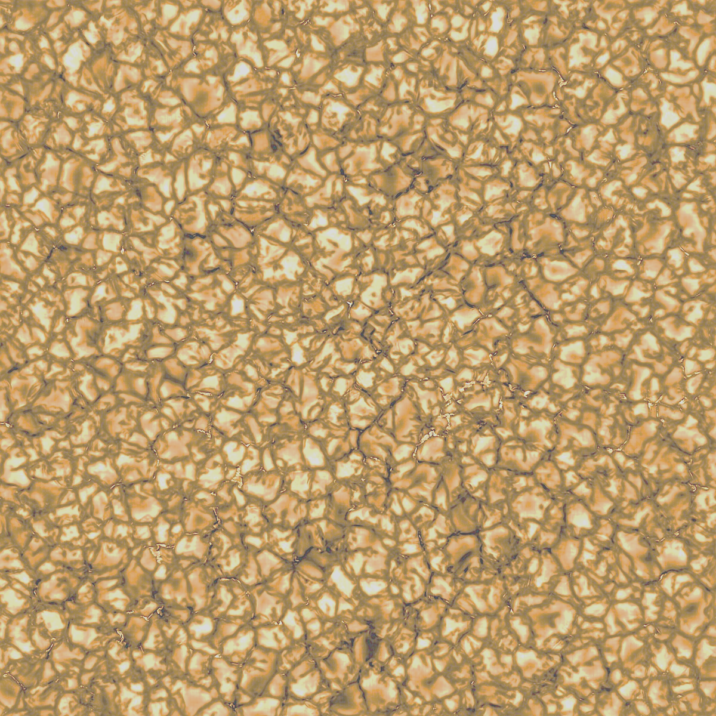



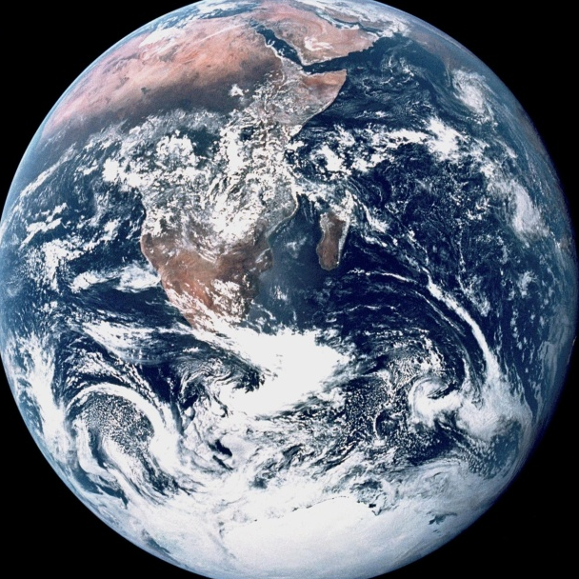
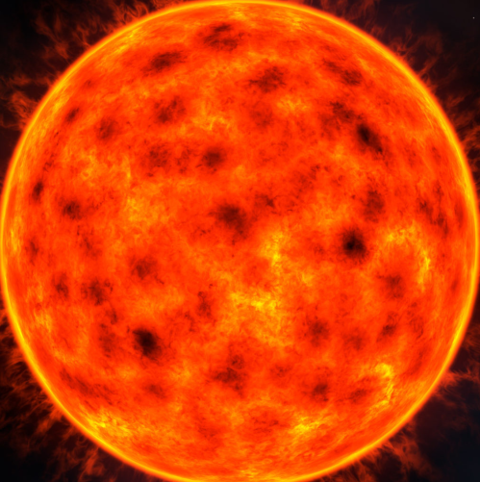
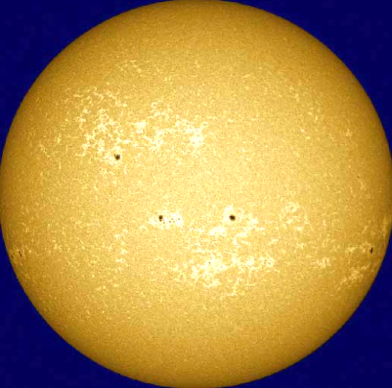
Mitigation of RV response to granulation informed by line shift, depth and width variations
Christian Hartogh(1), Andrew Collier Cameron(1); Sowmya Krishnamurthy(2); Veronika Witzke(2); Djemma Ruseva(1); Thomas Tunstall(1); Valeriy Vasilyev(3); Alexander Shapiro(2)
(1) University of St Andrews; (2) University of Graz; (3) Max-Planck-Institute for Solar System research

Slide 2
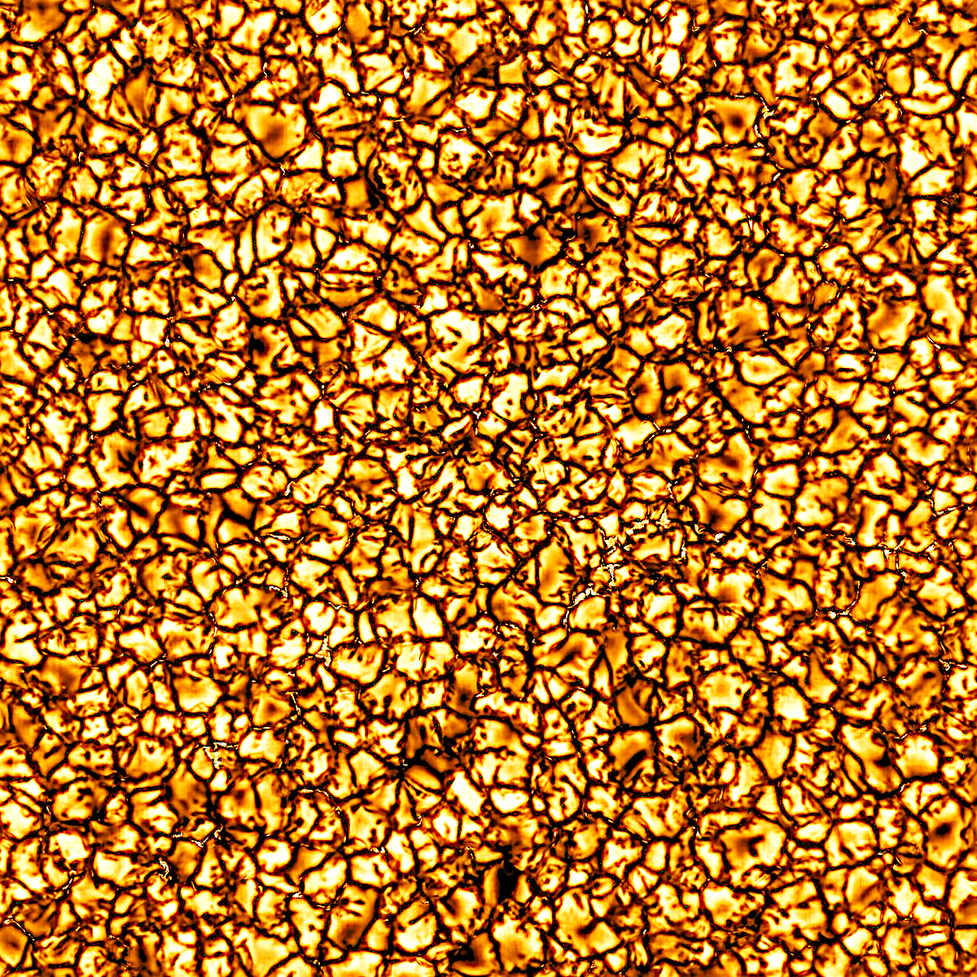
Granulation in Sun-like Stars
Convection in the stellar photosphere causes granulation pattern
Individual granules have velocities of ~1km/s and diameters of ~1000km and lifetimes of 10-15 minutes
Changing granulation pattern causes variations of ~1m/s
For finding Earth-like planets understanding and mitigating this signal is essential

Slide 3
Tools
3D MHD MURaM simulations of the photosphere of a Sun-like star (Vögler+ 2005)
Spatially resolved spectra synthesized with MPS-ATLAS (Witzke+ 2021) 380-800nm
Spatial spectra converted into spectral time series by smart sampling
Line-by-line analysis
Measure line depths, shifts widths relative to co-added master spectrum and perform Singular Value Decomposition (SVD)

Slide 4
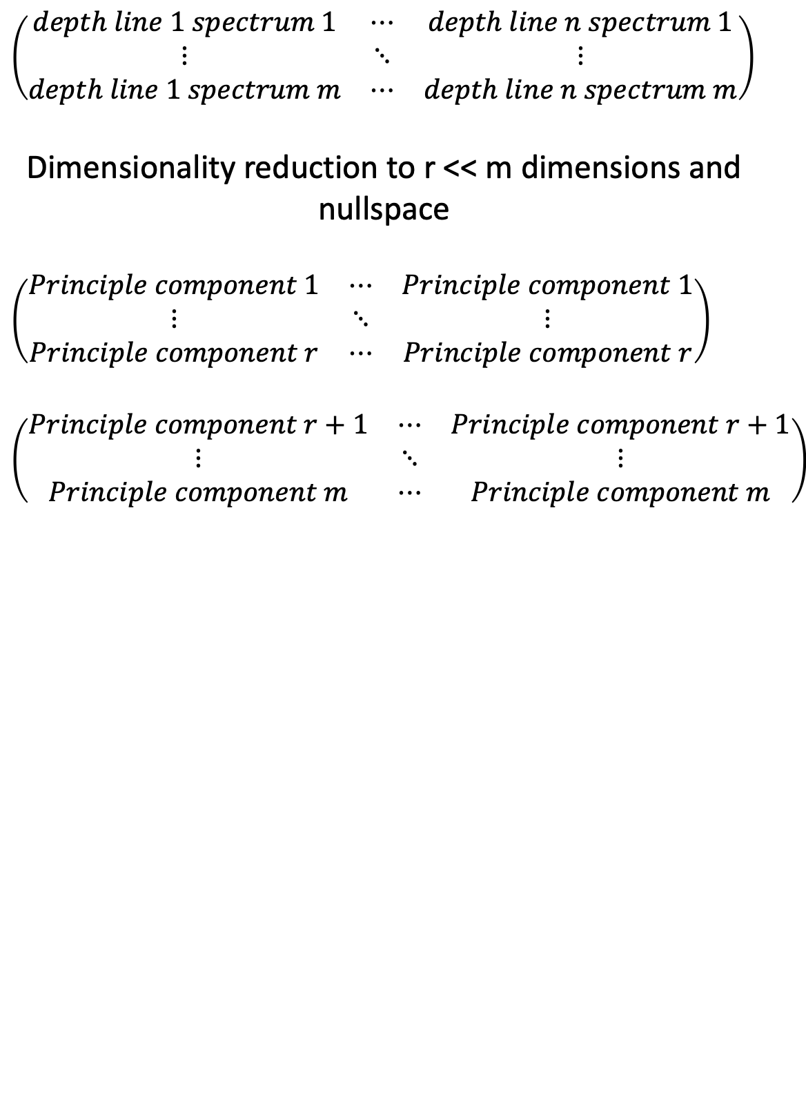
Singular Value Decomposition (SVD)
$$\left(\begin{matrix}depth line 1 spectrum 1 & ⋯ & depth line n spectrum 1 \\ ⋮ & ⋱ & ⋮ \\ depth line 1 spectrum m & ⋯ & depth line n spectrum m\end{matrix}\right)$$
Dimensionality reduction to r << m dimensions and nullspace
$$\left(\begin{matrix}Principle component 1 & ⋯ & Principle component 1 \\ ⋮ & ⋱ & ⋮ \\ Principle component r & ⋯ & Principle component r\end{matrix}\right)$$
$$\left(\begin{matrix}Principle component r+1 & ⋯ & Principle component r+1 \\ ⋮ & ⋱ & ⋮ \\ Principle component m & ⋯ & Principle component m\end{matrix}\right)$$

Slide 5
SVD on synthetic MURaM spectra

Slide 6
Line Identification
Cross-matching lines with VALD3 list (Piskunov+ 1995; Ryabchikova+ 2015)
Caveat: many shallow lines could lead to misidentifications

Slide 7
Results: Ionisation states
Iron
Titanium

Slide 8
Results: Molecular Lines
CN 1, C₂ 1, C 1
MgH, Mg 1

Slide 9
Results: Atomic Parameters
Excitation Potential
Oscillator Strength

Slide 10
Results: SVD projection
Reduced Rank 5 Principal Component model

Slide 11
Results: SVD projection in HARPS-N solar data
Reduced Rank 5 Principal Component model

Slide 12
Conclusions
RV bias due to granulation can be described by a small number of principal components using line depth variations
Behaviour of line depth, shift and width in the MURaM models can depends on their physical parameters such as their ionisation state, if they are molecular or atomic origin and their oscillator strengths and excitation potential
SVD on MURaM spectra explains >99% of variance
Projection into HARPS-N Solar data explains ~20% of RV variance

