Slide 1

Mitigating Satellite Light Pollution with Vantablack® Coatings
A collaborative Approach to Protecting Astronomy
James Whitfield, Astha Chaturvedi, Dr Keiran Clifford, Dr Noelia Noël

Slide 2
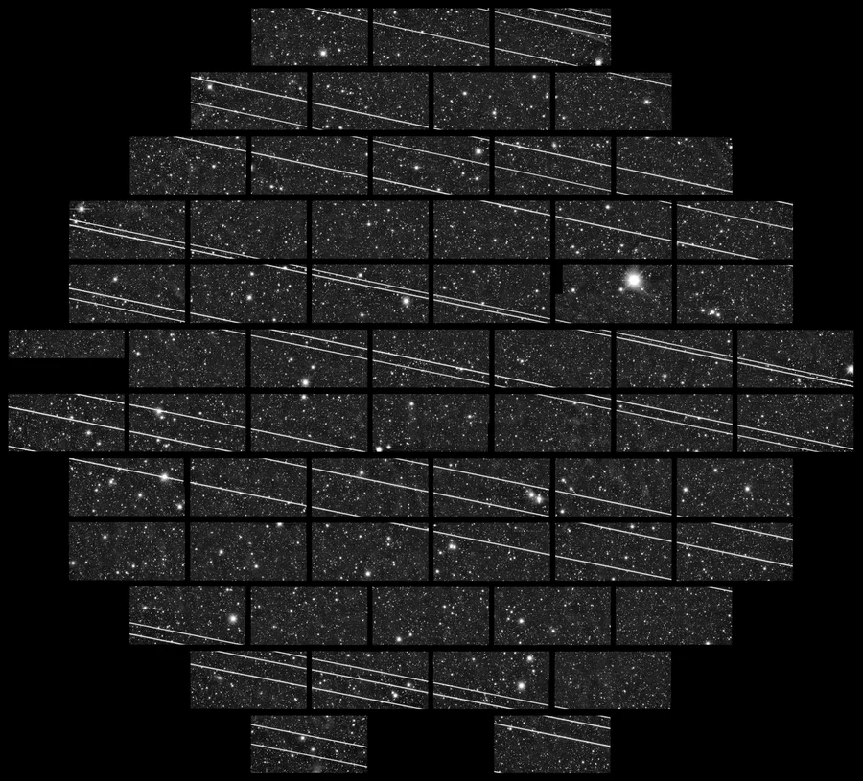
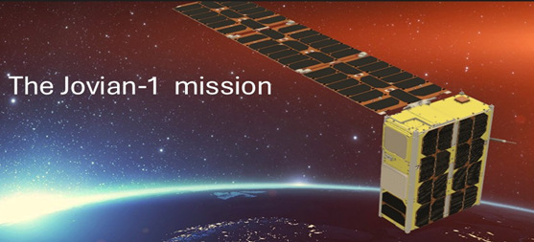
2
Motivation
Proliferation of satellite constellations poses major risk to ground-based astronomy
>20,000 LEO satellites anticipated by 2030
Partnership with the University of Surrey exploring brightness mitigation solutions
  SNS – Nanotechnology
  UOS – Jovian 1 and LSST
→ Exploiting new space coating Vantablack® 310
Notes:
Time-lapse image shows the passage of a Starlink satellite cluster (bright streaks) through a telescope’s field of view at the Cerro Tololo Inter-American Observatory in Chile in November 2019. CTIO, NOIRLab, NSF, AURA and DECam DELVE Survey

Slide 3
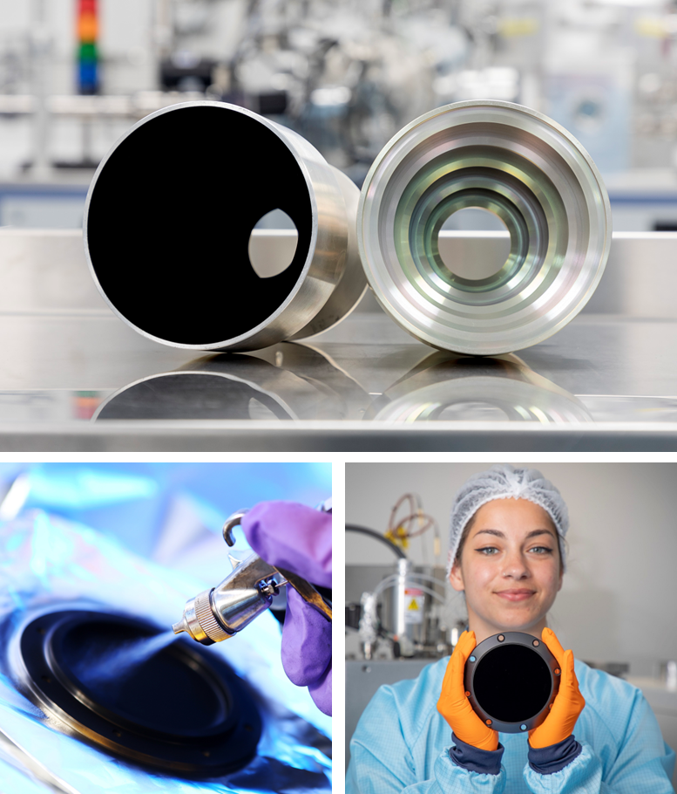
3
About Surrey Nanosystems
The leaders in ultra-black coatings – the original Vantablack® coating absorbs 99.965% of broadband light.
10+ years experience providing stray-light solutions to the space sector across applications including:
  Star tracker baffles
  High-precision blackbodies
  Cold shields
Notes:
Using our experience and heritage in the space sector and ultra-black paints, we wanted to create something new that could bring the absorbance of our bespoke coatings to a scalable mass applied coating that could be used by customers.

Slide 4
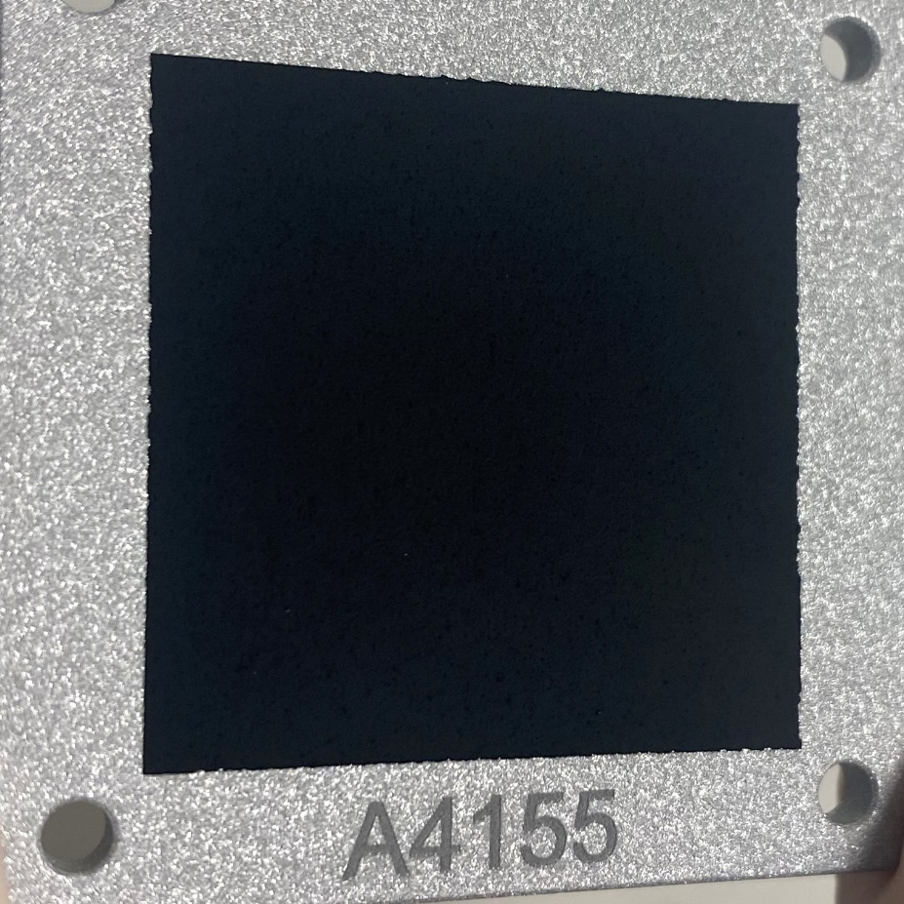
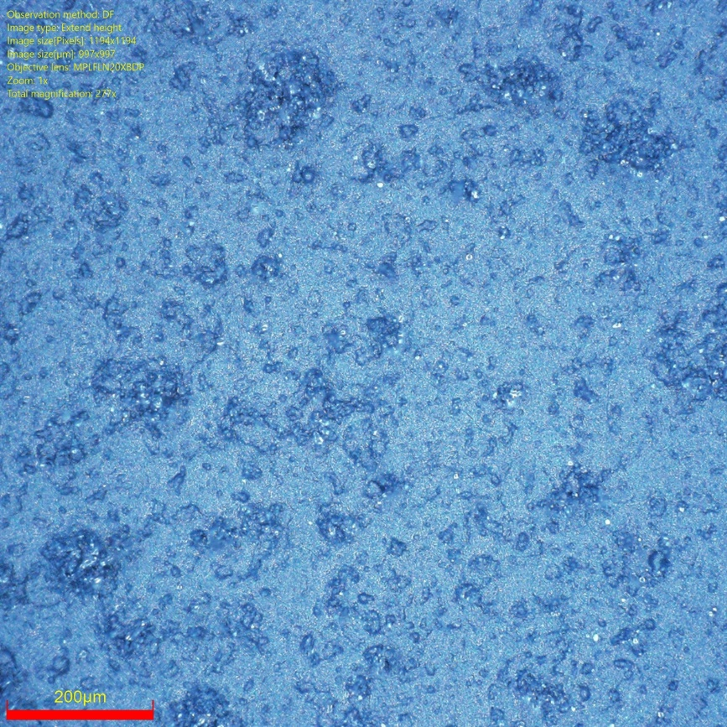
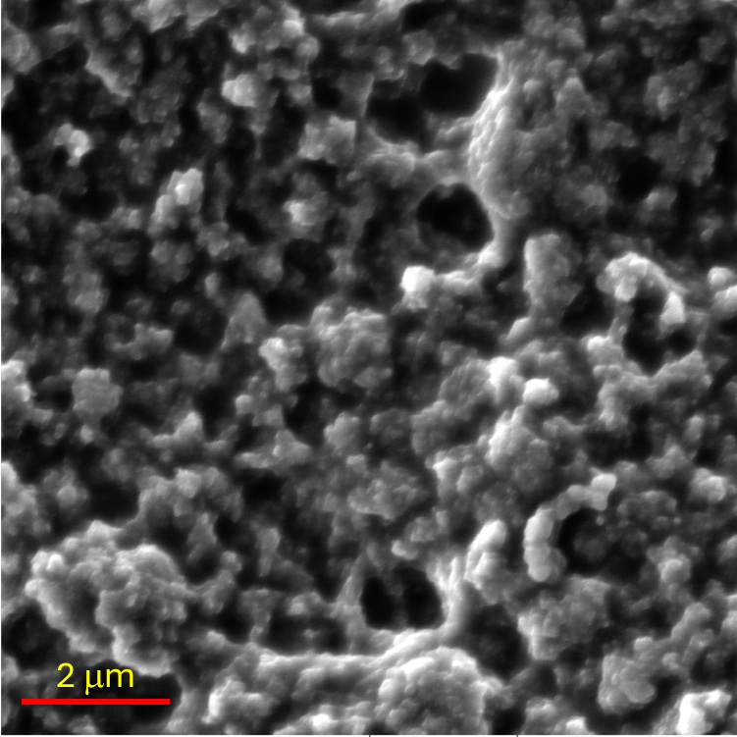
Vantablack® 310
4
For the first time
A handleable and user-applied ultra-black aerospace paint:
  Hierarchical optical structure
  Low broadband reflectance ~2%
  Near-Lambertian surface
  Robust to ATOX & ionizing radiation
  Ultra-low outgassing TML <1%
  Appreciable electrical conductivity for ESD
200 μm
2 μm
Notes:
GUIDE AUDIENCE THROUGH MACRO to MICRO, SAY HOW UOS ENABLED CHARACTERISATION
Vantablack are a suit of space qualified ultrablack coatings used for optical systems, cold shields, black body calibrators and more.
VB 100 series with established space heritage since 2015, the industry leader in ultra-low reflectance
Vantablack 310 is a new handleable coating with market potential as a reflectance dampening coating for external use on satellites.
High ATOX performance
2% THR
Low outgassing
One key component to Vantablack coatings is the uniform absorbance across all angles of incidence.

Slide 5
Vantablack® 310
5
For the first time
A handleable and user-applied ultra-black aerospace paint:
  Low broadband reflectance ~2%
Near-Lambertian surface
[A] UV-VIS-NIR
[B] Infrared
[C] BRDF
Vantablack 310
Traditional Industry Standard Competitor
Notes:
Vantablack are a suit of space qualified ultrablack coatings used for optical systems, cold shields, black body calibrators and more.
VB 100 series with established space heritage since 2015, the industry leader in ultra-low reflectance
Vantablack 310 is a new handleable coating with market potential as a reflectance dampening coating for external use on satellites.
High ATOX performance
2% THR
Low outgassing
One key component to Vantablack coatings is the uniform absorbance across all angles of incidence.

Slide 6
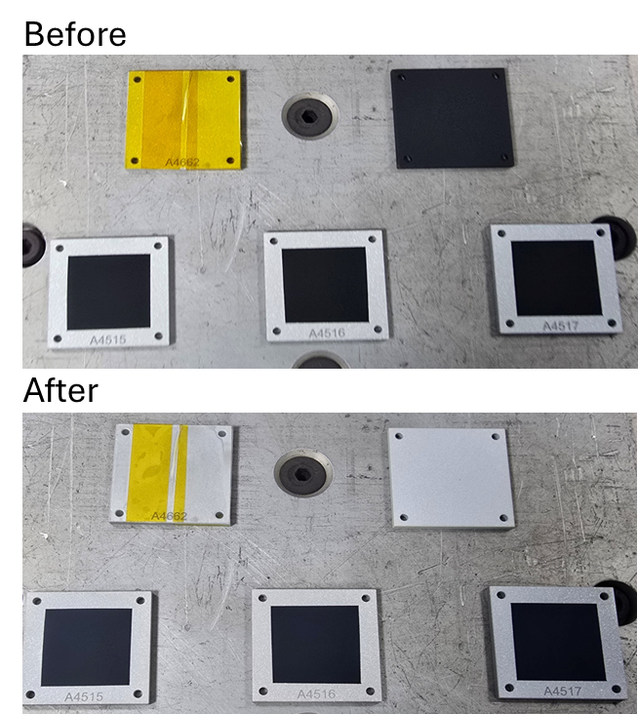
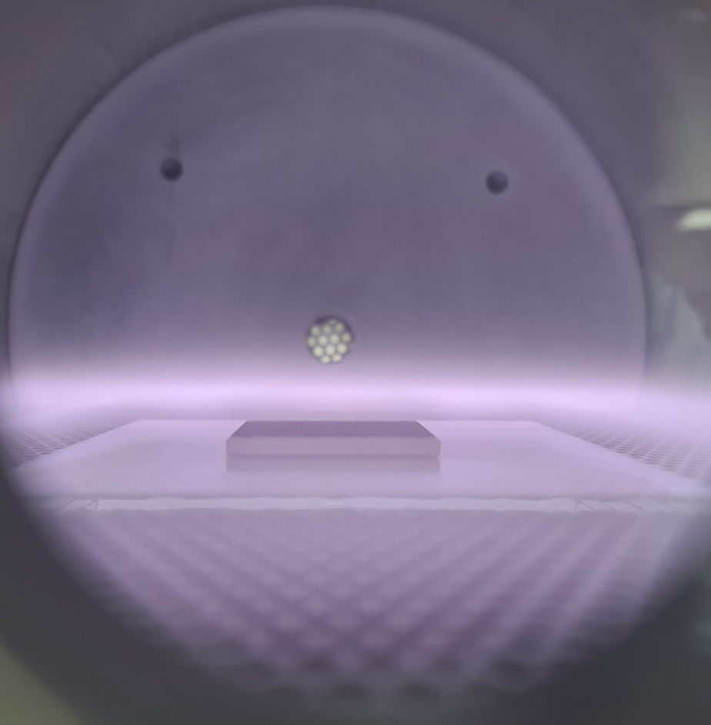
Vantablack® 310
6
For the first time
A handleable and user-applied ultra-black aerospace paint:
B
  Robust to ATOX & ionizing radiation
  Ultra-low outgassing TML <1%
  Appreciable electrical conductivity for ESD
C
Oxygen plasma
>10²¹ atom/cm²
Notes:
Vantablack are a suit of space qualified ultrablack coatings used for optical systems, cold shields, black body calibrators and more.
VB 100 series with established space heritage since 2015, the industry leader in ultra-low reflectance
Vantablack 310 is a new handleable coating with market potential as a reflectance dampening coating for external use on satellites.
High ATOX performance
2% THR
Low outgassing
One key component to Vantablack coatings is the uniform absorbance across all angles of incidence.

Slide 7

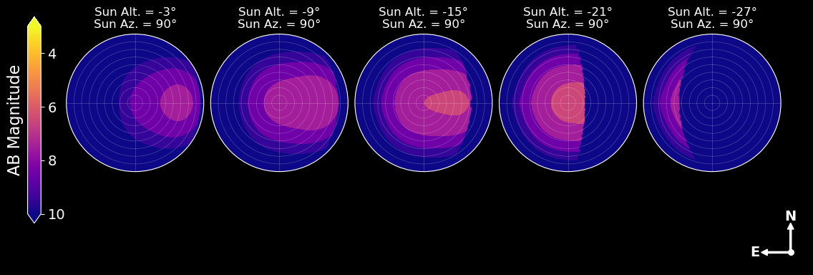
Satellite modelling – strong reduction in brightness
7
Surrey industrial placement student Astha Chaturvedi developing brightness models using BRDF data
Broadly meets IAU-CPS 7.0 Magnitude limit – Invisible to the human eye
The strongest reflection of Vantablack 310 is 6.6 AB Magnitude
Observer frame of reference
Notes:
Starlink V1.5 is ≥ 4 AB Magnitude
BRDF uses various incident angles and grazing angles to look at reflection (specular and diffuse) to determine total reflectance of a coating from every viewing angle. Data can be acquired in both 2D and 3D varieties however as we know VB 300 has a uniform reflection so 2D data can be used for all angles
Observer’s frame of reference = looking into the night sky. Imagine the satellite approaching from right to left starting at the horizon, reflection reaches the strongest when the satellite is directly above. AB magnitude is a reflectance measurement is on a log scale, the closer to 0 the more bright an object.

Slide 8
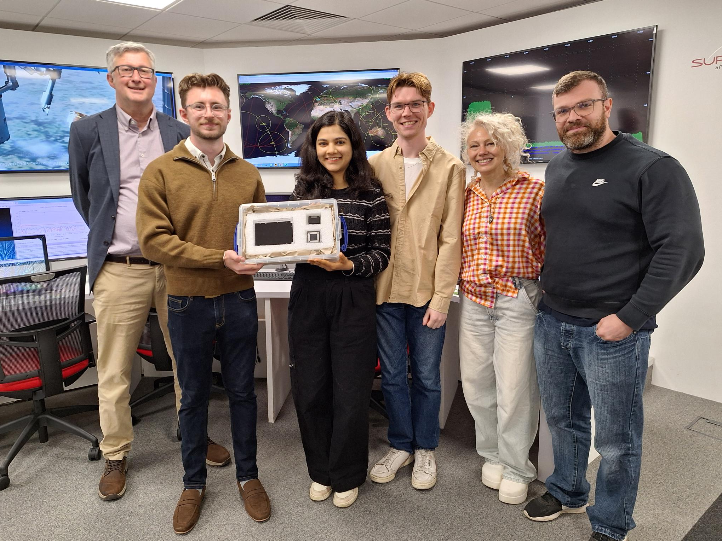

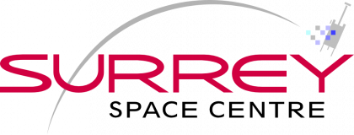


Thank you
Contact:
James Whitfield, Application Scientist
j.whitfield@surreynanosystems.com
Astha Chaturvedi, Doctoral Researcher
aa07223@surrey.ac.uk

Slide 9

Summary
Vantablack 310 specifically engineered for LEO environment
Brightness modelling indicates strong improvement in reflectance
Supplementary ground-based measurement to follow in 2026
Thank you

