Slide 1
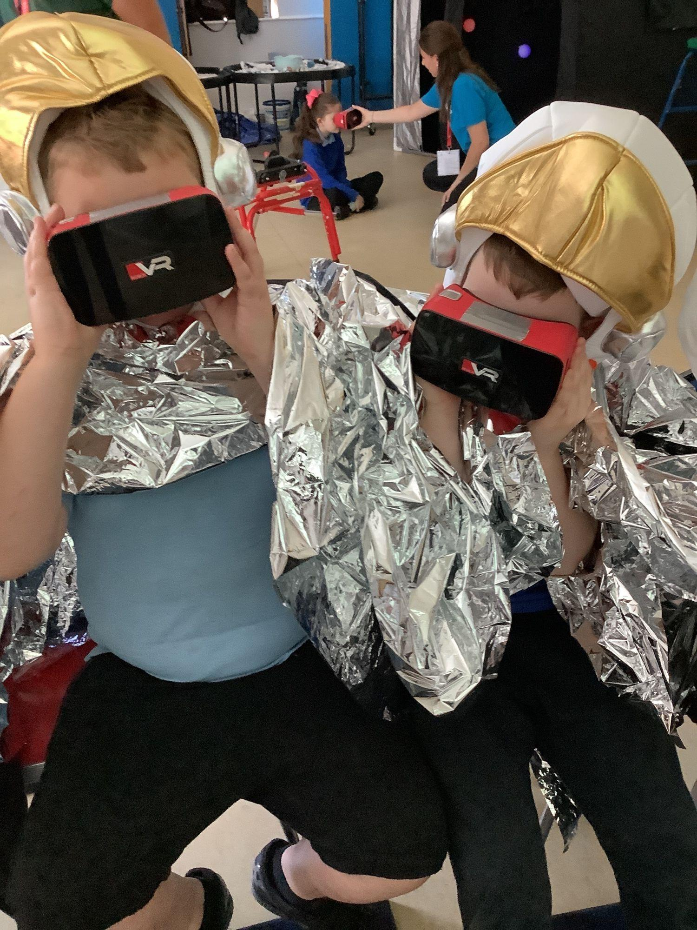
Safe Space: Developing multi-sensory resources for disabled children
Dr Josie Rawes and Liv McCready from the School of Physics, Engineering and Technology Outreach Team
University of York
In collaboration with
Funded by

Slide 2
Motivation
Background
There is a reluctance from universities to deliver outreach to audiences who they don’t see as potential recruits
Apprehension over working with a new audience without the necessary expertise.
Our motivation
Specific focus on equality and diversity within the School of PET
Close relationship with the Lightyear Foundation
Part of a wider project that ties into undergraduate teaching, other outreach and PE projects
Notes:
Intimidating to work with SEN children since we aren’t aware of their specific needs when we go in

Slide 3
Our Approach
We consulted with Lightyear to utilise their expertise and experience in delivering activities to this audience
We collaborated with Dr Nic Bonne to create tactile 3D printed resources, based on his expertise from his Tactile Universe project.
Lightyear ran training sessions for all our staff and undergraduate volunteers on the project
Built a relationship with Chellow Heights Special School in Bradford, Applefields Secondary School in York and Welburn Hall Special School in North Yorkshire
Site visit
Resource sharing
Widget symbols and Makaton
Assistance on the day
Consider what our aims are - educational or experiential?
Notes:
Details of 3D printed resources: Jupiter, Saturn, Rings, Moon crater, Mars rover
Explain a bit about makaton and widgets: consistent symbols that the schools themselves use so children are familiar with them, Makaton is a language program that can help children to process verbal communication better.
Depending on the audience aims are either educational and experiential, or purely experiential

Slide 4
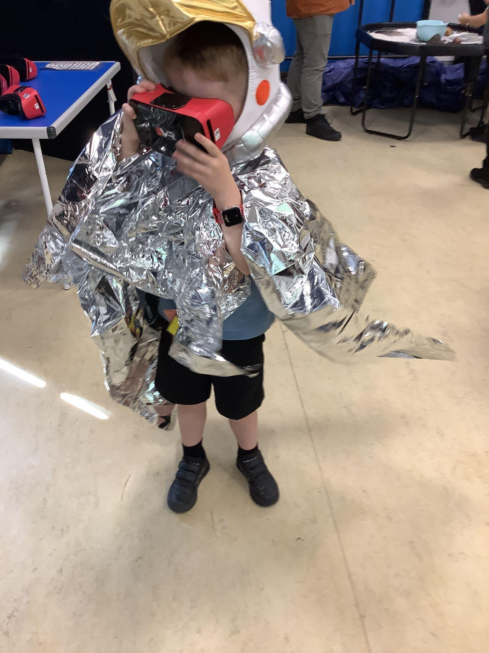
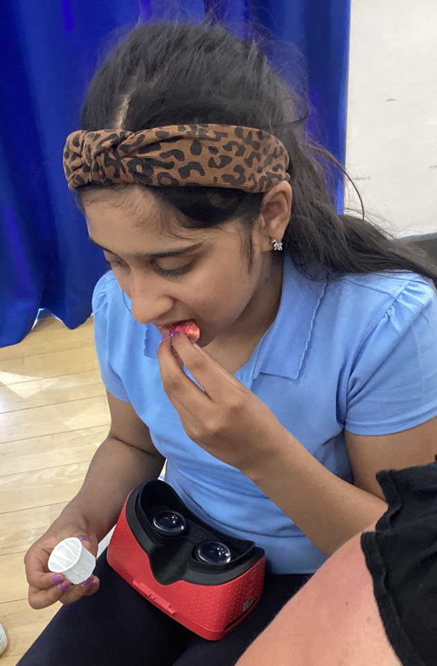
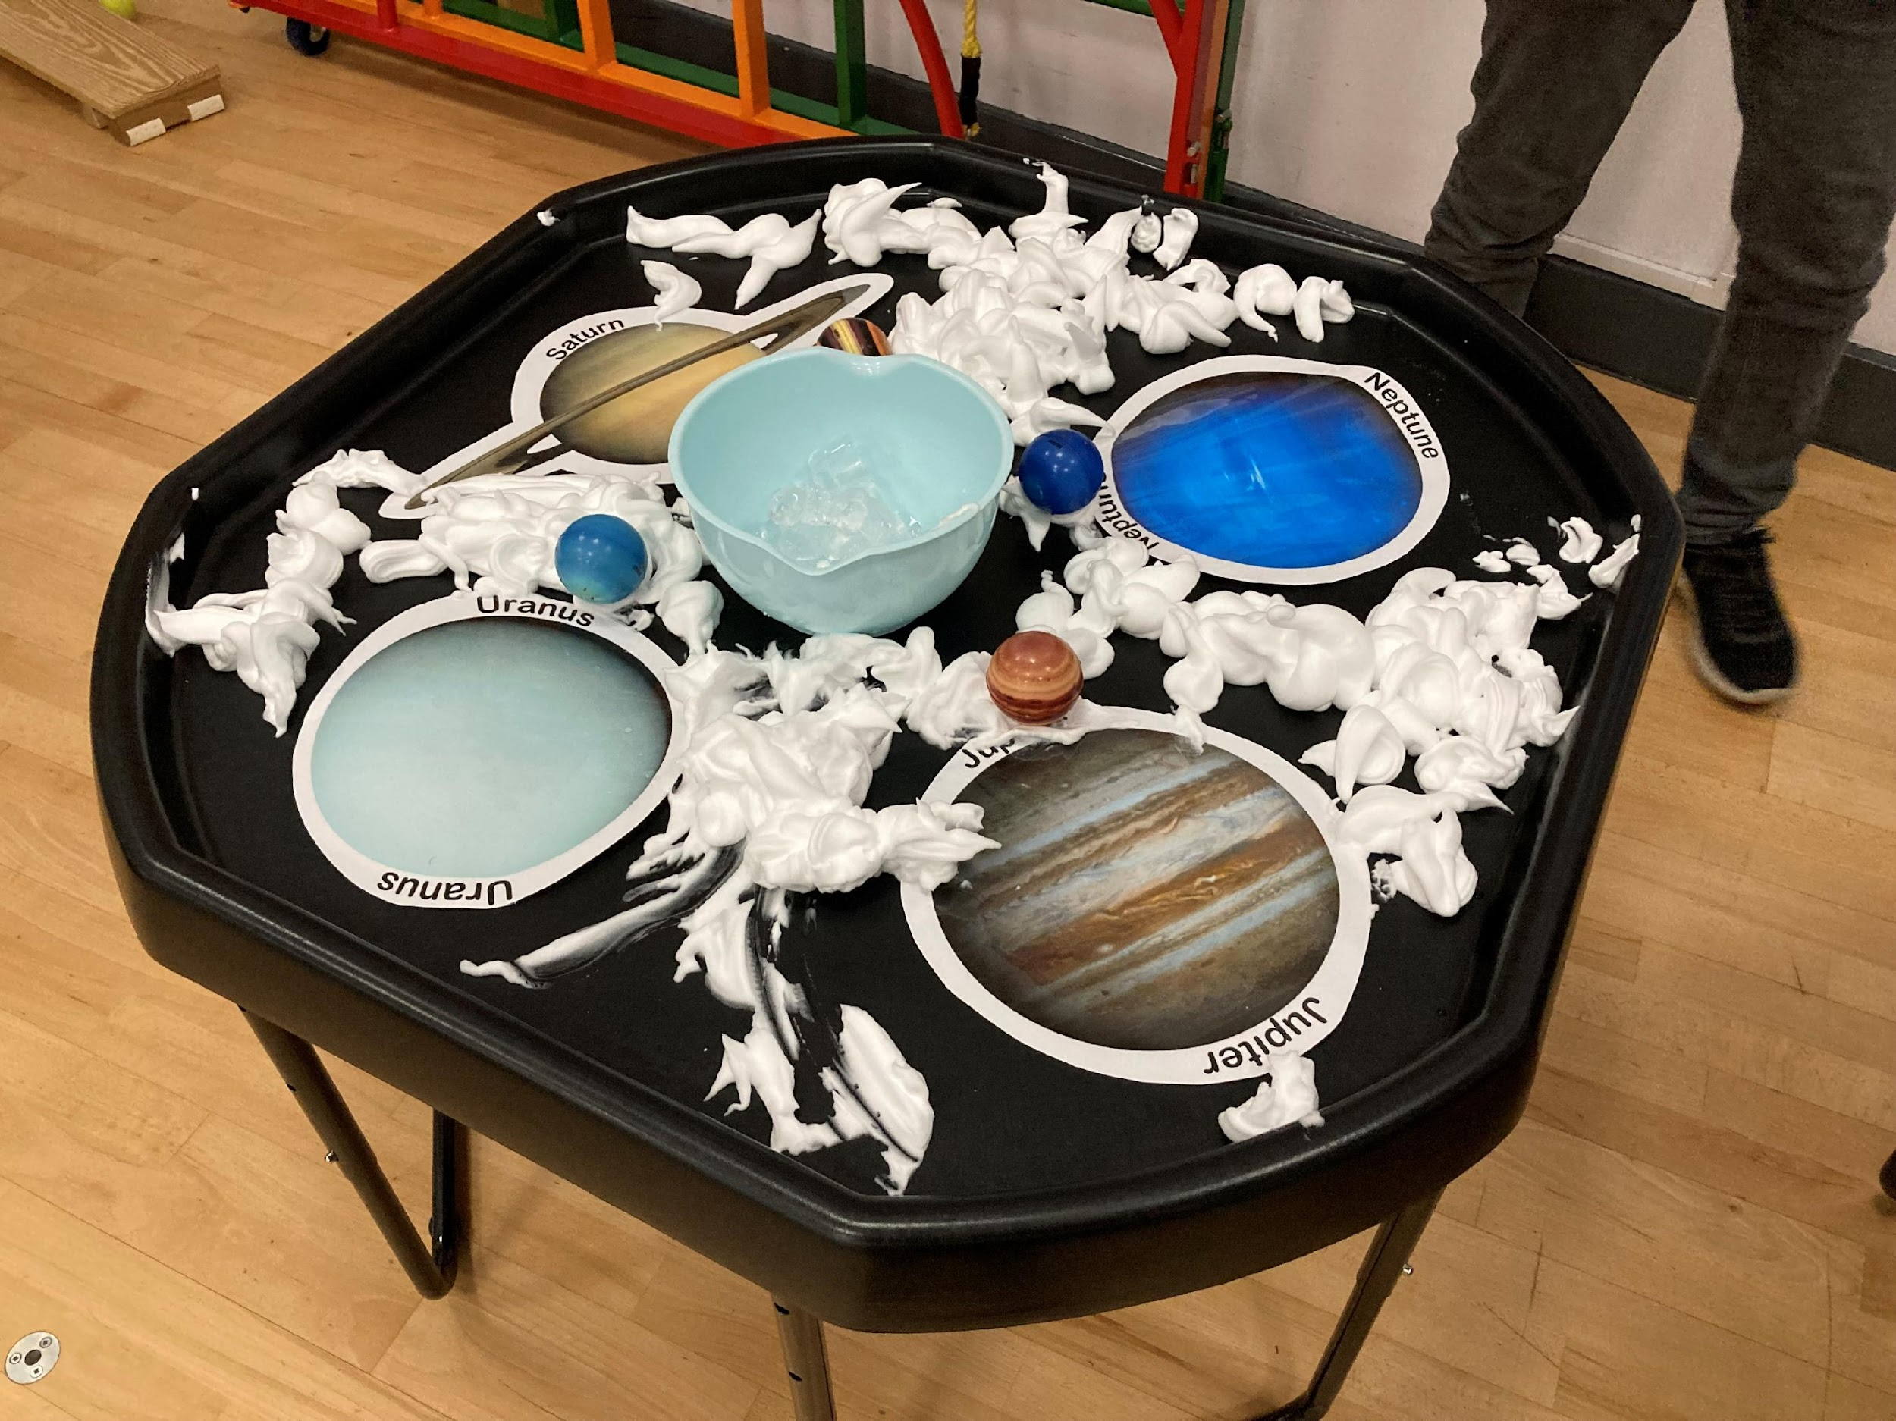
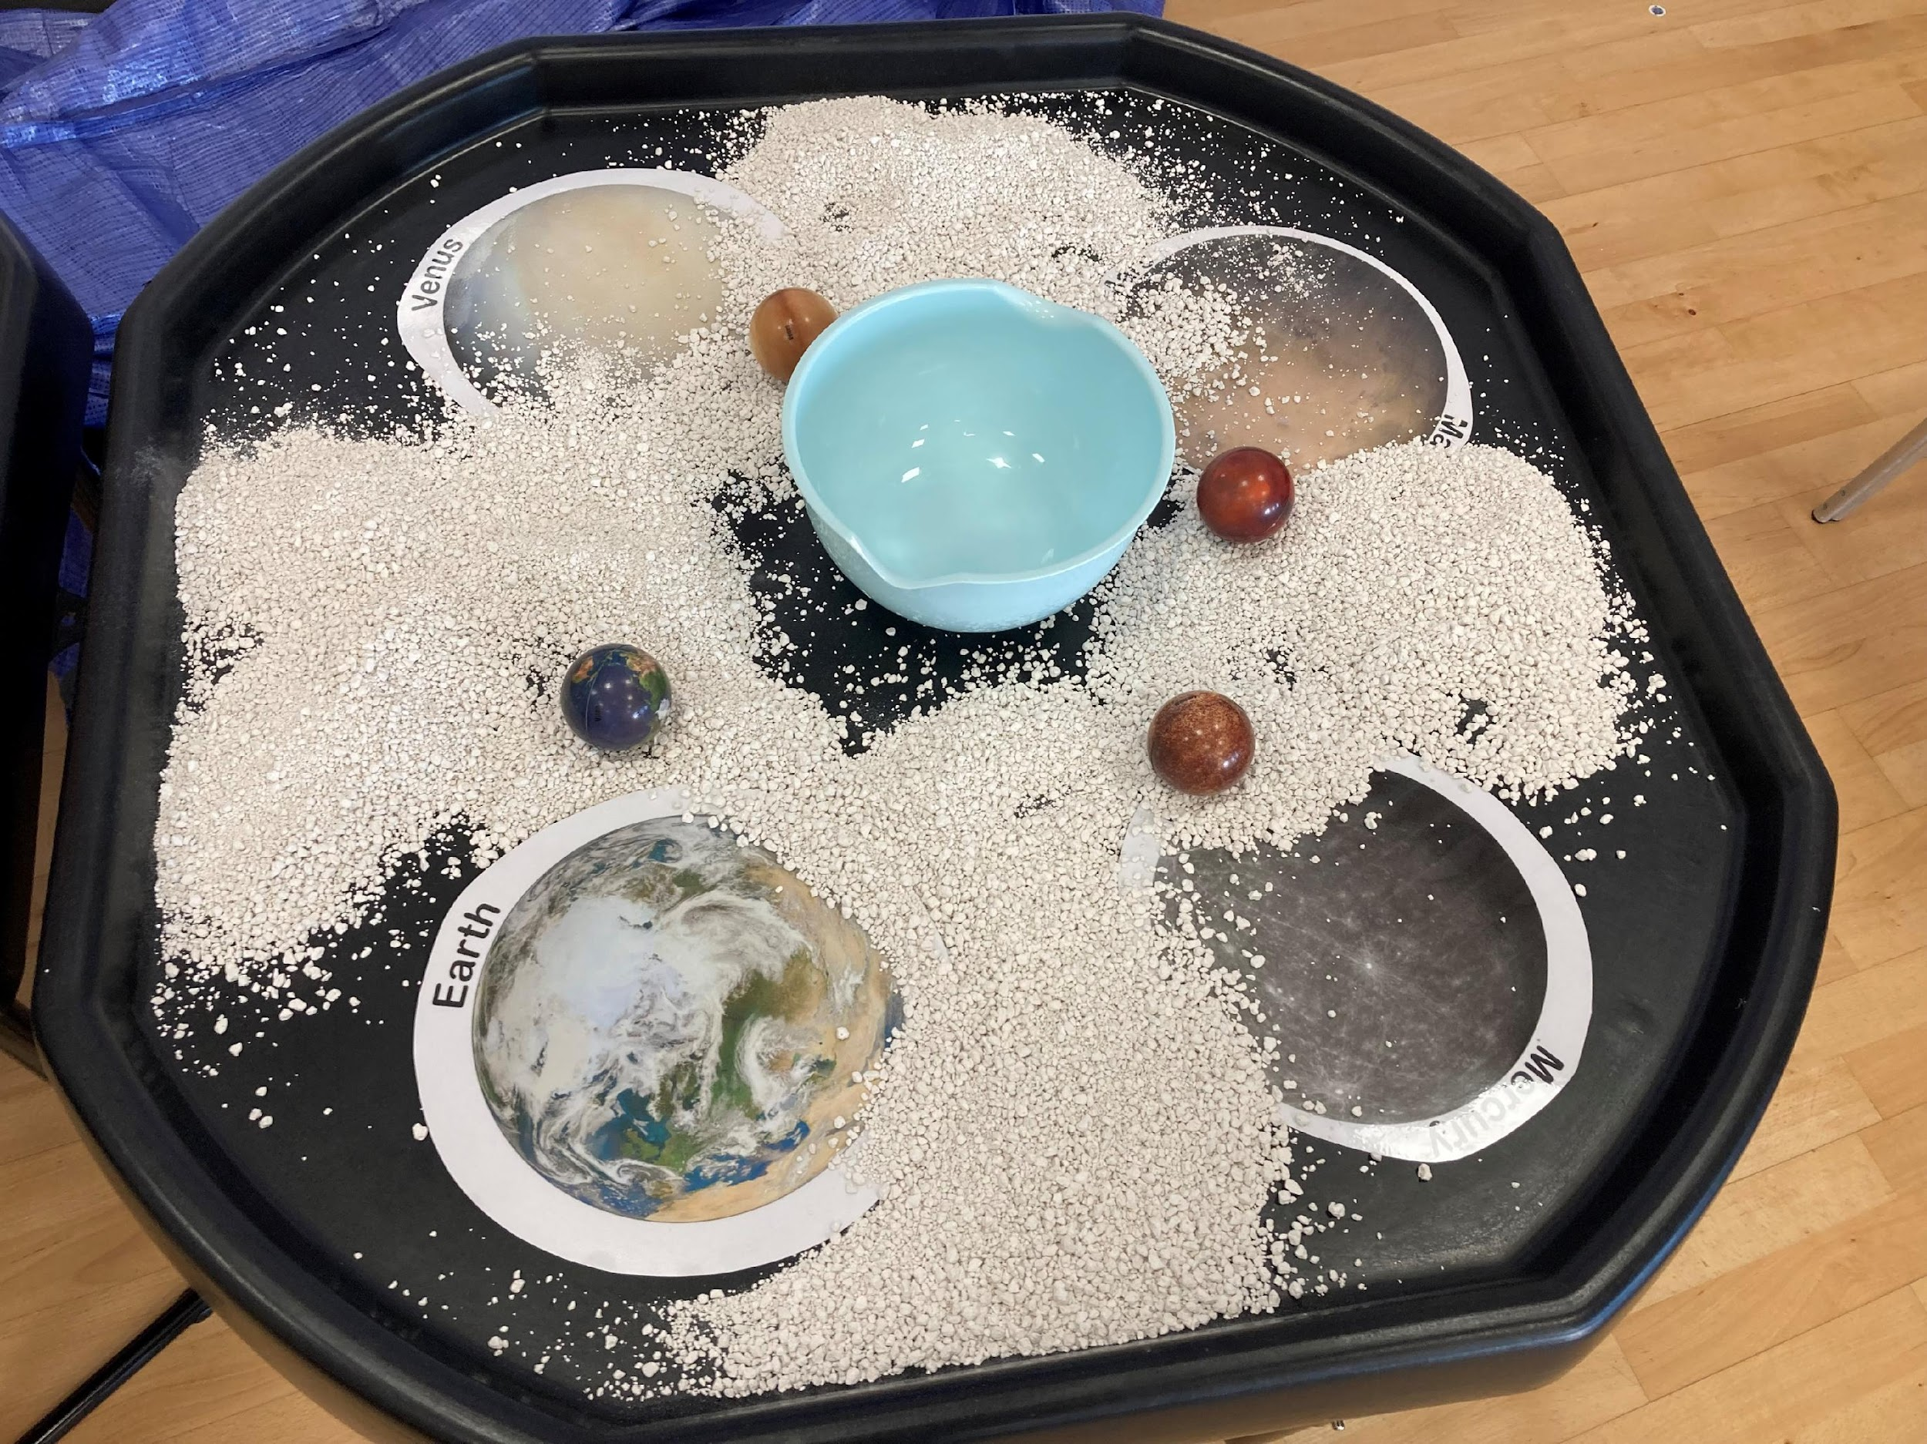
What we did
Space themed multi-sensory workshops
Welcome astronauts! Including launch into space sound buttons, astronaut dress up
VR launch video
Tactile planet tuff trays
Wheelchair accessible dark dens
VR flyby of Saturn and Mars
Weighted cans to demonstrate gravity
3D printed lunar surfaces, constellations and planets
Planet size scale props
Tasting space food

Slide 5
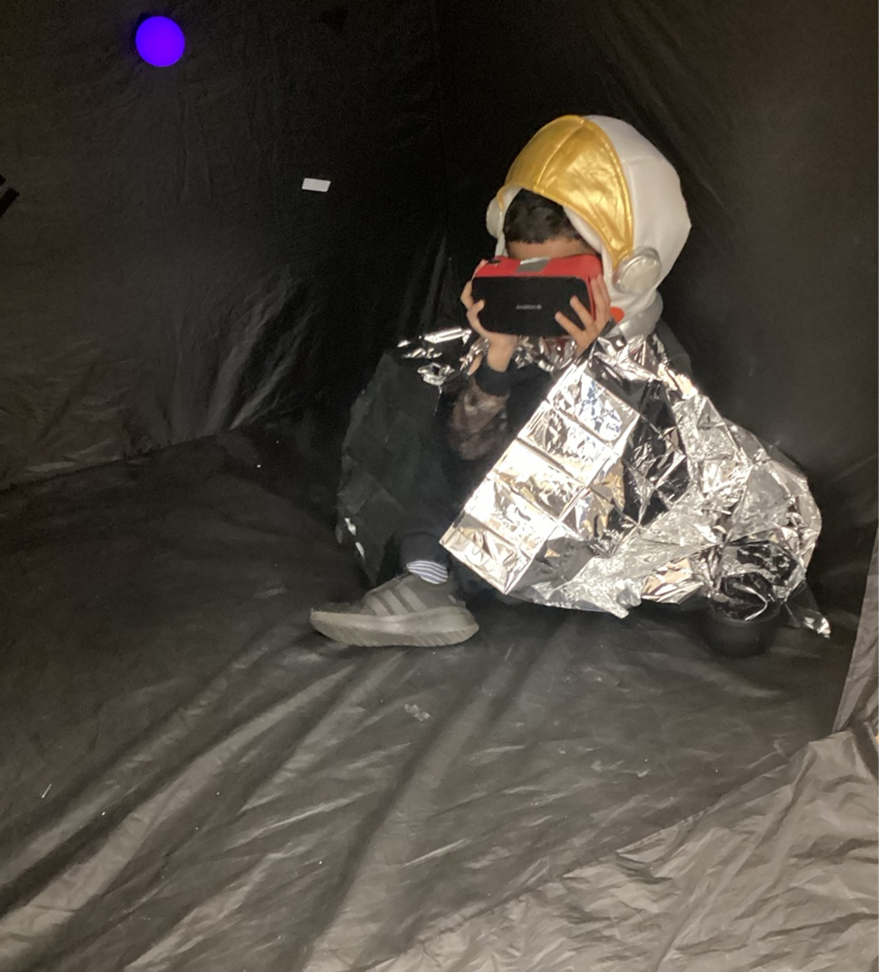
Feedback and evaluation
“The quality of the resources was superb – but it was the team who
delivered it that made it special, and they were so great with the young
people. They got young people engaged who even we struggle with.
They were brilliant.”
(Welburn Hall School)
“We hope it will become a whole school / whole child offer including
our early years. It’s truly inclusive. Outer space can be a dry topic, very
factual. This outreach has been a wonderful way to bring it alive and
make it experiential. Other SEN young people need this experience too,
one that caters to all their needs.” (Chellow Heights)

Slide 6
Feedback and evaluation
We received overwhelmingly positive feedback for our multisensory sessions:
95% of 162 young participants reporting being happy or very happy.
Teachers gave a high recommendation score of 9.4/10.
Independent ethnography confirmed the VR approach effectively engages diverse learners and makes space-related content broadly appealing.
Schools reported increased student interest, enjoyment, and knowledge, while staff gained new teaching practices.
The programme was especially valued by special schools as a free, high-quality resource.
Overall, the initiative is seen as highly effective, with all participating schools eager to continue the partnership.
Evaluation: Paul Rhodes (external consultant)

Slide 7
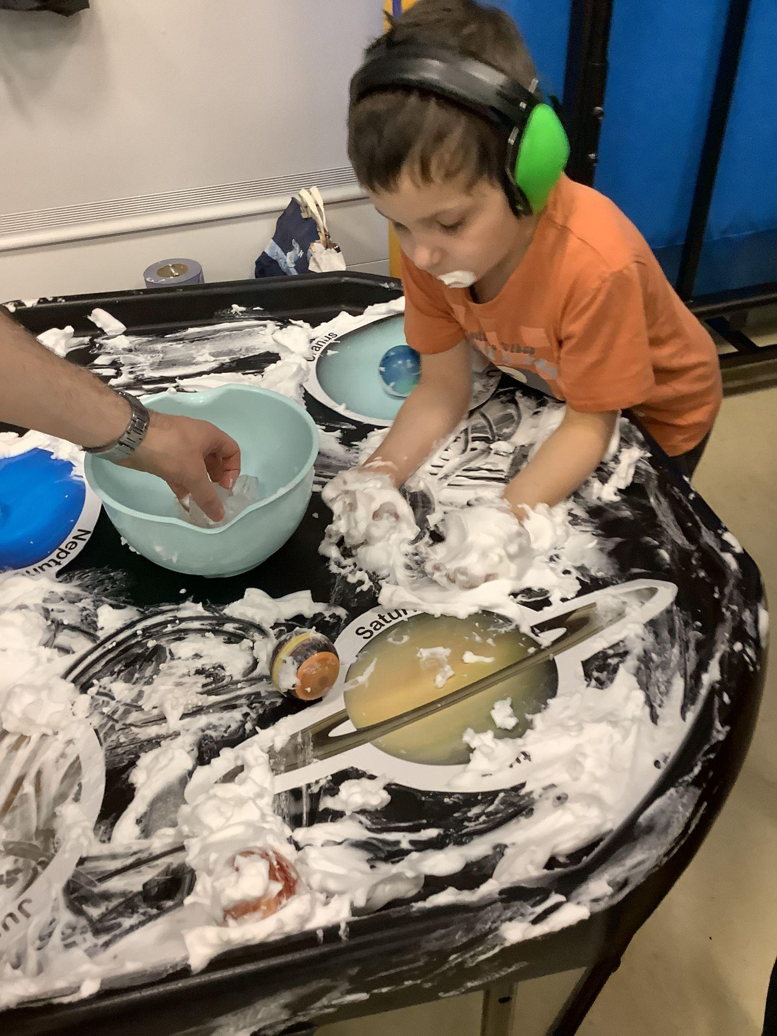
Learnings
3 key learning points from the project so far:
Collaborative approach and development of resources with LYF and the individual schools
Multisensory approach - integrate this across all our outreach activities to be more accessible and inclusive, tells a more coherent story.
Having a range of activities for students to engage with depending on their interests and needs. Need to be flexible.

Slide 8
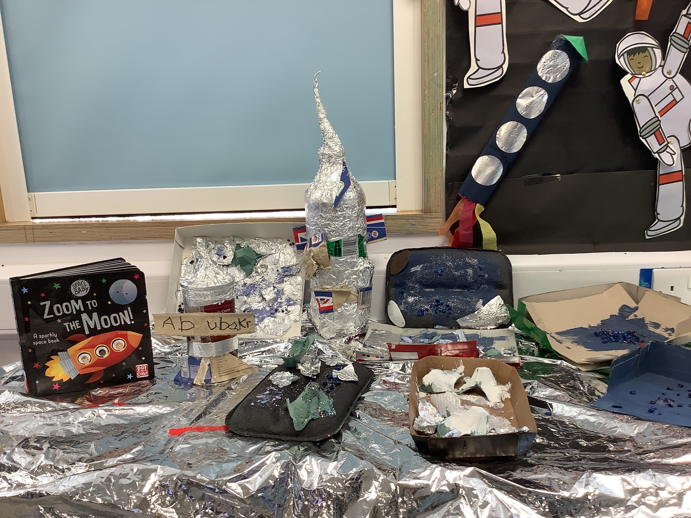
Going forward
We plan to repeat the process in other settings:
secondary schools
Community groups
Incorporate the resources into all of our outreach activities
We anticipate that each setting will have different challenges and needs - continue to be flexible and guided by the expertise of the teachers and carers.

Slide 9
Find out more
We brought 4 headsets and some other resources along to showcase the videos and VR kit that we used - find us during the break!
See our PET outreach webpage
Visit the Lightyear Foundation website
Email josie.rawes@york.ac.uk or pet-outreach@york.ac.uk

