Slide 1
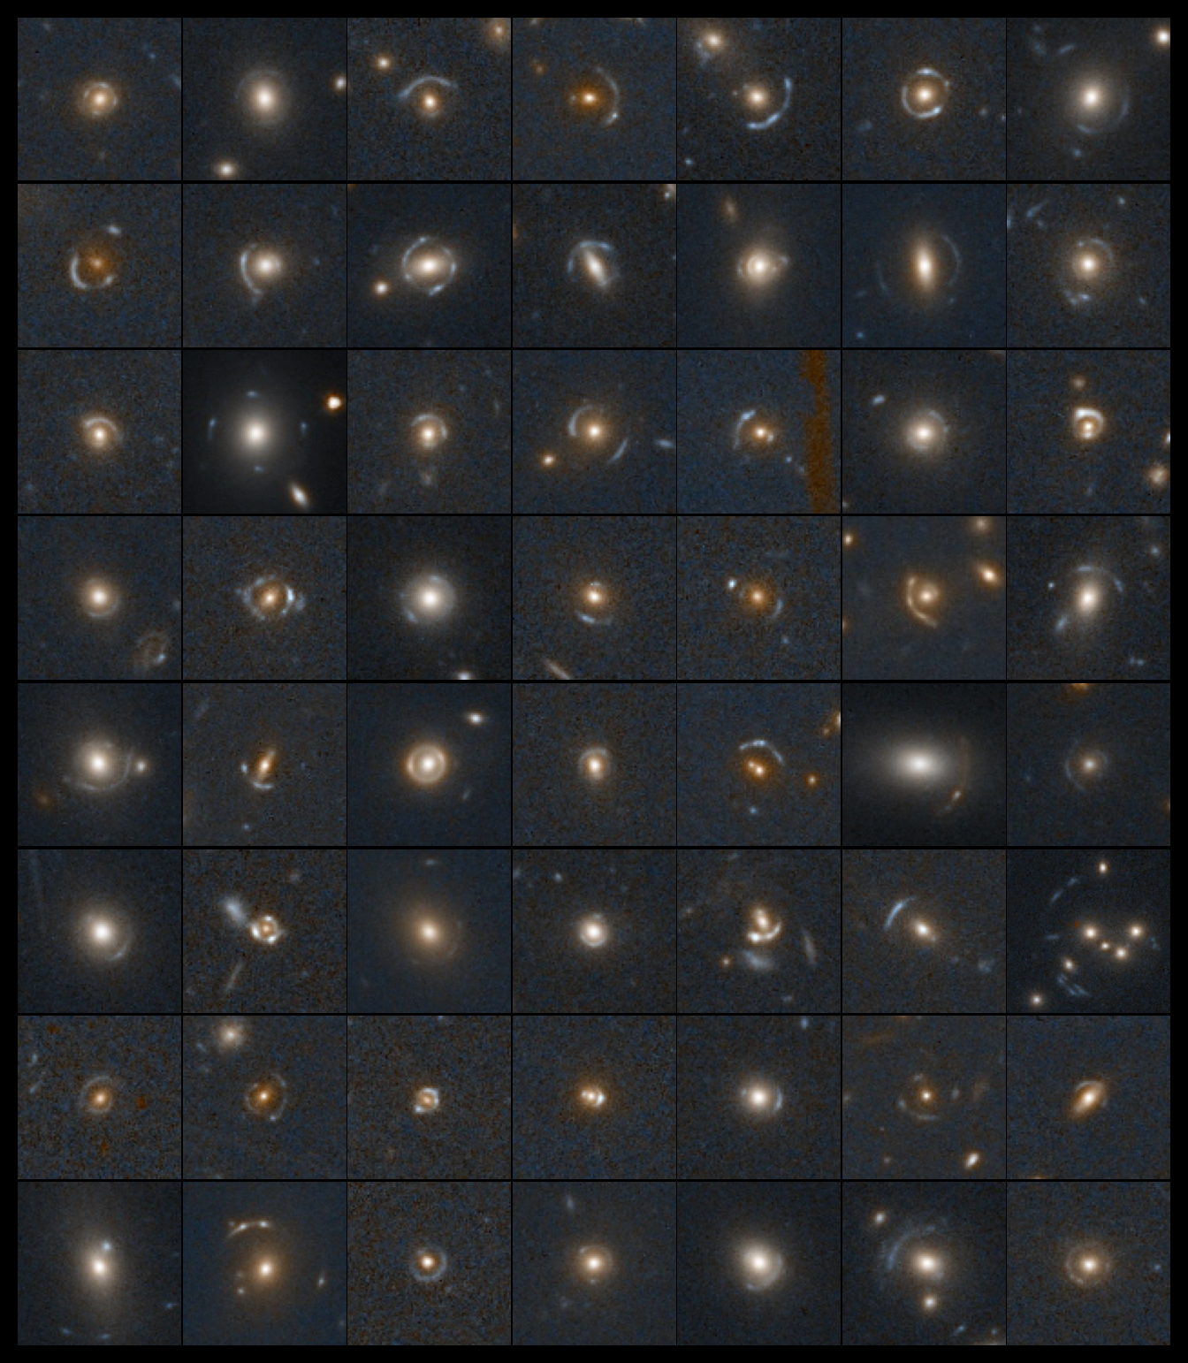
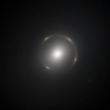


Searching for strong lenses in Q1 with Machine Learning
Natalie Lines
With: Tom Collett, Mike Walmsley, Karina Rojas, Tian Li, Phil Holloway, Aprajita Verma, James Nightingale,
Euclid Strong Lensing SWG, Zooniverse

Slide 2
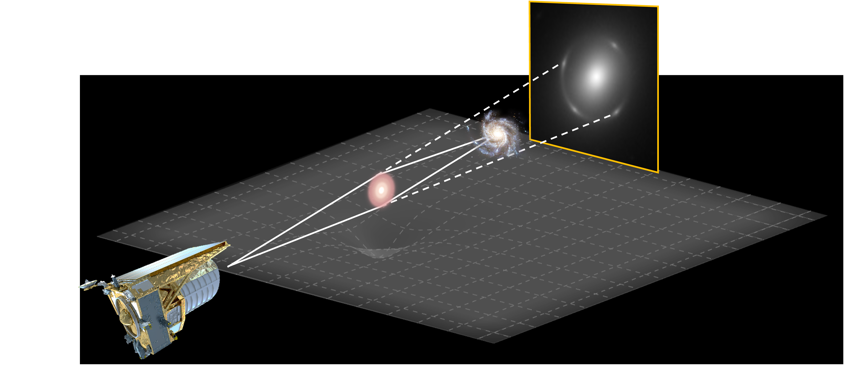
Strong gravitational lensing
Natalie Lines, NAM, 11th July 2025

Slide 3
Euclid: a perfect weak strong lensing telescope
Natalie Lines, NAM, 11th July 2025

Slide 4
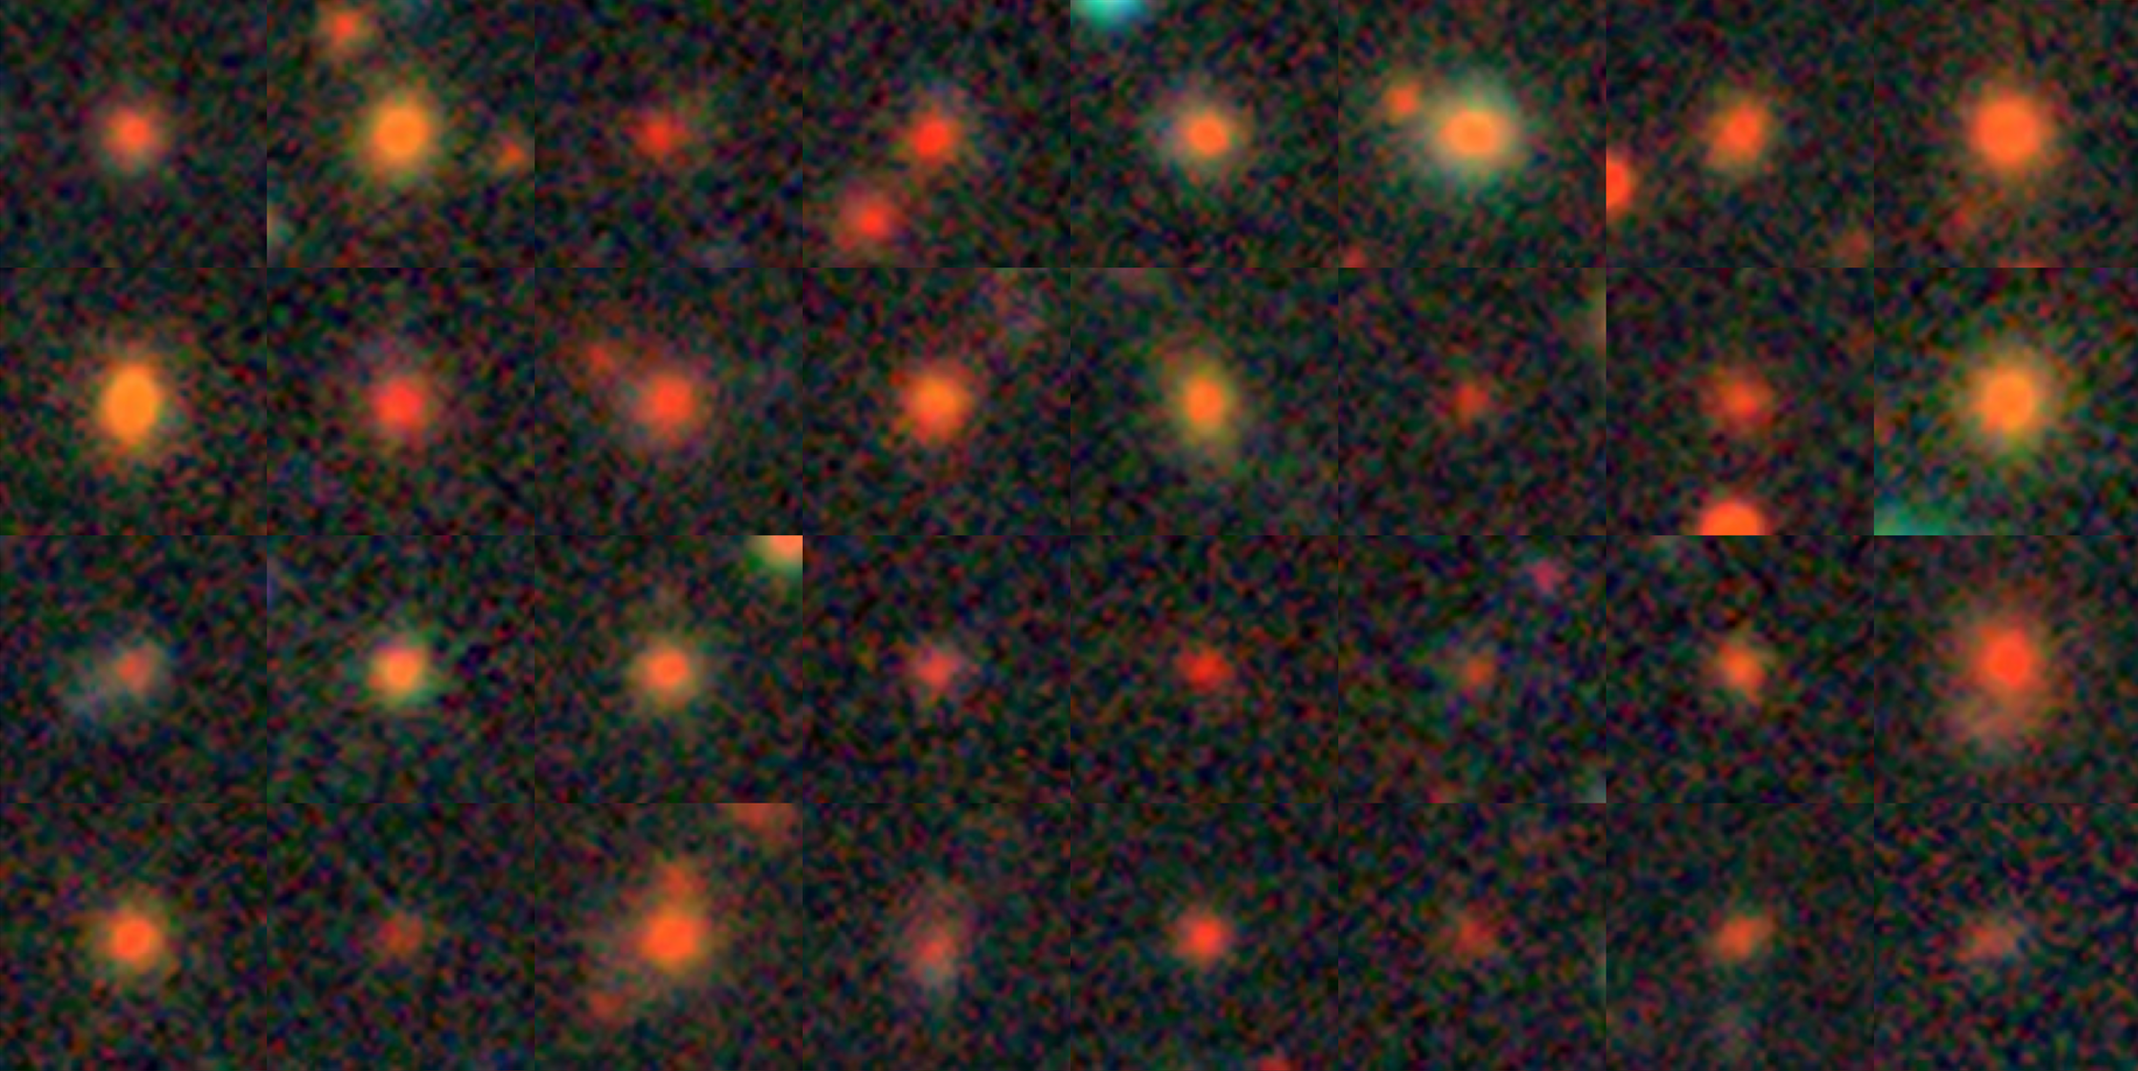
Euclid: a perfect weak strong lensing telescope
Natalie Lines, NAM, 11th July 2025
Images from Legacy Survey (North, BASS/MzLS)

Slide 5
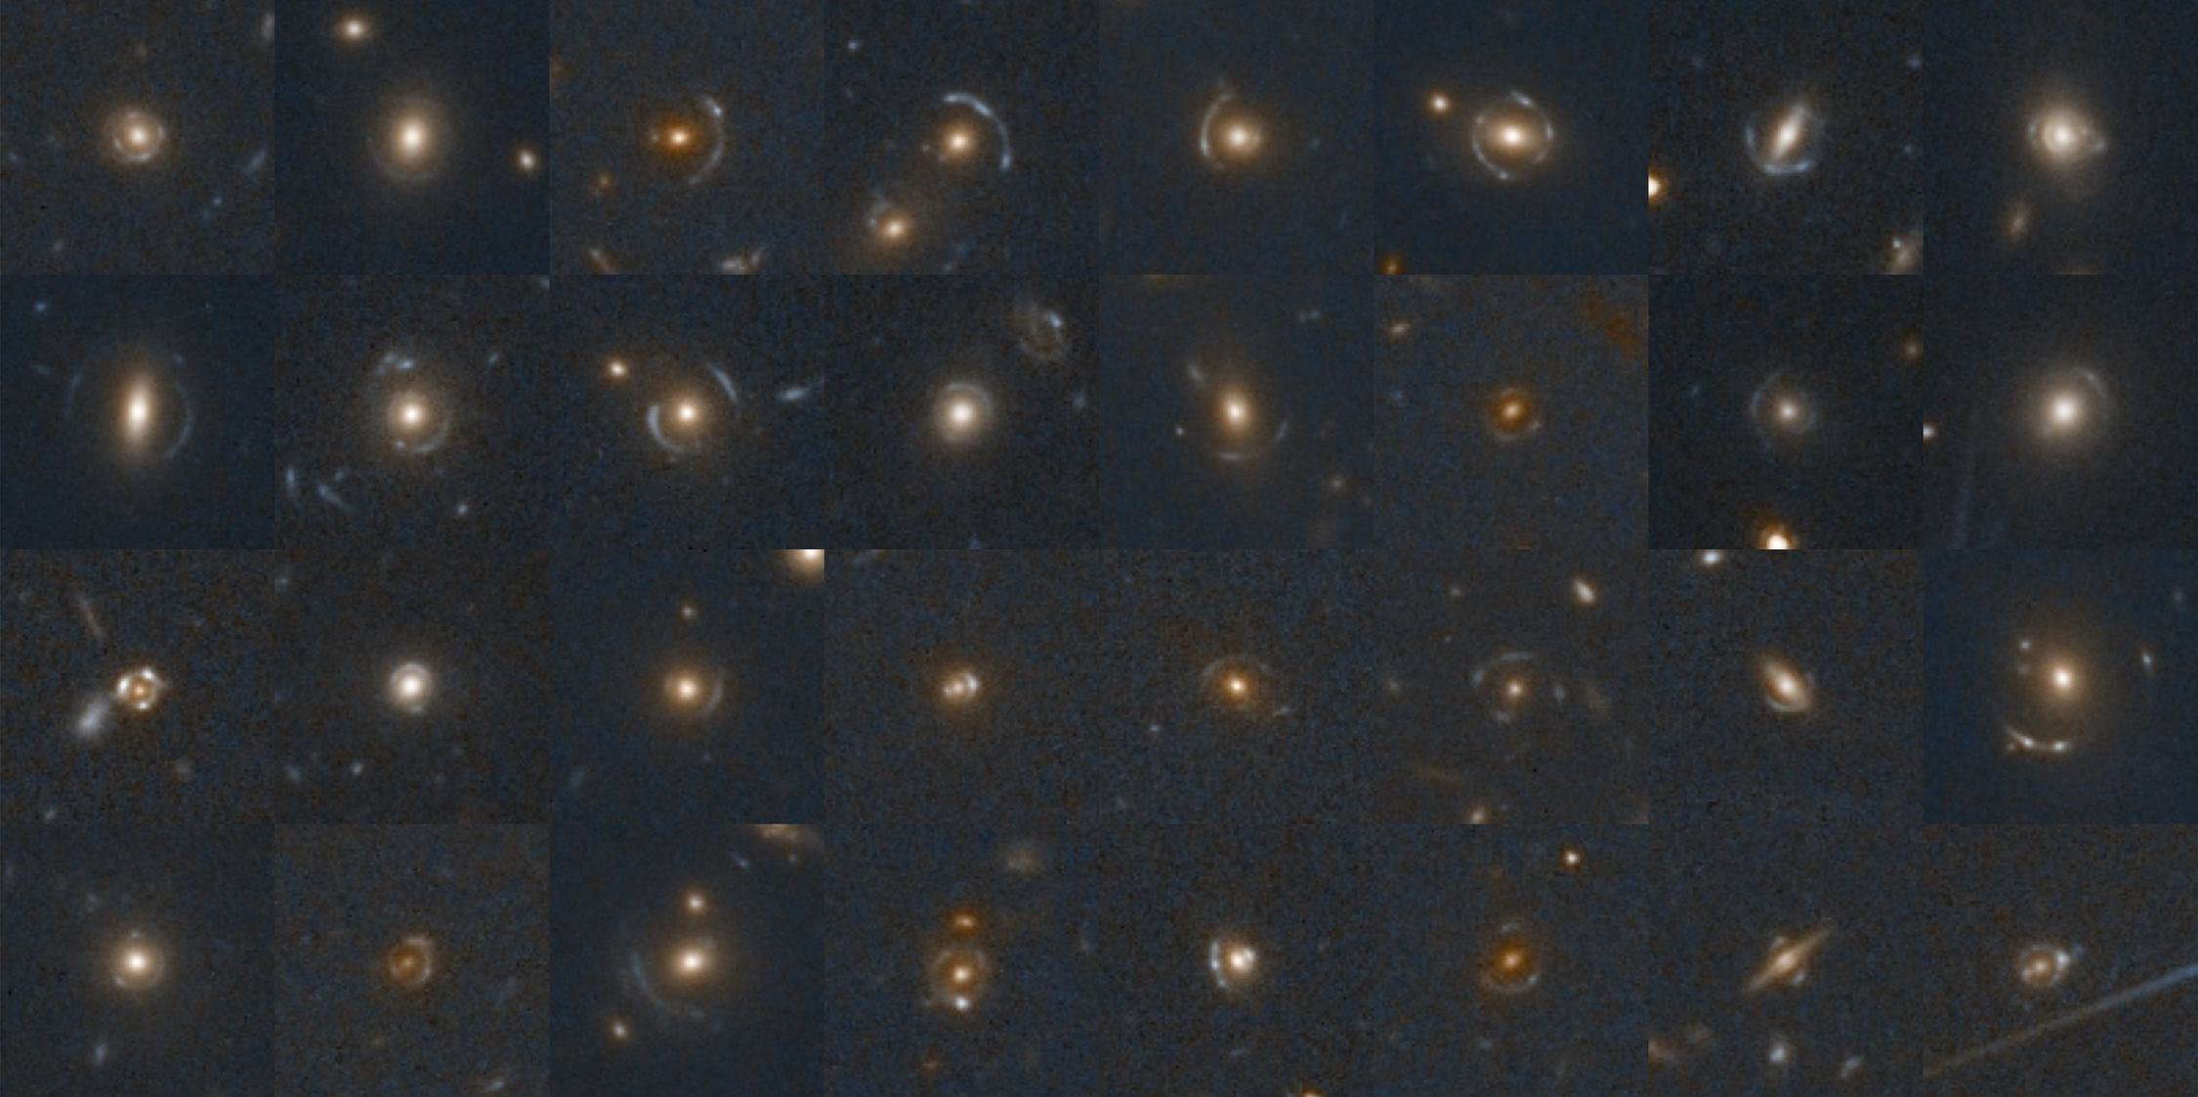
Euclid: a perfect weak strong lensing telescope
Natalie Lines, NAM, 11th July 2025
Images from Euclid Deep Field North
Notes:
Euclid reveal a wealth of strong lenses previously undetectable

Slide 6
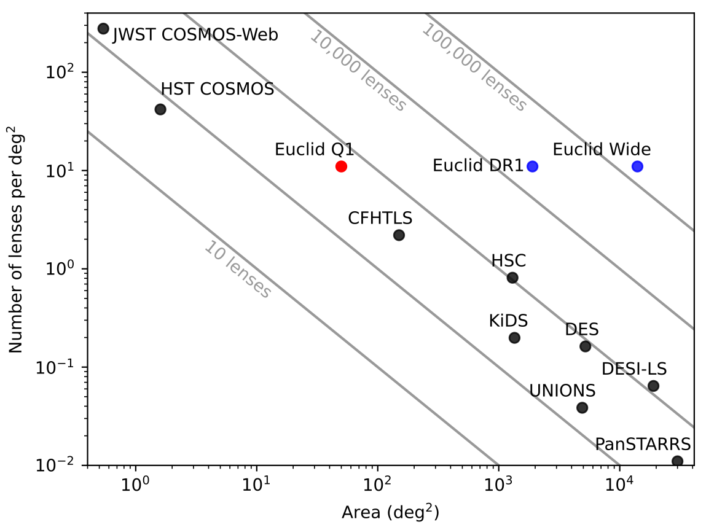
Euclid: a perfect weak strong lensing telescope
Previous strong lens candidates: ~1000
Euclid forecast to image ~100,000 strong lenses…
Natalie Lines, NAM, 11th July 2025

Slide 7
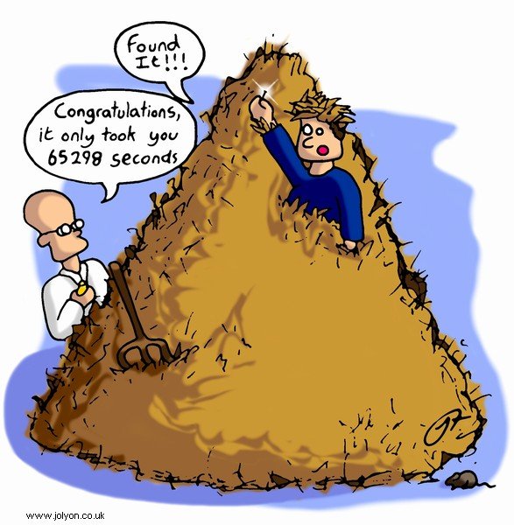
Euclid: a perfect weak strong lensing telescope
Previous strong lens candidates: ~1000
Euclid forecast to image ~100,000 strong lenses…
…but also 1.5 billion non-lenses
Natalie Lines, NAM, 11th July 2025

Slide 8
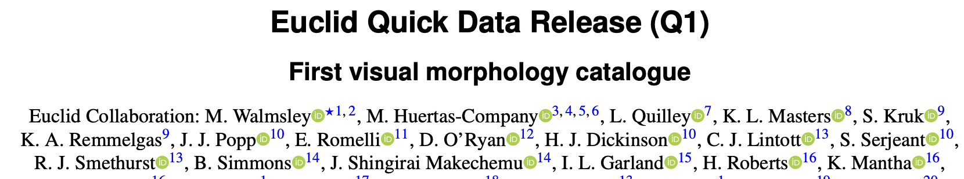
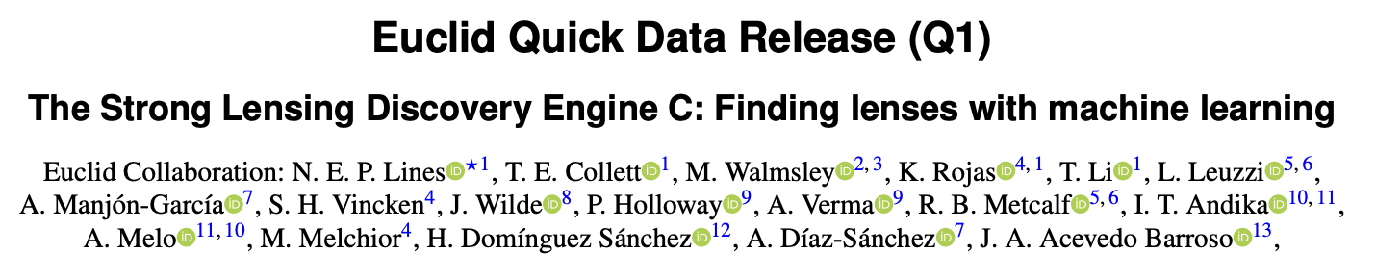
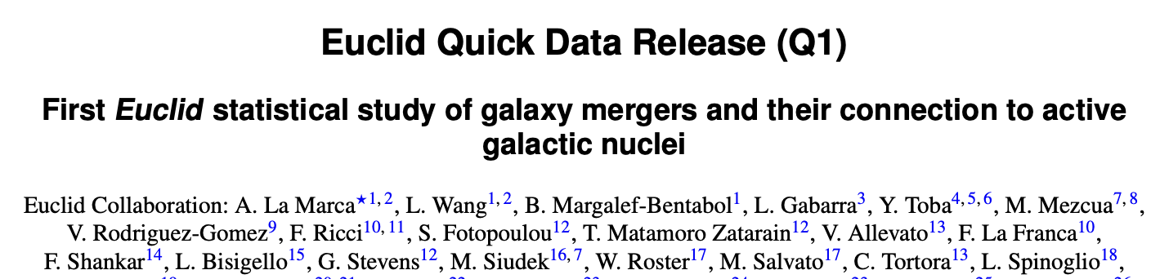
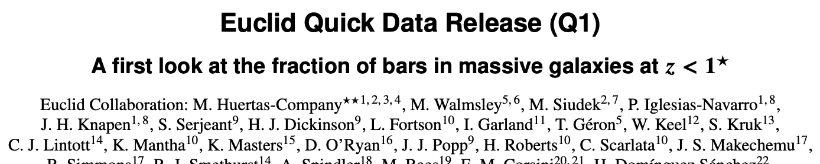
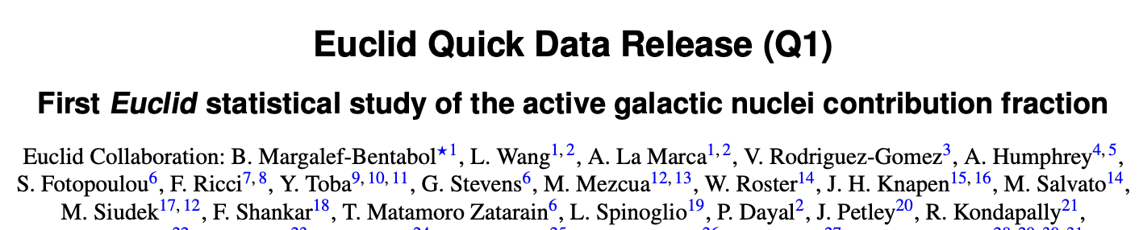
Zoobot foundation model
Trained on 100M Galaxy Zoo morphologies from SDSS, HST, HSC+
Can then be fine-tuned to perform specific tasks
Strengths:
  Transferable information
  More robust
  Require less task-specific training data
Natalie Lines, NAM, 11th July 2025

Slide 9

Training
Simulated galaxy-galaxy lenses
Morphologically classified non-lenses
~20,000 training images
Natalie Lines, NAM, 11th July 2025
Vetting
Visually inspected predicted lenses with citizen science
Lens candidates graded by experts

Slide 10
500 strong lenses
Natalie Lines, NAM, 11th July 2025
Notes:
largest catalogue of strong lenses with space-based imaging to date - rememeber this is only just the start for euclid

Slide 11
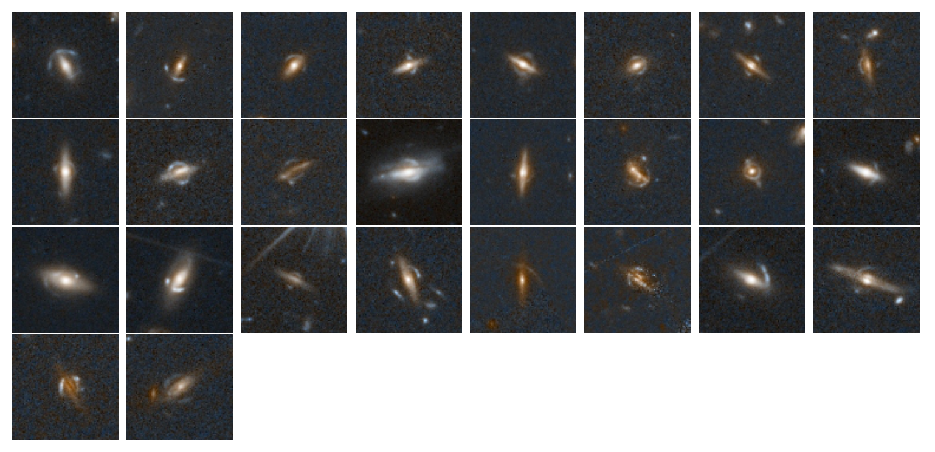
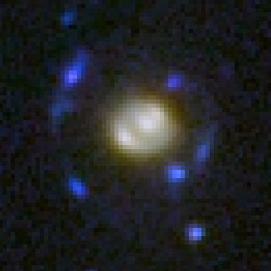
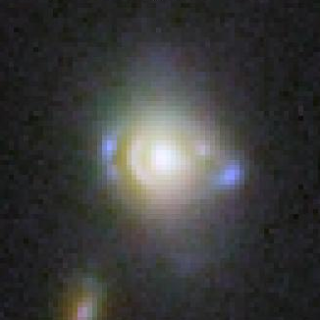
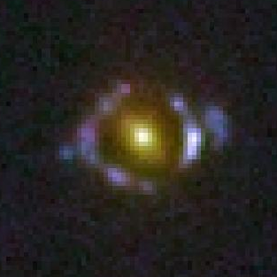
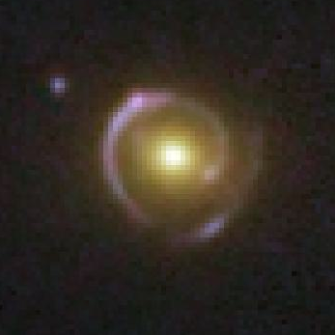
Compound lenses
Edge-on disc lenses
Natalie Lines, NAM, 11th July 2025
Li et al. (2025)

Slide 12
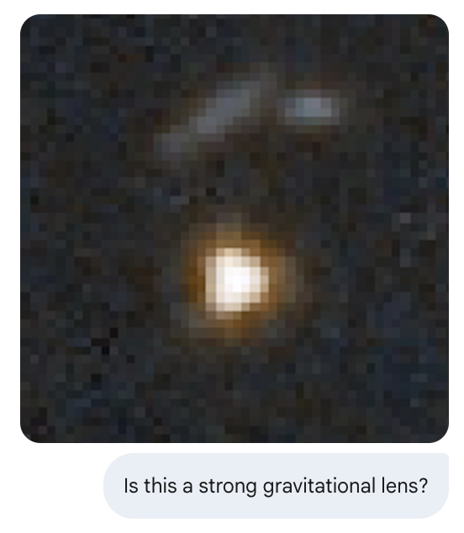
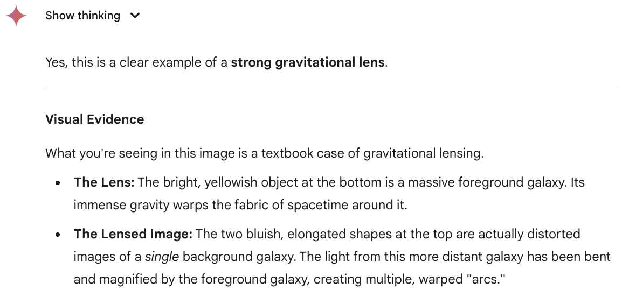
Scaling up
Challenges:
  False positives
  Limited visual inspection time
Solutions:
  Combining multiple ML approaches
  Re-training on Q1 lenses and non-lenses
Natalie Lines, NAM, 11th July 2025
?
?
?
?
?
?

Slide 13
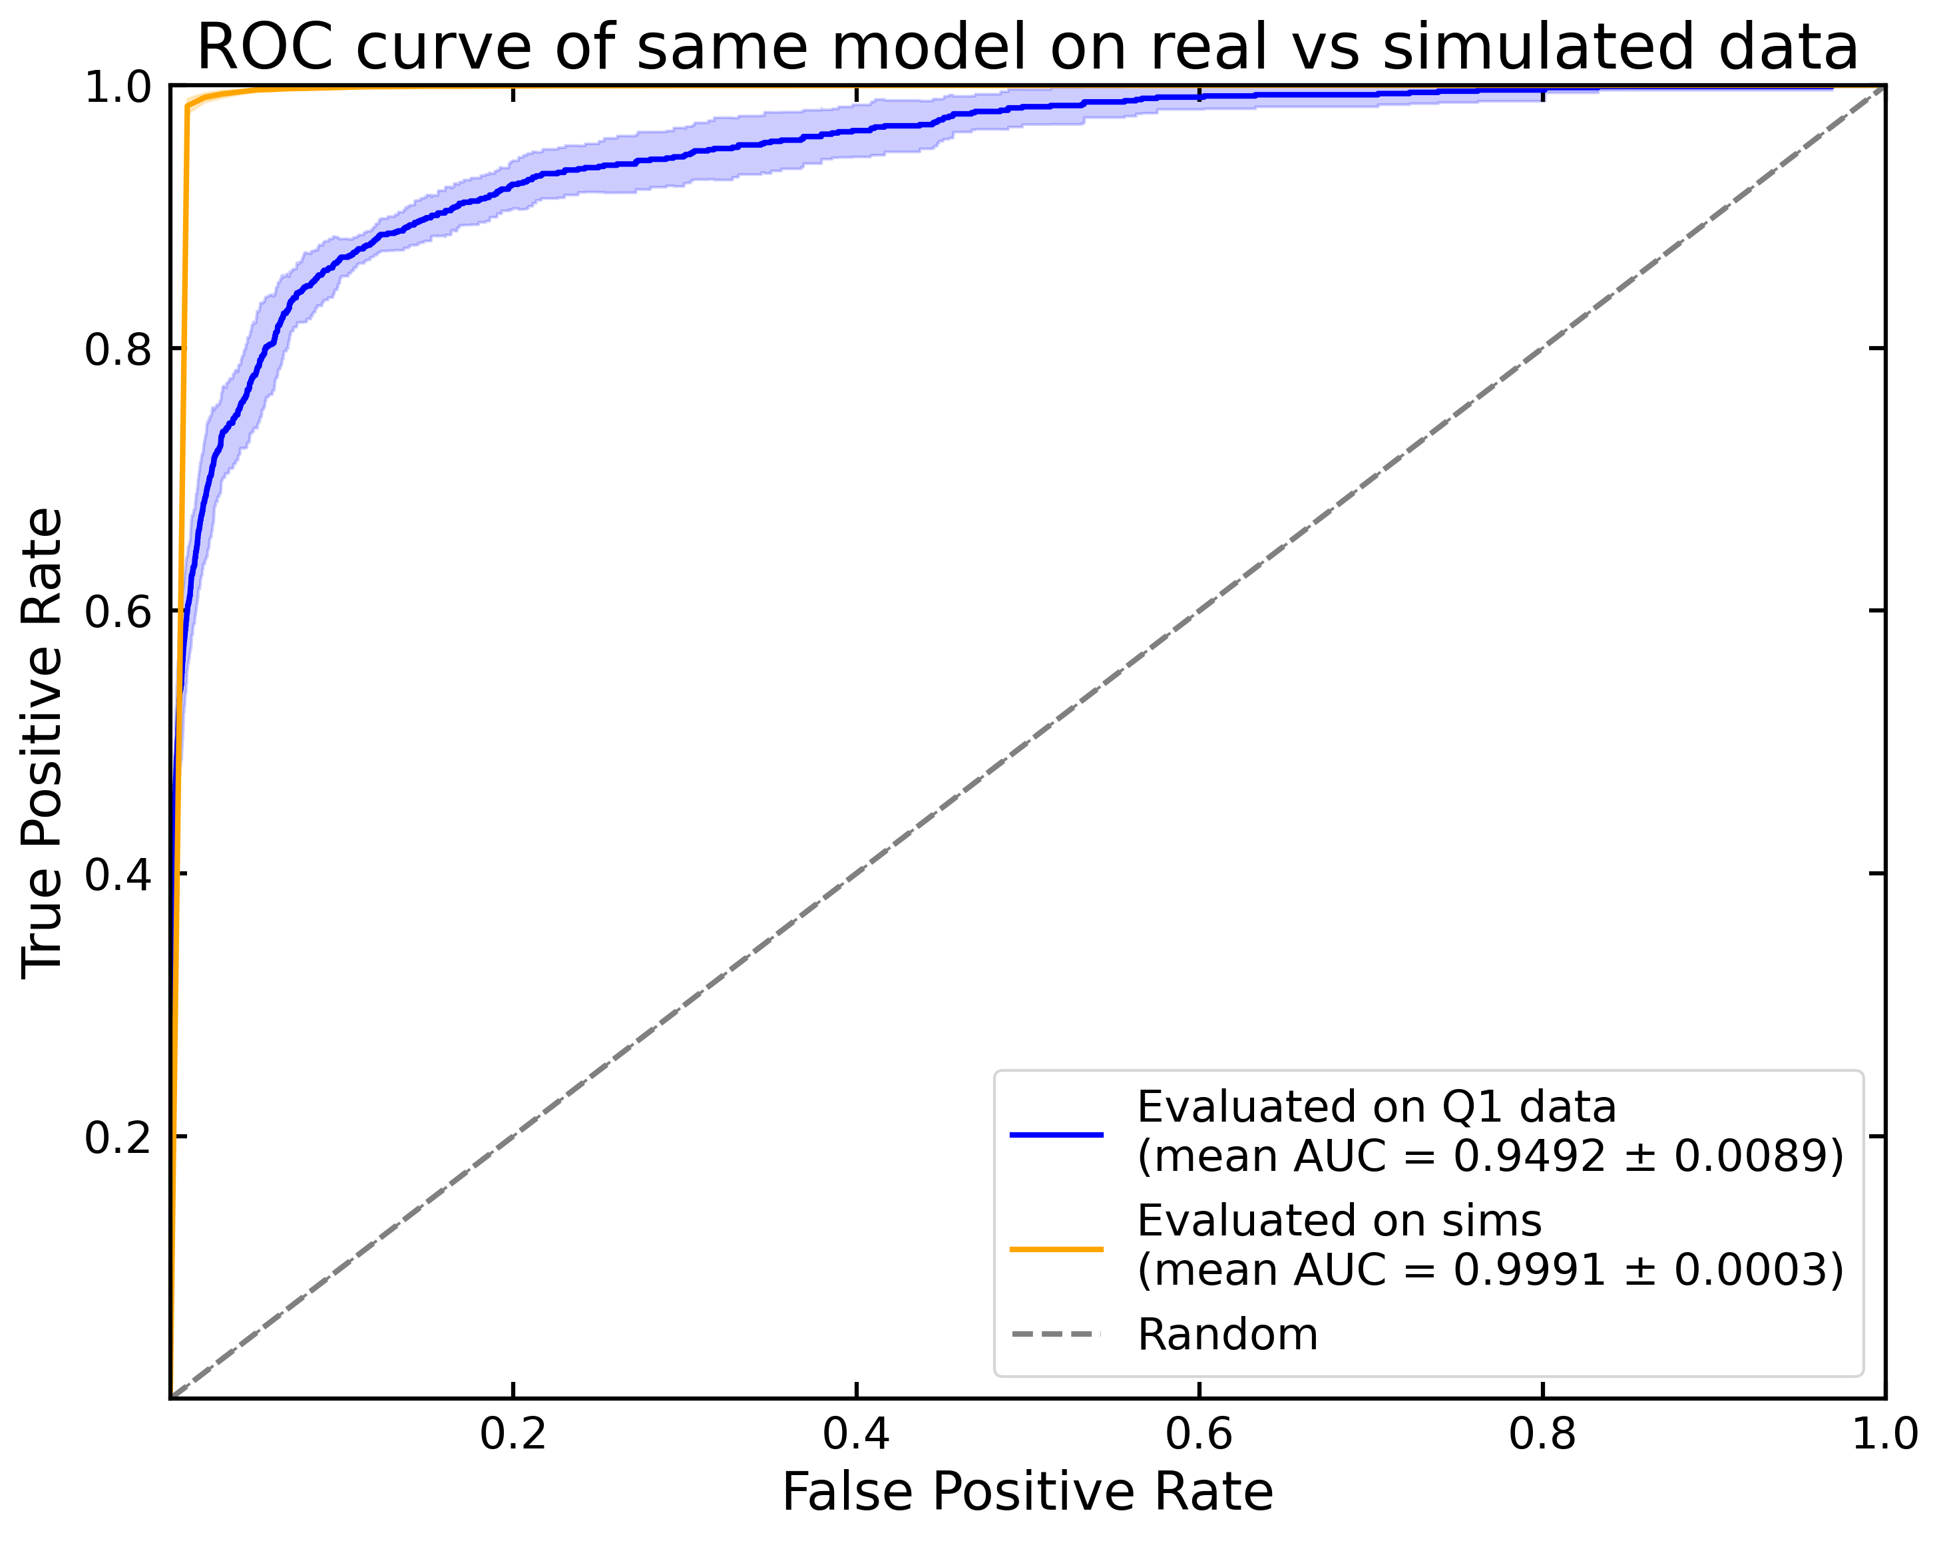
The simulation/real data gap
Significant discrepancy between performance
Scope for ML improvement with real lenses
Natalie Lines, NAM, 11th July 2025

Slide 14
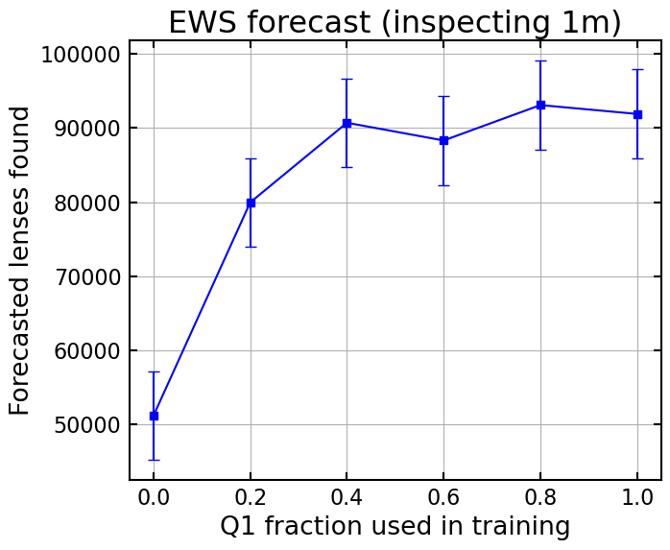
Future
>110,000 strong lenses expected in full survey
>90,000 discoverable with current best ML model
Expect further improvements as we collect more labelled Euclid data
Natalie Lines, NAM, 11th July 2025

Slide 15
Summary
500 Q1 lenses
-> 15,000 DR1 lenses
-> 110,000 EWS lenses
Foundation machine learning models (e.g. Zoobot) essential for finding lenses in Euclid
Revolutionise strong lensing science
Natalie Lines, NAM, 11th July 2025
Euclid Quick Data Release (Q1). The Strong Lensing Discovery Engine C: Finding lenses with machine learning, N. Lines et. al. 2025, A&A, doi: 10.1051/0004-6361/202554542

Slide 16
End
Natalie Lines, NAM, 11th July 2025

