Slide 1


Discovery of bright galaxies at redshift 7 with UltraVISTA and Euclid COSMOS
Rohan Gadiyar Varadaraj
With: Rebecca Bowler, Matt Jarvis, John Weaver, Eduardo Bañados, Euclid Collaboration (LBG Work Package)
rohan.varadaraj@physics.ox.ac.uk
NAM 2025, Durham, UK
Friday 11th July
ESA/Euclid/Euclid Consortium/NASA

Slide 2
How can we prevent contamination in our searches for distant galaxies?

Slide 3
The High Redshift Universe
Q) How did the first galaxies form and grow?
JWST: Revealed galaxies out to unprecedented redshifts.
Dashed line = semi-empirical luminosity evolution of haloes.
z=7 corresponds to 750 Myr after the Big Bang.
Ideal candidates to study assembly histories.
Can build large samples at z=7.
Carniani+24

Slide 4
The Lyman Break Technique
Lyman-break galaxy
(LBG) spectral energy distribution at z=7

Slide 5
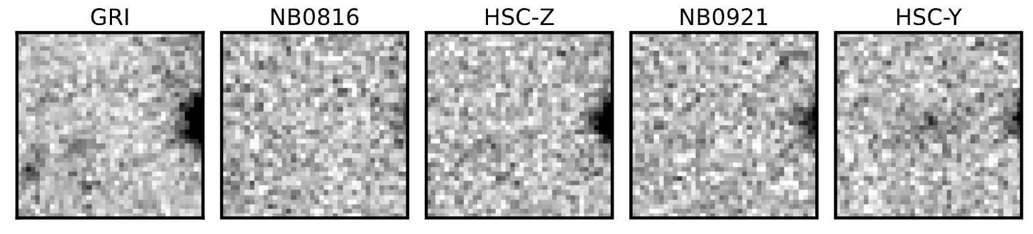
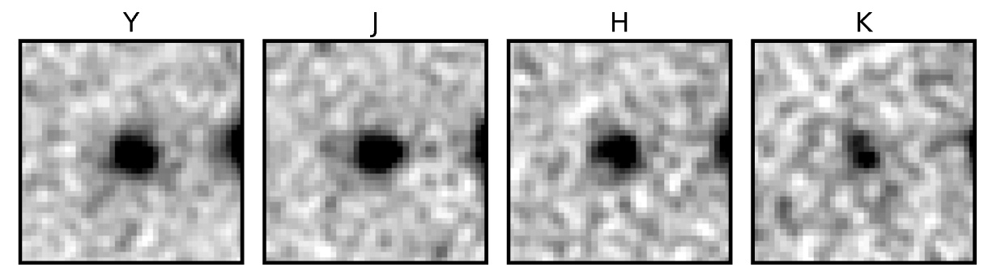
The Lyman Break Technique
Lyman-break galaxy
(LBG) spectral energy distribution at z=7
Spectral Energy Distribution (SED) fitting:
Identify ‘dropout’ sources
Fit templates to the photometry
Get photometric redshifts
Optical non-detections
Subaru HSC
NIR detections
VISTA

Slide 6
Low-redshift contaminants for z=7 searches
Lyman-break galaxy
(LBG) spectral energy distribution at z=7
Dusty galaxy with strong Balmer break
z=1-2

Slide 7
Low-redshift contaminants for z=7 searches
Lyman-break galaxy
(LBG) spectral energy distribution at z=7
Ultra-cool dwarf (UCD)
in the Milky Way
(M-, L-, T-type)
Dusty galaxy with strong Balmer break
z=1-2

Slide 8
Ultra-cool dwarf (UCD) contaminants
L-type
Ultra-cool dwarf
VISTA
Euclid
Ground-based filters can’t probe the UCD molecular absorption features!
Euclid fills in the gaps.

Slide 9
Euclid imaging in the COSMOS field
Performance verification imaging in COSMOS.
Covering 0.7 square degrees.
Perfect to combine with ground-based data.

Slide 10


141 LBGs at $6.5<z<7.5$ ($−22.6<M_{UV}<−20.2$)
Diamonds: VISTA
Squares: Euclid
Euclid Collaboration (preliminary)
6"
Two components!
…remove as point sources?

Slide 11



Lyman-$α$ emitters with pseudo-narrowbands
Euclid Collaboration
(preliminary)
Euclid Y_{E}
VISTA Y
HSC y
Three overlapping ‘y’ filters: HSC-y, VISTA-Y, Euclid $Y_{E}$
Can they detect emission lines?

Slide 12
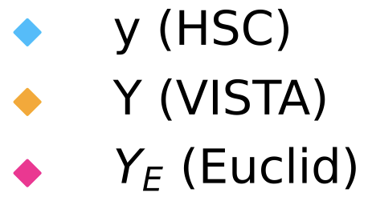
Lyman-$α$ emitters with pseudo-narrowbands
Euclid Collaboration
(preliminary)
Double-peaked morphology in VISTA-Y.
Ideal for spectroscopic follow-up with JWST.
Same filters available in Euclid Auxiliary Fields (XMM-LSS, CDFS/EDF-Fornax, total 10 deg²).

Slide 13
Conclusions
  Combination of VISTA+Euclid leads to clean z=7 samples via removal of UCDs with SED fitting.
  Potential to find strong line emitters in the Epoch of Reionisation in the Euclid Auxiliary Fields.
  Chat to me about the clean measurement of the rest-frame UV luminosity function!
rohan.varadaraj@physics.ox.ac.uk
Paper in internal review!

Slide 14
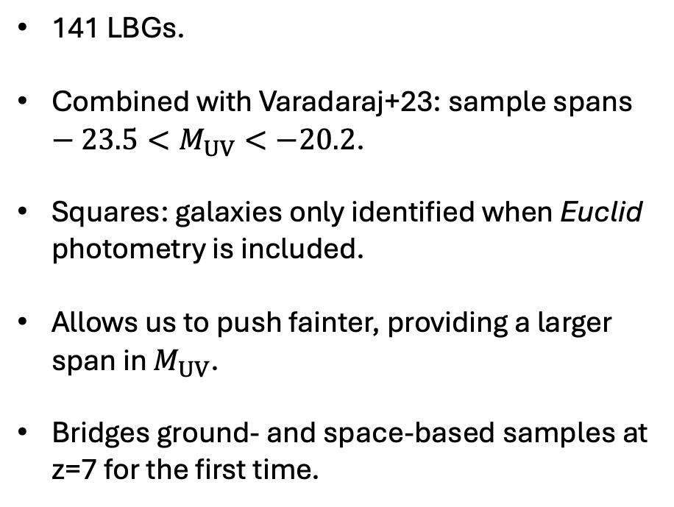
The sample
141 LBGs.
Combined with Varadaraj+23: sample spans $−23.5<M_{UV}<−20.2$.
Squares: galaxies only identified when Euclid photometry is included.
Allows us to push fainter, providing a larger span in $M_{UV}$.
Bridges ground- and space-based samples at z=7 for the first time.
Euclid Collaboration (preliminary)

Slide 15
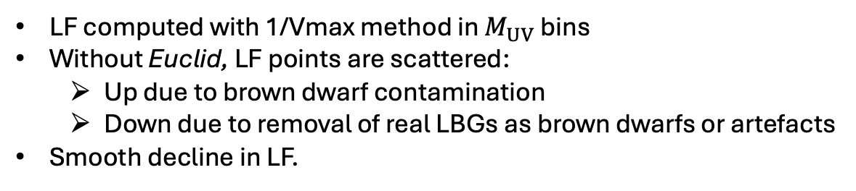
Improved LF determination with Euclid
Euclid Collaboration
(preliminary)
LF computed with 1/Vmax method in $M_{UV}$ bins
Without Euclid, LF points are scattered:
  Up due to brown dwarf contamination
  Down due to removal of real LBGs as brown dwarfs or artefacts
Smooth decline in LF.

Slide 16




The rest-frame UV LF at $z=7$
Compute LF: bin galaxies in $M_{UV}$, find $V_{max}$, sum $1/V_{max}$ in each bin.
Rule out Schechter function form at $M_{UV}<−22.5$.
Double Power Law preferred.
Euclid Collaboration
(preliminary)
Bright
Faint
(Absolute rest-UV magnitude)

Slide 17
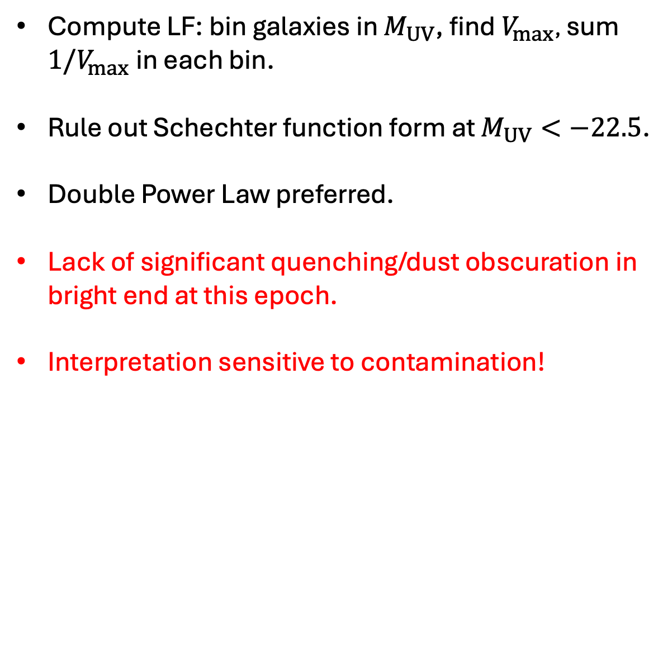
The rest-frame UV LF at $z=7$
Compute LF: bin galaxies in $M_{UV}$, find $V_{max}$, sum $1/V_{max}$ in each bin.
Rule out Schechter function form at $M_{UV}<−22.5$.
Double Power Law preferred.
Lack of significant quenching/dust obscuration in bright end at this epoch.
Interpretation sensitive to contamination!
Euclid Collaboration
(preliminary)
Bright
Faint
(Absolute rest-UV magnitude)

Slide 18
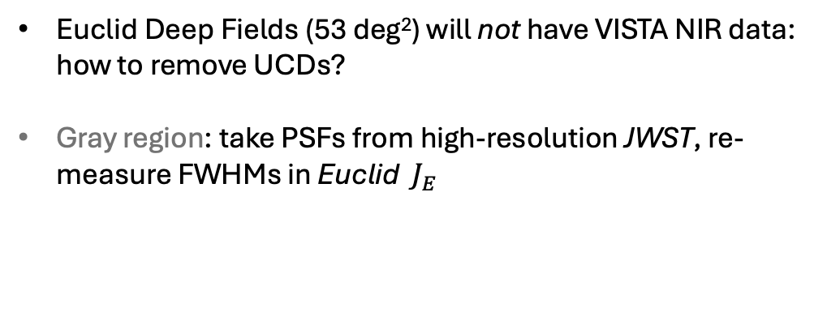
Can UCDs be removed as PSFs?
Bright
Faint
Euclid will discover 1000s of bright LBGs…
Euclid Deep Fields (53 deg²) will not have VISTA NIR data: how to remove UCDs?
Gray region: take PSFs from high-resolution JWST, re-measure FWHMs in Euclid $J_{E}$
LBGs
UCDs
Euclid Collaboration
(preliminary)

Slide 19
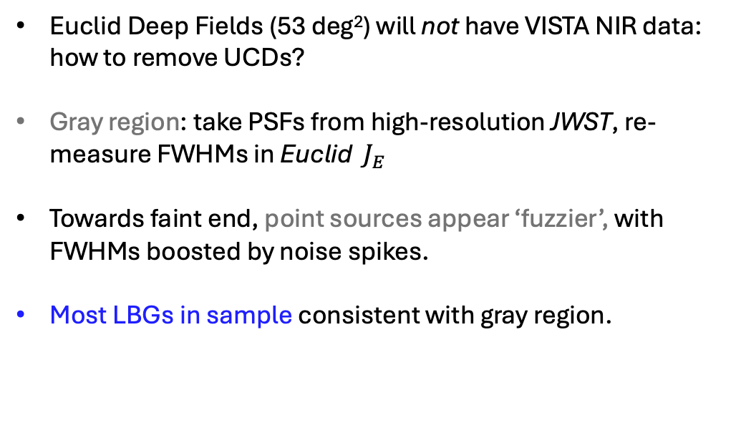
Can UCDs be removed as PSFs?
Bright
Faint
Euclid will discover 1000s of bright LBGs…
Euclid Deep Fields (53 deg²) will not have VISTA NIR data: how to remove UCDs?
Gray region: take PSFs from high-resolution JWST, re-measure FWHMs in Euclid $J_{E}$
Towards faint end, point sources appear ‘fuzzier’, with FWHMs boosted by noise spikes.
Most LBGs in sample consistent with gray region.
LBGs
UCDs
Euclid Collaboration
(preliminary)

Slide 20
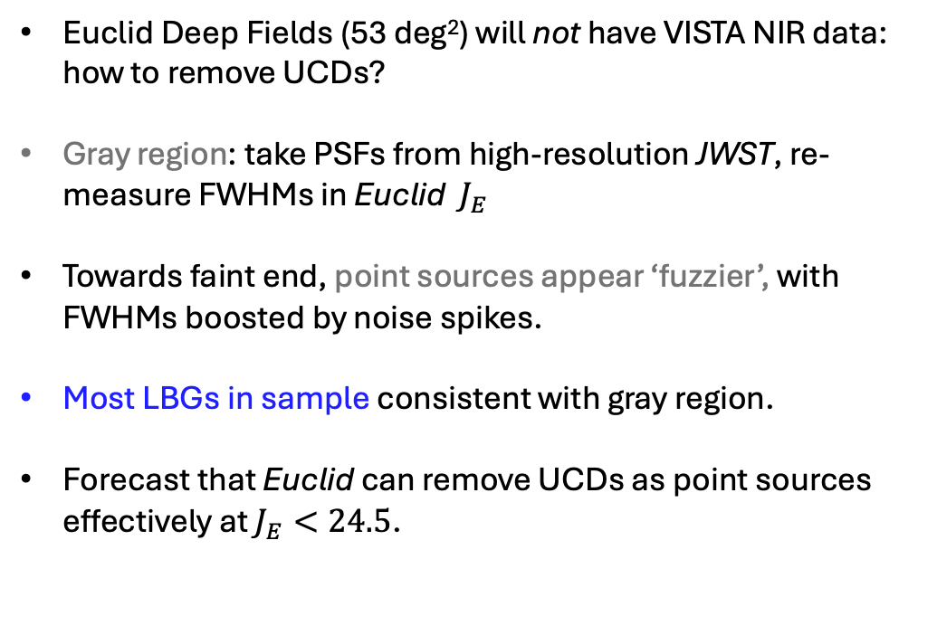
Can UCDs be removed as PSFs?
Bright
Faint
Euclid will discover 1000s of bright LBGs…
Euclid Deep Fields (53 deg²) will not have VISTA NIR data: how to remove UCDs?
Gray region: take PSFs from high-resolution JWST, re-measure FWHMs in Euclid $J_{E}$
Towards faint end, point sources appear ‘fuzzier’, with FWHMs boosted by noise spikes.
Most LBGs in sample consistent with gray region.
Forecast that Euclid can remove UCDs as point sources effectively at $J_{E}<24.5$.
LBGs
UCDs
Euclid Collaboration
(preliminary)
Size-magnitude relations at z=7

