Slide 1
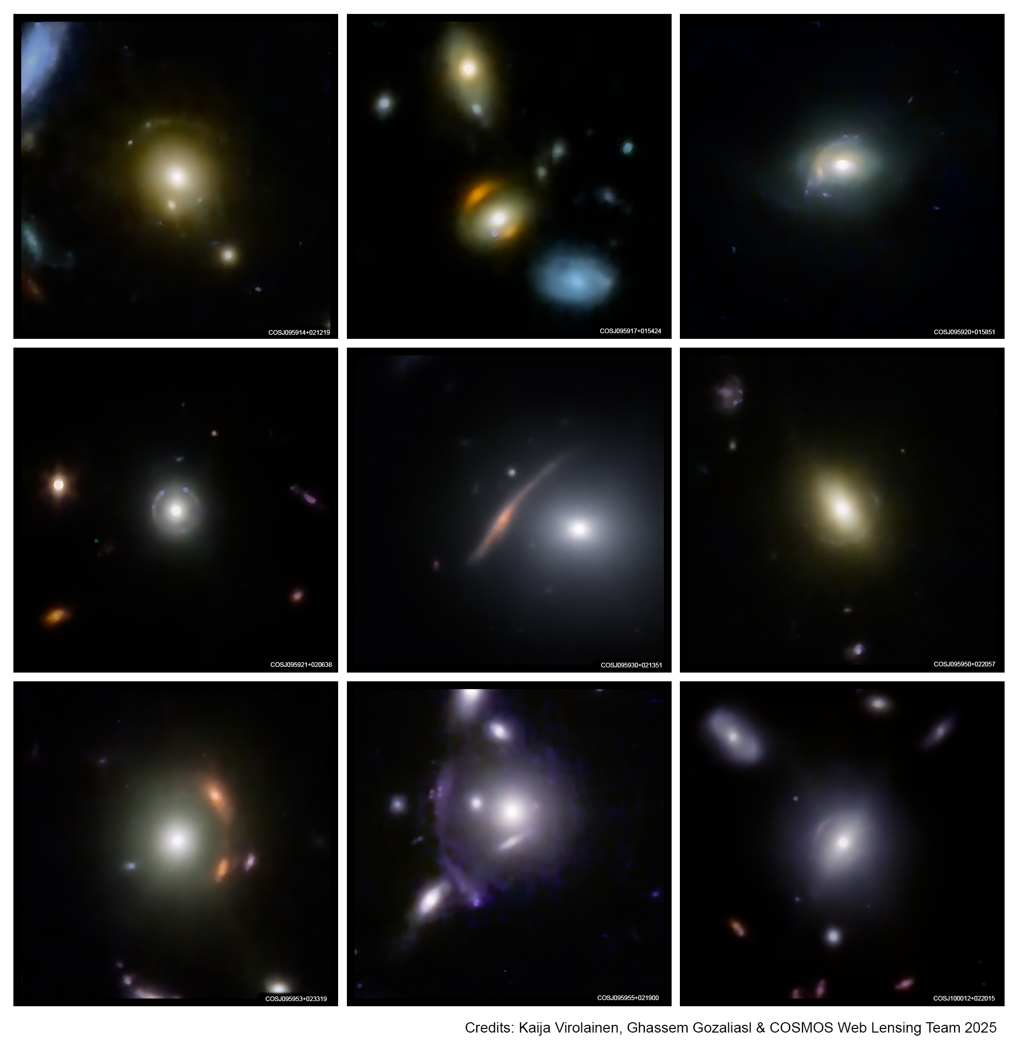
The COSMOS-Web Lens Survey (COWLS)
James Nightingale, COWLS SWG
Ernest Rutherford Fellow
www.jamesnightingale.net

Slide 2
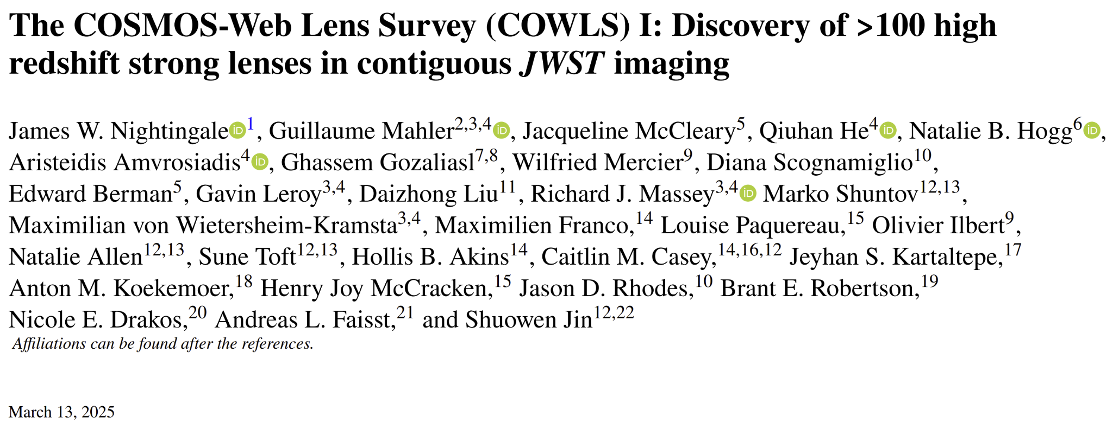

Slide 3
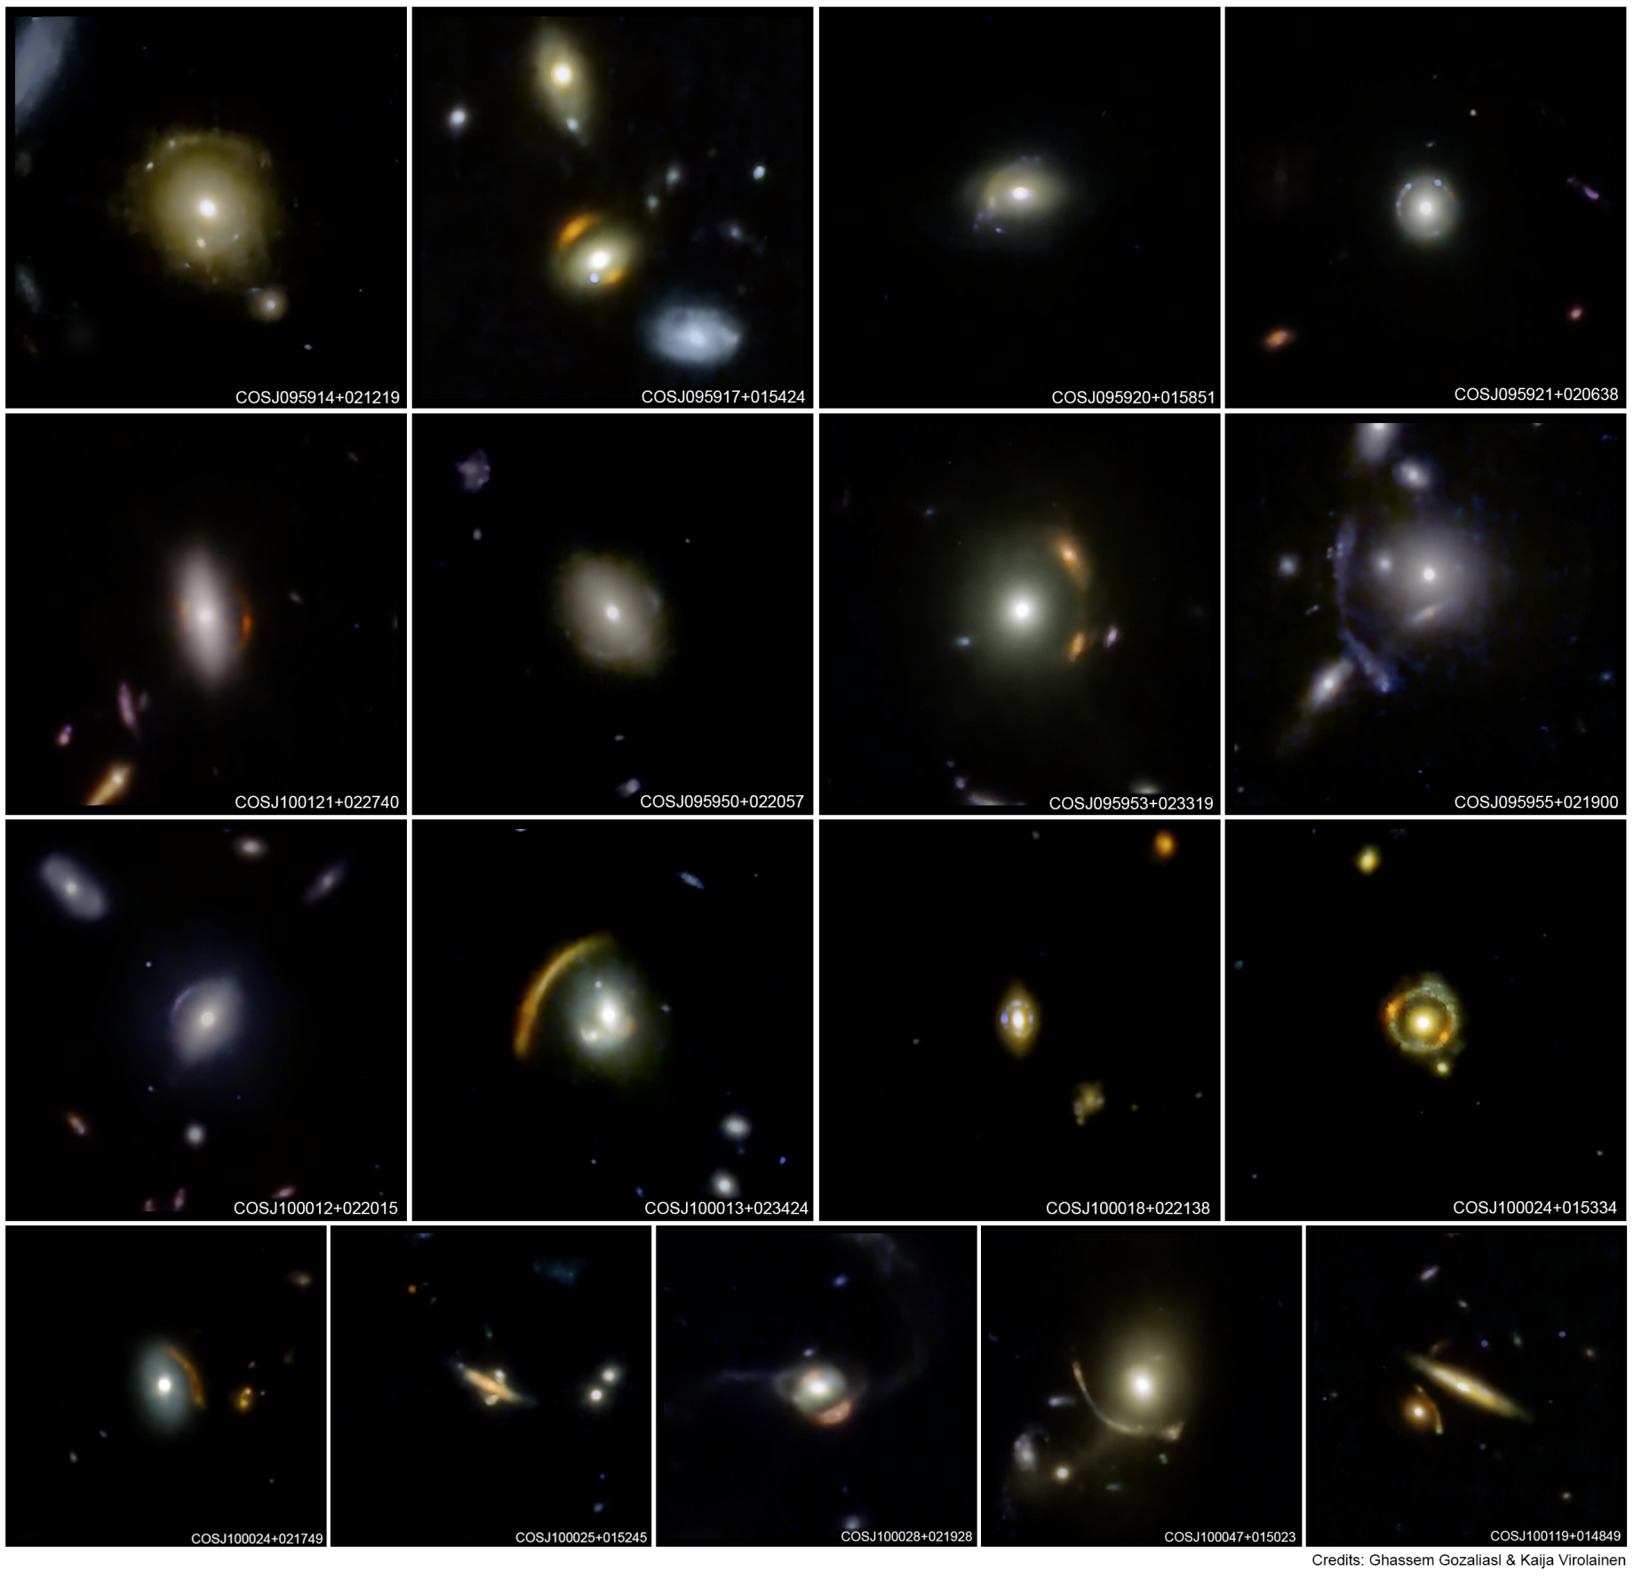

Slide 4
Lens Finding with JWST

Slide 5
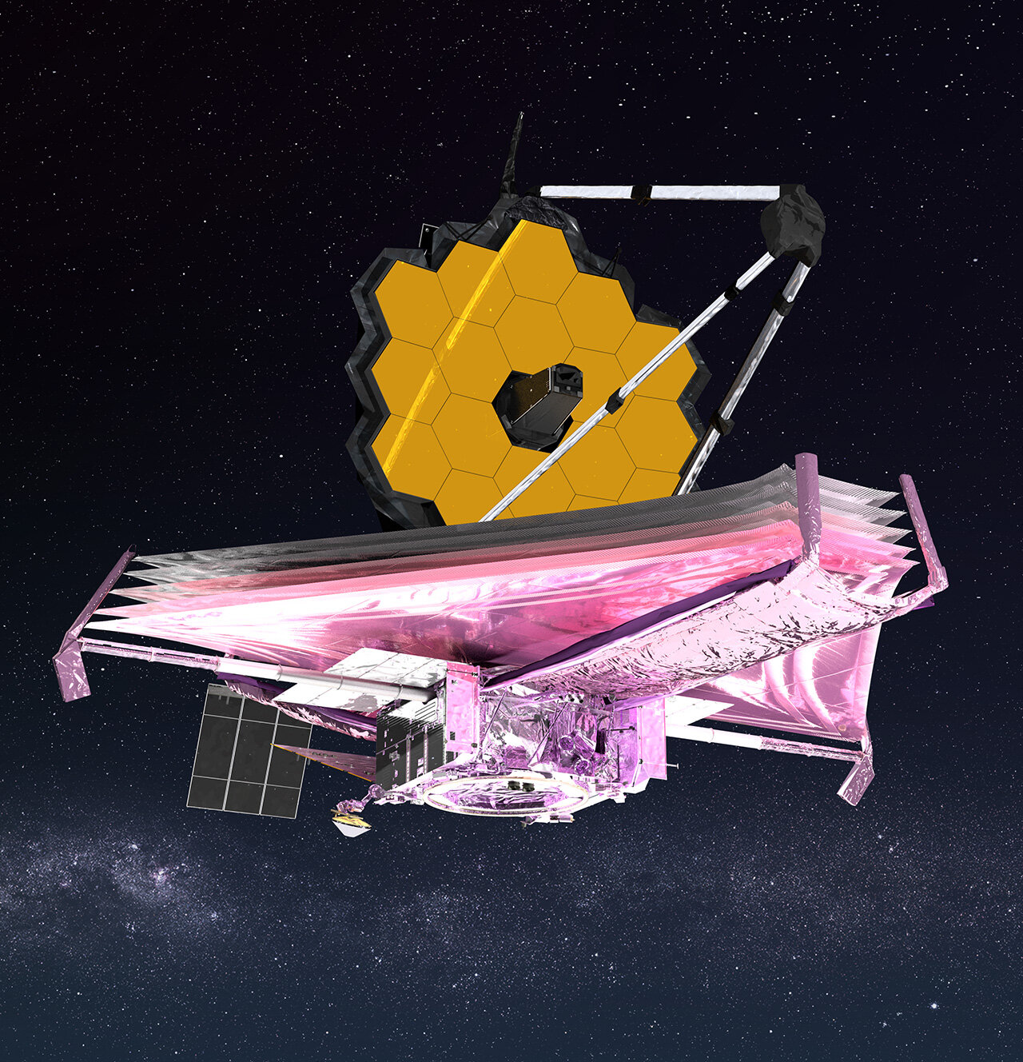
JWST
Unprecedented image quality and resolution means that simply pointing JWST at a small patch of the Universe will lead to the discovery of new strong gravitational lenses.

Slide 6
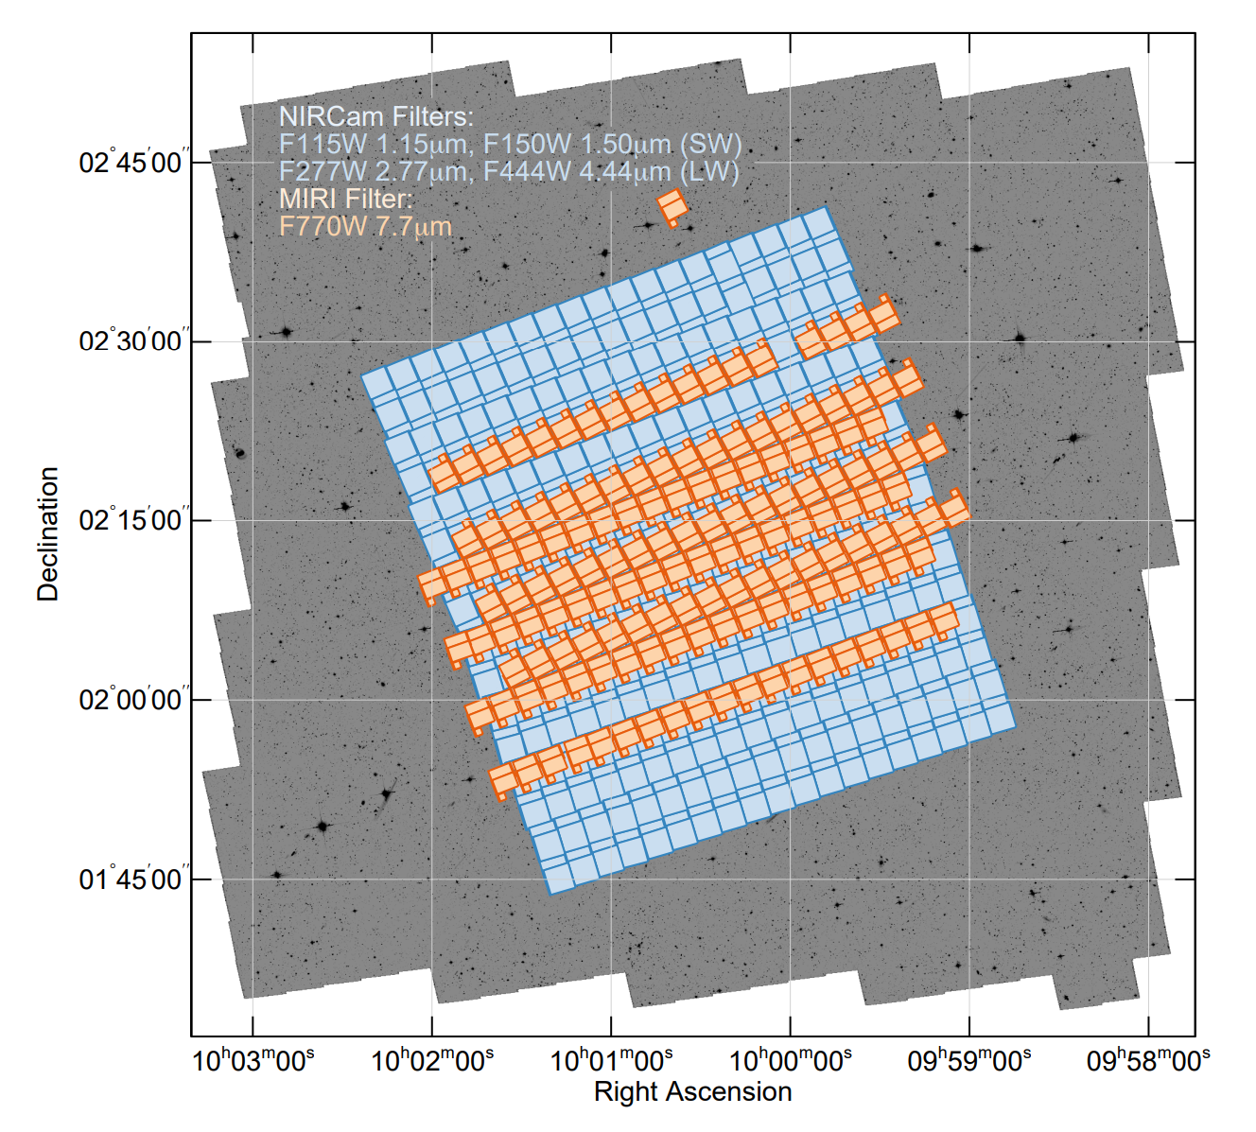
COSMOS-Web
A 0.54 deg^2 survey of JWST imaging overlapping the COSMOS fields.
It should contained of order 100 strong lenses!
If we find them, we get exquisite JWST imaging across 4+ wavebands for free.

Slide 7
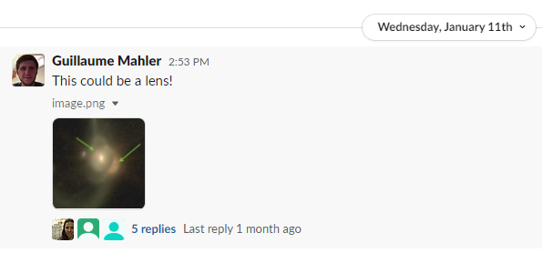
COSMOS-Web
First ~4% of COSMOS-Web data taken in January 2023:
First gravitational lens!
Next ~46% of data taken April 2023, remaining ~50% taken December 2023.

Slide 8
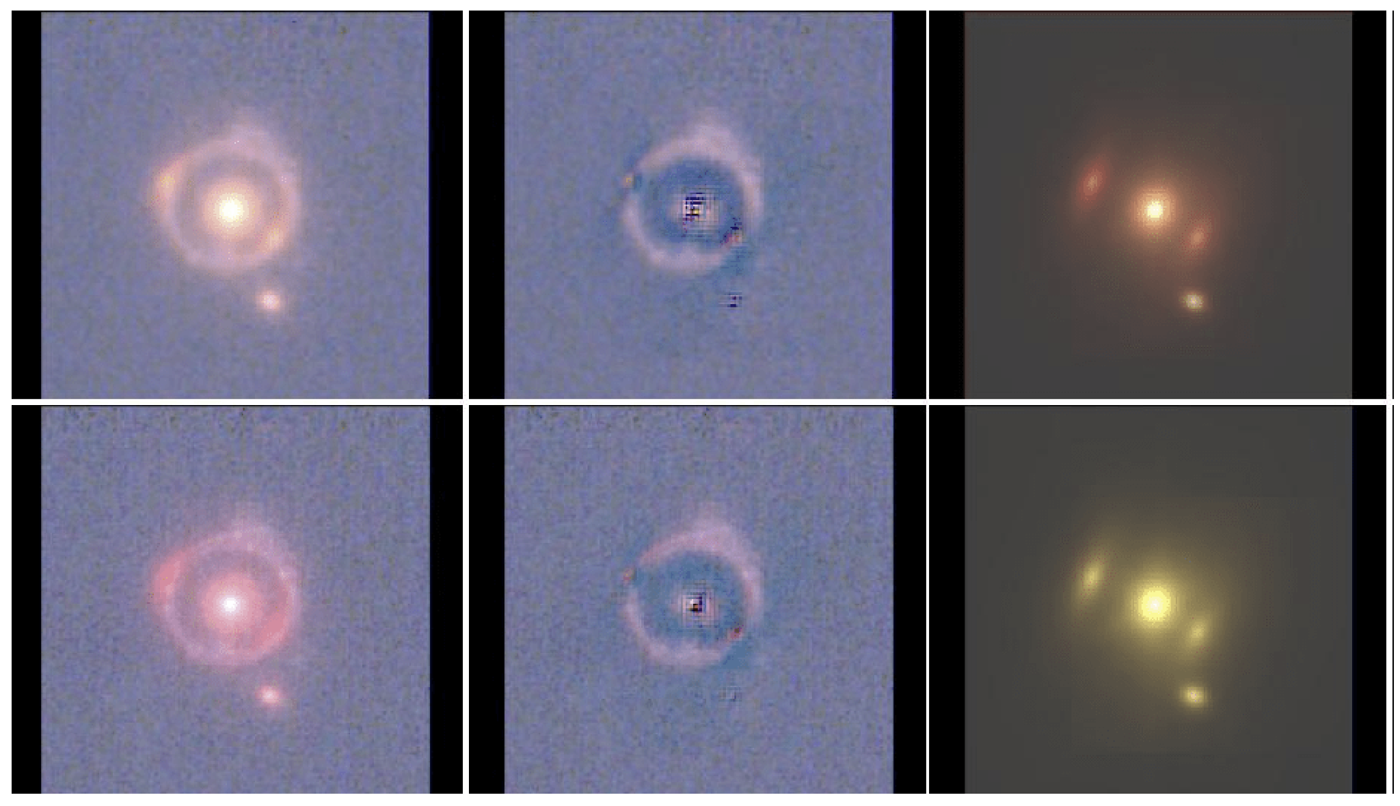
Visual Inspection Round 1
Team of 5 inspectors looked at ~43000 RGB images.
Include foreground lens light subtraction.

Slide 9
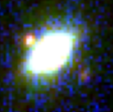
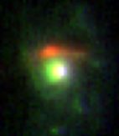
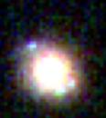
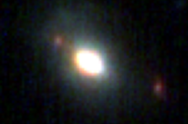
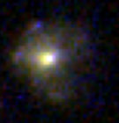
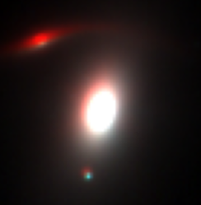
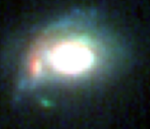
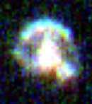
Visual Inspection Round 1
We found ~ 10 obvious lenses, but were expecting ~100.

Slide 10
Visual Inspection Round 1
We found ~ 10 obvious lenses, but were expecting ~100.
First Lesson: Distinguishing genuine strong lenses from contaminants via RGB images is really difficult with JWST.
This conclusion still holds after Euclid.

Slide 11
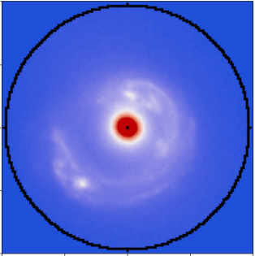
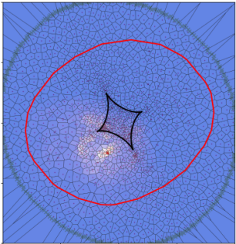
What Next?
Previous surveys used HST snapshot programs to confirm lenses.
We already have JWST data…
Obtaining spectra is also not going to be easy given the observed sources are faint.
Can lens modeling separate out most contaminants?

Slide 12
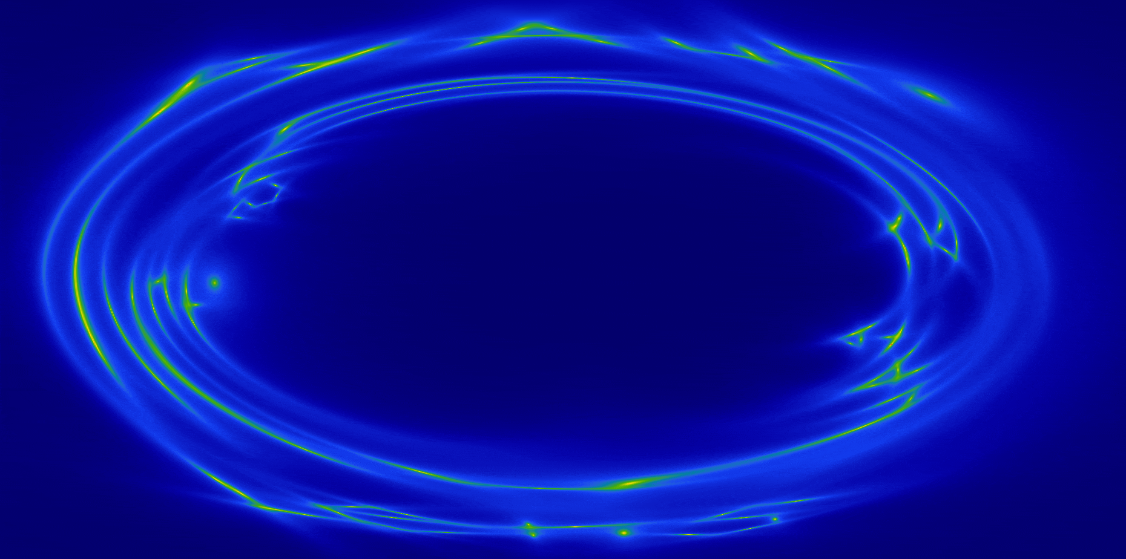
PyAutoLens: Open Source Gravitational Lensing
Open Source: 50+ publications since 2021 release: https://github.com/Jammy2211/PyAutoLens
[Nightingale et al 2015, 2018, 2021a]
Animation Credit: Amy Etherington

Slide 13
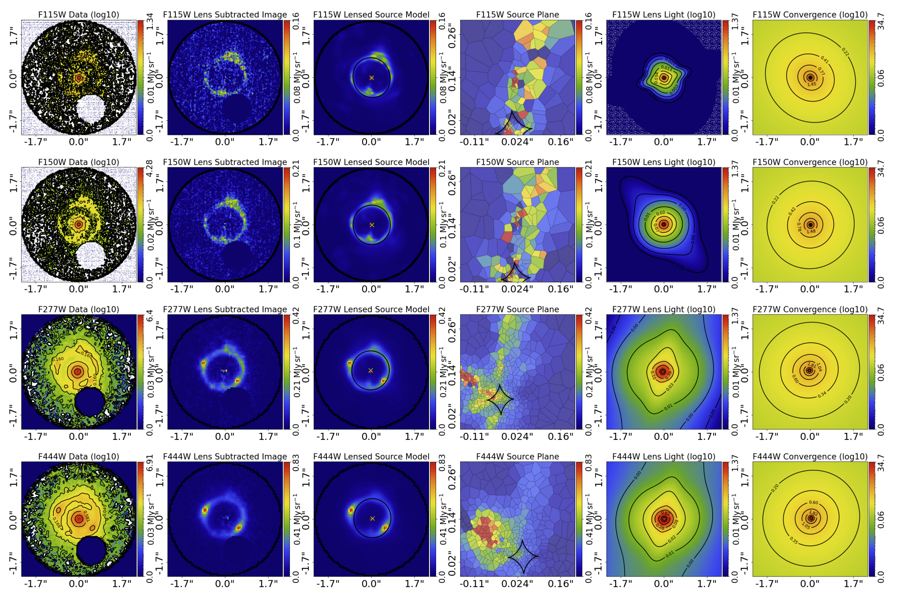
Visual Inspection Round 2
Uses lens modeling of ~450 best candidates to aid interpretation of strong lenses.

Slide 14
Revealing Images Behind Lens (that were visible)

Slide 15
Revealing Images Behind Lens (that were not visible)

Slide 16
Multi-Mutliple Image Pairing

Slide 17
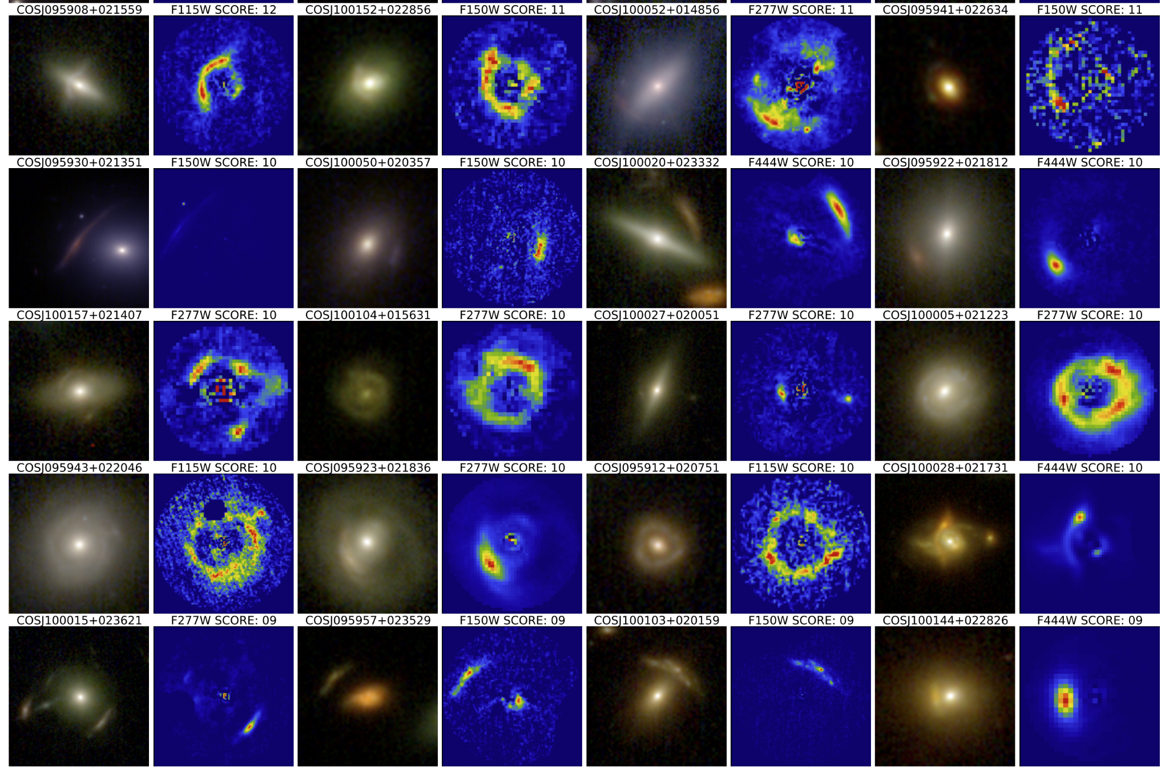
Visual Inspection Round 2
Second Lesson: Lens modeling is the best tool to separate strong lenses from contaminants with multi-band JWST imaging.
Lens modeling was not important for doing this in Euclid.

Slide 18
Lens Sample

Slide 20
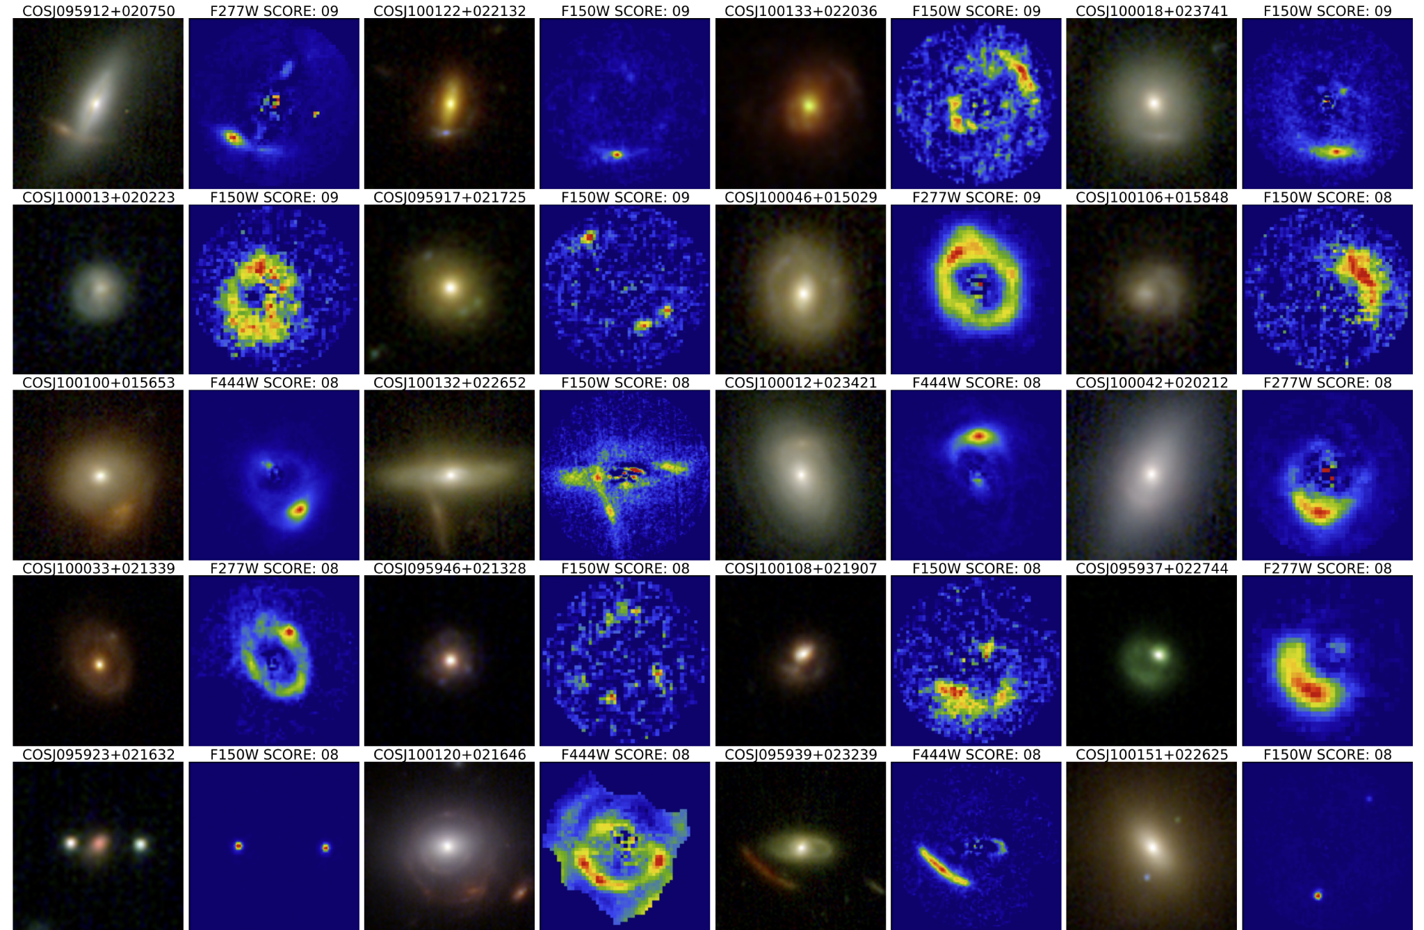

Slide 21
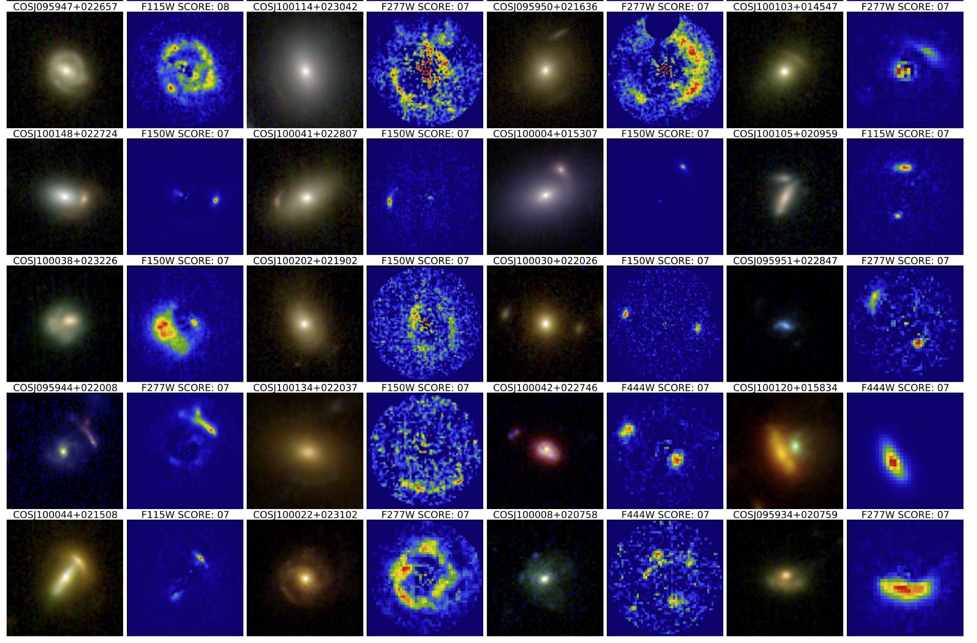

Slide 22
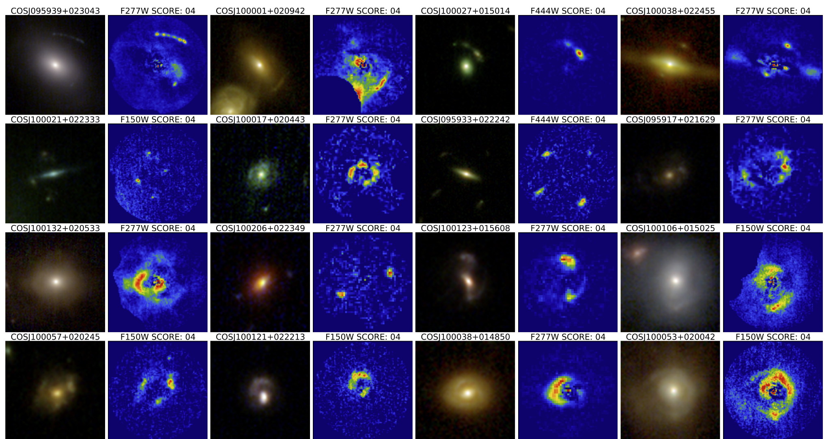
Low Scoring Candidates

Slide 23
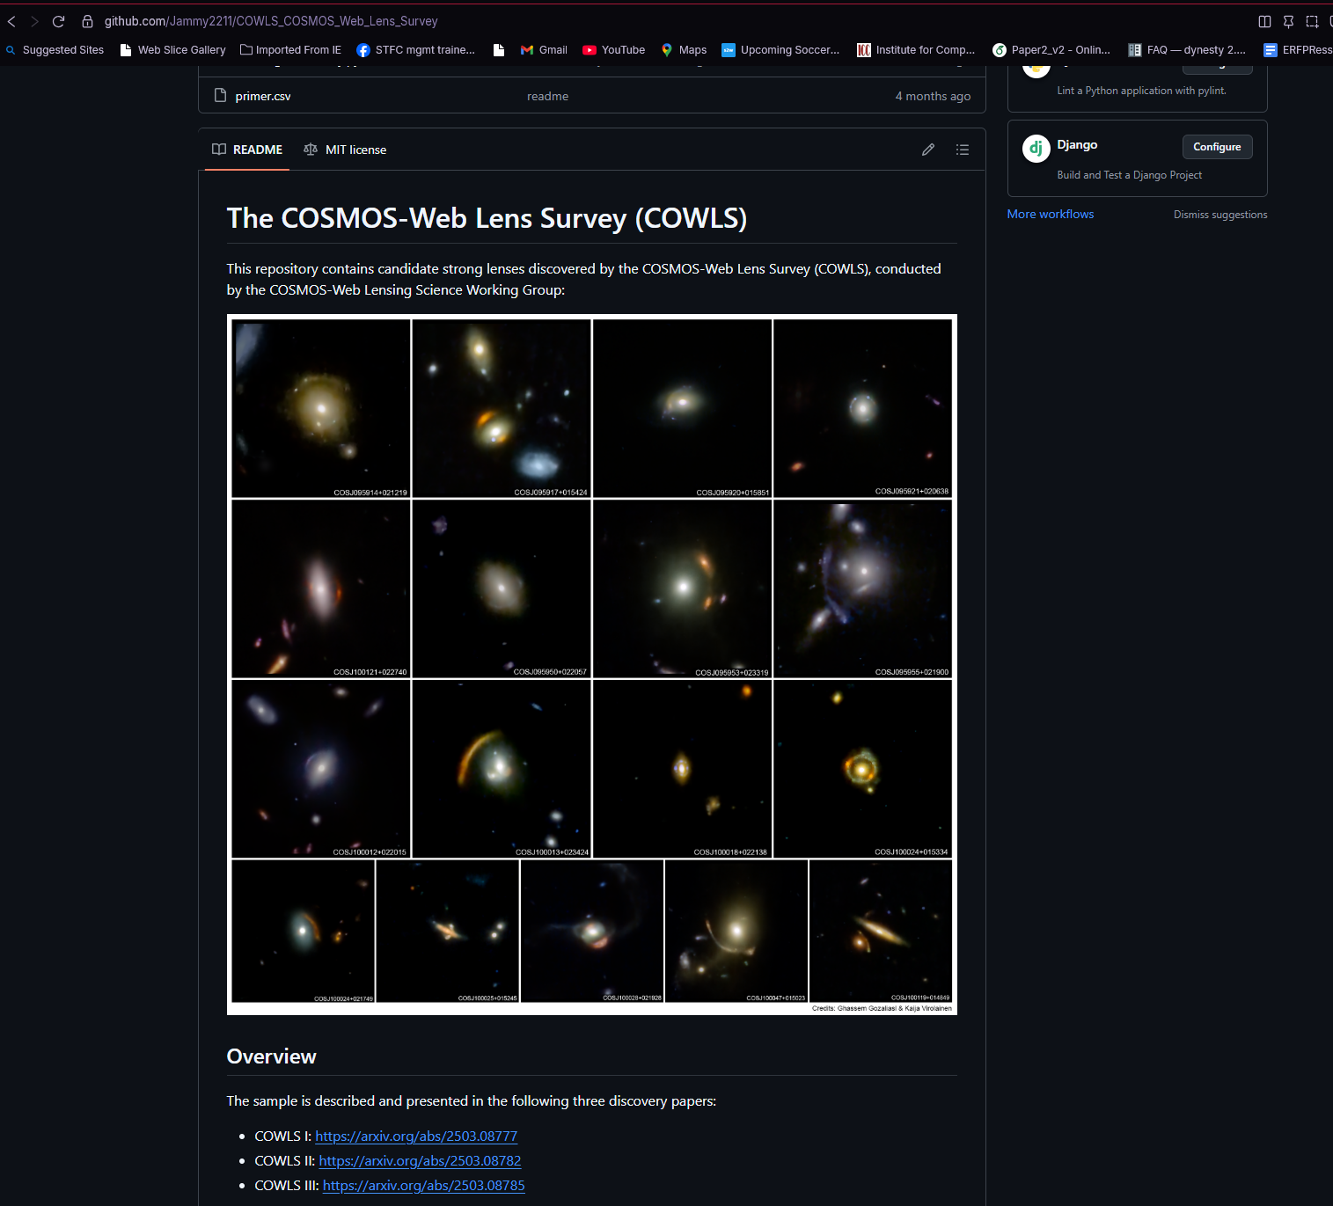
Public Catalogue
COWLS is the first strong lens sample with a mature public catalogue.
https://github.com/Jammy2211/COWLS_COSMOS_Web_Lens_Survey

Slide 24
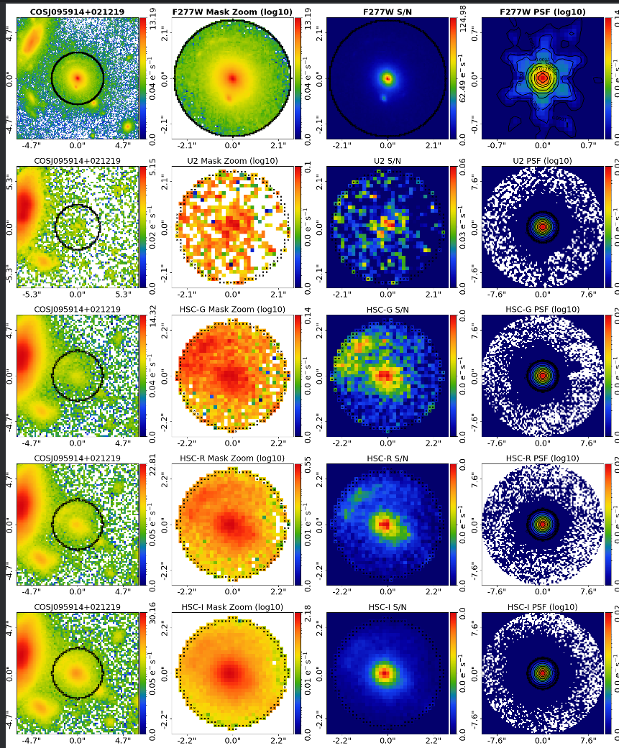
18+ Multiband Imaging
Incredible multi wavelength coverage of all COWLS lenses:
HST F814W, HSc, JWST MIRI, JWST NIRCam, IRAC, etc.
Hope for some photometric redshift information on sources!

Slide 25
Science

Slide 26
The “Most Everything” Lens Sample

Slide 27
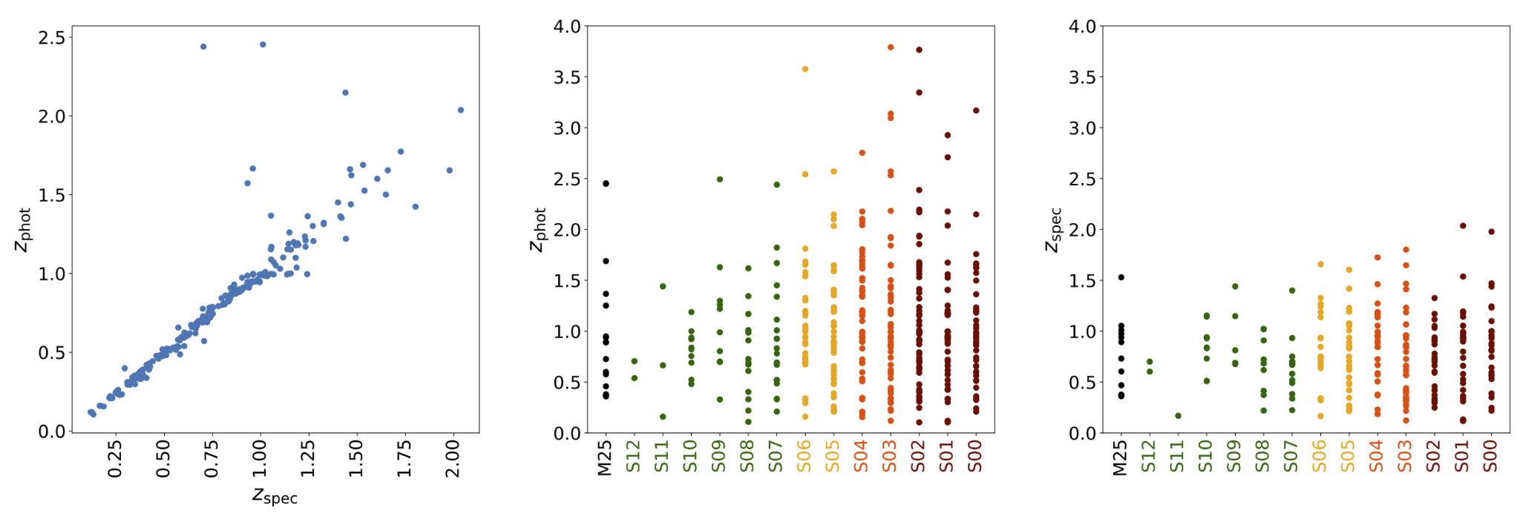
The “Most High” Lens Redshifts (z > 2)
Most low mass, most non-typical morphology (e.g. disks), etc.

Slide 28
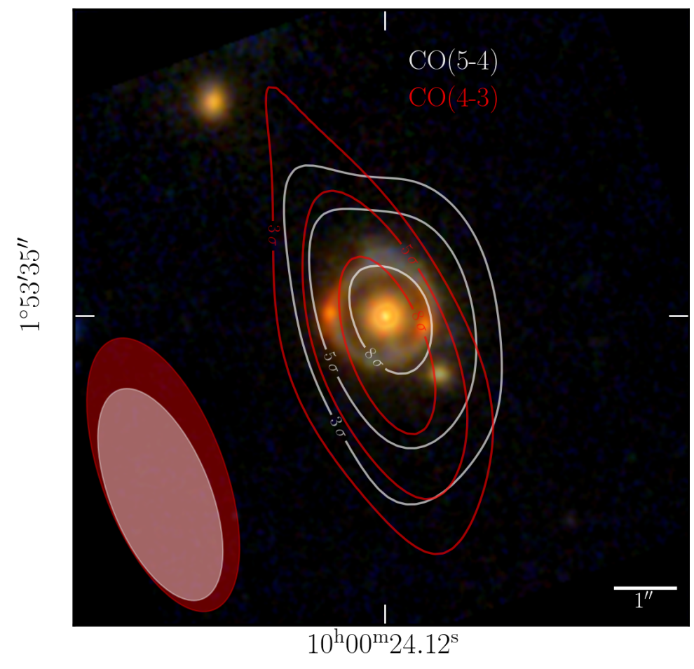
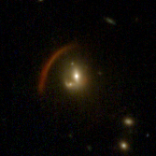
The “Most High” Source Redshifts (z > 5)
First two spectroscopic redshift confirmation of sources are both z > 5!
COWLS III forecast (Hogg et al 2025) predicts there are z > 6 sources, we just don’t know which ones!

Slide 29
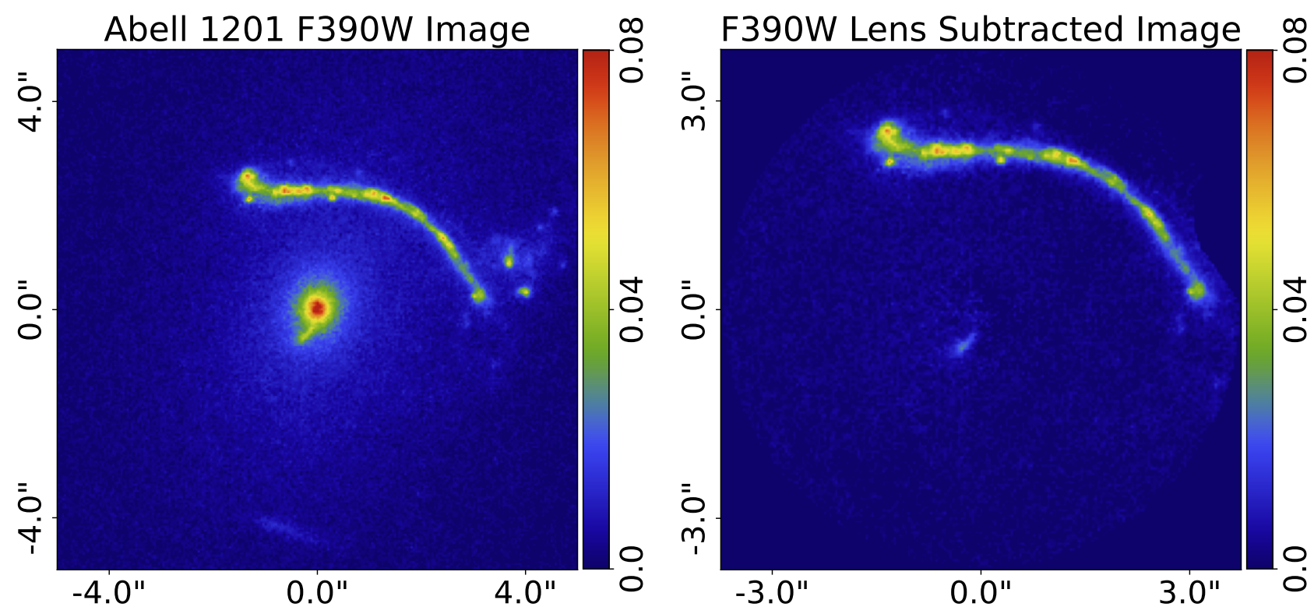
Supermassive Black Holes

Slide 30
Most close to the lens galaxy centre
Over 20 strong lenses where counter image is within 0.3” of lens centre.

Slide 31
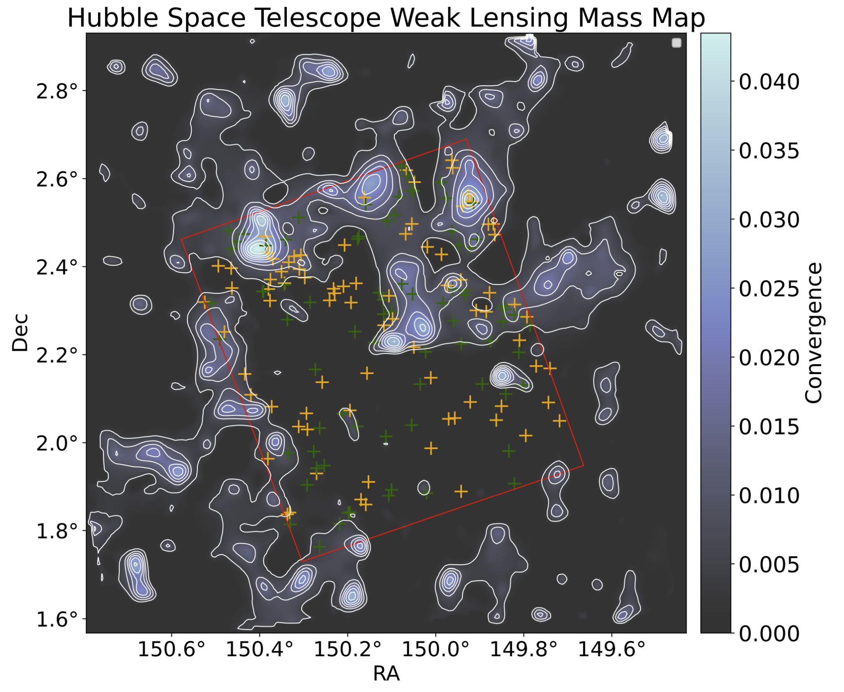
Most Contiguous
All lenses in a 0.54^deg patch of the Universe.
Enable unique studies of lens environment.
Huge potential to combine strong and weak lensing.

Slide 32
Most Dust Absorption
Clear evidence for dust absorption in the lens galaxy.
Seen via missing emission in the source emission over wavelength

Slide 33
Summary
Next Steps
Found > 100 strong lenses with properties unlike any previous or upcoming lens sample
Photomertric redshifts and spectroscopic confirmation of source galaxies.
Follow up imaging in other wavelengths (e.g. ALMA)
Use lens sample for science!

Slide 34
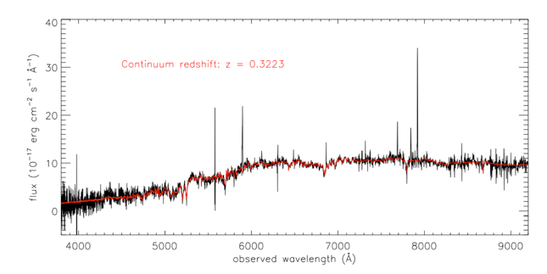
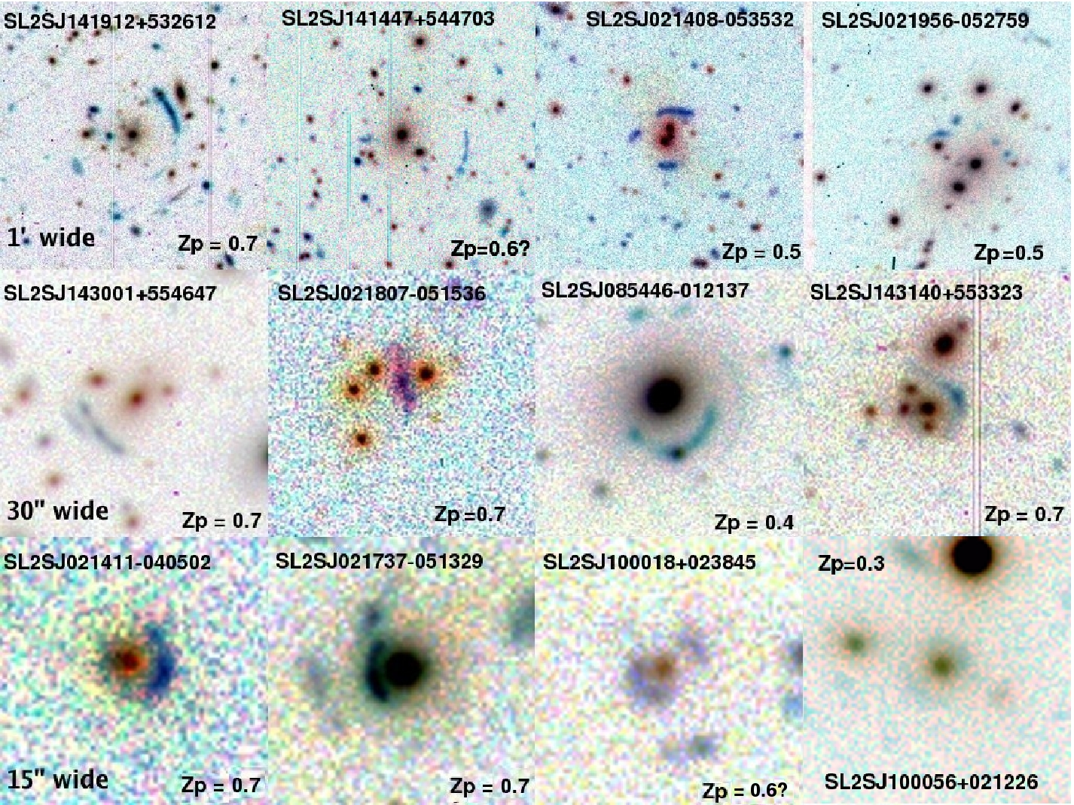
Lens Finding Pre JWST
Spectra based: Look for multiple emission lines in spectra of massive red galaxies (SLACS, BELLS, SWELLS).
Imaging based: Look for arcs / rings in wide-field ground based imaging surveys (SL2S, AGEL).
Spectroscopic Redshifts: Spectra based they come “for free” whereas follow up required for imaging based.

Slide 35
Imaging Based
Resolution: Low resolution of ground based surveys (CFHTLS, DES) limits lensing to largest Einstein Radius systems.
Signal to Noise: Limits surveys to bright and closer sources.
Multi-wavelength: Contrasting red lenses and blue sources key to finding.
Reliance of large area to overcome low lensing probability.

Slide 36
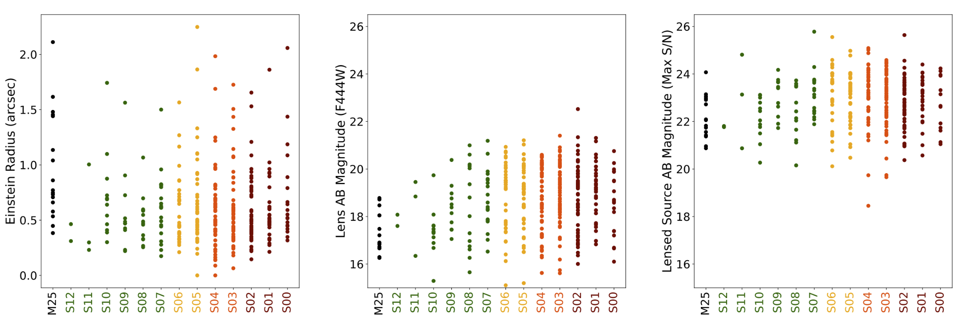
Einstein Radii / Magnitudes

Slide 37
Source Magnitude / Magnification / Stellar Mass

Slide 38
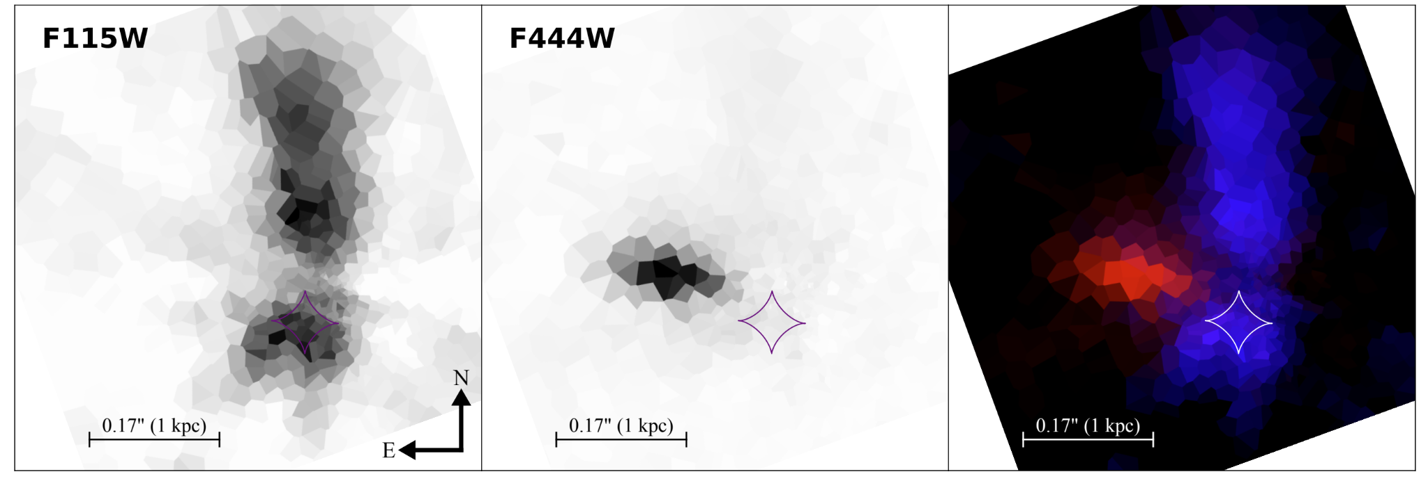
Source Science

