Slide 1
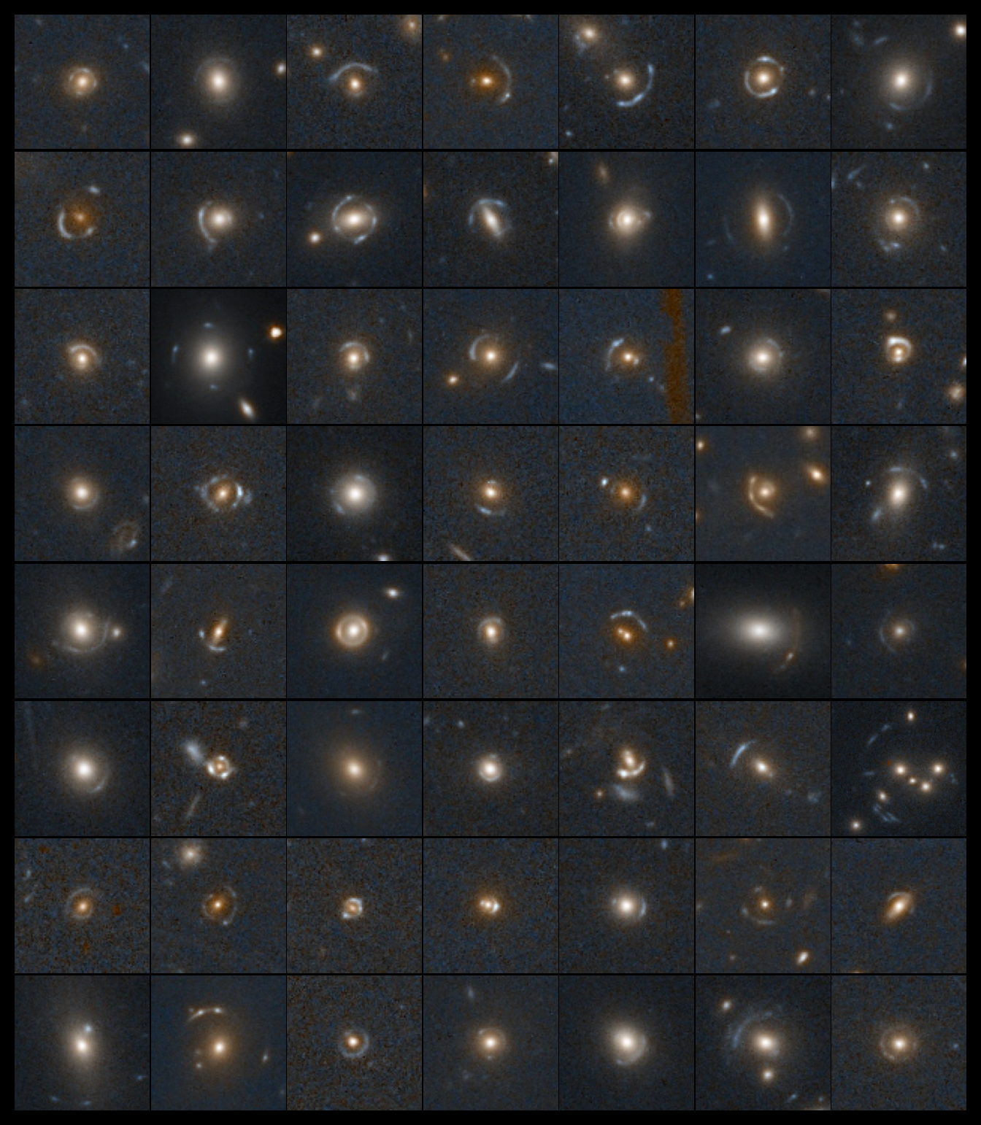


The roadmap to 100,000 strong lenses with Euclid
Natalie Lines
With: Tom Collett, Mike Walmsley, Karina Rojas, Tian Li, Phil Holloway, Aprajita Verma, James Nightingale,
Euclid Strong Lensing SWG, Zooniverse

Slide 2
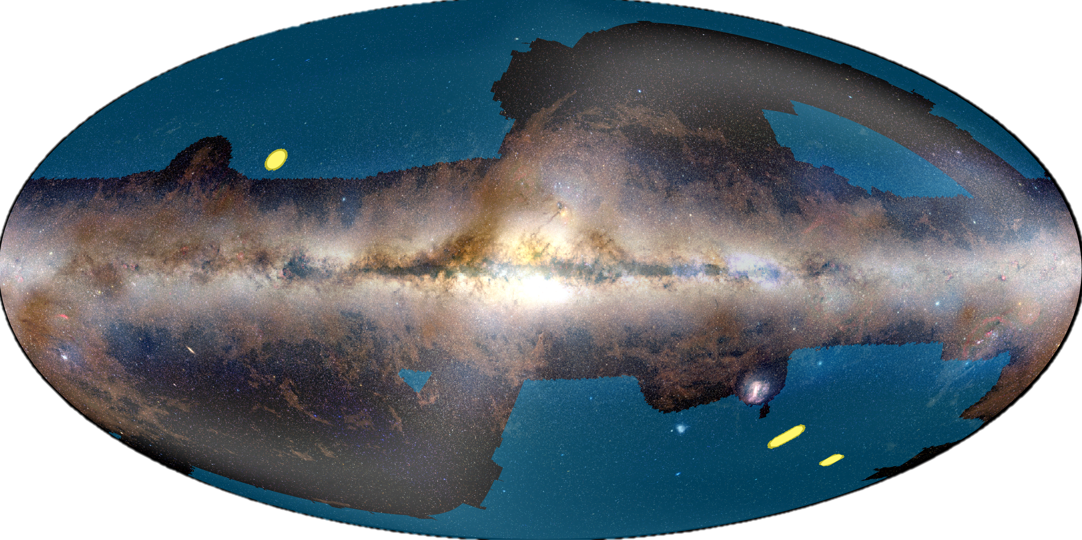
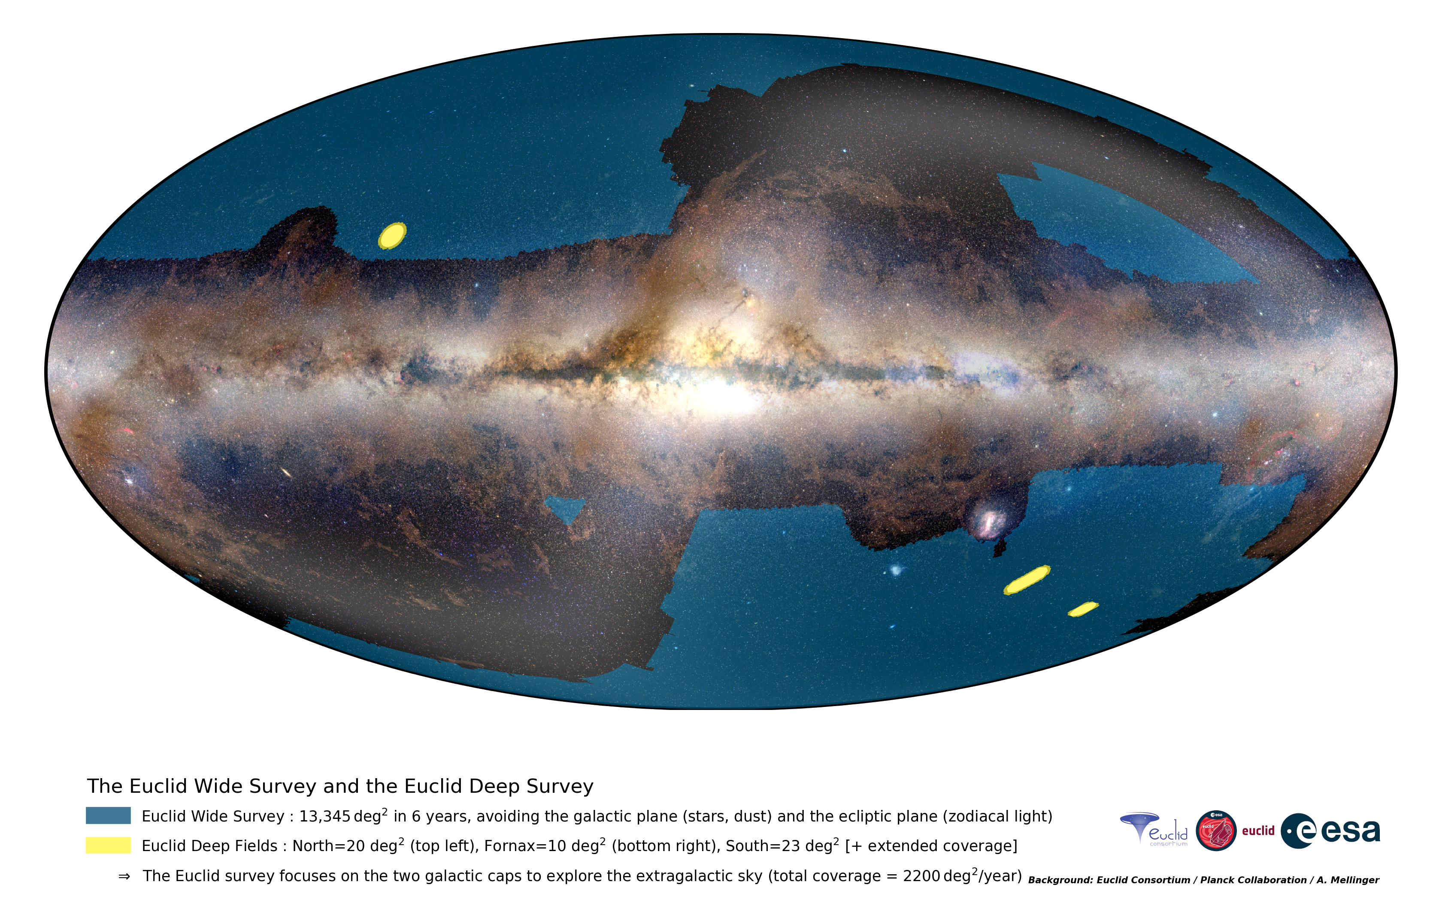
Euclid
Total survey area: ~14,000 deg²
0.16” resolution
Forecasted >100,000 strong lenses
(Collett 2015)
Natalie Lines, NAM 2025, 7th July
Notes:
Forecasted to revolutionise strong lensing a decade ago now,
But now Euclid is here!!!!
these q1 results are the first time we can see if these promises are true

Slide 3
Euclid
Q1:
7 days of data
63 deg²
0.45% of full survey
Total survey area: ~14,000 deg²
0.16” resolution
Forecasted >100,000 strong lenses
(Collett 2015)
Natalie Lines, NAM 2025, 7th July
Notes:
Forecasted to revolutionise strong lensing a decade ago now,
But now Euclid is here!!!!
these q1 results are the first time we can see if these promises are true

Slide 4
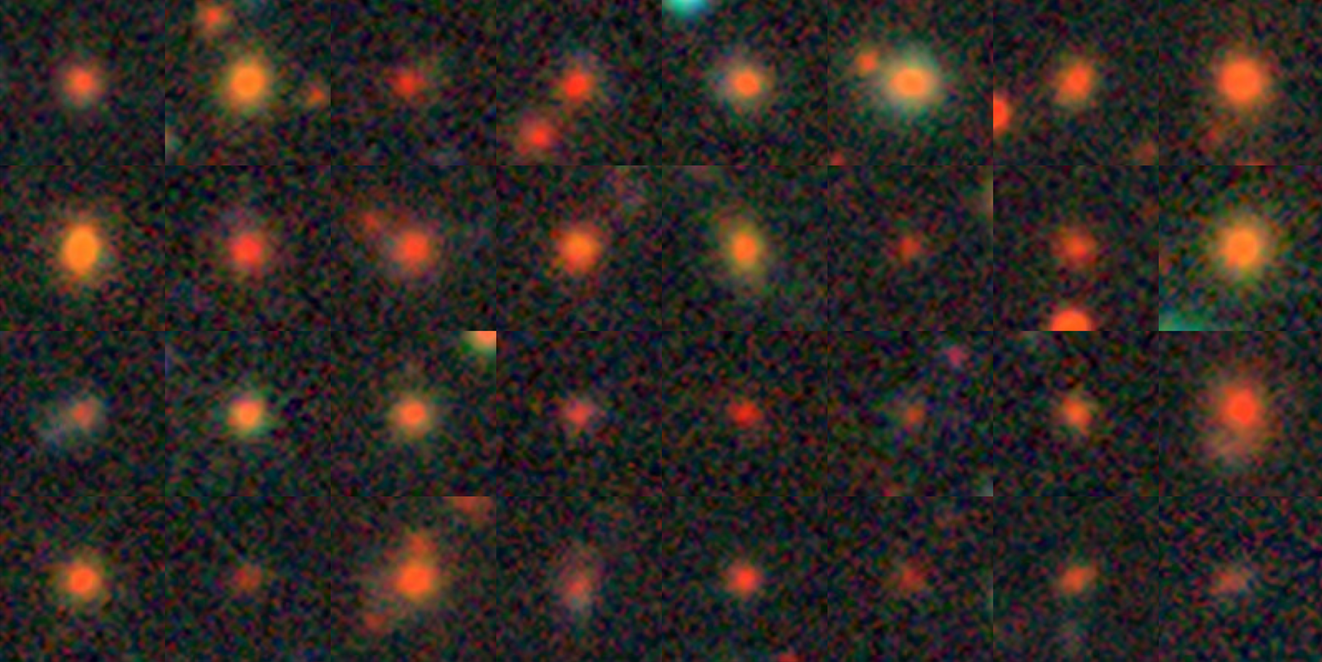
Euclid vs ground-based surveys
Natalie Lines, NAM 2025, 7th July
Images from Legacy Survey (North, BASS/MzLS)

Slide 5
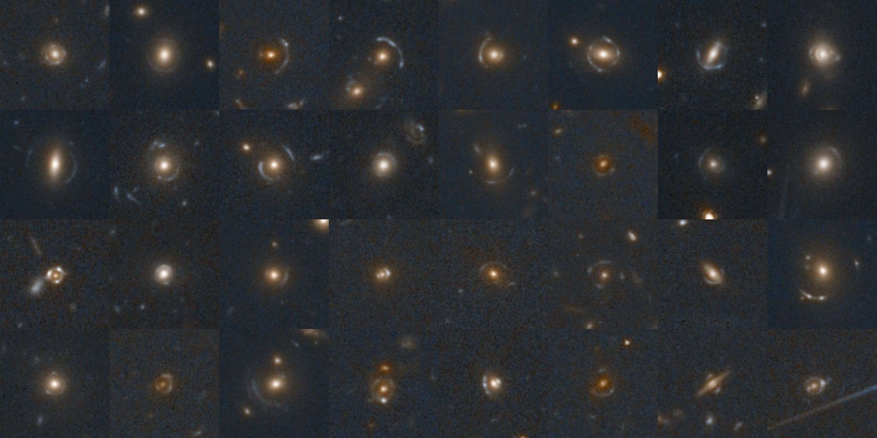
Euclid vs ground-based surveys
Natalie Lines, NAM 2025, 7th July
Images from Euclid Deep Field North

Slide 6
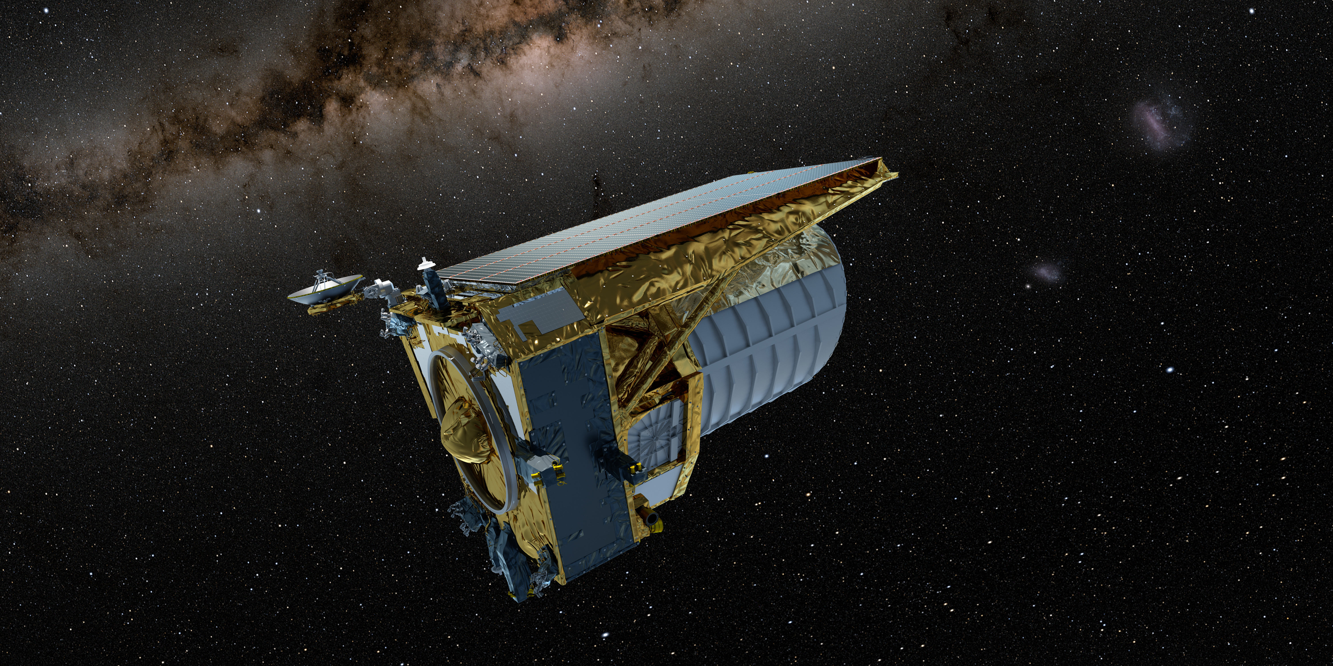
Search method
Natalie Lines, NAM 2025, 7th July

Slide 7
Euclid Q1 GGSL discovery engine
30 million Q1 sources
1 million VIS < 22.5
100,000 ranked highly by ML
Natalie Lines, NAM 2025, 7th July
7000 possible lenses according to citizens
500 grade A/B strong lenses graded by experts

Slide 8
Filtering candidates with Machine Learning
Combined five ML networks:
  Pre-trained CNN (Zoobot)
  Pre-trained vision transformer
  CNNs trained from scratch
Trained on simulated galaxy-galaxy Euclid lenses
Natalie Lines, NAM 2025, 7th July
Rojas et al. (2025)

Slide 9
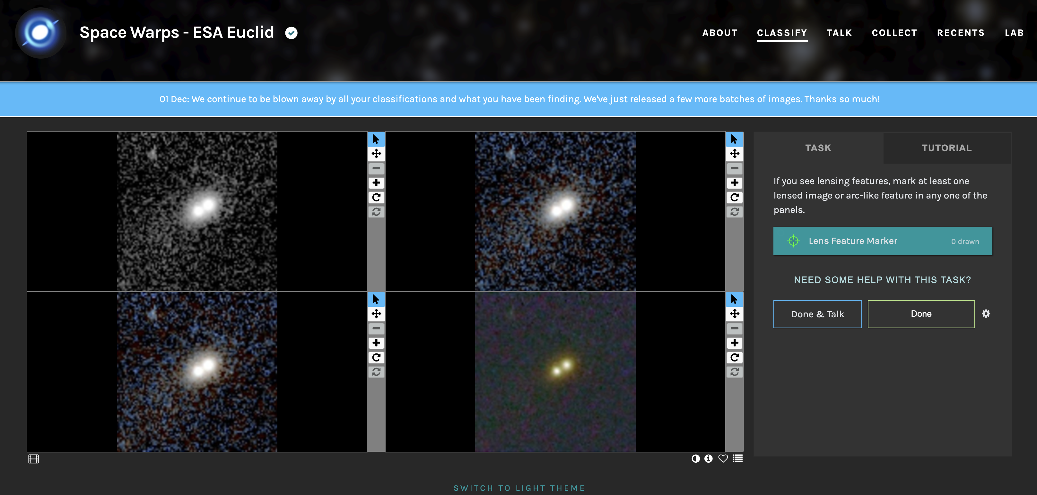
Visual inspection with citizen science
Natalie Lines, NAM 2025, 7th July

Slide 10
Results
Natalie Lines, NAM 2025, 7th July

Slide 11
500 new strong lens candidates
Natalie Lines, NAM 2025, 7th July
Notes:
largest catalogue of strong lenses with space-based imaging to date - rememeber this is only just the start for euclid

Slide 12
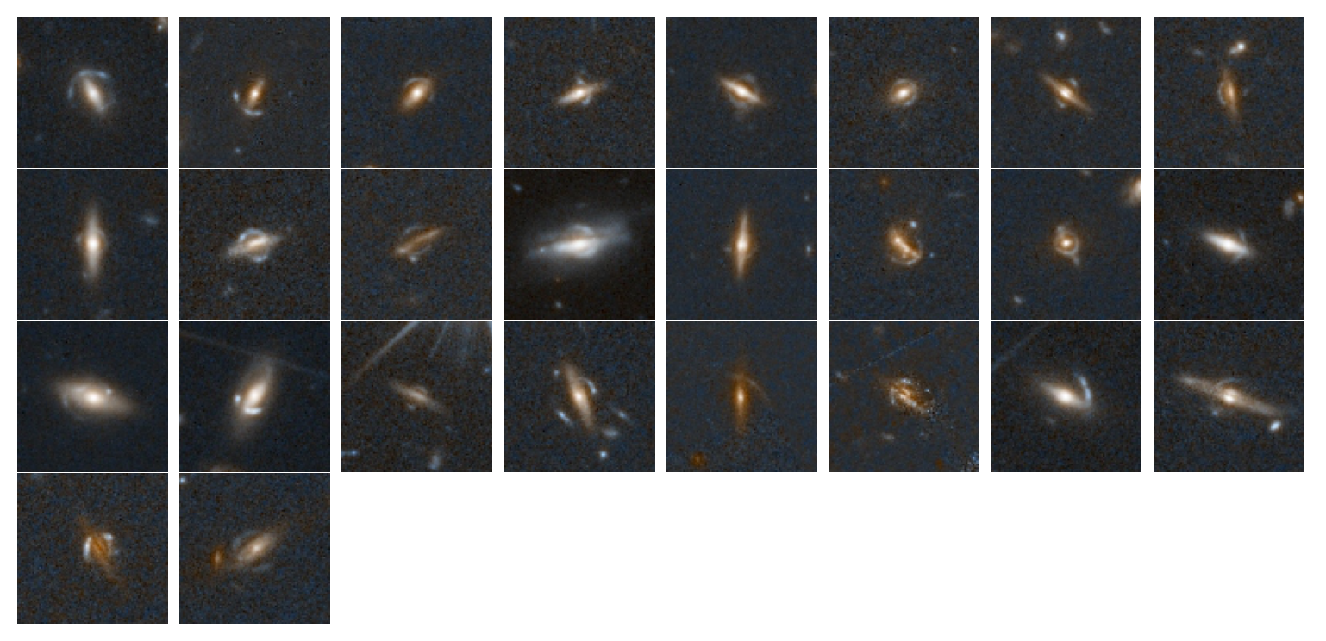
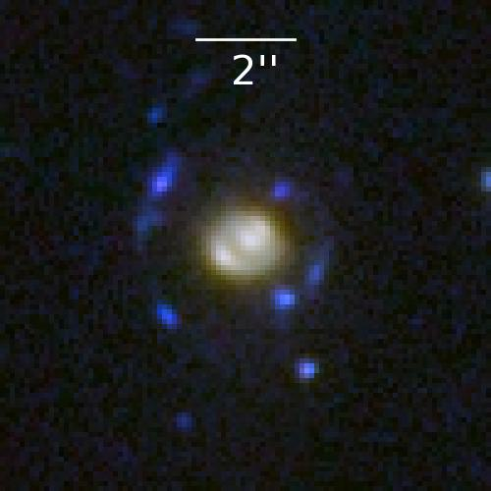
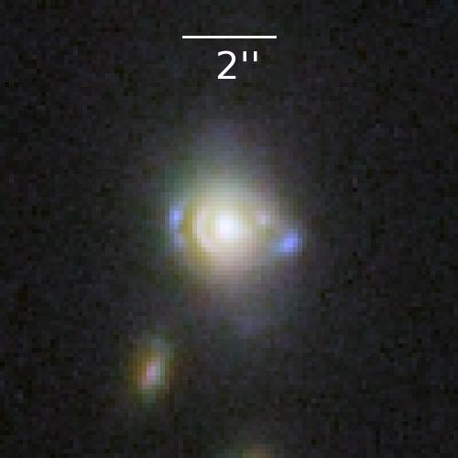
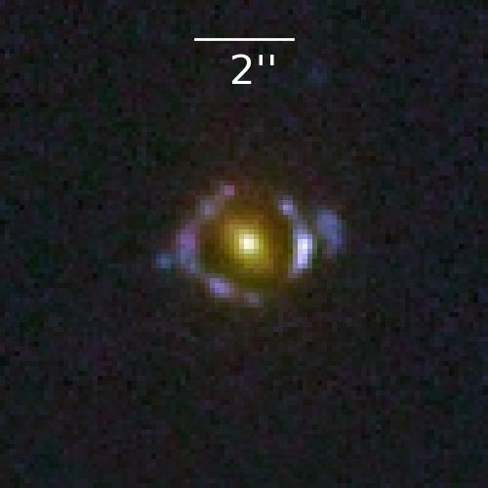
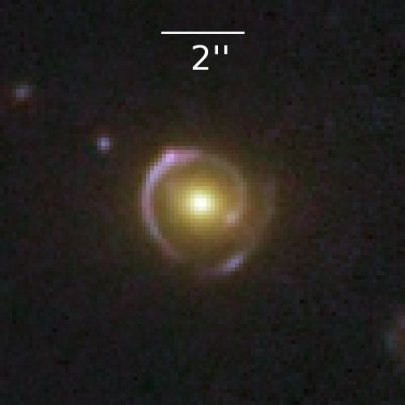
Compound lenses
Edge-on disc lenses
Natalie Lines, NAM 2025, 7th July
Li et al. (2025)
Notes:
ratio of einstein raddi is sensitive to cosoology so with large numbers of tese ou can constrain w
stronger probes of the density slope of the lens mass

Slide 13
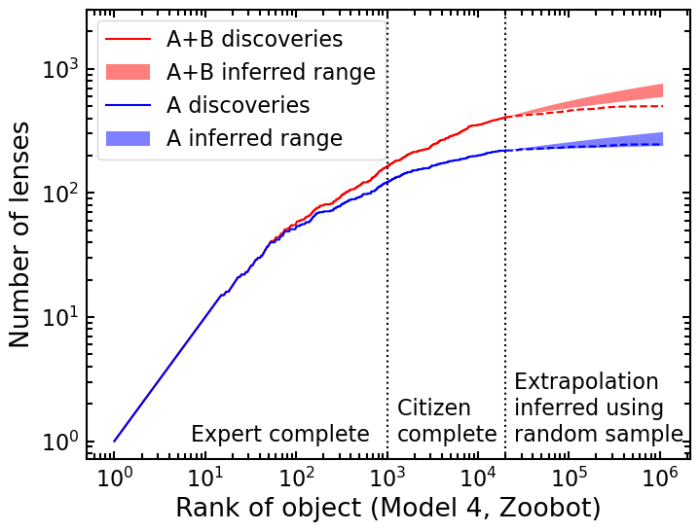
How many lenses did we miss?
Estimate lens frequency from visually inspecting 40k random Q1 objects
Likely found almost all grade A lenses
Missed ~200 grade B lenses

Slide 14
Scaling up by area
Q1
Area: 60 deg²
Lenses found: 500
(March 2025)
DR1
Area: 1900 deg²
Total lenses expected: 15 000
(October 2026)
Full survey
Area: 14 000 deg²
Total lenses expected: 110 000
(~2031)
Natalie Lines, NAM 2025, 7th July
Notes:
two orders of magnitude

Slide 15
Q1 = 63 deg²
(500 lenses)
Natalie Lines, NAM 2025, 7th July

Slide 16
Q1 = 63 deg²
(500 lenses)
Natalie Lines, NAM 2025, 7th July
DR1 = 1900 deg²
(~10,000 lenses)

Slide 17
Q1 = 63 deg²
(500 lenses)
DR1 = 1900 deg²
(~10,000 lenses)
Natalie Lines, NAM 2025, 7th July
Euclid Wide Survey = 14000 deg²
(~100,000 lenses)

Slide 18
Scaling up by area
Q1
Area: 60 deg²
Lenses found: 500
(March 2025)
DR1
Area: 1900 deg²
Total lenses expected: 15 000
(October 2026)
Full survey
Area: 14 000 deg²
Total lenses expected: 110 000
(~2031)
Natalie Lines, NAM 2025, 7th July
Visually inspecting 10% = 100k images
☺
Visually inspecting 10% = 3m images
😐
Visually inspecting 10% = 20m images
☹
Notes:
two orders of magnitude

Slide 19
Scaling up by area
Q1
Area: 60 deg²
Lenses found: 500
(March 2025)
DR1
Area: 1900 deg²
Total lenses expected: 15 000
(October 2026)
Full survey
Area: 14 000 deg²
Total lenses expected: 110 000
(~2031)
Natalie Lines, NAM 2025, 7th July
Visually inspecting 10% = 100k images
☺
Visually inspecting 10% = 3m images
😐
Visually inspecting 10% = 20m images
☹
Need to compensate with ML improvement
Notes:
two orders of magnitude

Slide 20
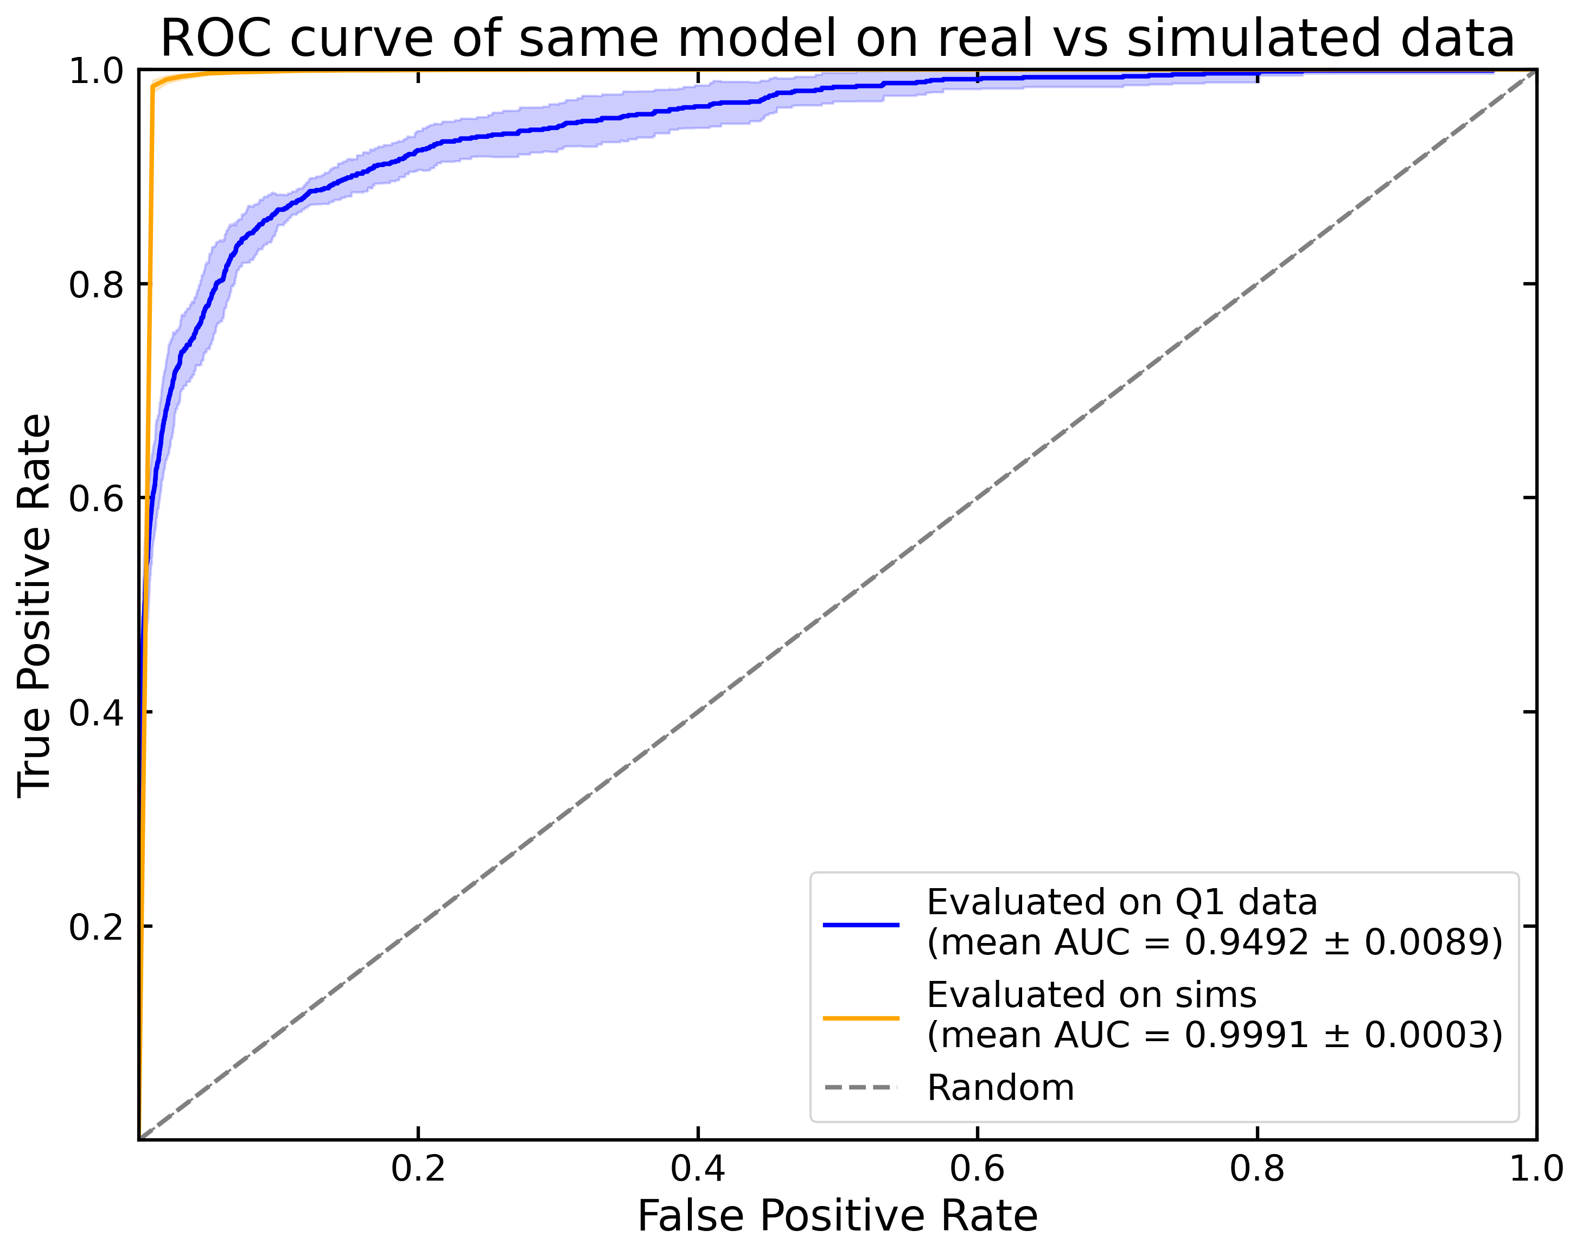
The simulation/real data gap
Significant discrepancy between performance
Scope for significant ML improvement with real lenses
Natalie Lines, NAM 2025, 7th July
Notes:
two orders of magnitude

Slide 21
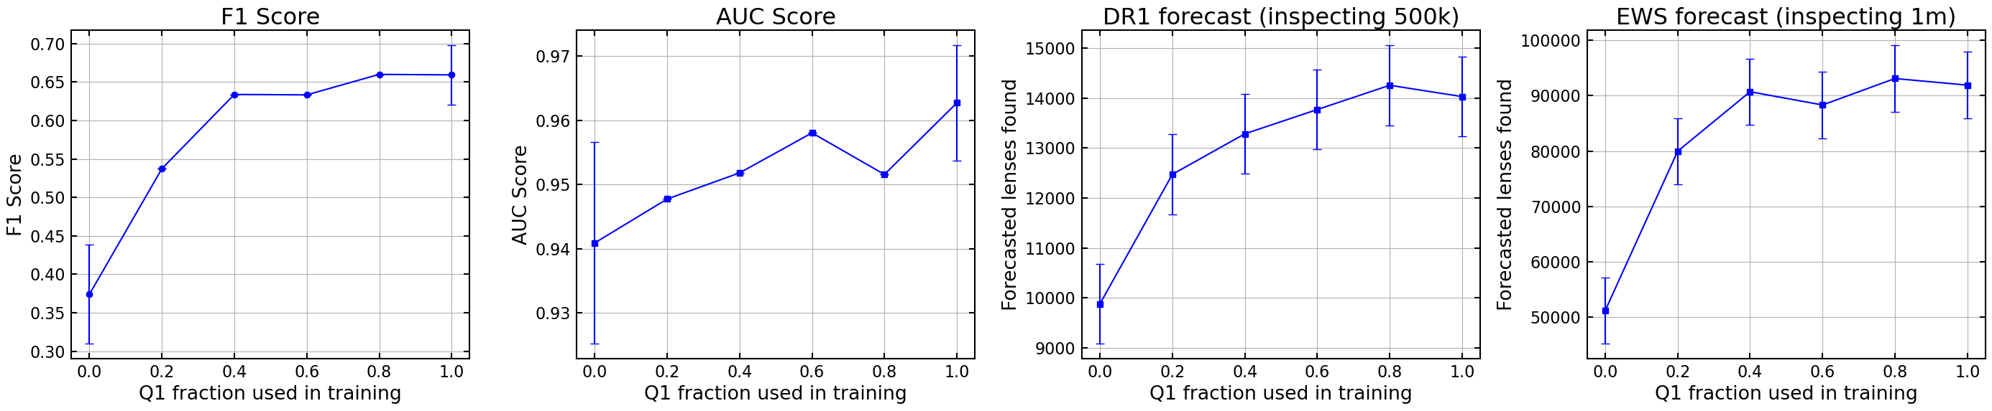
Adding Q1 lenses to ML training data
Adding real lenses/non-lenses leads to significant improvement
Potential further improvement as we find more lenses
Expecting to discover the large majority of Euclid lenses

Slide 22
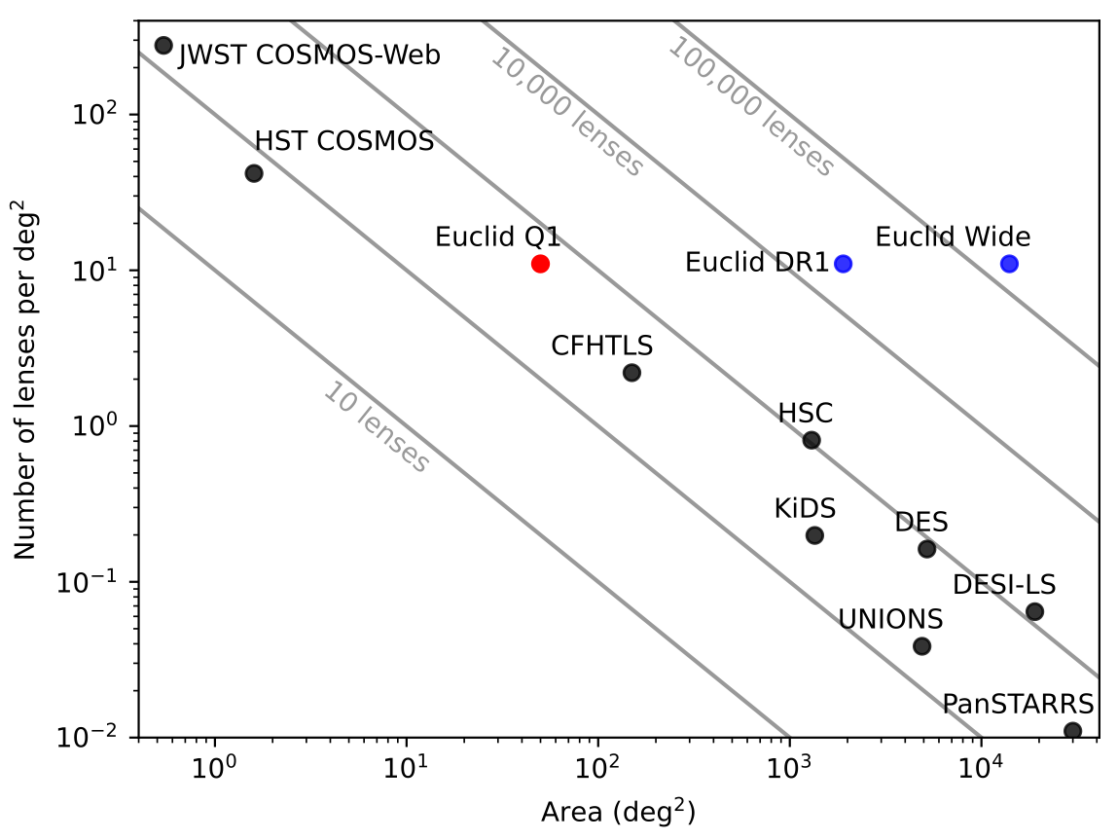
Natalie Lines, NAM 2025, 7th July
Notes:
100,000 strong lenses will revolutionise blah blah

Slide 23
Summary
Q1 Papers:
  A: Overview and Catalogue, M. Walmsley et. al. 2025
  (arXiv:2503.15324)
  B: Early Strong Lens Candidates from Visual Inspection, K. Rojas et. al. 2025 (arXiv:2503.15325)
  C: Finding Lenses with Machine Learning, N. Lines et. al. 2025 (arXiv:2503.15326)
  D: Double Source Plane Lens Candidates, Li et. al. 2025 (arXiv:2503.15327)
  E: Ensemble Classification of Strong Gravitational Lenses, Holloway et. al. 2025 (arXiv:2503.15328)
Natalie Lines, EAS Meeting, 27th June
Q1 lenses and modelling results publicly available: doi.org/10.5281/zenodo.15003116
Notes:
100,000 strong lenses will revolutionise blah blah

Slide 24
Natalie Lines, NAM 2025, 7th July

Slide 25
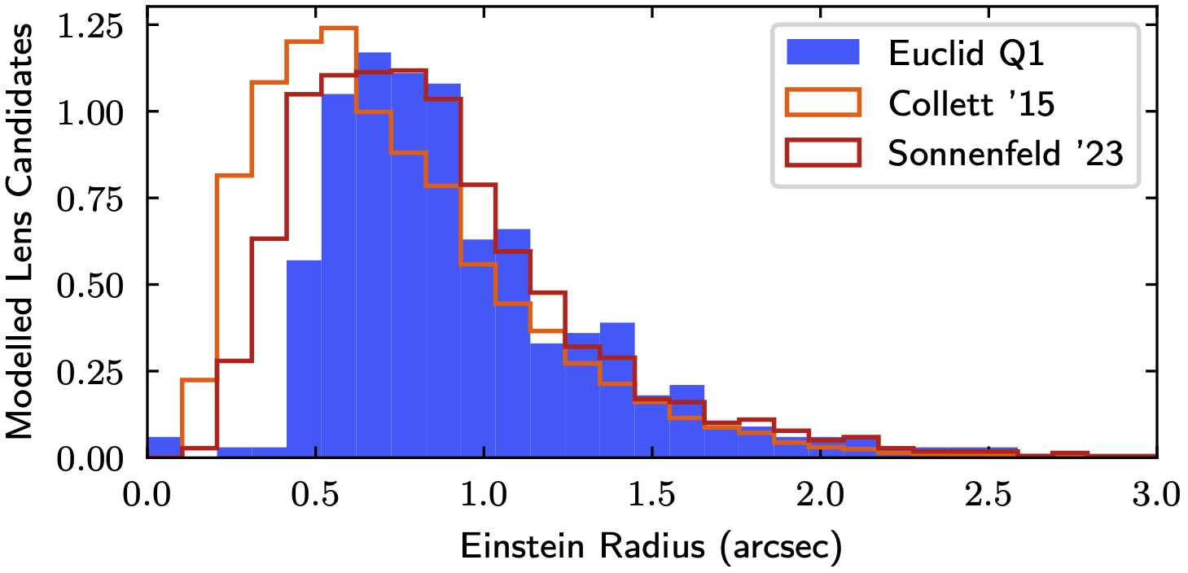
PyAutoLens modelling
Successful fit, likely lens: 315/374
Successful fit, unlikely lens: 59/374
Unsuccessful fit, likely lens: 80
Natalie Lines, NAM 2025, 7th July
Walmsley et al. (2025)

Slide 26
4 new double-source plane lenses
Natalie Lines, NAM 2025, 7th July

Slide 27
Natalie Lines, NAM 2025, 7th July

