Slide 1


The SCALES slenslit: a novel integral field unit concept for Exoplanet characterisations
Session #72: The Future of Exoplanet Detection
9 July 2025
Centre for Advanced Instrumentation
Cyril Bourgenot, David Bramall, Jurgen Schmoll, James Wells, Paul White, David Ryder, Levon Bainbridge, Laureen Pradeel
University of California - Santa Cruz
Andrew J. Skemer, R. Deno Stelter, Renate Kupke, Stephanie Sallum, Daren Dillon, Isabel J. Kain, Cristian A. Rodriguez, Nicholas K. MacDonald, Michael Gonzales, Athira Unni, Raquel A. Martinez
Notes:
Good morning. I’m Cyril Bourgenot from the Centre for Advanced Instrumentation in Durham, and today I’ll present a novel integral field concept developed collaboratively between Durham and UCSC for high-contrast exoplanet spectroscopy — the SCALES slenslit

Slide 2
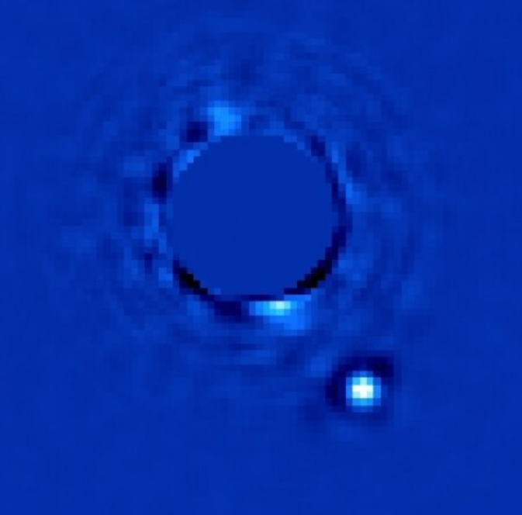
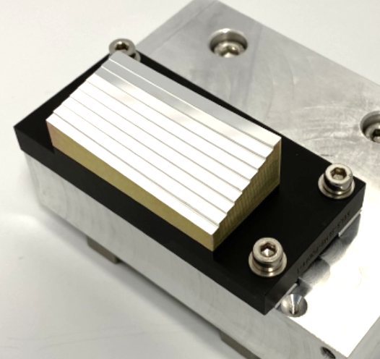
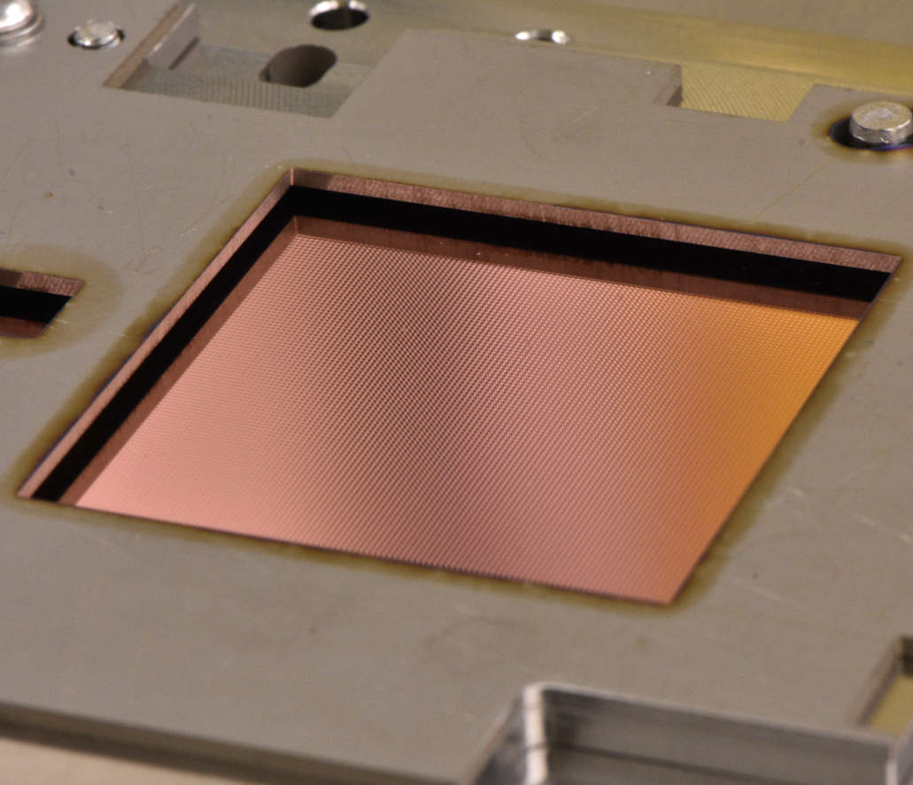
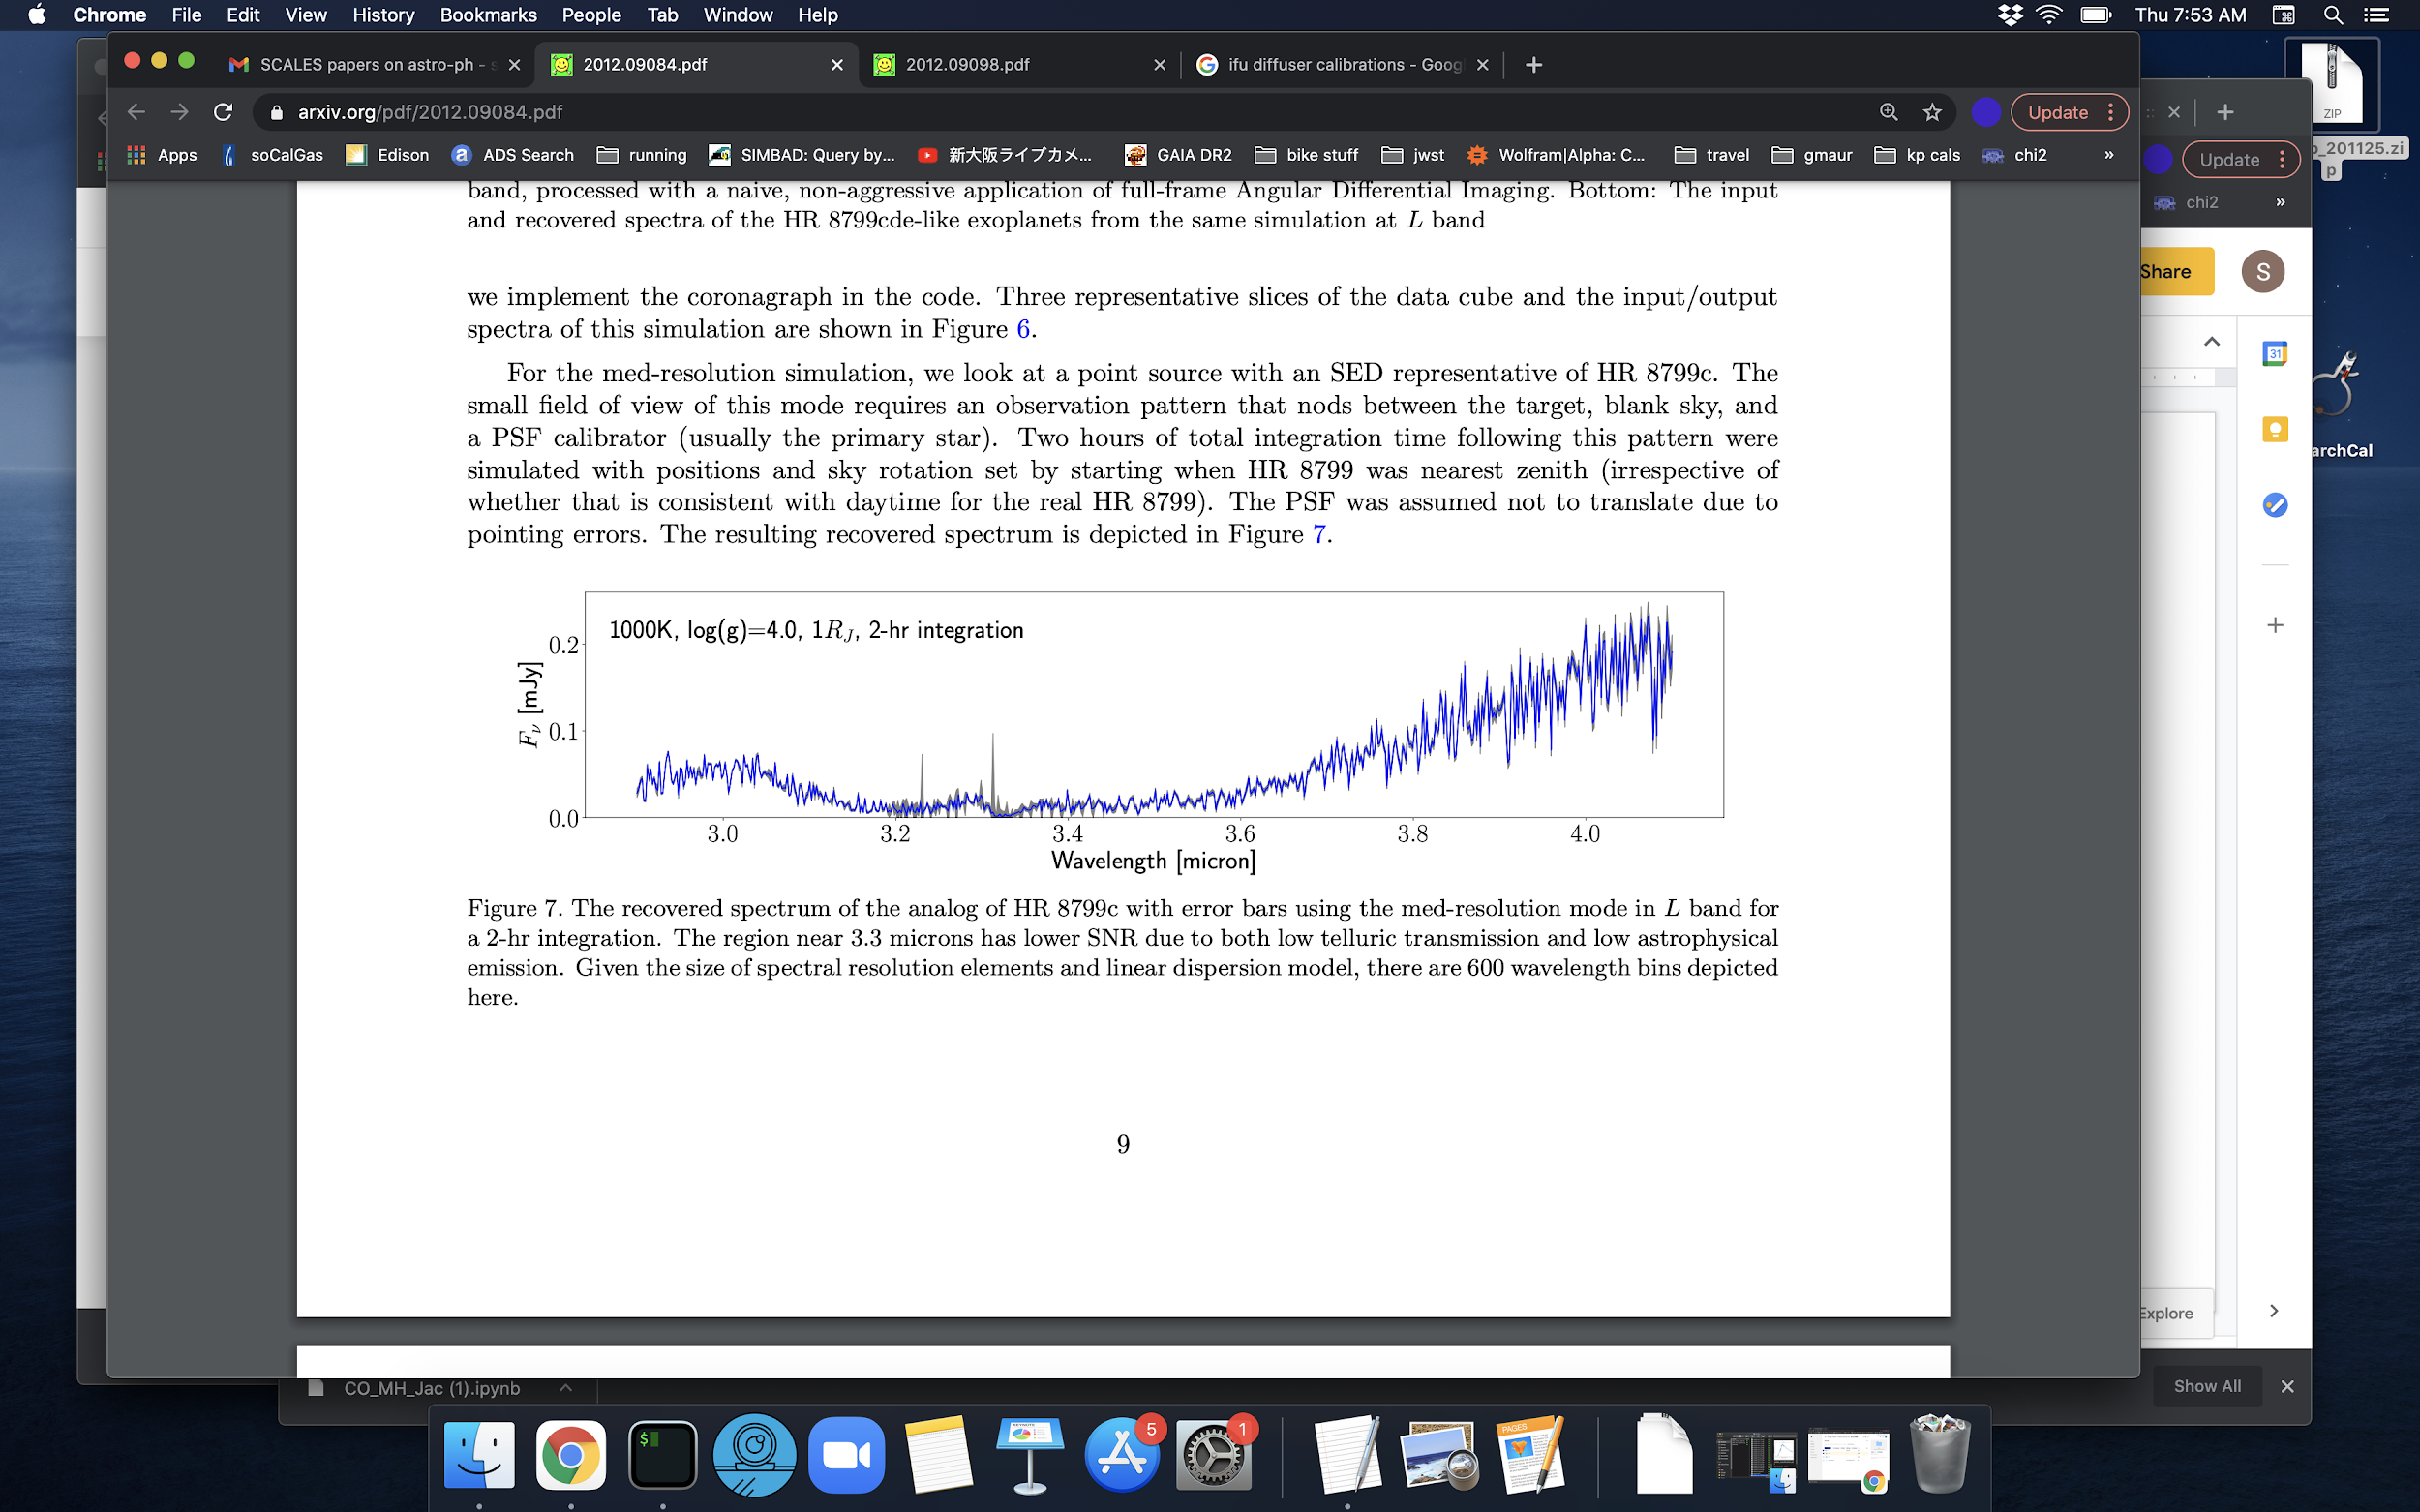
Acronym
SCALES = Slicer Combined with Array of Lenslets for Exoplanet Spectroscopy
Notes:
SCALES stands for 'Slicer Combined with Array of Lenslets for Exoplanet Spectroscopy.’ The novel concept is to combine an image slicer with a microlens array, and this hybrid design is optimised for exoplanet spectroscopy.

Slide 3


Acronym
SCALES = Slicer Combined with Array of Lenslets for Exoplanet Spectroscopy
Notes:
Incidentally, Scales is also a hamlet at the foot of Blencathra mountain in the Lake District, so next time you go to the lakes, have a thought about exoplanet.

Slide 4
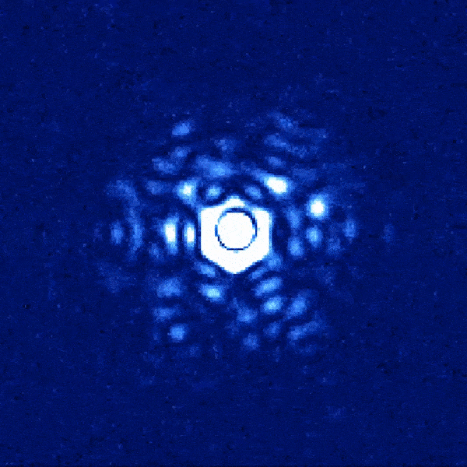
Goal: High Contrast Exoplanet Spectroscopy
High contrast requires Adaptive Optics (AO), advanced coronagraphy, and favours thermal infrared (2-5 µm, aka K, L, & M bands)
Exoplanets are faint, and thermal infrared background (for ground-based observing) is punishingly high
Use of Integral Field Spectroscopy (IFS), especially for multi-planet systems like HR 8799
Speckle
Injected Planet
Notes:
What is the recipe for high contrast exoplanet spectroscopy?
You need high contrast, and therefore Adaptive optics for image stability and optimal resolution, an advanced coronograph, and most importantly, an thermal infra-red system, looking in the KLM bands.
In the 3-5micron band, contrasts are less severe, but backgrounds are higher — pushing the instrument design.
Finally, if you want to do exoplanet atmosphere characterisation, you also need an IFS with a very small FOV.

Slide 5
Scientific Motivation
Discovering and characterizing cold exoplanets that are brightest in the thermal infrared.
lower contrast needed in the thermal-infrared (3-5 um)
Direct imaging of cold Planets from Gaia's extended mission (300 K) visible in M-band.
With astrometry (Roman in 2030), planet mass will lead to confidence in atmospheric properties (degenerate without masses).
=> Molecular abundance, Metallicity, Surface gravity, Cloud Opacity etc…
Notes:
What are the scientific motivation : Discovering a characterizing cold exoplanets through direct imaging and spectroscopy, as they are brightest in the L and M bands. As you can see on the plot, which shows the contrast needed with respect to a G2V star as a function of the wavelength. (Our Sun is the best-known G2V star, they’re stable and common and import for exoplanet). You just need a lower contrast particularly for the colder planets.

Slide 6
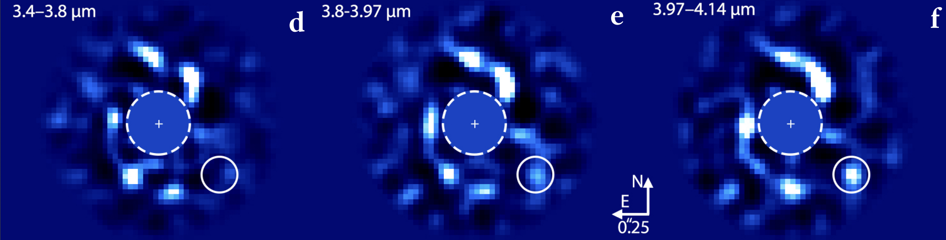
LBT / ALES Images at Different Wavelengths
Increased Methane Absorption in Exoplanets
Decreased Methane Absorption in Exoplanets
The disk spirals looks roughly the same, while the planet has a distinct color. ALES is R~30. SCALES will be able to pick out molecular features.
Wagner et al. (2023)
Notes:
An example of how exoplanet brightness changes with increasing wavelength. Here we can see a relatively constant flux from the disk and a notable rise of flux from
the planet candidate towards longer wavelengths: 3.4–3.8 μm. This can reveal the presence of methane in a Jupiter like planet as Methane has a strong absorption in the 3.4 micron range. And we don’t need high spectral resolution to show this.

Slide 7
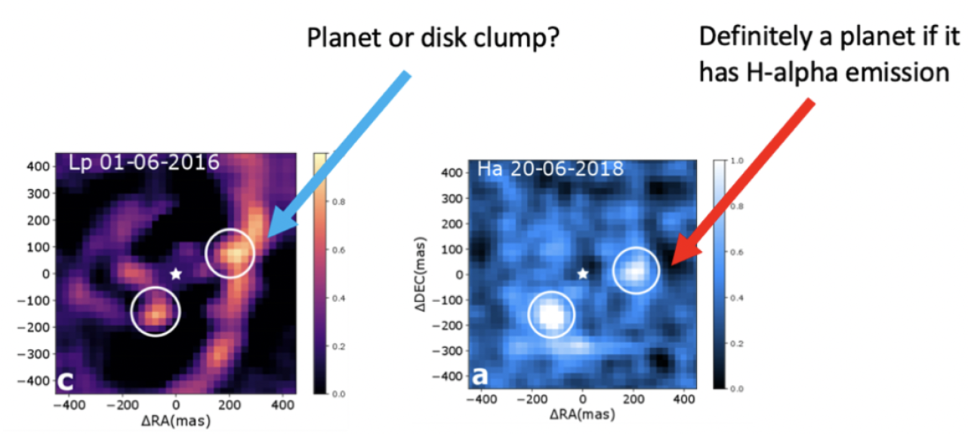
Scientific Motivation
Directly Detecting Accreting Protoplanets in Gapped Protoplanetary Disks
Imaging protoplanets is challenging due to disk-scattered light mimicking them.
Integral field spectroscopy near 4 µm helps distinguish true protoplanet signals via spectral slopes and IR hydrogen lines like Br-γ and Br-α.
Notes:
This is also the second scientific motivation of SCALES : Directly detecting accreting Protoplanets in Gapped Protoplanetary disks.
On the image below, looking at the H-Brackett-alpha emission line with the mid spatial resolution.

Slide 8
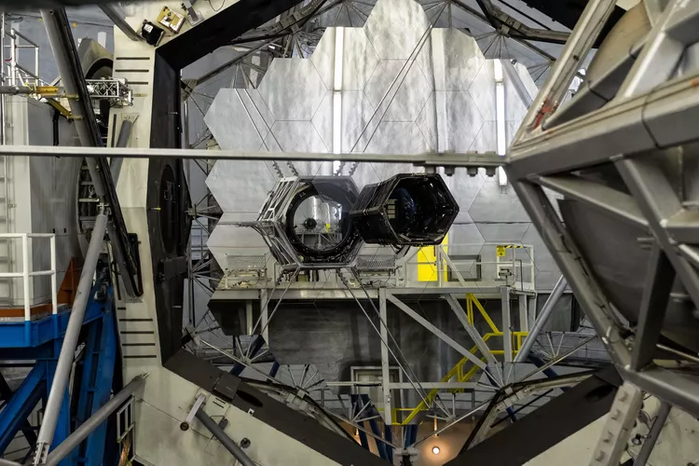
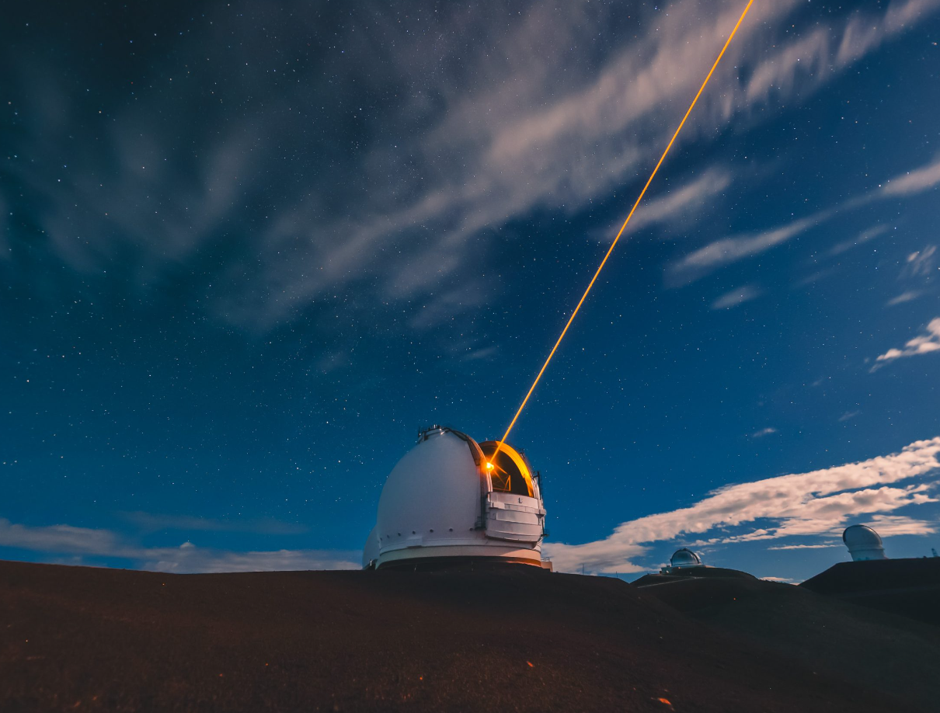
Why Keck?
UCSC is leading the development of the instrument
Need for an Extreme Adaptive Optics for high contrast exoplanet atmospheric characterisation.
  Keck AO upgrade (a high-order deformable mirror) expected before SCALES commissioning.
Notes:
SCALES is designed for Keck, taking advantage of its extreme AO upgrade, which provides the stability and correction needed for these faint IR targets

Slide 9
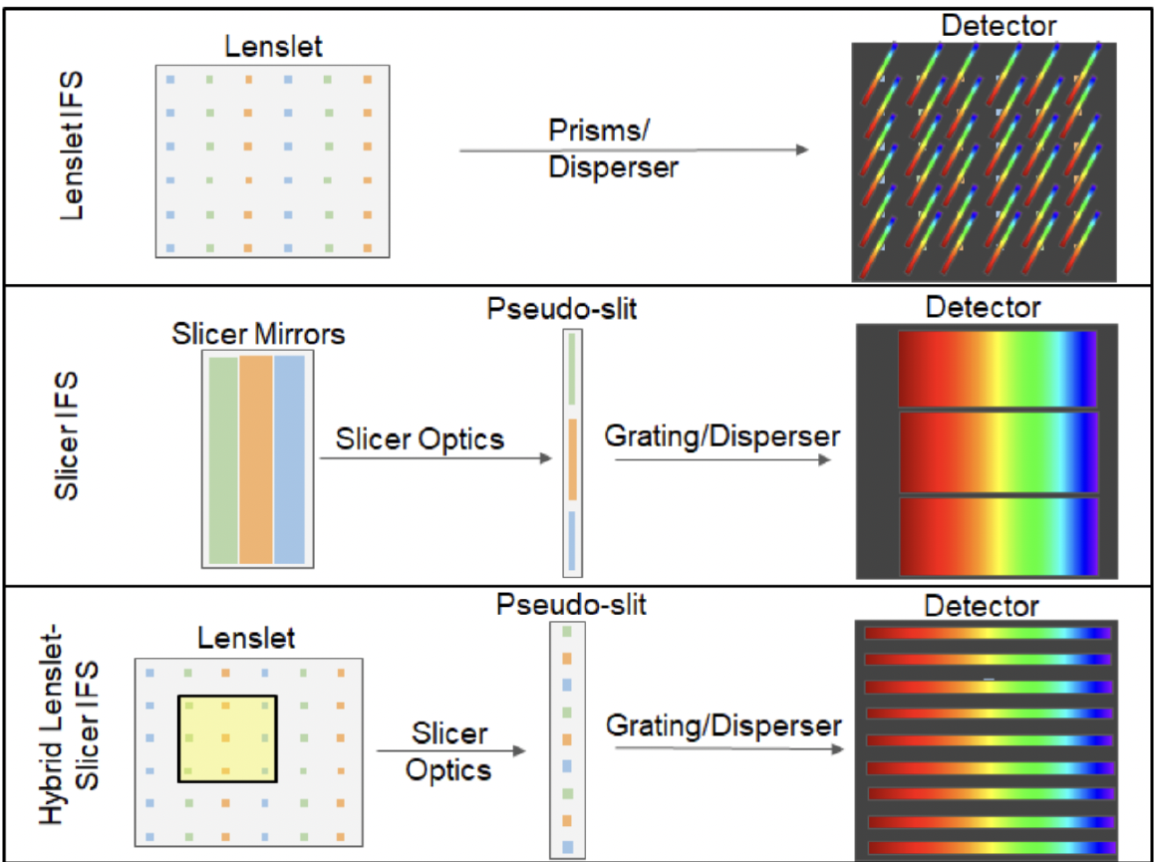
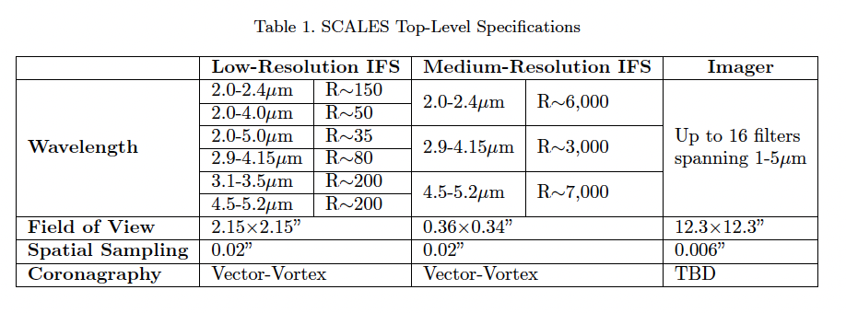
Instrument Concept & Design Overview
Notes:
The instrument uses a hybrid IFU we call the slenslit, combining a slicer and a lenslet array.
The concept is modular: we can move from Large field low R, to smaller field Mid R.

Slide 10
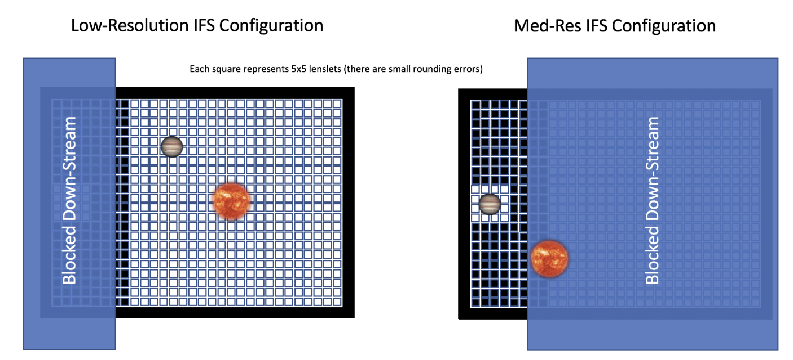
Instrument Concept & Design Overview
Image slicers are tricky in high-contrast imaging because their optics impart aberrations that are detrimental to high-contrast imaging.
In SCALES, the lenslet array samples the field before any optical aberrations are imparted by downstream spectroscopic optics
The lenslet design also makes it also easier to move from a larger field to a smaller field
Notes:
Slicers alone introduce optical aberrations - bad for contrast. So instead, the lenslet array samples the field early, before aberrations are introduced, maintaining image quality.
This also gives us flexibility in adjusting the field size while preserving contrast performance.
[Image of Jupiter standing in for an exoplanet, with an image of the sun (orange, with yellow active regions visible) standing in for the host star. -RDS]

Slide 11
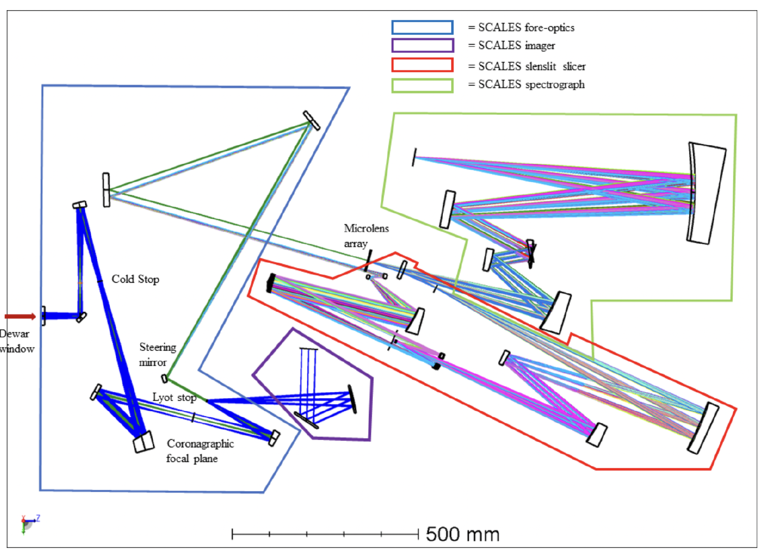
Instrument Concept & Design Overview
Notes:
Characteristic exoplanet-to-star contrasts (ux ratios) vs. wavelength showing that giant exoplanets can be
detected with lower contrast in the thermal-infrared (3-5 m) than in the near-infrared (1-2 m), and that this eect is
most dramatic for cold planets. While most directly-imaged planets to date are relatively warm (> 700 K), the majority
of self-luminous exoplanets are much cooler.

Slide 12
Instrument Concept & Design Overview
Notes:
Characteristic exoplanet-to-star contrasts (ux ratios) vs. wavelength showing that giant exoplanets can be
detected with lower contrast in the thermal-infrared (3-5 m) than in the near-infrared (1-2 m), and that this eect is
most dramatic for cold planets. While most directly-imaged planets to date are relatively warm (> 700 K), the majority
of self-luminous exoplanets are much cooler.

Slide 13
Instrument Concept & Design Overview
Notes:
Characteristic exoplanet-to-star contrasts (ux ratios) vs. wavelength showing that giant exoplanets can be
detected with lower contrast in the thermal-infrared (3-5 m) than in the near-infrared (1-2 m), and that this eect is
most dramatic for cold planets. While most directly-imaged planets to date are relatively warm (> 700 K), the majority
of self-luminous exoplanets are much cooler.

Slide 14
Instrument Concept & Design Overview
Notes:
Characteristic exoplanet-to-star contrasts (ux ratios) vs. wavelength showing that giant exoplanets can be
detected with lower contrast in the thermal-infrared (3-5 m) than in the near-infrared (1-2 m), and that this eect is
most dramatic for cold planets. While most directly-imaged planets to date are relatively warm (> 700 K), the majority
of self-luminous exoplanets are much cooler.

Slide 15
Instrument Concept & Design Overview

Slide 16
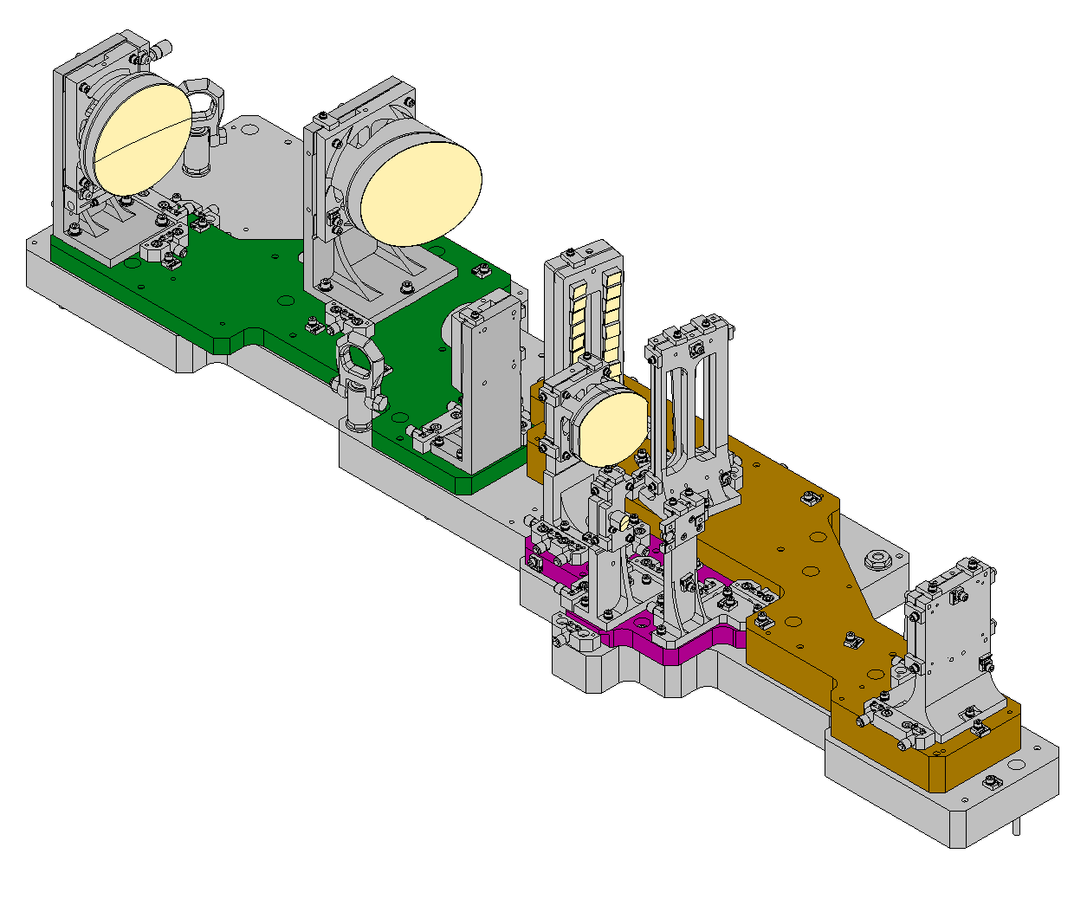
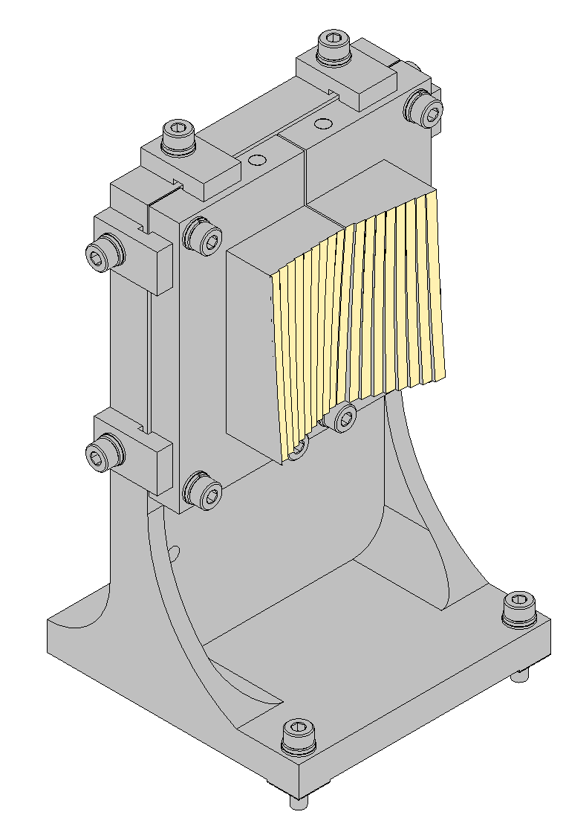
SCALES : Slenslit bench
Input relay
Slicing optics
Output relay
1.3m \ 48Kg

Slide 17
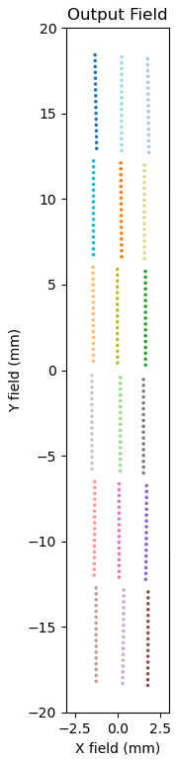
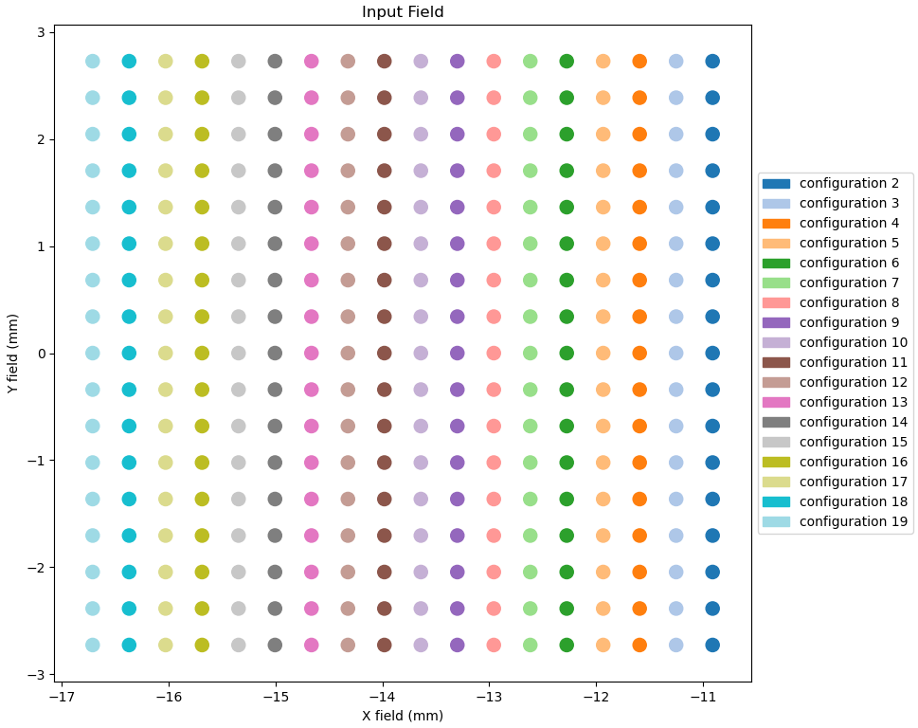
SCALES Slenslit:
At the Pseudoslit
At the lenslet focus
spectrograph
Notes:
17 x 18 spots 306 spots

Slide 18
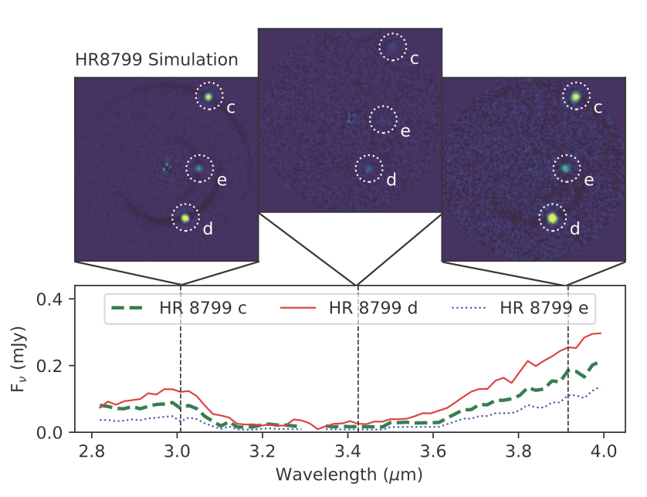
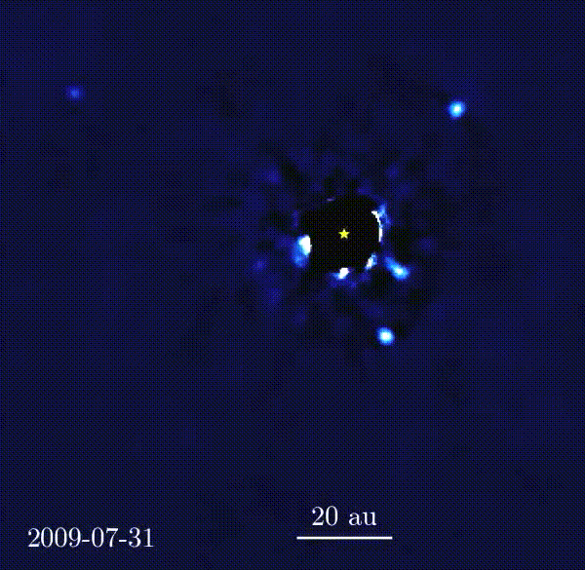
Exoplanet Detection and Characterization with Lenslet IFS – HR 8799
Simulations by Zack Briesemeister and Steph Sallum: https://arxiv.org/abs/2012.09084
Can do some composition studies (e.g., Miles, et. al. 2020) but need higher spectral resolution for further characterization

Slide 19
Mid resolution spectra of exoplanets
Simulated observation of HR 8799c using a slenslit
NOW we can talk atmospheric chemistry*!
CO, CH₄, PH₃…
*does require good mass estimates for determining exoplanet’s atmospheric scale height, etc
Notes:
With mid-resolution (R~30–100), we can start retrieving molecular signatures like CO, CH₄, PH₃(Phosphine).
This spectral information, combined with mass estimates from Gaia or Roman, allows us to constrain metallicity, temperature, cloud structure — giving a full atmospheric profile

Slide 20
Summary & Conclusion
SCALES (Slicer Combined with Array of Lenslets for Exoplanet Spectroscopy) is a novel integral field unit designed for high-contrast exoplanet characterisation in the thermal infrared (2–5 µm).
SCALES is designed for Keck, with upcoming AO upgrades enabling the required wavefront correction performance.
The hybrid slenslit concept combines slicer and lenslet technologies to overcome the limitations of each for high-contrast imaging.
Targets include cold exoplanets detected by missions like Gaia and Roman, where mid-resolution spectroscopy enables retrieval of key atmospheric properties (e.g. CH₄).
Protoplanet detection is enabled through spectral discrimination of disk features using IR hydrogen lines (Br-γ, Br-α).

Slide 21
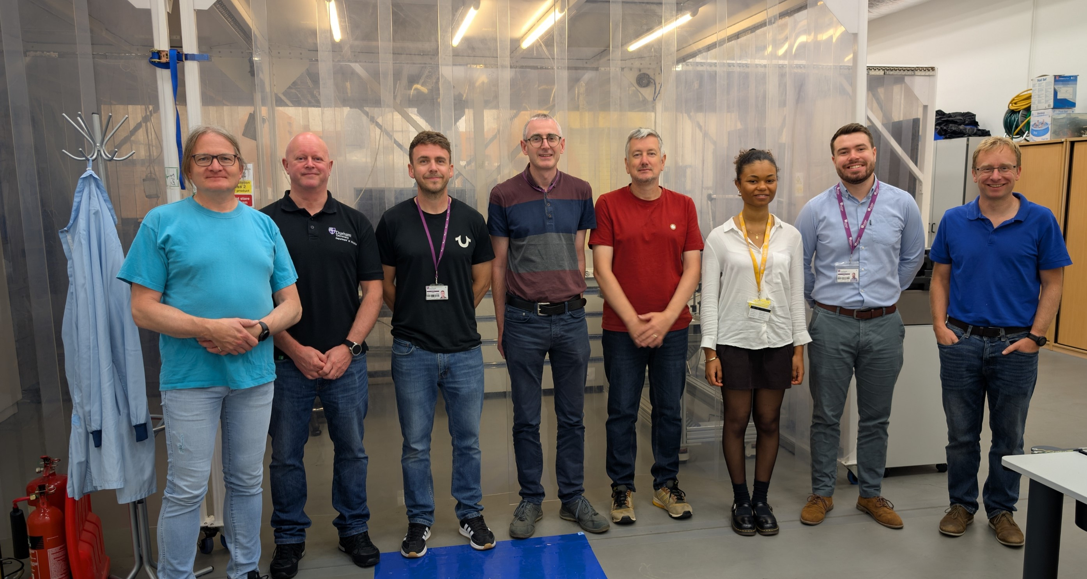

Thank you and Q&A
Durham’s team
Notes:
I’d like to thank the full team at Durham and UCSC. Happy to take any questions.

