Slide 1
Probing baryonic feedback and cosmology with patchy screening in the FLAMINGO simulations.
Jonah Conley – 4th year PhD student
Astrophysics Research Institute
National Astronomy Meeting 2025

Slide 2
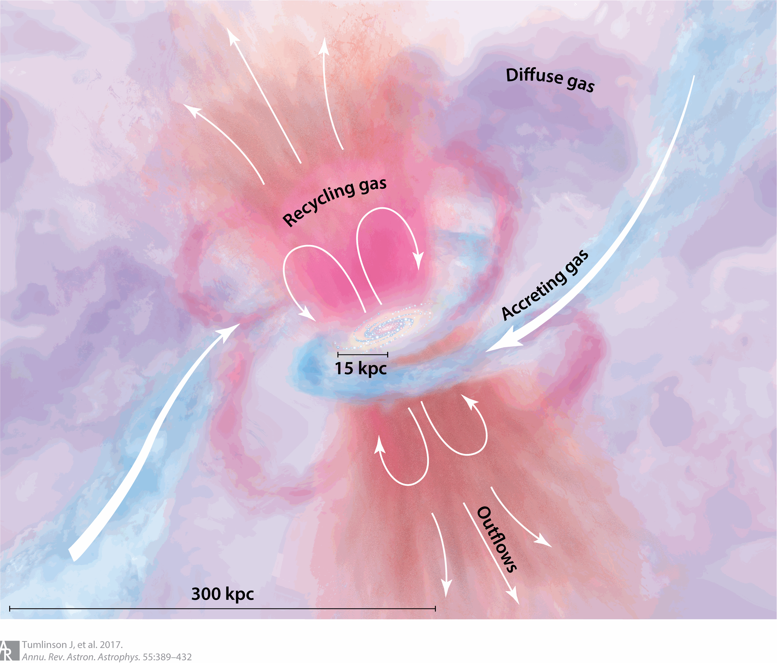
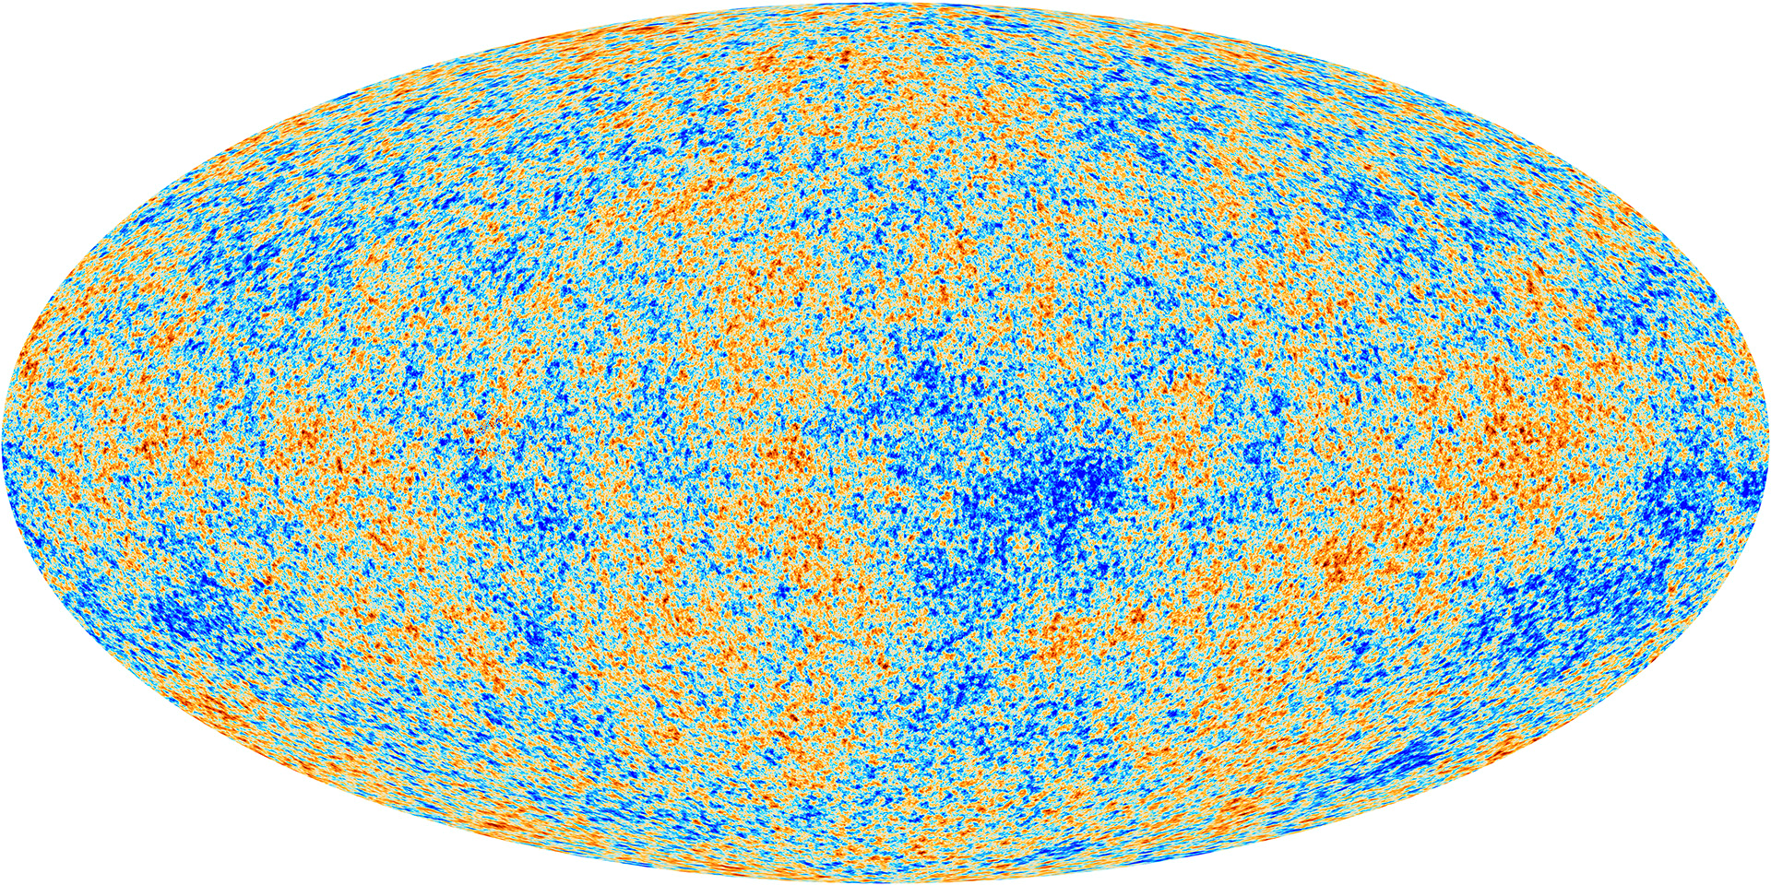
Background
Email: J.T.Conley@2022.ljmu.ac.uk
Cosmic Microwave Background & Circumgalactic Medium (CGM):
Image credit: Tumlinson, Peeples & Werk (2017)
Image credit: ESA and the Planck Collaboration

Slide 3
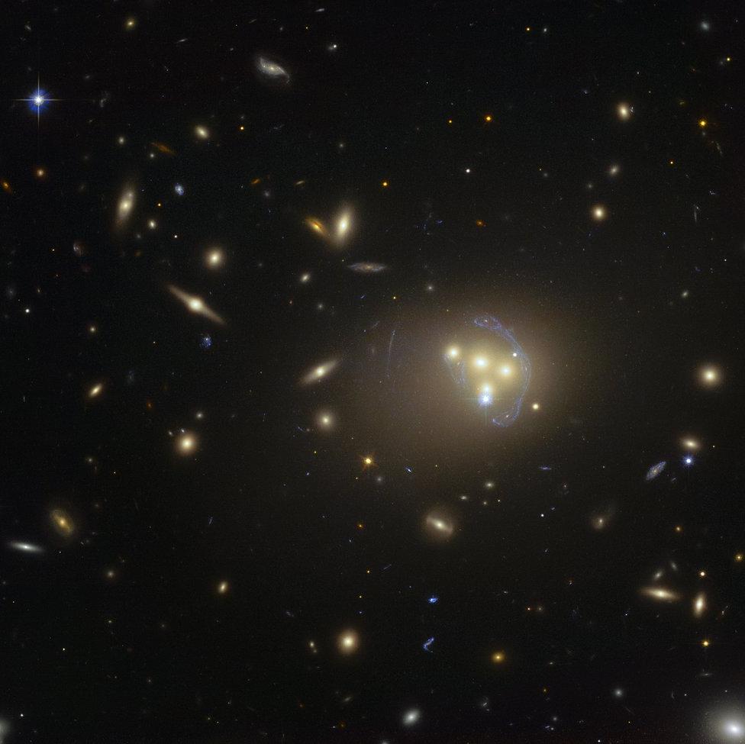
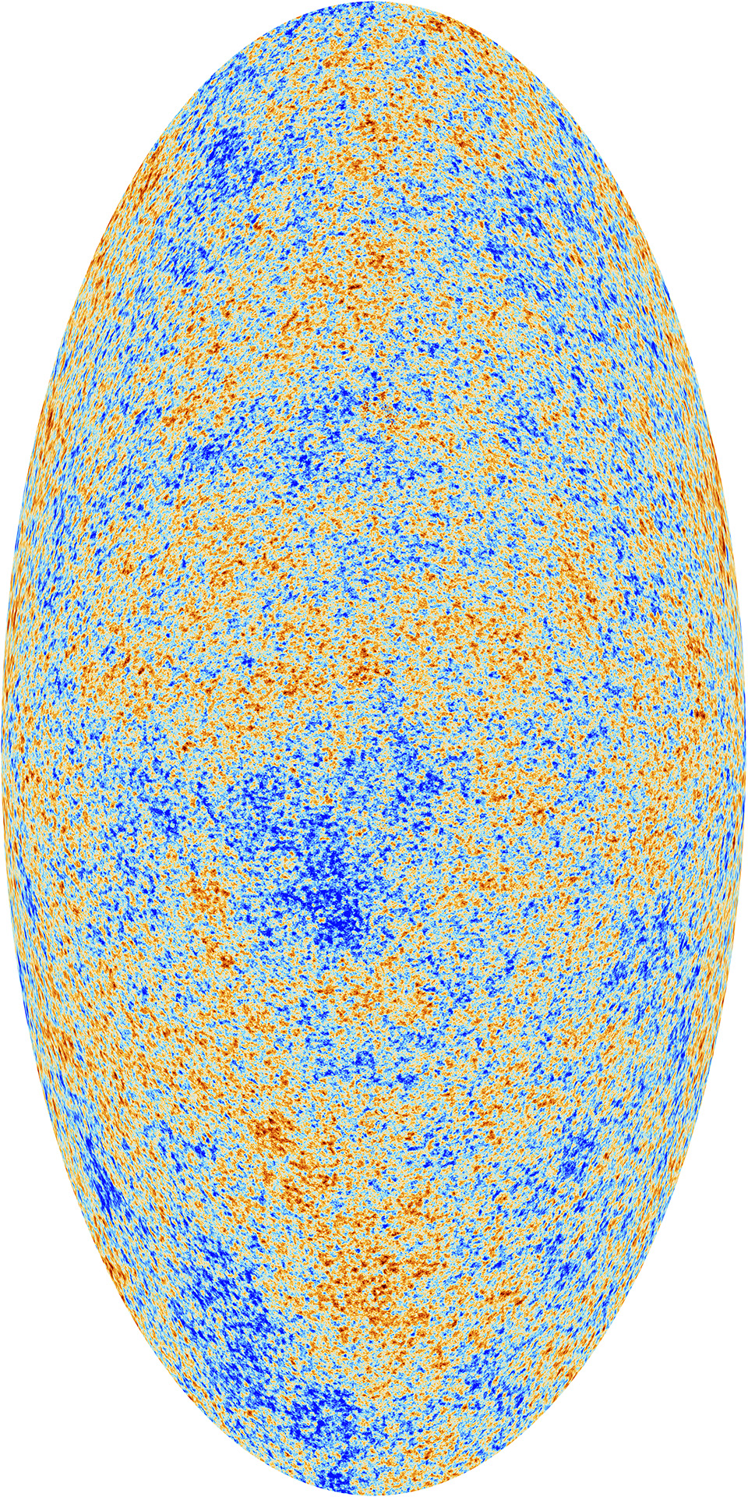
Motivation
Email: J.T.Conley@2022.ljmu.ac.uk
$$ρ_{m}$$
Lensing
$$P_{e}$$
Thermal SZ
$$\vec{v}⋅\vec{n}$$
$$ρ_{e}$$
Kinetic SZ
$$ρ_{e}$$
Screening
Image credits:
David Alonso,
Will Coulton,
ESO,
ESA and the Planck Collaboration
From Coulton et al. (2024),
Patchy Screening equation:

Slide 4
Methodology
Email: J.T.Conley@2022.ljmu.ac.uk
From Coulton et al. (2024)
Sign estimator:
Frequency band-pass filters:
unWISE galaxy sample:

Slide 5
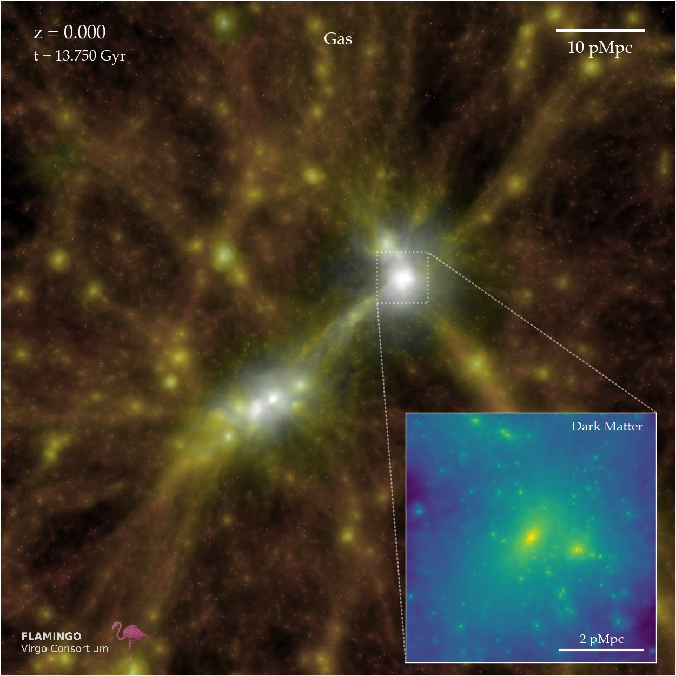
Methodology
Email: J.T.Conley@2022.ljmu.ac.uk
FLAMINGO simulations (Schaye et al., 2023):
Calibrated cosmological hydrodynamic simulations, run to z=0.
Suite contains variations in box size; variations in cosmology & variations in baryonic feedback (AGN & stellar).

Slide 6
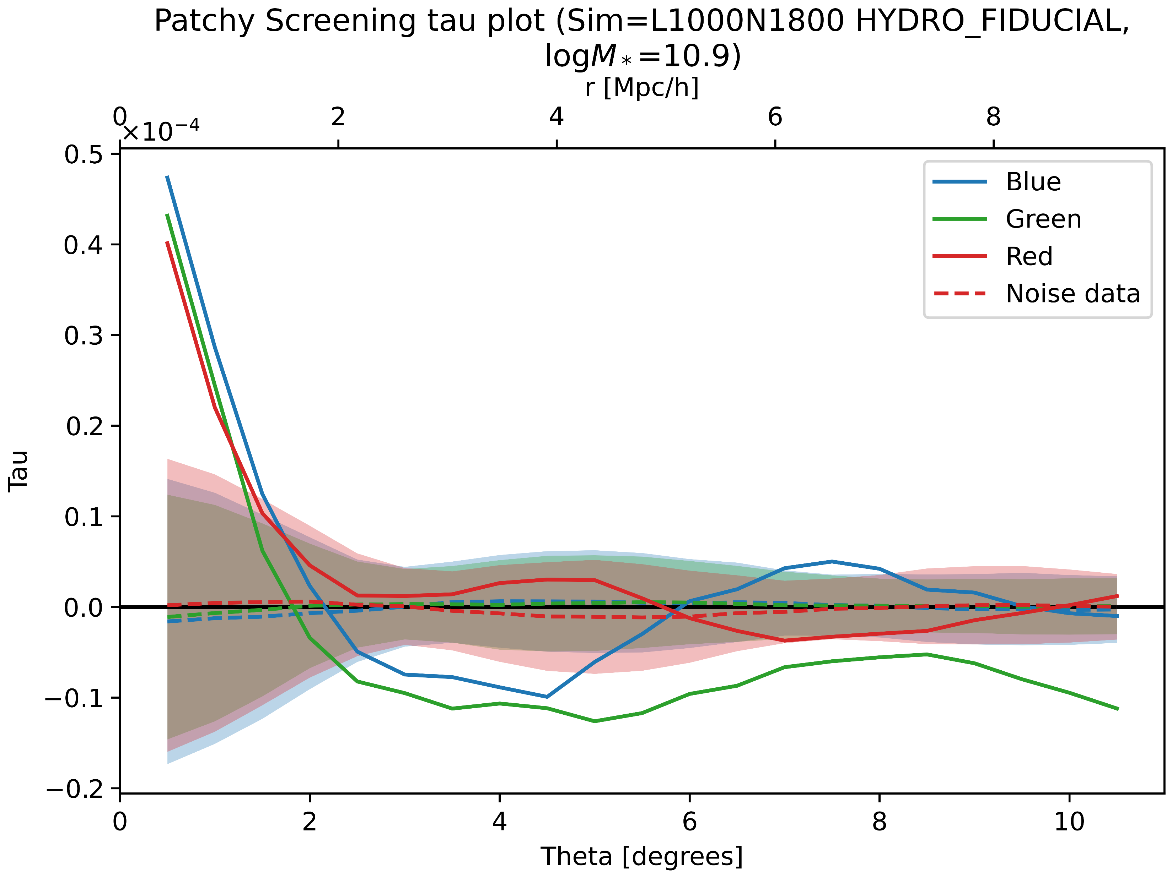
Initial Results
Email: J.T.Conley@2022.ljmu.ac.uk
< Varying galaxy sample; fixed stellar cut.
Noise level quantified.

Slide 7
Initial Results
Email: J.T.Conley@2022.ljmu.ac.uk
^ Varying stellar mass cut; fixed galaxy sample.
< Varying galaxy sample; fixed stellar cut.
Noise level quantified.

Slide 8
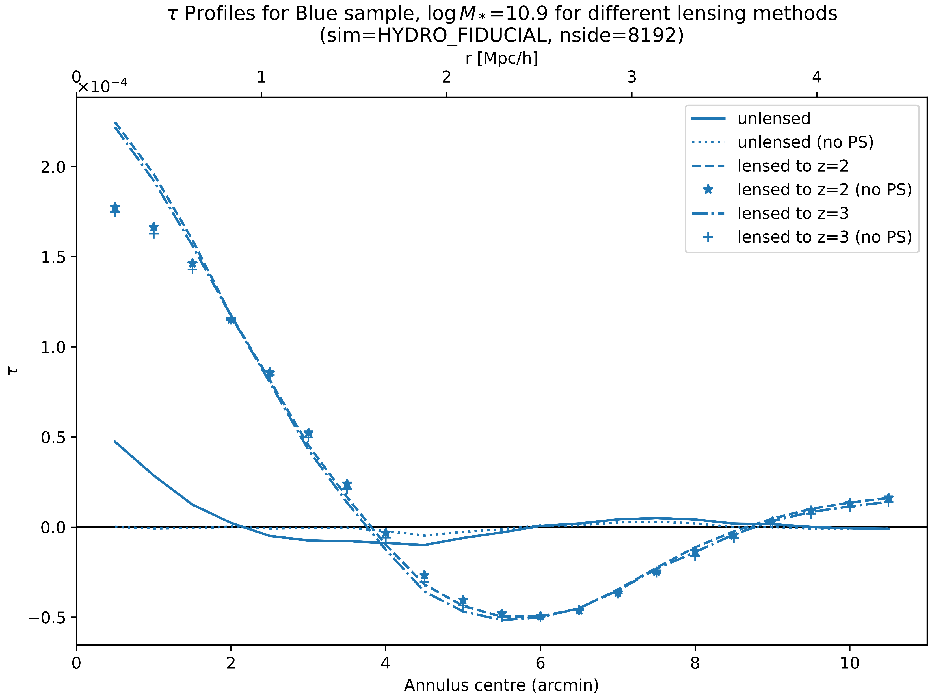
Comparing to CMB lensing
Email: J.T.Conley@2022.ljmu.ac.uk
< Varying primary CMB method; fixed galaxy sample and stellar cut.

Slide 9
Comparing to CMB lensing
Email: J.T.Conley@2022.ljmu.ac.uk
^ Varying stellar mass cut; fixed galaxy sample.
< Varying primary CMB method; fixed galaxy sample and stellar cut.

Slide 10
Mock halo catalogs & lensing considerations
Email: J.T.Conley@2022.ljmu.ac.uk
Comparing to mock primary CMB maps that are both lensed and unlensed.
Rescaling unWISE redshift distribution for halo sampling.
Using a z-dependant stellar cut:
$$\log_{10}{M_{star}\left(z\right)≥}\frac{d{(log}_{10}{M_{star})}}{dz} (z −{ z}_{mean})+\log_{10}{M_{star, cut, { z}_{mean}}}$$

Slide 11
Questions?
Email: J.T.Conley@2022.ljmu.ac.uk
GitHub: https://github.com/J0nl15a/Patchy-Screening
$$\log_{10}{M_{star}\left(z\right)≥}\frac{d{(log}_{10}{M_{star})}}{dz} (z −{ z}_{mean})+\log_{10}{M_{star, cut, { z}_{mean}}}$$

