Slide 1
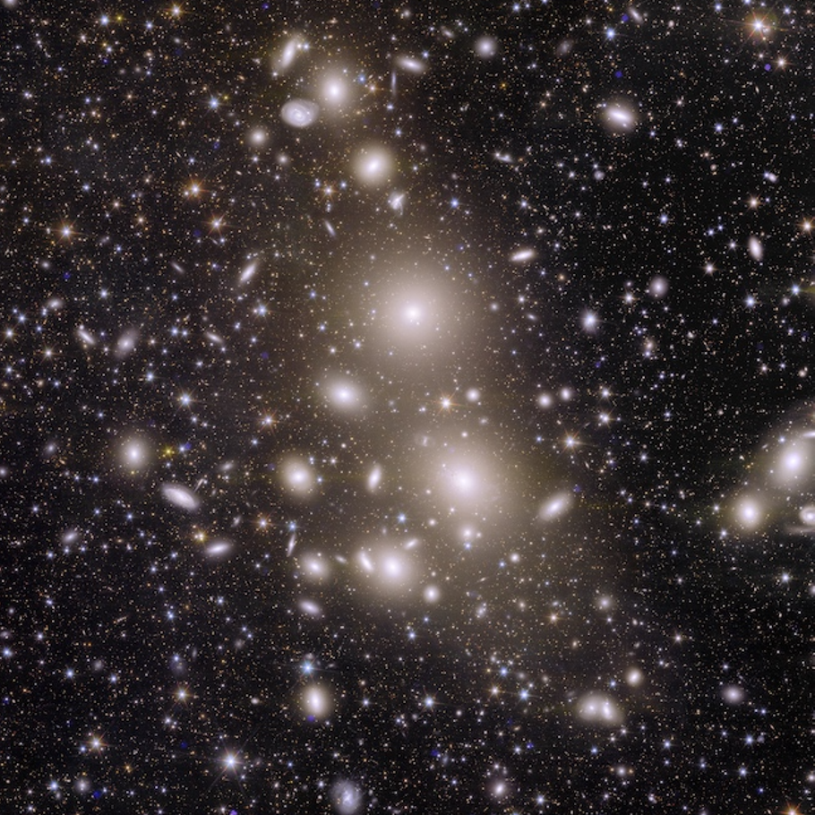


National Astronomy Meeting | 09.07.25
A first look at the shapes of ICL in Euclid Q1
Dr Tutku Kolcu
In collaboration with: Nina Hatch, Steven Bamford, Hua Gao and Jesse Golden-Marx
Credits: ESA/Euclid/Euclid Consortium/NASA, image processing by J.-C. Cuillandre (CEA Paris-Saclay), G. Anselmi.
Tutku.Kolcu@nottingham.ac.uk
Credits: ESA/Euclid/Euclid Consortium/NASA, image processing by J.-C. Cuillandre (CEA Paris-Saclay), G. Anselmi.
Notes:
-

Slide 2
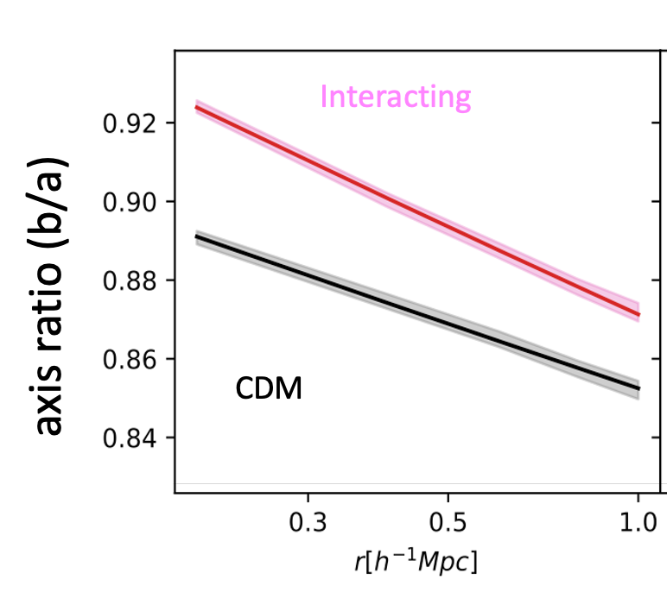
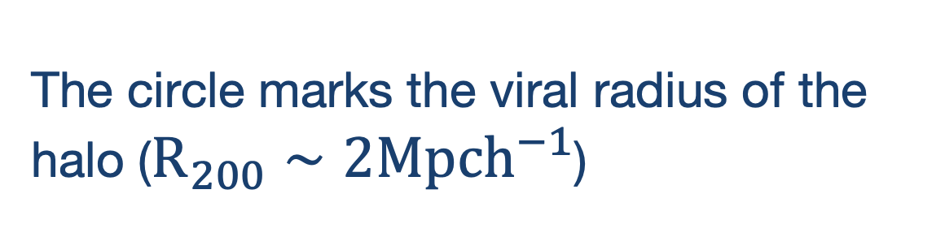
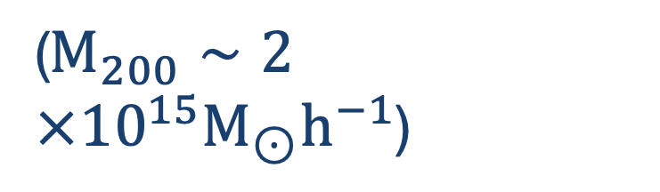
Why to study the shape of intracluster light (ICL)?
Self-interacting DM produces cored profiles, whereas CDM produces cuspy halos.
Measuring shape and profile of dark matter halos informs us about the nature of dark matter.
ICL is considered to be a distinct component, bound to cluster halo, rather than central galaxies,
thus can be used as a tracer of DM. Thus, studying ICL shapes sheds light on the nature of DM.
CDM
SIDM1
Gonzalez et al. 2024
Brinckmann et al. 2018
The circle marks the viral radius of the halo ($R_{200}∼2Mpch^{−1}$)
($M_{200}∼2×{10}^{15}M_{⊙}h^{−1}$)
Tutku Kolcu — tutku.kolcu@nottingham.ac.uk
Notes:
variety of morphologies! from smooth distributions to those with substructures.

Slide 3
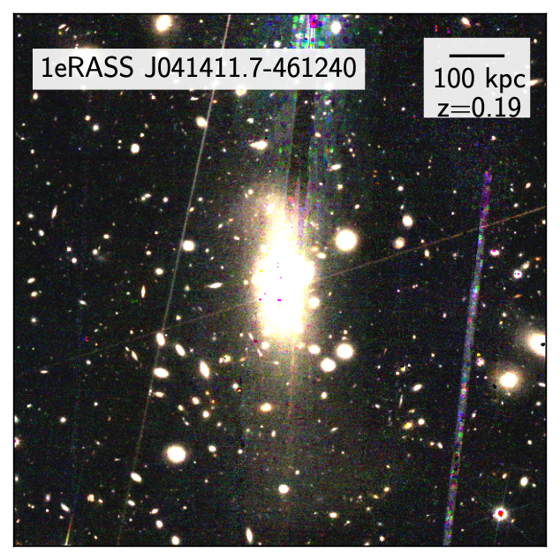
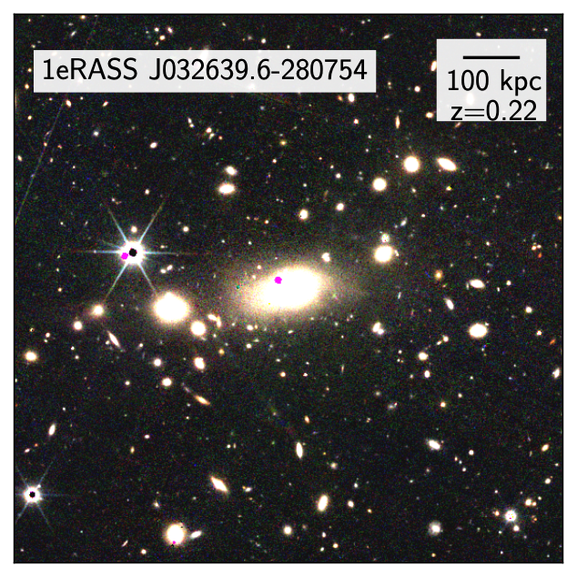
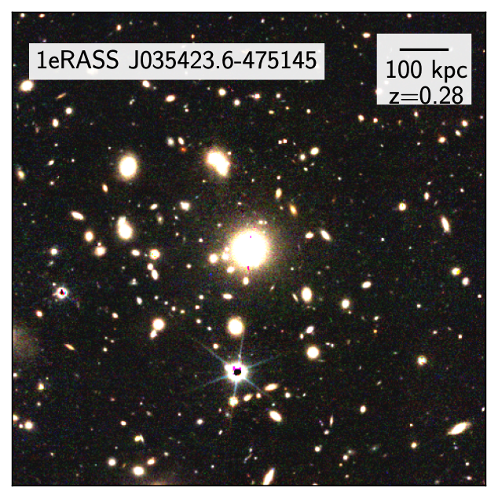

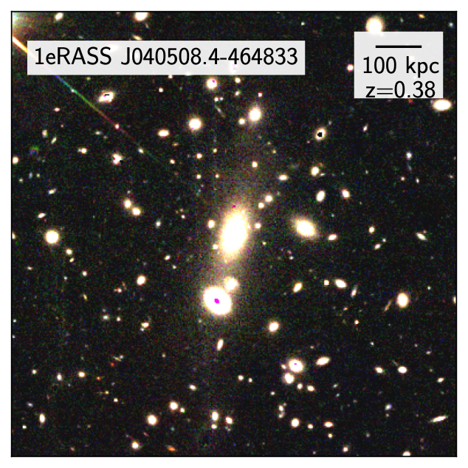
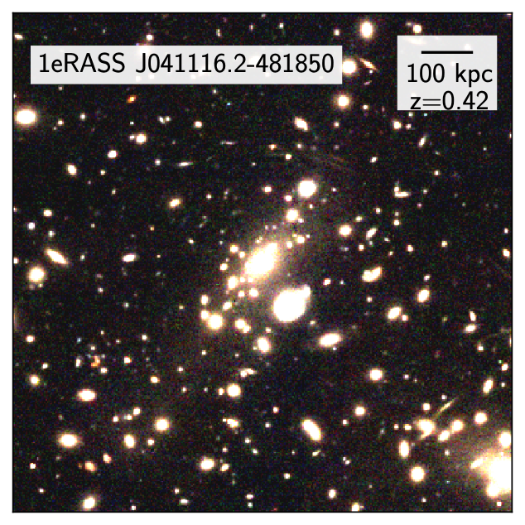
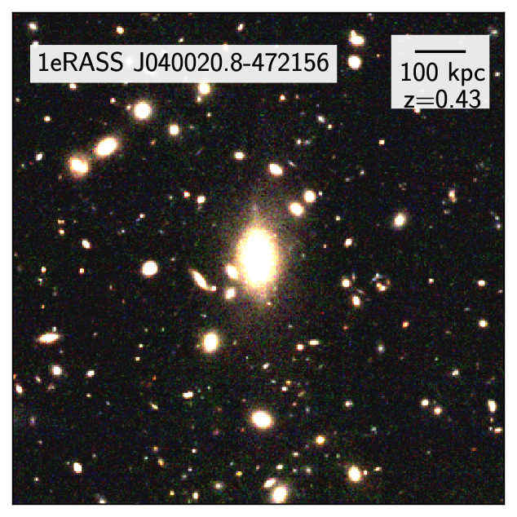
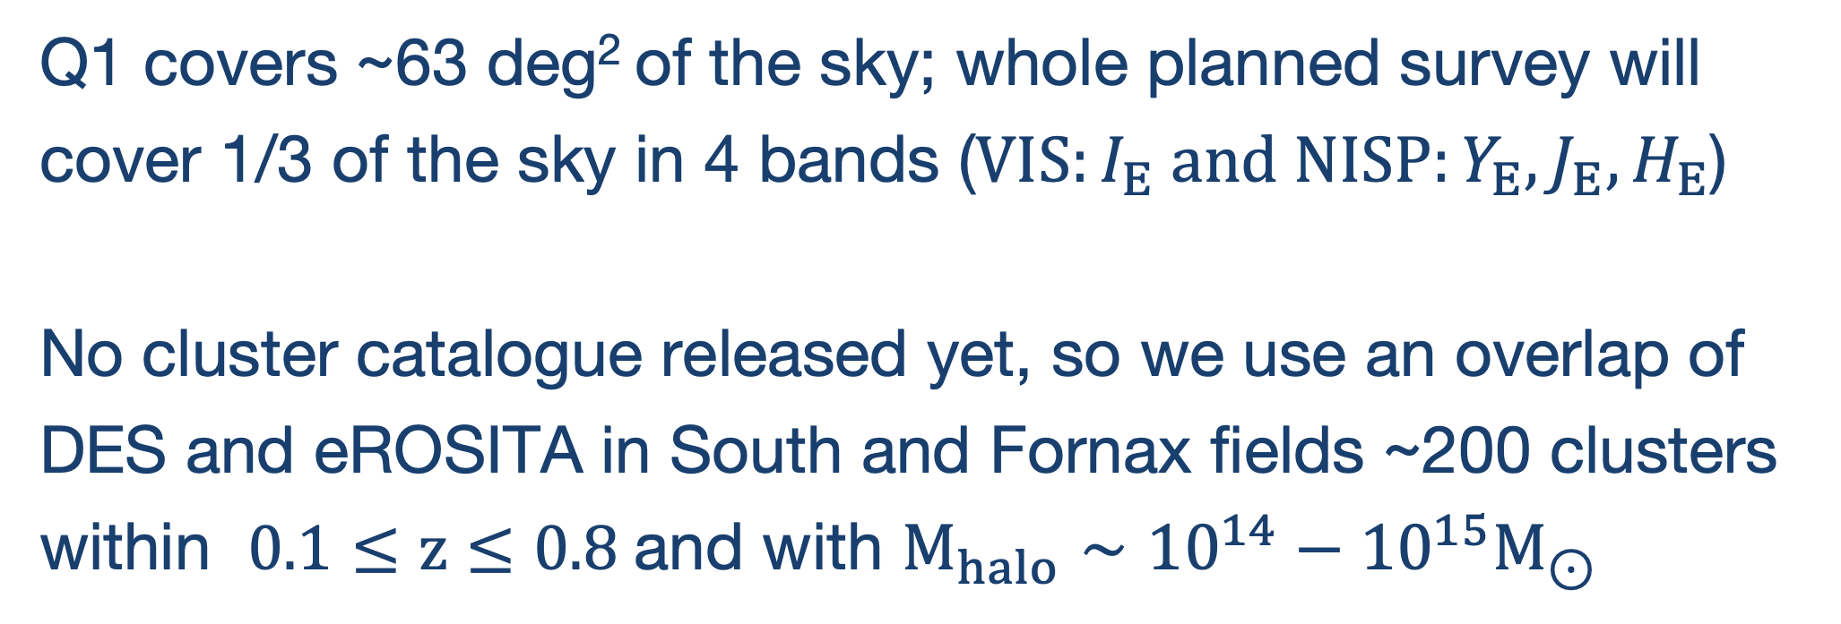
A first look at the shapes of ICL in Euclid Q1
Q1 covers ~63 deg² of the sky; whole planned survey will cover 1/3 of the sky in 4 bands ($VIS:I_{E} and NISP:Y_{E},J_{E},H_{E}$)
No cluster catalogue released yet, so we use an overlap of DES and eROSITA in South and Fornax fields ~200 clusters within $0.1≤z≤0.8$ and with $M_{halo}∼{10}^{14}−{10}^{15}M_{⊙}$
various morphologies!
Questions
How and how far out we can measure ICL signal and shape in individual clusters and stacks?
Which band traces the ICL extent and shapes further?
(no time, ask me later!)
How does ICL shapes compare to shape of galaxy distribution in clusters?
(no time, ask me later!)
Tutku Kolcu — tutku.kolcu@nottingham.ac.uk
Notes:
variety of morphologies! from smooth distributions to those with substructures.

Slide 4
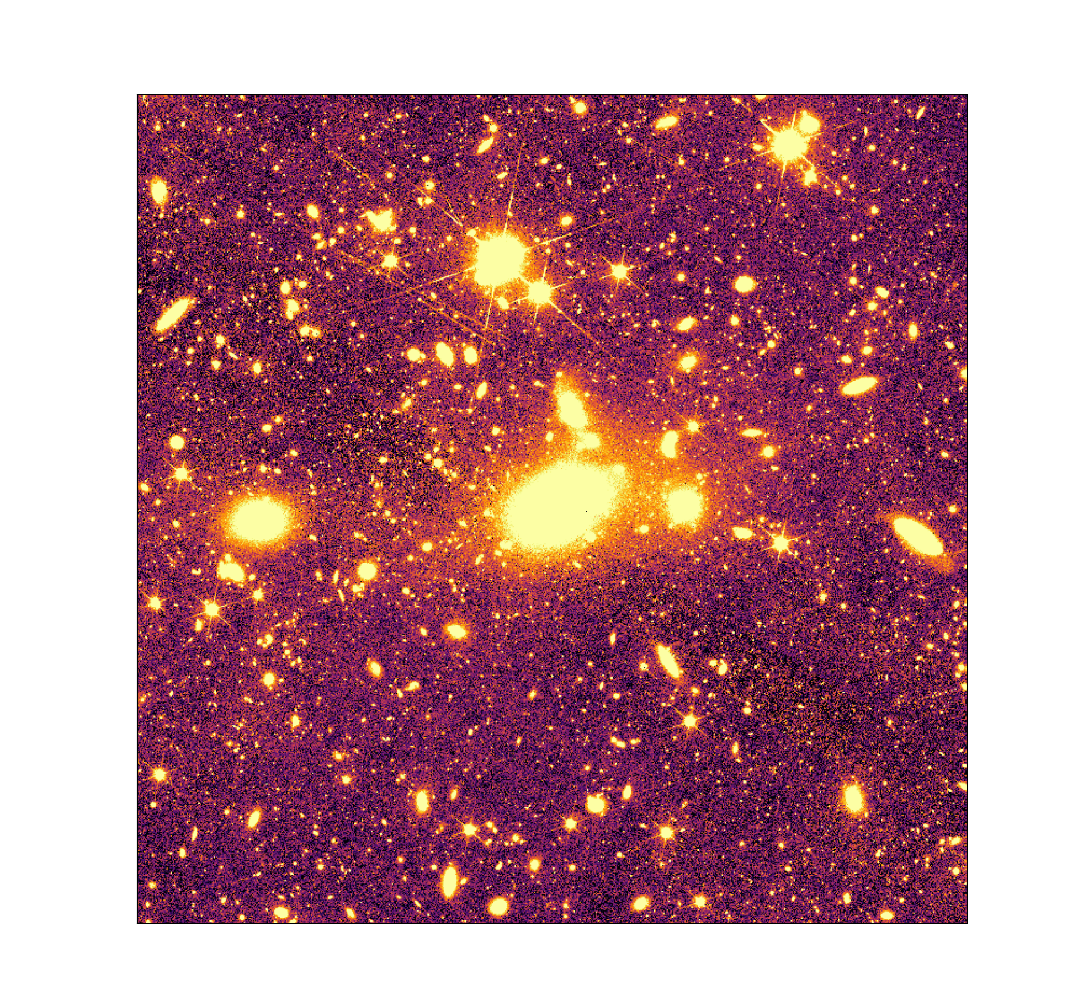
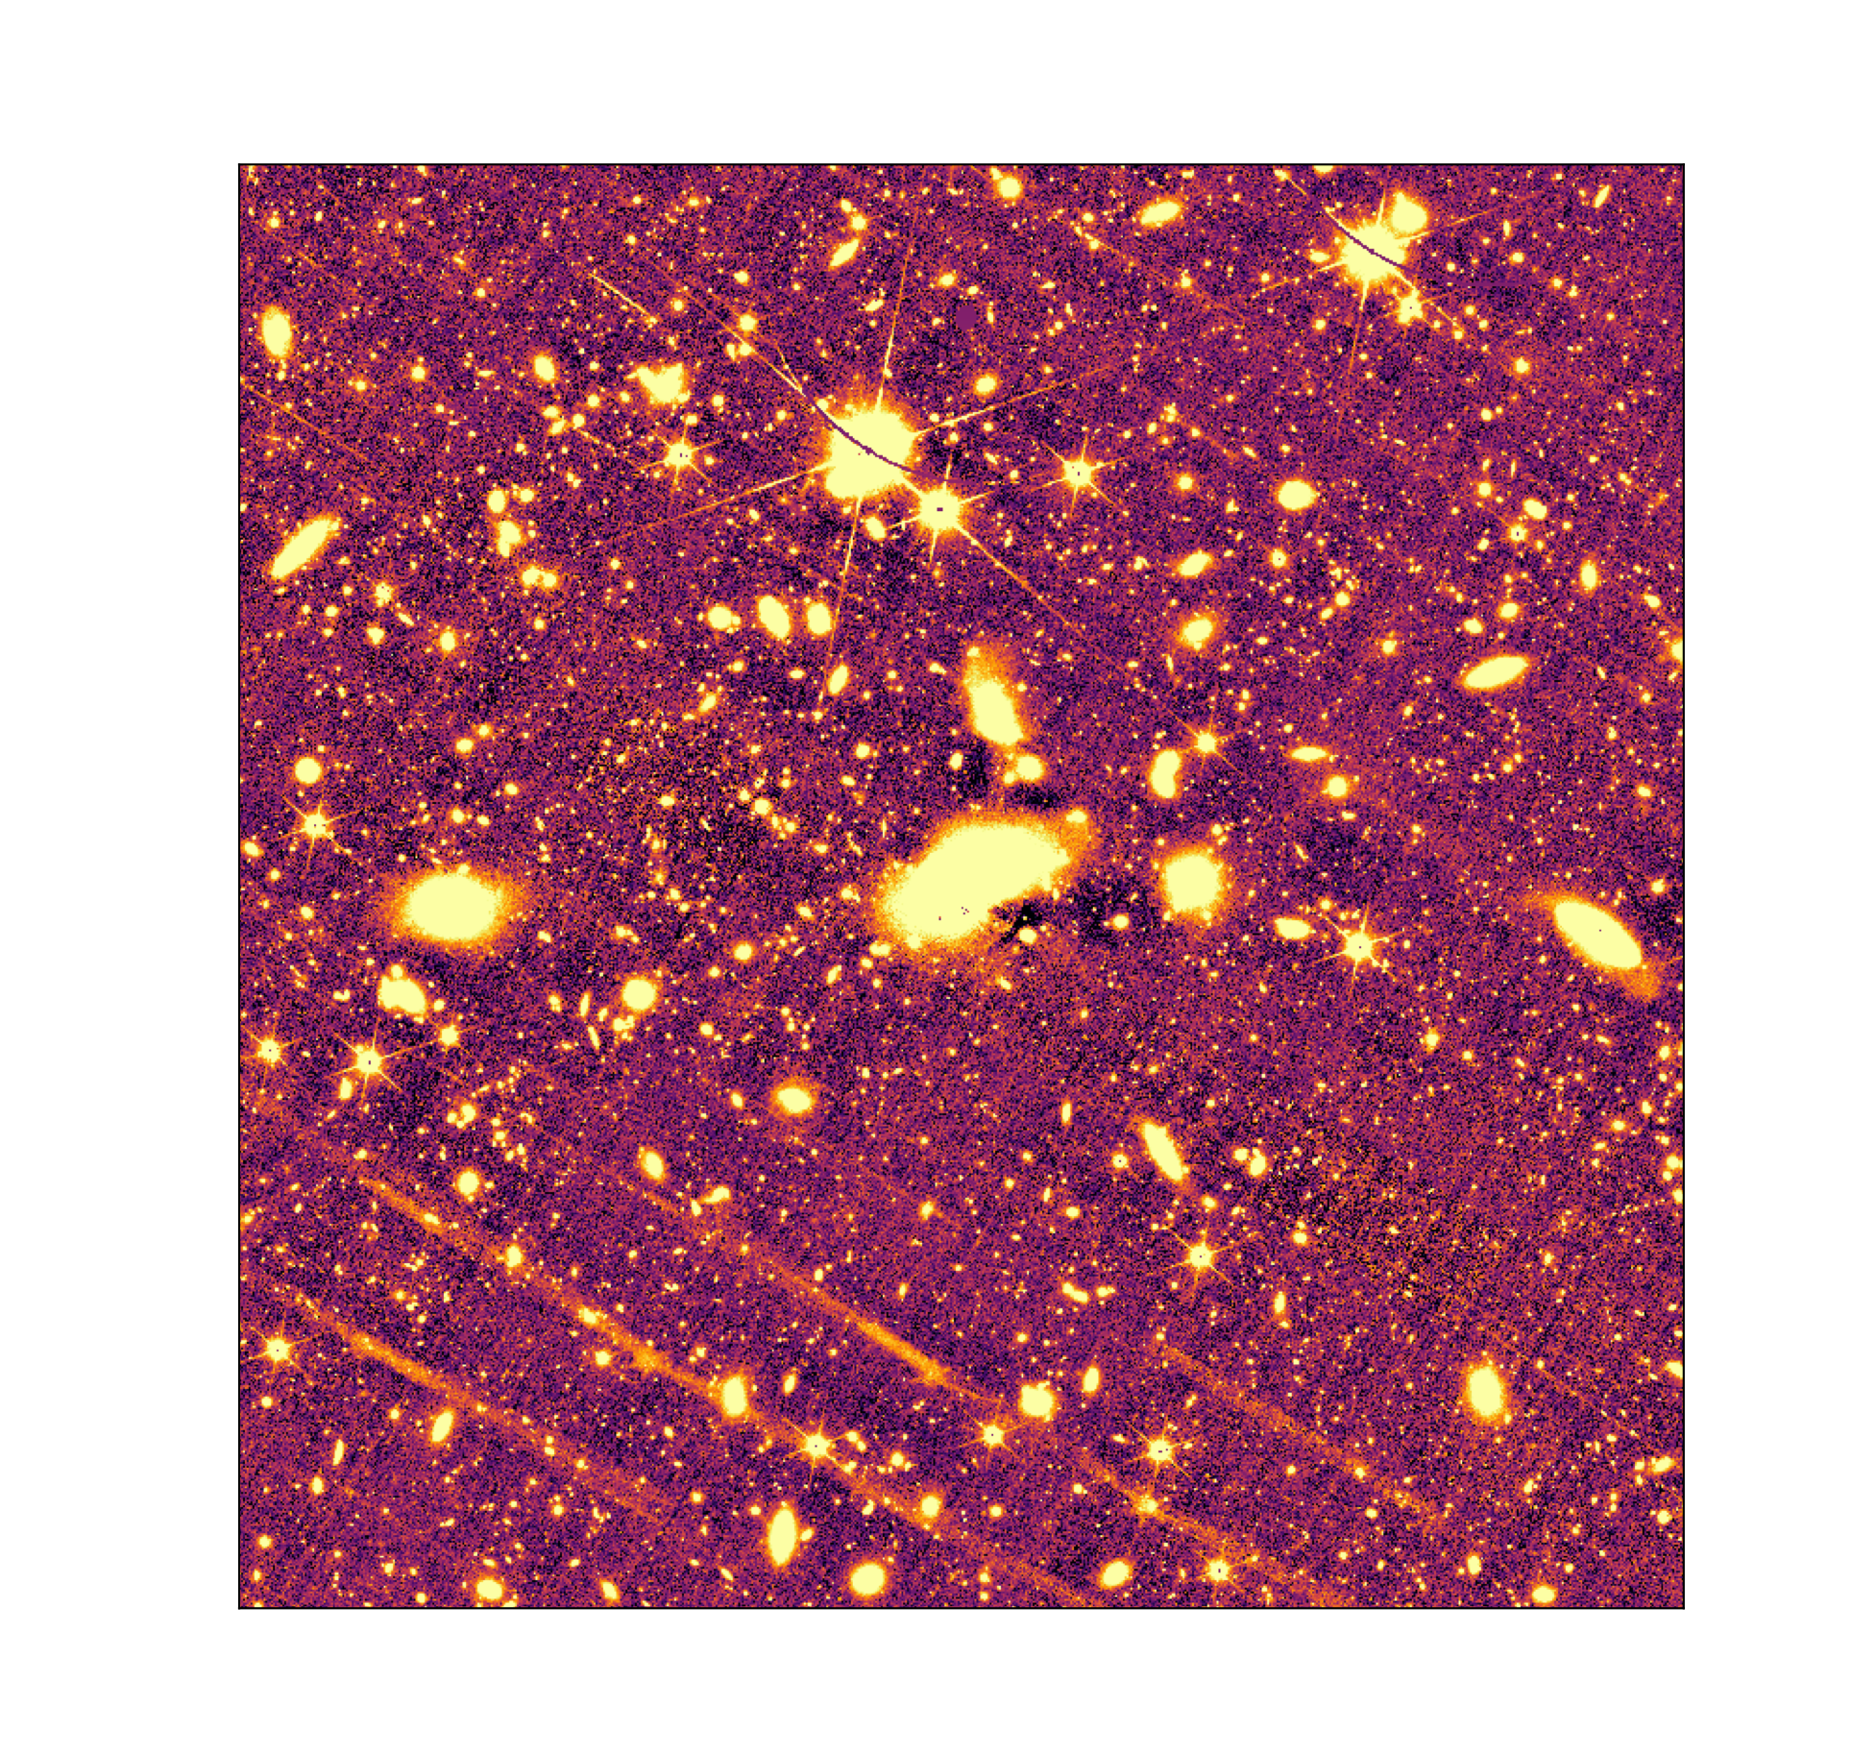
Processing of images for low surface brightness (LSB) science
We follow careful processing steps with several large and small scale corrections
to preserve as much ICL as possible in images
Fully post processed by nicl pipeline
Standard final product in Euclid archive
Bamford et al. in prep
Tutku Kolcu — tutku.kolcu@nottingham.ac.uk

Slide 5
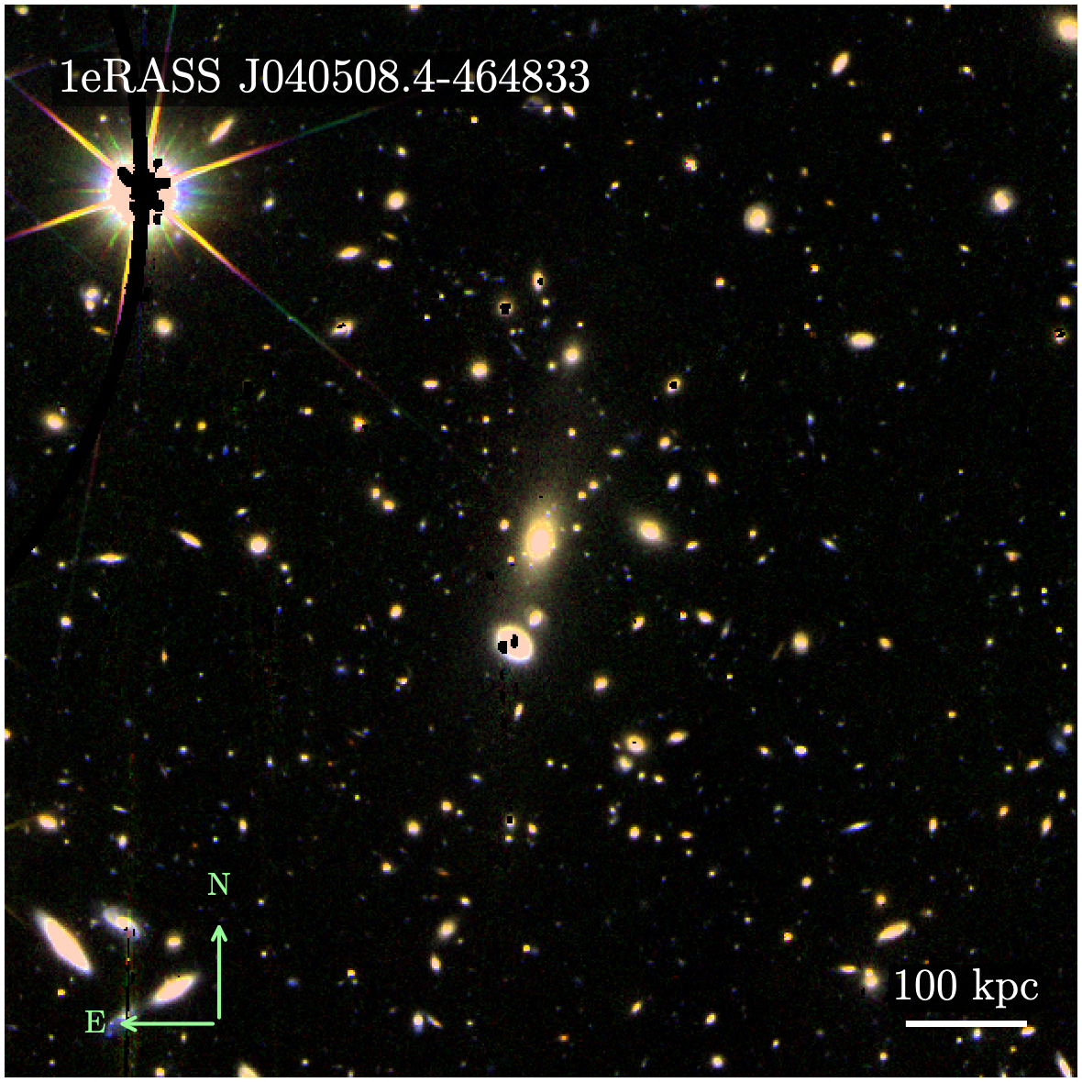
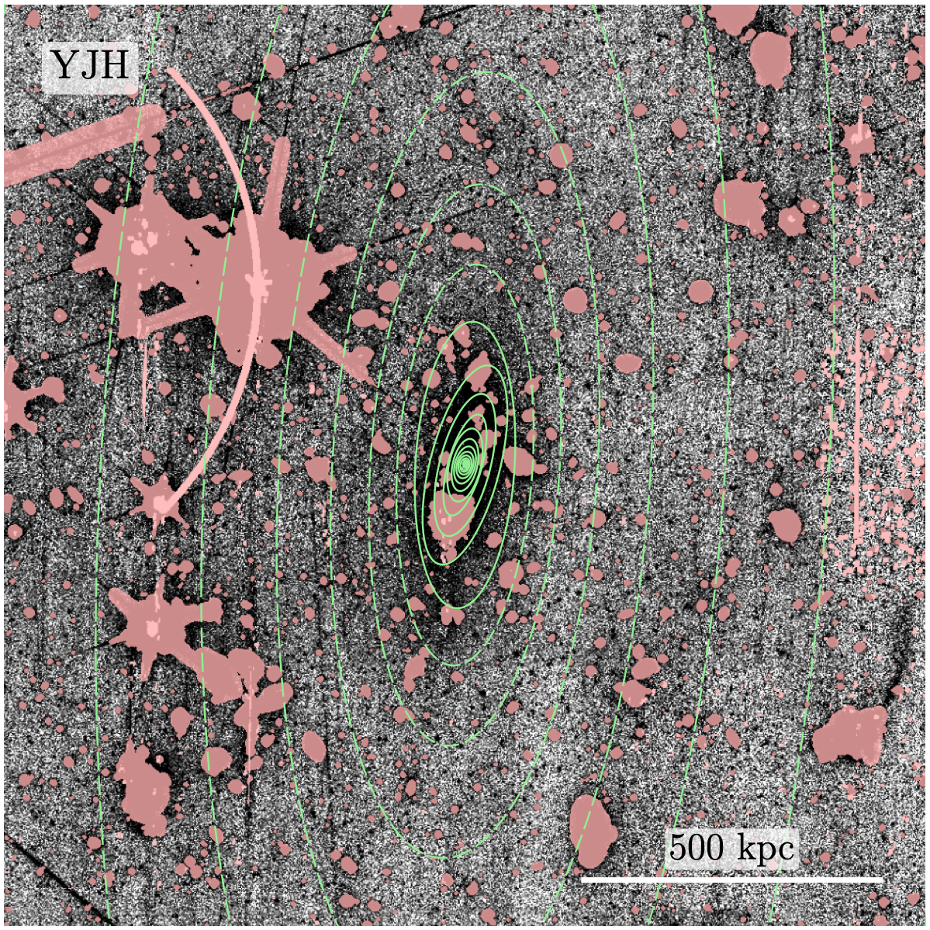
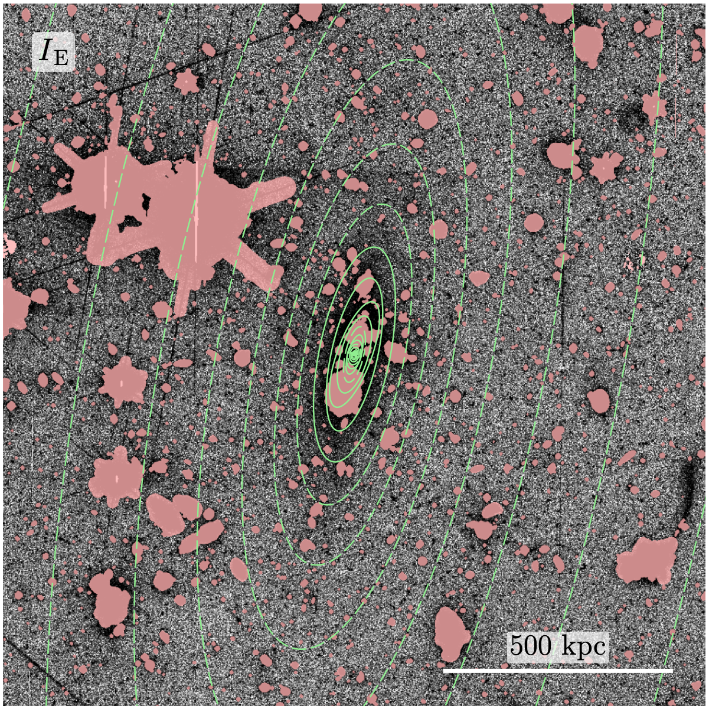
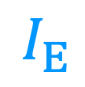




Preliminary Results
Measuring ICL shapes and surface brightness
Bright sources are masked leaving only BCG+ICL
Elliptical isophotes are fit to the BCG+ICL using AutoProf software (Stone et al. 2021)
Ellipticity and PA are measured out to ~S/N= 10, then are fixed to last values.
$$I_{E}$$
+
$$J_{E}$$
+
$$H_{E}$$
$$M_{200}∼2×{10}^{14}M_{⊙}$$
$$, z∼0.4$$
Kolcu et al. in prep
Tutku Kolcu — tutku.kolcu@nottingham.ac.uk

Slide 6
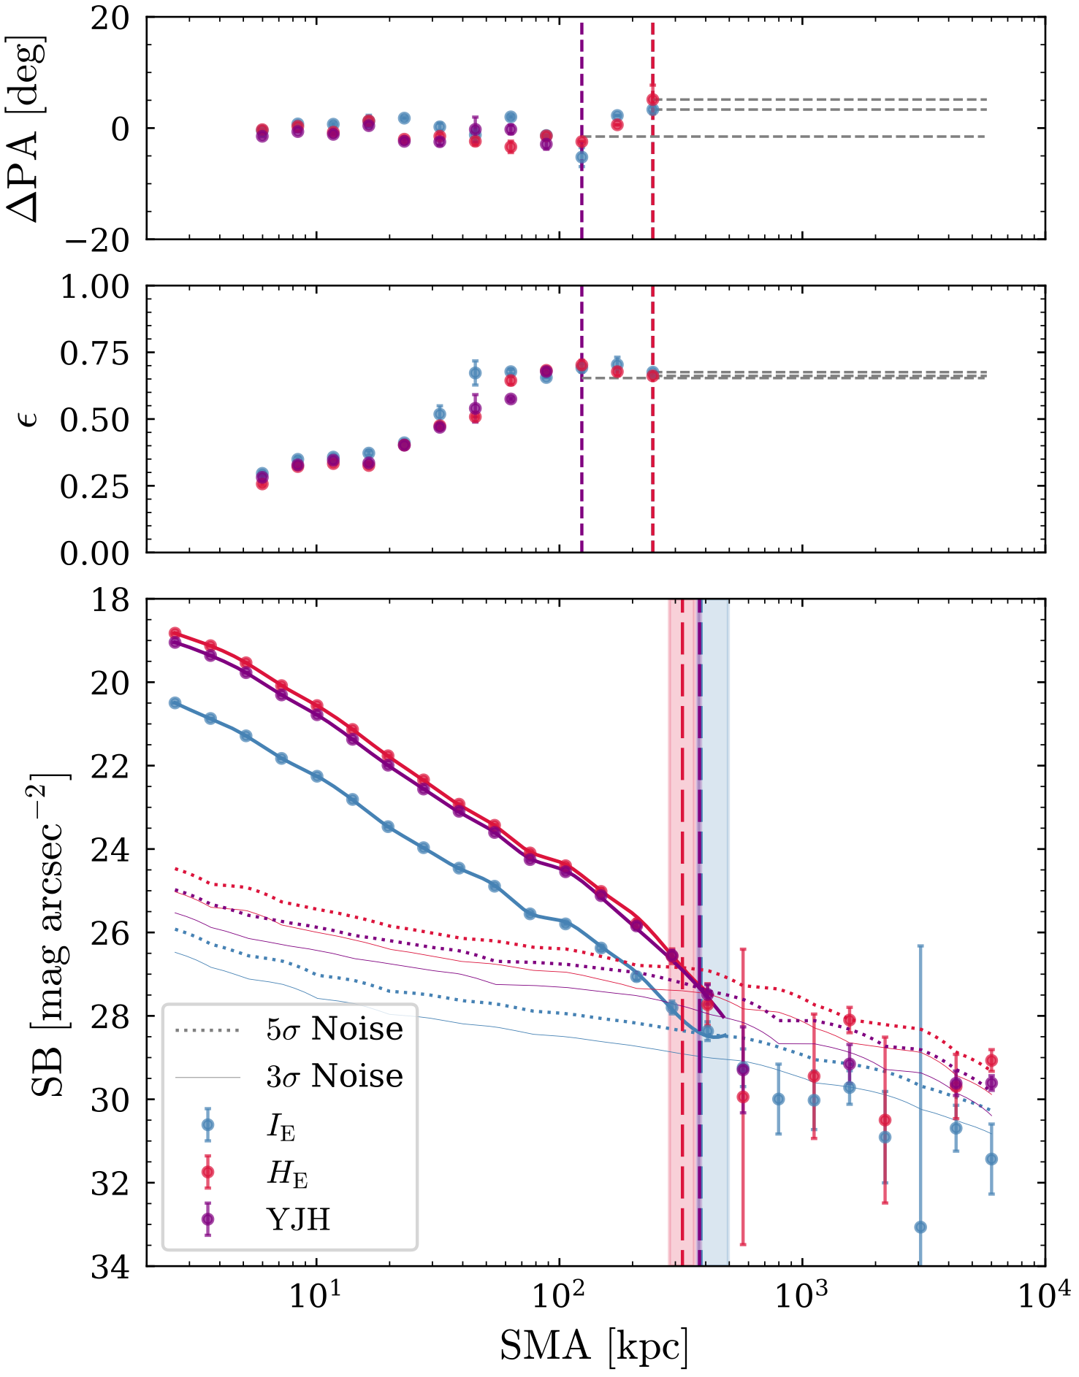


Preliminary Results
Measuring ICL shapes and surface brightness
In individual near-infrared bands of Euclid, metallicity-sensitive colours:
We can measure ICL shapes at R ~100—200 kpc
We can measure the ICL signal confidently up to ~400 kpc
Tutku Kolcu — tutku.kolcu@nottingham.ac.uk

Slide 7
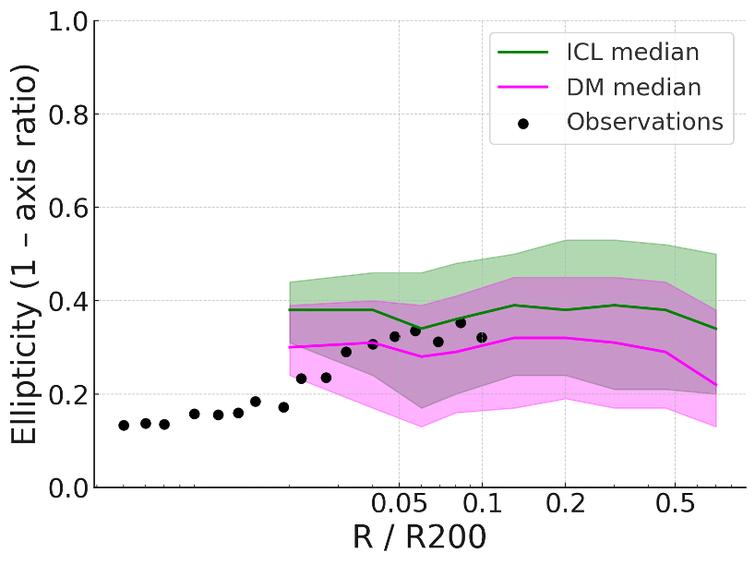
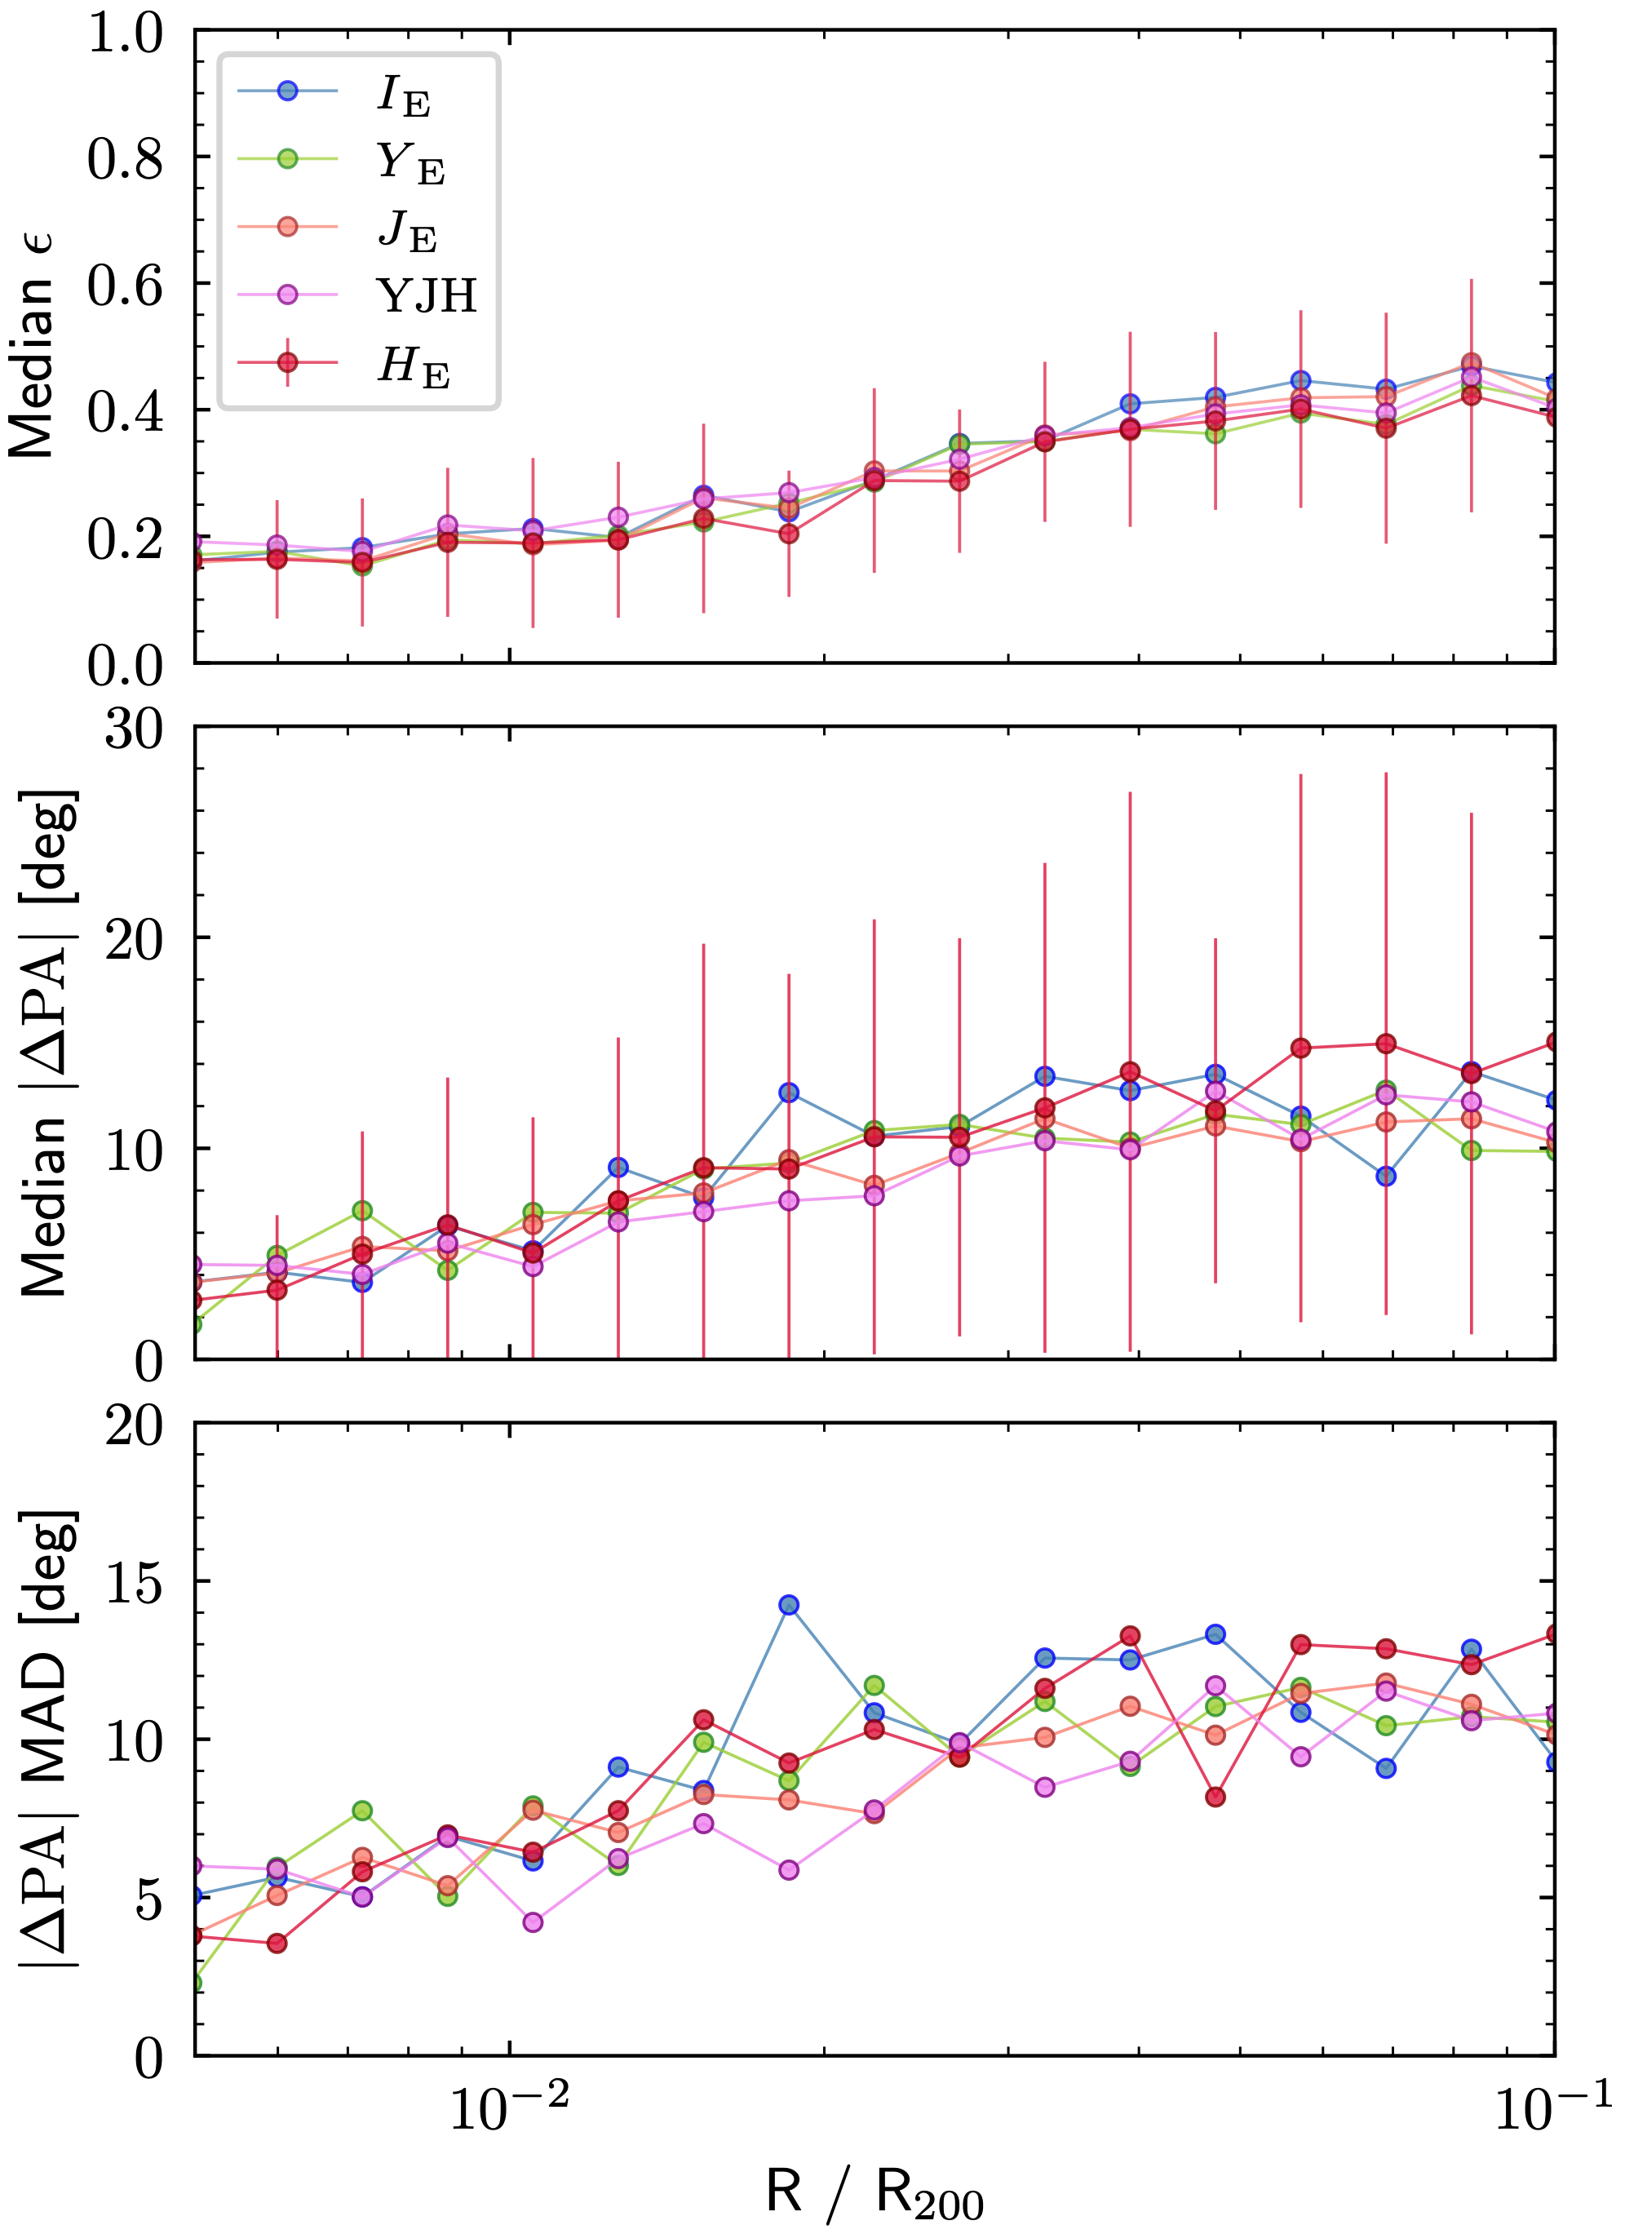
Preliminary Results
Average shape of ICL
Adela Fernandez | in prep.
Kolcu et al. in prep.
Hydrangea Simulations
~200 clusters
~200 clusters
The median ellipticity across bands are consistent.
Inner regions have consistently round isophotes and outer regions are more elliptical.
Both observations and simulations trace a similar ellipticity for DM halo with ~0.4
Tutku Kolcu — tutku.kolcu@nottingham.ac.uk
Notes:
Ell vs R/r500
PA vs R/r500

Slide 8
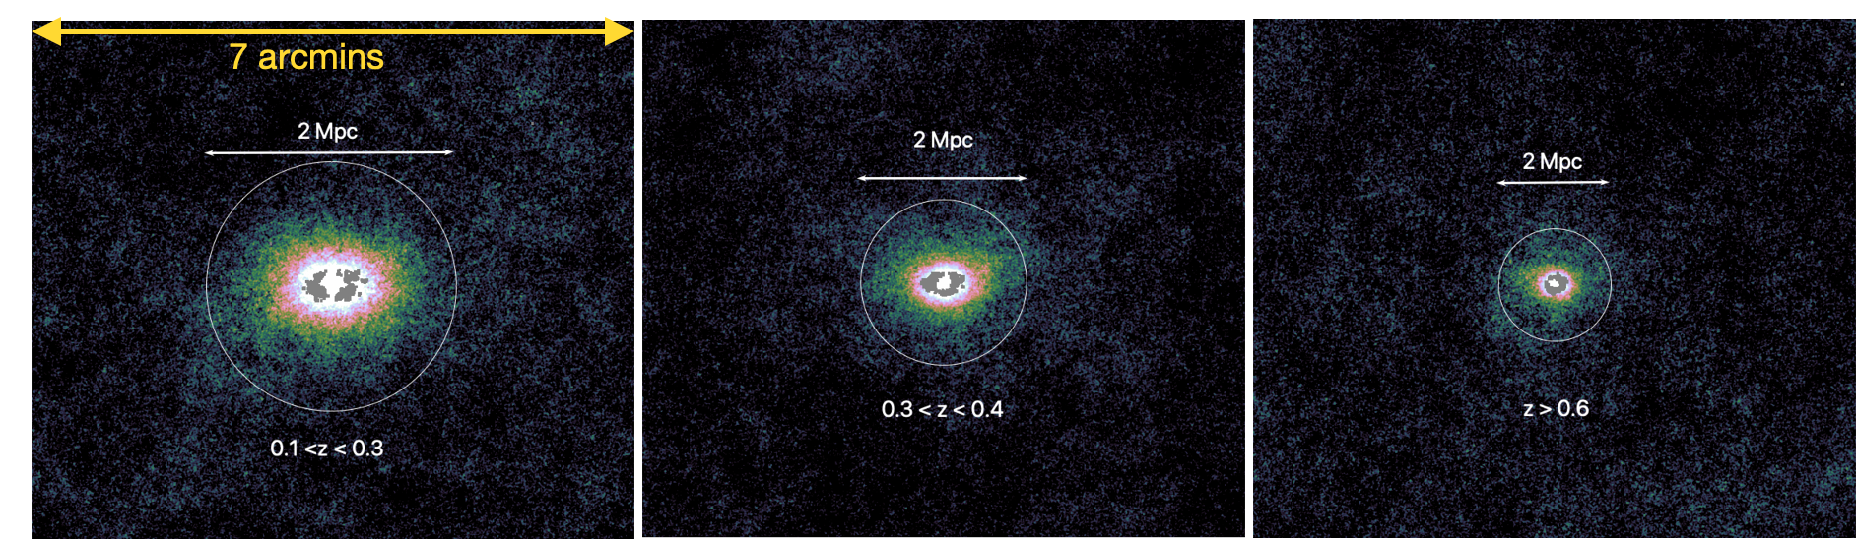
Preliminary Results
Shape of ICL Halo
Stacked images of ~40 clusters in each redshift bin with all galaxies masked to show the ICL.
All images rotated by the position angle of ICL measured in each cluster at ~0.1R500
Kolcu et al. in prep
Tutku Kolcu — tutku.kolcu@nottingham.ac.uk
Notes:
Ell vs R/r500
PA vs R/r500

Slide 9
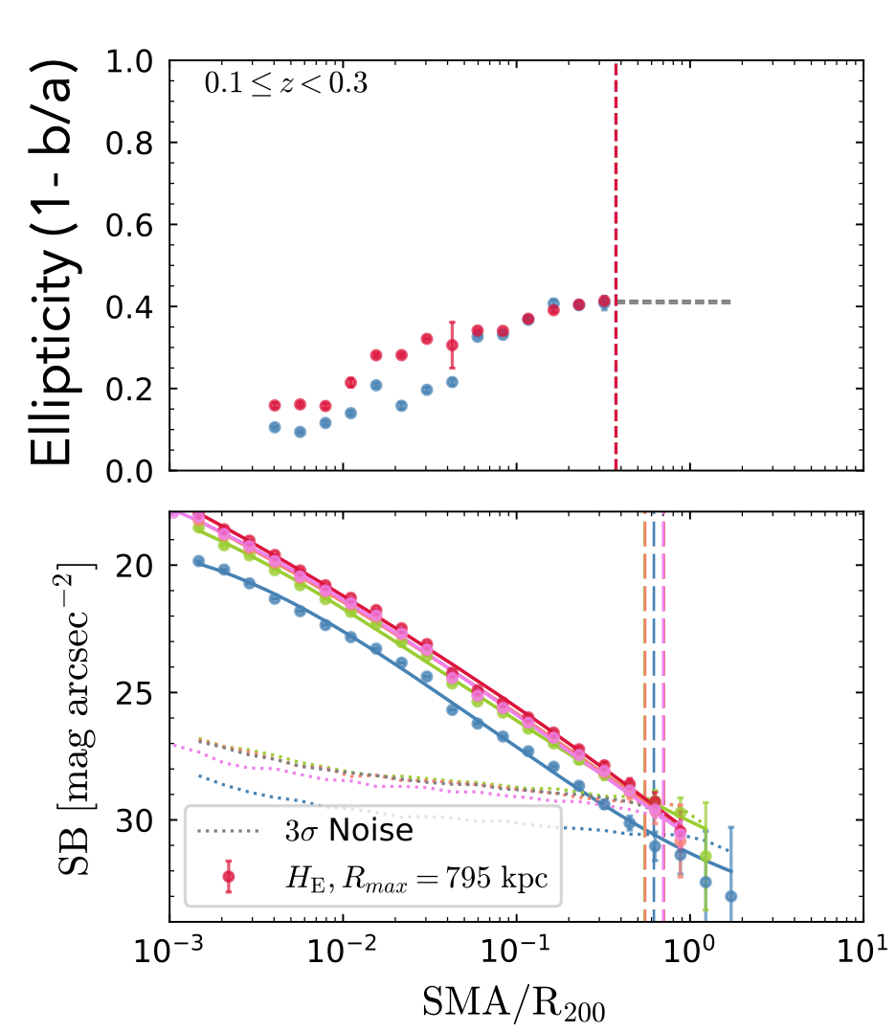
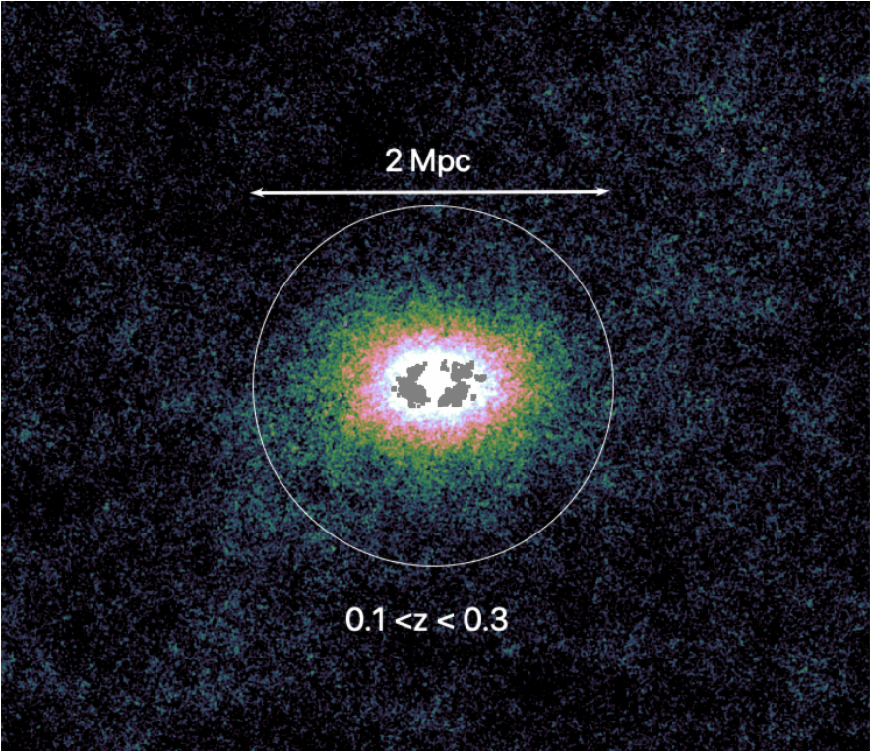

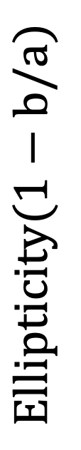
Preliminary Results
Stacking of clusters allow us to see further
$$Ellipticity(1−b/a)$$
$$R_{5σ}∼600kpc$$
Kolcu et al. in prep
Tutku Kolcu — tutku.kolcu@nottingham.ac.uk
Notes:
Ell vs R/r500
PA vs R/r500

Slide 10
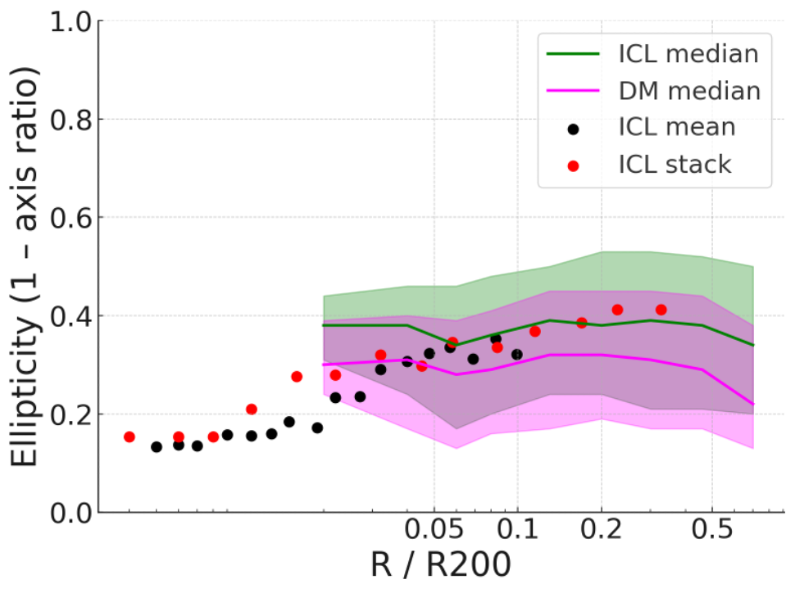
Preliminary Results
Stacking of clusters allow us to see further
Adela Fernandez | in prep.
Hydrangea Simulations
$$Ellipticity(1−b/a)$$
$$R_{5σ}∼600kpc$$
Tutku Kolcu — tutku.kolcu@nottingham.ac.uk
Notes:
Ell vs R/r500
PA vs R/r500

Slide 11
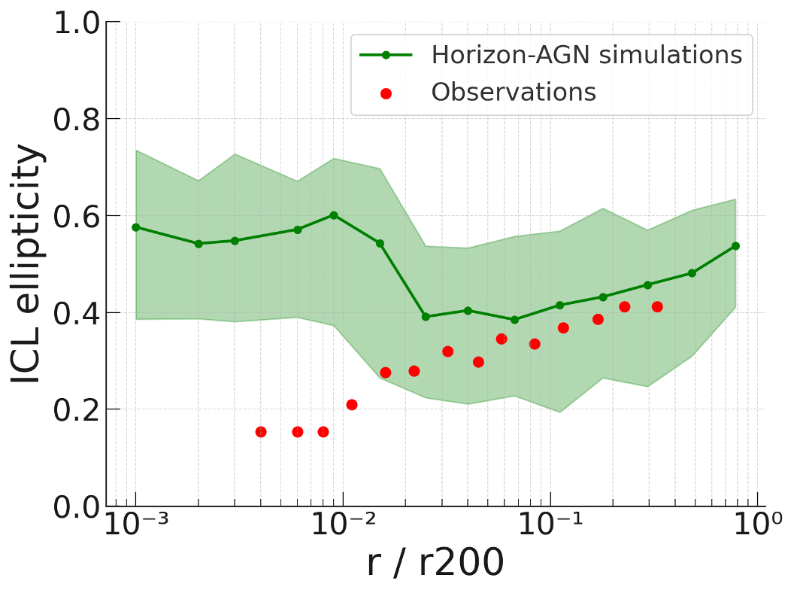
Preliminary Results
Simulations and observations do not match for BCG
Adela Fernandez | in prep.
Horizon-AGN predicts slightly more elliptical ICL than Hydrangea and observations so far
Predict highly elliptical BCG in cluster core due to overcooling problem
Massive disks forms in BCGs via cooling flows
Tutku Kolcu — tutku.kolcu@nottingham.ac.uk
Notes:
Ell vs R/r500
PA vs R/r500

Slide 12


Take home messages…
~40 clusters stacked
Measuring the shape and profile of ICL informs us about the nature of dark matter
We can measure shape of ICL halo at R ~100-200 kpc in individual clusters, while stacking allows us to measure it much further
Simulations and observations trace similar DM halo ellipticities at outer radii
Hydrangea Simulations
We will process and analyze ~12,000 clusters in the next few months as a part of Euclid DR1. We can then study the evolution of ICL shapes with redshift, mass and magnitude gap.
Credits: ESA/Euclid/Euclid Consortium/NASA, image processing by J.-C. Cuillandre (CEA Paris-Saclay), G. Anselmi.
Tutku.Kolcu@nottingham.ac.uk
Notes:
-

Slide 13
National Astronomy Meeting | 09.07.25
A first look at the shapes of ICL in Euclid Q1
Dr Tutku Kolcu
In collaboration with: Steven Bamford, Hua Gao, Jesse Golden-Marx and Nina Hatch
Credits: ESA/Euclid/Euclid Consortium/NASA, image processing by J.-C. Cuillandre (CEA Paris-Saclay), G. Anselmi.
Tutku.Kolcu@nottingham.ac.uk
Credits: ESA/Euclid/Euclid Consortium/NASA, image processing by J.-C. Cuillandre (CEA Paris-Saclay), G. Anselmi.
Notes:
-

